Slide 1
Thermal compensation issues: sensing and actuation
ASPERA Technological Forum – EGO 20-21 October, 2011
V. Fafone
University of Rome Tor Vergata and INFN

Slide 2

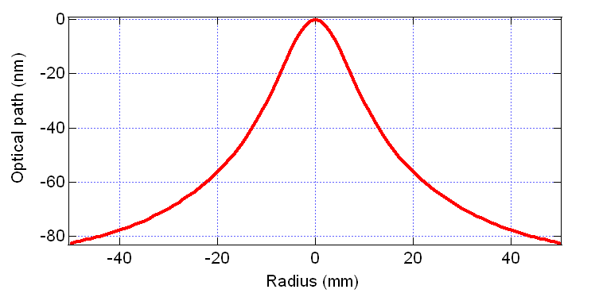
Thermal effects: introduction
High Reflectivity coating and substrate of the Test Masses absorb some (O(ppm)) power stored in the Fabry-Perot and recycling cavities.
Due to the low thermal conductivity of SiO₂, a thermal gradient is established in the substrate.
Thermal lensing:
  The refraction index is temperature dependent (dn/dT≠0, O(ppm/K)).
  The optical path inside the substrate of the TMs is not uniform.
  This is equivalent to putting a lens in the substrate of the ITMs.
Thermo-elastic deformation of the HR surface of all the TMs.

Slide 3
Working principle of TCS
Thermal effects are only due to the temperature gradient along the radial direction.
So, we can heat the peripheral of the test mass to flatten the gradient and, thus, the optical path length.

Slide 4
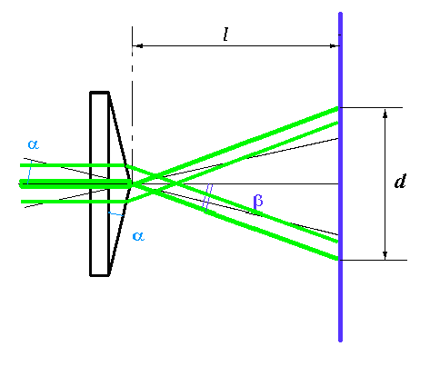
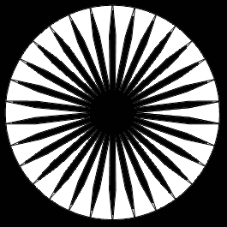
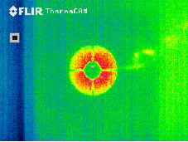
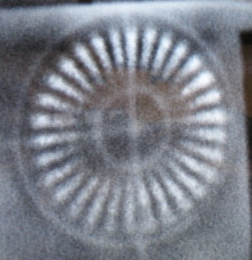
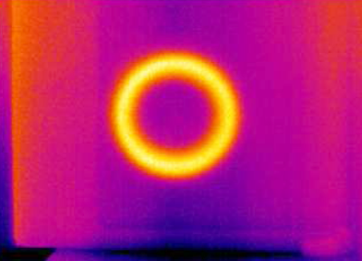
Current compensation systems
All use CO₂ (λ=10.6 μm) lasers to heat the peripheral of the input test masses: this wavelength is all absorbed within a thin layer of SiO₂
CO₂ Laser
AXICON
Annular heating
Gold star mask
Enhanced LIGO and Virgo+
Initial LIGO

Slide 5
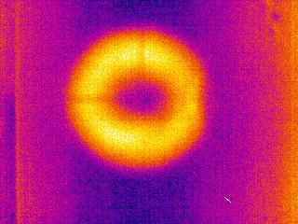
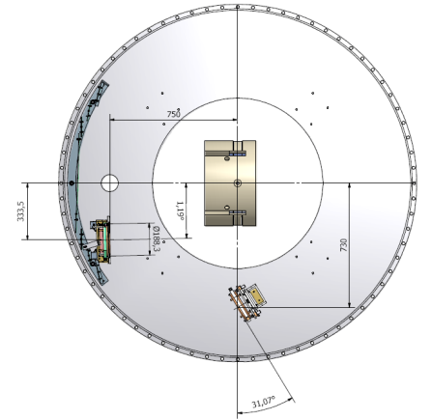
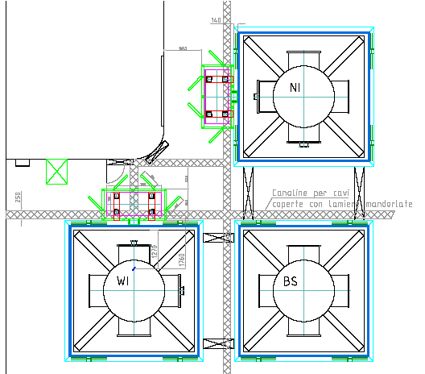
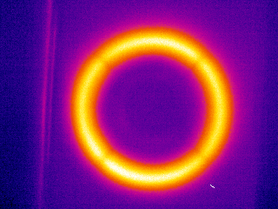
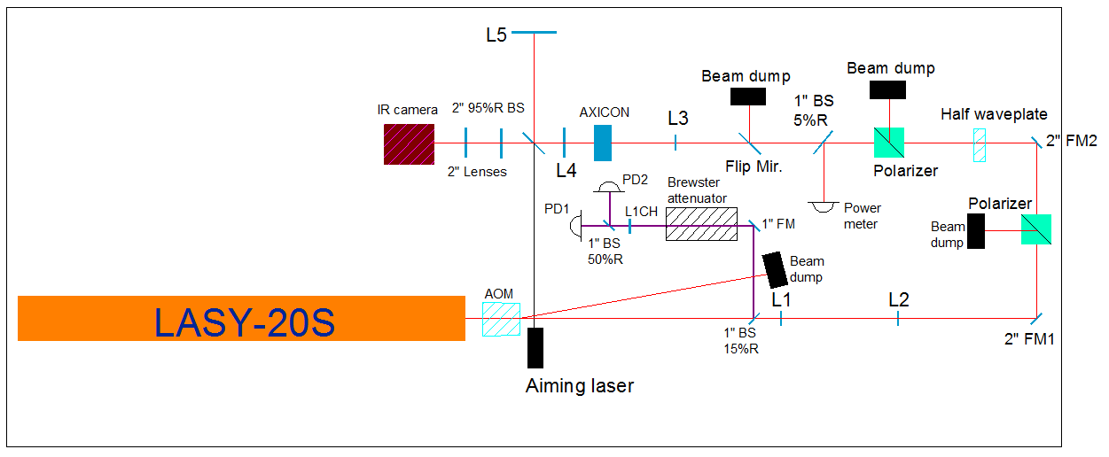
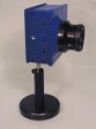
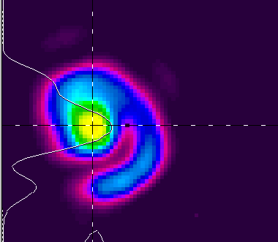
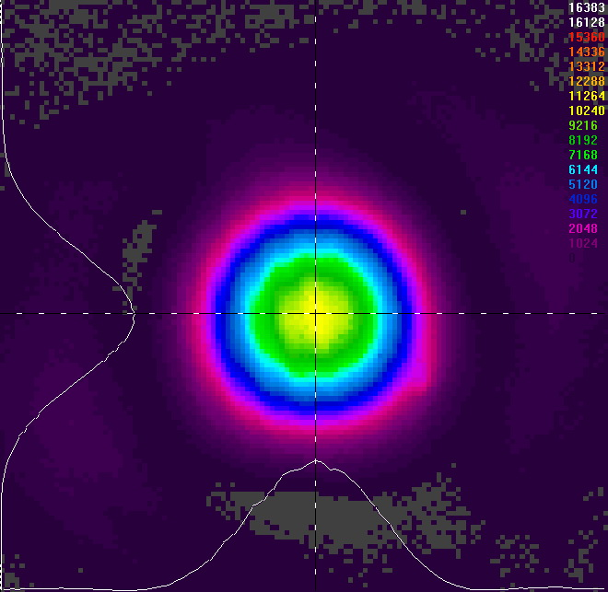
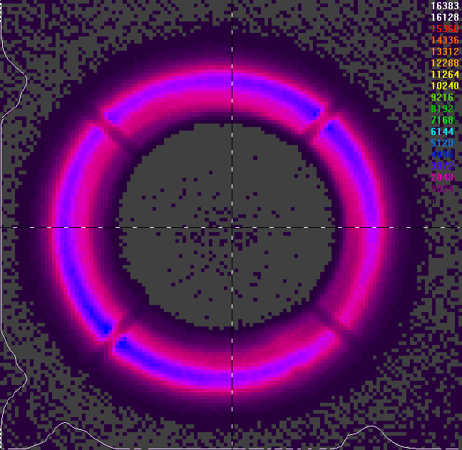
Virgo/Virgo+ scheme
Intercapedine
Chiller
TCS Room
Electronics
Mirror B
Mirror A
II-VI half wave plate and fixed polarizer are used for DC power control. This system does not deviate the beam impinging on the AXICON
Single AXICON used to convert a Gaussian beam into an annular beam. Size of the annulus hole can be set by moving L3
To monitor the CO₂ beam quality, a Spiricon infrared camera has
been installed on each bench.
Access Laser Co.

Slide 6
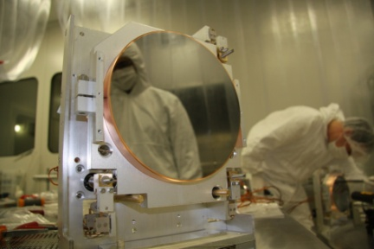
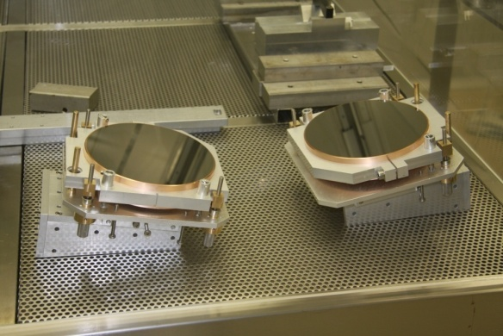
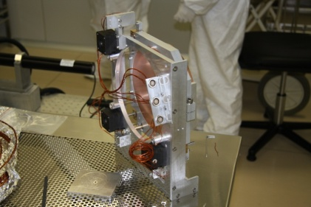
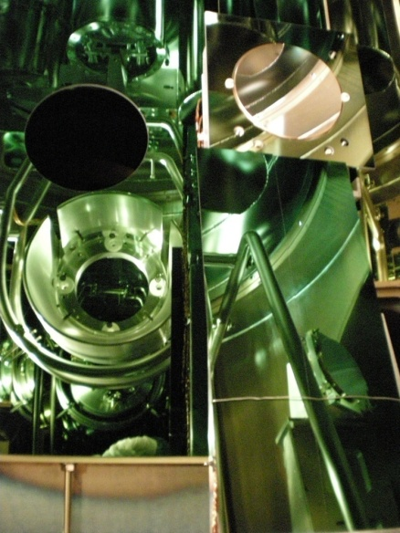
Virgo/Virgo+ scheme
Mirror B
Mirror A: manually adjustable in all degrees of freedom: angular and translational
Mirror A
About 20 cm diameter Cu mirrors, Maximum Metal Reflector coating by II-VI
CO₂
Mirror B: remotely adjustable, with stepping motors by AML, in all angular degrees
of freedom and one translation, perpendicular to the mirror surface. Used to align TCS beam on ITM.

Slide 7
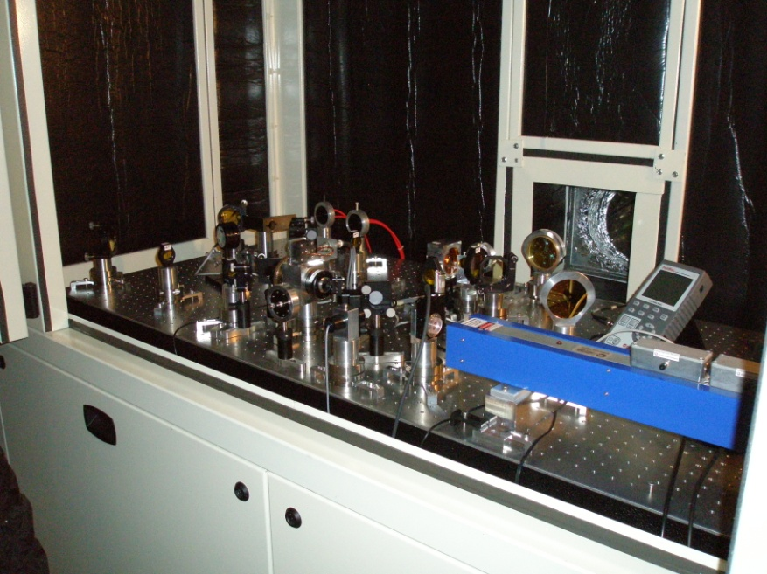
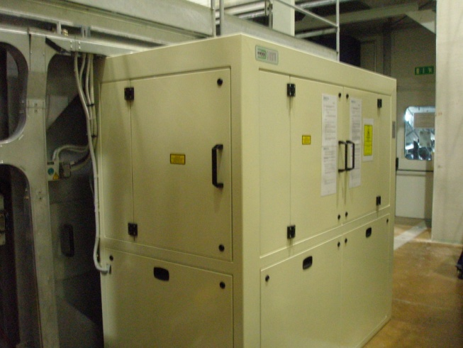
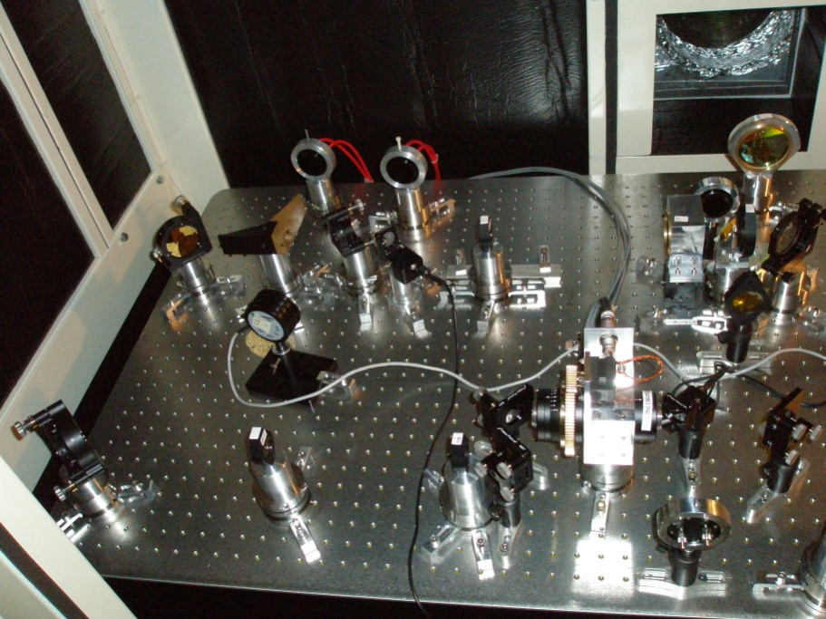
Virgo/Virgo+ scheme

Slide 8
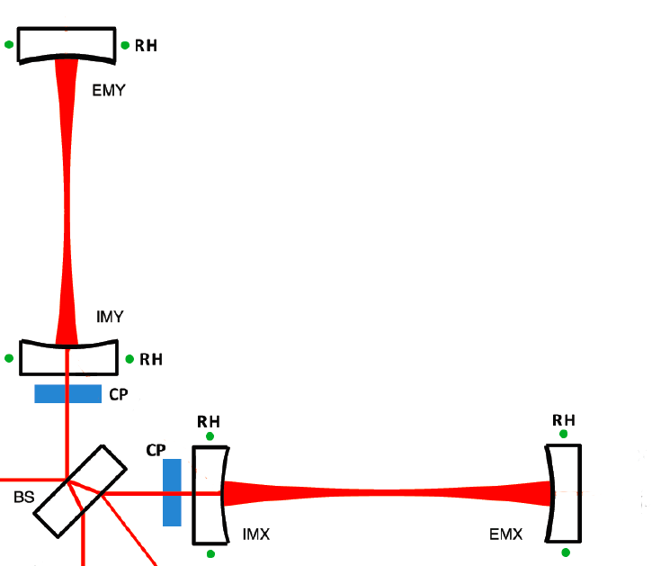
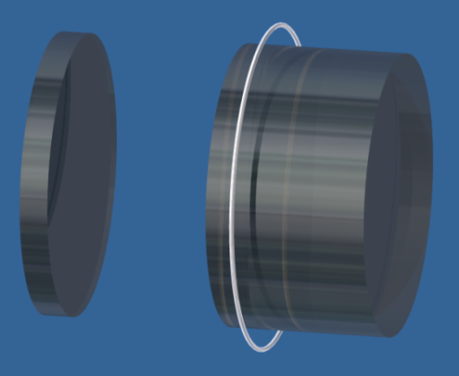
TCS in Advanced detectors
Power absorbed by TMs is about 0.5W, wrt ~20mW in initial detectors
TCS can inject displacement noise into the detector: achievable level of intensity stabilization (10⁻⁷/√Hz) not enough to heat with CO₂ directly the TM in advanced detectors (10⁻⁹/√Hz needed) ⇒ compensation plates required.
Compensation plates shined with CO₂ laser will correct thermal effects in the RCs
Ring heaters will compensate HR
surface deformations
Green dots: heating rings
Blue rectangles: CPs
This set up allows to control independently the thermal lensing and the ROCs

Slide 9
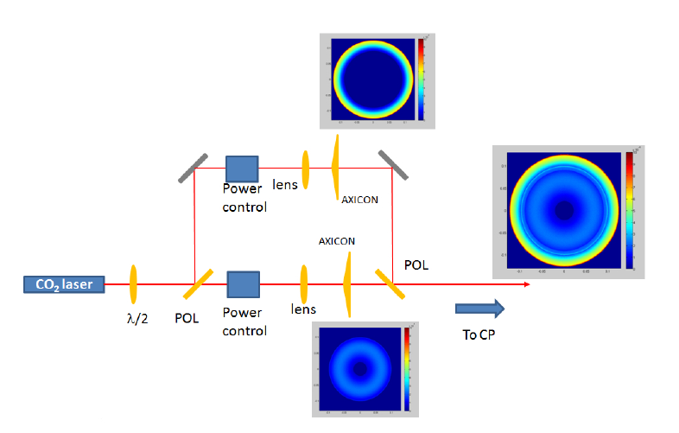
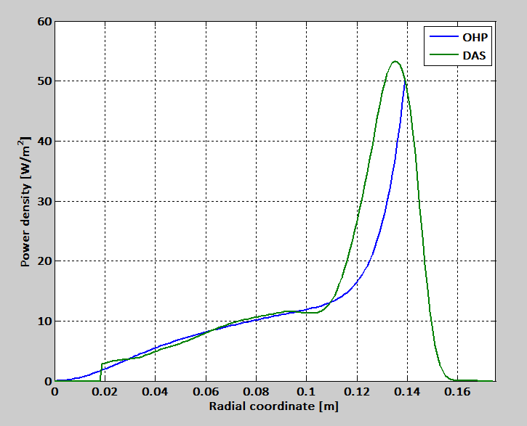
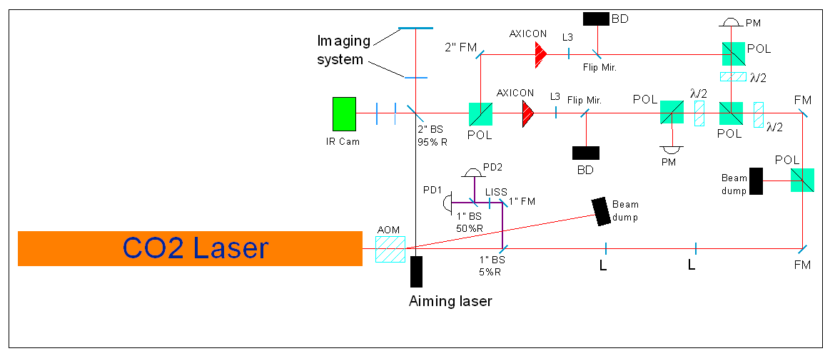
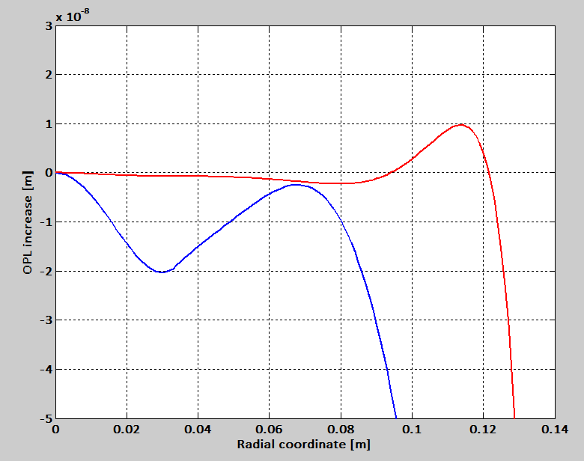
Heating pattern generation: DAS
The heating profile must be much more precise than in present detectors
  Simple system like Virgo TCS is not enough
Solution using known technology: modulate rings dimensions by changing distances between lenses and axicons and modulate power in each ring (Double Axicon System)
axicon
OHP

Slide 10
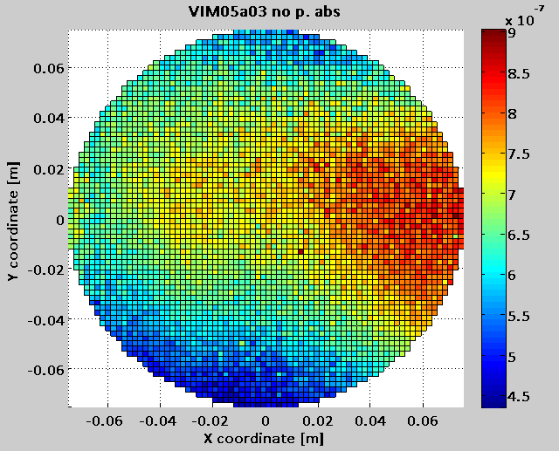
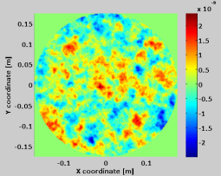
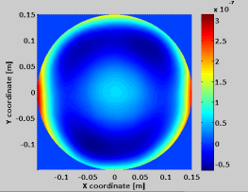
A new challenge: asymmetric defects
The DAS, due to its natural symmetry, can only correct axi-symmetric effects.
However, in an ITF there are several sources of non-symmetric optical defects:
  Inhomogeneity of the coating absorption;
  Non-uniformity of the substrate transmission map;
  Mirror surface figure errors.
These defects lead to a strong aberration of the sideband fields.
Substrate transmission map (measured at LMA on a aLIGO mirror)
Coating absorption map (measured at LMA on a aLIGO mirror)
Surface roughness map (simulated)

Slide 11
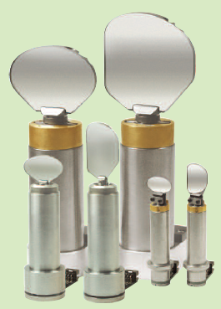
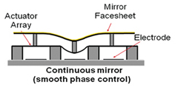
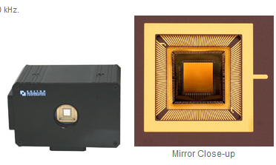

Correction of asymmetric defects
In AdV, it is mandatory to develop a non-symmetric compensation system.
Laser based techniques:
  Scanning system;
  MEMS deformable mirrors.

Slide 12
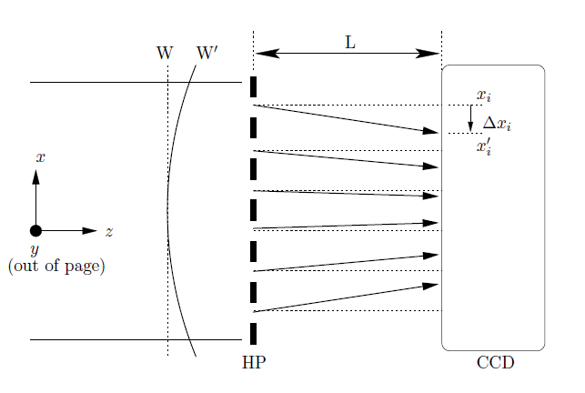
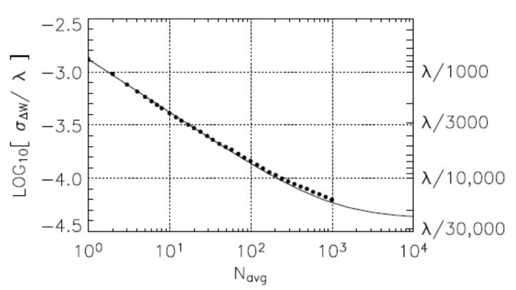
Wave-front sensors for TCS
Double pass measurement in reflection with auxiliary dedicated beams.
Wave-front measurement performed with high sensitivity Hartmann sensor [Opt. Express 15 (16), (2007)]:
  Noise level: λ/15500 for 990 averages @ 820 nm;
  Reproducibility: λ/1450 @ 820 nm;
  Precision: λ/5200 with 1000 averages @ 820 nm.
SLED sources to generate the probe beam.
Optic under test
From source
Back to Hartmann
sensor

Slide 13
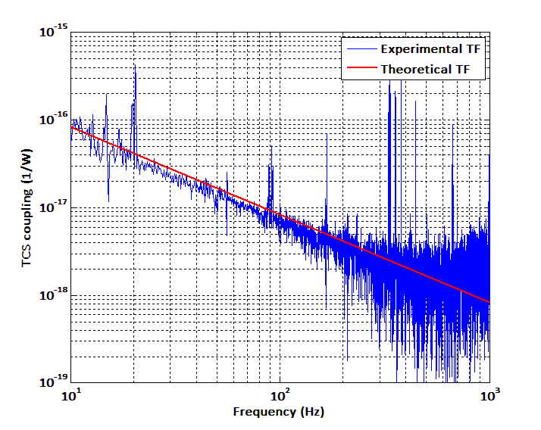
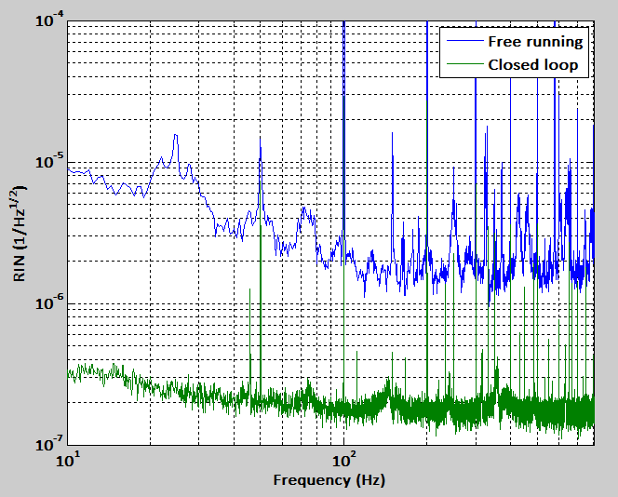
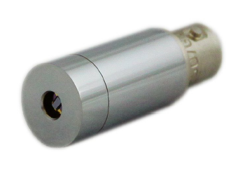
CO₂ laser intensity stabilization
CO₂ laser intensity noise couples into the detector generating displacement noise and thus limiting its sensitivity to GW signals. Intensity stabilization loop is thus required.
⇒ High sensitivity, low noise photo-detectors are needed @ CO₂ laser wavelength.
Loop scheme
Filter
25W CO₂ Laser
AOM
In-loop PD
Out-of-loop PD
VIGO System IR Photovoltaic Hg-Cd-Te PD
PD dark noise limited

Slide 14
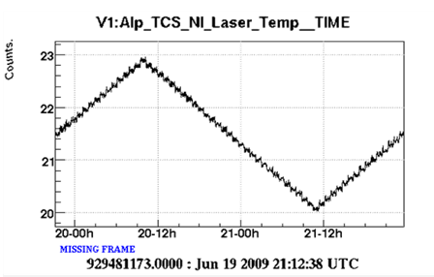
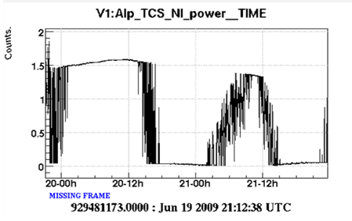
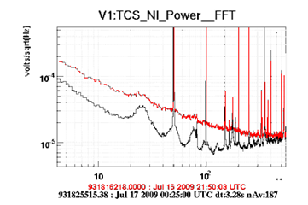
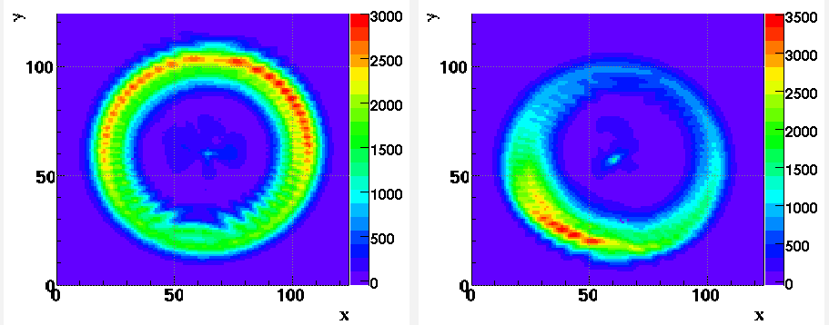
TCS issues: CO₂ laser temperature instabilities
Access Laser CO₂ lasers are temperature tuned:
  Emitted mode depends on cavity length, thus on cavity temperature
  Amount of power and polarization state in the mode differ from mode to mode
  Some modes are unstable and noisier than others
  Beam pointing is also affected by temperature
  Laser state depends also on environmental temperature
Infrared images of the TCS beam before and after a 1 deg temperature fluctuation
As measured by the IR camera on the bench.

Slide 15
Conclusions
What a “good” TCS needs to beat the next challenges:
Medium power (20-50 W) CW CO₂ lasers
  High purity TEM₀₀ mode;
  Good temperature stability (better if cavity length is actively controlled).
High sensitivity low noise photo-detectors @ 10.6 μm to reduce the laser intensity fluctuations.
High sensitivity IR beam profilers with good spatial resolution.
Chillers with 800-1000 W cooling capacity and a high temperature stability (0.01°C).
High efficiency beam shaping systems: custom refractive optics, diffractive optical elements, MEMS deformable mirrors. All for λ=10.6 μm.
High sensitivity low noise CCD cameras for Hartmann sensors.
High power stable SLED sources (λ=(650÷900) nm).

Slide 16
The End

