Slide 1
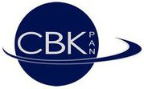
Carbon fiber composite mirrors in SMC technology Space Research Centre – Polish Academy of Sciences
Presenter: Michal Karczewski
PI: Karol Seweryn
Team:
Monika Ciesielska, Jerzy Grygorczuk, Michal Karczewski, Janusz Nicolau-Kuklinski, Lukasz Platos, Miroslaw Rataj, Karol Seweryn, Michal Sidz, Marta Tokarz, Piotr Wawer, Roman Wawrzaszek, Lukasz Wisniewski.

Slide 2
Outline
Intro
What is the Sheet Moulding Comound tech
How we develop the mirror substrates..
Coatings
Prototyping status
Mirror testing system
Summary

Slide 3
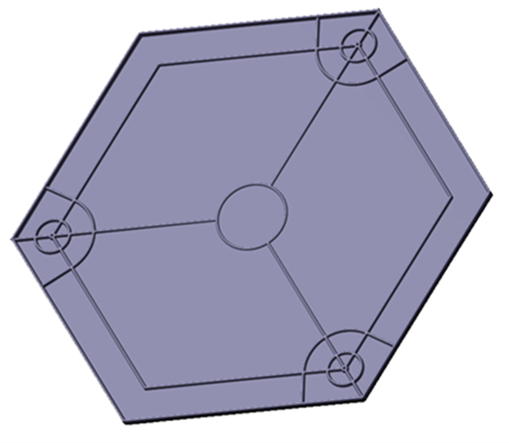
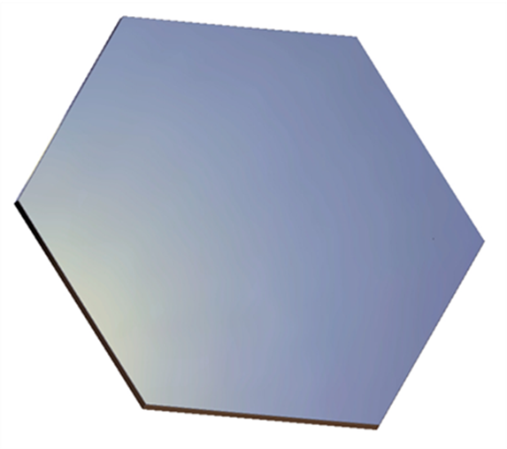
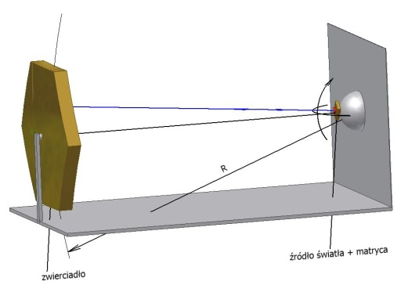
Introduction - our approach includes:
1. substrate preparation
2. coating
(intermediate and optical)
3.testing system

Slide 4
SMC – sheet moulding compound

Slide 5
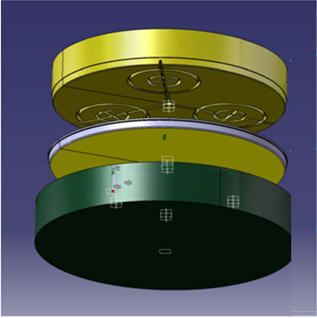
Summary of SMC mirror technology
Adventages:
Sheet Moulding Compound: is proven technology in automotive industry,
Production: 1-step process to form the structure with the ribs,
Quick: the forming process takes 3 - 30 min,
Profitable: up to tens of thousands pieces,
Shrinkage: 0% is possible,
Glass: is not used:
„Coating” means for us:
coating for surface improvement + optical coating
Sheet Moulding Compound
Disadvantages:
coating of SMC surface is difficult,
CTE’s of carbon fiber SMC and aluminum honeycomb don’t match.

Slide 6
SMC modifications
Steel mold High temperature
Steel/Glass mold
Low temperature
Steel/Glass mold Low temperature
High pressure ~60 bar
Low pressure ~6 bar
Low pressure ~6 bar
1
2
3
SMC + ribs
SMC honeycomb
SMC honeycomb
IMC layer
Foils
Gel-coats, polymers, paints
Our base concept of Sheet Moulding Compound process

Slide 7
Substrates

Slide 8
Comparison of SMC mirror technologies
SMC composite
mirror structure
High temperature process
Structure with ribs (high pressure)
Structure with honeycomb (low pressure)
Low temperature process
Structure with honeycomb (low pressure)

Slide 9
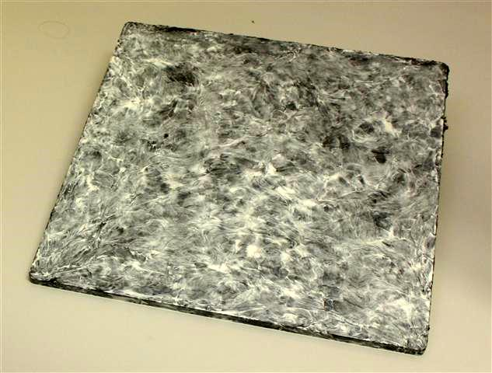
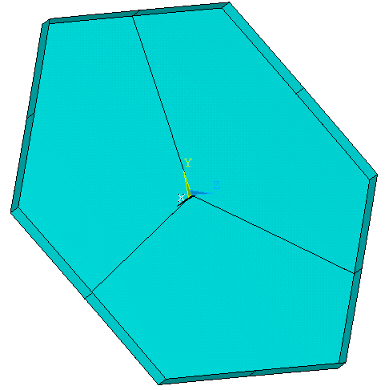
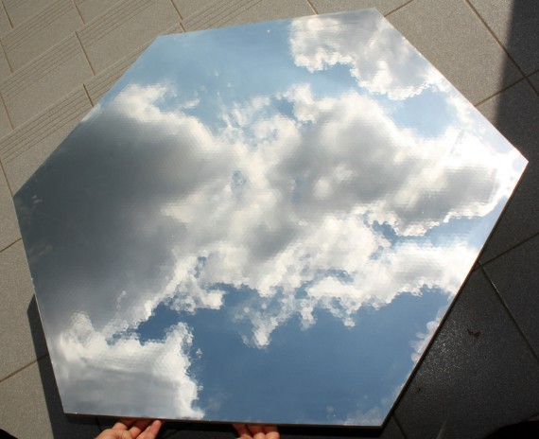
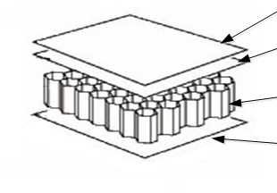
Examples of developed structures
Project
Sample
SMC
ribbed
structure
Reflective layer
SMC
sandwitch
structure
SMC
HC
SMC
Notes:
Zadane obciazenia
Zakladane punkty mocujace

Slide 10
Requirements for design analysis
1. CTA requirements:
Constraint | Value
Reference temperature | 22 [°C]
Operating temperature range | From -10[°C] to +30 [°C]
Max. temperature range | From -15 [°C] to + 60 [°C]
Max. operation wind velocity | 55 [km/h] (525 [Pa] – inc. 2.5 safety factor)
Max. critical wind | 200 [km/h] (7000 [Pa] – inc. 2.5 safety factor)
Gravity – worst case | 3g
PSF | 0.6 [mrad] (6,75 [mm] for SST)
2. Our assumptions regarding mounting points:
3 mounting points fixed in XYZ, free in rotational DOF
Ribbed SMC structure
Sandwich structure
b
b
k92
k91
a
a
k91
k93
k93
k92
K91, k92, k93 are located in 2/3 of the outer radius

Slide 11
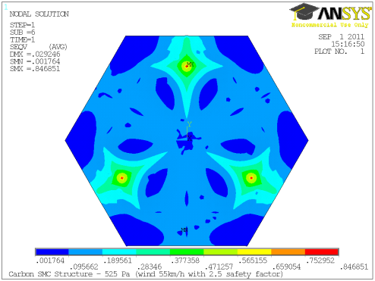
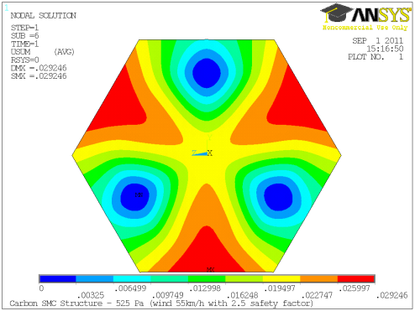
Example of analysis
Stresses
PSF = 0,45 mrad
0,001764 MP
0,84651 MP
Deformation
Sample FEM analysis for ribbed SMC
0 mm
0,029246 mm
ANSYS → ZEMAX → PSF

Slide 12
Results of design analysis
General results:
FEM analyses: results meet the CTA requirements;
Mass:
sandwich structure: achieved mass 14-20 kg,
ribbed structure: achieved mass: ~14 kg,
Stresses: much below critical.
Notes:
Omowienie wynikow

Slide 13
Coatings

Slide 14
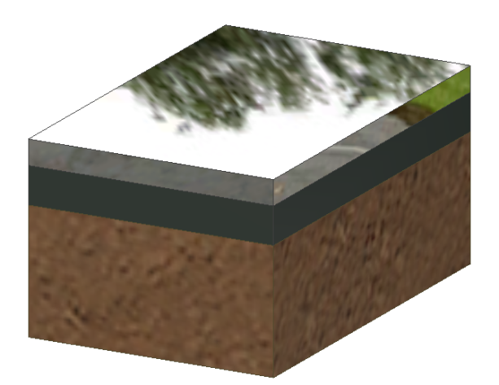
Optical coatings issue
SMC composite mirror quality
depends on
depends on
Spectral reflectance
Optical coating
depends on
SMC surface quality
Intermediate coating
depends on
depends on
Optical coating
Specular r.
Diffuse r.
Intermediate
coating
Substrate

Slide 15
Coating types and technologies
Intermediate coating:
Optical lacquer: applied by the immersion of the substrate, layer thickness is 2-5 microns,
In-Mould Coating: is a coat applied during the SMC process,
BASF coats: sprayed on the surface,
Polymer: coat formed on high polished mold, very low raughness, even better than IMC.
Optical coating:
Aluminum covered with SiO or SiO2: Thickness of the Aluminum layer is few hundred nanometers (a standard PVD process in vacuum).
Alanod: is a 0,5mm thick Aluminum plate (useful as as a optical layer for quick test; for production requires improvement by producer)

Slide 16
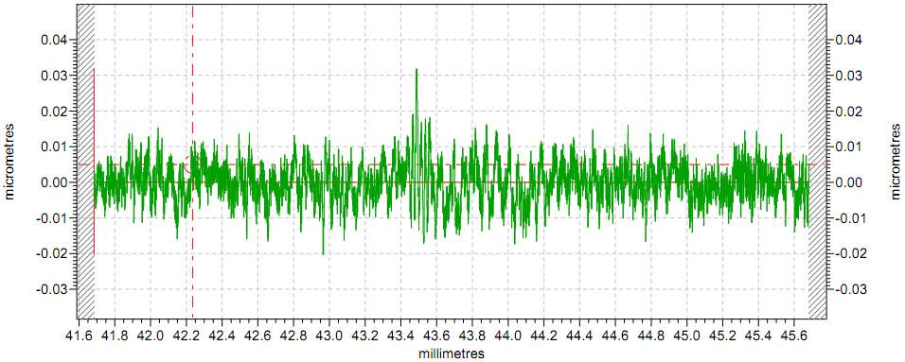
Results surface quality tests
Roughness of polymer sample; Ra - 0,0044 um; Rz = 0,0351 um
Optical quality

Slide 17
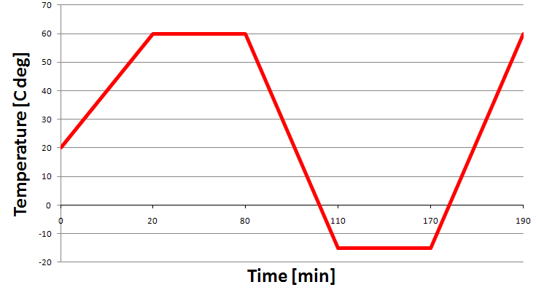
Results of the durability tests
Temperature cycle
Short-term thermal cycling:
tests in climatic chamber,
temperature: -15 C deg to 60 C deg.,
time of one cycle: 190 min.,
temperature cycles: 8 or 18.
Conclusions after the temperature cycles
reflectance did not change,
waviness appears on the sandwich
samples because of different CTE’s of
substrates.

Slide 18
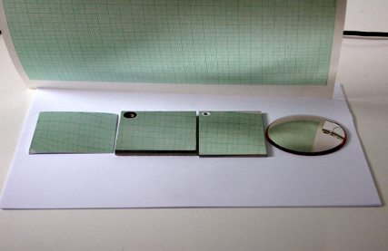
Coatings on different substrates
Optical coatings on different substrates, from left: 1. Alanod, 2. SMC with IMC, 3. SMC with BASF, 4. Polymer
The polymer surface is most promising,
IMC layer from high polished mold is in next stage of devlopment,
Optical lacquer improves the surface smoothness a little bit,
BASF coat works better, but the application method causes waviness.

Slide 19
Prototyping status

Slide 20
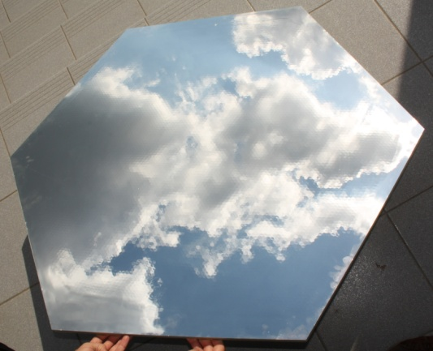
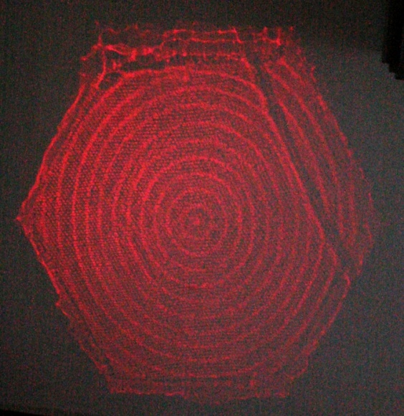
Prototyping Status – spherical prototype 1:1
Picture from first prototype covered with Alanod
The surface of the mirror illuminated by lasers
Dimmensions: flat to flat: 1,05 m, hexagonal shape, radius of the curvature: 22,5 m.
Results:
Imprinted HC on Alanod surface,
Imprinted rings from honeycomb milling.
Conclusion: We are able to manufacture the 1:1 prototype, the technology has been
already improved.

Slide 21
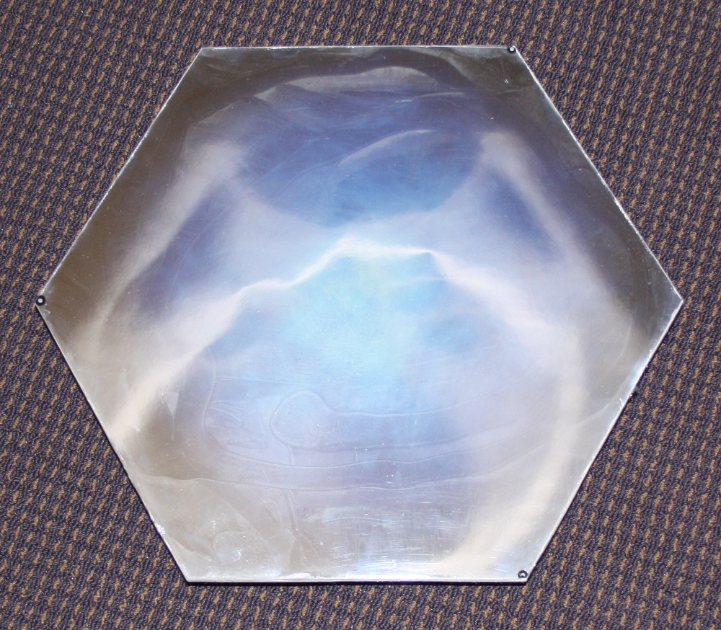
Prototyping status - spherical prototype 1:4
Dimensions: flat to flat: 40 cm, hexagonal shape: 462 mm, radius of the curvature: 22,5 m.
Results: Direct composite coating with Aluminum is possible.
Conclusion:
Thermal issue plays important role for the composite mirrors,
Fully sealed honeycomb solutions is problematic due to pressure changes.

Slide 22
Tests of the prototypes
Optical Tests:
Flat samples:
Test: climatic chamber: 10 cycles (180min. each); -15°C to +60°C,
Results: Slight deformation of sandwich structures,
Conclusion: Glass fiber most resistant for sandwich samples but carbon fiber for flat ones.
The first 1:1 prototype:
Test: 2f setup,
Results: Imprinted HC on Alanod surface and rings from HC milling,
Conclusion: The technology was updated for third prototype.
Results of Field Tests:
Field test with the 1:1 prototype at HESS location since October 2011. (ageing, deflection and stress determination)
Mechanical Tests:
Under investigation → determination of material properties of the flat samples to check the FEM analyses correctness

Slide 23
Mirror testing system

Slide 24
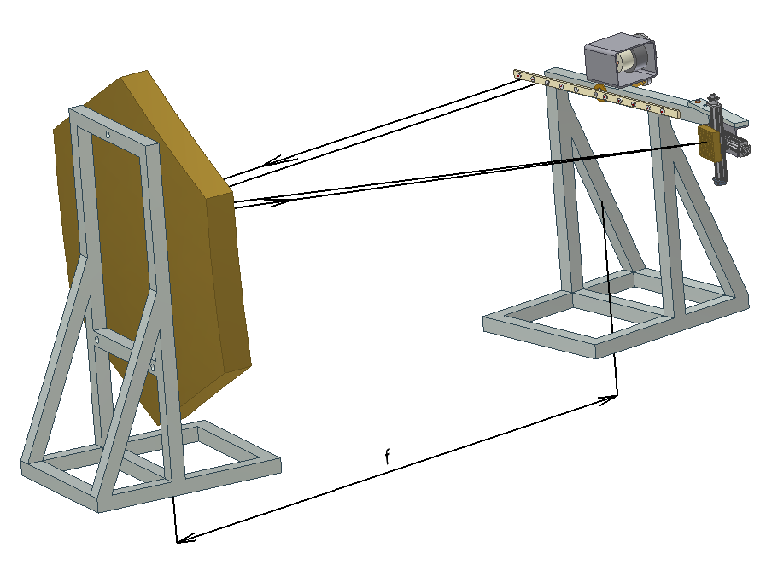
Conception of the mirror testing system
mirror
light source
detector
How it works:
the mirror is illuminated by collimates beams,
light sources consists of several lasers (about four) which are fixed on the rotating arm,
the light focuses on the detector in the mirror focal distance,
industrial camera will be used as a detector.
Test objective:
Rating of geometry and reflexing
properties of mirrors
Confirmation of established
requirements
Possibility of detailed analysis of mirror surface
Quick test
Advantage and disadvantage:
Fast and multiple-point test
Authenticity with the target task
Required long distance (mirror focal distance)

Slide 25
Final remarks
The substrate is our strongest point
Now we concentrate on the development of the „middle layer” for surface roughness improvement.
We are still looking for new industrial partners to cooperation
Experience:
The prototypes allowed us to verify and improve the technology,
The thermal effects play an important role for composite mirror stability,
Direct aluminum coating on composite seems to be feasible and is under development now.
Contact person:
Michał Karczewski:
Project Manager
mkarczewski@cbk.waw.pl tel. +48 504 208 109
Thank you Space Research Centre Team

