Slide 1
Substrates and nano-structured surfaces for future GW observatories
ASPERA-Forum 20/10/2011
Introduction- Brownian thermal noise of mirrors
Functionality of resonant waveguide gratings (RWGs)
RWGs for mirrors
RWGs for beam splitters
Fabrication
Major issues : (1) accuracy
(2) mechanical features
Outlook & conclusion
E.-B. Kley , S. Kroker, T. Käsebier, F. Brückner, F. Fuchs, A. Tünnermann

Slide 2
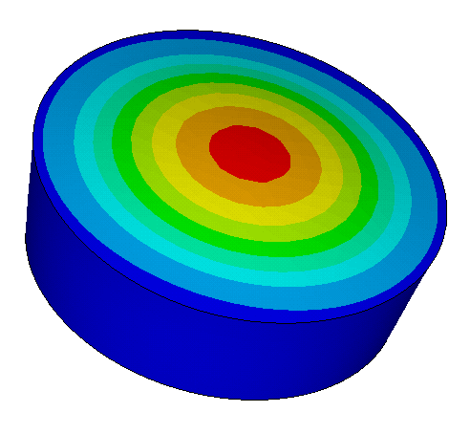
Introduction – Brownian thermal noise of mirrors
fluctuations of surface -> phase of reflected light randomly changed/ distortion
in wavefront
Brownian thermal noise of mirrors
light
φ large
T=300 K
~
φ->0
T->0
S_{x}
S_{x}
S_{x}
Fluctuation-Dissipation-Theoreme: loss (mechanical dissipation) thermal noise
analog:
R
f
f

Slide 3
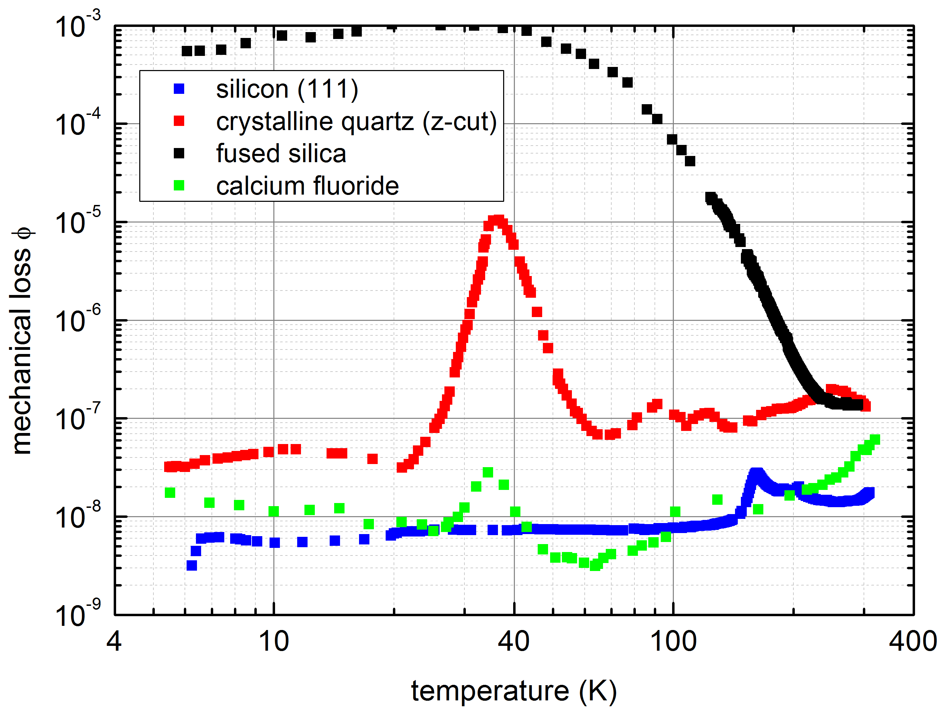
Low loss at low temperatures:
crystalline materials
Functionalization of surface
additional coatings
reduce temperature
reduce coating thickness
use low loss materials
inhomogeneously distributed losses
~
(IFK U Jena)
Harry et al., CQG 19 (2002)
Welton, Callen, (1953)

Slide 4
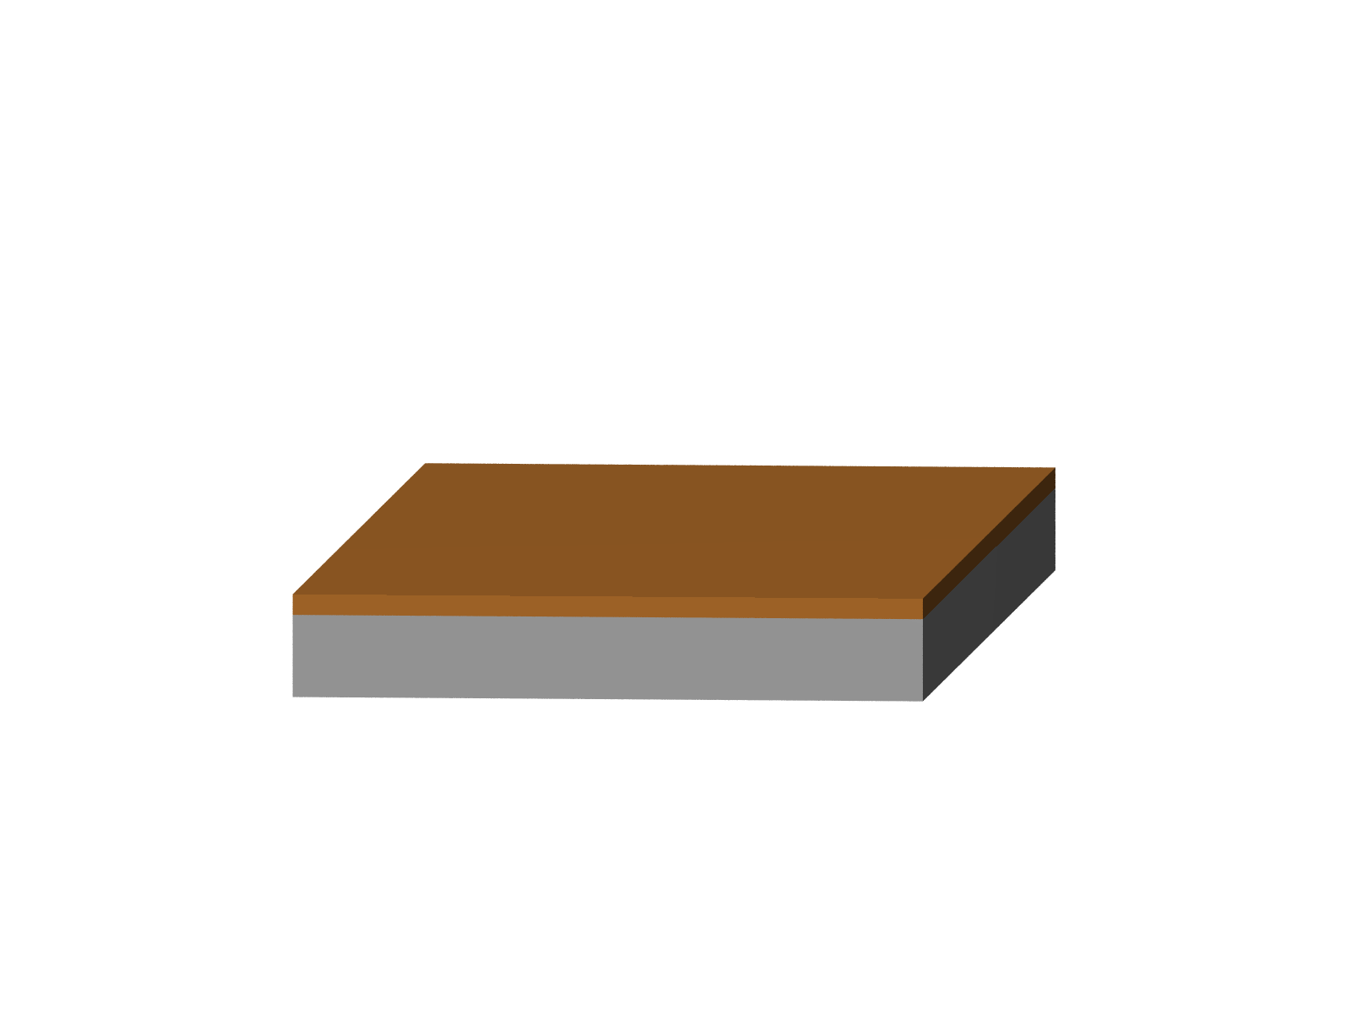
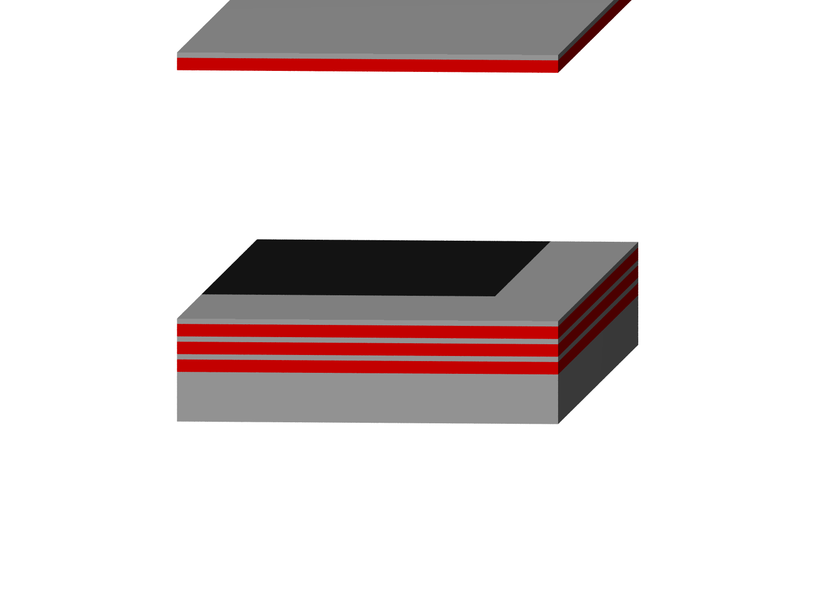
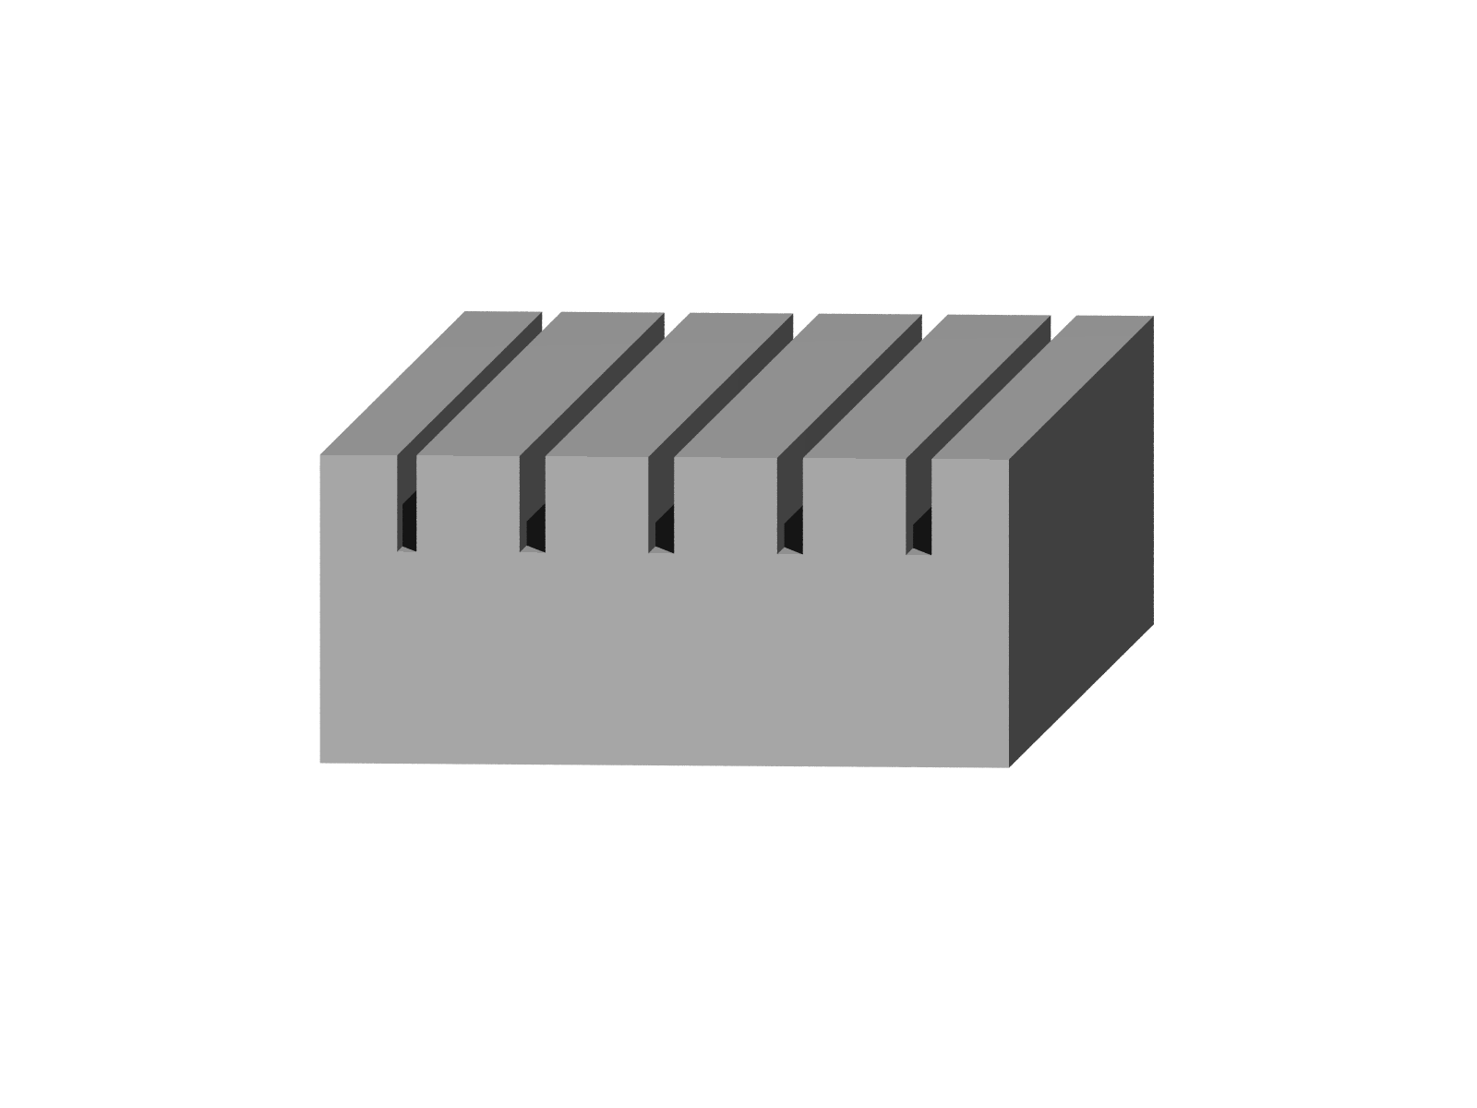
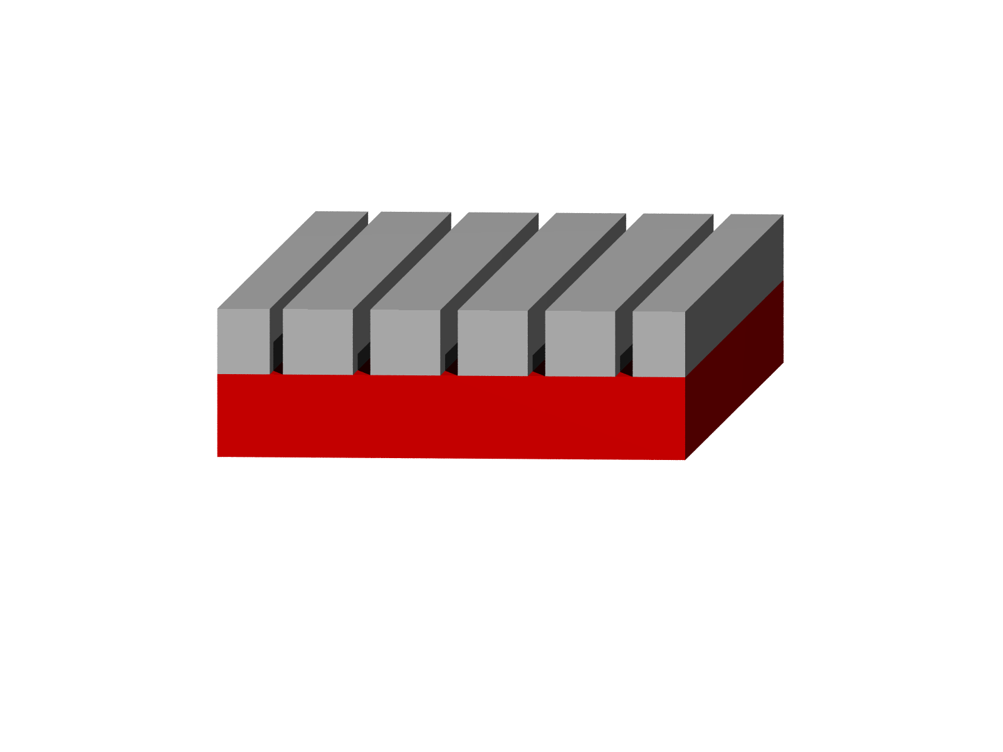
high reflectivity
metal coating
dielectric multilayer stack
structured surface
(RWGs)
…
amorphous coatings
crystalline coatings
AlGaAs/GaAs
(U Vienna, Aspelmaier)
large loss
large thickness
monolithic
non-monolithic
absorption
minimize thickness
approp. materials
reflectivity by multiple
beam interference
reflectivity by resonant
light coupling
Notes:
Crystalline/RWG hervorheben für high-preciscion metrology - > RWG – Substrat, T-shape, graues substrat

Slide 5
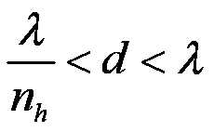
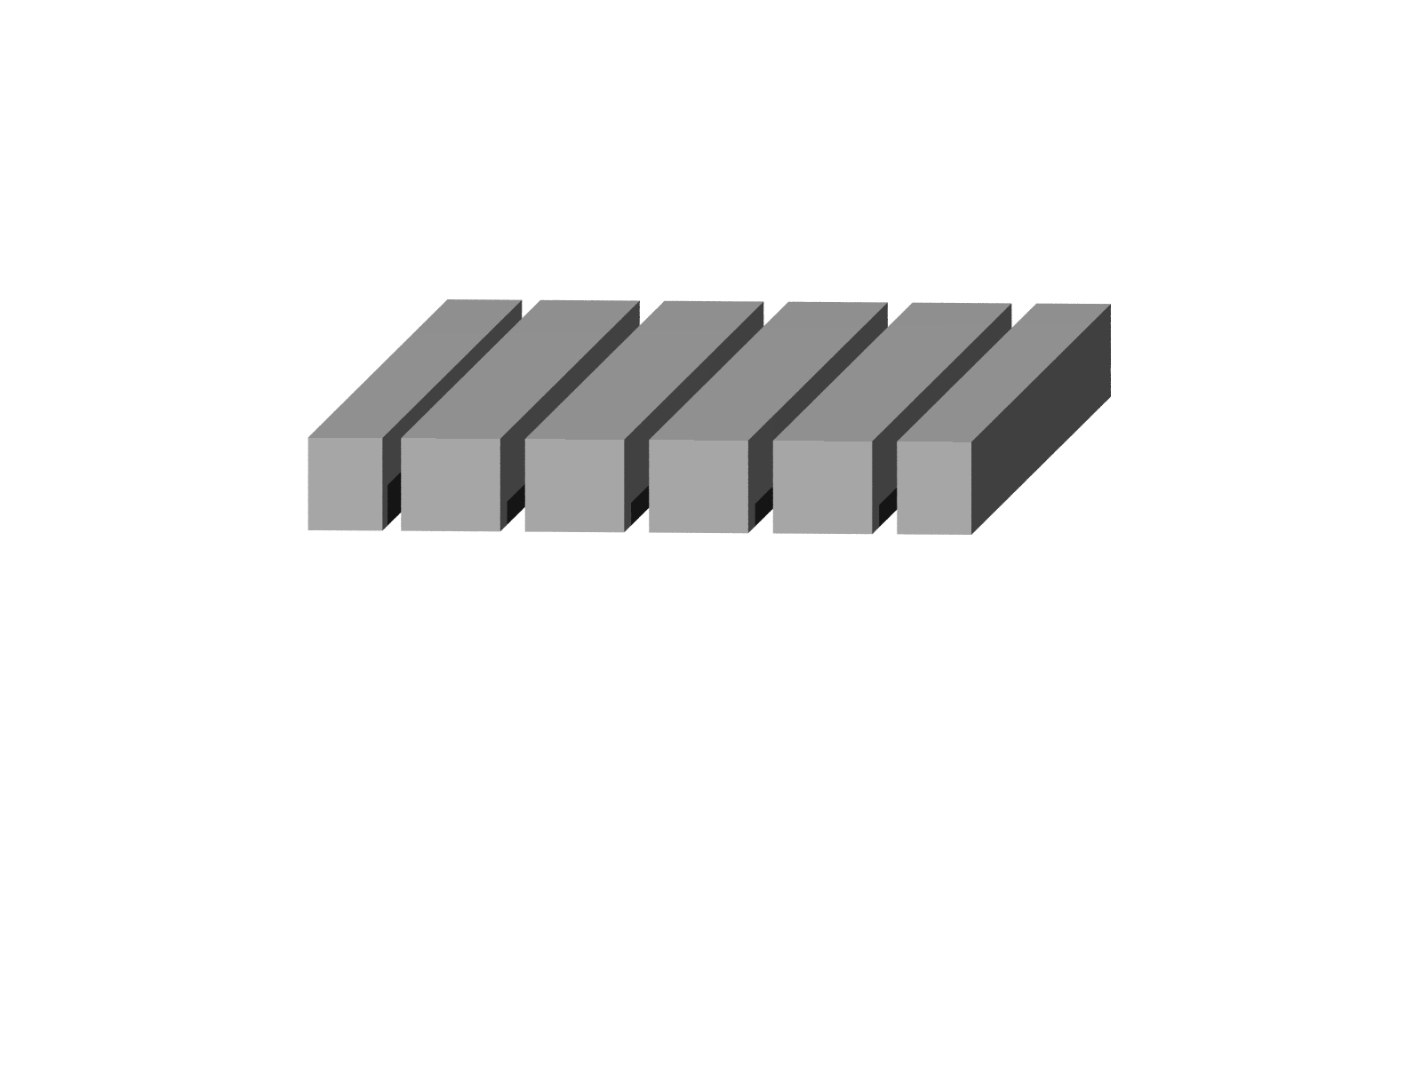
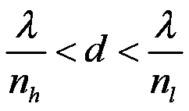
Functionality of resonant waveguide gratings (RWGs)
first diffraction order
in grating material
only zeroth diffraction
order in free space
n_{h}
n_{l}
-1
1
T₀
Notes:
Mit einelne ordnungen , transmission

Slide 6
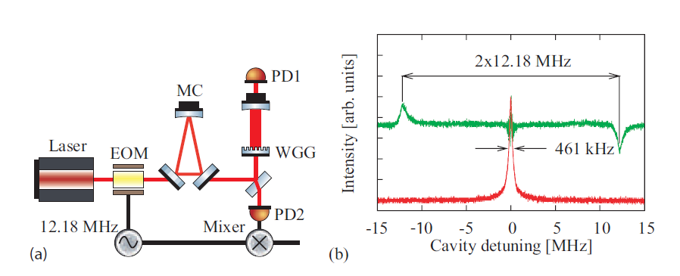
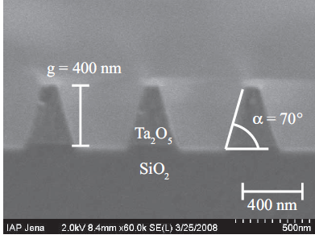
RWGs for mirrors
RWGs on silica
Tantala grating on silica
silica as low-index layer and substrate
Brückner et al., Opt. Express (2008)

Slide 7
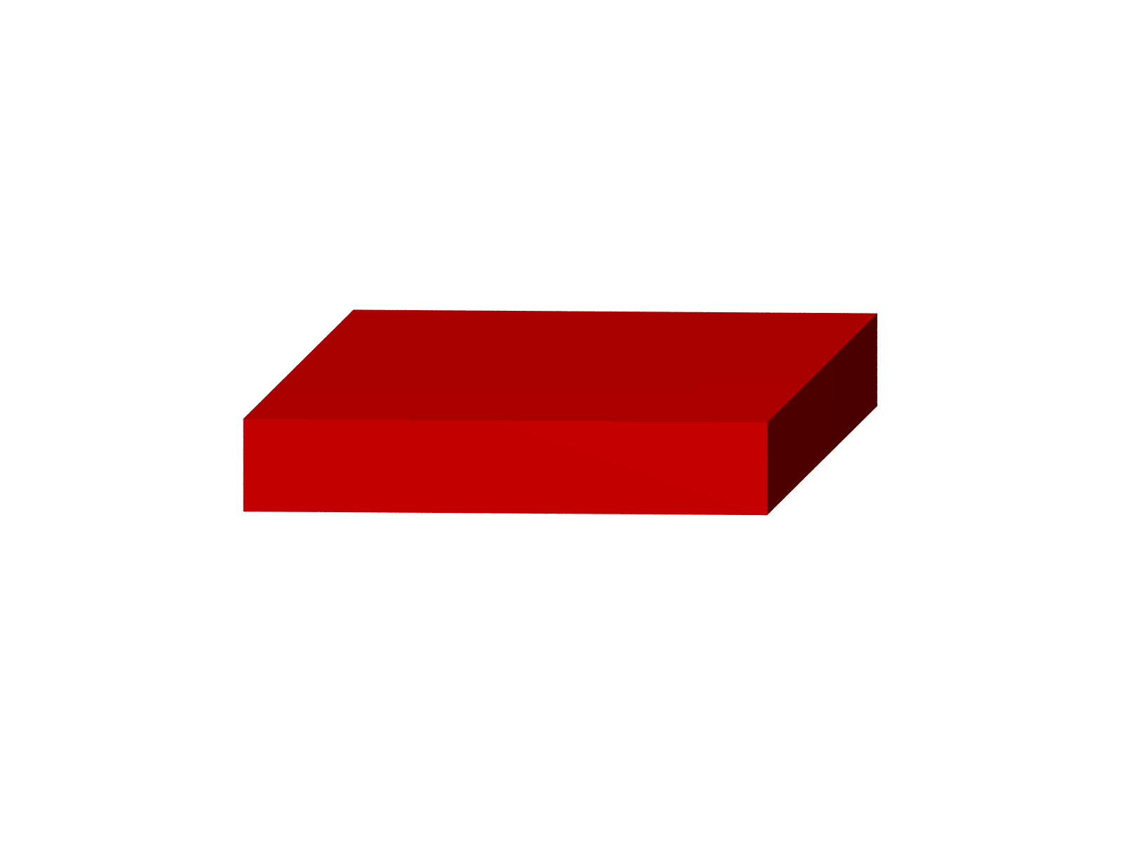

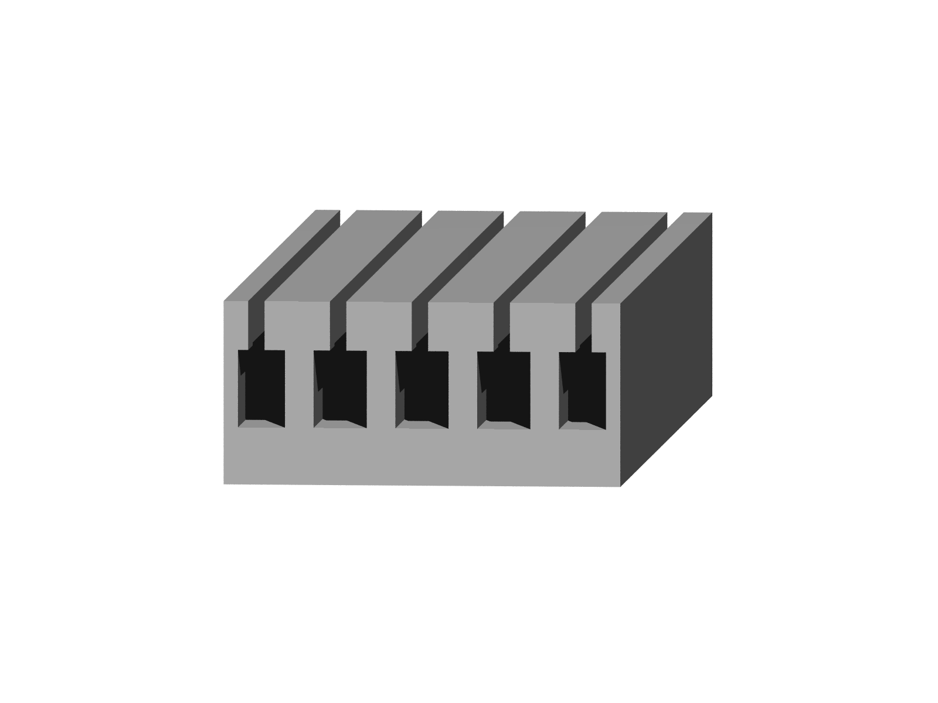
RWGs on silicon
cryogenic temperatures, low mechanical loss ~10⁻⁸
high index
λ=1064 nm Ta₂O₅, TiO₂
λ=1550 nm silicon
low index
silica
silicon
high index n≈3.5
Better: use crystalline silicon only
No additional coating!
Notes:
Monolithisch…. Mit hinmalen, führungseigenschaften oben stärker

Slide 8
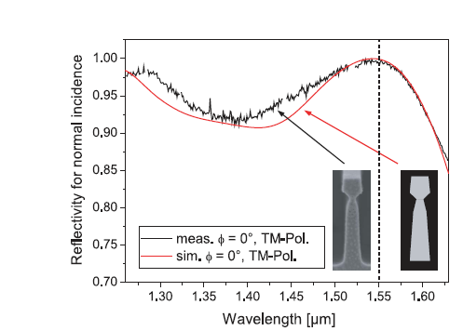
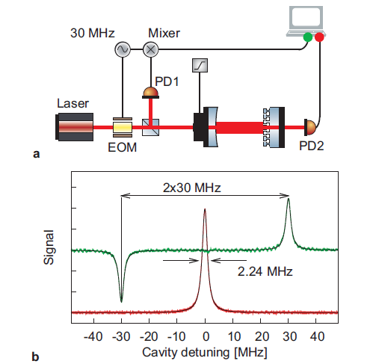
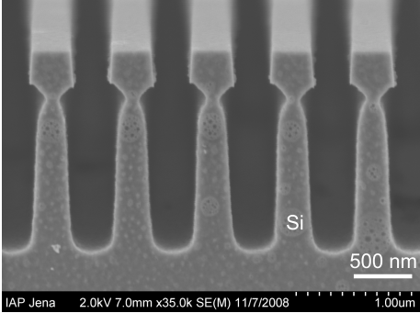
Not measured at predicted maximum wavelength,
Brückner et al., PRL (2010)

Slide 9

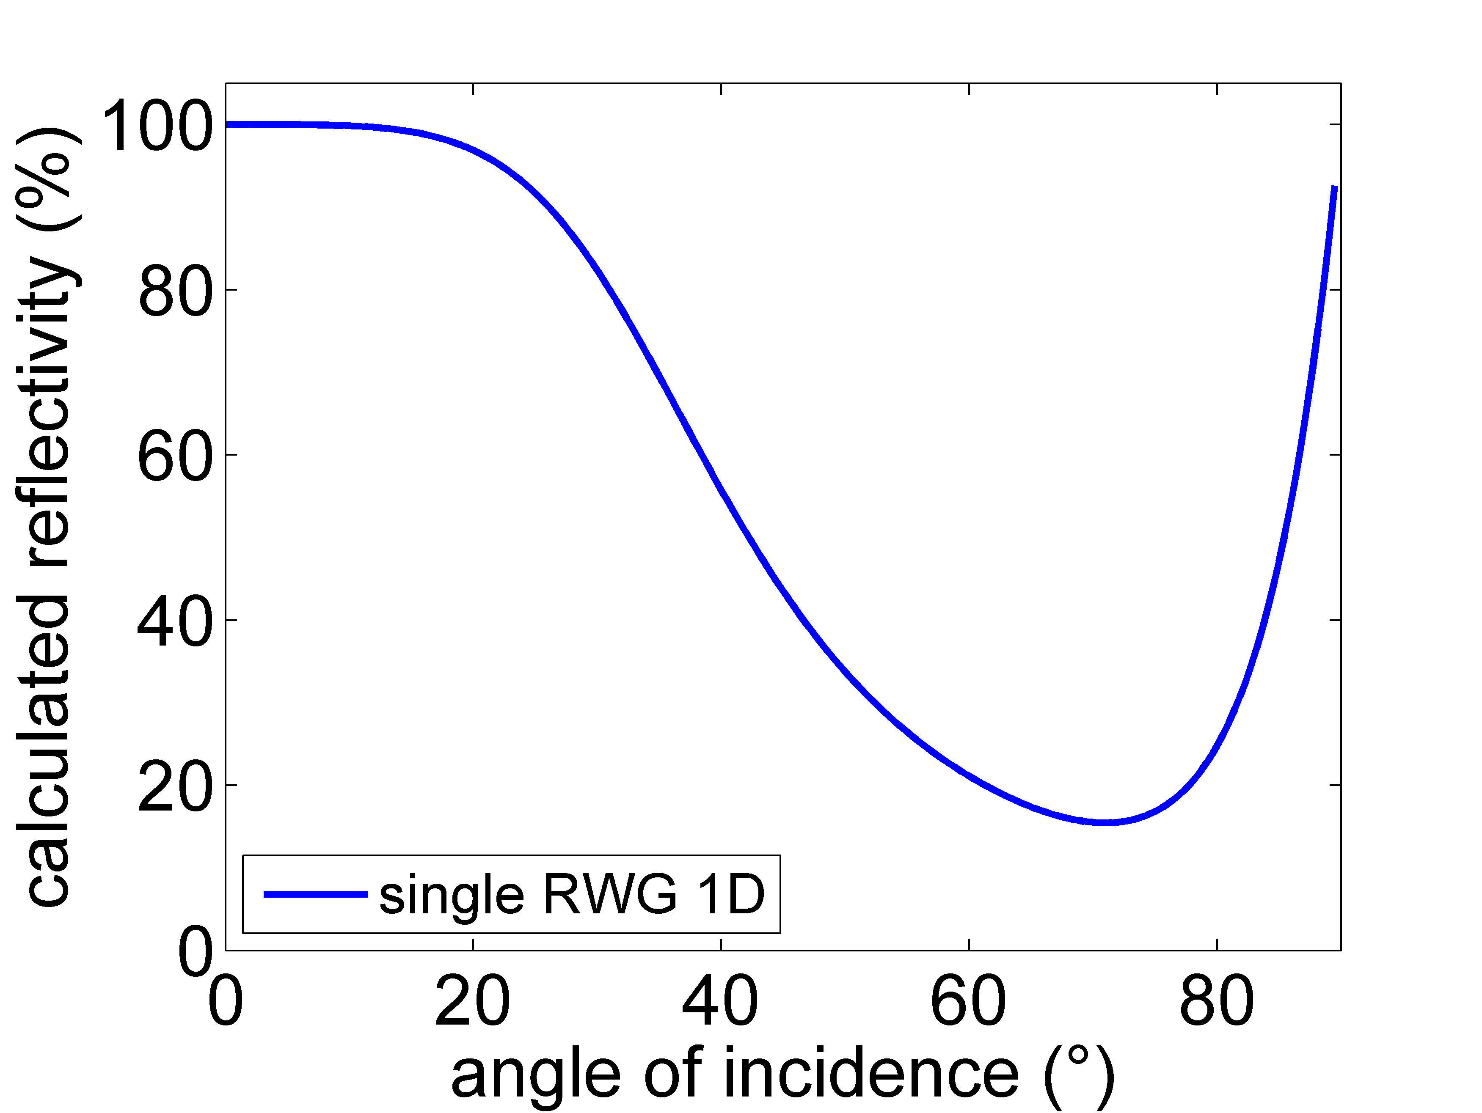

RWGs for beam splitters
Large angular tolerances necessary.
α₀
α₀
incident light
incident light
Light incident at larger angles mainly transmitted.
Kroker et al., Op. Letters (2011)
Kroker et al., Opt. Express (2011)
Notes:
Skizze von einzelnem daneben, beugungsordnung mit reinmalen, struktur noch n bissel verschnörkseln

Slide 10
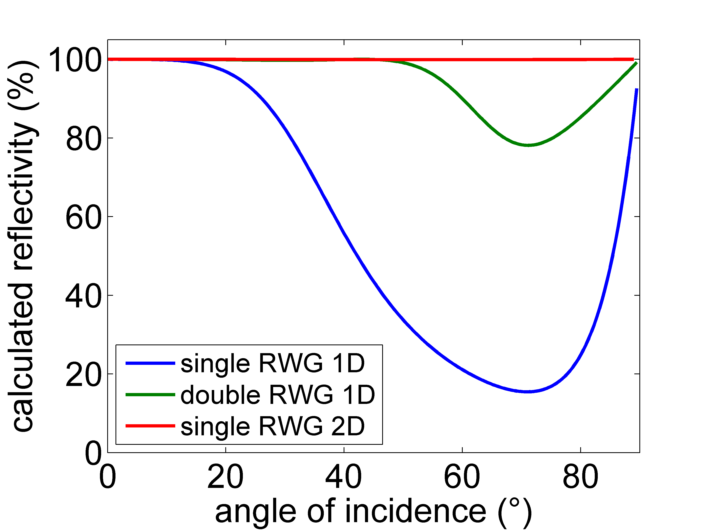
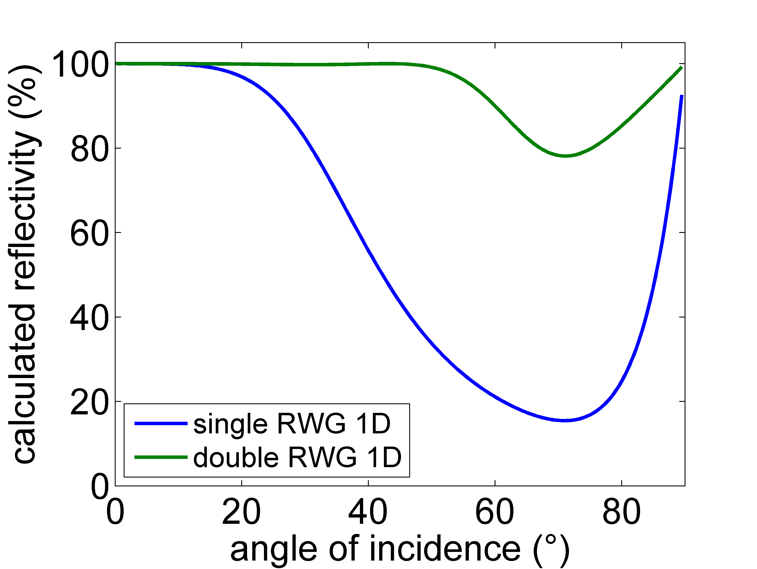
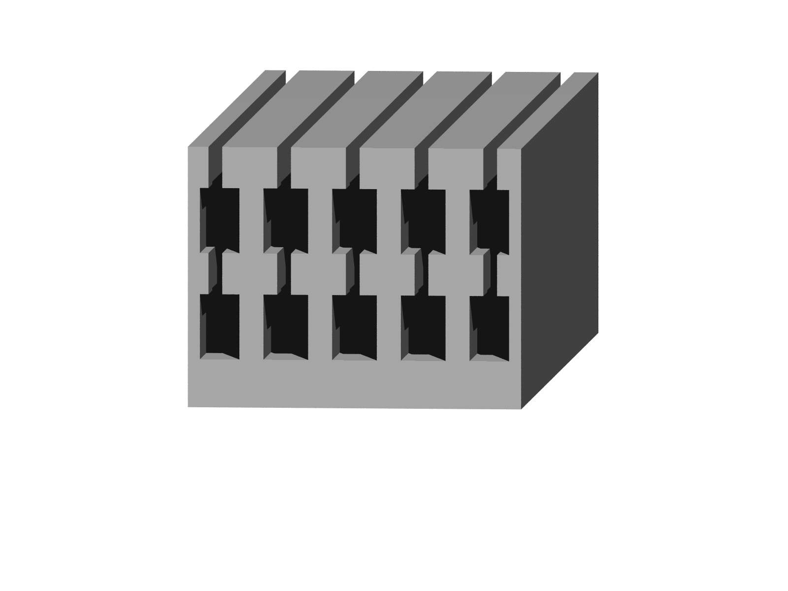
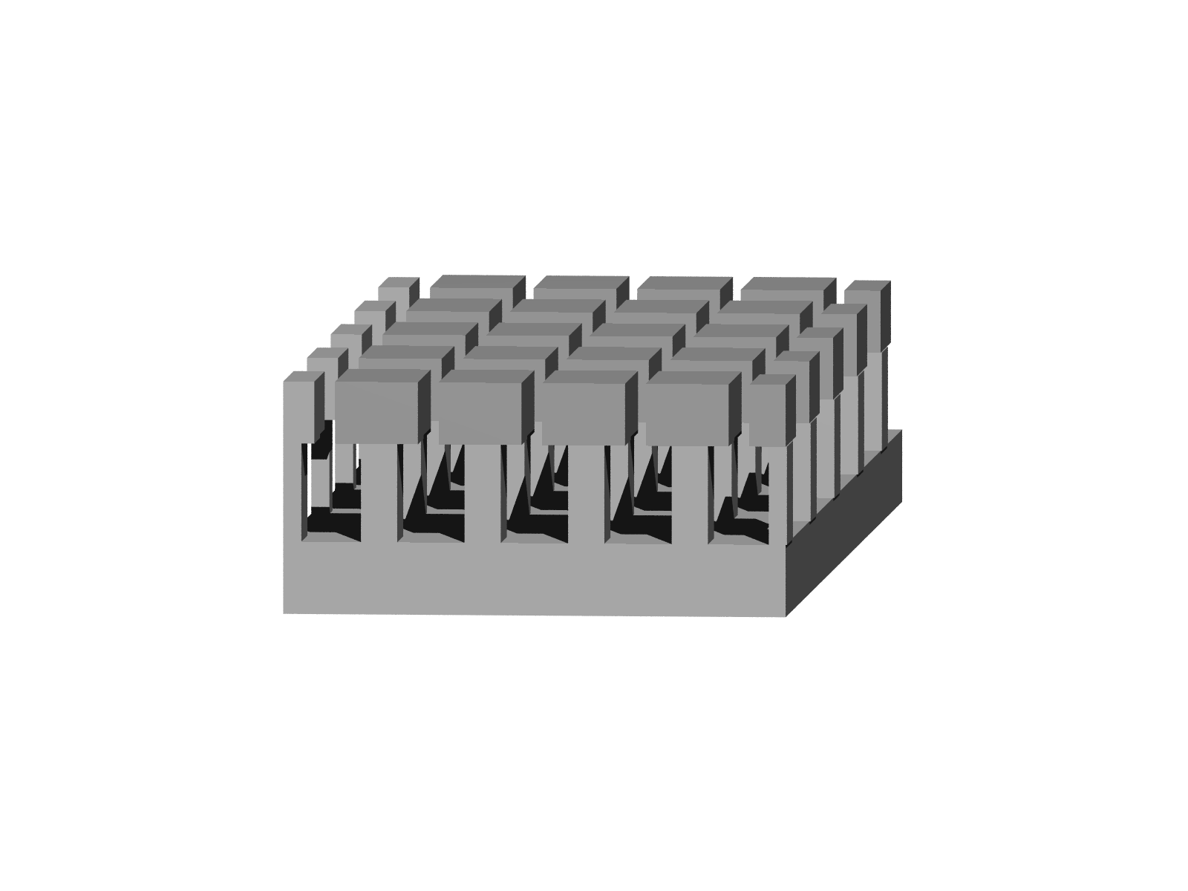
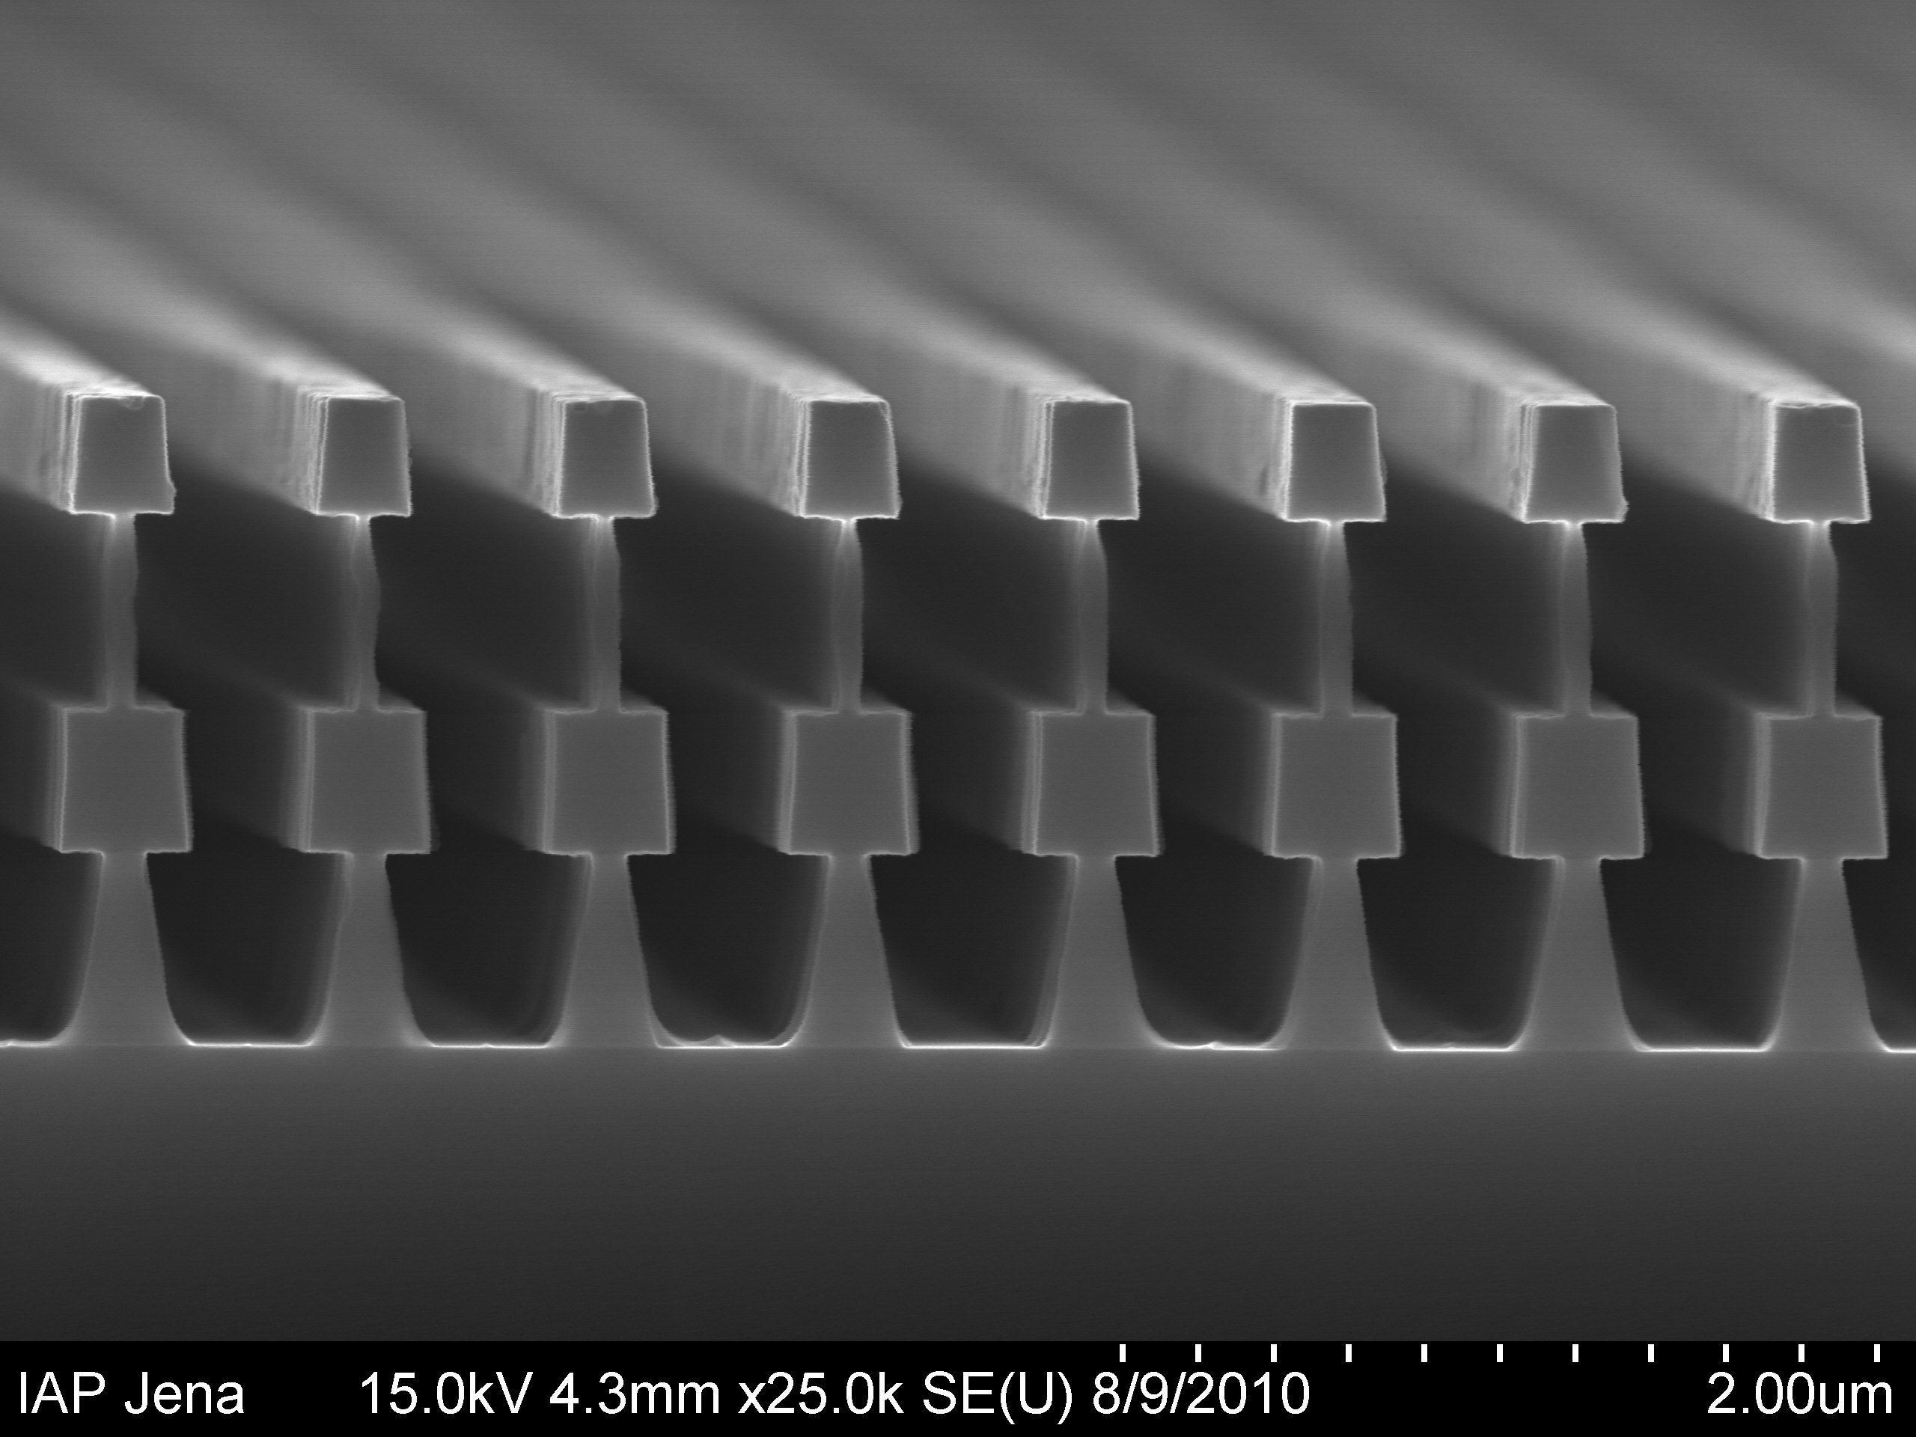
enhanced angular tolerances
double T-shape
2D T-shape

Slide 11
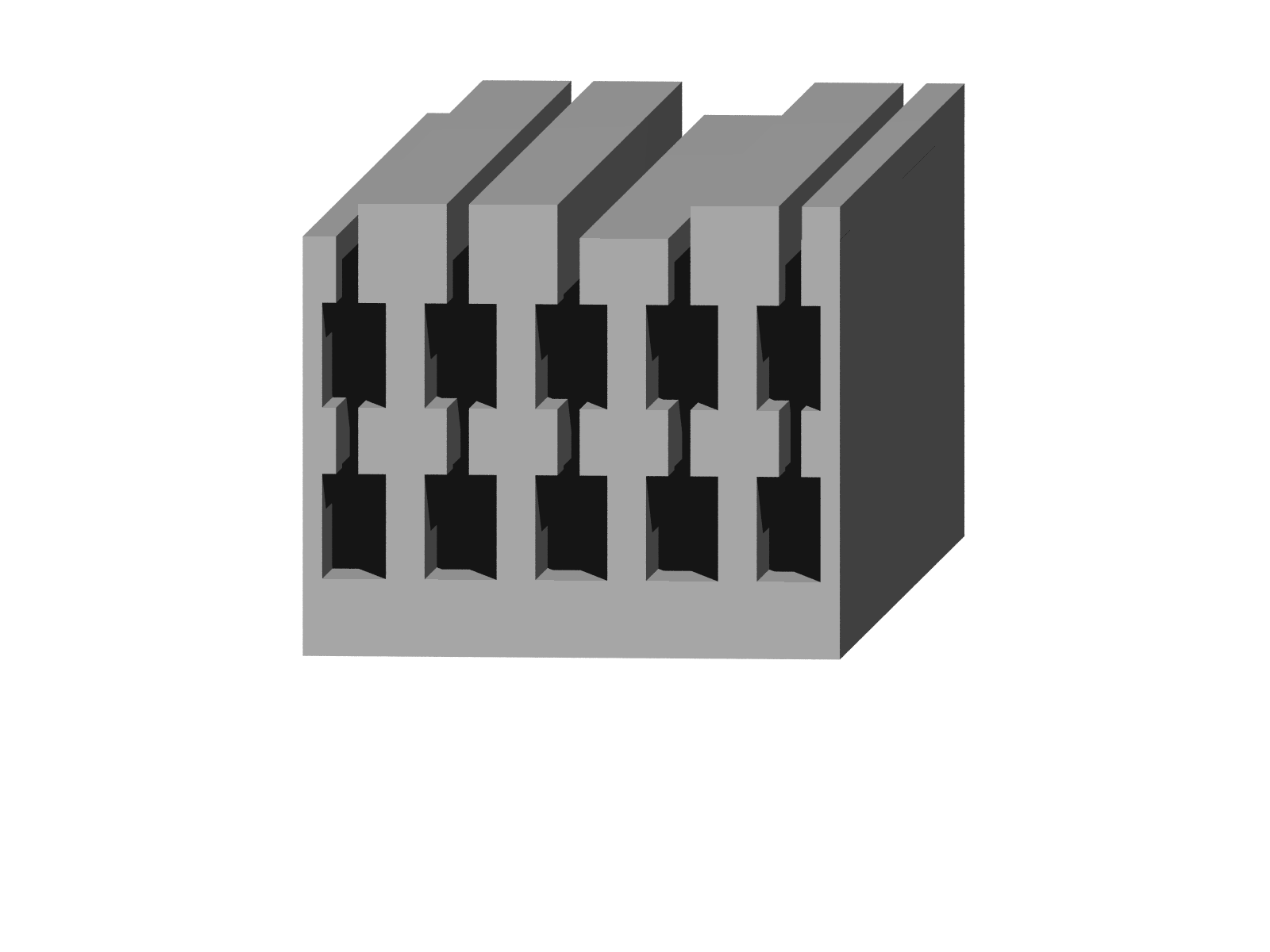
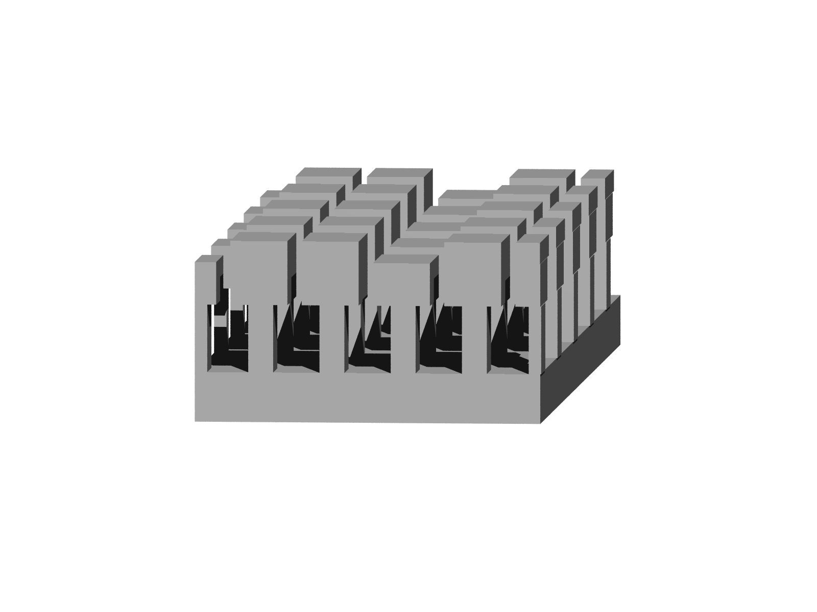
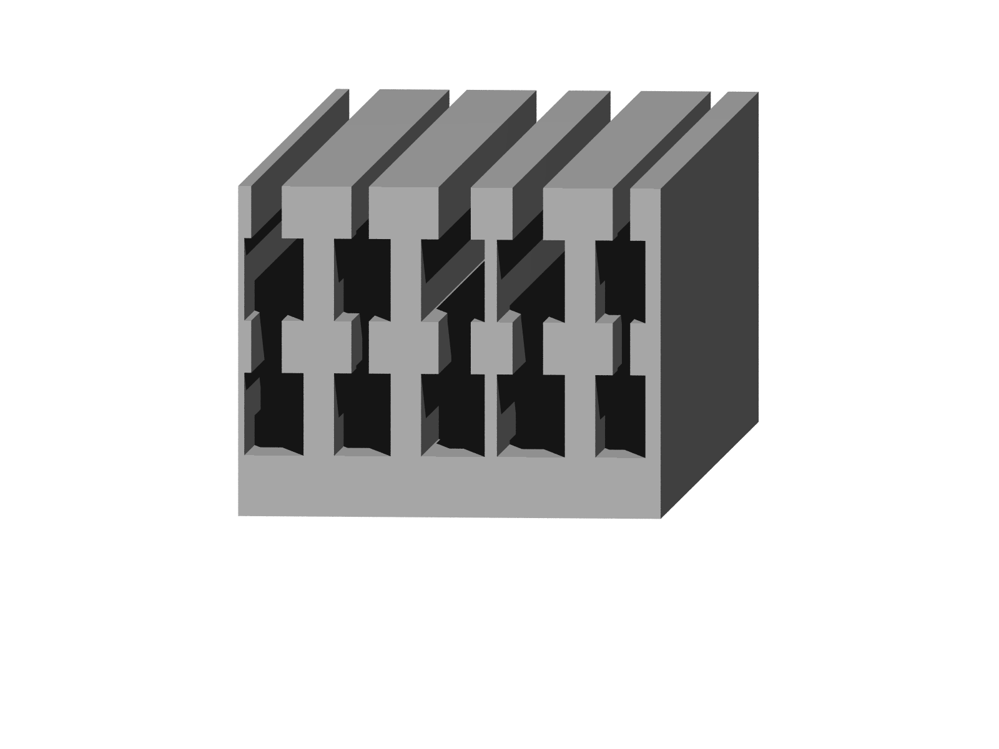
generation of additional diffraction orders
modulation of the RWG
perturbation of the mirror
α₀
α₀
incident light
R₋₁
depth
modulation
fill factor
modulation
incident light
control of the cavity’s finesse via diffraction efficiency R₋₁
Notes:
Periodenmodulation noch mal deutlicher hervorheben

Slide 12
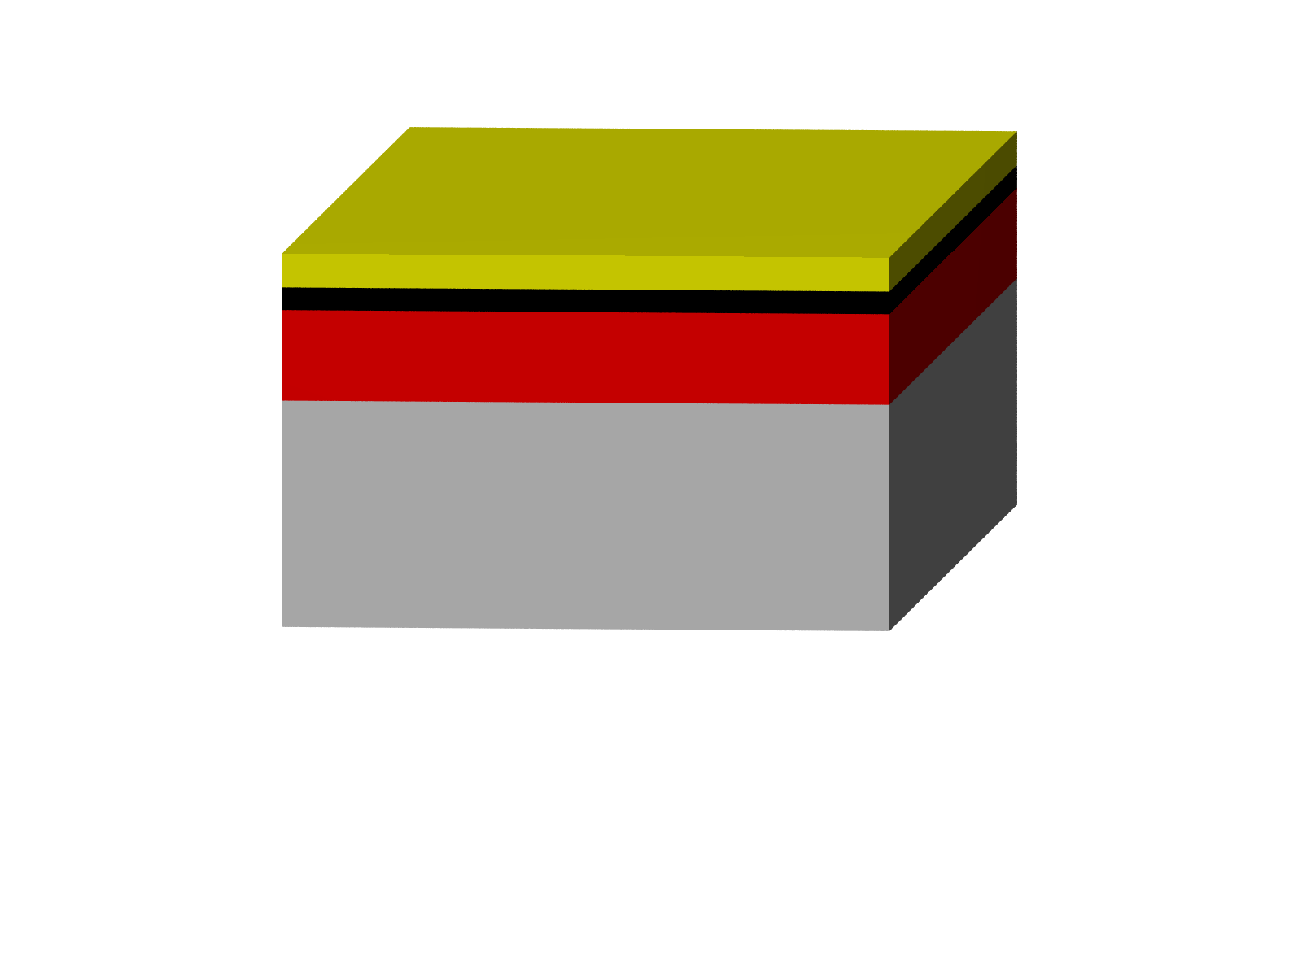

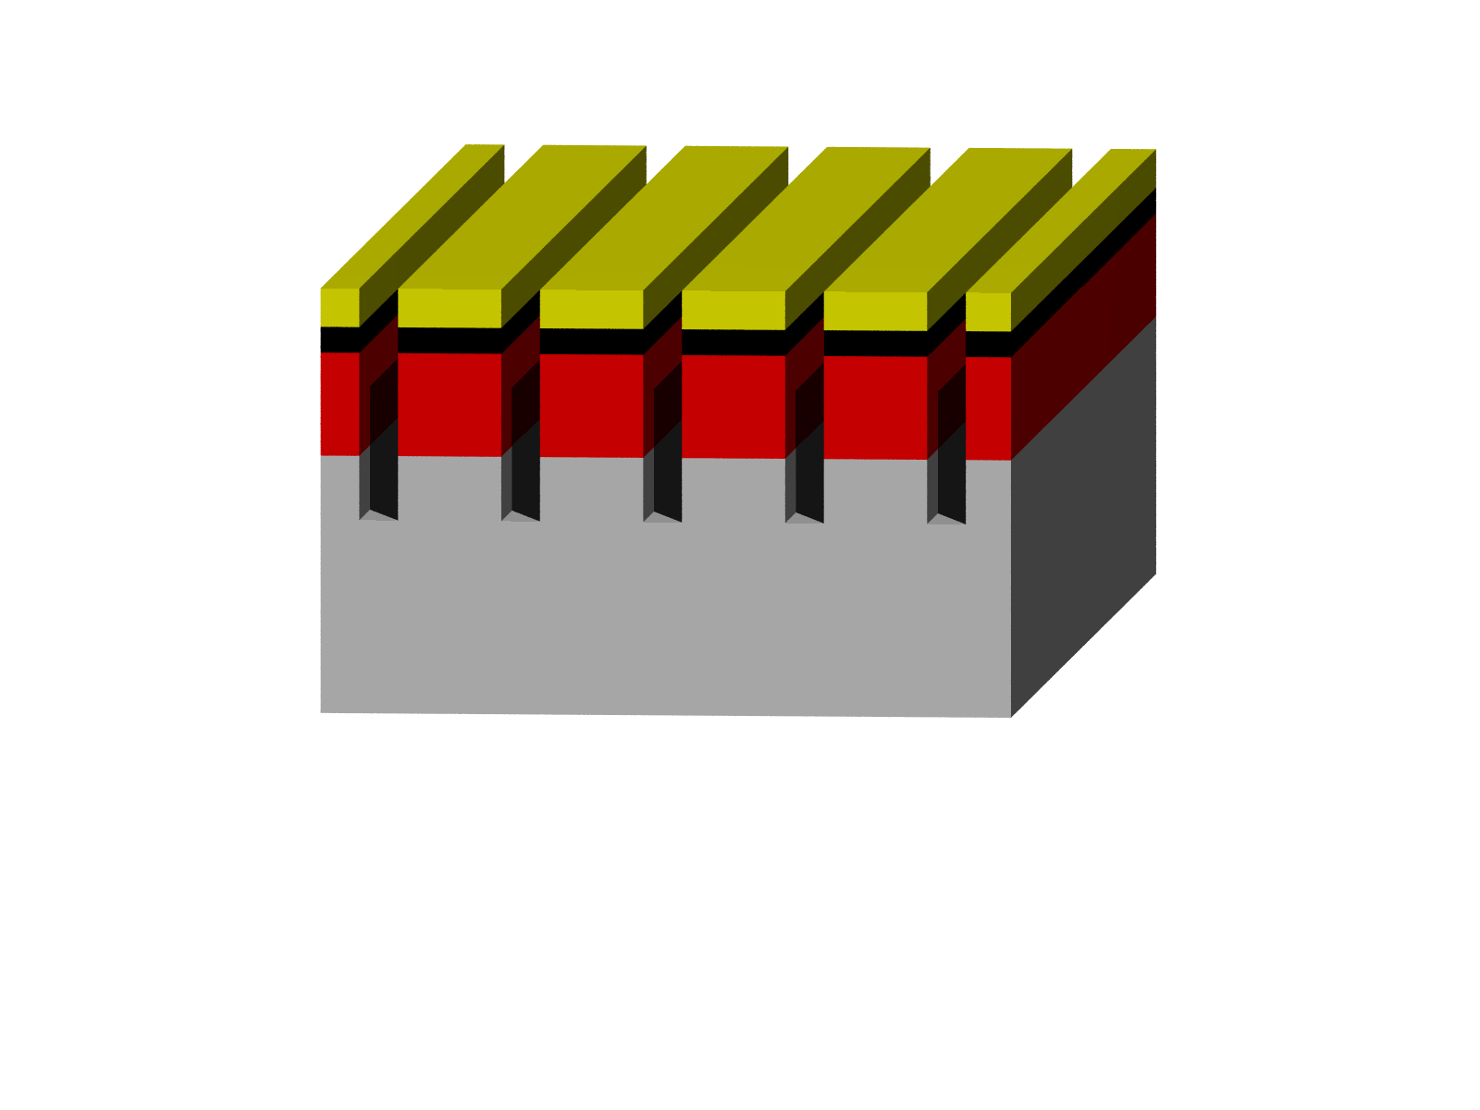
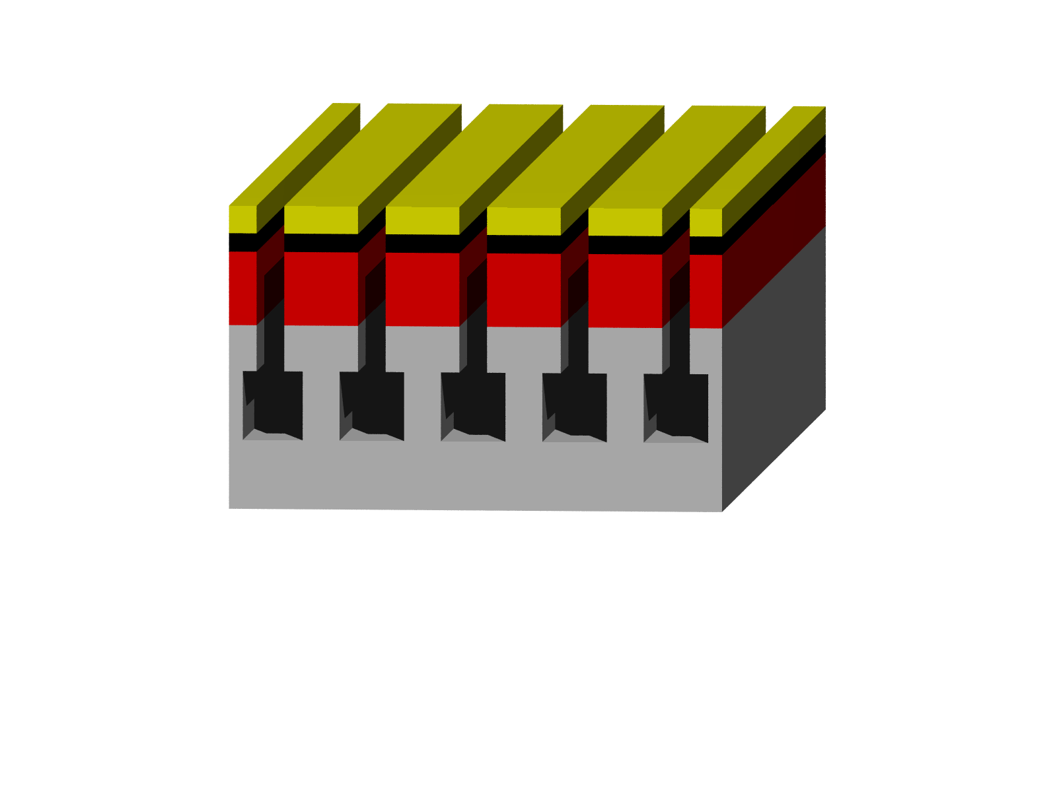
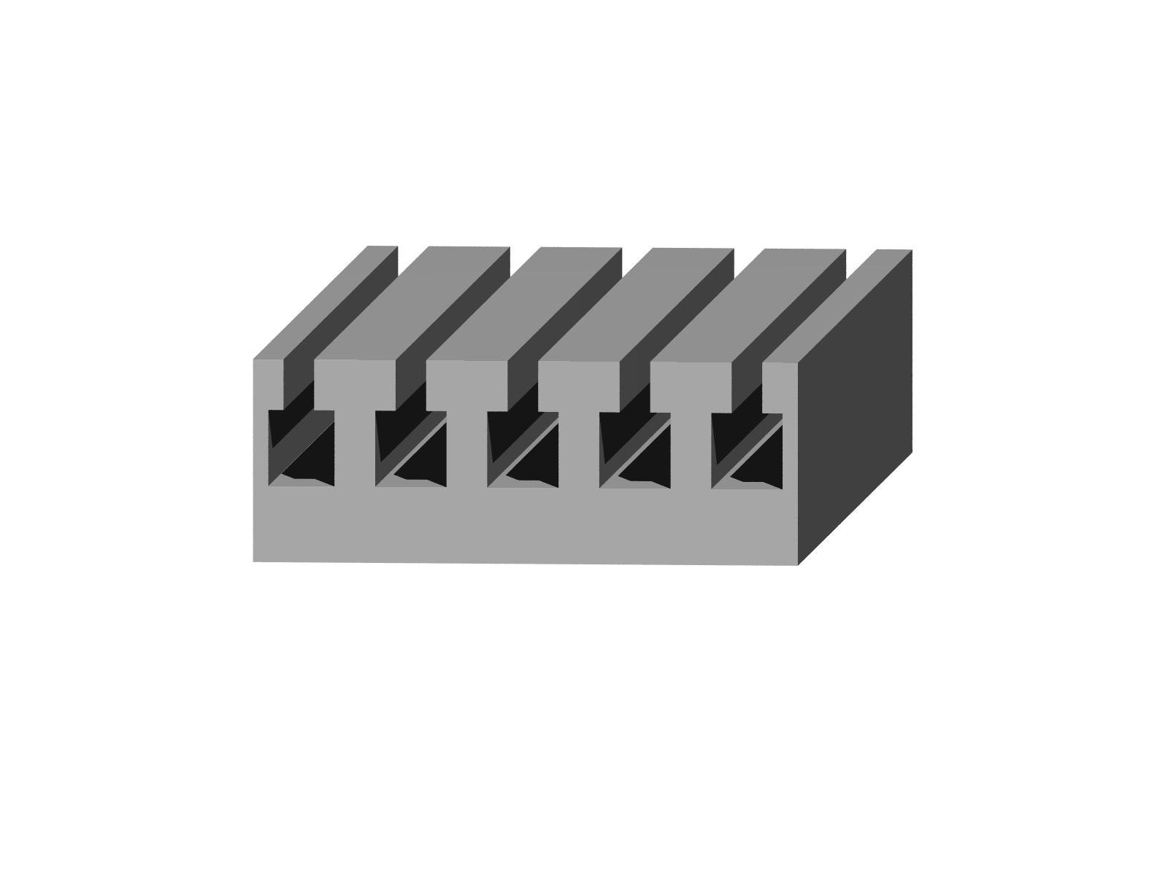
Fabrication
Typical fabrication procedure for monolithic RWGs:
“isotropic” etching
e-beam exposure
development
anisotropic etching +
sidewall passivation
resist
chromium/
hard mask
silicon
silica
Notes:
Seitenwandpassivierung mit einmalen?

Slide 13
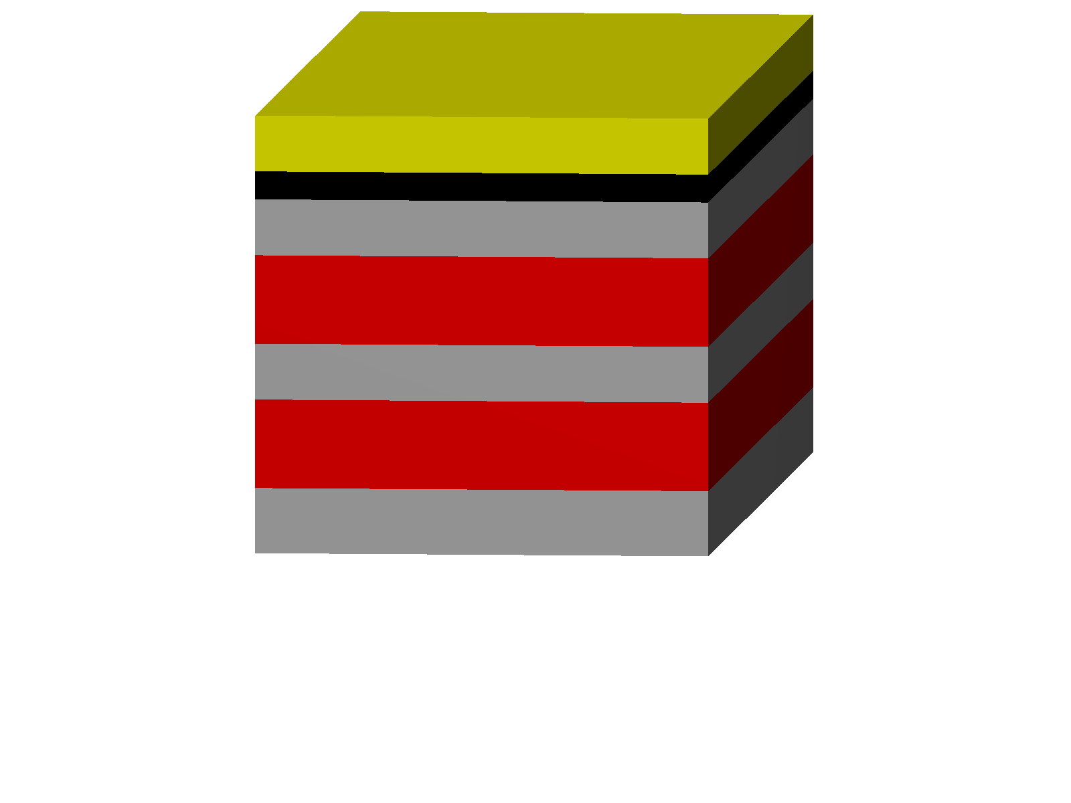


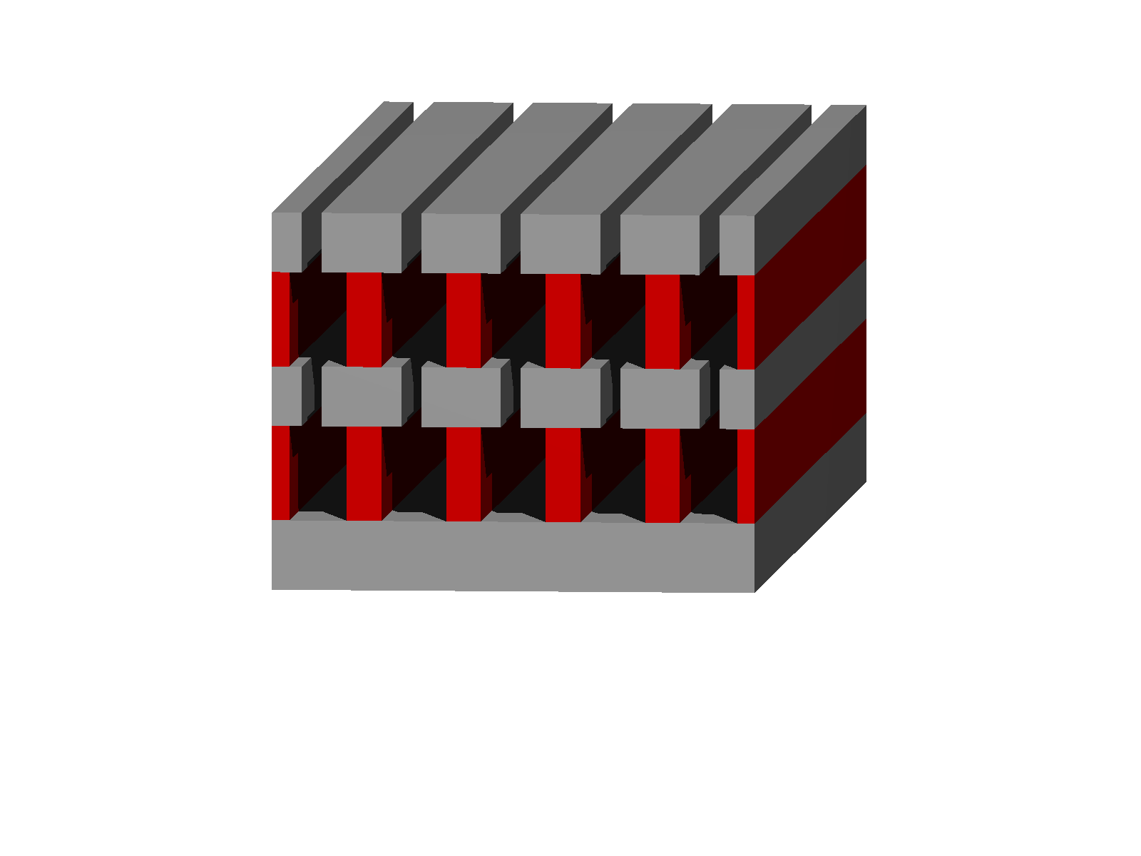
non-monolithic RWGs:
e-beam exposure
development
anisotropic etching
isotropic (wet) etching
Material combinations:
silicon-diamond
silicon-silica
resist
chromium/
hard mask
silicon
silica/diamond

Slide 14
How good is e-beam writing?
Notes:
Wichtigstes is effizienz, wieviel geht verloren?... Weit praktisch kommen, wissen wir nicht, glauben dass es min. eine 9 mehr wird
Wavefront and scattered light
How good is e-beam writing… usually stitching errors…. Wavefront
Aberration, parasitiv diffraction orders, straylight

Slide 15
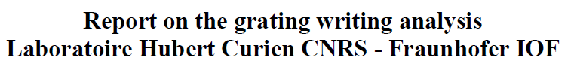
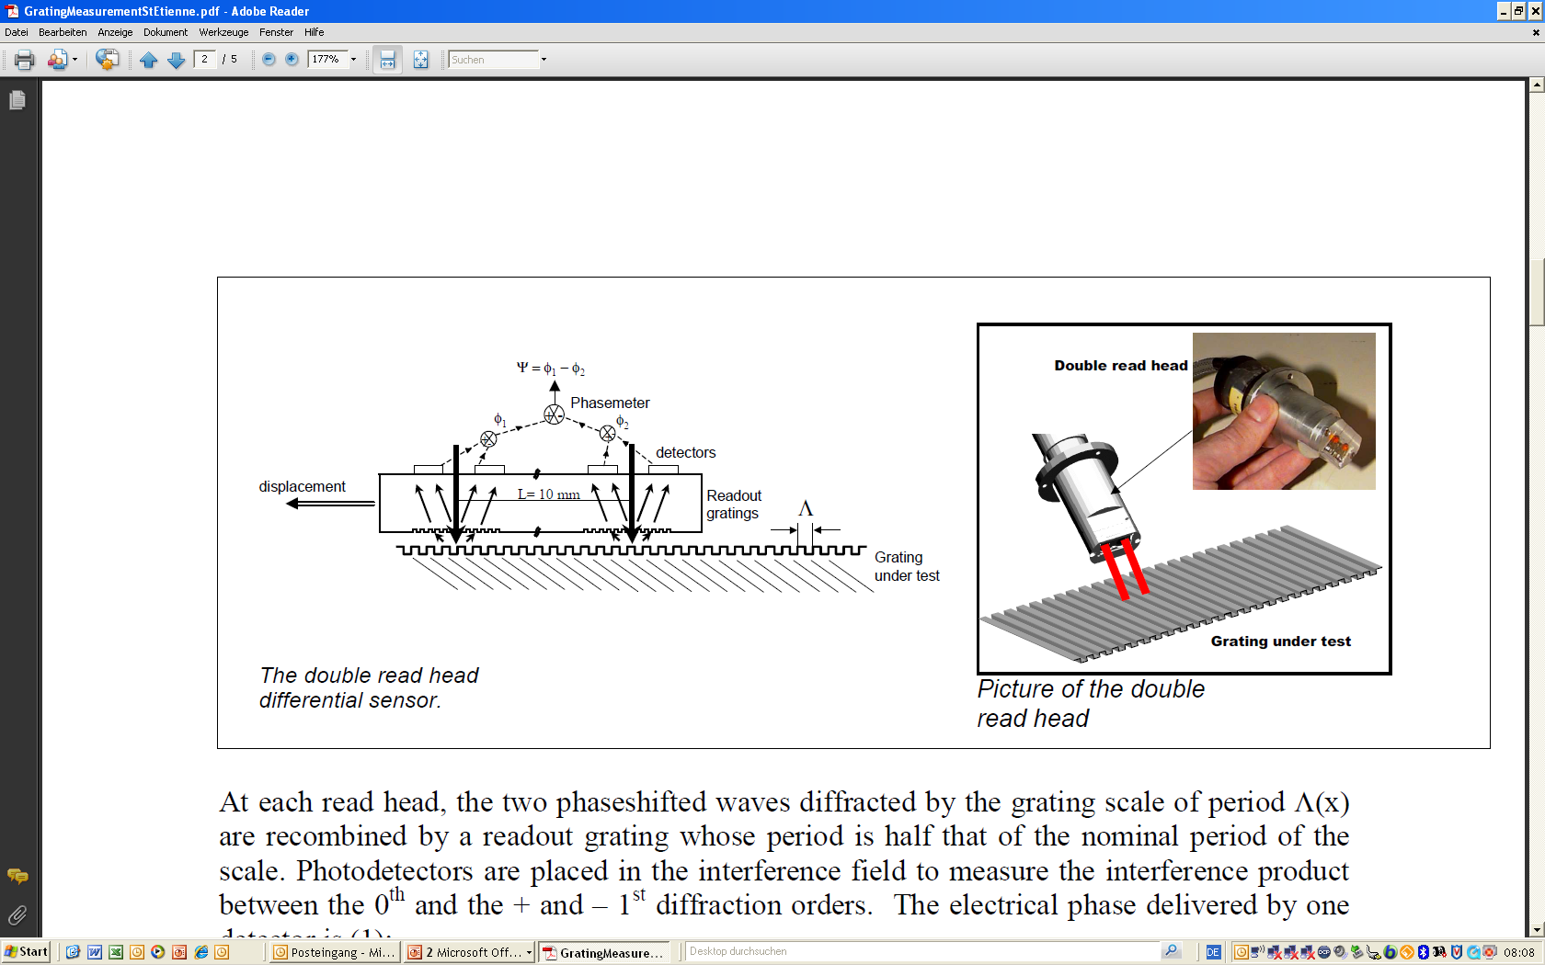
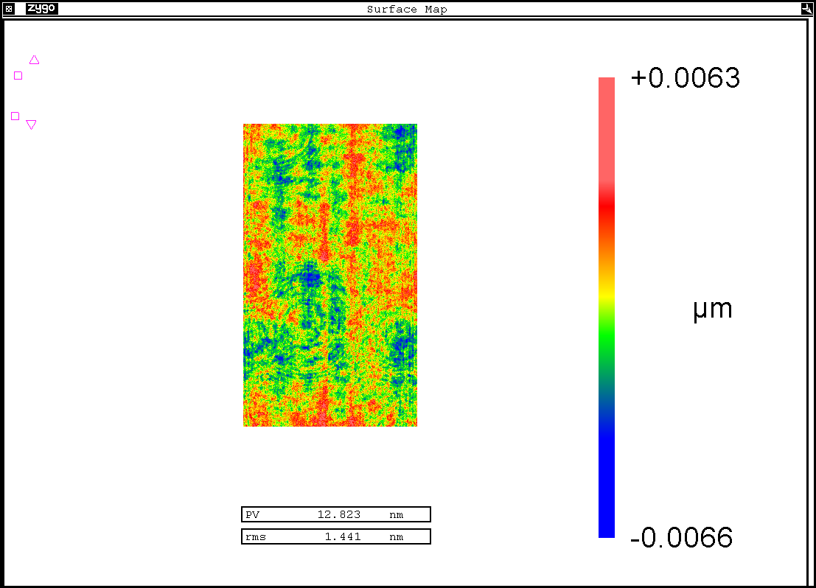
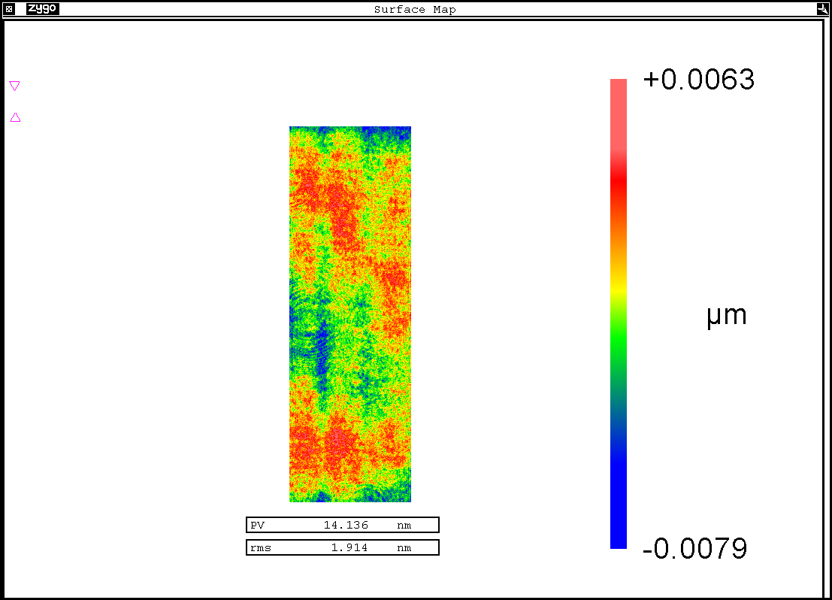
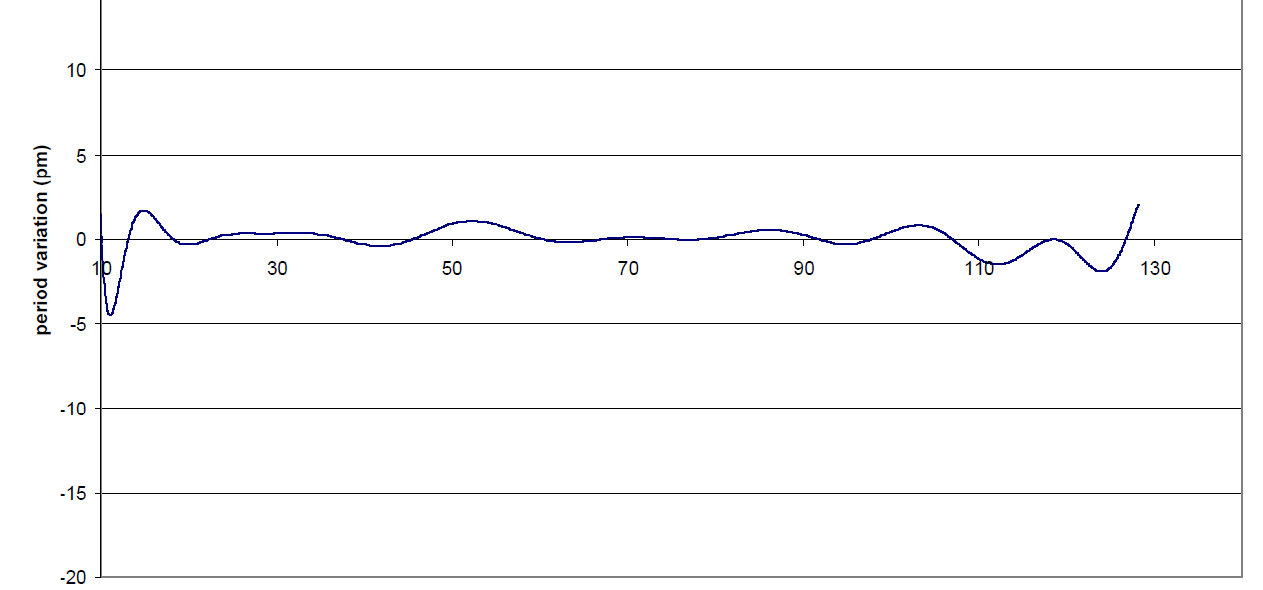
Grating accuracy
wave-front measurement
(1 µm period grating + technology,
Littrow-Mount, λ=633 nm)
19 mm
+ 6.3 nm
50mm
period variation [pm]
- 6.6 nm
position [mm]
 | wavefront | placement
PV | 12.8 nm | <10.3 nm
rms | 1.4 nm | <1.1 nm
period variation < 5 pm
significantly better than interferometric gratings

Slide 16
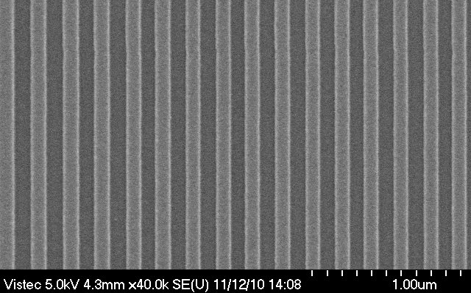
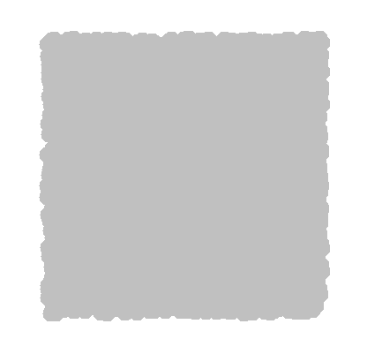
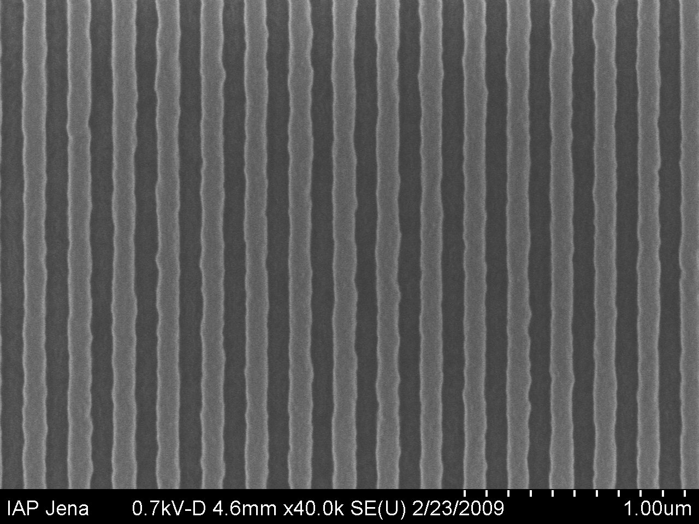
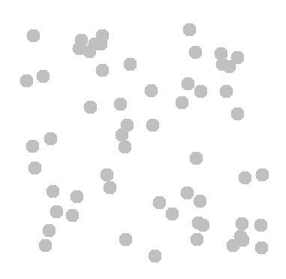
Problem: Lithographic process induces line-edge roughness due to statistics
100 nm lines and spaces
10nm
HSQ (1300 µC/cm²)
FEP 171 (9.5 µC/cm²)
10nm
Notes:
Wissen noch nicht, wo die grenzen liegen, sind noch weit entfernt, von technologiebedingten grenzen

Slide 17
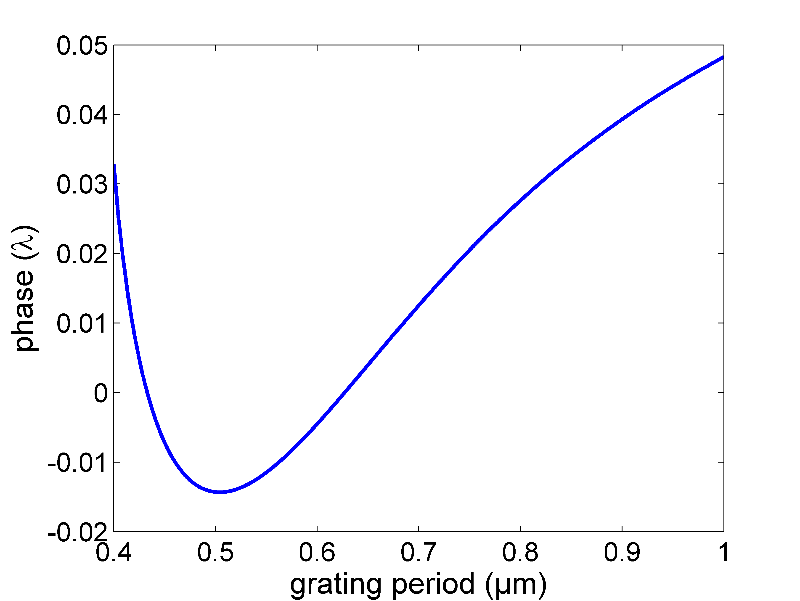
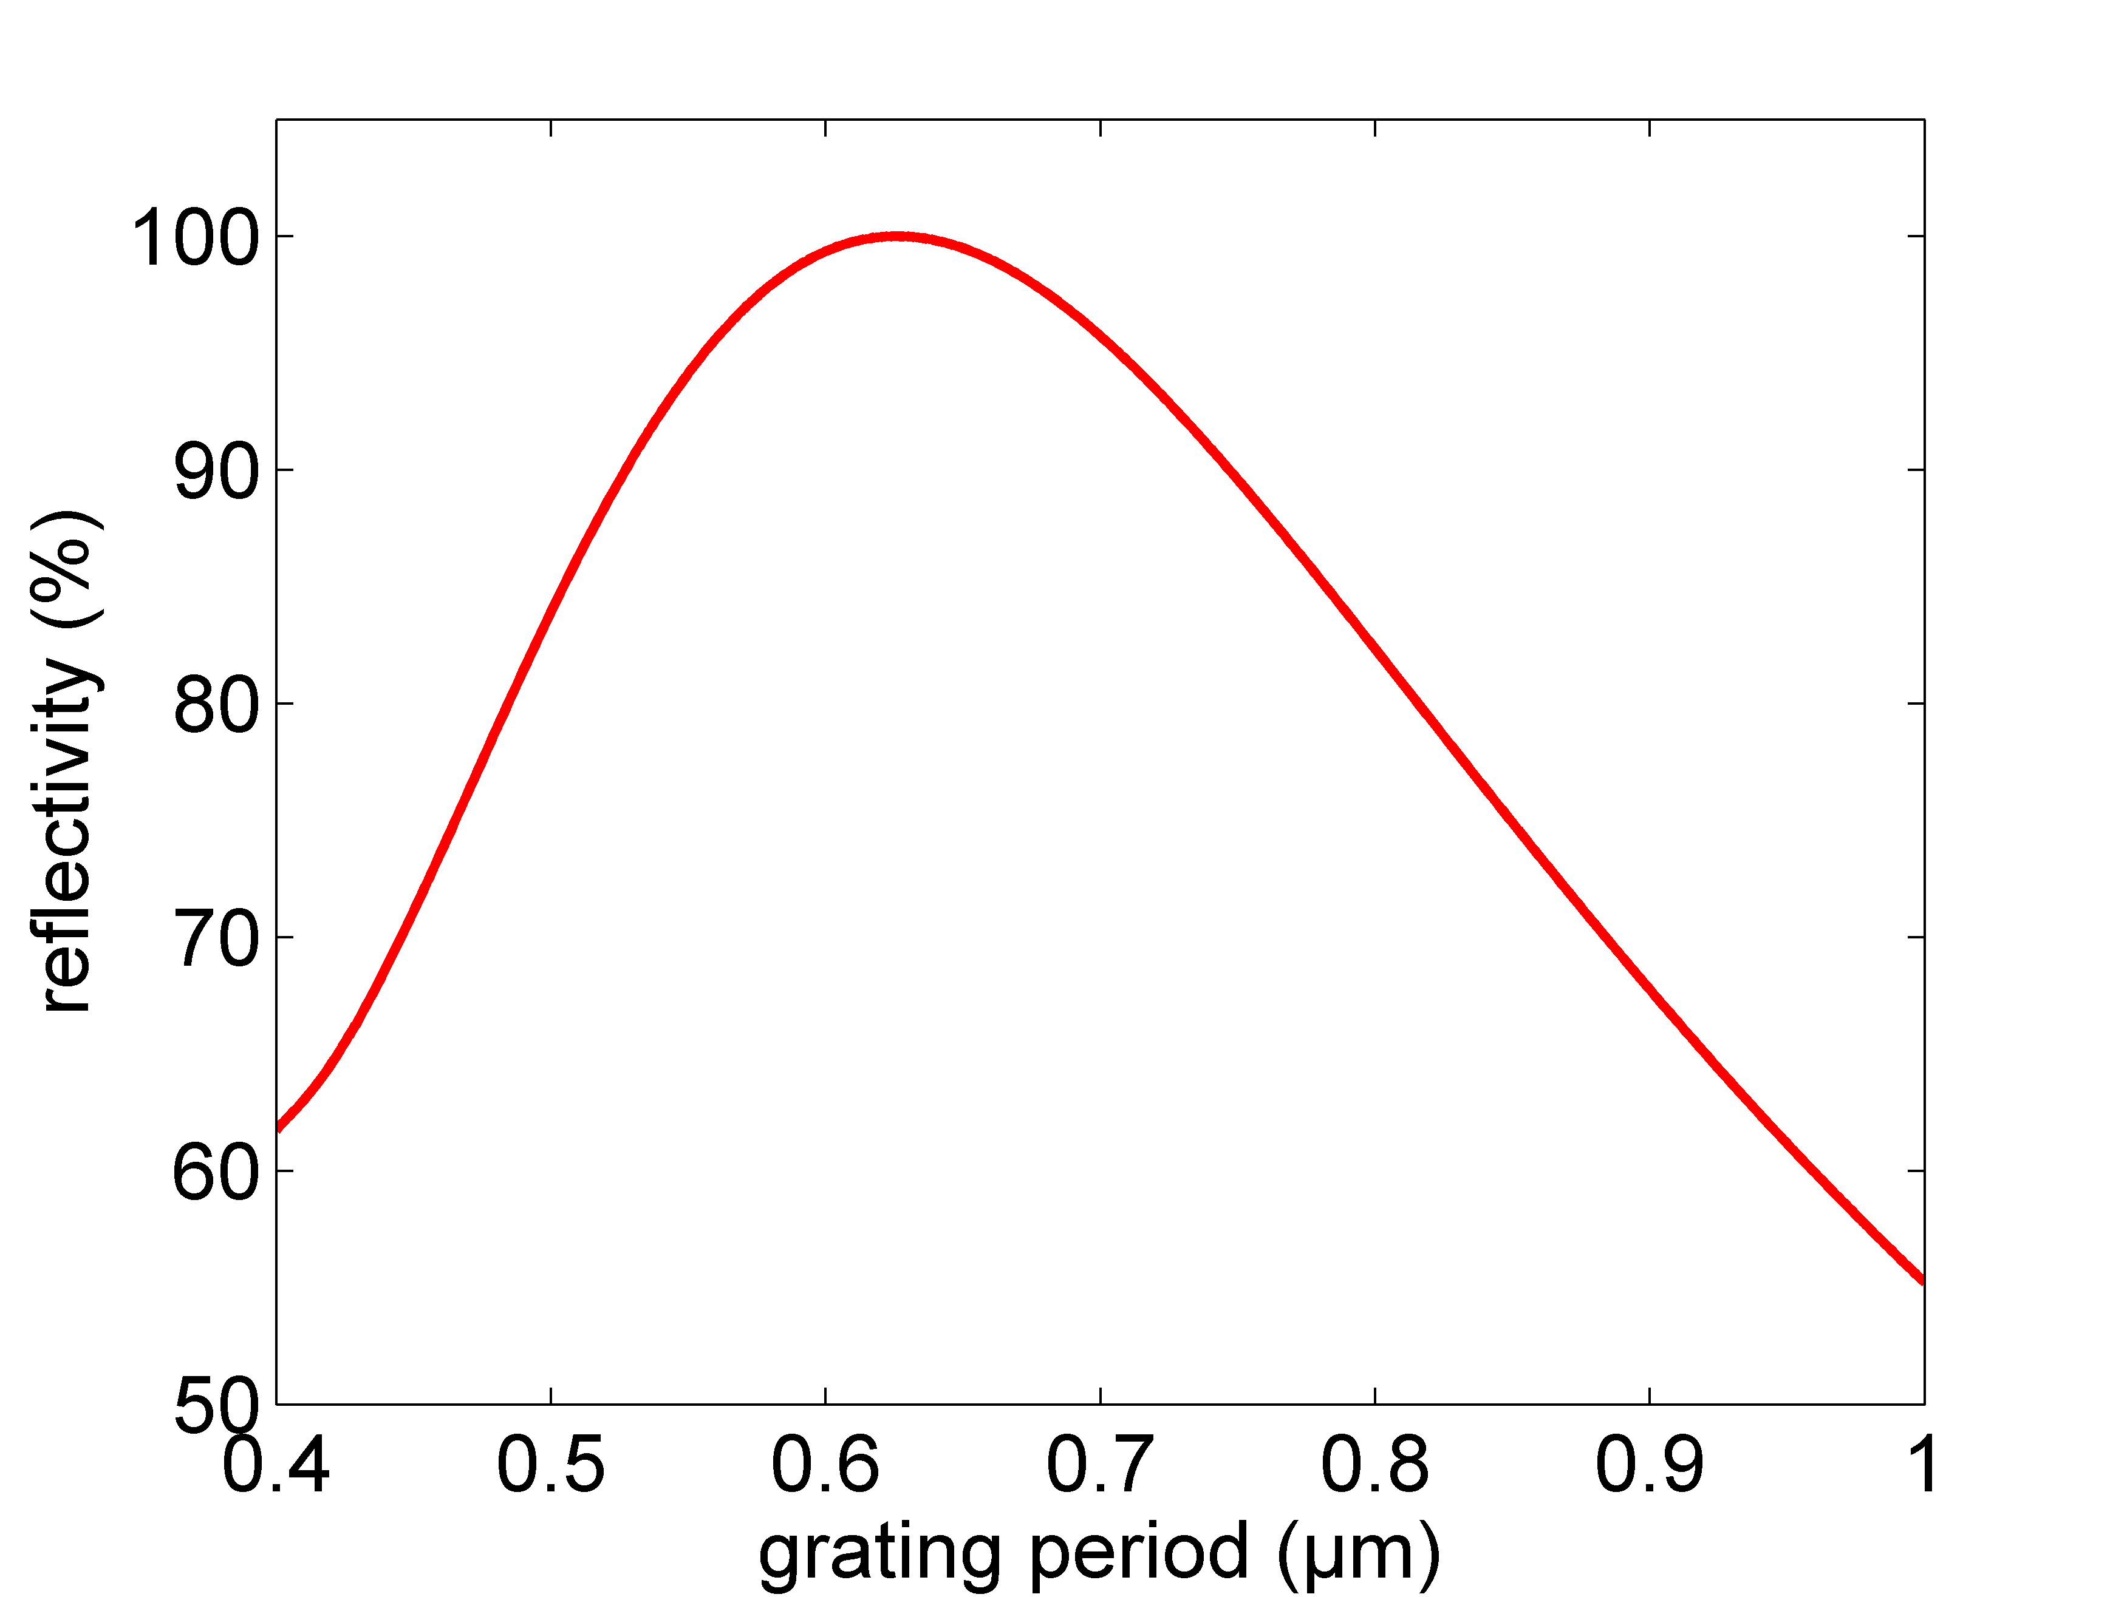
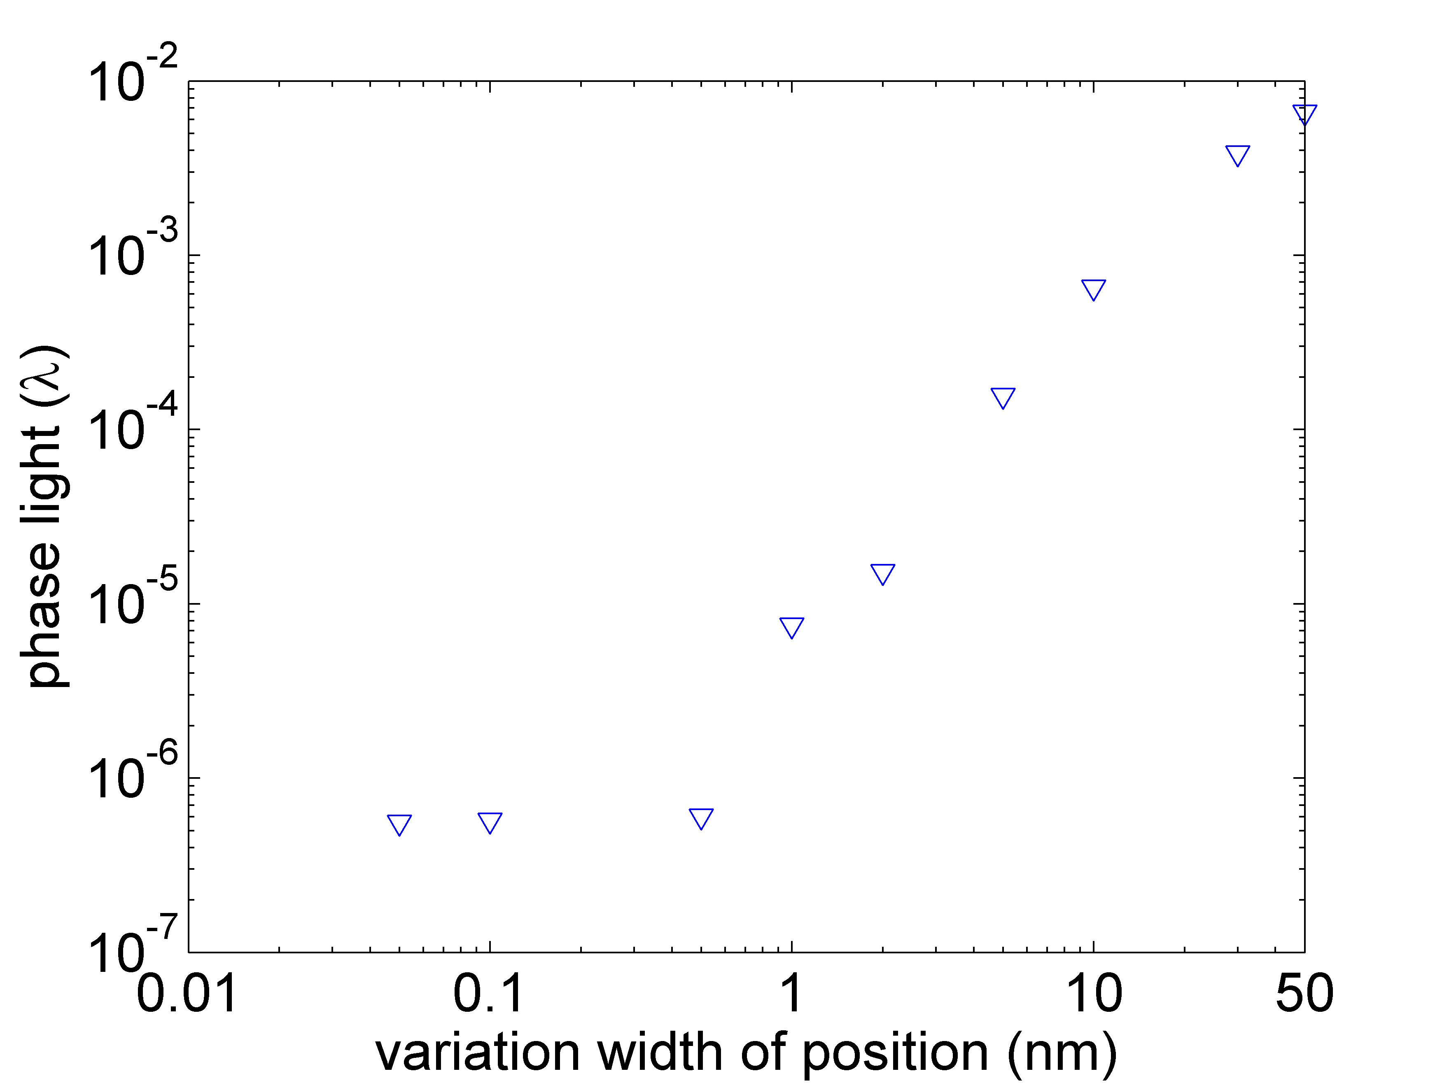
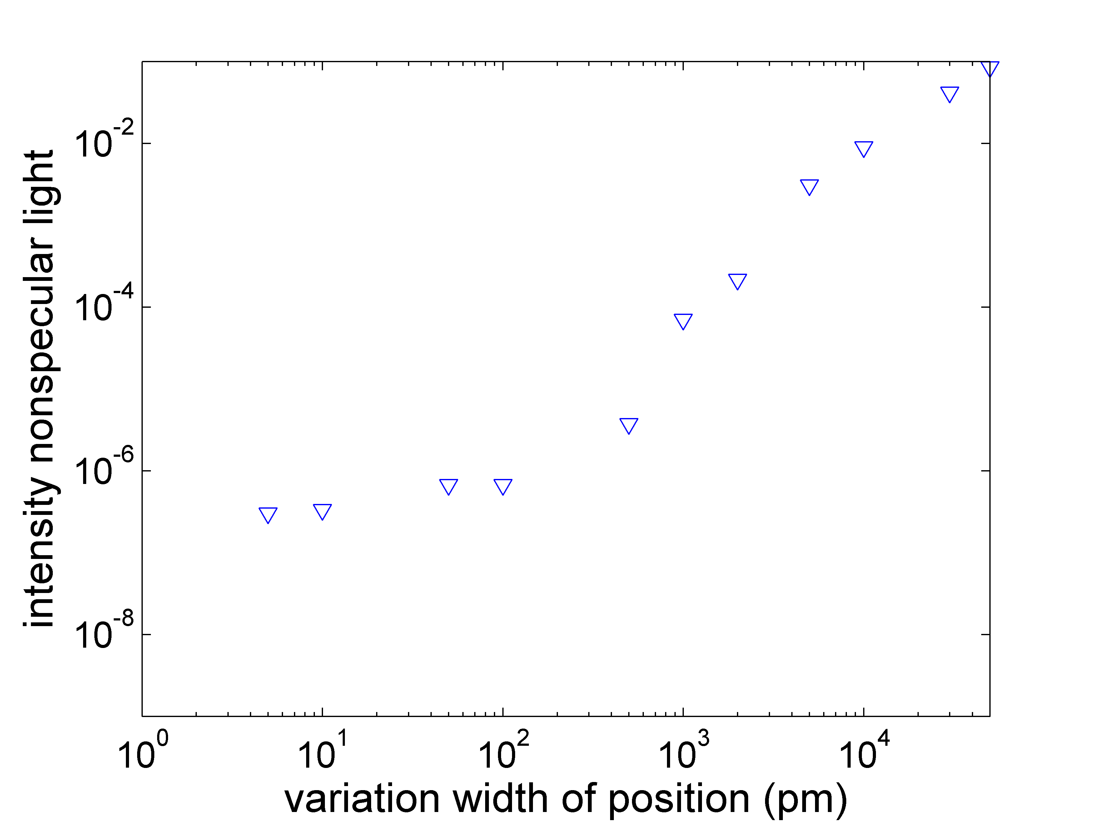
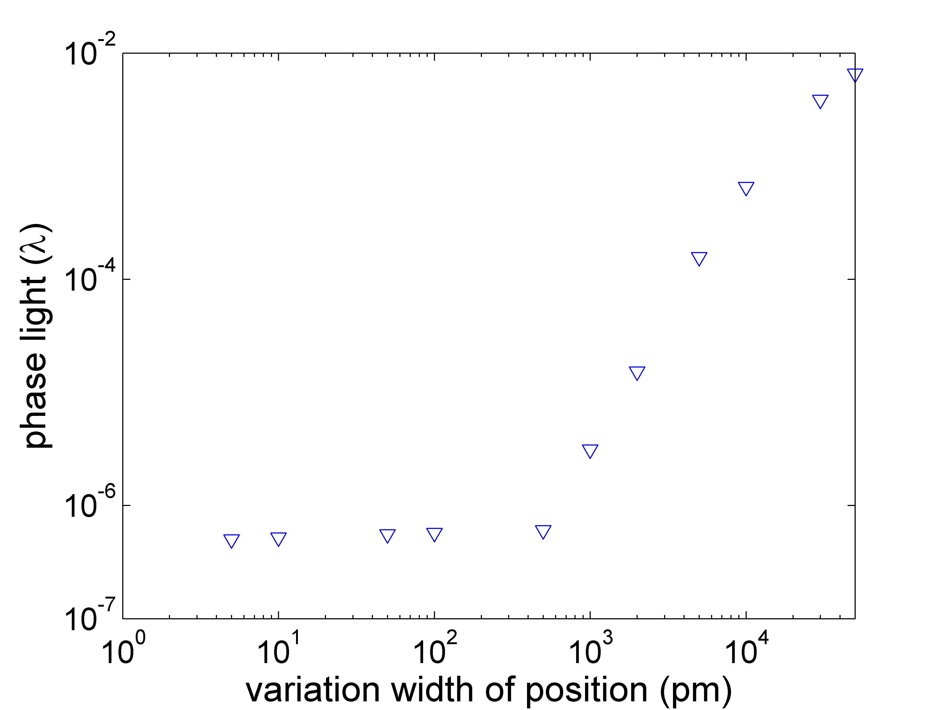
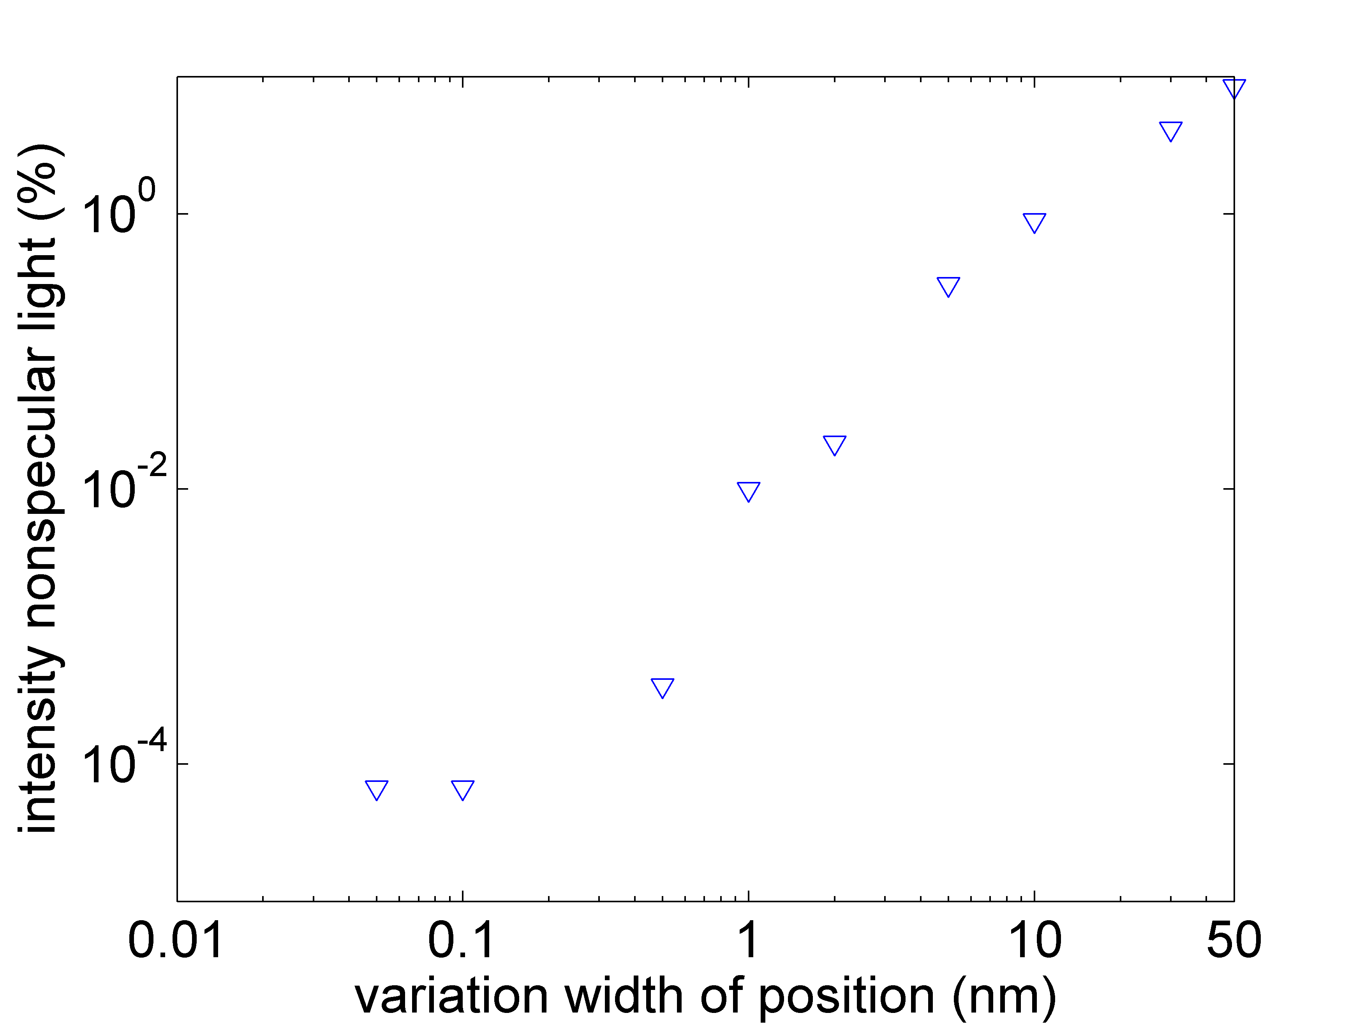
Influence of period variation on scattering and phase of reflected light
variation width ~ 100 pm intensity nonspecular light less than 1 ppm
Can performance be affected by mechanical vibrations of grating ridges?
Notes:
Fabrication or vibration?,

Slide 18


Some remarks on potential vibrations of ridges
Mechanical eigenfrequencies of T-shape structures
material combi-nation | structure type | frequency basic mode (MHz) | frequency 1st mode (MHz)
Si-SiO₂ | single | 155 | 1020
Si-dia |  | 545 | 2540
Si mono |  | 235 | 1460
Si-SiO₂ | double | 25 | 302
Si-dia |  | 140 | 794
Si mono |  | 70 | 434
FEM calculations with Ansys
shape of basic mode
mechanical eigenfrequencies far beyond detection band
Notes:
Si-SiO2-double noch mal überprüfen

Slide 19
Coupling of mechanical oscillations to vibrations in the detection band?
frequency conversion:
Nonlinear process
required to convert
mechanical down
to relevant frequency
range.
“difference
signal”
“mixing
signal” f₂
amplitude
detection
band
10 MHz
eigen-
frequency f₁
frequency
spectrum
f₂
f₁
two interfering vibrations (linear process):
nonlinear process:
f₂
f₁
diff.
sum
Notes:
In any case noise induced vibrations uncorrelated; WANN kommt man in der Elastizität in den nichtlinearen Bereich? Sub pm? - > messungen canti… auslenkung cm-bereich keine nichtlinearen effekte erkennbar-… unwahrscheinlich dass strukturen….

Slide 20
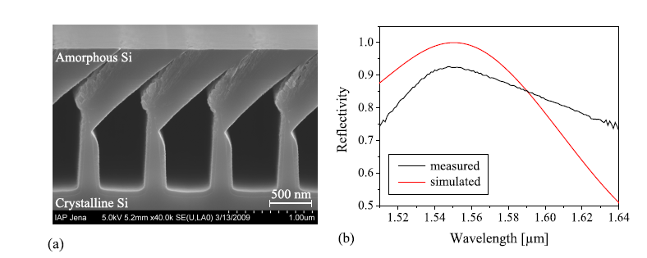
Minimize effects due to vibrations:
Encapsulated grating
old concept:
problem: small perturbation of waveguide
narrowband (small perturbation),
small parameter tolerances
Brückner et al.,
Opt. Express. (2009)
alternative concept:
realization: bonding, overcoating

Slide 21
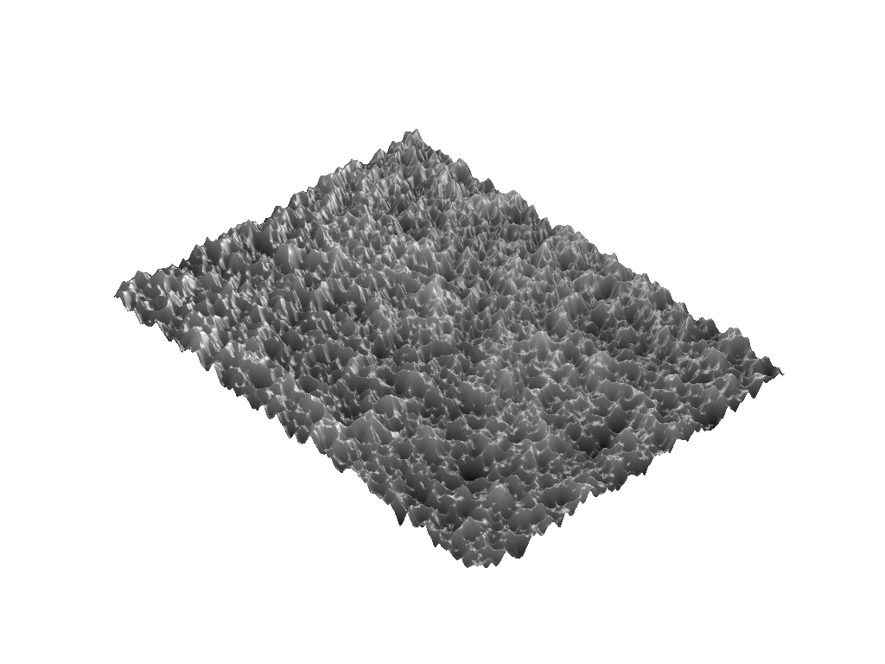
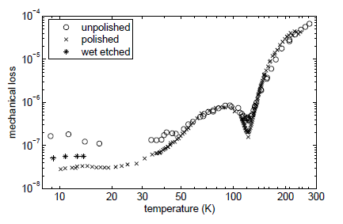
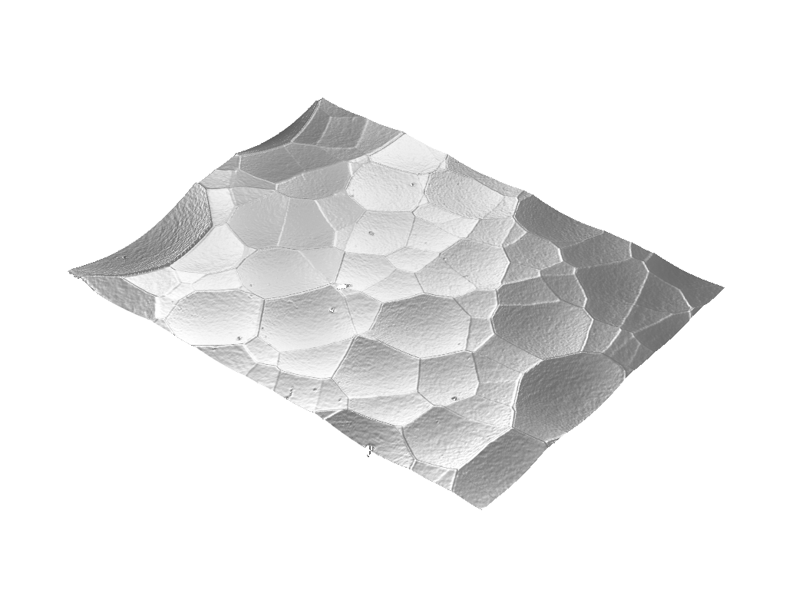

Influence of surface structures on mechanical loss
surface
surface loss
U Jena/ U Glasgow
unpolished
wet etched
dry etched
Notes:
It’s not only about surface roughness

Slide 22


Surface loss of structured flexures
loss about factor of 2 smaller
Possible surface loss mechanisms
Notes:
– position change of surface particles/molecules
– switching of „dangling“ bonds
– terminated surface layers (e.g. hydrogen, fluorine)
– micro-cracks in the surface from mechanical polishing

Slide 23
 | Dielectric layer stack |  | Nano-structures (RWG)
 | amorphous | crystalline | monolithic | Non-monolithic
Thermal noise | -- high | +++ low | ++ low | + medium
Substrate | ++ all | 0 GaAs | + silicon, … | ++ all
Scalability | ++ | - ? | + | +
Straylight | ++ | ++? | + | +
availability | ++ yes | 0 in progress | 0 in progress | 0 in progress
- Low thermal noise
- Substrate?? GaAs

Slide 24
Conclusion & Outlook
RWG allow for high reflectivities and low coating thickness
mirrors with high angluar tolerance possible
diffractive elements based on RWGs possible
technological limits not yet achieved
line edge roughness maybe limiting
influence of mechanical vibration on optical performance unlikely
extensive characterization of scattered light planned
influence of surface modification on mechanical loss to be characterized
Notes:
Was bringt uns ansatz… wo können probleme liegen……

Slide 25
Special thanks to: M. Banasch, D. Lehr, H. Schmidt, D. Schelle, W. Gräf, T. Weber
Thank you for your attention!
This research is supported by the DFG within „Sonderforschungsbereich Transregio 7“.

