Slide 1
SuperB
Programma di attività e preventivo di spesa 2012
Sezione di Pavia
Phone meeting su preventivi SuperB 2012
24 giugno 2011

Slide 2
Front-end for striplets/strips
Striplets (layer 0) and strips (layer 1 to 5) are the baseline option for the SuperB vertex detector
Very hard (if possible at all) to cope with such a large span of detector capacitances (from 10 pF in the innermost to 70 pF in the outermost layer) and hit rate values (from 2 MHz/strip to 20 kHz/strip) with a single design
Proposed solution
fast readout channel (25 ns to 200 ns peaking time) for low capacitance/high hit rate layers (0 to 3)
slow readout channel (from 400 ns to 1 μs peaking time) for high capacitance/low hit rate layers (4 and 5)
Amplitude information available through local A/D conversion or time over threshold techniques
Digital readout architecture virtually the same for both readout channels (pipeline depth requirements are less severe for the slow front-end)

Slide 3
Proposed layer grouping
Layer | C_{D} [pF] | available t_{p} [ns] | selected t_{p} [ns] | ENC from R_{S} [e rms] | ENC [e rms] | Channel width [μm] | Hit rate/strip [kHz] | Efficiency 1/(1+N)
0 | 11.2 | 25, 50, 100, 200 | 25 | 220 | 740 | 3000 | 2060 | 0.890
1 | 26.7 |  | 100 | 460 | 940 |  | 697 | 0.857
2 | 31.2 |  | 100 | 590 | 1100 |  | 422 | 0.908
3 | 34.4 |  | 200 | 410 | 940 |  | 325 | 0.865
4 | 52.6 | 400, 600, 800, 1000 (or 500 and 1000) | 500 | 490 | 1000 | 9000 | 47 | 0.947
 |  |  | 600 | 440 | 940 |  |  | 0.937
5 | 67.5 |  | 800 | 560 | 1090 |  | 28 | 0.949
 |  |  | 1000 | 500 | 1030 |  |  | 0.937
RC²CR shaping, I_{D}=500 μA, L=200 nm, N-channel input device, analog dead time=2.4 t_{p}

Slide 4
Strip front-end prototype
Past experience with the design of the microstrip front-end electronics for the BaBar and BTeV experiments
AToM chip (BaBar): first test structure included 64 channels with 50 μm pitch
FSSR chip (BTeV): first test structure included 114 channels (covering the area of 128 channels with 50 μm pitch, the area of the 14 missing channels being used for the probing pads of individual channels)
64 channels (50 μm pitch or less) for each front-end (fast and slow) in a single or two separate test chips are needed to fully understand power distribution problems
Supplementary area for the test of auxiliary blocks (DC-DC converters, LDO regulators, LVDS or SLVS transceivers, voltage references)
Design to be submitted in the IBM 130 nm CMOS technology – several groups are working with this process, some building blocks and auxiliary electronics may be already available from CERN design team

Slide 5
Strip front-end development
Milestones for strip front-end development
2 x 64 channel strip front-end test structure
strip wire bond pads
2012: first test structures - 2 x 64 channels (fast and slow front-end), auxiliary blocks
2013: first fully operational prototype chip – 2 x 128 channels (fast and slow readout)
64 fast analog channels (45 um pitch)
64 slow analog channels (45 um pitch)
4 mm
pipeline, digital back-end
2014: production run
pipeline, digital back-end
Account for some contingency after the first or the second step
7 mm
area for test structures

Slide 6
Monolithic and hybrid pixel R&D in VI technology
Features of Vertical integration (VI), or 3D, CMOS technology are being exploited for the design of 50 μm pitch monolithic sensors and front-end for hybrid pixels (R&D activity for SVT)
Digital section
Digital section
1st layer
Direct bonding (e.g. Ziptronix)
Analog section
2nd layer
Analog section
detector layer
DNW sensor
ApselVI - DNW MAPS
SuperPIX1 - 3D front-end for Hybrid pixels
Preamplifier, RC-CR shaper, threshold correction, voltage drop compensation
Preamplifier, constant current shaper, threshold correction, polarity selection (from p-on-n or n-on-p pixels)
Sparsified readout architecture (data push or triggered) for both options
Waiting for the characterization of the first 3D prototypes before submission

Slide 7
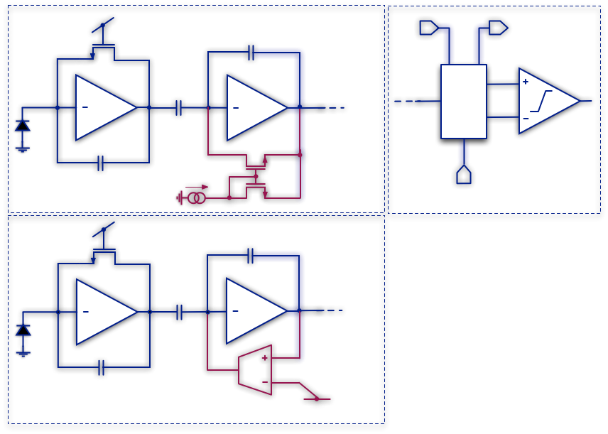
Monolithic and hybrid pixel R&D in VI technology
C₂
TIER 1
TIER 2
Threshold DAC and discriminator on the second tier (together with the in-pixel logic, not shown
4bit THR DAC
C₁
Similar THR DAC and discriminator design for both front-end channels
C_{F}
SuperPIX1
threshold DAC/ discriminator
C₂
TIER 1
 | Apsel VI | Superpix1
Charge sensitivity | 850 mV/fC | 48 mV/fC
Peaking time | 320 ns | 260 ns
ENC | 34 e- | 130 e-
Threshold dispersion before/after correction | 103/13 e- | 560/65 e-
Analog power consumption | 33 μW/pixel | 10 μW/pixel
Detector parasitic capacitance | 300 fF | 150 fF
Matrix size | 128x100 | 128x32
Pixel pitch | 50 μm | 50 μm
C₁
C_{F}
ApselVI
Analog front-end on the first tier (optimized for the detector features)
Polarity selection to be added in the hybrid pixel readout channel

Slide 8
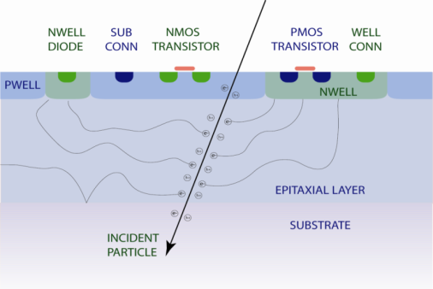
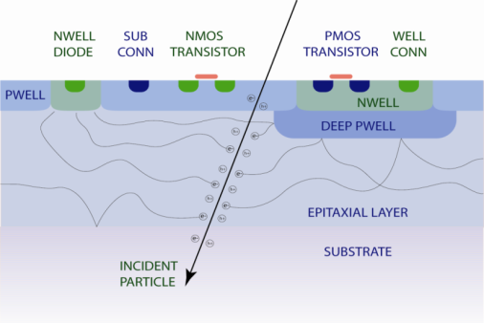
INMAPS process
Charge collection efficiency of planar and (to a lesser extent) 3D CMOS MAPS structures could be affected by the presence of competitive N-wells
This issue may be addressed by means of a quadruple well technology: N-wells (and N⁺ diffusions) are shielded from the substrate by means of a high energy P-type implant (deep P-well)

Slide 9
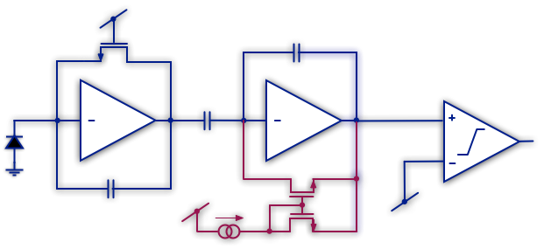
Monolithic sensors in INMAPS technology
CMOS 180 nm technology with 6 metal layers, quadruple well and high resistivity epitaxial layer(~1 kΩ cm², 12 μm thickness) options for better collection efficiency and radiation hardness (as compared to DNW MAPS)
Detector with very low capacitance (a few 10 fF) read out by optimum chain for capacitive detector (preamplifier and shaper) followed by a discriminator (binary readout)
First run on beginning of July this year
V_{F}
C₂
32 x 32 matrix (50 μm cell) with sparsified digital readout
3x3 matrices (test structures with different number of collecting electrodes, input devices with and without enclosed layout), single channels with detector emulating capacitor, N-well/P-epi and N⁺/P-epi diodes
C₁
C_{F}
V_{th}
I_{S}

Slide 10
Personale impegnato nel progetto
NOME e COGNOME | Qualifica | Gruppo di afferenza | Percentuale
RICERCATORI
Valerio Re (responsabile locale) | PO |  | 50%
TECNOLOGI
Luigi Gaioni | Assegnista |  | 100%
Alessia Manazza | Dottorando |  | 80%
Massimo Manghisoni | RU |  | 80%
Lodovico Ratti | RU |  | 50%
Gianluca Traversi | RU |  | 30%
Stefano Zucca | Dottorando |  | 40%
NUMERO TOTALE DI RICERCATORI |  | 1 (0.5 FTE)
NUMERO TOTALE DI TECNOLOGI |  | 6 (3.8 FTE)
PERSONALE FULL TIME EQUIVALENT |  | 4.3

Slide 11
Attività prevista (II semestre 2011/I e II semestre 2012)
Test prototipi MAPS in tecnologia a quadrupla well (sviluppati nel primo semestre nell’ambito di diverso progetto)
II semestre 2011
Progetto front-end per striplet/strip e blocchi ausiliari
Test prototipi in tecnologia CMOS VI
Test di radiation hardness su MAPS a quadrupla well e CMOS VI
II run in tecnologia INMAPS
I semestre 2012
Completamento progetto front-end per strip e blocchi ausiliari
Completamento progetto front-end per pixel ibridi e MAPS VI
Test strutture II run in tecnologia INMAPS
Test strutture in tecnologia VI
II semestre 2012
Test canali di front-end per strip ed elettronica ausiliaria
Partecipazione a test beam con prototipi in tecnologia INMAPS e ad integrazione verticale

Slide 12
Preventivo di spesa 2011
Missioni interne | 2 meeting SuperB in Italia * 3 persone | 4.8 kEuro
 | Metabolismo (1.5 kEuro/FTE) | 6.4 kEuro
Missioni all’estero | Meeting con gruppi di ricerca a RAL e Strasburgo su tecnologia INMAPS (1 mese uomo) | 5 kEuro
 | Meeting con IC design group del CERN su tecnologia IBM 130 nm (1 mese uomo) | 5 kEuro
 | 1 meeting SuperB all’estero * 3 persone | 4.5 kEuro
 | Partecipazione a test beam (4 settimane uomo) | 4 kEuro
 | Metabolismo (5.4 kEuro/FTE) | 23 kEuro
Consumo | Sviluppo di fast front-end e slow front-end per striplets/strips, 28 mm² * 3 kEuro/mm² (64 canali per prototipo + blocchi ausiliari, i.e. DC-DC converter, LDO regulator, LVDS transceiver) | 84 kEuro
 | Realizzazione di PCB per caratterizzazione di prototipi e test di radiation hardness | 4 kEuro
 | Metabolismo (1.7 kEuro/FTE) | 7.3 kEuro
 | TOTALE | 148 kEuro

