Slide 1

Helicity and OAM at Low-x and Large-N_{c}: an Exact Solution for Revised Helicity Evolution and the Small-x Asymptoics of OAM Distributions
Yuri Kovchegov
The Ohio State University
Based on recent works with Jeremy Borden and Brandon Manley

Slide 2
Quark and Gluon Helicity at Small x: a Brief Overview
YK, D. Pitonyak, M. Sievert, arXiv:1511.06737 [hep-ph], arXiv:1610.06197 [hep-ph] (KPS);
YK, M. Sievert, arXiv:1505.01176 [hep-ph], arXiv:1808.09010 [hep-ph];
F. Cougoulic, YK, A. Tarasov, and Y. Tawabutr, arXiv:2204.11898 [hep-ph] (KPS-CTT).

Slide 3
Sub-Eikonal Operators and Beyond

Slide 4
Dipole picture of DIS
x⁻
x⁺
Large q⁻ → large x⁻ separation
aka the “shock wave”

Slide 5
Polarized Dipole: non-eikonal small-x physics
All flavor-singlet small-x helicity observables depend on “polarized dipole amplitudes”:
Double brackets denote an object with energy suppression scaled out:
unpolarized quark
polarized quark: eikonal propagation,
non-eikonal spin-dependent interaction

Slide 6
Notation
Fundamental light-cone Wilson line:
Adjoint light-cone Wilson line:

Slide 7
Sub-eikonal quark S-matrix in background gluon and quark fields
The full sub-eikonal S-matrix for massless quarks is (Balitsky&Tarasov ‘15; KPS ‘17; YK, Sievert, ‘18; Chirilli ’18; Altinoluk et al, ’20; YK, Santiago ‘21)
“helicity
independent”
“helicity
dependent”
“helicity
independent”
“helicity
dependent”

Slide 8
Helicity Distributions and Observables at Small x

Slide 9
Dipole Gluon Helicity TMD
We start with the definition of the gluon dipole helicity TMD, corresponding to the Jaffe-Manohar PDF ΔG,
Here U^{[+]} and U^{[-]} are future and past-pointing
Wilson line staples (hence the name
‘dipole’ TMD, F. Dominguez et al ’11 – looks
like a dipole scattering on a proton):

Slide 10
Gluon Helicity
A calculation gives
Here we defined a new dipole amplitude G₂ (cf. Hatta et al, 2016; KPS 2017)
What is this D-D operator? Turns
out it is related to the DD operator
from before.

Slide 11
Quark Helicity PDF and TMD
The flavor-singlet quark helicity PDF and SIDIS TMD are
G₂ was defined before. This is the gluon admixture to quark helicity distributions.
The dipole amplitude Q is due to F¹² & axial current.
The contribution of G₂ comes from the DD operator in the quark S-matrix.
Hence, the DD operator is related to the Jaffe-Manohar distribution.

Slide 12
Amplitude Q
The amplitude Q is defined by
with , where
This is the ‘old’ KPS polarized dipole amplitude. U = adjoint light-cone Wilson line.

Slide 13
g₁ structure function
g₁ structure function is obtained similarly, using DIS in the dipole picture:
One gets
such that one reproduces the standard result

Slide 14
Helicity Evolution

Slide 15
Evolution for Polarized Quark Dipole
One can construct an evolution equation for the polarized dipole:
Spin-dependent (non-eikonal) vertex
polarized
particle
similar to the
unpolarized
BK evolution
box =
target shock
wave (proton)

Slide 16
Large N_{c}
At large-N_{c} the equations close (Q → G).
Everything with 2 in the subscript (e.g., G₂ and Γ₂) is new compared to the KPS (‘15-’18) papers.

Slide 17
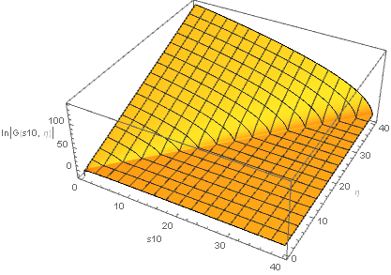

Solution of the Large-N_{c} Equations
The large-N_{c} equations for G and G₂ can be solved
numerically (and, possibly, analytically).

Slide 18
Small-x Asymptotics
Fitting the slope of the log plots of G and G₂ vs e we can read off the small-x intercept (the power of x):
F. Cougoulic, YK, A. Tarasov, Y. Tawabutr, 2022

Slide 19
Small-x Asymptotics for Helicity Distributions
The resulting small-x asymptotics for helicity PDFs and the g₁ structure function at large N_{c} is
This power (aka the intercept) is in complete agreement with the work by J. Bartels, B. Ermolaev, and M. Ryskin (BER, 1996) using infrared evolution equations (with the analytic intercept constructed by KPS in 2016):
“Peace in the valley.”
Right?

Slide 20
Quark Helicity at Small x and Large-N_{c}: Analytic Solution
J. Borden, YK, 2304.06161 [hep-ph]

Slide 21
Analytic Solution of the Large-N_{c} Equations
We want to solve
these equations:

Slide 22
Analytic Solution of the Large-N_{c} Equations
The strategy is to use the double Laplace transform,
One gets the expressions for all the other dipole amplitudes this way, for instance
Neighbor amplitudes involve several different double Laplace transforms:

Slide 23
Analytic Solution of the Large-N_{c} Equations
In the end, all the amplitudes in the double-Laplace space can be expressed in terms of the initial conditions/inhomogeneous terms, e.g.,
with
More details in J. Borden, YK, 2304.06161 [hep-ph].

Slide 24
Small-x Asymptotics for Helicity Distributions
Let’s take a closer look at the anomalous dimension:
In the pure-glue case, Bartels, Ermolaev and Ryskin’s (BER) anomalous dimension can be found analytically. It reads (KPS ‘16)
Our evolution’s anomalous dimension can be found analytically at large-N_{c}
(J. Borden, YK, 2304.06161 [hep-ph]):

Slide 25
A Tale of Two Anomalous Dimensions
The two anomalous dimensions look similar but are not the same function.
Their expansions in α_{S} start out the same, then differ at four (!) loops (the first 3 terms agree with the existing finite-order calculations, the four-loop result is unknown):

Slide 26
A Tale of Two Intercepts
The intercept (largest power Re[ω]) is given by the right-most singularity (branch point) of the anomalous dimension.
For BER this gives
For us

Slide 27
A Tale of Two Intercepts
The power α_{h} is known as the intercept.
BER:
Us:
Our numerical solution also gave the intercept of 3.660 or 3.661, but we believed we had larger error bars.
We (still) disagree with BER. Albeit in the 3rd decimal point…

Slide 28
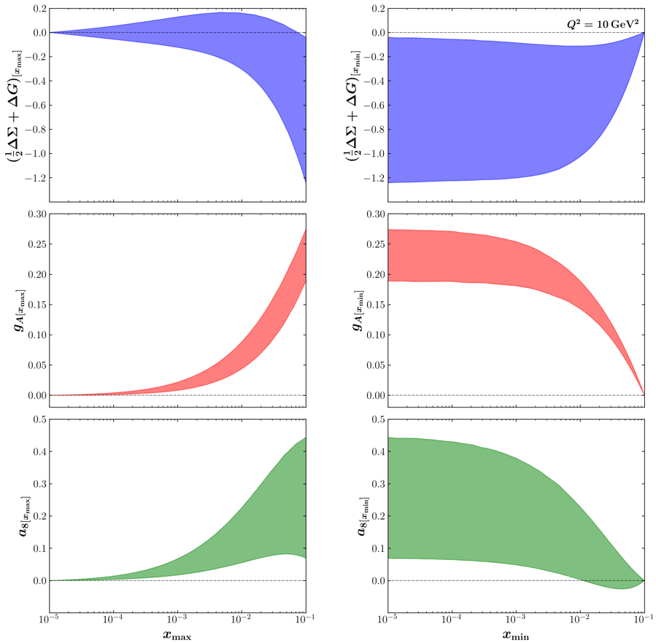
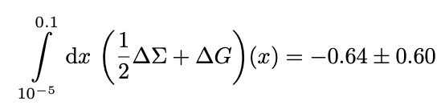
How much spin is there at small x?
JAMsmallx: Adamiak, Baldonado, YK, Melnitchouk, Pitonyak, Sato, Sievert, Tarasov, Tawabutr 2023
Negative
net spin at
small x!
Potentially a lot of spin at small x. However, the
uncertainties are large. Need a way to constrain the initial conditions.

Slide 29
Quark and Gluon OAM at Small x and Large N_{c}
YK, B. Manley, 2310.18404 [hep-ph]; B. Manley, 2401.05508 [hep-ph]

Slide 30
OAM Distributions
We begin by writing the (Jaffe-Manohar) quark and gluon OAM in terms of the Wigner distribution as
After much algebra, we arrive at the quark and gluon OAM distributions at small x :

Slide 31
OAM Distributions and Moment Amplitudes
Q and G₂ are the same as above. However, we also now have the impact parameter moments of dipole amplitudes, labeled I₃, I₄, I₅ and I₆:

Slide 32
Evolution for Moment Dipole Amplitudes
Evolution equations for
the moment amplitudes
in DLA and at large N_{c}
are derived in
YK, B. Manley,
2310.18404 [hep-ph].
They can be solved
numerically (same ref)
and analytically (B. Manley,
2401.05508 [hep-ph])

Slide 33
Small-x asymptotics of OAM distributions
Solving the above evolution equations numerically, we arrive at
Consistent with Boussarie,
Hatta, Yuan 2019 (based on
BER IREE from 1996) within
the numerical precision

Slide 34
Two intercepts, again
The evolution equations for moment dipole amplitudes have been solved analytically by B. Manley in 2401.05508 [hep-ph]. The solution was constructed using the double Laplace transform, similar to the solution for the impact-parameter integrated amplitudes.
The resulting small-x OAM asymptotics at large N_{c} is the same as for helicity PDFs,
with the intercept
This slightly disagrees with the work of Boussarie, Hatta, and Yuan (2019), which resulted in the same intercept as BER:

Slide 35
OAM Distribution to hPDF Ratios
Following Boussarie et al (2019), we consider the ratios of OAM distributions to helicity PDFs at small x.
For these ratios, Boussarie et al, predict, using the Wandzura-Wilczek approximation:

Slide 36
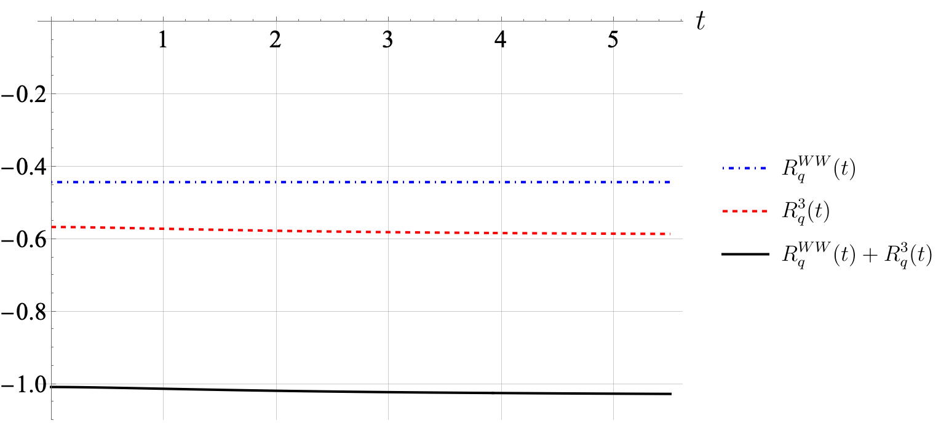
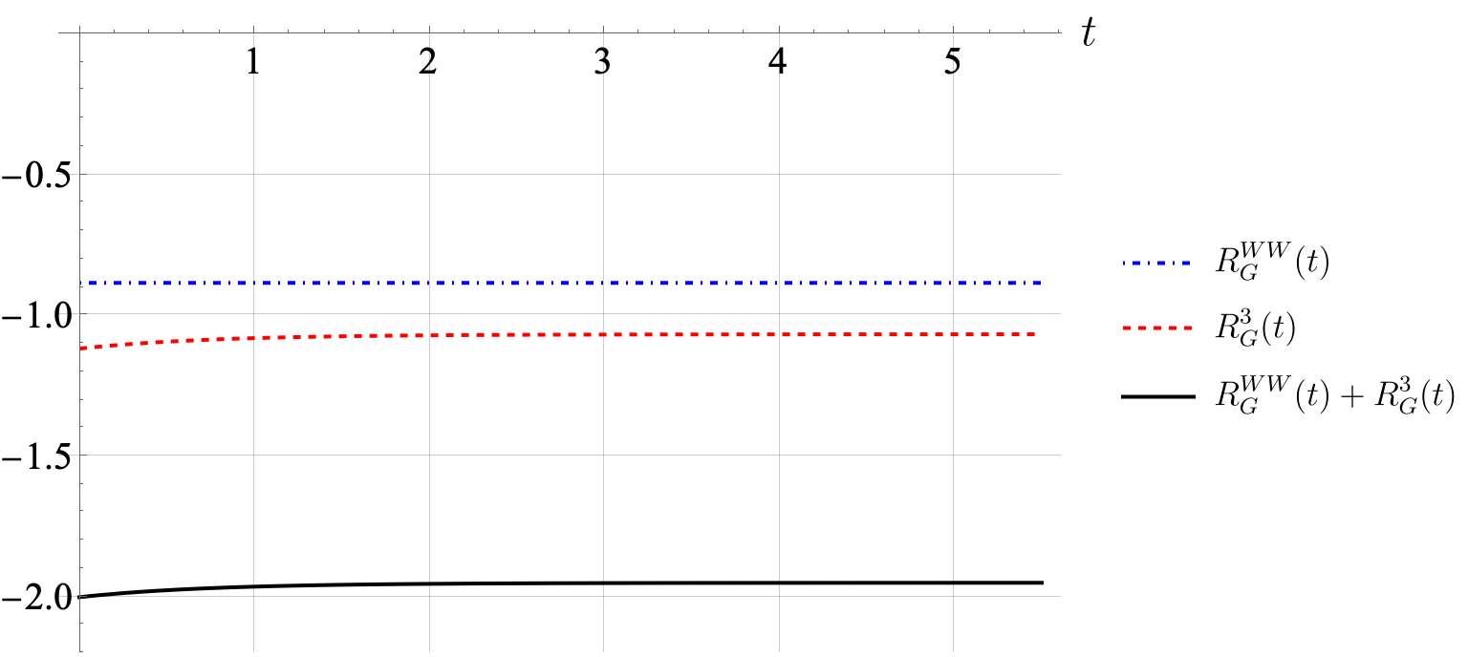
OAM Distribution to hPDF Ratios
Analytic solution from B. Manley,
2401.05508 [hep-ph], gives

Slide 37
Conclusions
We have constructed an exact analytical solution of the large-N_{c} helicity evolution equations. It yielded small-x asymptotics of ΔΣ(x, Q²) and ΔG(x, Q²). The solution agrees with the results in the literature to the 3 known loops but slightly disagrees with BER starting from 4 loops and on the intercept.
We have obtained the small-x asymptotics of OAM distributions for quarks and gluons at large N_{c}. Again, the intercept slightly disagrees with the one in the literature. Our ratios of the OAM distributions to hPDFs also appear to deviate from the ones obtained using the WW approximation.
Stay tuned for the additional corrections to the large-N_{c}&N_{f} helicity evolution due to q→G and G→q transitions in the shock wave (J. Borden, M. Li, YK, in preparation; see also G. Chirilli, 2021)
+ the exact analytical solution of those modified equations.
Gluon production in longitudinally polarized p+p collisions at small x has also been calculated recently (see talk by Ming Li on Wednesday): ready for phenomenology (N. Baldonado et al, in preparation).
Small-x phenomenology of the polarized DIS and SIDIS data has been done, giving an estimate of the amount of quark and gluon spin at small x. Error bars are large though.

Slide 38
Backup Slides

Slide 39
Polarized fundamental “Wilson line”
To complete the definition of the polarized dipole amplitude, we need to construct the definition of the polarized “Wilson line” V^{pol}, which is the leading helicity-dependent contribution for the quark scattering amplitude on a longitudinally-polarized target proton.
At the leading order we can either exchange one non-eikonal t-channel gluon (with quark-gluon vertices denoted by blobs above) to transfer polarization between the projectile and the target, or two t-channel quarks, as shown above.
We employ a blend of Brodsky & Lepage’s LCPT and background field method-inspired operator treatment. We refer to the latter as the light-cone operator treatment (LCOT).

Slide 40
Evolution for Polarized Quark Dipole
Equation does not close!

Slide 41
OAM Distribution to hPDF Ratios
Our numerical solution gives the following ratios (α_{S}=0.25):

