Slide 1
Electron spectroscopy with cyclotron radiation measurement in the PTOLEMY detector
Federico Virzi
Università degli studi dell’Aquila
28/02/2024

Slide 2
Table of contents
Introduction: PTOLEMY concept
why we need a RF region
what are the required performances
RF region:
Electron motion
Cyclotron emission
Bouncing motion
How to measure K_{t},K_{l}
Electron trap:
What it is? Why?
3D model
RF Signal readout
Electrodes configurations
CST simulation

Slide 3
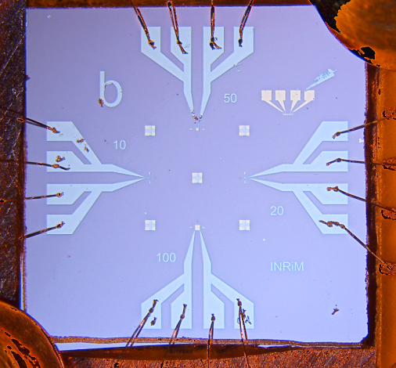
High resolution endpoint measurement
Electrons from tritium
PTOLEMY Dynamic Filter
Sgn and Bkg vs K (kinetic energy)
Events
Beta decay
Decrease energy from 18.6 keV to O(100 eV)
Low electron rate
CνB
2mν
K
But you need
mν
Need good energy resolution: σ_{E}=50 meV
We want to use Transition Edge Sensors as micro-caloremeters

Slide 4
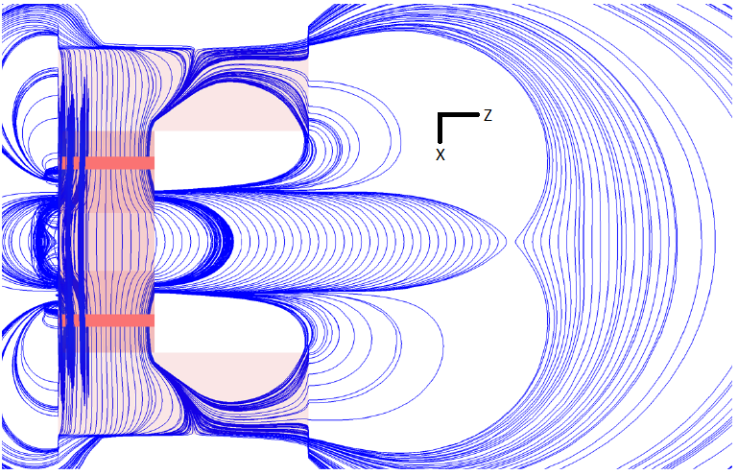
Dynamic EM Filter
Exponential decaying magnetic and electric field
Electron decelleration: Drain K_{t} , K_{l} up to O(100 eV) on TES
TES
Longitudinal kinetic energy with respect to B lines
If electron has: K<Q_{β} K ~Q_{β}
Discarded
TES
K
10 eV
Event by event basis
If K_{t} , K_{l} known
RF Region

Slide 5
RF region: filter trigger
Requirements:
Measurement K_{t} , K_{l} for each electron in the ROI
O(10 eV) energy resolution
In O(100 μs)
Non destructive way
Uniform 1T field
K
10 eV
How?
Cyclotron radiation
In uniform 1T
Bouncing motion
Electron spectroscopy with cyclotron radiation (CRES)
Thank you!

Slide 6
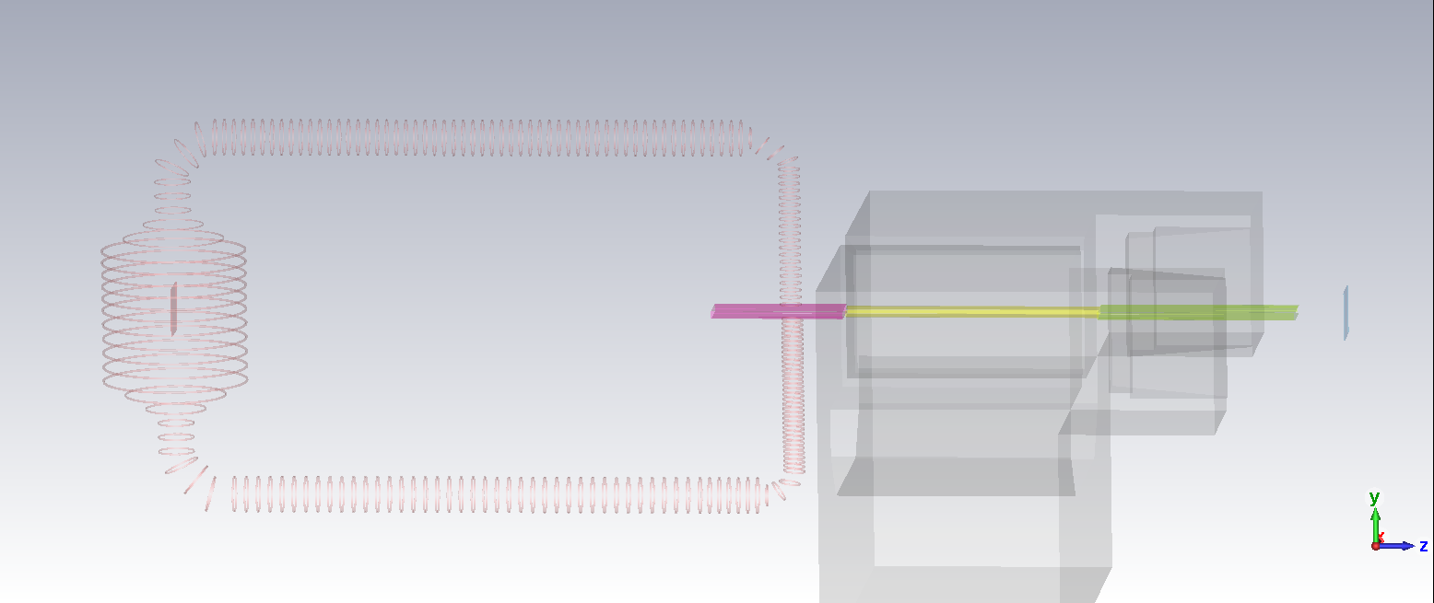
PTOLEMY Concept
How to reconstruct Target’s electron kinetic energy K_{i}?
K_{i}=qΔV+E_{RF,corr}+E_{TES}
ΔV
This talk
Target
Injection
RF region
Filter
TES
Possible injection geometry
Not in scale
Magnet

Slide 7
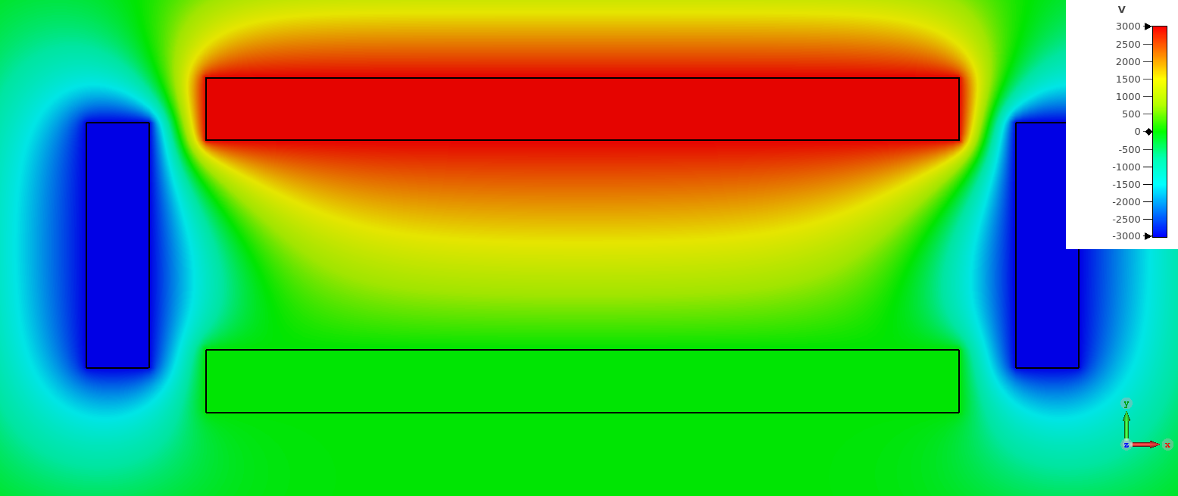
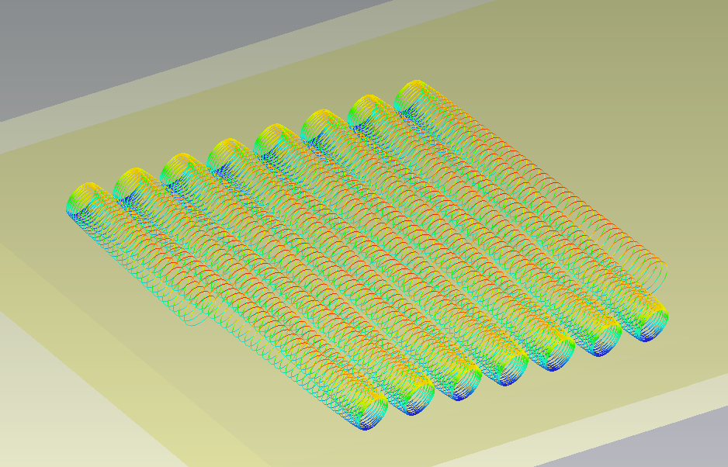
RF region: electron motion
Z
In the inner air-gap magnet: uniform 1T region
B
Drift Electrodes+Bouncing electrodes
Cyclotron motion+ X bouncing motion+Zdrift
B
Z
B

Slide 8
RF region: electron motion
?
How to reconstruct K, K_{l}?
We’ll see that in a couple of slides
?
Cyclotron motion+bouncing motion+Zdrift
Z
Expected pattern RF?
B

Slide 9
RF region: electron motion
Uniform B->no Grad(B)xB
No E_{z} component
No y drift
We expect a stable bouncing motion
V_{e}
Θ
K_{l}=0
B
K_{l}=0
K_{l}=Kcos²(Θ)
Y
Scale length: O(12 cm)
X

Slide 10
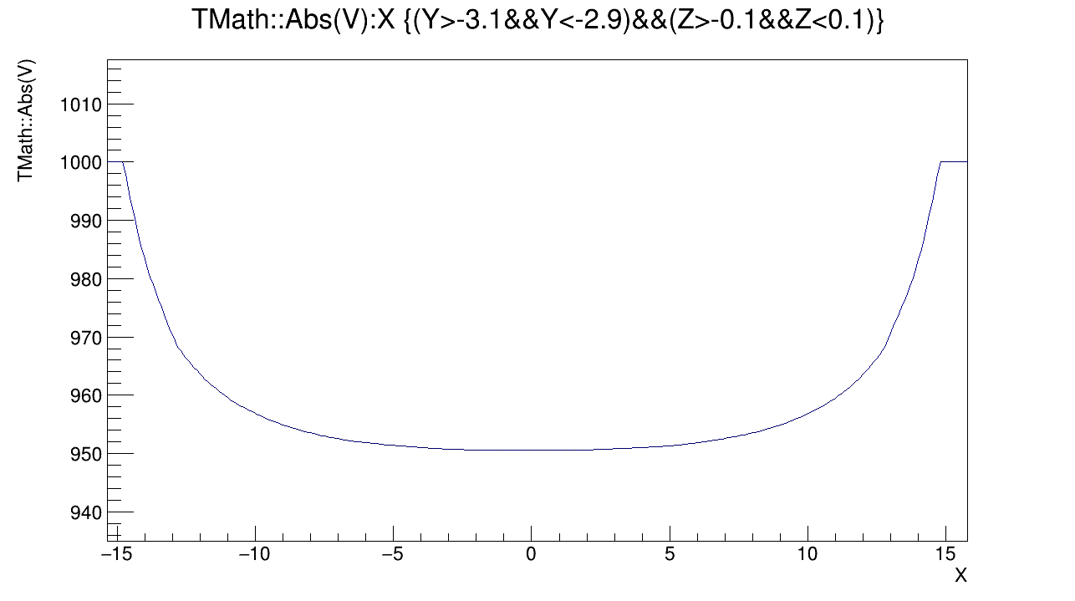
RF Region: cyclotron radiation
V[V]
During the motion: cyclotron emission in a potential well
K variation
Frequency variation
X[mm]

Slide 11
RF Region: is this signal detectable?
Thermal noise level
RF region Temperature
RF region Frequency resolution
(energy resolution)
If P>N: signal detectable
Crucial for fast measurement and for energy measurement

Slide 12
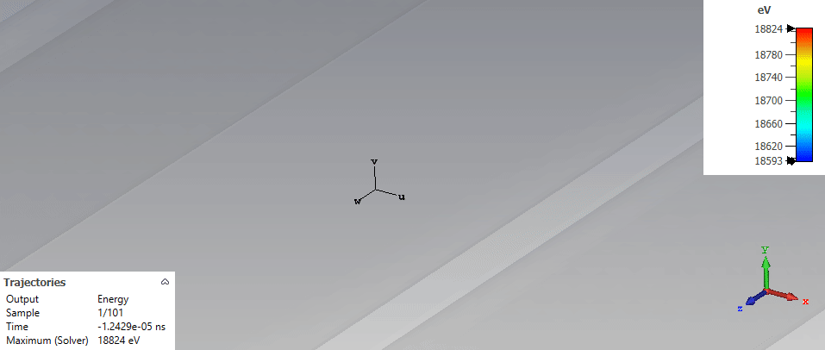
RF Region: bouncing motion
Bouncing motion: allow reduced size detector
High stability motion expected
Z drift by drift electrodes
The bouncing motion has a periodicity of T_{b}
T_{b} depends by pitch angle aka K_{l}

Slide 13
RF region: expected signal
1/T_{b}
1/T_{b}
Carrier frequency f_{c}:
Cyclotron motion in potential well
Sidebands: 1/T_{b}
P
Information on K
Information on K_{l}
How much time do we need to detect the signal?
What about the energy resolution?
f_{c}
Δf
f
NB: T_{b}=O(10ns)

Slide 14
RF region: expected signal
For trigger task we want to be fast
1/T_{b}
1/T_{b}
P
Exploit large timebin size
Nt
Good frequency resolution
@ cost of frequency shift/timebin
f_{c}
Δf
f
Δf
Δf

Slide 15
RF region: expected signal
1/T_{b}
1/T_{b}
SNR problem?
P
Reduce T, better Δf
Tritium not in thermal contact
Nt
f_{c}
Δf
f

Slide 16
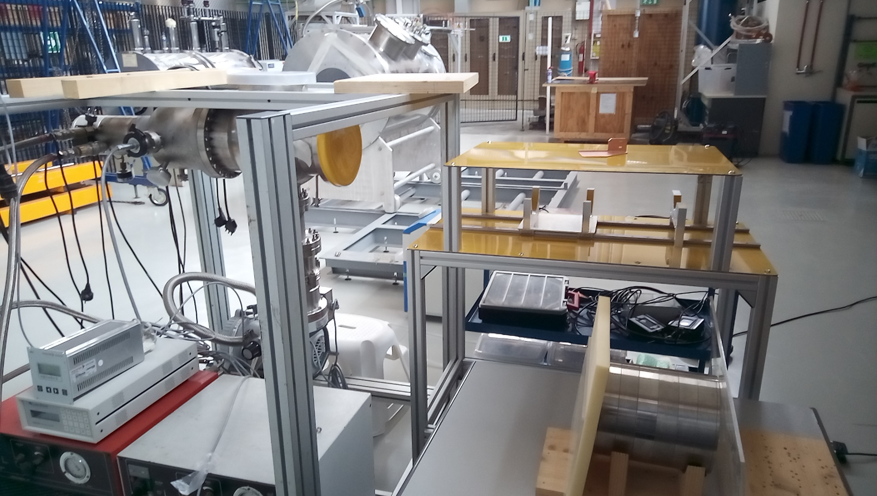
Electron trap: what it is?
Setup to study RF measurement
Possibility to study electron emission for high drift time
Under construction @ LNGS hall di montaggio
We use ^{83m}Kr gas source:
K1=32151.6eV
K2=9405.7eV
Source available @ LNGS

Slide 17
Electron Trap: why?
Test for RF region measurement:
How much background events?
How much energy resolution?
How good it is K_{l} measurement by T_{b}?
How much time signal (time drift in antenna region) we need?
How much it is good the detection with waveguide?
Electrodes inside
Kr port
RF readout:
WR42
B

Slide 18
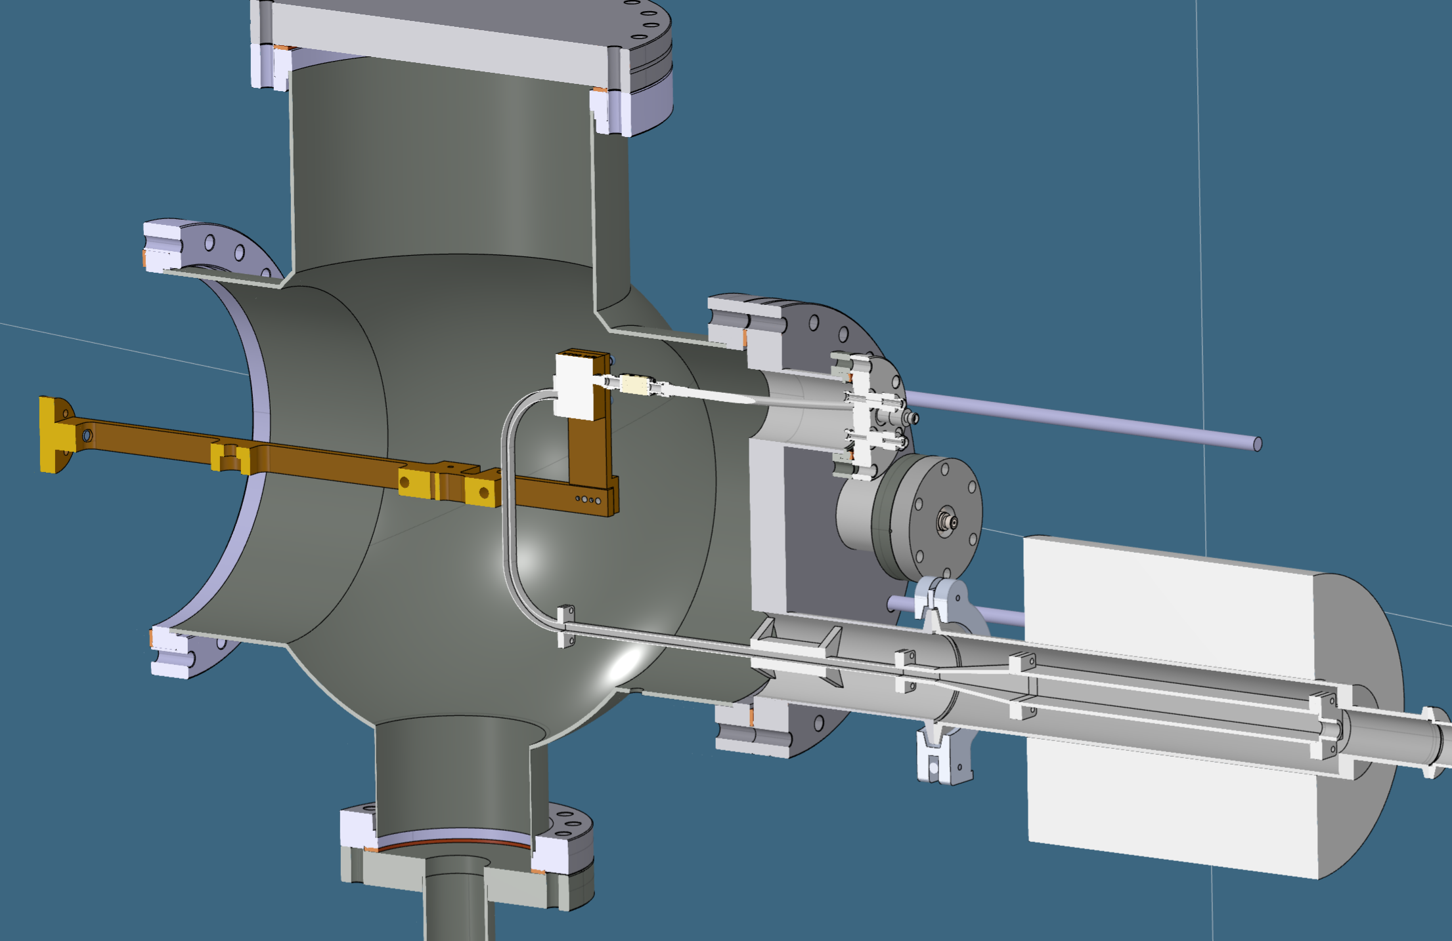
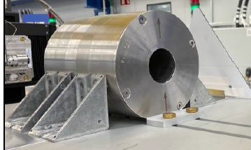
Electron Trap: cryogenic setup
Uniform 0.984T
LNA
RF-Out
12K cold head
LNA
bias
PBF
Trap
Kr+HV cables
Pumping system

Slide 19
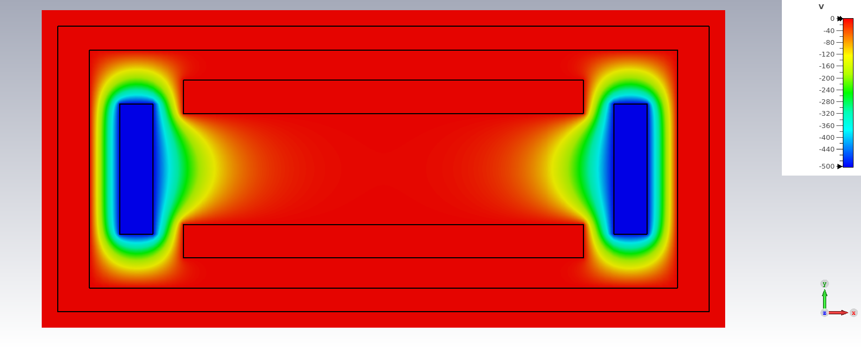
Electron Trap: electrodes
Tunable Z drift (drift electrodes)
Tunable V_bouncing (ΔΘ)
Tunable potential well (frequency smearing)
NB: demonstrator magnet airgap~12cm
37mm
15mm
B

Slide 20
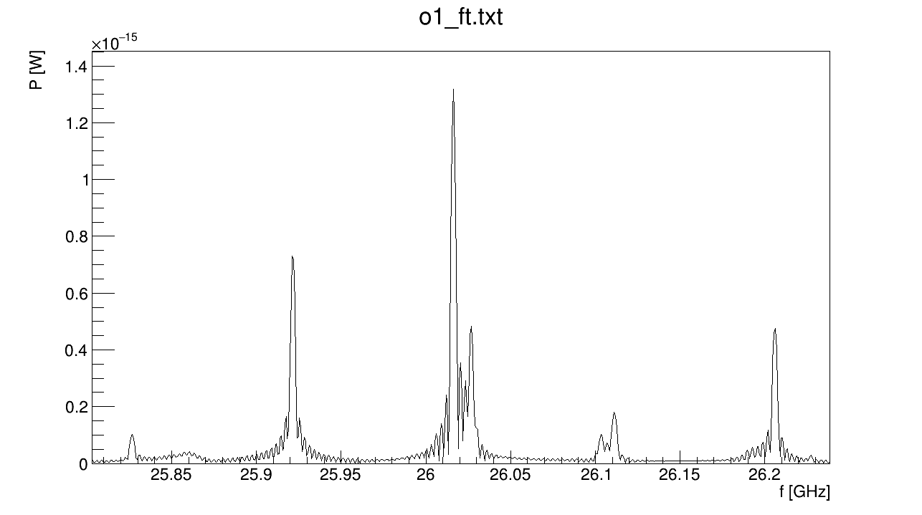
Electron Trap: CST simulation signal
1/T_{b}
1/T_{b}

Slide 21
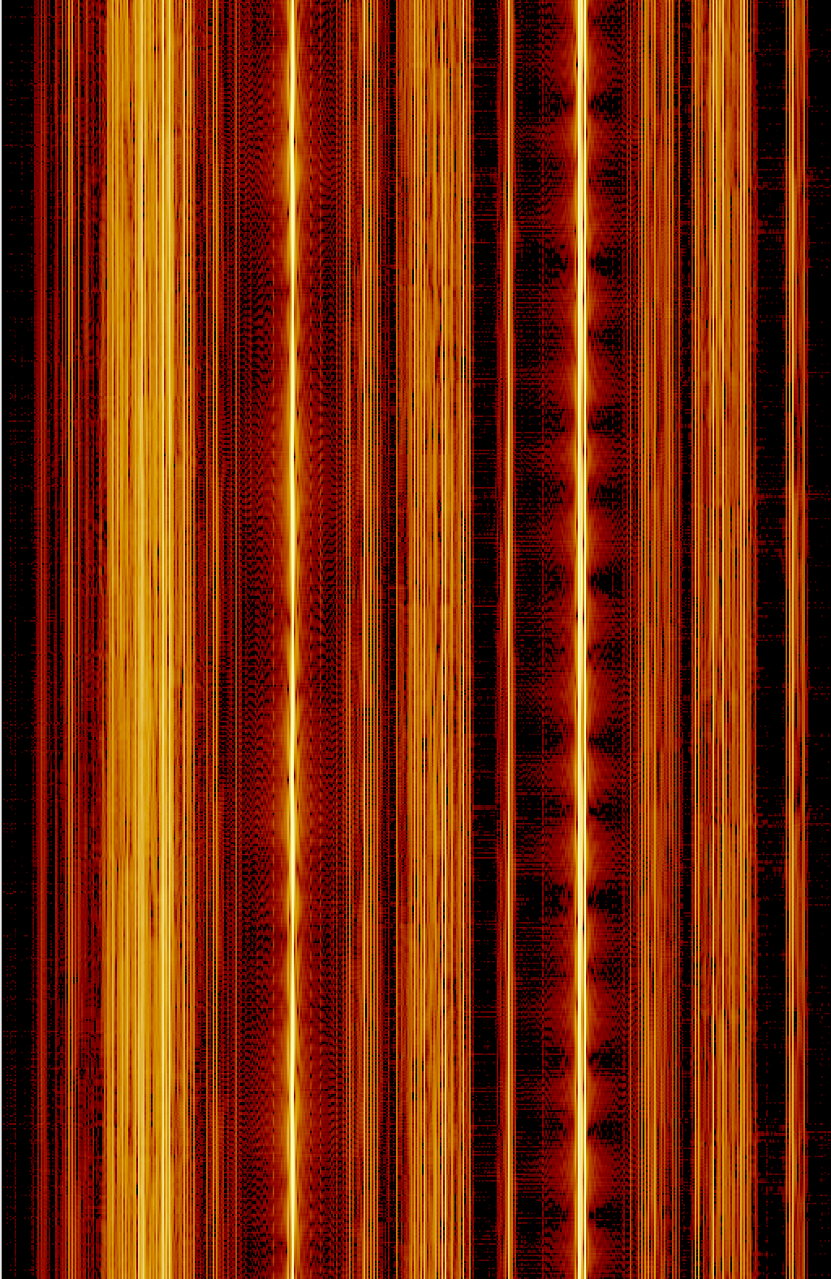
Electron Trap: spectrogram
spectrogram of simulated signal
Wait…
This color scale remind me something
Time[ns]
f[MHz]

Slide 22
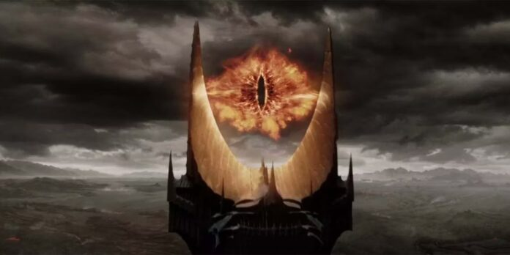
Electron Trap: spectrogram Sauron Plot
spectrogram of simulated signal
I seeee youuu

Slide 23
Electron Trap: K_{t}, K_{l} reconstruction
Measure central peak->K
Measure sidebands->measure T_{b}->K_{l}
1/T_{b}
1/T_{b}

Slide 24
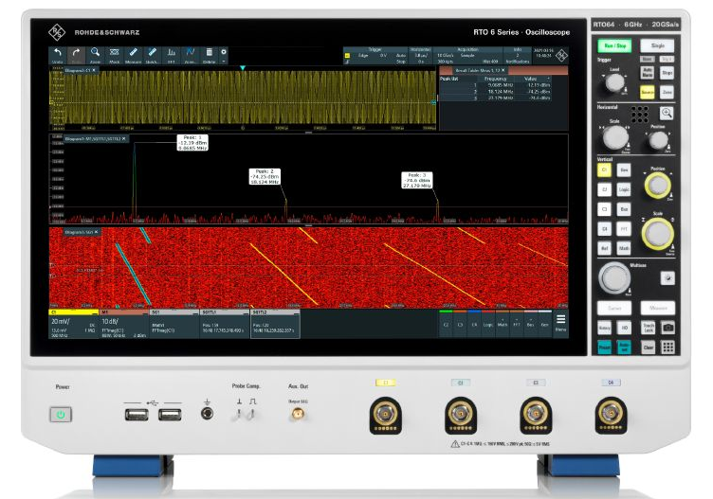
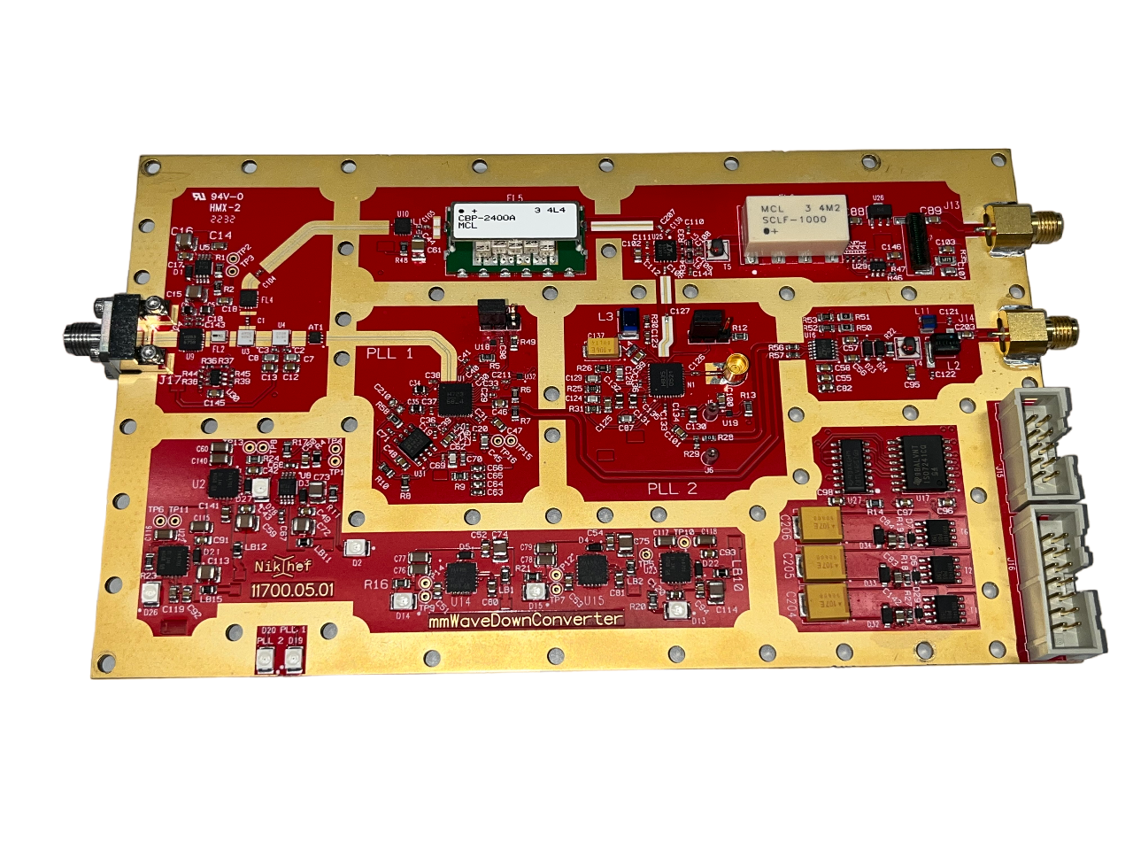
Electron Trap: readout electronics
RF
IF
LNA
PBF
Amp
DIPLEXER
DAQ
LNA
LO
RTO64 used for trigger task
Dedicated downconverter developed @ NIKHEF
DAQ with FPGA trigger under development @ NIKHEF

Slide 25
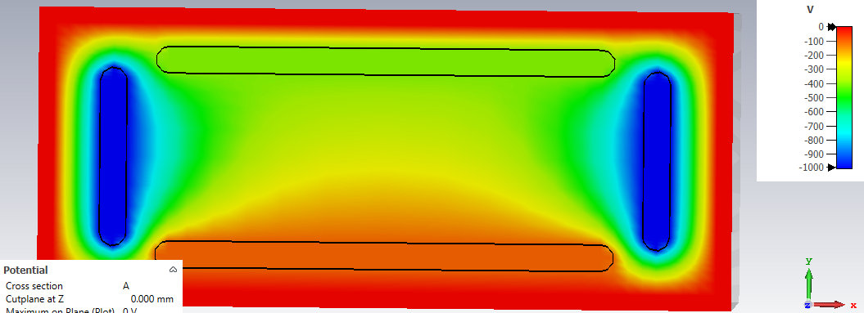
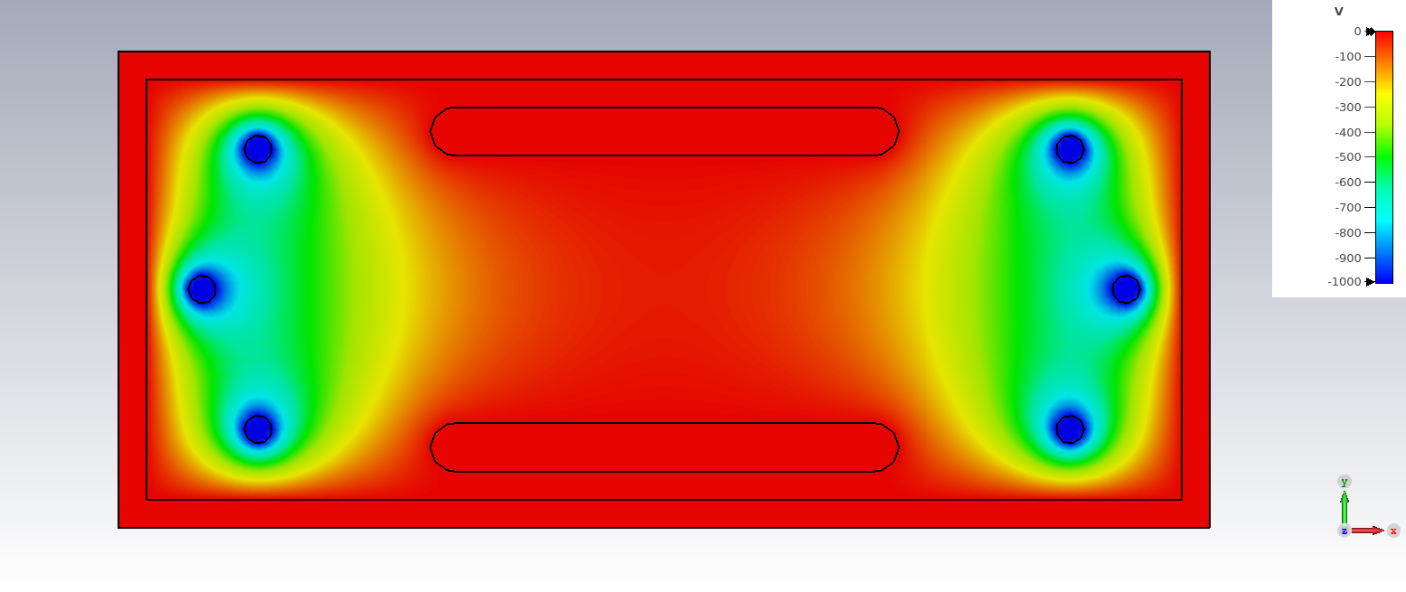
Outlook
Electron Trap setup construction @ LNGS external labs
Electron Trap data run Kr electron K=32 keV
Electron Trap data run Kr electron K=9 keV
Z drift stress test
Frequency resolution stress test
Change Electron Trap electrodes geometry

Slide 26
Backup Slides

Slide 27
PTOLEMY Concept
Target
Injection
RF antenna
Filter
TES

Slide 28
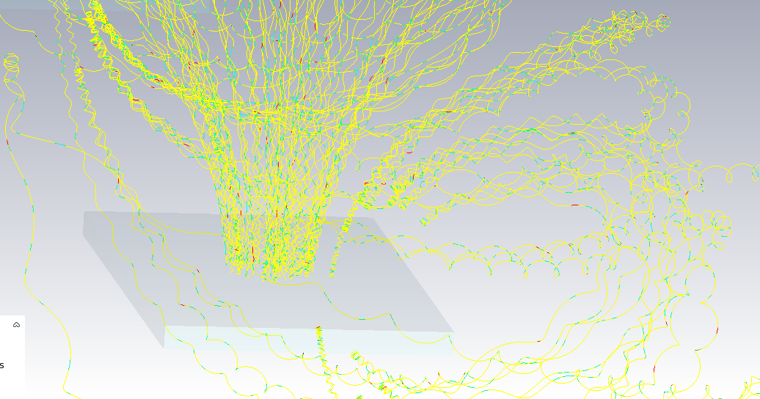
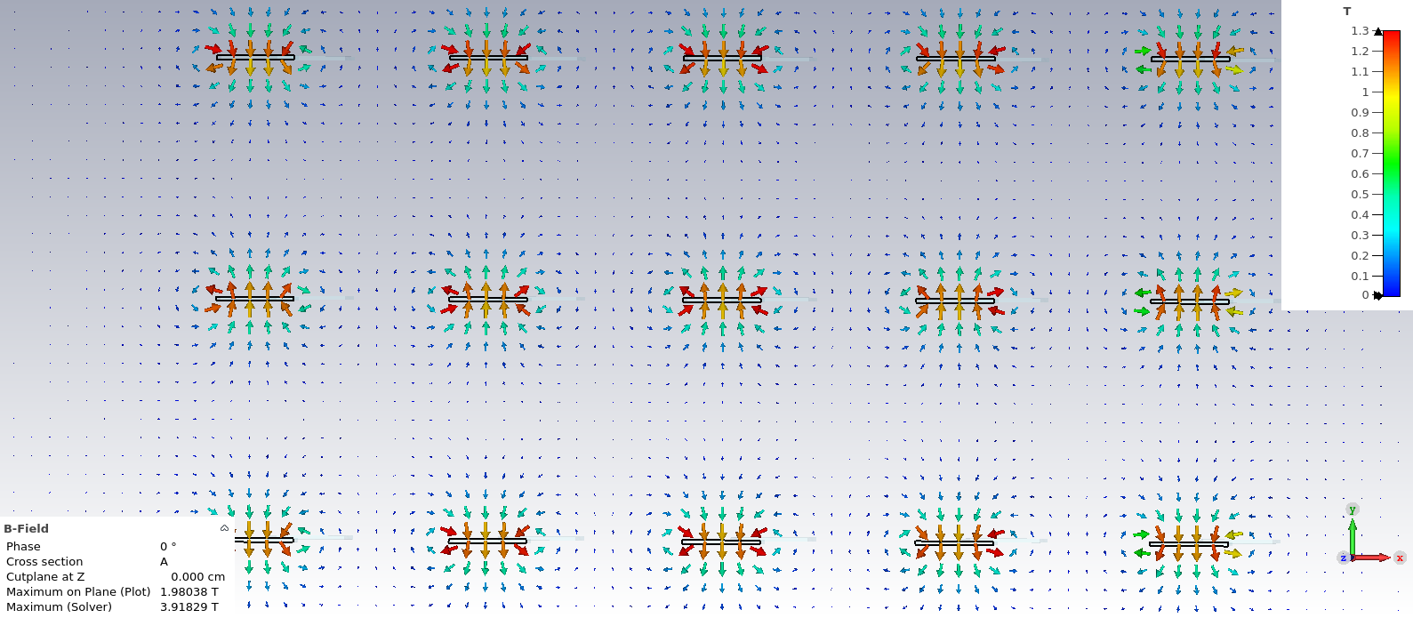
Permanent magnet target
PRELIMINARY
Only B_target it is shown, field on graphene=1.1-1.3T
B_coils=0.1T
Here: B_coils > B_target
Y
B_coils
X
Z

Slide 29
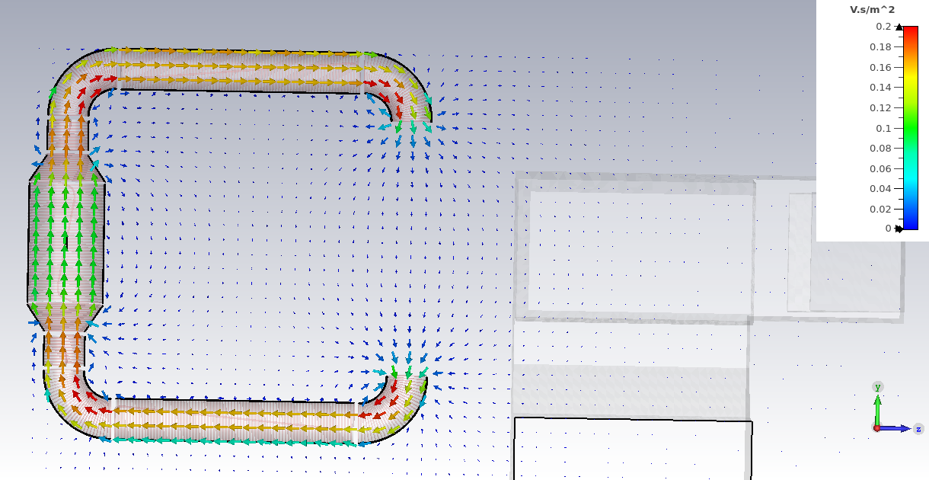
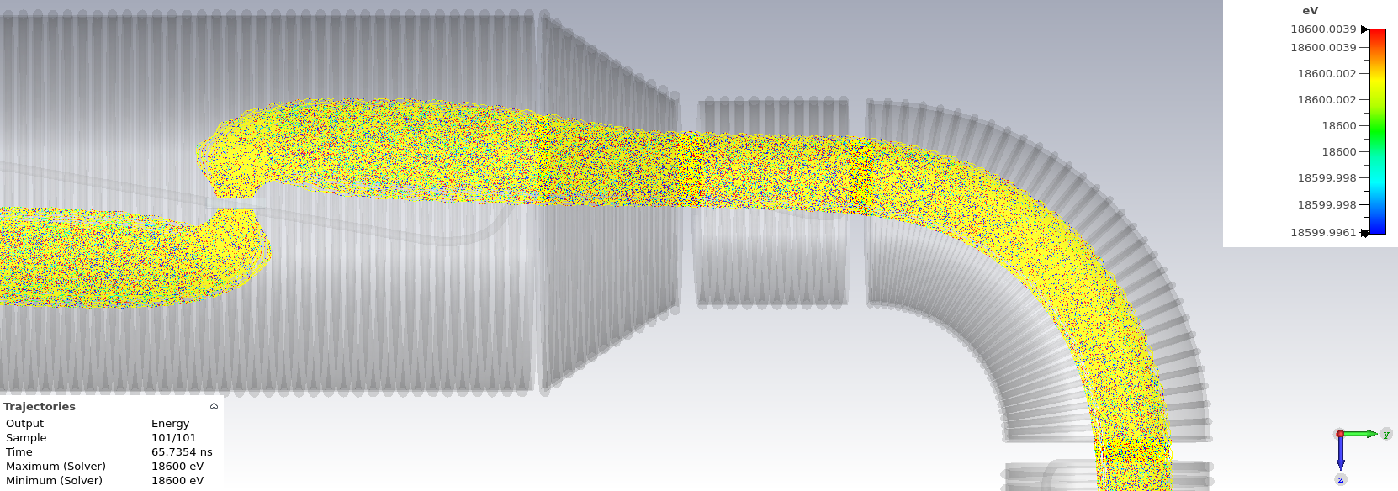
Transport coils

Slide 30
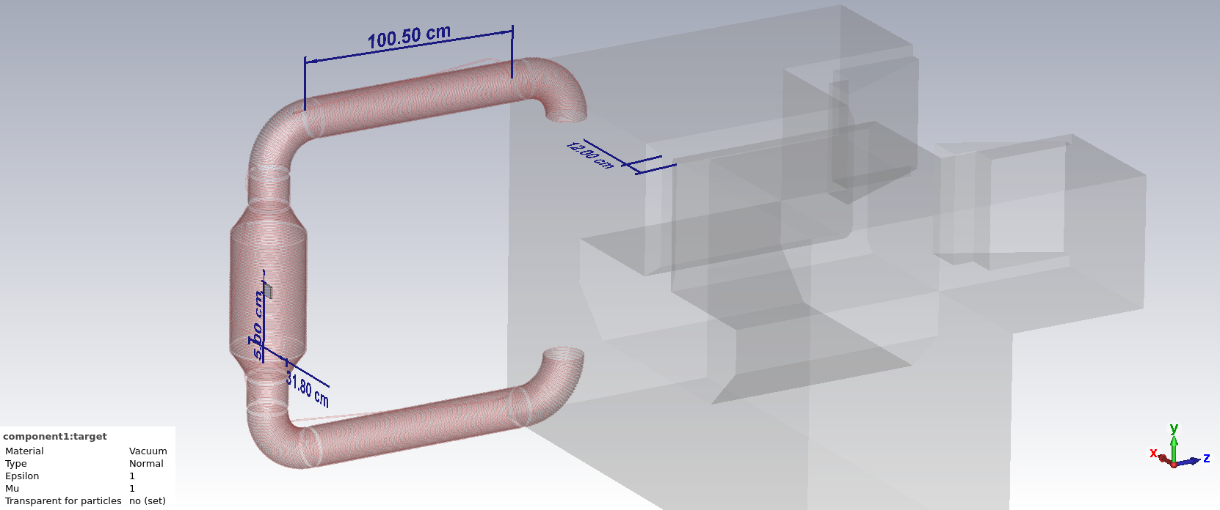
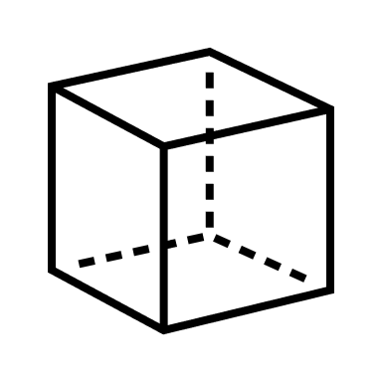
From target to RF

Slide 31
Injection in magnet
PRELIMINARY²

Slide 32
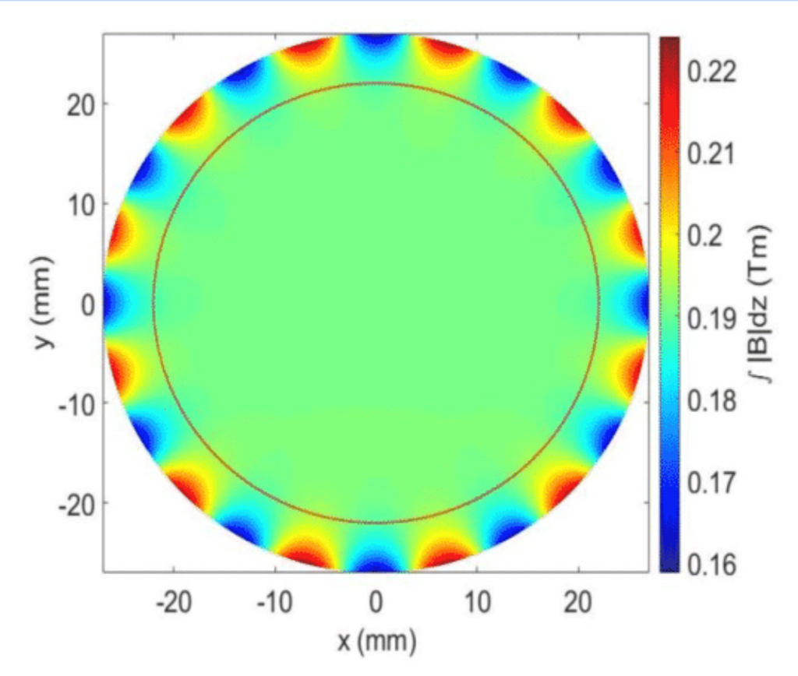
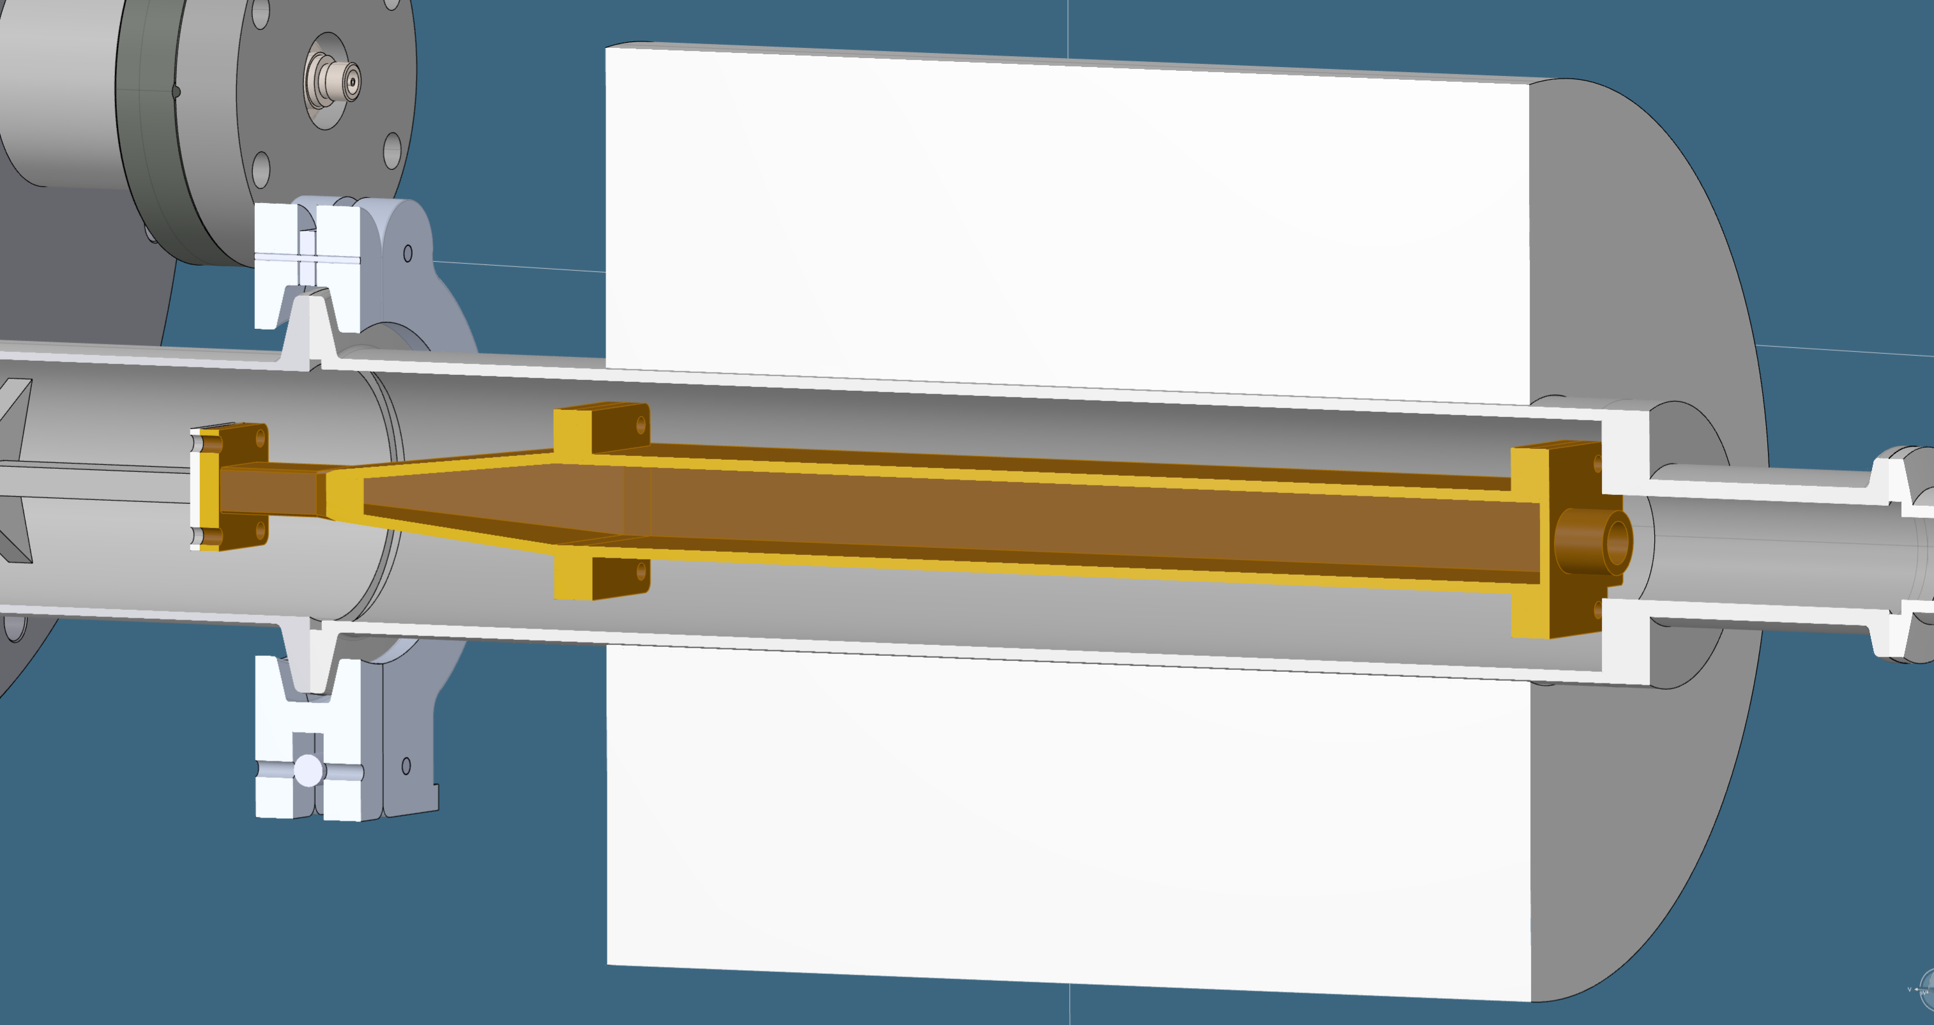
Electron Trap: Permanent Magnet
B=0.9843361T
Measured at CERN

Slide 33
Electron Trap: Electron motion
z
S1: no Zdrift, bottom of potential well
S2: Zdrift, top of potential well
S2, Δt2
S1, Δt1
x
0
10 mm

Slide 34
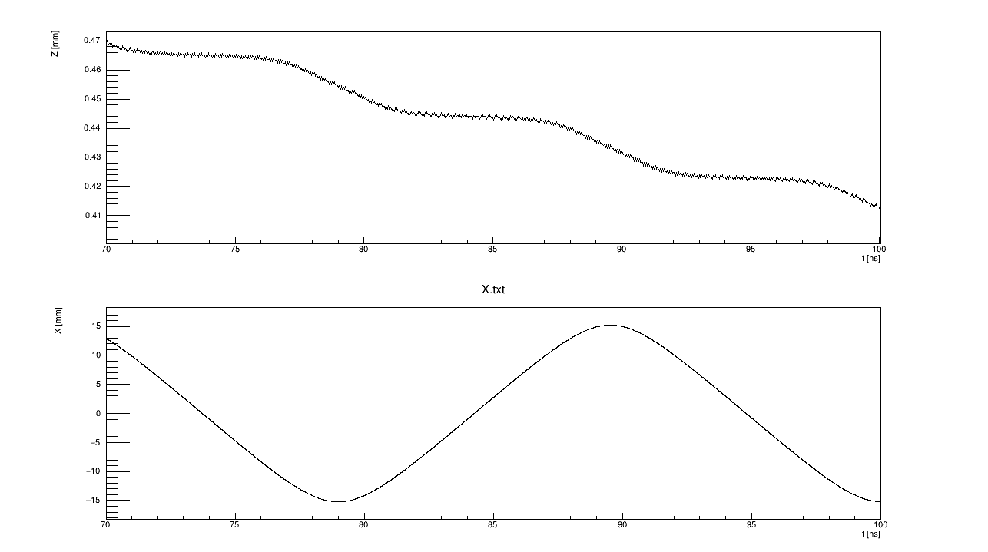
Electron Trap: Electron motion
Drift only during S2 (10<|x|<15, close to bouncing electrodes)
Vz=3*10^-4cm/ns
Zgcs
Vz=E_y/B
S1
E_y
S2
Time[ns]
X
X[mm]
Time[ns]

Slide 35
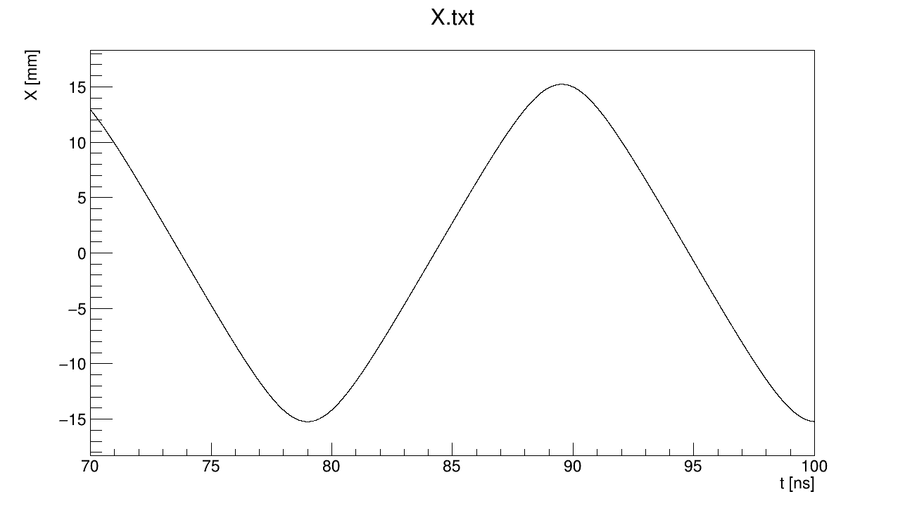
Electron Trap: Electron motion: bouncing period
t1≈76.5-71=5.5ns
t2≈81.5-76.5=5ns T_{b}=10.534ns

Slide 36
Wavelet
10^4 samples=67 ns, T_b=10.53ns
T_b
frequency
The signal goes to stationary regime in 300ns
Confirmation of S1-S2 motion
We could measure T_b also here
Time[samples]

Slide 37
Electron Trap: CST simulation
Carrier modulation in frequency from K in pot. well
Right Shift from cos(Δω*t) term
Armonics from FM
Δ
1/T_{b}
1/T_{b}
Δ₀

Slide 38
Reconstruction K_{t}, K_{l}: Experimental procedure
Let’s think that these are experimental data->measure K,K_{l}
We expect: T_{b}=10.53ns , K=32151.6eV, K_{l}=43.2eV
Measure 1/T_{b} by FM modulation
Shift carrier frequency to the left by 1/T_{b}
Measure S1->K
Measure K_{l} by T_{b} and K
Electron trap cst simulation

Slide 39
Experimental procedure
F(S1)=26,0165 (7) GHz
F(S2)=26,0260 (7) GHz

Slide 40
Experimental procedure: measure T_{b}
F(S1)-F(nΔ,L/R)= Δ
F(1Δ,L)=25,9215 (7) GHz 0,095
F(2Δ,R)=26,2060 (7) GHz 0,09475
F(1Δ,R)=26,1110 (7) GHz 0,0945
F(2Δ,L)=25,8270 (7) GHz 0,09475
<Δ>=0,09475 GHz
T_{b}=1/<Δ>=10,554 ns
T_{b}(expected)=10,534 ns
In real life some of them will be hidden below thermal noise

Slide 41
Measurement of K
K2
K1
F(S1)- <Δ>=25,9218 (7) GHz->K=32193.7eV=K1
K(expected)=32151,6eV
F(S1)
F(S2)

Slide 42
Measurement of K_{l}
Obtained from tracker simulations
KL=Kcos²(Ɵ)
Plot T_{b}(cos²(Ɵ))
We don’t know Y a priori
T_{b}=10.554ns
K_{l}(Y=0)=35,39eV->88,1°
K_{l}(Y=-3)=30,02eV->88,25°
K_{l}(expected)=43.17eV->87,9°
Y=0
Y=-1
Y=-3
10,554
Cos²(Ɵ) * K (measured)

Slide 43
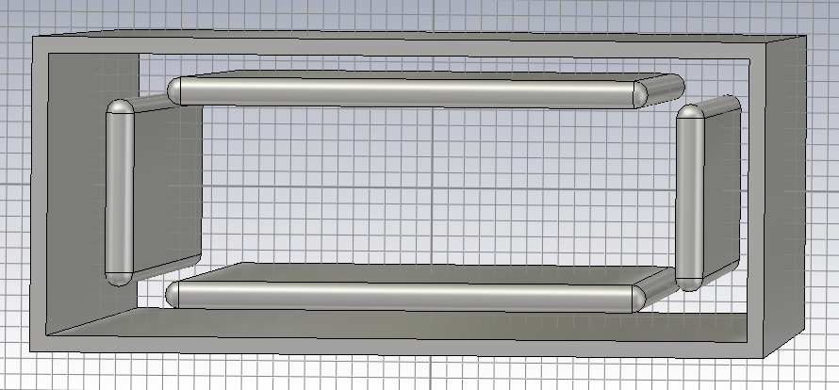
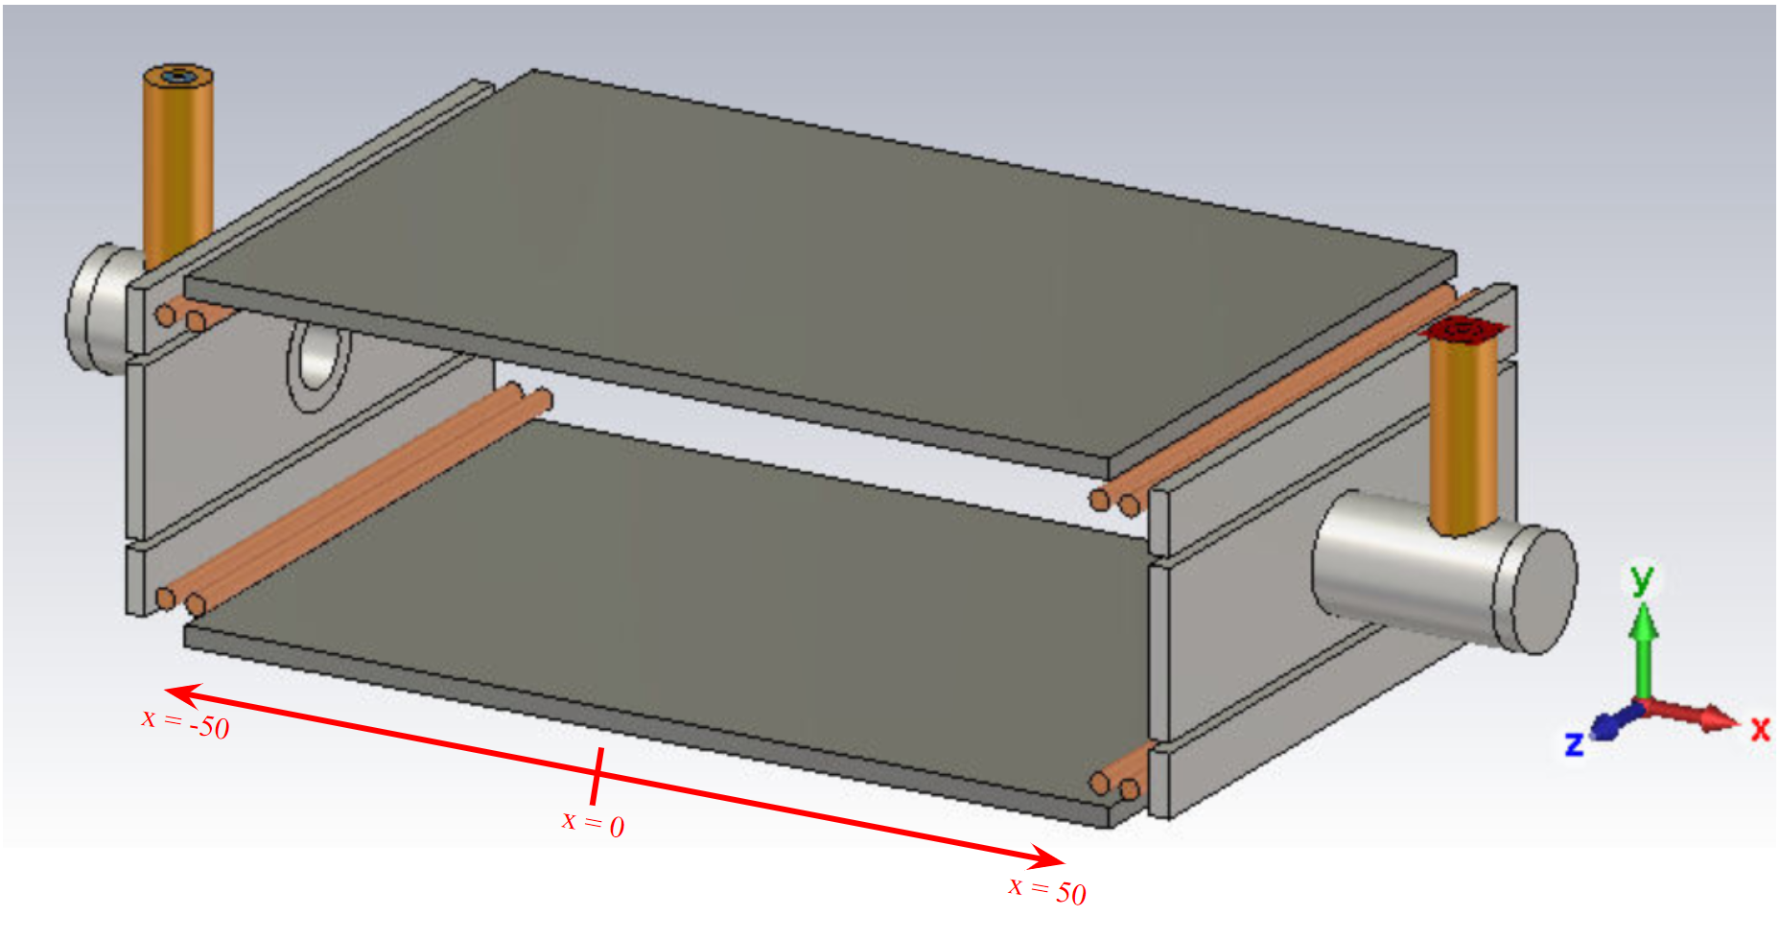
Antenna Region: possible geometries
PRELIMINARY
Rectangular waveguide
Free-space: pin antenna
Free-space: spare ribs

