Slide 1

Machine Learning clustering of spike protein mutations

Slide 2








Adele de Hoffer, Shahram Vatani, Corentin Cot, Giacomo Cacciapaglia, Maria Luisa Chiusano, Andrea Cimarelli, Francesco Conventi, Antonio Giannini, Stefan Hohenegger, Francesco Sannino
Variant-driven early warning via unsupervised machine learning analysis of spike protein mutations for COVID-19.
Sci Rep 12, 9275 (2022). https://doi.org/10.1038/s41598-022-12442-8

Slide 3
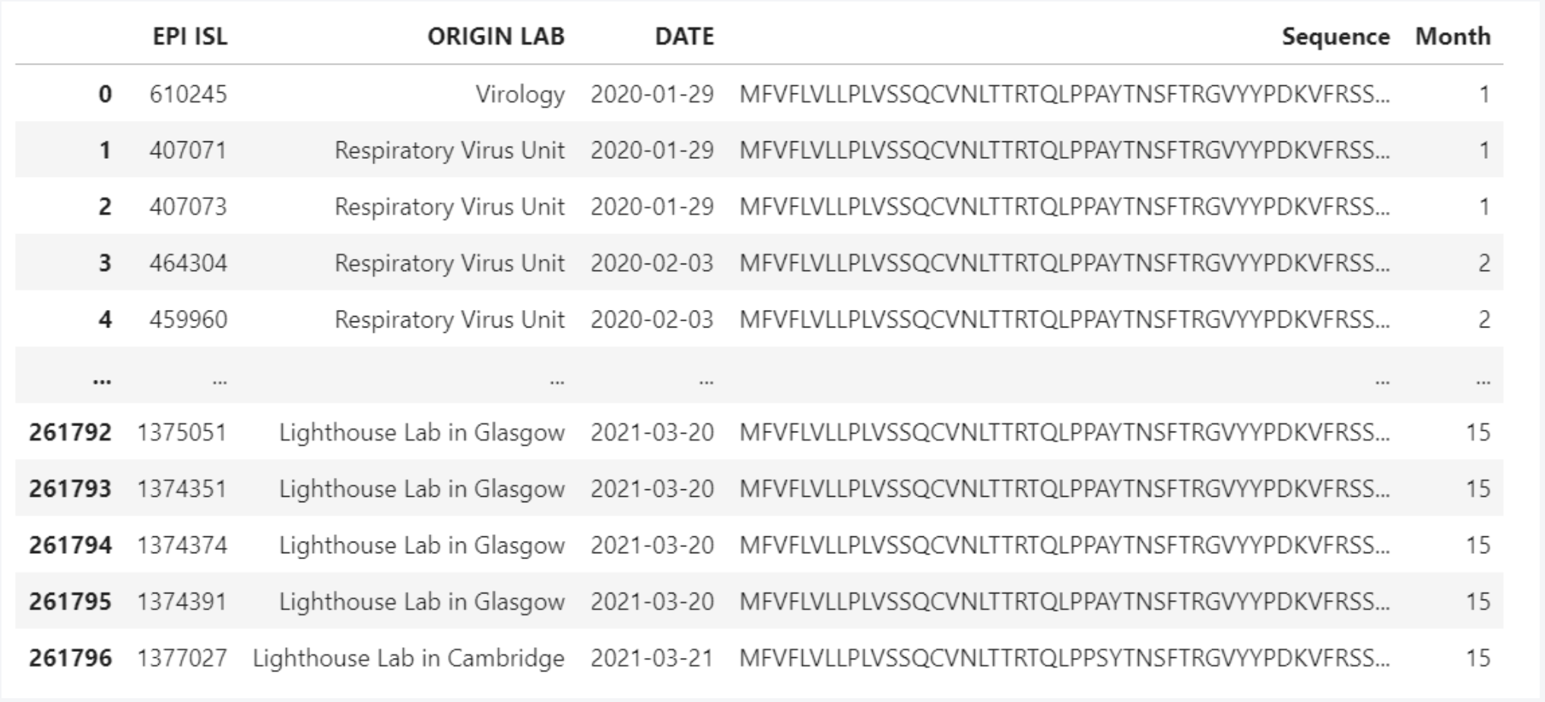
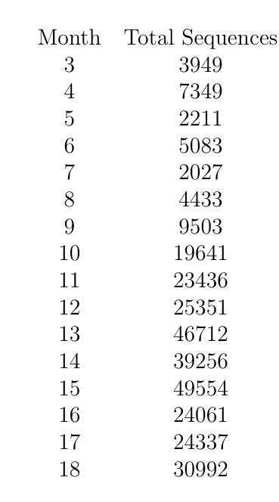
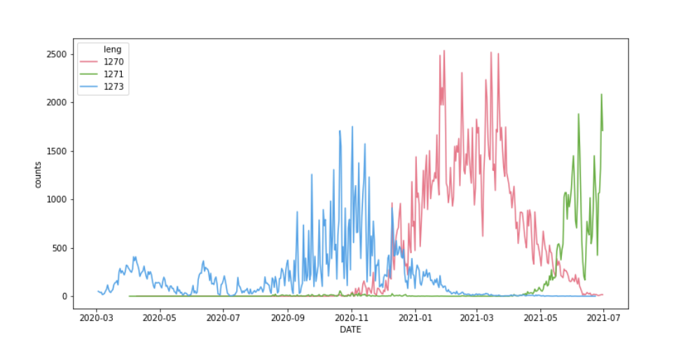
The basic IDEA
Spike protein single sequence
(*) see: Bioinformatics, 36(9), 2020, 2697–2704

Slide 4

THE COOK RECIPT: 1)CLUSTERING
Spike protein single sequence
Cluster of sequences (at time t)
(*) see: Bioinformatics, 36(9), 2020, 2697–2704

Slide 5
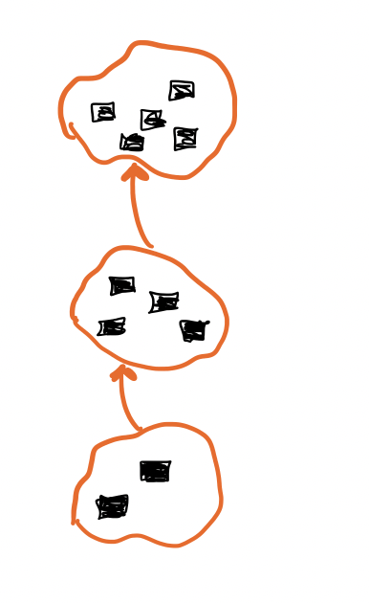
THE COOK RECIPT:
2) BUILD TIME SERIES
Spike protein single sequence
Cluster of sequences (at time t)
Time series of sequences
(*) see: Bioinformatics, 36(9), 2020, 2697–2704

Slide 6
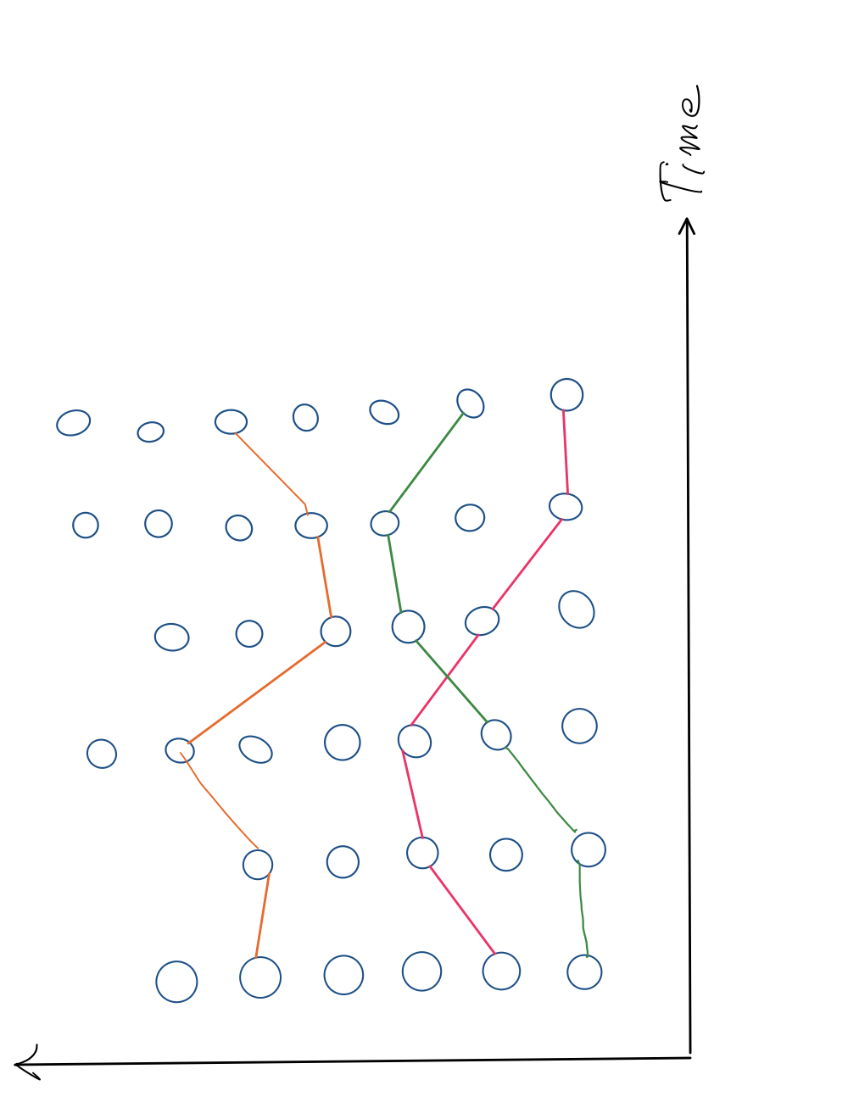
THE COOK RECIPT:
2) BUILD TIME SERIES
Spike protein single sequence
Cluster of sequences (at time t)
Time series of sequences

Slide 7
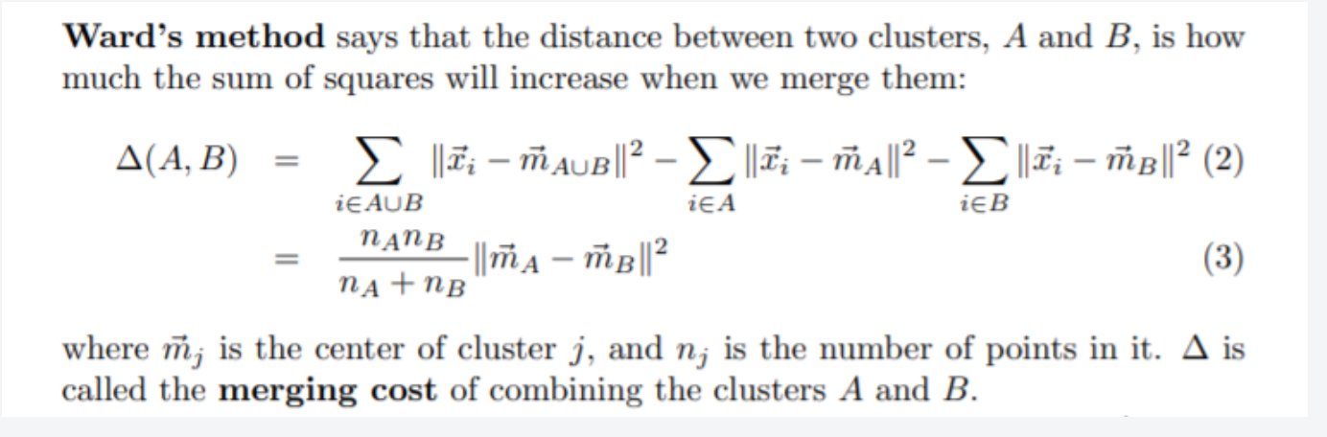
Clustering (on sequences)
We need a distance defined on 1274 (or similar) chars string:
How to choose the working point?
We need a criteria to build trees
Levenshtein distance: the minimum number of single-character edits (insertions, deletions or substitutions) required to change one word into the other
Tree obtained aggregating elements based on thier Ward distances

Slide 8
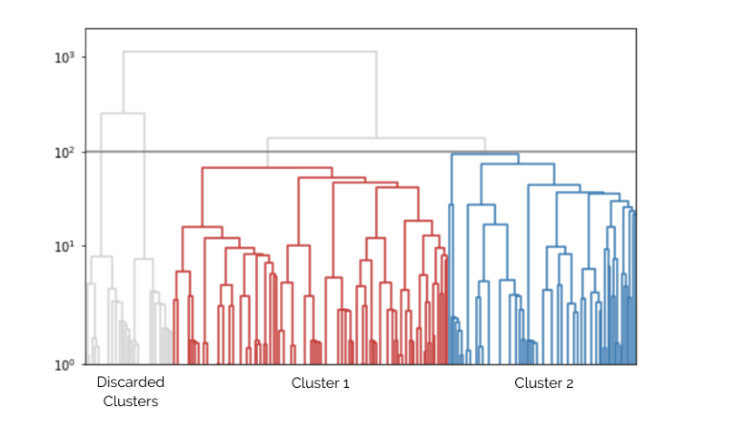
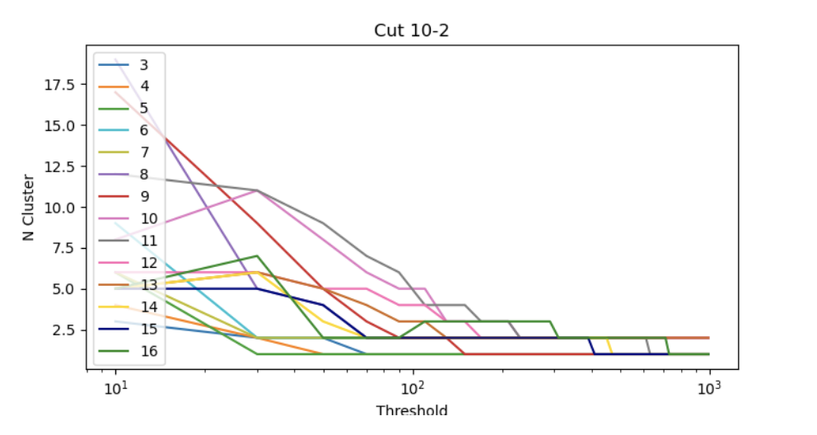
Clustering (on sequences)
  How to choose the working point?
This line set the working point!
Too few clusters!
Too many clusters!

Slide 9
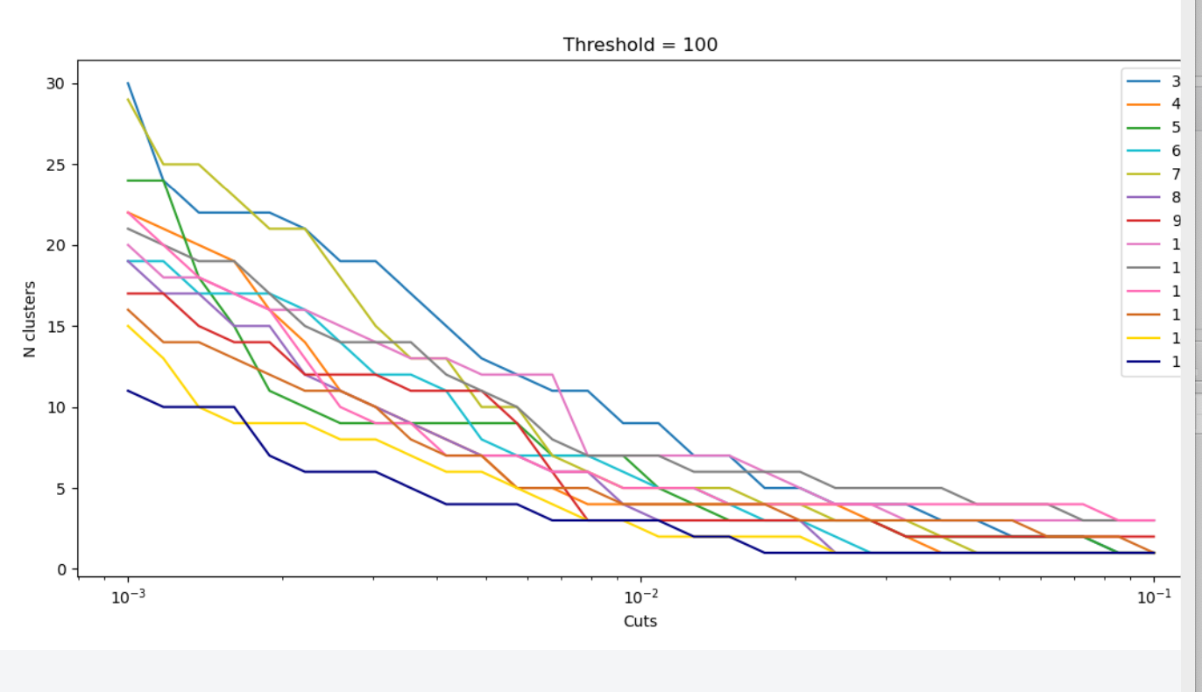

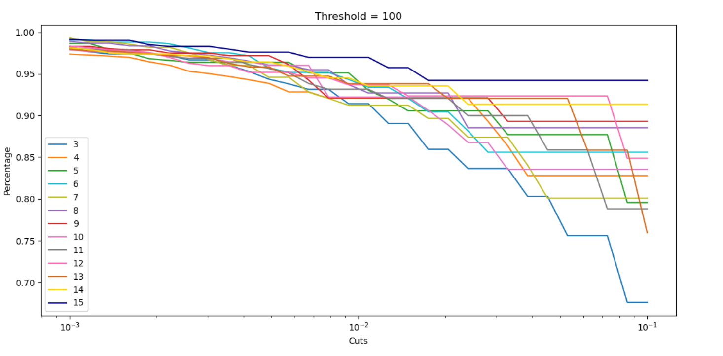
Working points
Threshold = 100
Number of Clusters
100
THRESHOLD
MINIMUM SIZE
Dataset Coverage
We need to find the right tradeoff between the number of custers and the percentage of the dataset we are analysing, varying the cut and the threshold
Minimum Size

Slide 10
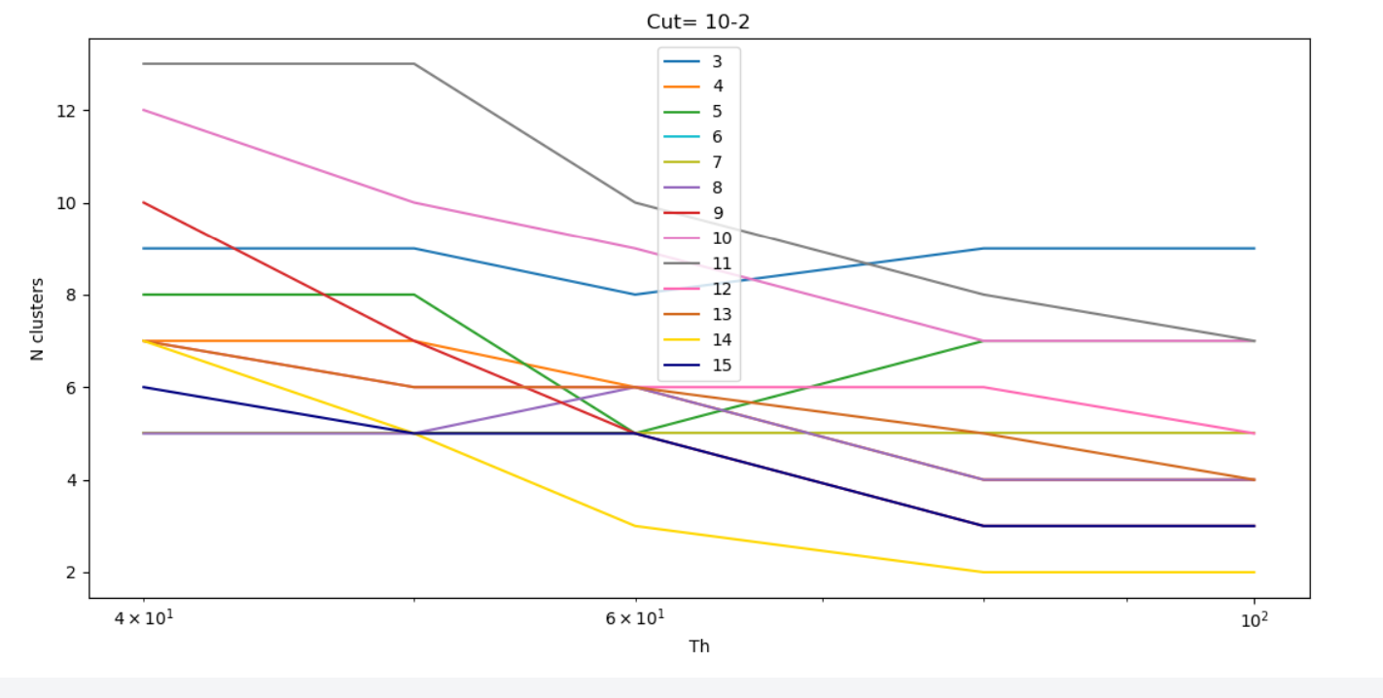
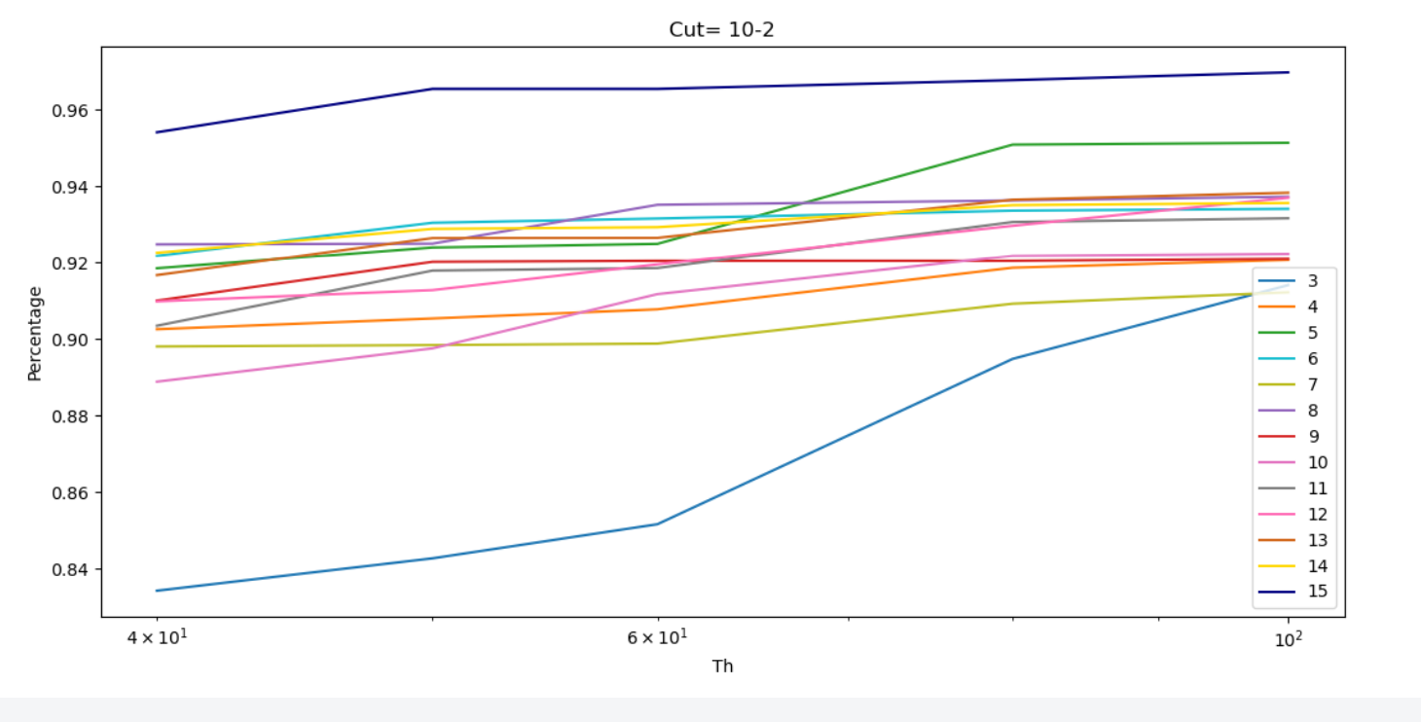
Working points
Number of Clusters
0.01
THRESHOLD
MINIMUM SIZE
Dataset Coverage
We need to find the right tradeoff between the number of custers and the percentage of the dataset we are analysing, varying the cut and the threshold
Threshold

Slide 11
Working points
100
Setting:
Threshold = 100
Minimum Cluster size = 0.01
It is a good option to keep a good dataset coverage without increase too much the numbers of clusters.
0.01
THRESHOLD
MINIMUM SIZE

Slide 12
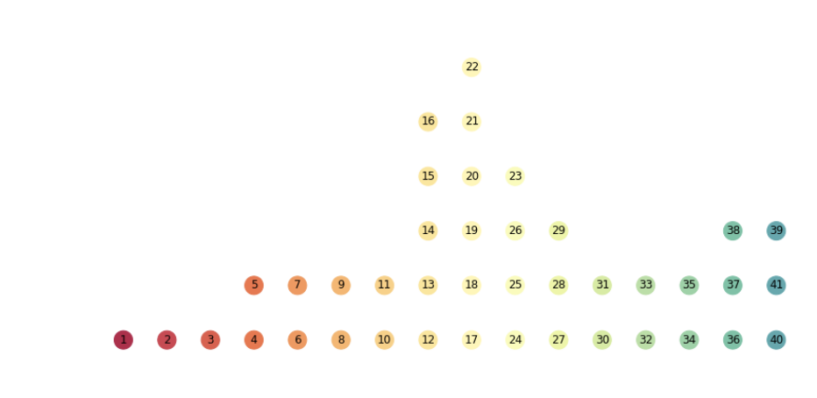
Hierarchical clustering RESULTS:
How to link consecutive clusters?
- Connect two or more consecutive clusters if have same dominant sequence → Chain definition
time

Slide 13
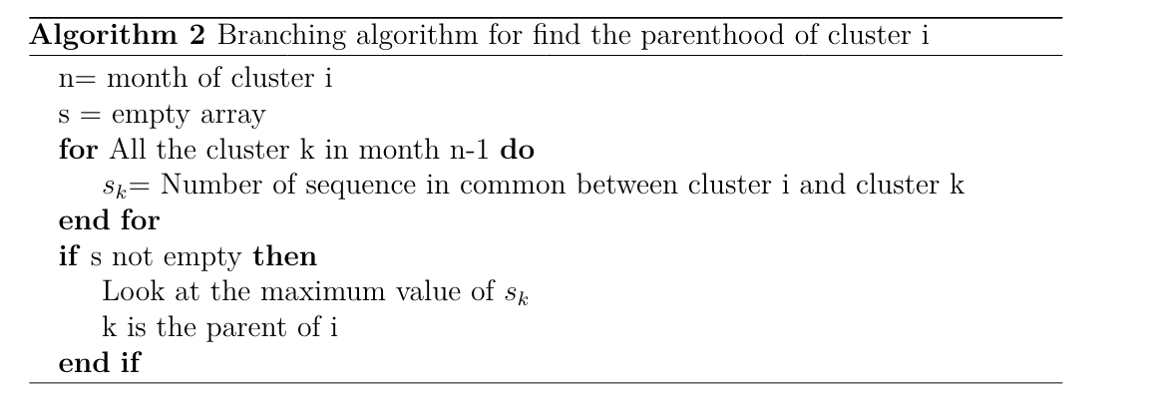
Hierarchical clustering RESULTS:
How to link consecutive clusters?
- Connect two or more consecutive clusters if have same dominant sequence → Chain definition
+ Branching algorithm!(*)
time
(*) (inherithed from HEP MC truth parentID)

Slide 14
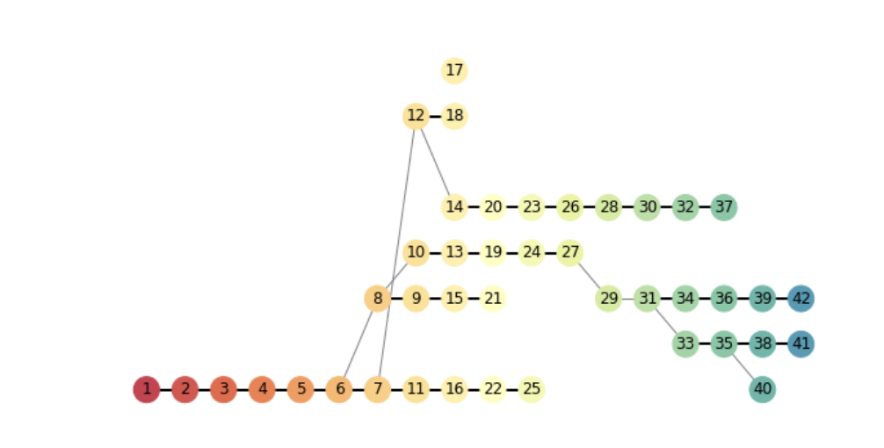
SPIKE PROTEIN TIME-SERIES
Are the dominant variants time-ordered cluster chains??

Slide 15
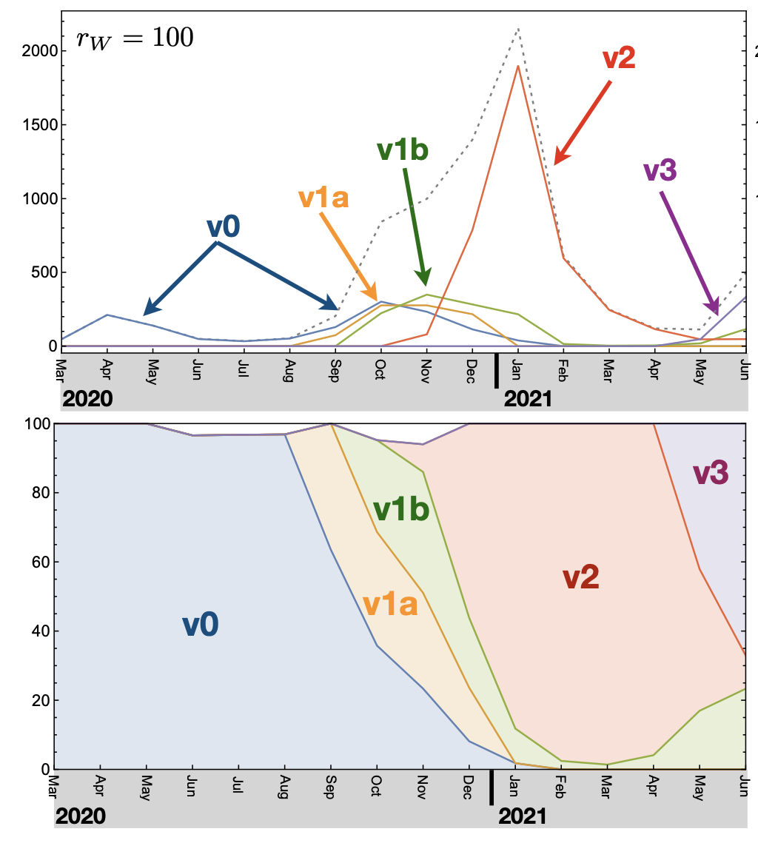
SPIKE PROTEIN TIME-SERIES
The dominant variants can be seen as time-ordered cluster chains!!
v₂
v_{1b}
v_{1a}
v₃
v₀

Slide 16
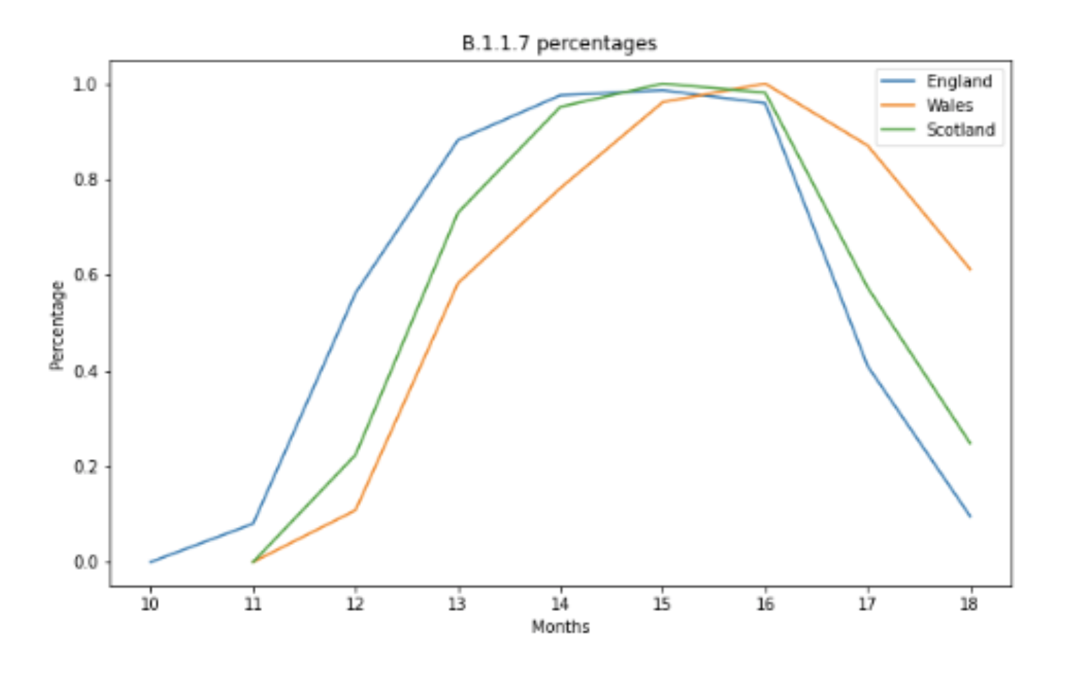
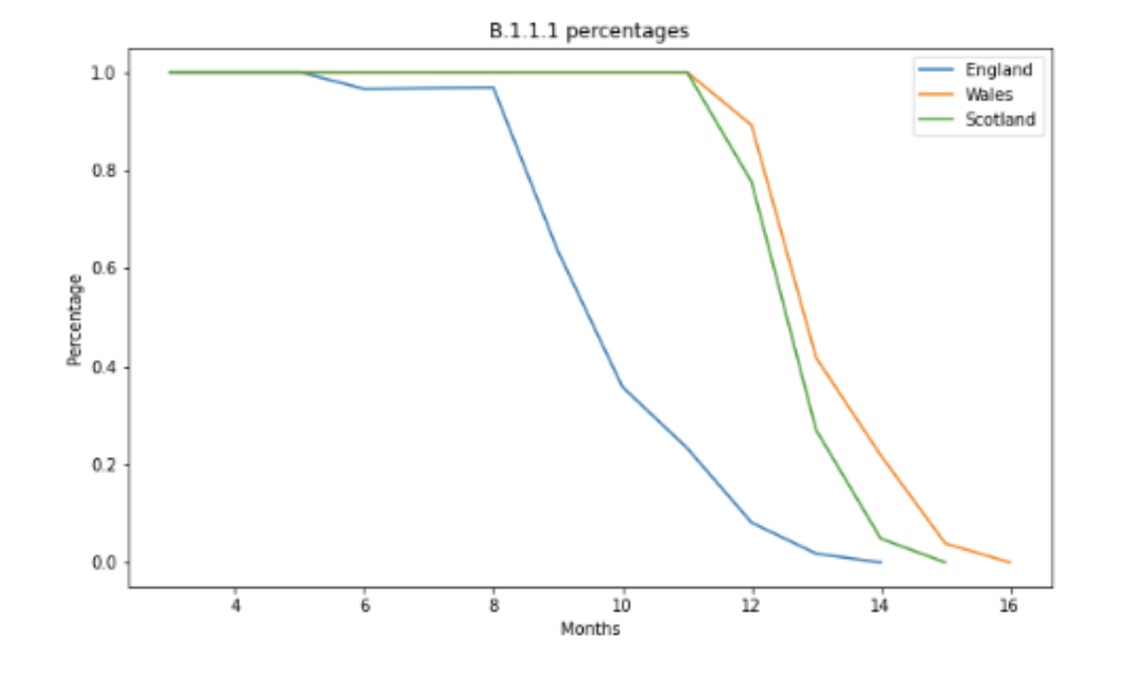
CROSS-COuNTRY Validation:
V₀
Same procedure applied on Wales and Scotland dataset (number of sequences = O(10-1)) in blind mode!
We kept the same working point for the clustering procedure
Results reproduce the dominant variants spread also for Wales and Galles!
V₂

Slide 17
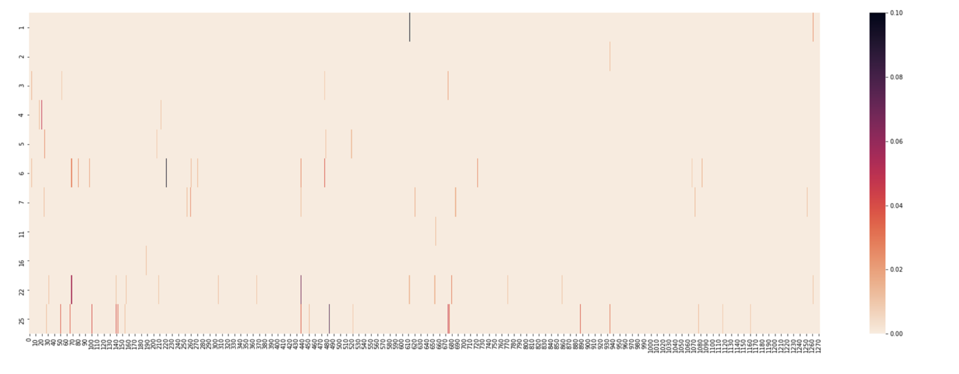
HEAT MAP (MUTATIONS SITE) FOR TIME ORDERED CLUSTER CHAIN (V0)

Slide 18
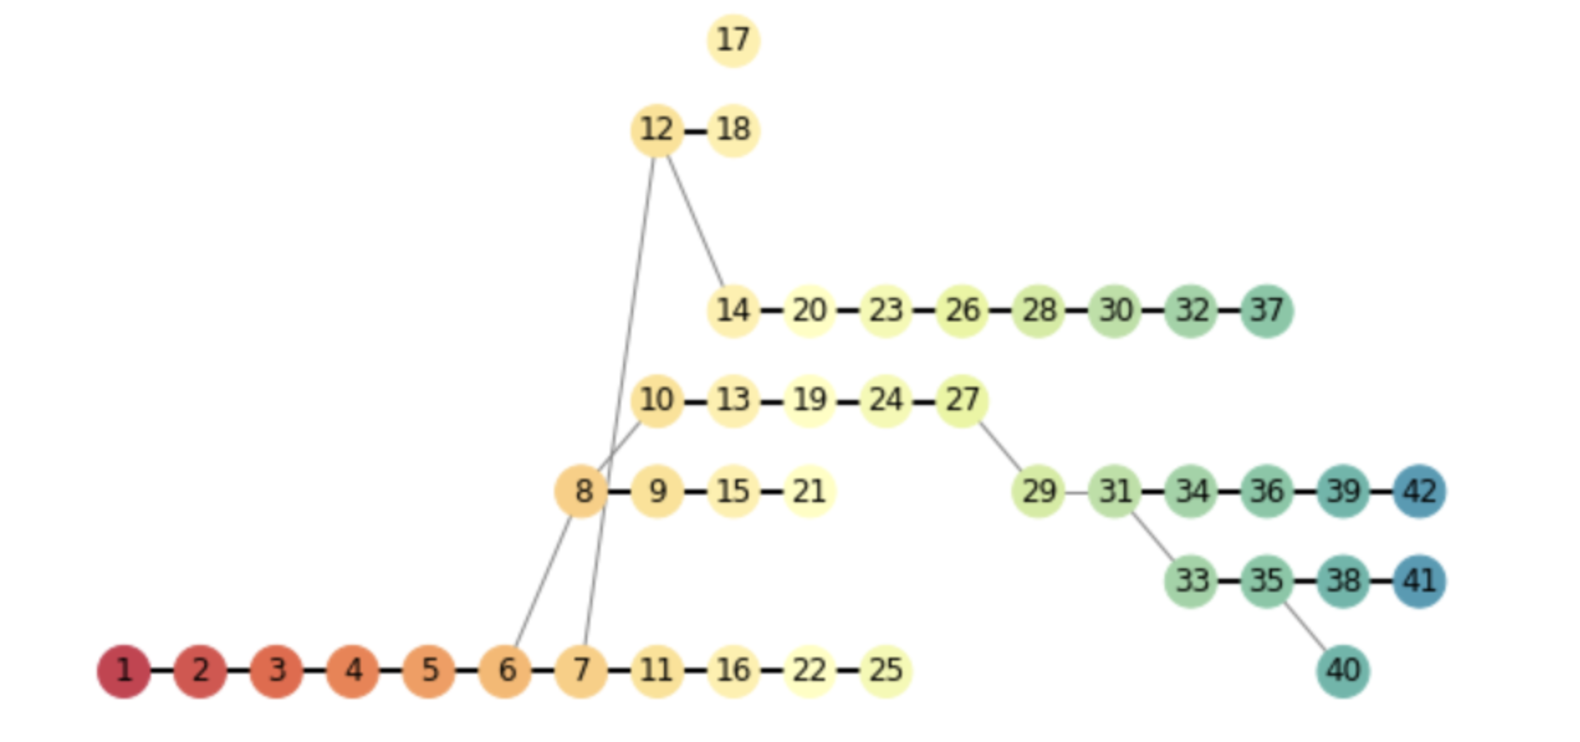
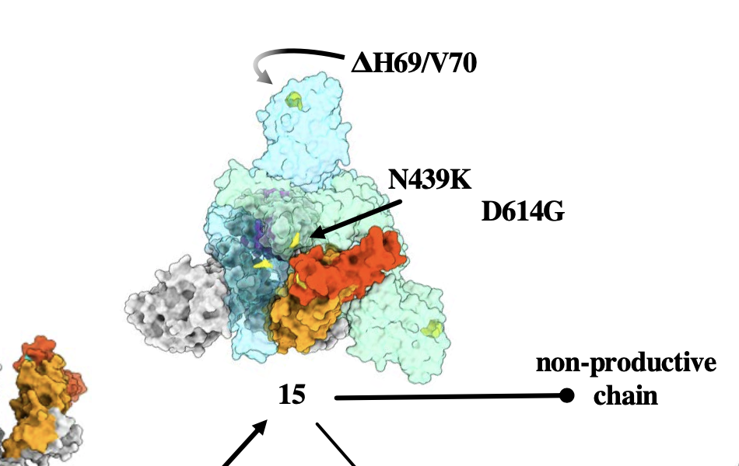
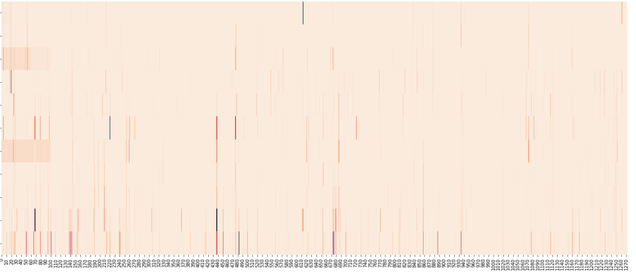
Dominant sequence in cluster 12 is:
['H69-', 'V70-', 'N439K', 'D614G’] (55% of dataset).
with 3 mutations (in red) never seen before.
First time we found the ['H69-', 'V70-', 'N439K', 'D614G’] mutations is 2 months before in cluster 6
These mutations are clearly visible in the heatmap and also if absorbed in a new chain (like the cluster 12 and then 14..) we saw them recursively re-appear in the heatmap!
6

Slide 19
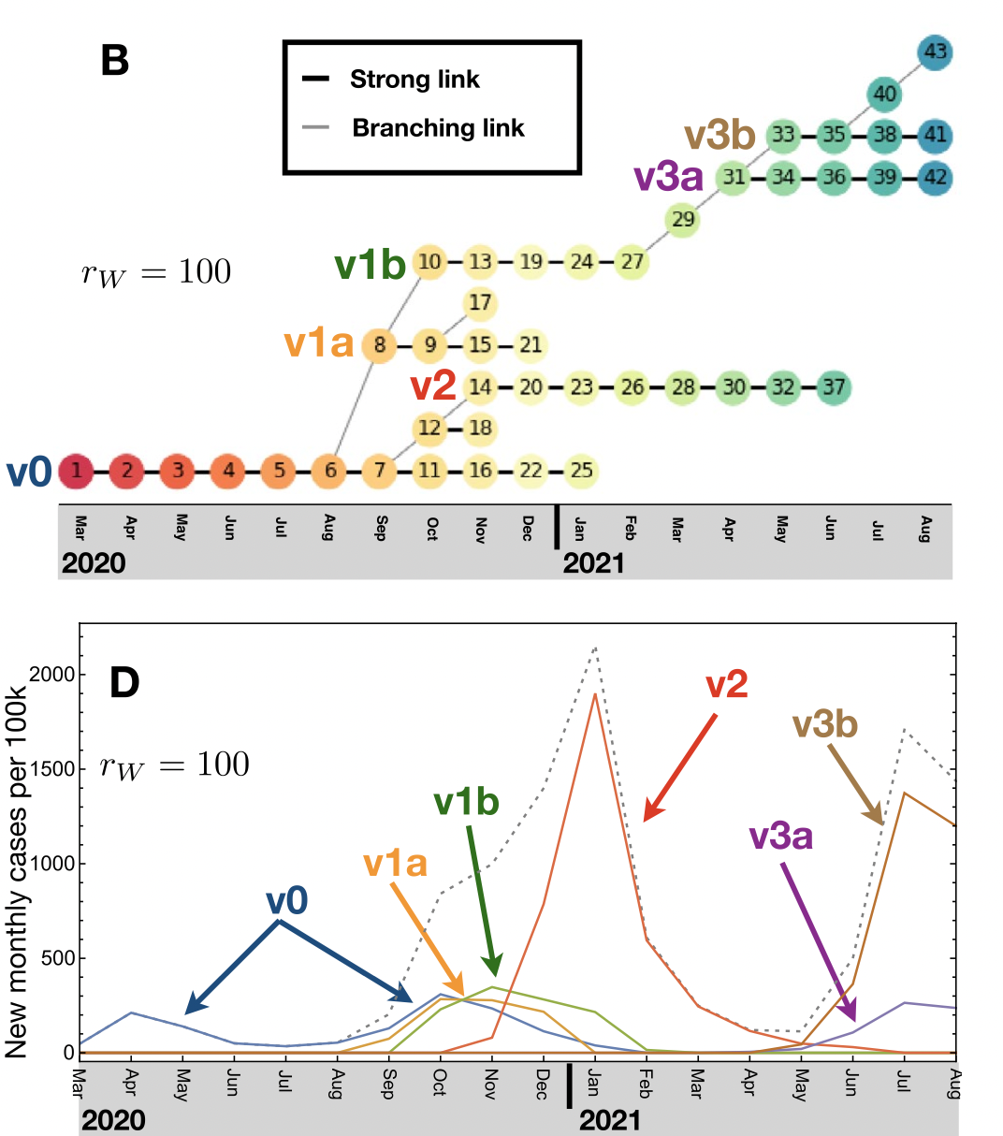
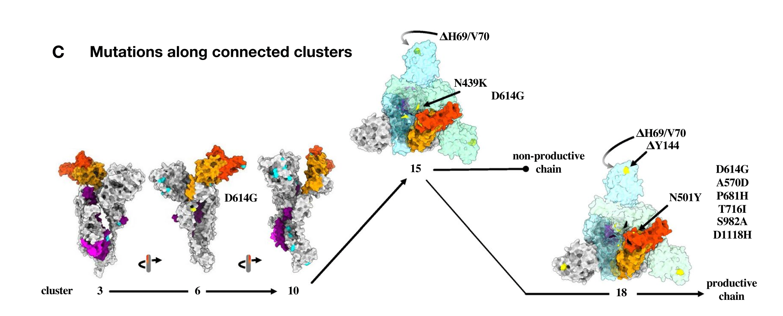
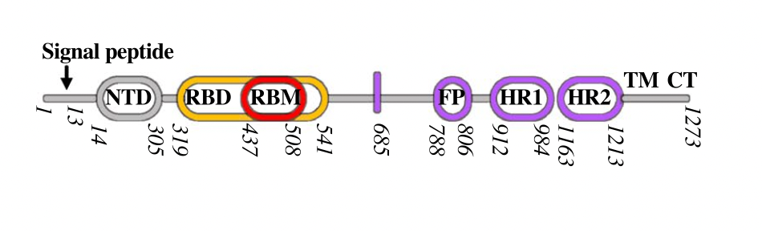
Alpha VoC
Looking at ['H69-', 'V70-', 'N439K', 'D614G’] mutations

Slide 20
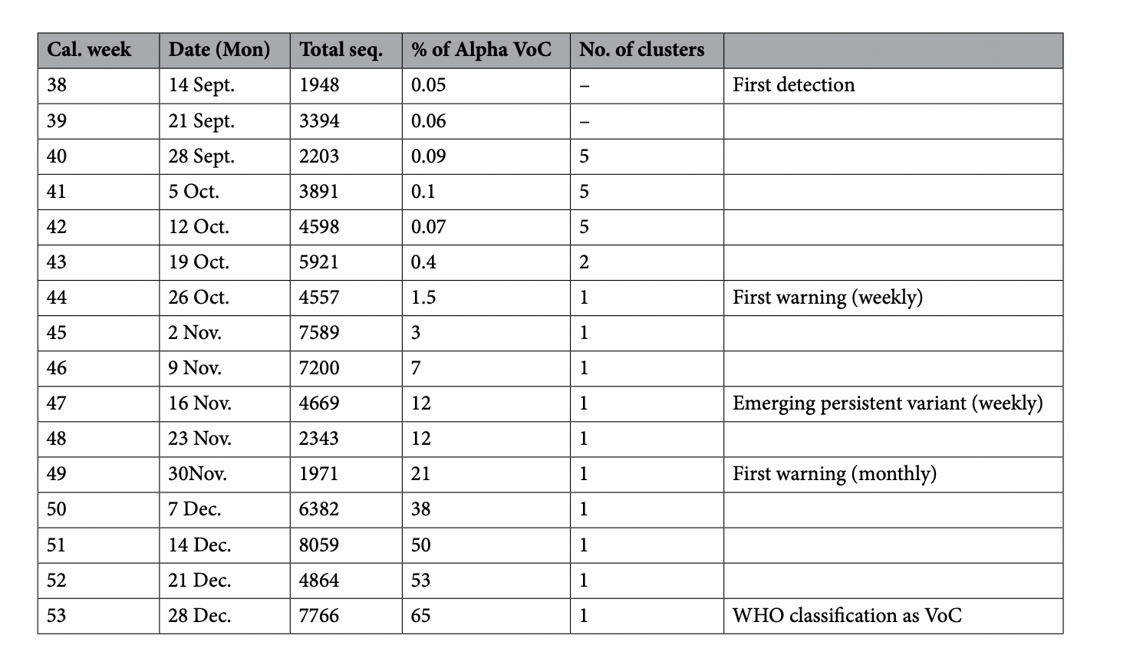
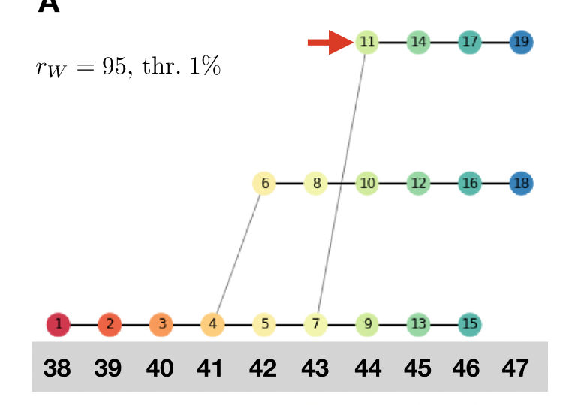
EARLY WARNING TOOL
The first case of alpha variant is registered on 2020-09-20

Slide 21
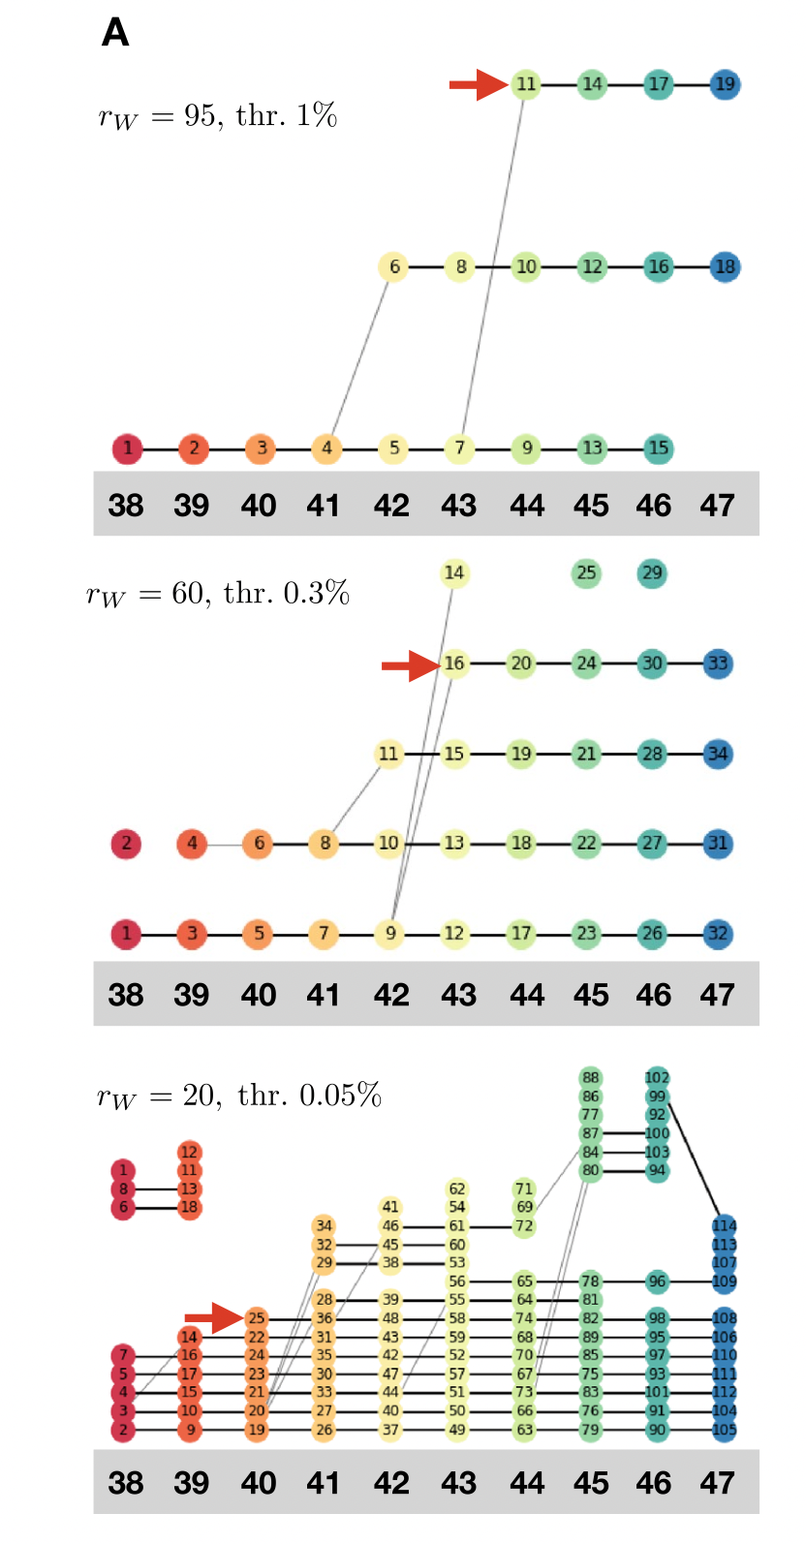
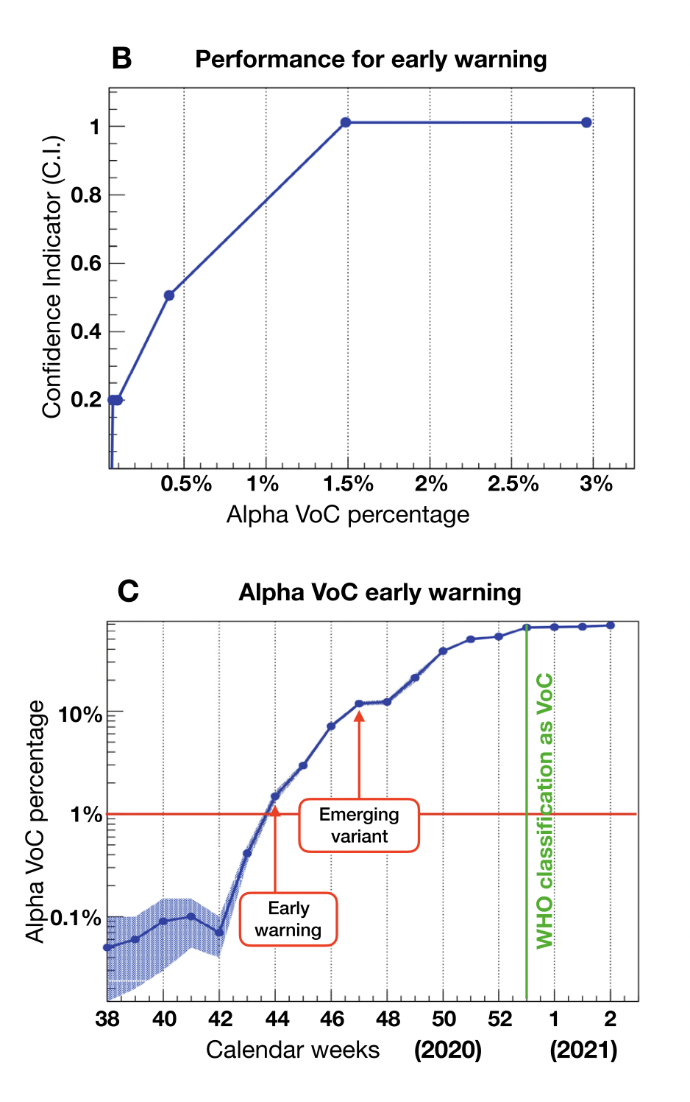
EARLY WARNING TOOL
The first case of alpha variant is registered on 2020-09-20

Slide 22
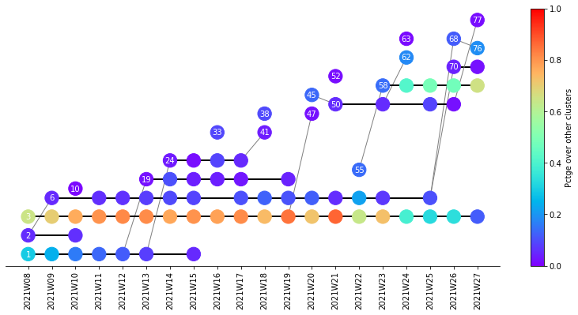
CODE OUTPUT:
The code is currently installed and running on ibisco cluster @ INFN_NAPLES (CPU or GPU). A set of utilities (mainly .py notebook) have been written to obtain graphical output
Output #1 : Network graph
Time interval : week/month
Filtering on the number of weeks.
Data avalaible from 01/01/2020 → today
This Example:
France dataset 02/2021 → 07/2021

Slide 23
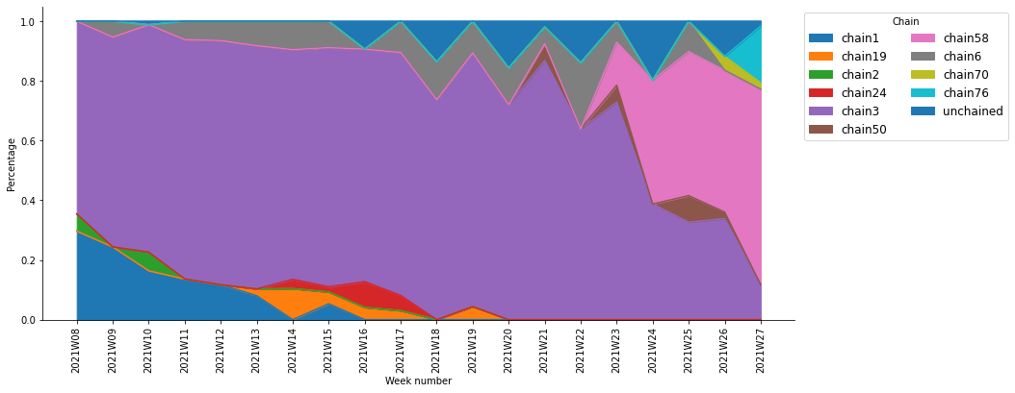
CODE OUTPUT:
The code is currently installed and running on ibisco cluster @ INFN_NAPLES (CPU or GPU). A set of utilities (mainly .py notebook) have been written to obtain graphical output
Output #2 : Distribution of chains over time

Slide 24
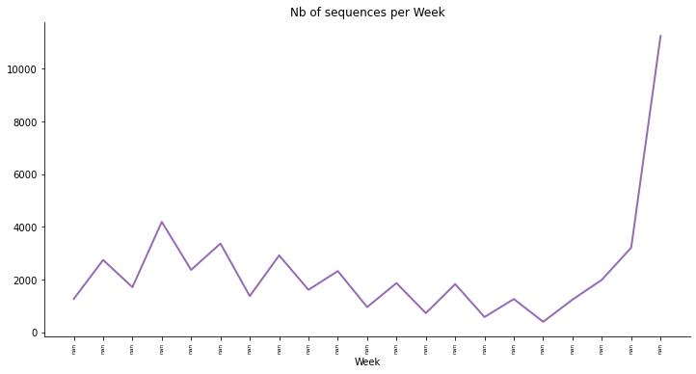
CODE OUTPUT:
The code is currently installed and running on ibisco cluster @ INFN_NAPLES (CPU or GPU). A set of utilities (mainly .py notebook) have been written to obtain graphical
Output #3 : Number of avalible sequences over time

Slide 25
CODE OUTPUT:
The code is currently installed and running on ibisco cluster @ INFN_NAPLES (CPU or GPU). A set of utilities (mainly .py notebook) have been written to obtain graphical
Output #4 : Simplified Alert level
For the latest week and by chain, alert level with 4 categories
  Level 0 : Stable chain
  Level 1 : New cluster not linked to existing chain
  Level 2 : New chain
  Level 3 : Rapidly evolving new chain

Slide 26

Future WORK: NLP and GRAPH NN interpretation

Slide 27


EMBEDDING AND T-SNE
Using NLP approach (→ ProtVec (*)) to represent each sequence as $\vec{a}∈ R^{n }$vector
Sequence as a sentence
3-grams as basic words
Variants bring new words to the spoken language?
Any semantic in the sequence sentence?
..and what about dominant variants?
Whole dictionary with about 8x10³ words
A single Covid Spike Protein sequence (sentence) use <= 5% of dictionary words
(*) PLoS ONE 10(11): e0141287, 2015

Slide 28
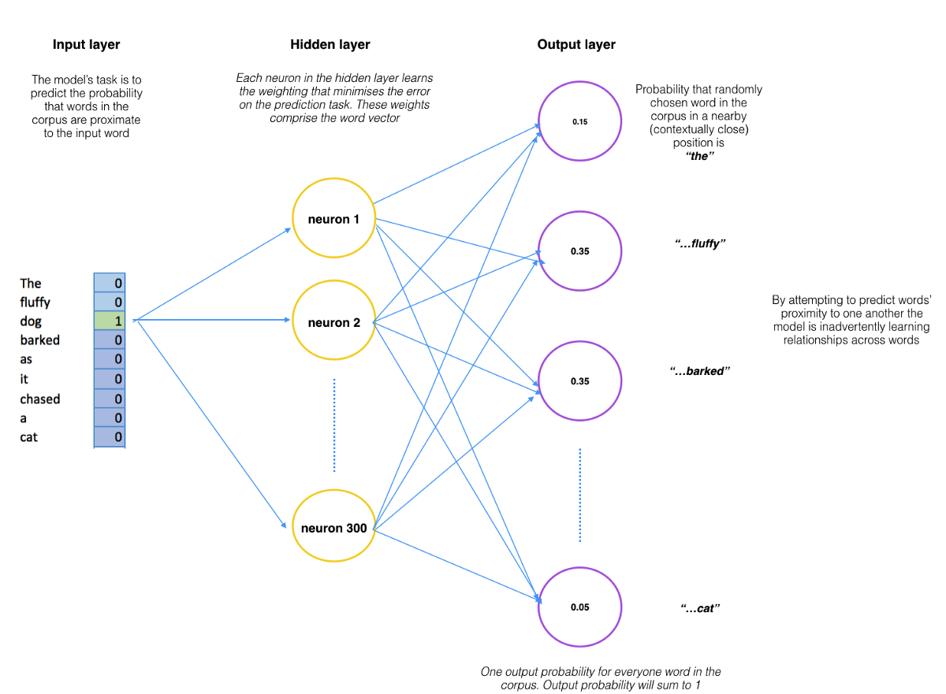
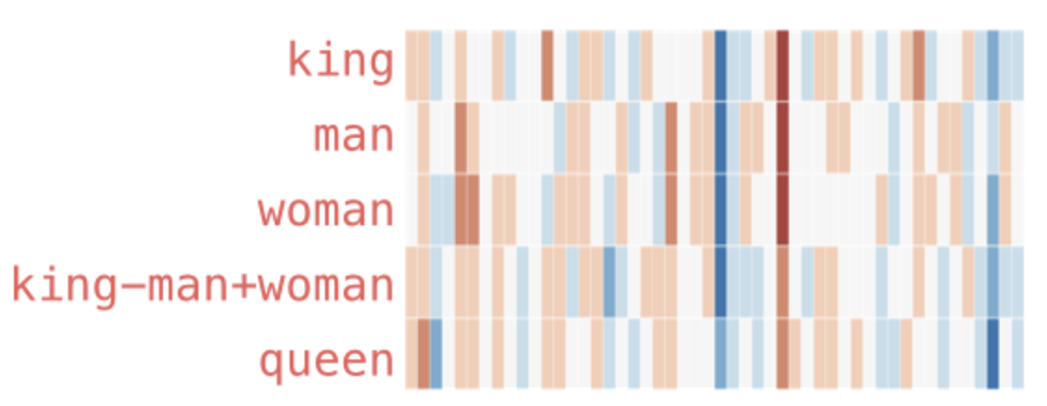
EMBEDDING AND T-SNE
Each 3-gram (word) is embedded in a 100 dim vector
Weights are used to represent a 3-grams

Slide 29
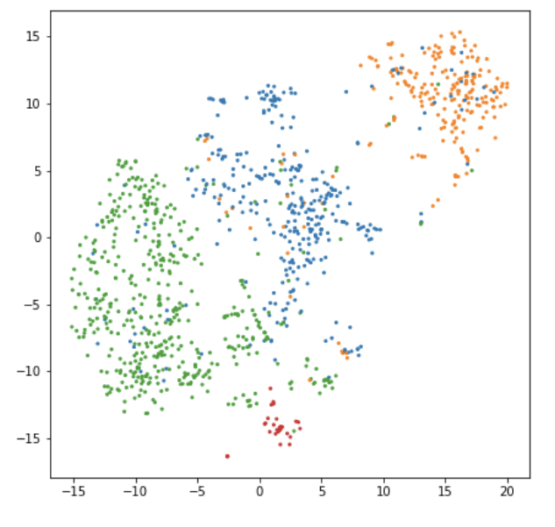
EMBEDDING VALIDATION
Is the clustering procedure based on Levenshtein distance equivalent to the ProtVec high dimensional embedding?
Dimensionality reduction and 2-dim projection using t-SNE (T-distributed Stochastic Neighbor Embedding)(*)
(*) https://lvdmaaten.github.io/tsne/

