Slide 1
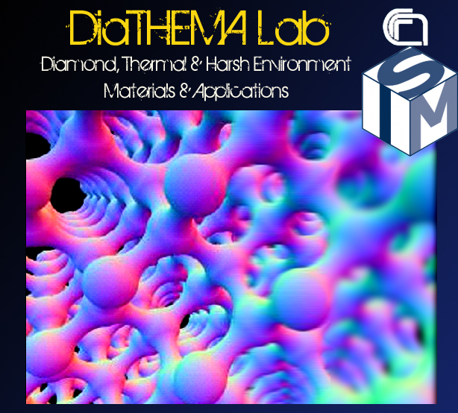
DiaC²Lab
Diamond and Carbon Compounds Laboratory
Diamond measurements under irradiation and
measurement of CCE and mu-tau
Institute for Structure of Matter (ISM)
of the Italian National Research Council (CNR)
Rome, Italy
DiaTHEMA Lab is inside the CNR Research Area of Roma 1
Via Salaria km. 29,300 - 00015 Monterotondo Scalo (RM), Italy

Slide 2
X-ray Diamond Detectors – Photoconductor Performance
Priming process consists of a prolonged pre-irradiation to make the diamond detector signal stable and reproducible (priming is effective even for months).
Priming
Why? CVD Diamond has deep traps in the wide band-gap which have to be electrically filled by photo-generated charge carriers to be neutralized.
It is well known that priming process induces:
  An increase of signal,
  But a concomitant increase of dark current
Signal increases with irradiation time (i.e. accumulated dose) until it saturates (priming dose of about 2 Gy), reaching stable and reproducible conditions.
Electronic-Grade Films
Electronic-Grade Films do not suffer from priming!
No Deep Traps!
Trapping mechanisms reduce carriers lifetime in competition with thermionic re-emission favored by bias voltage.
“Flat curve” condition is obtained by applying voltages > 150 V (electric field > 3000 V/cm)
Frequency Dependence
Very fast detectors (ms range or less under integrated measurements)
D.M. Trucchi, P. Allegrini, P. Calvani, A. Galbiati, K. Oliver, G. Conte, IEEE Electron Device Letters 33 (2012) 615-617

Slide 3

X-Ray Photoconductive Model
Electronic-Grade Dosimeters
Hecht’s Photoconductive Model
Charge induction
Homogeneous illumination
Trapping & detrapping phenomena
$$I_{ph}(V_{bias},DR)=qAG_{0}\frac{μτV_{bias}}{d}(1−\frac{μτV_{bias}}{d2}(1−e^{−\frac{d^{2}}{μτV_{bias}}}))$$
μτ = constant = (3.0 ± 0.5) x 10⁻⁵ cm² V⁻¹
μ ≈ 2.2 x 10³ cm² V⁻¹ s⁻¹
τ ≈ 14 ± 3 ns
Collection length = μτF
CCE = μτV/d² =
= 100%, V>80 V

Slide 4
X-ray Diamond Detectors – Photoconductor Performance
Signal shows, as a function of radiation dose-rate, the expected Fowler’s dosimetric relation:
Dosimetric Evaluation
Δ = 1.02, slightly overlinear under CW operations
The specific sensitivity is about 50×10⁻³ C Gy⁻¹ cm⁻³
Region of no reliable detection
Minimum detectable dose-rate
Applying low voltages, the capability of detection increases
Dose-rates even of tens of nGy/min are detectable!
D.M. Trucchi, P. Allegrini, A. Bellucci, P. Calvani, A. Galbiati, M. Girolami, Nucl. Inst. Meth. A 718 (2013) 373–375

Slide 5
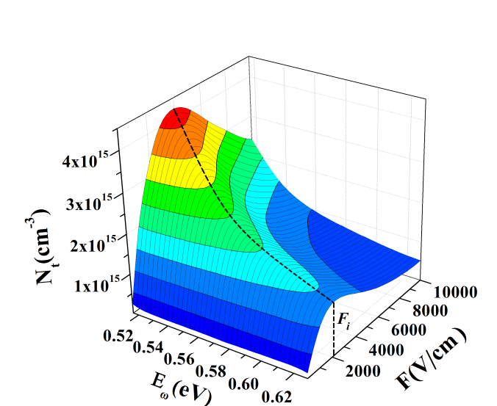
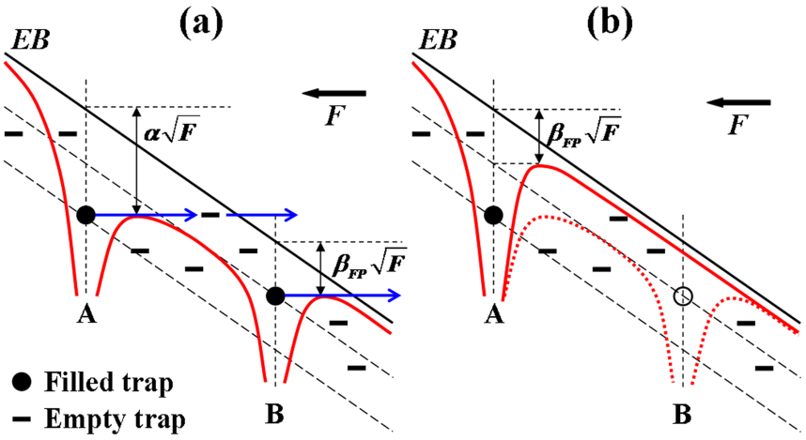
Device Physics: Study of the DOS of shallow traps
Frenkel Poole transport
Two Frenkel-Poole regimes:
F_{i} < F < Fc, a Frenkel-Poole-like with slopes of the curves > β_{FP}
F > Fc, a classic Frenkel Poole transport
F_{i} is the electric field separating trapping from detrapping
For F > F_{i}, an electric field parabolic dependence on energy appears
Electric Transport under DARK CONDITIONS shows a Frenkel-Poole transport only for F > Fc
The electric field is not able to detrap charge carriers for F<Fc because the traps are empty under dark conditions
It means that occupied states influence the electric field seen by an emitting charge carrier by effectively decreasing the energy barrier towards the extended band
M. Girolami, A. Bellucci, P. Calvani, R. Flammini, and D.M. Trucchi, Applied Physics Letters 103 (2013) 083502

Slide 6
Irradiation with Alpha Particles
The short penetration depth of alpha particles can be used to disentangle the transport of photo-electrons and –holes as a function of bias polarity
The drift velocity of electron and holes can be estimated from the related transit time in the bulk of the detector.
The mobility for electrons and holes can be consequently fitted
Data from Girolami, M. et al. Mosaic diamond detectors for fast neutrons and large ionizing radiation fields. Physica Status Solidi a-Applications and Materials Science 212, 2424-2430 (2015). https://doi.org:10.1002/pssa.201532191

Slide 7
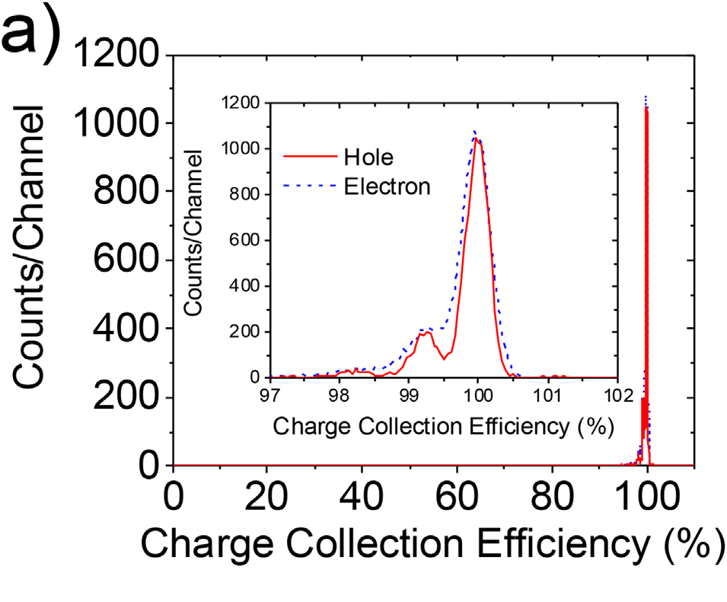
Irradiation with Alpha Particles
By considering the distance of the alpha-particle source from the detector, it is possible to reconstruct the mean flux of alpha particles impinging on the surface also in air.
Data from Hirano, S. et al. Substrate Effects on Charge Carrier Transport Properties of Single-Crystal CVD Diamonds and an 8 mm Square Radiation Energy Spectrometer. physica status solidi (a) (2018). https://doi.org:10.1002/pssa.201800333
By knowing the ionization energy in diamond (13.1 eV) and particle flux, it is immediate to reconstruct the CCE from the pulse statistics.

Slide 8
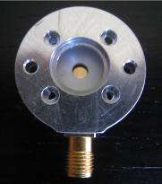
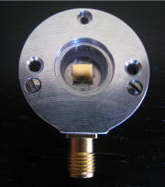
CVD Diamond Spectrometer for Alpha Particle Sources
 | Front | Back
+400 V | 4714 | 4725
-400 V | 4622 | 4783
Back-side irradiation
Front-side irradiation
Source-detector distance: 10.0 mm
Active area: 4 mm × 4 mm
Test pulse peak channel: 5850
Source-detector distance: 9.5 mm
Active area: 3 mm circular diameter
Test pulse peak channel: 5850
Average charge collection efficiency > 98 % @ F > 1500 V/cm
FWHM of the pulse (energy resolution) is about 1.5 %

Slide 9
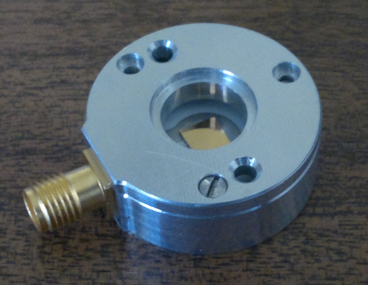
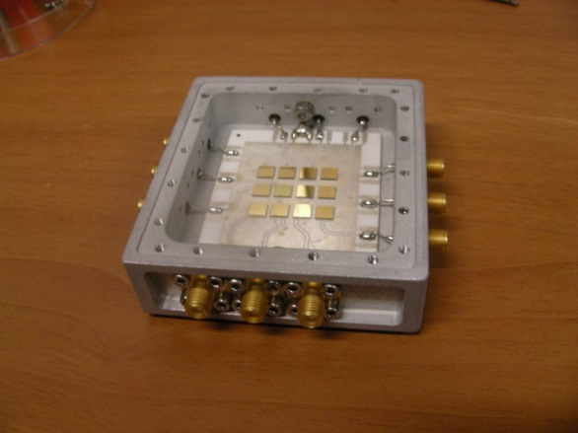
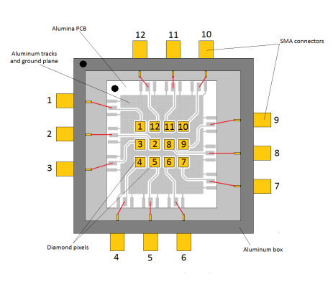


CVD Diamond Spectrometer
CVD Diamond detector is a compact and versatile solution for alpha and beta particles, fast neutron spectroscopy and time-of-flight.
Diamond radiation hardness, high radiation sensitivity, low dark current and high thermal conductivity allow room temperature spectroscopy as well as time of flight accurate measurements.
The development of the diamond technology for neutron detection was performed by the DiaTHEMA Lab of CNR-ISM (Rome)*,
in collaboration with CNR-ISTP (Milan) & Bicocca
For details:
“Pixelated Single-crystal Diamond Detector for fast neutron measurements”, M. Rebai et al., JoI 10 (2015) C03016.
“A diamond based neutron spectrometer for diagnostics of deuterium-tritium fusion plasmas”, C. Cazzaniga et al. Review of Scientific Instruments, 85 (2014) 11E101.

Slide 10
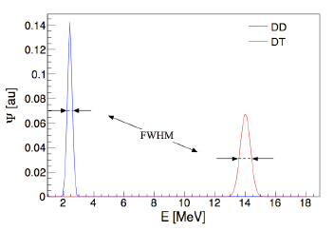
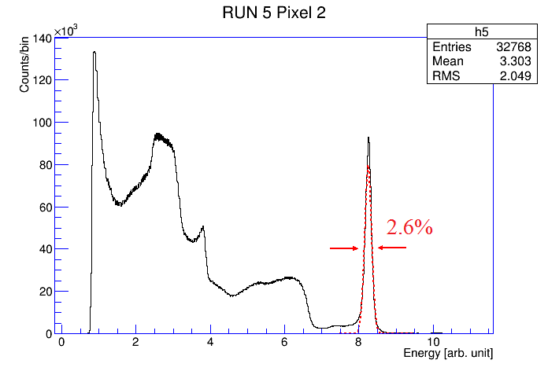

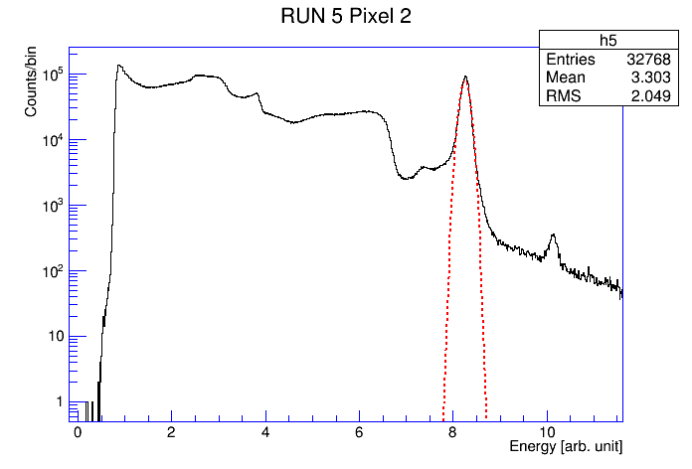

CVD Diamond Spectrometer for monitoring Thermofusion Plasmas
140 keV
DD neutrons → elastic scattering on carbon nuclei
DT neutrons → (n, a) reactions on carbon nuclei
¹²C(n, α)⁹Be (Q_{value}=5.7 MeV, E_{thr}=6.17 MeV) good for 14 MeV neutron spectroscopy.
¹²C(n, n’)¹²C* only possible for 2.5 MeV neutrons.
¹²C(n,n’)3a (Q_{value}= 7.23 MeV, E_{thr}=7 MeV)
¹²C(n, D)¹¹B (Q_{value}= 13.7 MeV, E_{thr}=13.8 MeV)
L Giacomelli et al., Rev. Sci. Instr 87(2016) 11D822
Log scale
The energy resolution achieved by CNR-ISTP is better than 1% at 14 MeV obtained with a system capable to operate at MHz counting rates.
The high energy side features about 1% sensitivity relative to the 14 MeV neutron peak

Slide 11
Thank you for the Attention!

