Slide 1
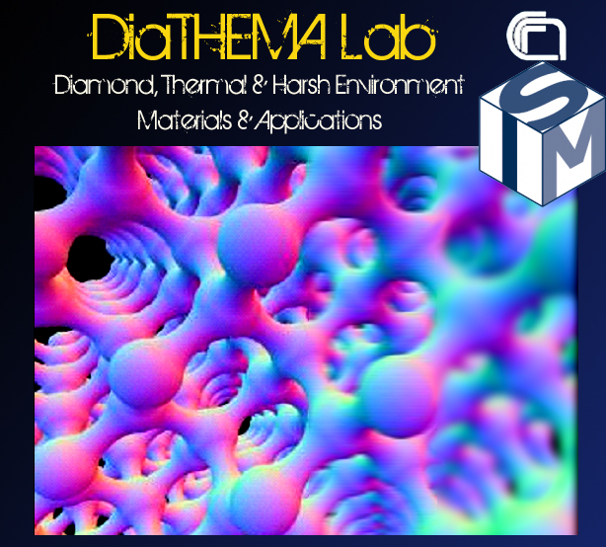
DiaC²Lab
Diamond and Carbon Compounds Laboratory
Experience with diamond metallization and
effect of non-ohmic contacts
Institute for Structure of Matter (ISM)
of the Italian National Research Council (CNR)
Rome, Italy
DiaTHEMA Lab is inside the CNR Research Area of Roma 1
Via Salaria km. 29,300 - 00015 Monterotondo Scalo (RM), Italy

Slide 2
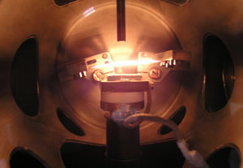
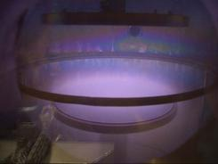

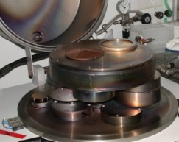
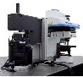
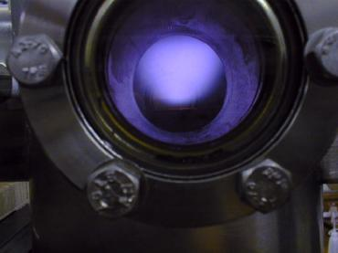
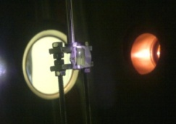
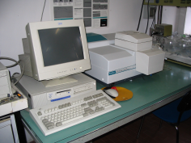

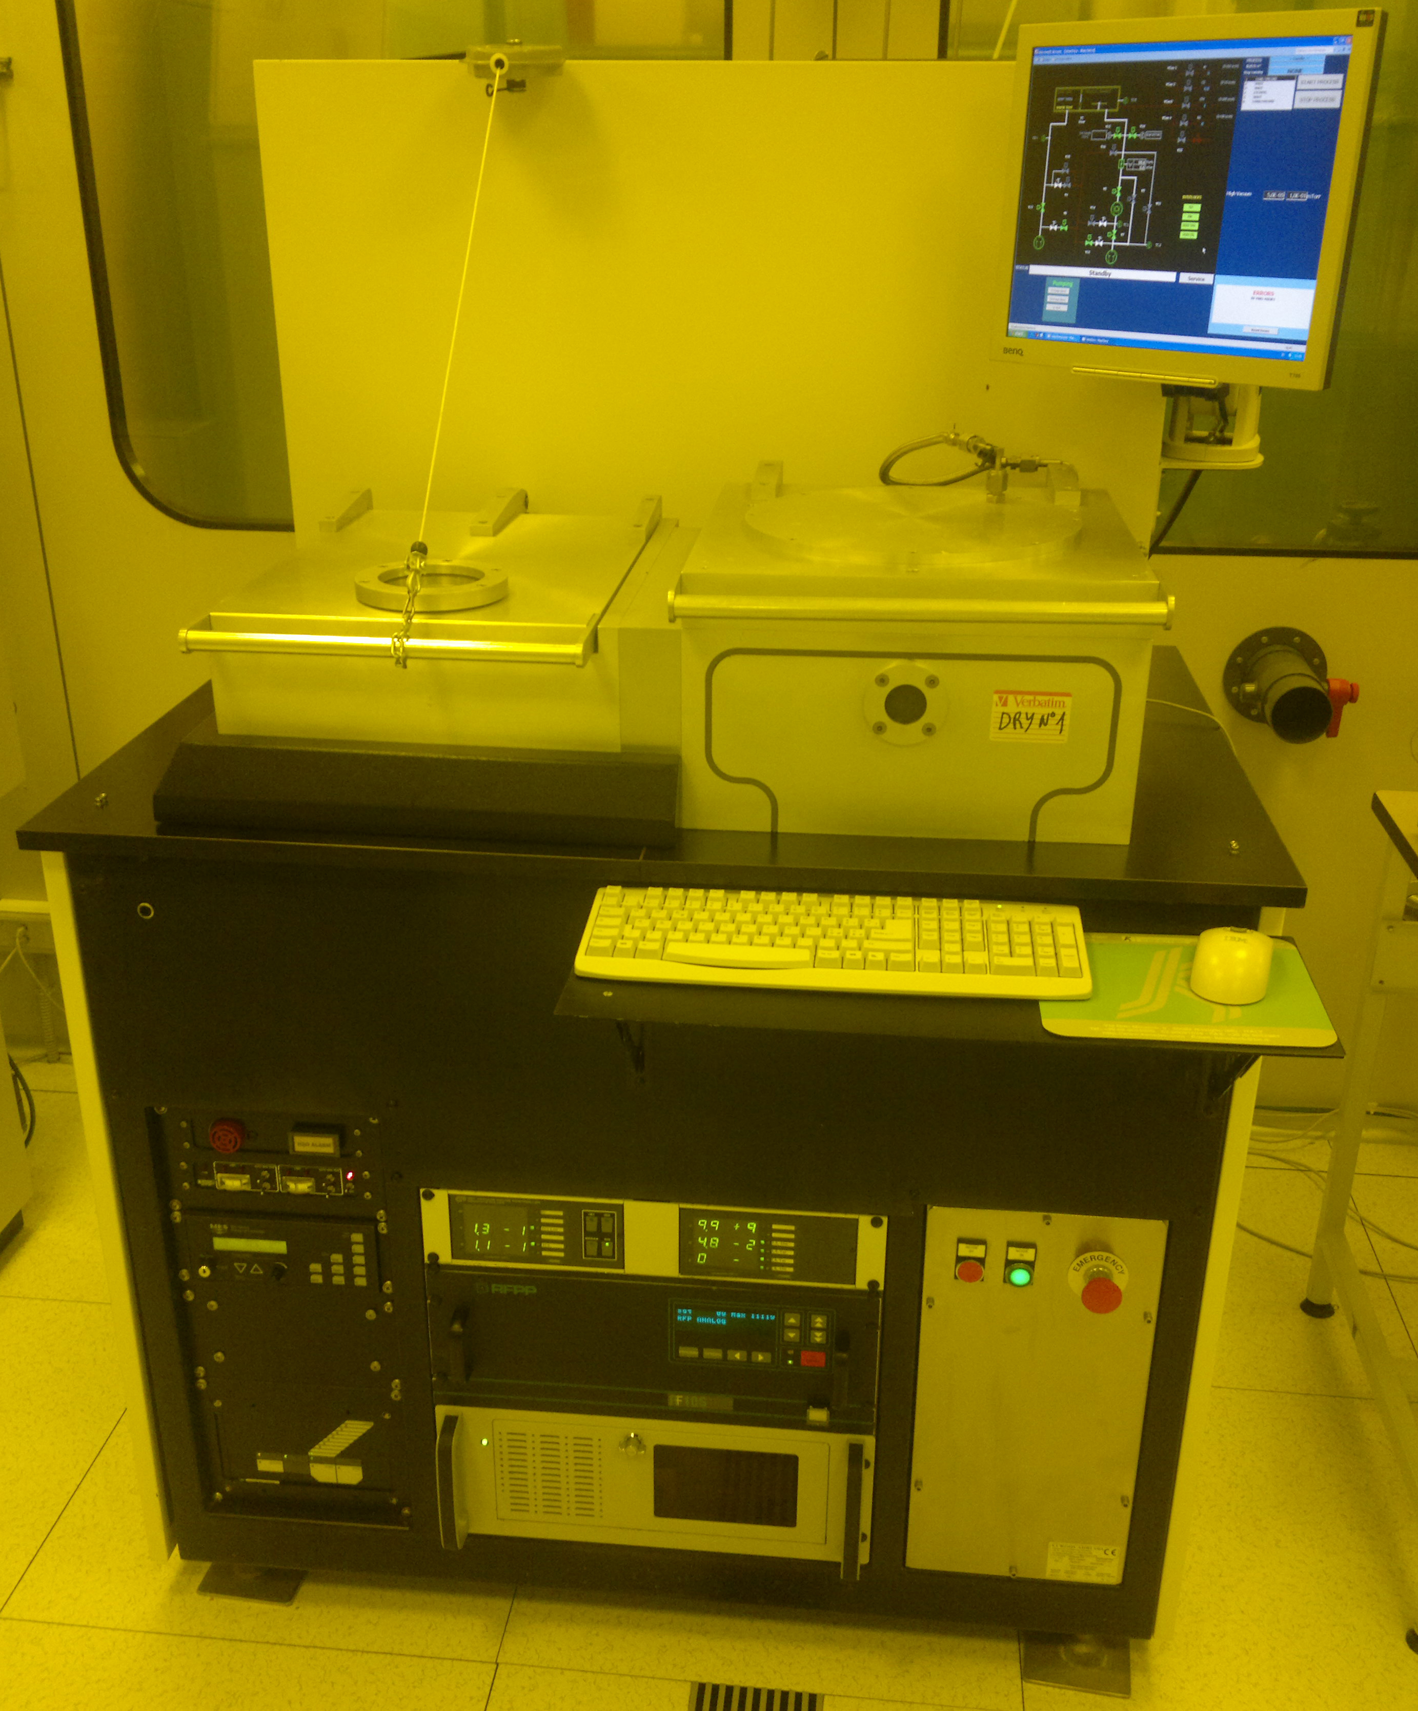
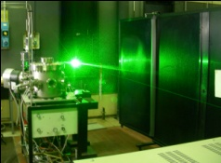

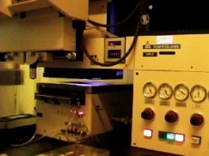
DiaTHEMA Lab Facilities
Material Production
Chemical-Physical Properties Characterization
Technological Processes
for Device Fabrication
MW-CVD
Surface Hydrogen Termination
Thermal Annealing (up to 750°C)
RF & DC Sputtering
Ti, Al, Cr, a-C, HOPG, WC, Ag, Au
Up to 300°C
Substrate bias
Wire bonding
Hot Filament CVD
Carbon-based film deposition (up to 4’’) on Si, Mo, Carbides
Raman & IR spectroscopy
Femtosecond Laser PLD & Treatments
3D Structures
Cutting and Drilling
Up to 600°C, RF Plasma Enhanced
Scanning probe microscopy
e⁻-beam evaporator
2.5 kW e-beam power
Up to 10 kV
Beam fine control
Microwave CVD ASTEX 1500 (2.45 GHz)
diamond film deposition (up to 4’’) on Si, Mo, Carbides
Nitrogen n-type doping
Hydrogen p-type surface doping
Spectral Photometry
(200-25000 nm)
Reactive Ion Etching (RIE)
3D Structures
1000 W RF Power (13.56 MHz)
Ar, O₂
Optical lithography
800 nm resolution
Up to 4” masks
Direct Writing System
Pulsed laser Ablation (PLD)
nanostructured thin-film deposition of carbon, carbides, refractory metals
(Excimer (ArF, KrF) & Nd:YAG, Femtosecond Ti:Sapphire)
Contact angle measurements
Microwire bonding

Slide 3
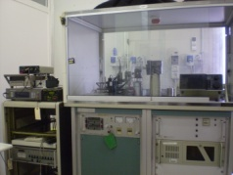
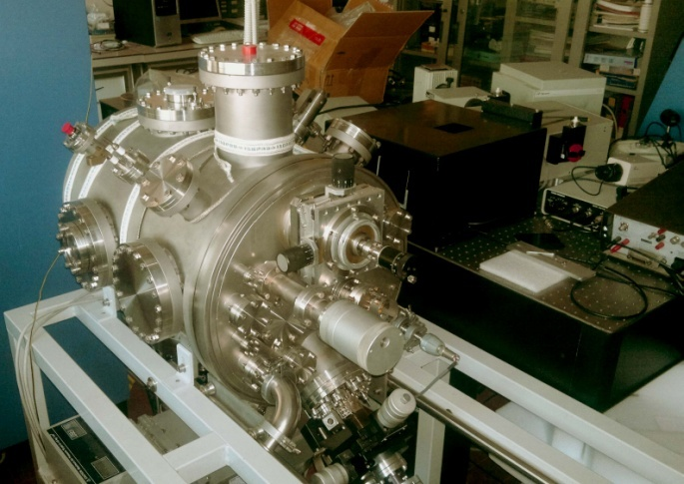
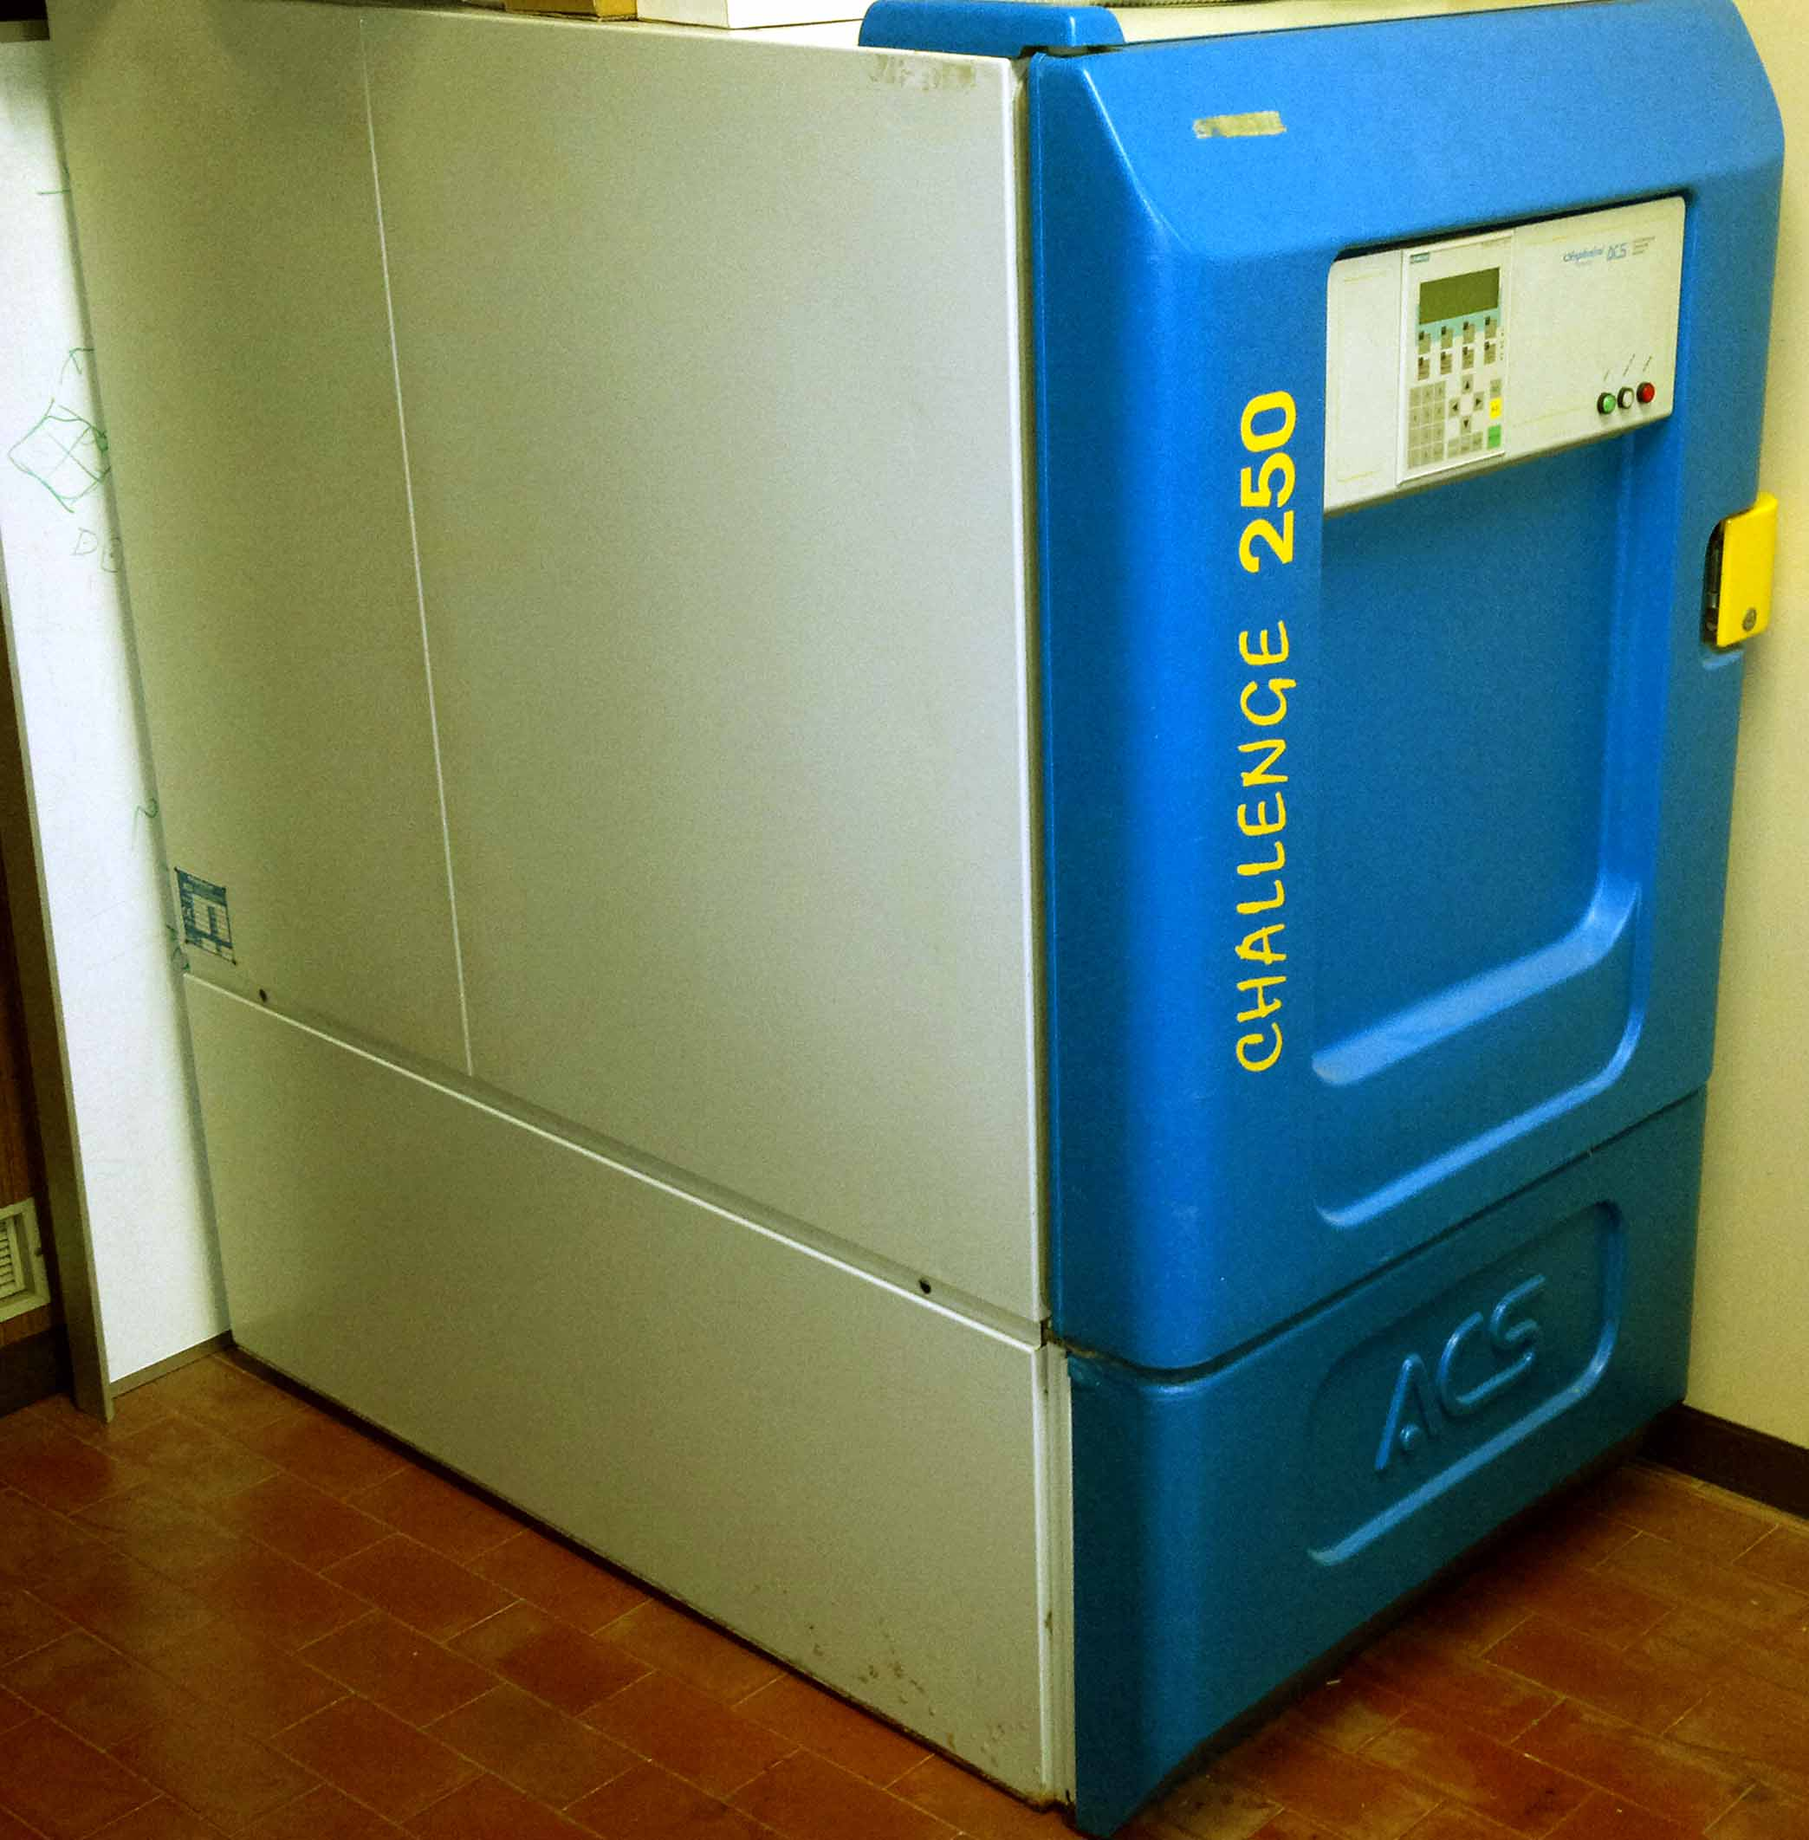
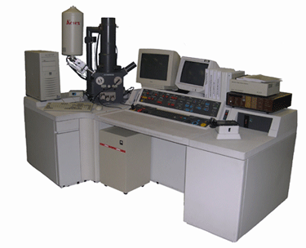
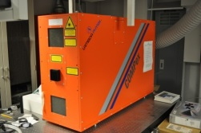
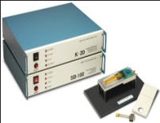
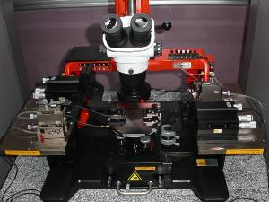

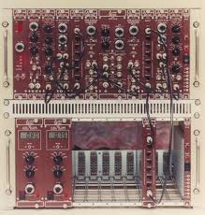
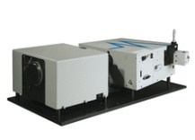
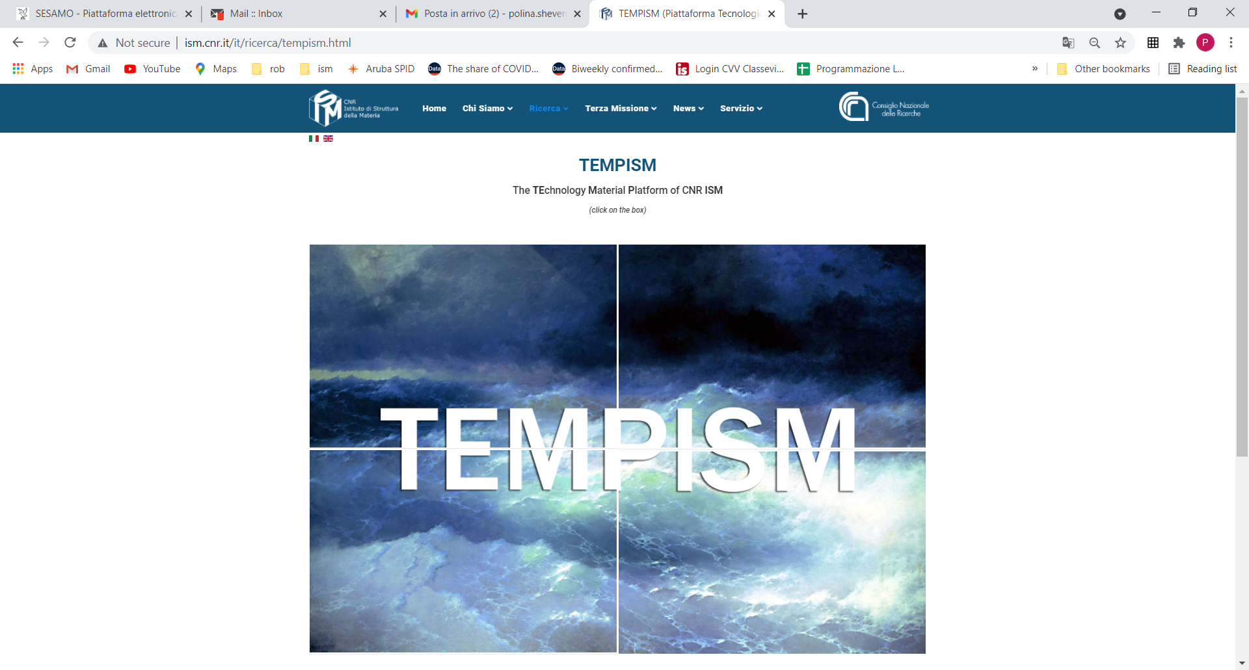
DiaTHEMA Lab Facilities
Characterization of
Device Performance
X-Ray Photoconductivity
Intensity resolved
Frequency modulated
Secondary Electron Emission Characterization Setup
Time resolved Photoconductivity
laser ArF, Yokogawa 500 MHz – 2 Gs/s
Climatic chamber analysis
T from -40 to 180 °C
Humidity value up to 98%
Burn-in
Ageing characterization
VTEC
Vacuum & Temperature Electronic Characterization
UHV 10⁻⁹ Torr
Thermionic Emission T = < 2300 K
  Electrode distance down to 30 ± 5 um
  Mass spectrometry in situ
  Rapid Thermal Annealing
UHV Field Emission
Photo-Thermionic Emission T = < 1000 K
Photoconductivity (200-1300 nm)
Total Photo Emission Yield (190 – 1150 nm)
I-V and C-V curves 77<T<800 K
Impedance Spectroscopy
Four Point Probe
Seebeck Effect Measurement System for Thermoelectric Characterization
Karl Suss Probe Station
Time of Flight *
CAEN A1423
²⁴¹Am alpha particles in vacuum.
Alpha & Beta Spectroscopy *
²⁴¹Am , ⁹⁰Sr
Ortec 142IH
Amptek MCA PX4
Ortec NIM
*collaboration with Univ. Roma Tre
Solar Furnace
Testing, Ageing, Annealing up to 2500 °C
Spectral (UV-Vis-NIR) Photoconductivity Setup
https://www.ism.cnr.it/it/ricerca/tempism.html

Slide 4
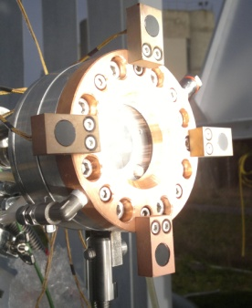
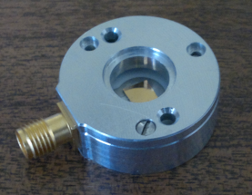

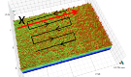

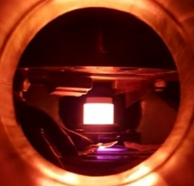
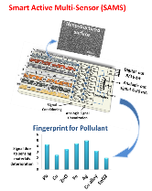

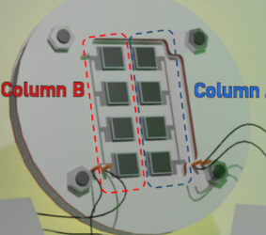
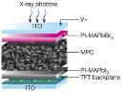
DiaTHEMA Lab – Main Active & Recent Projects
2010 - 2013 FP7-Energy Project E²PHEST²US – n. 241270
Thermionic-thermoelectric conversion module for solar concentrated systems
Scientific Coordination in charge of CNR
2013-2017 Fusion for Energy UE project
Development of CVD Diamond Neutron Spectrometers and 10 cm² Array for Neutron, in collaboration with CNR-IFP
2014-2018 FP7-ENERGY IRP Project STAGE-STE – n. 609837
Scientific and Technological Alliance for Guaranteeing the European Excellence in Solar Thermal Energy”
In collaboration with CNR-ISTEC, CNR-INO
2013-2016 FP7 FET-ENERGY Project ProME³ThE²US² - n. 308975
Photon-enhanced thermionic energy conversion technology for solar concentrated systems
2017-2018 H2020 FET-Launchpad Project DMS - n. 754568
Approach to the market activity for the Dielectric MicroSpacer technology
2017-2019 H2020 FET-OPEN Project AMADEUS – n. 737054
Next GenerAtion MateriAls and Solid State DevicEs for Ultra High Temperature Energy Storage and Conversion
2019-2022 H2020 NMBP Project APACHE – n. 814496
Active & intelligent PAckaging materials and display cases as a tool for preventive conservation of Cultural Heritage.
2021-2022 H2020 FET-Launchpad Project TECSAS n. 101034922
New CSP plants with scalability and high-efficiency.
2021-2022 Supply of Diamond Matrix Detector for ITER Radial Neutron Camera Diagnostics System Diamond matrix for high-temperature operations in ITER
2021-2022 Lazio Innova Project PARIDE n. 36698
Perovskite detectors for radiotherapy and radioprotection in medicine
2023-2025 PRIN 2022 TECHPRO n. 2022KXKR3S
Perovskite, III-V, diamond-based devices for photon-enhanced thermionic emission

Slide 5
Why Diamond as Active Material for Devices?
Wide band-gap semiconductor properties (5.47 eV) with very low electrical conductivity.
Excellent electrical properties (high carriers mobility and breakdown electric field).
The most resistant solid material.
The most thermal conductive material (4 times larger than copper and 3 times than silver).
UV, Visible light, IR blindness (down to 225 nm).
High electron emission capability (NEA, negative electron affinity).
The most radiation-damage resistant solid material.
Biocompatible and tissue-equivalent (Z=6).
Chemical inertness.
Property | Diamond | Silicon
Band-Gap Energy (eV) | 5.47 | 1.12
Intrinsic Electric Resistivity (Ω⋅cm) | >10¹⁵ | 3.2×10⁵
Thermal Conductivity (W⋅cm⁻¹⋅K⁻¹) | 20 | 1.12
Breakdown Electric Field (V⋅cm⁻¹) | >10⁷ | 3×10⁵
Electron Mobility (cm²⋅V⁻¹⋅s⁻¹) | 2100 | 1500
Hole Mobility (cm²⋅V⁻¹⋅s⁻¹) | 2500 | 600
Dielectric Constant (ε_{r}) | 5.7 | 11.9
Ionization Energy (eV) | 13 | 3.6
Energy to remove an atom from lattice (eV) | 80 | 28
Lifetime under intense irradiation (a.u.) | 10² | 1
Atomic number (Human Tissue = 6.5) | 6 | 14
Wide Band-Gap Semiconductor
Electrically Insulating & Thermally Conductive
Excellent electrical properties
High Radiation Damage Resistance:
Applications concerning use of high-energy radiation
Tissue-equivalent behavior

Slide 6
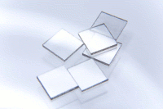
Single Crystal CVD Diamond: Homoepitaxy Deposition
HPHT Substrate
Low Cost Single Crystal Substrate
Highly defected (Ni, Fe, heavy metals)
MicroWaves
CH₄
H₂
Separation by
High-energy laser
Mechanical methods (Ir interface)
Diamond HTHP Substrate (700 – 800 °C)
Element Six Ltd’s monocrystalline CVD Diamond standard and electronic-grade samples
Diamond Detectors Ltd has got use exclusivity on electronic-grade samples until the end of 2010
 | Standard-grade Samples | Electronic-grade Samples
Lateral size | (4.6±0.1) × (4.6±0.1) mm² | (4.6±0.1) × (4.6±0.1) mm²
Thickness | 500 ± 50 μm | 500 ± 50 μm
Crystallographic Orientation of Surfaces | {100} ± 3 deg | {100} ± 3 deg
Surface roughness | <10 nm | <5 nm
Nitrogen concentration | <1 ppm | <5 ppb
Boron concentration | <0.05 ppm | <1 ppb
RT Electrons Mobility | 1714 cm²·V⁻¹·s⁻¹ | 2145 ± 30 cm²·V⁻¹·s⁻¹
RT Holes Mobility | 2064 cm²·V⁻¹·s⁻¹ | 2430 ± 45 cm²·V⁻¹·s⁻¹
Electrons Saturation Velocity | 0.96×10⁷ cm/s | 0.98×10⁷ cm/s
Holes Saturation Velocity | 1.41×10⁷ cm/s | 1.54×10⁷ cm/s
Customer Cost | 190 €/film | ~1000 €/film
N and B concentration 200 and 50 times less, respectively
R&D challenge is focused, at a R&D level, on developing device structures able to maximize the performance of the specific device
Carriers mobility larger than 25%, saturation velocities larger than 2-10%

Slide 7
Metallizations
A metal on diamond surface has to:
adhere stably and be mechanically resistant
be stable at the operating temperature and ambient atmosphere
guarantee compatibility with other metal layers in case of wire-bonding (e.g., with gold as topping)
form a diamond/metal junction with null barrier height (i.e., ohmicity)
be thin enough not to perturb the monitored radiation in case of detectors
Ti
Cr
Co
Mo
Pd
Post-annealing of metals forming ultra-thin carbide layers at the diamond/metal interface
Koide, Y. Metal–diamond semiconductor interface and photodiode application. Applied Surface Science 254, 6268-6272 (2008). https://doi.org:10.1016/j.apsusc.2008.02.157
The low barrier height of 0.5 eV is independent from the metal work-function (i.e., metal type) since carbides have similar electronic structure on diamond surface
Werner, M. Diamond metallization for device applications. Semiconductor Science and Technology 18, S41-S46 (2003).

Slide 8
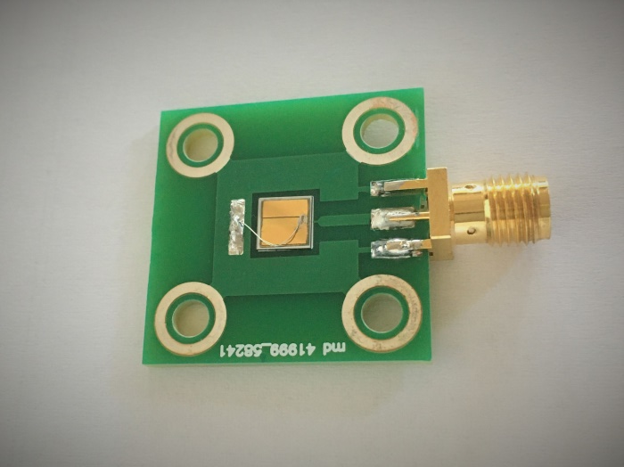
Metallizations - DLC
Me, 100 nm
Au, 100 nm
DLC, 1-3 nm
A diamond-like-carbon (DLC) ultrathin layer can have the same role of carbides
Galbiati, A. et al. Performance of Monocrystalline Diamond Radiation Detectors Fabricated Using TiW, Cr/Au and a Novel Ohmic DLC/Pt/Au Electrical Contact. IEEE Transactions on Nuclear Science 56, 1863-1864 (2009).
CVD Diamond
DLC, 1-3 nm
Me, 100 nm
Au, 100 nm
We develop the DLC layer by bombarding in a short time the diamond surface by metal ions in a sputtering system.
After that, deposition of the metal is performed and final gold layer to facilitate wire-bonding.

Slide 9
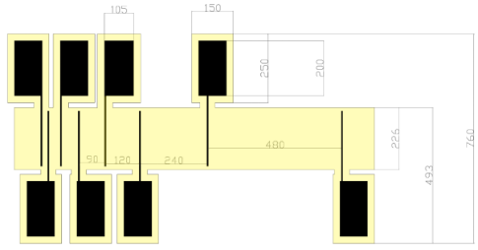
Effects and characterization of ohmicity
I(V) Characteristics
Transfer Length Method TLM
DLC/Ag/Au
NOT annealed
Ti/Au contact

Slide 10
Effects and characterization of ohmicity
Open circuit voltage under irradiation
Drift of signal under intense irradiation
DLC/Ag/Au
Voc = 0.04 V
Polarization is caused by a progressive accumulation of charge underneath the irradiated electrode, establishing a counter-field that progressively weakens the action of the electric field created by the applied bias voltage
(collaboration with CNR-ISTP in Girolami, M. et al. Mosaic diamond detectors for fast neutrons and large ionizing radiation fields. Physica Status Solidi a-Applications and Materials Science 212, 2424-2430 (2015). https://doi.org:10.1002/pssa.201532191)
Al/Au contact
The open-circuit voltage increases of an order of magnitude when Al/Au contacts are fabricated
Girolami, M. et al. Self-powered solar-blind ultrafast UV-C diamond detectors with asymmetric Schottky contacts. Carbon 189, 27-36 (2022). https://doi.org:10.1016/j.carbon.2021.12.050
Voc =
0.35 V

Slide 11
Thank you for the Attention!

