Slide 1
Microstrip sensor production at FBK
Benno Margesin

Slide 2
Introduction
Initial specifications
Frontside electrodes with 20 µm minimum feature size
Backside metallization with only coarse alignment requirements
Metallization in aluminum or nickel
Substrate: sapphire 110 µm and 150 µm
Possible challenge
Transparent wafer vs automatic handling
Real challenge
Substrate size 2” only manual processing and limits on available machines and processes

Slide 3
First fabrication run DZ1
The device and the wafer layout was prepared with Tanner Tools™
A wafer handling jig was fabricated by UniPd used as wafer holder and shadow mask for the back metallization
Summary process flow
Rinsing
Evaporation of 300 nm aluminum
Lithography of the microstrips
Manual resist processing
Litho with mask aligner
Wet aluminum etching
Ashing
Evaporation of 200 nm aluminum on the back with shadow mask
5 wafers processed, one without sintering, 3 with sintering and one lost

Slide 4
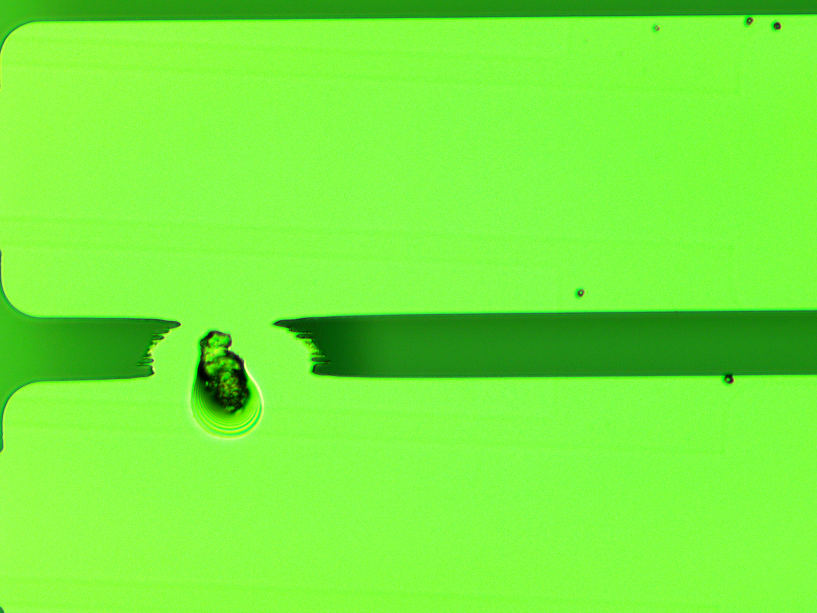
First fabrication run DZ1 cont.
Processing issues
Shift of the wafer during exposure. Alignment disc is not precise (mask aligner cannot align on the wafer itself)
Rotation and shift in the jig for shadow evaporation
Outcome and problems
Definition of the structures was ok as expected
Main defects were shorts caused by particles on the wafer due to poor cleanliness of the substrates

Slide 5
First fabrication run DZ1 cont.
Removal of shorts with FIB
On a few wafers an attempt was made to remove the shorts using a Focused Ion Beam
This was partially successful
Hard to find the defects in this large dies
Some shorts were very persistent

Slide 6
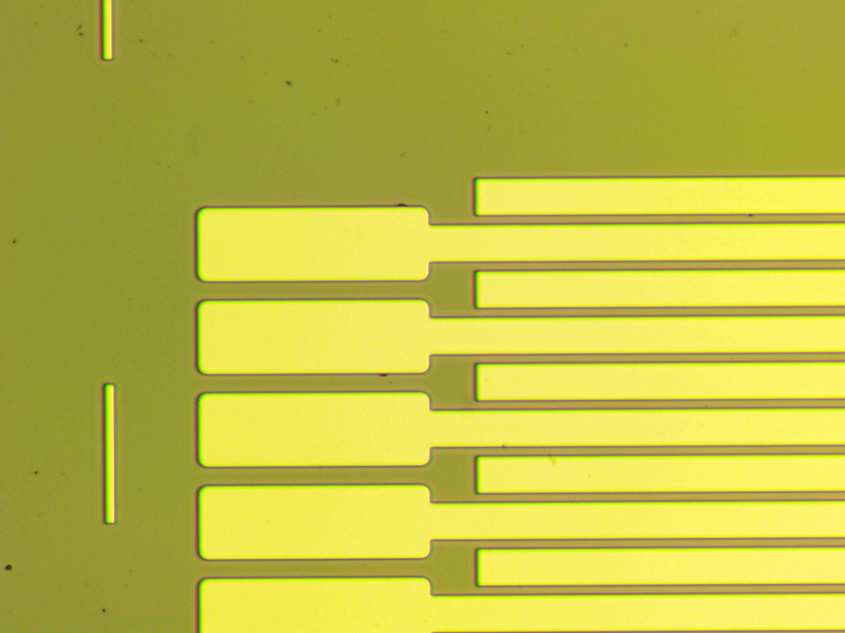
2nd Fabrication run DZ2
Summary process flow
Piranha only clean
Oxygen plasma clean
Evaporation of 30/300 nm of Cr/Al
Lithography
Wet etching & Ashing
Evaporation of 30/200 nm Ti/Al on the back with shadow mask
Sintering at 200 °C 30 min
1 wafer processed
Results
Definition is Ok
Improved adhesion
Much reduced shorts due to better wafer cleaning
Opens due to air bubbles in the photoresist

Slide 7
Third fabrication run DZ3
Summary process flow
First clean with air gun
Piranha only clean followed
Oxygen plasma clean
Evaporation of 30/300 nm of Cr/Al
Lithography
Wet etching & Ashing
Evaporation of 30/200 nm Ti/Al on the back with shadow mask
Sintering at 200 °C 30 min
2 wafer processed
Results
Similar outcome as with DZ2
Air gun cleaning removes more particles
Issues with air bubbles in the photoresist still persisted

Slide 8
Conclusions and Suggestions
Major issues encountered
Centering of the mask on the 2” wafer is difficult
This affects mainly the overlap with the back metal
Initial cleanliness of the wafers affects the lithography generating shorts
Bubbles in the resist (responsible for opens) can hardly be avoided due to the manual resist processing
In summary not being fully equipped for working on 2” substrates is a major handicap
We can not fully exploit our capabilities
The whole work is more cumbersome
The use of standard 6”(150 mm) substrates could substantially improve fabrication
Better cleanliness
Much improved resist processing
Possibility of using dry etching
Substantial higher throughput

