Slide 1
Status and plans for the study of X-ray polarimetry
E. Baracchini¹, E. Costa², G. Dho³, F. Di Giambattista¹, A. Di Marco², D.Fiorina¹, D. Marques¹, G. Mazzitelli³, F. Muleri², A. Prajapati¹, P. Soffitta², S. Torelli¹
1) GSSI & INFN
2) INAF/IAPS
3) LNF

Slide 2
High Yield Polarimetry Experiment in X-rays
HypeX - Funded by PRIN2020
Collaboration with INAF
Goal
  Use a CYGNO-like detector to measure the polarization of Xray from cosmic sources – GSSI & LNF
  Use different readout methods (TimePix) to improve GDP (IXPE GEM currently on data taking) performances - INAF/IAPS
Summary:
IXPE
Xray polarimetry & methods
Directionality capability of CYGNO-like TPC
Future plan

Slide 3
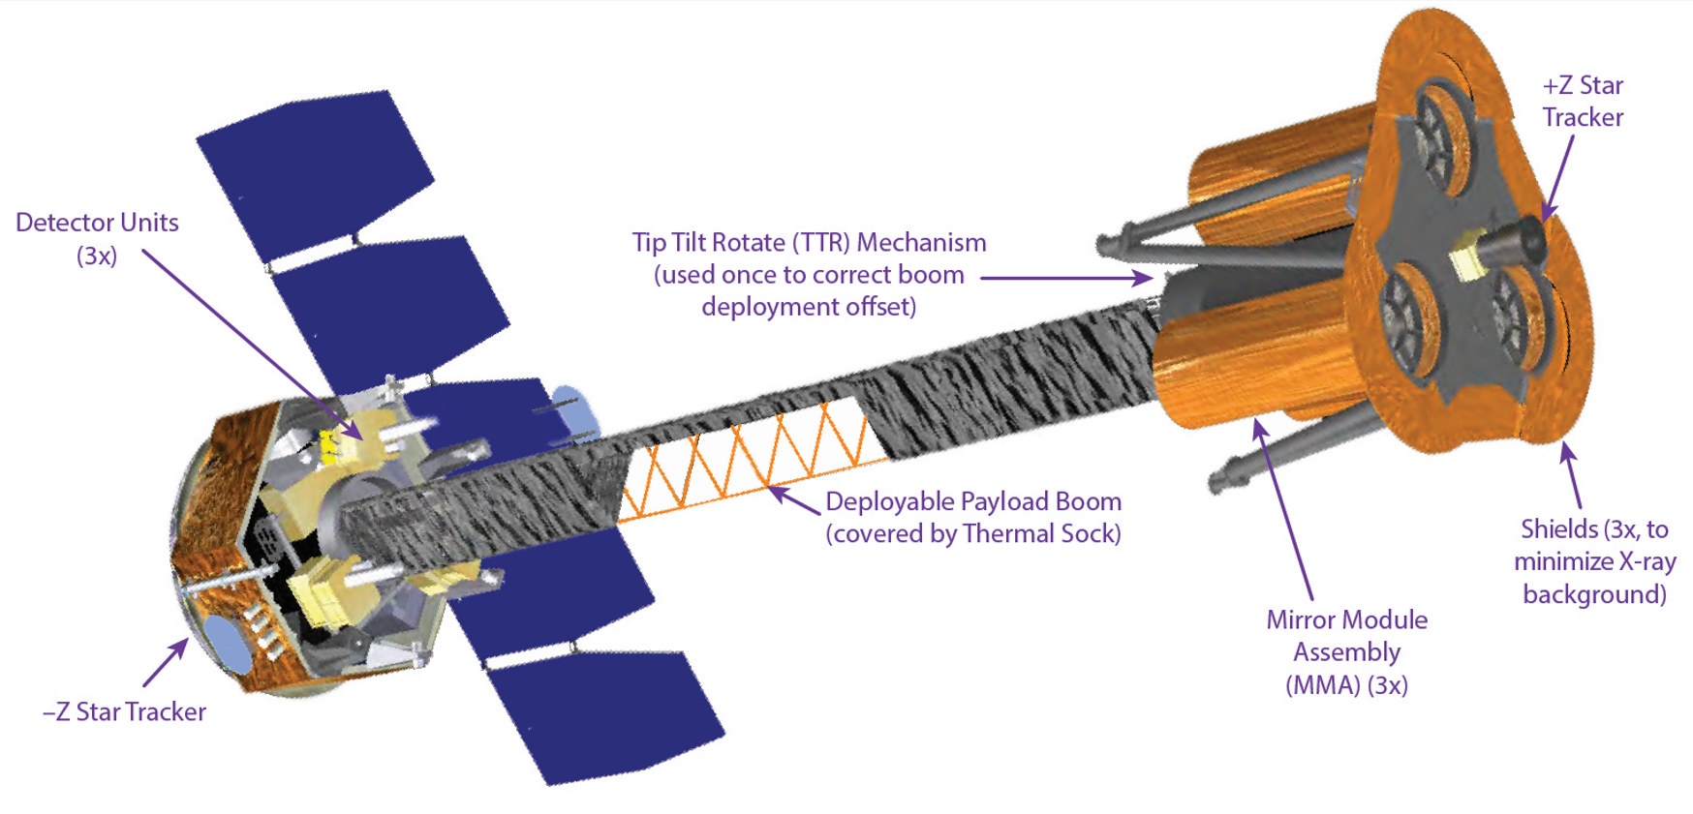
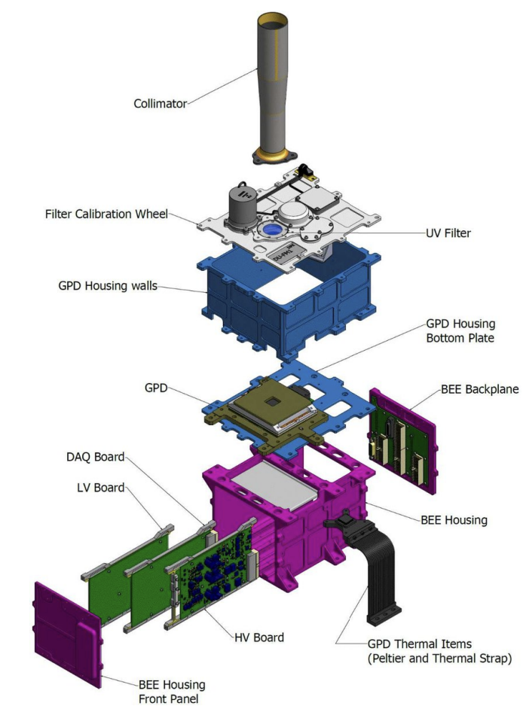
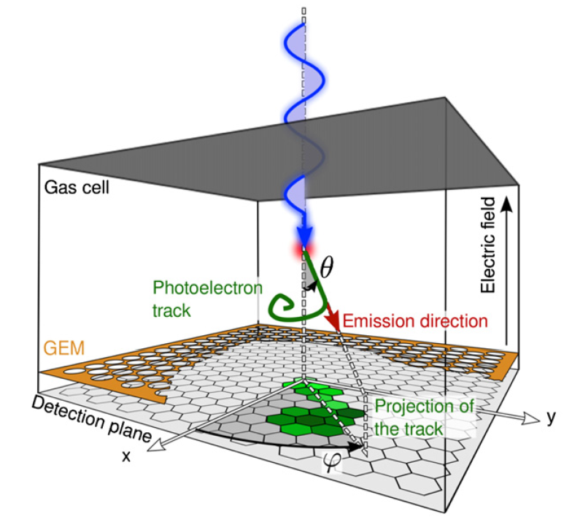
IXPE mission
First dedicated satellite to Xray polarimetry
3x Telescopes
3x Mirror Units (MUs) + 3x Detector Units (Dus)
A Detectors Service Unit (DSU) with built-in redundancy
4 m focal length, deployable boom, and X-ray shield
GPD is a single GEM detector operated in pure DME 800mbar
Performance :
Polarization sensitivity: MDP_{99%}<5.5% in 1 day for flux 10⁻¹⁰ ergs/cm²/s
Energy range 2-8 keV
Angular resolution: better than 30 arcsec, field of view larger than 9 arcmin
UTC synchronization: better than 250 μs
Energy resolution: better than 25%

Slide 4
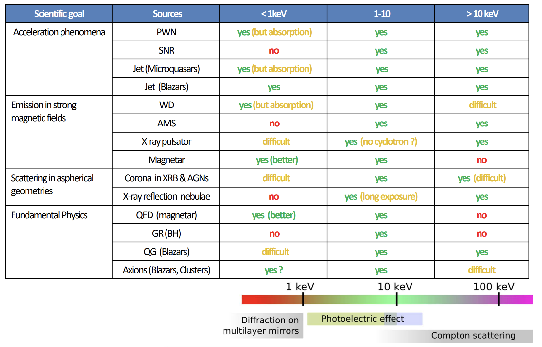
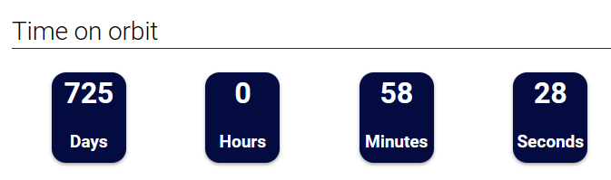
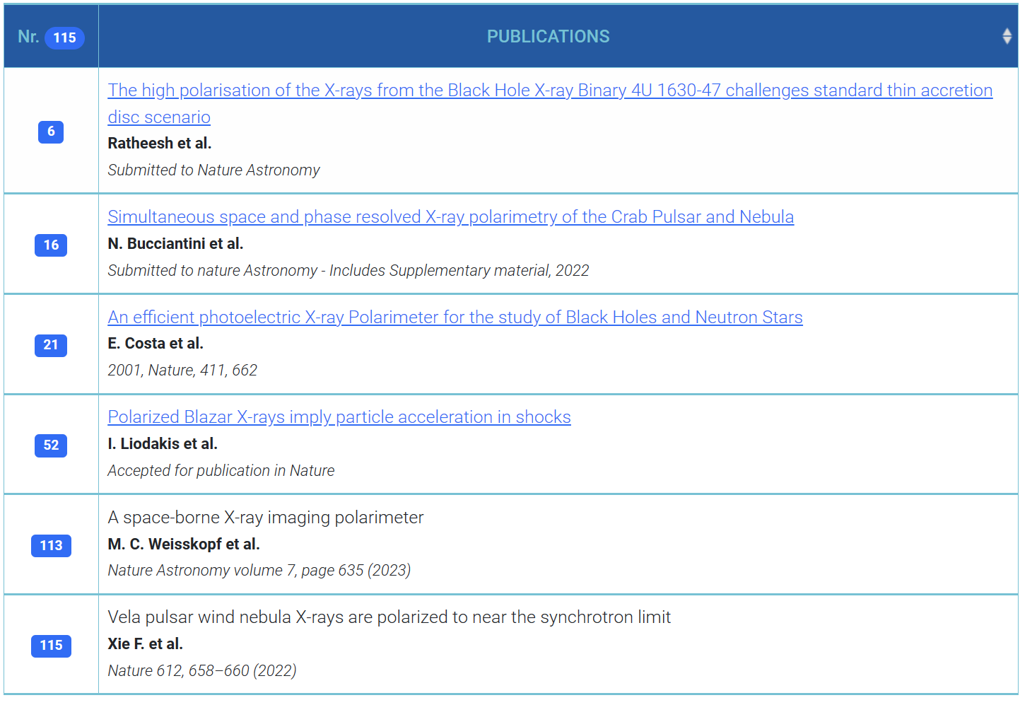
Astronomical Sources and Physics sectors
IXPE - Imaging X-ray Polarimetry Explorer (inaf.it)
SOFFITTA_XPE_TEXAS_2015.pdf (cern.ch)

Slide 5

From a LIME Underground to a MANGO in space

Slide 6
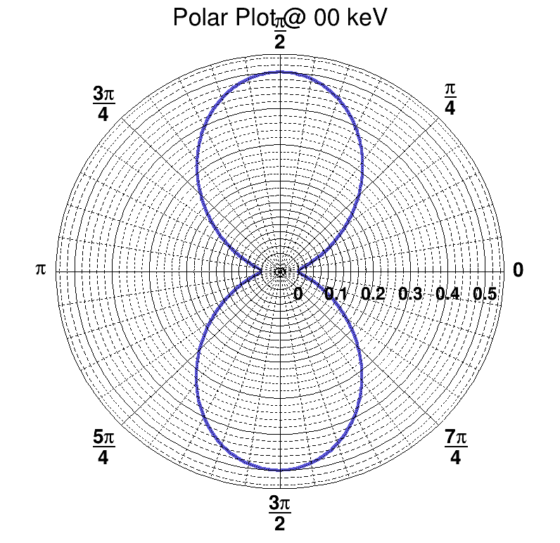
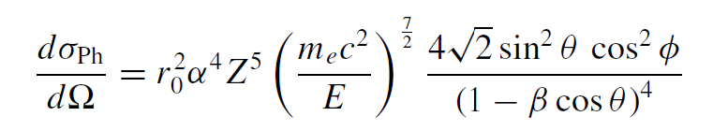
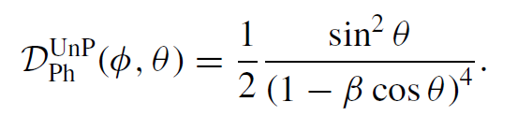
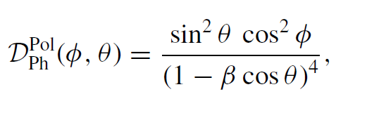
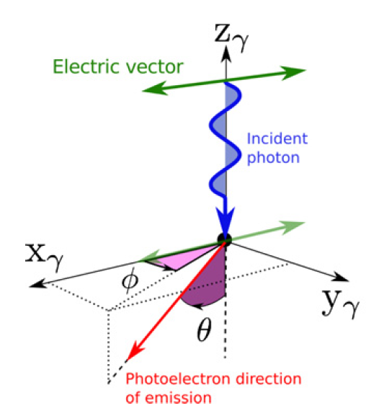
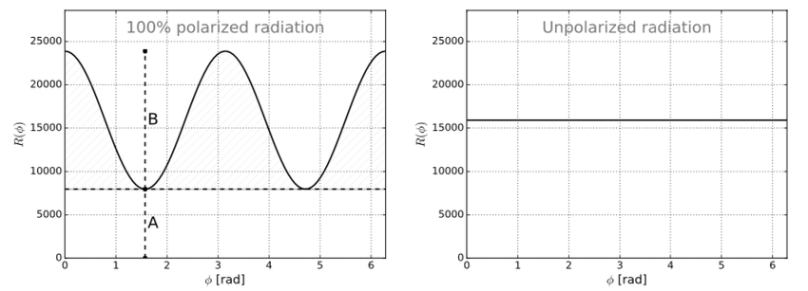
Photoelectric effect
Valid only for spherical symmetric shells!
Usually true since PE is dominant on inner shells that are spherical
θ emission distribution (common on Pol and UnPol)
Unpolarized photons
Linearly polarized photons
Φ emission distribution modulated on Xray Polatization
fiorotto8/AngularProbabilityPhotoelectric (github.com)

Slide 7
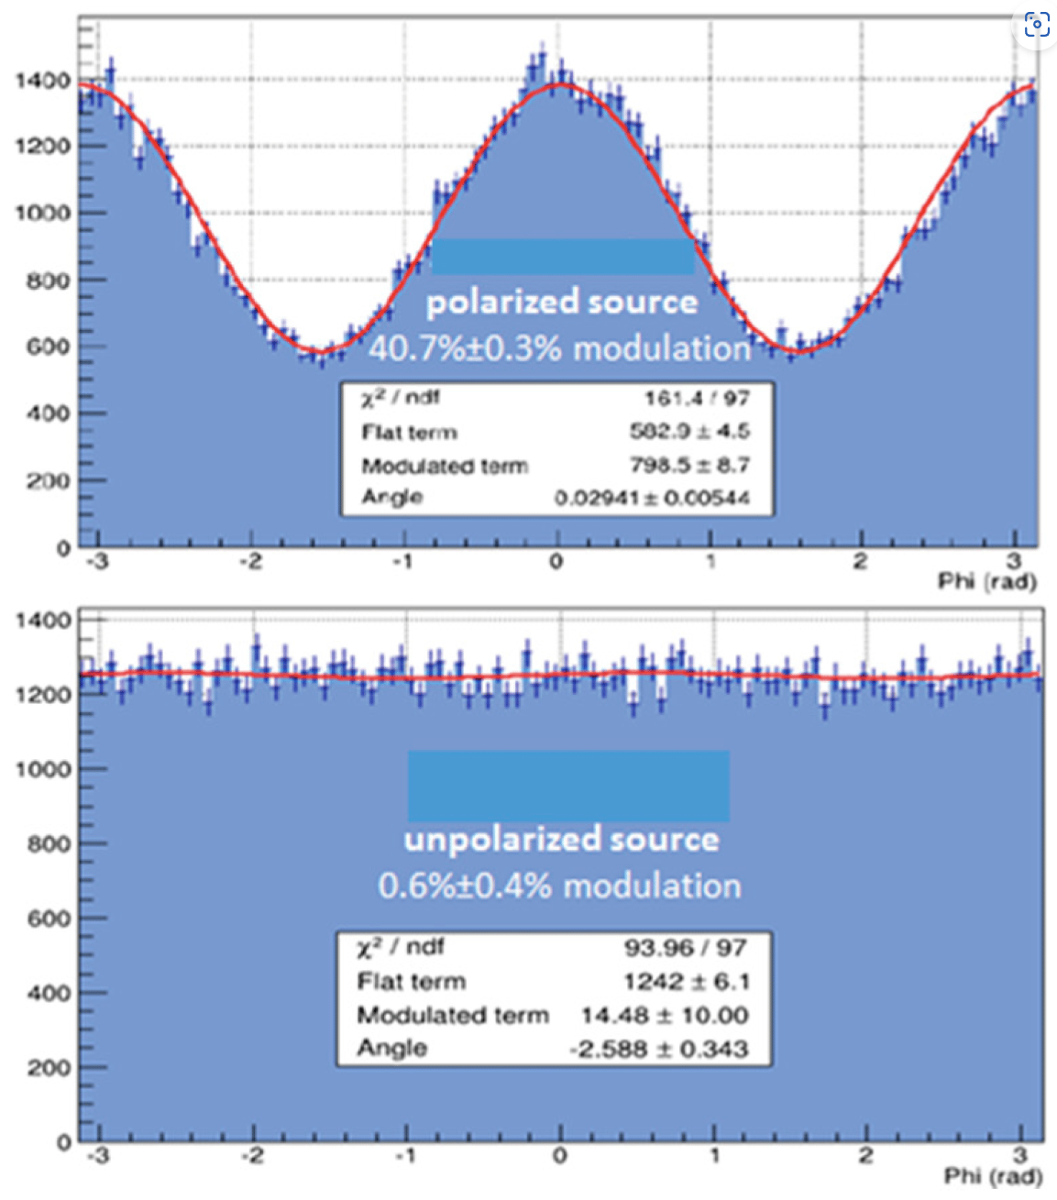
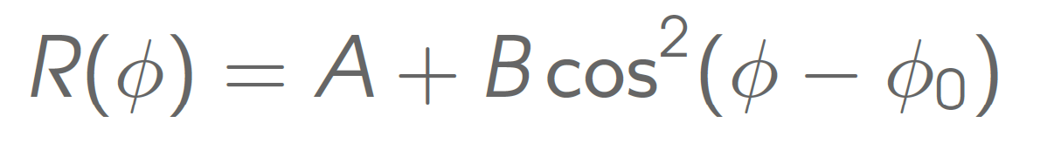
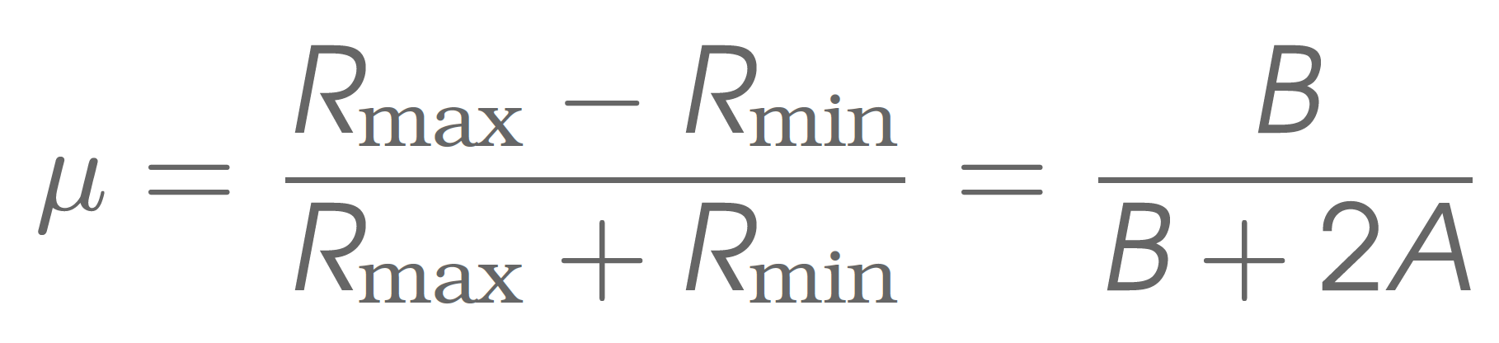
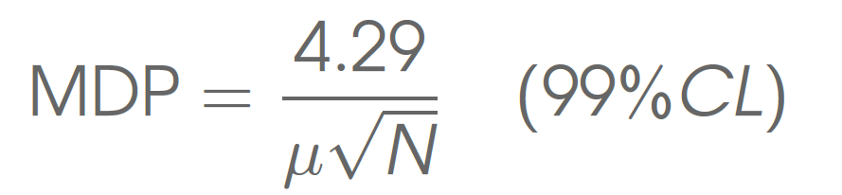
Photoeletron directionality and Xray polarimetry
Doing X-ray Polarimetry means doing electron directionality! (also, energy is essential)
Reconstruct the photoelectron angular distribution to get some modulation in the azimuthal angle
Modulation factor: response to 100% polarized radiation:
Minimum Detectable Polarization (MDP) with no background:

Slide 8
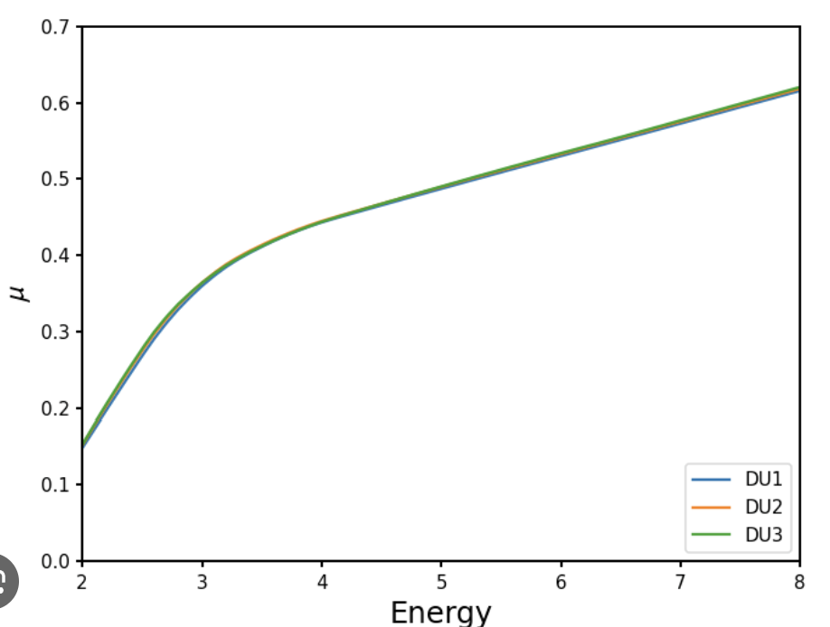
Photoeletron directionality and Xray polarimetry
Doing X-ray Polarimetry means doing electron directionality! (also, energy is essential)
Reconstruct the photoelectron angular distribution to get some modulation in the azimuthal angle
Modulation factor: response to 100% polarized radiation:
Minimum Detectable Polarization (MDP) with no background:
IXPE modulation factor

Slide 9
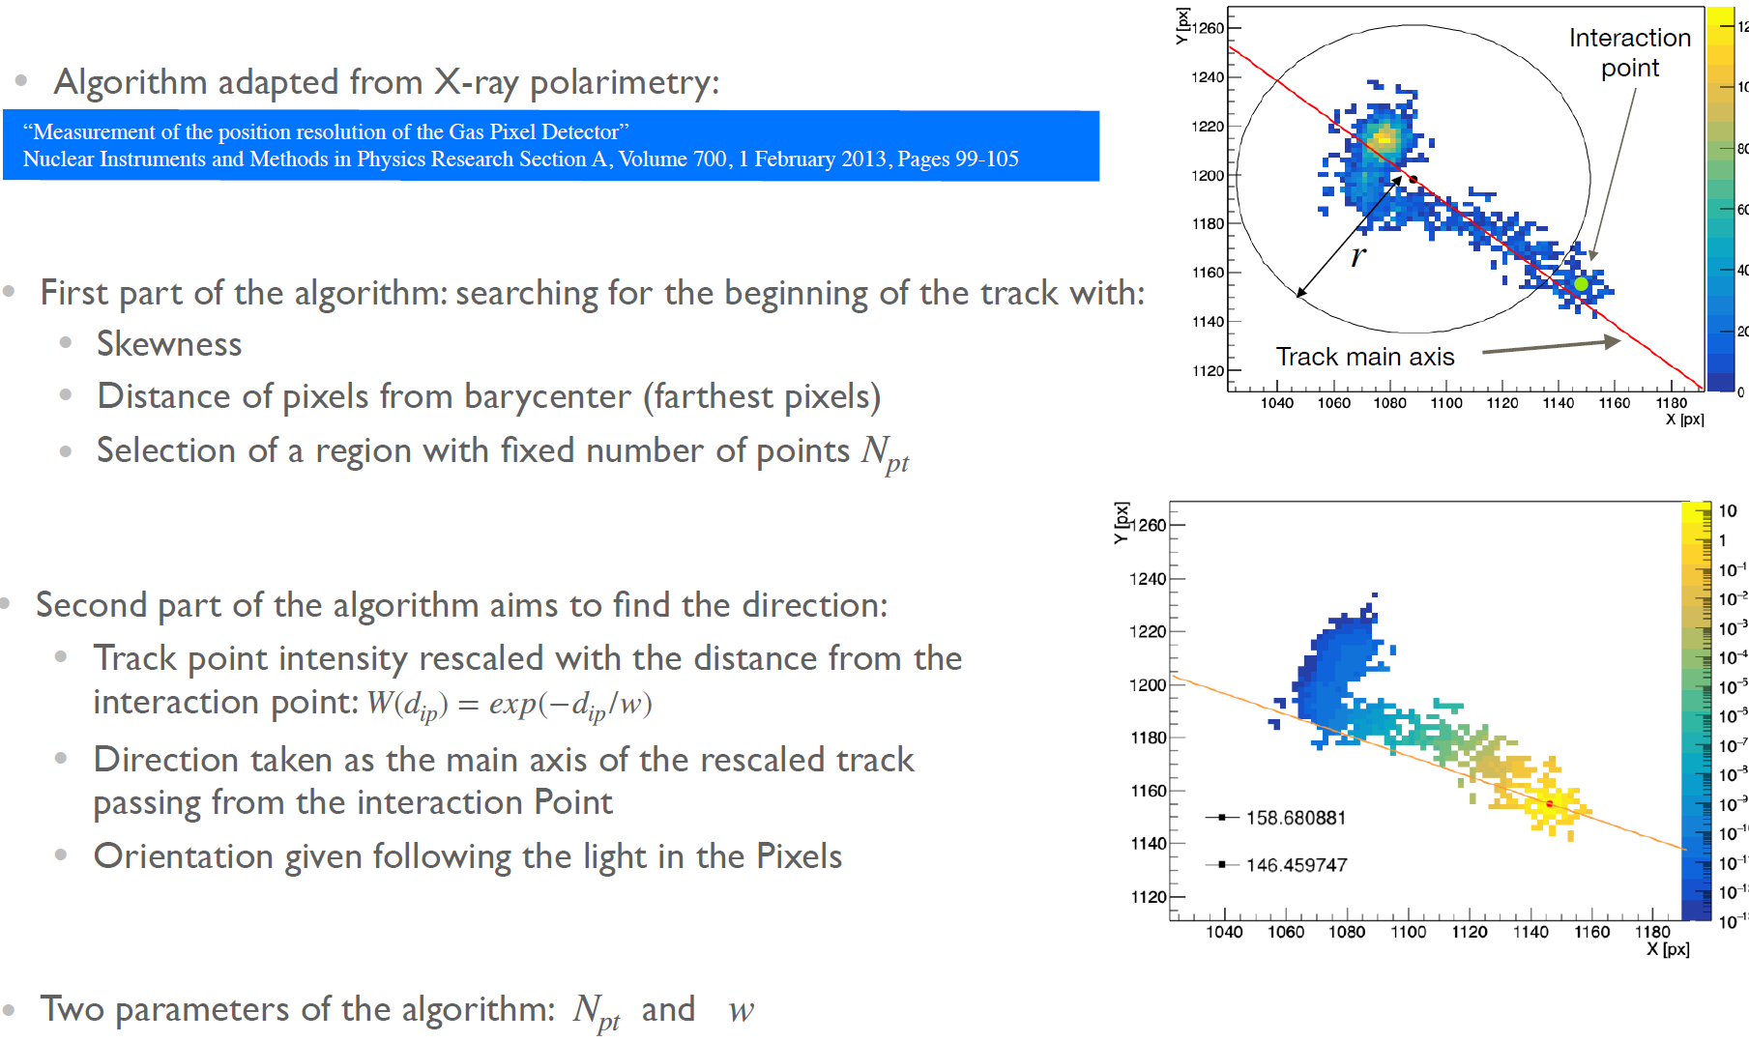
Reconstruction & Directionality
To do X-ray polarimetry, you need to reconstruct the impact point of the X-ray and its direction!
Let’s start with CYGNO simulation
Samuele applied the IXPE algorithm for directionality to electrons simulated and digitized in LIME

Slide 10
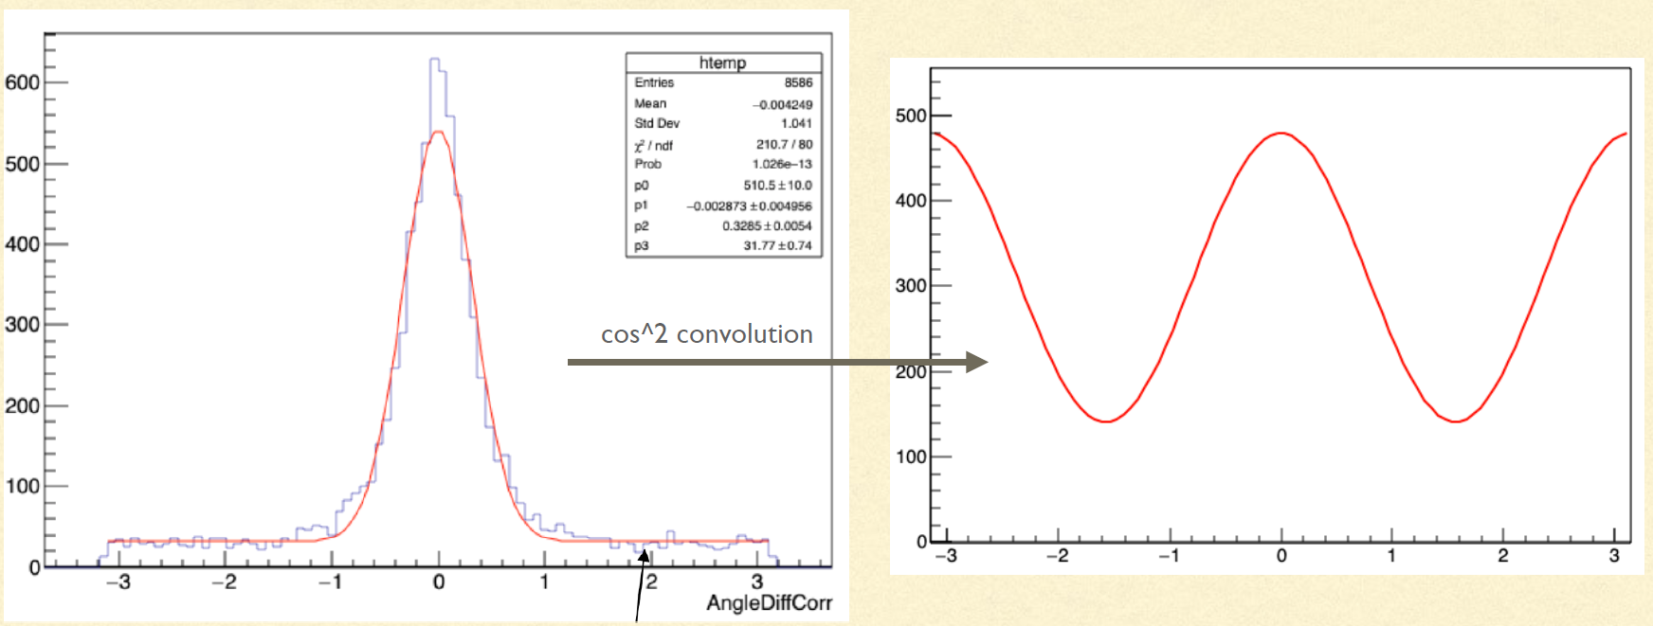
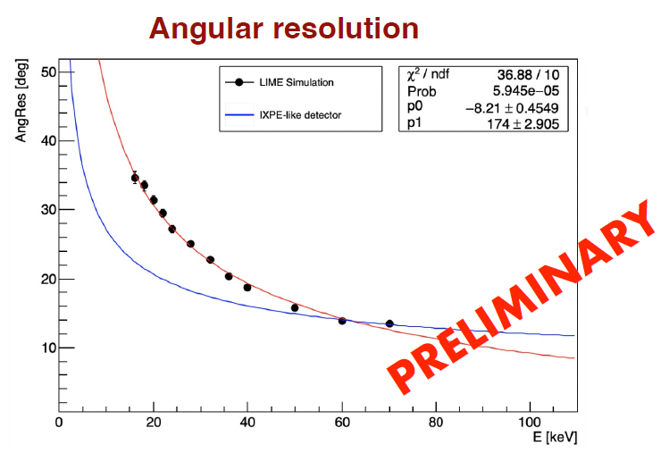
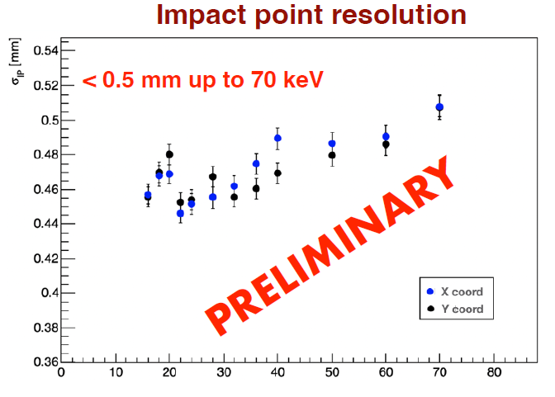
Reconstruction & Directionality
Simulated and digitized Electron tracks in LIME range of 15-70 keV (Samuele’s Thesis)
Directionality code for IP and direction
From angular distribution, you may apply a cos² convolution to simulate linearly polarized Xrays
Then you can measure the Modulation factor!

Slide 11
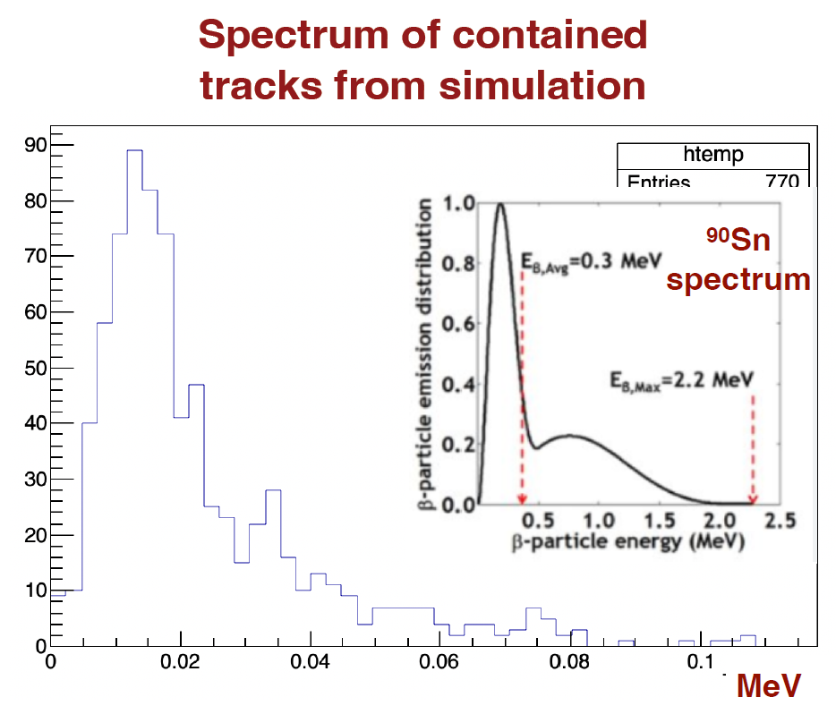
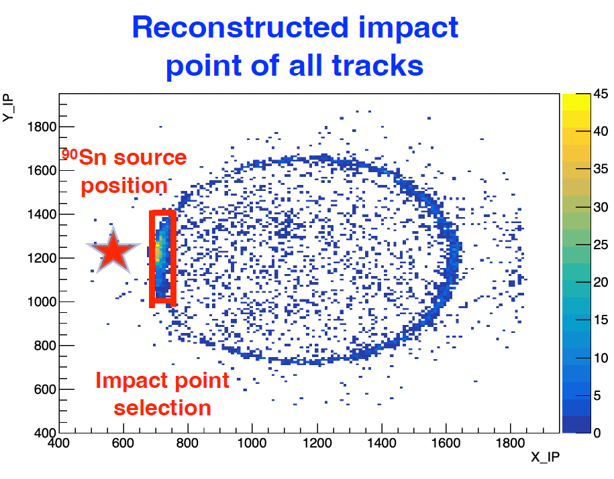
First test @ INAF
Collimated ⁹⁰Sr source
Simulation and measurement of electron tracks
The detector was not operated in the appropriate condition (Gain saturation)
However, there is quite a good agreement with the simulation
PRELIMINARY!

Slide 12
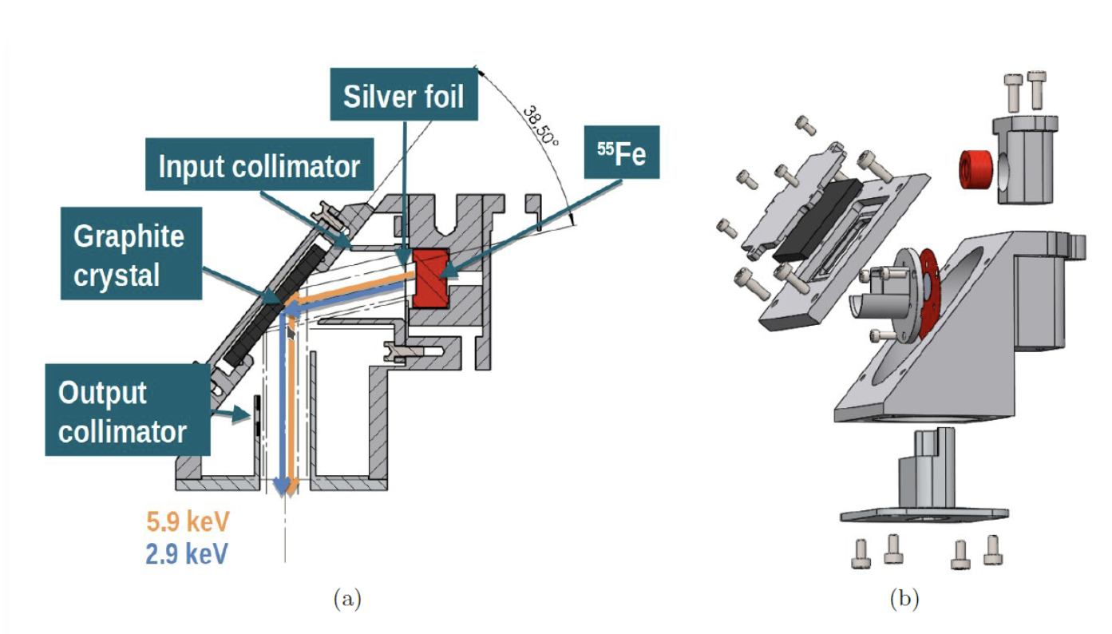
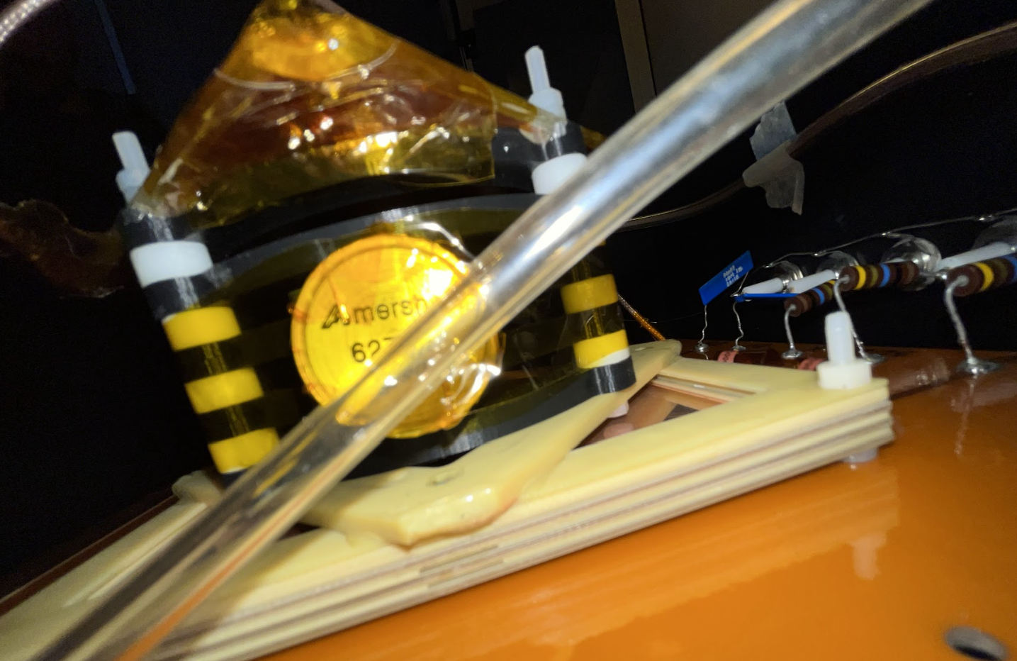
Future Plan
Collimated 90Sr source (with a good working detector!)
Polarized Xray source
  Source/crystal can be changed and determine the energy of the emitted Xrays (both Xray gun and source)
  In crystals, Bragg diffraction ≈45°→ the direction of linearly polarized Xrays
  We would need sources with higher energies → to be discussed with INAF colleagues
Gas Studies (Ar, Ne, He with CF4 comparison)
  Diffiuson measurement with different gases
  Simulation & measurement
Different Amplification Stages:
  Minimize the diffusion and extend the energy range
  MMGEM (THGEM with embedded mesh) – Available
Other approaches to directionality
Di Marco et al. Calibration.pdf (inaf.it)

Slide 13
BACKUP

Slide 14
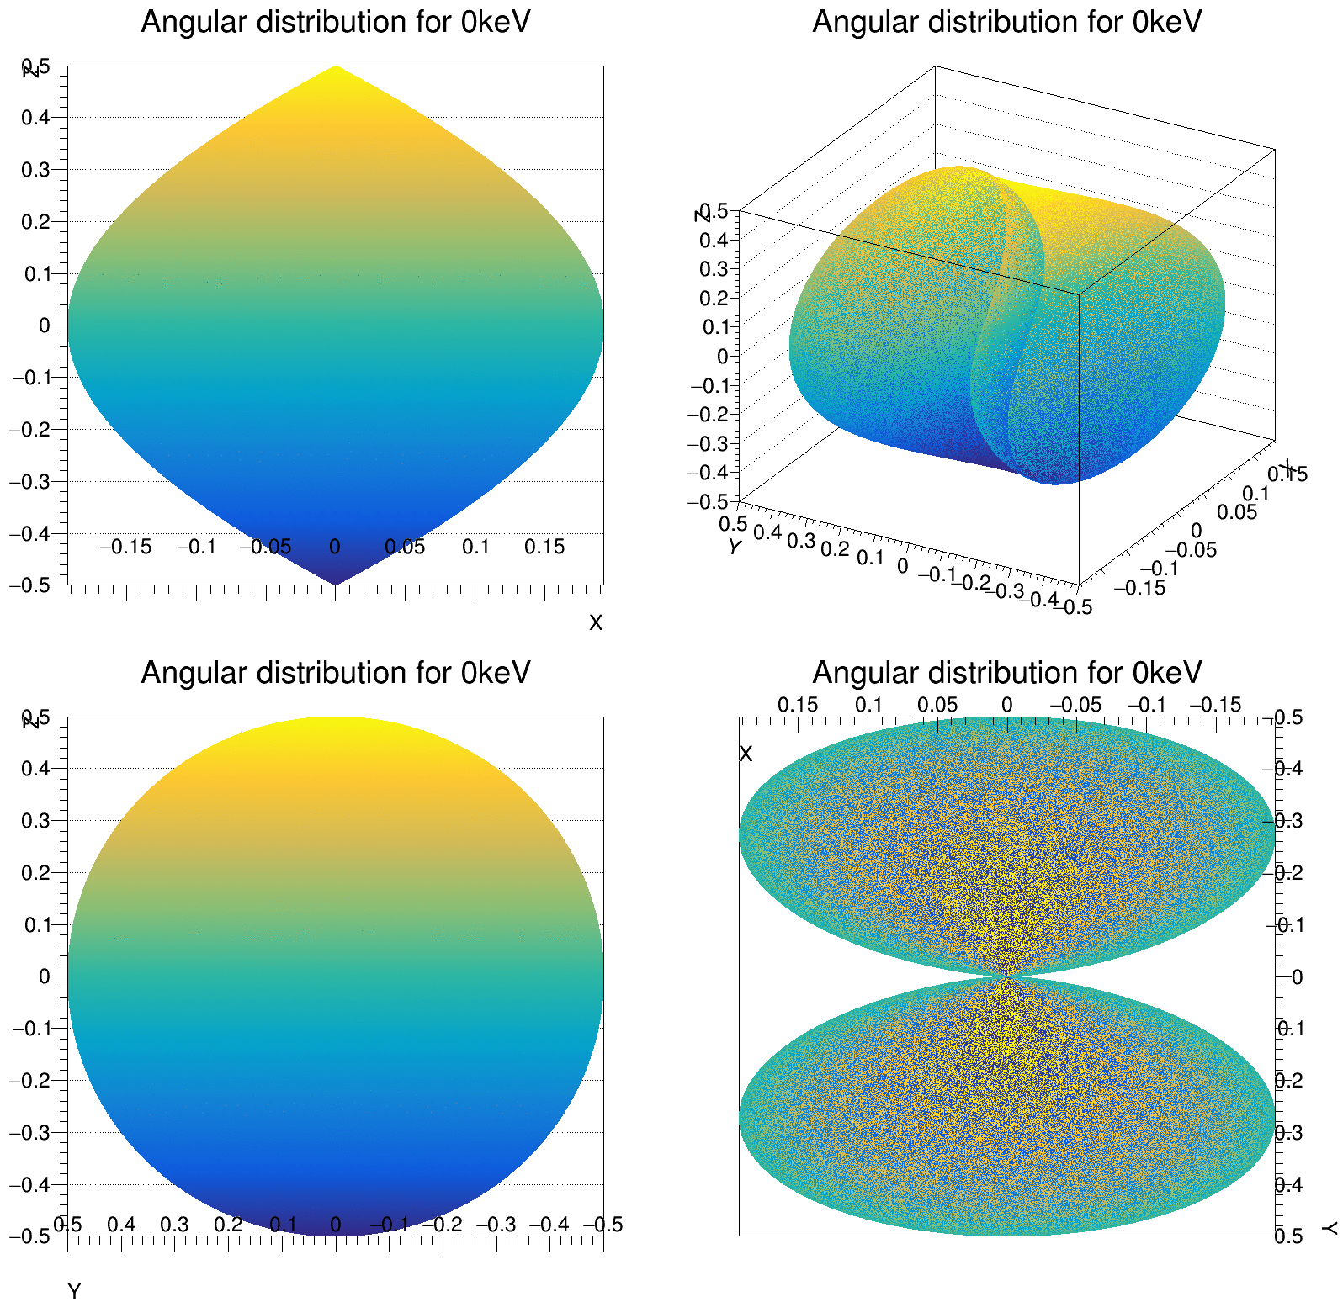
Photoelectric Effect - UNPOLARIZED
Spherical coordinates
The blue-yellow color is just for the sake of drawing. No physical sense is associated
fiorotto8/AngularProbabilityPhotoelectric (github.com)

Slide 15
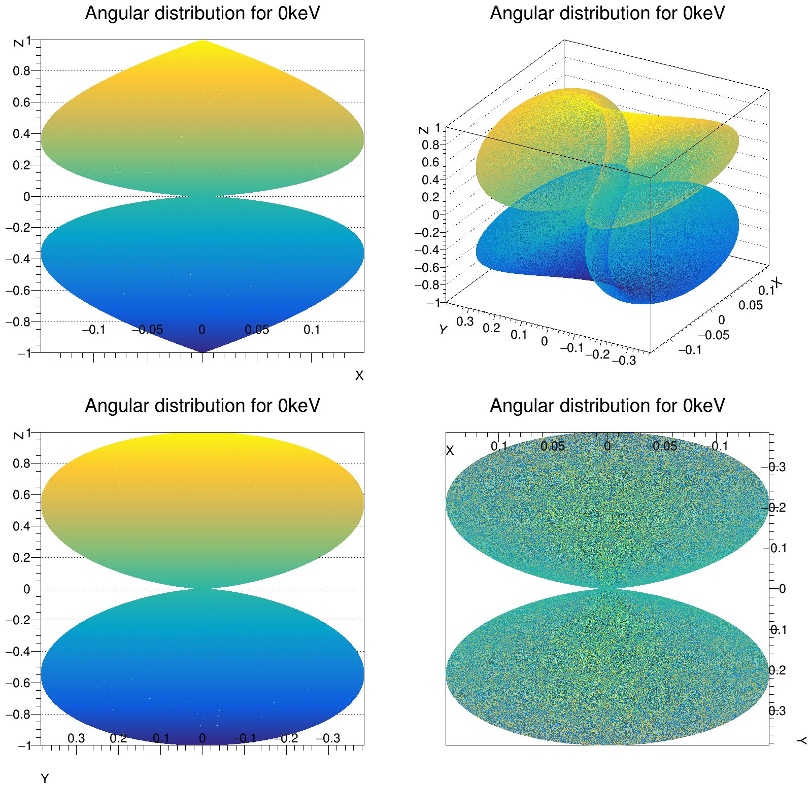
Photoelectric Effect – LINEARLY POLARIZED
Spherical coordinates
Pol Vector
The blue-yellow color is just for the sake of drawing. No physical sense is associated
fiorotto8/AngularProbabilityPhotoelectric (github.com)

Slide 16
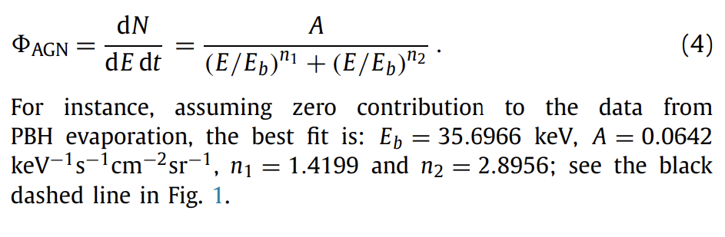
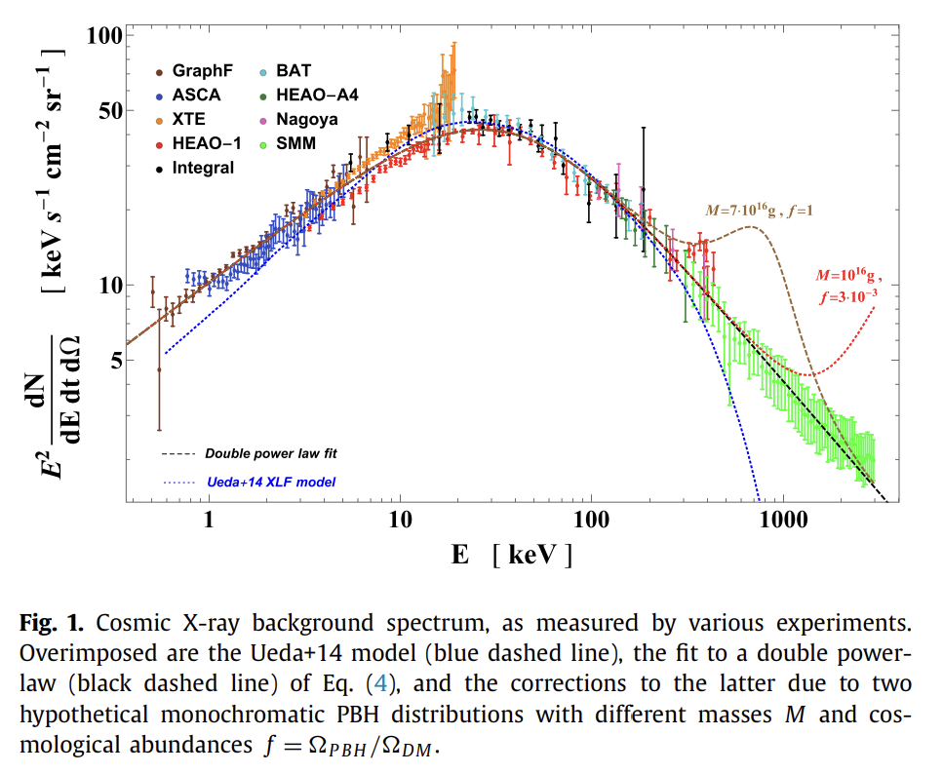
Cosmic Xray Background
Xray Cosmic BackGround Power Flux measurement
X-ray and gamma-ray limits on the primordial black hole abundance from Hawking radiation
X-ray and gamma-ray limits on the primordial black hole abundance from Hawking radiation - ScienceDirect
In “hard” X-rays, E = 3 - 300 keV, the emission is remarkably uniform across the sky, except for a narrow “ridge” of emission in the plane of the galaxy. (qui)
Superimposition of many far point-like sources (AGNs) so uniform. Nearer to us the things are different so on the galactic plane the intensity is larger (no idea how much…)

Slide 17
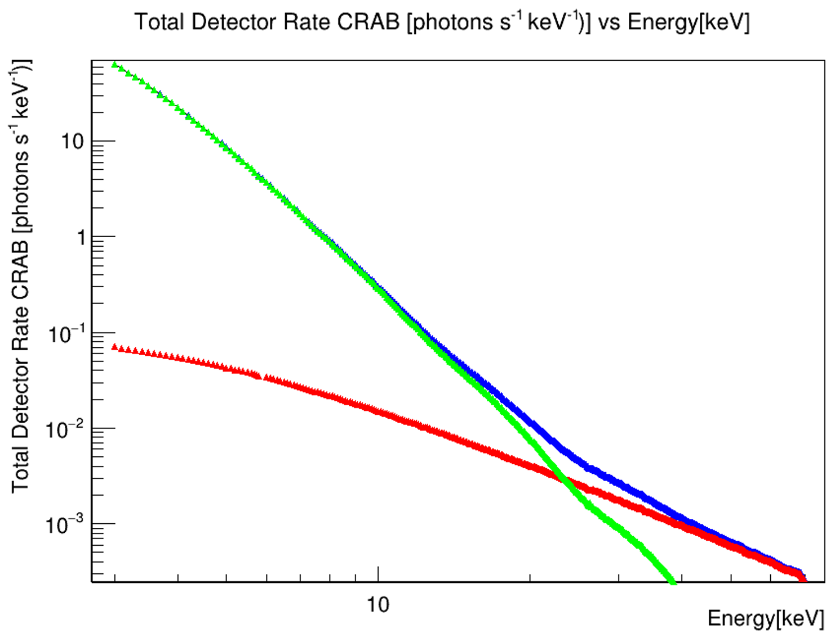
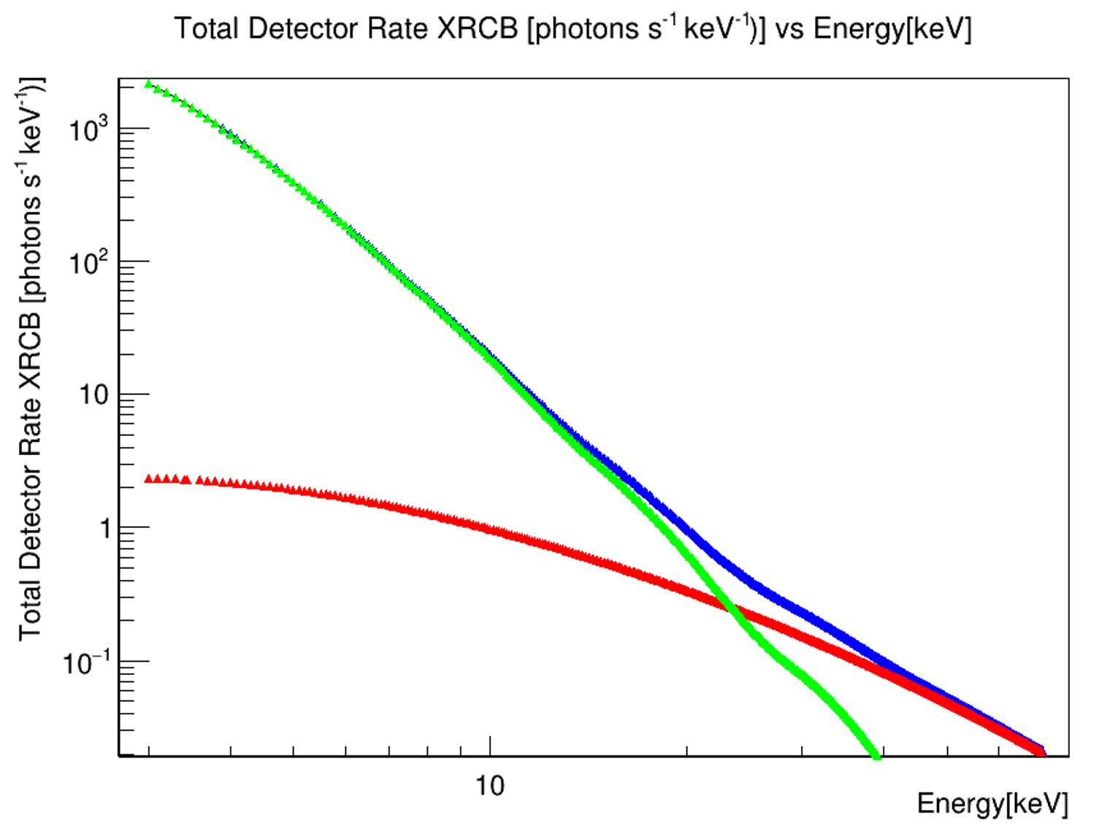
Expected hit Rate on 100cm2 detector
NIST XCOM: Element/Compound/Mixture
Every energy bin is multiplied by the sensitity data from
  Sensitity and CRAB flux evaluated with Eval with Tspline (very small difference with linear interpolation)
Photoelctric
Compton
Total
Addendum:
XRCB flux is computed supposing all the 4π flux impining on a single 10x10cm² side (overestimation of the flux but underestimation of the active area)
For CRAB this is not the case
Photoelctric
Compton
Total
CRAB nebula NuStar Power Flux measurment
BROADBAND X-RAY IMAGING AND SPECTROSCOPY OF THE CRAB NEBULA AND PULSAR WITH NuSTAR
C: (iop.org)
Cosmic Xray background rate: 2700 Hz
Crab Nebula Rate: 70 Hz
Code and data available:
fiorotto8/RateCalc_CRAB-XRCB (github.com)

Slide 18

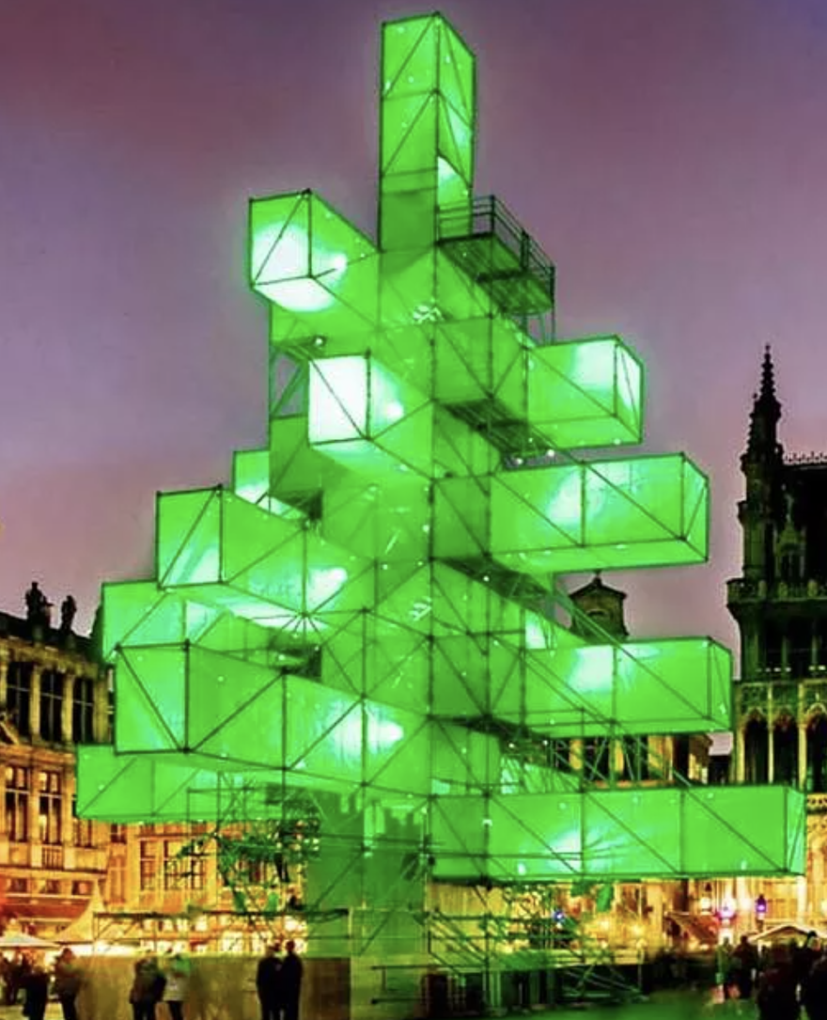
Christmas tree solution

Slide 19
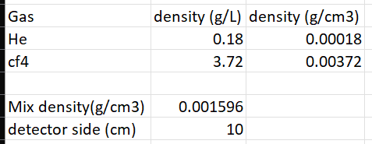
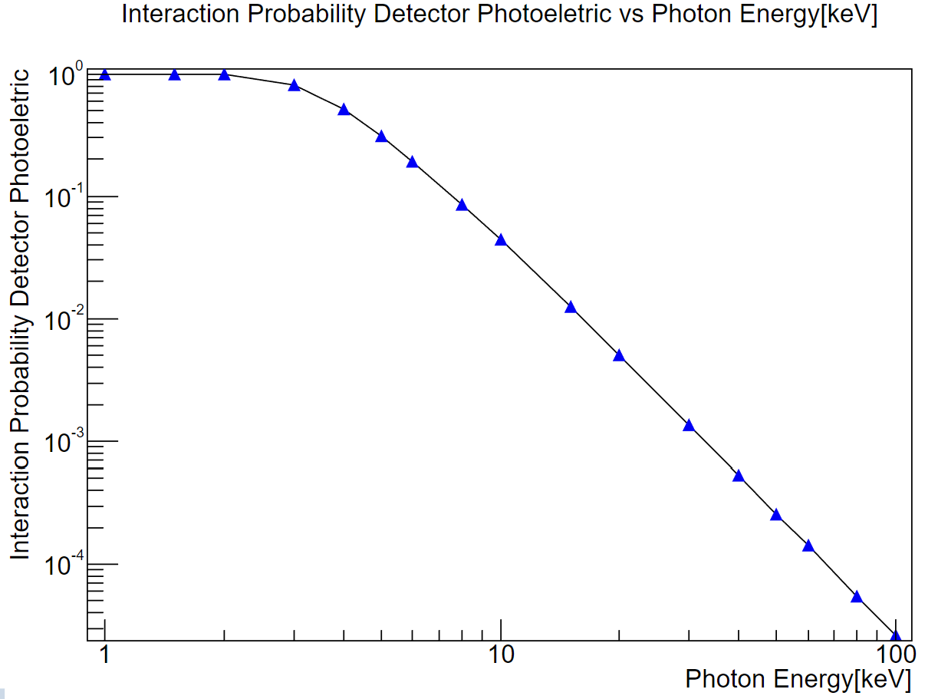
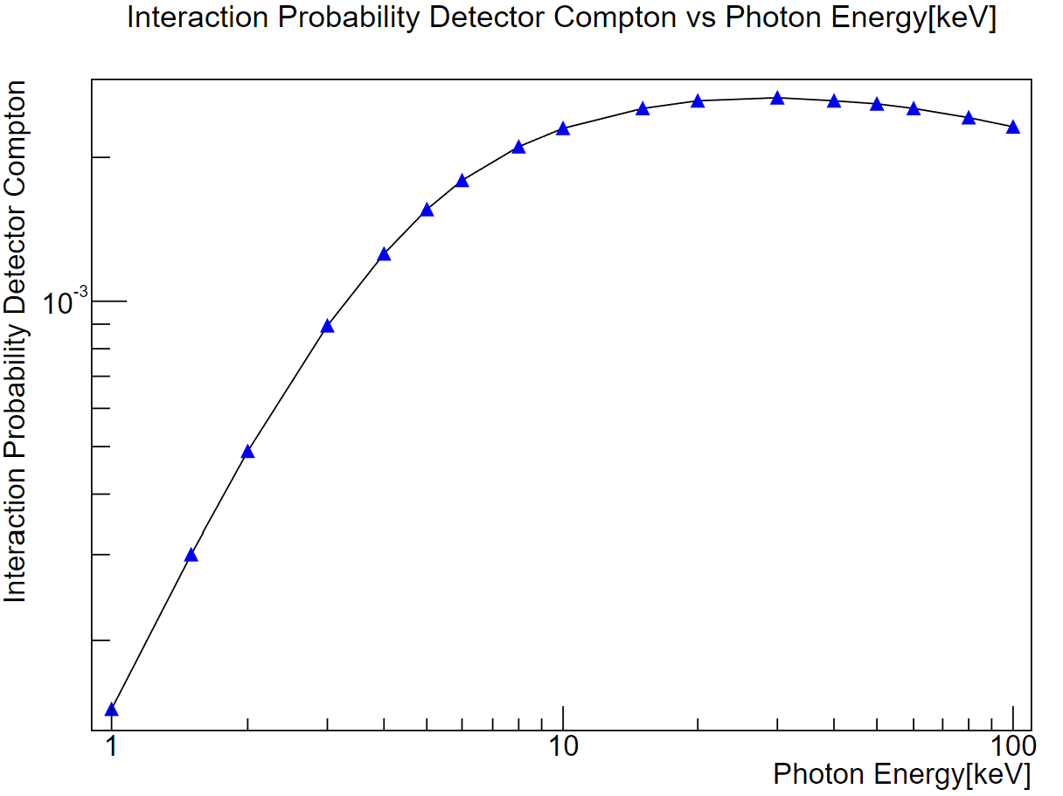
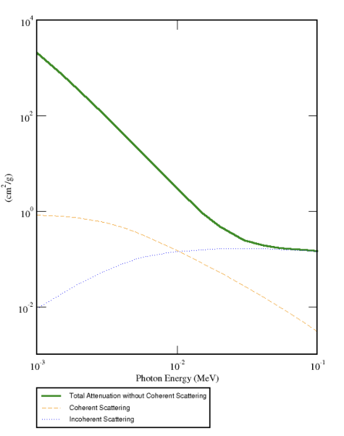
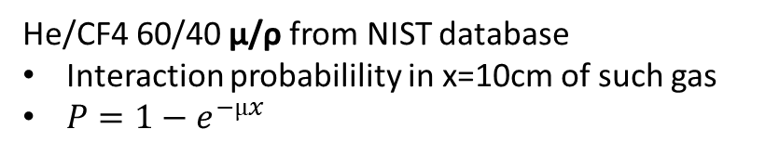
Gas Attenuation factors and Sensitivity
He/CF4 60/40 µ/ρ from NIST database
Interaction probabilility in x=10cm of such gas
$P=1−e^{−µx}$
NIST XCOM: Element/Compound/Mixture

Slide 20
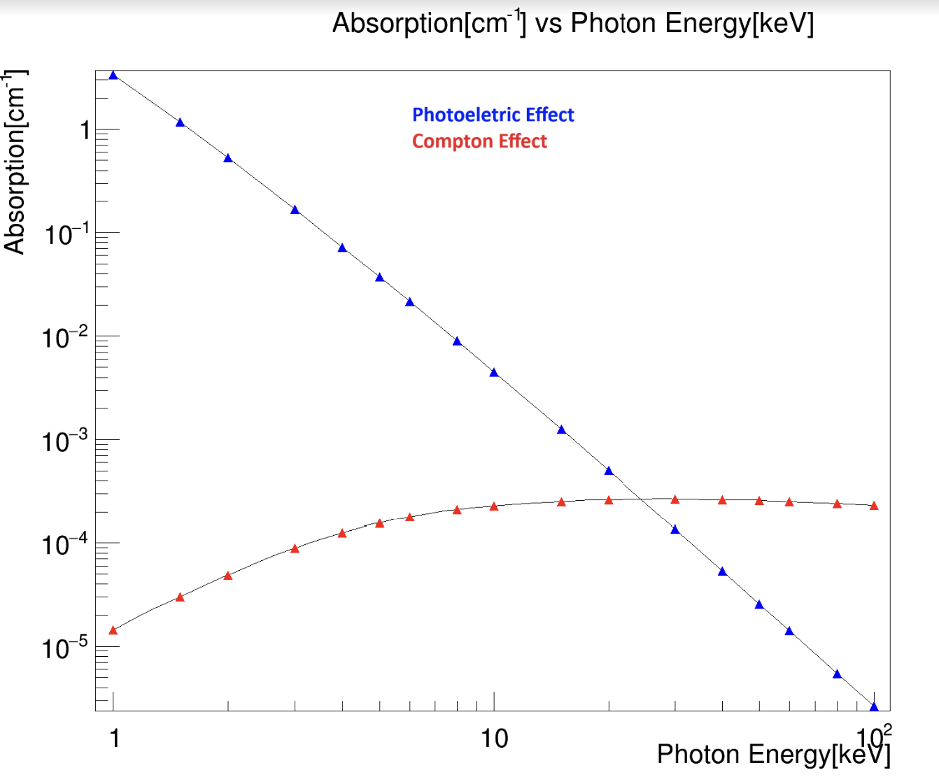
He/CF4 60/40

Slide 21
Requirements for a CYGNO-like Polarimeter
Polarimetry is also possible with Xrays not on-axis HERE
Compton process is also polarization-dependent
If the background is too large to use a ‘slow’ ORCA-like camera we may switch to Phoebe: The single-photon TPX3CAM – YouTube (Used by ARIADNE experiment)
  Small area (256x256 pixels) but fast readout (no need of PMT in principle), probably noisy (image intensifier)
Gas choice is a trade-off of many factors:
  Quantum efficiency → heavy elements
  Modulation factor → light elements (straight tracks)
The K-edge of the chosen gas should be (much) lower than the minimum energy of interest
  Otherwise, we got contaminated by the Auger electron, which is emitted isotropically
For HypeX TPC, we foresee good directionality of the photoelectron from 15 keV up to fully contained tracks (He/CF4)
  Potentially, we can work up to the Argon (K-shell ≈3keV)
  Larger efficiency with heavier gases (also to the background!)
  Choice of gas (with fixed dimension) fixes the energy range

