Slide 1


SWRIPS:
Sustainable Water Re-use with Innovative Purification and Sensing system for the agri-food supply chain
WP3
Spectroscopy apparatus for Online Water Quality Monitoring
Antonella Sciuto
First SWRIPS General Meeting
Catania 14-15 December 2023
Notes:
Good morning everyone, I am antonella sciuto, researcher at CNR IMM, and leader of the WP3 dedicated to the development of a Spectroscopy system

Slide 2
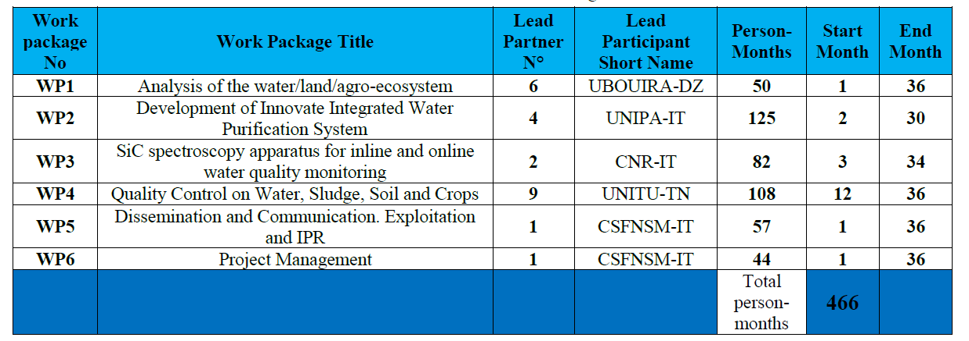
Role of the CNR-IT in the project
Unit participants:
Antonella Sciuto, Sebania Libertino & Silvia Scalese, CNR-IMM, Sabrina Carroccio, CNR-IPCB
We are leader of WP3: Spectroscopy apparatus for Online Water Quality Monitoring => development of an in-line test system for continuous monitoring of the physical and chemical parameters of the purified water to be re-used for irrigation, consisting of compact UV spectroscopy apparatus and visible sensor systems adopting innovative SiC and Silicon Photomultipliers (SiPM) photo-detectors
We are Involved in the WP2, WP5 and WP6
Notes:
First of all, I want to introduce the CNR unit within the project, the cnr unit involves 4 researchers from two different institutes, the imm and the ipcb, and I would like to briefly introduce to you

Slide 3

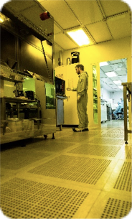
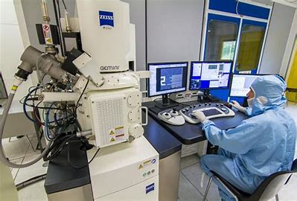
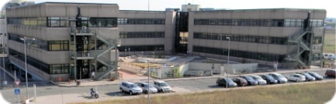
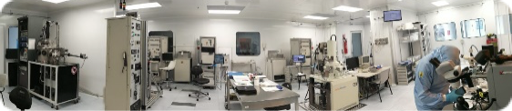
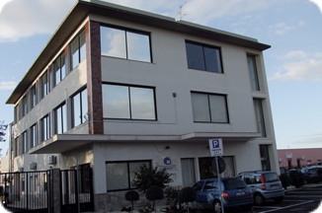
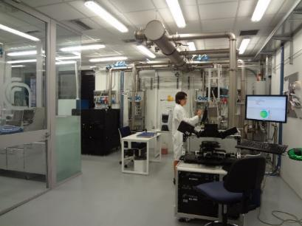
Agrate Brianza
Bologna
Founded in 2002 from the merger of 4 CNR institutes
6 locations over the entire country
Headquarters in Catania
Roma
Lecce
240 researchers, technologists, technicians, administrators
50 research grants + scholarships + phD student
Catania HQ
Catania
University
Notes:
First of all I would like to introduce IMM. IMM is one of the largest research center of the Italian National Research Council. About 300 people are employed, distributed in six different sites:
Headquarters is in Catania (hosting about seventy 70 people). Research Units are in Lecce, Naples, Rome, Bologna, and Agrate Brianza covering the entire country

Slide 4

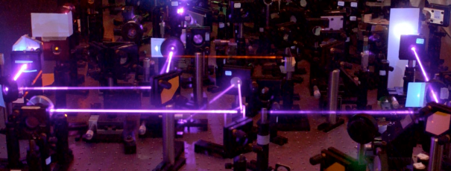
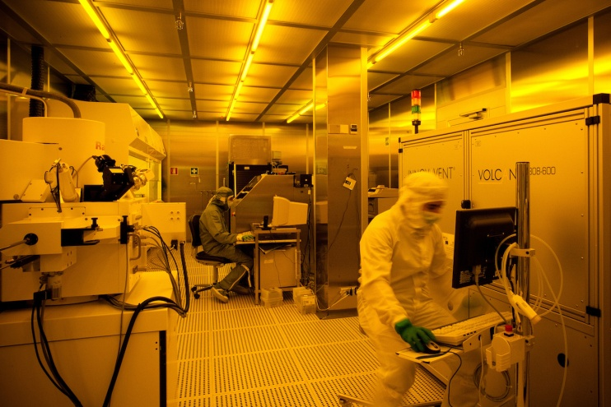
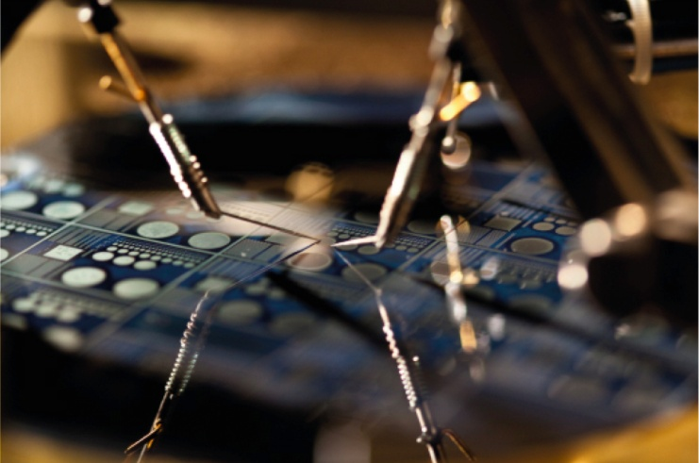
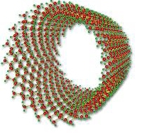
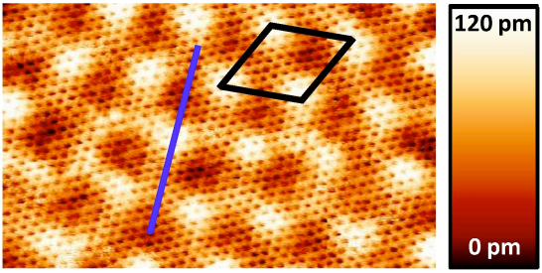
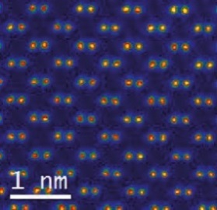
Research activities
Investigation of innovative materials
Development of advanced Micro– and nanofabrication processes
Materials and process integration in complex microsystems
IMM activities span from material science and process development to device fabrication and system integration, thanks to the micro-nanofabrication facilities present at the different sites (clean-room areas totaling >1550 m²).
Notes:
Our research activity spans from the investigation of innovative materials to the development of advanced micro- and nanofabrication processes, up to the integration of materials and processes in complex microsystems for microelectronics, energy conversion or sensing applications

Slide 5
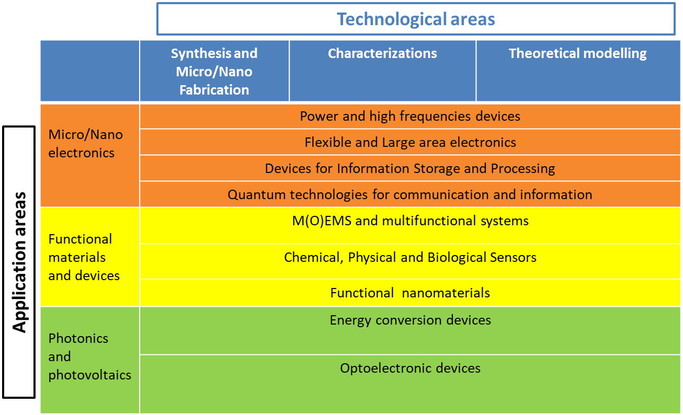
Research activities
Notes:
among other activities, at IMM a group is focused on sensor development and today we are involved in the SWRIPS project
the research activities focus on three main application areas:
Micro/Nanoelectronics,
Functional Materials and devices,
Photonics.
In addition, the skills and structures are coordinated in three main technological areas which provide transversal support to the application areas.
Synthesis and Micro/Nanofabrication,
Characterization,
Theoretical Modeling,

Slide 6
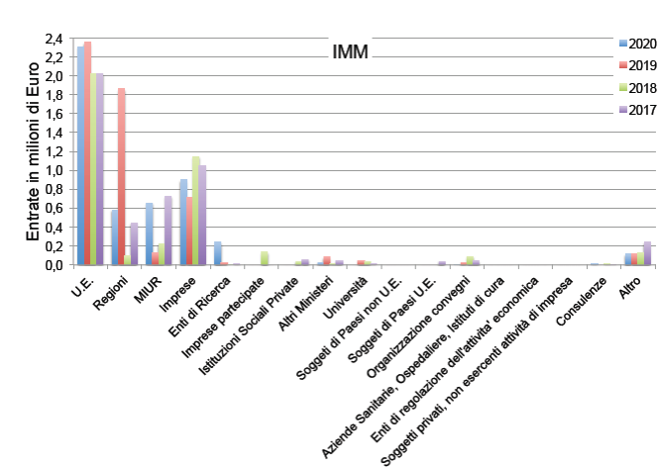
Scientific results
Funding
∼30 Patents
(8 USA patents are mine)
In the last 10 years
The annual budget is quite high and external funding largely comes from European, national and regional projects.
Yearly budget about € 5-6 million
∼ 300 JCR publications each year
The IMM is classified as "excellent" by the internal evaluation board of the CNR
In 2021 - Highest IF 30.849
29 publications with IF > 10
(7 with IF > di 25)
Notes:
Scientific results are presented at numerous international conferences. About 30 patent were deposited in USA in the last 10 years, and 8 of these are mine, 300 articles are published each year in indexed journals.
The IMM is classified as "excellent" by the internal evaluation board of the CNR (the IMM is among the three best Institutes of the Department of Physics)
While from the national agency for the evaluation of research results reports one of the highest indicators among the institutes of the Department of Physics.
The annual budget is quite high and external funding largely comes from European, national and regional projects.
According to the National Agency for the Evaluation of the University and Research System, IMM has one of the highest scores

Slide 7







Technology Transfer and
Industrial Research Collaborations
CATANIA
STMicroelectronics (power electronics, process simulations, characterizations)
Enel Green Power (photovoltaic, solar cells)
SME environmental applications
AGRATE
STMicroelectronics (characterization of the structural, electrical, optical and magnetic properties of thin films and devices for MEMS, memories and power electronics)
LECCE
Leonardo
SME
Regione Puglia
BOLOGNA
Private Public Partnerships @ TECHNOPOLE “AMBIMAT”
ROME
NanoMicroFAB (Sensors, MEMS and IoT, Printed, Flexible electronics) Research Infrastructure of micro-nanoelectronics
The institute has a strong commitment to technology transfer activities and collaborations with major companies.
Notes:
The institute has a strong commitment to technology transfer activities and collaborations with major companies. Here is a diagram that indicates the main ones and shows how all the sections have their interactions with the main local industrial realities. In particular, Catania, as already mentioned, have strong activity with STMicroelctronics, and also strong collaboration with Enel green power on solar cells.
Bologna takes part in two public private partnership the first MISTER on mechatronics and the other on environment, agrifood and cultural heritage.
While in the Rome section a research infrastructure, open to companies, has been created. This latter operates in the enabling technology of micro and nano electronics and which collaborates closely with local companies but above all with Leonardo, a very important Italian company active in the defense, aerospace and security sectors.

Slide 8
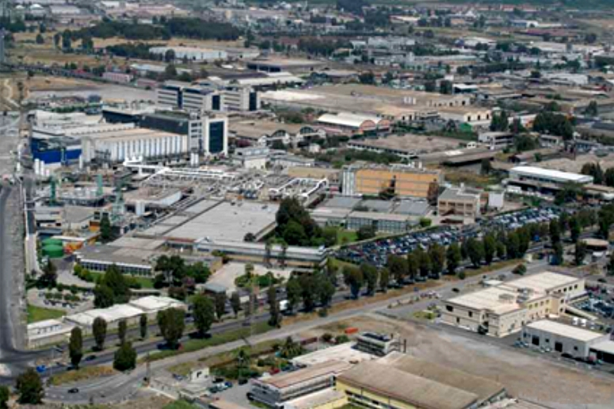

…and now focus on Catania HeadQuarters
offices and laboratories
Offices (1.000 m²)
IMM labs in the premises of ST (1200 m²)
Stradale Primosole

Slide 9
HeadQuarters – Activities
Micro-Nanoelectronics: power electronics, including the development of processes and materials (SiC, GaN) for power devices
  Collaboration with STMicroelectronics (part of IMM labs are within ST)
Photovoltaics: improvement of electrical stability of solar cells, development of new materials for solar cells and light trapping; water splitting.
  Collaboration with ENEL Green Power and STMicroelectronics (some IMM labs are within EGP)
Sensors: physic- chemical- and bio-sensors for health ( blood oxygenation, DNA or proteins detection); environmental monitoring (water pollution, gas detection, radiation detection); UV and particle detectors based on SiC devices;.
  Joint lab with the «Laboratorio di Riferimento regionale per la Sorveglianza ambientale, clinica e il Controllo della Legionellosi» located within the Medical Science Dept. of the University of Catania (G.F. Ingrassia)
Nanostructured materials, nanomaterials and nanocomposites (carbon, metals, semiconducting oxides, polimers) for sensing; water and air treatment.
  as briefly anticipated, a large activity is dedicated to sensors
Notes:
as briefly anticipated, a large activity is dedicated to sensors and

Slide 10
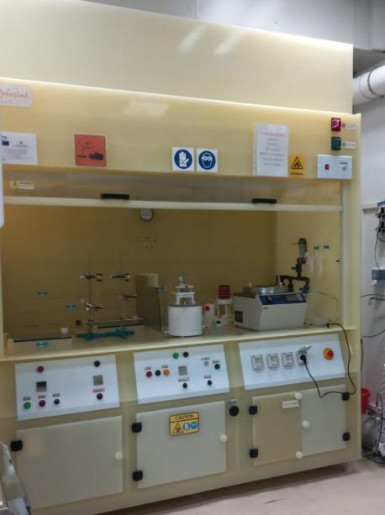
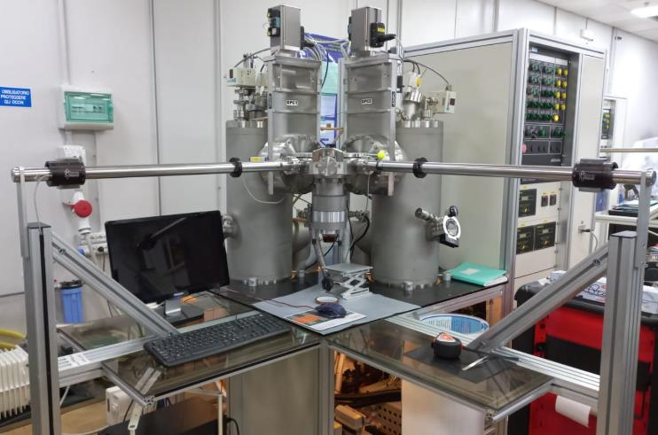
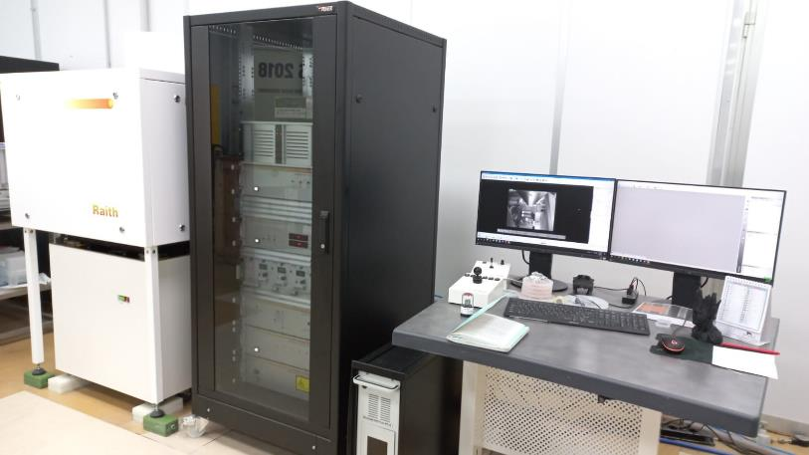
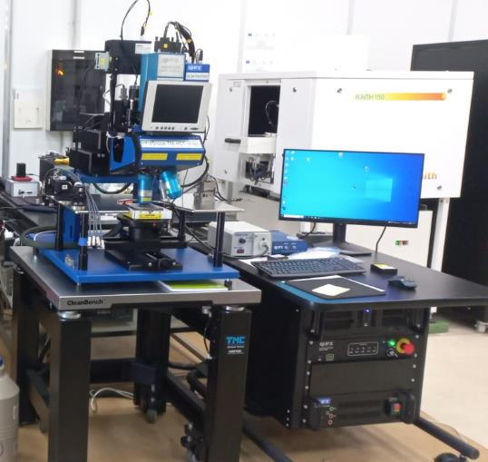
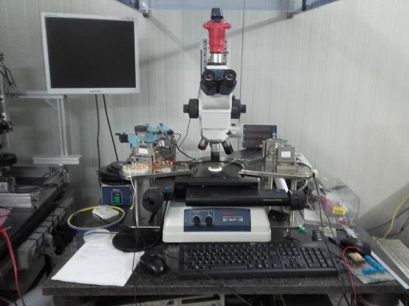
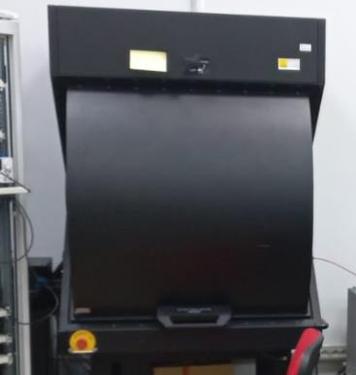
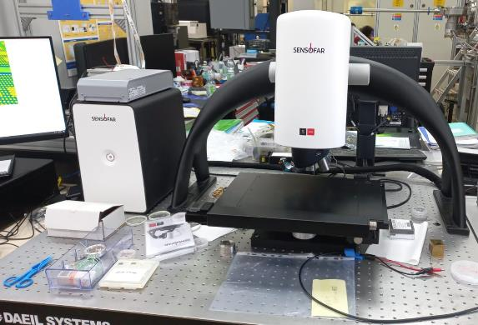
…just to mention some of the equipment in our laboratories for
Processing and characterisation
of materials and devices
Chemical benchs
Metal deposition systems
Optical and e-beam litographies
Thermal Microscope
Electrical probes stations
Interferometric Microscope
Notes:
just to mention some of the equipment in our laboratories

Slide 11

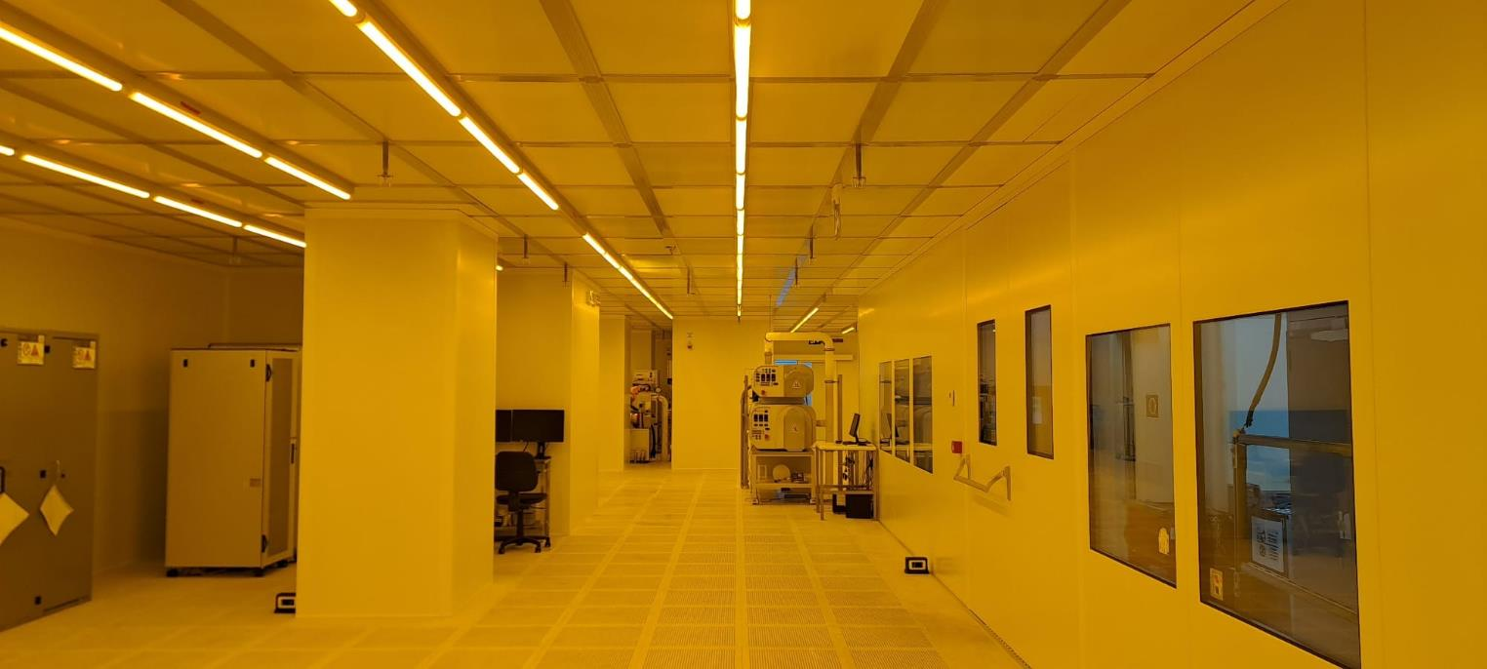
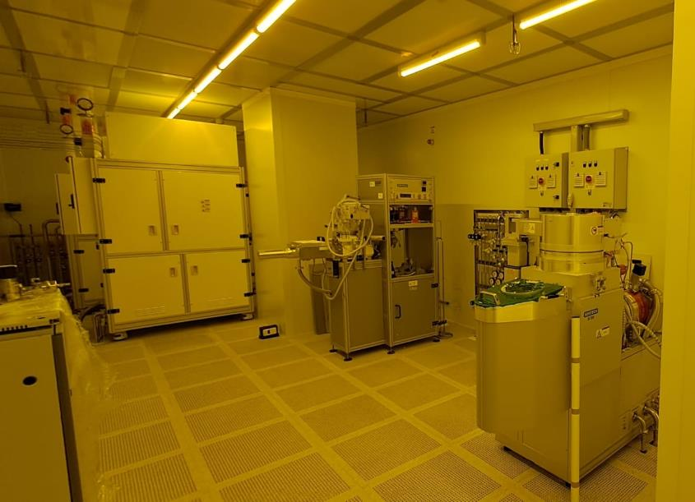
New clean room recently upgraded
Thanks to Sicilian Regional and National Ministry and Internal CNR Founding
New Clean Room completed
in June 2023
400 Sq m / 2,2 M€
Instrumentation for material and device processing
2,6 M€
Thanks to funding from the Sicily Region, the Ministry of Economic Development and internal funds from the CNR, it was possible to build a new, large clean room with state-of-the-art equipment for processing materials and for devices fabrication
Notes:
Thanks to funding from the Sicily Region, the Ministry of Economic Development and internal funds from the CNR, it was possible to build a new, large clean room with state-of-the-art equipment for processing materials and devices fabrication. The new Clean Room was recently completed and it has a 4 hundred square meters area with furnace for hight temperature processing, optical litograpy system, chemical bench, plasma etching, Atomic layer deposition apparatus and other semiconductor processing systems.

Slide 12
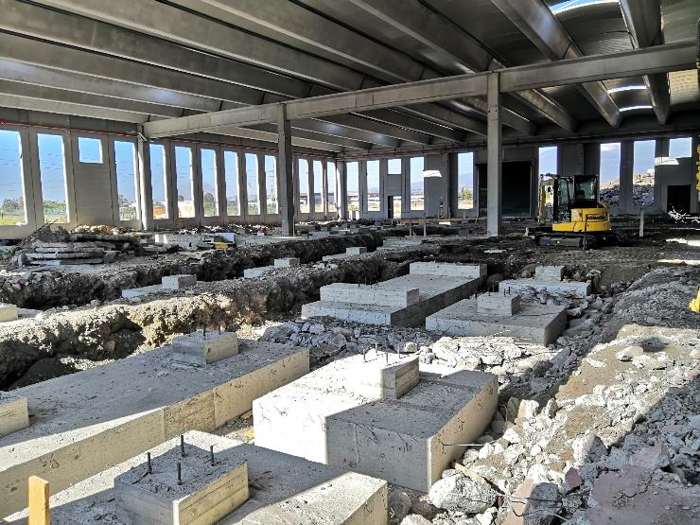
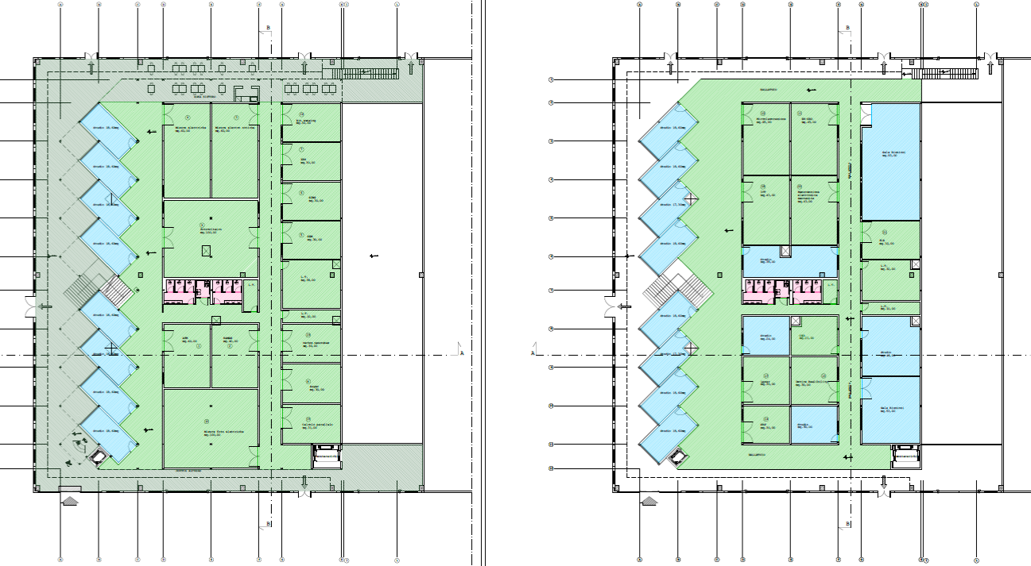
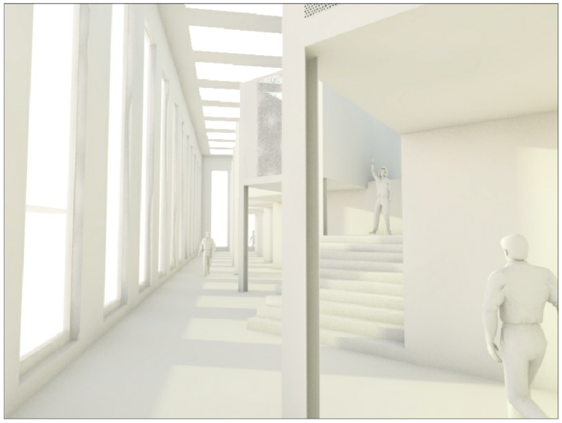
New headquarters under construction in Catania
….Not olny a new clean room, actually is under construction also a new building that will host offices and new labs
More space for offices and labs
Notes:
.

Slide 13

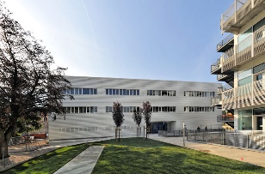
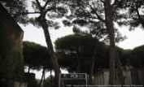

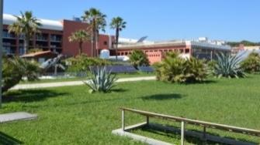
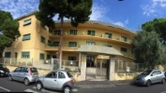
INSTITUTE OF POLYMERS, COMPOSITES AND BIOMATERIALS
5 locations & 1 unit research over the entire country
Headquarters in Pozzuoli (Na)
Lecco
Pozzuoli
112 researchers, technologists, technicians, administrators
25 research grants + scholarships + phD student
Portici
Napoli
UTR Lecce
Catania

Slide 14
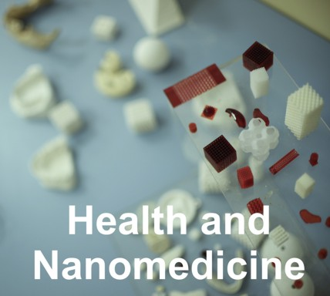

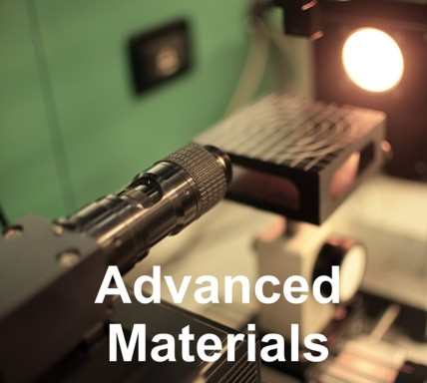



Main Research Topics
CATANIA site
12 permanent staff (researchers, technologists, technicians, administrators)
5 Temporary staff (PostDoc/Research grants)
N-Glycomics in human health and diseases
Mass Spectrometric Characterization of lipopolysaccharides
Polymeric Systems for controlled drug delivery
Synthesis and characterization for drug carrier applications
Synthesis and characterization of polyelectrolytes
Polymers containing porphyrin units and their use as sensors
New polymeric materials from reactive blending
Synthesis and characterization of hyperbranched polymers
Additive Manufacturing
Biodegradable Polymers: synthesis, characterization, degradation;
Chemicals from agro-industrial waste;
Pyrolysis Studies of Polymeric Formulates;
Eco-sustainable synthesis of polymer for environment

Slide 15
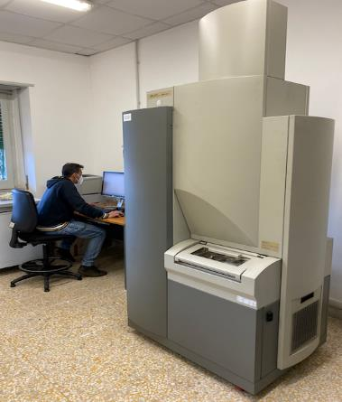
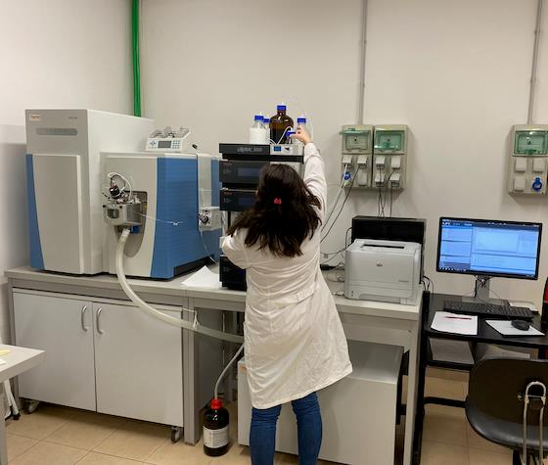
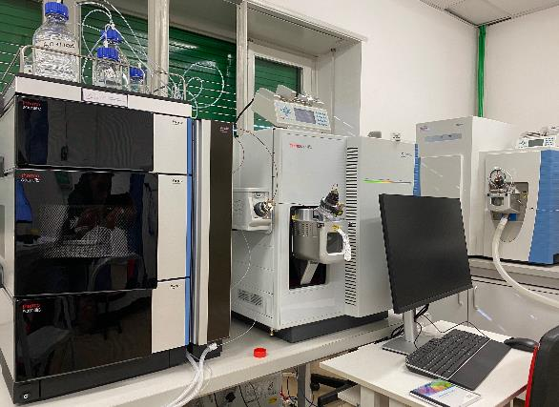
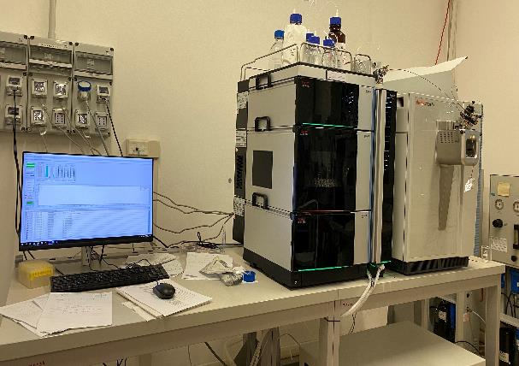
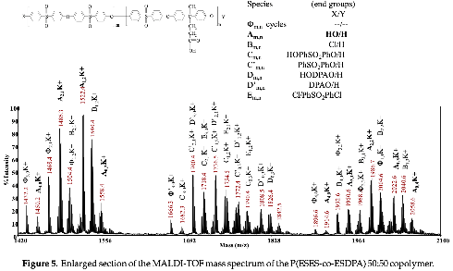
CATANIA site
MATRIX ASSISTED LASER DESORPTION IONIZATION - TOF
ELECTROSPRAY UHPLC
MASS SPECTROMETER
ELECTROSPRAY TRIPLE QUADRUPOLE MASS SPECTROMETER
ELECTROSPRAY ORBITRAP LC
MASS SPECTROMETER
Great tradition in the MS techniques for polymer grade determination; composition; structural characterization.
Notes:
We have a great tradition in the MS techniques, starting MALDI TOF/TOF and ESI MS for polymer grade determination; composition; structural characterization.

Slide 16
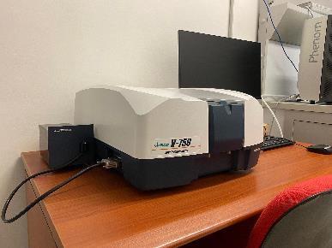
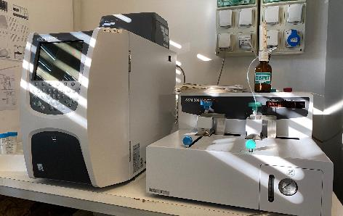
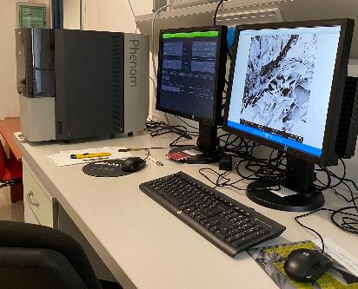
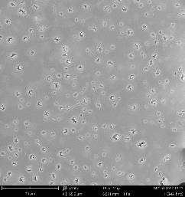
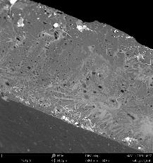
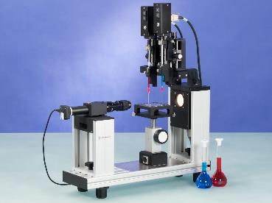
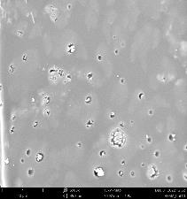
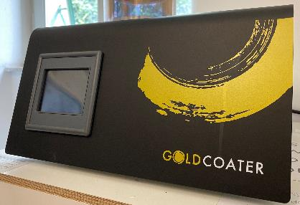
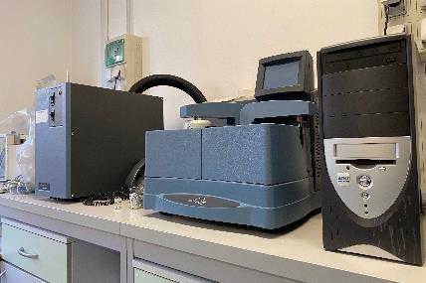
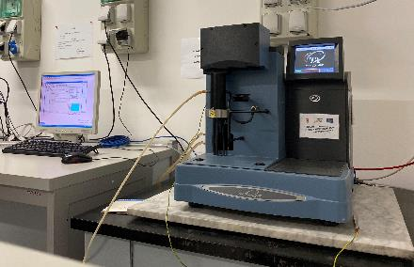
Processing and characterisation of polymers
CATANIA site
TOTAL ORGANIC CARBON ANALYZER
UV SPECTROPHOTOMETER
SCANNING ELECTRON MICROSCOPY
CONTACT ANGLE
MORPHOLOGY
DIFFERENTIAL SCANNING CALORIMETER
TERMOGRAVIMETRICAL ANALYZER
Notes:
.

Slide 17





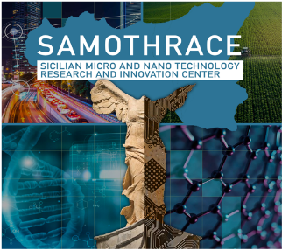

Some of the active research projects… with a common thread: the environment protection!
CATANIA site
H 2020 SFS 2018-2020
Grant Agreement 10100210
Plastic in Agricultural Production: Impacts, Lifecycles and LONg-term Sustainability.
Misura 1.40 lett. a del PO FEAMP 2014/2020
Valorisation of plastics collected from the sea via Pyrolysis.
PRIN 2017
SICILIAN MICRO AND NANO TECHNOLOGY
RESEARCH AND INNOVATION CENTER
Valorizing Sustainable Plastics through a CLEver use of NANoparticles.
Sustainable Energy
Agritech
Environment
Notes:
These are some of the projects we are currently following. The common thread that unites them is precisely the protection of the environment.

Slide 18









CATANIA site
PoC MISE 2020 Programma AMICO del CNR
Polymeric cryogels active against toxic metals in water.
2022 – 2023 EUREKA! PoC
Towards the foundation of a Spin-Off
Eco-sustainable production
Effective against organic/inorganic pollutants
CONSOLIDATION OF THE TECHNOLOGICAL MATURITY OF CRIOPURA
Europa, EP application nr. 20737048.7 (EP3999228) 13.07.2020
USA, US Patent application nr. 17/626227 11.01.2022
Cina, Chinese patent application nr. 202080052559.2 (CN114302771A) 11.01.2022
The IPCB team gained a wide experience on the removing of toxic metals from water. This will be the starting point for sensing applications in SWRIPS project

Slide 19














Technology Transfer and Industrial Research Collaborations
CATANIA site
CNR IPCB recently signed an Agreement with the company WES TRADE LTD to compliment its Research activities with the support of a skilled company on ICT and proven experience in the subjects of:
  Artificial Intelligence
  Machine Learning
  Blockchain Technology
See more at www.westradeltd.com
and
PLASTICA ALFA for deep Research and Innovation on advanced material for piping.
See more at https://www.plasticalfa.it/
Notes:
IPCB is used to network with highly efficient companies able to compliment our researches with high potential expertise, such as Plastica Alfa and WES TRADE.

Slide 20
Role of the CNR-IT in the project
Unit participants:
Antonella Sciuto, Sebania Libertino & Silvia Scalese, CNR-IMM, Sabrina Carroccio, CNR-IPCB
We are leader of WP3: Spectroscopy apparatus for Online Water Quality Monitoring => development of an in-line test system for continuous monitoring of the physical and chemical parameters of the purified water to be re-used for irrigation, consisting of compact UV spectroscopy apparatus and visible sensor systems adopting innovative SiC and Silicon Photomultipliers (SiPM) photo-detectors
We are Involved in the WP2, WP5 and WP6
Notes:
First of all, I want to introduce the CNR unit within the project, the cnr unit involves 4 researchers from two different institutes, the imm and the ipcb, and I would like to briefly introduce to you

Slide 21




SiC
WP 3 Implementation
Task 3.1 Development of sensors and electronics (CNR-IT, CSFNSM-IT, UNICT-IT)
Our objectives:
Design and fabrication of innovative SiC sensors operating in deep UV with large area, low noise and high sensitivity
Development of Lecture electronics ensuring biasing of source and detector, low noise, sensing current amplification and digital conversion.
Key aspects:
solid state based compact UV spectroscopy system for chemicals and/or biological agents
Our Strategy:
=> Commercial cheap LED or compact sources
=> Silicon Carbide based UV detector opportunely designed and fabricated by CNR-IT ensuring : technological maturity and 3.26 eV energy band gap ensuring blindness over the band edge (~ 380 nm).
=> Schottky junction photodiode will be adopted &
=> innovative nanostructured front electrode will be explored to enhance the deep UV sensitivity.
hostile environment applications
insensitivity to environment temperature,
chemical inertness
visible blindness ensuring absence of false response due to visible fluorescence of chemicals interfering.
remote control of the sensing system
The dedicated electronics:
to handle optical flux by regulating power supply current,
to bias the SiC detector
to measure the output current (in the order of 100 pA – 100 nA).

Slide 22





WP 3 Implementation
Task 3.2 Optically sensible polymeric substrates for heavy metals and pesticide detection (CNR-IT, SRTACITY-EGY)
Our objectives:
design and fabrication of Optically sensible polymeric substrates for heavy metals and pesticide detection;
Key aspects:
Detection of heavy metals and pesticides will be explored by adopting opportune sensing materials
Substrates based on acrylic and vinylic polymeric materials
Funtionalised polymers to detect target molecules and to obtain optical variation while in action
Characterisation :
by thermal analysis (TGA and DSC),
by spectroscopical measurements (FTIR)
By Mass spectrometry-based techniques (Py/GCMS and ICP-MS for metal detection)
Methodology:
Polymeric substrates will be assembled and integrated with the optical apparatus to ascertain the detection ability, selectivity, saturation limits, and the range of applicability in terms of temperatures and pHs
Sensing tests will be evaluated on mercury, lead, arsenic, and chromium, as well as selected pesticides
Test on the durability of the polymeric substrate, along with the time, will also be assessed to avoid the release of microparticles during use.

Slide 23




WP 3 Implementation
Task 3.3 Detector assembly and readout software development (UNICT-IT, CSFNSM-IT, CNR-IT)
Our objectives:
design and assembly of spectroscopy apparatus operating in the UV range and its complete electro-optical characterization
Key aspects:
The spectroscopy system will be assembled using a steel or aluminium tubular chamber.
The chamber dimensions (optical path ) will be fixed evaluating the optical absorption of the chemicals of interest using standard laboratory characterization
Methodology:
Different Systems operating with the same principle will be designed
=>for detection in liquid of:
Nitrogen compound
Biological agent
=>for the monitoring of sensing substrates devepoled in Task 3.2 for heavy metals and/or pesticides
Complete characterization of the system will be performed in lab with bench electronics and test water solutions
Labview could be a favorable framework for laboratory test being the most diffuse devices (picoammeters, power supplyes, thermometers..) compatible with Labview.
A lot of Labview experience is shared among collaboration members. Existing routines could be rapidly converted to the new applications
Successively, opportune readout software will be developed for the complete control of the system locally and in remote configuration
System we recently designed for vulcanic applications

Slide 24


WP 3 Implementation
Task 3.4 Detector test and calibration with use cases (CSFNSM-IT, CNR-IT, UNICT-IT, UV-ES,)
Our objectives:
Test and calibration of the spectroscopy apparatus
Characterisation:
The complete spectroscopy apparatus will be tested and calibrated in laboratory against gold-standard instrumentation and protocols, using water solutions with different fixed concentration of the chemical species to be monitored opportunely prepared. Water solution contaminated with bacteria as described in Task 2.3, will be adopted also for the spectroscopy apparatus testing towards biological contamination. A prototypal system emulating the final set-up will be assembled and tested in laboratory using a flow rate scaled-down water pipeline.

Slide 25


WP 3 Implementation
Task 3.5 Development of data network and online monitoring software for remote control (UNICT-IT, CNR-IT, UBOUIRA-DZ, UV-ES)
Our objectives:
Development of data network and of the software for the remote control
Key aspects:
Different sensors can be deployed in field. In order to allow for a centralized water distribution monitoring, a suitable ICT data network will be developed. Different protocols and gateway will be used in relationship with distance between on-field sensor and data center. For group of close-locally distributed sensors, a LoRA network (or eventually WiFi / ZigBee network) can be used. Then, different LoRA gateway can be connected to the data center using for example standard 4G or NB-IOT (if available) network with standard protocol as MQTT. The best configuration will be on-field evaluated during the whole system integration phase. At the data center, a suitable software with user interface will be developed or integrated, starting from opensource, in order to allow for data storage in a database, whole system behavior monitoring and mis-behavior alarm information monitoring.

Slide 26

Thanks for your attention

