Slide 1

X-band linac and TEX facility
David Alesini
(INFN-LNF)
6th EuPRAXIA@SPARC_LAB TDR Review Committee, 21–23 Nov 2023

Slide 2
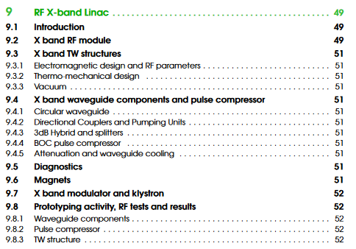
RF X-BAND LINAC: TDR STRUCTURE

Slide 3
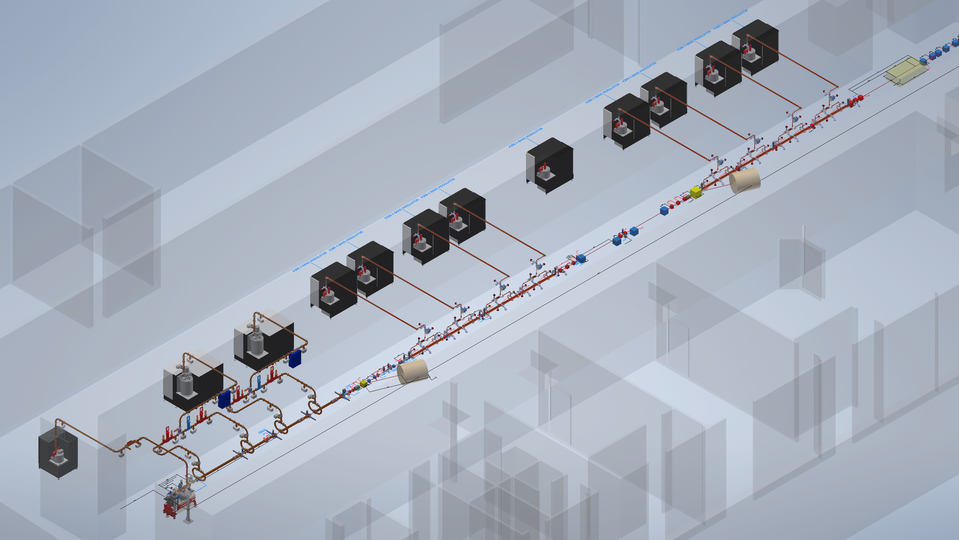
RF X-BAND LINAC: INTRODUCTION
High brightness electron beam up to 1 GeV, at 100 Hz repetition rate (baseline) with a possible future upgrade at 400 Hz, single bunch;
S-band (2.856 GHz) injector composed by a photocathode 1.6 cells SW RF Gun and 1x 3m TW S-band structure and 3x 2m TW S-band structures;
X-band (11.994 GHz) booster composed by 16xTW, 0.9 m accelerating structures with a nominal gradient of 60 MV/m, 8 X band power station (25 MW, 1.5us, up to 400 Hz)
Magnetic chicane
X-band power stations
S-band power stations
Plasma module
X-band Booster
Magnetic chicane
S-band Injector
Courtesy of E. Di Pasquale

Slide 4
RF X-BAND LINAC: TDR STRUCTURE

Slide 5
X-band RF Module
Mode converter
(INFN design)
BOC pulse compressor
(PSI design or INFN brazing free)
Power Source: Solid State Pulsed Modulator + Klystron
Spiral RF LOADS
(CERN Design)
circular waveguide
Pumping units
(INFN design)
25 MW
1.5 us
100 Hz
140-70 MW
6 m
130 ns
100 Hz
Hybrid
(CERN design)
Transport line: Low loss Circular waveguide
X band structures
(INFN design)
70-35 MW
130 ns
100 Hz
Pumping units (CERN design)
NEXTORR Pumps
(SAES)
Directional Coupler
(CERN design)
Accelerating module
2.3 m

Slide 6
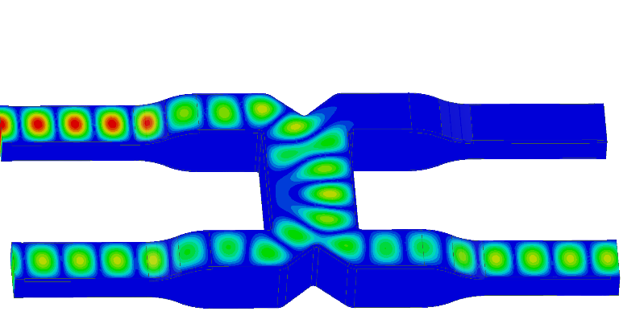
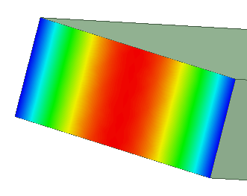
X BAND RF MODULE: SCHEMATIC LAYOUT
Klystron gallery
Linac hall
wall
Pump units (rect. Wav.)
Mode converter circular/rect
Directional coupler
3dB hybrid
RF load
Pump unit (circ. Waveg.)
BOC pulse compressor
Circular waveguide
Standard waveguide
Accelerating structures
140-70 MW
TRASPORT LINE
130 ns
100 Hz
3dB hybrid
25 MW
1.5 us
100 Hz
70-35 MW
130 ns
100 Hz
SCANDINOVA MODULATOR K300
&
CANON E37119
∼33 MV/m
Power Source
ACCELERATING MODULE

Slide 7
RF X-BAND LINAC: TDR STRUCTURE

Slide 8
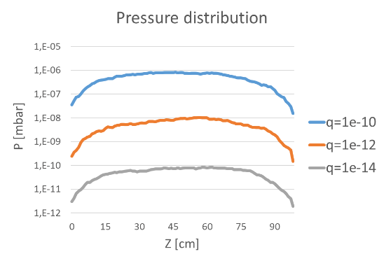
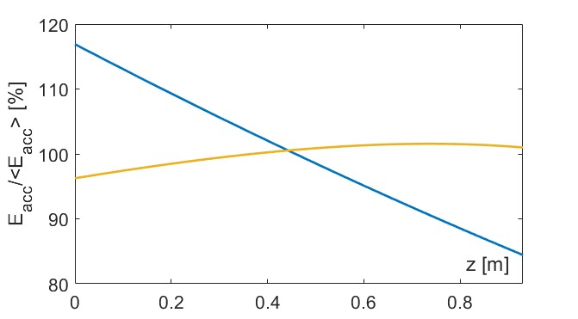
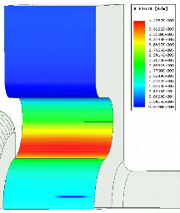
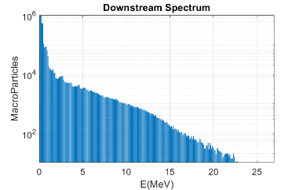
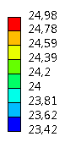
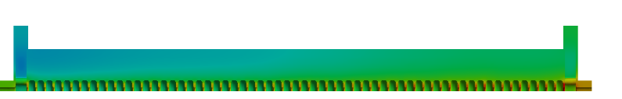
X-band TW structures
The EM design of the structure is completed: 0.9 m long structures with 3.5 mm average iris radius design to work with an average acceleration gradient of 60 MV/m. The single cell and RF structure optimization has been completed developing a semi-analytical code to consider also the power gain from the BOC pulse compressor: done
Thermo-mechanical simulations to demonstrate the correct sizing of the cooling system (at 100 Hz and 400 Hz): done
Dark current simulations (CST Particle in cell) have been performed to evaluate the background radiation together with vacuum calculation to verify the pression distribution along the structure: done
The final mechanical design of the final X-band structure has been completed after iterations with the prototyping activity: done
PARAMETER | Value
 | Quasi-Constant Gradient | Constant Impedance
Frequency [GHz] | 11.9942
Average acc. gradient [MV/m] | 60
Structures per module | 2
Iris radius a [mm] | 3.85 - 3.15 | 3.5
Tapering angle [deg] | 0.04 | 0
Struct. length L_{s} act. Length [m] | 0.94
No. of cells | 112
Shunt impedance R [MΩ/m] | 93-107 | 100
Effective shunt Imp. R_{sh_eff} [MΩ/m] | 350 | 347
Peak input power per structure [MW] | 70
Input power averaged over the pulse [MW] | 51
Average dissipated power [kW] | 1
P_{out}/P_{in} [%] | 25
Filling time [ns] | 130
Peak Modified Poynting Vector [W/μm²] | 3.6 | 4.3
Peak surface electric field [MV/m] | 160 | 190
Required Kly power per module [MW] | 22.5
Kly RF pulse length [µs] | 1.5
Repetition Rate [Hz] | 100 (400)
@ 100Hz RF pulse, 4x cooling channels with 4 l/min water flux

Slide 9
RF X-BAND LINAC: TDR STRUCTURE

Slide 10
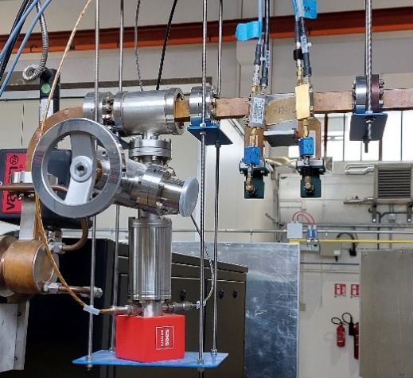
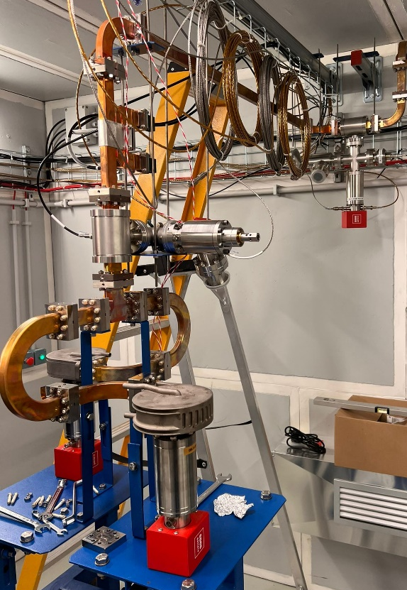
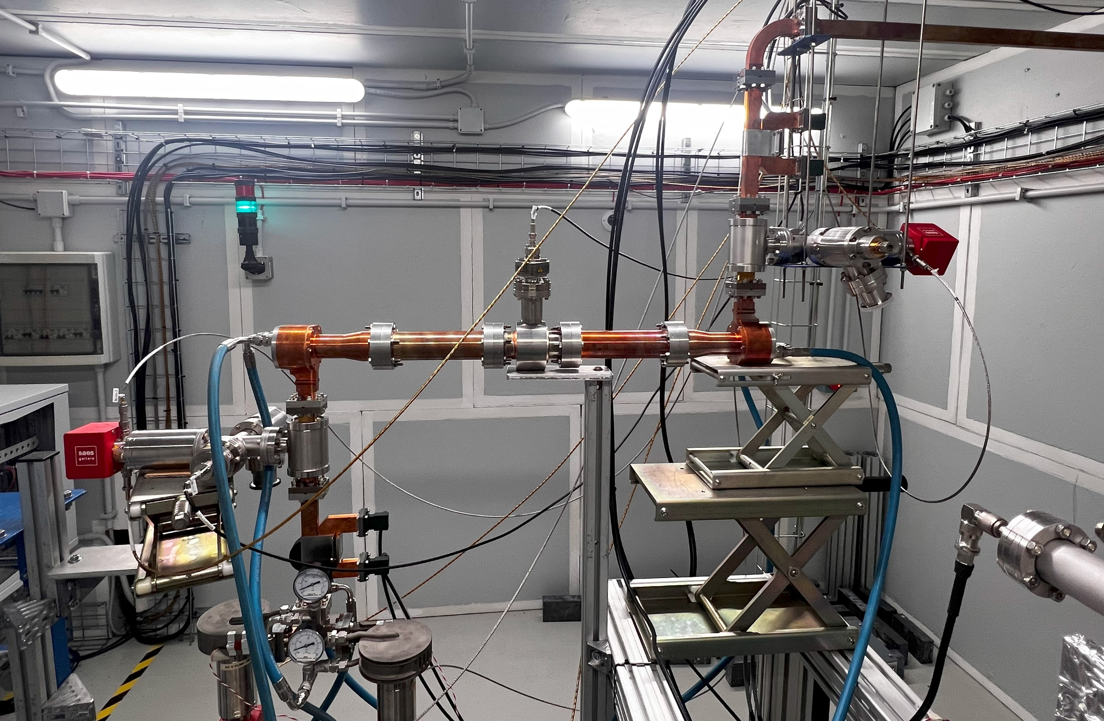
X-band WAVEGUIDE COMPONENTS AND PULSE COMPRESSOR
COMPONENT | DESIGN BY | STATUS | LEVEL OF POWER TO BE TESTED | COMMENTS
Pump units (rect. Wav.) | CERN | Fabricated and installed @ TEX | 25 MW 1.5 μs and 70-35 MW 0.13 μs Compressed pulse 100 Hz | Testati finora fino a 0.6 μs, 50 Hz, 33 MW e 200ns, 50Hz, 49MW
Directional coupler | CERN | Fabricated and installed @ TEX | 25 MW 1.5 μs and 70-35 MW 0.13 μs compressed pulse 100 Hz | Testati finora fino a 0.6 μs, 50 Hz, 33 MW e 200ns, 50Hz, 49MW
Splitter | CERN | Fabricated and installed @ TEX | 70-35 MW, 0.13 μs Compressed pulse 100 Hz | Testati finora fino a 0.6 μs, 50 Hz, 33 MW e 200ns, 50Hz, 49MW
RF load | CERN | Fabricated and installed @ TEX | 18-9 MW 0.13 μs compressed pulse 100 Hz | Currently, realization is by additive manufacturing. We are developing a design that can be implemented by milling, Testati finora fino a 0.6 μs, 50 Hz, 16 MW.
Mode converter circular/rectangular | INFN | Fabricated and Installed @ TEX | 25 MW 1.5 μs 100 Hz | Testati finora fino a 0.6 μs, 50 Hz, 25 MW
Pump unit (circ. Waveg.) | INFN | Fabricated and Installed @ TEX | 25 MW 1.5 μs 100 Hz | Testati finora fino a 0.6 μs, 50 Hz, 25 MW
3dB hybrid | CERN | To be ordered | 140-70 MW 0.13 μs Compressed pulse 100 Hz
BOC pulse compressor | PSI | Ordered (Delivery Spring 24) | 140-70 MW 0.13 μs Compressed pulse 100 Hz | We also have brazing free design we would like to built

Slide 11
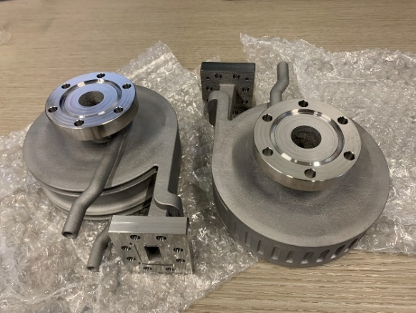
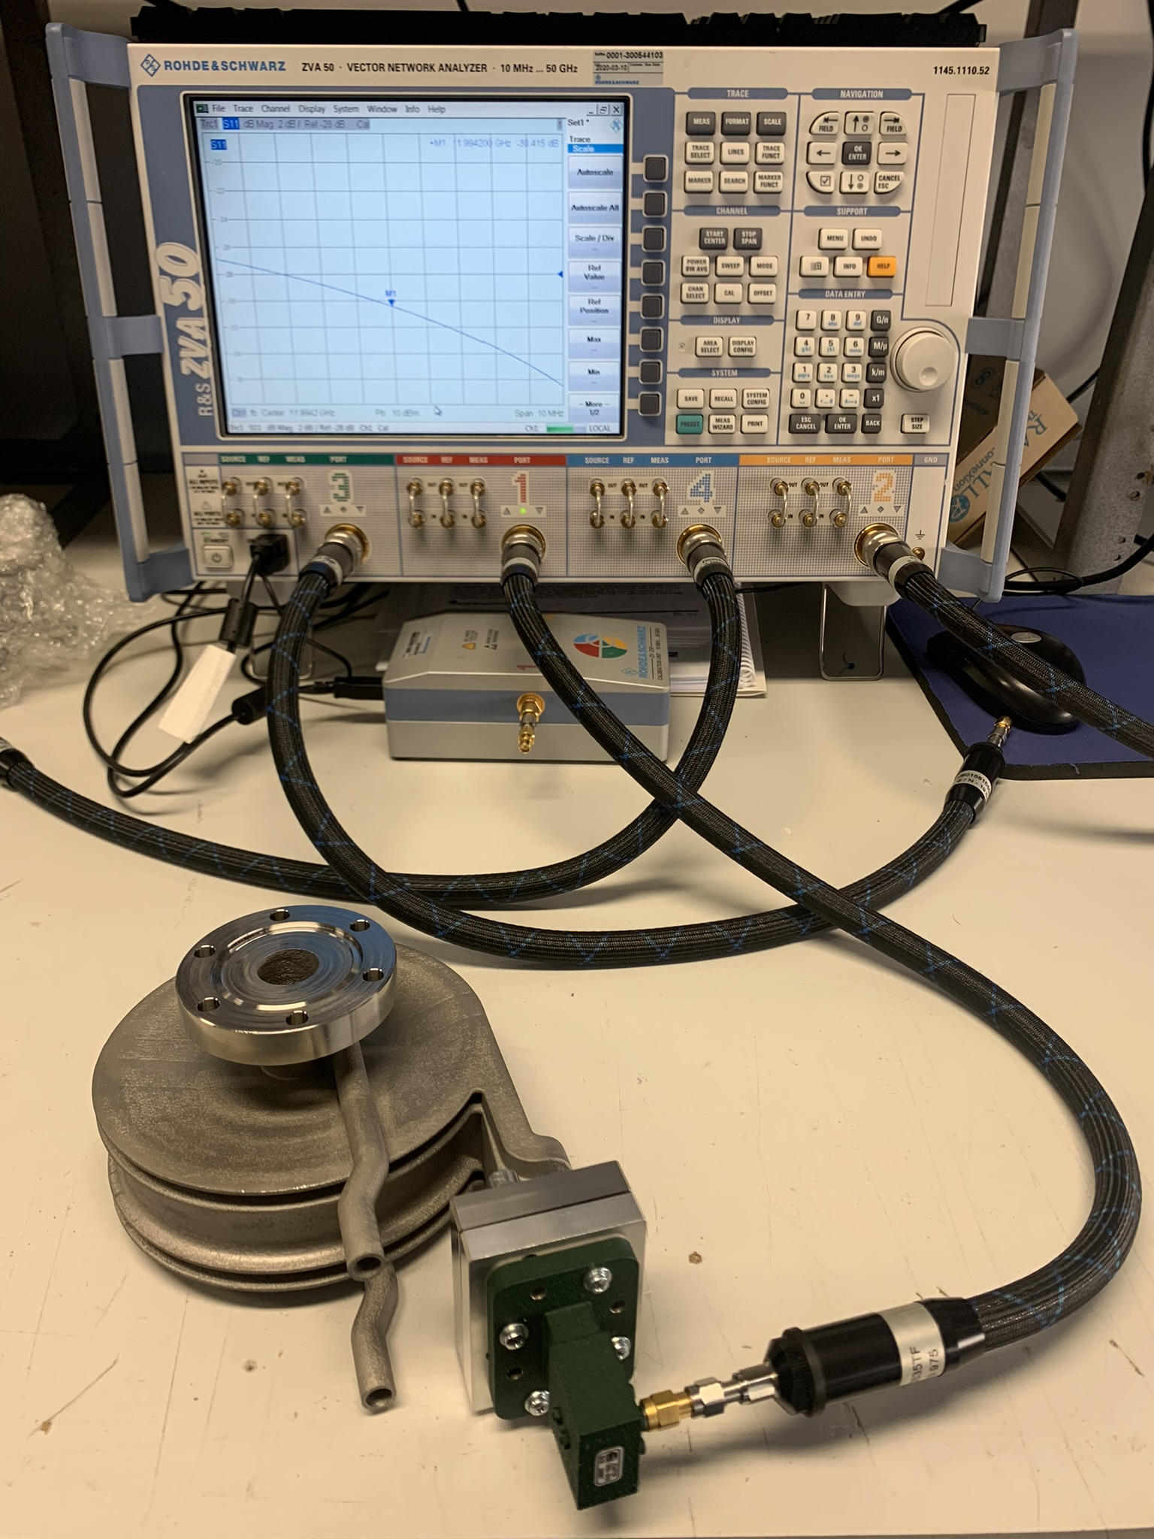
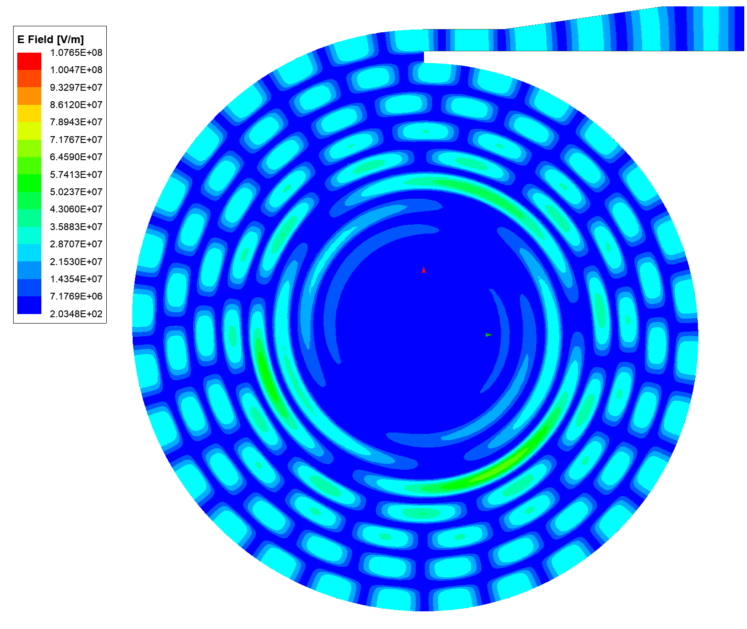
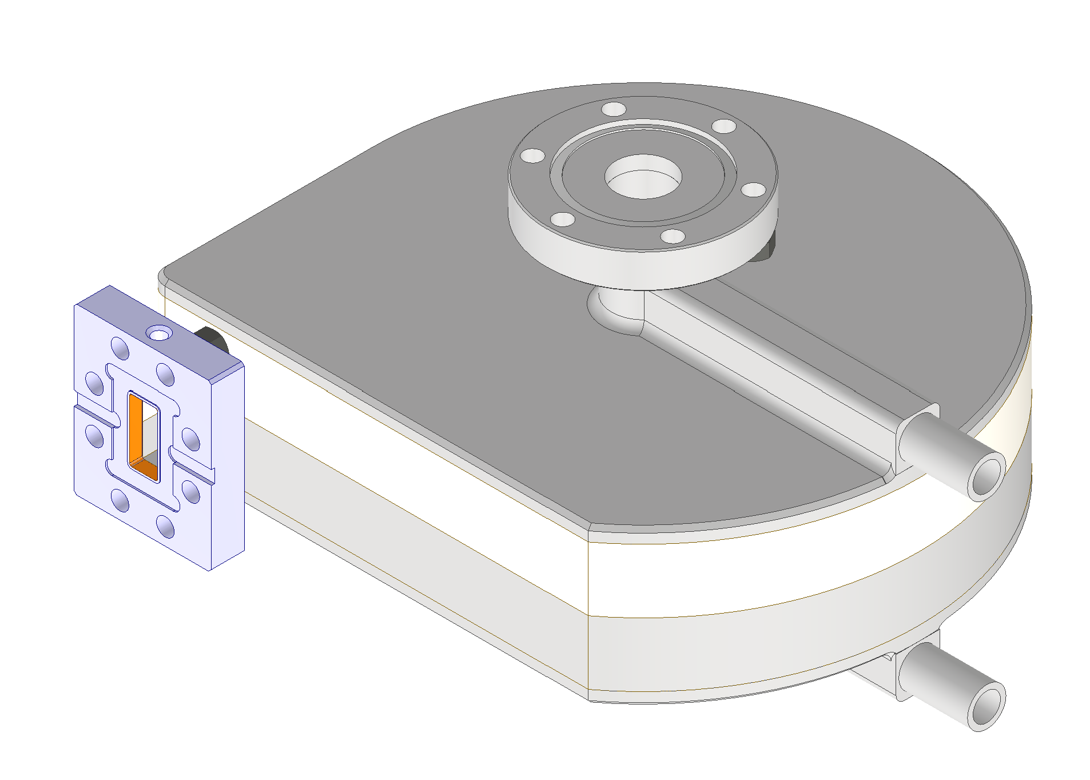
RF SPIRAL LOADS
Several X-band components needed for the EuPRAXIA module are based on CERN design and have been manufactured, purchased and installed in TEX: directional couplers, pumping units, splitter, loads.
3D printed Ti spiral load
We procured 6 spiral loads 3D printed. Two has been installed and conditioned up to 35 MW with 200 ns pulse length at 50 Hz.
# | Company | S11@f0 [dB]
001 | 3t am | -31
002 | 3t am | -30
003 | ISC | -37,7
004 | ISC | -36,4
005 | ISC | -42
006 | ISC | -43,9
Machined spiral load
EM and mechanical design: done
Manufacturing : ongoing
Spiral loads

Slide 12
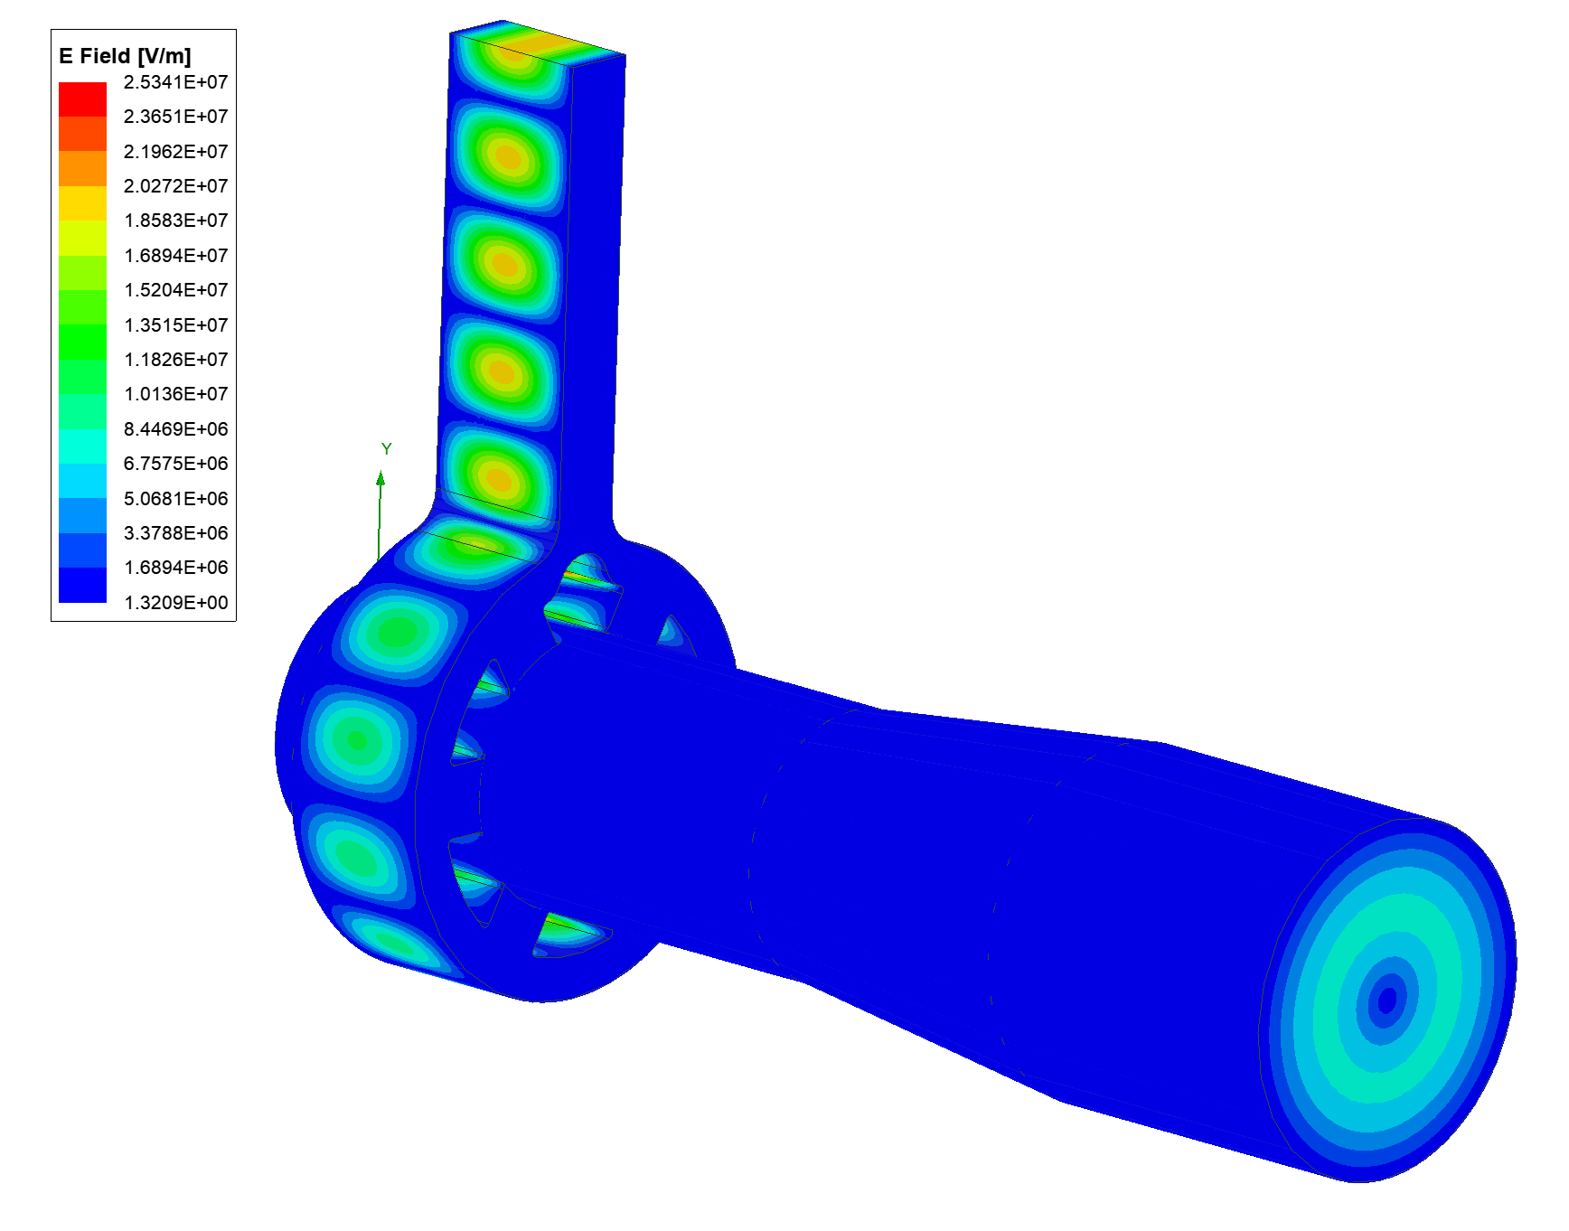
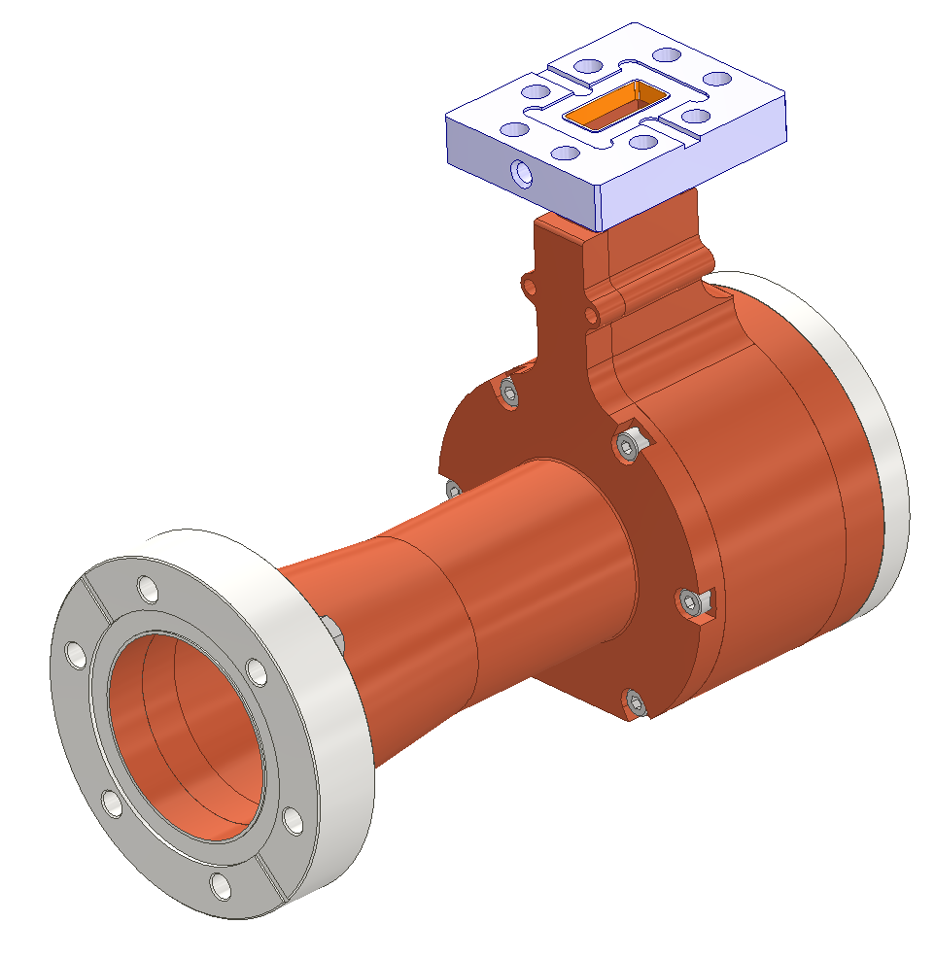
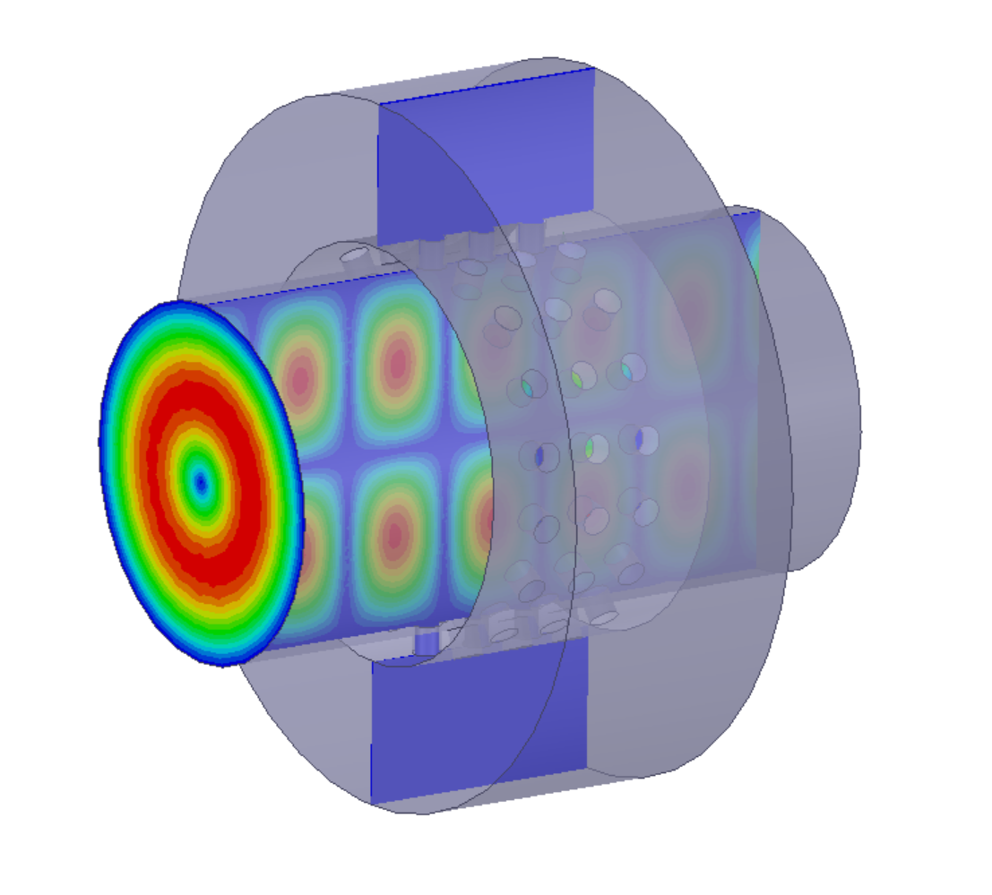
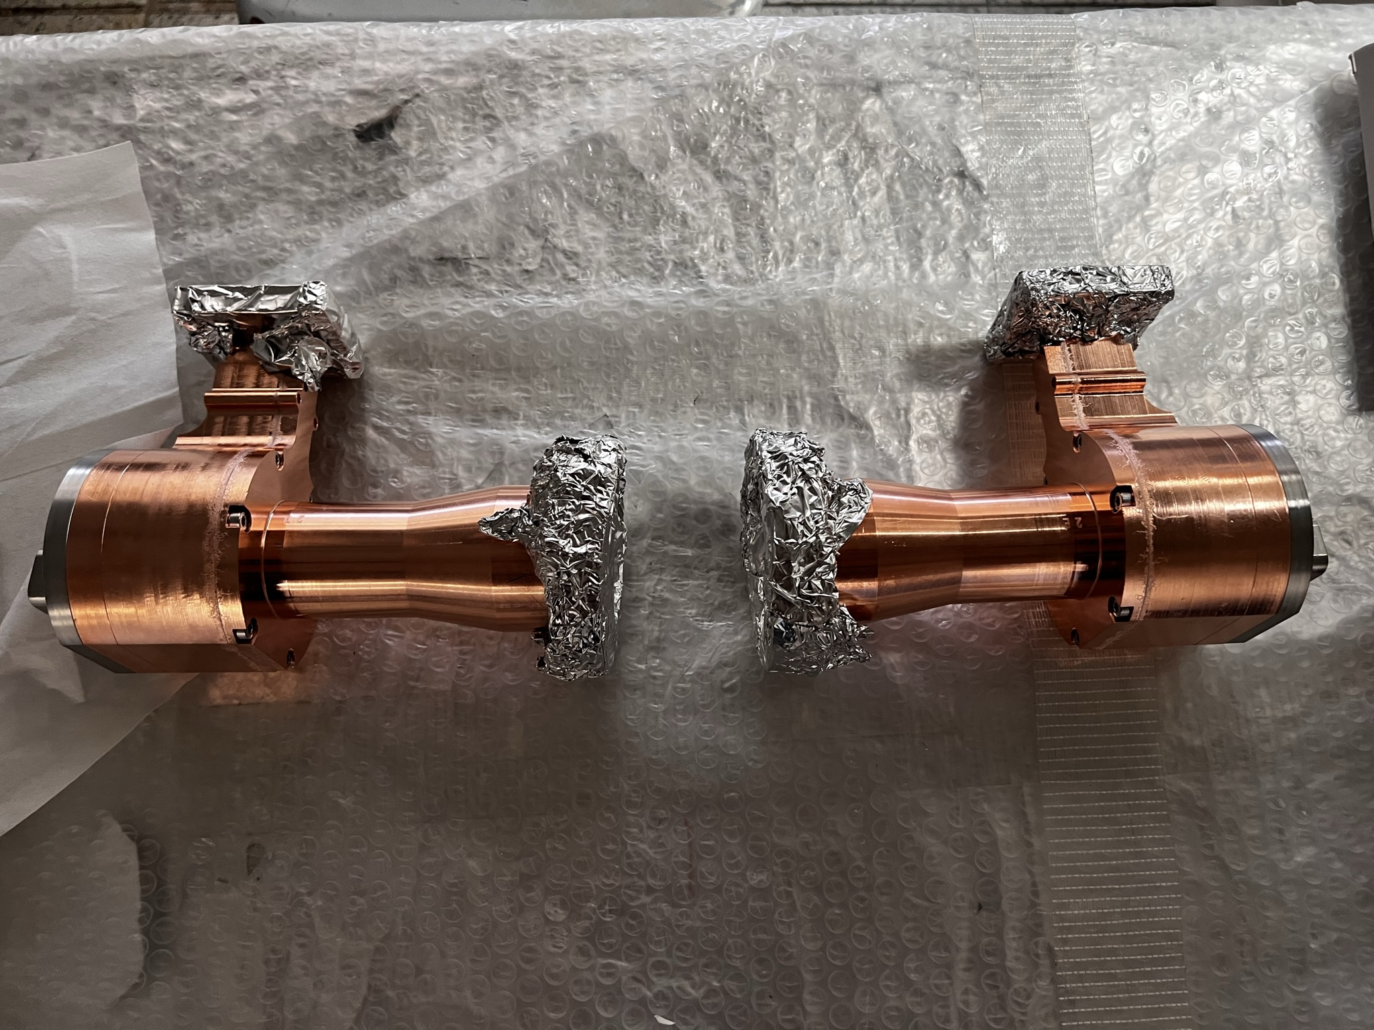
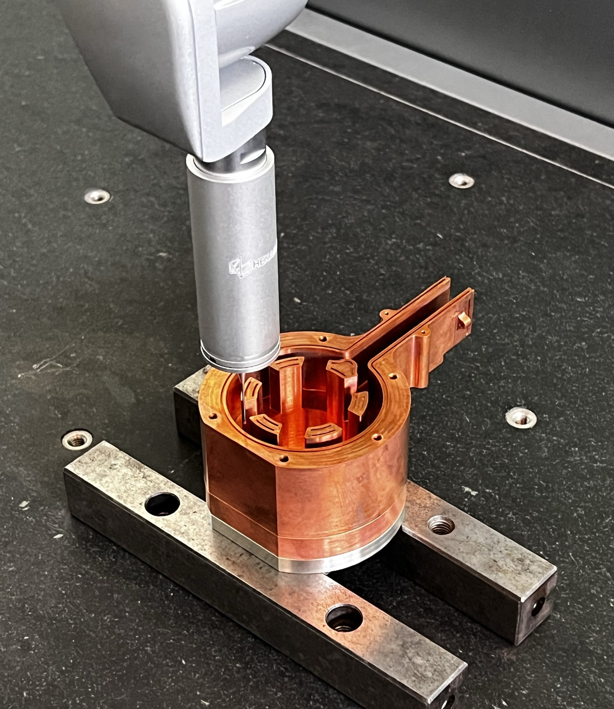
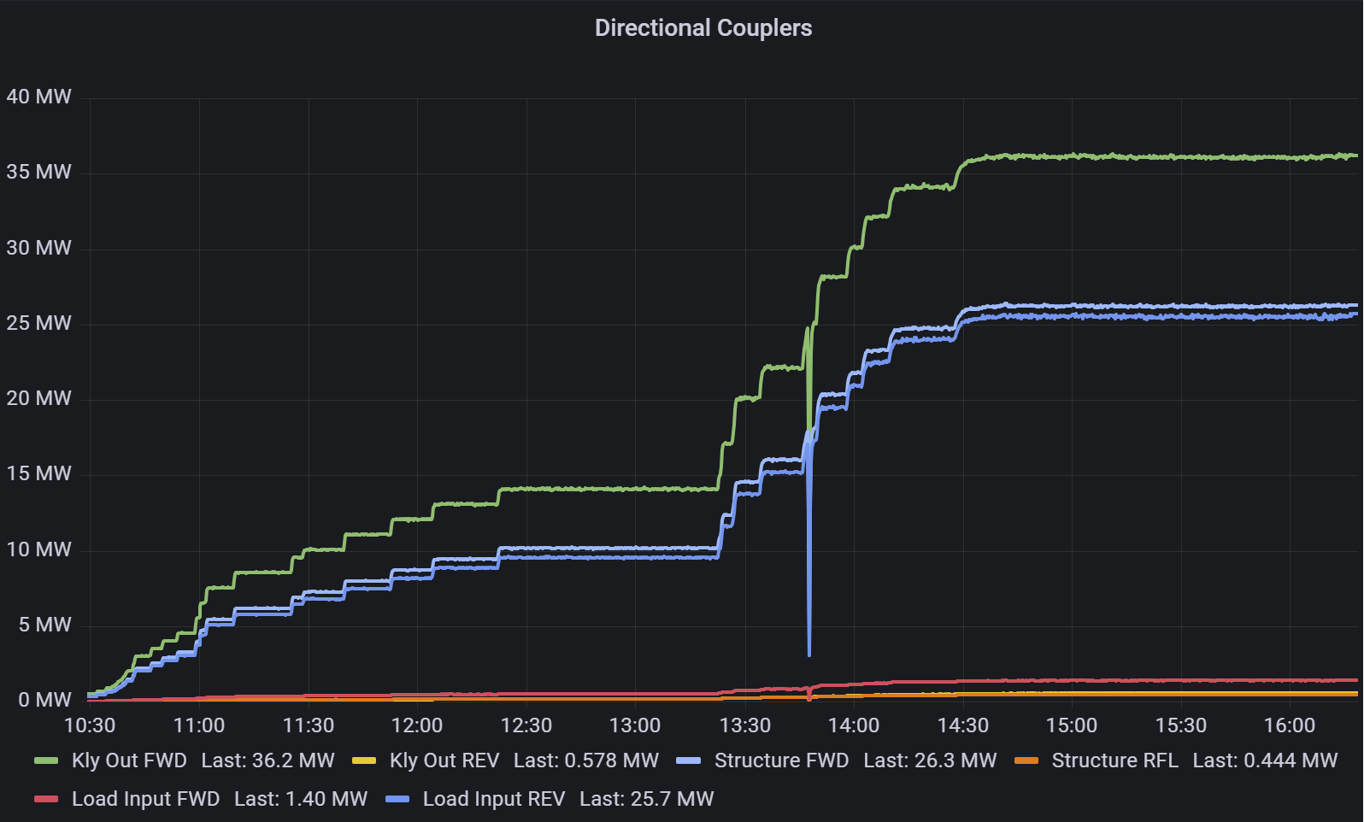
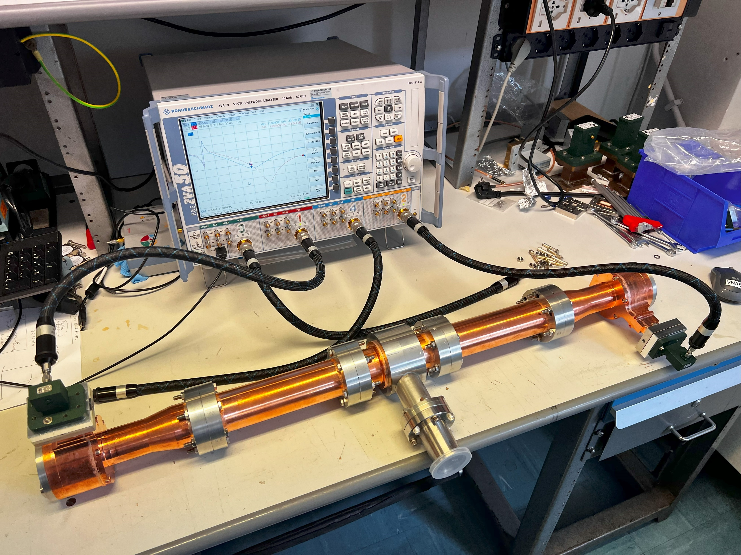
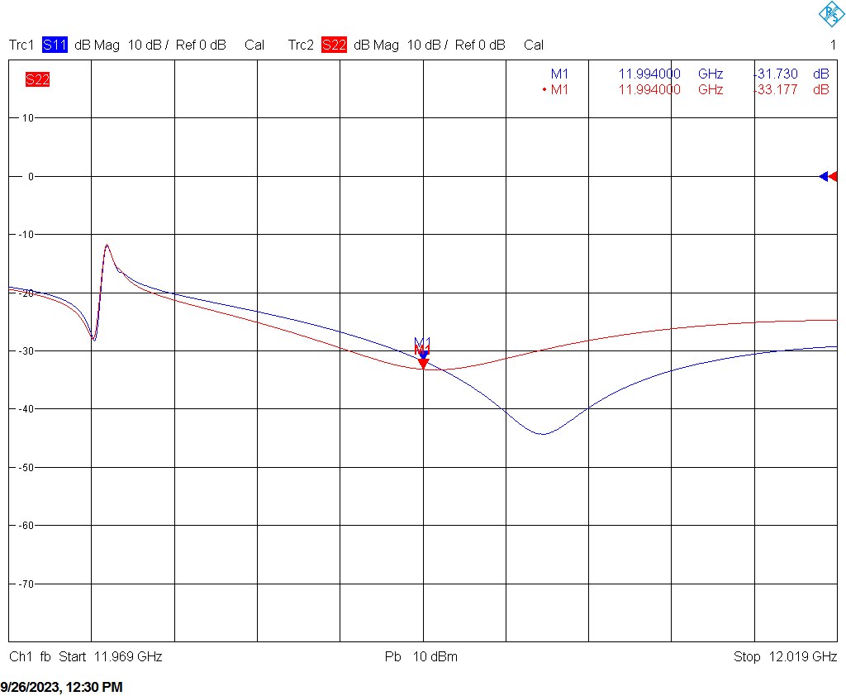
RECTANGULAR/CIRCULAR MODE CONVERTER AND PUMPING UNITS
Modified version of the “wrap around” mode converter from TE₁₀ to TE₀₁ developed at SLAC and pumping port for circular waveguide
EM and mechanical design: done
Machining by a private company: done
Brazing at INFN-LNF: done
Low Power RF test: done
High Power test: Ongoing

Slide 13
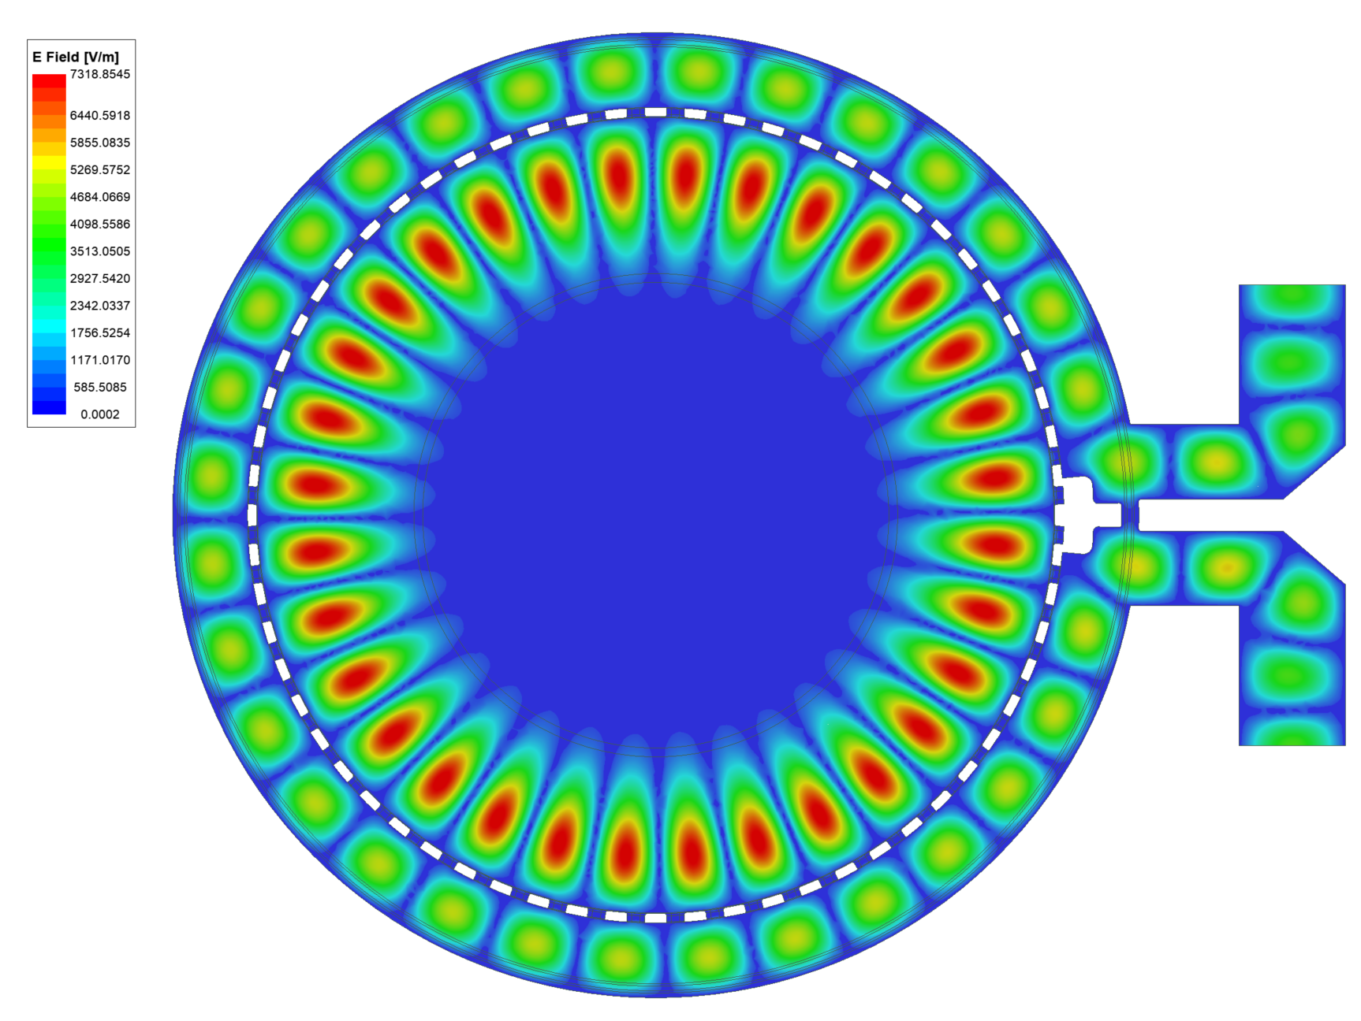
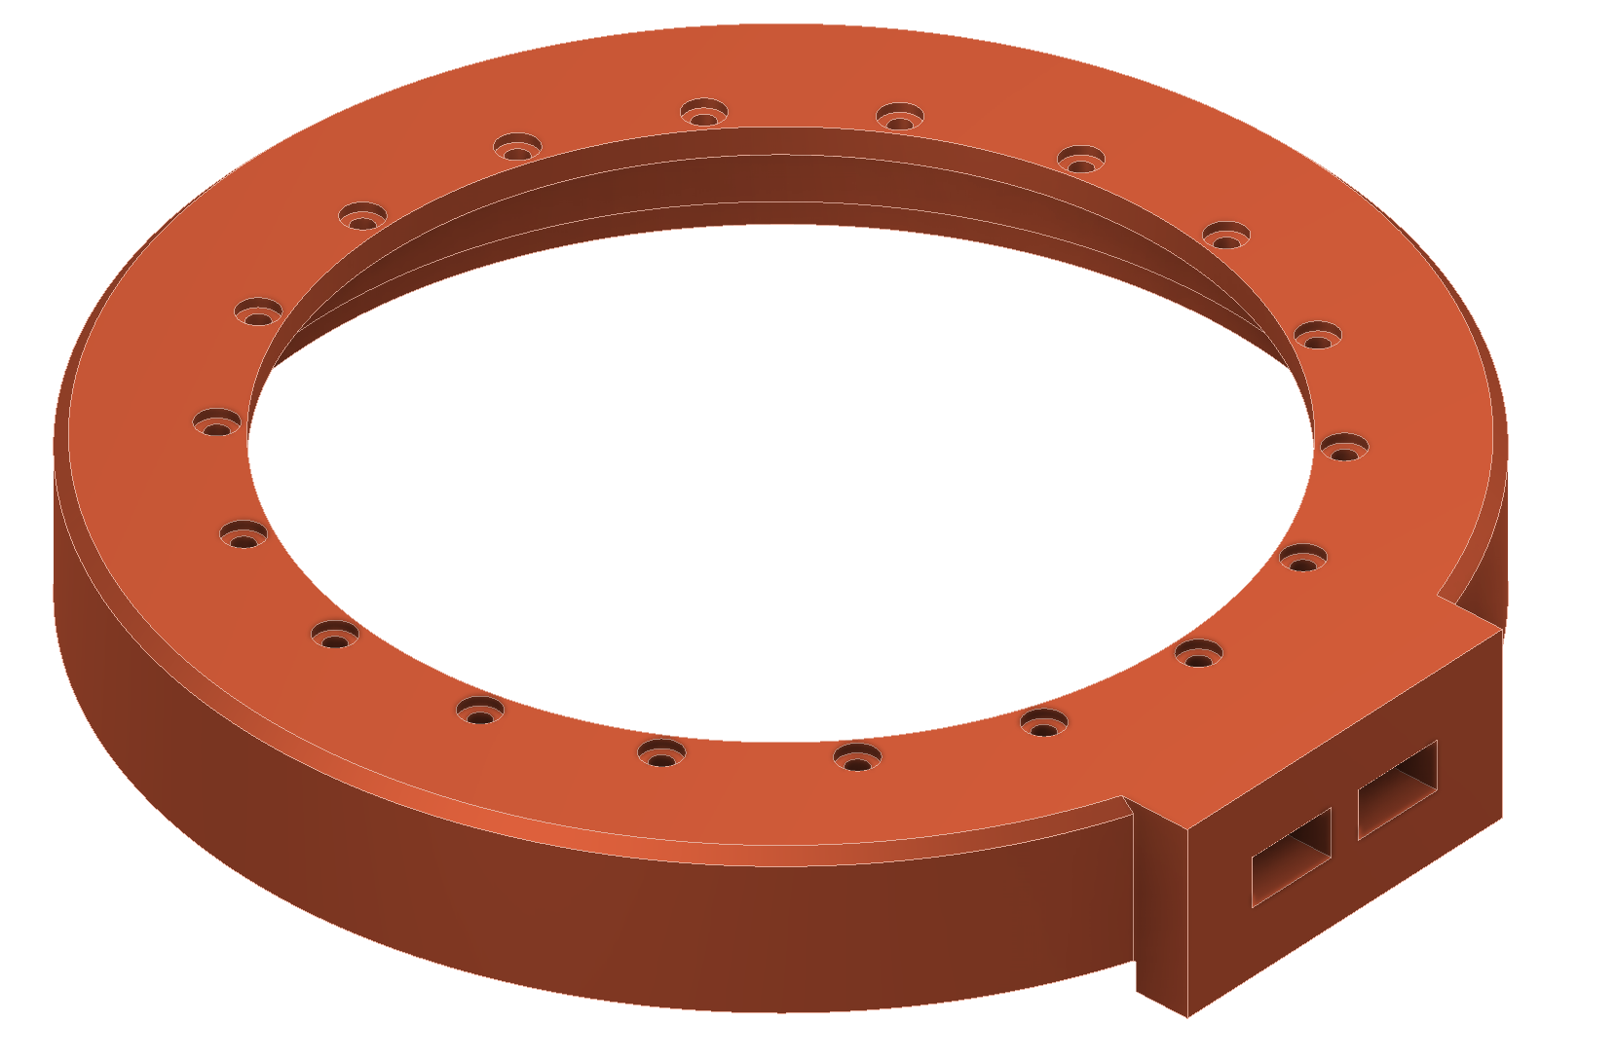
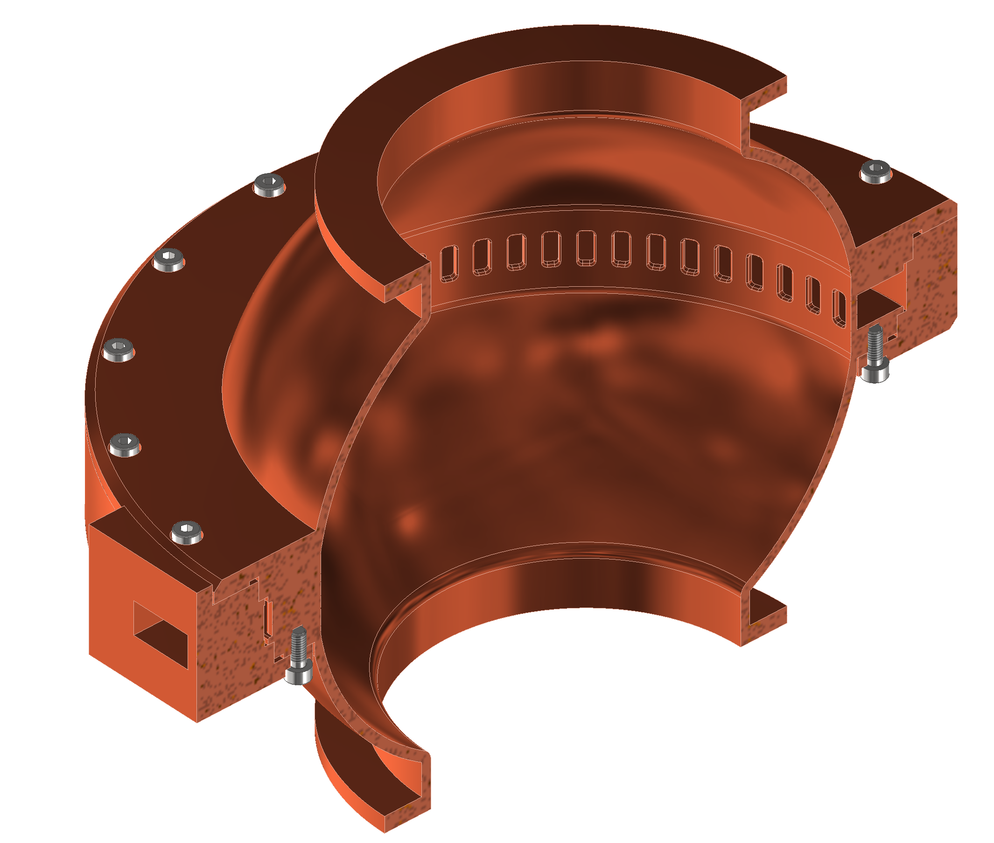
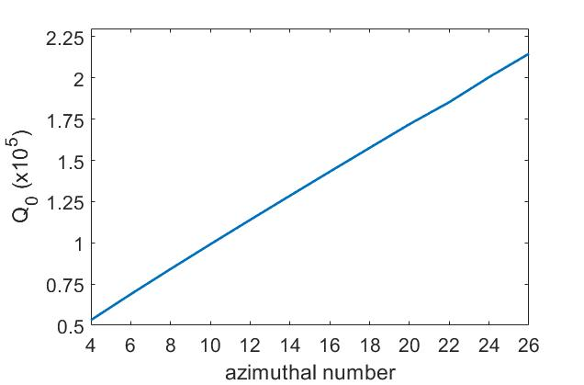
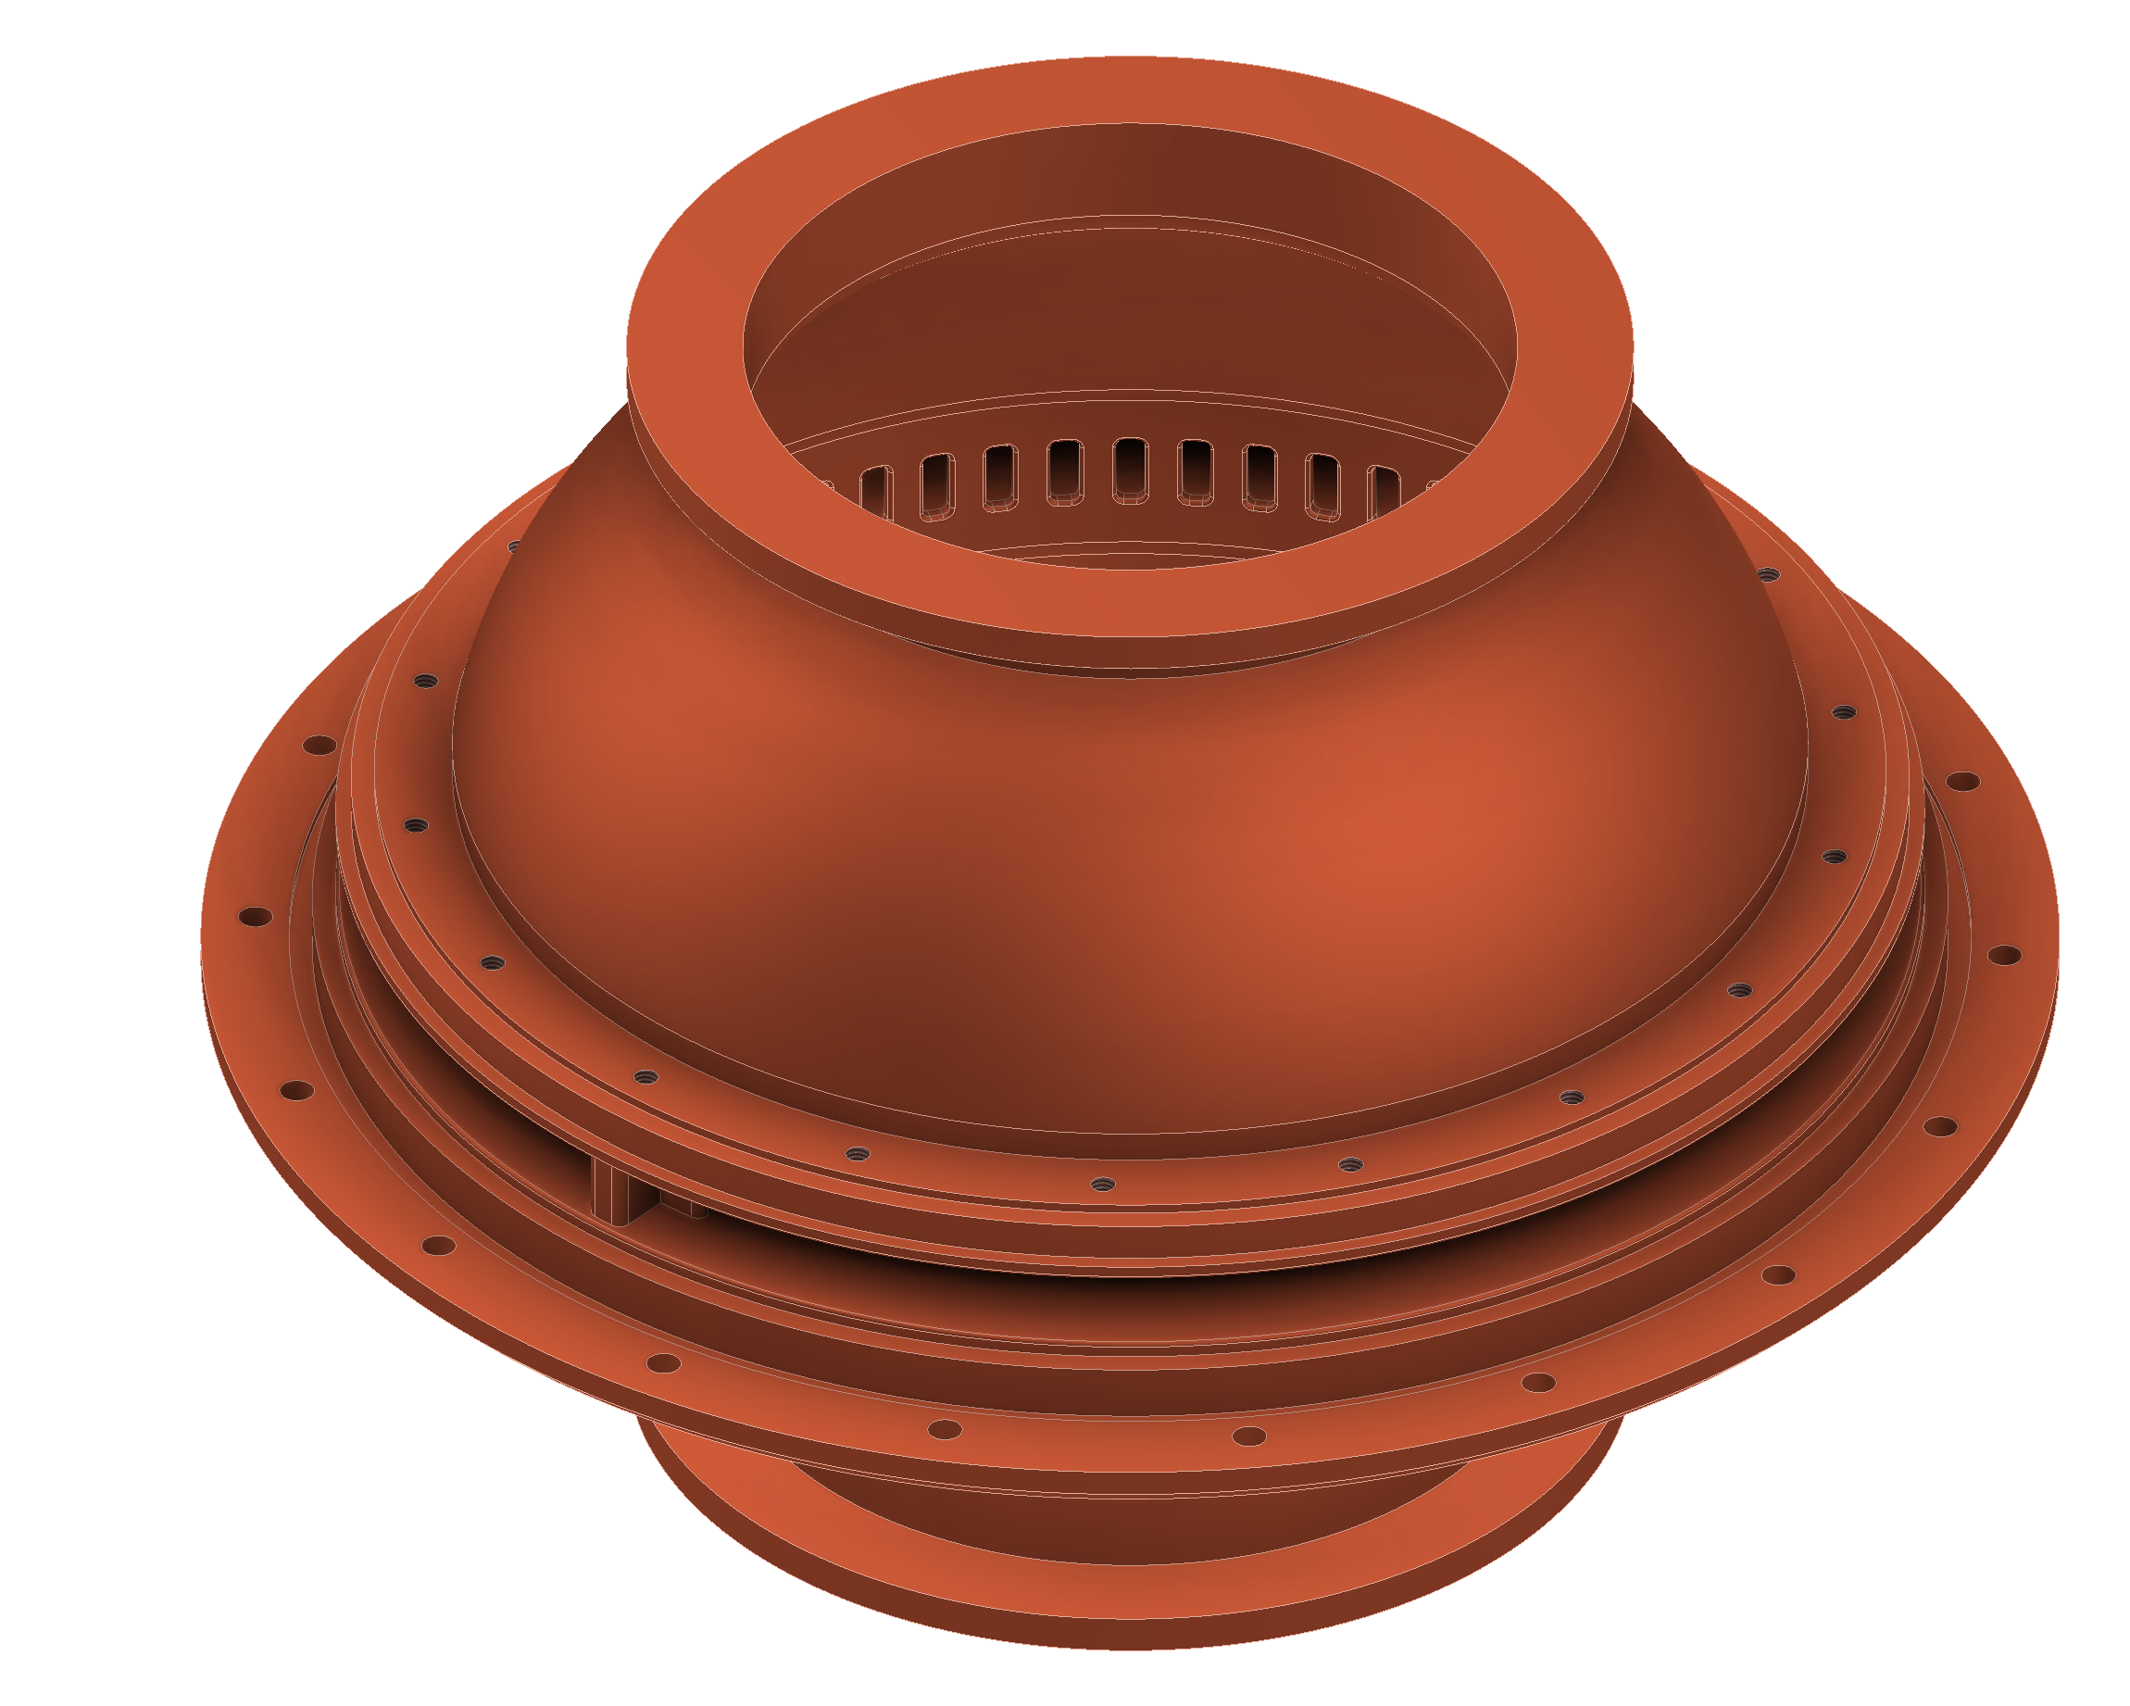
Brazing free BOC pulse compressor
Pulse Compressor | Parameter
Frequency | 11.994 GHz
Resonant Mode | TM_{16,1,1}
Diameter | 171 mm
Q₀ | 130000
Coupling factor β | 6.5
The BOC we are now being purchase is from PSI
We are developing a new design for X-band BOC that implements the INFN-LNF brazing-free technology. The brazing free or “clamping” technology is based on the use of special RF/vacuum gaskets
EM design: done
The mechanical design and cooling system design: ongoing
In order to use a single copper gasket for both vacuum and RF contact the use of CuZr is under investigation
Special gaskets

Slide 14
RF X-BAND LINAC: TDR STRUCTURE

Slide 15
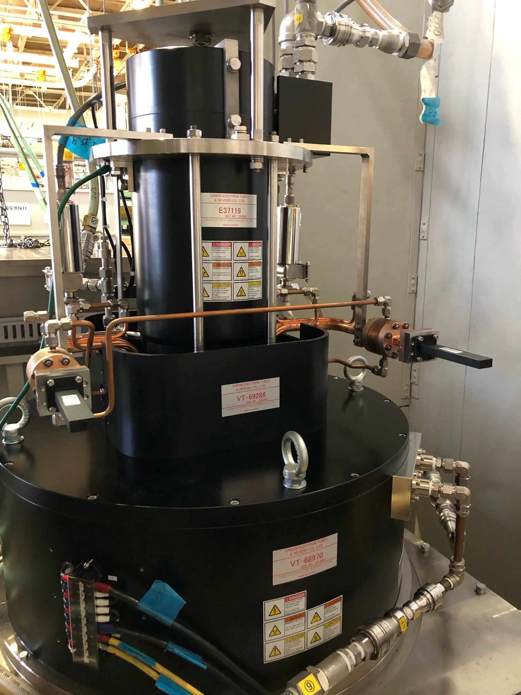

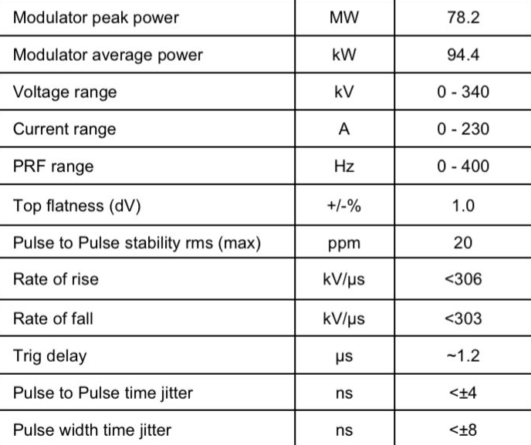
X-band RF Power Source
KLYSTRON
CANON E37119
Parameter | Unit | Canon E37119
Frequency | MHz | 11994
Vk beam voltage | kV | 318
Ik cathode current | A | 197
Peak RF output Power | MW | 25
Average RF output power | kW | 15
Modulator Average power | kW | 75,2
RF pulse length | μs | 1,5
Repetition Rate | Hz | 400
Gain | dB | 47
Efficiency | % | 40
Perveance | μP | 1.16
CANON E37119 klystron with modulator is in procurement phase:
    FAT done @CANON 11/2023, 10 Hz, diode mode, klystron only
    FAT do be done with modulator @ SCANDINOVA spring 2024
MODULATOR
SCANDINOVA K300
    FAT to be done spring 2024

Slide 16
RF X-BAND LINAC: TDR STRUCTURE

Slide 17

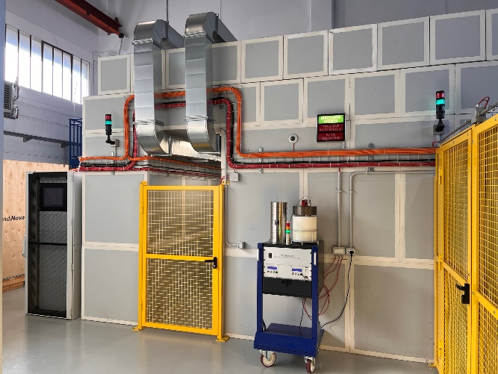
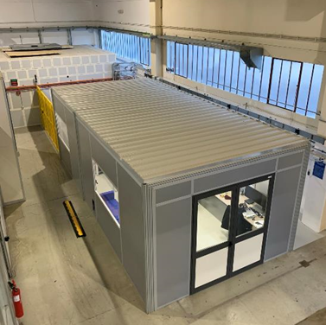
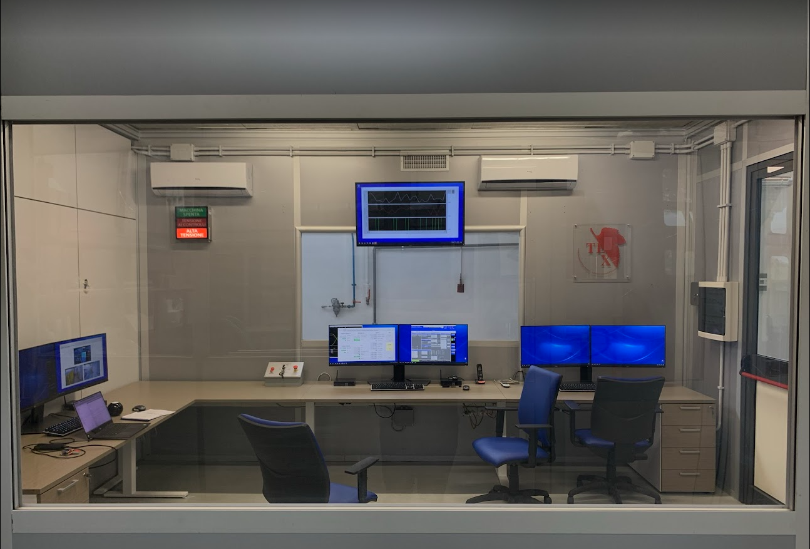
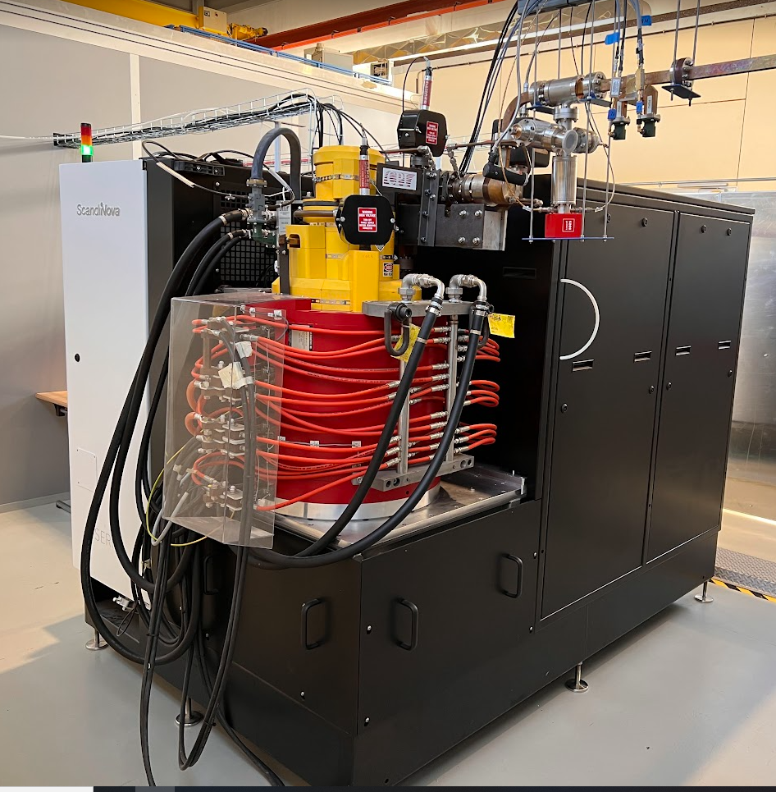
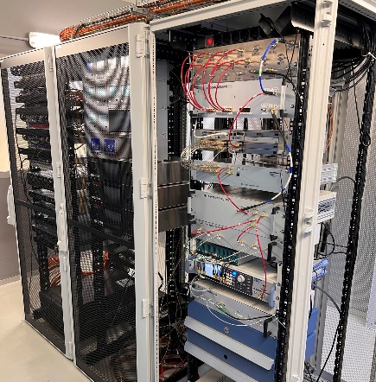
X BAND HIGH POWER TEST: TEX Facility
Concrete Bunker
Modulator
Accelerating structure
The TEst-stand for X-band (TEX) is conceived for R&D and test on high gradient X-band accelerating structures, RF components, LLRF systems, Beam Diagnostics, Vacuum system and Control System;
It has been co-funded by Lazio region in the framework of the LATINO project (Laboratory in Advanced Technologies for INnOvation). The setup has been done in collaboration with CERN and it will be also used to test CLIC structures;
It is now in operation with the SCANDINOVA K400 and CPI KLYSTRON (from CERN) VKX8311A
Will be upgraded with:
  Scandinova K300 and CANON KLYSTRON E37119, baseline EUPRAXIA (spring 2024)
  Scandinova K300 modulator with Canon E37217, C Band, 400 Hz (spring 2024)
  CPI klystron will be upgraded to the high efficiency klystron VKX8311HE (expected delivery 02/2025).
SSD
LLRF
Klystron
DC
DC
DC
DC
Control Room
Operational Parameters | Unit | VKX8311A
RF frequency | GHz | 11.994
RF Peak Power | MW | 50
Gain | dB | 48
Modulator Peak Power | MW | 140
Operational voltage | kV | 420
Operational current | A | 320
PRF | Hz | 100
Pulse length (top) | us | 1.5
Efficiency | % | 40
RF Source
LLRF system

Slide 18
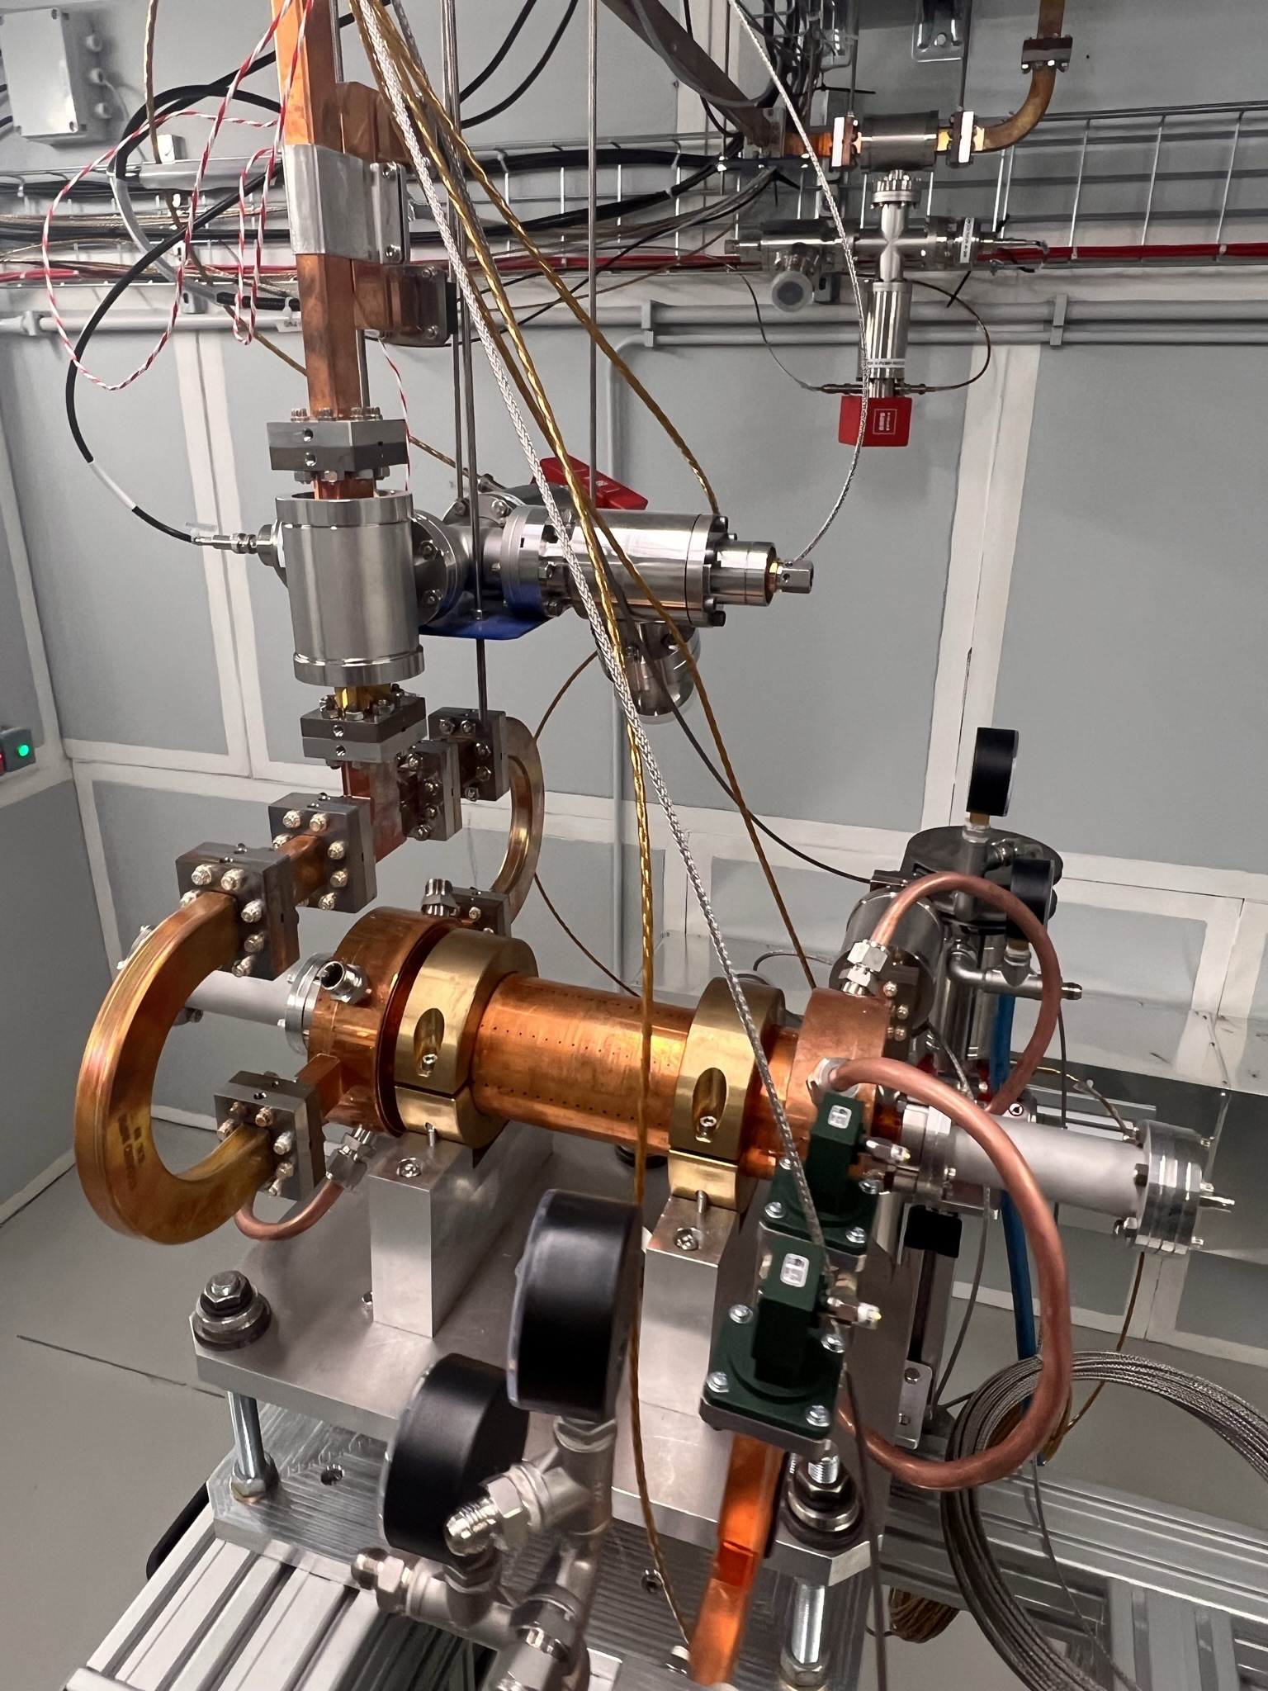
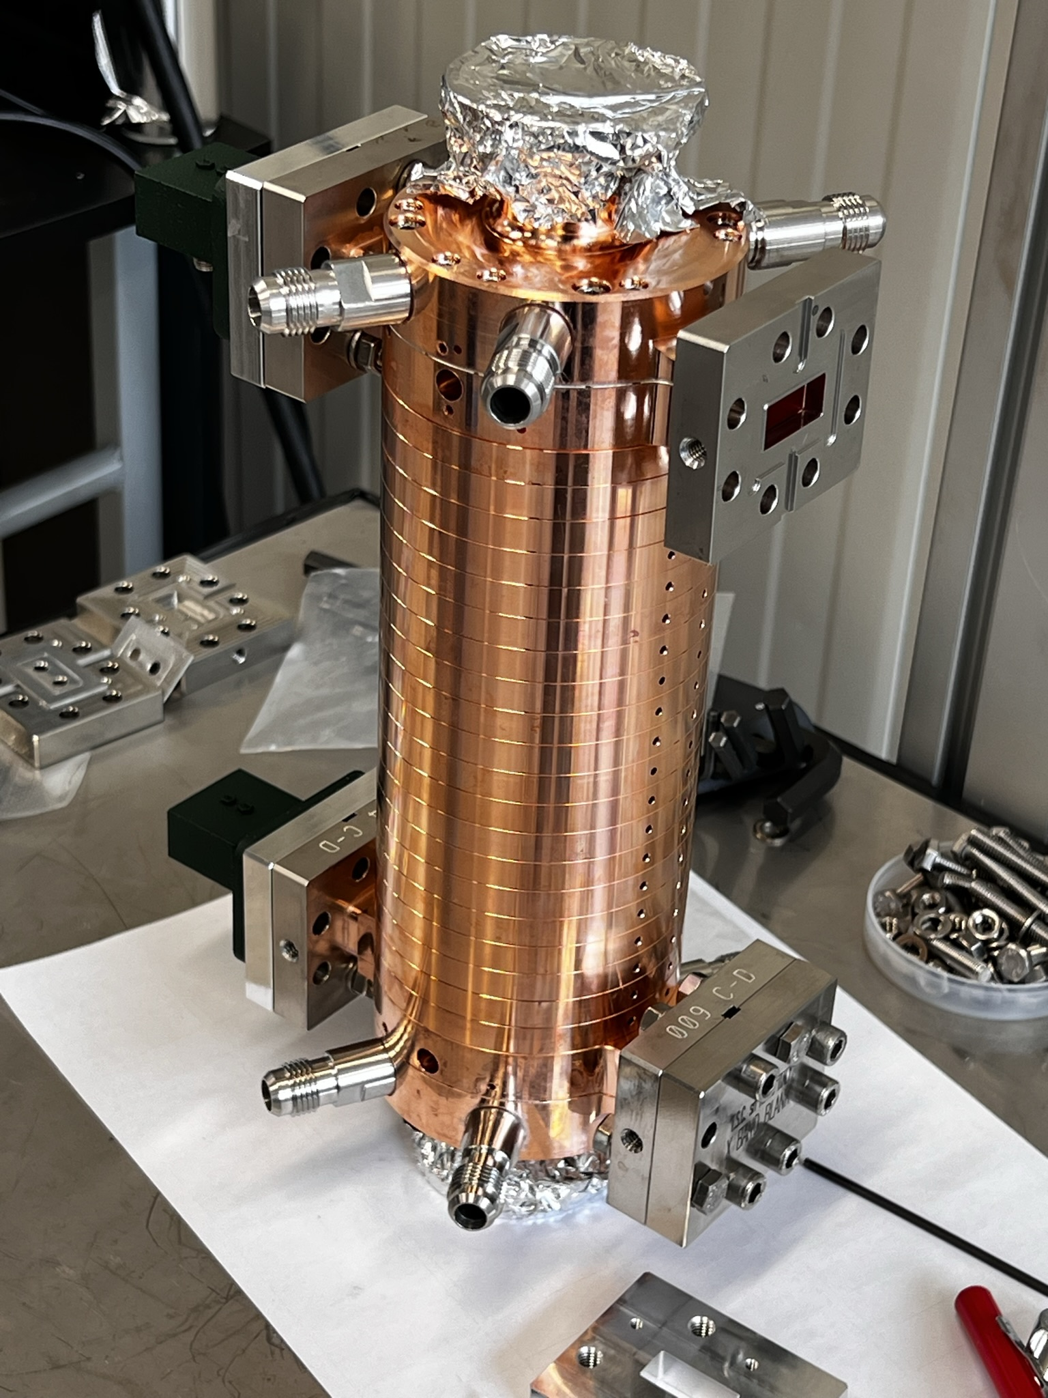
TEX Facility ACTIVITY: DONE AND PLANNED
Spiral Load/waveguide elements conditioning
CLIC structure conditioning
Mode launcher circular/rectangular
Intervention for cooling, power upgrade etc
New RF sources commissionig
EUPRAXIA prototypes
EUPRAXIA module test with BOC
1/1/23
1/5/23
1/9/23
1/1/24
1/5/24
1/9/24
1/1/25

Slide 19
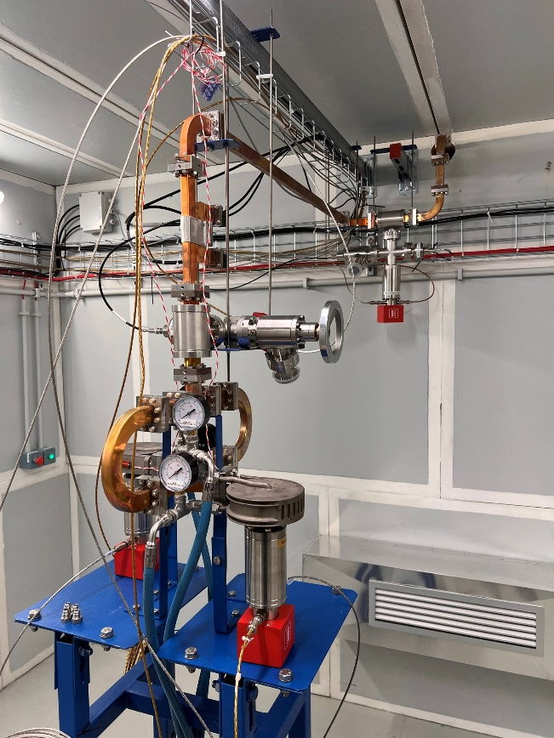
CONDINIONING of waveguides and Spiral Loads
A conditioning run of the waveguide distribution line terminated on two 3D printed Titanium Spiral Load has been completed in February 2023
A final forward klystron peak power of 42 MW with 250 ns pulse length at 50 Hz has been reached in 3 weeks. The test has been interrupted to perform some civil work in the building
The forward Klystron power has been gradually increased with an automatic conditioning routine integrated in the control and machine protection system [5]
Directional coupler
Pumping unit
3D printed spiral loads
Power splitter

Slide 20
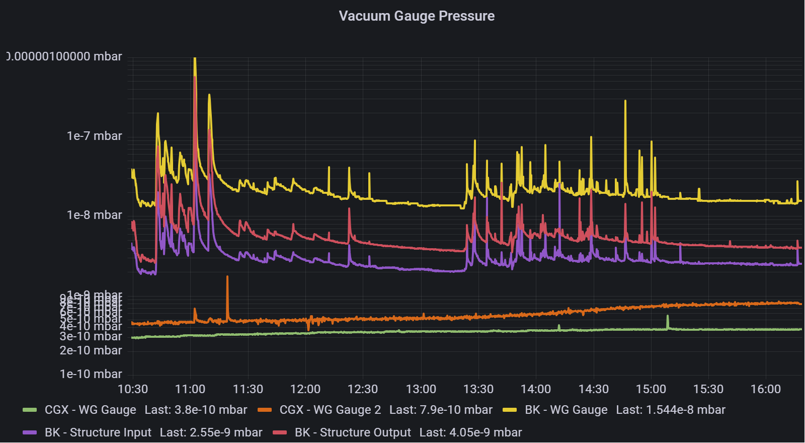
TEST OF Mode RECT./CIRC. MODE Converter AND CIRC. PUMPING UNIT
Modified version of the “wrap around” mode converter from TE₁₀ to TE₀₁ developed at SLAC and pumping port for circular waveguide
EM and mechanical design: done
Machining by a private company (TSC): done
Brazing at INFN-LNF: done
Low Power RF test: done
High Power test: Ongoing

Slide 21
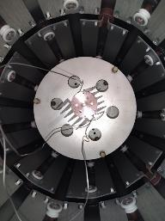
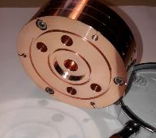
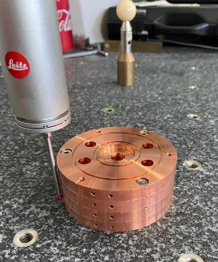
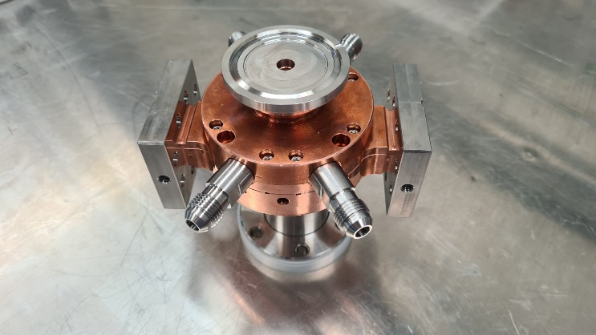
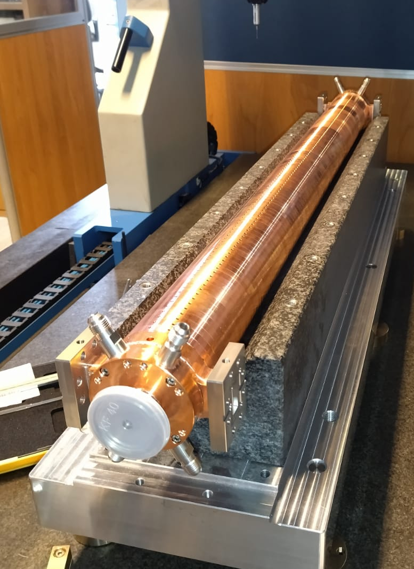
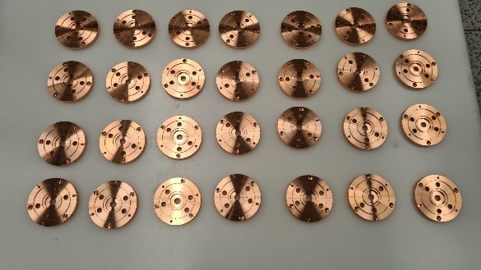
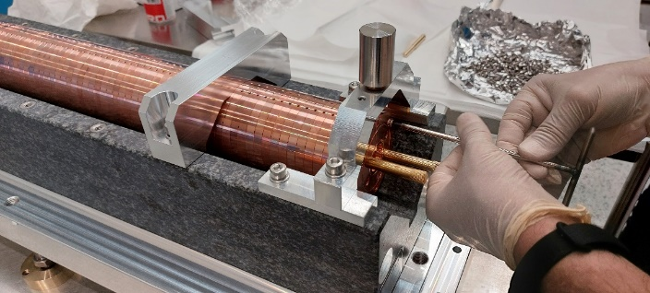
X band Structure Prototyping Activity: MECHANICAL/VACUUM
Four main steps of prototyping:
Pre-prototypes on 3-cells and simplified couplers to test and optimize the brazing procedure, cells assembly, alignment etc: done
2 Full scale mechanical prototypes: 0.9 m prototype to test the overall brazing process of the full structure and the cell-to-cell alignment before and after brazing: done
25 cells RF prototype for high power test w/o tuning, constant impedance: final brazing done yesterday
Final full scale EuPRAXIA@SPARC_LAB structure prototype 0.9 m constant impedance: spring 24

Slide 22
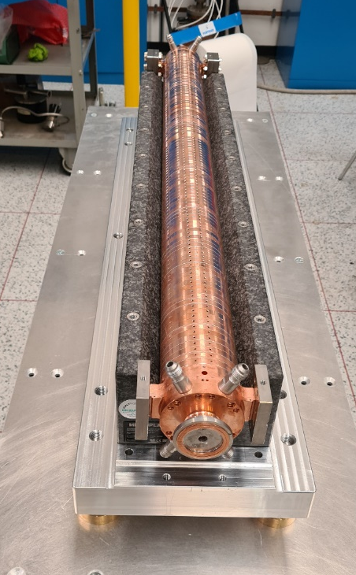
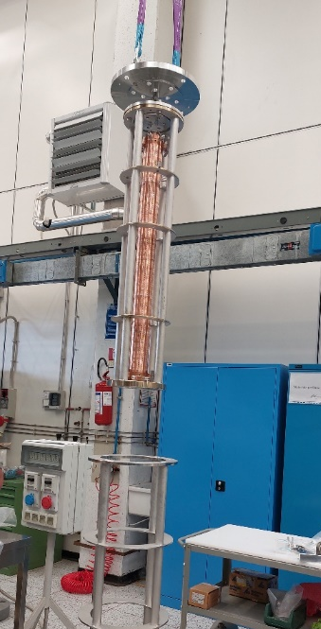






X band Structure MECHANICAL/VACUUM PROTOTYPE: RESULTS
Full scale mechanical prototype brazing
To maintain the alignment and cell to cell straightness during and after the brazing process, each cell is fixed to the next one by means of screws and mounted on a very precise granite support. This ease also the cells assembly
Results on the brazed structure
Vacuum test OK (except one coupler for a miss-positioning of the brazing alloy)
Straightness ±15 μm obtained after brazing (±30 μm required by BD)

Slide 23




RF Prototype: RESULTS (1/2)
X-band, 25 (+2) cells, CI, travelling wave structure prototype
The structure has been realized without tuners on the cells
Measurement conditions in air:
  T_{cav} = 24.9°C, T_{amb} = 24 °C
  P = 1,006 bar
  Humidity = 37 %
  f₀ = 11.9942 GHz
  T_{op} = 25 °C
Vacuum to ambient frequency = 11.9905 GHz
Measurement of reflection and transmission coefficient of the structure before brazing, fed with an input splitter

Slide 24


RF Prototype: RESULTS (2/2)
The frequency shift due to the wire is about 1 MHz at the working frequency
Results of the beadpull test:
Phase advance per cell
Cumulative Phase advance
f_{cw} = 11.9925 GHz
Average Phase advance = 120,2 °
At this frequency the cumulative slope is compensated (±2 deg) and seems to have the best response from the cells, if we add the wire contribution f₀ = 11.9935 GHz → T_{cav} = 35-40°C

Slide 25



X-band LLRF activities at TEX and R&D for EuPRAXIA@SPARC_LAB
  To drive and control the X-band RF power stations a dedicated Low-Level RF systems must be developed
  The systems must reach stabilities at the state of the art of the existing technology.
  At present no X-band commercial systems are available on the market
  The RF group has already developed and commissioned a hybrid system made of:
  S-band Libera LLRF (commercial solution from Instrumentation Technologies)
  Custom UP/DOWN converter and reference generation systems developed at LNF
  Very good performance achieved at TEX:
    amplitude stability: 0.02%,
    phase stability: 0.09 deg (20.7 fs)
There are however some limitations of such approach, that could be overcome with an R&D activity of Instrumentation Technologies either on the S-band system (keeping the UP/DOWN converter scheme), or on a brand-new X-band system (expensive)
We are also performing a survey of other partners that could be interested to supply these systems:
  PSI for SwissFEL has developed, commissioned and put in operation a LLRF system close to the EuPRAXIA needs in terms of performances. Some R&D is however needed (e.g. to support 400 Hz operation, migrate platform from VME to Compact PCI, and eventually try to push the performance of amplitude and phase stability further). During a first informal meeting, PSI and INFN-LNF LLRF groups expressed their interest in setting up a collaboration. However, the effort must be better defined (in terms of schedule, required R&D, support, product maintenance and so on) due to the limited manpower and resources available at PSI
  There is also and interest of LNF Research Division Electronics Lab to start to work together on a simple prototype, to understand if we have the capabilities to develop an entire system only with LNF in-kind contributions. This could have several benefits: train young engineers on LLRF systems and FPGA programming, having the know-how to solve and repair any malfunctioning of the systems, cheaper option. At the expenses of a much more complicated and time-consuming R&D program.
In any case, TEX facility will be extremely useful to test any prototype or RF feedback electronics in the road to EuPRAXIA@SPARC_LAB TDR and beyond

Slide 26
RF X-BAND LINAC: CONCLUSIONS
The structure of the TDR related to the X band LINAC has been shown
All the different topics have been identified and the content has been illustrated
Our goal is to demonstrate the feasibility and reliability of the X band accelerating module: to this purpose all the waveguide elements have to be tested at TEX at nominal parameters
This work is in good progress and will be completed after the installation of the nominal X band power station (k300+CANON klystron): expected conclusion of the test beginning of 2025;
TEX will also allow to teste the LLRF performances
Not covered in this presentation but will be included in the TDR: Waveguide attenuation, Waveguide cooling (clamped), Module supports,…
THANK YOU!
Aknowledgements:
INFN-LNF: S. Bini, B. Buonomo, F. Cardelli, S. Cantarella, R. Clementi, M. Diomede, L. Faillace, A. Gallo, L. Giuliano, C. Di Giulio, E. Di Pasquale, G. Di Raddo, R. Di Raddo G. Latini, A. Liedl, V. Lollo, L. Piersanti, S. Pioli, R. Ricci, B. Serenellini, M. Zottola
CERN: W. Wuensh, N. Catalan-Lasheras, A. Grudiev, G. McMonagle on behalf of the CLIC and XBOX group
SLAC: V. A. Dolgashev

Slide 27
RF MODULE POWER SOURCES: OPTIONS
 | Unit | klystron CPI VKX8311HE | klystron CPI VKX8311HE
Frequency | MHz | 11994 | 11994
Heater Voltage | V | 20 | 30
Heater Current | A | 20 | 30
Vk beam voltage | kV | 318 | 415
Ik cathode current | A | 197 | 201
Peak drive power | W | 500 | 500
Peak RF output Power | MW | 25 | 50
Average RF output power | kW | 15 | 7,5
Modulator peak power | MW | 62,6 | 83,4
Modulator Average power | kW | 75,2 | 25
Modulator flat pulse | us | 3 | 3
RF pulse length | us | 1,5 | 1,5
Repetition Rate | Hz | 400 | 100
Gain | dB | 47,0 | 50
Efficiency | % | 40 | 55
Operational Parameters | Unit | VKX8311A
RF frequency | GHz | 11.994
RF Peak Power | MW | 50
Gain | dB | 48
Modulator Peak Power | MW | 140
Operational voltage | kV | 420
Operational current | A | 320
PRF | Hz | 100
Pulse length (top) | us | 1.5
Efficiency | % | 40
Procurement High Rep. Rate Canon Klystron through Scandinova is ongoing: to be finalized beginning of 2023. We placed the order through Scandinova that will provide the modulator K300 and because it is difficult to directly buy from CANON.
Procurement High Efficiency High Power CPI Klystron concluded. Kickoff in the following weeks. CPI klystron is high efficiency and is a prototype. However, they guarantee the performance of the standard one.

