Slide 1
EuPRAXIA@SPARC_LAB Start to end Simulations
C. Vaccarezza
on behalf of WA1- Beam Physics & collaboration team

Slide 2
OUTLINE
June 2023, where we were:
Reference Working point
First results on jitter analysis at the Linac exit
Recommendations from TDR-RC report Jun 2023
Computing Resources update
Jitter studies including acceleration in plasma
Alternative solution for comb beam shaping
Conclusions and To-do list

Slide 3
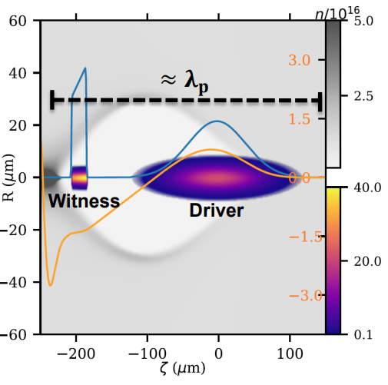
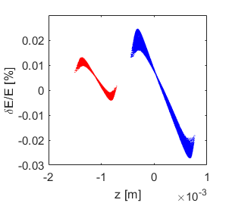
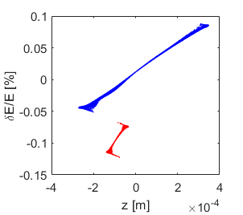
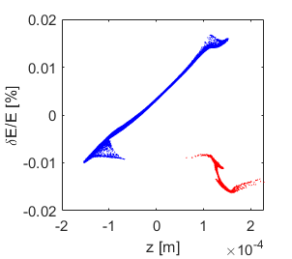
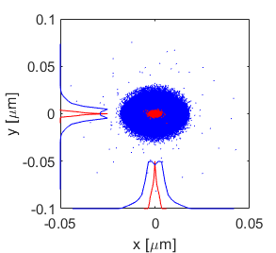
Reference Working point Beam Dynamics
A. Giribono
Beside the FEL specifications, the reference working point has been determined by the plasma module
At least 500 MeV energy gain (in less than 1 m)
Weakly non-linear regime (bubble with resonant behaviour)
200 pC driver + 30 pC witness
plasma density of the order of 10¹⁶𝑐𝑚⁻³ (𝜆_{𝑝} = 334 𝜇𝑚)
Velocity bunching technique
Driver-witness separation of around 0.5 ps ( i.e. 𝜆_{𝑝} /2)
Driver and witness bunches of 200 fs and 10 fs rms
Driver and witness spot size of 4 and 1 µm with α=1
0.5 ps
ơ_{W} = 1.0 µm
ơ_{D} = 4.0 µm
@650 MeV
Laser comb technique
4.8 ps

Slide 4
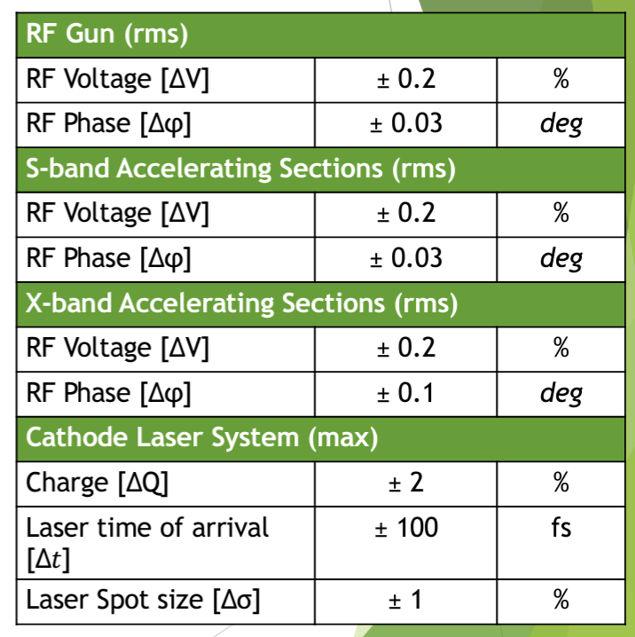
June 2023: first results on jitter analysis for the Linac
A. Giribono

Slide 5
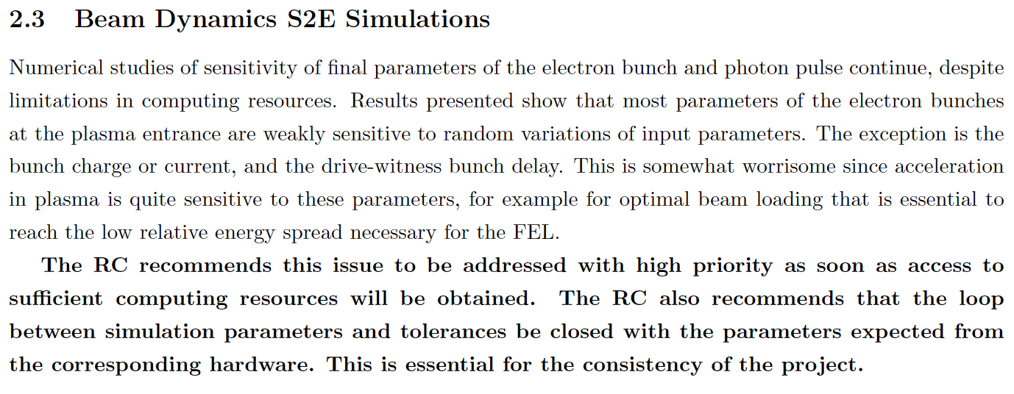
From TDR Rev Comm Jun 2023

Slide 6
Computing Resources update
It is made of 6 IBM Power 9, each equipped with 2 V100 GPU
We are effectively running Architect code in parallel exploiting up to about 600 parallel process
Other codes (i.e. Osiris, PIConGPU, WarpX, FBPIC) can be installed/used in the cluster
Unfortunately, in April 2023 a major fault occurred on storage disk system causing a significant lack of storage memory that determined a stop in simulations activity
A first batch of the storage disk supply was delivered and installed at the end of September and the simulation activity restarted in October 2023
Additional storage memory dedicated to EuPRAXIA up to hundreds of TB is under procurement
Additional IBM Power9s will be installed in the following months and infiniband connected
F. Fortugno

Slide 7
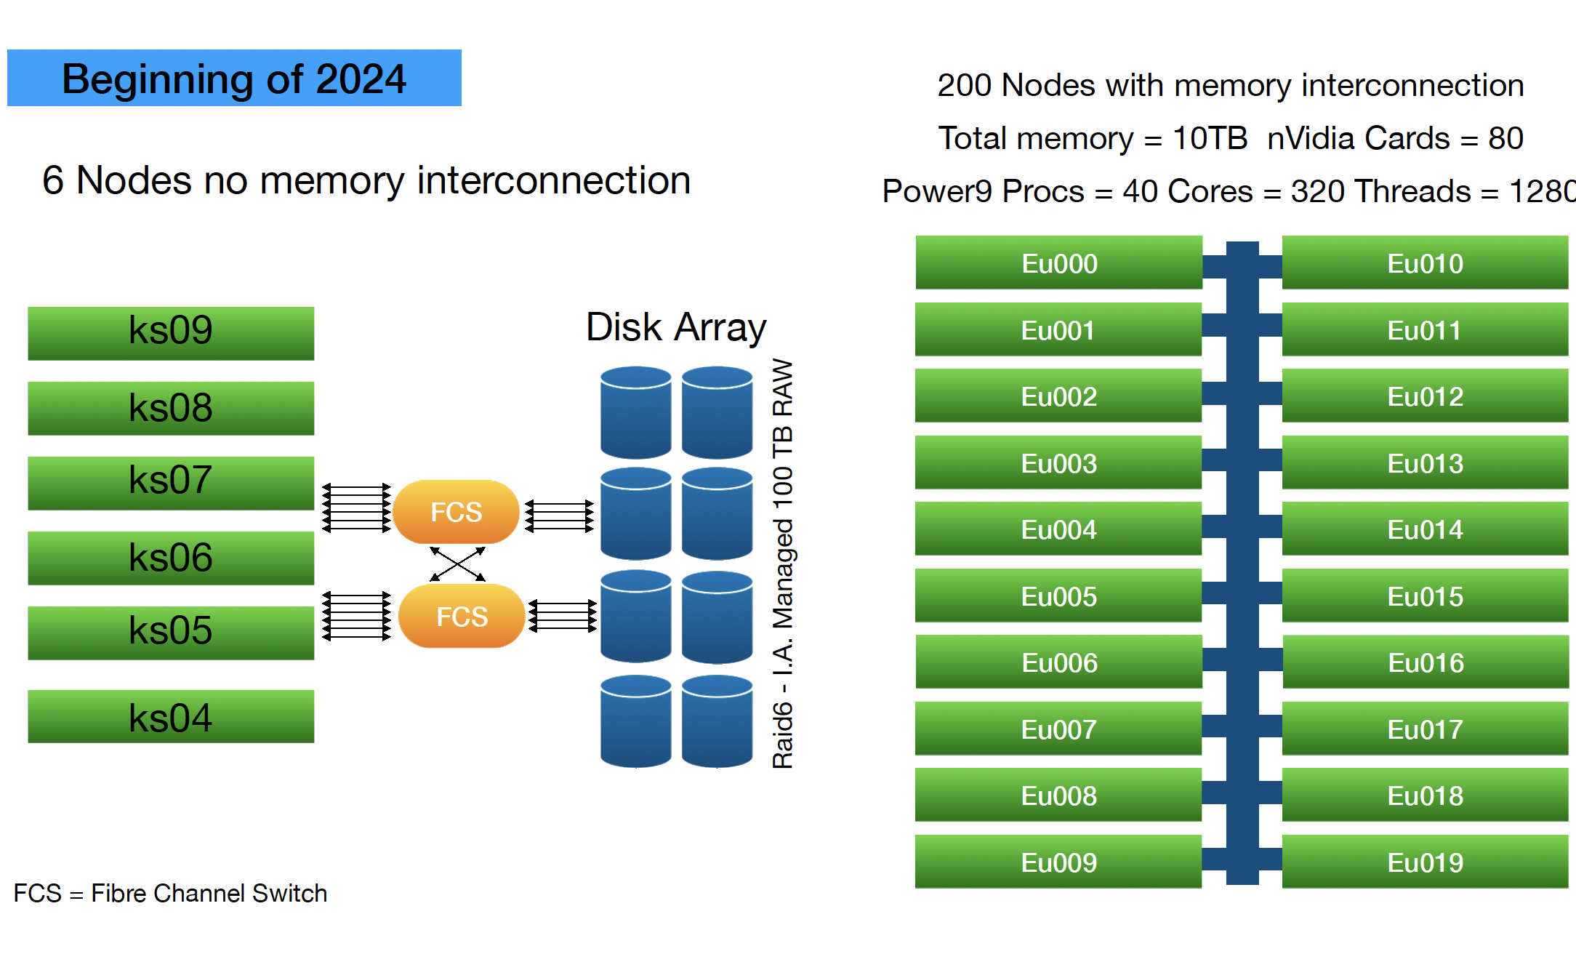
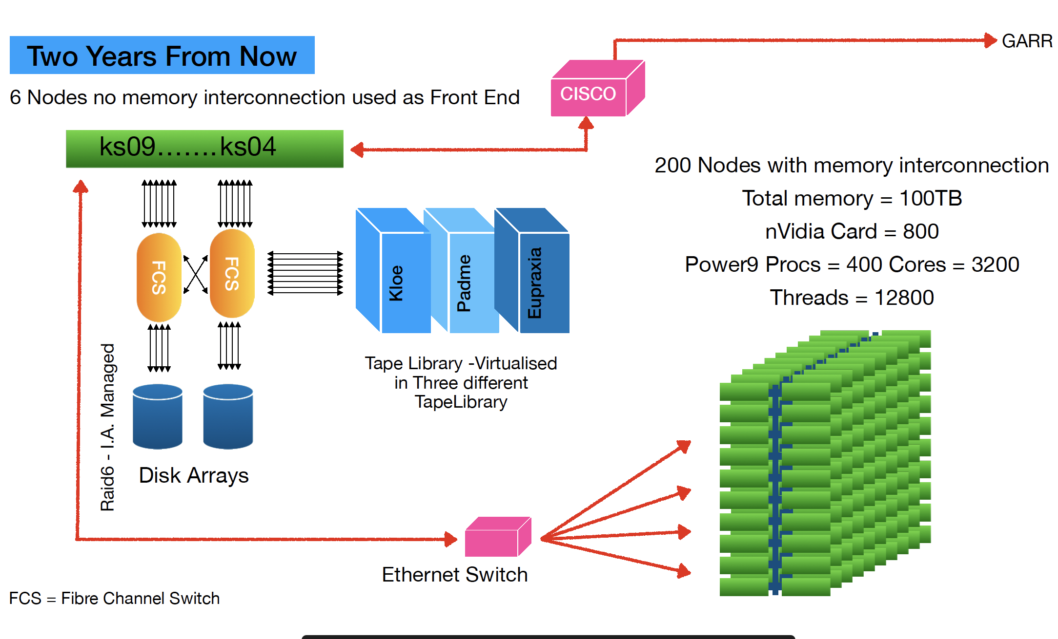
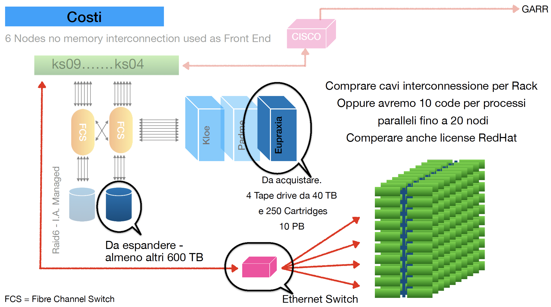
Computing Architecture & plan
F. Fortugno

Slide 8
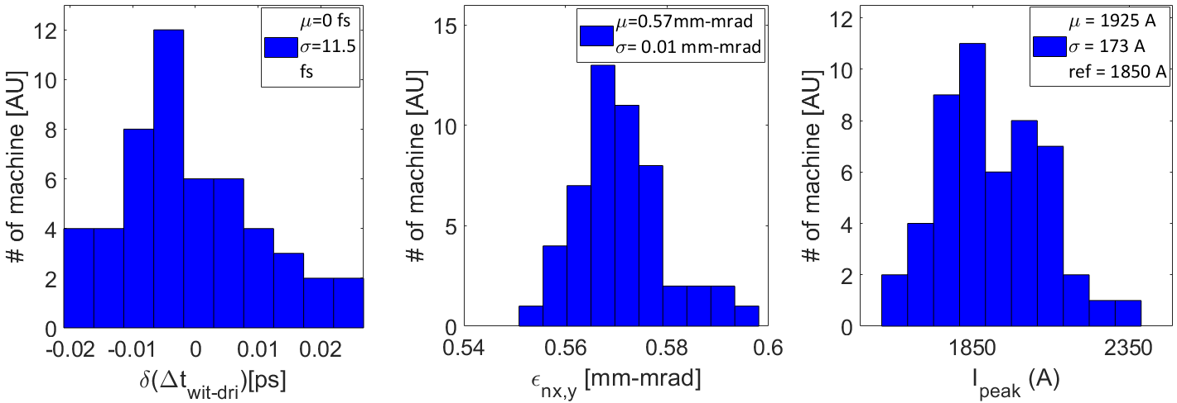
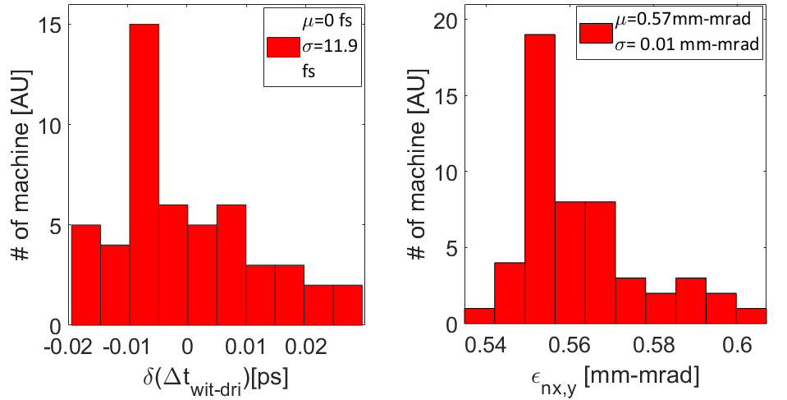
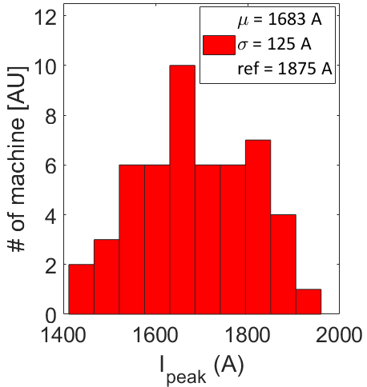
Some Details on the June Jitter analysis in the Linac
Jitter analysis in terms of beam delay, witness emittance and peak current at the photoinjector (upper) and X-band linac (lower) exit
The analysis is performed over 50 samples obtained by means of S2E simulations
The photoinjector is the source of the jittering of the beam separation and final rms beam length and current
The X-band linac is the main responsible for
the energy jitter that is negligible with respect to other parameters ← it operates almost on crest
final Twiss parameters that are almost stable ← the final focusing system is made of permanent magnet
the final profile of the witness peak current
The mean value over the 50 samples is reduced with respect to the photoinjector one with the benefit of a reduced deviation around the mean value

Slide 9
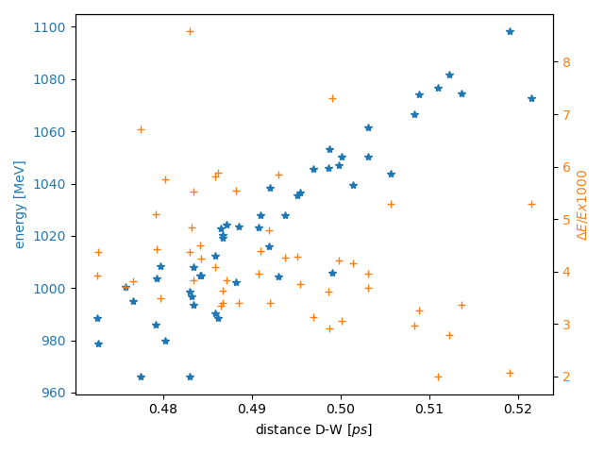
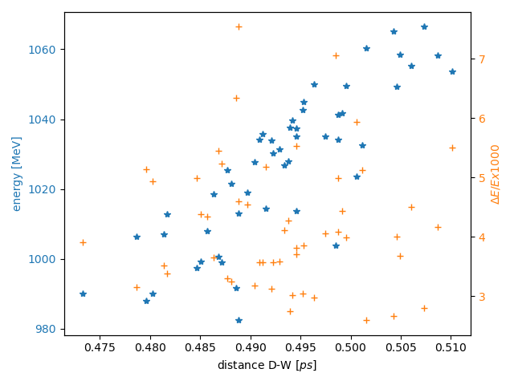
Witness-Driver distance distribution at the plasma module
Capillary length 60 cm
Cut at 80% of 30 pC charge
Nominal jitter case :
RF ampl ± 0.2 % (Sband)
RF phase ± 0.03° (Sband)
RF ampl ± 0.2 % (Xband)
RF phase ± 0.1 ° (Xband)
Half Sband phase&ampl jitter only
(phase value based on C-band solid state modulator performances and amplitude best performance at SPARC_LAB)
Nominal Jitter case
Half Sband phase&ampl jitter
A. Del Dotto, S. Romeo

Slide 10
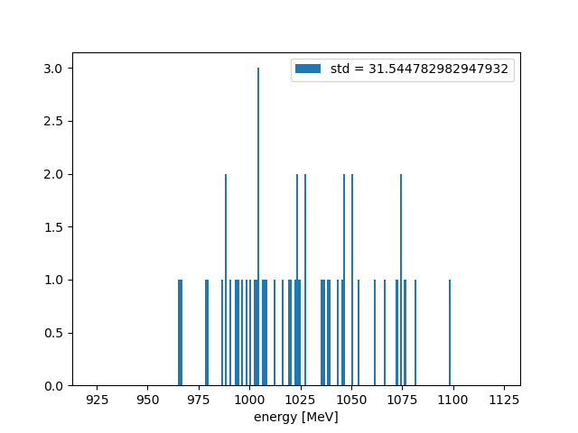
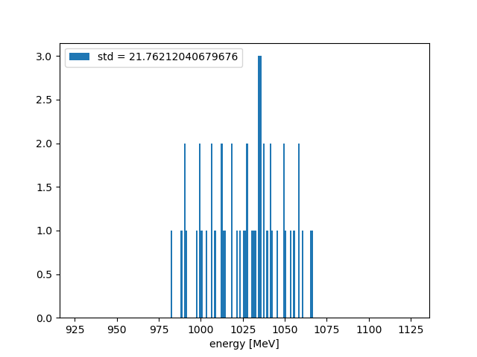
Witness energy distribution at the plasma module exit
A. Del Dotto, S. Romeo
Nominal jitter case:
RF ampl ± 0.2 % (Sband),RF phase ± 0.03° (Sband), RF ampl ± 0.2 % (Xband), RF phase ± 0.1 ° (Xband)
vs half of RF S-band phase&ampl value
Results: energy = 1025 MeV, std ∼ 3%
vs 1025 MeV, std ∼ 2%
Capillary length 60 cm
Cut at 80% of 30 pC charge
Nominal case
Half sband-phase jitters

Slide 11
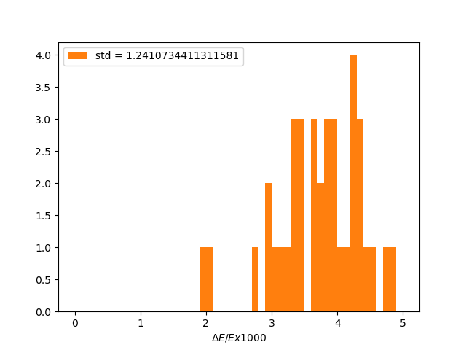
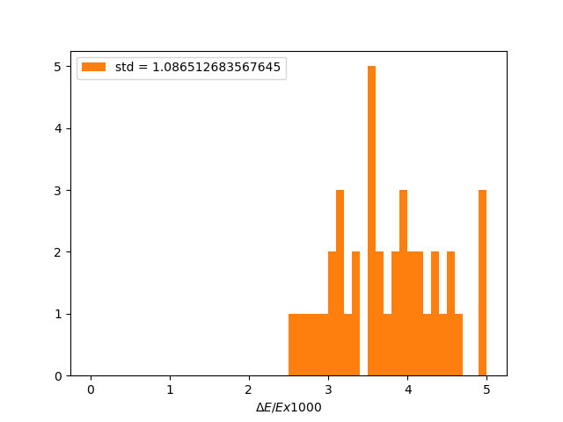
Witness energy spread distribution at the plasma module exit
A. Del Dotto, S. Romeo
Nominal jitter case:
RF ampl ± 0.2 % (Sband),RF phase ± 0.03° (Sband), RF ampl ± 0.2 % (Xband), RF phase ± 0.1 ° (Xband)
vs half of RF phase&ampl value
Results: $σ_{δ}=0.4\% , std 0.1\%$
vs $σ_{δ}=0.4\%, std 0.1\%$
Capillary length 60 cm
Cut at 80% of 30 pC charge
Nominal case
Half sband-phase jitters

Slide 12
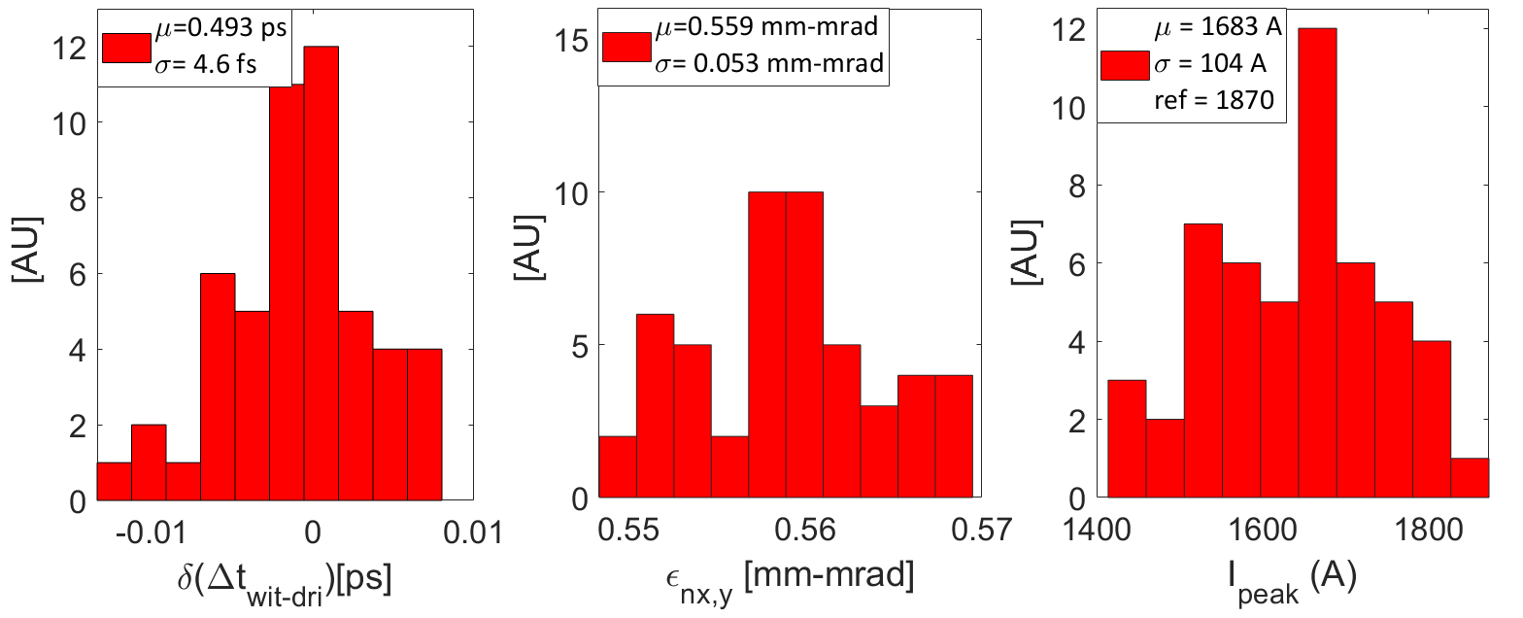
Updated analysis for Photoinjector w S-band ampl. jitter contribution comparable w phase jitter contribution and neglecting the laser time arrival
Updated machine performances
$\sim 1/2$of Wit-Dri distance and Peak current variation
Updated jitter values have been evaluated as in Table
The major upgrade of the machine regarded the photocathode laser TOA jitter → 0 fs
In the chosen range the timing jitter depends quite linearly on the considered quantities
RF Gun (rms)
RF Voltage [ΔV] | ± 0.030 | %
RF Phase [Δφ] | ± 0.015 | deg
S-band Accelerating Sections (rms)
RF Voltage [ΔV] | ± 0.030 | %
RF Phase [Δφ] | ± 0.015 | deg
X-band Accelerating Sections (rms)
RF Voltage [ΔV] | ± 0.02 | %
RF Phase [Δφ] | ± 0.10 | deg
Cathode Laser System (rms)
Charge [ΔQ] | ± 0.3 | %
Laser time of arrival [Δ𝑡] | ± 0 | fs
Laser Spot size [Δσ] | ± 0.3 | %

Slide 13
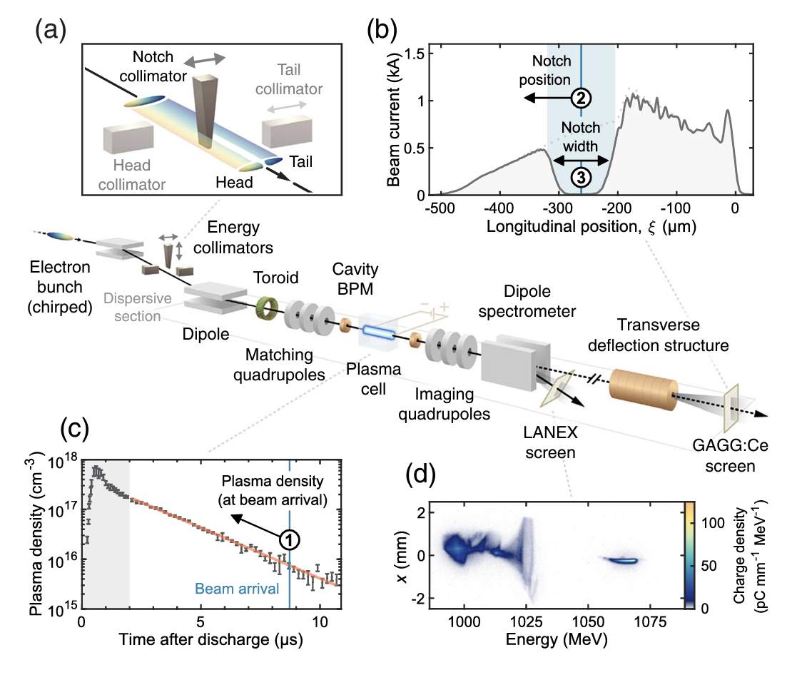
Alternative solution for COMB beam shaping
To reduce the jitter sensitivity of the Witness-Driver electron beam configuration an alternative solution has been explored:
magnetic compression + transverse beam shaping
in the dispersive section
A numerical cut has been applied to the particles close to the third magnet of the BC chicane to simulate the effect of a vertical wedge-shaped collimator like the one realized at Flash.
To obtain the desired asymmetric current distribution a slightly chirped 400 pC beam (𝜱 = 90°,80°,60°,60°), has been generated in the photoinjector (Tstep code) to be longitudinally compressed in the LH and BC magnetic chicanes.
Taking advantage of the typical double peak current configuration at the bunch edges, applying a central 550 mm cut in the horizontal plane resulted in a Witness-Driver configuration tracked up to the plasma exit by means of Elegant and Architect codes.
A jitter analysis taking into account RF-phase and Voltage of the first Linac section, plus Dipoles Magnetic Field has been performed on 50 runs of the first considered working point
Energy-Spread Preservation and High Efficiency in a Plasma-Wakefield Accelerator
C.A. Lindstrøm (DESY), et al. Phys.Rev.Lett. 126 (2021) 1, 014801

Slide 14
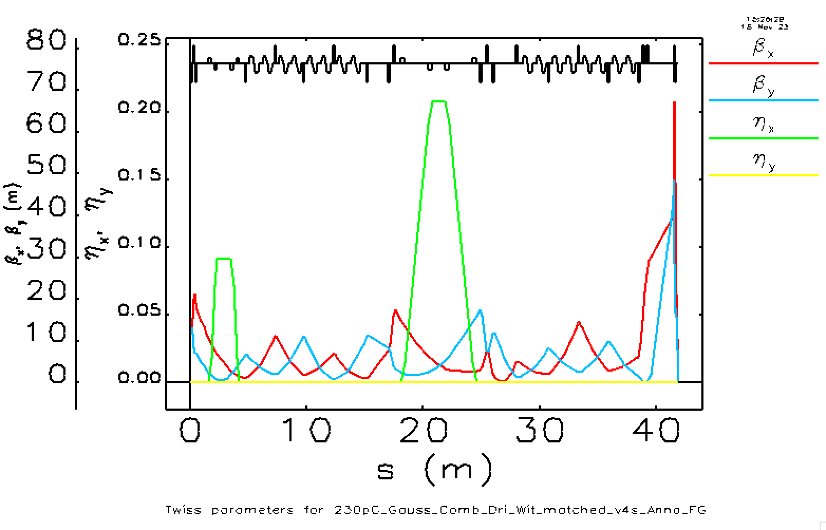
Linac lattice
Nominal parameters:
RFX_TW1 𝛷=82.3, 𝜃₁=17.9E-2 rad, 𝜃₂=8.8E-2 rad
LH
BC
Linac 1
Linac 2
$$R_{56}≈28 mm$$
$$R_{56}≈10 mm$$
Changes:
The LH chicane magnetic length from 12 cm to 20 cm
The matching upstream Linac2 slightly longer

Slide 15
Longitudinal phase space evolution
Photoinjector exit
LH chicane exit
Upstream BC 3rd magnet
Upstream BC 3rd magnet after the cut
BC chicane exit
Capillary entrance

Slide 16
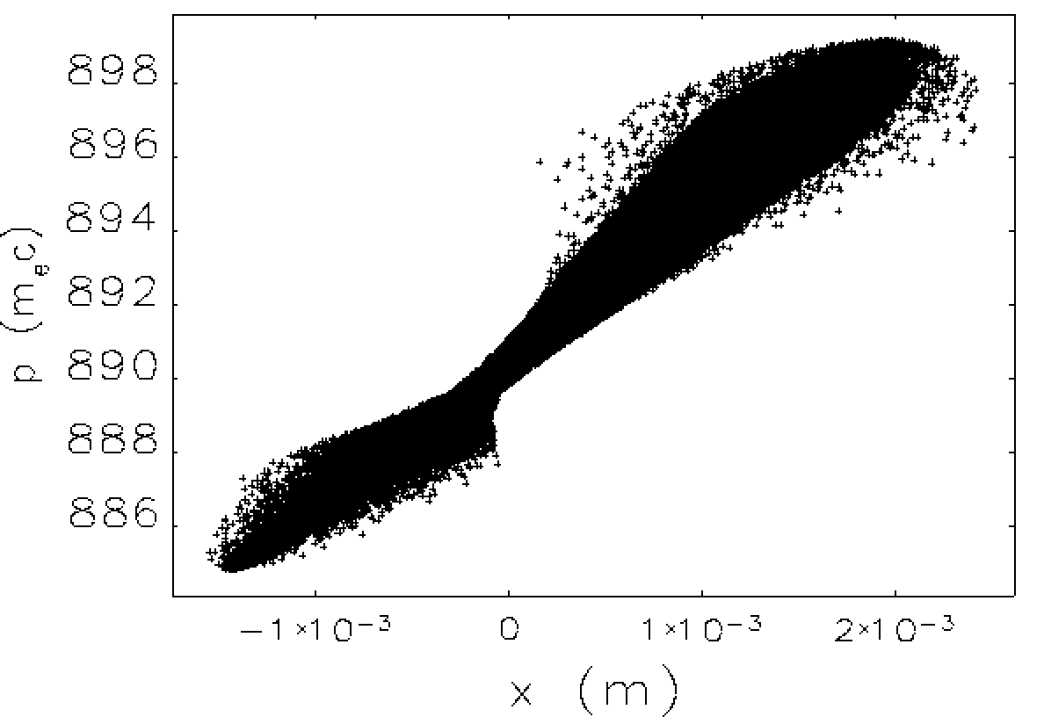
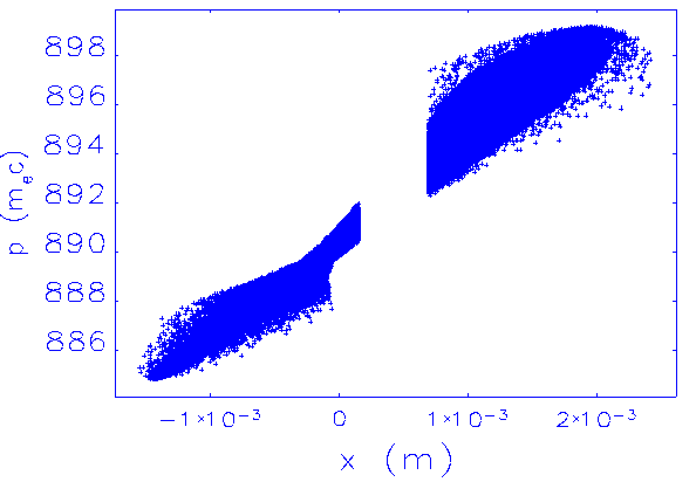
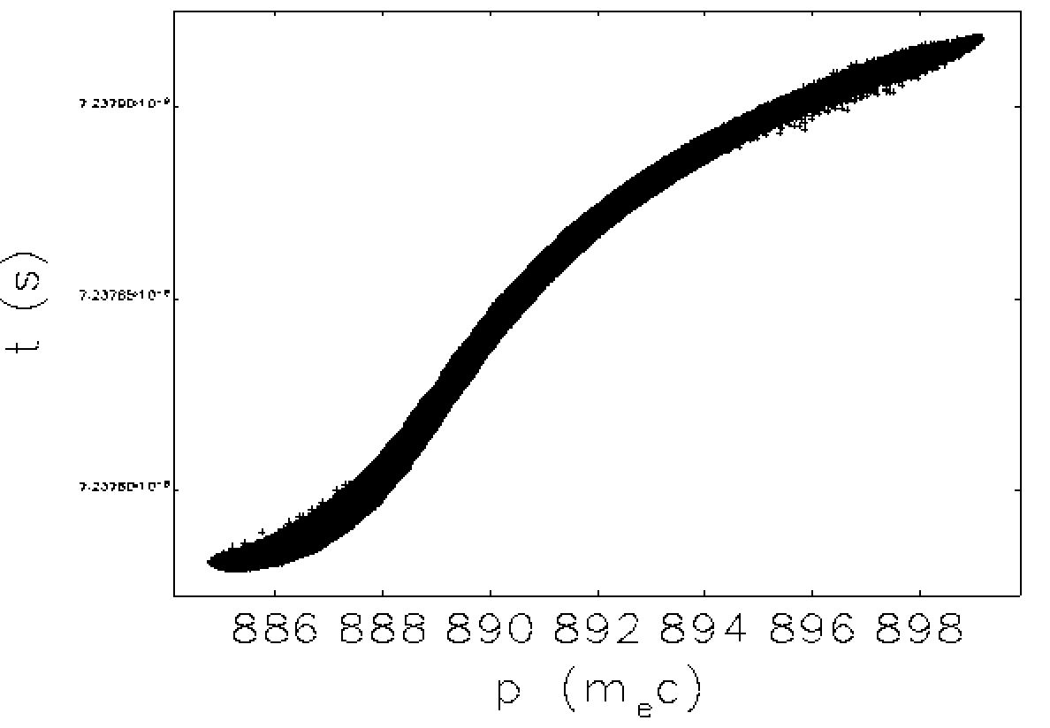
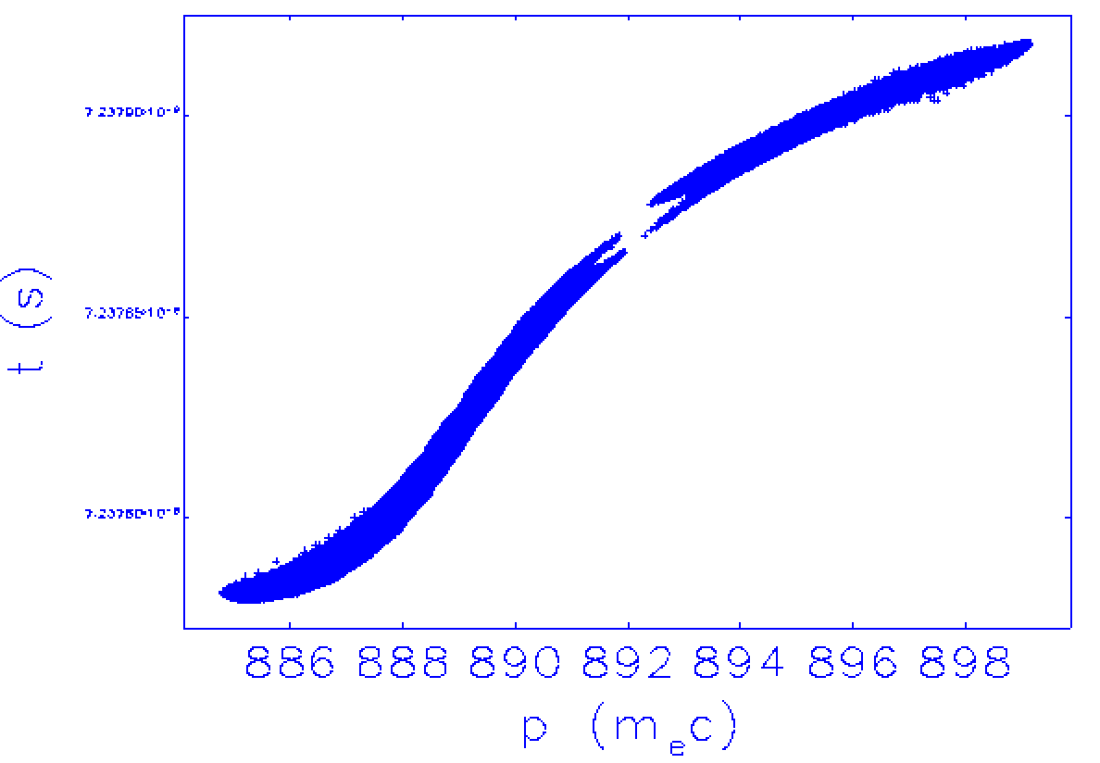
From Longitudinal to transverse phspace

Slide 17
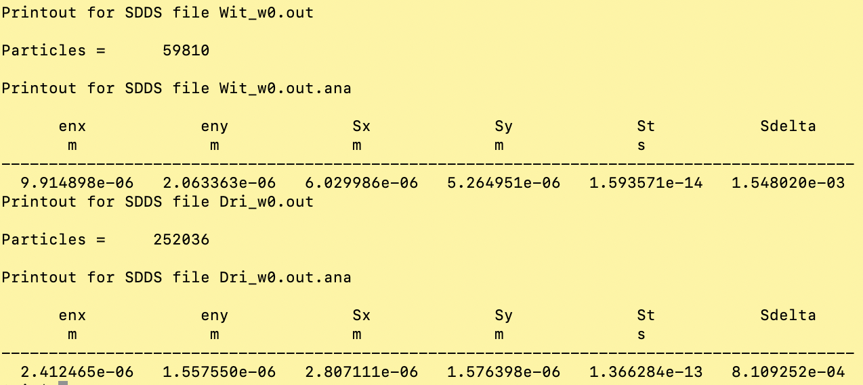
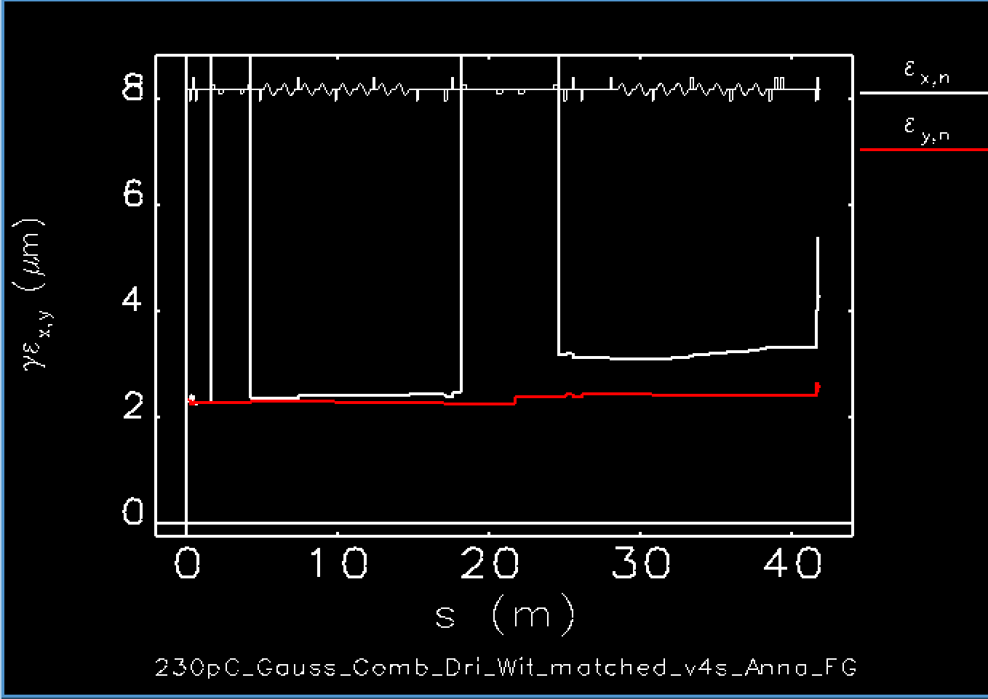
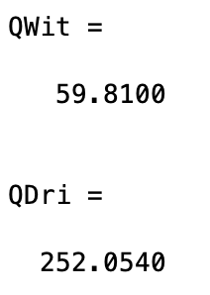
Witness & Driver analysis
Witness bunch
Driver bunch

Slide 18
Jitter studies including acceleration in plasma for magnetic-mask shaping
50 machines have been tracked trough the Linac up to the plasma entrance applying the RF phase and amplitude jitters in the accelerator according to:
LNF measurements at TeX
PSI measurements (“RF System Performance in the SwissFEL Linac”, C. Beard et al , JACoW LINAC2022 (2022), TH2AA02)

Slide 19
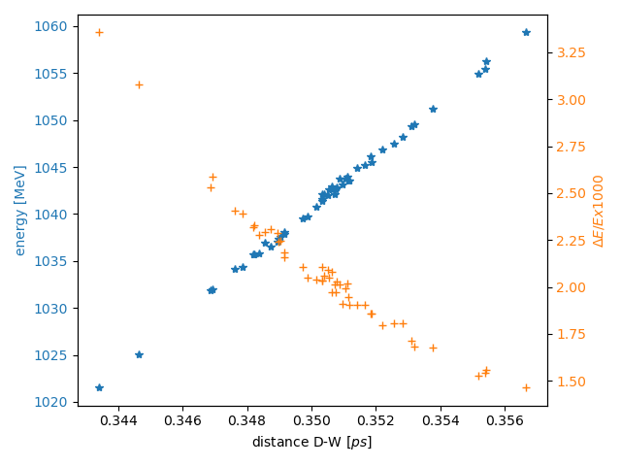
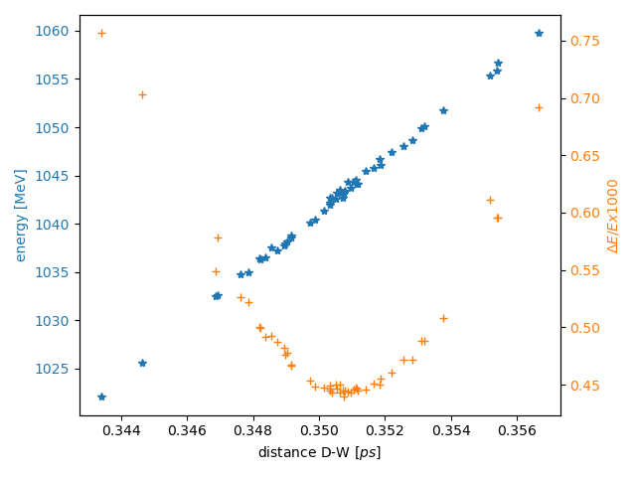
First Results for magnetic-mask shaped beam 1
Dri-Wit distance correlation with energy end energy spread (Capillary length 40 cm)
Cut at 80% of 60 pC charge
Cut at 40% of 60 pC charge

Slide 20
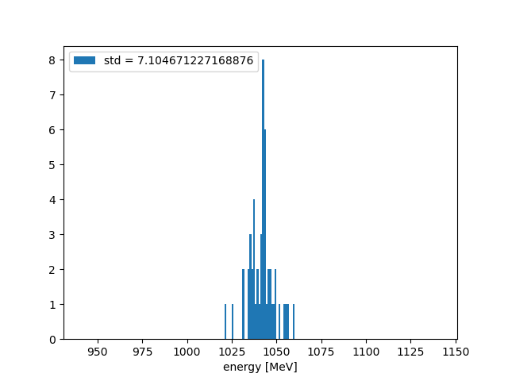
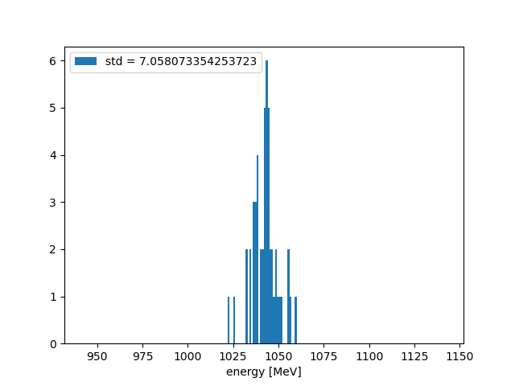
First Results for magnetic-mask shaped beam 2
Energy variation (Capillary length 40 cm)
Cut at 80% of 60 pC charge
energy = 1045 MeV, std∼0.7%
Cut at 40% of 60 pC charge
energy = 1045 MeV, std∼0.7%

Slide 21
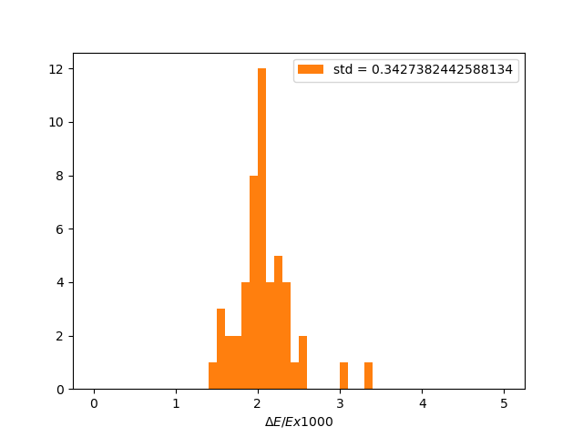
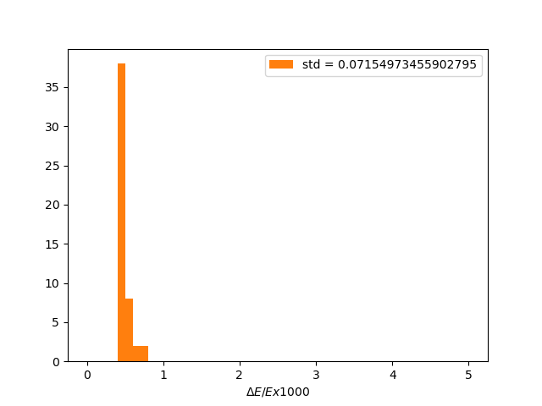
First Results for magnetic-mask shaped beam 3
Energy spread variation (Capillary length 40 cm)
Cut at 80% of 60 pC charge
energy spread mean value 0.2% with std∼0.03%
Cut at 40% of 60 pC charge
energy spread 0.05 % with std∼0.007%

Slide 22
Jitter analysis Summary Table & Open Points
Summary Table
Magnetic Shaping open points:
Witness Transverse emittance optimization
Beam loading check and optimization
Geant4 simulation of the wedge
Complete start2end jitter analysis
Technological solution
Microbunching Instability now priority item
Comb scheme | Q pC | Final Energy std 80% charge | Final Energy Spread 80% charge | Final Energy std 40% charge | Final Energy Spread 40% charge
Velocity Bunching | 30 | 3⇨2 % | 0.4% std=0.1%
Magnetic-shaping | 60 | 0.7 % | 0.2% std=0.03% | 0.7% | 0.05 % std=0.007%

Slide 23
Conclusions and To-do List
The BD simulation work restarted from October 2023
For the Velocity Bunching Comb scheme, the obtained results show an energy std for the witness beam of about 3-2% with the previous jitter values (June 2023) and one half of these values respectively. For the energy spread we got $σ_{δ}=\left(0.4±0.1\right)\%$ in both cases.
With updated and better Jitter values Oct 2023 the studies in photoinjector showed one half of the sensitivity for Wit-Dri distance and Witness peak current.
An alternative solution has been studied based on a “quasi” on crest single electron bunch provided by the Photoinjector (𝜱 = 90°,80°,60°,60°), longitudinally compressed and shaped by a numerical “mask” in the two available chicanes. The jitter studies concerning the Linac 1 plus chicanes system show an energy stability of 0.7 % and $σ_{δ}=\left(0.2±0.07\right)\%$ with an 80% charge cut and $σ_{δ}=\left(0.05±0.007\right)\%$ with a 40% charge cut.
The magnetic solution has to be optimized in terms of transverse emittance of the Witness bunch and BD evolution in plasma for the Driver, and mostly the Jitter analysis must be completed including the Photoinjector.
Moreover, a Montecarlo simulation of the beam interaction with a physical wedge collimator is necessary, together with the feasibility study of the mechanical system.
Finally, the MIB effect and LH efficiency must be included.

Slide 24
Thanks for your attention

Slide 25
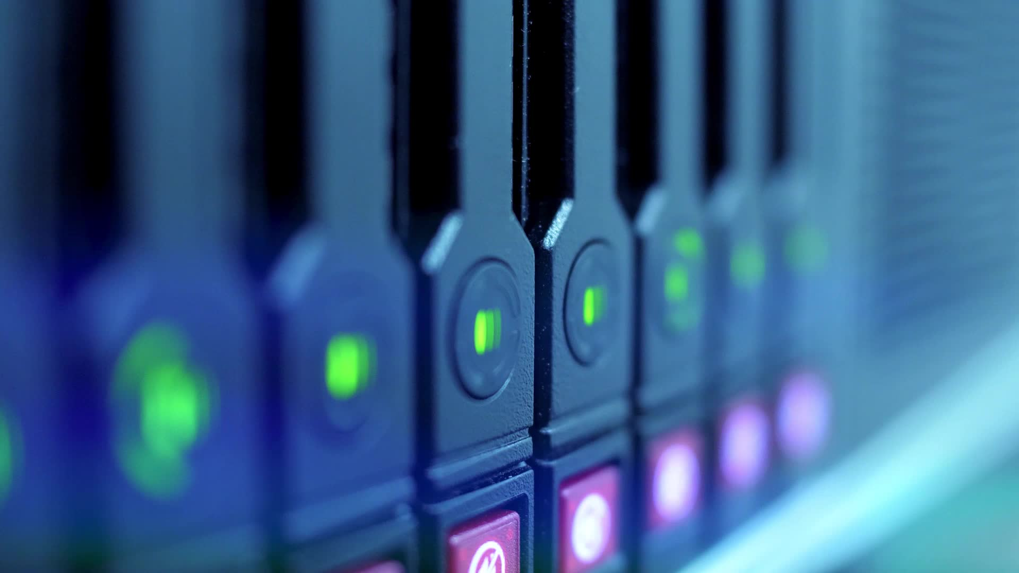
Backup Slides

Slide 26
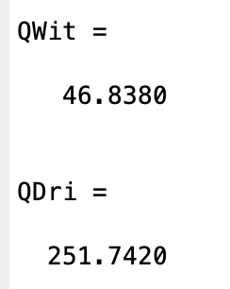
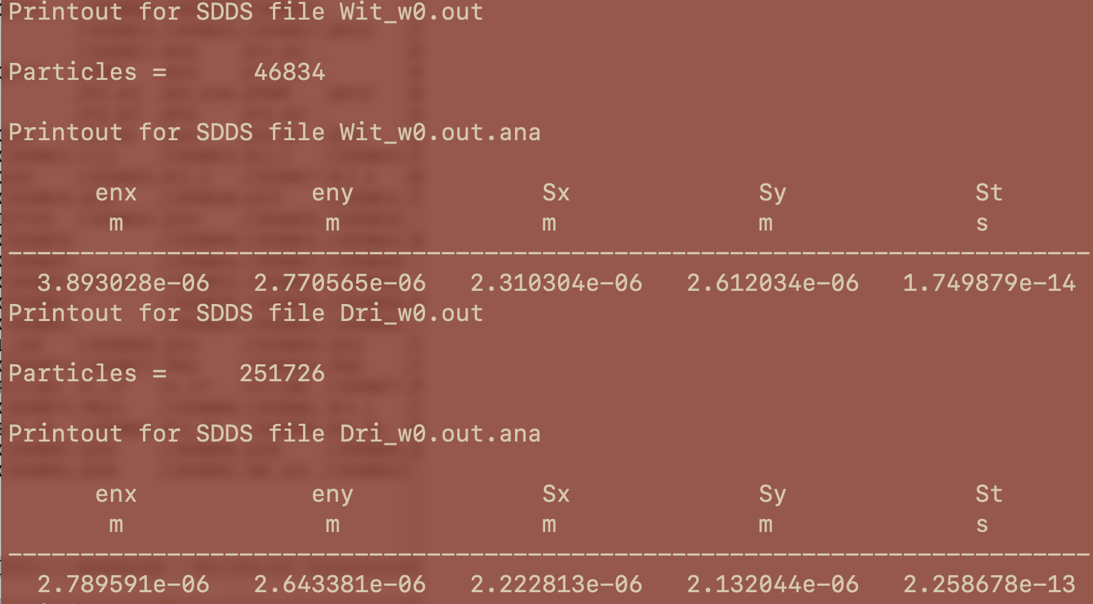
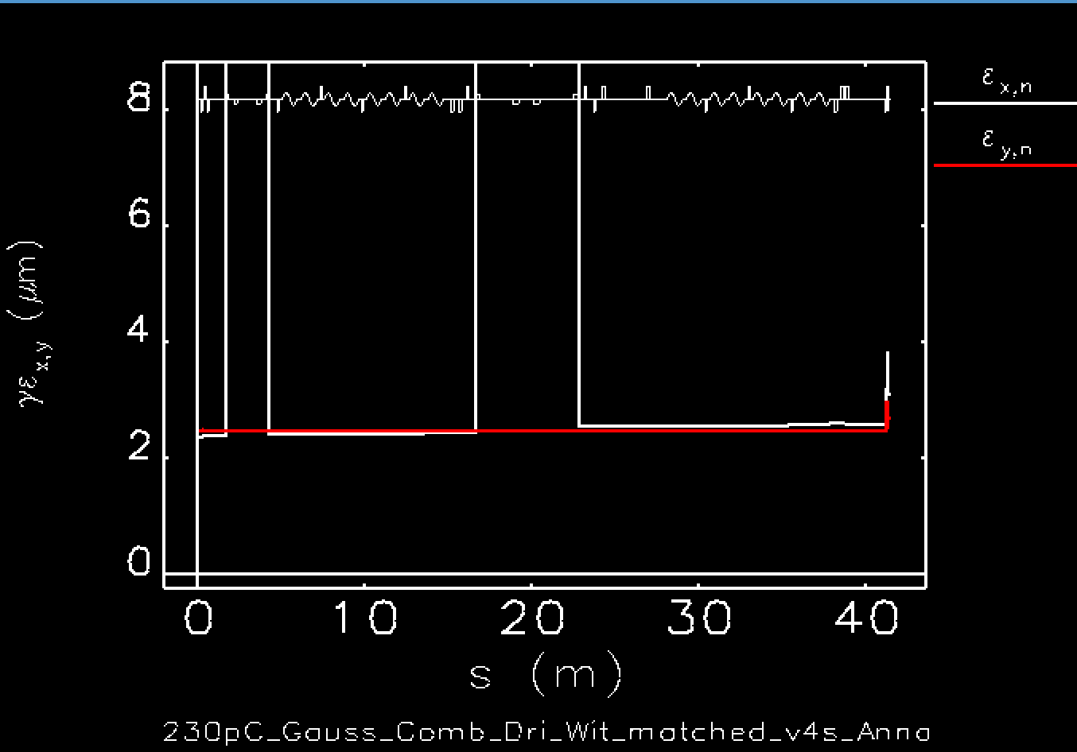
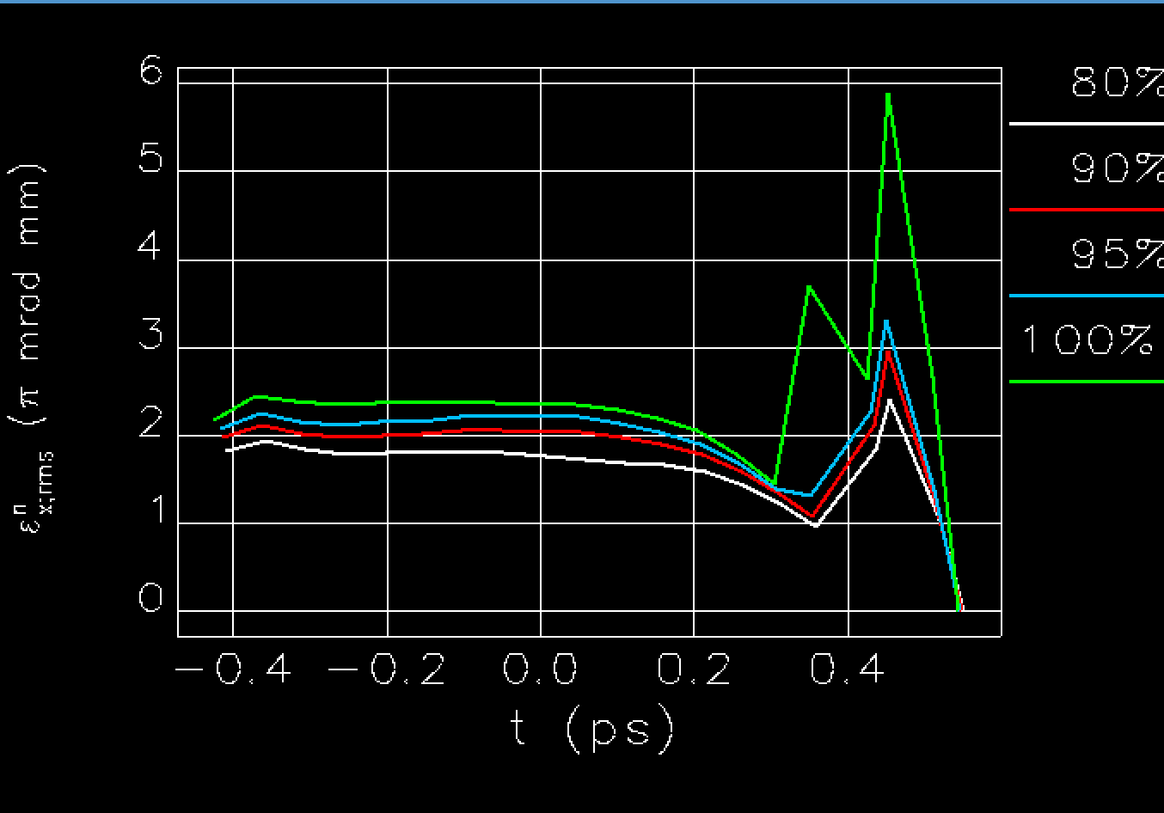
Slit nella chicane RFXTW phase=84° 400kp iniziali 298.584kp finali
PInj exit
@capillary
entrance
Witness
Driver

Slide 27
Some statistics on accelerated Witness bunch
$$\left\langle σ_{δ}\right\rangle =0.08\% w 30 pC$$
$$\left\langle σ_{δ}\right\rangle =0.1 \% w 40 pC$$
$$\left\langle σ_{δ}\right\rangle =0.3 \% w 50 pC$$
$${∆E}/E=0.68\% w 30pC$$
$${∆E}/E=0.66\% w 40pC$$
$${∆E}/E=0.64\% w 50pC$$

Slide 28
The Basic Layout
X-band
LH
Linac 1
Linac 2
RF
GUN
Plasma
U1
BC
4 S-band
8 X-band
8 X-band
Photo
Injector
Linac
Plasma
TL
Undulator
XB
D
D
D
D
Focused on Plasma acceleration operation scheme = WoP1
Checked at each iteration for the High Charge Single Bunch boosted by an All-RF Linac up to 1 GeV = WoP2

Slide 29
Start2End for the basic layout
PhotoInjector Layout consolidation with 3m +3x2m S-band scheme:
Revision of nominal 30+200 pC WoP1 scheme for plasma acceleration: Photoinjector (no Xband)+ Linac + Plasma
Transfer Line with CSR & SC for Undulator optics matching
Undulator results
On going:
Diagnostics feasibility/efficiency check w virtual measurements (priority order) to finalize the basic layout
done
Elegant (WF, CSR)
Tstep (SC)
Elegant (WF, CSR)
Astra (SC)
Tstep+Astra (SC, Fmaps)
Architect
Genesis 3D
Photo
Injector
Linac
Plasma
TL
Undulator
XB
D
D
D
D
2
3
1
4

Slide 30
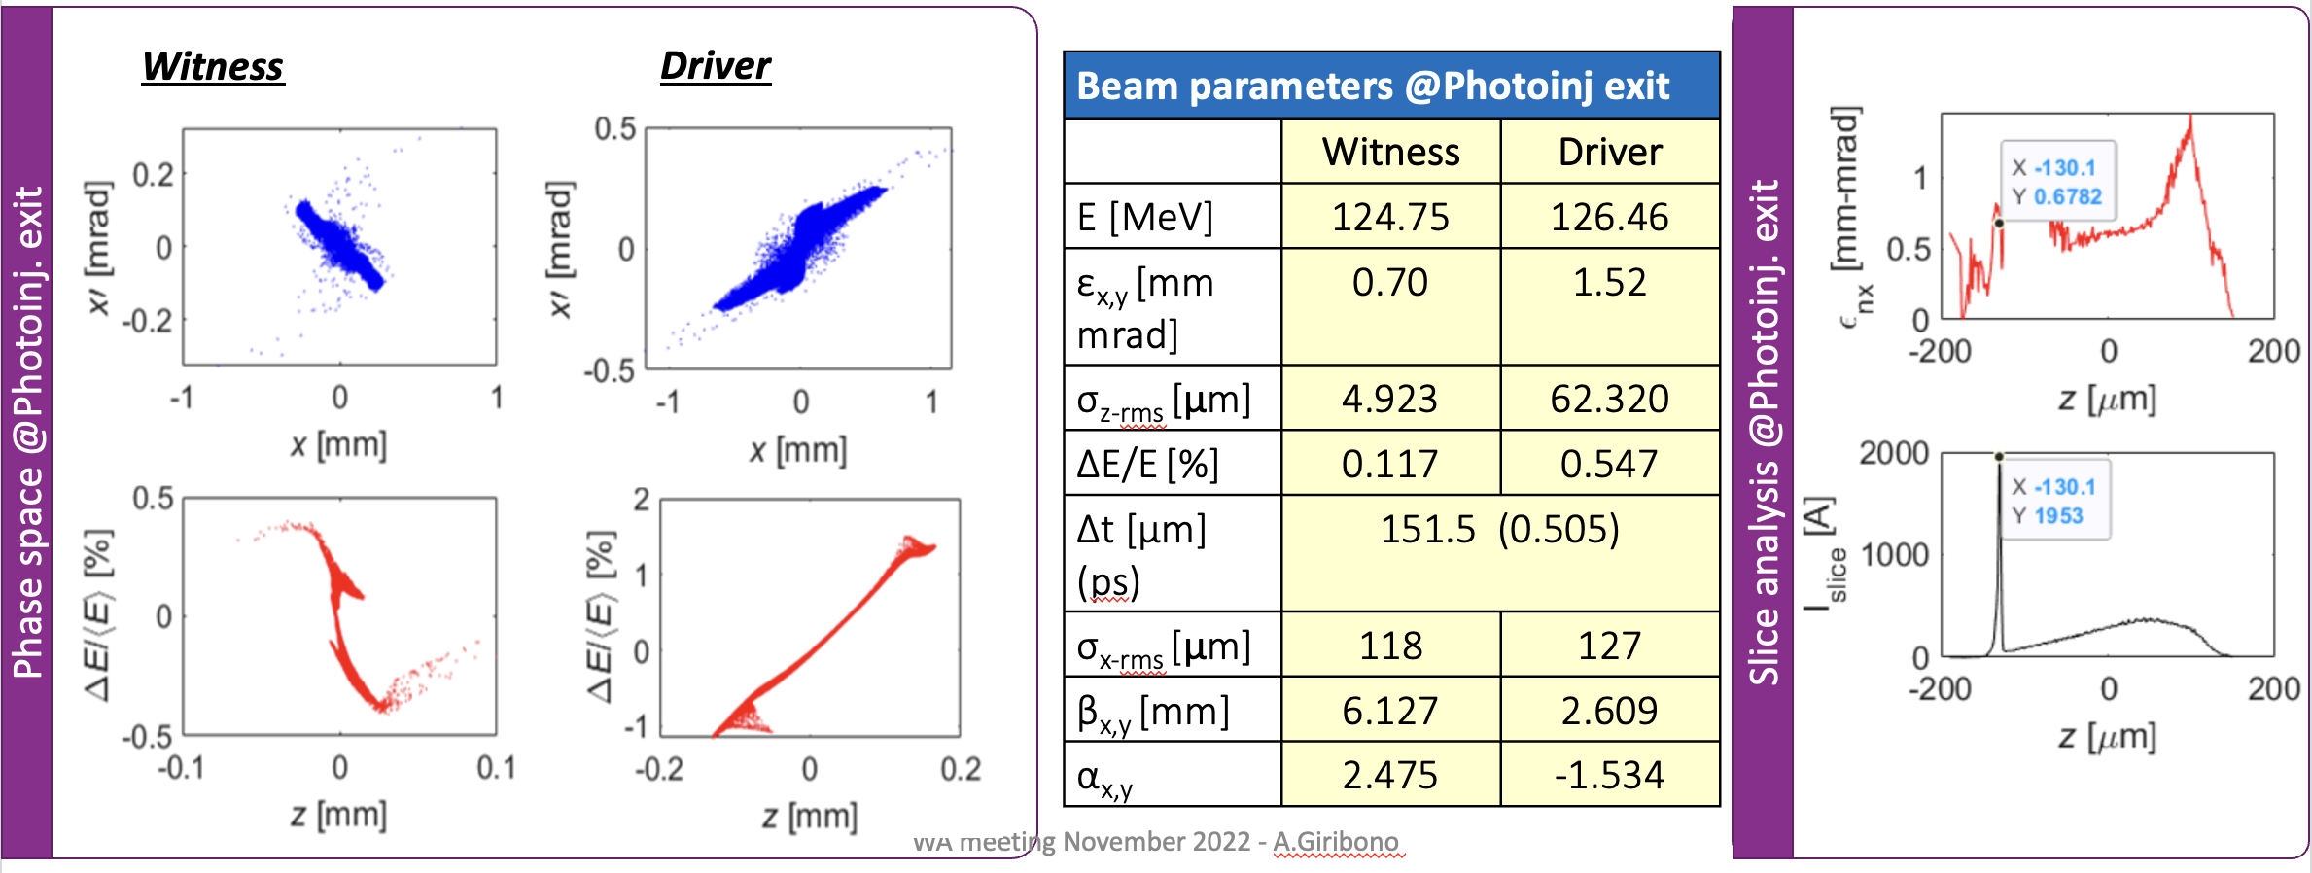
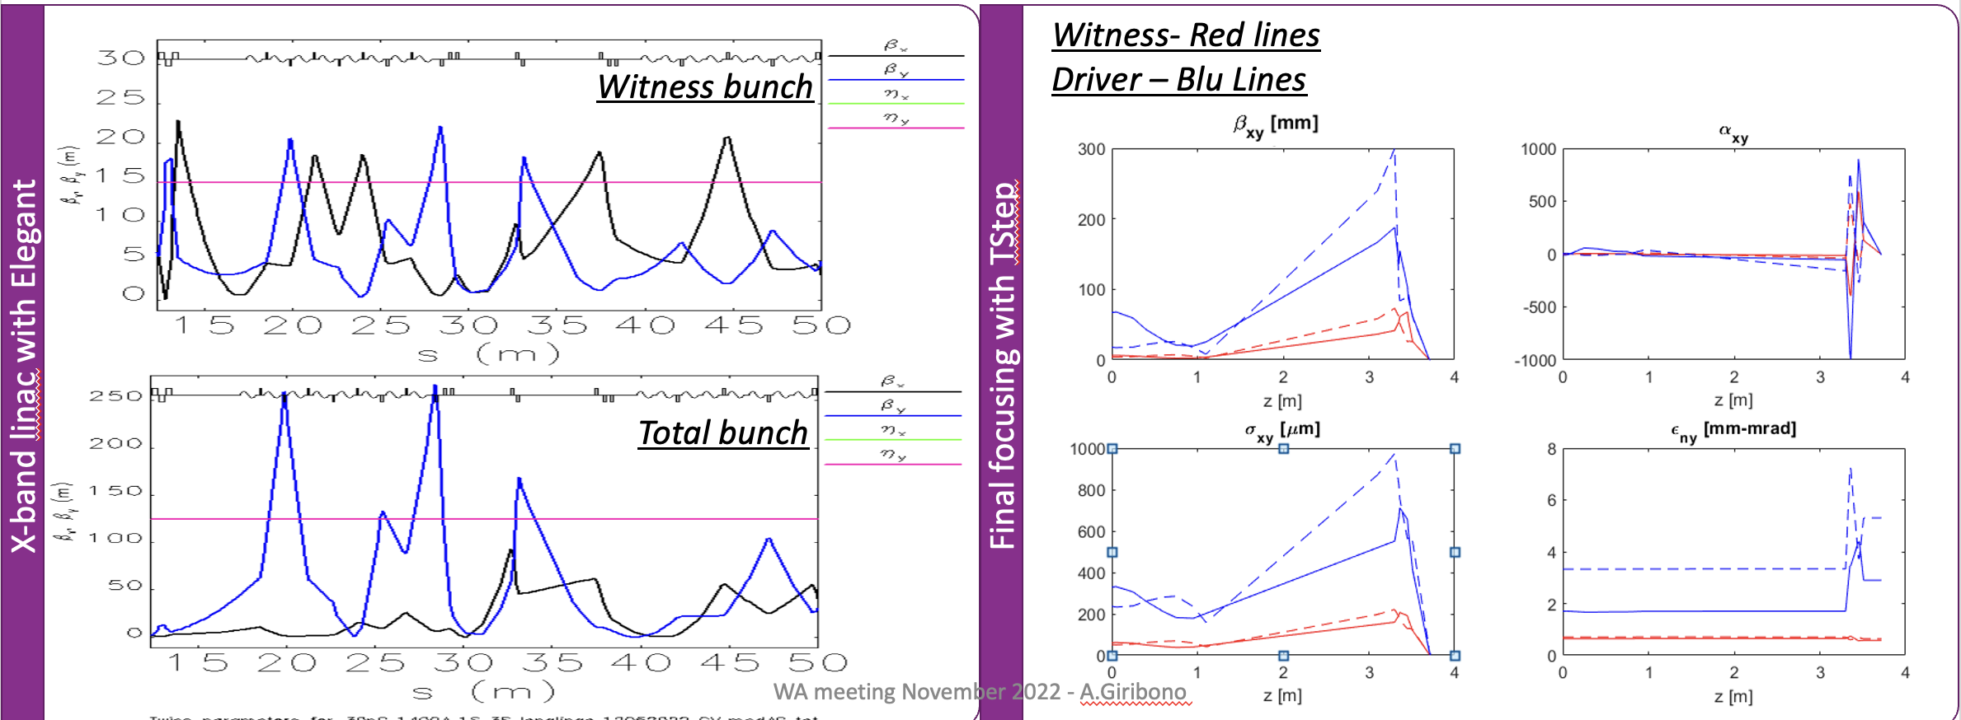
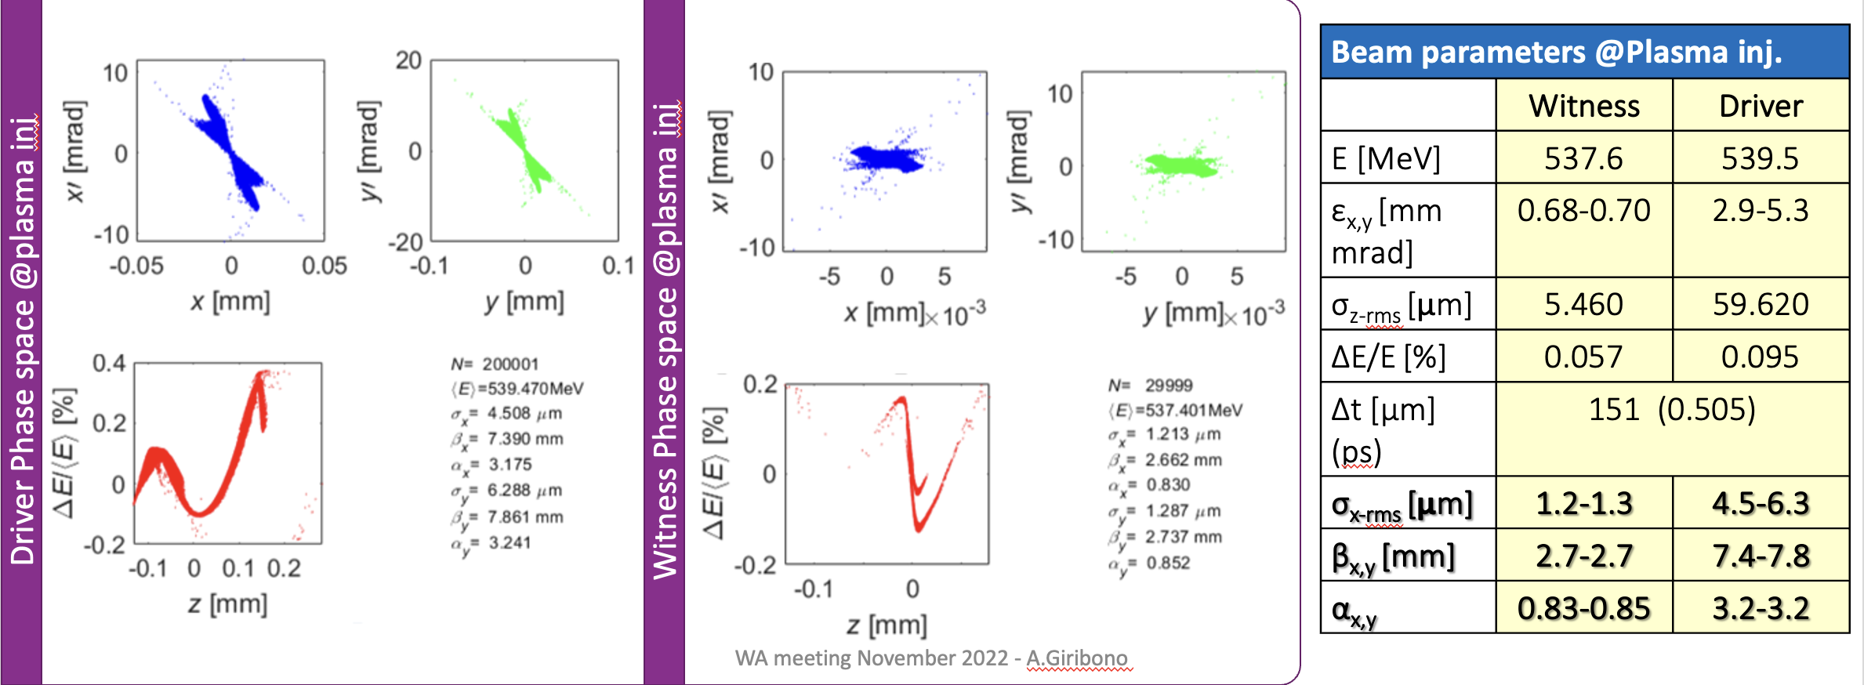
S2E «basic» details: 1/4
A. Giribono
PhotoInjector
Linac
Capillary entrance
30 + 200 pC

Slide 31
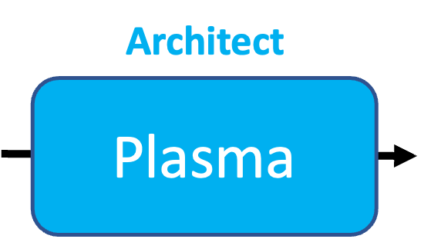
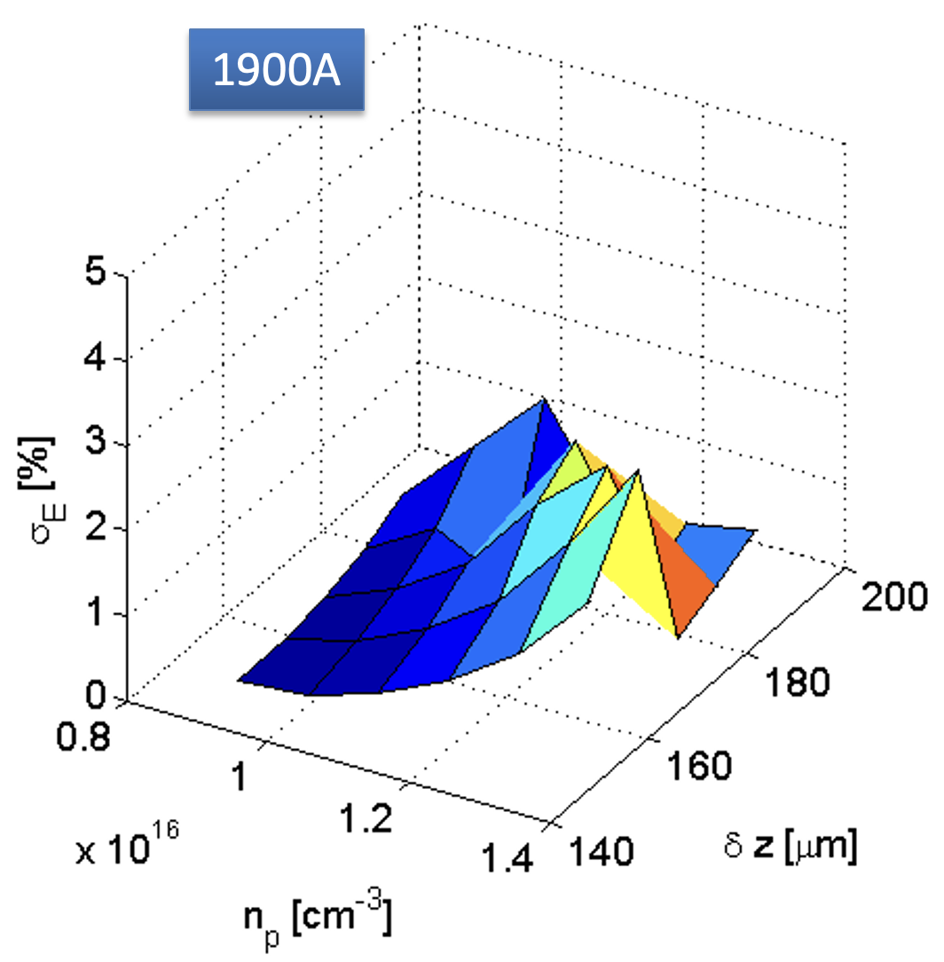
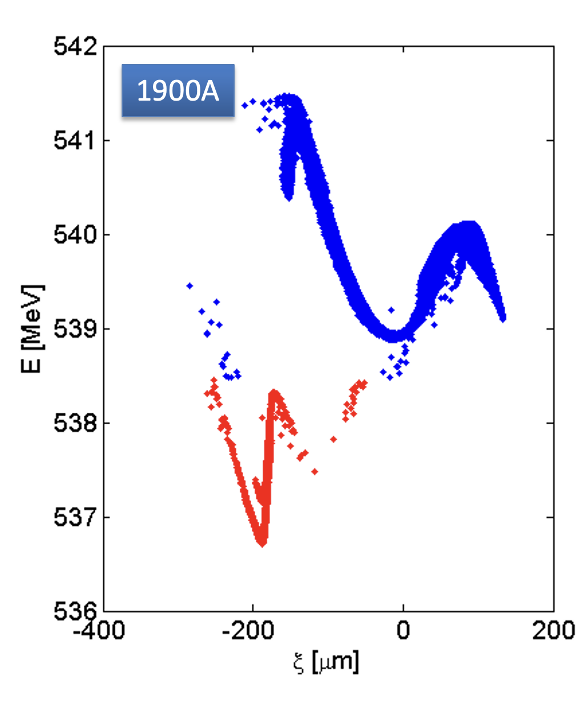
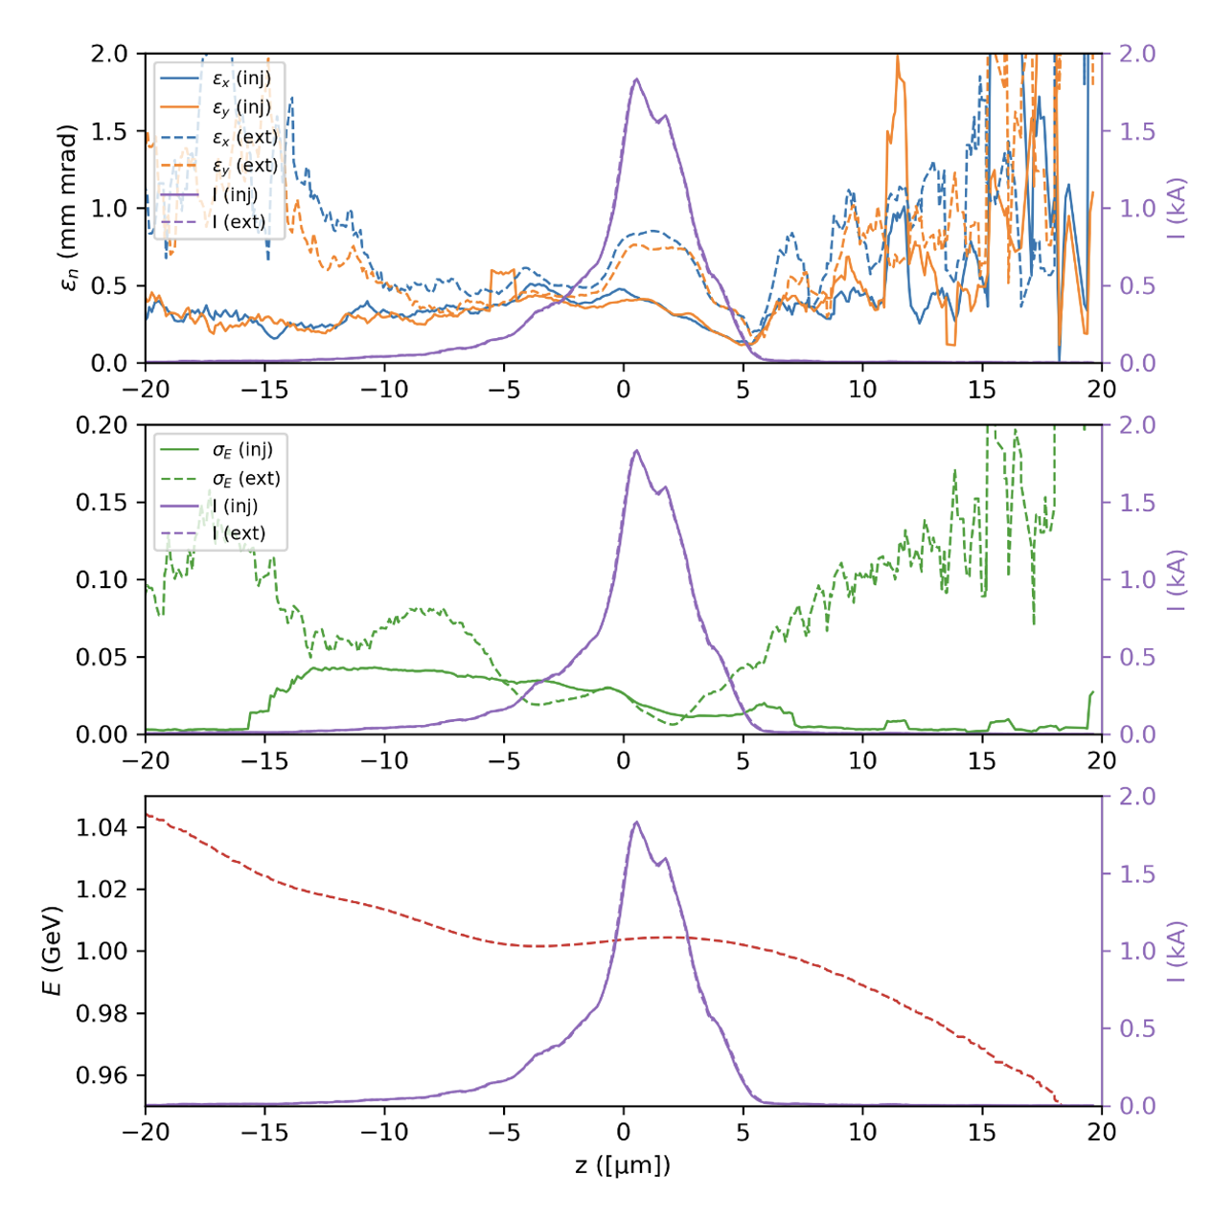
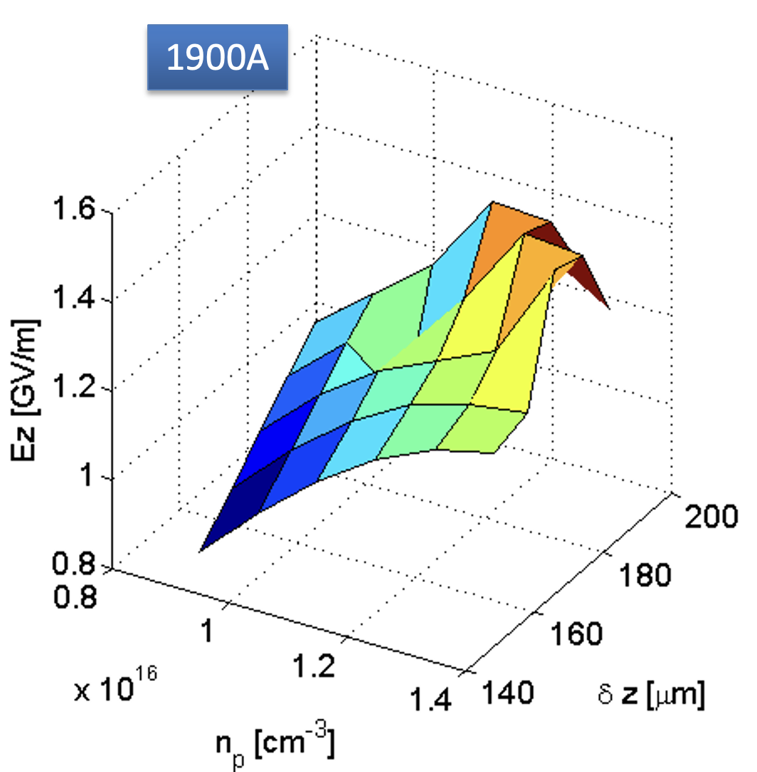
S2E «basic» details: 2/4
S. Romeo
$Δz=158 μm$
$n_{p}=0.9⋅{10}^{16} {cm}^{−3}$
$σ_{E}=0.06\%$
$E_{z}=0.9 GV/m$ (including 1 cm injection ramp, so, actually, slightly higher)
Slice energy spread, virtually untouched (or reduced)
Slight emittance increase (to be improved with ramps)
Accelerating length 0.56 m

Slide 32
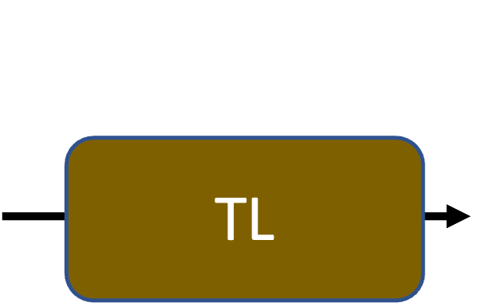
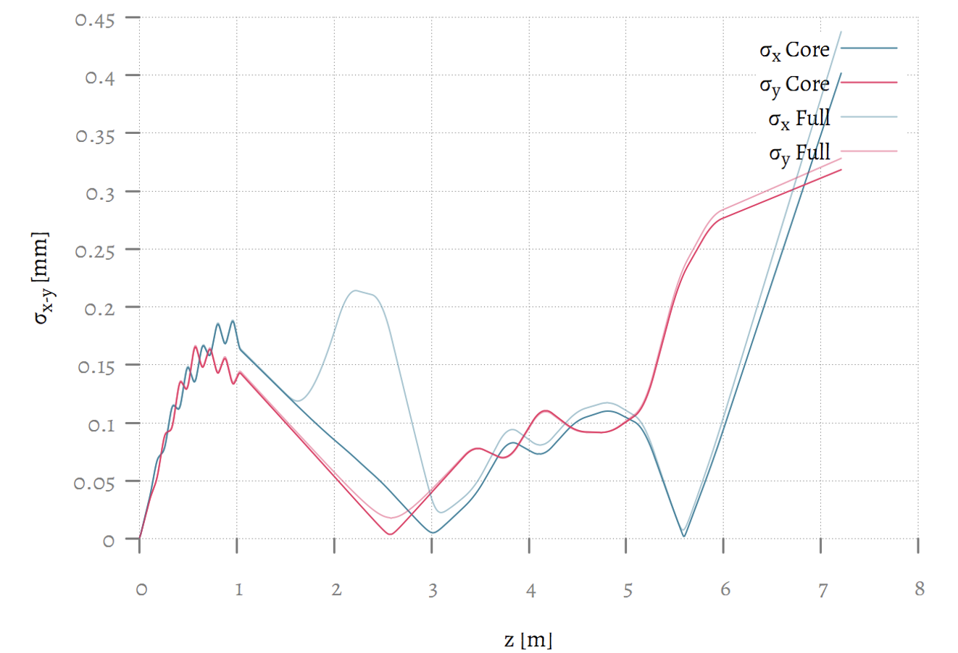
S2E «basic» details: 3/4
M. Rossetti Conti
Layout
Transverse beam size evolution w Space Charge (Astra)

Slide 33
S2E «basic» details: $λ_{r}=4 nm$ 4/4
V. Petrillo
Beam from TL with space charge E=1GeV, Q= 30 pC.

Slide 34
S2E «basic» details: $λ_{r}=3.3 nm$ 4/4
V. Petrillo
Beam from TL with space charge E=1GeV, Q= 30 pC.

Slide 35
EuPRAXIA@SPARC_LAB Parameter List update 1
Nominal FEL parameters from CDR
FEL Parameters Nov 2022
Parameter | Unit | PWFA | Full X-band
Radiation Wavelength | nm | 3 | 3
Photons per Pulse | $$×{10}^{12}$$ | 0.1 | 1
Photon Bandwith | % | 0.9 | 0.5
Undulator Area Length | m | 30 | 30
𝜌(1D/3D) | $$×{10}^{−3}$$ | 1 | 2
Photon Brilliance per shot | $$\left(\begin{aligned}s {mm}^{2}{mrad}^{2} \\ bw\left(0.1\%\right)\end{aligned}\right)$$ | $$1 ×{10}^{27}$$ | 1
Parameter | Unit | PWFA | Full X-band
Radiation Wavelength | nm | 3-4 | 4
Photons per Pulse | $$×{10}^{12}$$ | 0.1- 0.25 | 1
Photon Bandwith | % | 0.1 | 0.5
Undulator Area Length | m | 30 | 30
𝜌(1D/3D) | $$×{10}^{−3}$$ | 2 | 2
Photon Brilliance per shot | $$\left(\begin{aligned}s {mm}^{2}{mrad}^{2} \\ bw\left(0.1\%\right)\end{aligned}\right)$$ | 1$−2 ×{10}^{28}$ | $$1 ×{10}^{27}$$

Slide 36
EuPRAXIA@SPARC_LAB Parameter List update 2
Electron Beam parameters from CDR
Electron Beam Parameters Nov 22
Parameter | Unit | PWFA | Full X-band
Electron Energy | GeV | 1 | 1
Bunch Charge | pC | 30 | 200
Peak Current | kA | 1-2 | 1-2
RMS Energy Spread | % | 1.1 | 0.1
RMS Bunch Length | 𝜇m | 6-4 | 24-20
RMS norm. Emittance | 𝜇m | 1 | 1
Slice Energy Spread | % | 0.03 | 0.02
Slice norm Emittance | mm-mrad | 0.5 | 0.3
Parameter | Unit | PWFA | Full X-band
Electron Energy | GeV | 1-1.2 | 1
Bunch Charge | pC | 30-50 | 200-500
Peak Current | kA | 1-2 | 1-2
RMS Energy Spread | % | 0.1 | 0.1
RMS Bunch Length | 𝜇m | 6-3 | 24-20
RMS norm. Emittance | 𝜇m | 1 | 1
Slice Energy Spread | % | ≤0.05 | ≤0.05
Slice norm Emittance | mm-mrad | 0.5 | 0.5

