Slide 1
Status of the EuPRAXIA ESFRI Project
R. Assmann, GSI (via remote)
Frascati, Rome, Italy, 21 – 22 Nov 2023

Slide 2
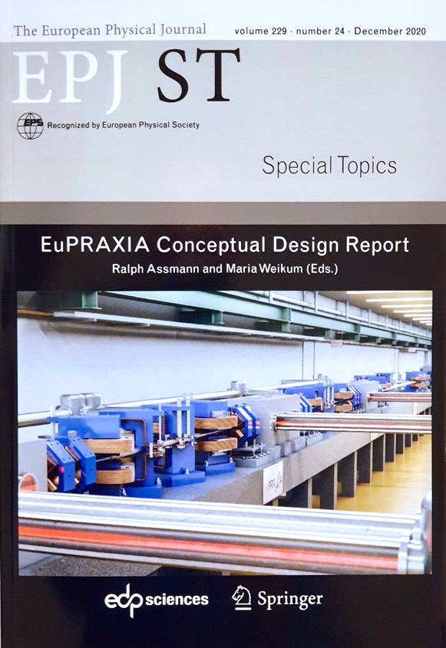
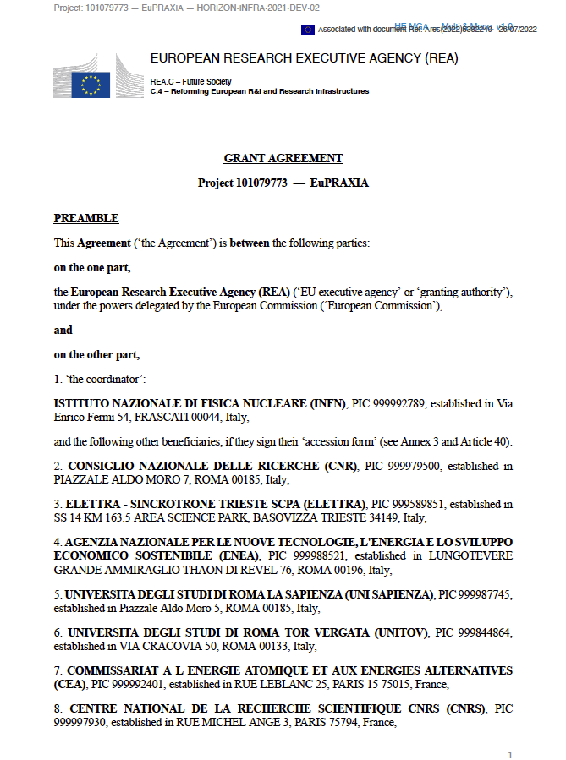

Reference Documents EuPRAXIA-PP

Slide 3
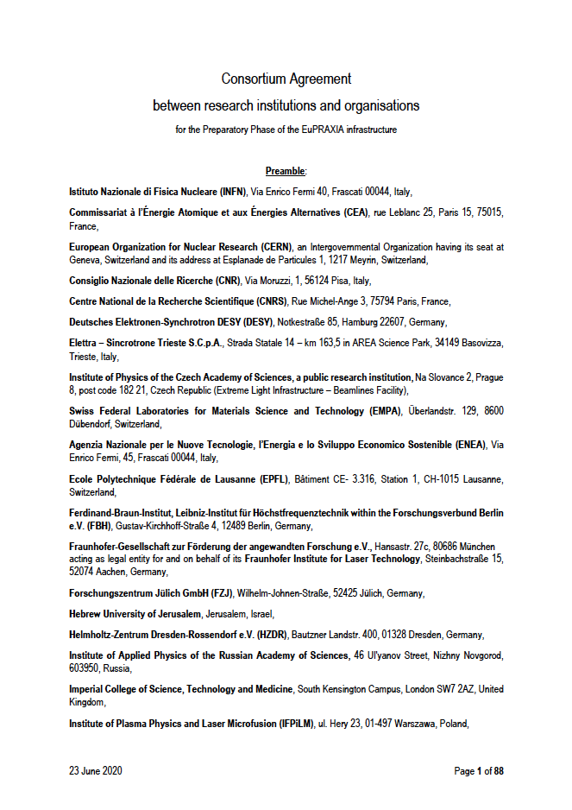
Reference Documents EuPRAXIA-ESFRI

Slide 4
Outline
Consortium
Outreach
The PP Project Bodies
Implementation RI
Budget
News & Changes (Progress with EU PO)

Slide 5
Outline
Consortium
Outreach
The PP Project Bodies
Implementation RI
Budget
News & Changes (Progress with EU PO)

Slide 6
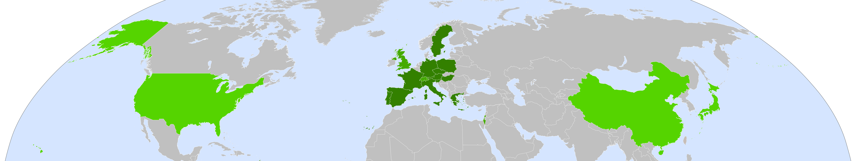
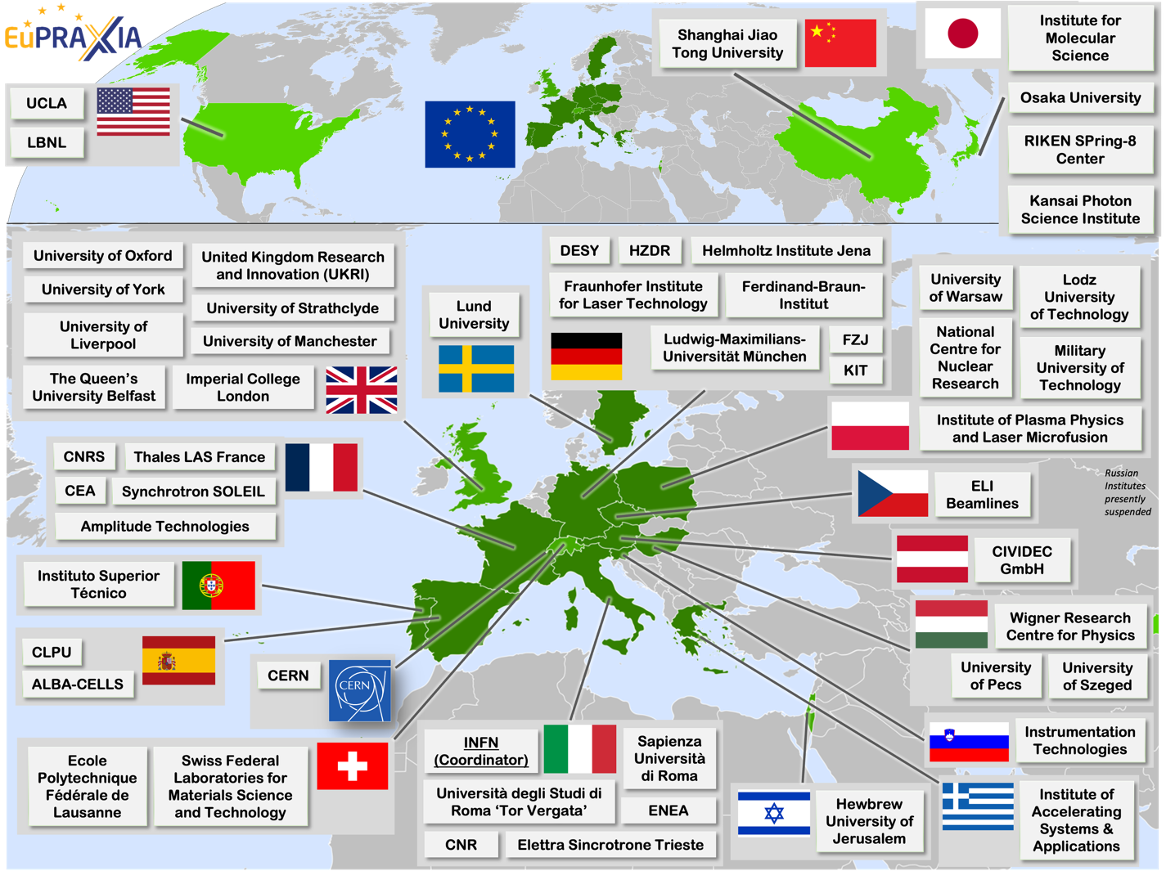
The EuPRAXIA Consortium Today
54 institutes (in addition 15 ask to join Preparatory Phase presently)
from 18 countries plus CERN
signed on one or several presently active EuPRAXIA consortia:
  ESFRI consortium (funding in-kind)
  Preparatory Phase consortium (funding EU, UK, Switzerland, in-kind)
  Doctoral Network (funding EU, UK, in-kind)

Slide 7
Outline
Consortium
Outreach
The PP Project Bodies
Implementation RI
Budget
News & Changes (Progress with EU PO)

Slide 8
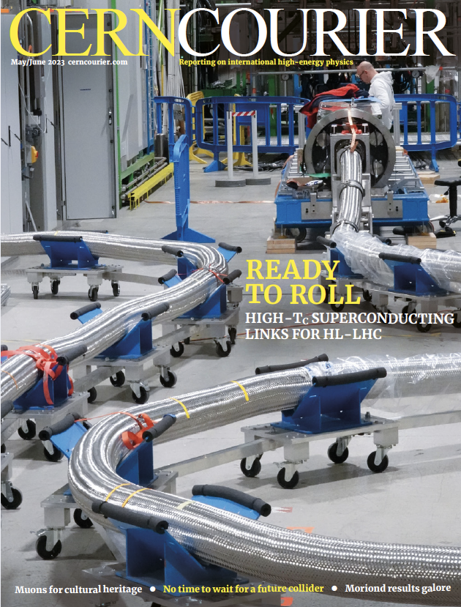
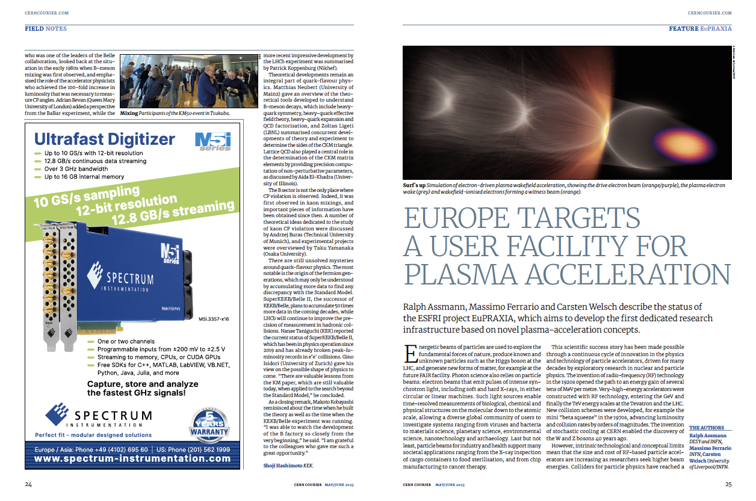
CERN Courier → Raises a Lot of Interest

Slide 9


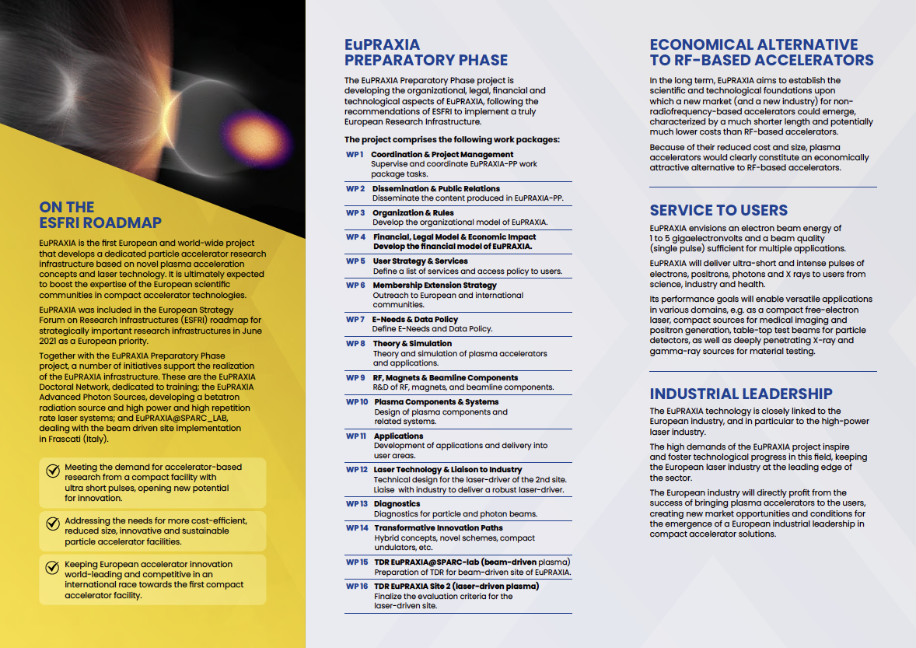
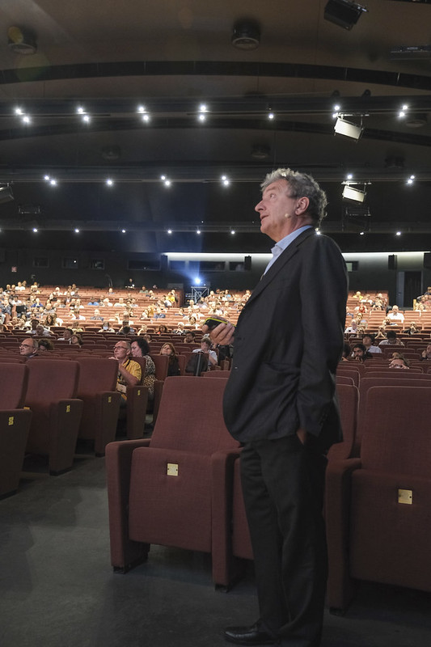
IPAC23 Talk, EuPRAXIA Leaflet

Slide 10
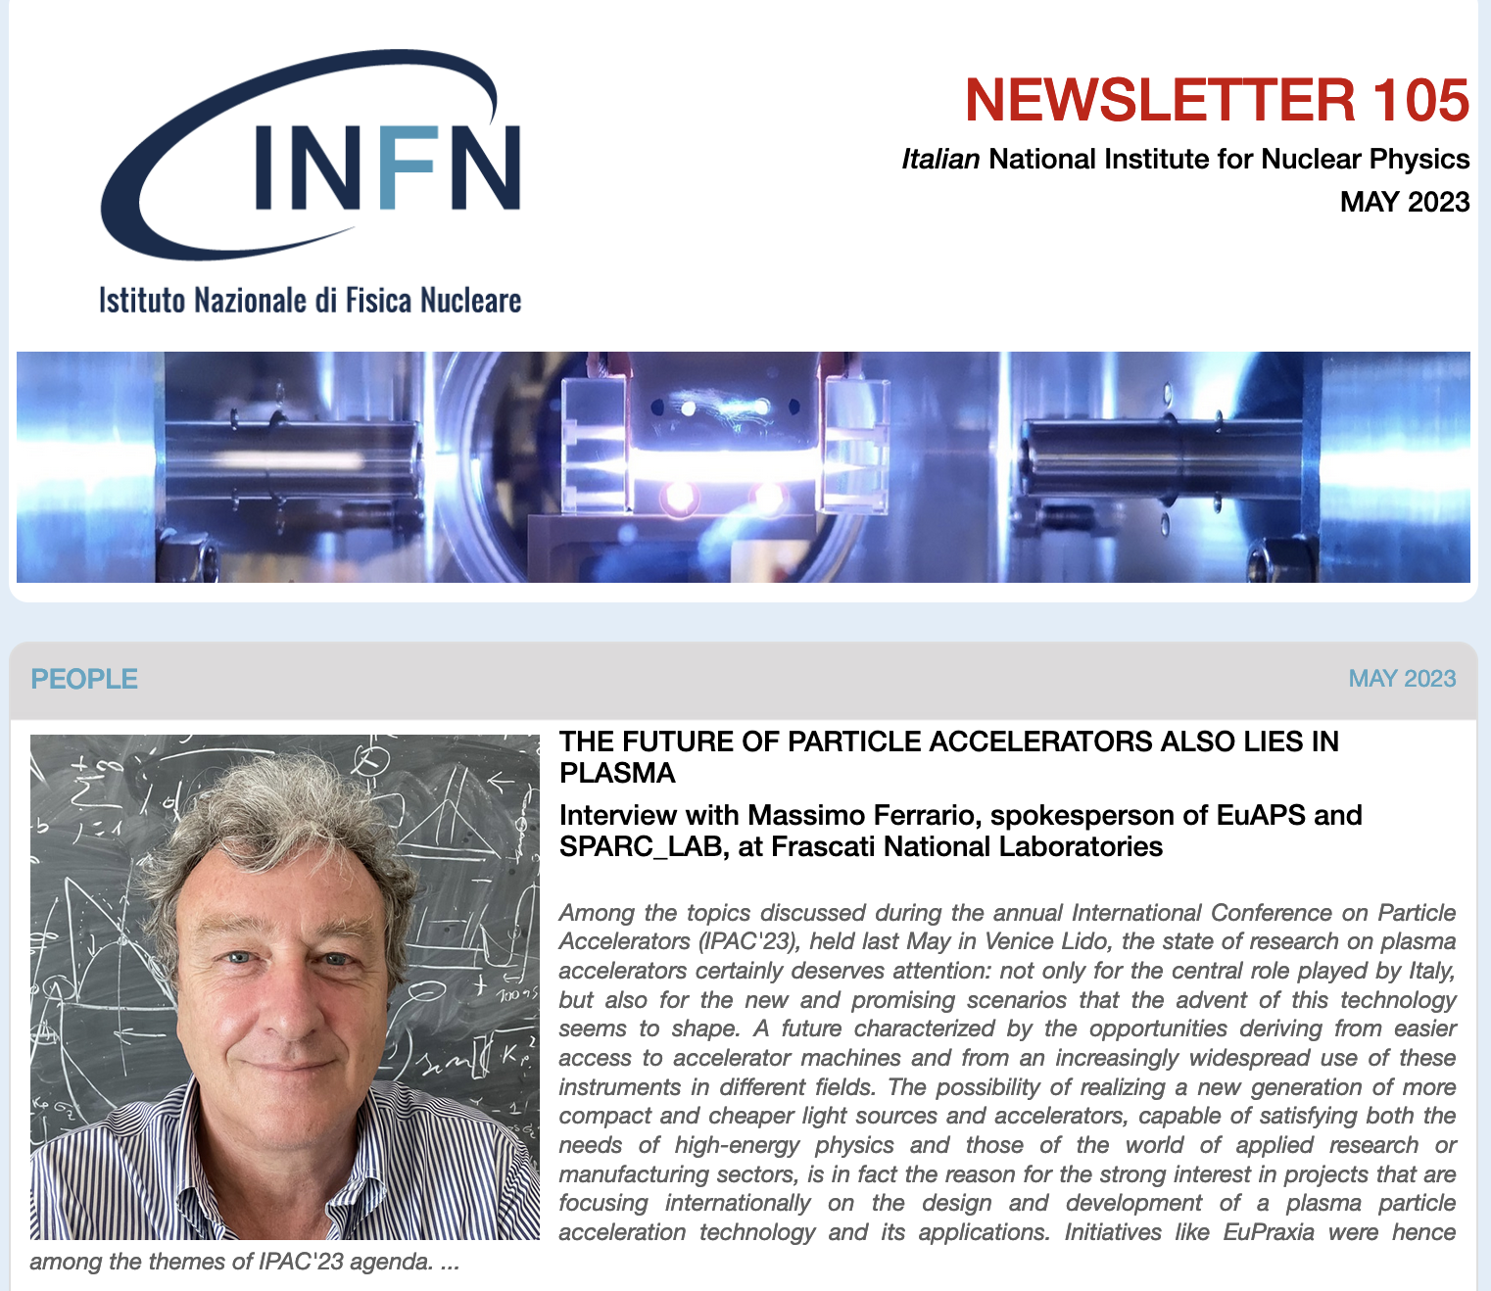

INFN Interview of Massimo, Fermi Prize, …

Slide 11
Outline
Consortium
Outreach
The PP Project Bodies
Implementation RI
Budget
News & Changes (Progress with EU PO)

Slide 12
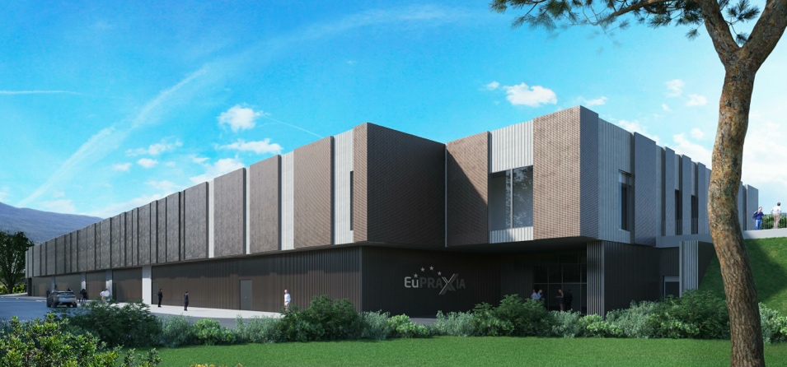

EuPRAXIA-PP (Preparatory Phase) Key Facts
Prepares the implementation of the full RI in Europe
Total project volume (including in-kind): 8.3 M€
  EU funding: 2.49 M€ (EU without in-kind)
  Outside EU 0.69 M€ (Switzerland)
  0.51 M€ (UK)
Work organized in 16 Work Packages
Project dates: 1 Nov 2022 – 31 Oct 2026
Coordinator and location of headquarters: INFN
34 participating organizations from 12 countries
Will establish a “Board of Financial Sponsors“ with representatives of funding agencies.
So far ~ 31% of total M&P funding (569 M€) secured. Site 1 is essentially financed → Massimo.

Slide 13

Project Boards PP
→
→
→

Slide 14
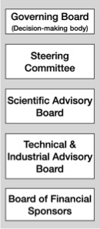
PP Steering Committee: Leaders Behind EuPRAXIA
WP1 - Coordination & Project Management
R. Assmann, INFN & DESY
M. Ferrario, INFN
WP2 - Dissemination and Public Relations
C. Welsch, U Liverpool
S. Bertellii, INFN
WP3 - Organization and Rules
A. Specka, CNRS
A. Ghigo, INFN
WP4 - Financial & Legal Model. Economic Impact
A. Falone, INFN
WP5 - User Strategy and Services
F. Stellato, U Tor Vergata
E. Principi, ELETTRA
WP6 - Membership Extension Strategy
B. Cros, CNRS
A. Mostacci, U Sapienza
WP7 - E-Needs and Data Policy
R. Fonseca, IST
S. Pioli, INFN
WP8 - Theory & Simulation
J. Vieria, IST
H. Vincenti, CEA
WP9 - RF, Magnets & Beamline
Components
S. Antipov, DESY
F. Nguyen, ENEA
WP10 - Plasma Components & Systems
K. Cassou, CNRS
J. Osterhoff, DESY
WP11 - Applications
G. Sarri, U Belfast
E. Chiadroni,U Sapienza
WP12 - Laser Technology, Liaison to Industry
L. Gizzi, CNR
P. Crump, FBH
WP13 - Diagnostics
A. Cianchi, U Tor Vergata
R. Ischebeck, EPFL
WP14 - Transformative Innovation Paths
B. Hidding, U Strathclyde
S. Karsch, LMU
WP15 - TDR EuPRAXIA @SPARC-lab
C. Vaccarezza, INFN
R. Pompili, INFN
WP16 - TDR EuPRAXIA Site 2
A. Molodozhentsev, ELI-Beamlines
R. Pattahil, STFC
WP’s on coordination & implementation as ESFRI RI (organization, legal model, financing, users)
WPs on technical implementation and sites

Slide 15
Scientific and Technical Advisory Board (STAB)
Final list of members:
* Lenny Rivkin - Chair PSI/LEAPS
* Mike Dunne SLAC
* Ursula Bassler CNRS
* Sandro de Silvestri Politecnico Torino
* László Veisz UMU Sweden
* Fernando Ferroni INFN
* Thomas Tschentscher Eu. XFEL
* Hagen Zimer Trumpf Laser CEO
* Roland Sauerbrey ex HZDR director, retired

Slide 16
Outline
Consortium
Outreach
The PP Project Bodies
Implementation RI
Budget
News & Changes (Progress with EU PO)

Slide 17
Construction Sites – Excellence Centers – Clusters/WP → Progress

Slide 18
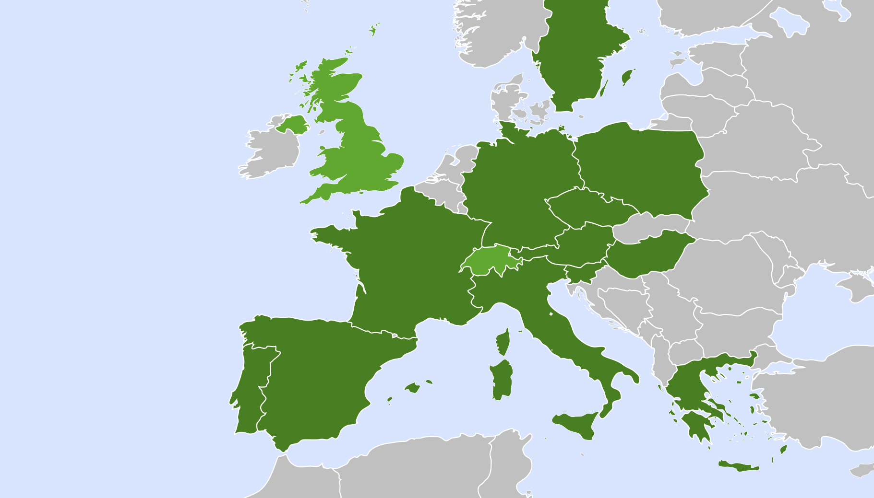


Distributed Research Infrastructure (10/23)
Today`s status
Excellence centers: all assumed to be realized
Second site: one to be selected
Beam-driven plasma user facility
EuPRAXIA Headquarter
Laser-driven plasma user facility: candidates
Excellence Center
Advanced Applications Beamlines (UK)
Plasma Acc. & High Rep. Rate Dev. (D)
2
2
3
4
Technology Incubator (CZ - ELI)
Second site will be decided in Preparatory Phase project.
Excellence centers (EC) perform technical developments, prototyping and component construction. Number of EC’s, locations, roles, responsibilities reviewed in Prep. Phase.
2
5
2
7
6
User Data Center (H)
Laser-Plasma Acc. & 1 GeV FEL (F)
Beam-driven plasma user facility
EuPRAXIA Headquarter
2
2
1
Theory & simulations (P)
Beam Diagnostics Center (CH)
Horizon Europe

Slide 19
Phased Implementation of Two Construction Sites
 | Laser-driven | Beam-driven
Phase 1 | FEL beamline to 1 GeV + user area 1 Ultracompact positron source beamline + positron user area | FEL beamline to 1 GeV + user area 1 GeV-class positrons beamline + positron user area
Phase 2 | X-ray imaging beamline + user area Table-top test beams user area FEL user area 2 FEL to 5 GeV | ICS source beamline + user area HEP detector tests user area FEL user area 2 FEL to 5 GeV
Phase 3 | High-field physics beamline / user area Other future developments | Medical imaging beamline / user area Other future developments
INFN (Italy):
Facility for beam-driven plasma accelerators
Beamline BB-A: Radiation sources
FEL user area 1
Undulator
Undulator
Plasma Accelerator
FEL user area 2
RF Injector
RF Accelerator
ICS X-ray source user area (BU3)
HEP detector test user area
laser
Plasma Accelerator
Conversion & conditioning
electrons
GeV-class positron user area
positrons
Beamline BB-B: GeV-class positrons & HEP detector test stand
Beamline LB-C: X-ray imaging – life sciences & materials
Facility for laser-driven plasma accelerators
Plasma Injector
Life-science & materials X-ray imaging user area
Beamline LB-B: Positron beam source & table-top test beam
Table-top test beam user area
Plasma Injector
Plasma Accelerator
Conversion & conditioning
Ultracompact positron source user area
Laser
FEL user area 1
Plasma Accelerator
Undulator
Undulator
RF Injector
Beamline LB-A: FEL
FEL user area 2

Slide 20
Demand-Interest-WP-Matrix EuPRAXIA-PP

Slide 21
Outline
Consortium
Outreach
The PP Project Bodies
Implementation RI
Budget
News & Changes (Progress with EU PO)

Slide 22
EuPRAXIA: Budget Status October 2023
Cost item | Invest (M€) | Personnel (M€) | Total cost (M€) | Obtained (M€) | Coverage (%) | Missing (§) (M€)
Site 1 (*), Frascati | 151,0 | 23,0 | 174,0 | 138,8 | 80% | 35,2
Site 2 (**), tbd | 149,0 | 29,0 | 178,0 | 0,0 | 0% | 178,0
Termination | 1,0 | 2,0 | 3,0 | 0,0 | 0% | 3,0
CDR | 0,2 | 2,8 | 3,0 | 3,0 | 100% | 0,0
Preparation, incl. excellence centers | 137,0 | 74,0 | 211,0 | 34,6 | 16% | 176,4
Total | 438,2 | 130,8 | 569,0 | 176,4 | 31% | 392,6
(*) includes estimate of 240 FTE-y of personpower from LNF-INFN
(**) cost will be reduced in case of relevant pre-invests (exisiting infrastructure, equipment)
(§) for full implementation, phased EuRAXIA approach allows user operation without full funding

Slide 23
Guidelines Site 2 / Excellence Centers
Great opportunity to profit budget-wise from invested EuPRAXIA work → we ask for relatively modest invest into a high tech project connected to various important industries (not too small – not too big)
Our strength: Bottom up approach, bringing distributed groups, science and industry on board towards a common goal → keeping this is essential
Need project plans with attractive (easy) contents supporting EuPRAXIA:
  7 year high tech project plans (2024 – 2030, start of full EuPRAXIA OP 2031)
  178 M€ max total cost for site 2 → 25.4 M€ / y
  cheaper if pre-invests can be materialized
  176.4 M€ max cost for 6 – 10 excellence centers → 2.5 – 4.2 M€ / y /center
Stay focussed: Make the connection to EuPRAXIA: relevant deliverable?

Slide 24
Outline
Consortium
Outreach
The PP Project Bodies
Implementation RI
Budget
News & Changes

Slide 25
Conclusion & Changes
Work ongoing to
  extend consortium of Preparatory Phase (16 additional institutes)
  adjust deliverables/MS to additional sites & extended time scale (within PP project)
  update some legal details (ELI-beamlines is now an ERIC, UK person → Germany)
  update of schedule for reviews
Personal remarks:
  I have recently joined GSI in Germany for a high level position in German science.
  Therefore I unfortunately have to leave the position as INFN coordinator of EuPRAXIA-PP. Until a new coordinator is being appointed I remain responsible as coordinator.
  I mandated Antonio Falone from INFN to discuss/agree the required changes with EU.
  I stay connected scientifically from GSI and University Frankfurt but much reduced.
  Driving EuPRAXIA forward and leading the effort in the last 10 years has been an adventure and a privilege for me → many thanks to all who helped, also in our advising committees!

Slide 26
Thank You

Slide 27
Backup Slides

Slide 28
Consortium

Slide 29
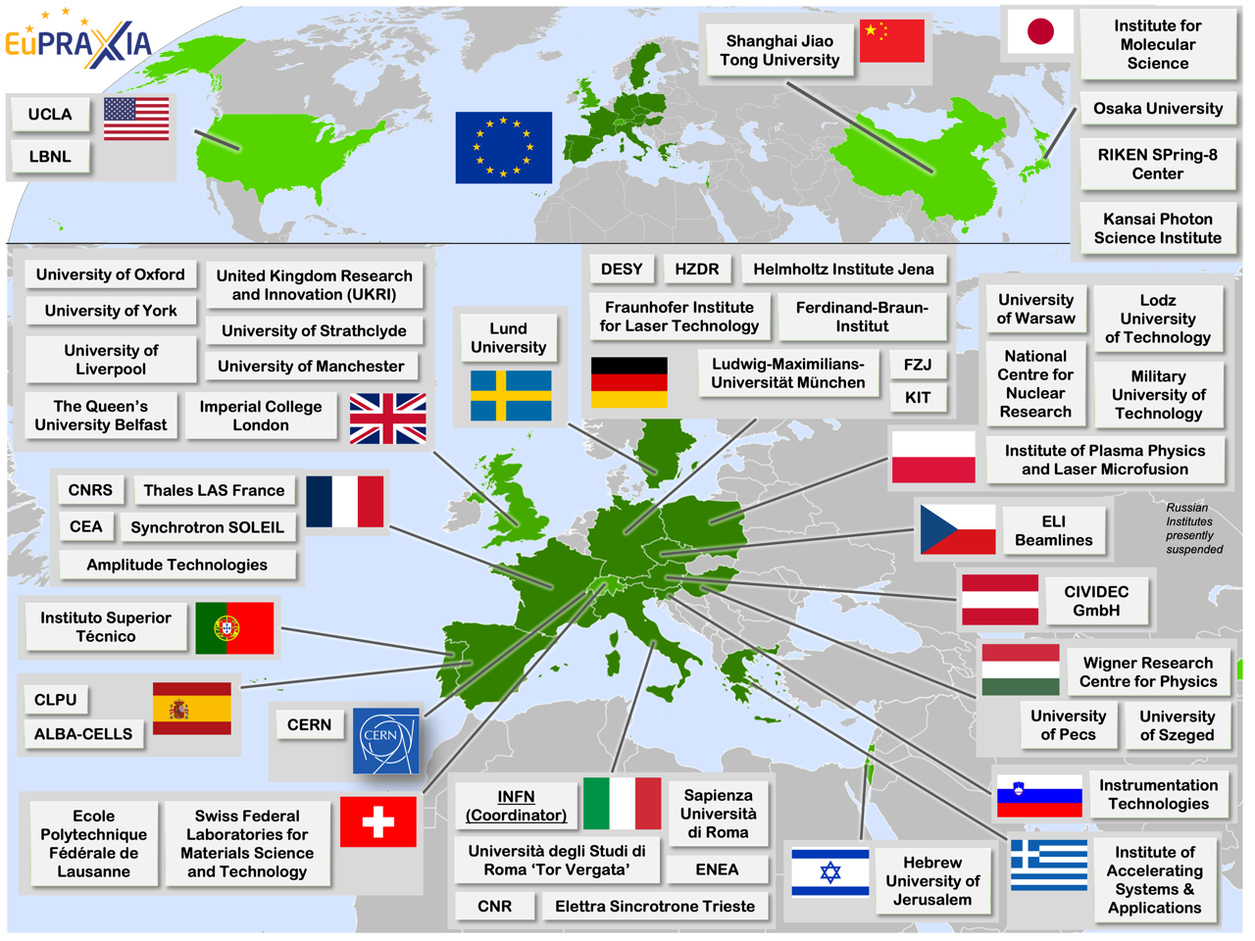
Consortia Map

Slide 30
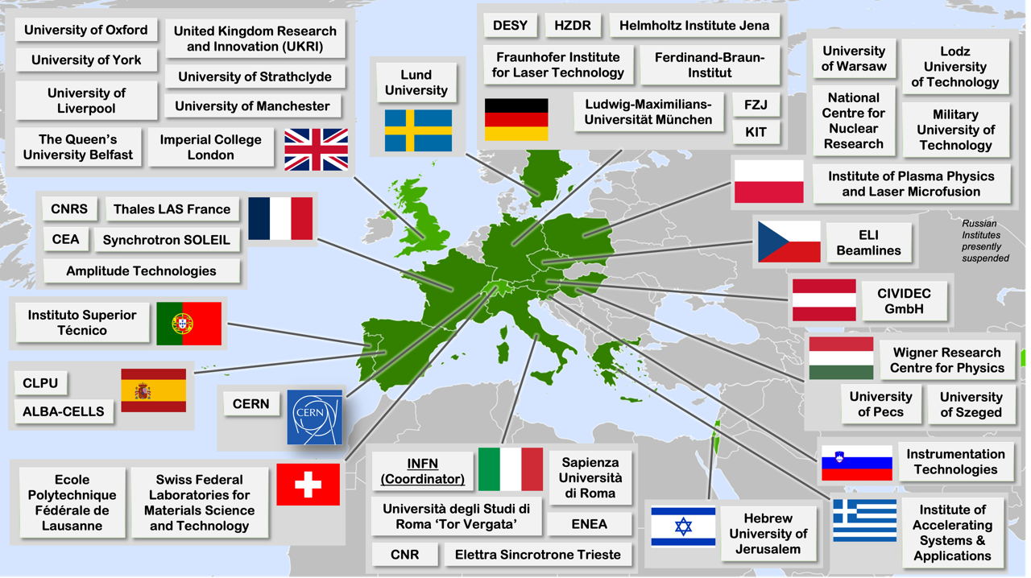
New Consortia Maps (Europe only)

Slide 31
Consortia News
16 more candidates to join Preparatory Phase consortium:
See list sent to EU PO, presented at end of this presentation
EuPRAXIA is still growing and attracting more labs and groups. Thanks for your trust and support.

Slide 32
The PP Project

Slide 33
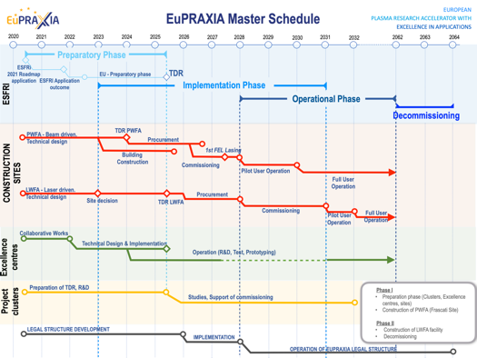
Preparatory Phase Main Goals
Managerial WP`s
  Outreach to public, users, EU decision makers and industry
  Define legal model (how is EuPRAXIA governed?), financial model, rules, user services and membership extension for full implementation
  Works with project bodies and funding agencies → Board of Financial Sponsors
Technical WP‘s (correspond to Project Clusters):
  Update of CDR concepts and parameters, towards technical design (full technical design requires more funding)
  Specify in detail Excellence Centers and their required funding: TDR related R&D, prototyping, contributions to construction
  Help in defining funding applications for various agencies
Output defined in milestones & deliverables with dates

Slide 34
Relevant Questions for Preparatory Phase
Updates to CDR concepts – towards a TDR
Second site on LWFA: Location and definition.
Excellence centres (add excellence centre lines to project overview and funding lines):
  Define final number and concepts (single hub, multi hub, connections)
  Can be cross-WP or single WP → EuPRAXIA PP workshop in first year
  Specify R&D, prototyping, testing and possible deliverables (baseline or upgrades) to construction sites for each excellence center
  Determine required budget and discuss implementation possibilities
User services and access models
E infrastructure requirement and integration
Legal and financial models. Open science and open innovation.
Rules and organization. Extension of membership.
…

Slide 35
Implementation RI

Slide 36

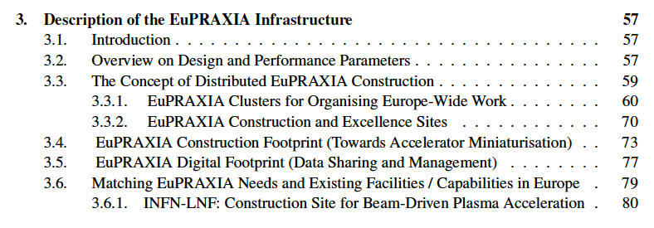
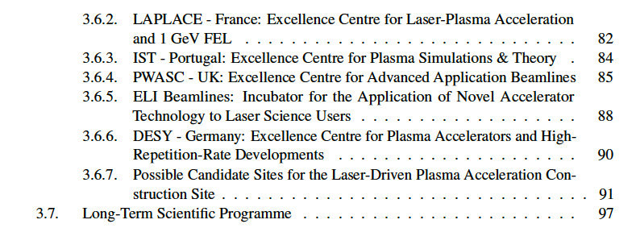
Concept from 2019 – Our Basis that we Adapt

Slide 37
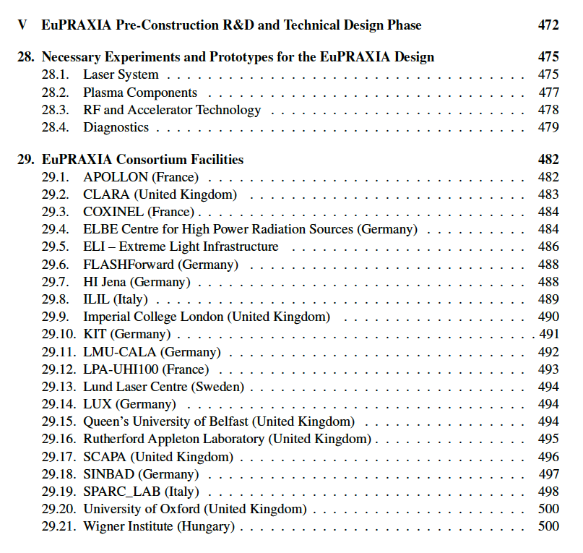
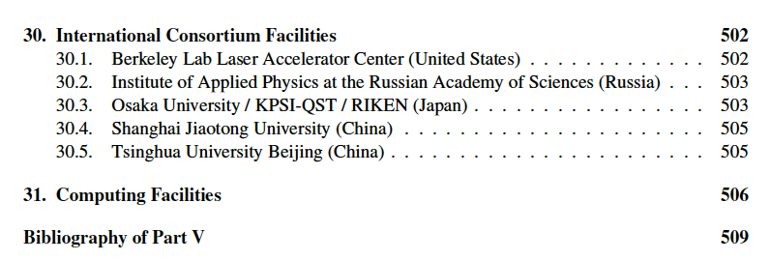
Concept from 2019 – Our Basis that we Adapt

Slide 38

Distributed RI Concept

Slide 39
Budget

Slide 40
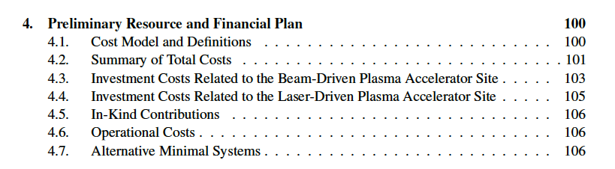
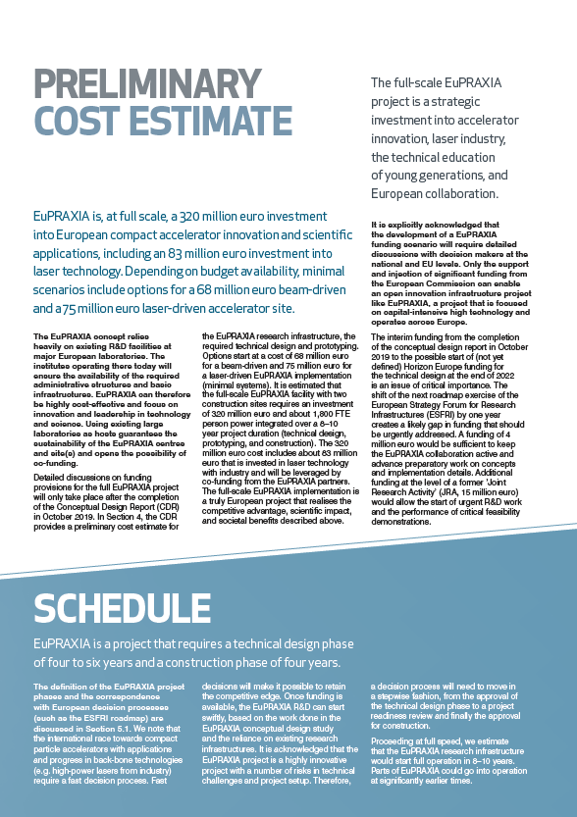
Budget was Defined in 2019 (CDR)

Slide 41
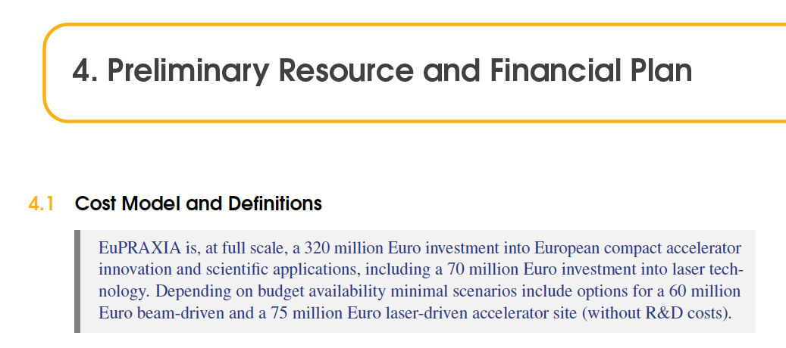
Budget was Defined in 2019 (CDR)

Slide 42
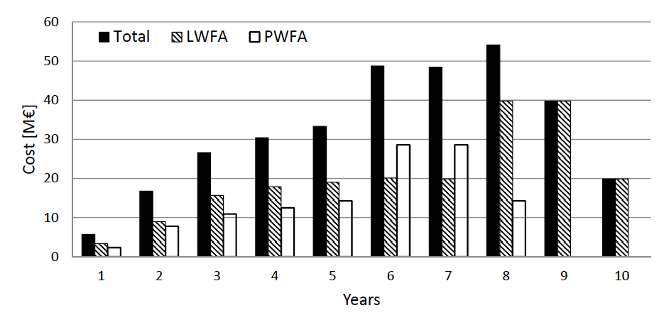
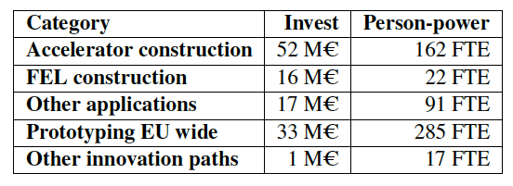
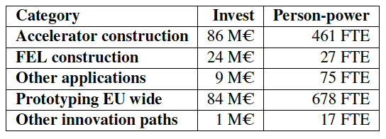
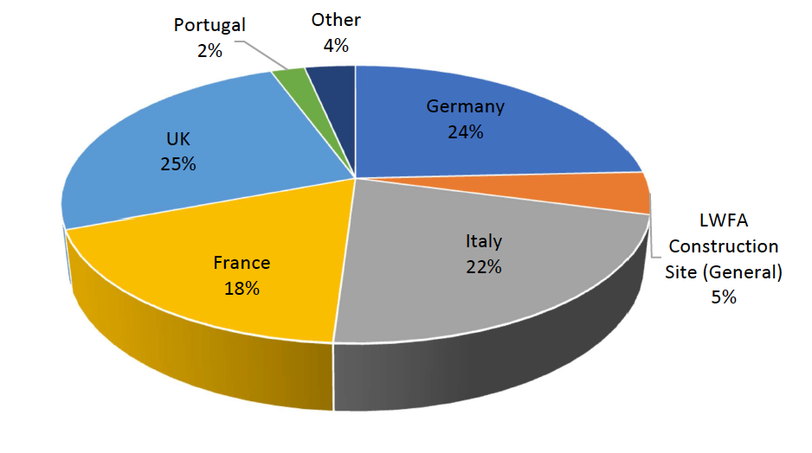
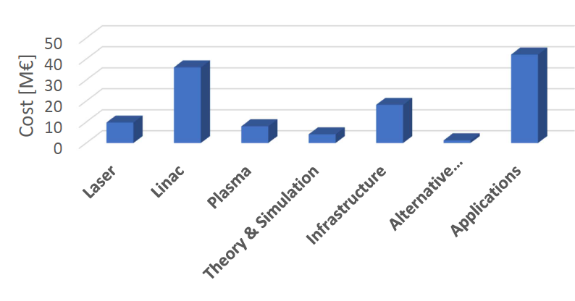
Budget was Defined in 2019 (CDR)

Slide 43
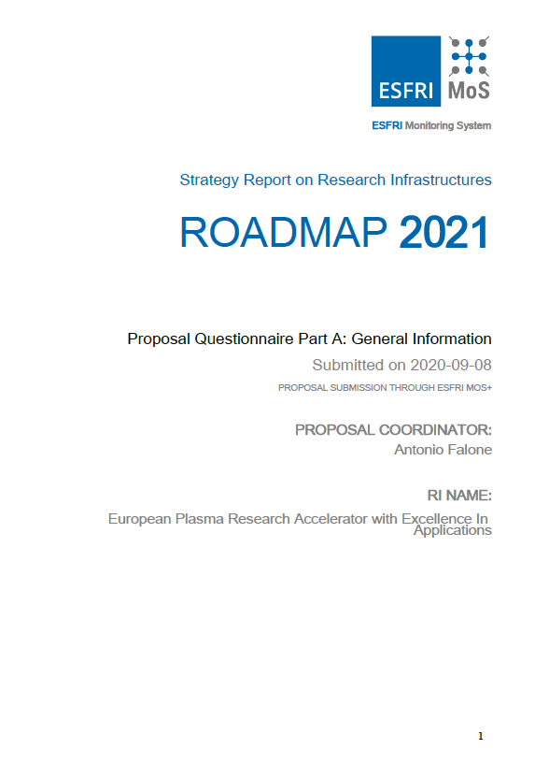
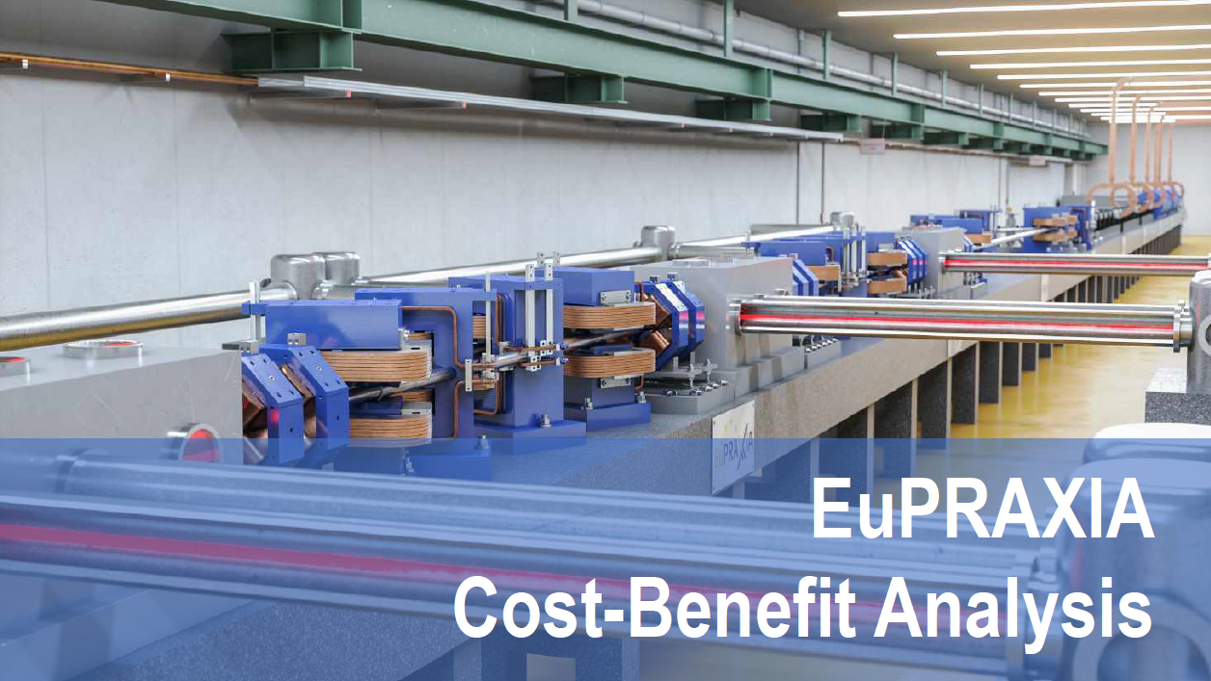
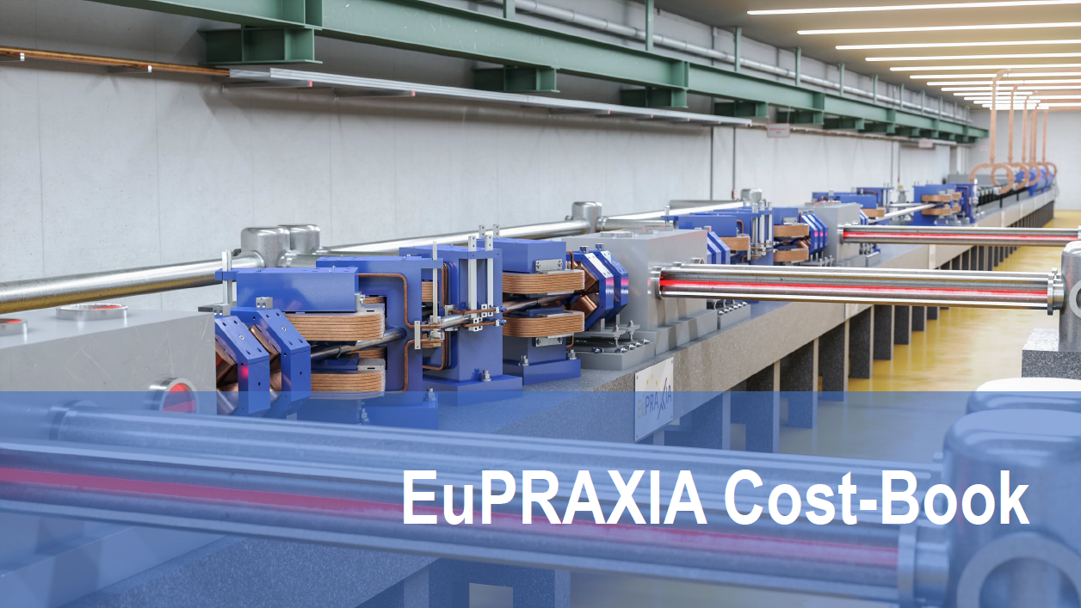
Budget was Refined (According to EU/ESFRI rules and Reviewed by ESFRI)

Slide 44
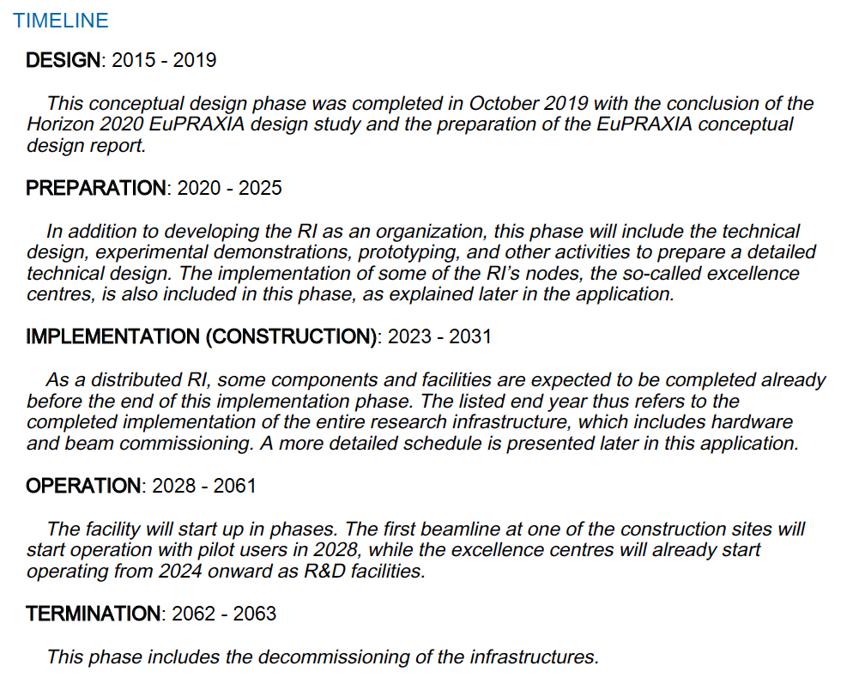
Refined EuPRAXIA Schedule

Slide 45
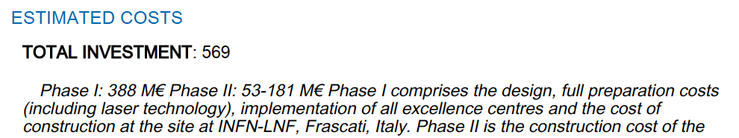
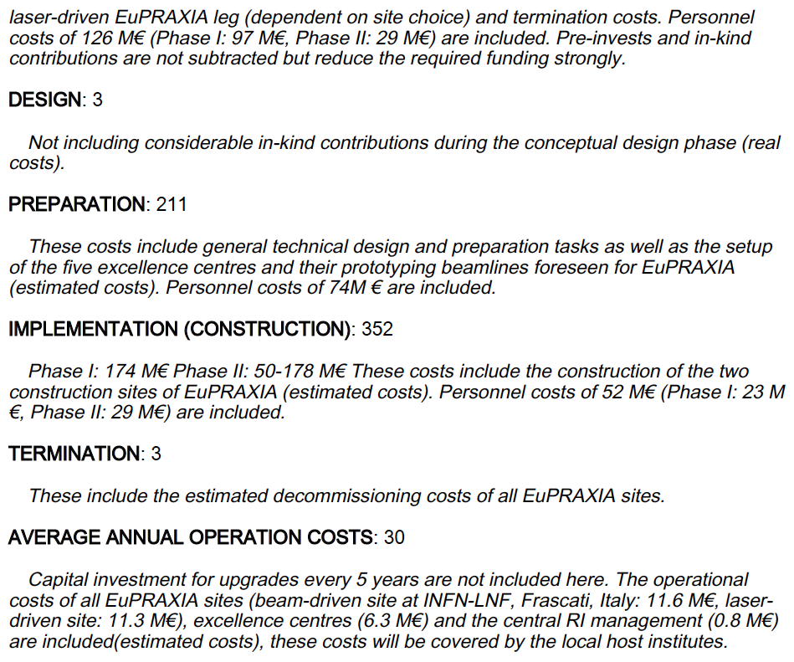
Refined EuPRAXIA Budget I

Slide 46
Refined EuPRAXIA Budget II

Slide 47
EuPRAXIA Project Overview & Funding Lines
162.6 M€ resources approved, 25 M€ applied for

Slide 48
Demand-Interest-WP-Matrix EuPRAXIA-PP
WP 2 – WP 8
No | Work Package Title
2 | Dissemination and Public Relations
5 | User Strategy and Services
6 | Membership Extension Strategy
7 | E-Needs and Data Policy
8 | Theory & Simulation
9 | RF, Magnets & Beamline Components
10 | Plasma Components & Systems
11 | Applications
12 | Laser Technology and Liaison to Industry
13 | Diagnostics
14 | Transformative Innovation Paths

Slide 49
Demand-Interest-WP-Matrix EuPRAXIA-PP
WP 9
No | Work Package Title
2 | Dissemination and Public Relations
5 | User Strategy and Services
6 | Membership Extension Strategy
7 | E-Needs and Data Policy
8 | Theory & Simulation
9 | RF, Magnets & Beamline Components
10 | Plasma Components & Systems
11 | Applications
12 | Laser Technology and Liaison to Industry
13 | Diagnostics
14 | Transformative Innovation Paths

Slide 50
Demand-Interest-WP-Matrix EuPRAXIA-PP
WP 10 – WP 11
No | Work Package Title
2 | Dissemination and Public Relations
5 | User Strategy and Services
6 | Membership Extension Strategy
7 | E-Needs and Data Policy
8 | Theory & Simulation
9 | RF, Magnets & Beamline Components
10 | Plasma Components & Systems
11 | Applications
12 | Laser Technology and Liaison to Industry
13 | Diagnostics
14 | Transformative Innovation Paths

Slide 51
Demand-Interest-WP-Matrix EuPRAXIA-PP
WP 12 a
No | Work Package Title
2 | Dissemination and Public Relations
5 | User Strategy and Services
6 | Membership Extension Strategy
7 | E-Needs and Data Policy
8 | Theory & Simulation
9 | RF, Magnets & Beamline Components
10 | Plasma Components & Systems
11 | Applications
12 | Laser Technology and Liaison to Industry
13 | Diagnostics
14 | Transformative Innovation Paths

Slide 52
Demand-Interest-WP-Matrix EuPRAXIA-PP
WP 12 b
No | Work Package Title
2 | Dissemination and Public Relations
5 | User Strategy and Services
6 | Membership Extension Strategy
7 | E-Needs and Data Policy
8 | Theory & Simulation
9 | RF, Magnets & Beamline Components
10 | Plasma Components & Systems
11 | Applications
12 | Laser Technology and Liaison to Industry
13 | Diagnostics
14 | Transformative Innovation Paths

Slide 53
Demand-Interest-WP-Matrix EuPRAXIA-PP
WP 13 – WP 14
No | Work Package Title
2 | Dissemination and Public Relations
5 | User Strategy and Services
6 | Membership Extension Strategy
7 | E-Needs and Data Policy
8 | Theory & Simulation
9 | RF, Magnets & Beamline Components
10 | Plasma Components & Systems
11 | Applications
12 | Laser Technology and Liaison to Industry
13 | Diagnostics
14 | Transformative Innovation Paths
→ I think a good start for a data based setup of our project.
Work in progress
Requires more fine tuning, discussions, iterations, …
→ Demand, interest and competence based matching of capabilities and needs. Then can propose strong funding demands and proposals.

Slide 54
Dates and Deliverables

Slide 55
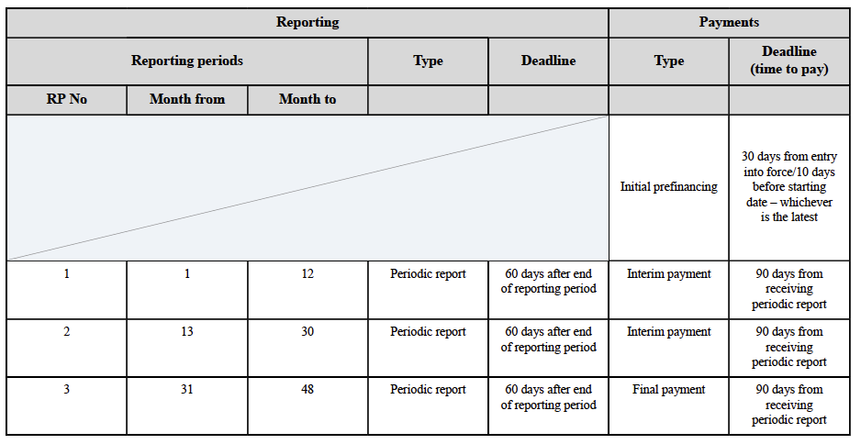
Reporting Periods – M12, M30, M48

Slide 56
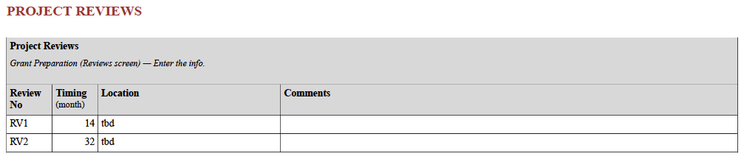
Project Reviews – M14, M32

Slide 57
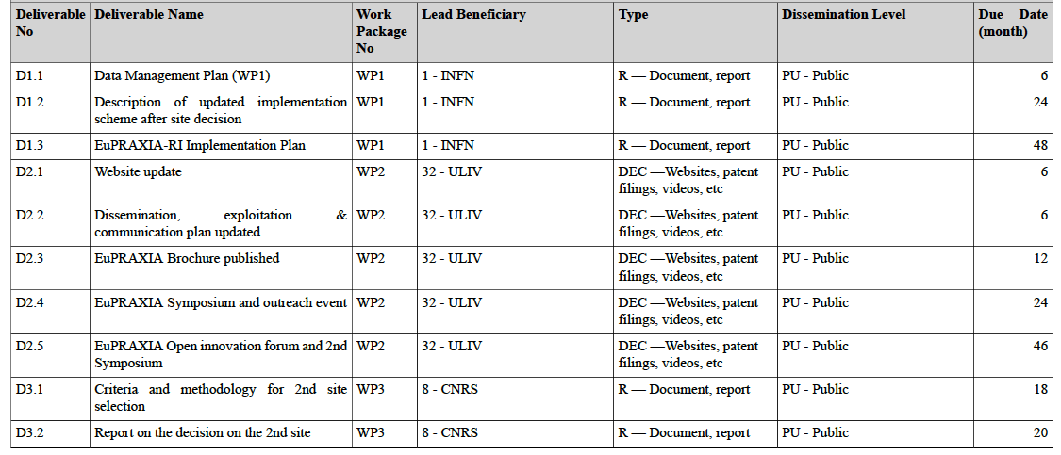
Deliverables and Dates
OK
our discussion
OK
OK
our discussion
our discussion

Slide 58
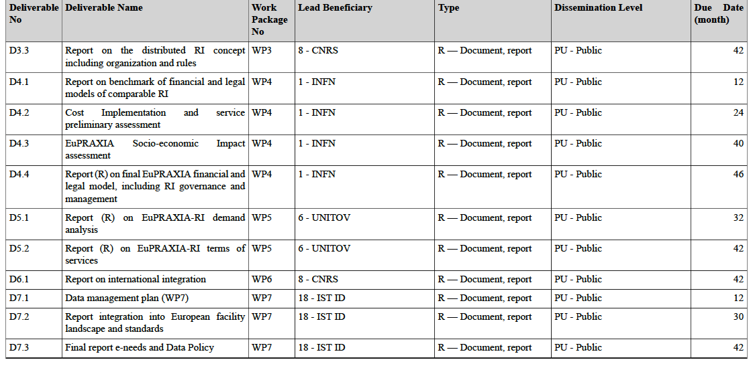
Deliverables and Dates
our discussion
our discussion
our discussion

Slide 59
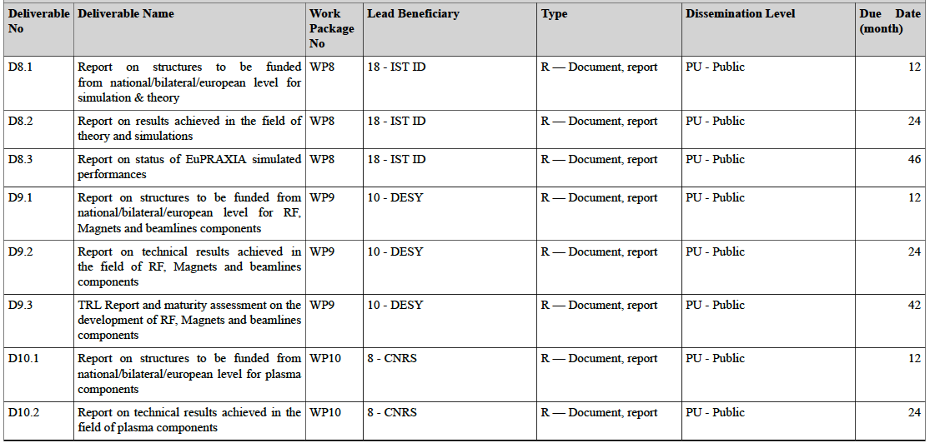
Deliverables and Dates

Slide 60
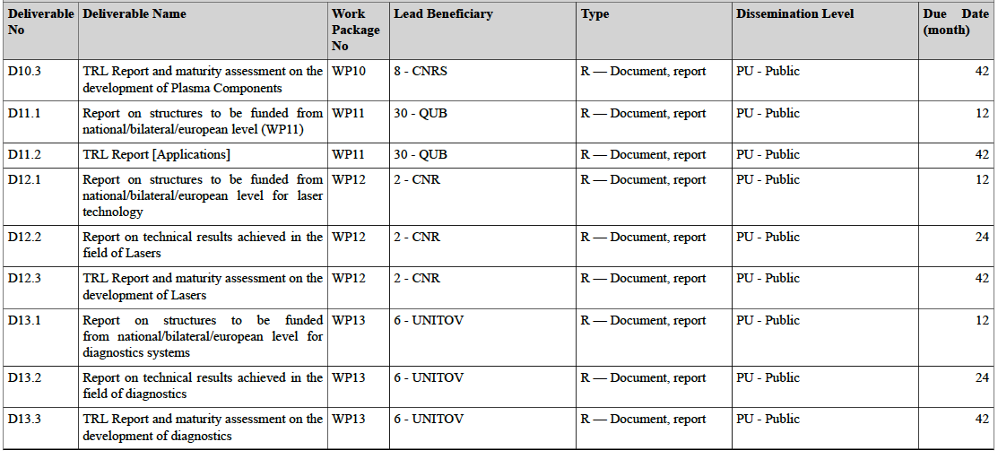
Deliverables and Dates

Slide 61
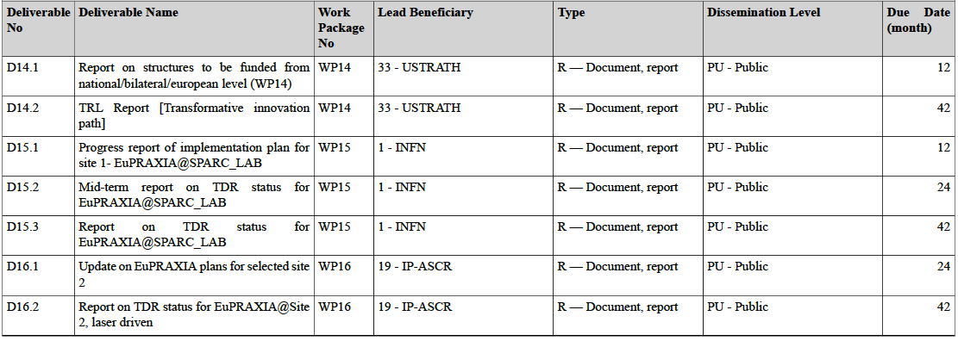
Deliverables and Dates

Slide 62
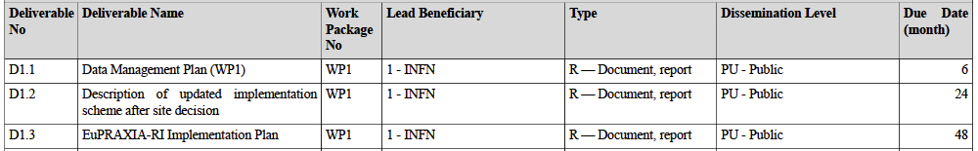
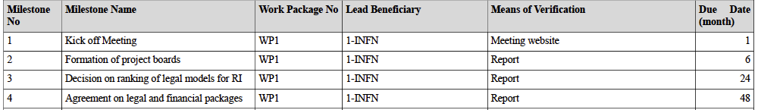
Deliverables & Milestones WP1

Slide 63
News & Changes Summarized
Communication to EU Project Officer
We ask for a delay of the EU project review from Dec 2023 (M14) to Feb 2024 (M16), so after the delivery of the Period 1 report (M12 + 60 days)
We want to add additional associated partners to the EuPRAXIA-PP CA
and GA:
University Düsseldorf (D) University of Nice (F) PSI (CH)
GSI (D) University Frankfurt (D) HI Jena (D)
Amplitude Technologies (F) University of Lund (Sweden)
University of Palermo (I) University of Manchester (UK)
Shanghai Jiao Tong University (China) Karlsruher Institut für Technologie (D)
Warsaw University of Technology (Poland) Institute for Molecular Science, National
University of Trieste (I) Institutes of Natural Sciences - Osaka
University (Japan)

Slide 64
News & Changes Summarized
Communication to EU Project Officer
We want to update the legal entity for ELI-Beamlines (now has become an ERIC) in the GA and the CA
A WP leader (WP14) has moved from Strathclyde (UK) to University Düsseldorf (D). We want to discuss the UK UKRI funding for WP14, originally managed by University Strathclyde in UK, and its possible transfer/reallocation/... to University Düsseldorf.
We want to check with EU if there is any problem for a new and additional candidate (CLPU, Spain) for the second site of our future infrastructure. Now we have 4 candidate sites instead of 3.

Slide 65
News & Changes Summarized
Communication to EU Project Officer
We must delay the date for decision of the 2nd construction site for several reasons, including financial and political considerations. Consequences:
  Several deliverables in the GA will be reworded and several new deliverables will be added. No deliverable will be deleted.
  Accordingly changes to milestones in the GA will be implemented.
The overall approach will be, that first we get agreement from the steering committee, then all is pre-discussed with EU to ensure feasibility, afterwards the collaboration board of the consortium will approve the changes and finally contract amendments both for the CA and the GA will be put into the signature loop.

