Slide 1
Performance of very high-energy electron therapy delivered in conventional and FLASH conditions:
the case of Stereotactic treatments
PhD in Accelerator Physics
Candidate:
Dott. Daniele Carlotti
Thesis Advisor:
Prof. Alessio Sarti
Daniele Carlotti
18/11/2023

Slide 2
Index
Radiotherapy, FLASH effect & VHEE
Clinical aspects in stereotactic pancreas treatments
Flash effect Activation & critical aspect
Lung lesions Non-Small-Cell-Lung Cancer (NSCLC)
Daniele Carlotti

Slide 3
Index
RADIOTHERAPY
FLASH EFFECT & VHEE

Slide 4
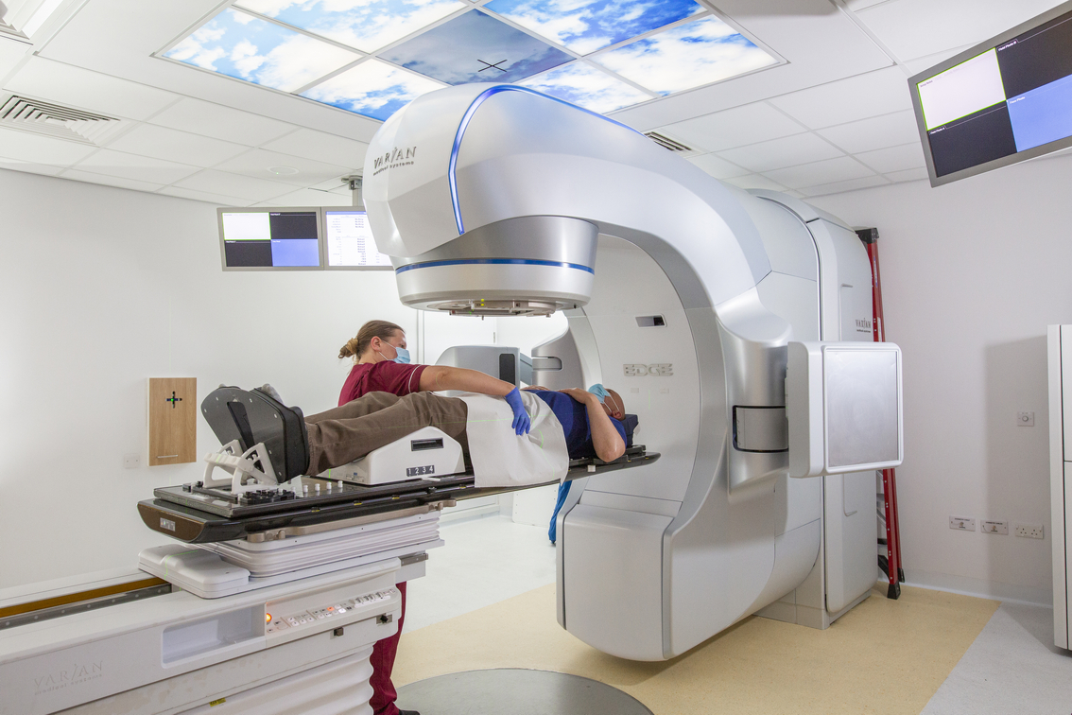
Conventional Radiotherapy
High-lines:
Delivery dose (2 Gy x Fraction)
Conventional Dose Rate (0.08 Gy/s)
Daniele Carlotti

Slide 5
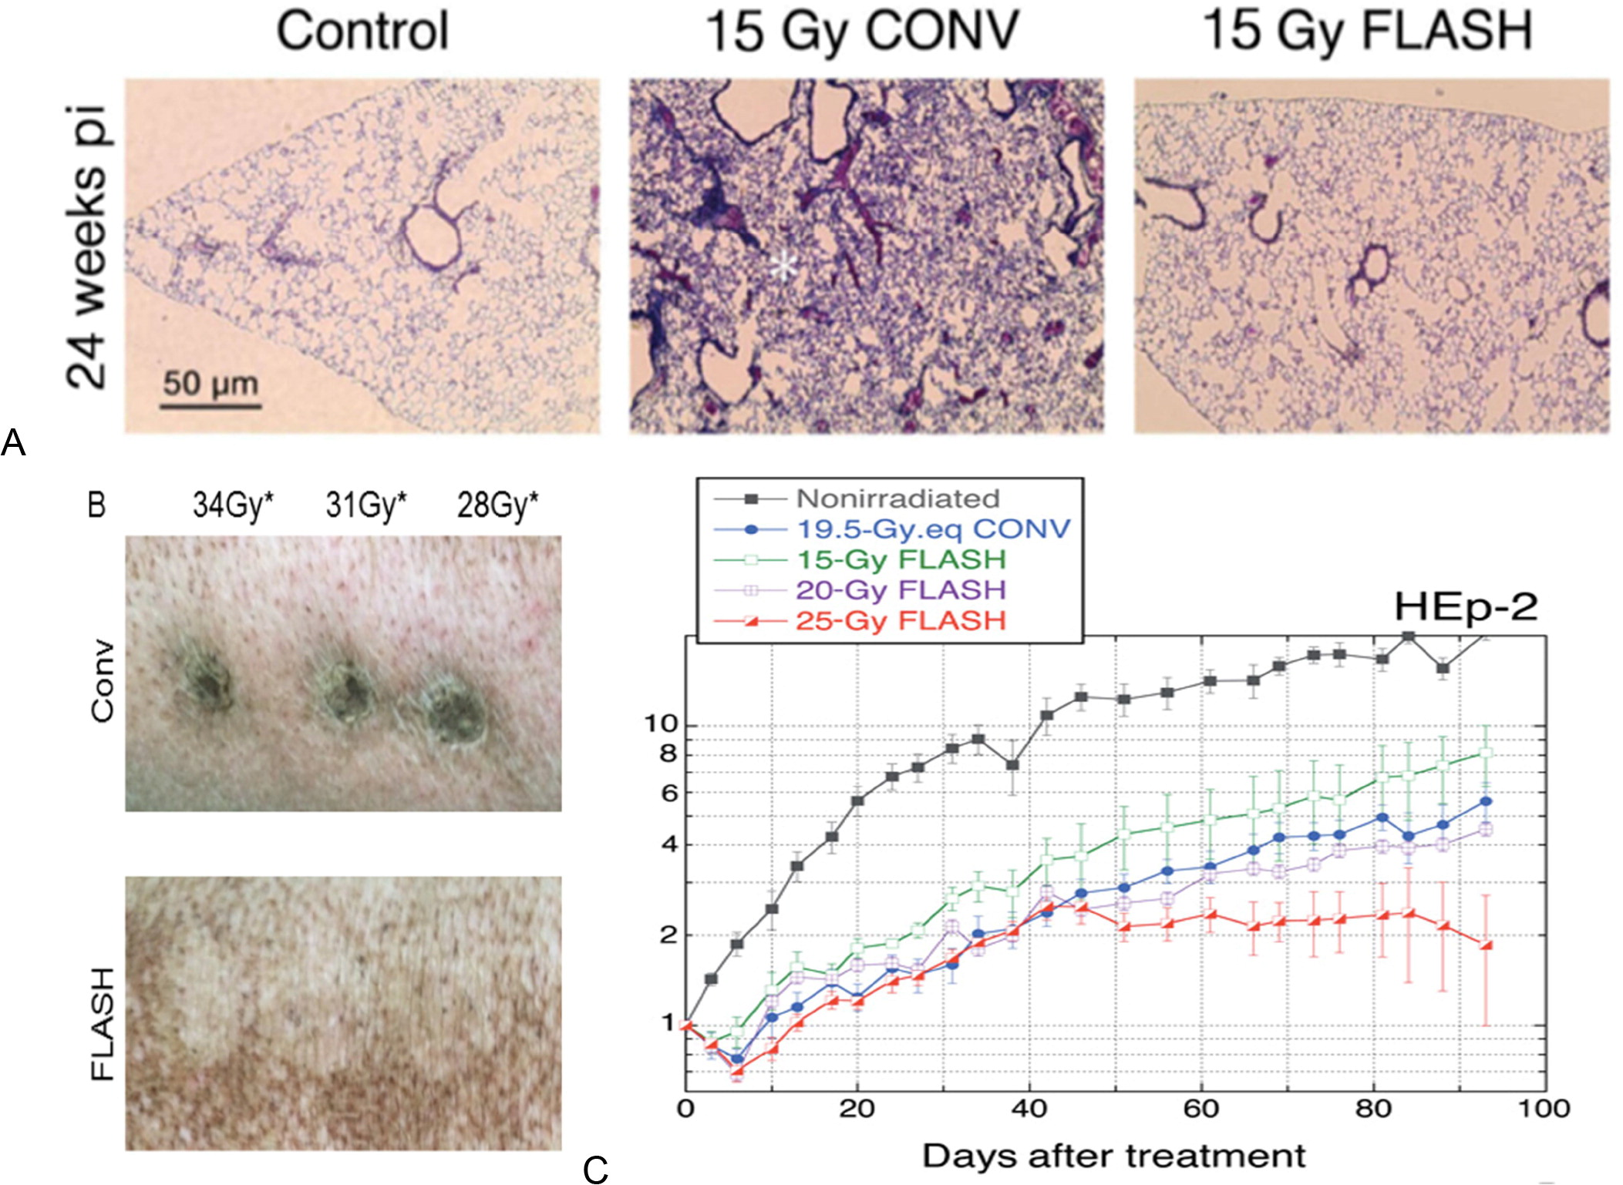
FLASH Effect
High-lines:
Delivery high dose (> 4-6 Gy)
Ultra High Dose Rate (> 40 Gy/s)
[1] V. Favaudon, L. Caplier, V. Monceau, F. Pouzoulet, M. Sayarath, C. Fouillade, M. F. Poupon, I. Brito, P. Hupé, J. Bourhis, J. Hall, J. J. Fontaine, and M. C. Vozenin. Ultrahigh dose-rate flash irradiation increases the differential response between normal and tumor tissue in mice. Sci Transl Med, 6(245):245ra93, 2014.
[2] J. Bourhis, W. J. Sozzi, P. G. Jorge, O. Gaide, C. Bailat, F. Duclos, D. Patin, M. Ozsahin, F. Bochud, J. F. Germond, R. Moeckli, and M. C. Vozenin. Treatment of a first patient with flash-radiotherapy. Radiother Oncol, 139:18–22, 2019. ISSN 1879-0887. doi: 10.1016/j.radonc.2019.06.019.
Daniele Carlotti

Slide 6
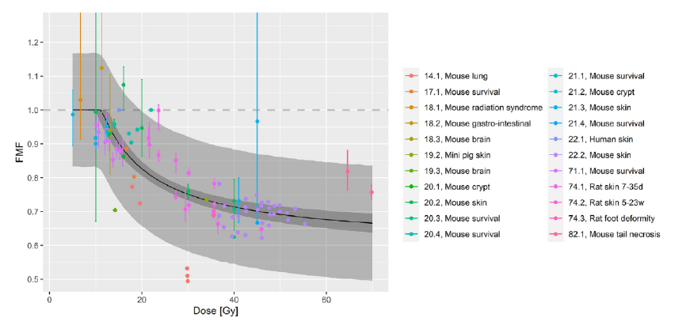
FLASH Effect
High-lines:
To meet these requirements:
pathologies that are already being considered for hypo-fractionation (treatment delivered in less fractions, with a dose per fraction exceeding the standard 2Gy/fraction conventional approach)
pathologies that have an outcome that is not yet satisfactory are particularly interesting.
Will focus on pancreatic and lung cancer
[3] T. T. Böhlen, J. F. Germond, J. Bourhis, M. C. Vozenin, E. M. Ozsahin, F. Bochud, C. Bailat, and R. Moeckli. Normal tissue sparing by flash as a function of singlefraction dose: A quantitative analysis. Int J Radiat Oncol Biol Phys, 114(5):1032– 1044, 2022. ISSN 1879-355X.
Daniele Carlotti

Slide 7
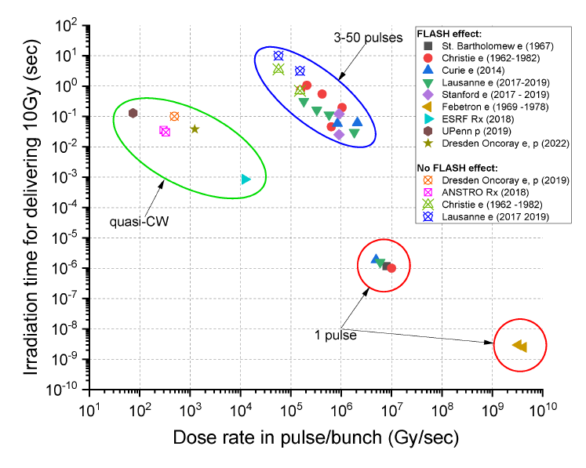
FLASH: the beam delivery
High-lines:
Going FLASH’ is not just a matter of ‘total absorbed dose’. One has also to deliver the dose within a given total time.
Changing the beam energy with protons becomes really difficult (--> 3D range modulators are being explored)
VHEE have the nice advantage that with a ‘single energy’ a complete field can be delivered!
Need to explore the ‘active scanning’ solution
[4] Montay-Gruel P, Acharya MM, Jorge PG, et al. Hypofractionated FLASH-RT as an effective treatment against glioblastoma that reduces neurocognitive side effects in mice. Clin Cancer Res. 2021;27(3):775-784.
Daniele Carlotti

Slide 8
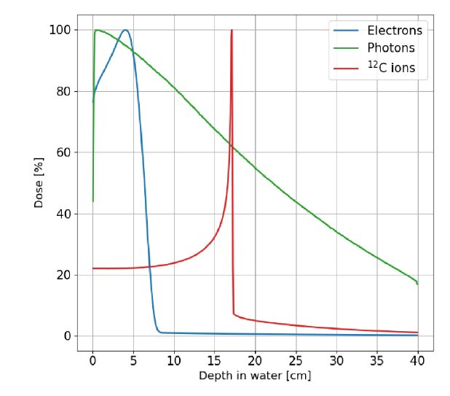
Very High-Energy Electron (VHEE)
High-lines:
Machine dimension
Difference RBE effect
Pencil beam scanning VS VMAT
Study VHEE as possible solution
Daniele Carlotti

Slide 9
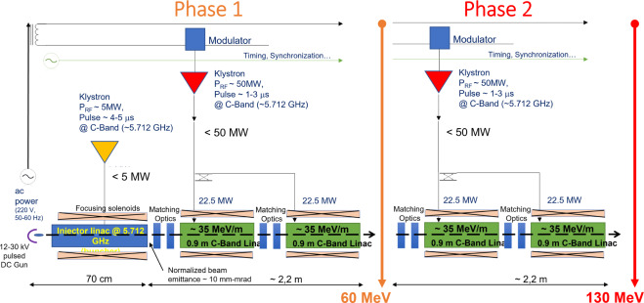
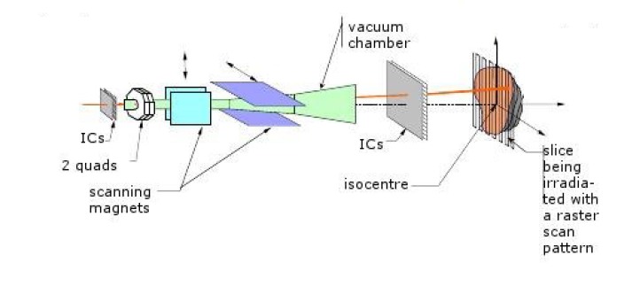
Prototipe VHEE Accelerator
High-lines:
To move from superficial (4-12 MeV) to deep-seated (up to 130 MeV) tumors.. a ‘new’ compact accelerator is needed
[5] L. Giuliano, D. Alesini, M. Behtouei, F. Bosco, M. Carillo, G. Cuttone, D. De Arcangelis, L. Faillace, V. Favaudon, L. Ficcadenti, S. Heinrich, M. Migliorati, A. Mostacci, L. Palumbo, A. Patriarca, B. Spataro, and G. Torrisi. Preliminary Studies of a Compact VHEE Linear Accelerator System for FLASH Radiotherapy. In Proc. IPAC’21, number 12 in International Particle Accelerator Conference, pages 1229– 1232. JACoW Publishing, Geneva, Switzerland, 08 2021.
Daniele Carlotti

Slide 10
Index
CLINICAL ASPECTS IN
STEREOTACTIC PANCREAS TREATMENTS

Slide 11
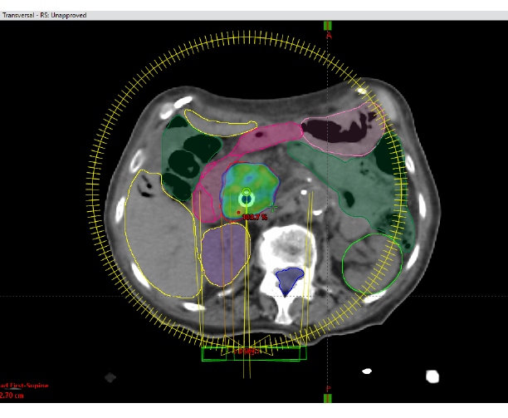
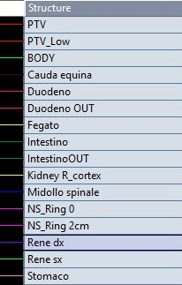
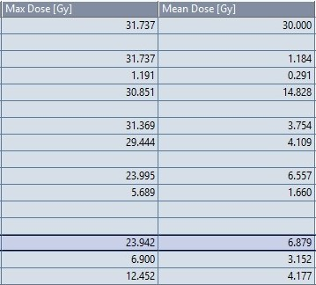
STEREOTACTIC PANCREAS - VMAT
High-lines:
PTV Prescription 6x5=30Gy
Duodenum Constraints: 35 Gy
Spinal cord Constraints: 18 Gy
Kidneys Constraints: Mean Dose 10 Gy
VMAT
Daniele Carlotti

Slide 12
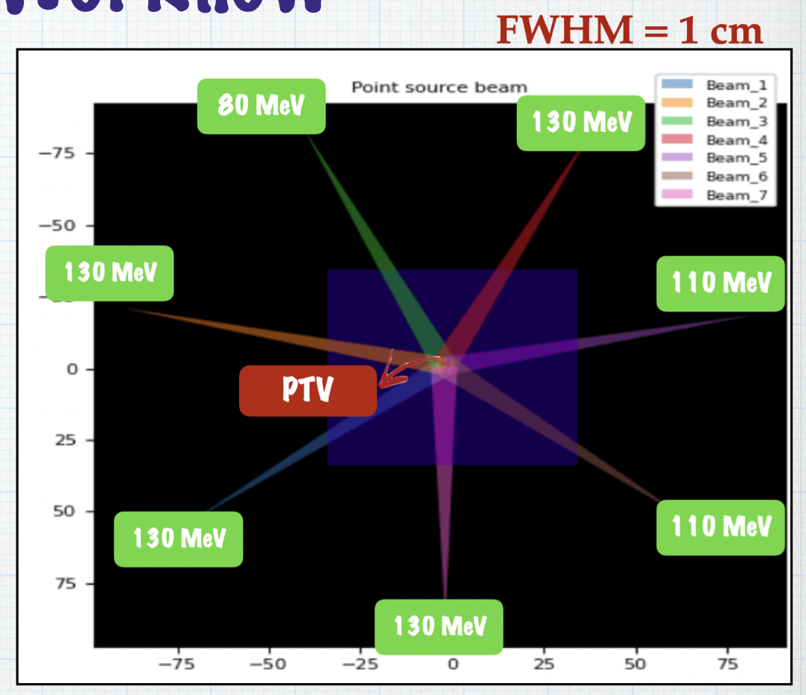
PANCREAS IMRT-Like for VHEE planning
IMRT-LIKE
VHEE
Daniele Carlotti

Slide 13
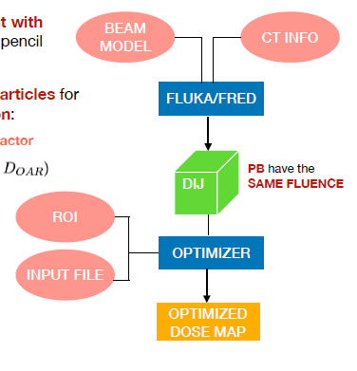
SBRT PANCREAS – VHEE Optimizer
The algorithm we currently use for the optimization of a treatment with VHEE is based on the Proton Therapy algorithm (LOMAX) for pencil beam, rearranged for electrons.
The main goal of the Optimizer is to select the number of particles for each Pencil Beam that minimize the Cost Function:
[6] A. Mairani, T. T. Böhlen, A. Schiavi, T. Tessonnier, S. Molinelli, S. Brons, G. Battistoni, K. Parodi, and V. Patera. A monte carlo-based treatment planning tool for proton therapy. Phys Med Biol, 58(8):2471–90, 2013. ISSN 1361-6560. doi: 10.1088/0031-9155/58/8/2471.
Daniele Carlotti

Slide 14
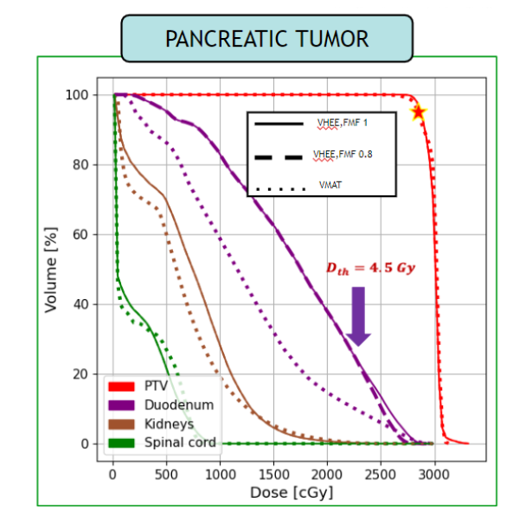
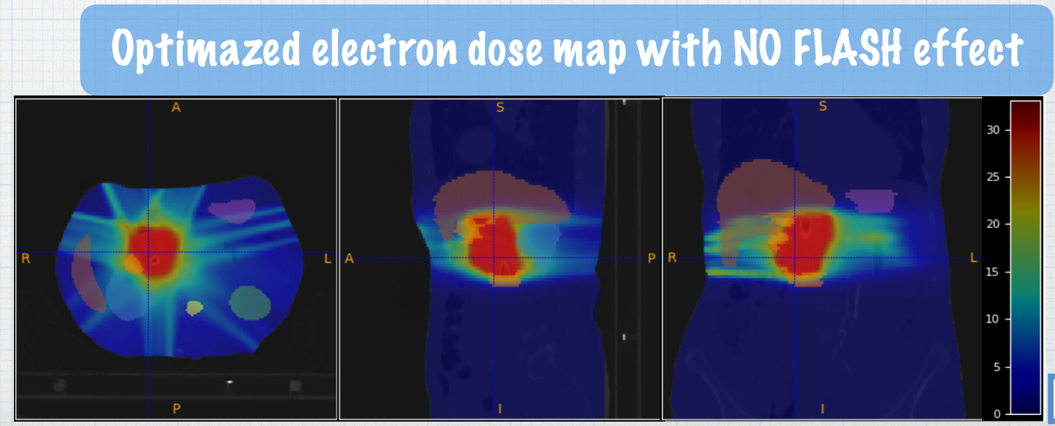
DVH RESULTS PANCREAS
First TPS for VHEE, there are no commercial solutions to plan VHEE since clinical machines do not exist
Daniele Carlotti

Slide 15
Index
FLASH EFFECT ACTIVATION
&
CRITICAL ASPECT

Slide 16
FLASH effect and dose rate
High-lines:
Radiobiology experiments the dose is pulsed in the time domain, with the entire field delivery happening simultaneously within one pulse. This mode of dose delivery has two characteristic dose rates:
The first is the instantaneous dose rate, which is the dose per pulse divided by the pulse duration.
The second is the average dose rate which is the total dose divided by the entire delivery duration.
BEAM FIELD of VIEW
Daniele Carlotti

Slide 17
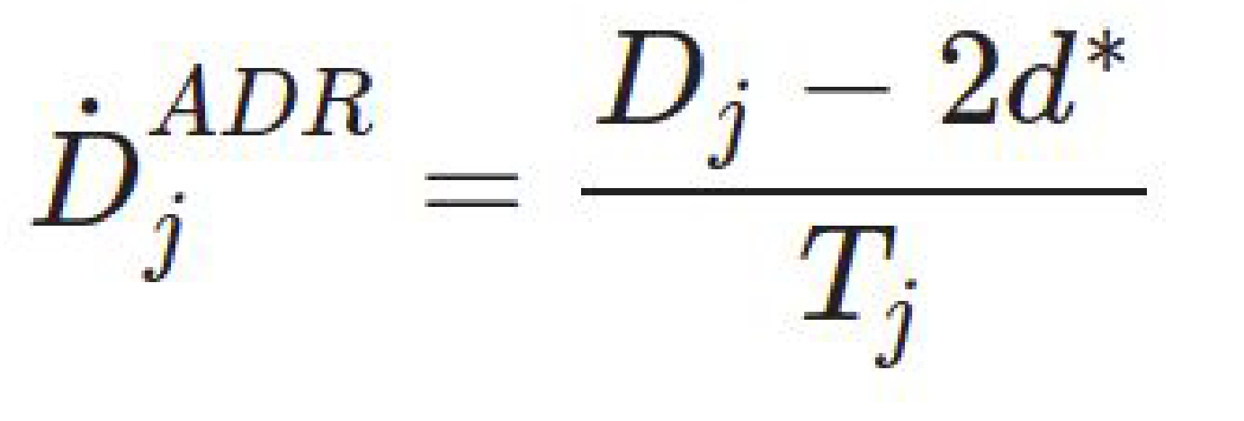
Average Dose Rate
Daniele Carlotti

Slide 18
Average Dose Rate
High-lines:
When analyzing the pancreas optimized plan, I have found that for a threshold dose of 4Gy none of the beams matches the delivery timing needed to activate the FLASH effect.
Daniele Carlotti

Slide 19
Index
LUNG LESIONS
NON-SMALL-CELL-LUNG CANCER (NSCLC)

Slide 20
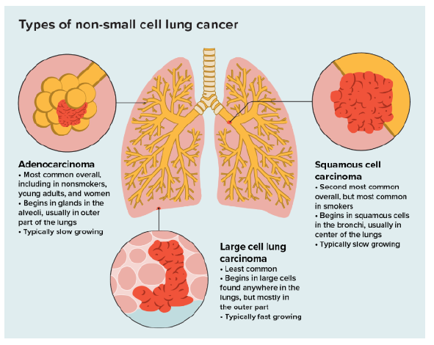
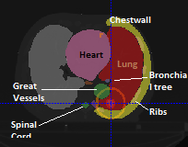
LUNG LESIONS NSCLC
High-lines:
PTV Prescription 12x4=48Gy
Ribs Constraints: 43 Gy
Spinal cord Constraints: 23 Gy
Daniele Carlotti

Slide 21
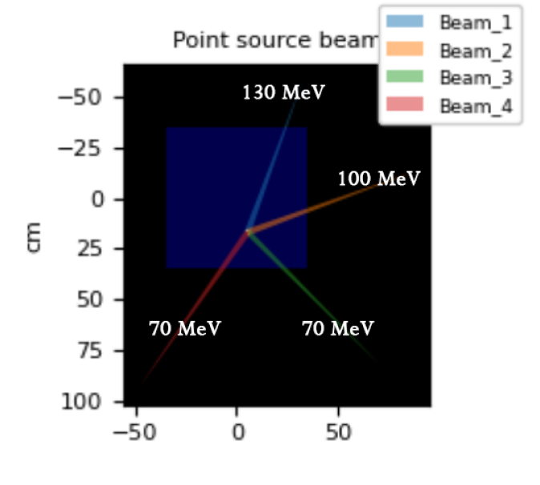
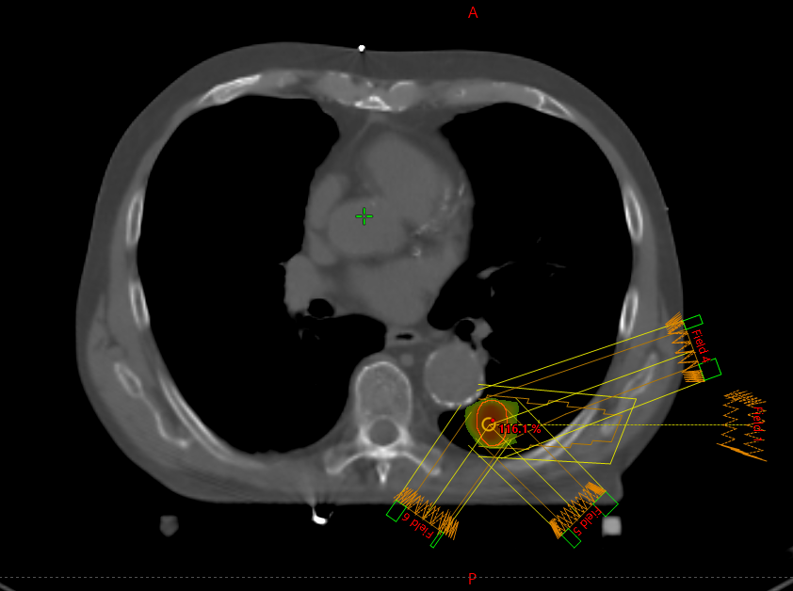
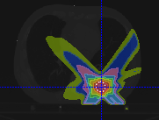
Lung IMRT-Like for VHEE planning
IMRT-LIKE
VHEE
Daniele Carlotti

Slide 22
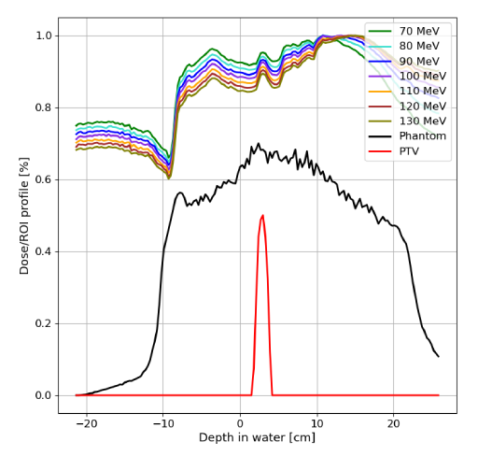
Lung Cancer – Energy Beam
Daniele Carlotti

Slide 23
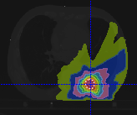
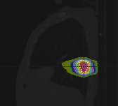
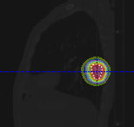
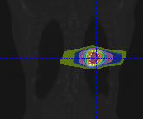
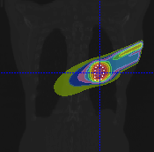
Lung Cancer – isodose distribution
VMAT
VHEE
Daniele Carlotti

Slide 24
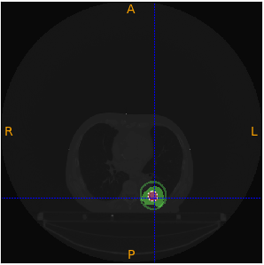
Lung Cancer
VMAT
VHEE
Daniele Carlotti

Slide 25
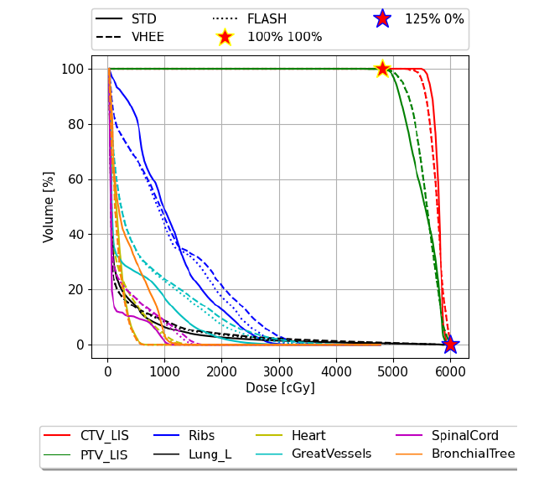
Lung Cancer DVH RESULTS
High-lines:
PTV Prescription 12x4=48Gy
Ribs Constraints: 43 Gy
Spinal cord Constraints: 23 Gy
Daniele Carlotti

Slide 26
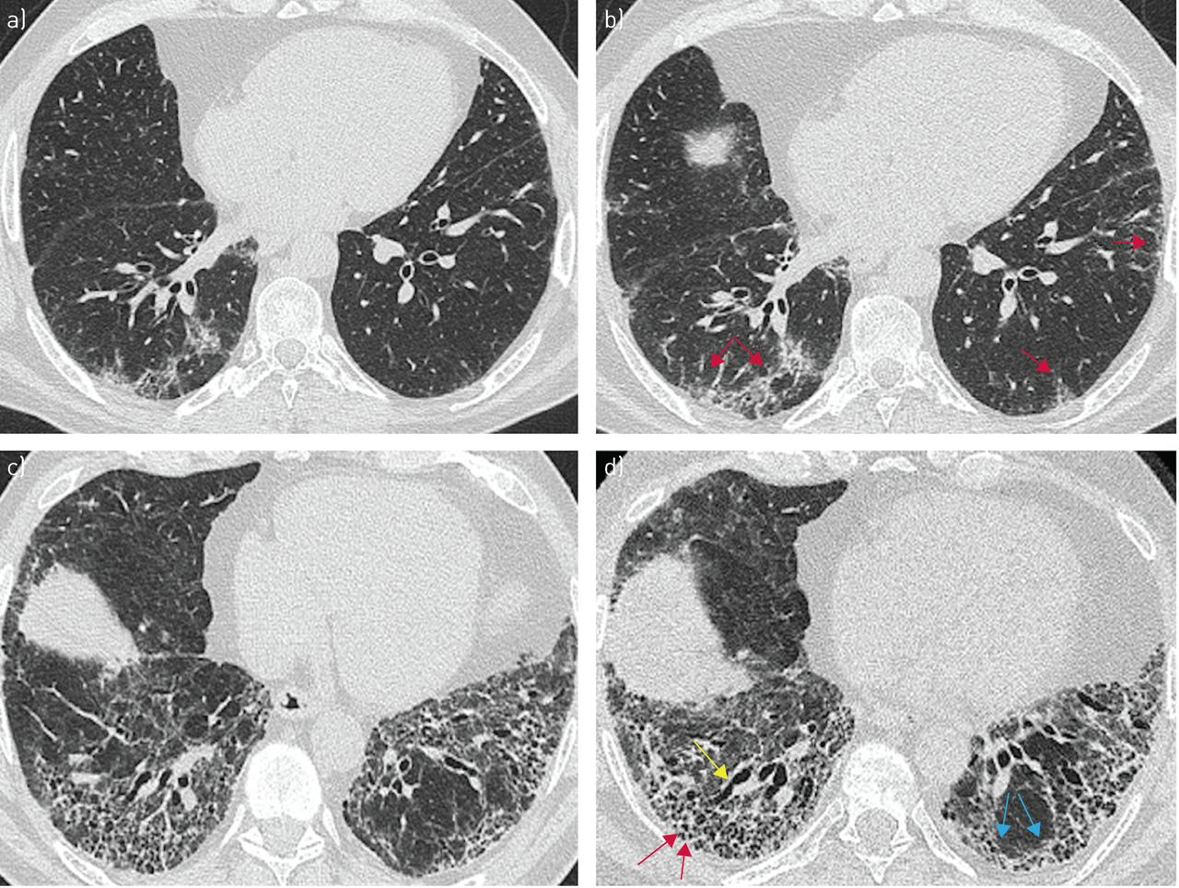
FLASH Fibrosis reduction
High-lines:
Pulmonary fibrosis is a late-stage injury that typically manifests in the time period from six to 24 months post irradiation
While currently there is no good therapeutic intervention for fibrosis available
[7] M. D. Wright, P. Romanelli, A. Bravin, G. Le Duc, E. Brauer-Krisch, H. Requardt, S. Bartzsch, R. Hlushchuk, J. A. Laissue, and V. Djonov. Non-conventional ultra-high dose rate (flash) microbeam radiotherapy provides superior normal tissue sparing in rat lung compared to non-conventional ultra-high dose rate (flash) radiotherapy. Cureus, 13(11):e19317, 2021. ISSN 2168-8184.
[8] V. Favaudon, L. Caplier, V. Monceau, F. Pouzoulet, M. Sayarath, C. Fouillade, M. F. Poupon, I. Brito, P. Hupé, J. Bourhis, J. Hall, J. J. Fontaine, and M. C. Vozenin. Ultrahigh dose-rate flash irradiation increases the differential response between normal and tumor tissue in mice. Sci Transl Med, 6(245):245ra93, 2014. ISSN 1946-6242. doi: 10.1126/scitranslmed.3008973.
Daniele Carlotti

Slide 27
FLASH News
Daniele Carlotti

Slide 28
Conclusions
The evaluation of FLASH VHEE potential in the treatment of selected pathologies, plays a fundamental role in shaping the future accelerating, delivery, monitoring technologies that will have to be implemented. The conclusion are:
FLASH effect is a complex phenomenon that is likely dependent on an optimal combination of various factor including dose, fractionation, field size and beam property.
In this kind of effect the rules of conventional radiotherapy will be overturned, and we need more radiobiology experiments to be able to apply the new FLASH methods so that prescriptions can be adapted to the new techniques.
The results obtained in this thesis show that VHEEs could represent an early field of experimentation of the FLASH effect in the field of stereotactic treatments. In the lung case, the high prescription allows for greater safety in activating the FLASH effect, thus solving the single-field problem encountered in the pancreas case; consequently, treatments of early-stage NSCLCs could be one of the first field of application for FLASH with VHEE.
Daniele Carlotti

Slide 29
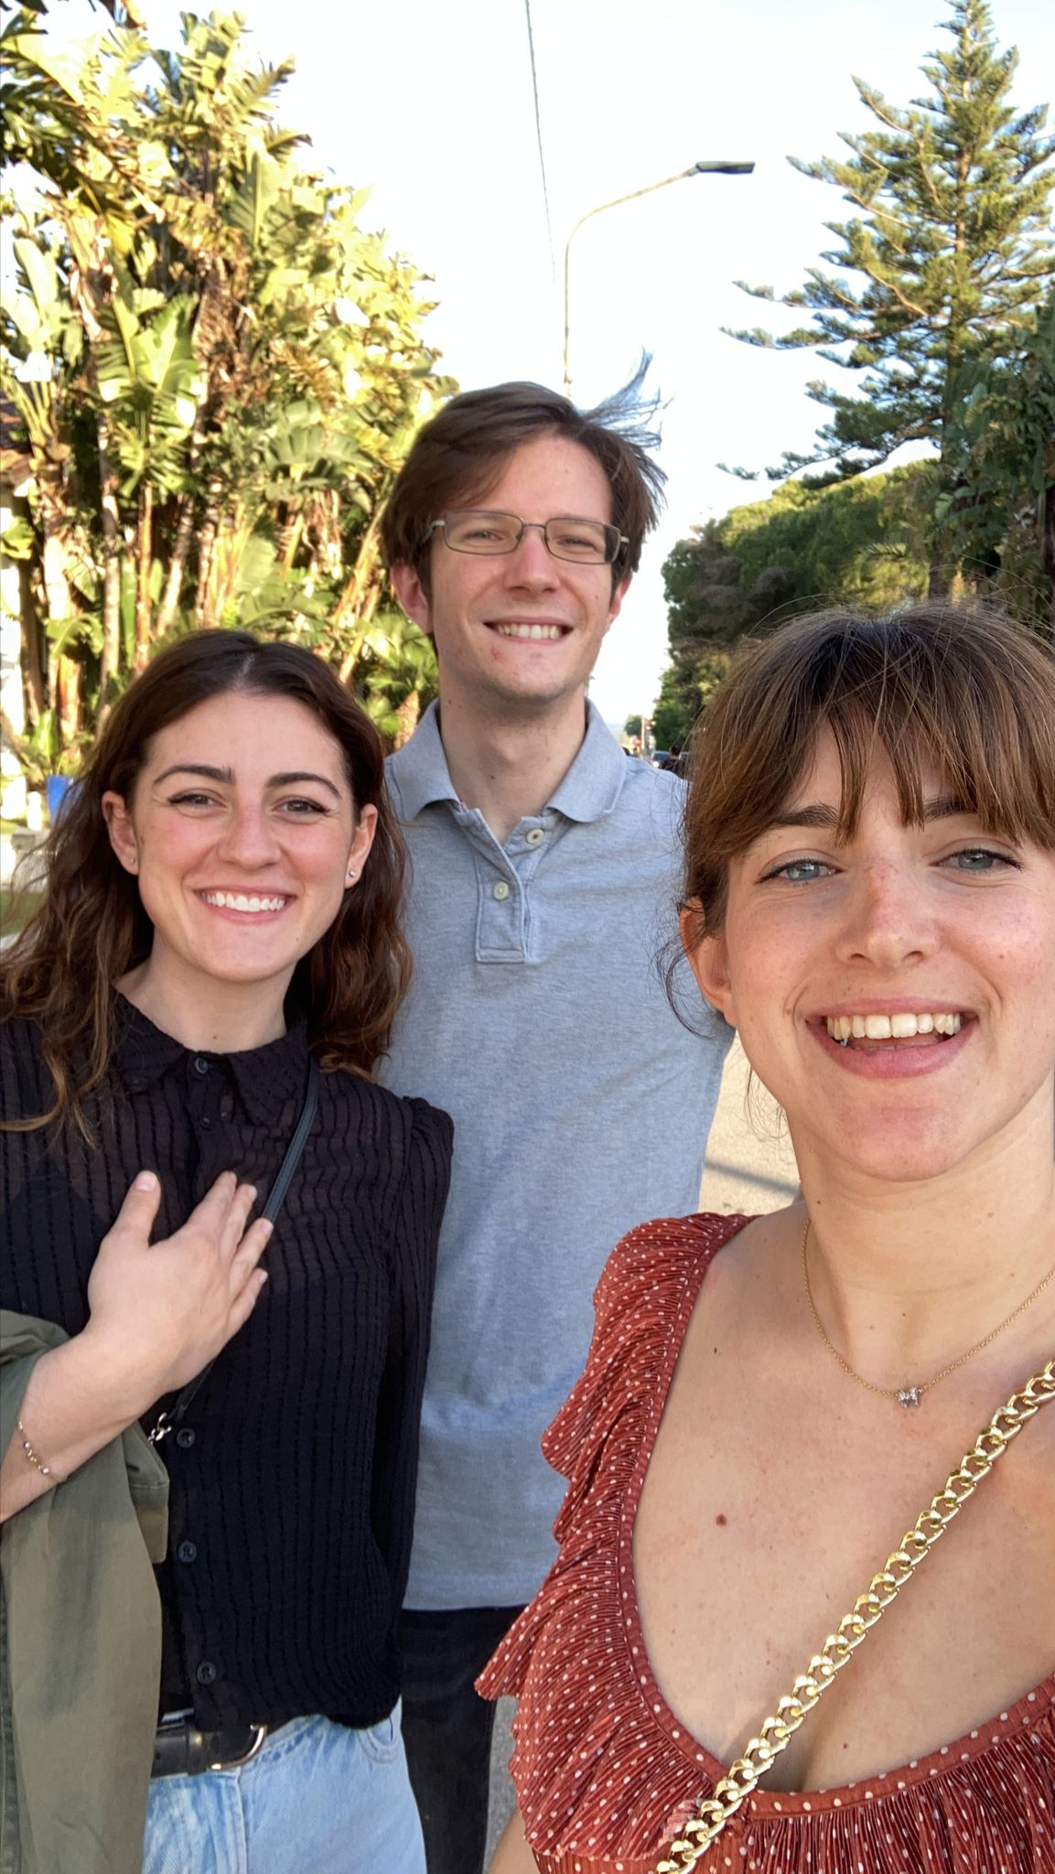
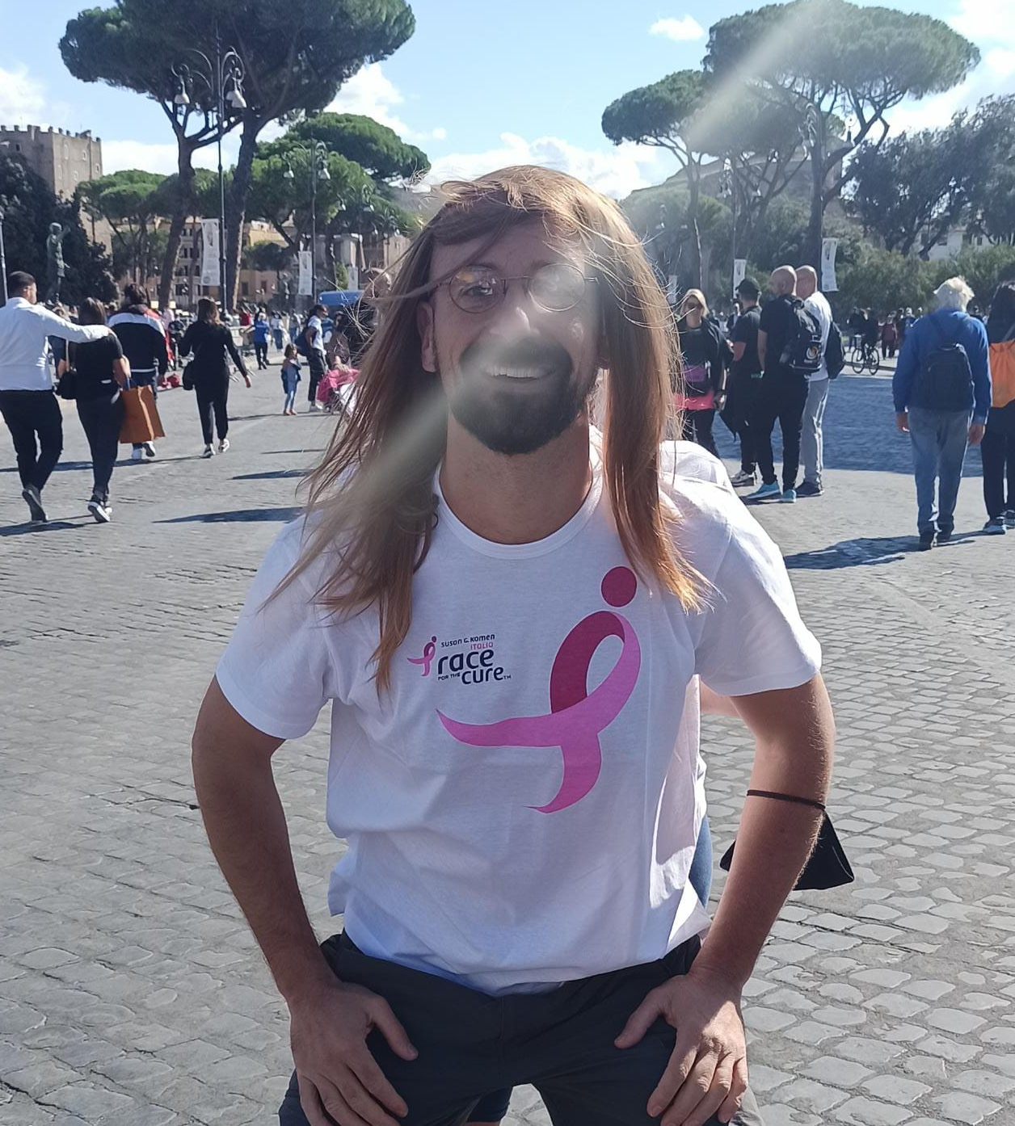
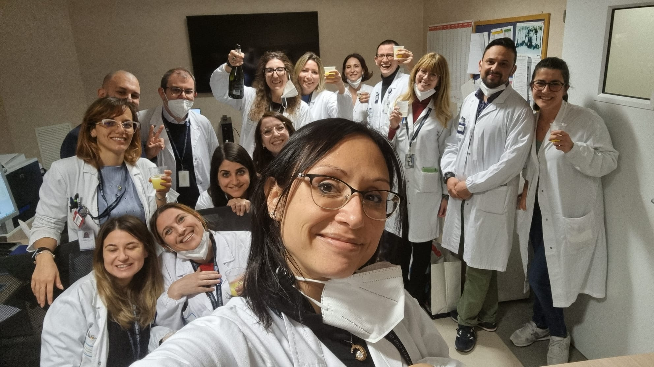
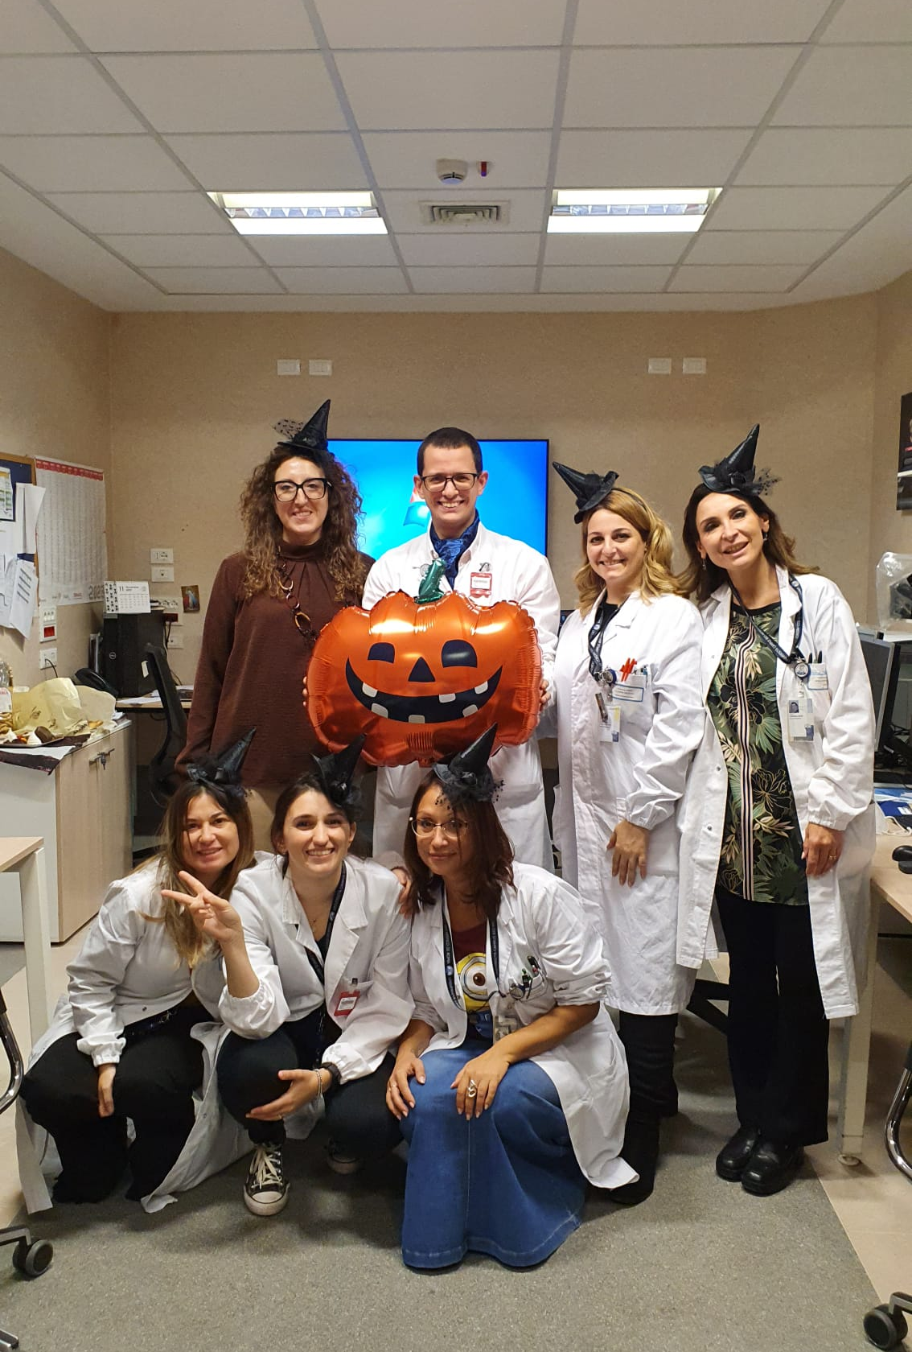
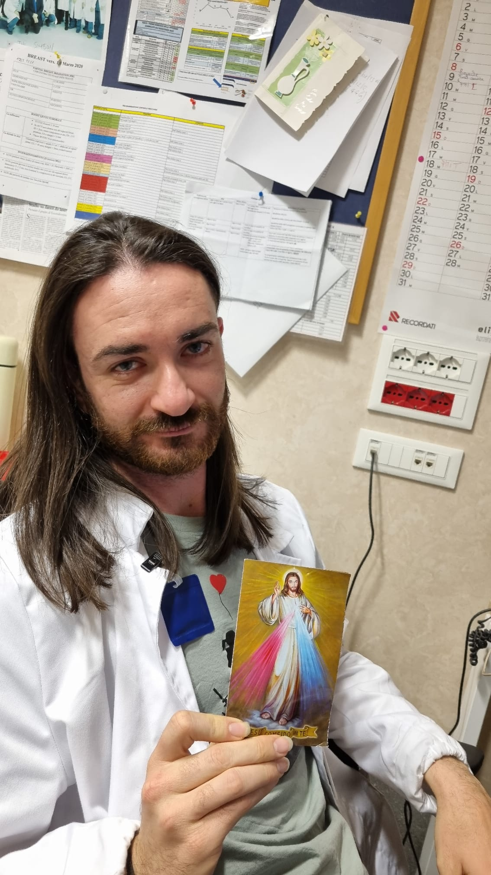
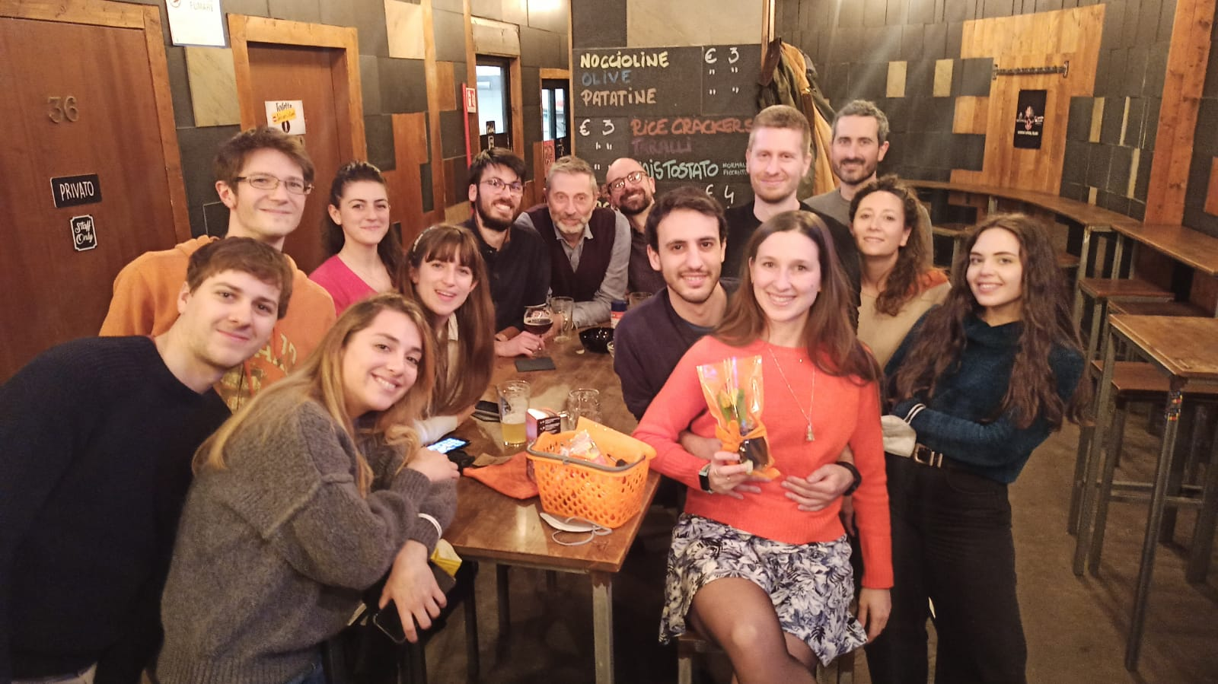
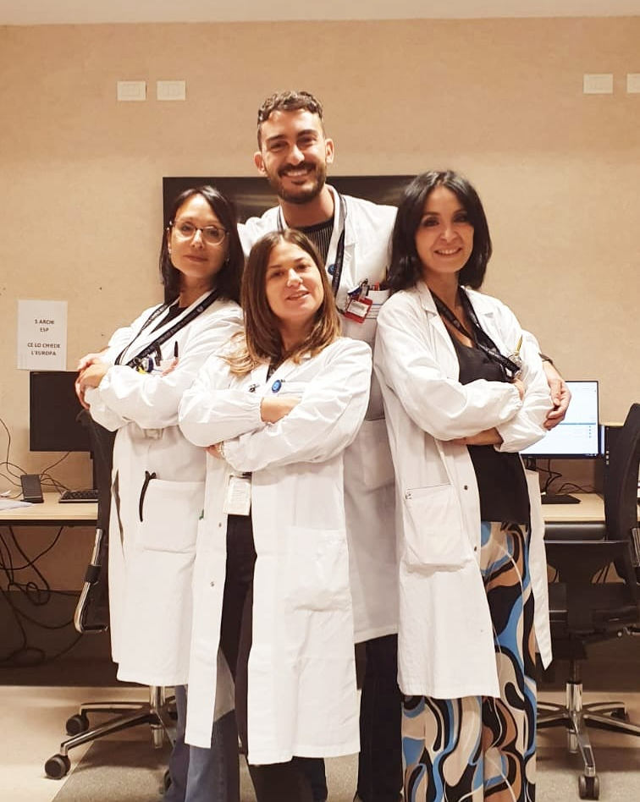
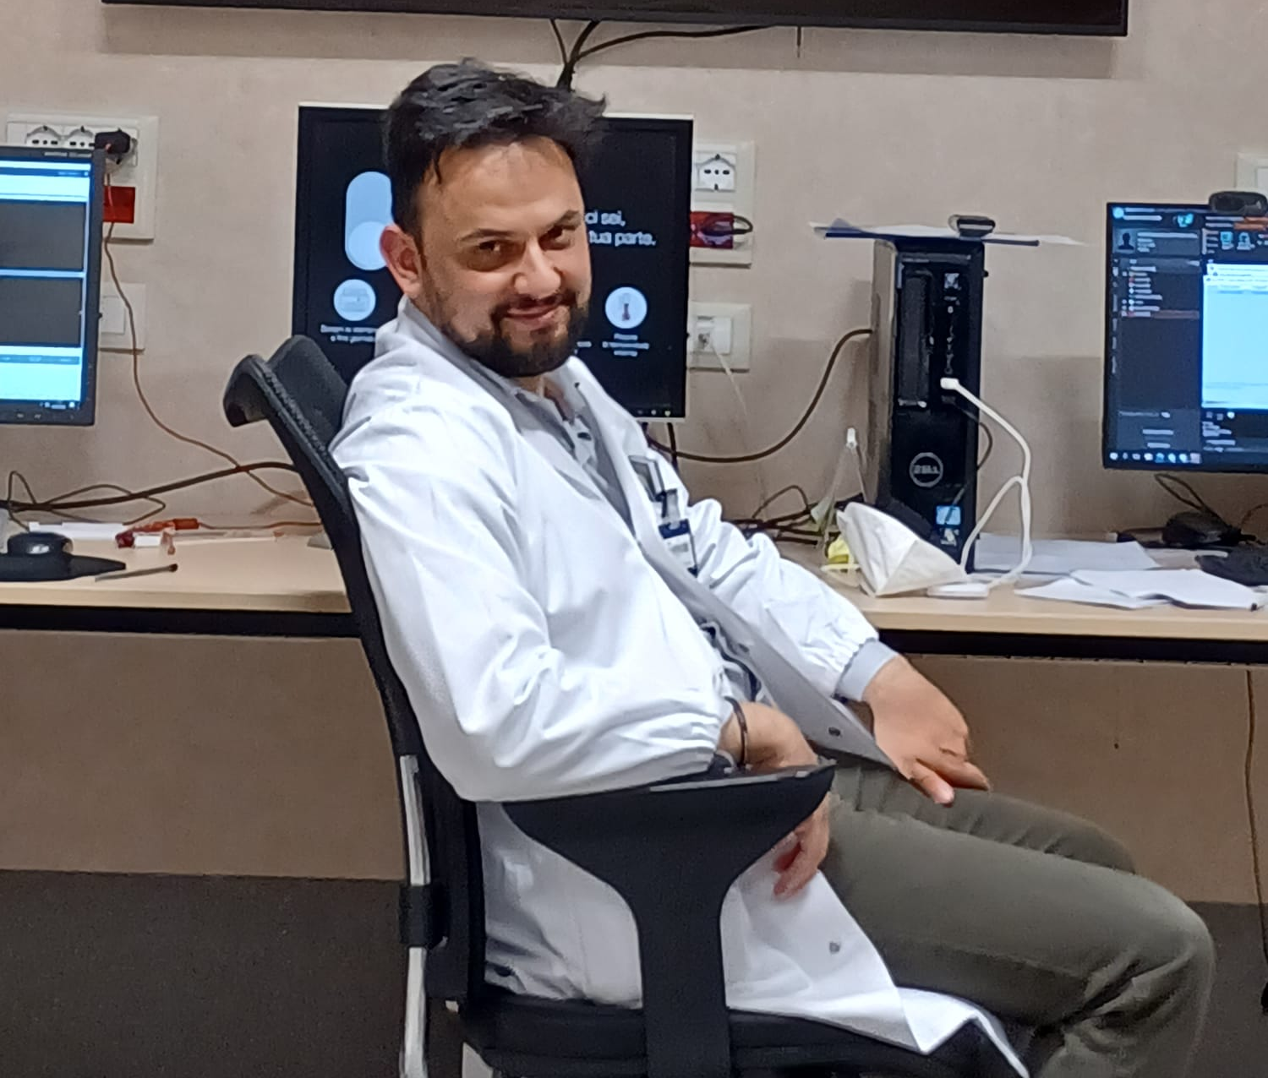
Acknowledge
Thanks to Gaia Antonio Angelica Annalisa Micol Giacomo Teresa e Valerio

Slide 30
Index
SPAN

Slide 31
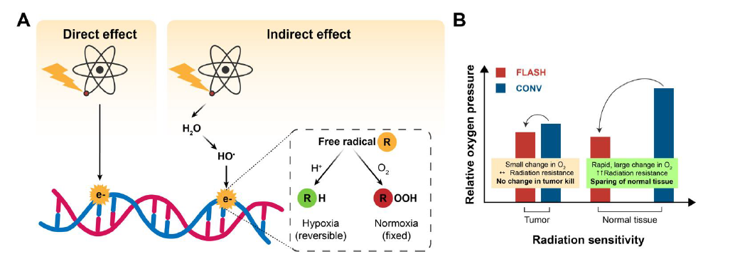
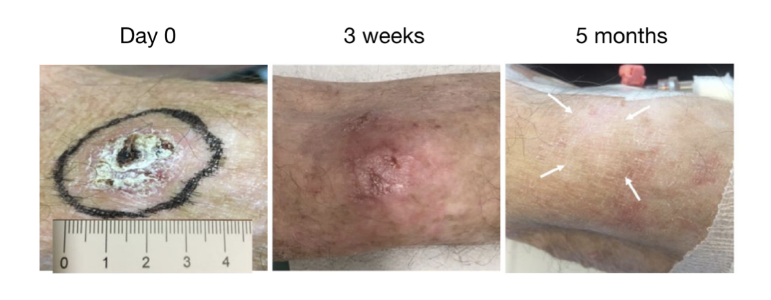
FLASH Effect
Highlines:
deliver high doses (>4-6 Gy)
very short period of time (<200 ms)
[5]. doi.org/10.1016/j.radonc.2021.12.045
Daniele Carlotti

Slide 32
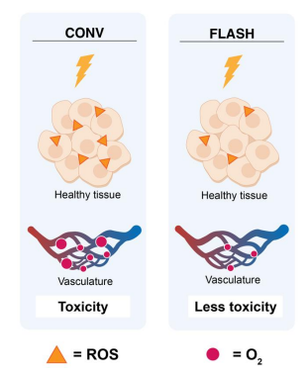
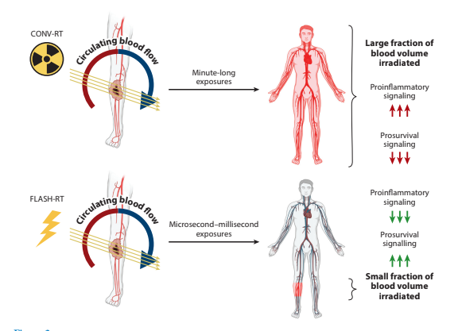
FLASH Effect
Daniele Carlotti

Slide 33
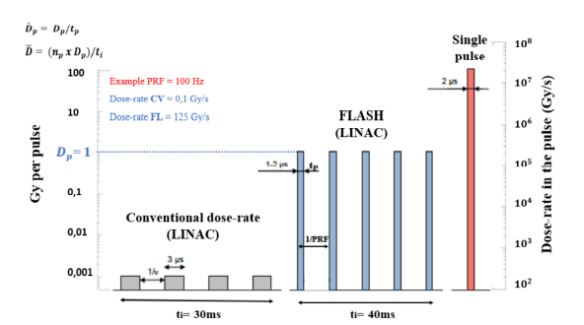
Very High-Energy Electron (VHEE)
Highlights:
70-130 MeV
Daniele Carlotti

Slide 34
HUMAN Trials need more data
FAST-01 completed proton FLASH RT for sintomatic bone mets (Univ. Cinn): 8Gy x 1 (Mascia et al, JAMA Onc, 2022)
FAST-02 ongoing proton FLASH RT for thoracic bone mets (Univ. Cinn): 8Gy x 1, up 7,3 x 30 cm
IMPulse ongoing electron FLASH RT for skin metastases from melanoma (CHUV): 2Gy increments from 22-34 Gy x1, <=5,5cm
LANCE ongoing electron FLASH RT and CONV RT for localized cutaneous SCC e BCC (CHUV): 22Gy x1 if <2cm, 5Gy x6 if >2cm but <= 4cm
SURFACE planned face I Study on Ultra-hight dose rate Radioterapy For Any Cutaneus or subcutanEous tumor to assess safety & efficacy of electron FLASH RT (MD Anderson)
Daniele Carlotti

Slide 35
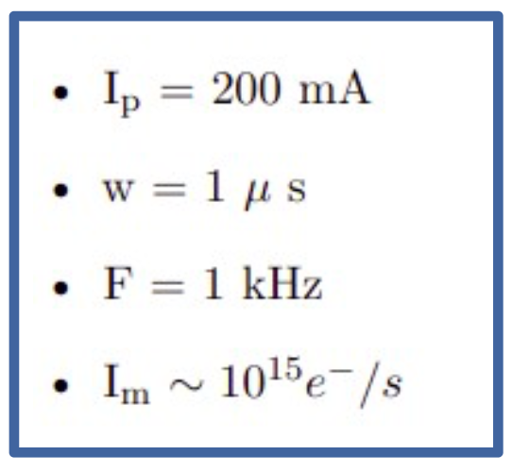
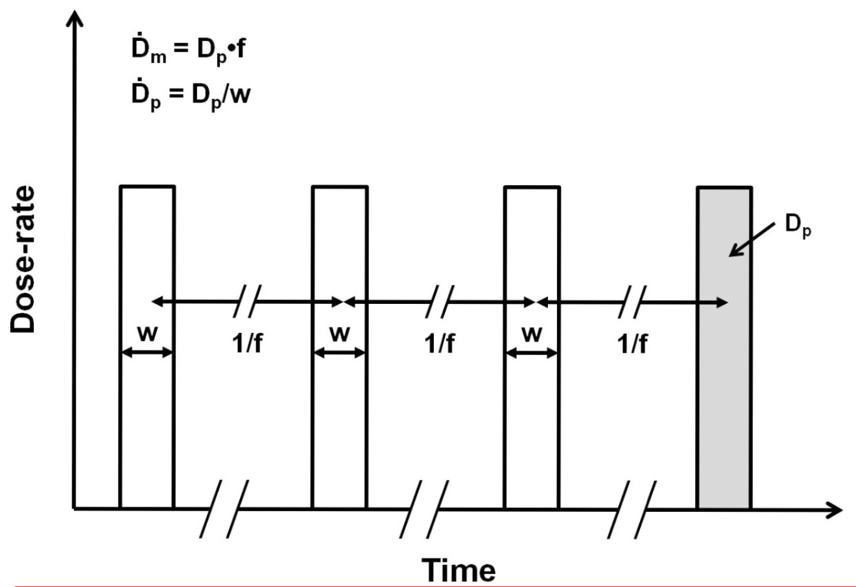
DADR - Dose Average Dose Rate
Accelerator hypothesis
Daniele Carlotti

Slide 36
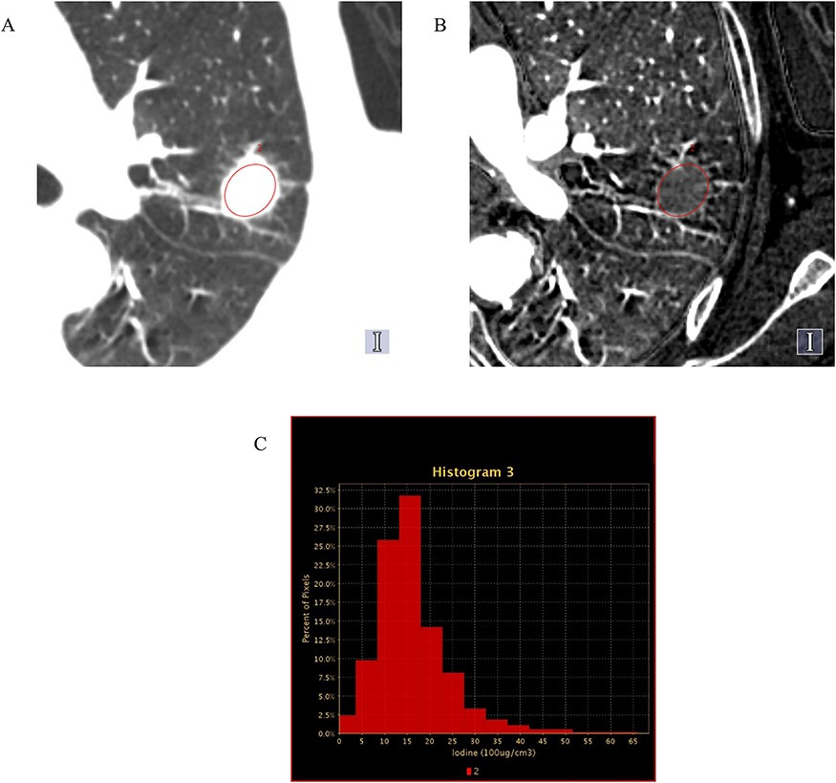
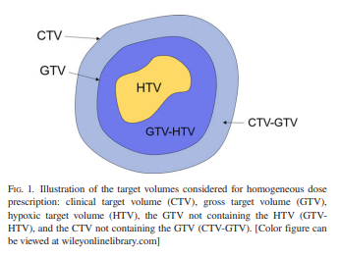
PERSONALIZED PRESCRIPTION
J Radiat Res, Volume 62, Issue 3, May 2021, Pages 448–456, https://doi.org/10.1093/jrr/rrab015
The content of this slide may be subject to copyright: please see the slide notes for details.
Daniele Carlotti

Slide 37
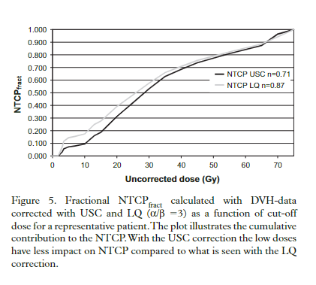
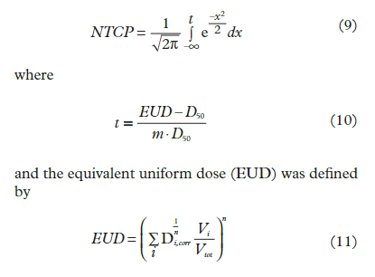
NTCP Lyman Kutcher Burman (LKB) model
https://doi.org/10.3109/0284186X.2010.543695
Daniele Carlotti

