Slide 1



Beam dynamics of high brightness beams in RF photoinjector
Martina Carillo
martina.carillo@uniroma1.it
XXXVI PhD School in Accelerator physics
At University of Rome “Sapienza”
Supervisors: Prof. Luigi Palumbo
Prof. James Rosenzweig

Slide 2

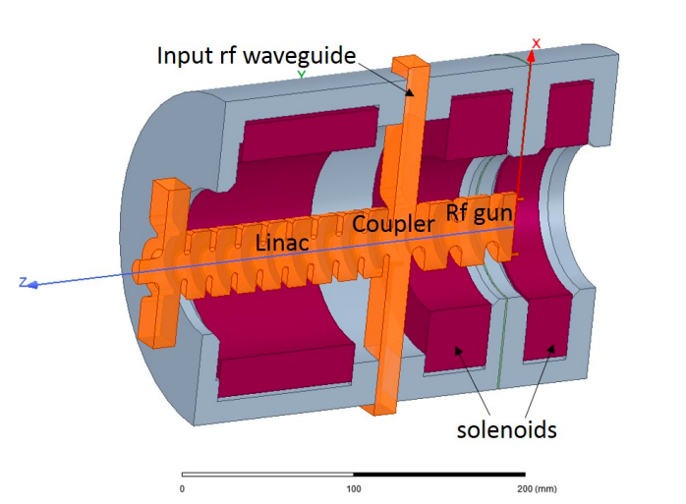



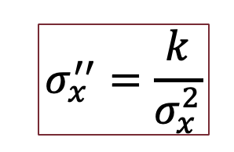
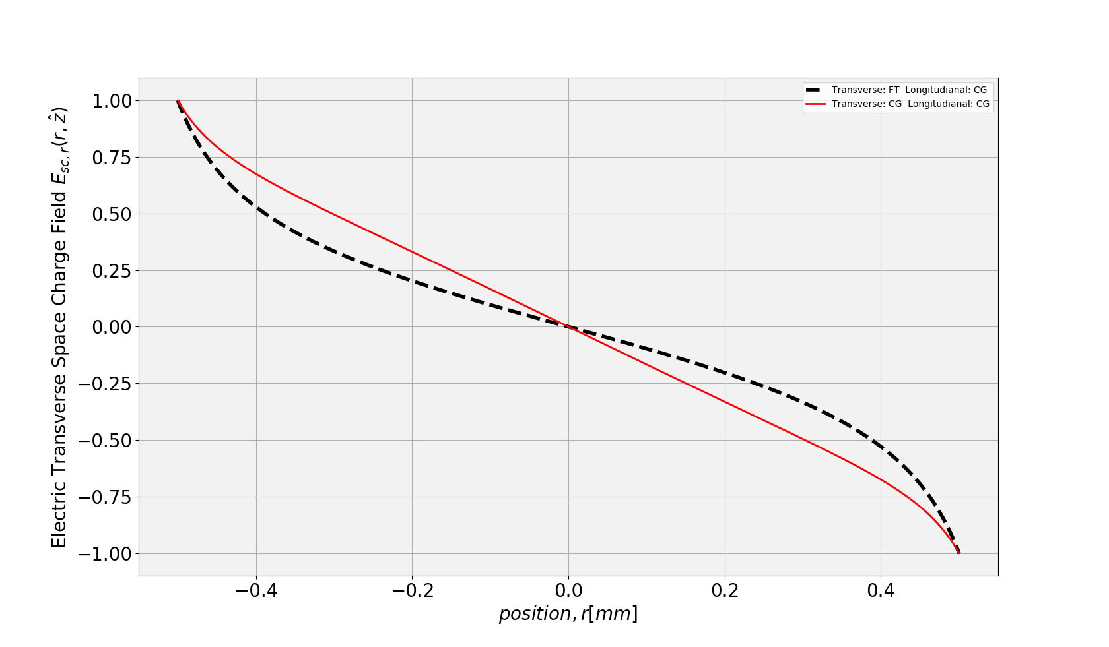
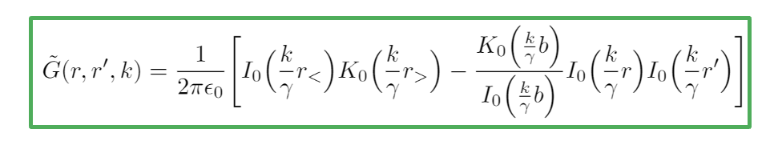
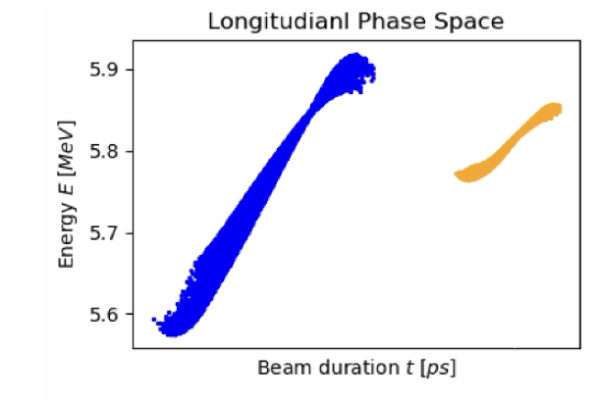
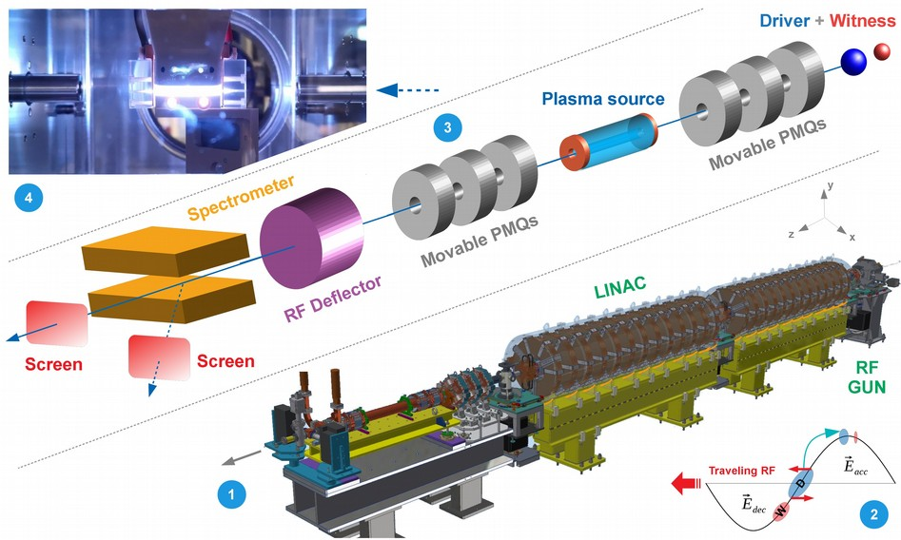
Outline
C-Band Hybrid photoinjector:
  Beam dynamics
  Envelope equation: the Triple waist approximation
  Emittance compensation:
    Multi-slice model and Double emittance minimum
    Laser distribution: space charge analytical model
SPARC_LAB:
  Gun conditioning
  Witness-Driver configuration
  Experimental results
UCLA Experience:
  Magnetic Characterization
  MITHRA’s Gun Characterization
  COMB beam with Hybrid Injector

Slide 3
Outline
C-Band Hybrid photoinjector:
  Beam dynamics
  Envelope equation: the Triple waist approximation
  Emittance compensation:
    Multi-slice model and Double emittance minimum
    Laser distribution: space charge analytical model
SPARC_LAB:
  Gun conditioning
  Witness-Driver configuration
  Experimental results
UCLA Experience:
  Magnetic Characterization
  MITHRA’s Gun Characterization
  COMB beam with Hybrid Injector

Slide 4
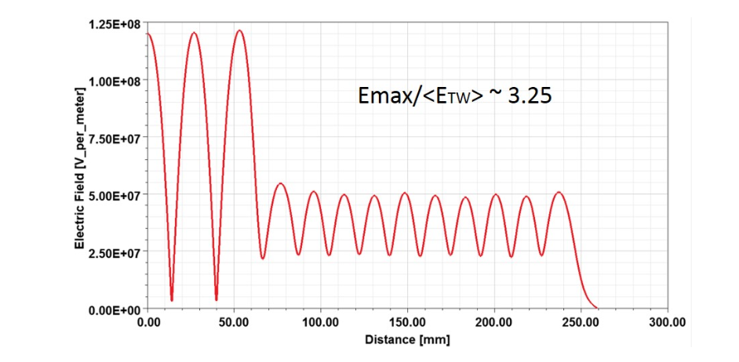
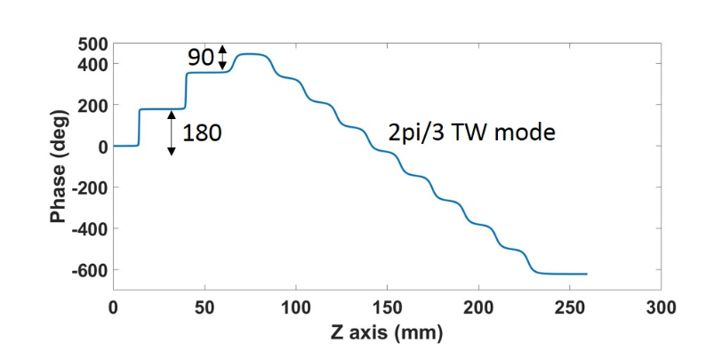
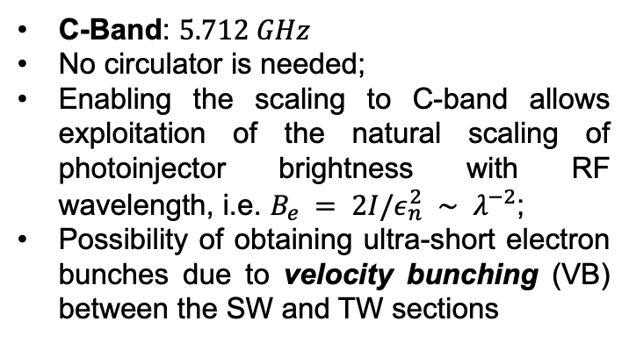
C-band Hybrid photoinjector
DARPA-GRIT
Project:
C-Band: $5.712 GHz$
No circulator is needed;
Enabling the scaling to C-band allows exploitation of the natural scaling of photoinjector brightness with RF wavelength, i.e. $B_{e} = 2I/ε_{n}^{2} ∼ λ^{−2}$;
Possibility of obtaining ultra-short electron bunches due to velocity bunching (VB) between the SW and TW sections
Cathode
TW
SW
[*]L. Faillace, J. B. Rosenzweig et al., High field hybrid photoinjector electron source for advanced light source
applications. Phys. Rev. Accel. Beams, 25:063401, Jun 2022. doi: 10.1103/PhysRevAccelBeams.
25.063401.
[*] L. Serafini and Massimo Ferrario. Velocity bunching in photo-injectors. Proc. AIP, 581, 08
2001. doi: 10.1063/1.1401564

Slide 5
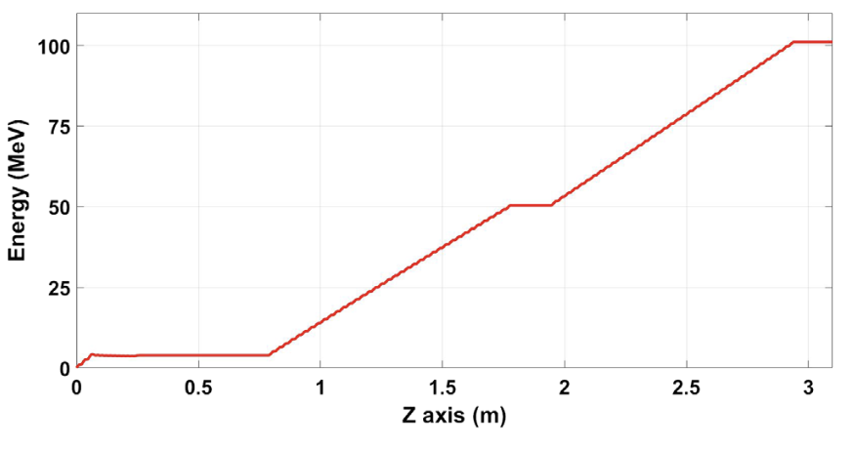
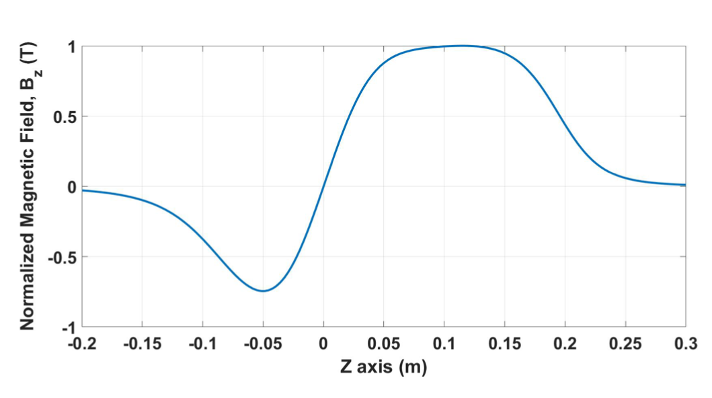
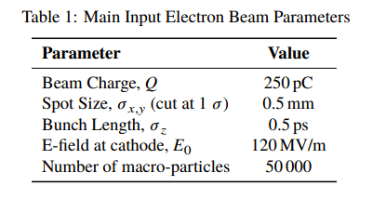
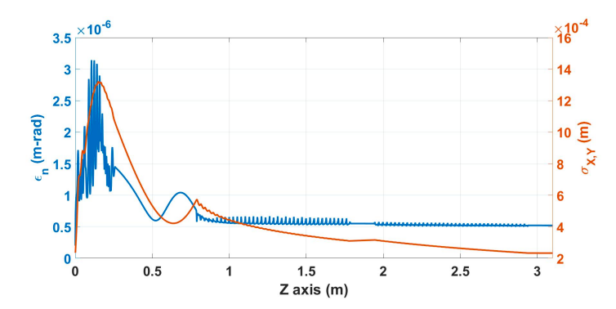
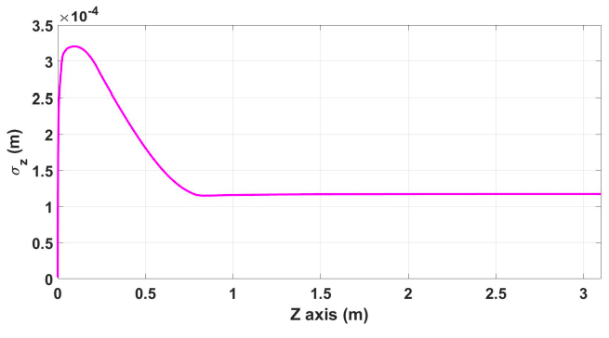
C-band Hybrid photoinjector:
Beam Dynamics
[*]L. Faillace et al. Start-to-End Beam-Dynamics Simulations of a Compact C-Band Electron Beam Source for High Spectral Brilliance Applications. In Proc. IPAC’22, number 13 in International Particle Accelerator Conference, pages 687–690. JACoW Publishing, Geneva, Switzerland, 07 2022. ISBN 978-3-95450-227-1

Slide 6
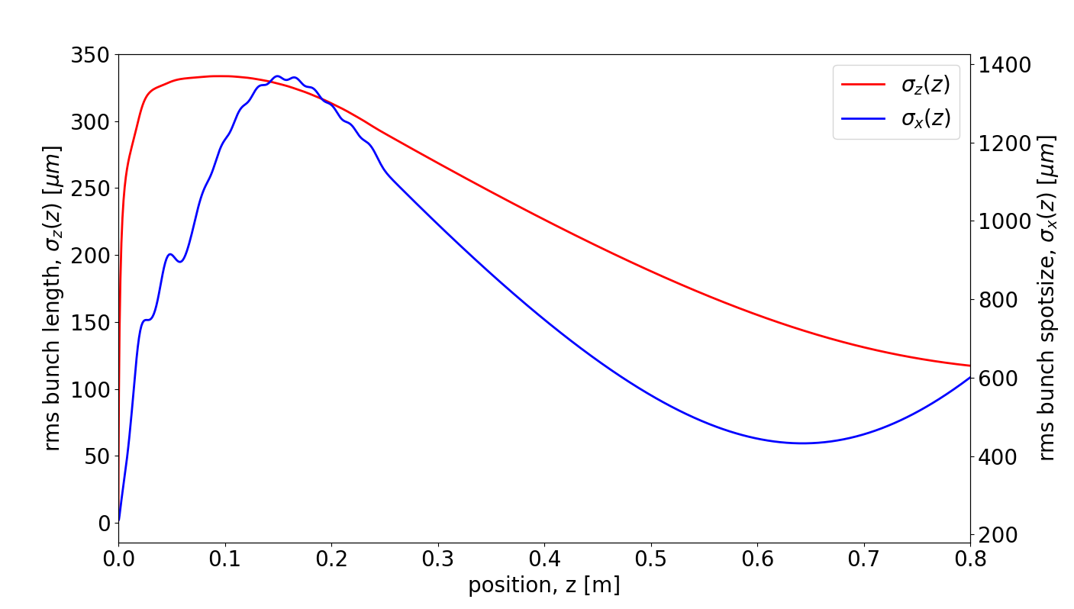
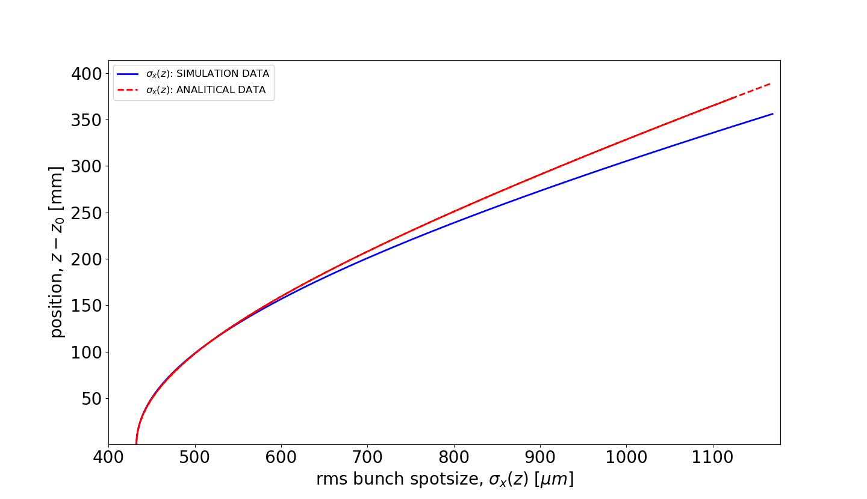
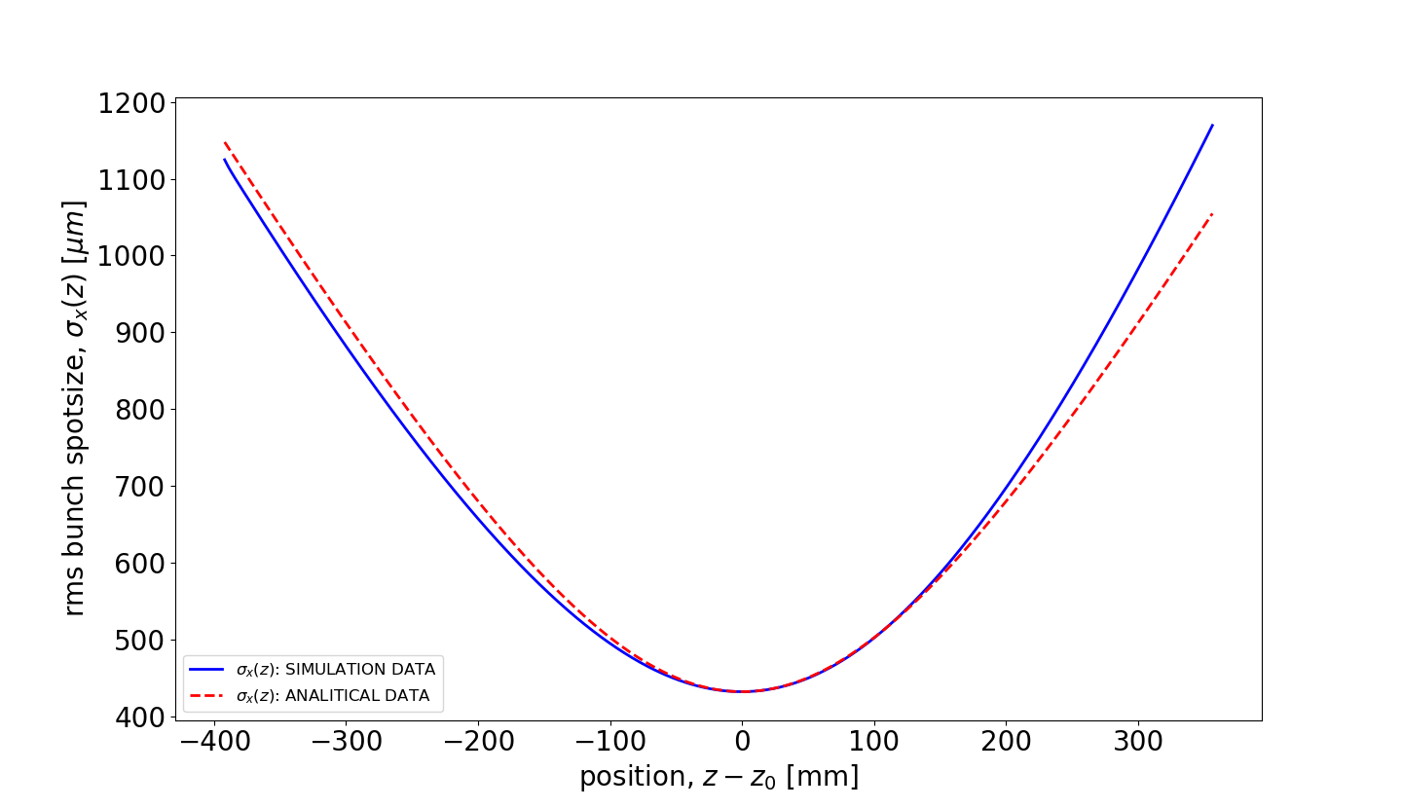

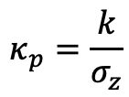
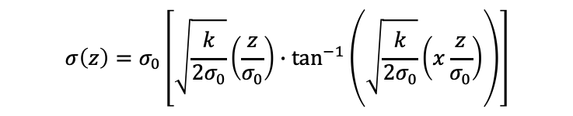

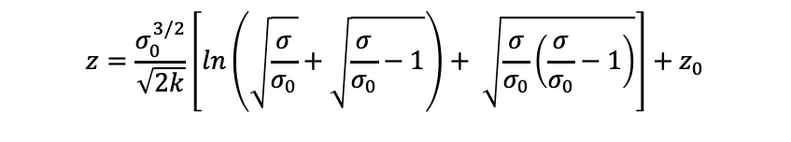


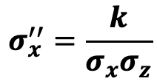
Envelope analysis in the drift: Triple waist approximation
[*]O. Kellogg,Foundation of Potential Theory. Dover, UK:Springer, 1953.
$$σ_{x}^{′′}=\frac{κ_{p}}{σ_{x}}$$
$$κ_{p}=\frac{k}{σ_{z}}$$
$$k=\frac{Nr_{e}f}{\sqrt{2π} γ^{3}}\frac{σ_{x,0}}{σ_{z,0 }}$$
$$σ_{x}^{′′}=\frac{k}{σ_{x}σ_{z}}$$
Drift region: space charge term is dominant on emittance pressure
with
Triple waist approximation:
$$σ_{z}\sim σ_{x}$$
(A)
$$σ_{x}^{′′}=\frac{k}{σ_{x}^{2}}$$
$$z=\frac{σ_{0}^{3/2}}{\sqrt{2k}}\left[ln\left(\sqrt{\frac{σ}{σ_{0}}}+\sqrt{\frac{σ}{σ_{0}}−1}\right)+ \sqrt{\frac{σ}{σ_{0}}\left(\frac{σ}{σ_{0}}−1\right)}\right]+z_{0}$$
Exact solution:
(A)
$$σ\left(z\right)=σ_{0}\left[\sqrt{\frac{k}{2σ_{0}}}\left(\frac{z}{σ_{0}}\right)∙\tan^{−1}\left(\sqrt{\frac{k}{2σ_{0}}}\left(x\frac{z}{σ_{0}}\right)\right)\right]$$
Perturbative solution:
(B)
(B)
[*] M. Carillo et al., “Three-dimensional space charge oscillations in a hybrid photoinjector”, presented at the 12th Int.Particle Accelerator Conf. (IPAC’21), Campinas, Brazil, May2021, paper WEPAB256

Slide 7
Outline
C-Band Hybrid photoinjector:
  Beam dynamics
  Envelope equation: the Triple waist approximation
  Emittance compensation:
    Multi-slice model and Double emittance minimum
    Laser distribution: space charge analytical model
SPARC_LAB:
  Gun conditioning
  Witness-Driver configuration
  Experimental results
UCLA Experience:
  Magnetic Characterization
  MITHRA’s Gun Characterization
  COMB beam with Hybrid Injector

Slide 8
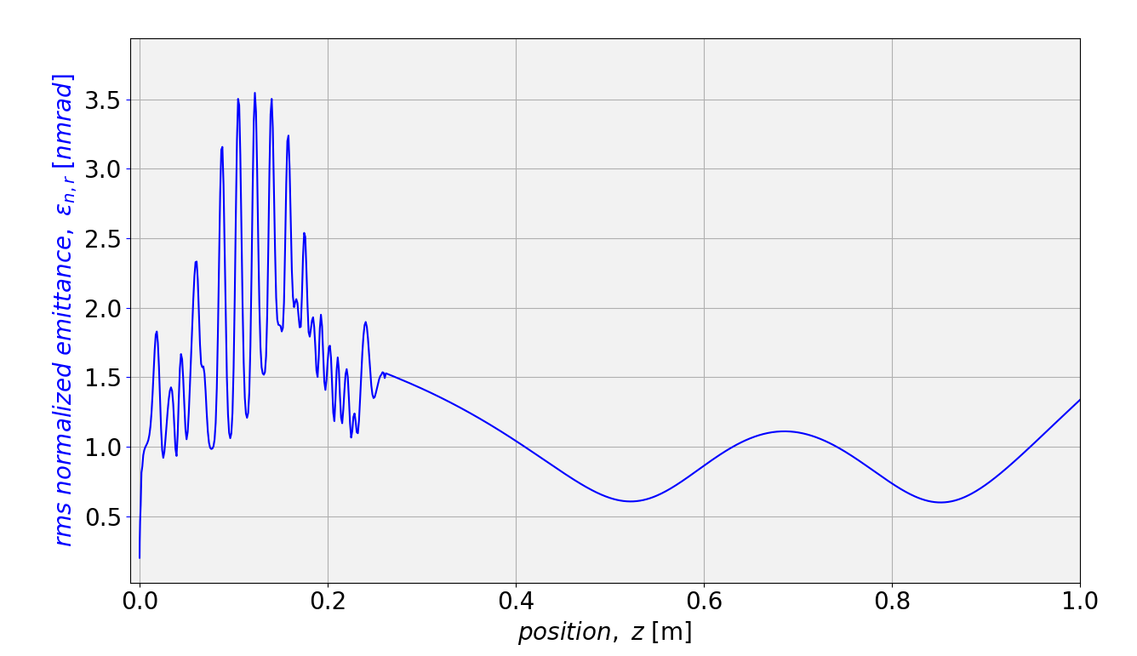
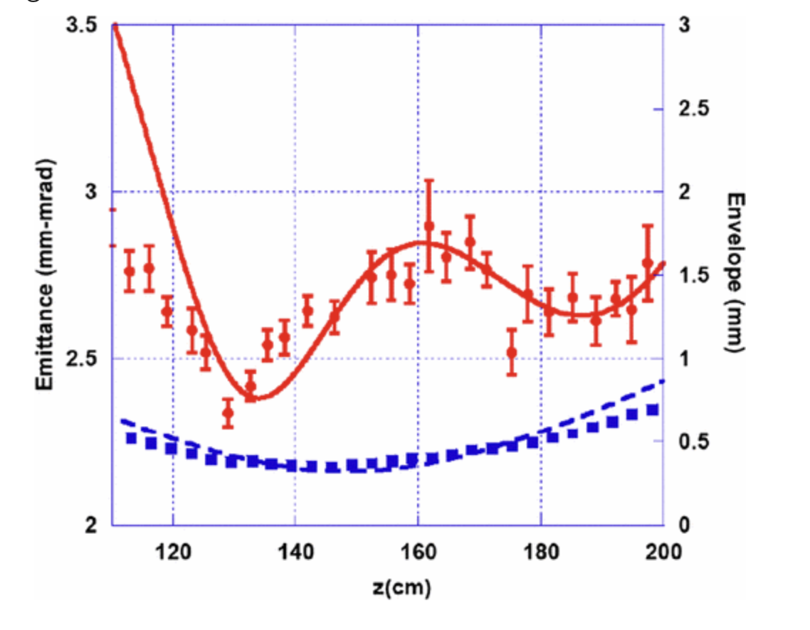
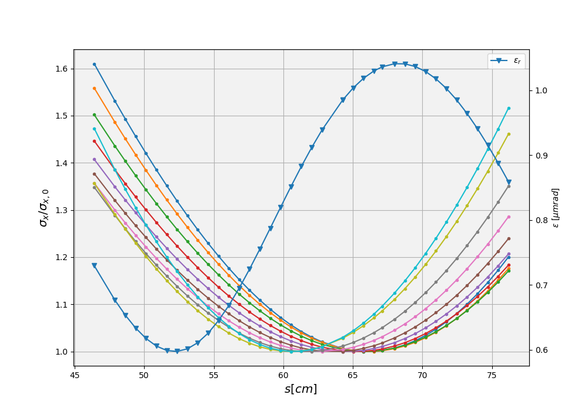
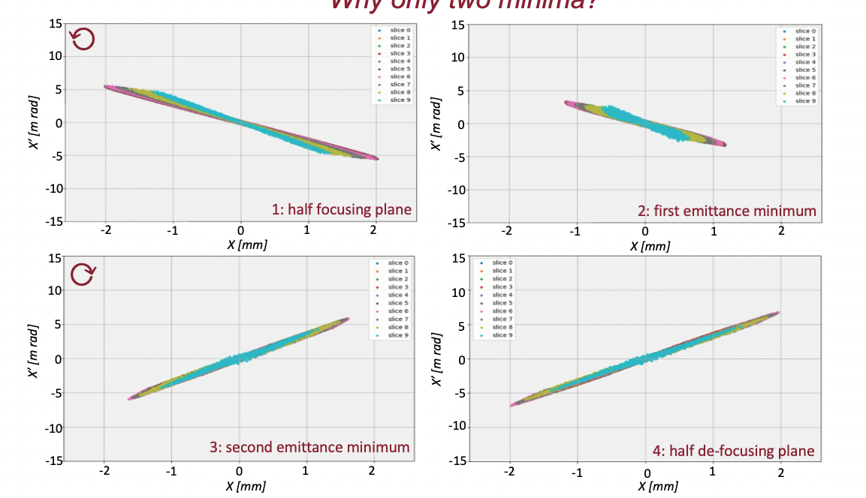
Double emittance minimum
Serafini and Rosenzweig:
In the space charge dominated regime, mismatches between the space charge correlated forces and the external rf focusing produce slice envelope oscillation
[*]Ferrario, M.; et al. Direct measurement of the double emittance minimum in the beam dynamics of the sparc high-brightness photoinjector. Phys. Rev. Lett. 2007, 99, 234801.
[*] L. Serafini, J. B. Rosenzweig, Phys. Rev. E 55, 7565- 7590 (1997)
the space charge dominated waist is rached at different position by the head and the tail slices of the bunch
Correlated slice
emittance
[*] M. Ferrario et al., SLAC-PUB-8400, (2000)
[*] C. Ronsivalle et al., Proceedings of EPAC08, Genoa, Italy MOZAG01

Slide 9
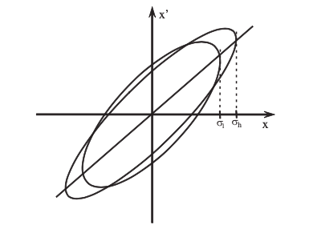

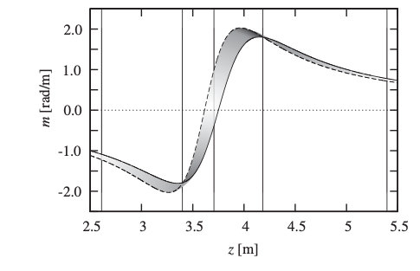
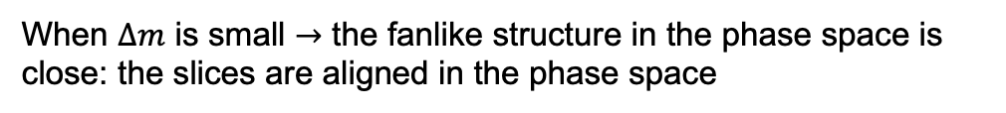

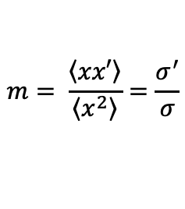
Double emittance minimum: Floettmann
The emittance of the beam is formed by a superposition of the slices with their respective orientation and form in phase space
L
H
$$z$$
$$m= \frac{\left\langle \left.xx′\right\rangle \right.}{\left\langle \left.x^{2}\right\rangle \right.}=\frac{σ^{′}}{σ}$$
To understand the emittance growth
When $Δm$ is small $→$ the fanlike structure in the phase space is close: the slices are aligned in the phase space
The condition for the emittance minimum is $Δm=0$
In the case of two slice, this condition become a quadratic equation in z, so we have two solution and so two position for minimum emittance
[*] K. Floettmann, Emittance compensation in split photoinjectors, Phys. Rev. Accel. Beams 20, 013401 (2017).

Slide 10
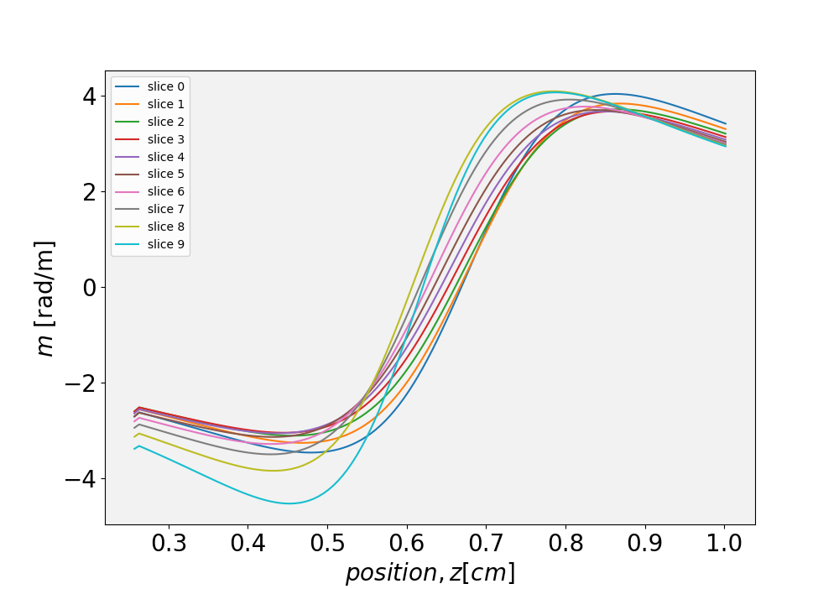

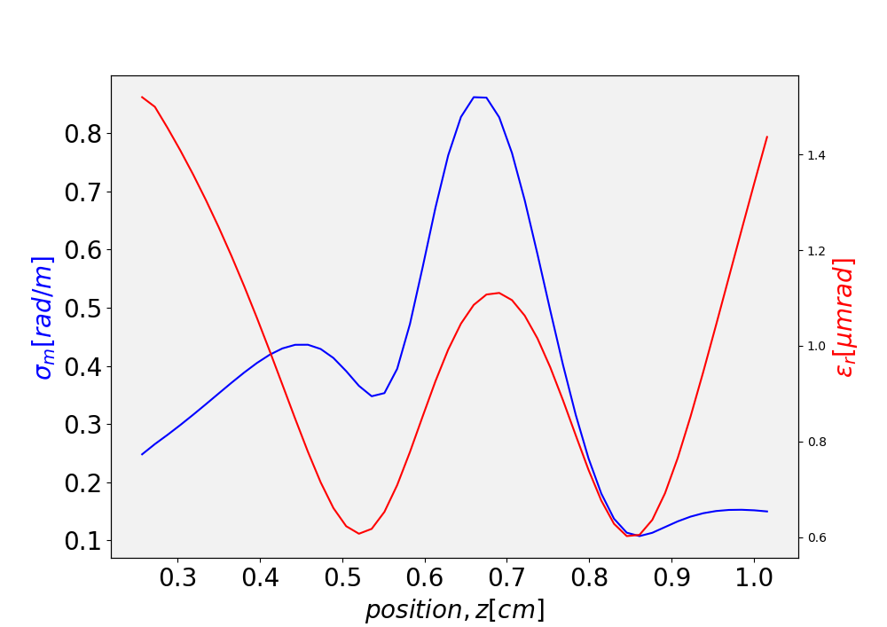
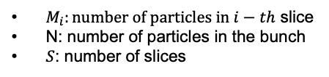
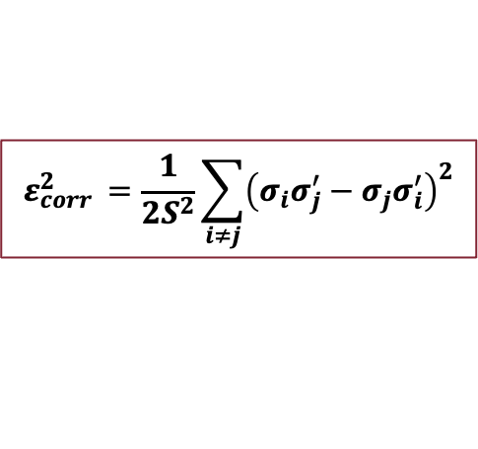
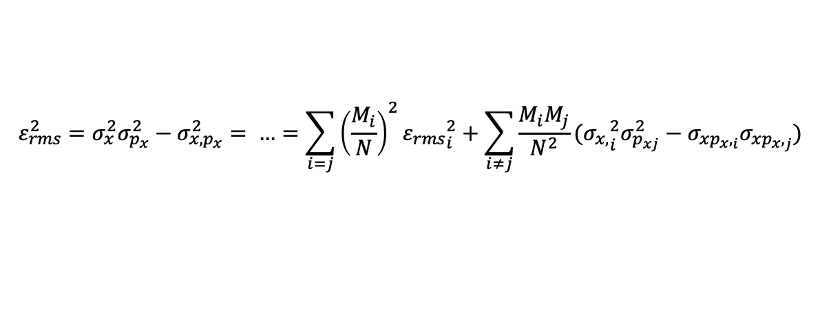
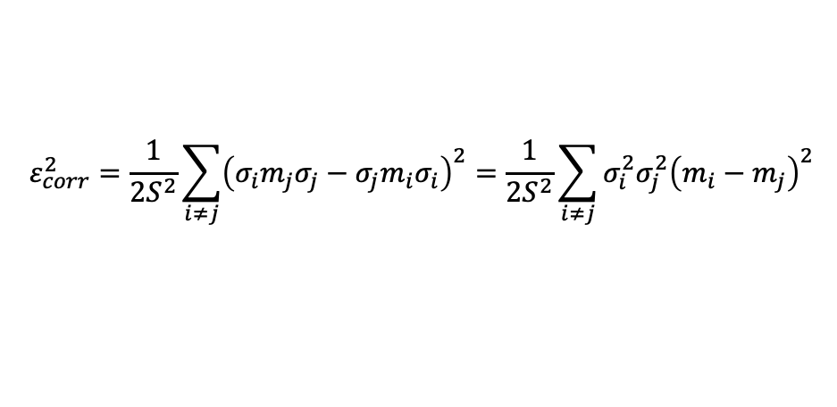


Multi slice model
$$ε_{rms}^{2}=σ_{x}^{2}σ_{p_{x}}^{2}−σ_{x,p_{x}}^{2}= …=\sum_{i=j}{{\left(\frac{M_{i}}{N}\right)}^{2}{ε_{rms}}_{i}^{2}+\sum_{i≠j}{\frac{M_{i}M_{j}}{N^{2}}({σ_{x,}}_{i}^{2}σ_{p_{xj}}^{2}−σ_{x{p_{x},}_{i}}σ_{x{p_{x},}_{j}})}}$$
$M_{i}:number of particles in i−th$ slice
N: number of particles in the bunch
$S$: number of slices
Correlated emittance
$$ε_{corr }^{2}=\frac{1}{2S^{2}}\sum_{i≠j}{{\left(σ_{i}σ_{j}^{′}−σ_{j}σ_{i}^{′}\right)}^{2}}$$
To connect $ε_{corr}$ with $m:$
$$σ_{i}^{′}=m_{i}σ_{i}$$
$$ε_{corr}^{2}=\frac{1}{2S^{2}}\sum_{i≠j}{{\left(σ_{i}m_{j}σ_{j}−σ_{j}m_{i}σ_{i}\right)}^{2}}=\frac{1}{2S^{2}}\sum_{i≠j}{σ_{i}^{2}σ_{j}^{2}{\left(m_{i}−m_{j}\right)}^{2}}$$
[*] M. Carillo et al., “Space Charge Analysis for Low Energy Photoinjector”, presented at the 13th Int.Particle Accelerator Conf. (IPAC’22), Bangkok, Thailand, June2022

Slide 11
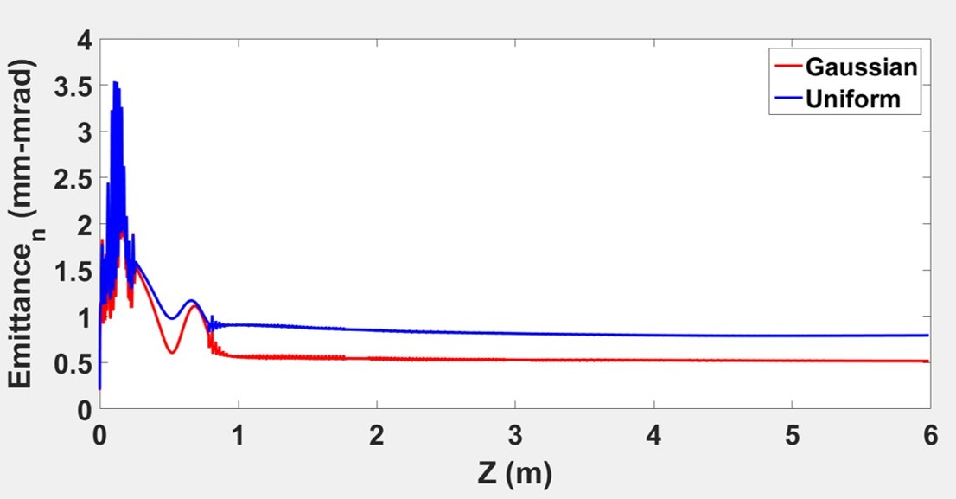
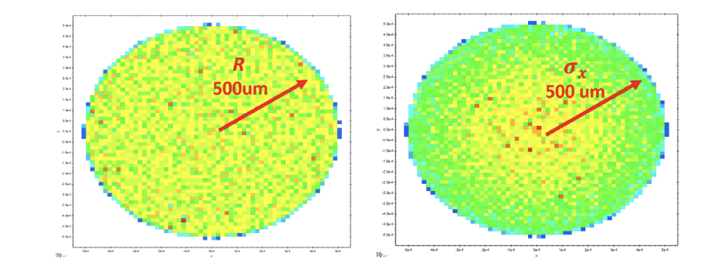
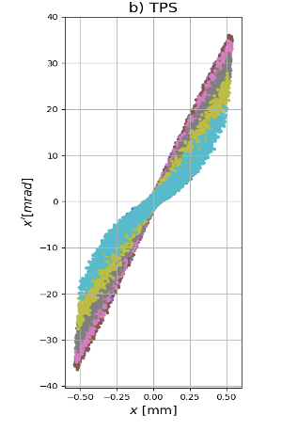
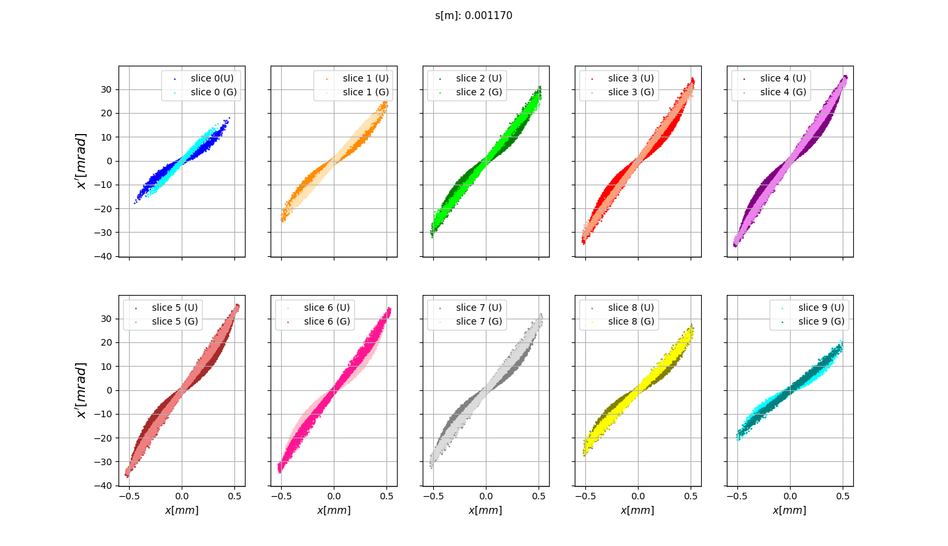
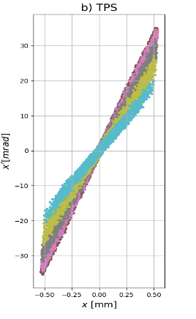
Emittance trend from transverse laser distribution
[*] M. Carillo et al., “Space Charge Analysis for Low Energy Photoinjector”, presented at the 14th Int.Particle Accelerator Conf. (IPAC’23), Venice, Italy (2023)
Cathode Laser shaping
HYBRID PHOTOINJECTOR
Uniform
Cut-Gaussian
Uniform
[*] L. Faillace, et al., “High field hybrid photoinjector electron source for advanced light source applications”, Phys. Rev. Accel. Beams 25, 063401 (2022).
Cut –Gaussian
Depending on the laser distribution sent to the cathode, the non-linear components of the space charge forces can degrade the quality of the beam.
How do the space charge forces depend on the distribution?

Slide 12
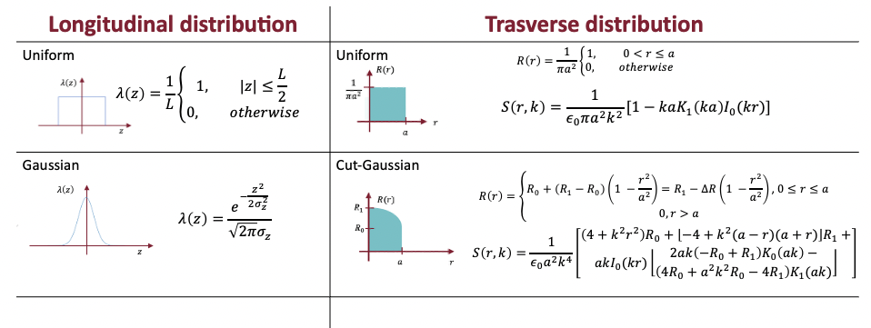

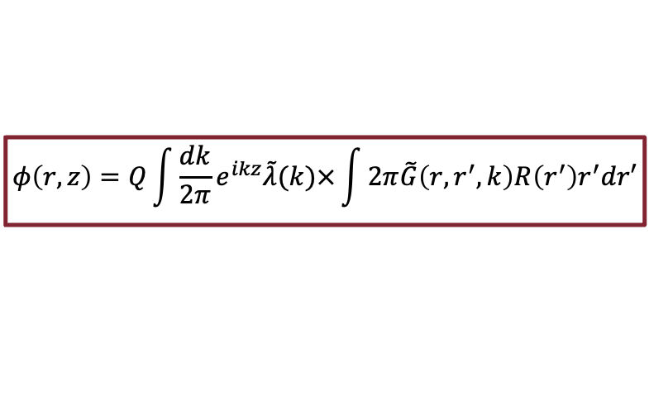


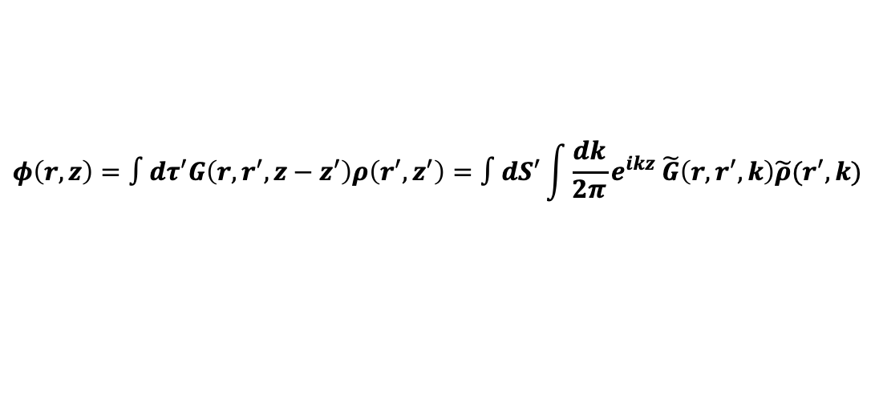


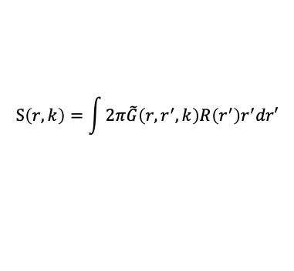
Space charge forces: analytical approach
$$\left(∇^{2}−\frac{1}{c^{2}}\frac{∂^{2}}{∂t^{2}}\right)φ=−\frac{ρ}{ε_{0}}$$
Inhomogeneous wave equation:
Green function-based methods can be used to describe arbitrary beam distributions:
$$φ\left(r,z\right)=∫dτ^{′}G\left(r,r^{′},z−z^{′}\right)ρ(r^{′},z′)$$
$$−ε_{0}{\text{◻︎}}^{2}G\left(r,r^{′}\right)=\frac{δ\left(r−r^{′}\right)}{2πr^{′}}δ(z−z′)$$
Green function for a ring of a unitary charge:
N.B.: this solution is expressed as superposition of the direct and the image charge contribution.
$$\tilde{G}\left(r,r^{′}, k\right)=\frac{1}{2πε_{o}}\left[I_{o}\left(\frac{k}{γ}r_{<}\right)K_{0}\left(\frac{k}{γ}r_{>}\right)−\frac{K_{0}\left(\frac{k}{γ}b\right)}{I_{0}\left(\frac{k}{γ}b\right)}I_{0}\left(\frac{k}{γ}r\right)I_{0}\left(\frac{k}{γ}r′\right)\right]$$
Solution in terms of zero-th order modified Bessel function:
Where $r_{<}=min⁡\{r, r′\}$ and $r_{>}=max\{r, r′\}$
$$φ\left(r, z\right)=∫dτ^{′}G\left(r, r^{′}, z−z^{′}\right)ρ\left(r^{′}, z^{′}\right)=∫dS^{′}\int{\frac{dk}{2π}e^{ikz} \tilde{G}\left(r, r^{′}, k\right)\tilde{ρ}(r^{′}, k)}$$
Assuming a separable form for the charge density (e.g., low energy approximation):
$$ρ\left(r, z\right)=QR\left(r\right)λ\left(z\right)↔\tilde{ρ}\left(r, k\right)=QR(r)\tilde{λ}(k)$$
For any separable distribution:
$$φ\left(r,z\right)=Q\int{\frac{dk}{2π}}e^{ikz}\tilde{λ}(k)×\int{2π\tilde{G}\left(r, r^{′}, k\right)R\left(r^{′}\right)r^{′}dr′}$$
Where
$$S\left(r,k\right)=\int{2π\tilde{G}\left(r, r^{′}, k\right)R\left(r^{′}\right)r^{′}dr′}$$

Slide 13
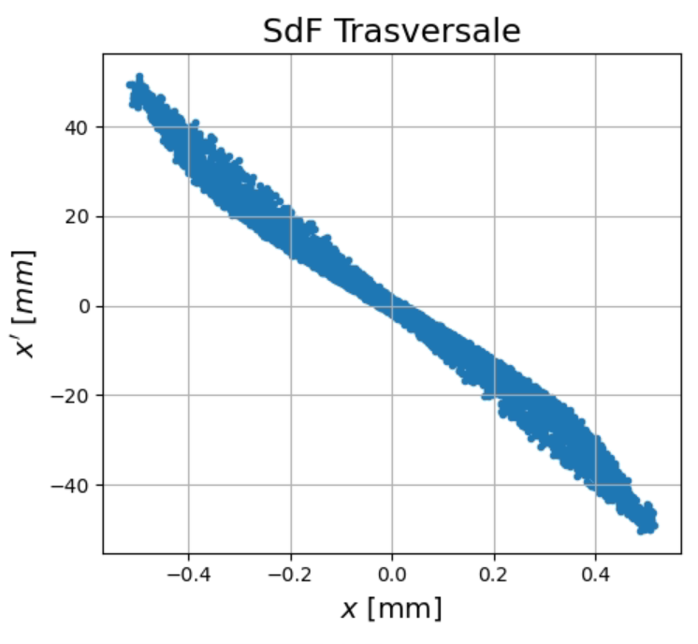
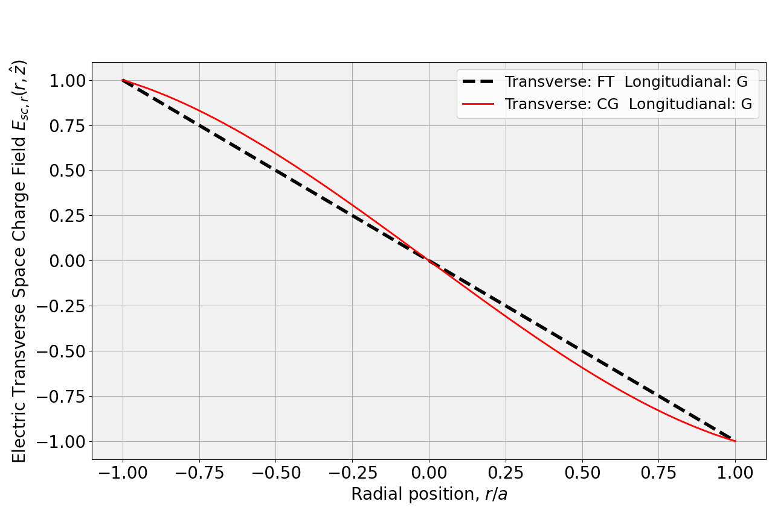
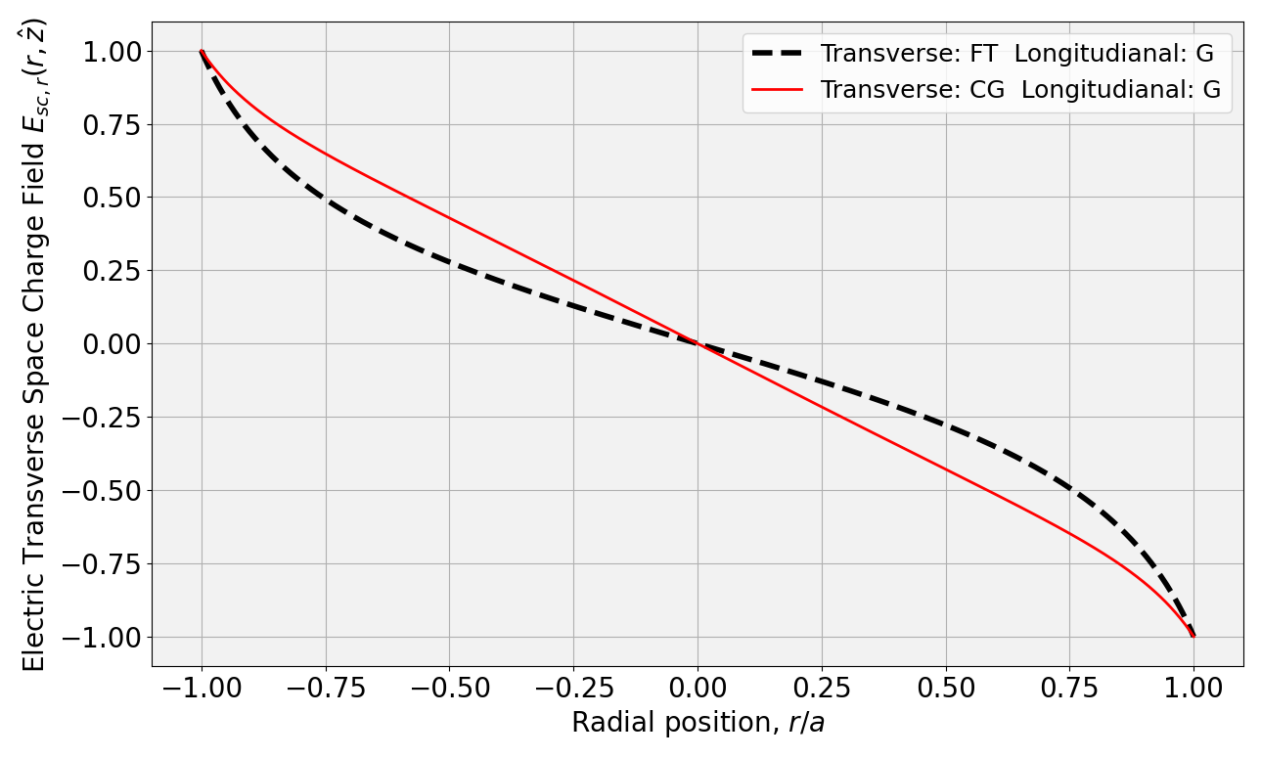




Space charge forces:
Field shape
[*] Feng Zhou et al., “Impact of the spatial laser distribution on photocathode gun operation”, SLAC National Accelerator LABORATORY
Pancake like regime ($L≪R$)
Cigar like regime ($R≪L$)
[*] Han Chen et al., “Analysis of slice transverse emittance evolution in a very-High-frequency gun photoinjector”, Accelerator laboratory, Department of Engineering Physics, Tsinghua University, Beijing, China

Slide 14








Space charge forces: analytical approach
+
$$\left(α_{m}=\left\{\begin{aligned}1 m=0 \\ 2 m≠0\end{aligned}\right.\right)$$
Multipolar expression of the Green function:
-
$$r’$$
-
Quadrupolar perturbation $m=2$
$$a$$
$$\tilde{G_{m}}\left(r, r^{′}, k, θ, θ^{′}\right)=\frac{α_{m} cos⁡(m(θ−θ^{′}))}{2πε_{0}}\left\{\begin{aligned}K_{m}\left(kr\right)I_{m}\left(kr′\right) 0<r^{′}<r \\ K_{m}\left(kr^{′}\right)I_{m}\left(kr\right) r<r^{′}<a\end{aligned}\right.$$
+
$$φ\left(r, z\right)+δφ(r,z, θ)=Q\int{\frac{dk}{2π}e^{ikz}\tilde{λ}(k)(S\left(k,r\right)+δS\left(k, r, θ\right))}$$
With perturbation: $θ$dependence
$$E_{r}^{sc}\left(r, z, θ\right)=−Q\int{\frac{dk}{2π}e^{ikz}\tilde{λ}(k)\frac{∂}{∂r}(S\left(k,r, θ\right)+δS(k, r,θ))}$$
$$E_{θ}^{sc}\left(r, z, θ\right)=−Q\int{\frac{dk}{2π}e^{ikz}\tilde{λ}(k)\frac{∂}{∂θ}(S\left(k,r, θ\right)+δS(k, r, θ))}$$

Slide 15
Outline
C-Band Hybrid photoinjector:
  Beam dynamics
  Envelope equation: the Triple waist approximation
  Emittance compensation:
    Multi-slice model and Double emittance minimum
    Laser distribution: space charge analytical model
SPARC_LAB:
  Gun conditioning
  Witness-Driver configuration
  Experimental results
UCLA Experience:
  Magnetic Characterization
  MITHRA’s Gun Characterization
  COMB beam with Hybrid Injector

Slide 16




SPARC_LAB: the facility
SPARC_LAB is a test-facility operating at the Frascati National Laboratories of INFN (LNF-INFN) devoted to advanced radiation sources and innovative acceleration techniques.
[*] M. Ferrario et al., SPARC_LAB present and future, Nuclear Instruments and Methods in Physics Research Section B: Beam Interactions with Materials and Atoms, Volume 309, 2013.

Slide 17







SPARC_LAB:
gun conditioning
[*] D. Alesini et al., The New SPARC_LAB RF Photo-Injector, in proceedings of the 13th International Particle Accelerator Conference (IPAC’22), Bangkok, Thailand, 12–17 June 2022, JACoW Publishing, Geneva, Switzerland (2022), pp. 671–674
[*] V. Shpakov et al, Design, optimization and experimental characterization of RF injectors for high brightness electron beams and plasma acceleration
2022 JINST 17 P12022
QE | $\sim 10^{−5}$ e/ph
DC | $$\sim 22 pC$$
No Discharge time | $24+$ h
Norm. Emittance 200pC,1.4 ps long | $1 mm ∙mrad$
Intrinsic Emittance | $$\sim 0.5 mm∙mrad$$

Slide 18
Outline
C-Band Hybrid photoinjector:
  Beam dynamics
  Envelope equation: the Triple waist approximation
  Emittance compensation:
    Multi-slice model and Double emittance minimum
    Laser distribution: space charge analytical model
SPARC_LAB:
  Gun conditioning
  Witness-Driver configuration
  Experimental results
UCLA Experience:
  Magnetic Characterization
  MITHRA’s Gun Characterization
  COMB beam with Hybrid Injector

Slide 19




SPARC_LAB: Witness-Driver configuration
Two-bunches configuration produced directly at the cathode with laser-comb technique ($500pC+50pC$)
The first section of the LINAC works in the velocity bunching configuration
[*] L. Serafini and Massimo Ferrario. Velocity bunching in photo-injectors. Proc. AIP, 581, 08
2001. doi: 10.1063/1.1401564
[*] M.Carillo et al., BEAM DYNAMICS OPTIMIZATION FOR HIGH GRADIENT BEAM DRIVEN PLASMA WAKEFIELD ACCELERATION AT SPARC-LAB, presented at the 14th Int.Particle Accelerator Conf. (IPAC’23), Venice, Italy (2023)

Slide 20





SPARC_LAB: High brightness beams dynamics
High brightness beam:
Both plasma acceleration and its application requires low emittance beam and short bunch
Charge: $500 pC$
Spot radius: ???
Laser duration: $100 fs (rms)$
Driver
Witness
Charge: $50 pC$
Spot radius: ???
Laser duration: $100 fs (rms)$
Distance
witness before driver @ cathode: ???
[*] M.Carillo et al., BEAM DYNAMICS OPTIMIZATION FOR HIGH GRADIENT BEAM DRIVEN PLASMA WAKEFIELD ACCELERATION AT SPARC-LAB, presented at the 14th Int.Particle Accelerator Conf. (IPAC’23), Venice, Italy (2023)

Slide 21









SPARC_LAB: Beam dynamics comb results
Charge: $500 pC$
Spot radius: $500μm (rms)$
Laser duration: $100 fs (rms)$
Driver
Witness
Charge: $50 pC$
Spot radius:$227(rms)$
Laser duration: $100 fs (rms)$
Distance
witness before driver @cathode:
$3.5 ps$
$$∼2.3 kA$$
$$∼2 kA$$
[*] M.Carillo et al., BEAM DYNAMICS OPTIMIZATION FOR HIGH GRADIENT BEAM DRIVEN PLASMA WAKEFIELD ACCELERATION AT SPARC-LAB, presented at the 14th Int.Particle Accelerator Conf. (IPAC’23), Venice, Italy (2023)

Slide 22






SPARC_LAB: Experimental results
Without plasma section:
High Gradient plasma acceleration
Repetition rate for PWFA
A parametric study exploring a wide range of plasma density ($n_{p}≈[{10}^{13},{10}^{16}]{cm}^{−3}$) and pump and probe delay ($Δt=\left[0.7−13\right] ns$)
With plasma section:
95.5 ± 0.2 MeV
3cm long capillary:
Gain energy 1.1 GeV
129.7 ± 0.5 MeV
NB: this results is important in the framework of EuPRAXIA@SPARC_LAB, where the aim is to achieve gradients of the order of 1.2 GeV/m in 40 cm capillary length
[*] R. Pompili et al., Toward gigahertz repetition rates for plasma-wakefield accelerators . Submitted on PRL
$Δ t$< 0.7ns

Slide 23
Outline
C-Band Hybrid photoinjector:
  Beam dynamics
  Envelope equation: the Triple waist approximation
  Emittance compensation:
    Multi-slice model and Double emittance minimum
    Laser distribution: space charge analytical model
SPARC_LAB:
  Gun conditioning
  Witness-Driver configuration
  Experimental results
UCLA Experience:
  Magnetic Characterization
  MITHRA’s Gun Characterization
  COMB beam with Hybrid Injector

Slide 24


UCLA Labs
MOTHRA Lab
MITHRA Lab
Development of ultra-high gradient RF accelerators and infrastructure development towards an ultra-compact X-ray free electron laser.
MITHRA is a constructed electron linear accelerator test facility situated on UCLA’s southwest campus in Westwood
Quantify the potential improvements in brightness achievable at the cathode when operated at cryogenic temperatures.
The facility will conduct initial proof-of-principle experiments in areas such as the ultra-compact X-ray free-electron laser,
advanced dielectric wakefield acceleration, bi-harmonic nonlinear inverse Compton scattering, and various radiation detectors.
[*]Lawler, G. E., A. Fukasawa, N. Majernik, J. R. Parsons, J. B. Rosenzweig, Y. Sakai, and A. Suraj. 2022. “CrYogenic Brightness-Optimized Radiofrequency Gun (CYBORG).” In Proc. IPAC’22, 2544–47. International Particle Accelerator Conference 13. JACoW Publishing, Geneva, Switzerland.
[*] O. Williams, et al., Overview and Commissioning Status of the UCLA MITHRA Facility, submitted on MDPI

Slide 25







Magnetic Characterization
Motors connected to a Hall probe, enabling movement of the probe in the x, y, and z directions. These motors are controlled and automated through an Arduino board. The probe is connected to a LakeShore’s F71 Teslameter, allowing the recording of measured magnetic field values

Slide 26
Outline
C-Band Hybrid photoinjector:
  Beam dynamics
  Envelope equation: the Triple waist approximation
  Emittance compensation:
    Multi-slice model and Double emittance minimum
    Laser distribution: space charge analytical model
SPARC_LAB:
  Gun conditioning
  Witness-Driver configuration
  Experimental results
UCLA Experience:
  Magnetic Characterization
  MITHRA’s Gun Characterization
  COMB beam with Hybrid Injector

Slide 27








MITHRA’s Gun Characterization

Slide 28
Outline
C-Band Hybrid photoinjector:
  Beam dynamics
  Envelope equation: the Triple waist approximation
  Emittance compensation:
    Multi-slice model and Double emittance minimum
    Laser distribution: space charge analytical model
SPARC_LAB:
  Gun conditioning
  Witness-Driver configuration
  Experimental results
UCLA Experience:
  Magnetic Characterization
  MITHRA’s Gun Characterization
  COMB beam with Hybrid Injector

Slide 29






Witness and Driver beams with Hybrid Photoinjector
Beam generation parameters:
Qd = 100 # Driver charge (pC)
Qw = 20 # Witness charge (pC)
Drad = 0.65e-3 # Driver radius 1e-3
Wrad = 450e-6 # Wit ness radius 630
Tlend = 100e-15 # Driver duration
Tlenw = 100e-15 # Witness duration
Dwt = 3.4e-12 # D-W distance
HGUN_E0 = 45e6 # Max E field at cathode in the hybrid gun. [V/m]
HGUN_PHASE = 30 #40(standard phase) # Phase of the hybrid gun defined sine-like. [deg]
Working in progress

Slide 30
Conclusion
C-Band Hybrid photoinjector:
  Beam dynamics
  Envelope equation: the Triple waist approximation
  Emittance compensation:
    Multi-slice model and Double emittance minimum
    Laser distribution: space charge analytical model
SPARC_LAB:
  Gun conditioning
  Witness-Driver configuration
  Experimental results
UCLA Experience:
  Magnetic Characterization
  MITHRA’s Gun Characterization
  COMB beam with Hybrid Injector
Optimization and deep understanding of hybrid gun beam dynamics thanks to analytica models develped
New gun installing for beam dynamics performance improvement + beam dynamics paraemter optimization
Successfull experimental results
Visiting period: Introduction to beamline characterization (Magnetic and Beamb dynamics)

Slide 31
Scientific Publications
Articles
• September 2023: F. Bosco, O. Camacho, M. Carillo, et al.,“Fast models for the evaluation of self-induced field effects in linear accelerators”, Nuclear Instruments and Methods in Physics Research Section A: Accelerators, Spectrometers, Detectors and Associated Equipment, Volume 1056,(2023)doi:10.1016/j.nima.2023. 168642.
• February 2023: L. Giuliano, F. Bosco, M. Carillo, G. Felici, L. Ficcadenti, A. Mostacci, M. Migliorati, L. Palumbo, B. Spataro and Luigi Faillace, “RF Design and Measurements of a C-Band Prototype Structure for an Ultra-High Dose-Rate Medical Linac”, Instruments 2023, 7, 10. doi.org/10.3390/instruments7010010
• December 2022: V. Shpakov, D. Alesini, M.P. Anania, M. Behtouei, B. Buonomo, M. Bellaveglia, A. Biagioni, F. Cardelli, M. Carillo, E. Chiadroni, A. Cianchi, G. Costa, M. Del Giorno, L. Faillace, M. Ferrario, M. Del Franco, G. Franzini, M. Galletti, L. Giannessi, A. Giribono, A. Liedl, V. Lollo, A. Mostacci, G. Di Pirro, L. Piersanti, R. Pompili, G. Di Raddo, S. Romeo, G.J. Silvi, A. Stella, C. Vaccarezza, F. Villa and A. Vannozzi, “Design, optimization and experimental characterization of RF injectors for high brightness electron beams and plasma acceleration”, Journal of Instrumentation, Volume 17, December 2022 doi:10.1088/1748-0221/17/12/P12022
• November 2022: L. Faillace, D. Alesini, G. Bisogni, F. Bosco, M. Carillo, P. Cirrone, G. Cuttone, D. De Arcangelis, A. De Gregorio, F. Di Martino, V. Favaudon, L. Ficcadenti, D. Francescone, G. Franciosini, A. Gallo, S. Heinrich, M. Migliorati, A. Mostacci, L. Palumbo, V. Patera, A. Patriarca, J. Pensavalle, F. Perondi, R. Remetti, A. Sarti, B. Spataro, G. Torrisi, A. Vannozzi, L. Giuliano, “Perspectives in linear accelerator for FLASH VHEE: Study of a compact C-band system”, Physica Medica 104 (2022) 149–159.
doi:10.1016/j.ejmp.2022.10.018
• June 2022: L. Faillace, R. Agustsson, M. Behtouei, F. Bosco, D. Bruhwiler, O. Camacho, M. Carillo, et al., “High Field Hybrid Photoinjector Electron Source for Advanced Light Source Applications”, Phys. Rev. Accel. Beams 25, 063401 (2022).
doi:10.1103/PhysRevAccelBeams.25.063401
• September 2021: M. Behtouei, B. Spataro, L. Faillace, M. Carillo, M. Comelli, A. Variola, M. Migliorati, “A Novel method to calculate the magnetic field of a Solenoid generated by a surface current element”, arXiv, (2021).
doi:10.48550/arXiv.2109.04464
• September 2021: B. Spataro, M. Behtouei, F. Cardelli, M. Carillo, V. Dolgashev, L. Faillace, M. Migliorati, L. Palumbo, “A hard open X-band RF accelerating structure made by two halves”, arXiv,
(2021).
doi:10.48550/arXiv.2109.03954
• September 2021: Journal paper, M. Behtouei, B. Spataro, L. Faillace, M. Carillo, A. Leggieri, L. Palumbo, M. Migliorati, “Relativistic approach to a low perveance high quality matched beam for a high efficiency Ka- Band klystron”, arXiv, (2021).
doi:10.48550/arXiv.2109.03520
Conference Volume
• July 2023: Fabio Villa, David Alesini, Maria P. Anania, Marco Angelucci, Alberto Bacci, Antonella Balerna, Marco Bellaveglia, Angelo Biagioni, Bruno Buonuomo, Sergio Cantarella, Fabio Cardelli, Martina Carillo, et al. “EuPRAXIA @ SPARC LAB status update”, Proceedings Volume 12581, X-Ray Free Electron Lasers: Advances in Source Development and Instrumentation VI; 125810H (2023) doi:10.1117/12.2668643
• June 2022: M. Carillo, M. Behtouei, F. Bosco, O. Camacho, E. Chiadroni, L. Faillace, et al.,“Space Charge Analysis for Low Energy Photoinjector”,in Proc. 13th International Particle Accelerator Conference (IPAC’22), Bangkok, Thailand, Jun. 2022, pp. 2272–2275. doi:10.18429/JACoW-IPAC2022-WEPOMS017
• June 2022: L. Faillace, R.B. Agustsson, M. Behtouei, F. Bosco, D.L. Bruhwiler, O. Camacho, M. Carillo, et al., “Start-to-End Beam-Dynamics Simulations of a Compact C-Band Electron Beam Source for High Spectral Brilliance Applications”, in Proc. 13th International Particle Accelerator Conference (IPAC’22), Bangkok, Thailand, Jun. 2022, pp. 687–690. doi:10.18429/JACoW-IPAC2022-MOPOMS023
• June 2022:,M. Behtouei, F. Bosco, M. Carillo, F. Di Paolo, L. Faillace, S. Fantauzzi, et al., “Studies of a Ka-Band High Power Klystron Amplifier at INFN-LNF”, in Proc. 13th International Particle Accelerator Conference (IPAC’22), Bangkok, Thailand, Jun. 2022, pp. 683–686. doi:10.18429/JACoW-IPAC2022-MOPOMS022
• June 2022: F. Bosco, O. Camacho, M. Carillo, et al., “Modeling and Mitigation of Long-Range Wakefields for Advanced Linear Colliders”, in Proc. 13th International Particle Accelerator Conference (IPAC’22), Bangkok, Thailand, Jun. 2022, pp. 2350–2353. doi:10.18429/JACoW-IPAC2022-WEPOMS045
• June 2022: D. Alesini, M.P. Anania, A. Battisti, M. Bellaveglia, A. Biagioni, F. Cardelli, M. Carillo et al., “The New SPARC-LAB RF Photo-Injector”, in Proc. 13th International Particle Accelerator Conference (IPAC’22), Bangkok, Thailand, Jun. 2022, pp. 671–674. doi:10.18429/JACoW-IPAC2022-MOPOMS019
• June 2022: L. Giuliano, D. Alesini, M. Behtouei, M.G. Bisogni, F. Bosco, M. Carillo, et al., “Proposal of a VHEE Linac for FLASH Radiotherapy”, in Proc. 13th International Particle Accelerator Conference (IPAC’22), Bangkok, Thailand, Jun. 2022, pp. 2903–2906. doi:10.18429/JACoW-IPAC2022-THPOTK054
• May 2021: M. Carillo, M. Behtouei, F. Bosco, L. Faillace, L. Ficcadenti, A. Giribono, et al., “Three-Dimensional Space Charge Oscillations in a Hybrid Photoinjector”, in Proc. IPAC’21, Camp- inas, SP, Brazil, May 2021, pp. 3240–3243. doi:10.18429/JACoW-IPAC2021-WEPAB256
• May 2021: L. Faillace, R.B. Agustsson, M. Behtouei, F. Bosco, M. Carillo, A. Fukasawa, et al.,“Beam Dynamics for a High Field C-Band Hybrid Photoinjector”, in Proc. IPAC’21, Campinas, SP, Brazil, May 2021, pp. 2714–2717. doi:10.18429/JACoW-IPAC2021-WEPAB051
• May 2021: F. Bosco, M. Behtouei, M. Carillo, et al.,“Modeling Short Range Wakefield Effects in a High Gradient Linac”,in Proc. IPAC’21, Campinas, SP, Brazil, May 2021, pp. 3185–3188. doi:10.18429/JACoW-IPAC2021-WEPAB238
• May 2021: L. Giuliano, D. Alesini, M. Behtouei, F. Bosco, M. Carillo, G. Cuttone, et al.,“Preliminary Studies of a Compact VHEE Linear Accelerator System for FLASH Radiotherapy”, in Proc. IPAC’21, Campinas, SP, Brazil, May 2021, pp. 1229–1232. doi:10.18429/JACoW-IPAC2021-MOPAB410

Slide 32
Attended Conference
May 2021: International Particle Accelerator Conference 2021- online conference, Three-Dimensional Space Charge Oscillations in a Hybrid Photoinjector, Poster presentation.
June 2022: International Particle Accelerator Conference 2022, Bangkok, Thailand, Space charge analysis for low energy photoinjector, Poster presentation.
September 2022: 108° Congresso Nazionale, Società Italiana di Fisica, Milano, Italy, Space charge analysis for photoinjector emittance compensation, Oral presentation.
September 2022: EuroNNAc Special Topics Workshop, La Biodola Bay, Isola d’Elba, Italy, A novel analytical model of space charge forces in RF-guns, Poster presentation. Student grant winner.
May 2023: International Particle Accelerator Conference 2023, Venice, Italy,
        Beam dynamics optimization for high gradient beam driven plasma wakefield acceleration at SPARC-LAB, Contributed Oral Talk.
        A Space Charge Forces analytical model for emittance compensation ,Poster presentation.
Student grant winner.
June 2023: Physics and Applications of High Brightness Beam Workshop, San Sebastian, Spain, An Analytical Study of Space Charge Fields in the Emittance Compensation Process, Poster presentation. Student grant winner.
September 2023: 109° Congresso Nazionale, Società Italiana di Fisica, Salerno, Italy, Beam dynamics optimization for high gradient beam driven plasma wakefield acceleration at SPARC_LAB, Oral presentation.
September 2023: 6th European Advanced Accelerator Concepts workshop, La Biodola Bay, Isola d’Elba, Italy, Witness-driver beam dynamics optimization in the SPARC_LAB photoinjector, Poster presentation. Student grant winner.
October 2023: 15th workshop on breakdown science and high gradient technology, HG2023, Frascati National Labs of INFN, (Rome), Italy. Local Organize Committee
Invited Talk
May 2023: International Particle Accelerator Conference 2023, Venice, Italy, Contributed Oral Talk
July 2023: SLAC National Accelerator Laboratory (SLAC), San Francisco, USA, Scientific seminary and in-person interview

Slide 33
Thanks to…
L. Palumbo, E.Chiadroni, F.Bosco, L.Faillace, L.Giuliano, M. Migliorati, A. Mostacci, B. Spataro J.B. Rosenzweig,
&
M. Ferrario, M.Galletti, A. Giribono, R. Pompili, V.Shpakow and all the SPARC_LAB group
&
G. Lawler, A. Fukasawa, Y. Sakai, S. Tantawi, O. Williams and all the PBPL group
And YOU for the attention

Slide 34





Envelope analysis in the drift:
Triple waist approximation solution
Exact solution:
Perturbative solution:
$$z=\frac{σ_{0}^{3/2}}{\sqrt{2k}}\left[ln\left(\sqrt{\frac{σ}{σ_{0}}}+\sqrt{\frac{σ}{σ_{0}}−1}\right)+ \sqrt{\frac{σ}{σ_{0}}\left(\frac{σ}{σ_{0}}−1\right)}\right]+z_{0}$$
$$σ\left(z\right)=σ_{0}\left[\sqrt{\frac{k}{2σ_{0}}}\left(\frac{z}{σ_{0}}\right)∙\tan^{−1}\left(\sqrt{\frac{k}{2σ_{0}}}\left(\frac{z}{σ_{0}}\right)\right)\right]$$
Triple waist approximation:
$$σ_{z}\sim σ_{x}$$
$$σ_{x}^{′′}=\frac{k}{σ_{x}^{2}}$$
$$k=\frac{Nr_{e}f}{\sqrt{2π} γ^{3}}\frac{σ_{x,0}}{σ_{z,0 }}$$
[*] M. Carillo et al., “Three-dimensional space charge oscil-lations in a hybrid photoinjector”, presented at the 12th Int.Particle Accelerator Conf. (IPAC’21), Campinas, Brazil, May2021, paper WEPAB256

Slide 35





Envelope analysis in the drift:
Numerical solution (STEP 1)
Longitudinal charge density (parabolic):
$$λ\left(ζ\right)=\frac{3Q_{b}}{2l}\left(1−{\left(\frac{ζ}{l/2}\right)}^{2}\right)$$
$$l^{′′}≈\frac{{3eQ_{b}g_{fac}}/{mc^{2}}}{πε_{0}β_{s}^{3}γ_{s}^{5}}\frac{1}{l^{2}}$$
$$σ_{z}^{′′}≈\frac{3eQ_{b}g_{fac}}{40\sqrt{5}πε_{0}β_{0}^{3}γ_{0}^{5}m_{e}c^{2}}\frac{1}{σ_{z}^{2}}$$
Initial condition from TW section exit
$$g_{fac}=1.5$$
$$Q_{b}=250 pC$$
$$β_{0}=0.9933, γ_{0}=8.6678$$
35
Beam dynamics of RF guns for high brightness beams
martina.carillo@uniroma1.it

Slide 36









Envelope analysis in the drift:
Numerical solution (STEP 2)
$$ζ=0, ±\frac{l}{4}$$
Numerical solution of radial equation knowing the longitudinal solution, for a slice ($ζ$ fixed):
$$λ\left(ζ\right)=\frac{3Q_{b}}{2l}\left(1−{\left(\frac{ζ}{l/2}\right)}^{2}\right)$$
$$λ\left(ζ\right)=I(ζ)/βc$$
Longitudinal numerical solution
$$σ_{x}^{′′}\left(z,ζ\right)=\frac{I\left(ζ\right)}{{2I}_{A}β^{3}γ^{3}}\frac{1}{σ_{x}(z, ζ)}$$
$$ζ=0$$
$$ζ=±l/4$$
Beam dynamics of RF guns for high brightness beams
martina.carillo@uniroma1.it

Slide 37


Double emittance minimum:
phase space behavior
Without space charge the slides would all rotate in the same way (with the same speed), this means that the correlated emittance of the beam remains constant at the output value from the hybrid.
Emittance minima:
$s=0.52 m$
$s= 0.85 m$
The double minimum arises from the fact that the alignment of the slices occurs in the two slopes: both in the beam focusing trend $(σ_{x}$focusing) and in the beam expansion trend ($σ_{x}$ defocusing).
[*] M. Carillo et al., “Space Charge Analysis for Low Energy Photoinjector”, presented at the 13th Int.Particle Accelerator Conf. (IPAC’22), Bangkok, Thailand, June2022
Notes:
Questa slice serve solo a mostrarci perche la presenza di due minimi.

Slide 38







Envelope analysis in the drift: connection to plasma oscillations
In a beam with density $n_{b}$ in equilibrium with the surrounding forces: small density oscillations
$$\frac{d^{2}n_{b}}{dt^{2}}+ω_{p}^{2}n_{b}=0$$
$$ω_{b}^{2}=\frac{4πe^{2}n_{b}}{γ_{b}^{3}m_{e}}$$
By changing the independent variable to z:
$$\frac{d^{2}n_{b}}{dz^{2}}+k_{p}^{2}n_{b}=0$$
$$k_{p}=\frac{ω_{p}}{v_{b}}$$
The beam density can be written as $n_{b}≅C/σ_{x}^{3}$
Constant that depends on the number of particles
$\frac{d^{2}n_{b}}{dz}=\frac{d^{2}}{dz^{2}}\left(\frac{C}{σ_{x}^{3}}\right)=−\frac{3n_{b}}{σ_{x}}\frac{d^{2}σ_{x}}{dz^{2}}=−\frac{3k}{σ_{0}}n_{b}=k_{p}^{2}n_{b}$
$$σ_{x}^{′}=0$$
Beam dynamics of RF guns for high brightness beams
martina.carillo@uniroma1.it
Notes:
La cosa interessante è stata anche cercare di collegare questi risultati alle oscillazioni di plasma.
Noi sappiamo che per un fascio con densità nb, circondato da forze, si hanno oscillazioni di densità secondo l’equazione di oscillatore, dove tutte le particelle oscillanno con la stessa frequenza che prende il nome di frequenza di plasma. Quindi cambiando la variabile indipendente da t a z, si ha la stessa espressione in funzione del numero d’onda id plasm.
Quindi quello che abbiamo fatto è stato scrive la densità di plasma, come unca costante C che dipende dal numero di particelle, diviso sigmaXa alla 3, ovvero sempre mantenendo l’approssimazione di triplo wais.
Quindi sostiutendo nell’equazione, abbiamo trovato una relazione tra il numero d’’onda di plasma e il nostro k.

Slide 39








Space charge forces: analytical approach
$$\left(∇^{2}−\frac{1}{c^{2}}\frac{∂^{2}}{∂t^{2}}\right)φ=−\frac{ρ}{ε_{0}}$$
Inhomogeneous wave equation:
$$r$$
Green function-based methods can be used to describe arbitrary beam distributions:
$$2b$$
$$e^{−}$$
$$φ\left(r,z\right)=∫dτ^{′}G\left(r,r^{′},z−z^{′}\right)ρ(r^{′},z′)$$
$$z$$
Green function for a ring of a unitary charge:
$$−ε_{0}{\text{◻︎}}^{2}G\left(r,r^{′}\right)=\frac{δ\left(r−r^{′}\right)}{2πr^{′}}δ(z−z′)$$
Solution in terms of zero-th order modified Bessel function:
$$\tilde{G}\left(r,r^{′}, k\right)=\frac{1}{2πε_{o}}\left[I_{o}\left(\frac{k}{γ}r_{<}\right)K_{0}\left(\frac{k}{γ}r_{>}\right)−\frac{K_{0}\left(\frac{k}{γ}b\right)}{I_{0}\left(\frac{k}{γ}b\right)}I_{0}\left(\frac{k}{γ}r\right)I_{0}\left(\frac{k}{γ}r′\right)\right]$$
Where $r_{<}=min⁡\{r, r′\}$ and $r_{>}=max\{r, r′\}$
N.B.: this solution is expressed as superposition of the direct and the image charge contribution.

Slide 40




Space charge forces: low energy approximation
$$φ\left(r, z\right)=∫dτ^{′}G\left(r, r^{′}, z−z^{′}\right)ρ\left(r^{′}, z^{′}\right)=∫dS^{′}\int{\frac{dk}{2π}e^{ikz} \tilde{G}\left(r, r^{′}, k\right)\tilde{ρ}(r^{′}, k)}$$
$$ρ\left(r, z\right)=QR\left(r\right)λ\left(z\right)↔\tilde{ρ}\left(r, k\right)=QR(r)\tilde{λ}(k)$$
Assuming a separable form for the charge density (e.g., low energy approximation):
For any separable distribution:
$$φ\left(r,z\right)=Q\int{\frac{dk}{2π}}e^{ikz}\tilde{λ}(k)×\int{2π\tilde{G}\left(r, r^{′}, k\right)R\left(r^{′}\right)r^{′}dr′}$$
Where
$$S\left(r,k\right)=\int{2π\tilde{G}\left(r, r^{′}, k\right)R\left(r^{′}\right)r^{′}dr′}$$

Slide 41


SLIDE DI BACKGROUND: CARICHE IMMAGINI NEL MODELLO DI GREEN

Slide 42




Space charge forces:
Field shape
[*] Feng Zhou et al., “Impact of the spatial laser distribution on photocathode gun operation”, SLAC National Accelerator LABORATORY
PARABOLIC LONGITUDINAL DISTRIBUTION
Pancake like regime ($L≪R$)
Cigar like regime ($R≪L$)
Pancake like regime ($L≪R$)
[*] Han Chen et al., “Analysis of slice transverse emittance evolution in a very-High-frequency gun photoinjector”, Accelerator laboratory, Department of Engineering Physics, Tsinghua University, Beijing, China
Cigar like regime ($R≪L$)

