Slide 1
Perspectives of CR Backtracing in the Magnetosphere
Davide Grandi & Davide Rozza
On behalf of INFN Milano Bicocca group
AMS Days 2023

Slide 2
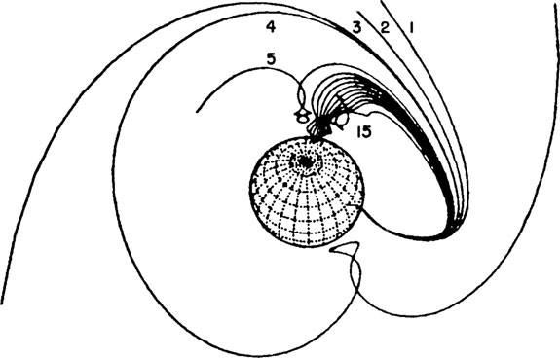

Slide 3
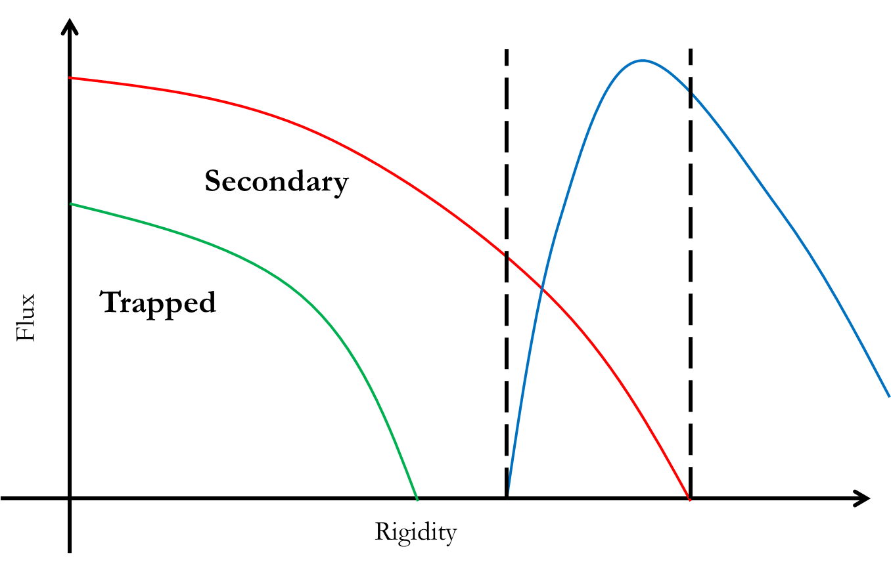
Backtracing & The Tsyganenko cut-off
In order to determine the cut-off, we used real selected events (in place of generated MC events) in the detector field of view.
We selected AMS-02 protons between 0.8 GV < R < 100 GV, during quiet and disturbed periods of the solar activity.
Using GeoMagSphere we back-traced all the selected particles, determining the rigidity distribution of:
particles coming from the outer magnetosphere → PRIMARY
particles created in the atmosphere → SECONDARY
particles trapped in the magnetic field lines → TRAPPED
The Tsyganenko rigidity cut-off is the upper rigidity cut-off, defined as the highest rigidity for particles identified as secondary
SO NO PENUMBRA!
Primary CRs
Operative definition of cut-off rigidity: the highest rigidity for secondary particles hereafter referred to as the Tsyganenko cut-off

Slide 4
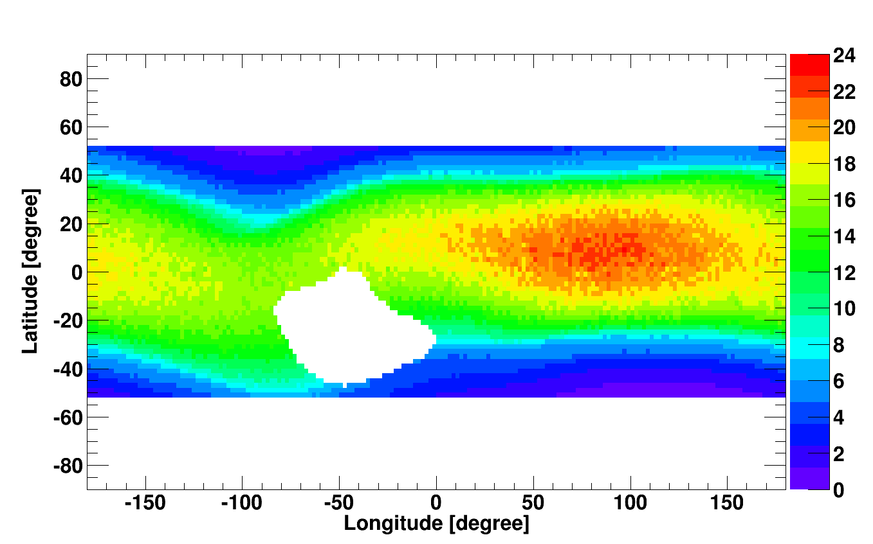
25° Rig Cutoff – Primary CR

Slide 5
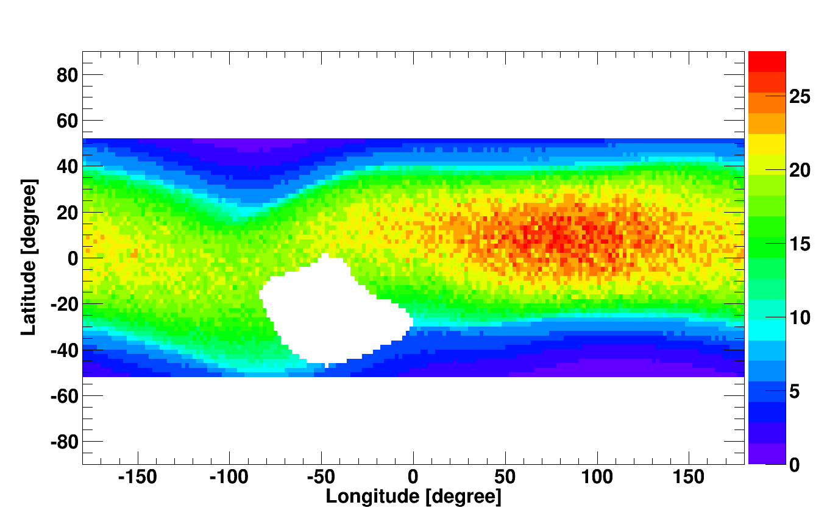
40° Rig Cutoff – Primary CR

Slide 6
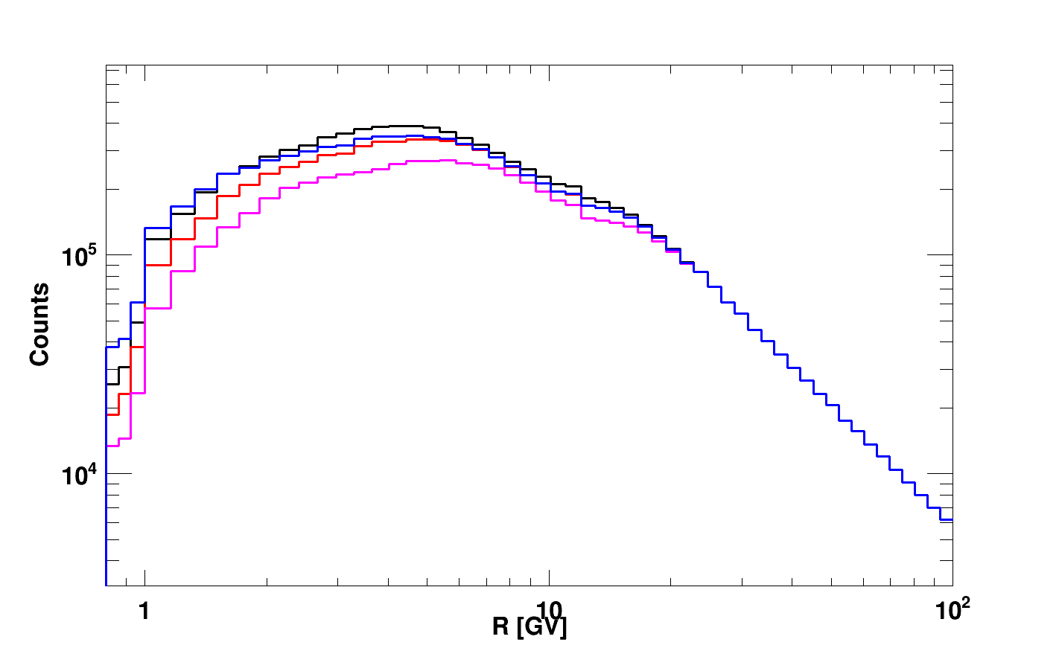
Tsyganenko vs IGRF – SF?
Analysis of AMS-02 protons and evaluation of possible safety factor to increase statistics
2012 March 4
0.8*IGRF
1.0*IGRF
1.2*IGRF
0.8*IGRF
1.0*IGRF
1.0*TS05
1.6 GV
6 GV

Slide 7
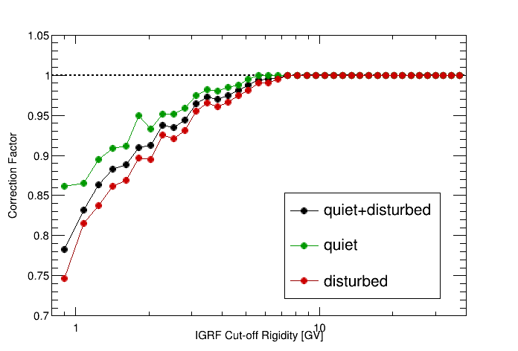
Geomagnetic cut-off correction factor
Inner Tracker + L1 geometry
June 2016
Quiet
Bartel 2495
Disturbed
Bartel 2437
March 2012

Slide 8
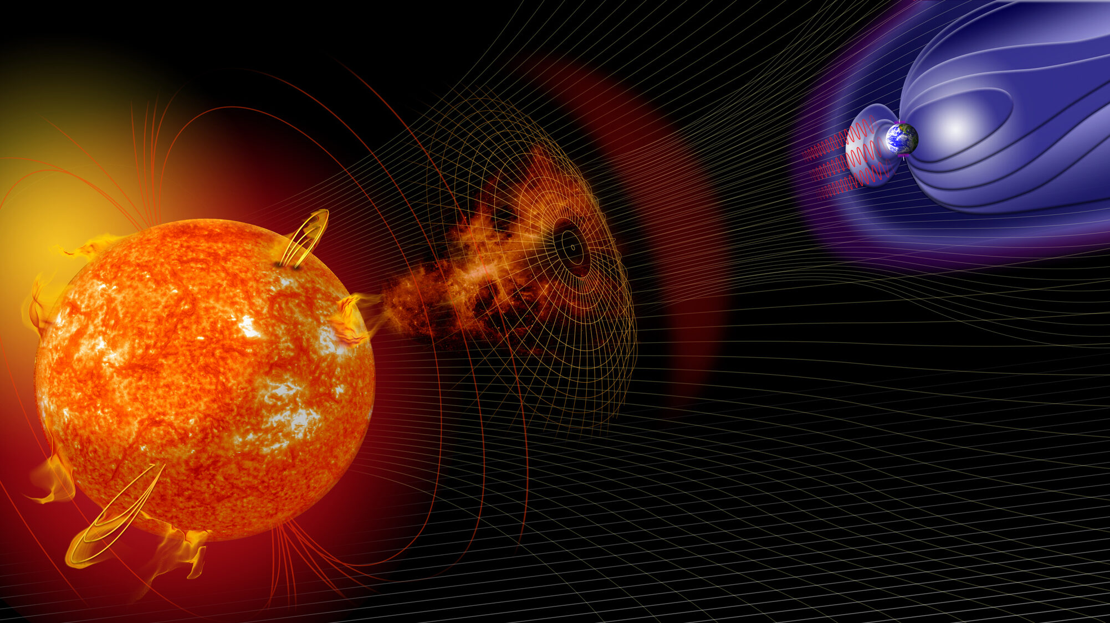

Slide 9
Solar Flares Analysis - March 2012 -
Total of 9 days data taking
Inside 25° FOV
Livetime > 0.1
Primary Protons
4,5x10⁷ Particles
Secondary Protons
7,9x10⁶ Particles
Trapped Protons
3,1x10⁵ Particles

Slide 10
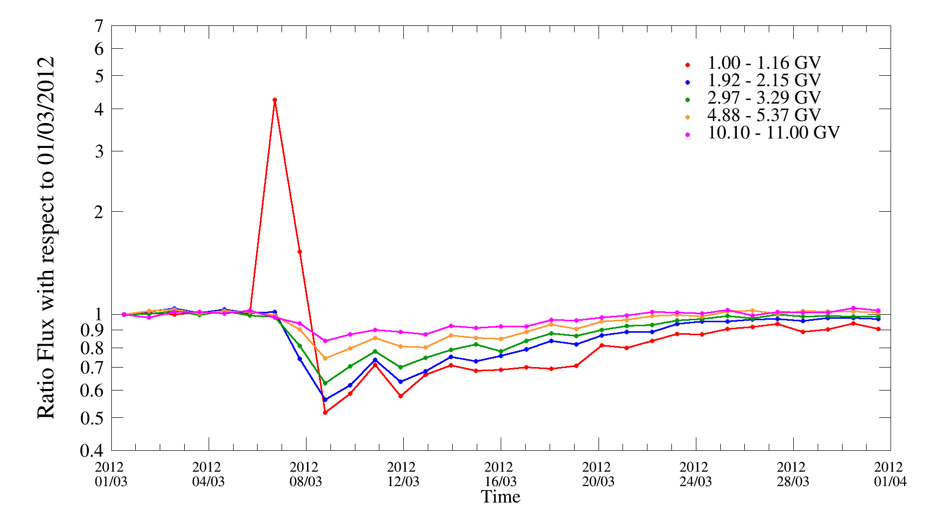
Ratio of Fluxes vs time
IGRF + Tsyganenko 2005

Slide 11
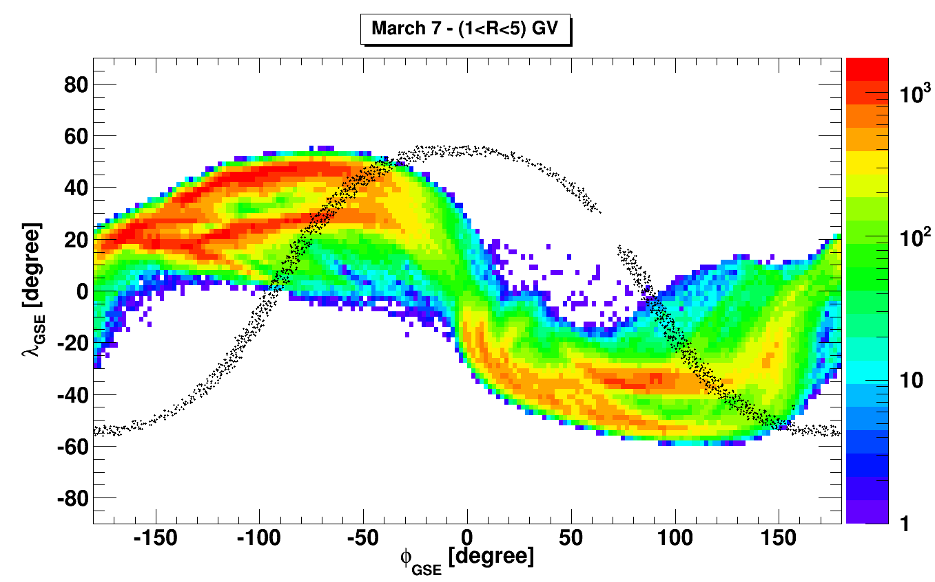
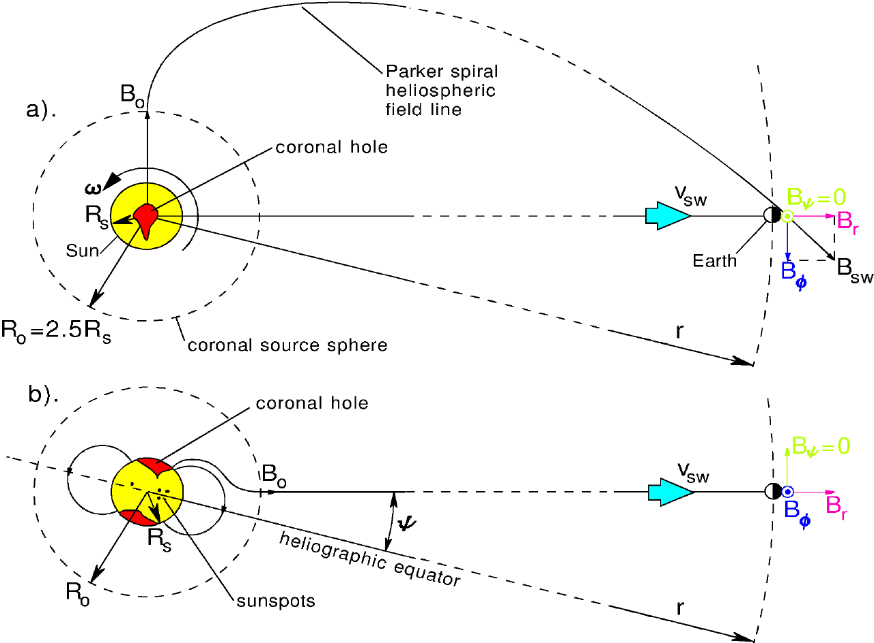
Anisotropy?
Separate Solar Particles from GCR
Study arrival directions
GSM frame
Normalization to be done
Primary Solar protons should follow the Solar Magnetic field spiral

Slide 12
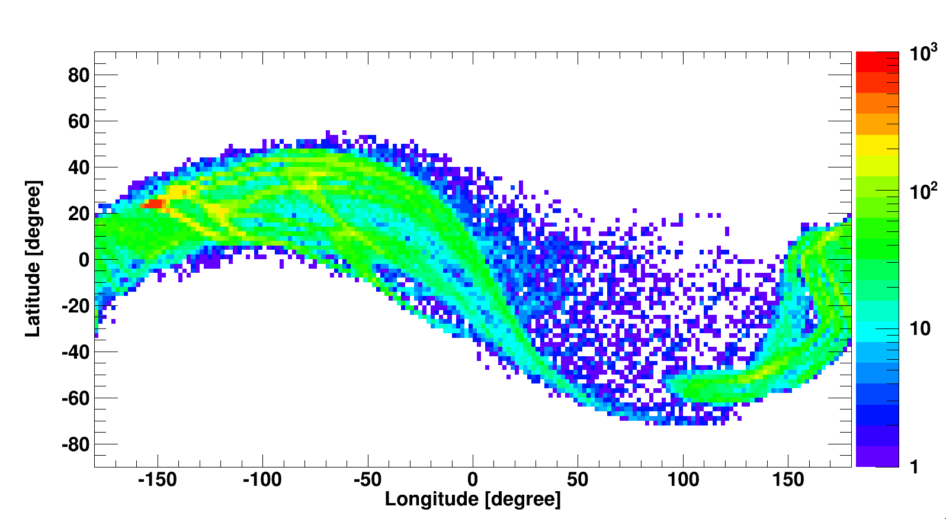
Anisotropy?
1-1.16 GV rigidity bin – March 4 2012

Slide 13
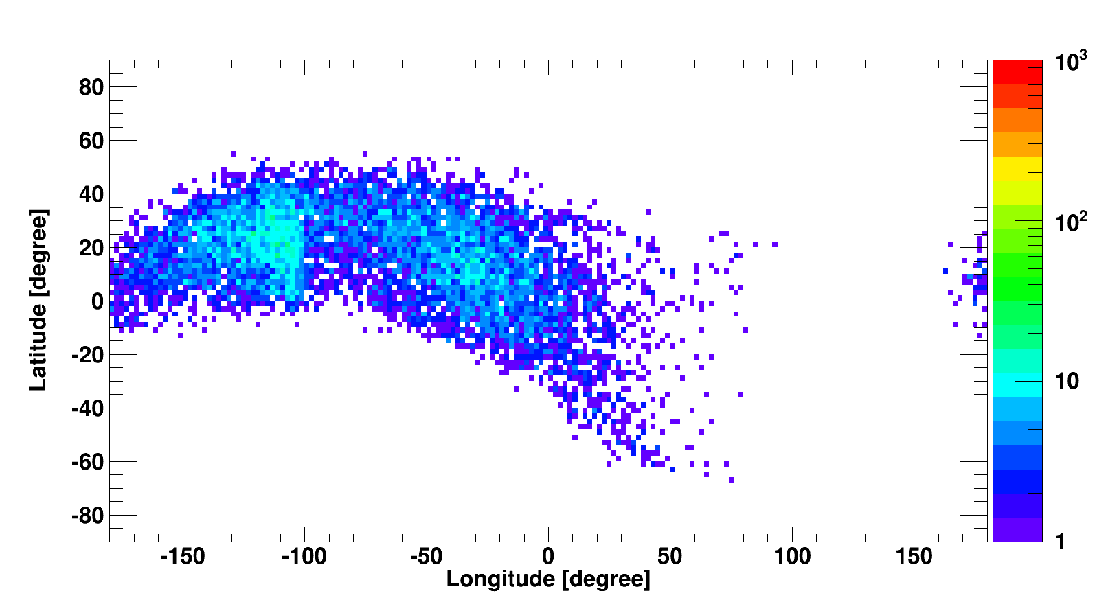
Anisotropy?
1-1.16 GV rigidity bin – March 7 2012 - !!!!!

Slide 14
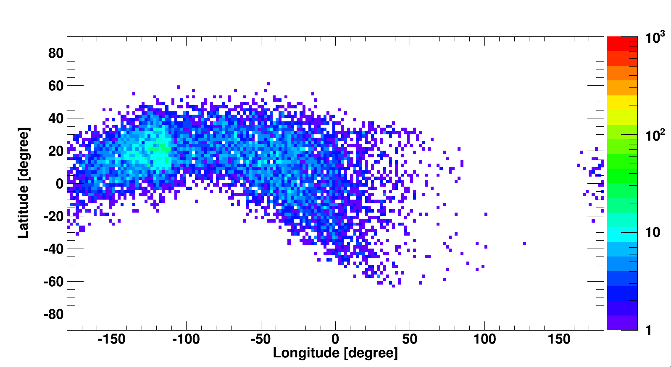
Anisotropy?
1-1.16 GV rigidity bin – March 8 2012

Slide 15
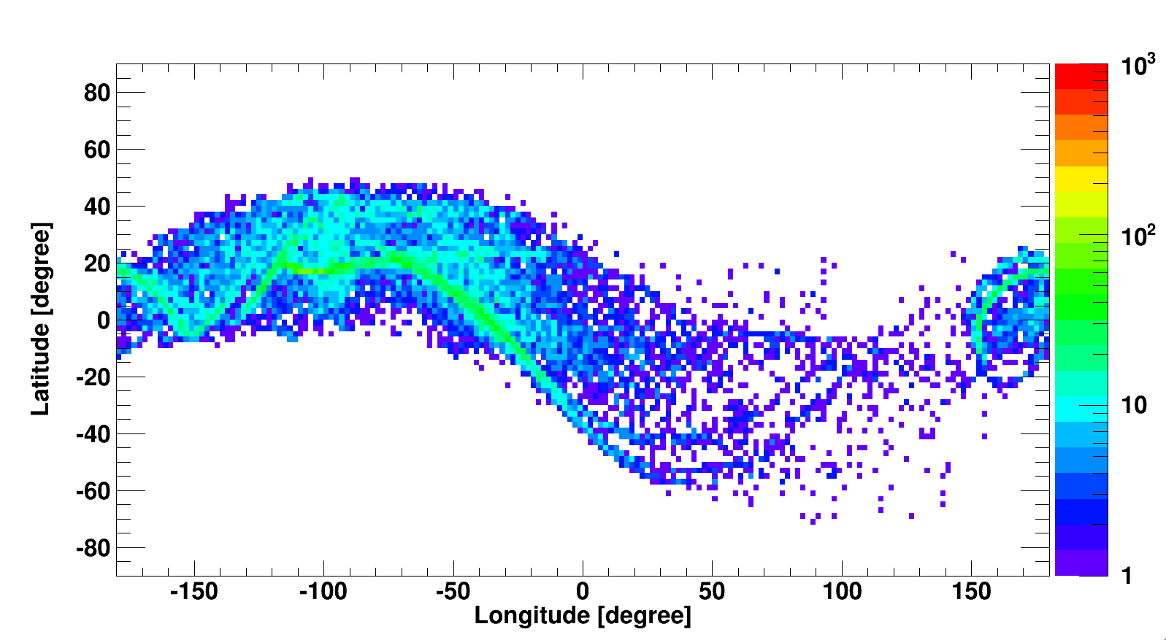
Anisotropy?
1-1.16 GV rigidity bin – March 9 2012

Slide 16
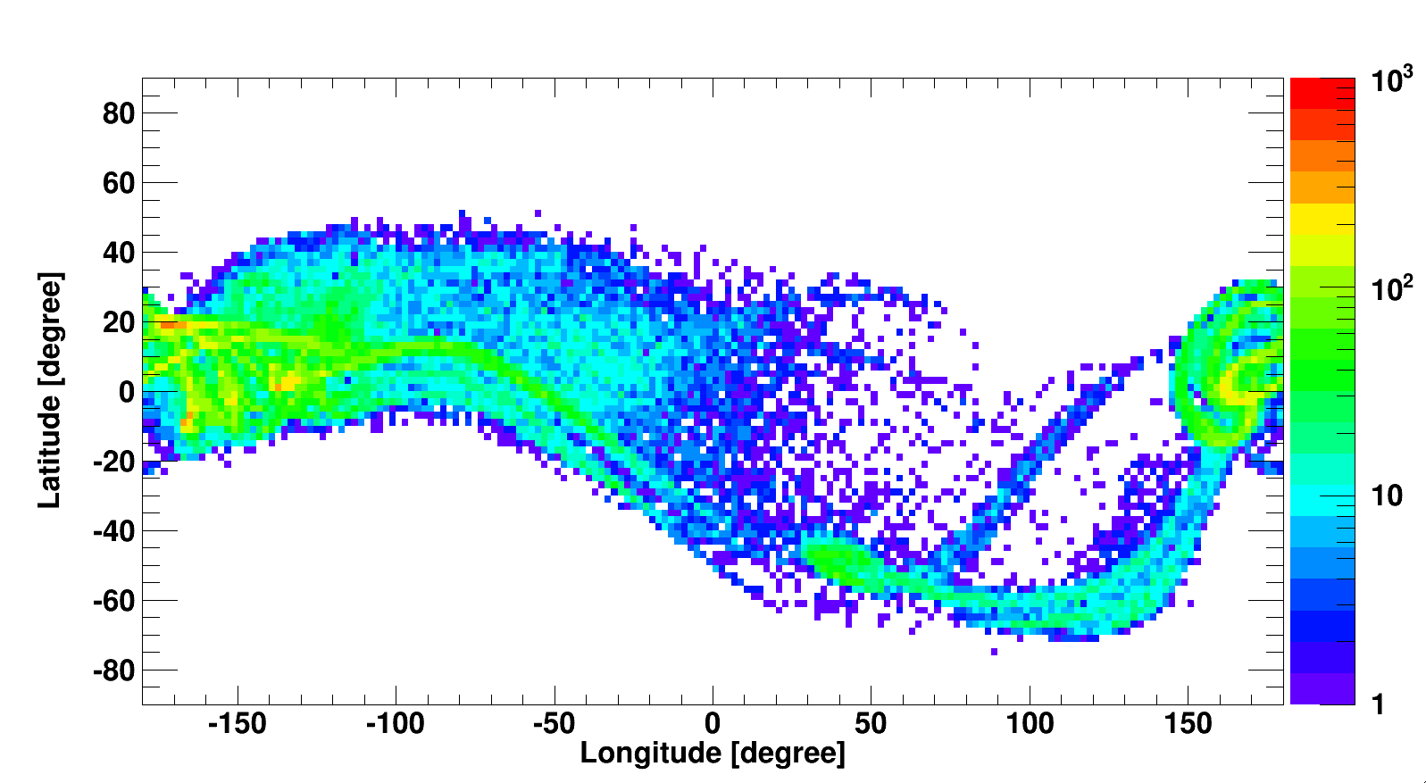
Anisotropy?
1-1.16 GV rigidity bin – March 12 2012

Slide 17
Some conclusions:
https://doi.org/10.1016/j.asr.2021.05.022
Close to the magnetic poles, IGRF upper rigidity cut-off is generally overestimated in comparison with TS05
In the lowest rigidity bins, IGRF CR counts and exposure time are lower in comparison with TS05
Nevertheless, rates evaluated with the two models are quite similar:
- difference on monthly average is 1% during quiet solar activity periods
- increasing up to 3% during disturbed periods
Differences on rates increase significantly, up to 10%, only for time periods as short as 1 day during disturbed periods
When days including large solar events, like March 7th 2012, are considered, only using TS05 model we were able to recover most of the CR counts in the lowest rigidity bins, up to 2 GV.
Thanks to backtracing it is possible to detect the arrival direction origin

Slide 18
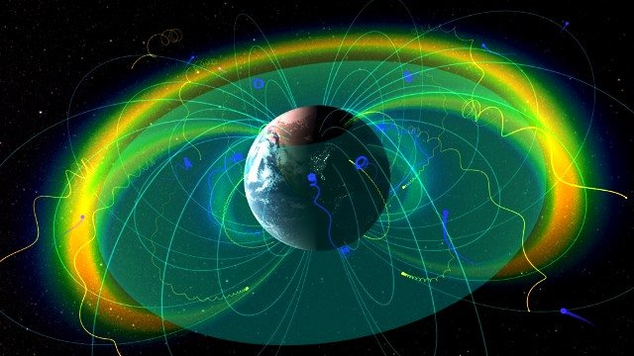

Slide 19
Trapper Particles & Trajectories
Ions from A. Oliva
Backtracing and analysis performed by D. Grandi and D. Rozza
Tailored code for trapped particles:
High precision (10⁻⁴ rad angle between 2 consecutive velocities)
Inner boundary decreased to 20 km (typical altitude of CR air showers starting point)
Increase time limit (up to 6-10 min of “real” trajectory time)
Particles main request to be considered as trapped: a WHOLE drift shell (> 360° in longitude)

Slide 20
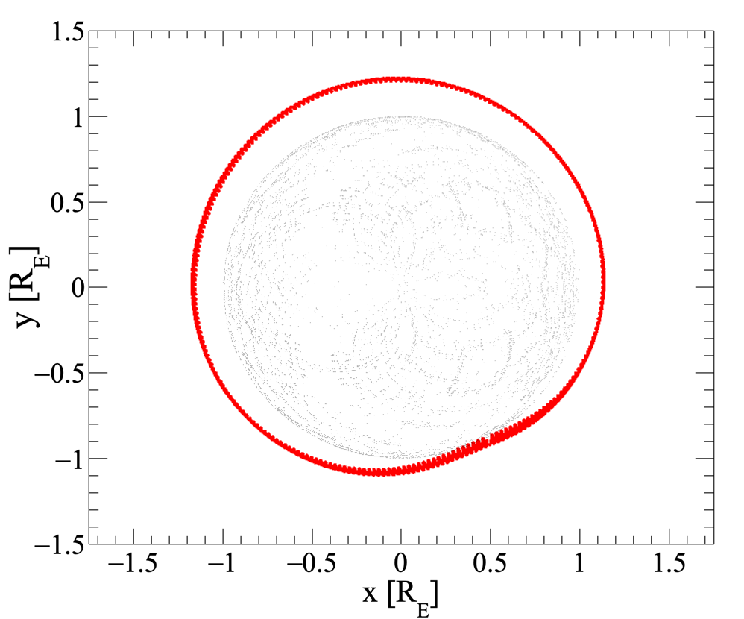
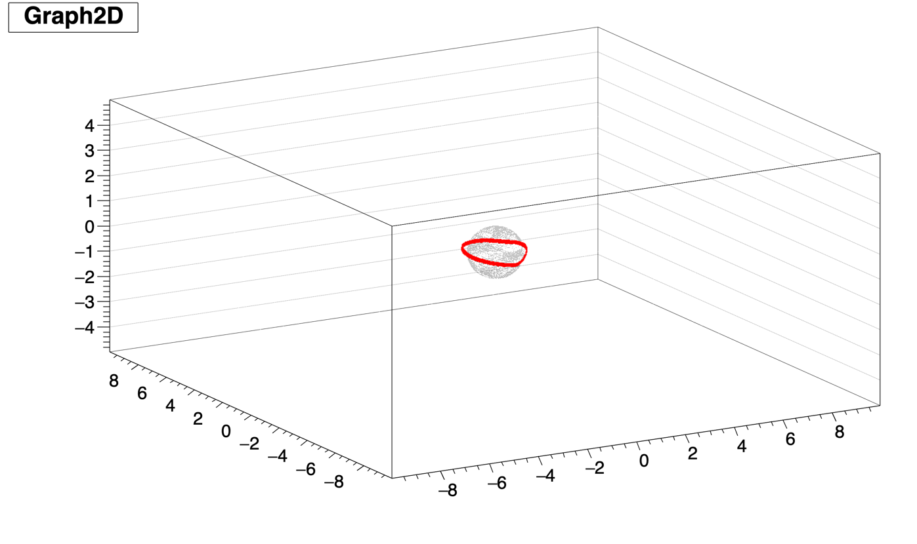
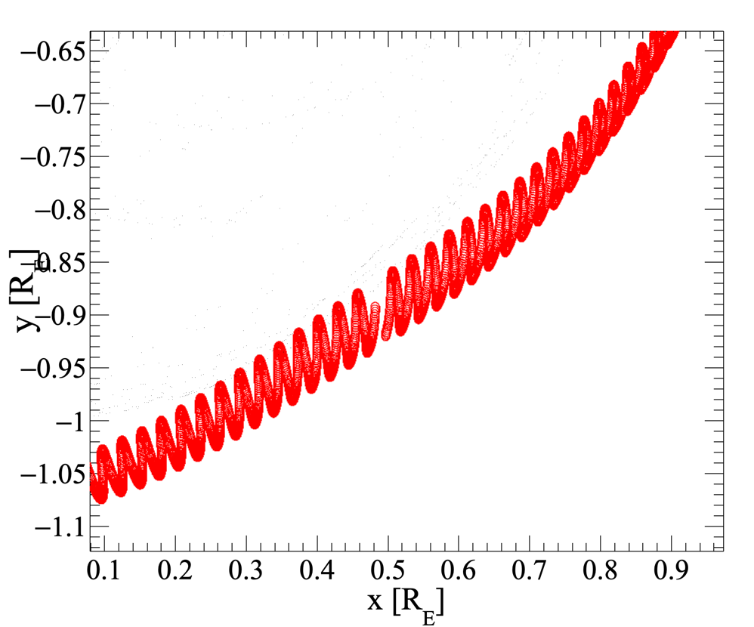
Lithium
ZOOM

Slide 21
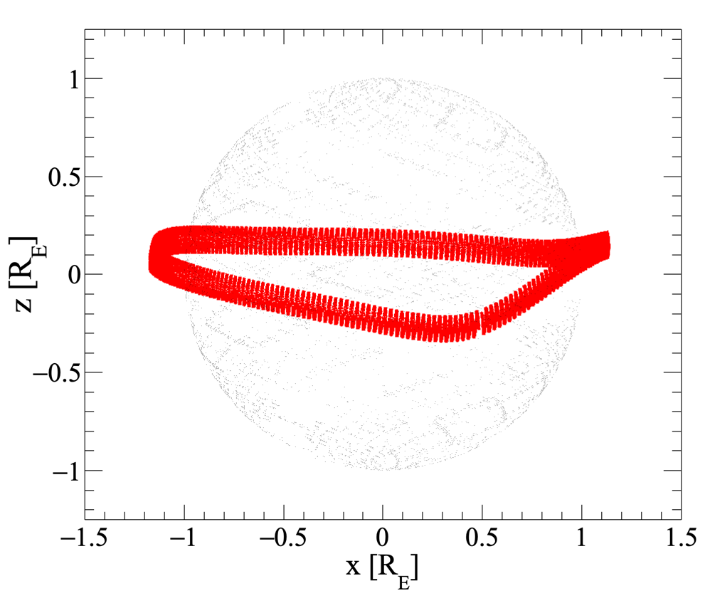
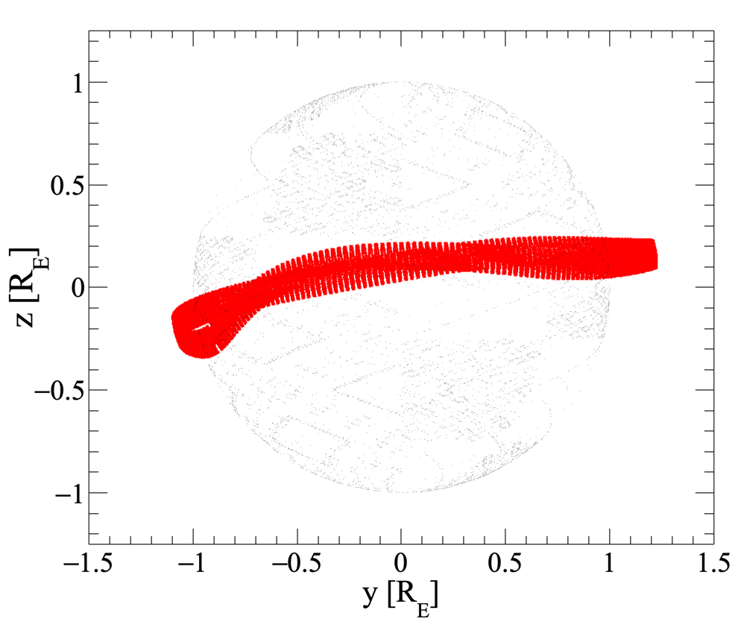

Slide 22
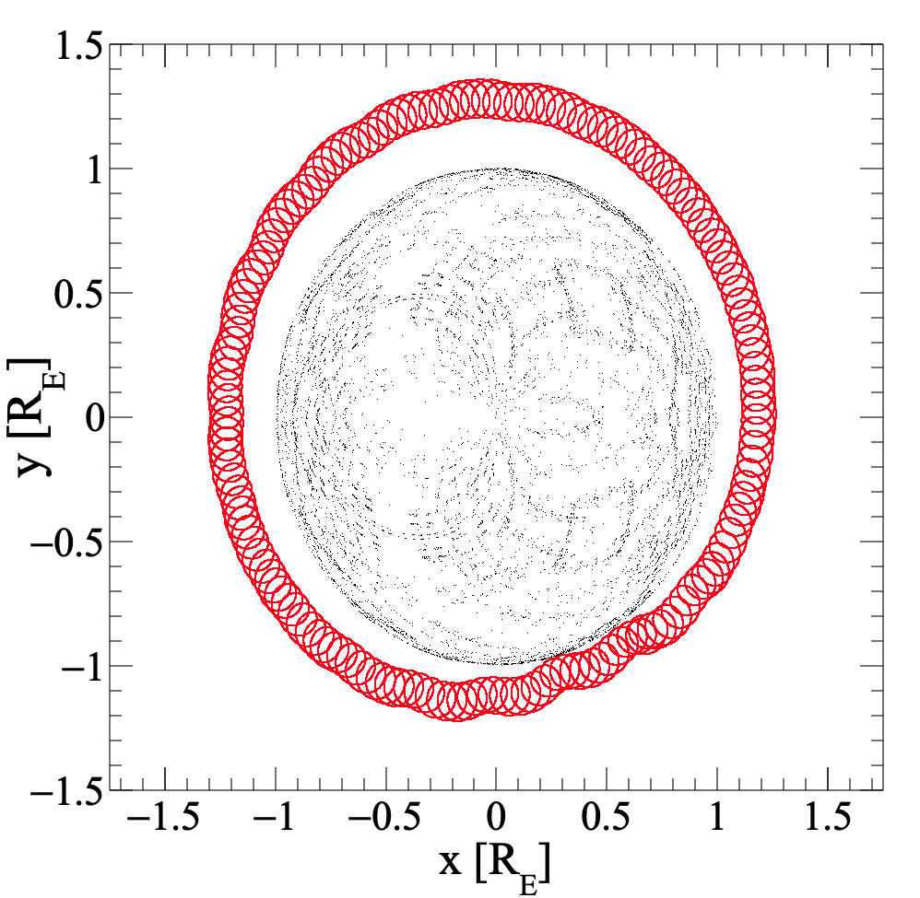
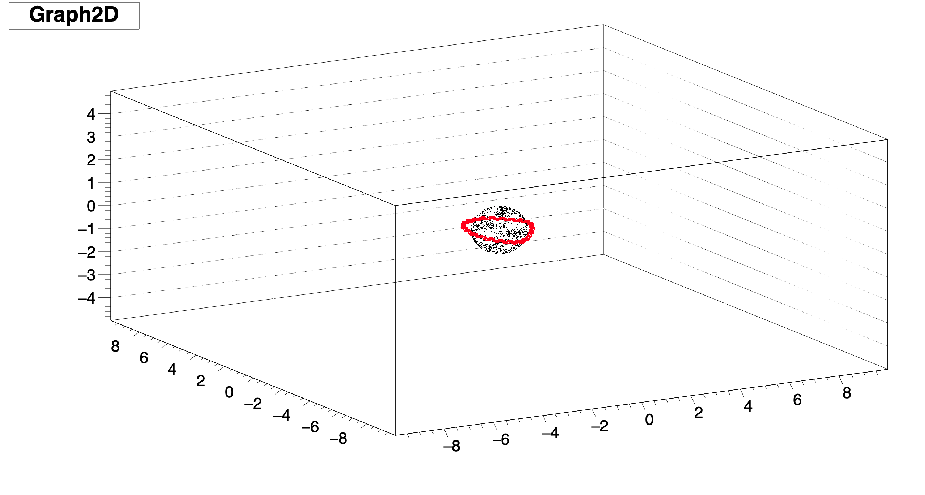
Carbon

Slide 23
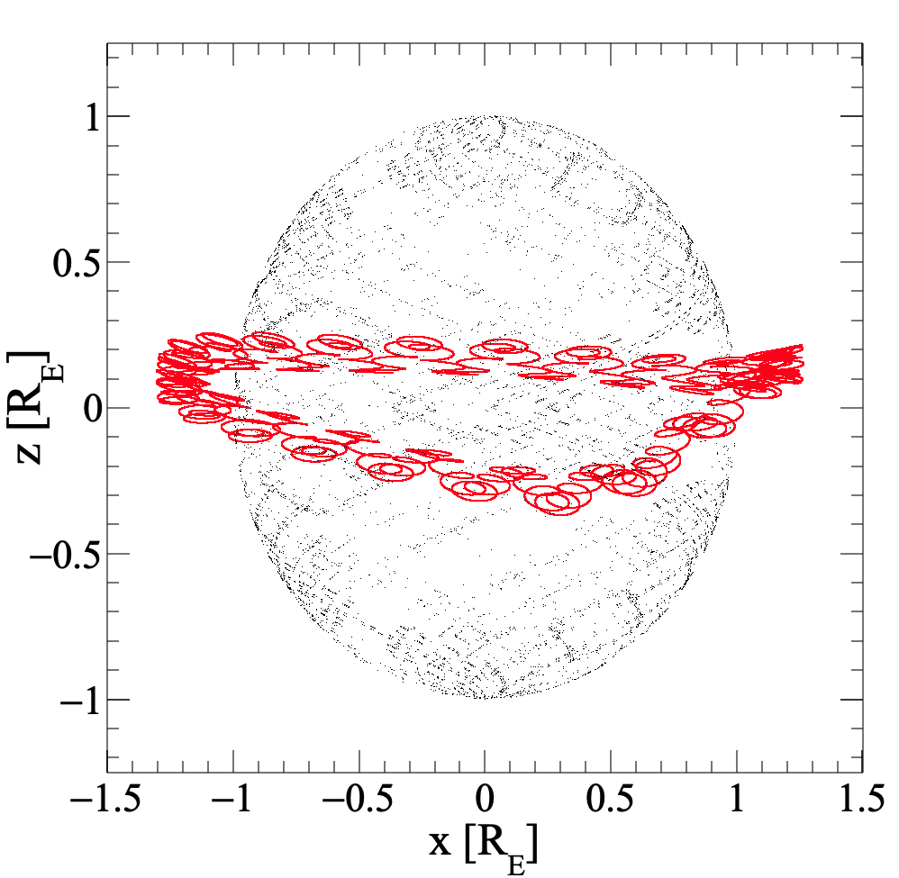
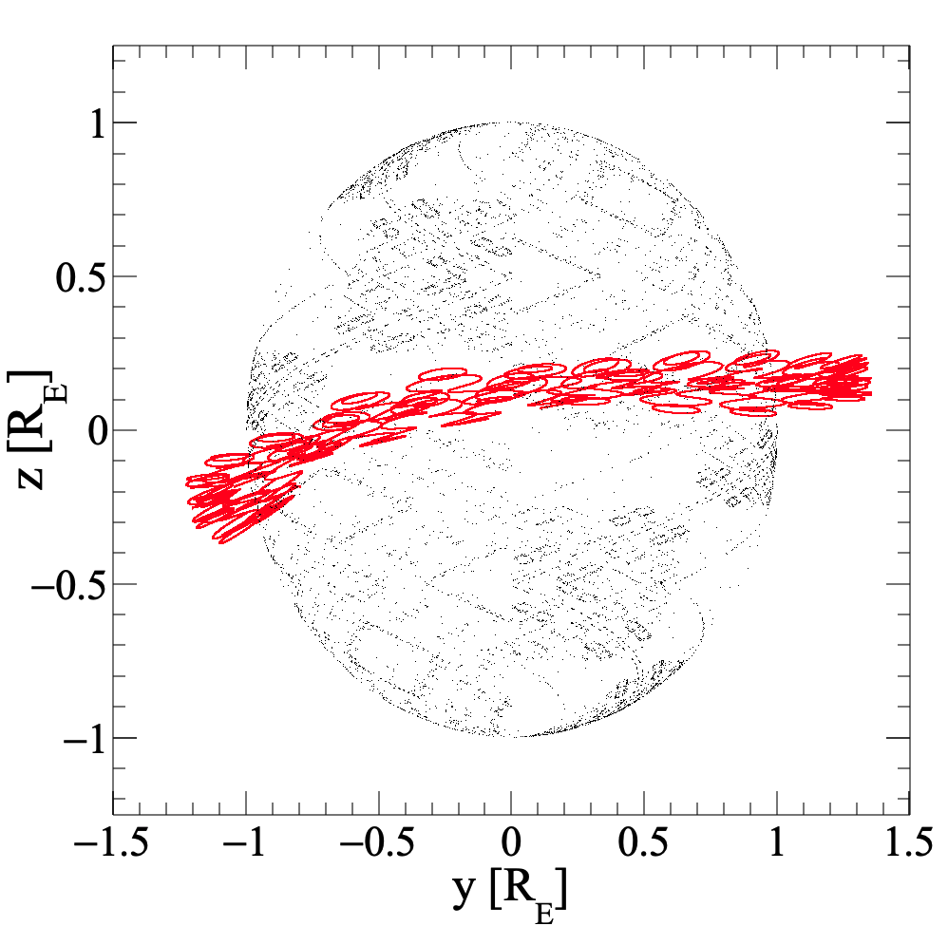

Slide 24
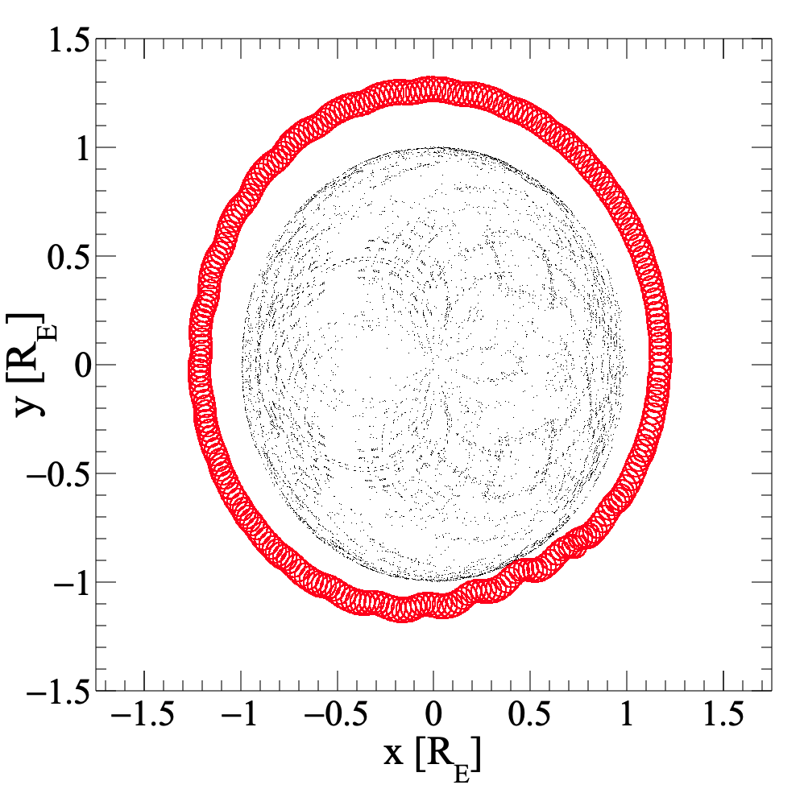
Berillium

Slide 25
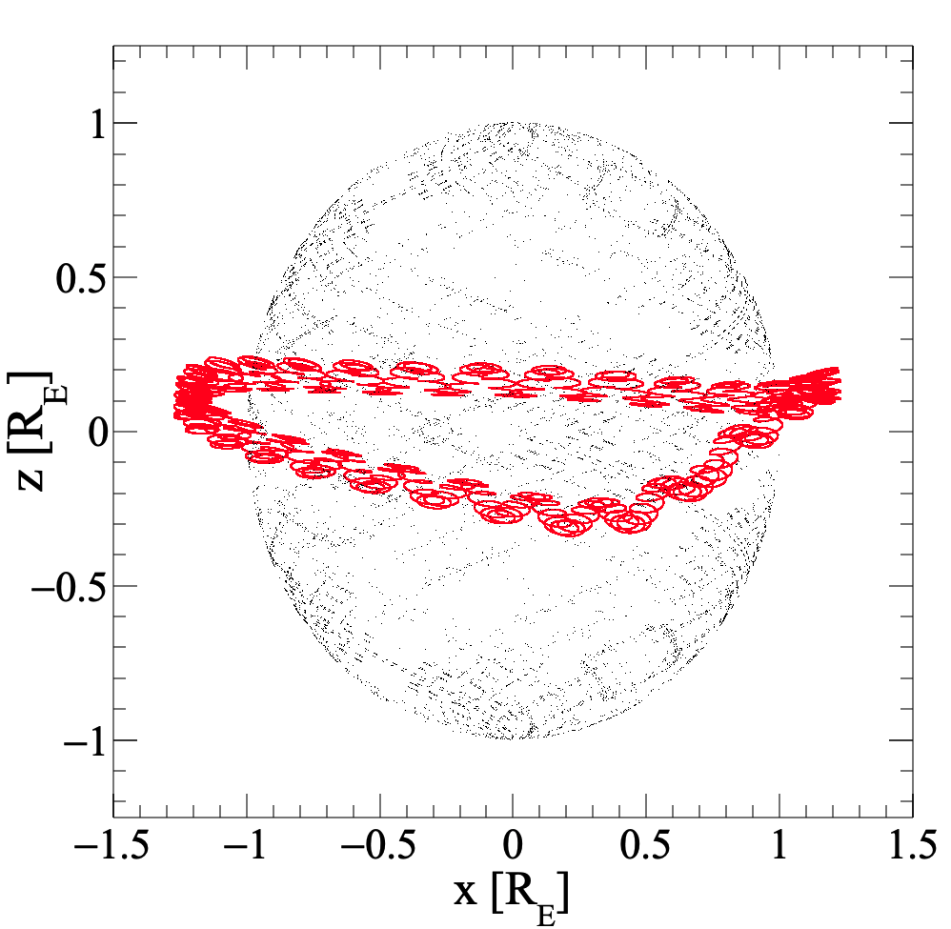
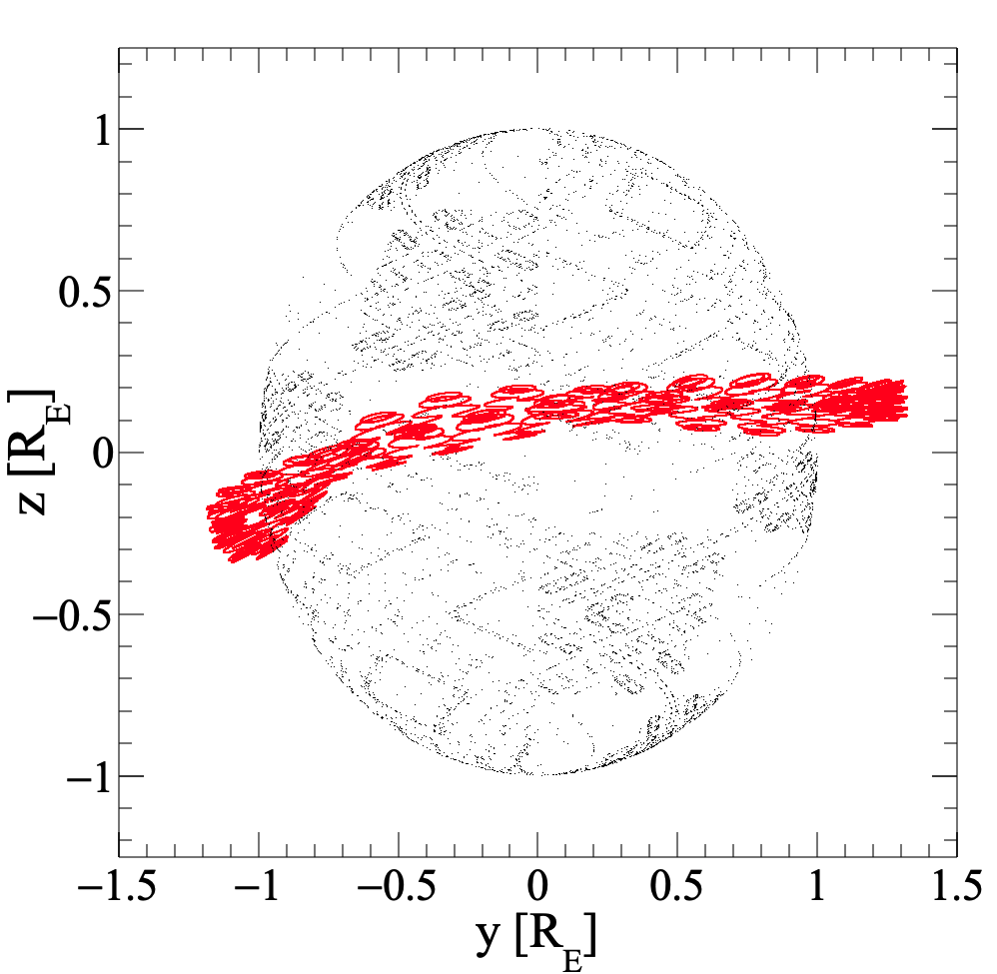
Berillium

Slide 26
Trapped Particles & Pitch Angle
Pitch Angle calculation from Dipole Approximation (IGRF)
Calculation:
Inside the backtracing code
After backtracing just for trapped
Check precision (guiding center)

Slide 27
Pitch Angle – Adiabatic Invariant
$\sin^{2}(θ)/B = \sin^{2}(θ0)/B0$ =
$B0$ = equatorial Magnetic Field
$\sin^{2}(θM)/BM= \sin^{2}(θ0)/B0$ = $1/BM$
$BM$ = Mirror Point Magnetic Field

Slide 28
Pitch Angle – Adiabatic Invariant
$B= B0$ (R_{e}/r)$3$ $\sqrt{1+3 \sin^{2}\left(λm\right)}$
$B/B0=$(R_{e}/r)$3$ $\sqrt{1+3 \sin^{2}\left(λm\right)}$

Slide 29
Pitch Angle – Adiabatic Invariant
$\sin^{2}\left(θ\right)B0/B = \sin^{2}(θ0)$
$\frac{\sin^{2}\left(θ\right)}{\text{(}\text{Re}\text{/}\text{r}\text{)}3 \sqrt{1+3 \sin^{2}\left(λm\right)}}$ $= \sin^{2}(θ0)$

Slide 30
Magnetic Field Line
Field Line → $r=r0 \cos^{2}(λm)$
L - shell → $r=L \cos^{2}(λm)$

Slide 31
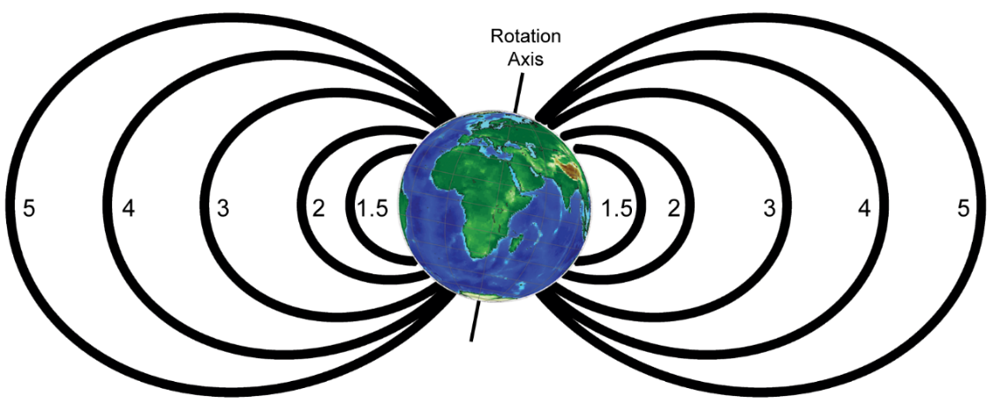
L - shell → $r=L \cos^{2}(λm)$

Slide 32
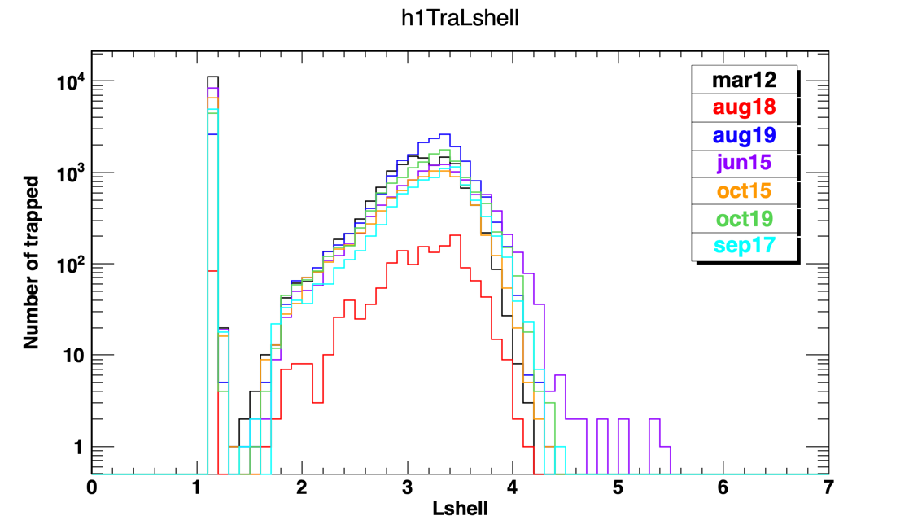

Slide 33
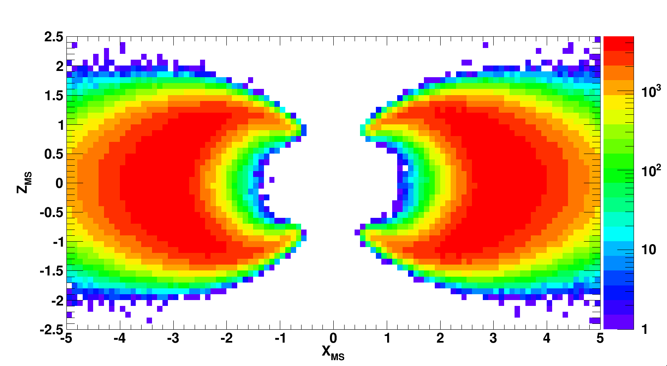
Trapped CR: Final position after 10 seconds of backtracing
OUTSIDE SAA

Slide 34
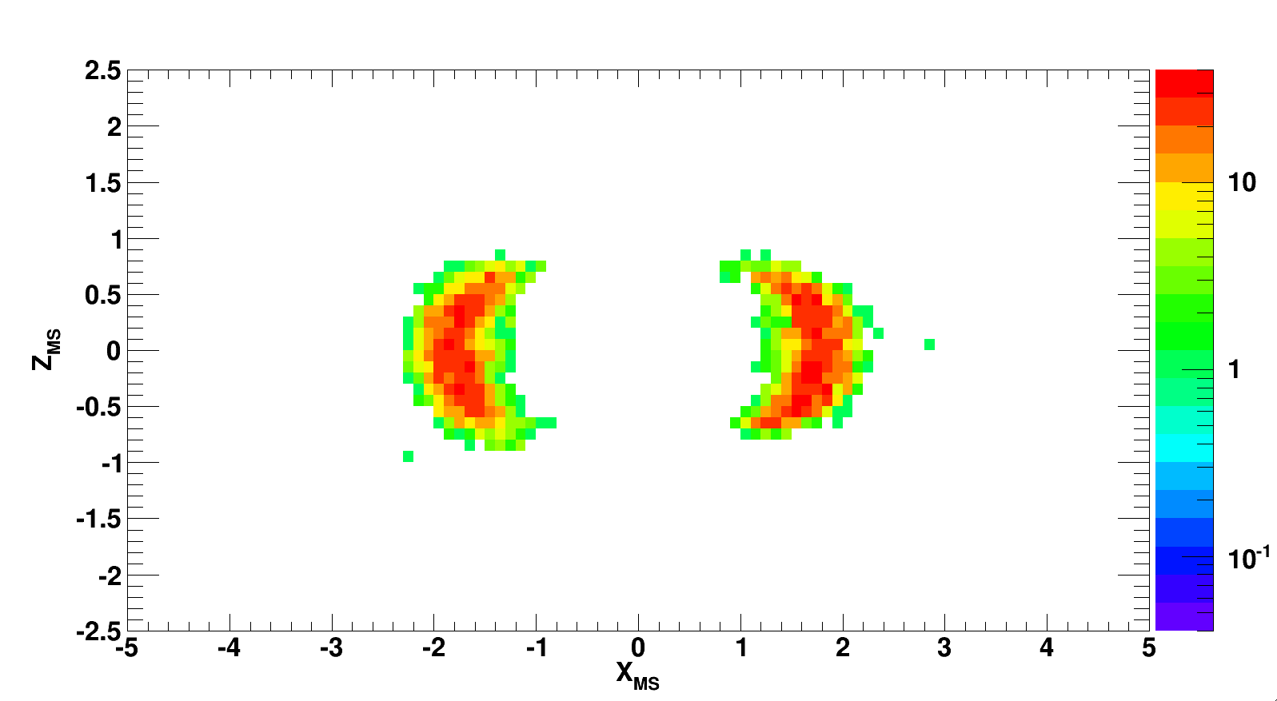
Trapped CR: Final position after 10 seconds of backtracing
INSIDE SAA

Slide 35
Trapped CR: Final position after 10 seconds of backtracing
OUTSIDE + INSIDE SAA

Slide 36
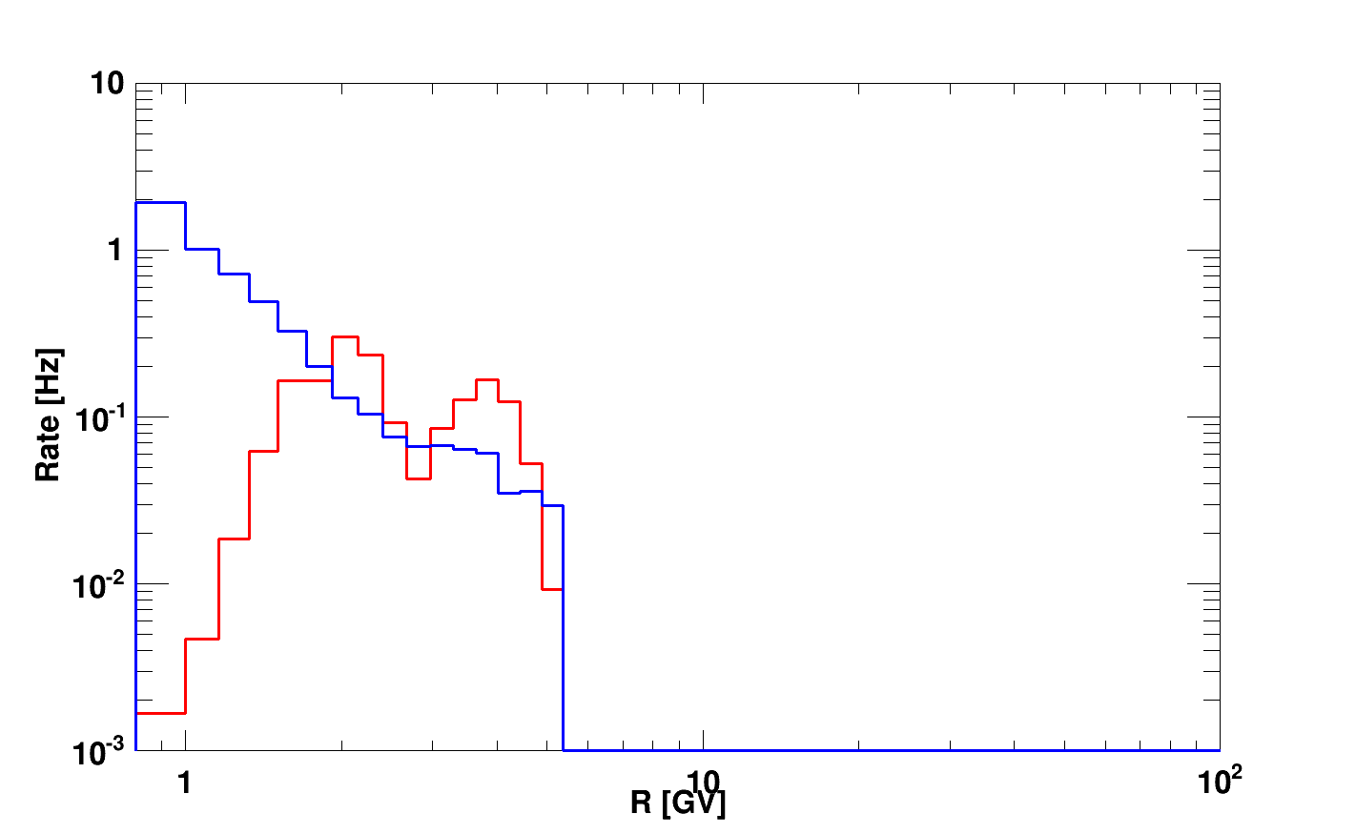
Trapped CR: RATE outside + inside SAA

Slide 37
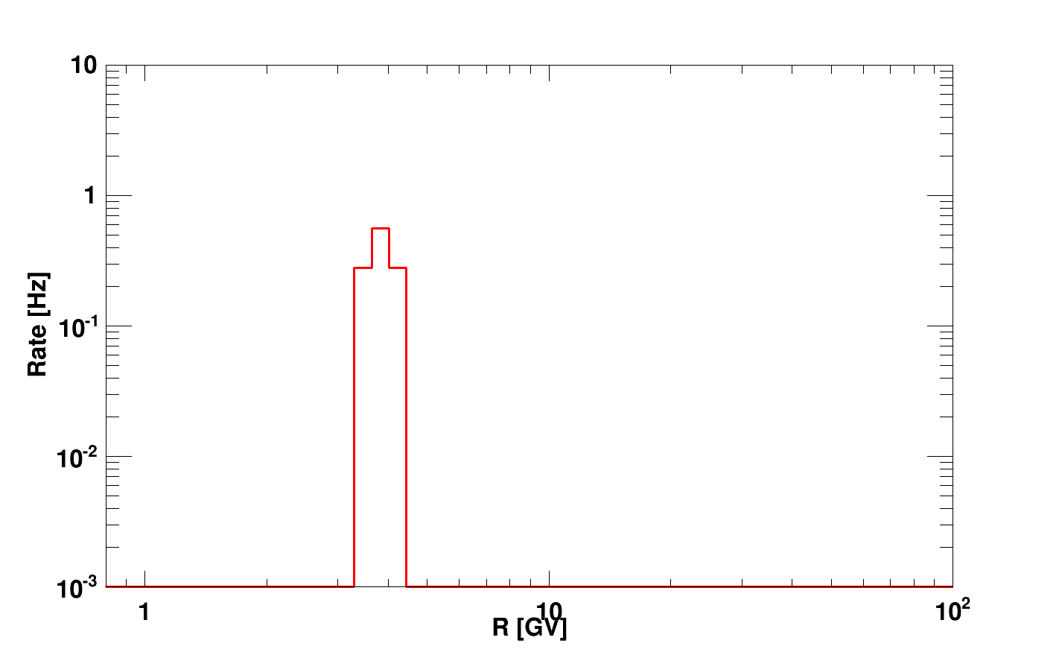
Trapped CR: RATE as a function of the L-shell outside + inside SAA
1 < L < 1.2

Slide 38
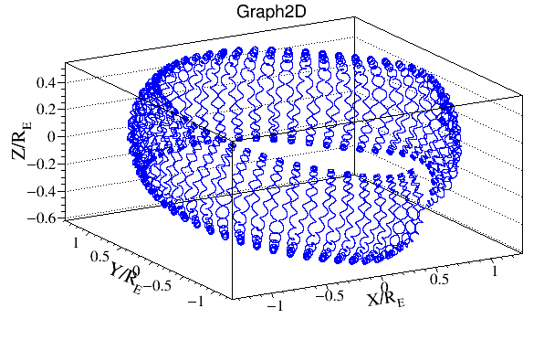
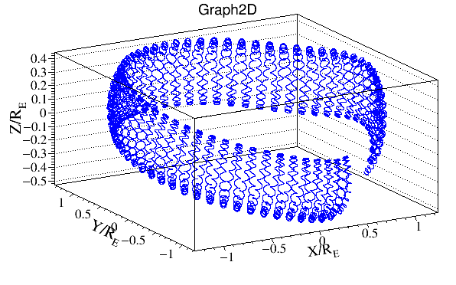
DRIFT of protons
Sample of Secondary CR detected inside SAA with
SINK
SOURCE

Slide 39
Some additional comments:
Thanks to backtracing it is possible to separate “real” trapped particles
Backtracing code should be tailored for different needs
Trapped – higher precision and higher time limit (one close drift shell)
Solar Flares - high precision and lower time limit for trapped (10-20 sec)
Primary Cutoff – calculated for different FOV and periods
Secondaries ?
A study that can always be done
Analysis tools – L Shell and Pitch angle
Calculated in the dipole approx. but with updated parameters
Additional requests?

