Slide 1
Daily Proton Flux and SEP Analysis
Francesco Faldi, PhD student in Perugia
Tutors: Nicola Tomassetti, Valerio Vagelli
AMS-Italia, Trento
30-11-2023

Slide 2
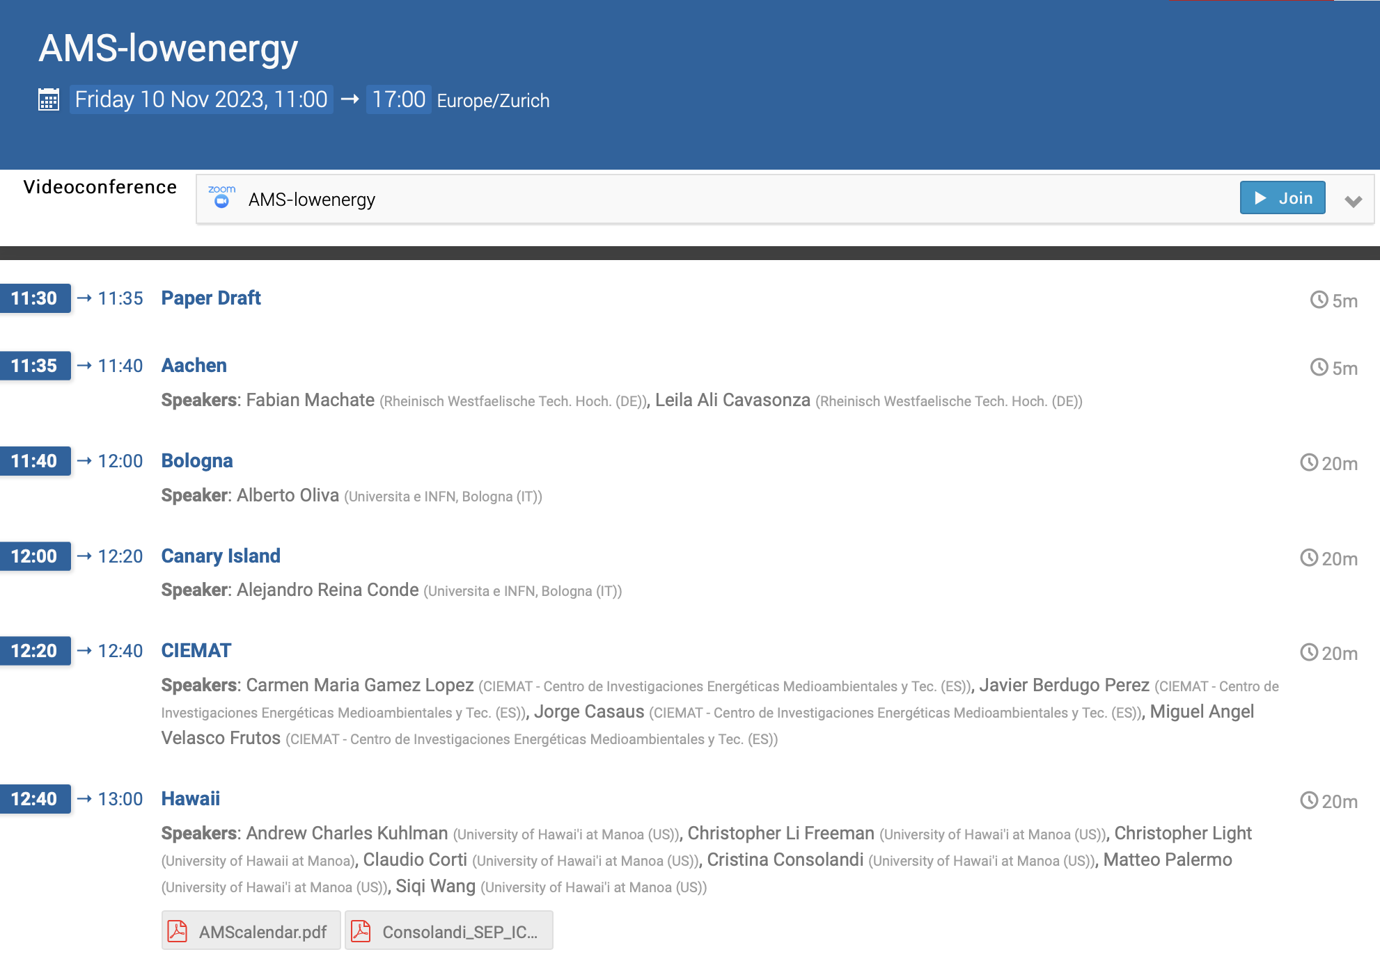
LOW-ENERGY MEETING
Hawaii
Kiel
Milano
Perugia

Slide 3
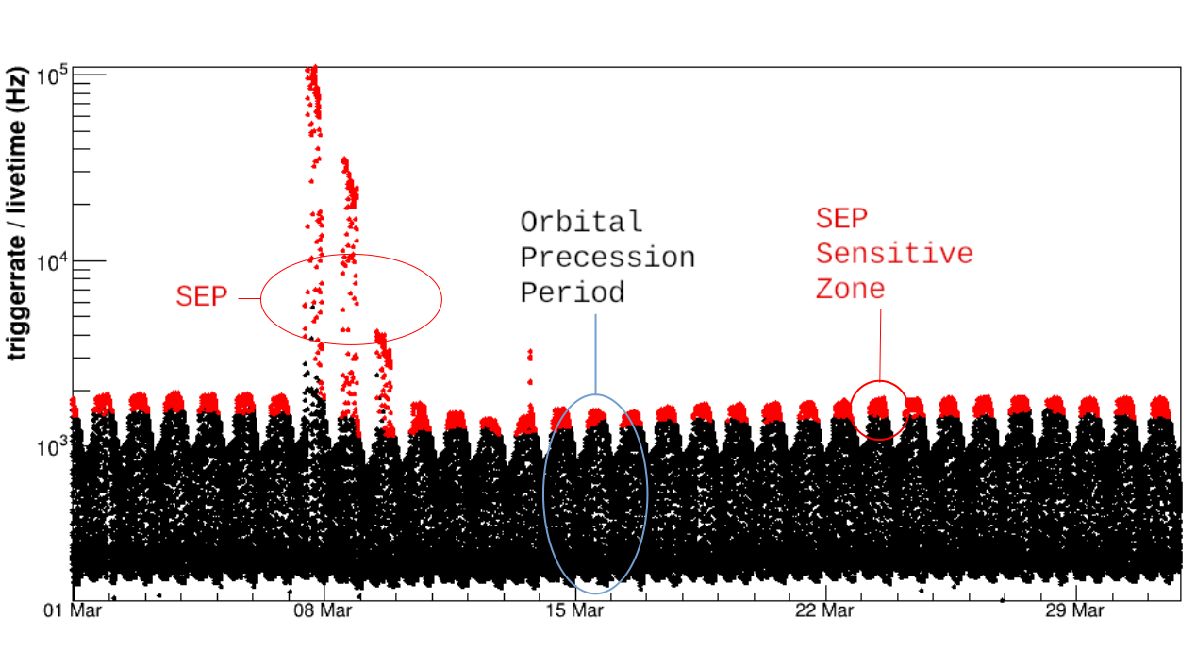
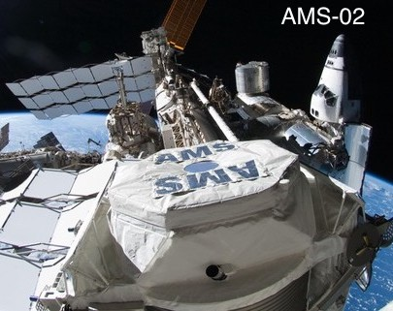
Space Weather with AMS
SEP Identification Algorithm development based on AMS low latency real-time data, using the AMS analysis software, starting from the preliminary test on offline data
Algorithm reliability test and implementation at POCC, CERN

Slide 4
PROTON FLUX VS RIGIDITY
$$Φ_{i}(t)=\frac{N_{selected,i}(t)}{ΔR_{i}⋅T_{exp,i}(t)⋅A_{eff,i}(t)}i=i^{th}rigidityinterval$$
$$N_{selected}$$
Selected counts corresponding to proton events
$$T_{exp}$$
Exposure Time in seconds
$$A_{eff}=A_{MC}⋅DA/MCCorr$$
Effective Acceptance: Montecarlo Acceptance
multiplied by corrections
$$DA/MCCorr$$
Efficiencies on Data / Efficiencies on Montecarlo

Slide 5
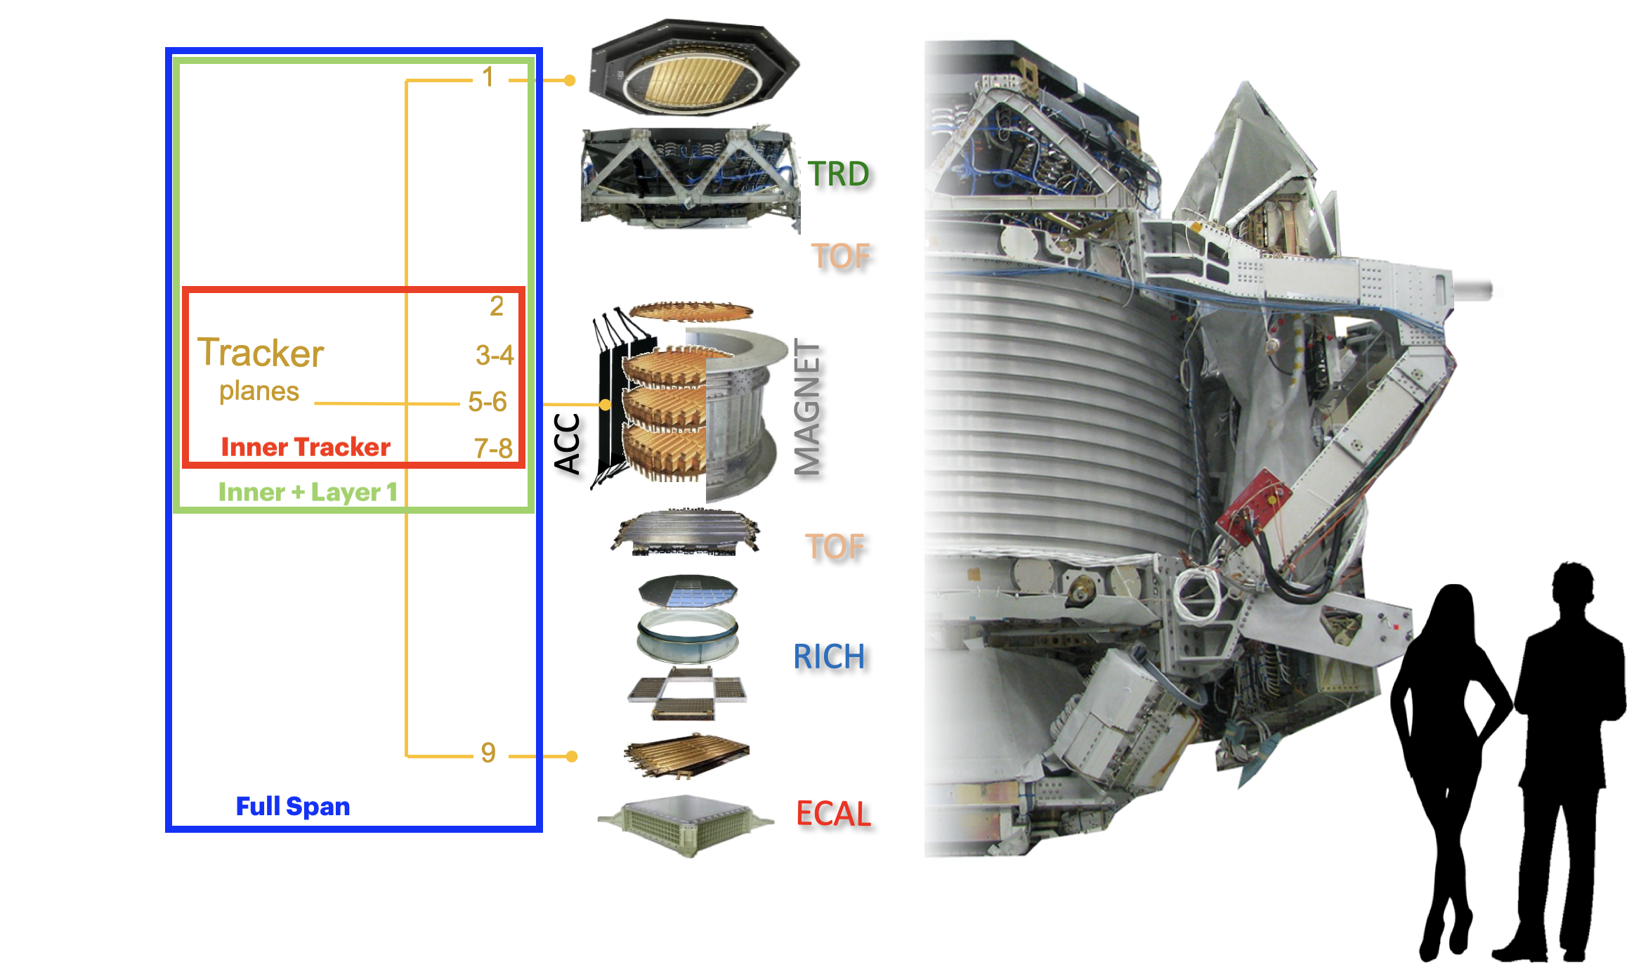
Event selection cuts - INNER+L1 analysis
Charge Reconstruction Type: GBL
Fit Type: Yi Jia
RTI Cuts
Livetime Fraction > 0.05
Zenith Angle < 25
Not in SAA
Mean Difference PG-CIEMAT Trk Calibration
Orange: Only Pass8
Physical Cuts
Any Physical trigger
Chi2Y < 10 (Inner rigidity)
Hits on: L2 & (L3|L4) & (L5|L6) & (L7|L8)
At least 5 Hits in Inner Tracker
Chi2Y < 10 (InnerL1 rigidity)
0.7 < Inner Charge < 1.5
Inner Charge / Inner Charge RMS < 0.4
0.6 < L1 Charge < 1.9
Inside Inner Fiducial (InnerL1 rigidity)
Inside L1 Fiducial (InnerL1 rigidity)
L1 Normalized Residual < 10
Beta > 0.3
0.5 < Upper ToF Charge < 2.5
Mass Cut
Inner Rigidity > 1 * IGRF Cutoff

Slide 6
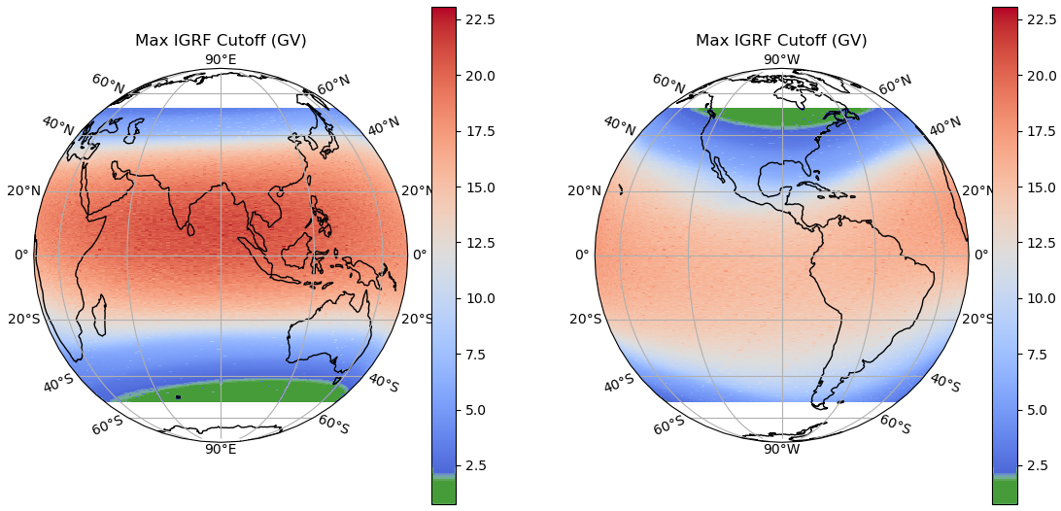
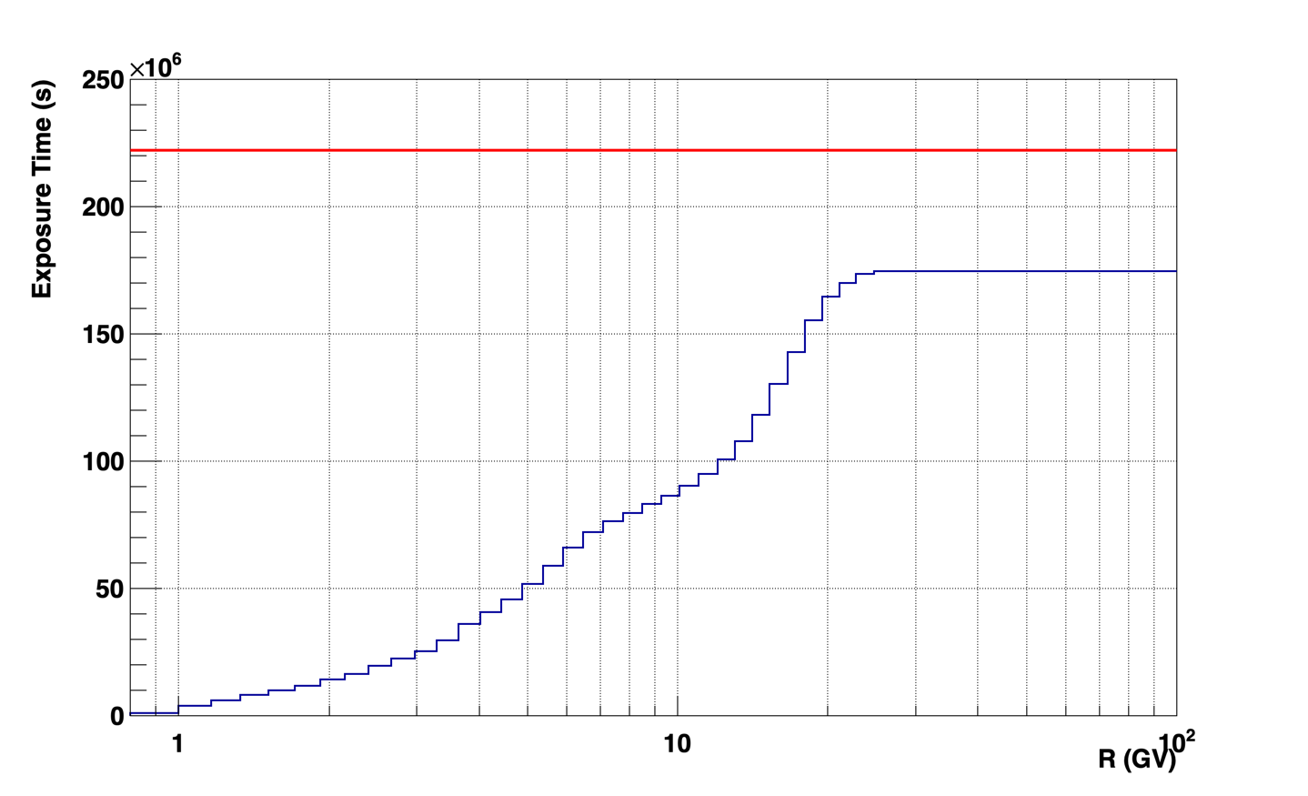
Exposure Time
Exposure Time: seconds, weighted by the detector livetime, with rigidity above maximum IGRF cutoff in the AMS FoV (for each rigidity bin)
The Rigidity Cutoff is lower near magnetic poles —> A lot of low energy particles reach Earth
The time with detector not in nominal status (calibration, ISS technical activities) are excluded from reconstruction
Total time from 15/05/2011 to 28/05/2018
Total acquisition time

Slide 7
RAW AND CORRECTED ACCEPTANCE
True MC Acceptance
Montecarlo Acceptance (sr m²)
$$i=i^{th}rigidityinterval$$
$$A_{MC,i}=\frac{N_{i}^{selected}}{N_{i}^{generated}}⋅S_{i}^{generated}⋅Ω_{i}^{generated}$$
$$S^{gen}=gensurface$$
$$Ω^{gen}=gensolidangle$$

Slide 8
DATA/MONTECARLO CORRECTIONS
Efficiencies
DATA
MC
L1 Pickup Efficiency
Track Efficiency
Tof Efficiency
Trigger Efficiency
L1 Pickup Corr
Track Corr
Tof Corr
Trigger Corr
Total Correction
Data/Montecarlo Corrections

Slide 9
RAW AND CORRECTED ACCEPTANCE
Montecarlo Acceptance
Montecarlo Acceptance (sr m²)
X CORRECTIONS
Corrected Acceptance
Corrected Acceptance (sr m²)

Slide 10
FINAL PROTON INTEGRAL FLUX
The flux equation is finally integrated in the time interval [29-05-2011, 29-05-2018], to compare it with the previous publication in “Physics Reports 894 (2021) 1–116”
My Flux
Physics Report 2021 Flux
$$Φ_{i}(t)=\frac{N_{selected,i}(t)}{ΔR_{i}⋅T_{exp,i}(t)⋅A_{eff,i}(t)}$$
MyFlux/PR2021 Ratio
PR2021 Total Uncertainty
$$i=i^{th}rigidityinterval$$
The flux is in agreement within the total uncertainties of the published flux.

Slide 11
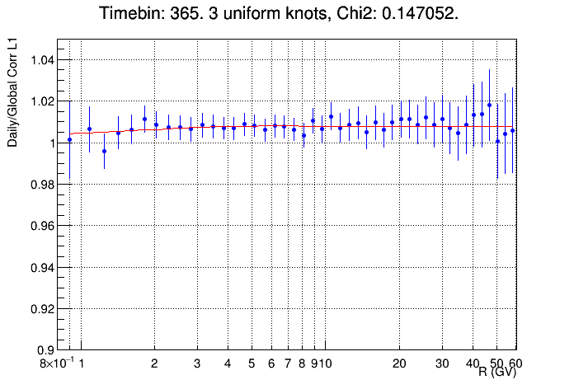
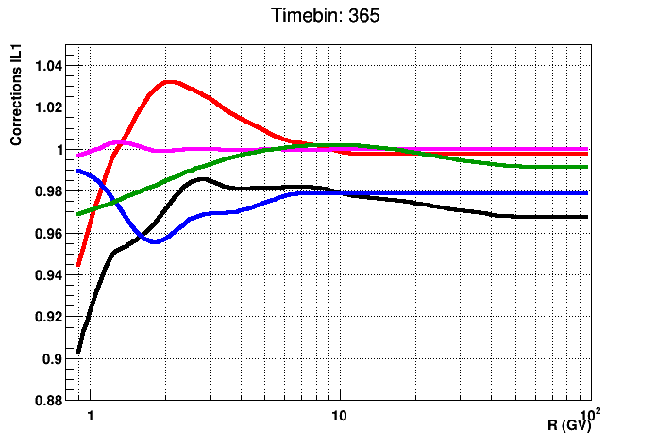
DAILY PROTON FLUX
The daily flux evaluation follows the same procedure as the integral flux. Instead of integrating over the whole time period, the flux is calculated for each day.
The main difference is in the efficiencies: due to statistical fluctuations, the DATA/MC corrections are not fitted directly with a spline, but the integral/daily corrections ratio is evaluated and multiplied to the daily correction to maintain the shape of the integral correction.
L1
Track
Tof
Trigger
Total
Compute Daily/Integral ratio
and fit with spline (3 knots) up to 20 GV
Multiply Integral correction
by the spline fit of the ratio
Due to the very low statistics of the daily trigger efficiencies,
a moving average in a 15 day window is considered instead of the daily trigger efficiency.

Slide 12
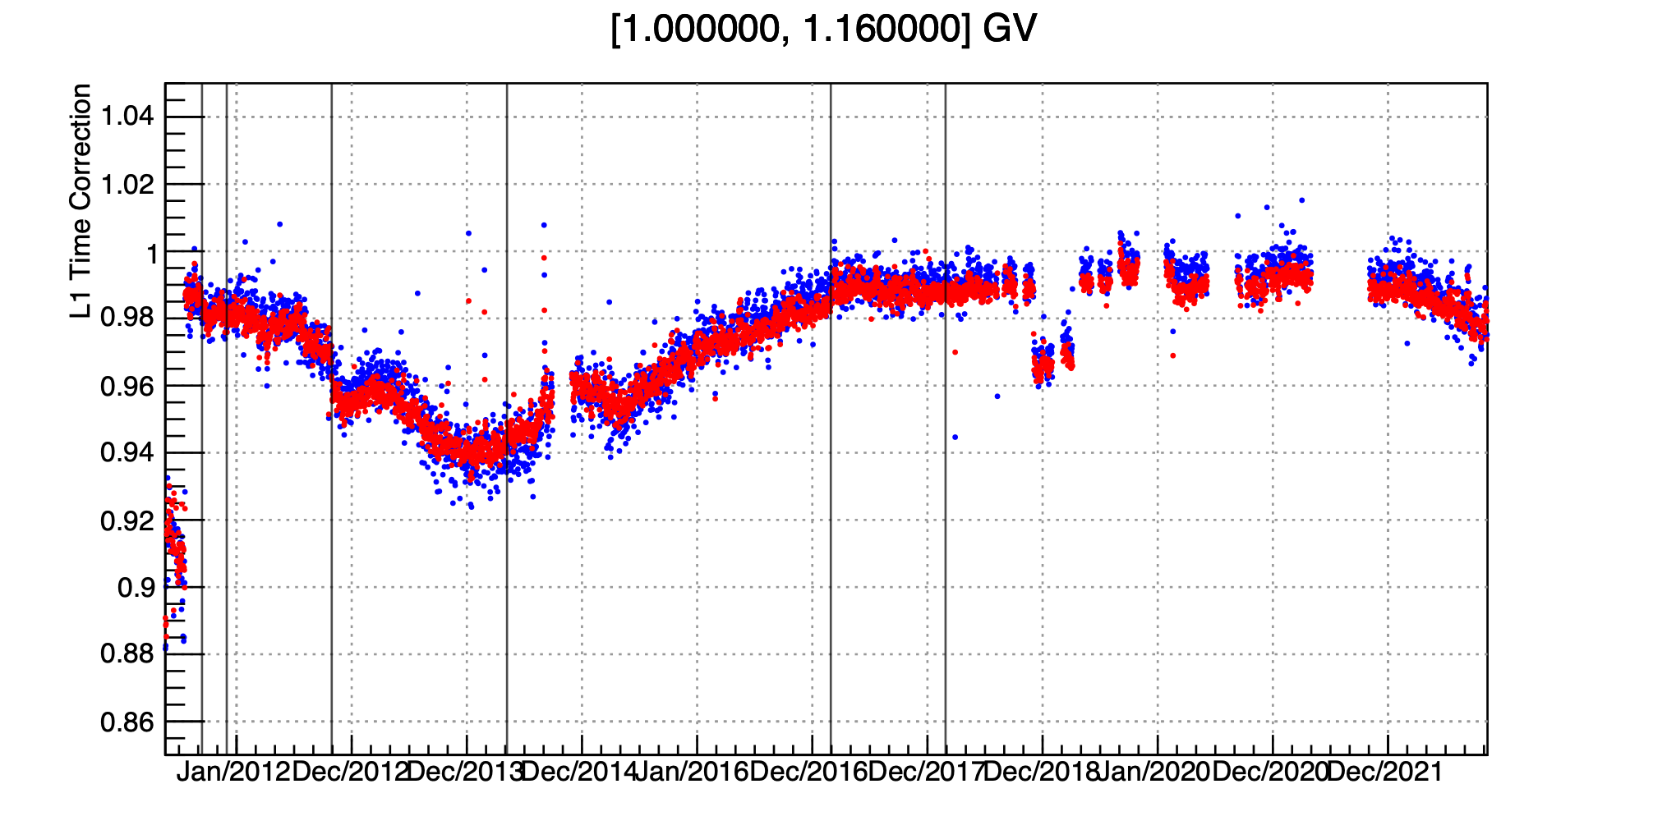
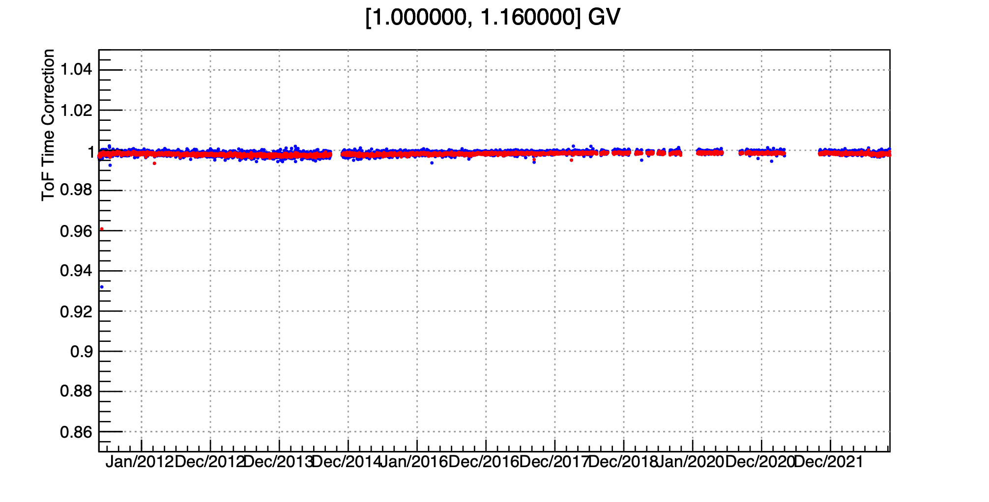
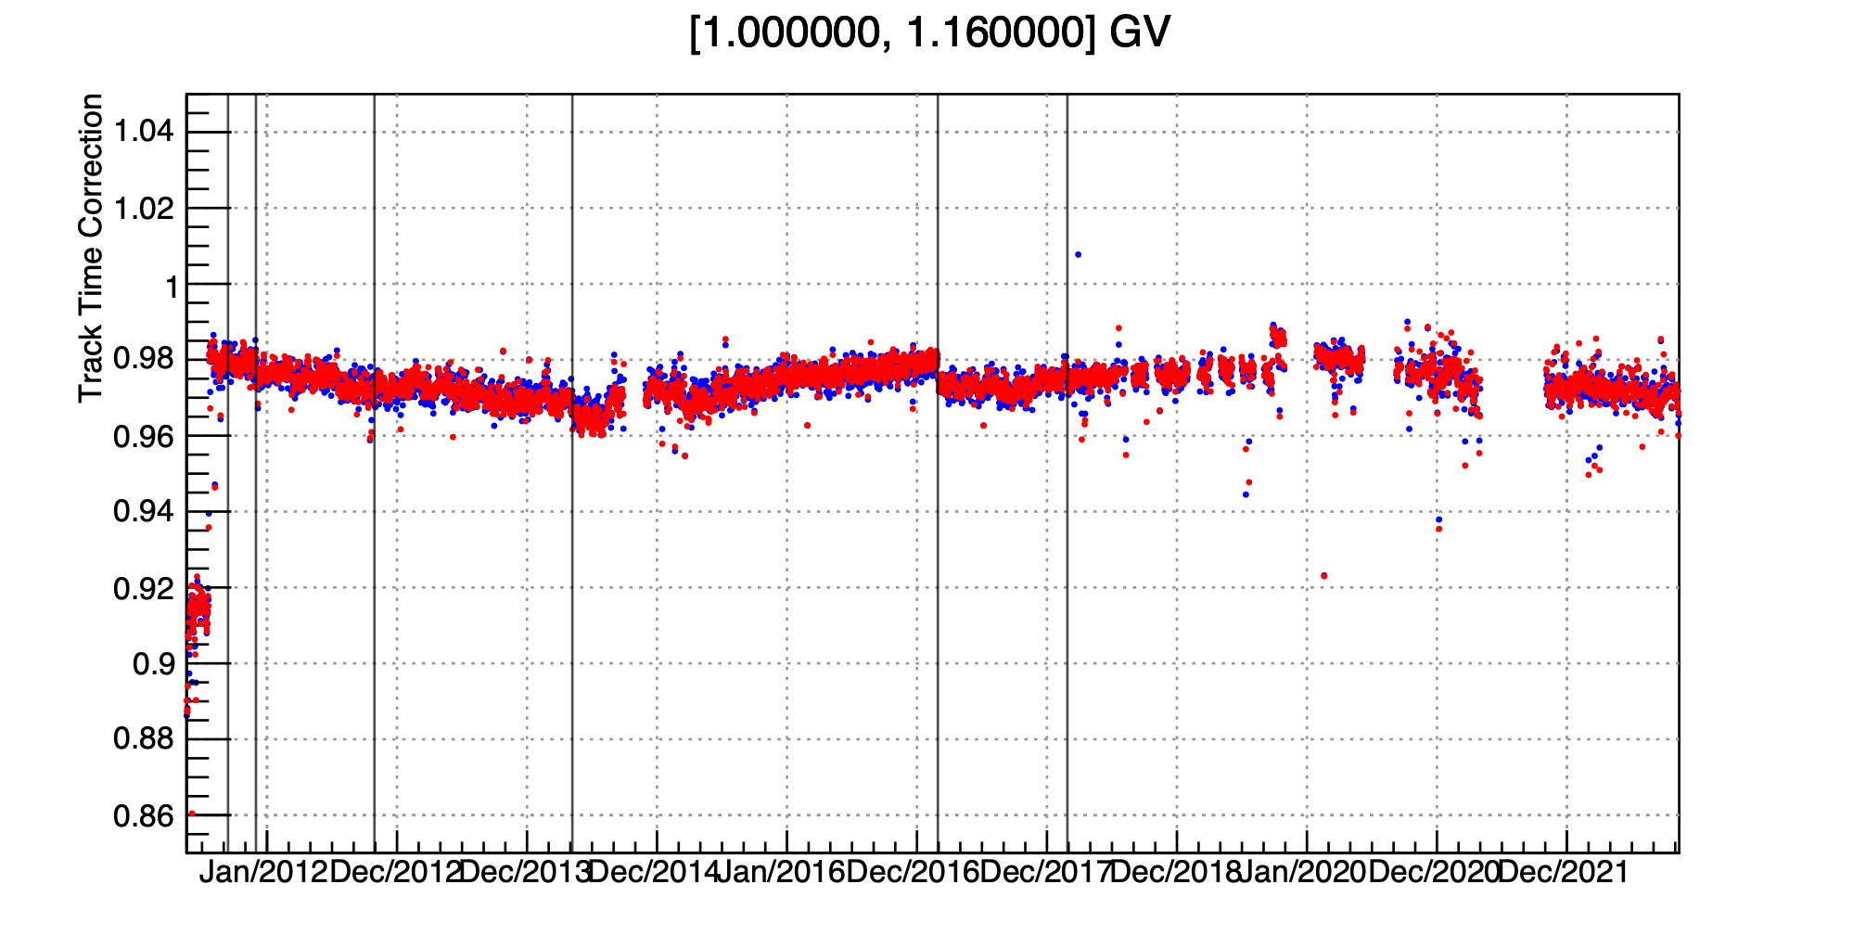
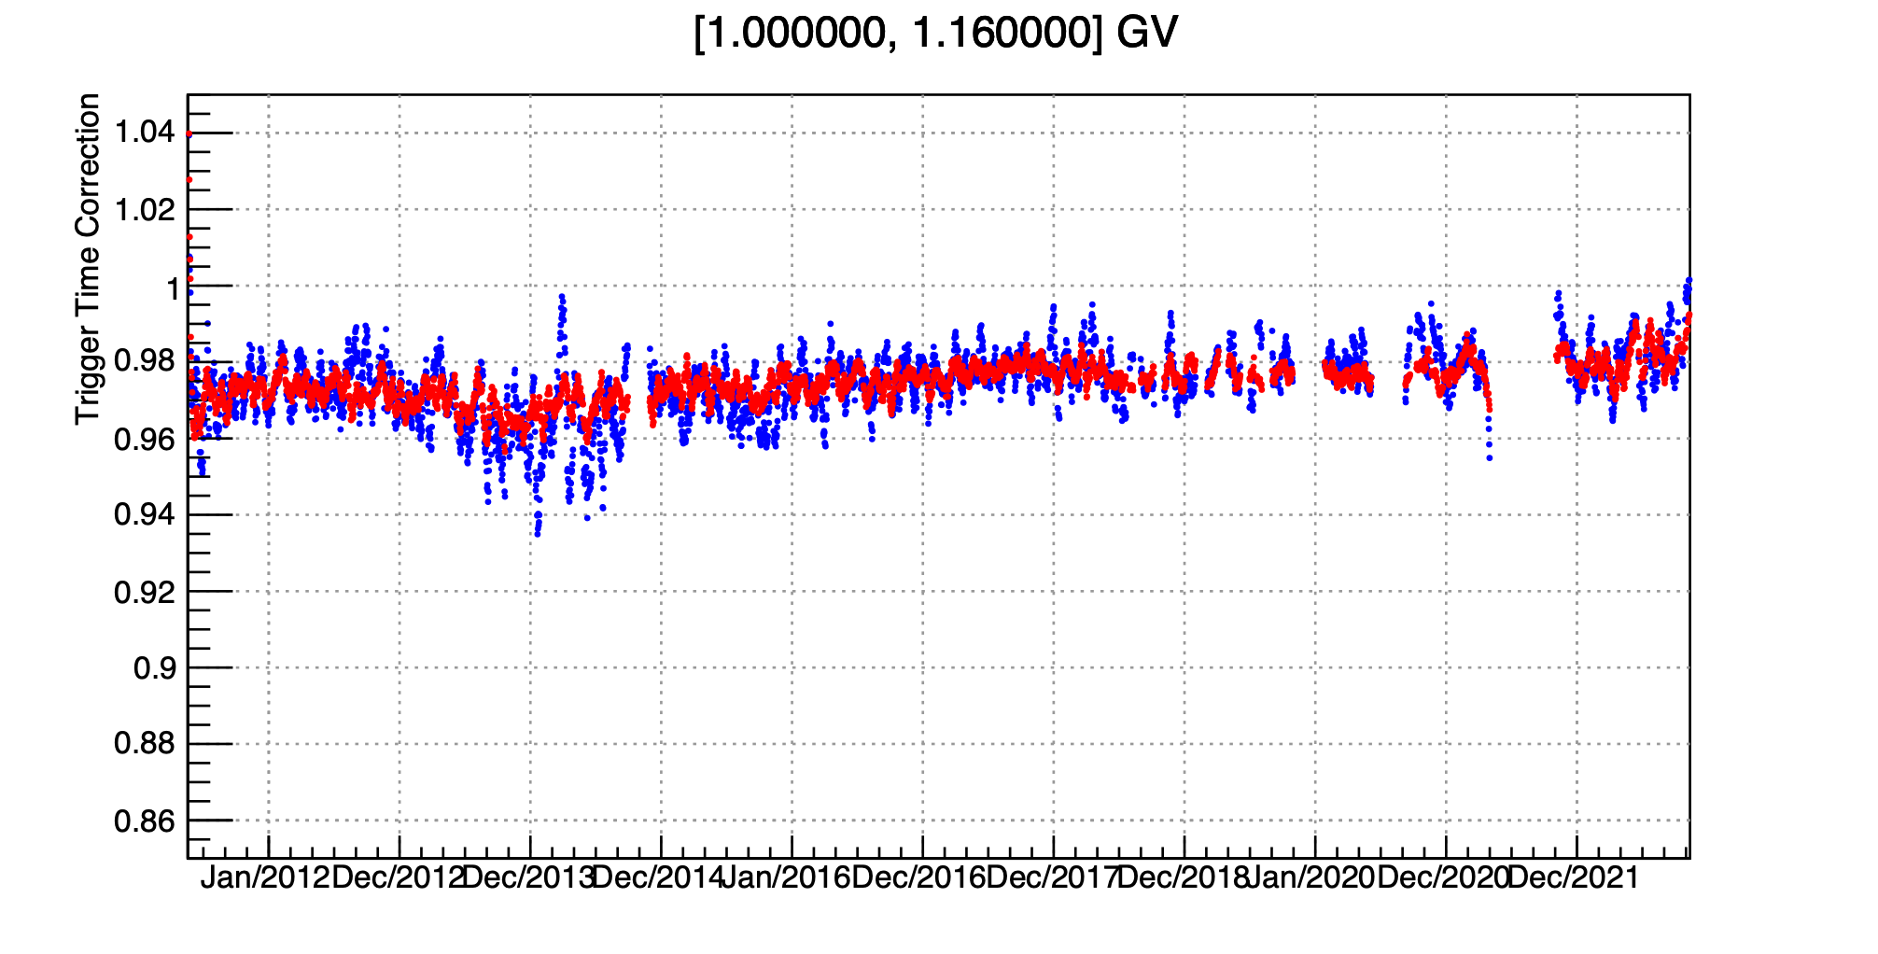
DAILY PROTON FLUX - CORRECTIONS
L1
TOF
TRIG
TRACK

Slide 13
DAILY PROTON FLUX
The daily proton flux (blue) is compared with the previous publication (red) in “Phys. Rev. Lett. 127, 271102 (2021)”.
The new measurements, in an extended temporal range, include improvements in the rigidity reconstruction algorithm of the AMS tracker and a different track fitting method (GBL).
From 0.8GV up to 2.4GV, days with enhanced flux level are clearly visible and correspond to SEP events found with the SEP ID algorithm (green lines).
1 GV
2.4 GV

Slide 14
DAILY PROTON FLUX
PRL 2021 (YiJia)
My Flux
SEP Start from
ID Algorithm
1 GV

Slide 15
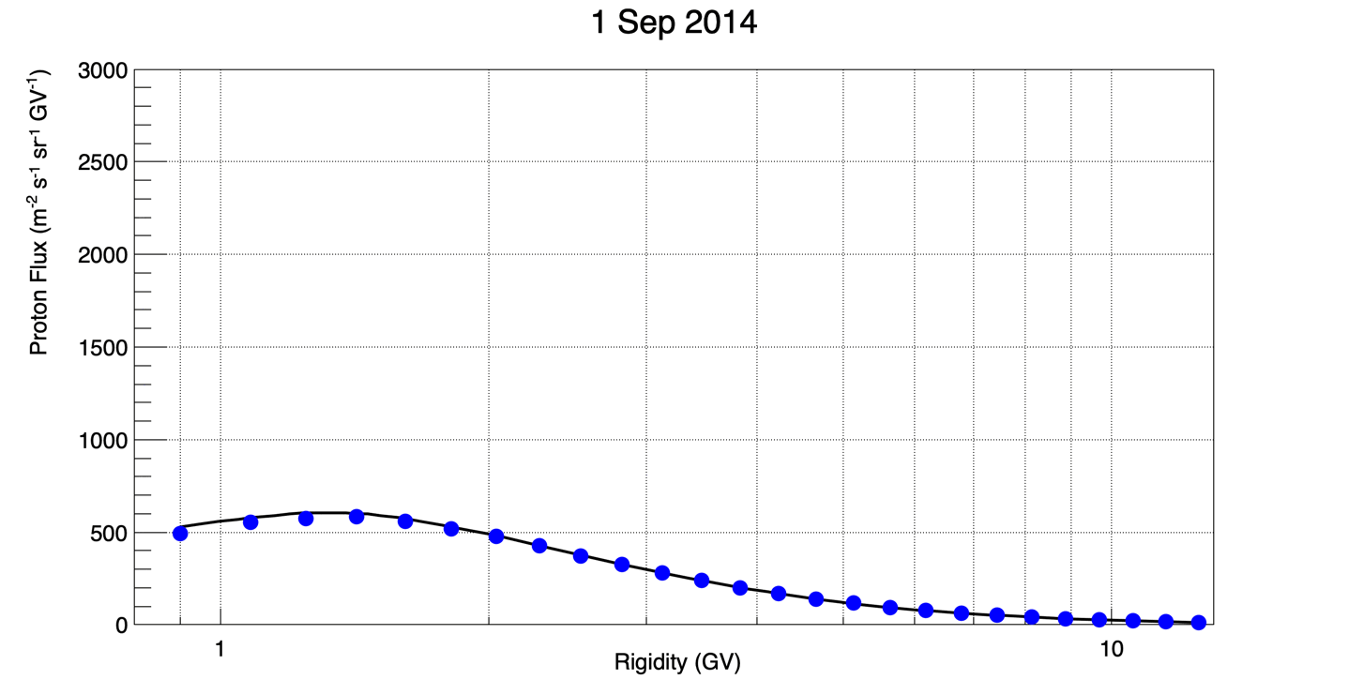
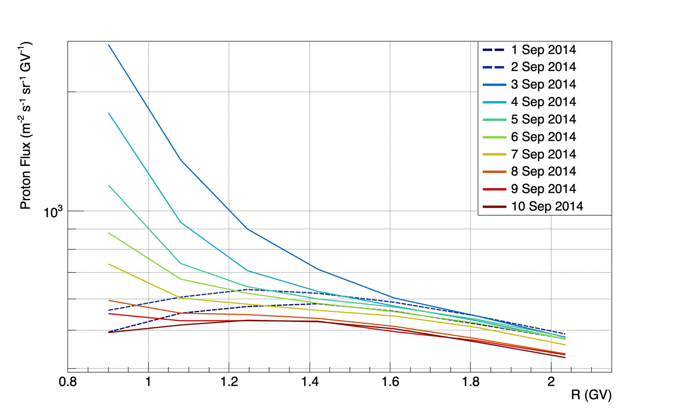
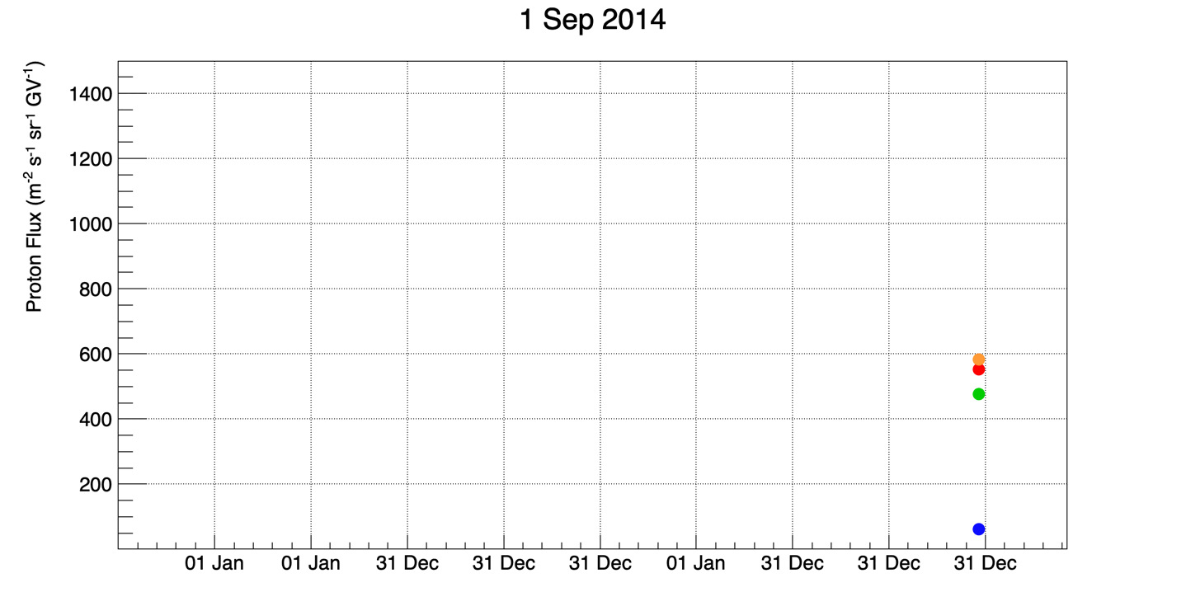
SEP FLUX - 3 SEPTEMBER 2014
The AMS proton flux allows to study SEP events with high precision in the charged particles domain.
The rigidity spectrum hints at the possible acceleration mechanisms of charged particles.
The time evolution gives important informations on the evolution of the ejected plasma from the Sun, within the heliosphere.
1 GV 1.5 GV 2.4 GV 6GV

Slide 16
Summary
- Completed Tasks:
Integral proton spectrum in agreement with publication.
Daily proton flux within 8% with publication, temporal variation of corrections under investigation.
SEP Identification Algorithm completed and operative.
- To do:
Daily flux systematics estimation.
GCR Background subtraction algorithm under development.
Final SEP-only spectrum and fluxes: comparison with other solar activity indexes.
Daily proton flux repository on GitLab by the end of the meeting

Slide 17
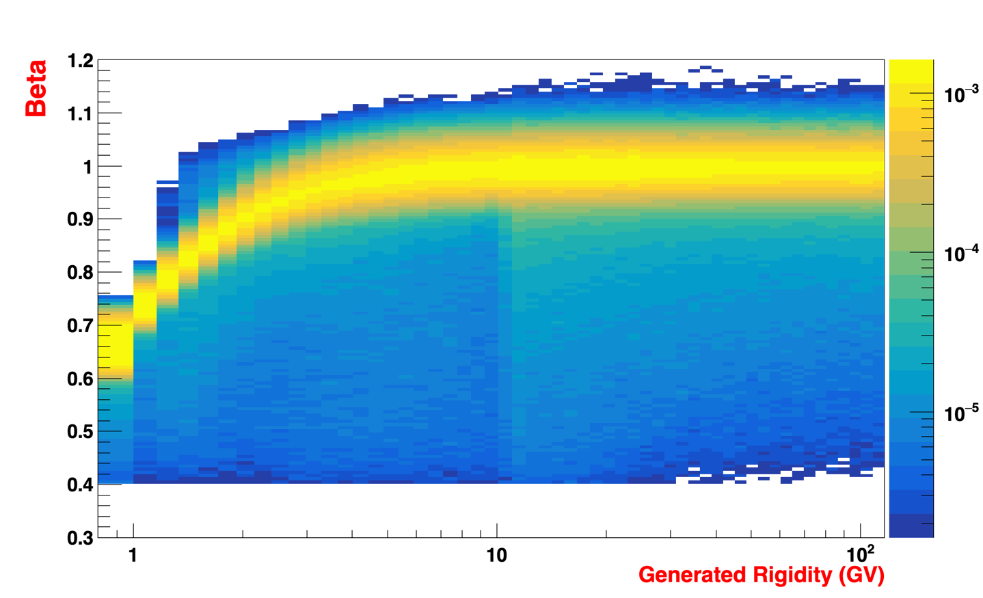
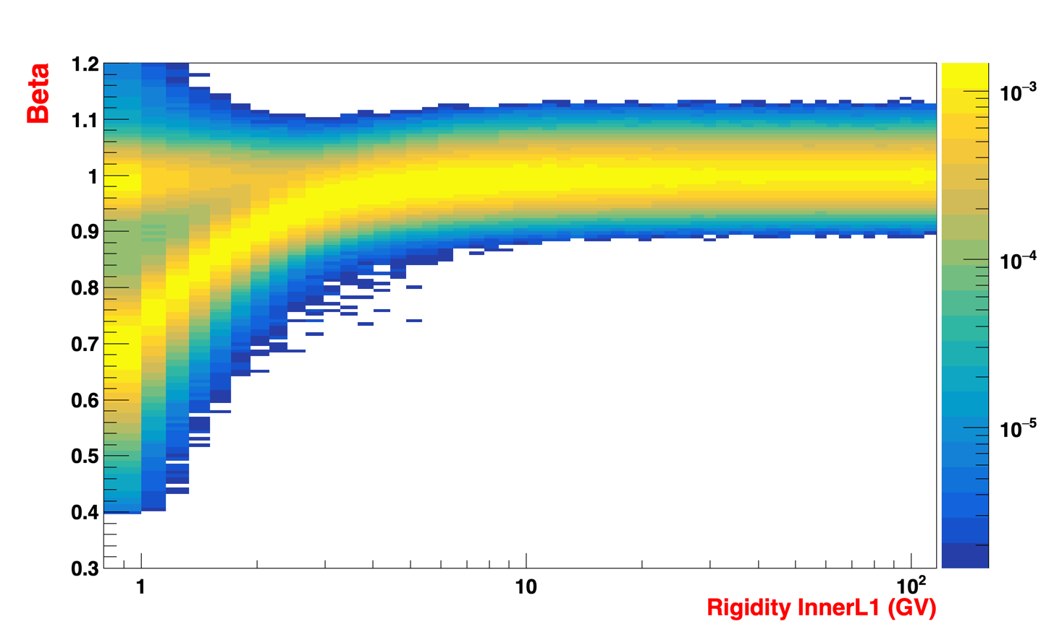
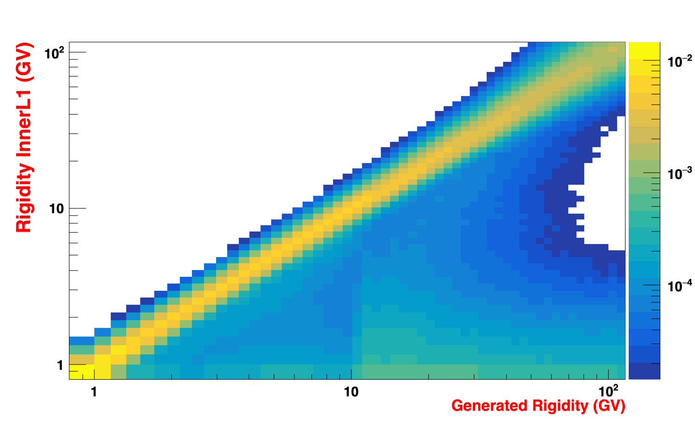
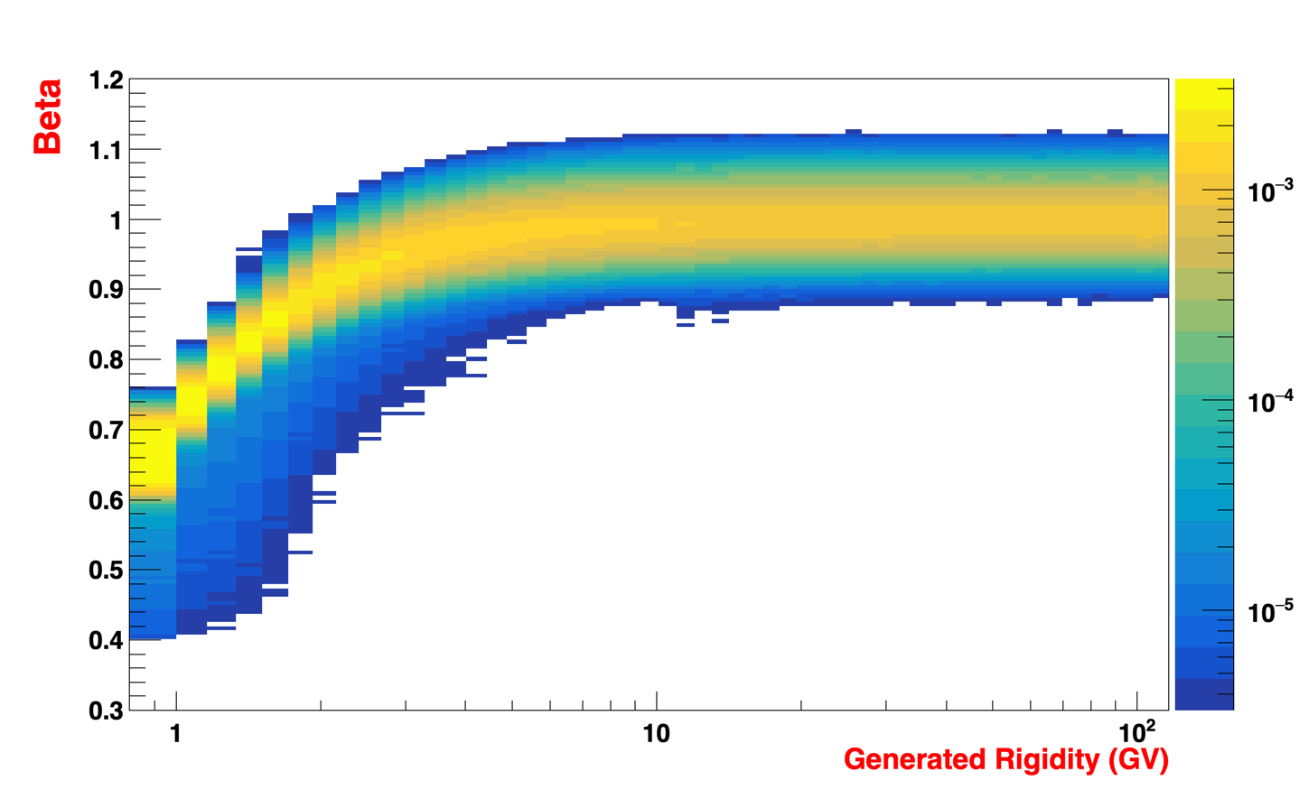
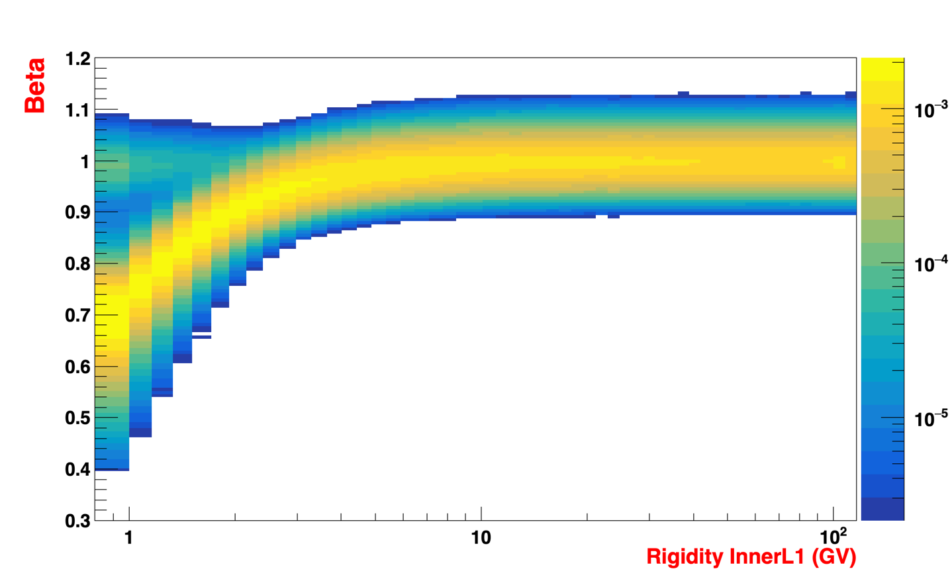
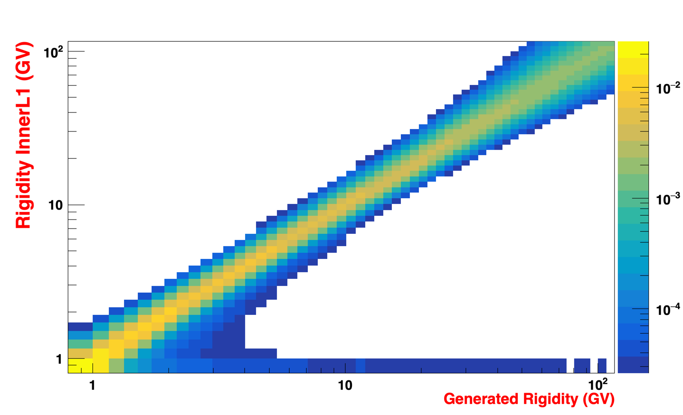
TRIGGER EFFICIENCY STUDIES
Montecarlo Trigger efficiency susceptible to “interactions”? Weird Rgen>10GV population.
Trigger Efficiency Denominator
Trigger Efficiency Denominator
Trigger Efficiency Denominator
Trigger Efficiency Numerator
Trigger Efficiency Numerator
Trigger Efficiency Numerator

Slide 18
TRIGGER EFFICIENCY STUDIES
Montecarlo Trigger efficiency susceptible to “interactions”? Weird Rgen>10GV population.
Trigger Efficiency Pass8
Trigger Efficiency Montecarlo VS IL1 Rigidity
Trigger Efficiency Montecarlo VS Gen Rigidity

Slide 19
TRIGGER EFFICIENCY STUDIES - NEW MASS CUT
$$β≶\frac{R}{\sqrt{R^{2}+m^{2}}}±\frac{Δβ}{\sqrt{R}}$$

