Slide 1



Development of ML Algorithms for search of
Anti-Helium in Cosmic Rays
Luca Tabarroni
Università di Roma Tor Vergata
luca.tabarroni@roma2.infn.it

Slide 2
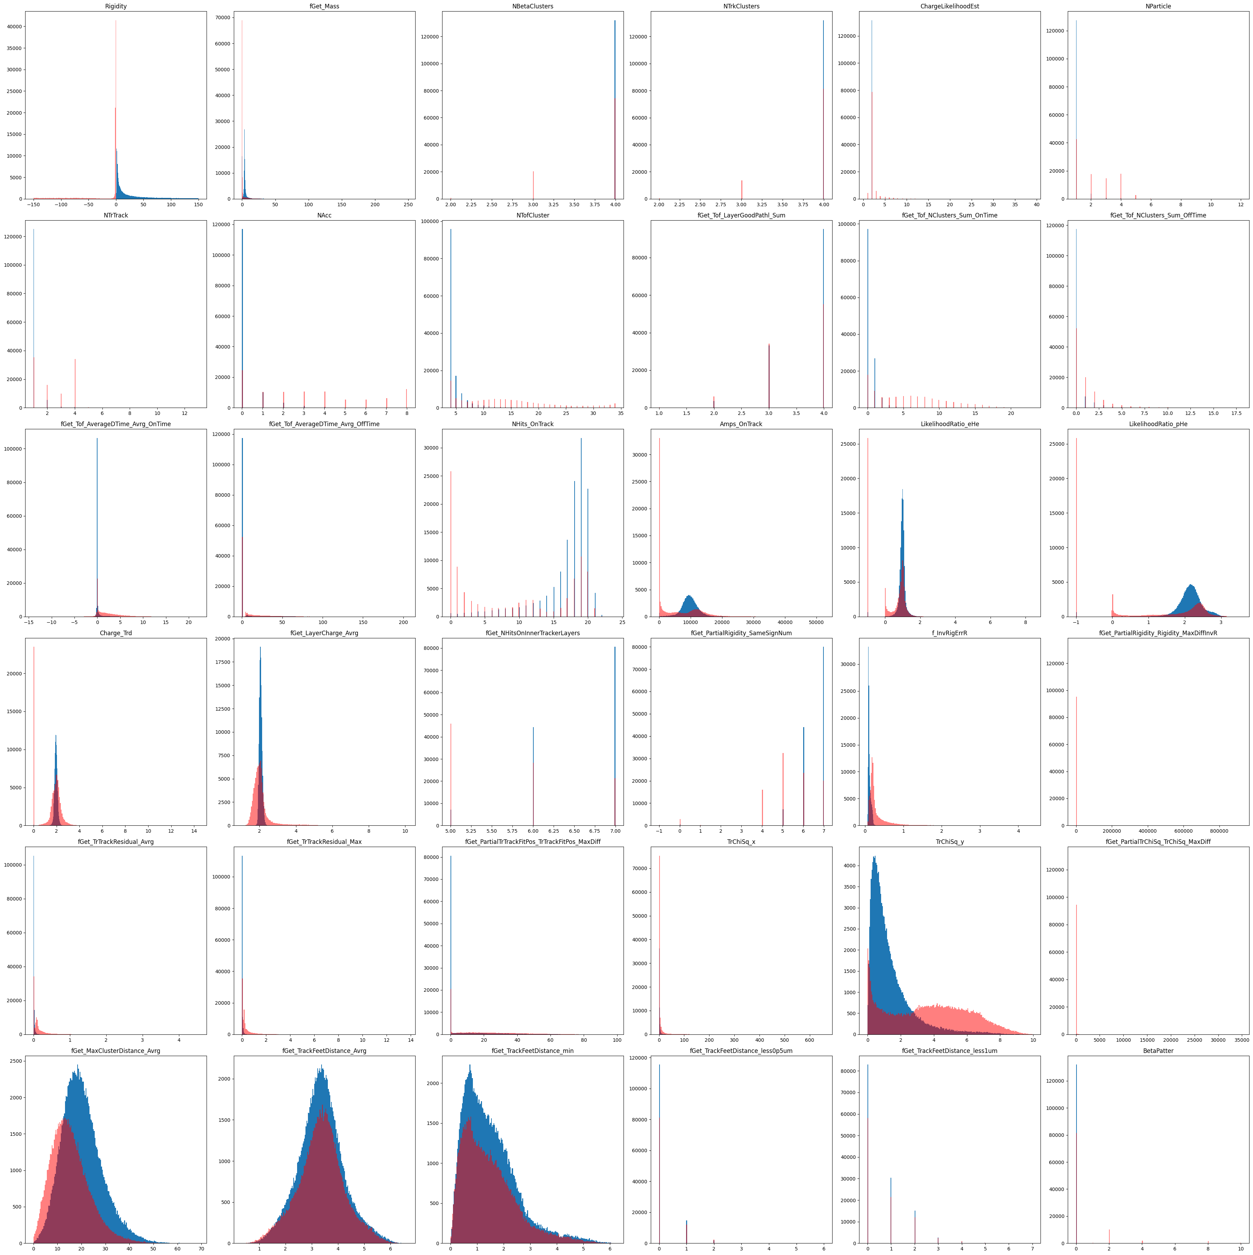
Feature distributions
36 different features distribution
Different shape for signal and background
Rigidity and Mass are not available features for our algorithms
/storage/gpfs_ams/ams/groups/AMS-Italy/ntuples/v1.0.0/He.B1236

Slide 3
Boost Decision Tree
Advantages
No need of features preparation
Missing values do not affect the building of the tree
A decision tree is human readable
Disadvantages
Very sensitive to Overfitting
Higher training time with respect to other algorithms

Slide 4

Boost Decision Tree
Faster training speed:
  Light GBM use histogram based algorithm i.e it buckets continuous feature values into discrete bins which fasten the training procedure.
Lower memory usage:
  Replaces continuous values to discrete bins which result in lower memory usage.
Better accuracy:
It produces much more complex trees by following leaf-wise split approach rather than a level-wise approach which is the main factor in achieving higher accuracy. However, it can sometimes lead to overfitting which can be avoided by setting the max_depth parameter.
https://lightgbm.readthedocs.io/en/stable/

Slide 5
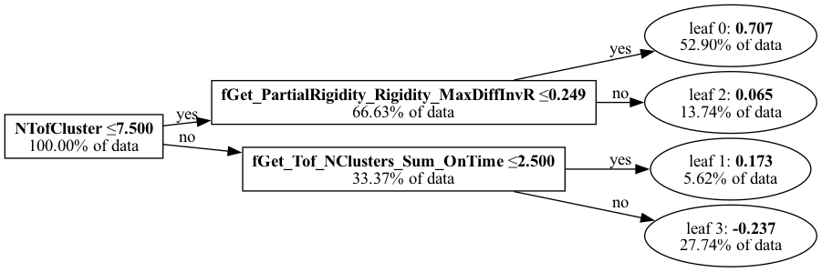
Boost Decision Tree
Diagraph Example
In our case, we implemented an algorithm with:
One-hundred trees
Stopping conditions:
  4 leaves
  No depth conditions
  No purity conditions
Gradient Boosting
Learning rate of 0.25

Slide 6
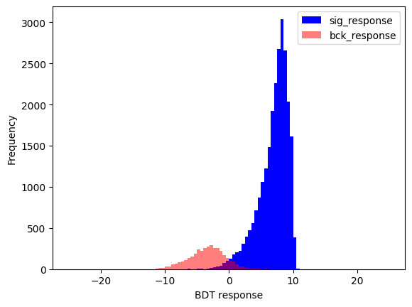
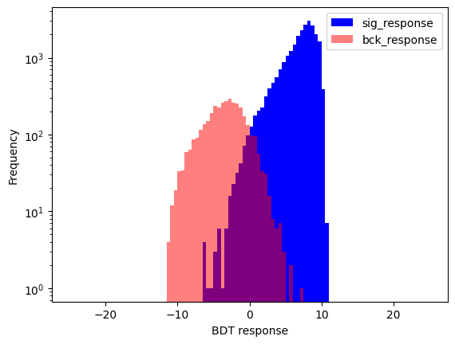
Boost Decision Tree
Response
The BDT associates a response to each leave
The response is the ”probability” to belong to the background/signal class of an event ending in the leave
The BDT response is used as classificator

Slide 7
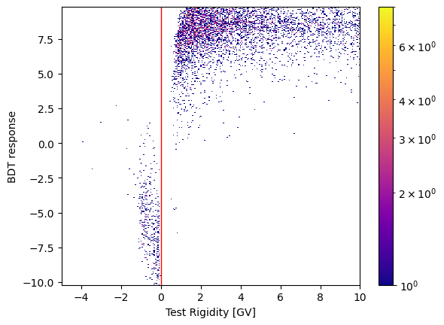
Boost Decision Tree
Response vs Rigidity
We can plot the BDT response vs the event Rigidity
We got a higher response for the signal and a lower for the background
A clear distinction is evident, but more background events are necessary

Slide 8
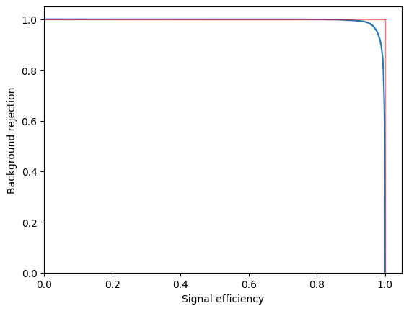
Boost Decision Tree
ROC Curve
The starting point, the baseline
We are going to implement ML algorithms to improve this result

Slide 9
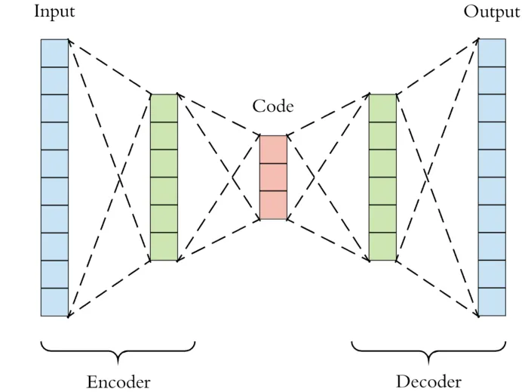
Auto-Encoder
General introduction
Main purpose: image compression
  Image reduction to a lower dimension object: Code space
  Image reconstruction from the Code space back to the original dimension
  Convolutional layers
  Max-Pooling layers
  Up-Sampling layers

Slide 10
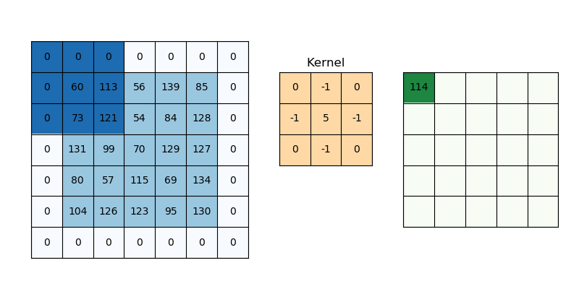
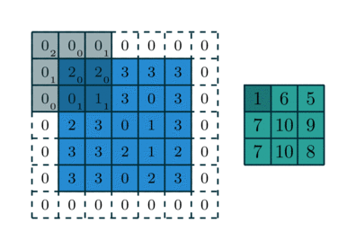
Auto-Encoder
Convolutional layers
Kernel, matrix that swipes on the whole input image. Each ConvLayer may have an arbitral number of kernel
Stride, number of entries of the input images along which the kernel skip
Padding, parameter that add zeros around the input image to regulate the output dimension
Output dimension:

Slide 11
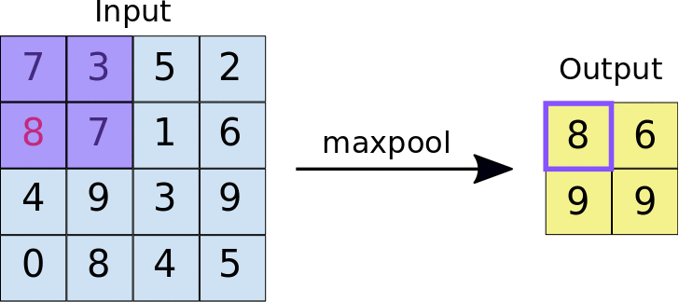
Auto-Encoder
Max-Pooling Layers
No learning parameters, only devoted to the reduction of the dimensionality
Pooling kernel, swipe the original input keeping only the maximal value of those considered
Stride, number of entries of the input images along which the kernel moves
Padding, parameter that regulates the output dimension
  Padding=‘same’
  Padding=‘valid’

Slide 12
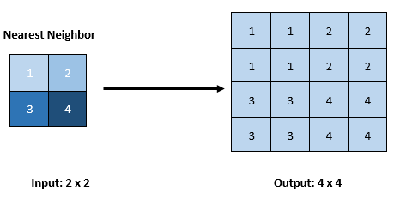
Auto-Encoder
Up-Sampling Layers
Devoted to the increase of the dimensionality
Size, upsampling factor along rows and columns
Interpolation, parameter defining how the new values are evaluated
  Nearest: the new pixel takes the value of the nearest pixel in the original image
  Bilinear: the new pixel is the result of a weighted mean of the four nearest pixels of the original image

Slide 13
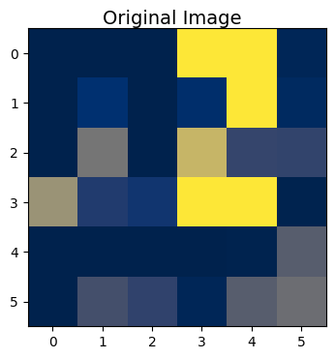
Auto-Encoder
Input and Output
Input
We arrange the whole events dataset as an array of 6x6 matrices
Each matrix is a single event
Each value of a matrix is a normalized feature of the event
Each feautre becomes a pixel of the input image

Slide 14
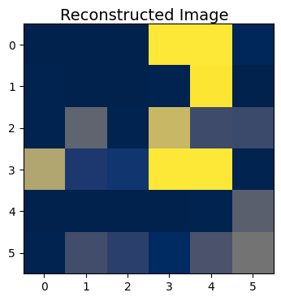
Auto-Encoder
Input and Output
Output
The Auto-Encoder reconstructs a corrispondent 6x6 image for each event
The Auto-Encoder is trained to reconsttuct correctly ONLY THE SIGNAL
We expect good perfomances for the signal
We expect bad perfomances or the background

Slide 15
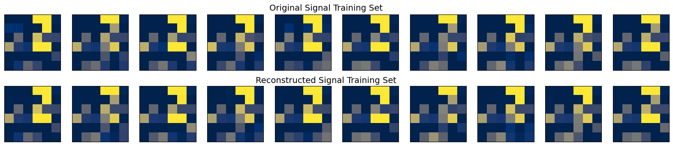
Auto-Encoder Training
We submit to the AEC a training set of images taken from the original signal dataset
The AEC will perform its training confronting the output images with the input ones
The AEC goal is to reach the maximal accordance between the input and the output

Slide 16
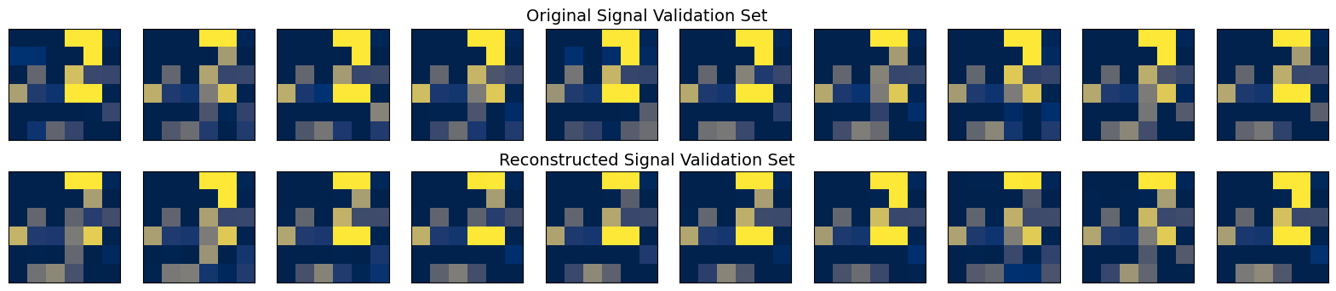
Auto-Encoder Validation
We submit to the AEC a validation set of images taken from the original signal dataset
The AEC has never seen this set of images
The AEC is expected to perform well on the signal validation set since it has been trained on the signal

Slide 17
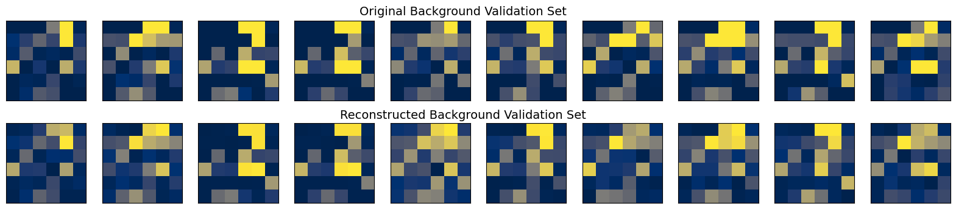
Auto-Encoder Validation
We submit to the AEC a validation set of images taken from the original background dataset
The AEC has never seen this set of images
The AEC is expected to perform poorly on the background validation set since it has been trained on the signal

Slide 18
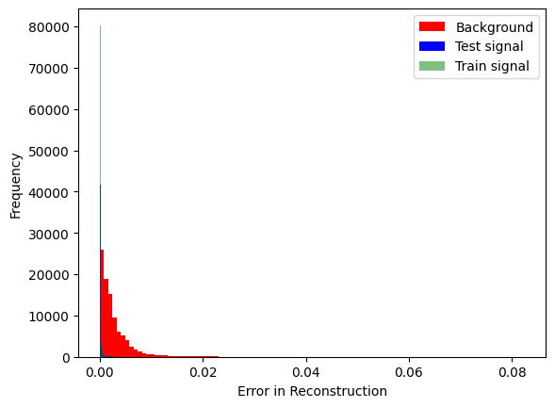
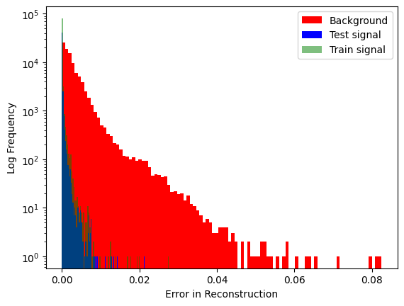
Auto-Encoder
Error in Reconstruction
We can evaluate the difference between an original and a reconstructed image, pixel by pixel:
The total error will be the AEC selector
.
.
.

Slide 19
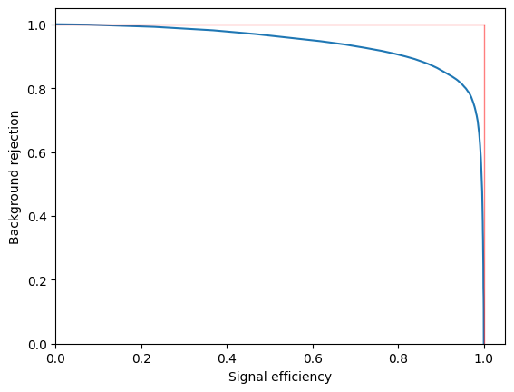
Auto-Encoder
ROC Curve
Less separation power w.r.t. the BDT
We are not really interested in the actual result
We want to know if the AEC is “learning” something different from the data with respect to the BDT

Slide 20
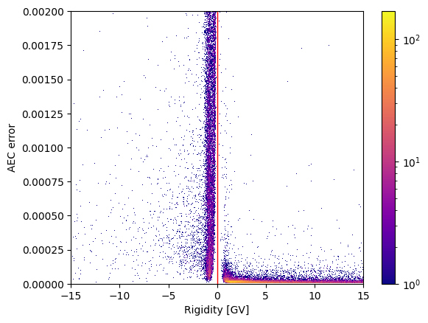
Auto-Encoder
Error vs Rigidity
The error on the signal is clearly concentrated on the lower values, as expected
The error on the background is distributed on a large range of values
A cut value is not evident

Slide 21
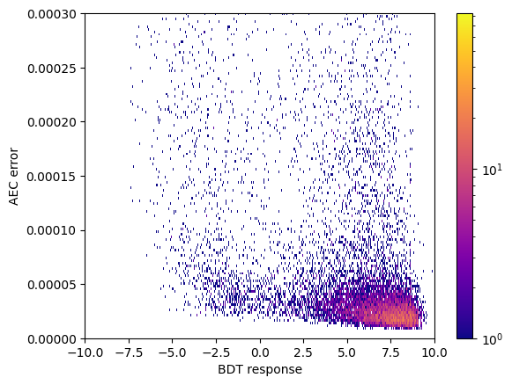
Auto-Encoder
AEC Error vs BDT Response
The signal is characterised by a lower AEC error and a higher BDT response
The background is characterised by a lower BDT response but no actual range for the AEC error
The two selectors, the BDT response and the AEC error, are not tightly correlated

Slide 22
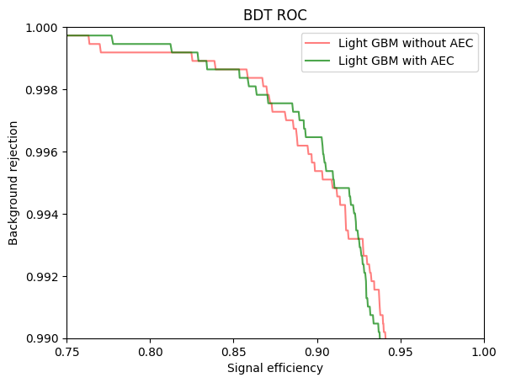
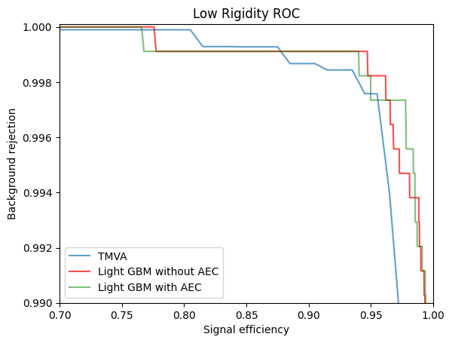
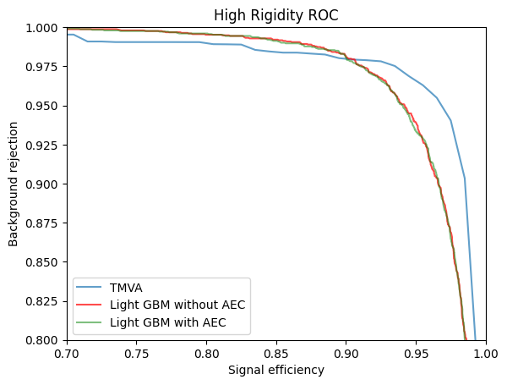
BDT combined with AEC
ROC Curve
The AEC error in reconstruction becomes an extra feature of each event
A new Boost Decision Tree is trained once again, but now the events have an extra feature
The final result for the separation power of the new BDT can be confronted with the previous result for the original BDT

Slide 23
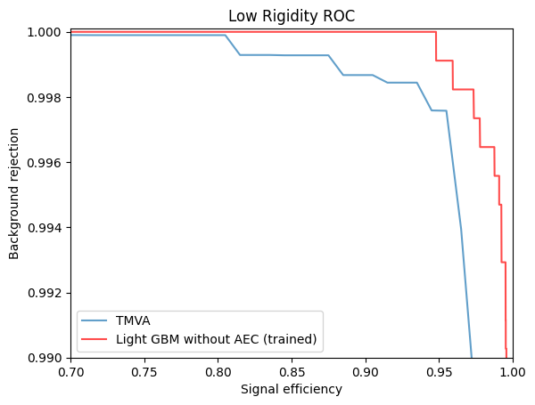
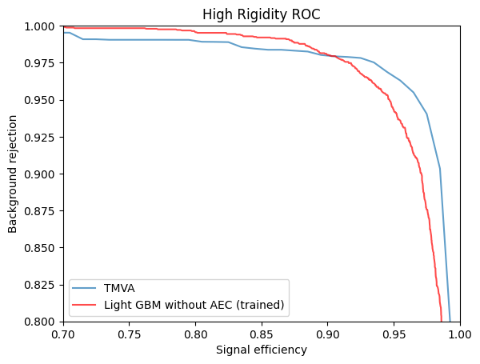
Comparison
TMVA vs LGBM
At low Rigidity LGBM is more powerful
At high Rigidity the results are similar with TMVA slightly better at high signal selection and LGBM slightly better at high background rejection

