Slide 1

NAIA/AMS-02 Italy Meeting:
Status of Light Ions Analysis
Li, Be, B, C, N & O
Alejandro Reina Conde, INFN Sezione di Bologna
Alberto Oliva, INFN Sezione di Bologna
Thursday 30th of November, 2023

Slide 2
Some Information
NAIA v1.0.2 ntuples
  First 11.5 years of AMS-02 pass8 data, from Bartels 2426 to Bartels 2581.
  MonteCarlo pass8 B1236 for Lithium to Oxygen.
  RTI v8.
What is new?
  Top-of-Instrument (TOI) correction done correctly.
  Estimation of all systematics error, both for Average and Bartels.

Slide 3

Differential Flux Estimation
Reminder
Number of events after contamination correction
The isotropic differential flux in the i-th rigidity bin (R_{i}; R_{i} + ΔR_{i})
Bin width
Unfolding factor, bin-to-bin migration correction
Exposure time
Effective acceptance

Slide 4
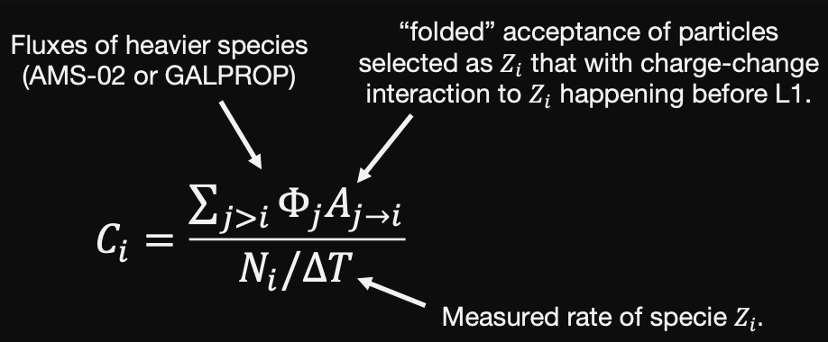
Top-Of-Instrument (TOI) correction (before partial XS)
Lithium
Beryllium
Boron
Carbon
Nitrogen
Oxygen
The estimation has been done using Lithium, Beryllium, Boron, Carbon, Nitrogen and Oxygen MonteCarlo.

Slide 5
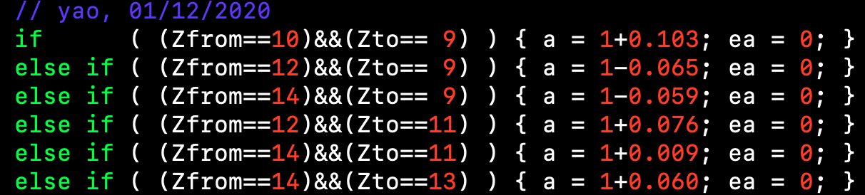
We need to take into account Partial-XS when doing TOI.
This partial-XS are now dependent on Rigidity, as an example O16 Montecarlo into Lithium
Before it was a normalization factor
BO
MIT
Li
Be
B
N

Slide 6
We need to take into account Partial-XS when doing TOI.
This partial-XS are now dependent on Rigidity, as an example O16 Montecarlo into Lithium
Before it was a normalization factor
BO
MIT
Li
Be
B
N

Slide 7
Top-Of-Instrument (TOI) correction (after partial XS)
Lithium
Beryllium
Boron
Carbon
Nitrogen
Oxygen
The estimation has been done using Lithium, Beryllium, Boron, Carbon, Nitrogen and Oxygen MonteCarlo.
The differences between TOI w/o partial XS is added as a systematic error.

Slide 8
Error breakdown
Li
Be
B
C
N
O
Two systematic error sources are not considered here:
  Cross section (XS) error, which is around 2-3% extra ”flat” in rigidity.
  Partial cross sections TOI correction error, estimated before.

Slide 9
Average vs MIT
Li
Be
B
C
N
O
BO
MIT
MIT total error

Slide 10
Average vs MIT vs PG/Rome2
Li
Be
B
C
N
O
BO
MIT
Perugia/Rome2
MIT total error

Slide 11
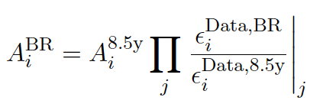
Data/<Data> Corrections
Reminder
Correct the average acceptance by all the Data/Data corrections.
11y
11y
Tracker Data/<Data> correction for Carbon

Slide 12
Forward Unfolding vs Time
Reminder
The flux model for each Bartels is given by the best-fit flux model obtained from the average flux forward unfolding method multiplied by a parametrization of the Φ^{BR}/Φ^{AVG} ratio by a spline allowed to fluctuate only at low rigidities.
This effectively allows to study the solar modulation effects on the unfolding.
Li
C
Be
N
B
O

Slide 13
Statistical Error (it is time dependent too)
Systematics Time dependent error (data/data + unfolding sampling + matrix resolution + rigidity scale)
Systematics Time independent error (raw acceptance + data/MC + background)
XS and partial XS TOI errors were not added to the systematics time independent.
Lithium
Carbon
[1.92-2.15] GV
[1.92-2.15] GV
[2.67-2.97] GV
[2.67-2.97] GV
[4.43-4.88] GV
[4.43-4.88] GV
[7.09-7.76] GV
[7.09-7.76] GV
[18-19.5] GV
[18-19.5] GV

Slide 14
Bartels Comparison: Lithium
[1.92 - 2.15] GV
[2.15 - 2.40] GV

Slide 15
Bartels Comparison: Beryllium
[1.92 - 2.15] GV
[2.15 - 2.40] GV

Slide 16
Bartels Comparison: Boron
[1.92 - 2.15] GV
[2.15 - 2.40] GV

Slide 17
Bartels Comparison: Carbon
[1.92 - 2.15] GV
[2.15 - 2.40] GV

Slide 18
Bartels Comparison: Nitrogen
[1.92 - 2.15] GV
[2.15 - 2.40] GV

Slide 19
Bartels Comparison: Oxygen
[2.15 - 2.40] GV
[2.40 - 2.67] GV

Slide 20
Bartels differences between groups
Difference is coming from Average → Normalize
Difference is coming from Bartels → Data/Data or/and Unfolding

Slide 21
Bartels differences between groups
Difference is coming from Average → Normalize
Difference is coming from Bartels → Data/Data or/and Unfolding
BO
Perugia/Rome2
Beryllium

Slide 22
Bartels Comparison: Beryllium
[1.92 - 2.15] GV
[2.15 - 2.40] GV

Slide 23
Bartels Comparison: Beryllium Normalized to Average
[1.92 - 2.15] GV
[2.15 - 2.40] GV

Slide 24
Conclusions
The Bartels fluxes for Lithium to Oxygen for the first 11.5 years of AMS data taking, from Bartels 2426 to Bartels 2581, have been present.
The agreement between the two groups is good enough for a publication. Anyway, a few more checks will be done:
  Compare Unfolding vs Time
  Compare Data/Data corrections
All the systematics, time dependent and time independent, have been estimated.
The Photon-Trigger period (6 months) is being studied to include it.
The goal is to have everything prepare for the General Meeting in January, and present something solid to publish.

Slide 25
Back Up

Slide 26
Carbon Trigger Data/<Data> correction

Slide 27
Carbon TOF Data/<Data> correction

Slide 28
Carbon L1-HitAssociation Data/<Data> correction

Slide 29
Carbon Tracker Data/<Data> correction

Slide 30
Carbon L1-UnbiasedHit Data/<Data> correction

Slide 31
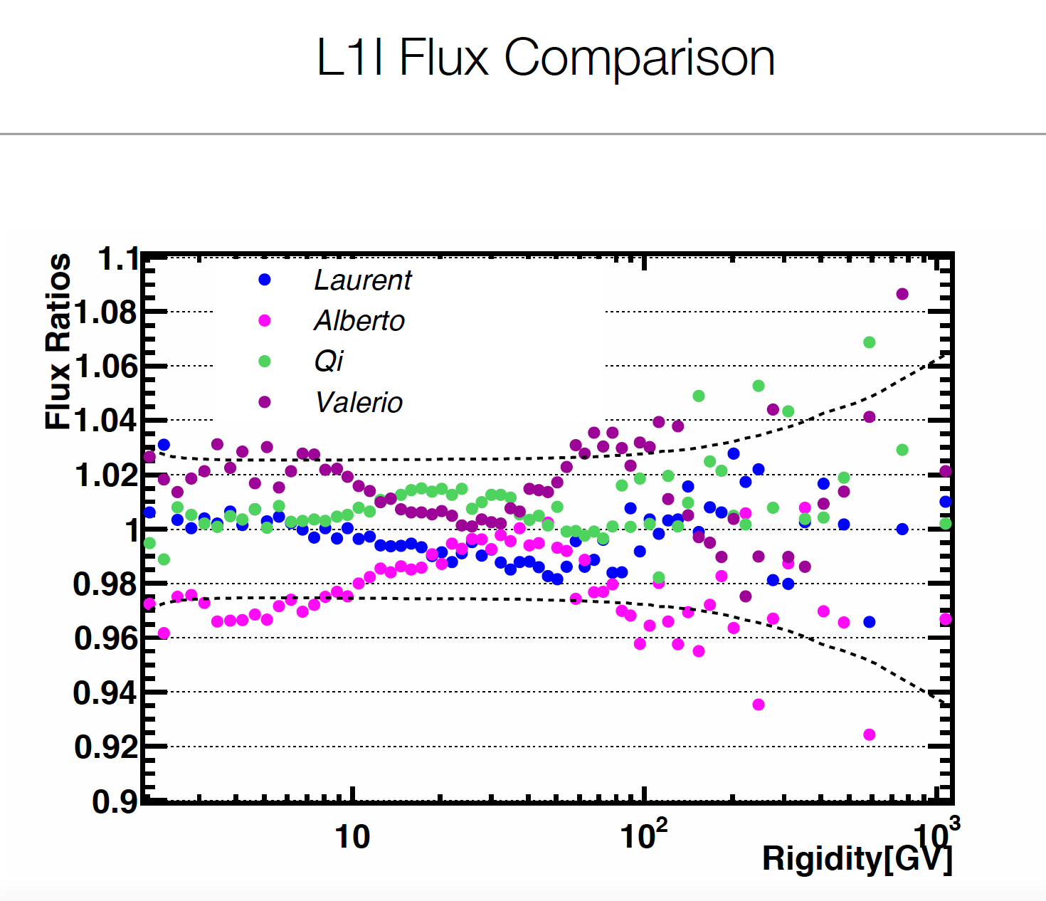
Lithium AMS comparison in 2017
Last comparison made for Lithium in detail.
This was the status before publication.

