Slide 1


Helmod updates and application to AMS data science cases
Stefano Della Torre
INFN Milano-Bicocca
AMS Italia 30 novembre 2023

Slide 2
Outline
HelMod Updates
Solar Modulation of isotopes
B/C vs Time
Forbush study

Slide 3
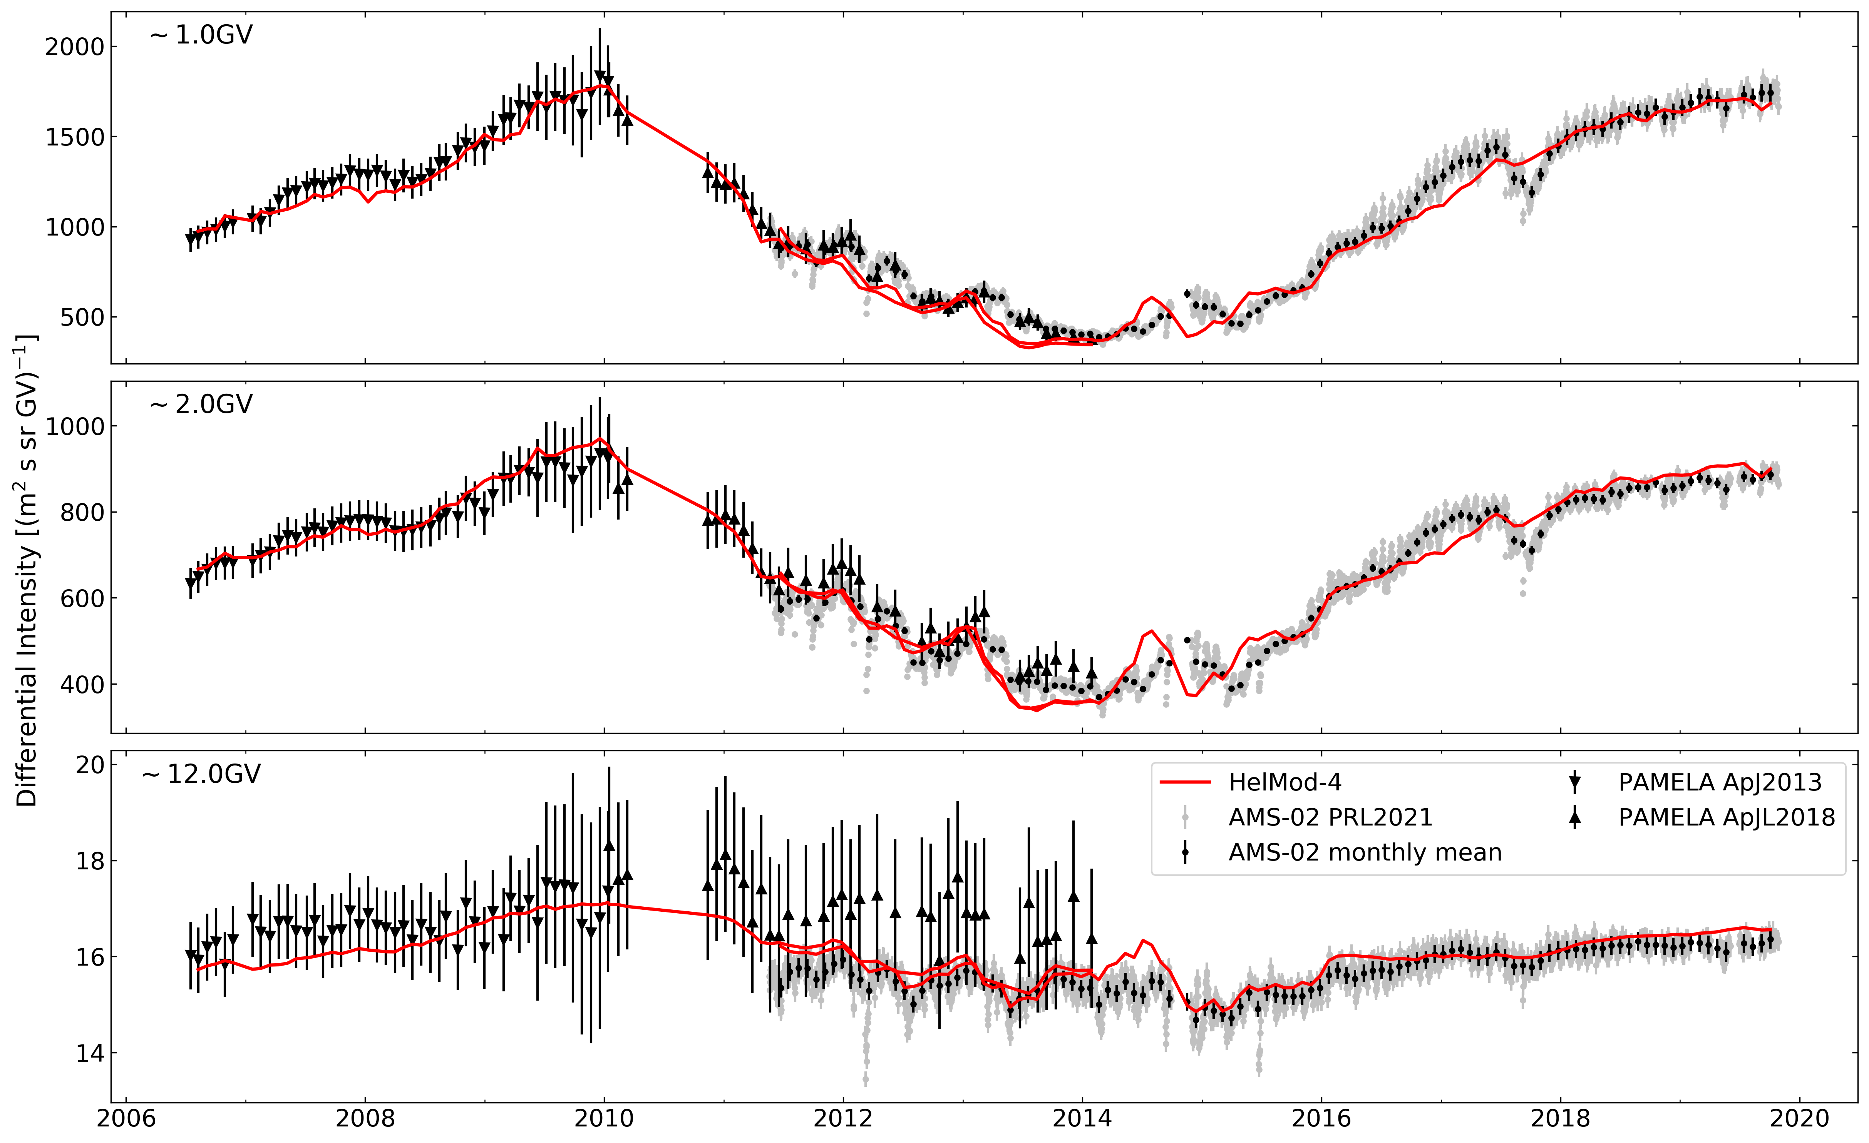
Continously updated with state-of-art measurements
HelMod-4 parameters are continuously kept updated and HelMod-4 results are compared with data from state-of-art space detector (i.e. AMS-02)
Model parameters are tuned using the most precise and accurate proton flux data. The same parametrization is then applied to all GCR species.
Boschini et al. 2023 to be submitted

Slide 4
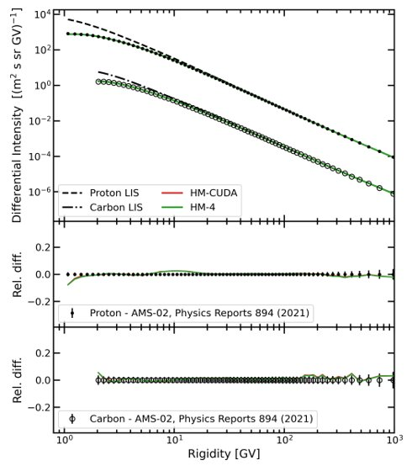
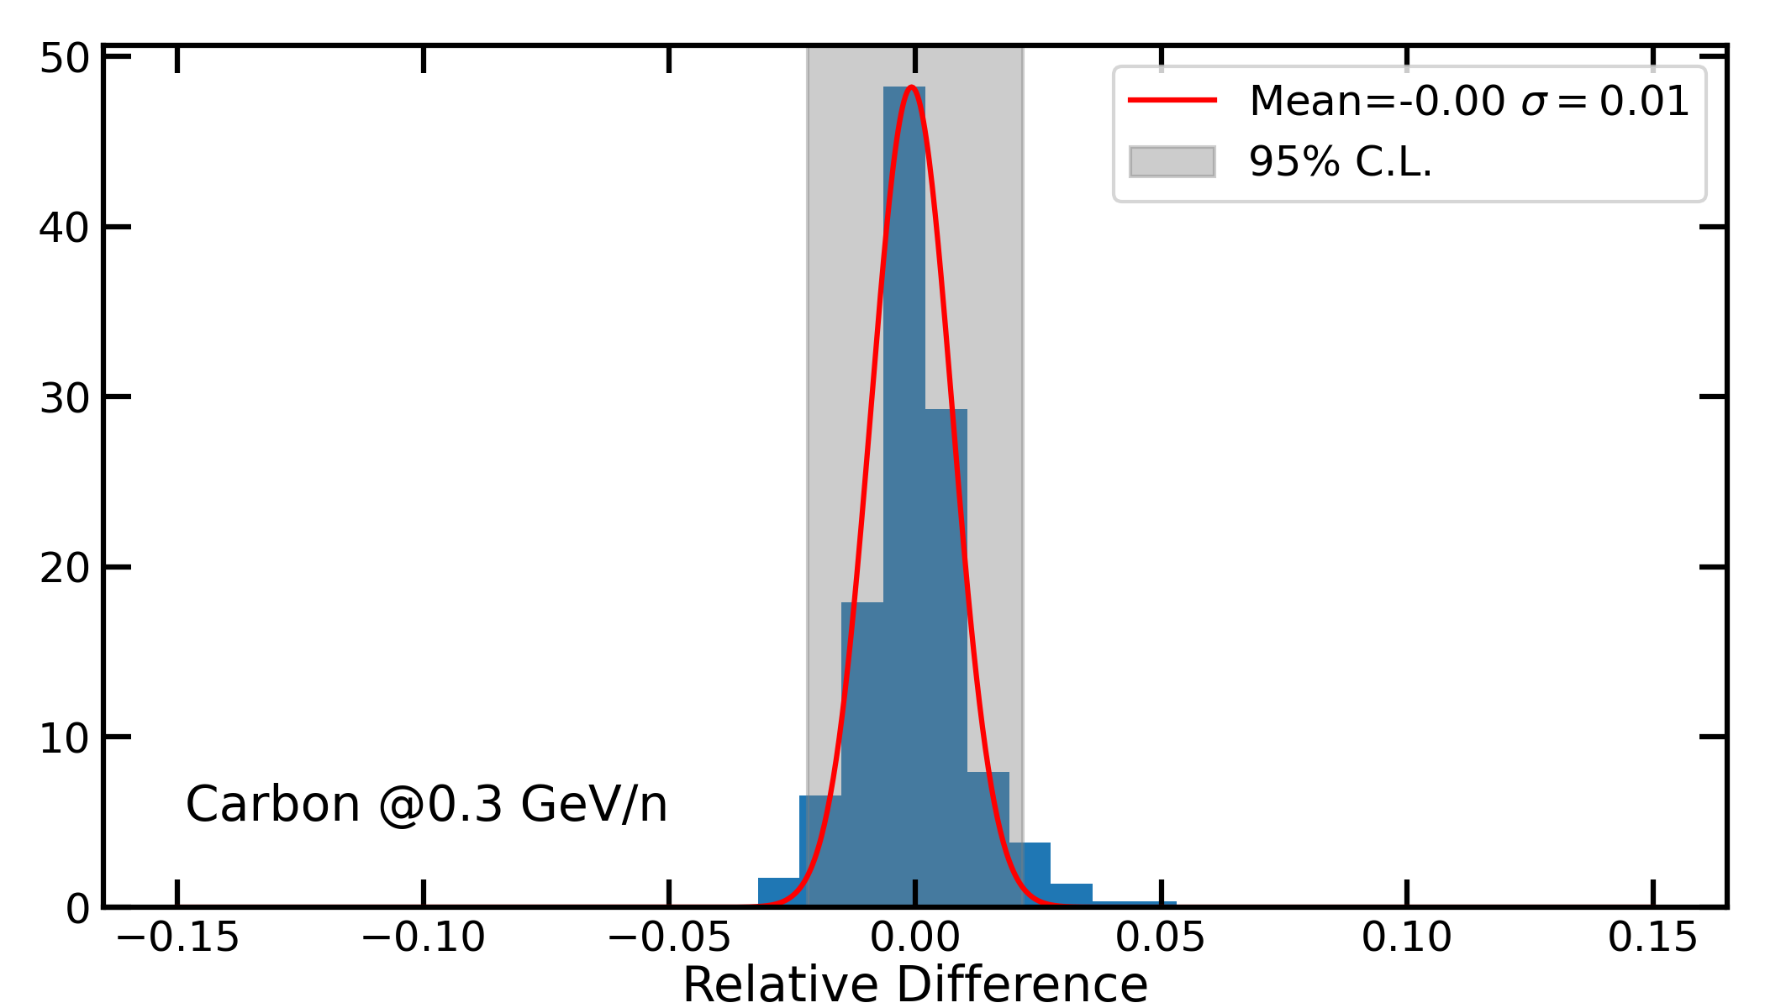
The MonteCarlo Algorithm was re-designed to run on GPU-accellerated architecture
HELMOD-4-CUDA
This allows to set up an algorithm ~40x faster than the previous code at the same accuracy level.
Relative difference between HelMod-4 and HelMod-4-CUDA
Actual simulation time 2-20 minutes per isotopes.
We got a ICSC-spoke 3 "borsa di studio" to emprove the algorithm and performances on GPUs.
Boschini et al. 2023 to be submitted

Slide 5
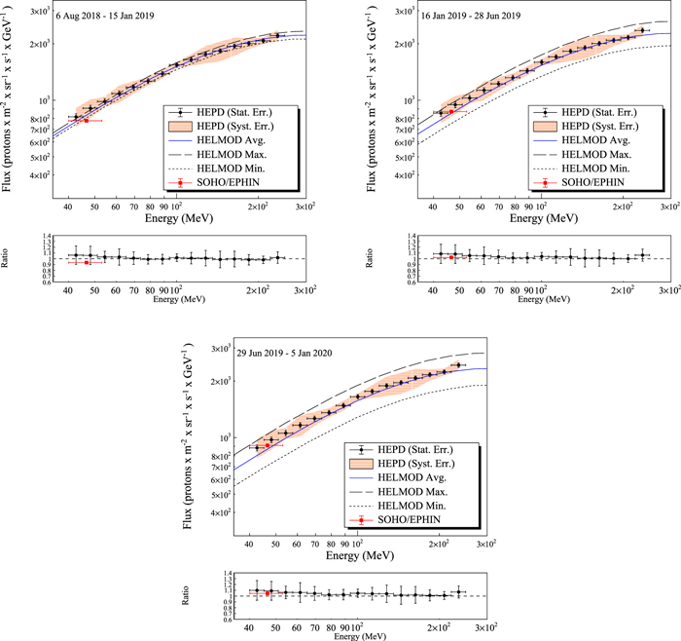
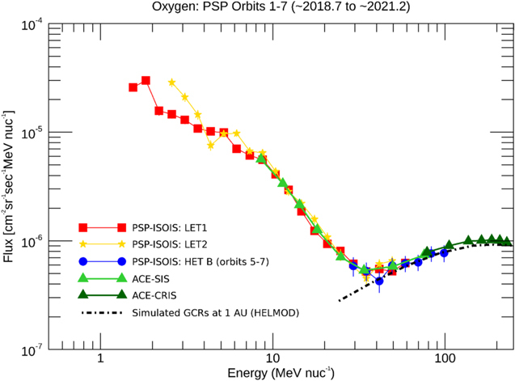
Some Application "out-of-the-box"
Rankin et al 2022 ApJ 925 9
Bartocci et al ApJ ,901:8, 2020

Slide 6

Isotopes

Slide 7
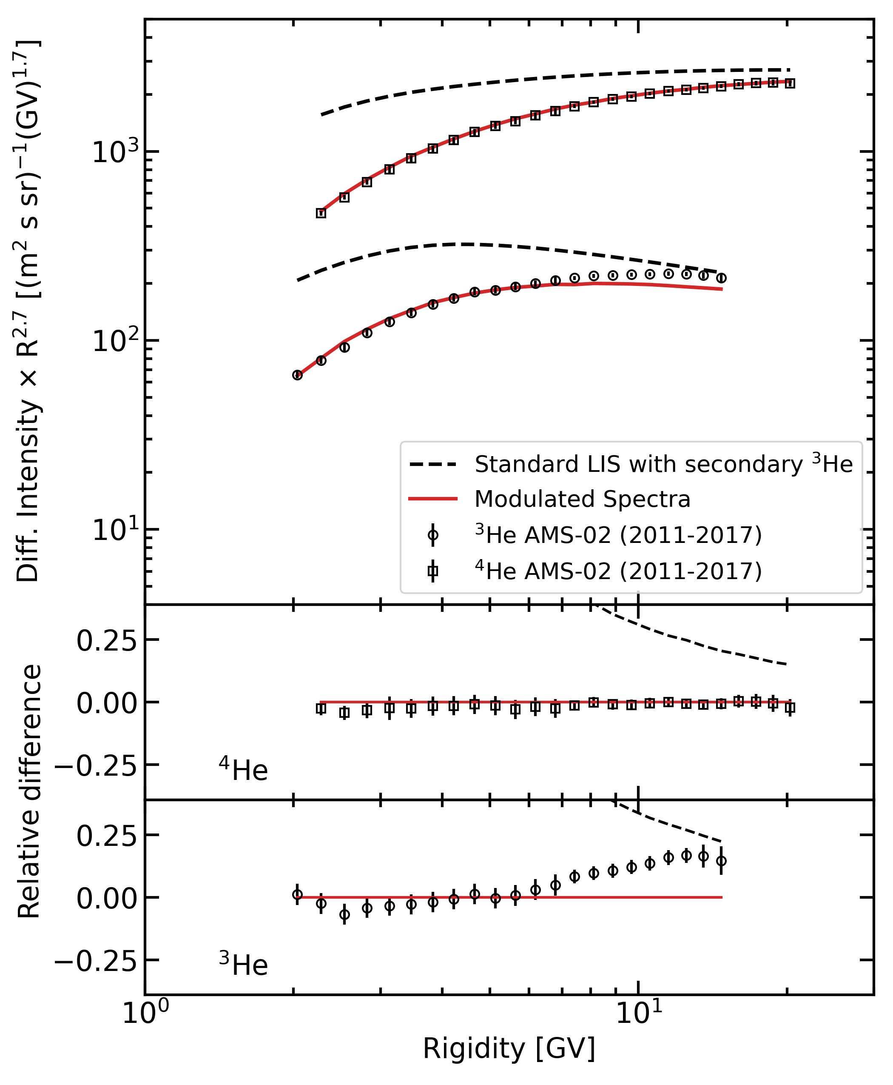
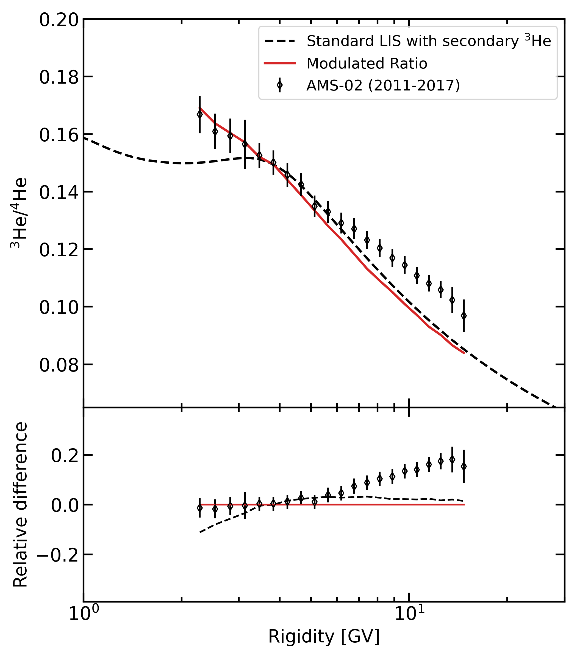
Now we are facing the study of isotopes
Preliminary, see Nicolò's talk

Slide 8
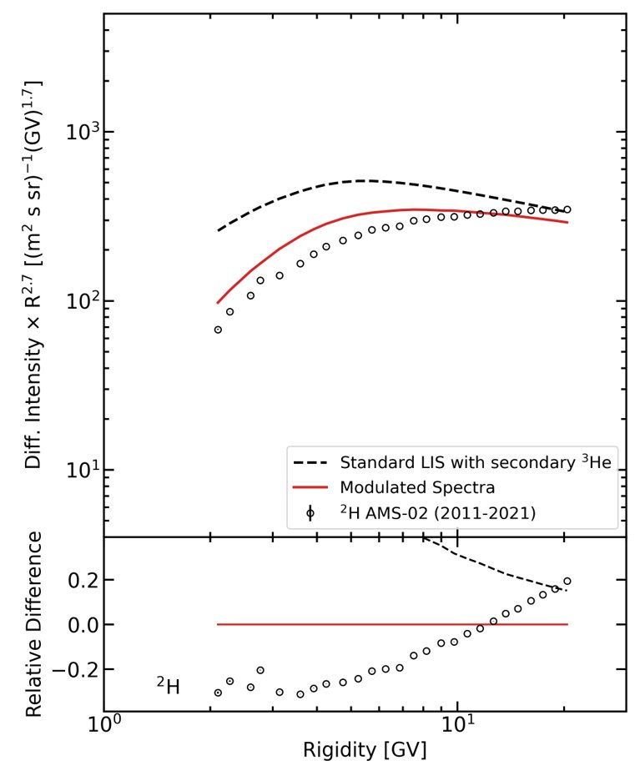
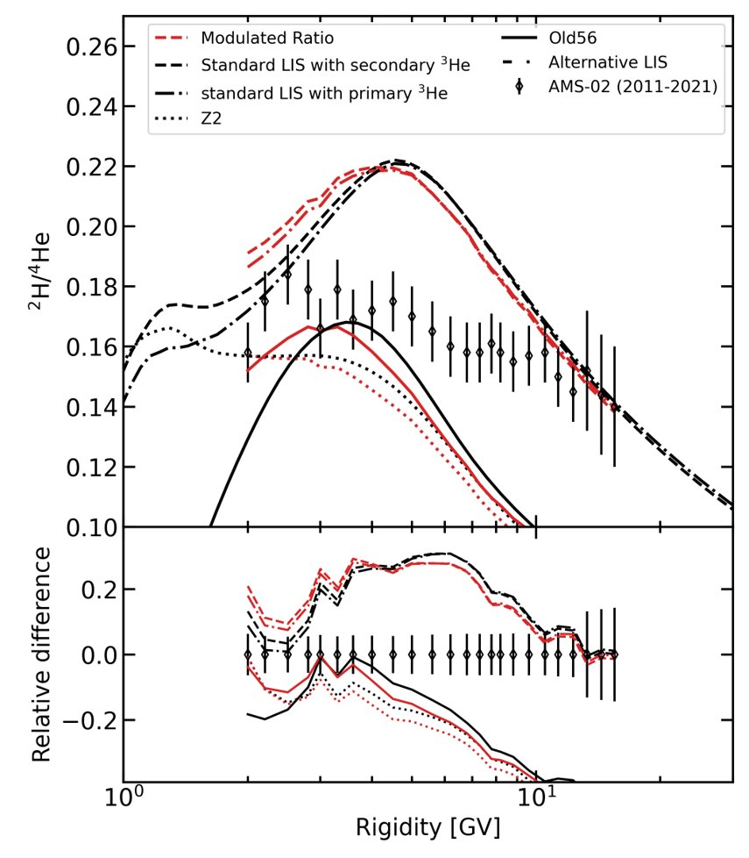
Now we are facing the study of isotopes
Preliminary, see Nicolò's talk

Slide 9

Boron/Carbon

Slide 10
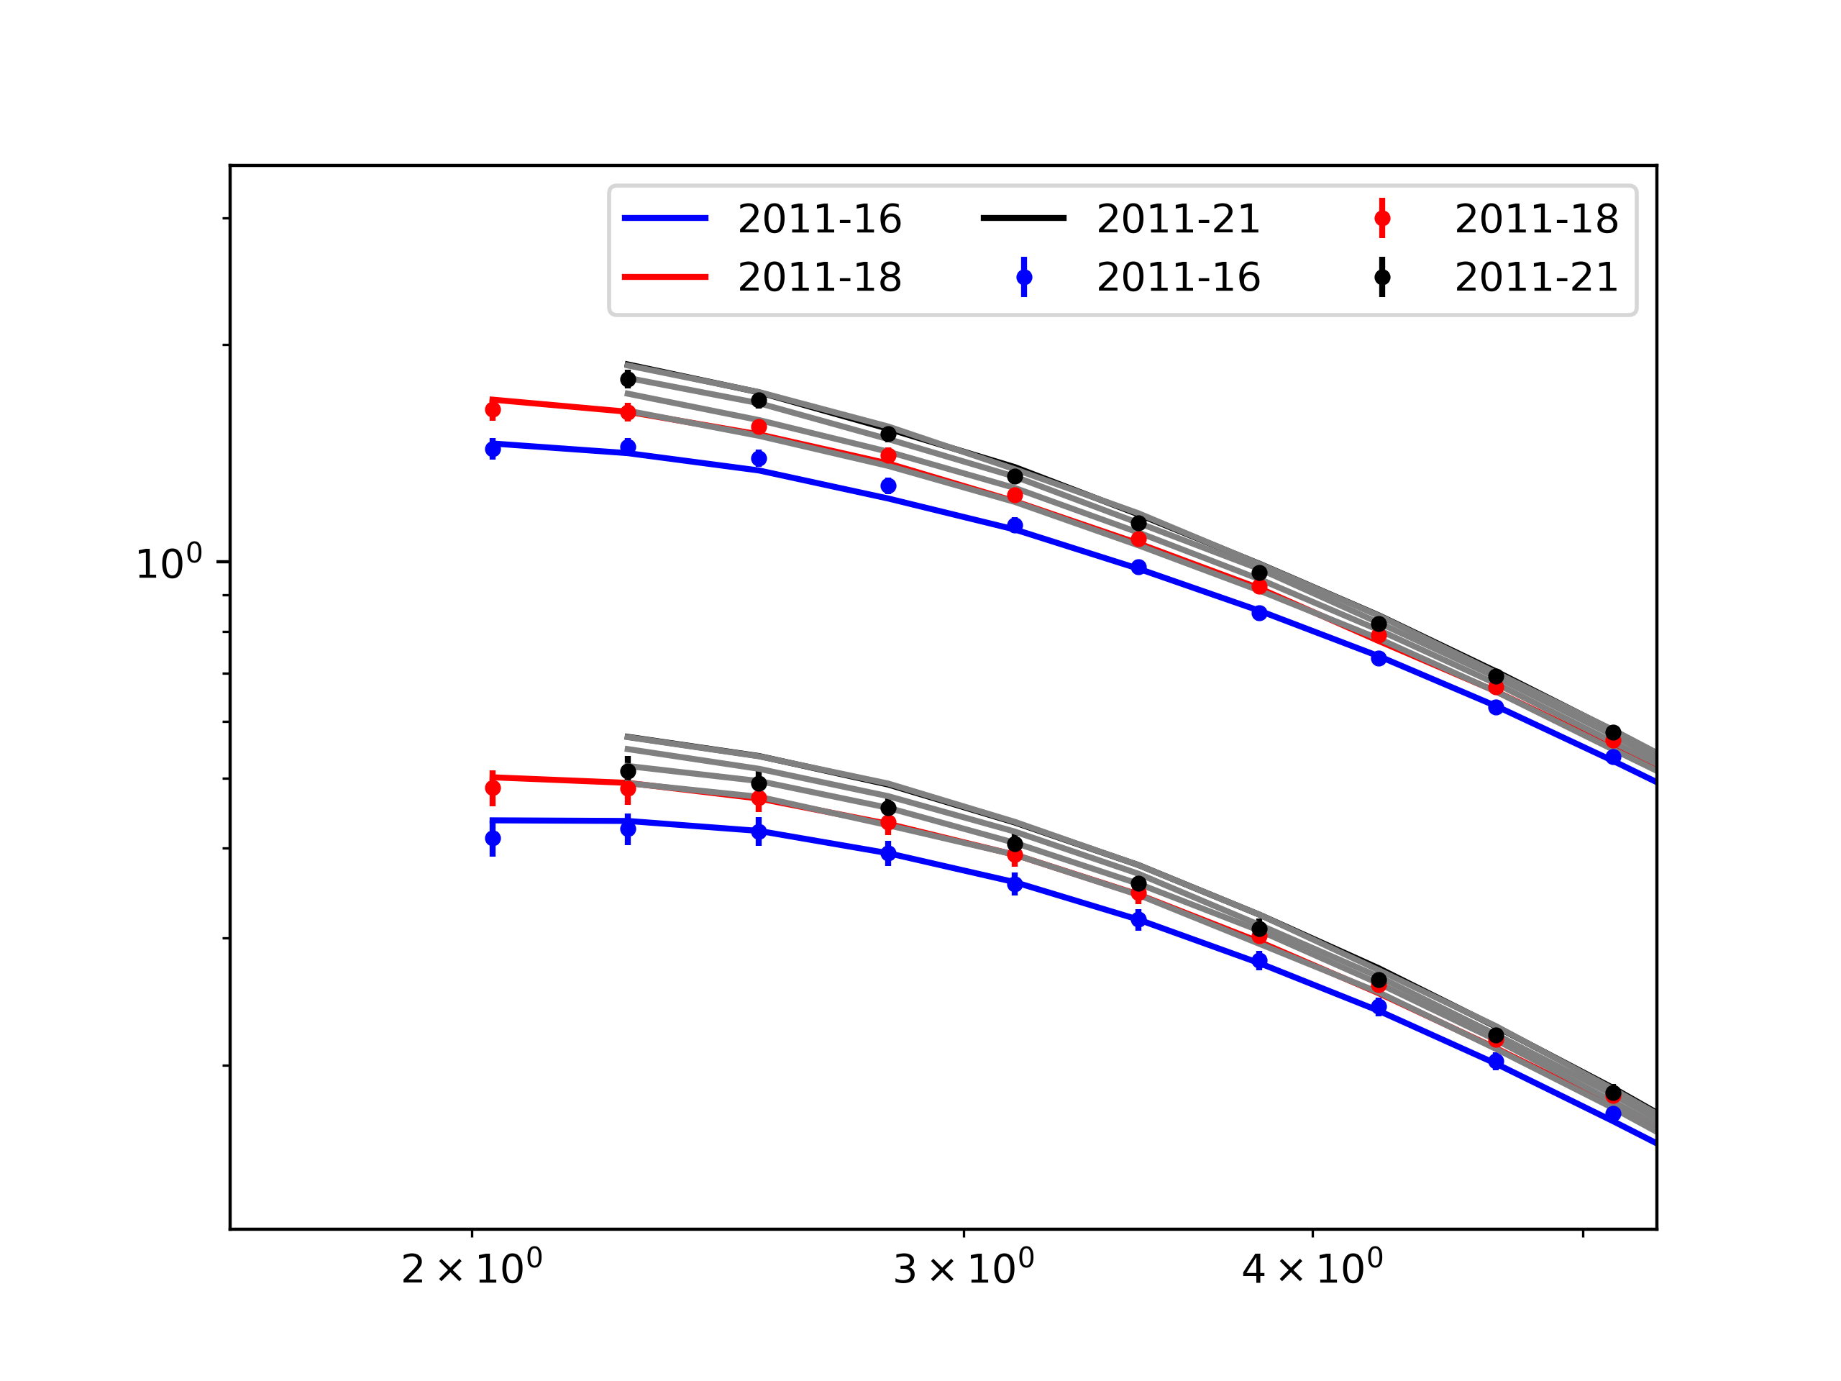
B/C
2011-2021
2011-2020
2011-2019
2011-2018
Anomaly on latest dataset
Carbon
2011-2021
2011-2020
2011-2019
2011-16
Phys. Rev. Lett. 117, 231102 (2016)
2011-2018
Boron
2011-18
Phys. Rep. 894, 1 (2021),
2011-21
Phys. Rev. Lett. 130, 211002 (2023),
Rigidity

Slide 11
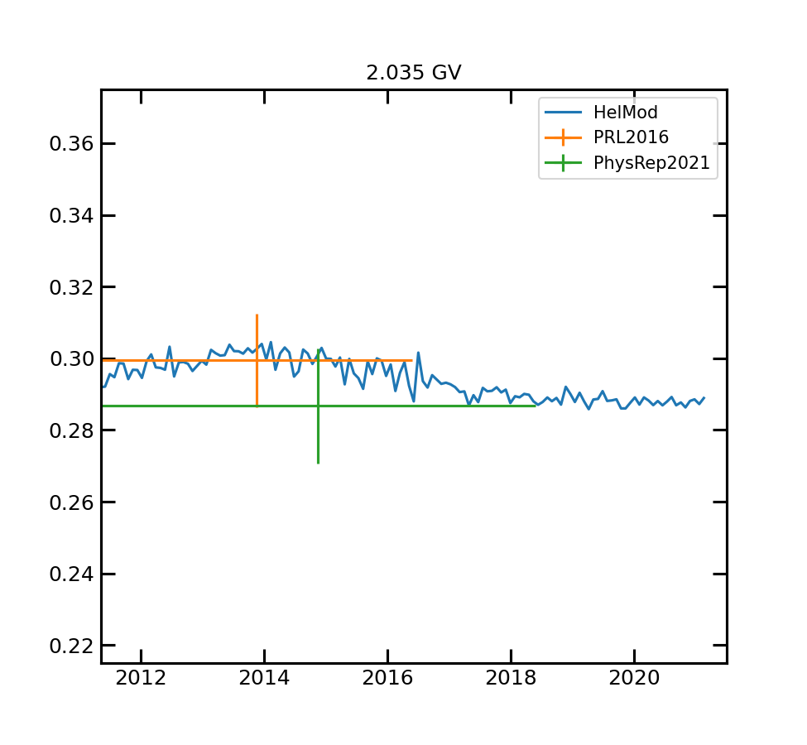
We try a rough comparison with B/C on different time span

Slide 12
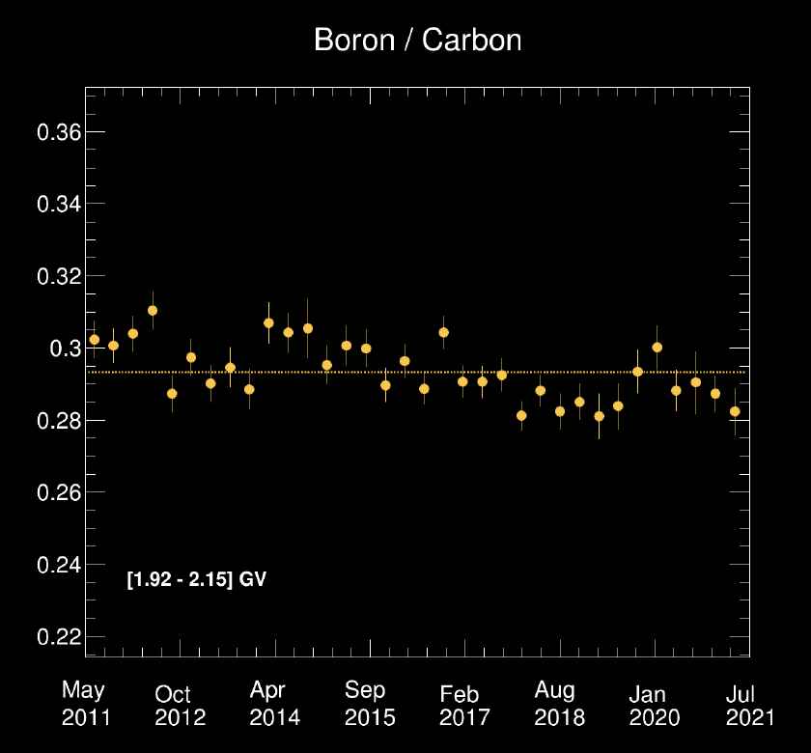
We try a rough comparison with B/C on different time span
With Valerio's presentation at General meeting in June

Slide 13
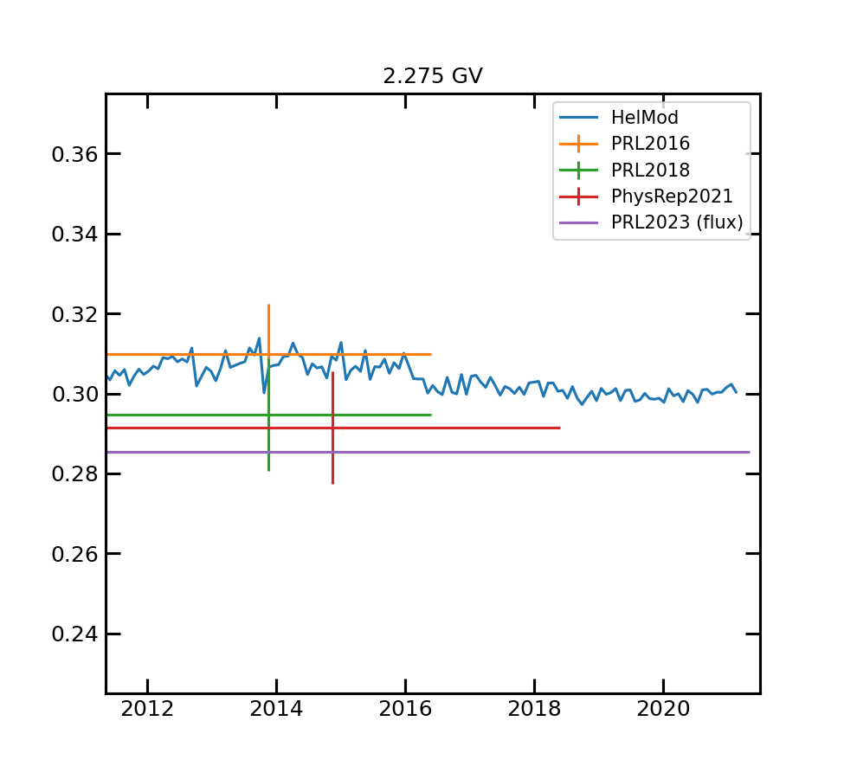
We try a rough comparison with B/C on different time span

Slide 14
We try a rough comparison with B/C on different time span
With Valerio's presentation at General meeting in June

Slide 15

Forbush decreases

Slide 16
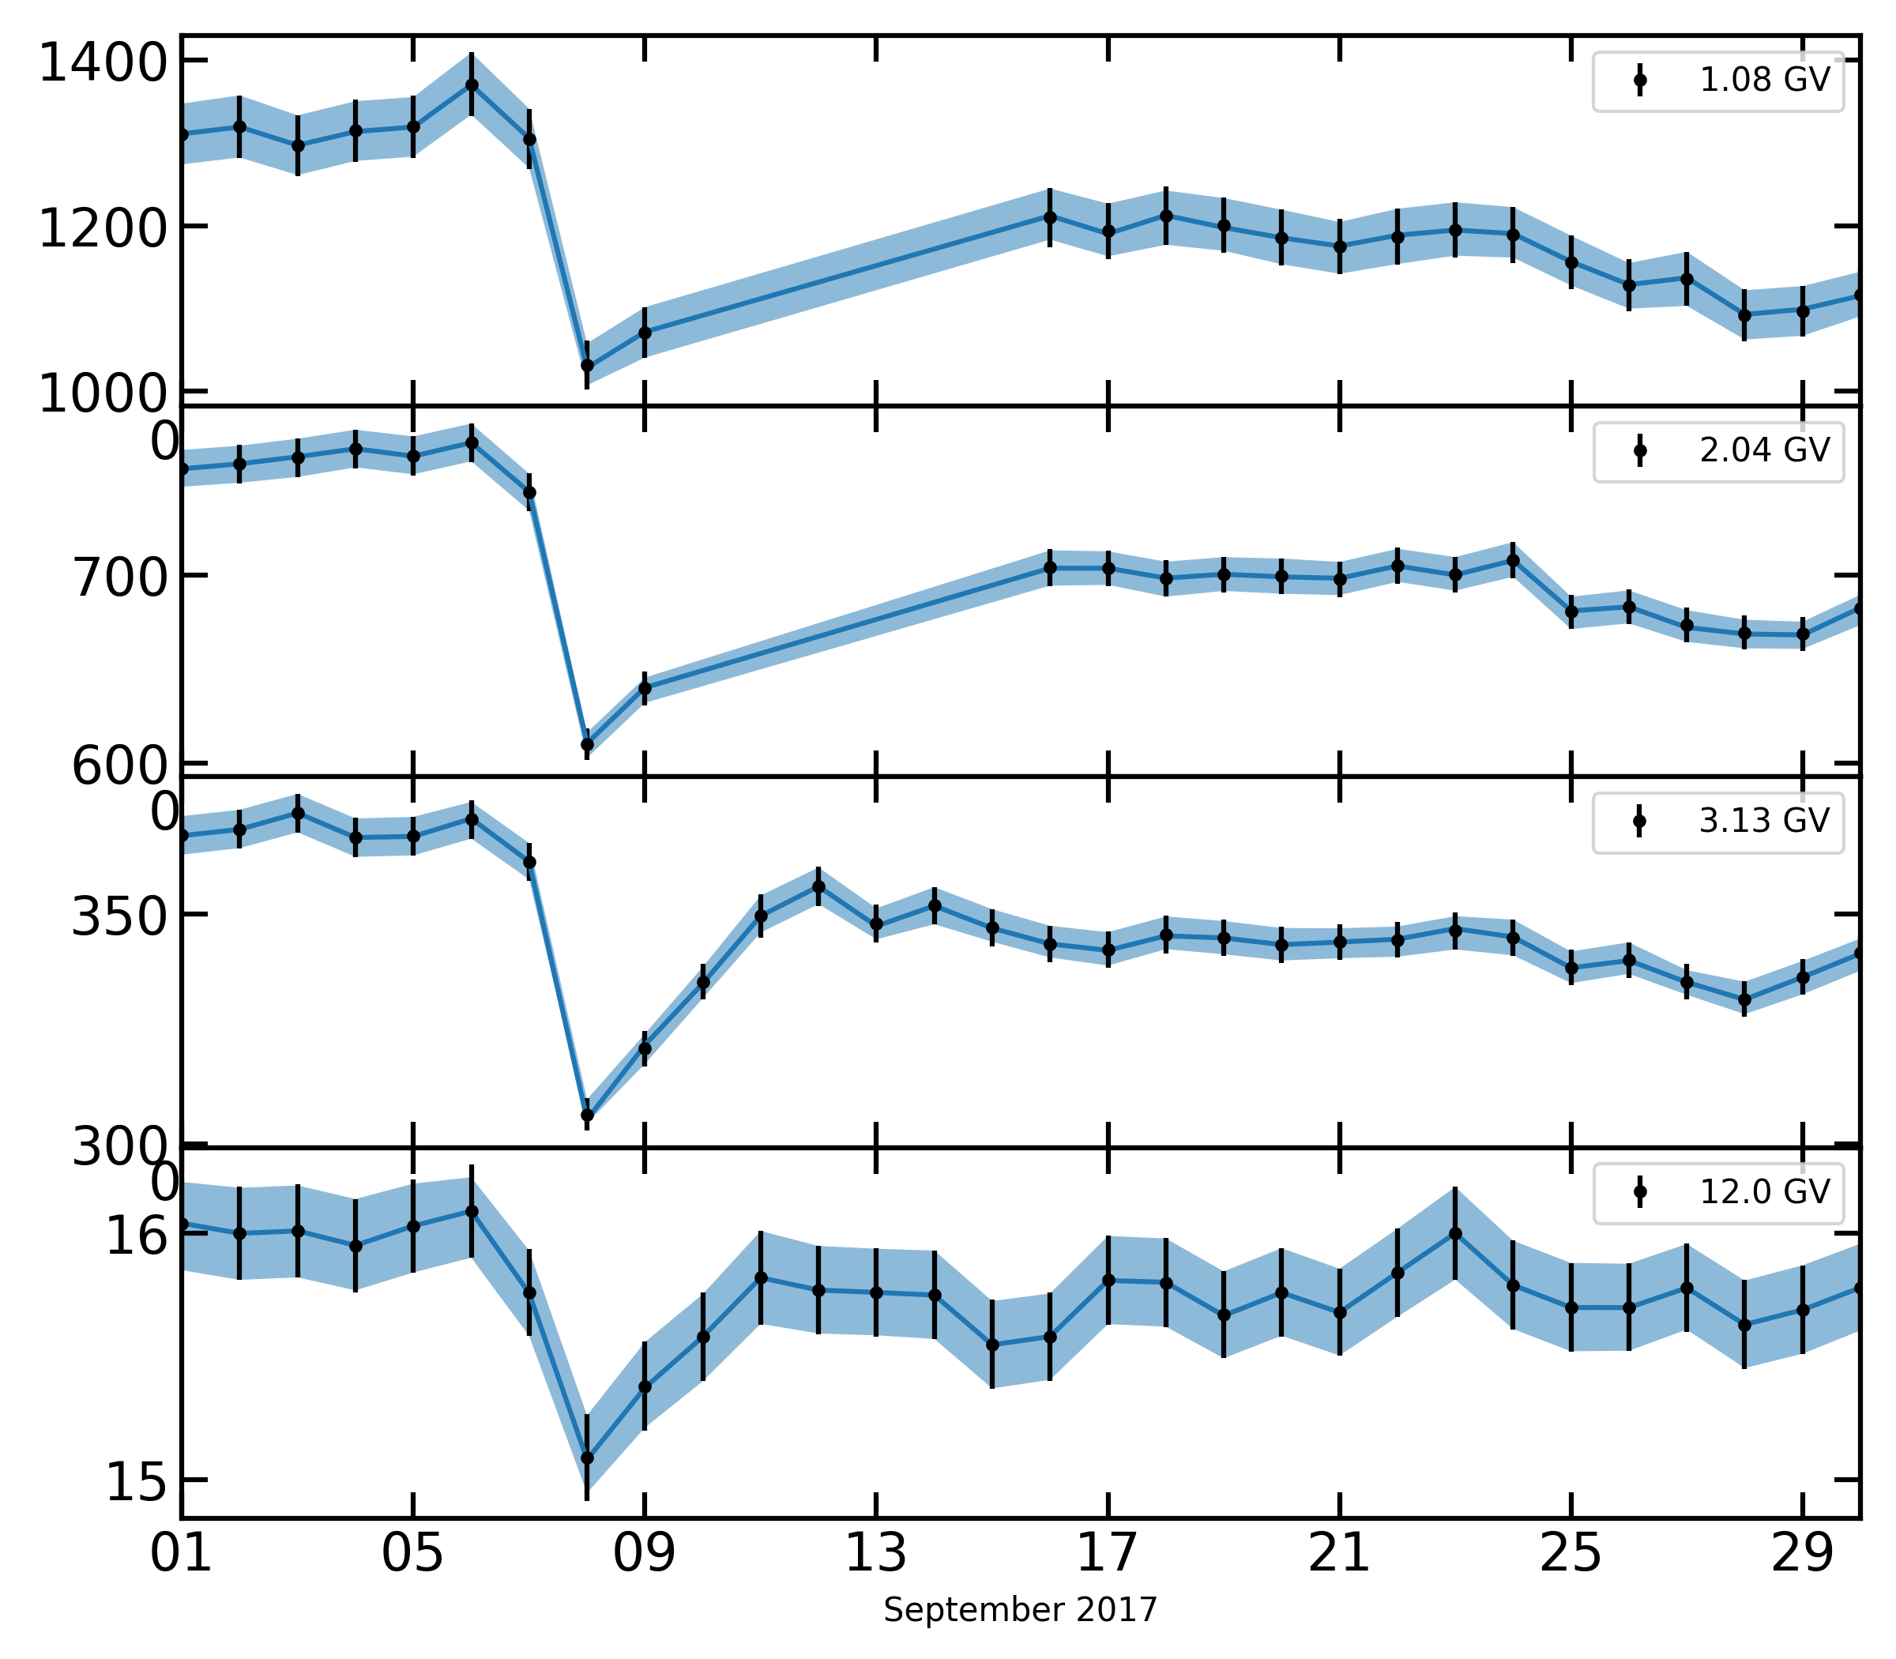
Forbush
Is a temporary flux reduction due to the passage in the medium of a coronal mass ejection
HelMod is designed to average on a solar rotation. But we can try to make some assessment

Slide 17
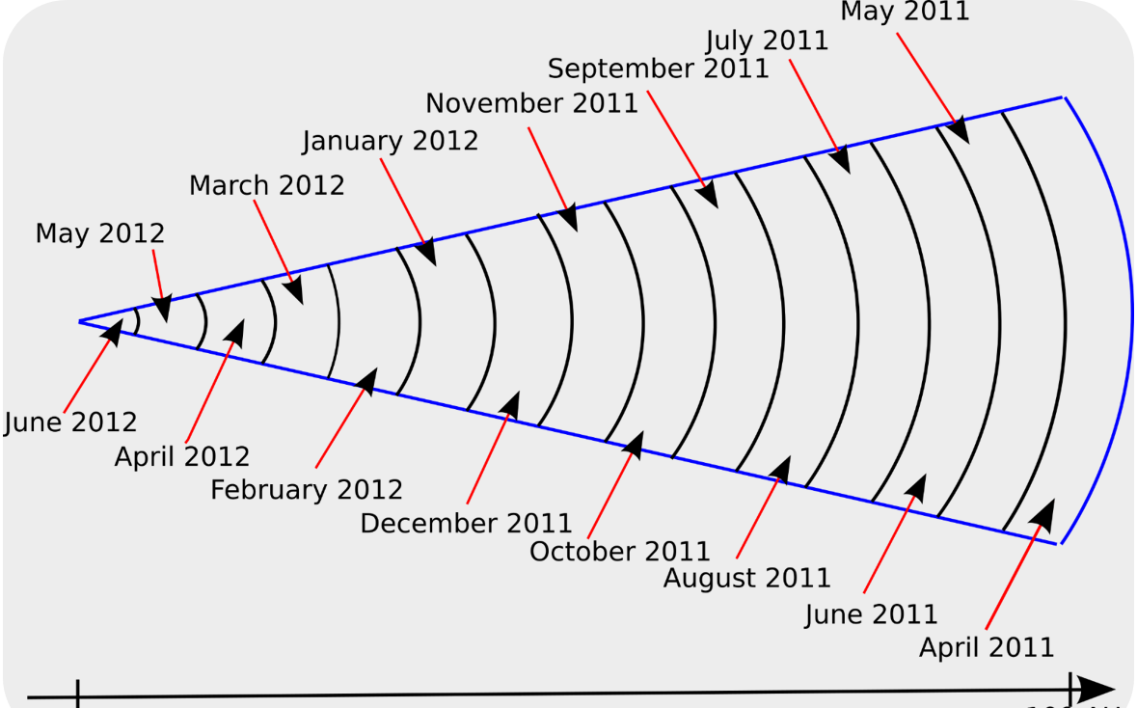
The idea
how the diffusion parameter change during the forbush?
We scan on a grid of values testing different values of K0 for the first region only
We evaluated each energy separetevely

Slide 18
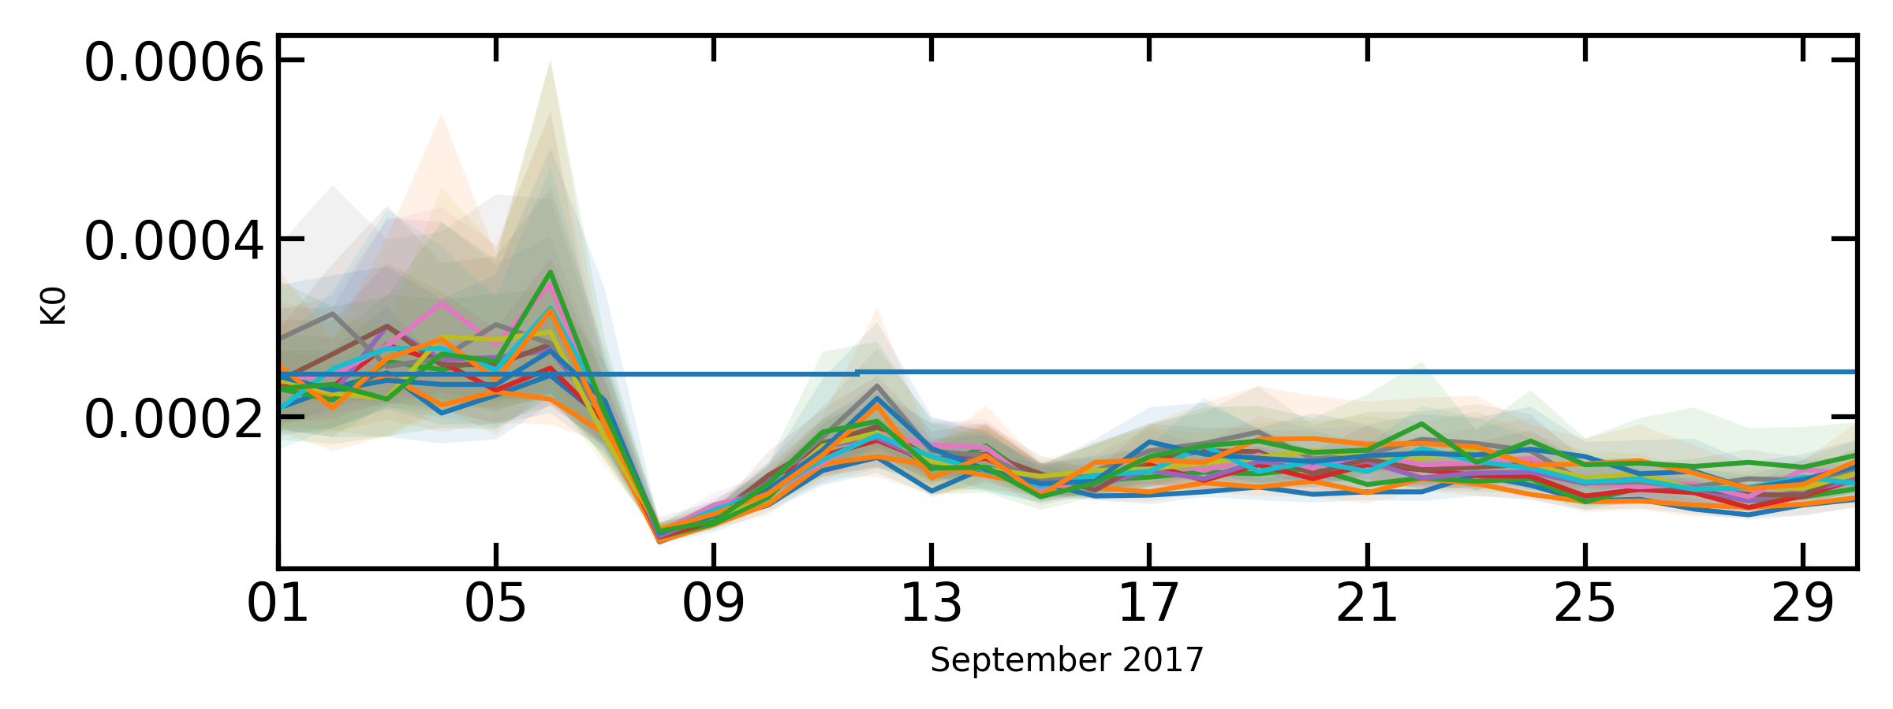
Best fitting K0 value from 3 GV to 10 GV
Expected value from
For energy below -> missing points during the Forbush
For energy below -> to be investigated, maybe not enough statistic

Slide 19
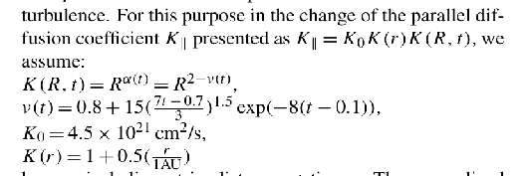
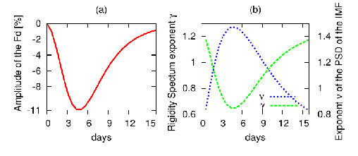
In literature
Precedent work using SDE were made on Neutron monitor only
Wawrzynczak, Alania Adv.Sp.Res. 41,2 2008
Xi Luo et al 2017 ApJ 839 53
The fact that K0 change in the same way from 3 to 10 GV is not trivial and is a result that worth to be better investigated

Slide 20

Thank for your attention

