Slide 1
The ATLAS BMA
M. Bruschi
Assemblea di Sezione - December 22nd 2023

Slide 2
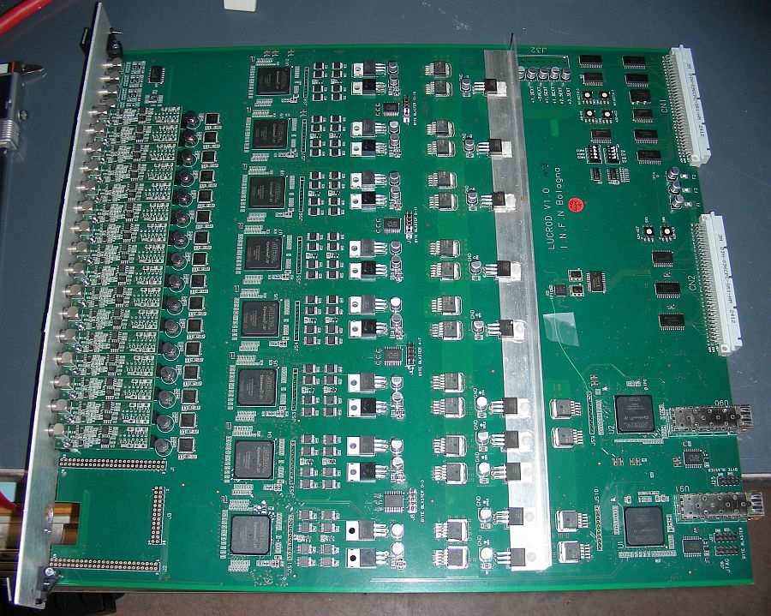
The Beam Monitor for ATLAS (BMA) project
BMA e’ un progetto dell’ INFN di BOLOGNA che e’ stato possibile sviluppare minimizzando costi e personale grazie alla grande esperienza acquisita con LUCID dal personale tecnico e ricercatore
Recentemente interesse e contributi importanti anche da altri gruppi di ATLAS
In Sezione, hanno contribuito al BMA attuale
G. Avoni, B. Giacobbe, C. Sbarra, A. Sbrizzi
Laboratorio di Elettronica (scheda LUCROD)
S. Meneghini
BMA
LUCROD

Slide 3
Importance of luminosity measurement
Important quantity for a collider at its center-of-mass energy
Integrated luminosity: how many collisions in a dataset
Precision measurement of the luminosity is a key ingredient for all physics analyses
For some measurements luminosity is one of the leading systematic uncertainty i.e. t$\overline{t}$/W/Z cross section
Related to
Rate of observed events
Machine parameters
Luminosity measurement for full Run2 ATLAS pp dataset finalized
140.1 ±1.2 fb⁻¹ (0.83%)
Highest precision achieved at the LHC and any other hadron Collider after ISR
Crucial inputs for ongoing Run 3 measurement and ultimate sub-percent precision goal for HL-LHC
LUCID is the ATLAS reference detector for ONLINE and OFFLINE LUMI
Project Under the Responsibility of INFN Bologna

Slide 4
Luminosity challenges for HL-LHC
HL-LHC will have a peak pile-up of mu ~ 200 and higher radiation
To reach the goal of < 1% overall precision on the luminosity measurement, a strategy for the luminosity measurement has been identified
At least three independent luminosity detectors with bunch-by-bunch calibration and that are reasonably linear over the full mu range to be used in physics runs
Multiple auxiliary luminosity measurements with linearity and stability < 1 %
RUN 3 Lumi detectors
+ HGTD, BCM’, (PLR?) in RUN 4

Slide 5
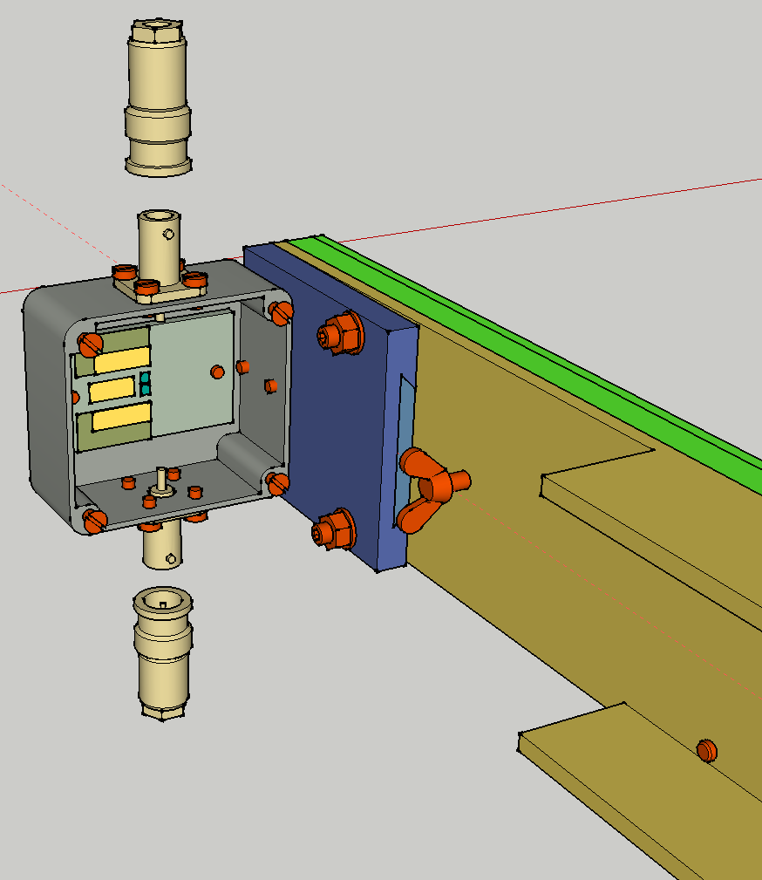
Beam Monitor for ATLAS (BMA): characteristics
BMA is a prototype for an additional ATLAS monitor for the HL-LHC
Installed in 2022
Main characteristics (to cope with μ_{b}~60 → ~200)
Low geometrical acceptance
Smaller systematics effects (non linearities with pile-up)
Potentially less μ dependence → good performances at high lumi
In the present prototype version can not be absolutely calibrated during van der Meer scans
Placed in the ATLAS Forward shielding
can be replaced at the end of every year → limited radiation damage
easy to install and uninstall
No cooling needed (good thermal contact with the forward shielding, an ideal heat reservoir)
BMA
Two LGAD PADS
1.7 mm² area
More on this:
Talk at TIPP 2023

Slide 6
Low-Gain Avalanche Detectors (LGAD)
Lab tests with a radioactive source showed that LGAD detectors are better candidates compared to standard Si, due to a better S/N ratio for the chosen readout scheme.

Slide 7
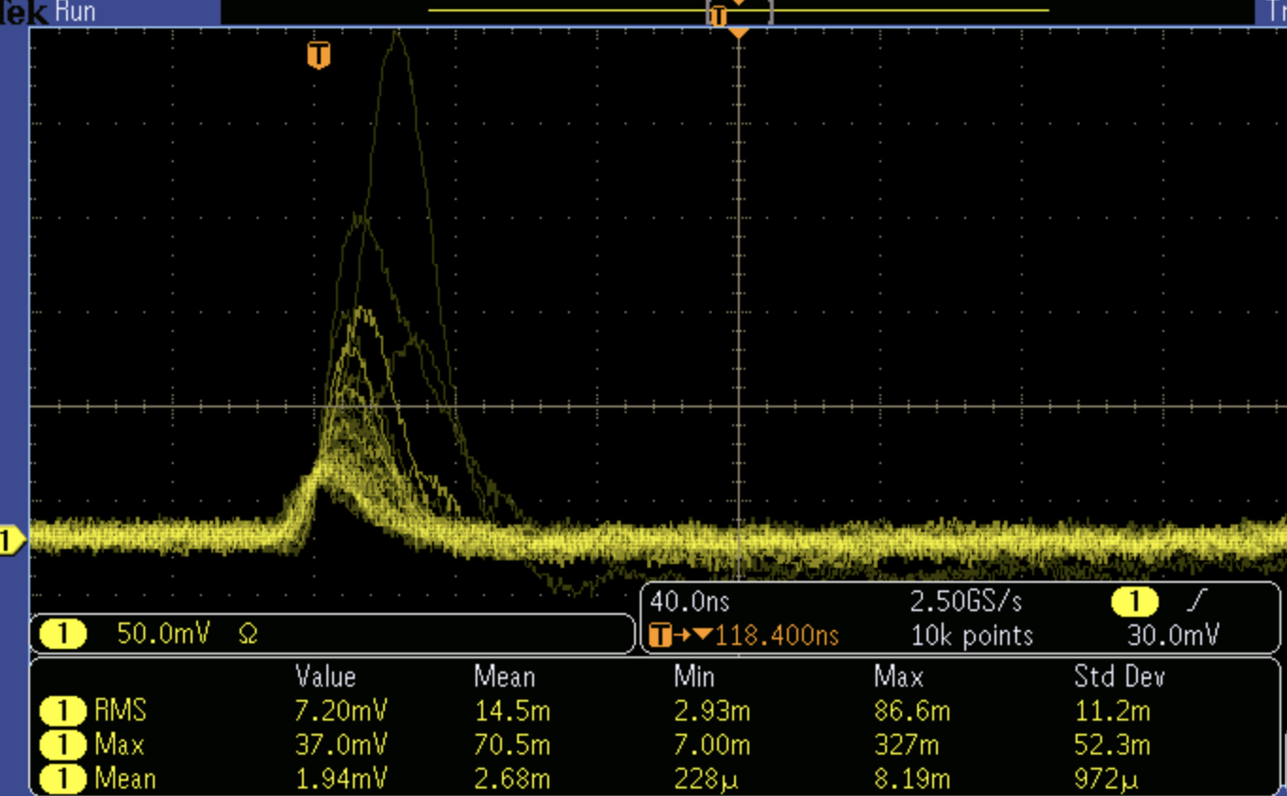
The Challenge !
ATLAS HALL
for ELECTRONICS
25 m TRIAX CABLE
CAEN
A 1426
120 m RG58 CABLE
NIM
JFC3
Side C
120 m CABLE
MIP
CLOSEST RACK
HV
MIP Charge ~ 10 fC
50 mV
40 ns
The charge preamplifier is 25m distant from the detectors (LOW irradiation!)
The NIM trigger electronics is 120m from the preamplifier (temporary solution)
The quality of the cables is quite “poor”: RG 58 cables are used for the 120 m path

Slide 8
The CAEN 1426 A (“Cardarelli”) charge preamplifier
This is a commercial device designed by the ATLAS physicist R. Cardarelli (INFN Roma2, Italy)
The key concept is that the input of this charge preamplifier is designed to be dynamically matched to the coaxial cable characteristics 50Ω impedance up to ~ 1 GHz frequency
Under this condition the cable load to the detector is almost purely resistive
the cable capacitive load becomes negligible and the charge produced in the detector can travel for tens of meters almost without losses
Specifications
Fast, non-inverting preamplifier, positive output
Up to 5 mV/fC sensitivity
ENC of 0.3 fC (2000 e)
Input impedance can be matched to a 50 Ω transmission line
Amplifier can be very far from the detector (up to 100 m)
Output range 0 to 1 V
Output impedance of 50 Ω
Up to 1 kV (positive or negative) detector bias voltage
Max detector capacitance ~ 10 pF

Slide 9
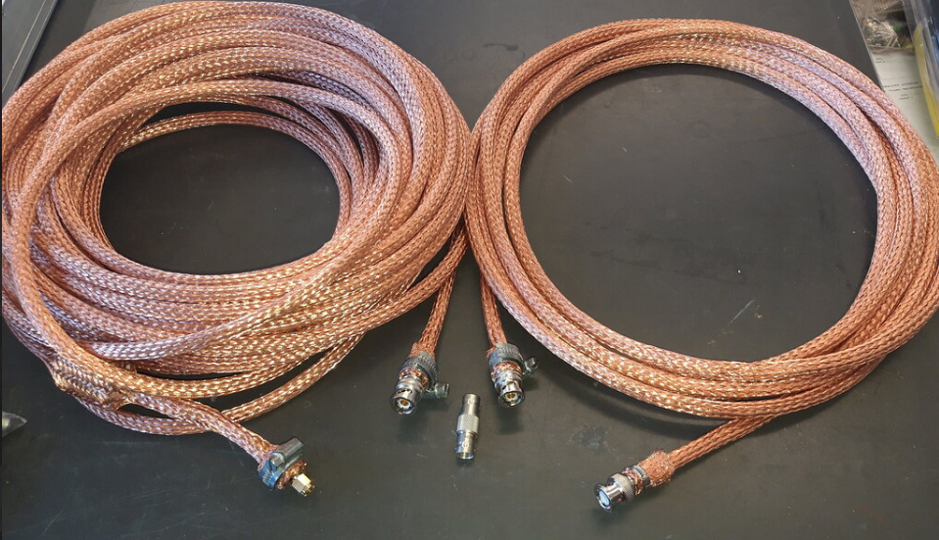
BMA shielded signal cables
A
20m
B
5m
Copper braid 10mm²
Copper braid 10mm²
2
3
1
4
Ferrite
Screw clamping ring
The use of these extra shielded cables to connect the detector box to the preamplifier (25 m) has been crucial for the proper working of the readout scheme
Their use reduced the environmental noise in the LAB and in ATLAS by 1 order of magnitude !

Slide 10
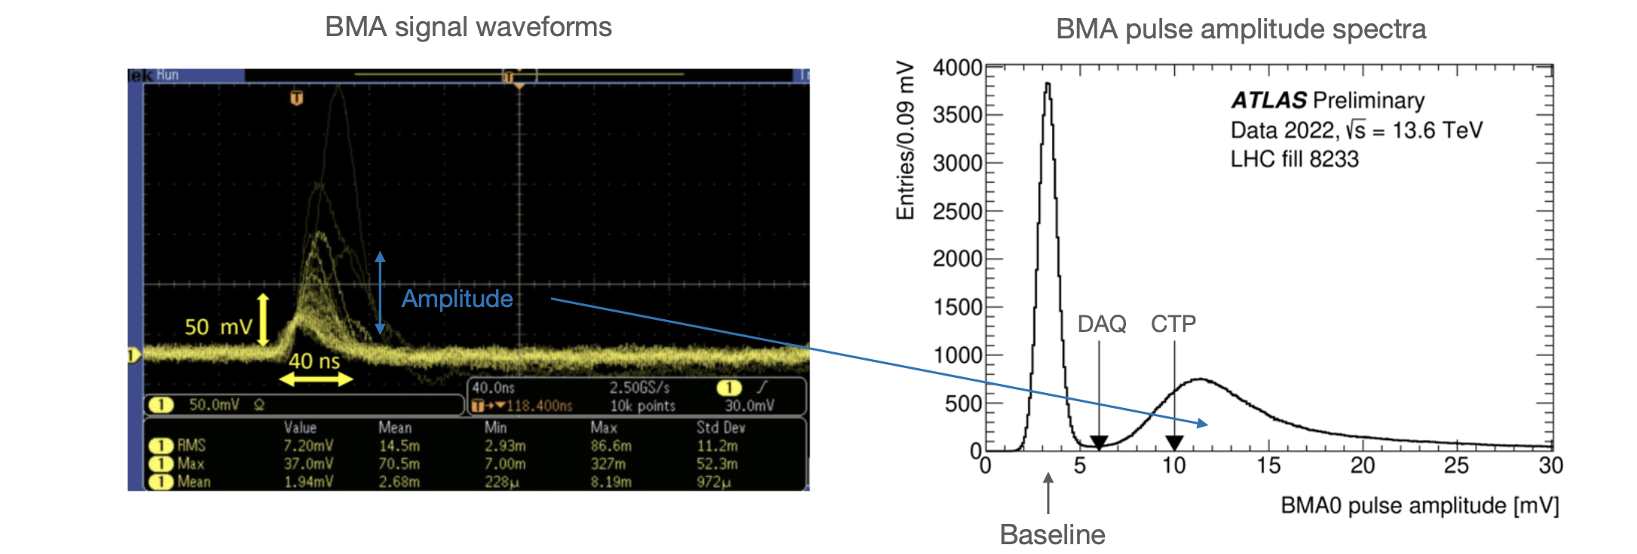
BMA: signal processing
LUCROD
Signal processing of LGAD signals different from HGTD
2022
CTP: standard NIM trigger with threshold at 10 mV
2023
using BMA LUCROD integrated in the OLC
DAQ: with a lower threshold at 7.3 mV
DAQ (gain-corrected): same as DAQ but increasing the LUCROD amplification to compensate for detector gain losses
S/N ~ 24!
Very low acceptance: σ_{vis}~80 μbarn
BMA pulse amplitude spectra can be considered as SINGLE MIP spectra (~ independent from μ value)
Calibration technique is very promising: under study

Slide 11
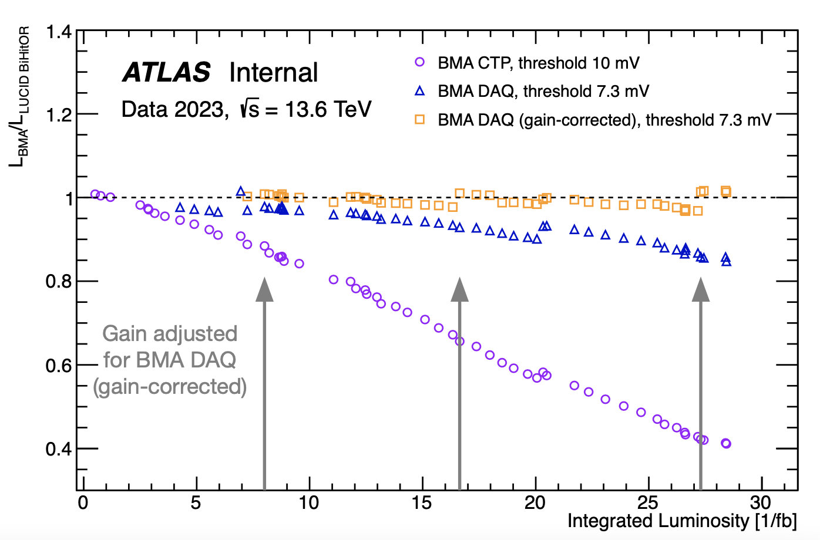
BMA Efficiency vs integrated luminosity
BMA CTP has a linear decrease with around 2.5% per /fb The first channel of BMA DAQ has a linear decrease with around 0.7% per /fb (between 10-20 /fb) and 1.25% per /fb (between 20-28 /fb)
For the second channel, BMA DAQ (gain-corrected), the gain was adjusted three times: May 17th (around 8 /fb), June 8th (around 16 /fb) and July 12th (around 28 /fb)
BMA DAQ (gain-corrected) follows LUCID somewhat closely with a total difference less than 2%
The efficiency loss is dominated by gain loss
The efficiency and stability can be improved by adjusting the gain regularly!
Ratio of the run-integrated-luminosity of BMA wrt to LUCID

Slide 12
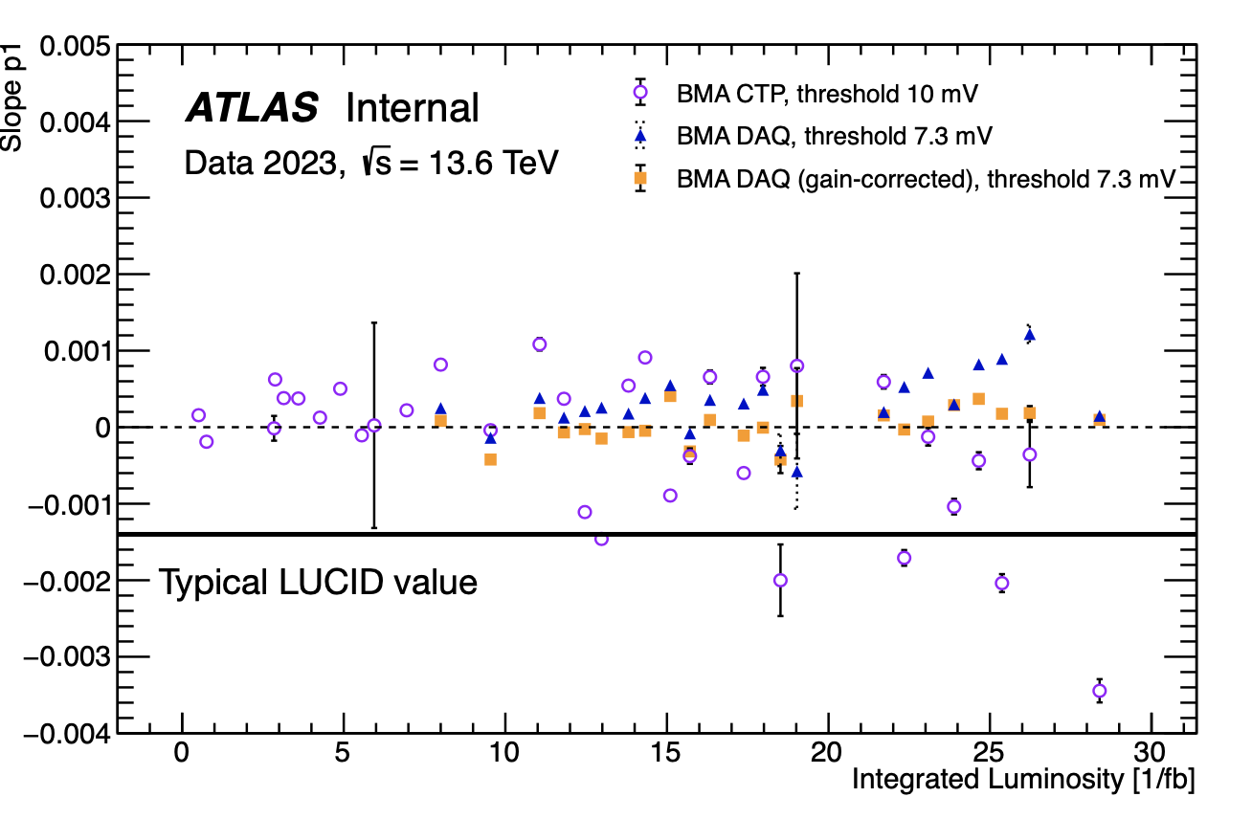
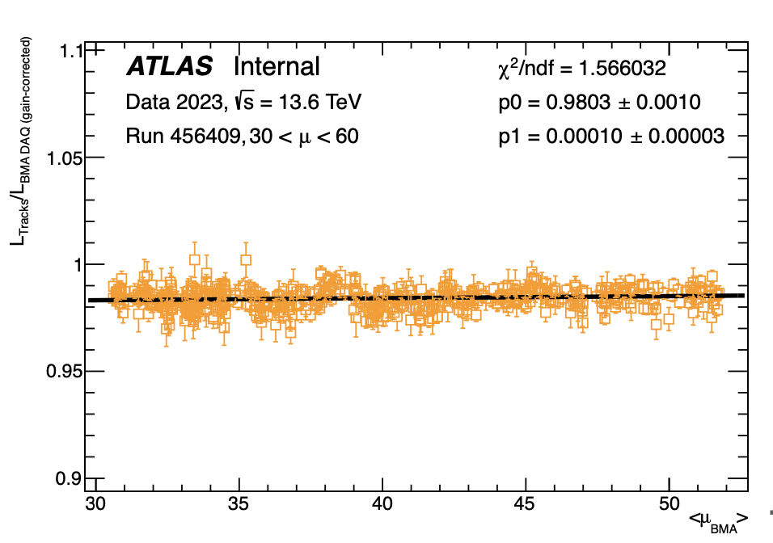
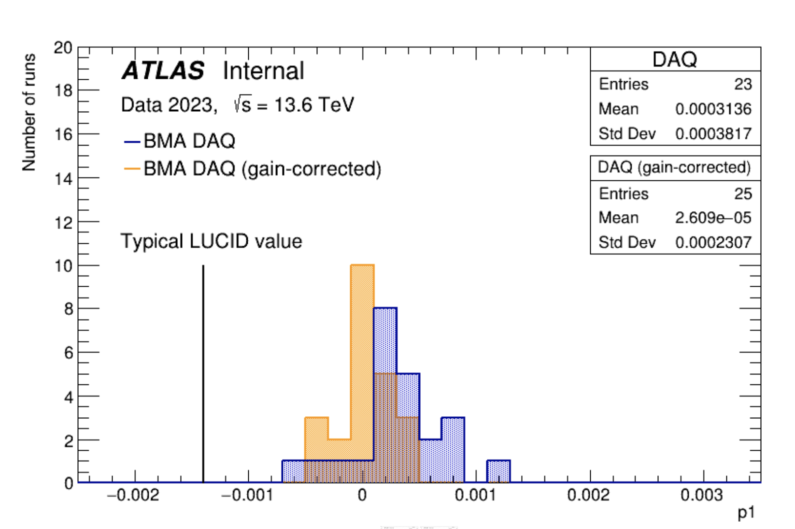
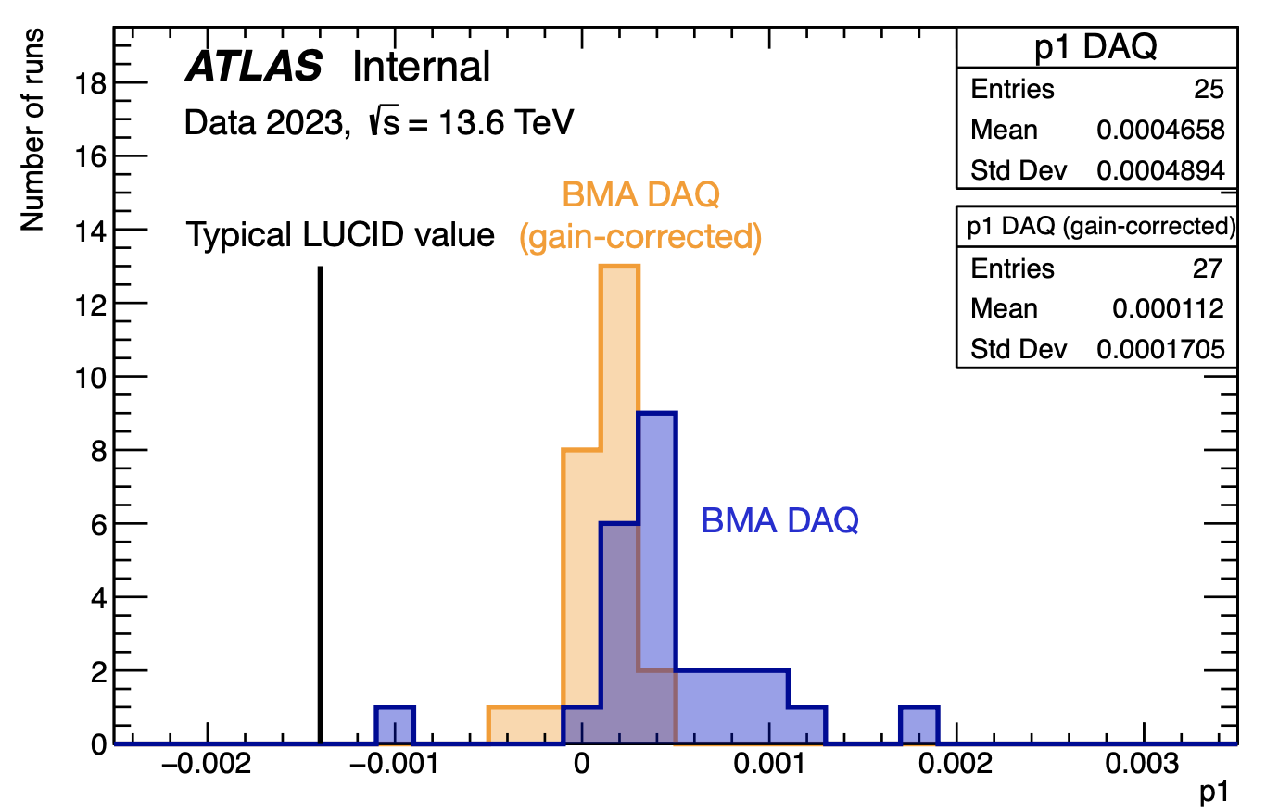
μ-dependence
μ-dependence: Any detector response systematic effect which affects the linearity of the luminosity measurement as a function of μ
The data points have been fitted with a straight line (p1 is the slope which gives the correction for unit of mu)
BMA DAQ (gain-corrected) performs the best of all configurations!
One order of magnitude less compared to the example value of LUCID of -0.0014
<p1>=(2.6±4.6)10⁻⁵ (0.6σ zero-compatibility)

Slide 13
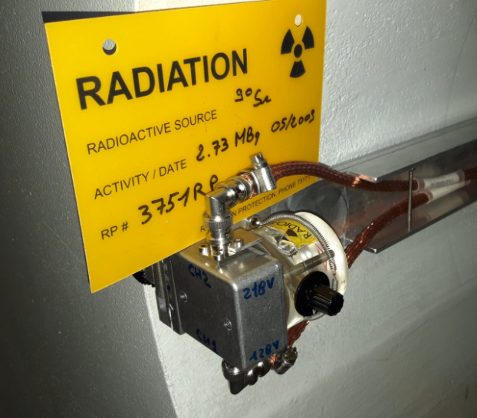
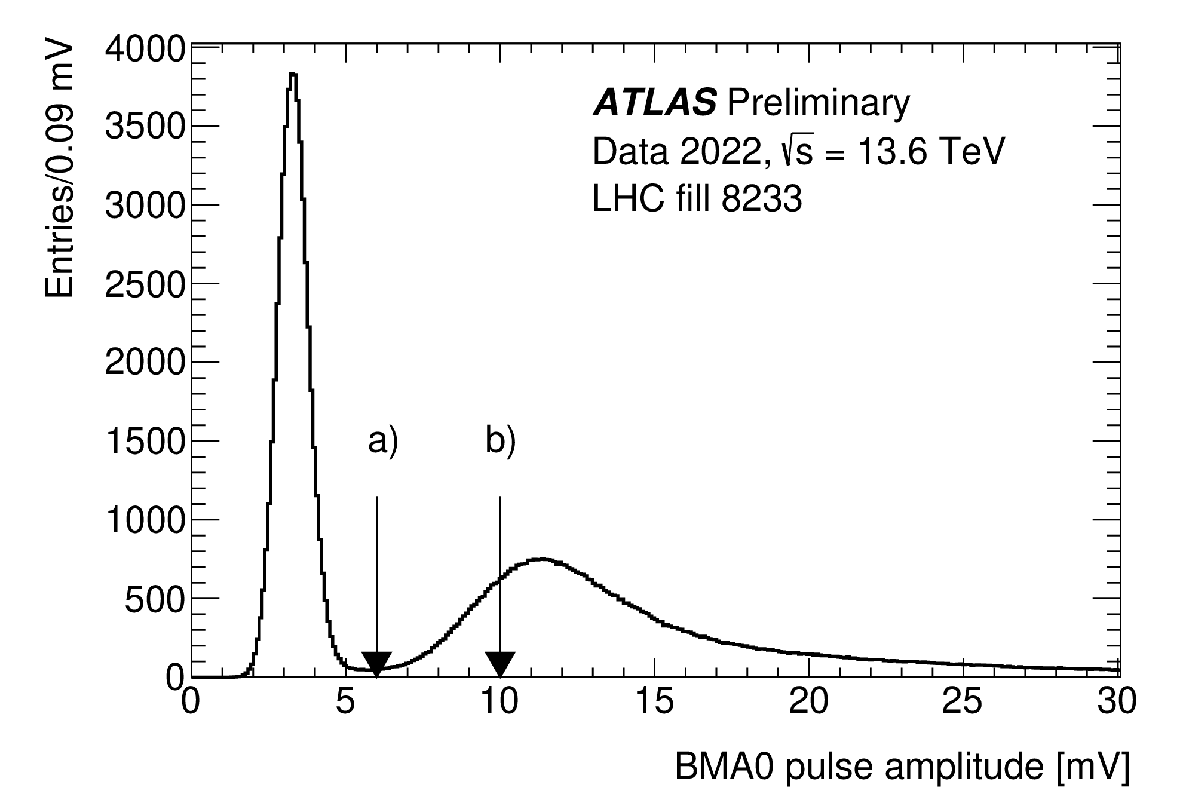
Calibration Strategy
It is of utmost importance to monitor the detector response and gain stability
Calibration using a standard RP ⁹⁰Sr
The present BMA box foresees already the possibility to place a source to regularly calibrate the detector
This method has been used during the installation phase of the detector
A final RP validation is needed for the installed detector
Self-calibration using P.H. spectra
The pad acceptance is very small, BMA is recording single track spectra
The efficiency variation can be hence be evaluated by the LUCROD amplitude spectra
A promising method based on keeping the MIP peak position fixed by adjusting the LUCROD amplification factor is under study

Slide 14
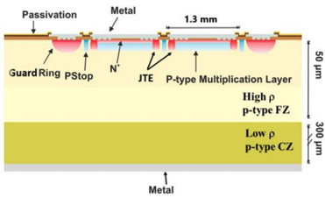
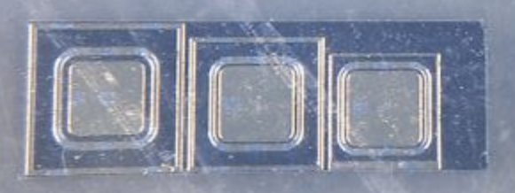
LGAD radiation resistance
Thin≈50μm active layer on thick≈300μm substrate
Multiplication layer
Affected by irradiation originated defects (acceptor removal)
Compensated by higher bias voltage up to a point
Single Event Burnout (SEB) observed in irradiated sensors at high HV
Robustness improved by carbon-enriched gain layer (from ATLAS HGTD R&D)
Only carbon-enriched gain layer modules viable for operation in HGTD
The BMA in 2024 will consist of
new HPK Typ 3.2 (for continuity with the past)
new C-enriched IHEP V3 pad

Slide 15
Present and future perspectives
BMA LUCROD
The BMA LUCROD card was finally integrated in the ATLAS online luminosity calculator (OLC) data stream at the beginning of the 2023 data taking
Works at lower threshold than the non-optimal NIM ones
records samples of BMA waveforms
stores pulse amplitude spectra
provides by-bunch luminosity data
All these features will be fundamental to
control BMA systematic effects possibly improving them !
The analyses using LUCROD data are started and first results are expected to be public in the next weeks
Detector in 2024
Depending on the outcome of the analyses on LUCROD data, we are planning to use and test (at least) one LGADs with carbon doped multiplication layer
LUCROD

Slide 16
NEW: Design of LGAD with small pixels
Pixel size: 0.65 mm x 0.65 mm
Array 2x2
This pad size could also be used, together with the standard one, since it is supposed to have ¼ occupancy
Design already performed, some samples should be ready next summer
One of these pads could be already installed and tested in 2025
Big thanks to Mei and Yunyun who took care of the design
New standard detectors to be tested have been received by IHEP (17 single pads)

Slide 17
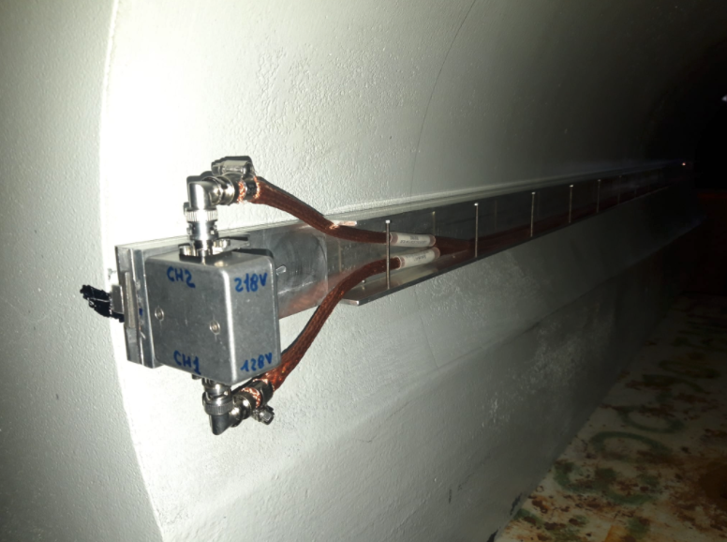
SUMMARY
La misura della luminosità è di fondamentale importanza poiché fornisce la scala di normalizzazione a tutte le analisi di fisica che si fanno, ad esempio, negli esperimenti di LHC
BMA è un monitor di luminosità aggiuntivo per l'esperimento ATLAS, finalizzato alla determinazione della luminosità nel Run 4 di LHC.
La lettura del rivelatore si basa su un concetto innovativo di preamplificatore di carica che consente di collocare l'elettronica in un'area non irradiata.
I dati raccolti finora mostrano già prestazioni considerevoli, anche se l'attuale resistenza alle radiazioni del rivelatore puo’ essere un problema per HL -LHC.
Un'installazione con un nuovo rivelatore LGAD drogato di carbonio, più resistente alle radiazioni, è prevista in occasione di questa chiusura invernale di LHC.

Slide 18
Next steps
BMA project presentation in many important ATLAS meetings (AW, AUW, ALOG, LTF) in the last few months
many important points discussed, the baseline of the project has been outlined
Decisive support of ATLAS UC and TC to this project
Kick-off meeting with the institutes interested in BMA soon
INFN Bologna (B. Giacobbe, A. Sbrizzi, myself)
IHEP (contact: J. Guimaraes): in kind contributions in providing detectors and HV power supply + expertise on LGAD (Mei Zhao, Yunyun Fan)
Uni. de Sao Paulo (contact: M. Leite): preliminary contacts: detectors + expertise in LGAD calibration using laser
KTH (contact: J. Strandberg): strong support presently to the detector commissioning [C. Ohm, O. Lundberg, M. Vande Voorde (QT)]
UCL (contact: M. Campanelli): interest of Mario to continue to work in the project
Technical Proposal will follow in the first middle of 2024

Slide 19
Backup

Slide 20
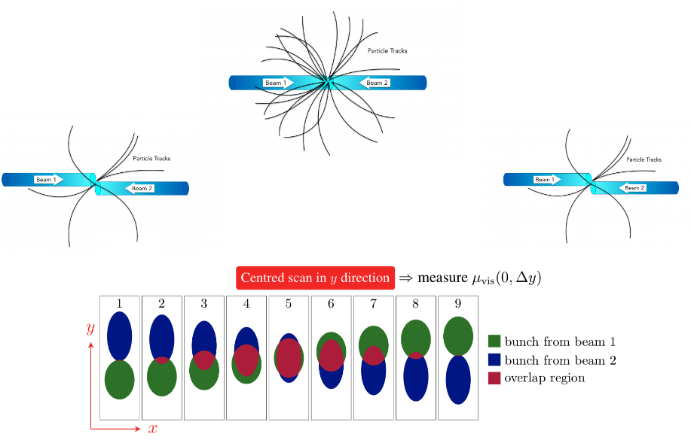
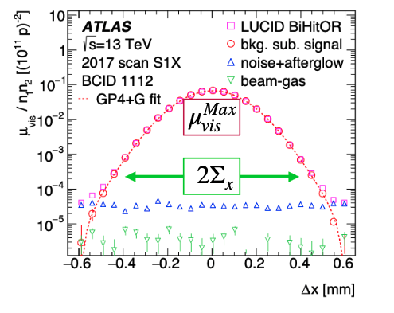
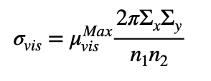
The ATLAS strategy for the luminosity measurement
Absolute calibration
van der Meer scan typically performed once per year
Allow to measure σ_{vis}, the calibration constant of the luminosity detectors
calibration of LUCID in controlled conditions → low-μ_{b}, isolated bunches
Calibration transfer
Extrapolation of LUCID measurement from vdM regime to physics regime (high-μ_{b})
Track counting used to correct LUCID
Cross-checked with Tile measurement for uncertainties
Long-term stability
Check of Run-to-Run stability throughout each year
Comparison of run-integrated luminosity of LUCID wrt Tile, EMEC, FCAL
Challanges for RUN4: μ_{b}~60 → ~200
Algorithms saturation
Calibration transfer
Detector irradiation
Goal for RUN 4 : ≲ 1% overall precision on ATLAS luminosity measurement

Slide 21
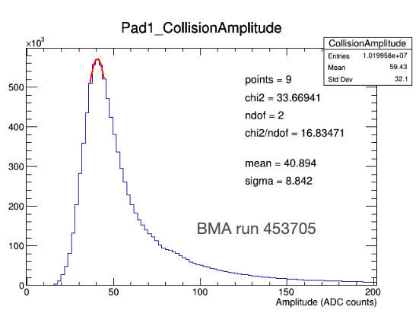
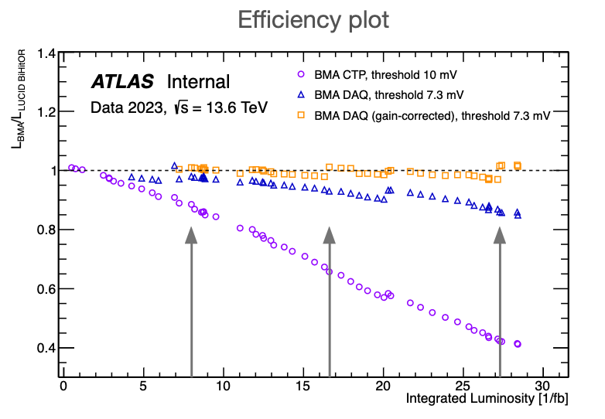
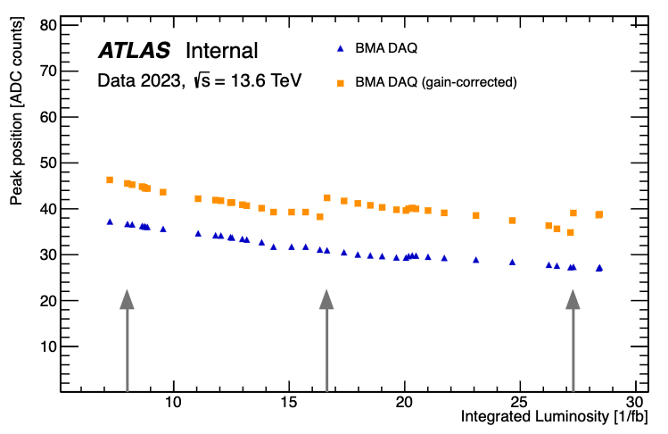
Self calibration using pulse height spectra
The pulse height spectra peak is fitted with a parabola (upper plot) and the peak position is plotted as a function of the integrated luminosity (lower right plot) for the BMA DAQ and DAQ (G.C.) channels
The peak positions trends are very similar to the ones reported in the Efficiency plot (lower left plot) already shown in slide 5
It looks like the peak position can be used as a monitor of the detector efficiency
Next (crucial) step
Prove that the peak position does not depend on the μ-value
Work in progress

Slide 22
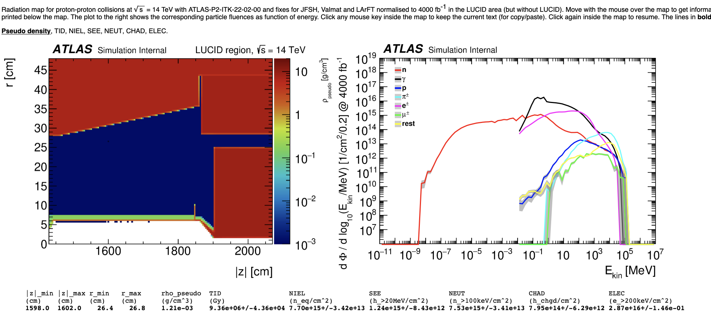
Particle flows
Pilot Beam
JFC3 RUN3
 | RUN 3 (100 ifb/year) | RUN 4 (300 ifb/year)
ELEC (1/BC/cm2) | 5.4 | 16.1
NEUT (1/YEAR/cm2) | 1.93E14 | 5.79E14
CHAD (1/YEAR/cm2) | 1.99E13 | 5.97E13
TID (Gy/YEAR) | 2.34E5 | 7.02E5

Slide 23
Expected performances
RUN 3
RUN 4
The measurements in this table are per BC and include 3 scenarios
VdM scans (T=30s)
Online lumi (T=2s)
Per lumiblock lumi (T=60s)
Since in the VdM there are 100 colliding BC, a BC-BLIND cross calibration seems to be possible

Slide 24
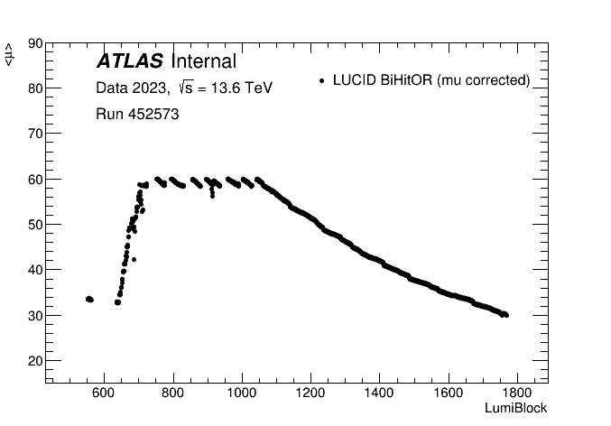
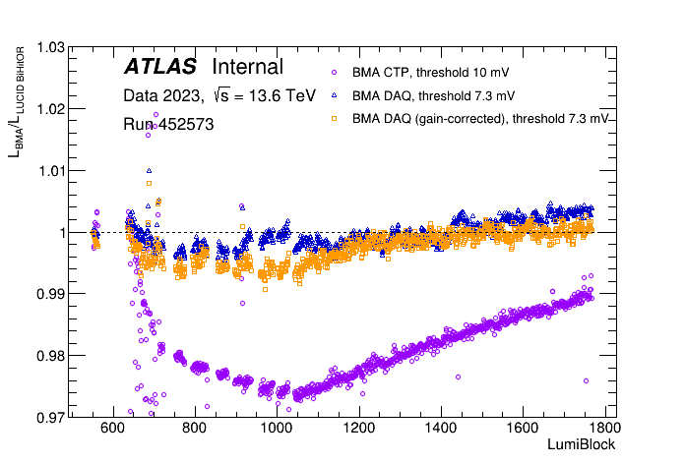
Physics performance
Study of BMA performance for run 452573 on May 18th, with an integrated luminosity of 0.762 /fb
Just after the first gain adjustment for BMA DAQ (gain- correction)
The upper plot shows the bunch-averaged mu as a function of LumiBlock for LUCID BiHitOR (the current best luminosity algorithm)
The lower plot shows the ratio between the integrated luminosity measured in each LumiBlock by LUCID BiHitOR and each BMA configuration as a function of LumiBlock. The ratios are normalized to 1 for each BMA configuration in the first LumiBlock
The maximum deviation for BMA CTP is around 2.5%
The maximum deviation for BMA DAQ is around 0.4%
• The maximum deviation for BMA DAQ (gain- correction) is around 0.4%
There are clear trends in the initial phase (30<mu<60) and the final phase (60>mu>30)
to be understood, under study

Slide 25
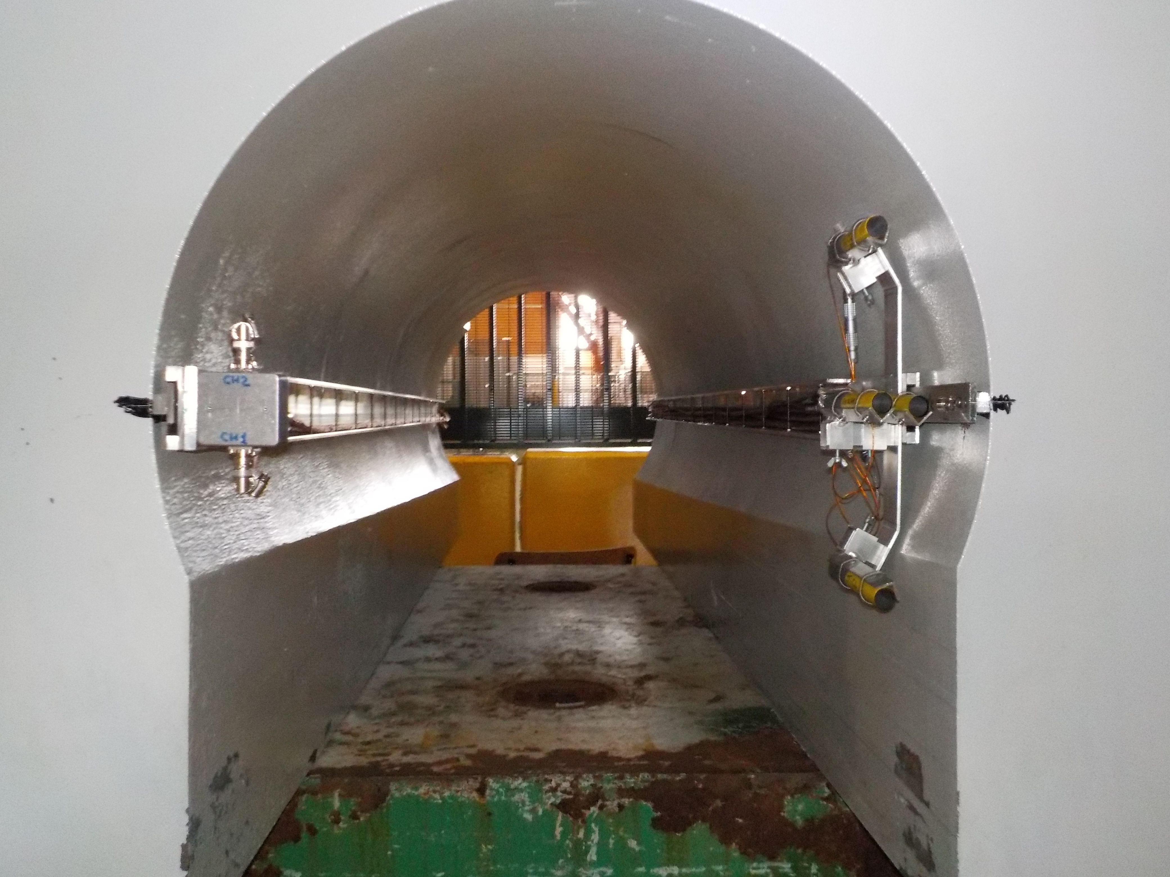
Back of the envelope cost estimate
Assume
Mechanics: 2x1k
8 LGAD detectors per side (in kind)
8 readout channel per side 2x15k
HV Power supply (in kind)
Cabling, connectors 2x1k
Slow control system (T,I) 2x2k
1 LUCROD per side 2x15k
Racks + LUCROD crate 2x10k
Total funding needed ~ 100 k
In case of vdM scan detector the number of channels per side would double, so ~ doubling the final price
FTE needed: presently (1 physicist + 1 PhD) → times ~2
PROPOSED BASELINE DETECTOR DESCRIPTION
SIDE A/C
1 box with 4 detectors (integrated with LUCID) per JFC3 side
Total # channels: 8+8=16 (NO vdM scan)
One LUCROD board can read 8 channels

