Slide 1
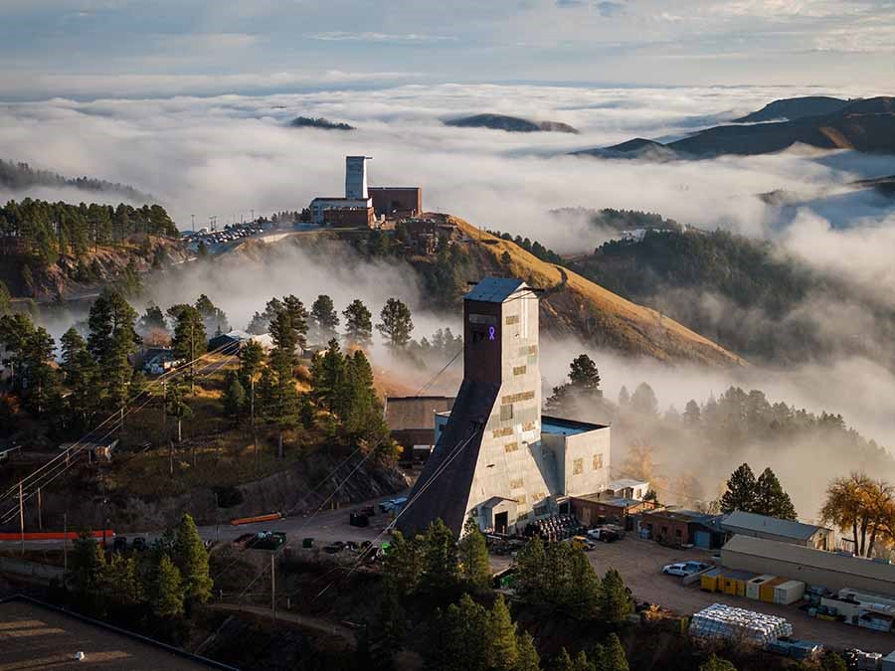
An Update from DUNE
(World, Italy, Bologna)
Sergio Bertolucci
INFN & University of Bologna & INPS

Slide 2
DUNE in 2023: a busy and successful year
Excavation of the far site nearing completion(93%, on time and on budget)
Construction of the warm structure of the FD1 and FD2 cryostats underway
ProtoDUNE-2 preparing for running in 2024 for both NP04 (HD) and NP02 (VD)
Multilateral MOU signed in November for FD1, FD2
Common fund established
P5 reports confirms DUNE Phase 1 as current top priority and recommends DUNE Phase 2
Countless reviews successfully passed
…..
Finalization of the multi-institutional MOU process, soliciting in parallel a written statement from the FA’s confirming their commitment to the FD1 and FD2 Annexes as expressed in the March RRB (almost) ready for signature

Slide 3
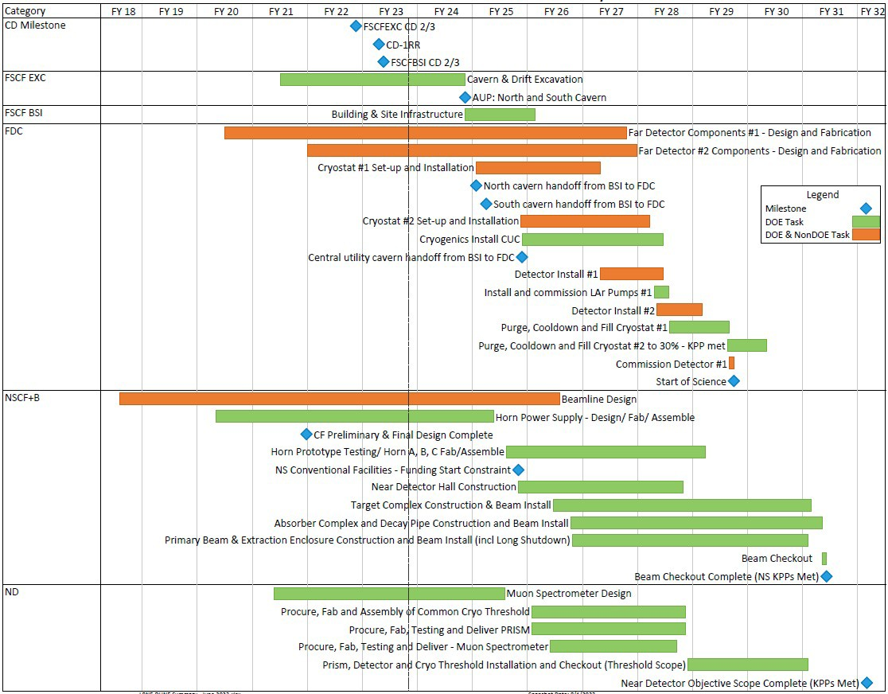




Summary Schedule with Critical Path
Far Site
Notes:
Fiscal Year display
June 2023 reporting cycle
Based on “CD-1RR ESAAB” funding profile
Early completion
dates shown
Near Site
F Update

Slide 4
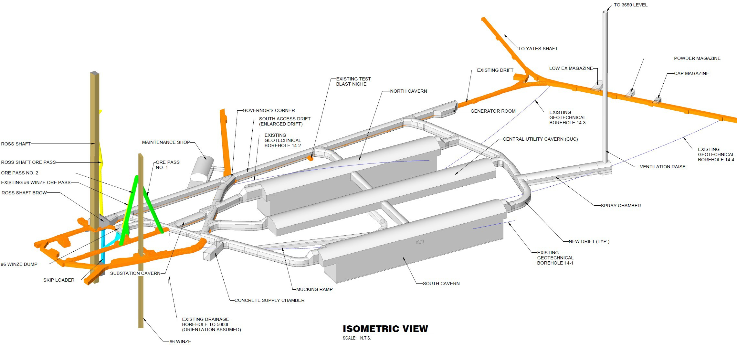
Excavation Overview

Slide 5

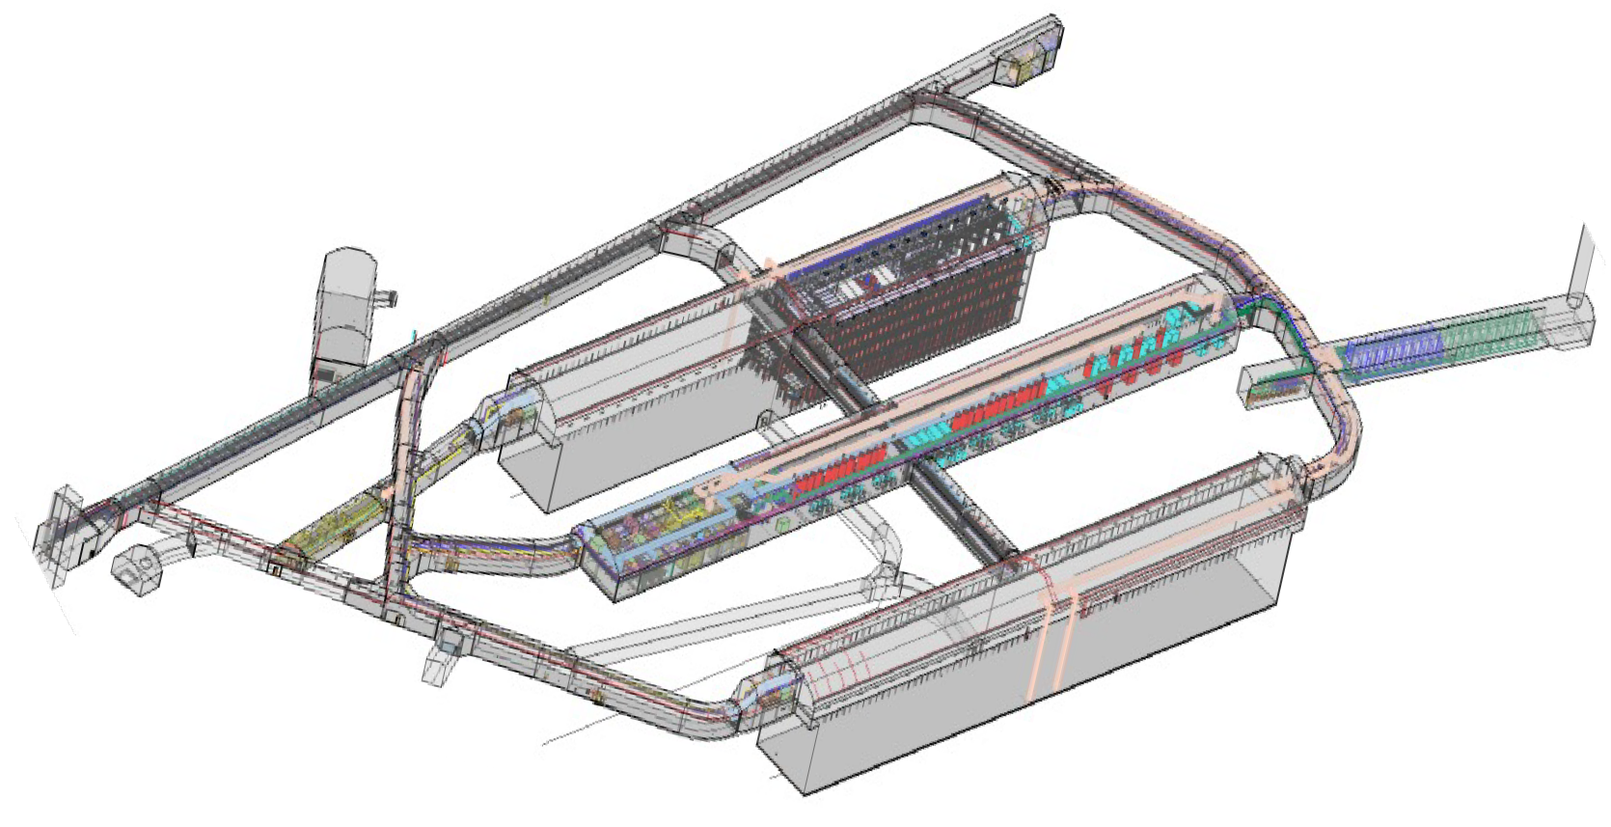


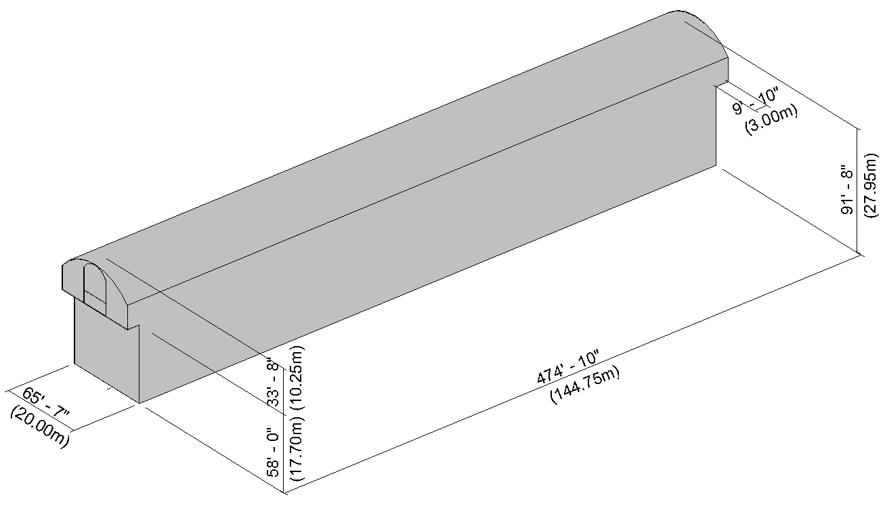

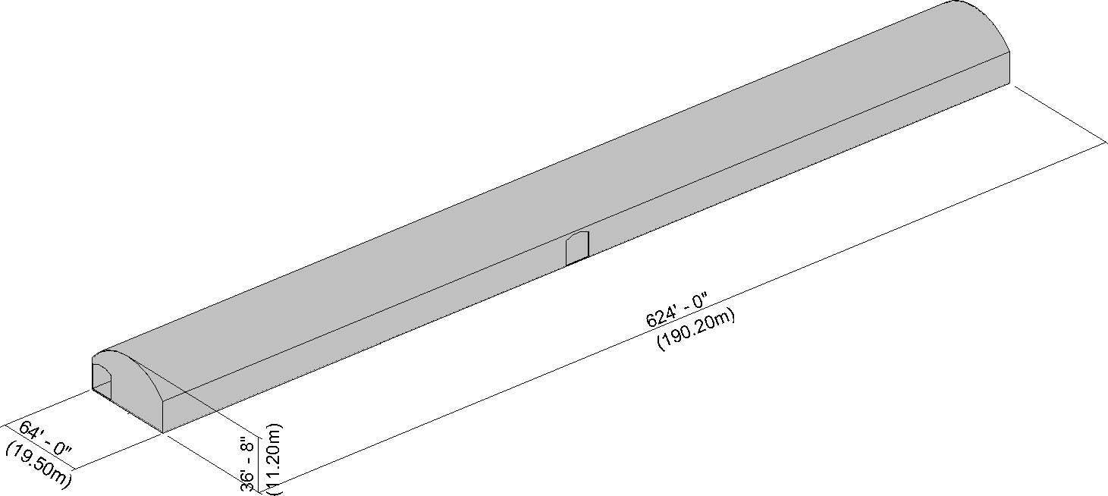
Size of Excavations
North / South Caverns
Central Utility Cavern

Slide 6
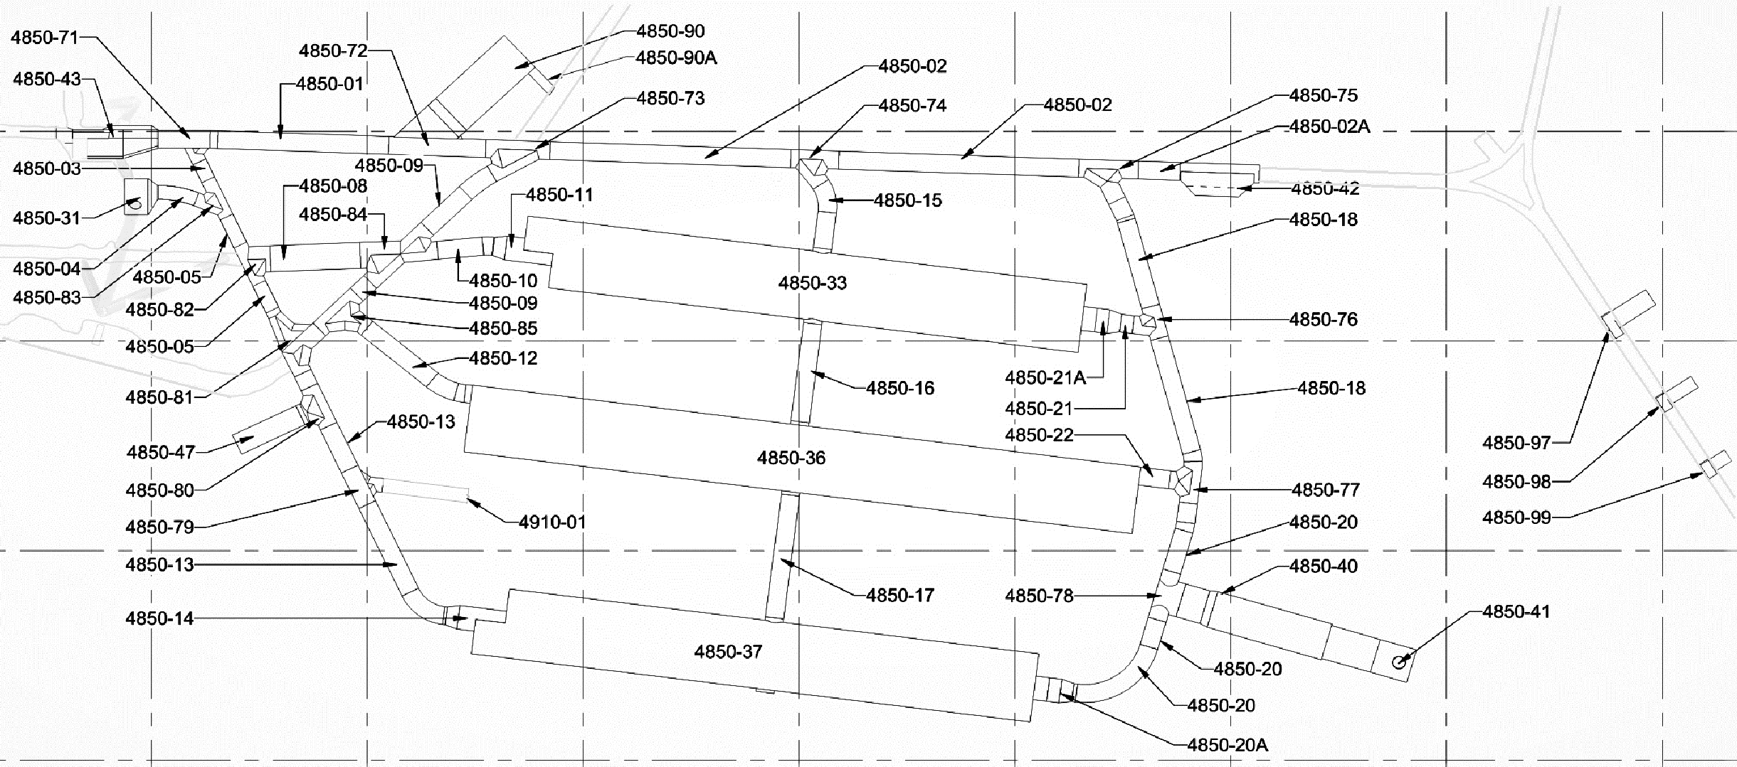

Total Excavation Completed to Date (Forecasted) ~ 93%
Completion of North Cavern (4850-33) Excavation & Shotcrete December 2023
West Access Drift
East Access Drift
South
Access
Drift
Spray Chamber
Benching 4850L – 4910L
4850L Excavation Completed
Excavation and Ground Support Complete and Accepted Concrete Complete
Bench C Bench D Bench E Bench F Bench G
Completion of South Cavern (4850-37) Excavation & Shotcrete January 2024

Slide 7
Cavern Excavation Forecasted Completion Percentage
Pilot 100%
Pilot 100%
Pilot 100%
Cut 3
100%
Cut 1
100%
Cut 2
100%
Cut 3
100%
Cut 1
100%
Cut 2
100%
Cut 3
100%
Cut 1
100%
Cut 2
100%
C1 C2 C3 100% 100% 100%
C4 100%
C1 C2 C3 C4 100% 100% 100% 100%
C1
100%
C2
100%
C3
100%
C4
100%
D1
100%
D2
100%
D3
100%
D4
100%
D1
100%
D2
100%
D3
100%
D4
100%
E1
100%
E2
100%
E3
100%
E4
100%
Benching 4850L – 4910L
Bench C Bench D Bench E Bench F Bench G
E1
100%
E2
100%
E3
70%
E4
70%
F1 F2 F3 F4
F1
100%
F2
100%
F3
100%
F4
100%
F1
F2
F3
F4
70%
70%
60%
60%
G1
100%
G2
100%
G3
100%
G4
100%
G1
G2
G3
G4
North Cavern
CUC Cavern
South Cavern

Slide 8
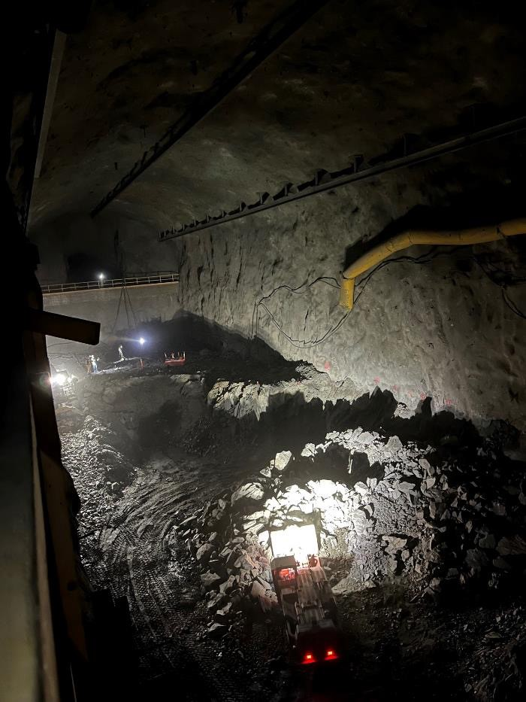
Excavation Quantities
Excavated 212,000 m³ or 733,000 Tons
Explosives Consumed: 560 Tons
75,400 Split Set Bolts Installed (Equivalent of 86 Miles)
11,000 Threadbar Bolts (Equivalent of ~34 km)
12,314 CT Bolts Installed (Equivalent of ~76 km)
14,219 Welded Wire Mesh Installed (Over 8 ha)
8400 m³ Shotcrete Applied
3,168 m³ Concrete Poured
South Cavern (4850-37) – Looking East

Slide 9
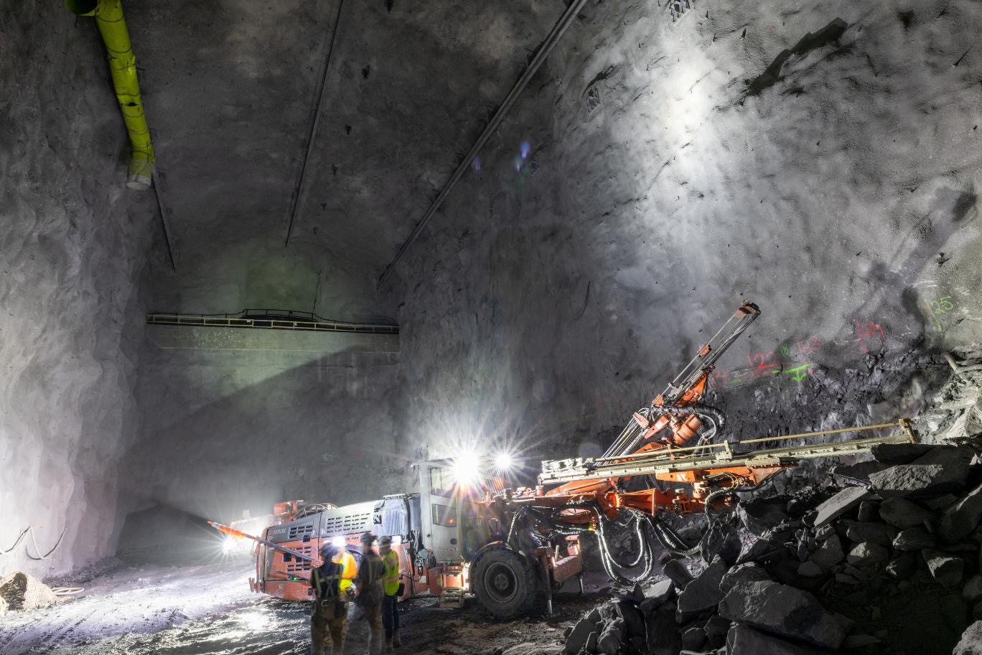
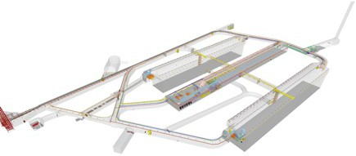

FSCF-EXC Excavation Progress – North Cavern
9

Slide 10
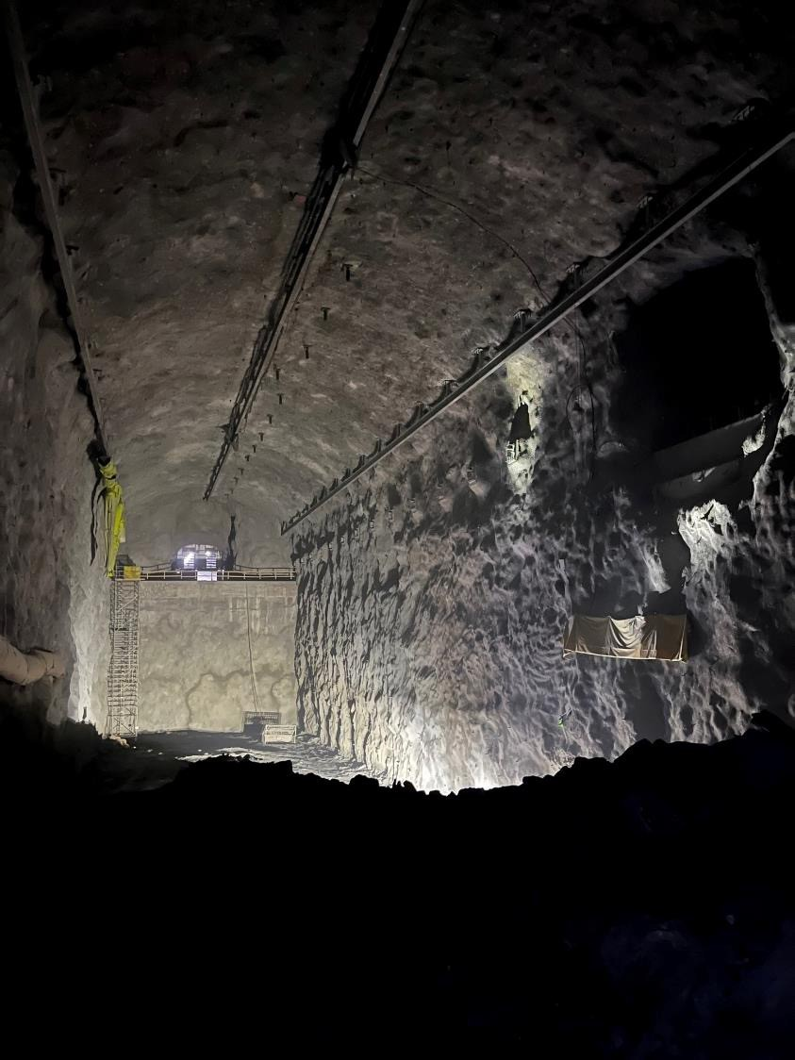
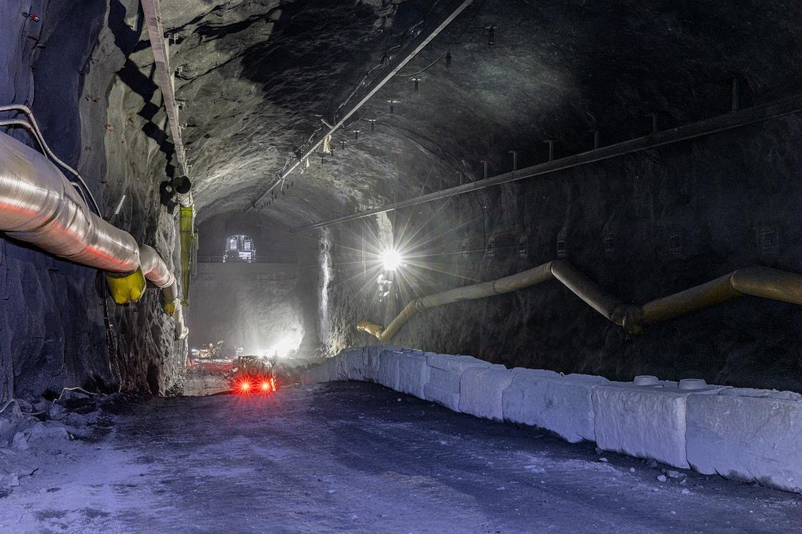
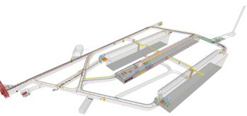


FSCF-EXC Excavation Progress – North Cavern
10

Slide 11
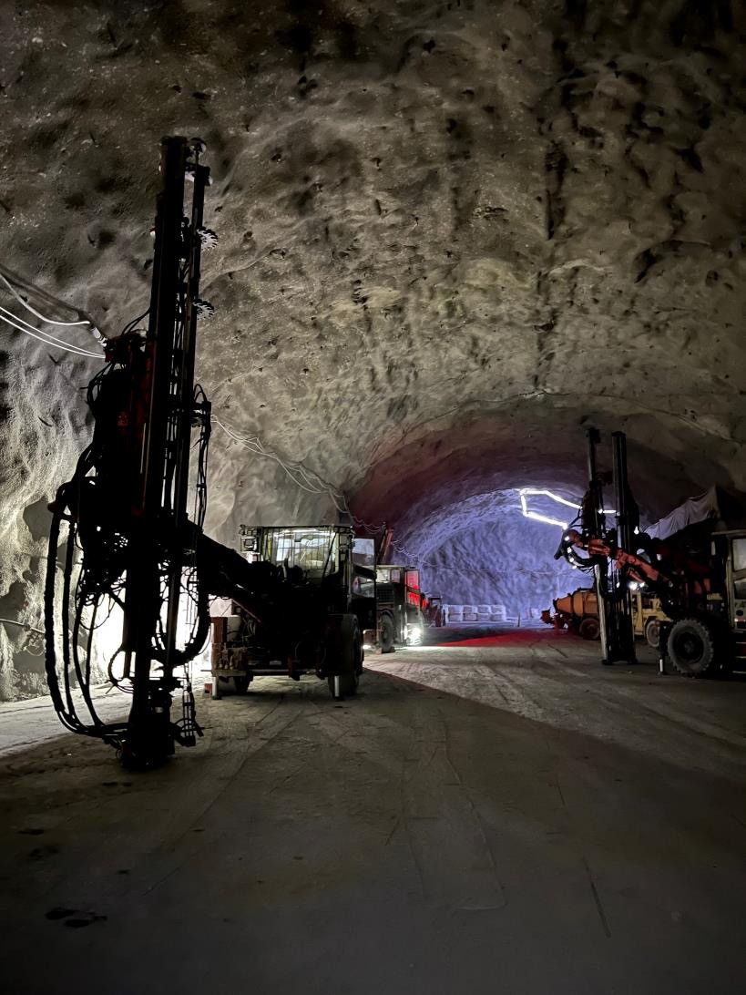
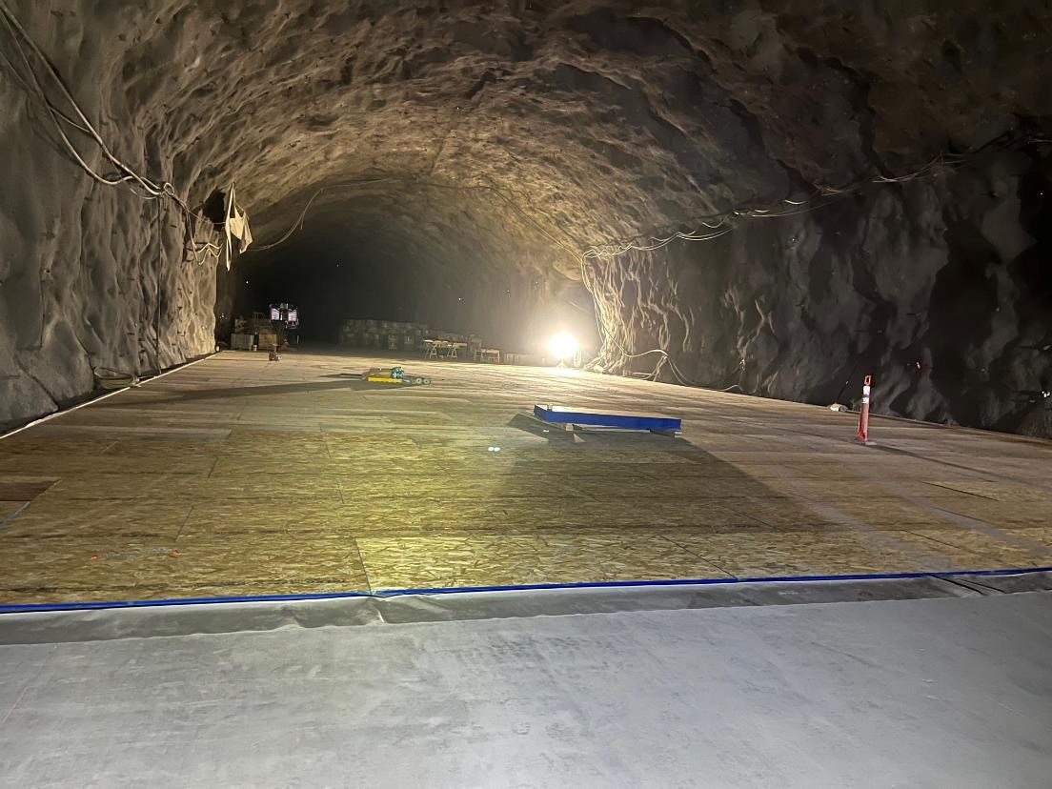

FSCF-EXC Excavation Progress – Central Utility Cavern
11

Slide 12

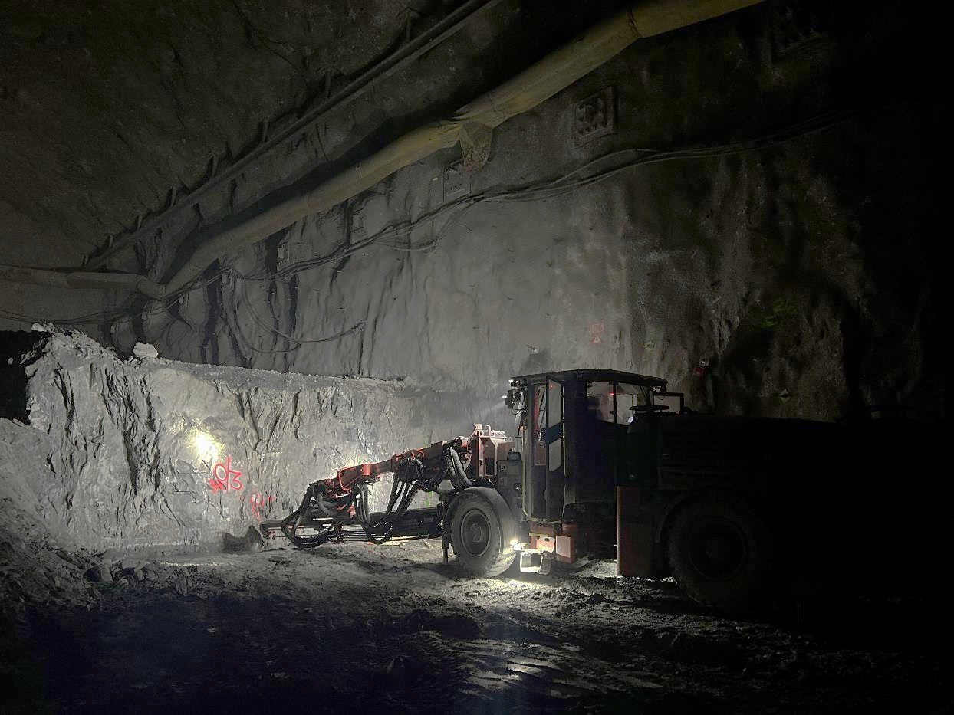

FSCF-EXC Excavation Progress – South Cavern
12

Slide 13
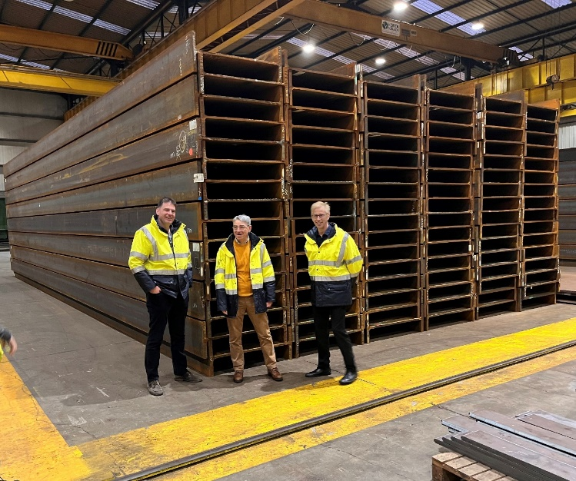
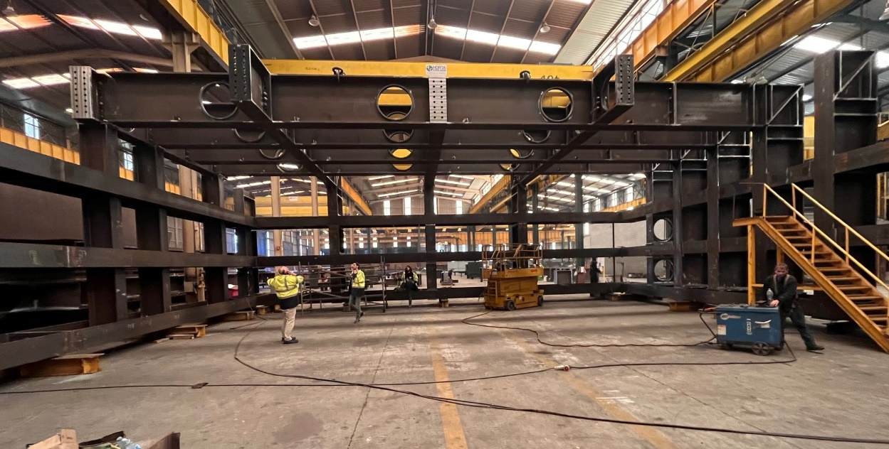
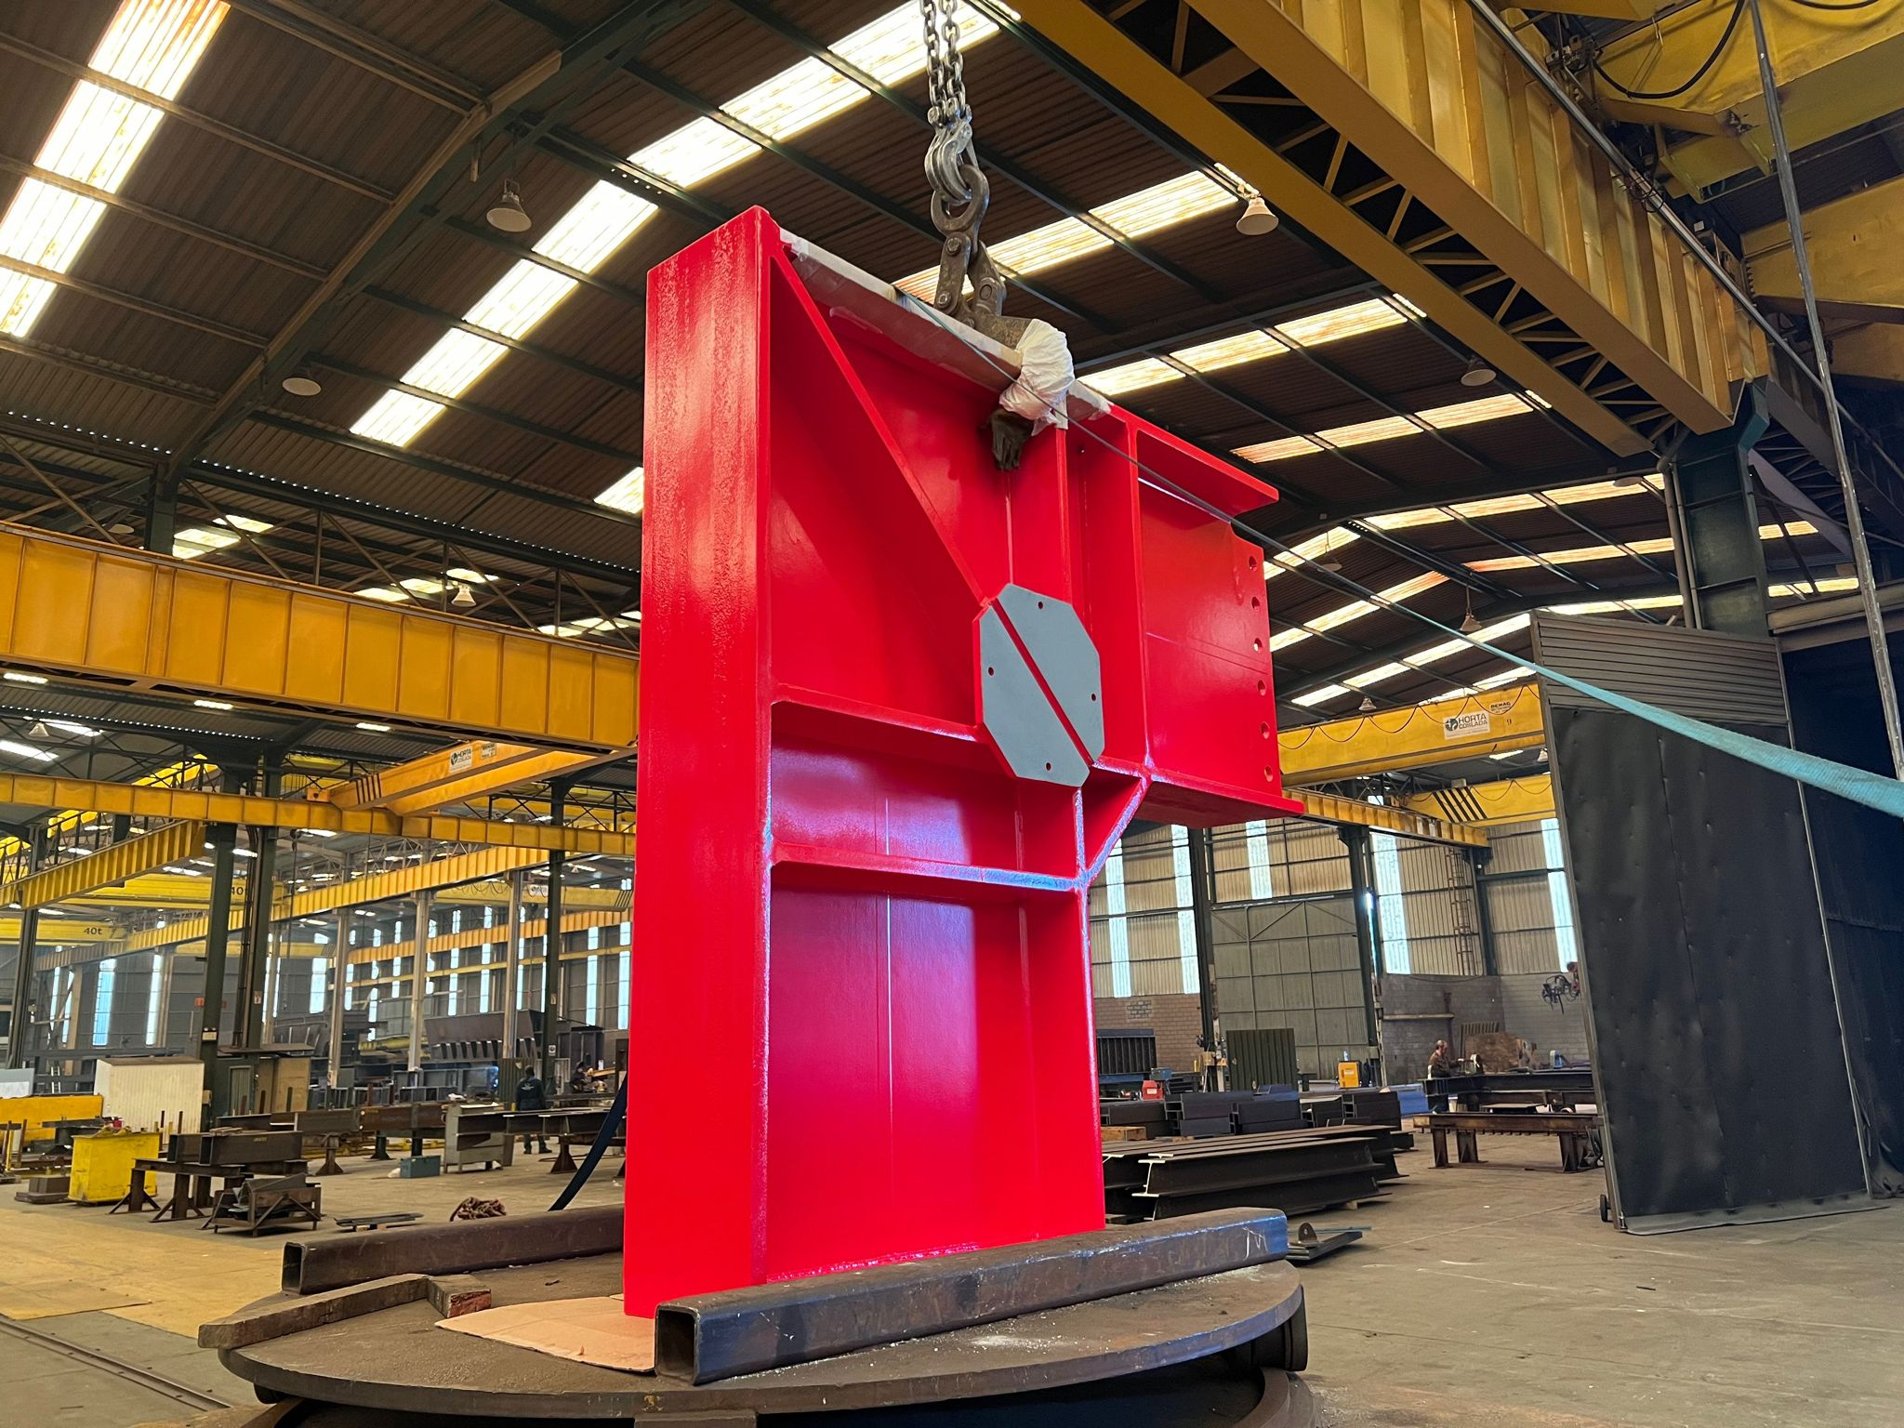
Far Detector and Cryogenic Infrastructure (FDC) Subproject
Major procurements are on track
  Nitrogen System
    Contract executed in March 2023
    Final engineering design underway
    Planning to exercise first option in Feb 2024 to initiate fabrication of system components
  Far Detector cryostat in fabrication under CERN contract

Slide 14
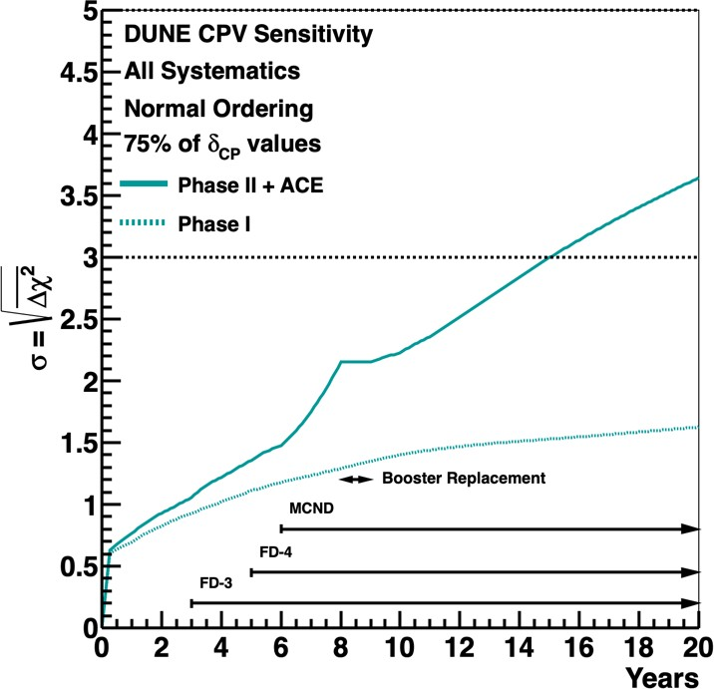

DUNE Staging (Phase I+Phase II)
DUNE is envisioned as a staged program (beam+detectors)
driven by the global scientific requirement of reaching 3σ sensitivity for 75% of δ_{cp} as set by the 2014 P5.
DUNE Phase I Detectors:
2 FD modules: FD1 “horizontal drift” and FD 2 “vertical drift” LArTPCs
ND LArTPC detector+ muon spectrometer + off-axis system
SAND magnetized tracker on-axis near detector.
P5 goal
Phase I FDs are currently under construction and contributions detailed in DUNE multilateral MOU annexes. ND LAr, TMS and SAND STT prototyping underway
DUNE Phase II Detectors:
Phase I with PIP-II only
Baseline is two additional “vertical drift” LArTPCs which meets all physics goals. R&D ongoing on options to enhance DUNE physics capabilities. Non LArTPC options for FD4 could be considered if performance and timeline requirements of DUNE are met.
More Capable Near Detector (MCND) to ensure completion of the DUNE physics program and open up exciting opportunities for new BSM physics searches.
Reaffirming the US commitment to full DUNE scope would ensure continued support of the international community and the realization a transformational scientific program

Slide 15
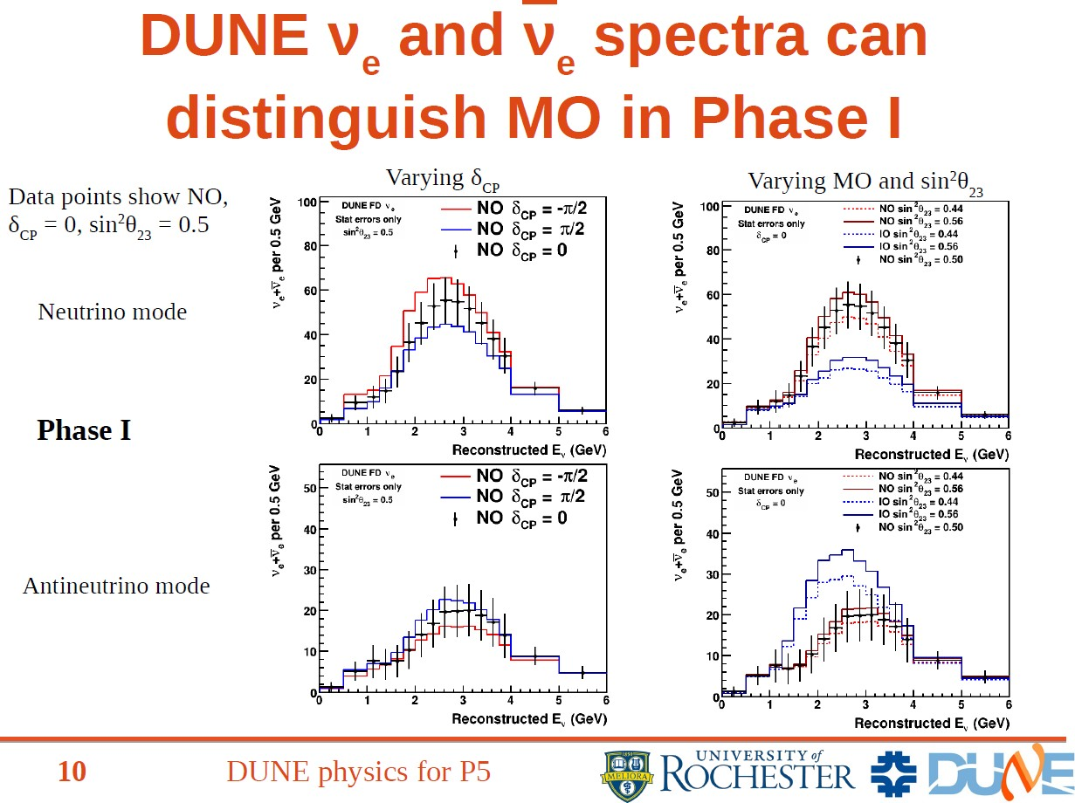
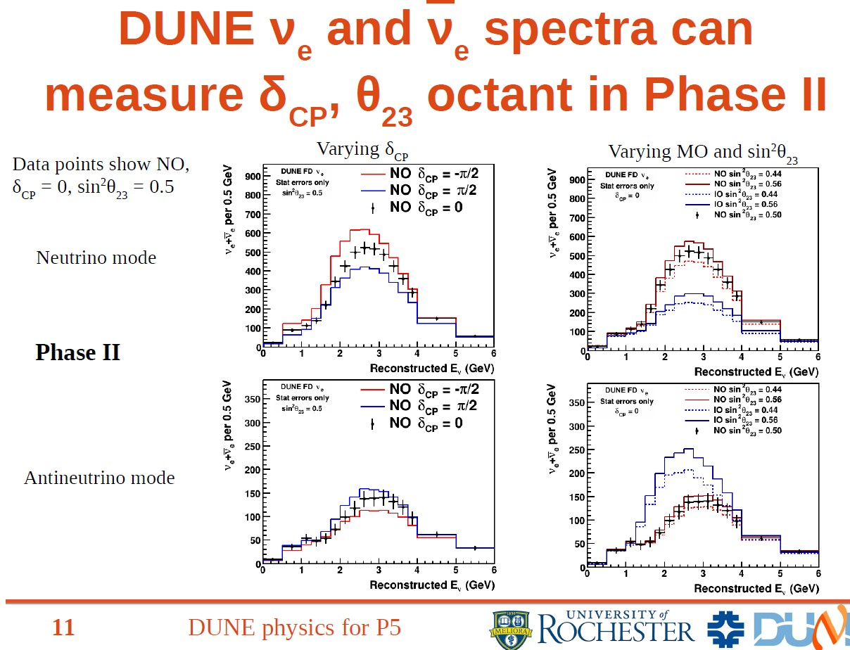

Slide 16
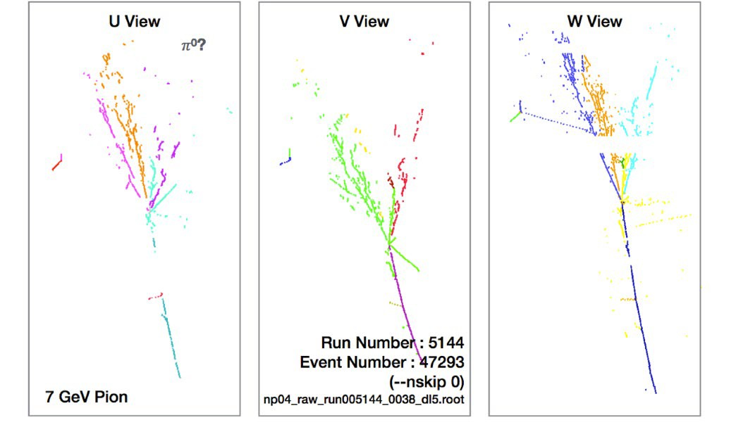
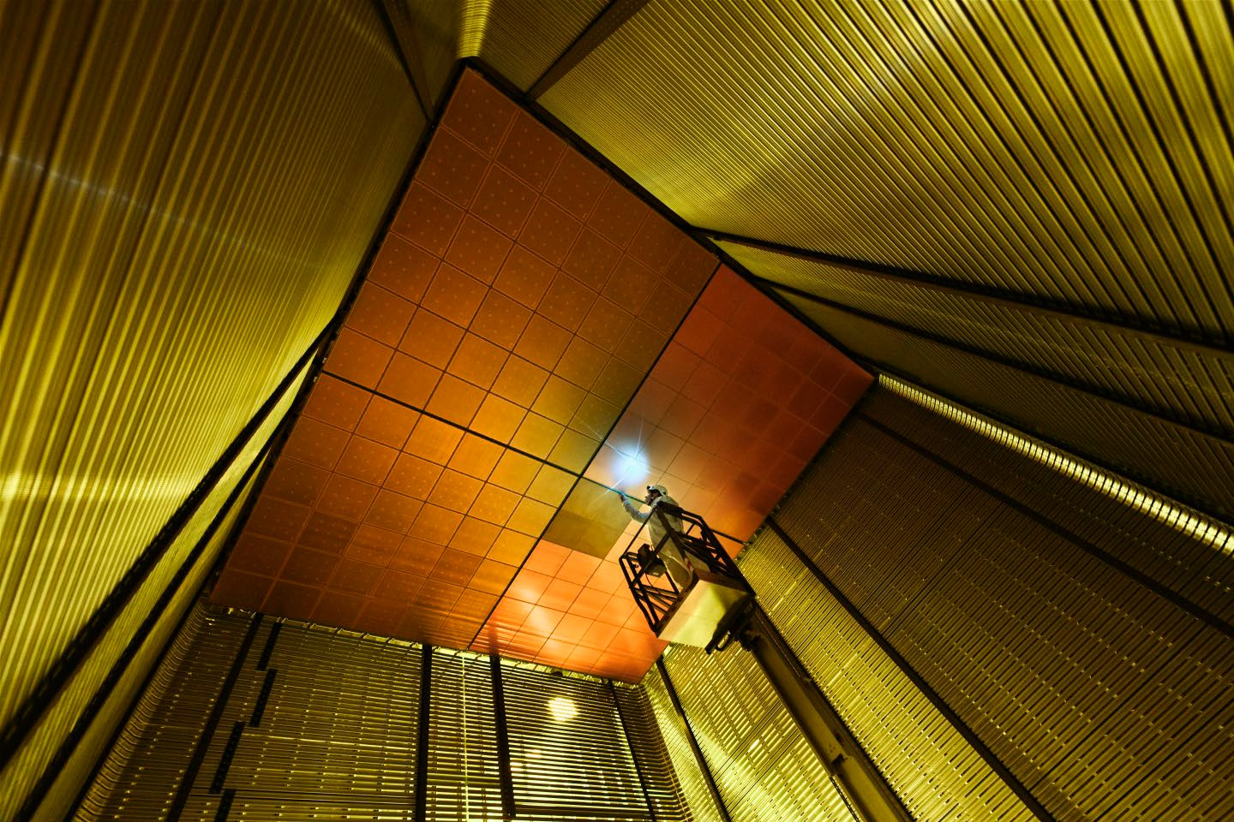
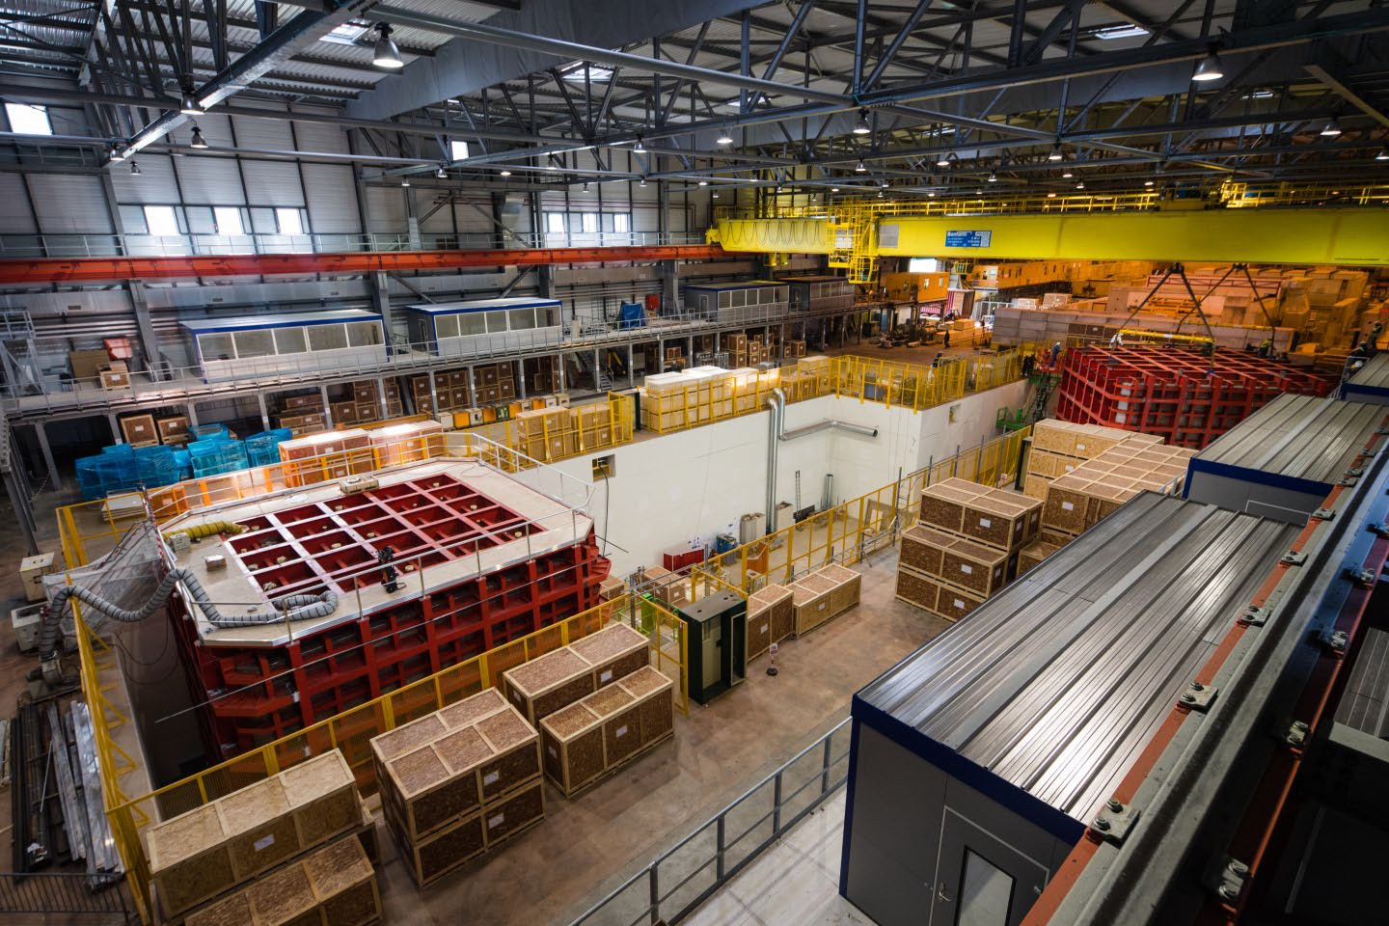

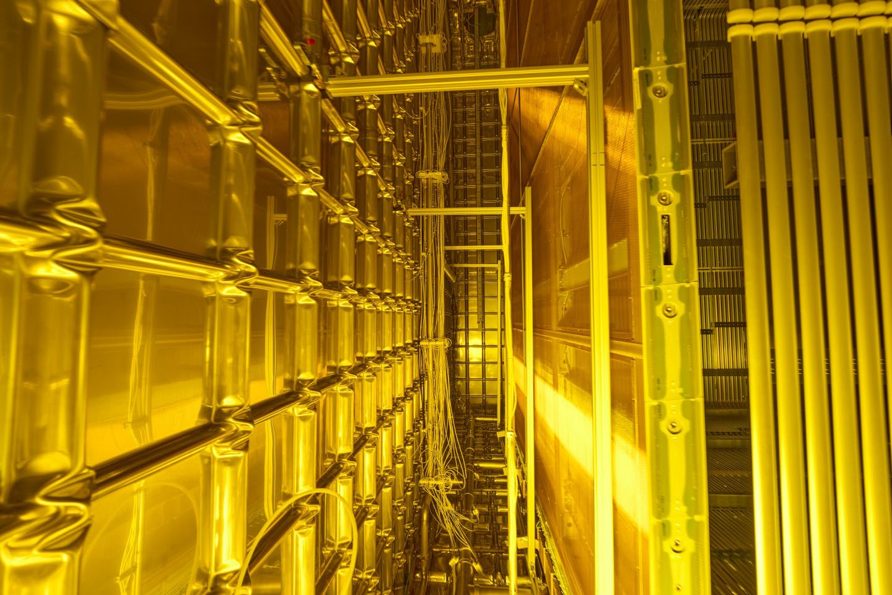

DUNE FD Prototypes @ CERN Neutrino Platform
NP02: FD2 vertical drift protoype
NP04: FD1
horizontal drift protoype
The ProtoDUNEs (FD Module 0) are ~5% scale using several full-scale TPC modules each and involve all the FD partners and CERN. Performance calibration with
test beams at CERN NP.

Slide 17
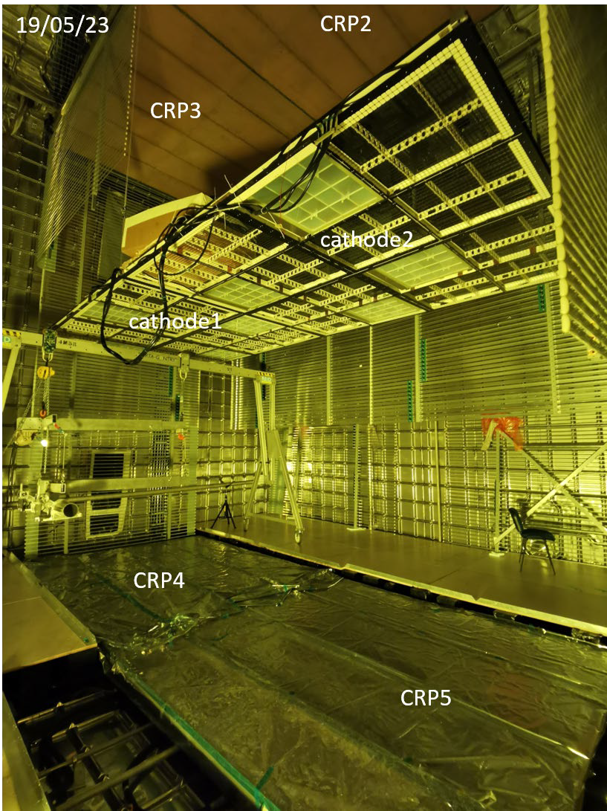
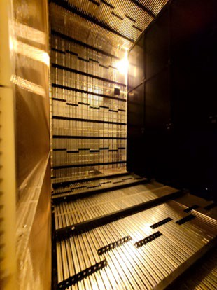
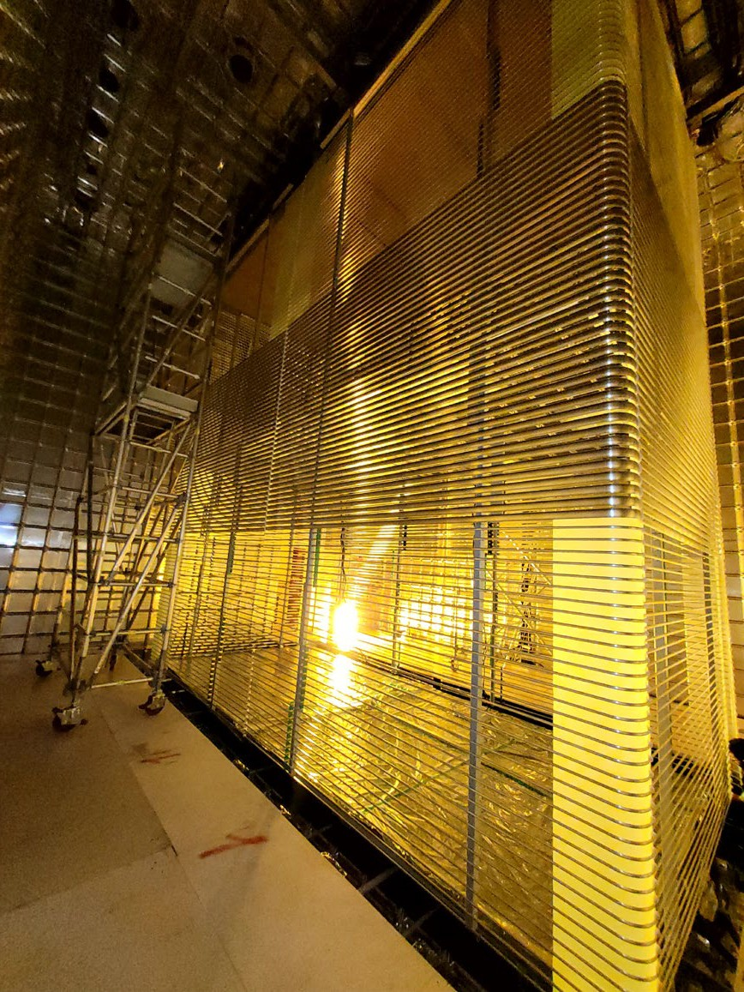
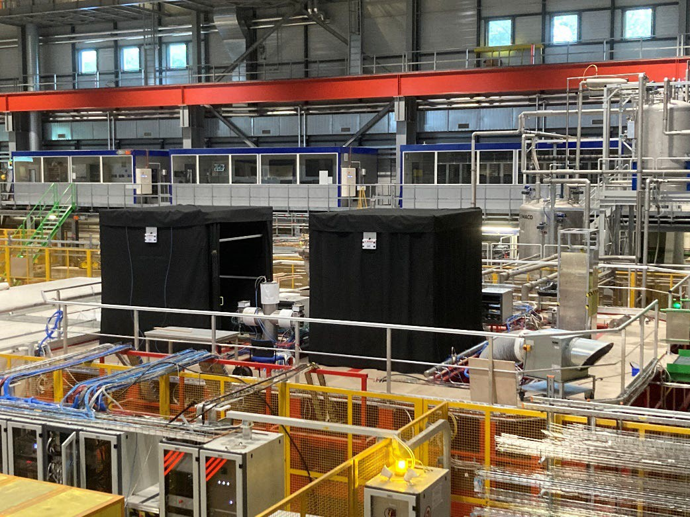
FD Prototypes Status (operate 2024)
NP04 Temporary Construction Opening
(TCO) will close JANUARY 2024.
NP02 FD-VD TPC complete June 9, 2023.
TCO closure by early 2024
Jun 8, 2023
NP02: FD2
vertical drift protoype
NP04: FD2 horizontal drift protoype
FD-HD laser system calibration tents on cryostat
Full TPC
NP02: FD2 vertical drift protoype
NP04: FD2 horizontal drift protoype

Slide 18
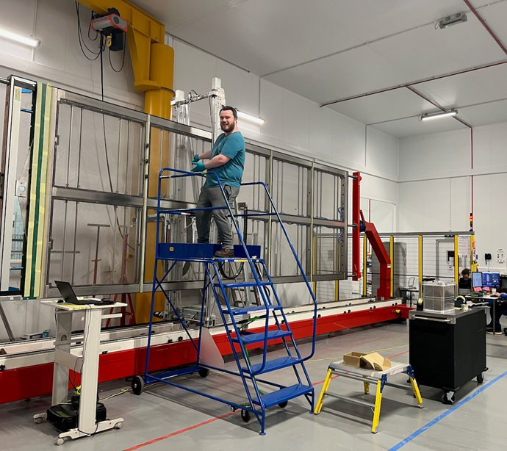
FD1 APA Production
At the May collaboration meeting, we were in the middle of an exercise to show that we could build an APA in 40 working days (needed to meet our installation schedule)
This APA was in fact successfully
completed in just under 40 days
A new UK project structure has been formed with more involvement and resources from STFC national laboratories

Slide 19
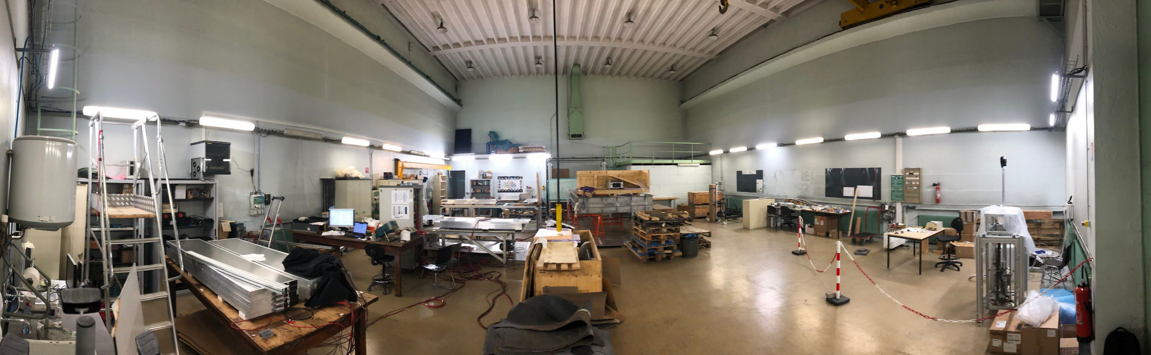
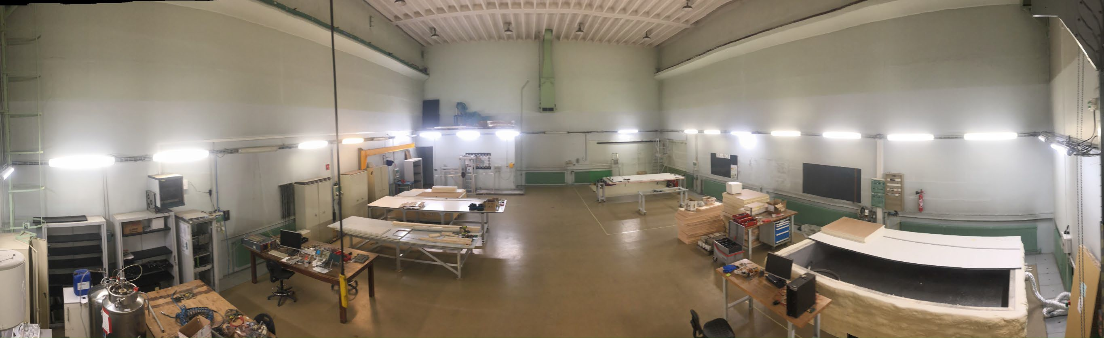



Grenoble FD2 CRP Factory assembly hall
June 2023
Lots of sorting and tidying done during this summer
The assembly hall is now fully dedicated to CRP factory
200 m²
September 2023
CRP assembly tables & tools
Coldbox
200 m²
14 Nov 16, 2023
M. Bishai, DUNE Status, INC/RRB Mtg

Slide 20
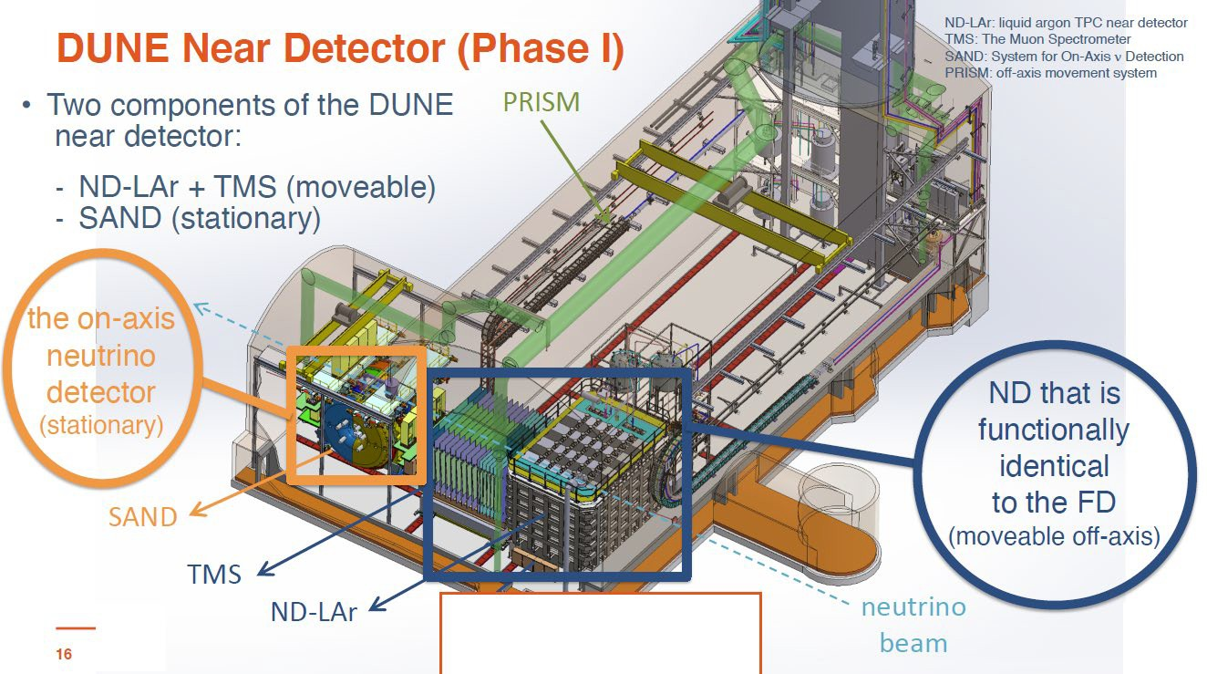
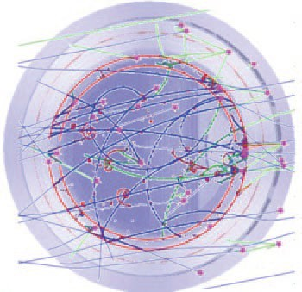
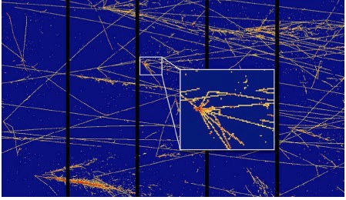
SAND
simulation
ND-LAr simulation
DUNE ND CDR, Instruments 5 (2021) 4, 31)

Slide 21
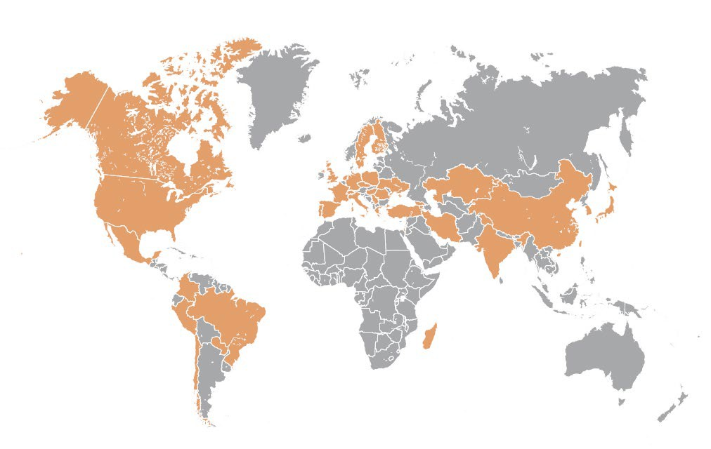

As of Oct 2023:
DUNE Collaboration
Total members: 1508
Active Collaborators: 1419
(657 US + 762 non-US)
Active Countries: 37 (including CERN) Active Institutions: 209
New Institutions Sep ‘23:
Institute of Nuclear Physics, Almaty, Kazakhastan
Hong Kong University of Science and Technology, China
List of participating institutions

Slide 22
DUNE Collaboration Stats
Position | In Collaboration |  |  | Effort on DUNE *
 | 2022** | 2021 | 2020 | 2022** | 2021 | 2020
Faculty | 683 | 654 | 676 | 194 | 195 | 200
Postdocs | 275 | 249 | 240 | 99 | 79 | 77
Graduate Students | 341 | 324 | 319 | 119 | 109 | 104
Engineers and CP | 155 | 164 | 158 | 50 | 54 | 67
* Effort reporting compliance is ~ 75-80% of collaboration
** As of mid-Sep 2023

Slide 23
DUNE ITALY IN 2024
Researchers: 109 (46.65 FTE) - Technologists: 26 (5.75 FTE) - Technicians: 17
BO - Laura Patrizii
FE - Luca Tomassetti
GE - Lea Di Noto
LE - Antonio Surdo
LNF - Danilo Domenici
LNS - Carla Distefano
MI - Massimo Lazzaroni
MIB - Francesco Terranova
NA - Francesco Di Capua
PD - Luca Stanco
PI - Fabrizio Raffaelli
ROMA1 - Antonio Di Domenico
ROMA2 - Giuseppe Di Sciascio
TO - Sandro Palestini
Involved in:
Far Detector: Photon Detection System (PDS)
Near Detector: SAND

Slide 24
DUNE Bologna
Researchers: 18 (10.3 FTE) - Technologists: 5 (1.25 FTE) - Technicians: 10
With strong support from:
Servizio Elettronica e Rivelatori
Servizio Tecnico Generale
Servizio Officina Meccanica
Servizio Progettazione Meccanica
Servizio Calcolo e Reti
Servizio Tecnologie Avanzate
Servizio Amministrazione
Involved in:
Far Detector :
PDS
Near Detector (SAND):
Tracker
GRAIN
KLOEtoSAND
Software and Computing

Slide 25
Excerpts on activities: GRAIN
Design of the Cryostat
Demonstrator tests preparations at ARTIC (Genova) and LNL
Realization of the readout system integrating the ALCOR ASIC
Development of the track reconstruction algorithms for the Hadamard masks (imaging and calorimetry)
Development of the netxt ALCOR chip (with Torino and Genova)
Development of back illuminated SiPMs

Slide 26
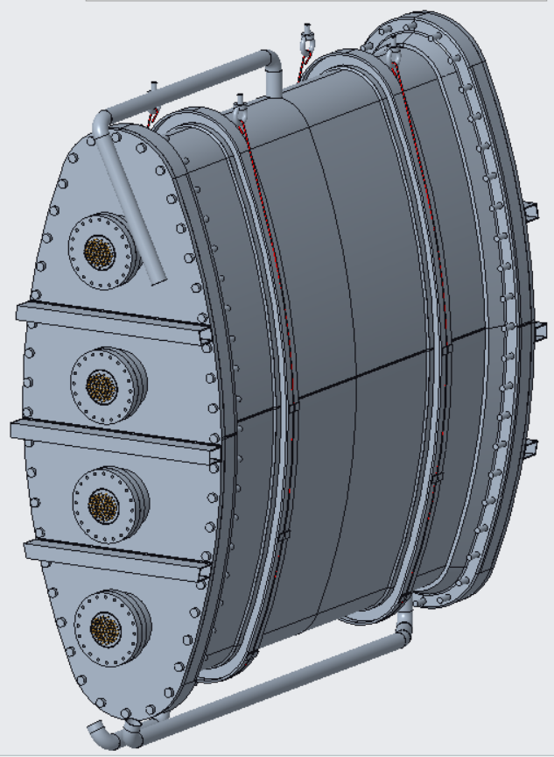
Inner vessel
Design certified for EN13445 standards but further study to be done for the definition of the Helicoflex, calculation of the bolts stresses
and deformation of cover and seal during cool down
Central wall thickness 6 mm
4 DN160 CF flanges per side

Slide 27
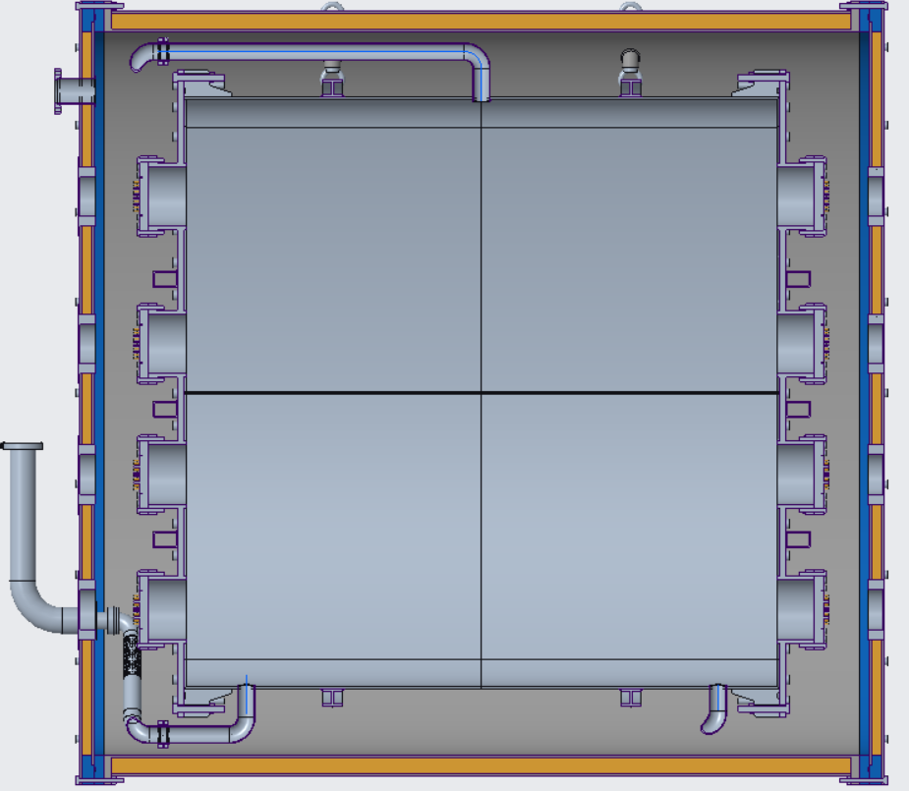
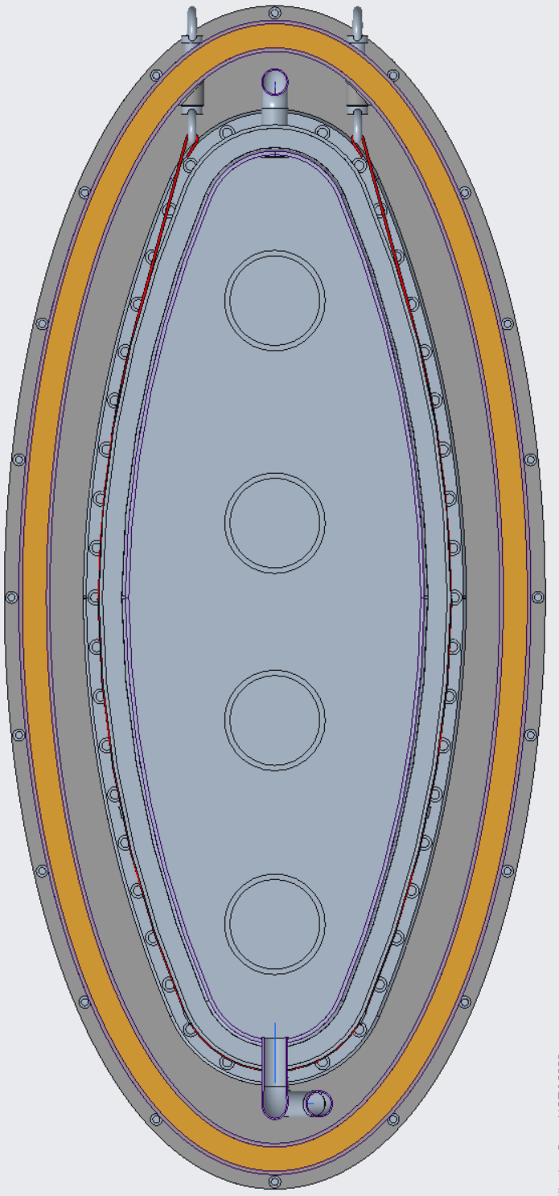
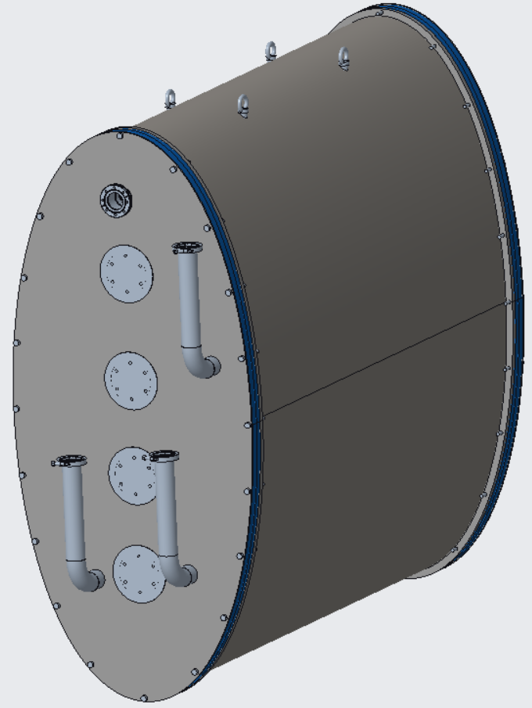
Vacuum tank
Design is still preliminar
Made of composite material:
Carbon fiber
Aluminum honeycomb
Aluminum alloy

Slide 28
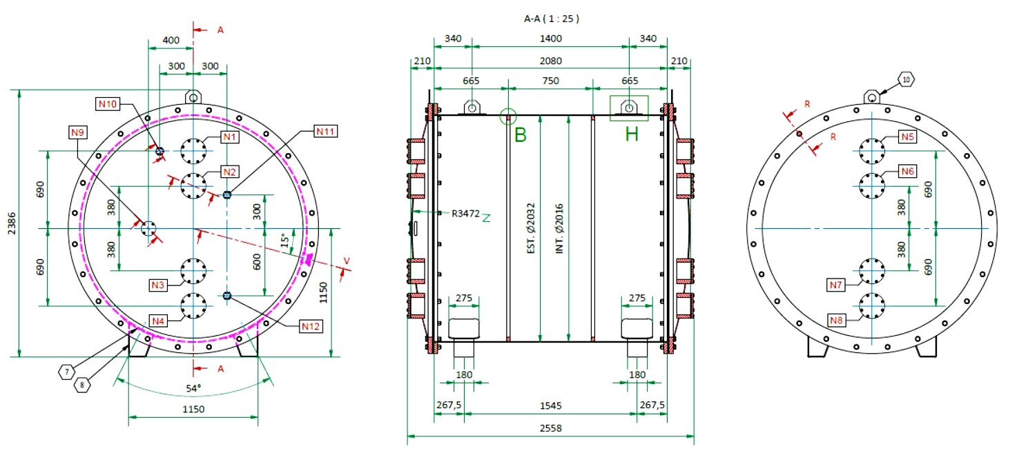
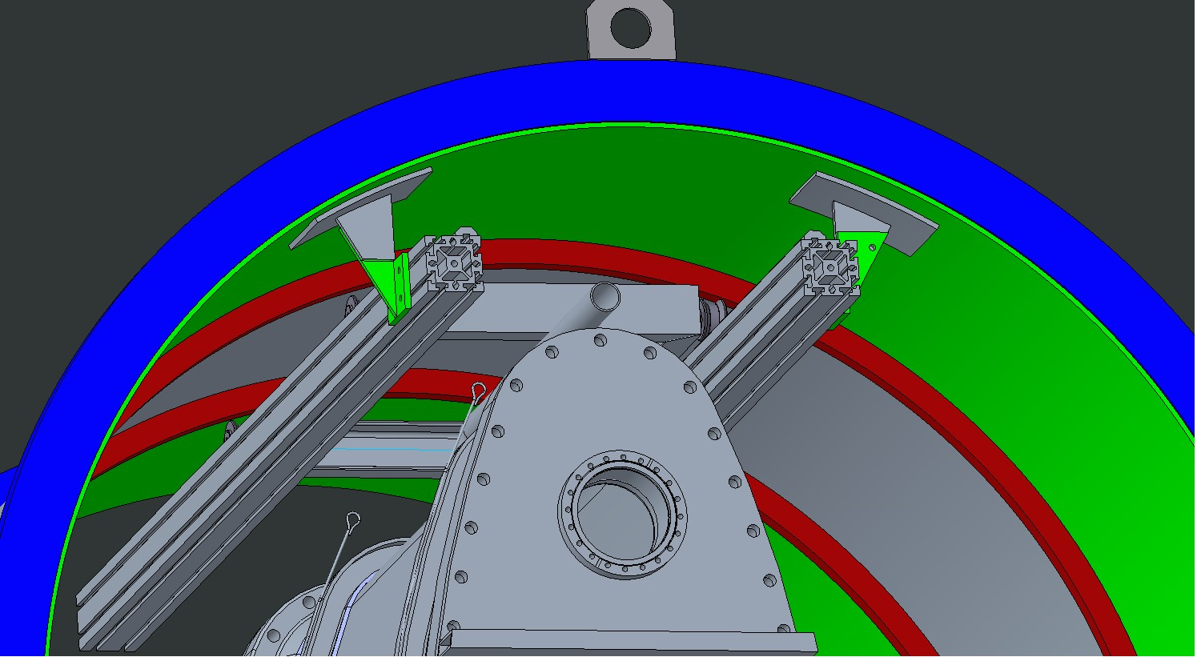
first vacuum tank for LNL facility test
Cryoservice encharged to build the tank
Sliding system with guide and rollers
for mounting and dismounting operations
is a work in progress

Slide 29
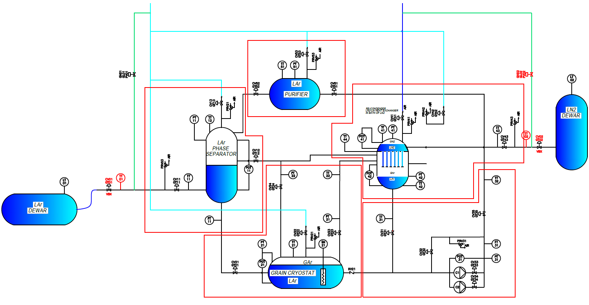
P&ID GRAIN cryogenics
For the facility test we will try to replicate all the layout of final destination (FNAL)

Slide 31
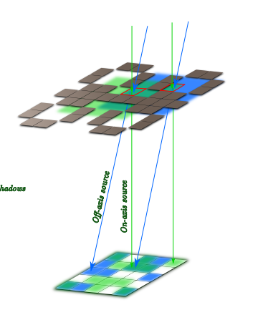
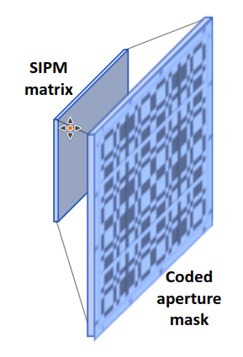
Coded aperture (CA) cameras
Alternative to traditional optical systems
evolution of a single pinhole camera -> Matrix of multiple pinholes to improve light collection
Image formed on sensor is the superimposition of multiple pinhole images.
Advantages:
  - light transmission ~ 50%
  - Good depth of field
  - compact and easy to build
  - no Xenon doping needed

Slide 32
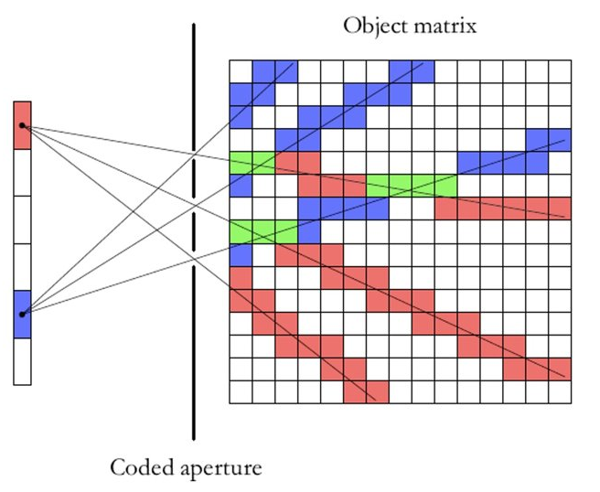
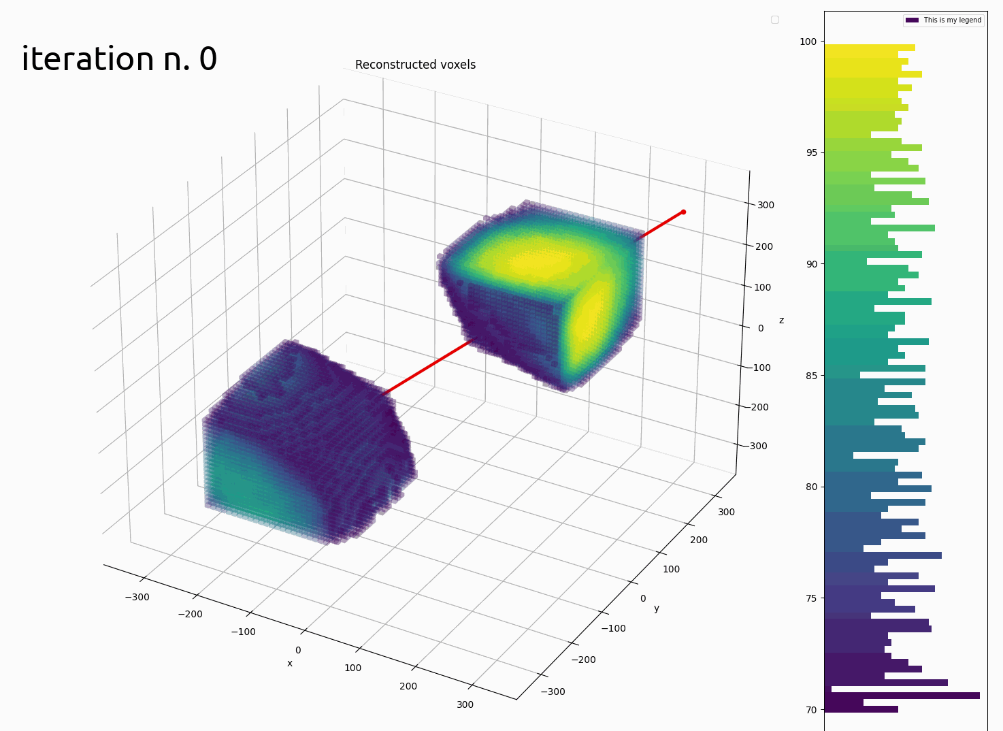
Reconstruction algorithm
Reconstruction directly in 3 dimensions
Iterative algorithm based on maximum likelihood expectation maximization
Backpropagation of the detected photons in the LAr volume through all mask holes, weighted appropriately
Weights (system matrix) represent the Bayesian probability of the voxel to be a source of the detected photons, computed analytically
Algorithm implemented in GRAIN using 4 GPUs and 120GB RAM to store weights

Slide 33
Tracker
Design of an alternative (Target) Tracker sysyem based on drift chambers
Simulate geometry, detector response, physics performances
Study cell geometry with Garfield
Design a prototype
Validate simulations
Scale it up to final design

Slide 34
A fast and furious prototype
Designed, fabricated, assembled and started to operate in less than a month:
E [V/cm]

Slide 35
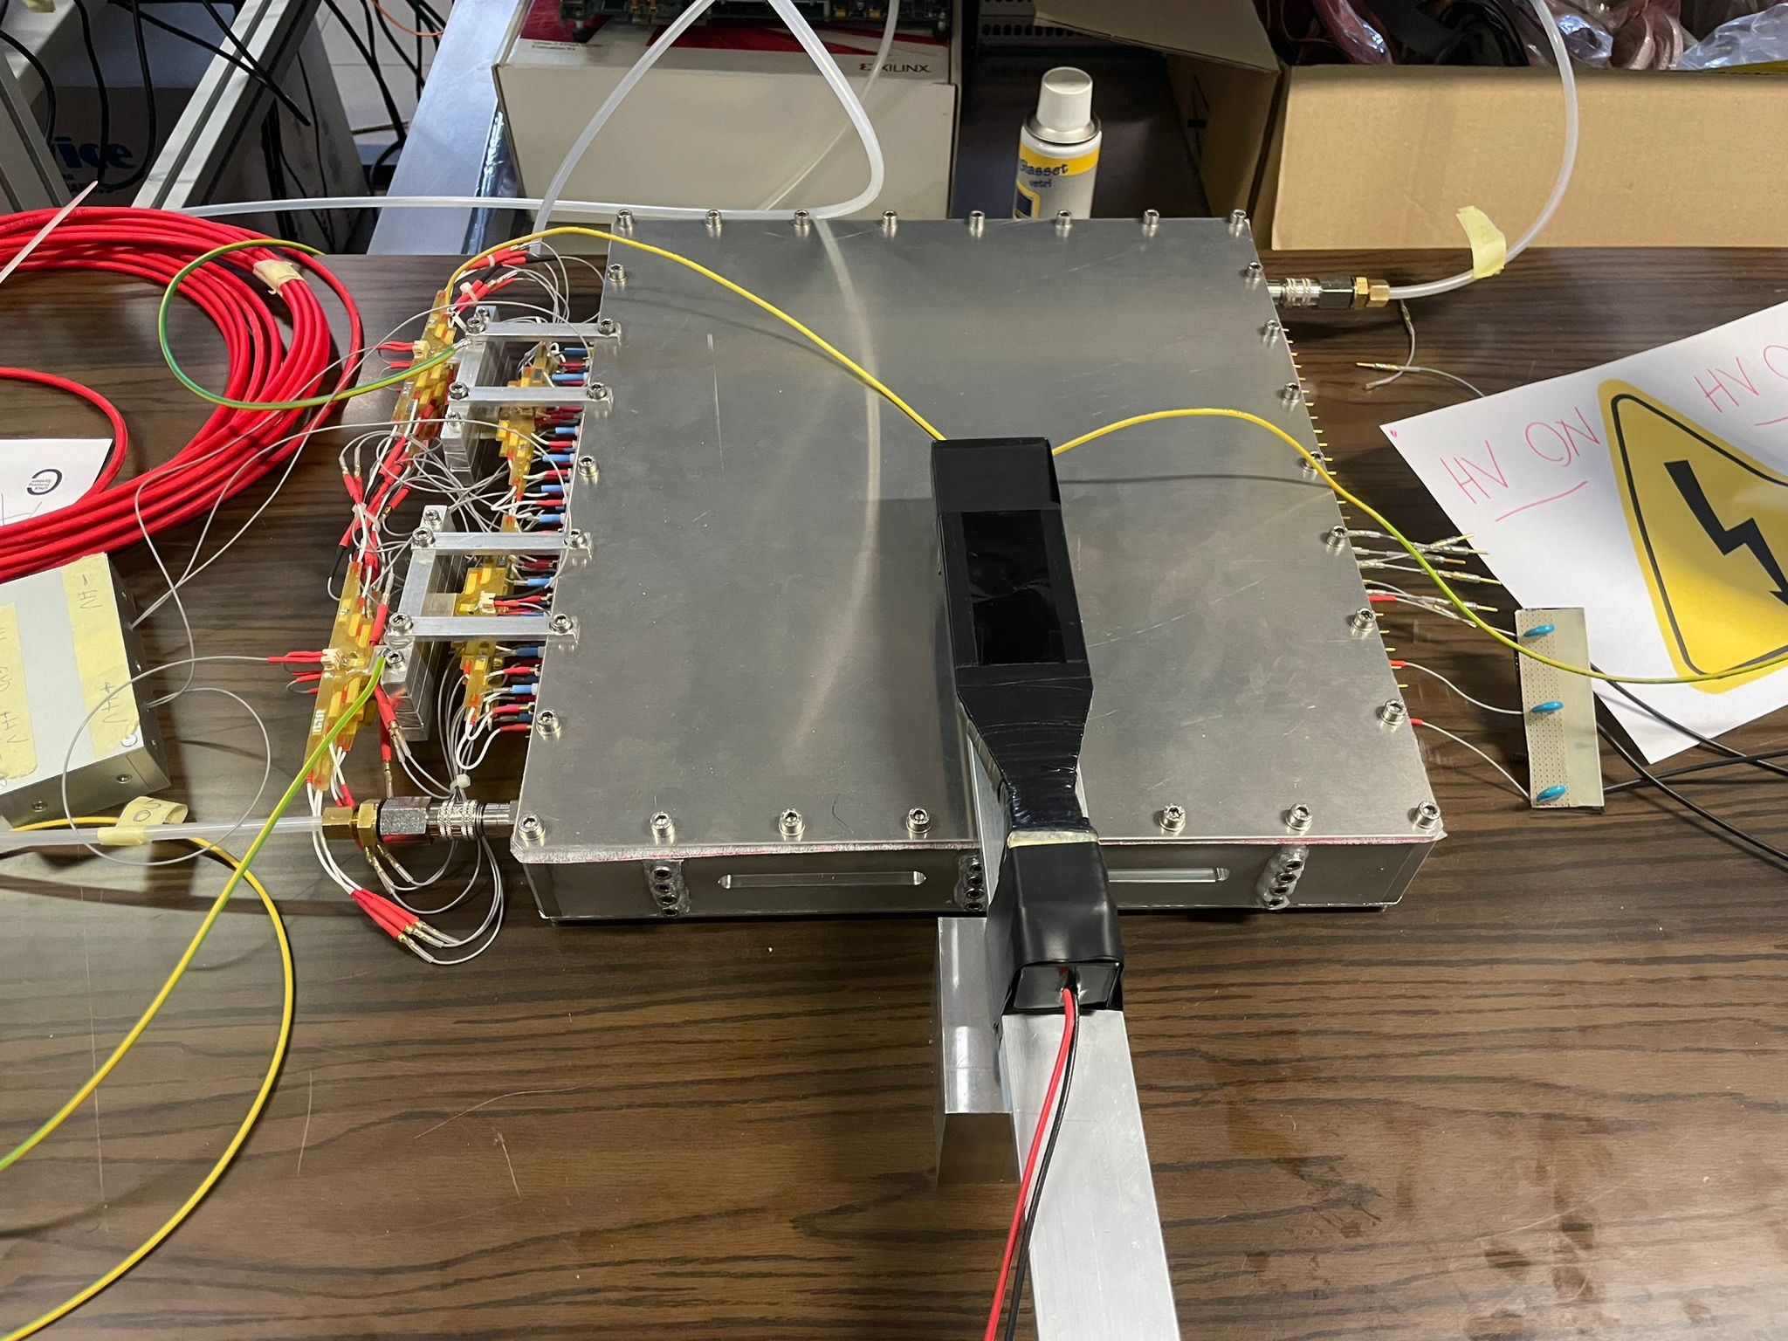
Proto-1

Slide 36
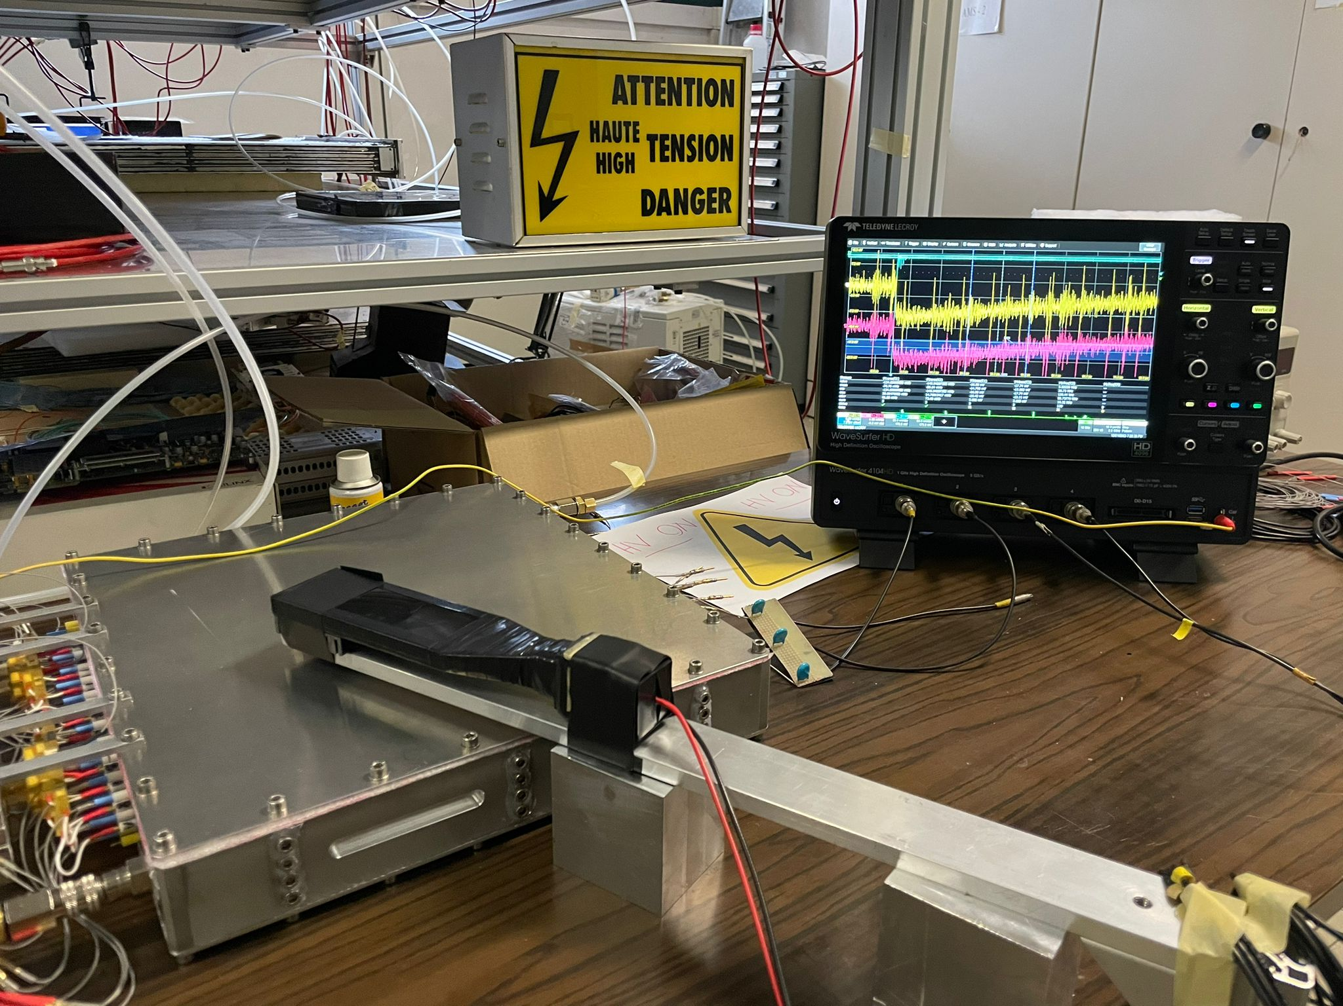
Proto-1 is Alive and Kicking!

Slide 37
To Conclude
DUNE is progressing swiftly to the construction phase
Italy has a substantial impact on DUNE
Italian DUNE groups are still growing in size and effort
Bologna group is very busy on several fronts…..
…and enjoys it!

Slide 38

THANK YOU

