Slide 1



Observations of the d-TGFs at the Telescope Array Detector
R. Abbasi, N. Kieu, J. Mazich, H. Johnson, J. Summers, K. O’Brien, G. Bratrud, N. Husseini
Loyola University Chicago , rabbasi@luc.edu
J. Belz, J. Remington, R. Levon, K. Smout, A. Petrizze
University of Utah
M. Saba, D. R. da Silva
National Institute for Space Research (Brazil)
P. Krehbiel, W. Rison, D. Rodeheffer M. Stanley
New Mexico Tech University
and the TA Collaboration
AtmoHEAD 2024 • July 15-17, 2024

Slide 2
Outline
Previous observations
Intermediate observations of TGFs
Optical observation of Downward directed Terrestrial Gamma-ray Flashes (TGFs).
  Time-resolved leader spectra in association with downward-TGF.
  Photometric array.

Slide 4
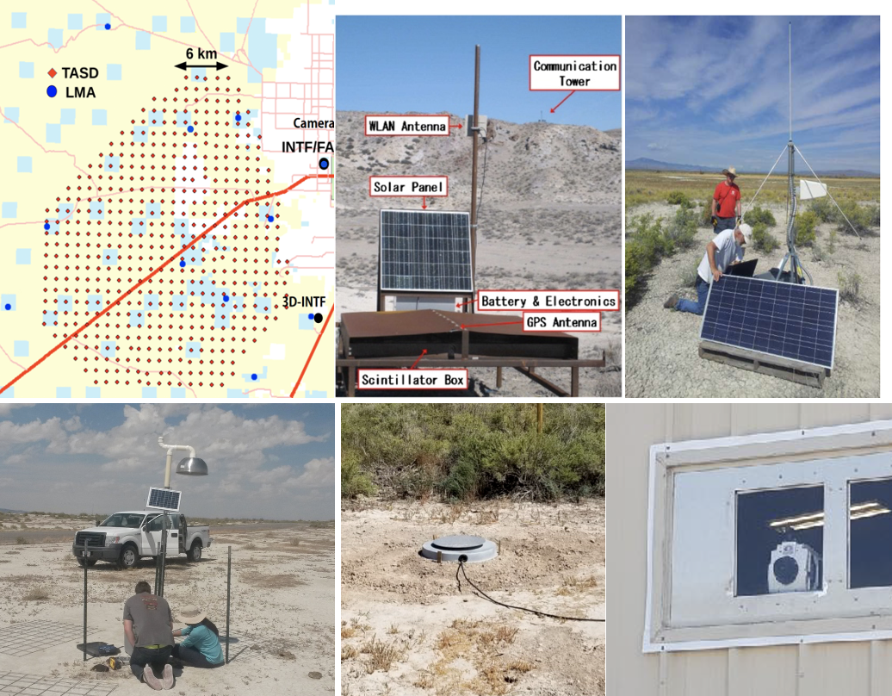
Lightning Detectors
Eleven Lightning Mapping Arrays
Two Interferometers INTerFreometers
Two Fast electric field change Antennas
Two high-speed video camera including Phantom v2012 & v711.
The National Lightning Detection Network (NLDN)

Slide 5
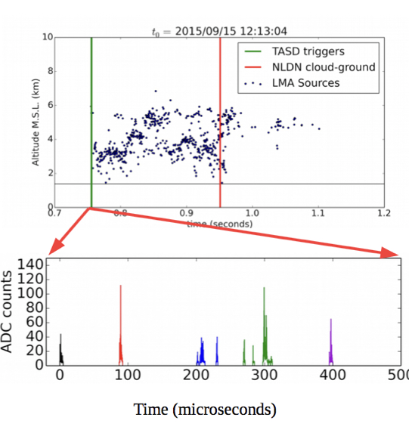
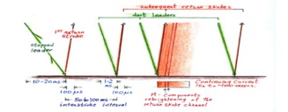
Stepped leader stage
occurred at the first 1 ms of the flash, ~200 ms before CG hit
Occurred as a negative breakdown with a leader height between 4-5 km AGL
TASD waveform has 400 𝜇s duration with 10s of 𝜇s in sub-pluses
Journal of Geophysical Research: Atmospheres, 123, 6864–6879. https://
doi.org/10.1029/2017JD027931

Slide 6
Bursts and TGFs
: Atmospheres, 125,e2019JD031940. https://doi.org/10.
1029/2019JD031940

Slide 7
Intermediate Downward Terrestrial Gamma-ray Flashes as Observed by the Telescope Array Surface Detector

Slide 8
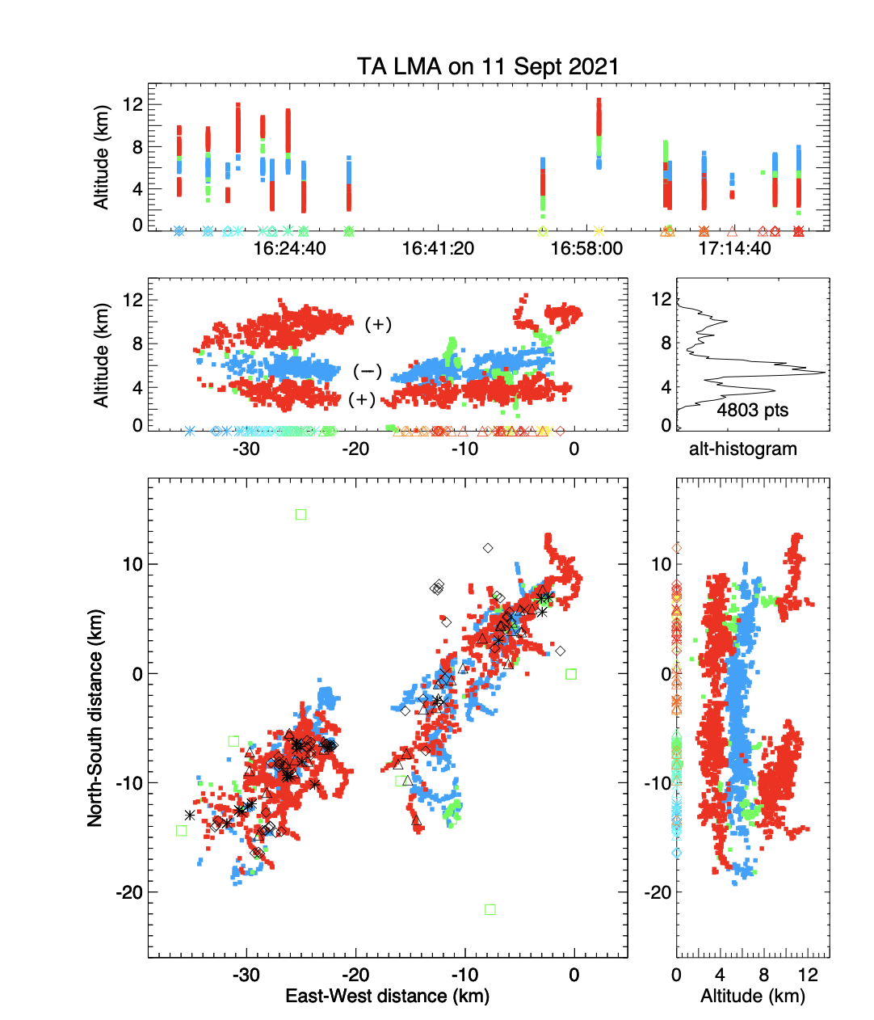
The first storm had a normal tripole structure indicative of normal convection.
The second storm had little or no upper positive charge, causing all flashes to be downward negative CG flashes.
The storms exhibited strong humidity, precipitation, and wind shear but were indicative of weak convective available potential energy (CAPE)

Slide 9
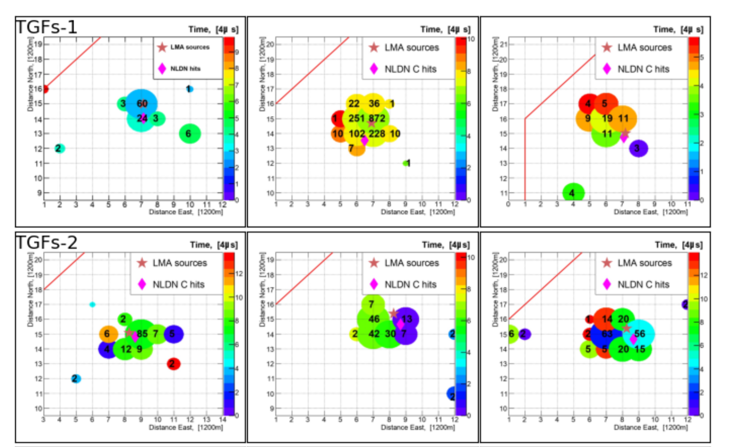
Typical TGF
2-4 km in diameter

Slide 10
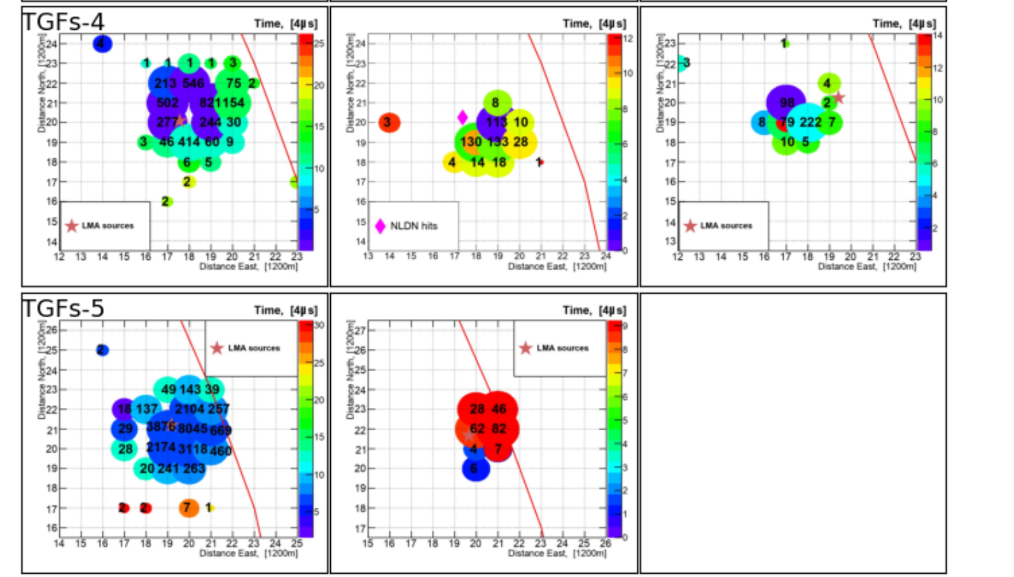
Intermediate TGF
Up to 7 km in diameter

Slide 11
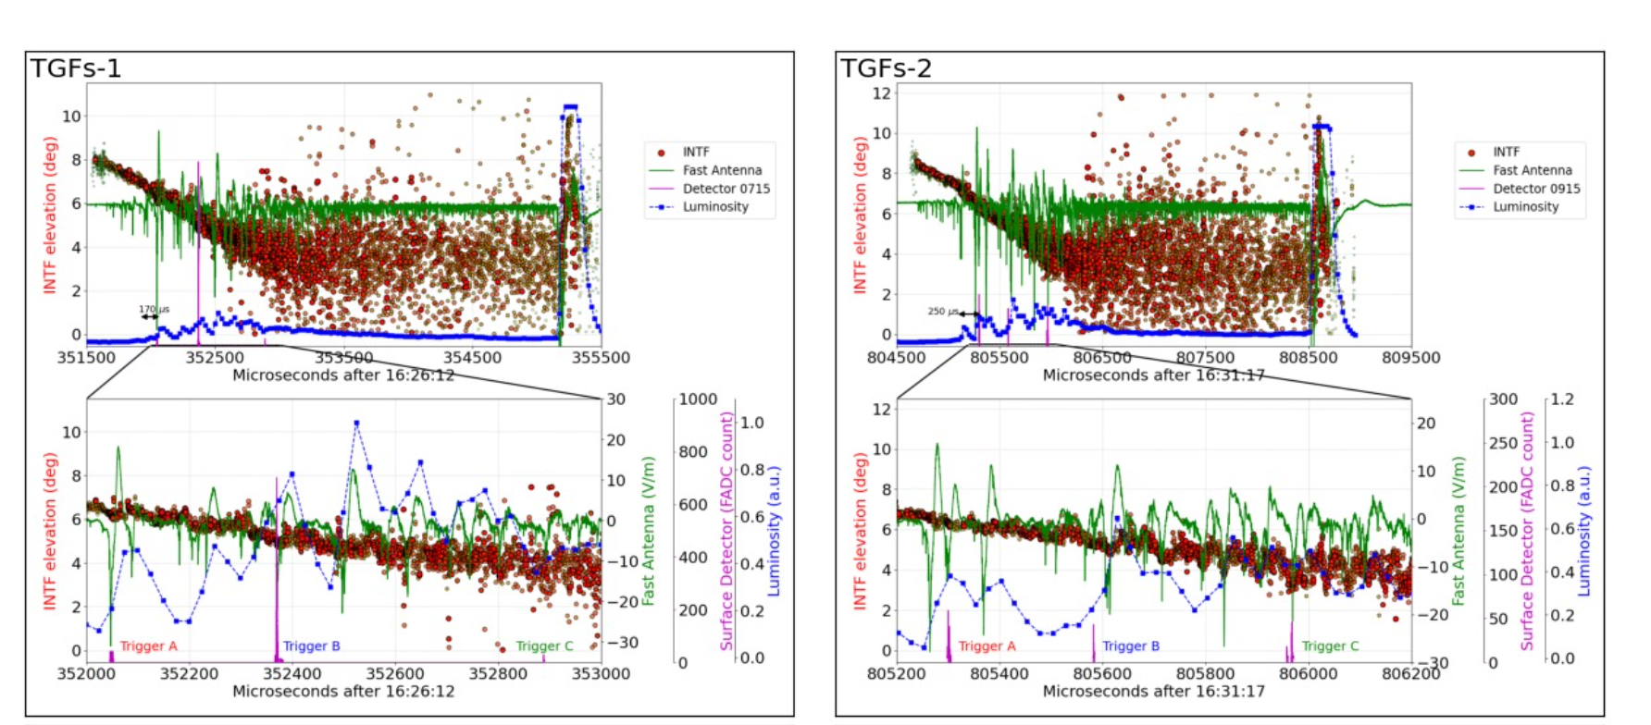
Typical TGF

Slide 12
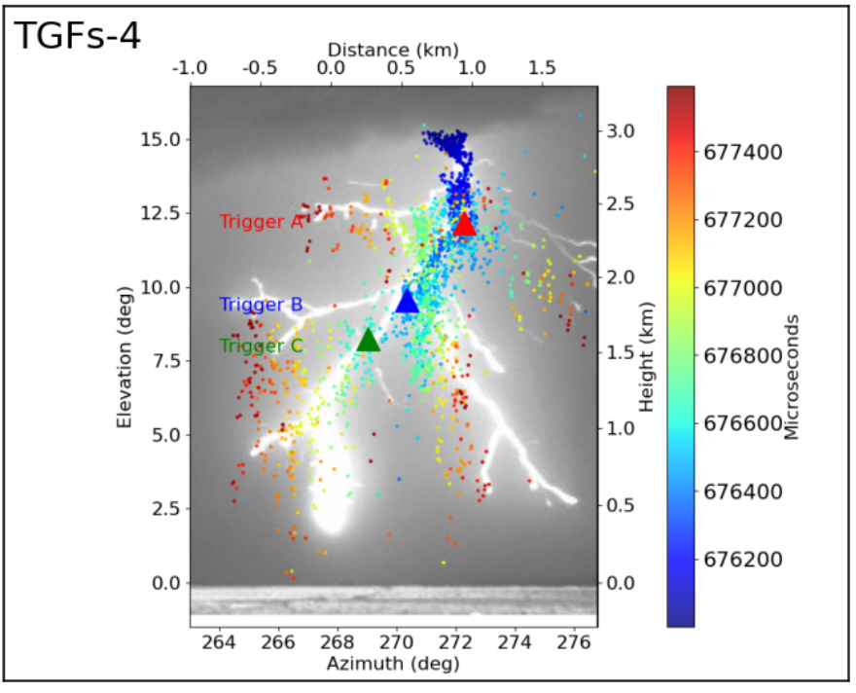
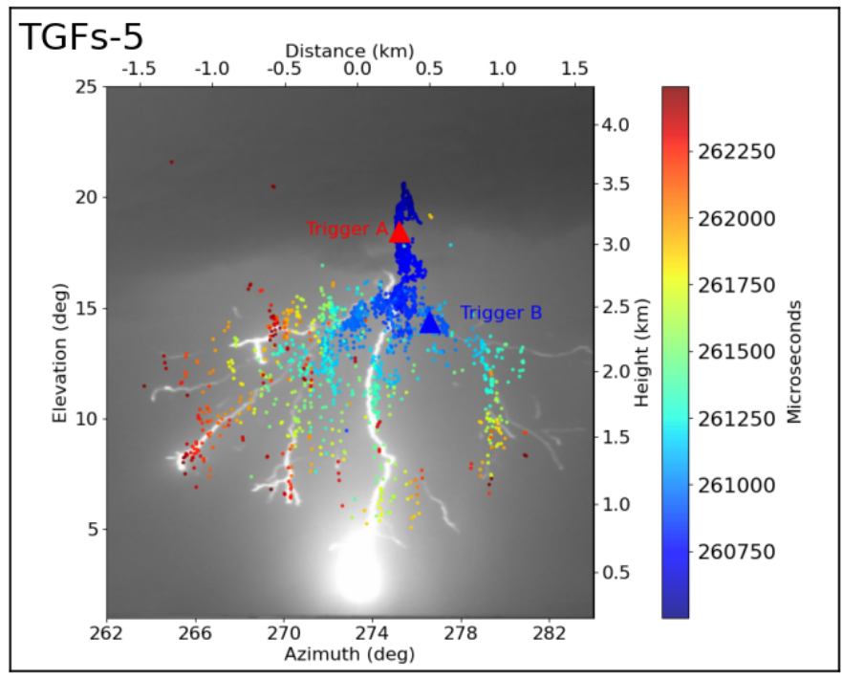
Intermediate TGF

Slide 13
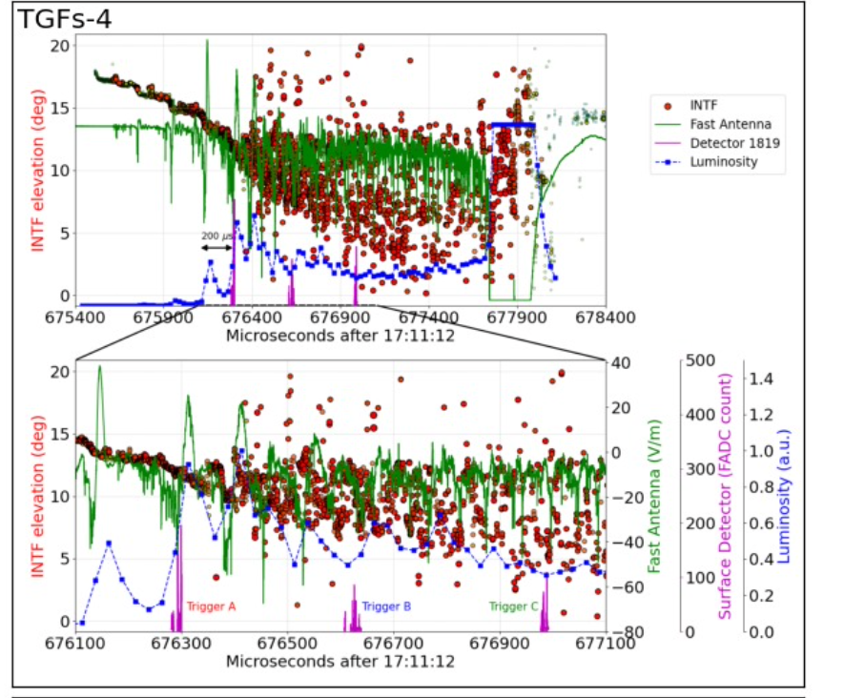
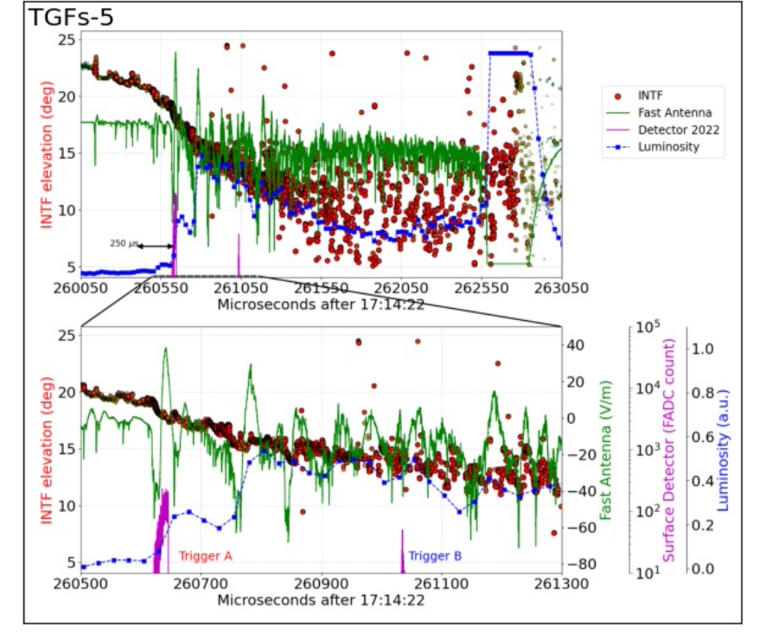
Intermediate TGF

Slide 14
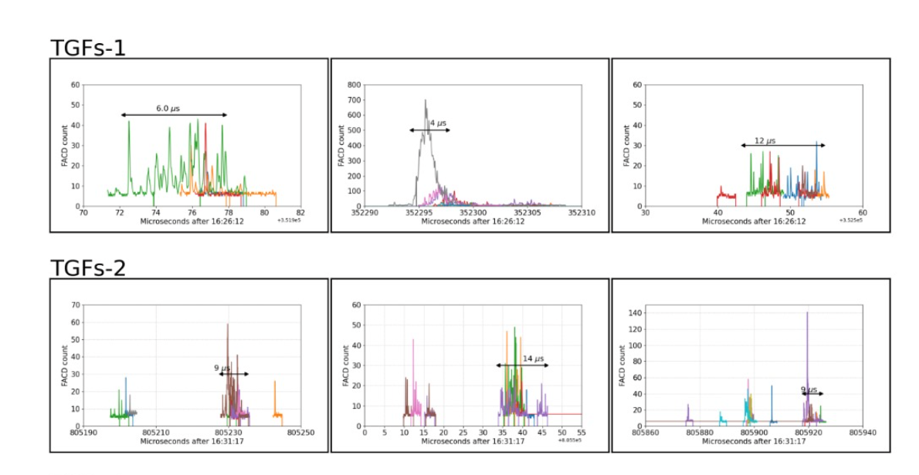
Typical TGF

Slide 15
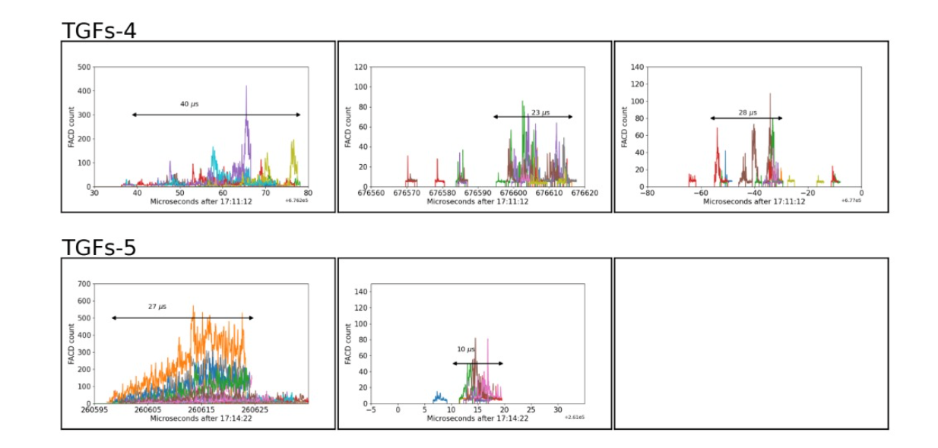
Intermediate TGF

Slide 16
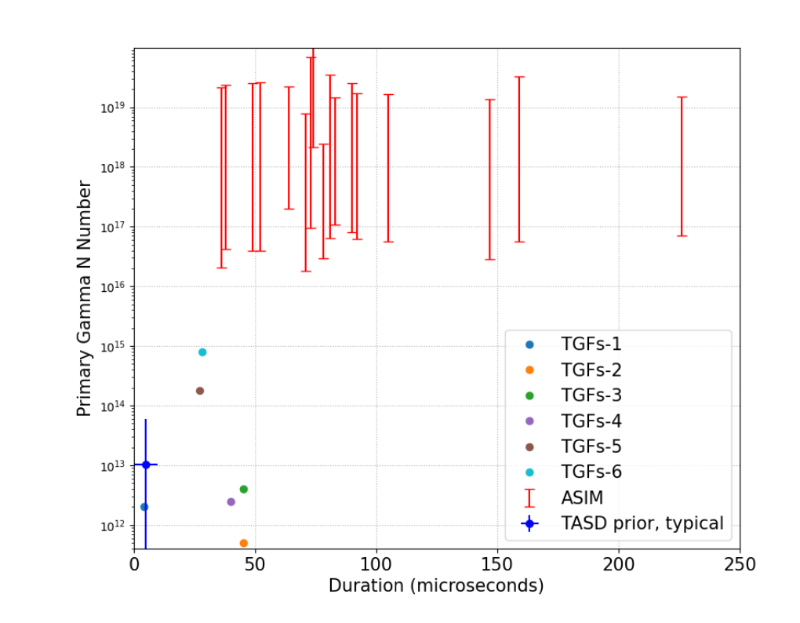
Fluence

Slide 17
Significance
Observed TGFs are detected as intermediate set of fluence values between previous TASD- and satellite-detected TGFs.
This finding emphasizes the similarity between upward and downward TGF varieties, suggesting a common origin for their production.

Slide 18
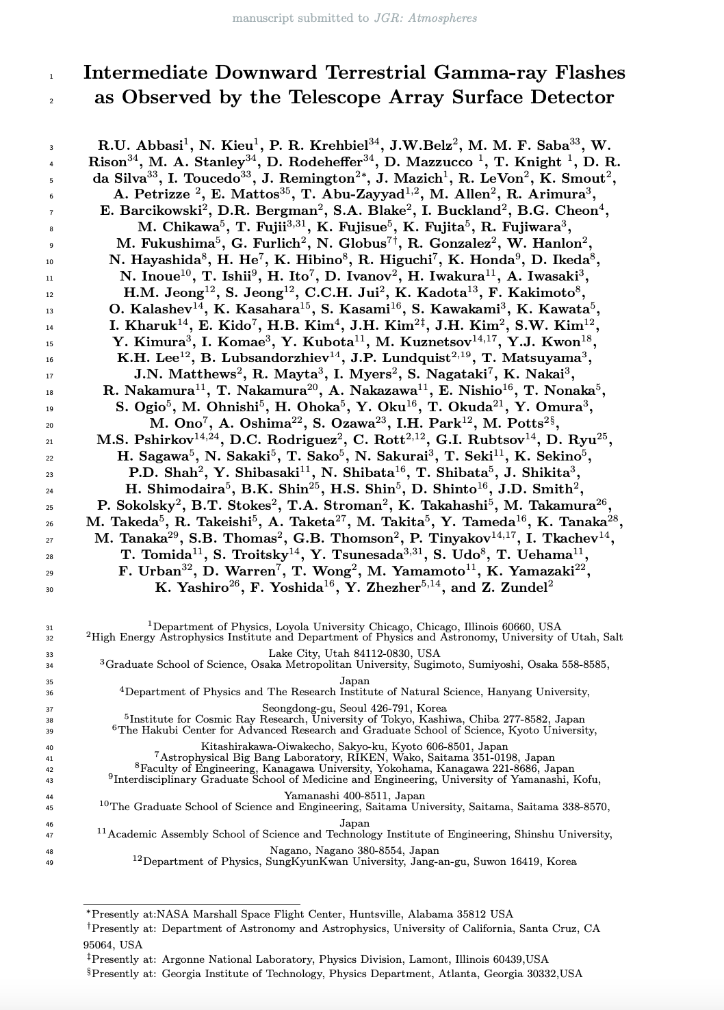
Publication
In Review Process at JGR-Atmosphere.

Slide 19
Optical observation of Downward directed Terrestrial Gamma-ray Flashes (TGFs)

Slide 20
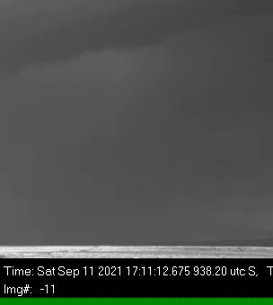
First High-Speed Video Camera Observations of a Lightning Flash Associated With a D-TGF
Simultaneous recordings of a downward-directed terrestrial gamma-ray flash (TGF), high-speed video images, and radio emissions
TGF events occurred while the leader was already branching below cloud base and even when it was halfway in its propagation to ground
Energetic downward-directed TGFs were associated with fast downward leaders that produced high return stroke peak currents

Slide 21
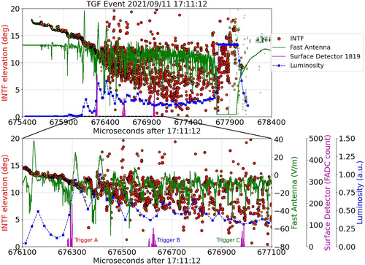
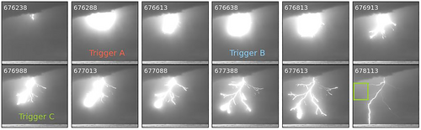
First High-Speed Video Camera Observations of a Lightning Flash Associated With a D-TGF

Slide 22
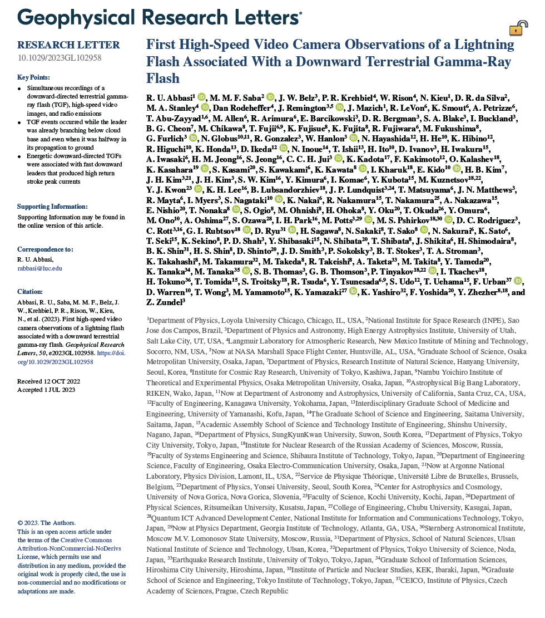
Published in Geophysics Review Letters
https://doi.org/10.1029/2023GL102958

Slide 23
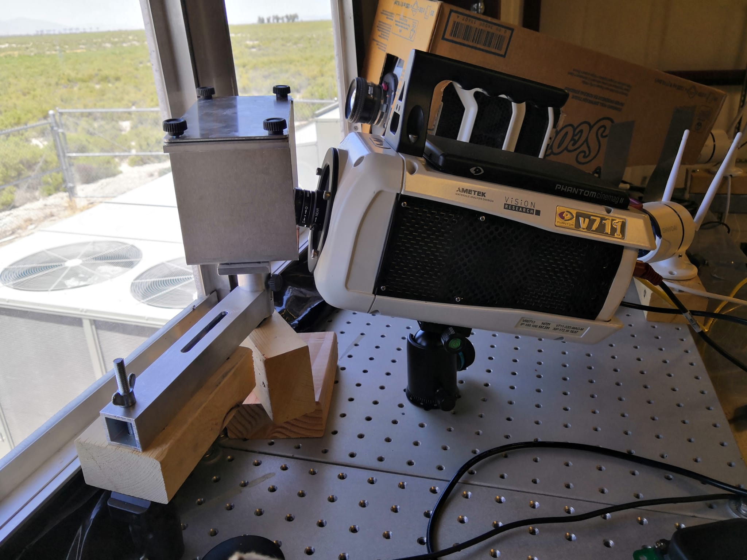
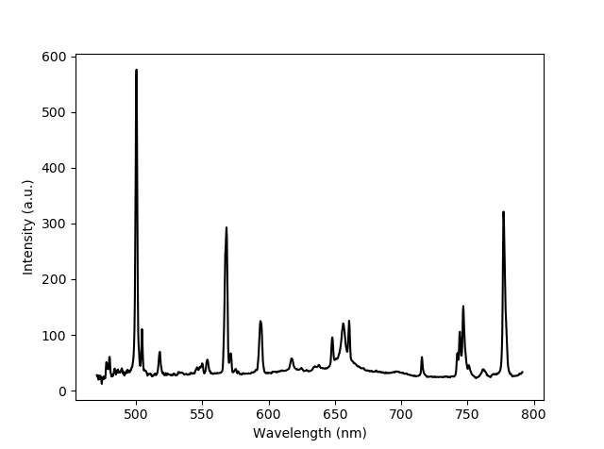
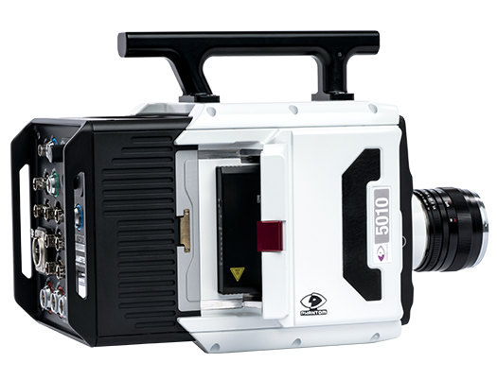

First Time-Resolved Leader Spectra associated with a Downward-TGF
    Placing a grism in front of a high-speed camera → a slitless spectrograph
O I - 777 nm
N II - 500 nm
H I - 656 nm
    Identify chemical components of optical data associated with TGF detections
    lightning leaders with and without TGF productions

Slide 24


Slide 25
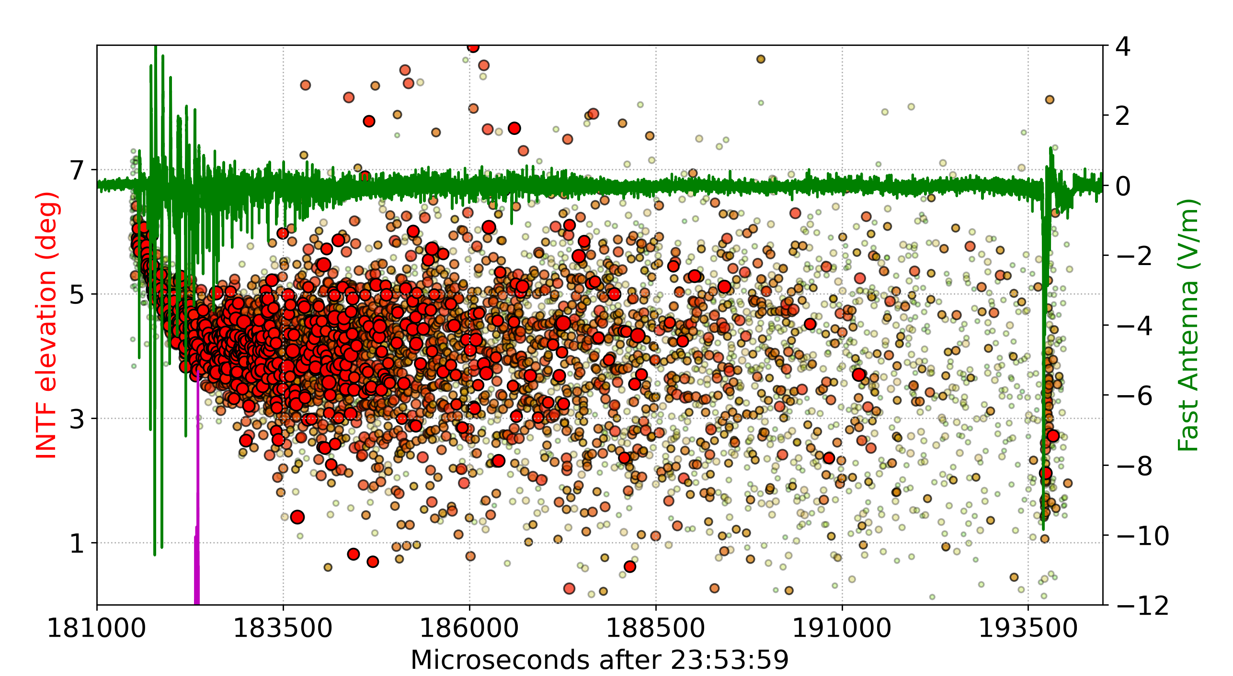
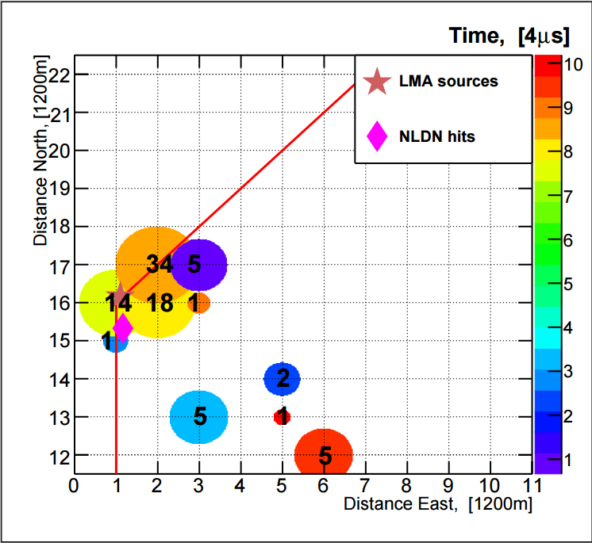

TGF Observation
Source altitude: 2.3 km
Velocity: 5x10⁷ m/s
TGF

Slide 26
Return Stroke Spectra

Slide 27
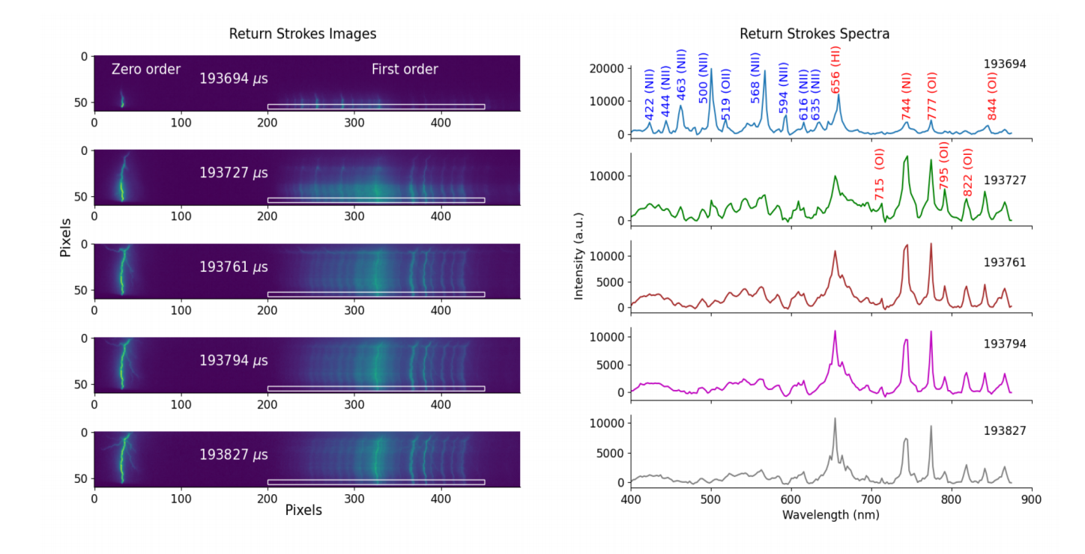
Return Stroke Spectra

Slide 28
We classify these spectra into three types:
  Spectra with ion emissions
  Spectra with neutral emissions
  Spectra with no emissions
Ion emissions: Single ionized N lines (463, 500, 568) and Single ionized O Iines (519 nm)
Neutral emissions: H (656), O(777 nm), N (744 nm)
These spectra show the presence of ion, neutral emissions of Nitrogen, Oxygen and Hydrogen:
  Ions emit in the early time disappear after 33 µs
  Neutral appear from the second frame and last up to 400 µs
  → Similar to natural return stroke spectra [Walker 2017, 2019 , Kieu 2021]

Slide 29
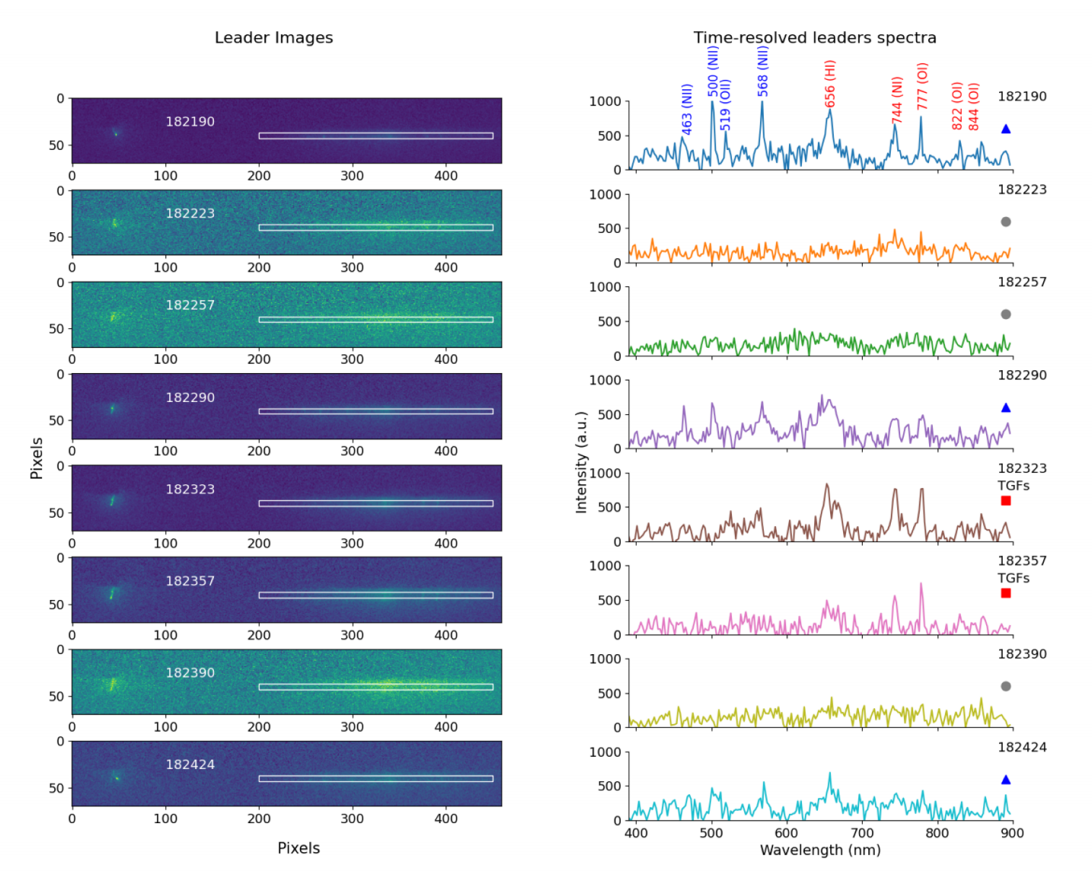
Leader Spectra

Slide 30
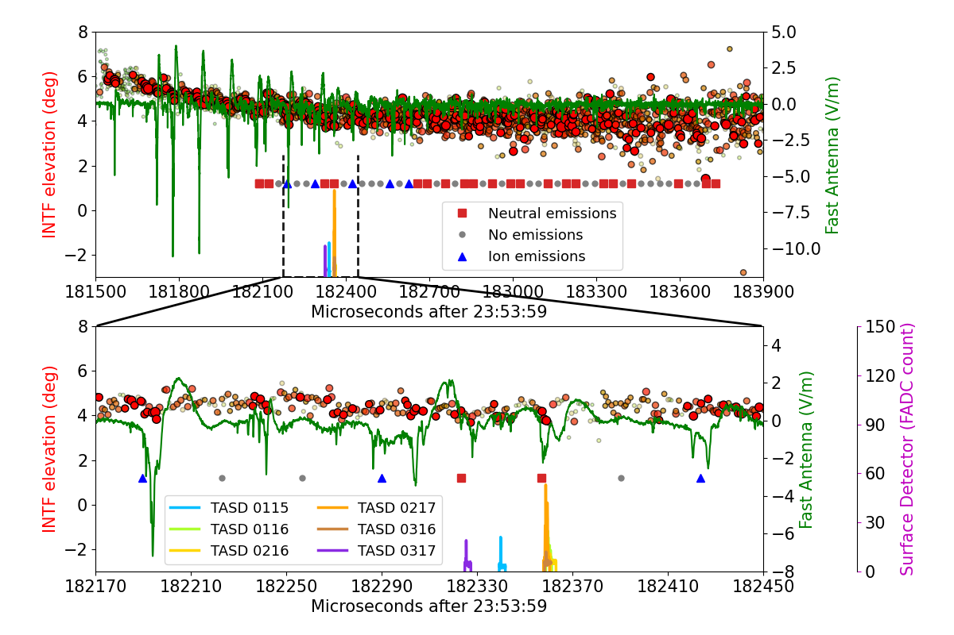
Leader Spectra
Optical emissions in a period of 1.67 ms
(- 0.27 ms before and +1.40 ms after)
Ion emissions: de-excitation of ionic species
in a period of 434 µs
-167 µs before and +0.267 µs after
At the moment TGF was detected, neutral emissions were recorded

Slide 31
Significance
  Ion emissions were recorded before and after the detection of the downward TGF, while only neutral optical emissions were recorded right at the moment when the TGF was detected.
  First time-resolved leader spectra suggests that the optical emissions occurring before and after the TGF are more energetic than the optical emissions produced right when the TGF is detected .

Slide 32
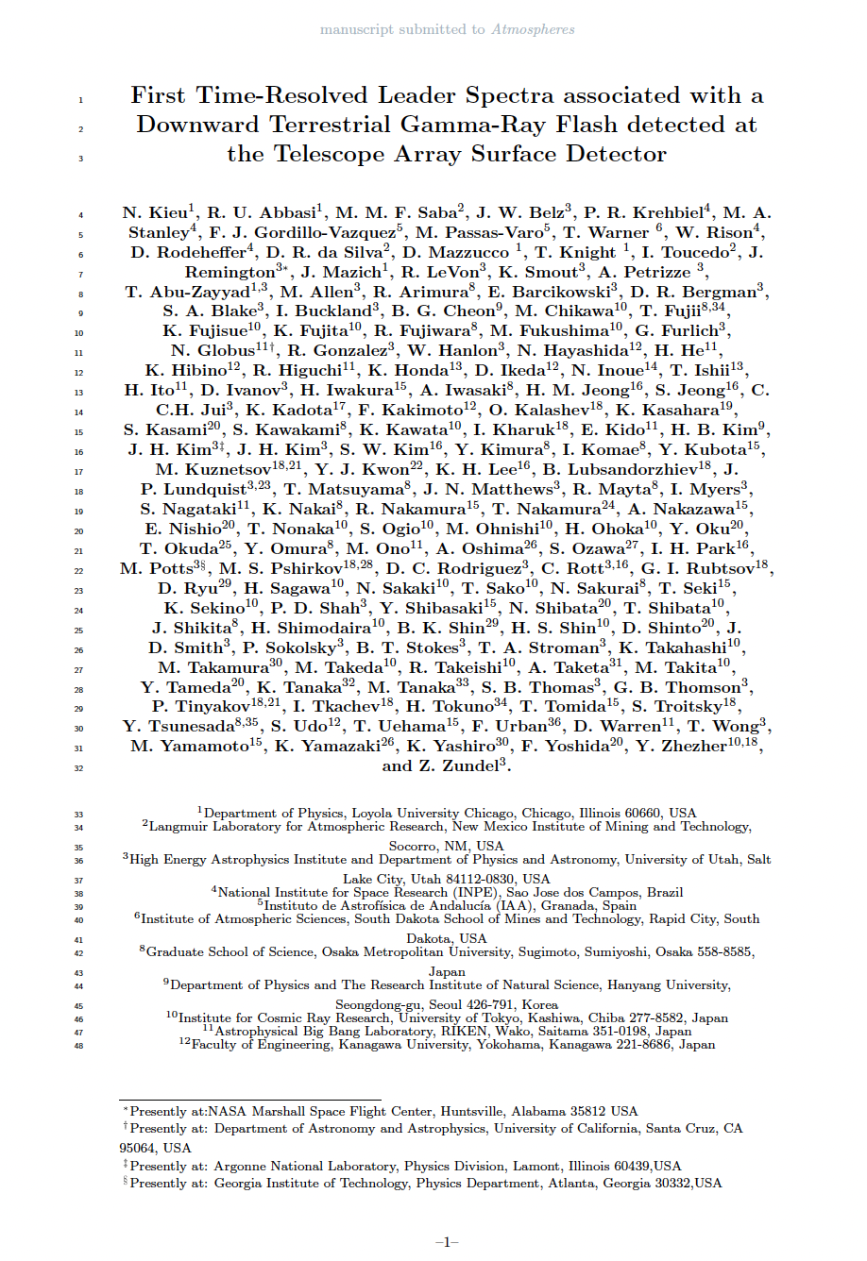
Publication
In Review Process at JGR-Atmosphere.

Slide 33
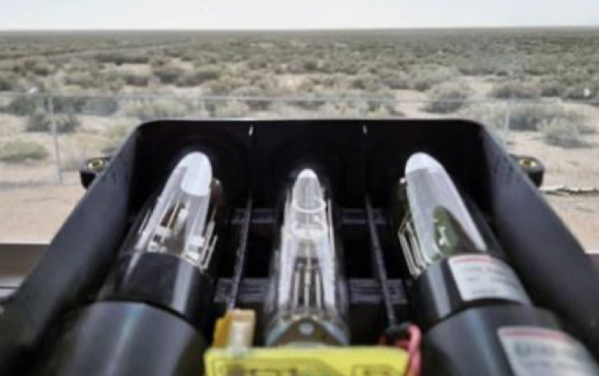
Photometric Array
Three Hamamatsu Photometers
Bandpass filters (337nm, 390nm, 777 nm)
PXI-5105 Digitizer at sampling rate of 30 MS/s
Triggered by the high-speed video camera V2012

Slide 34
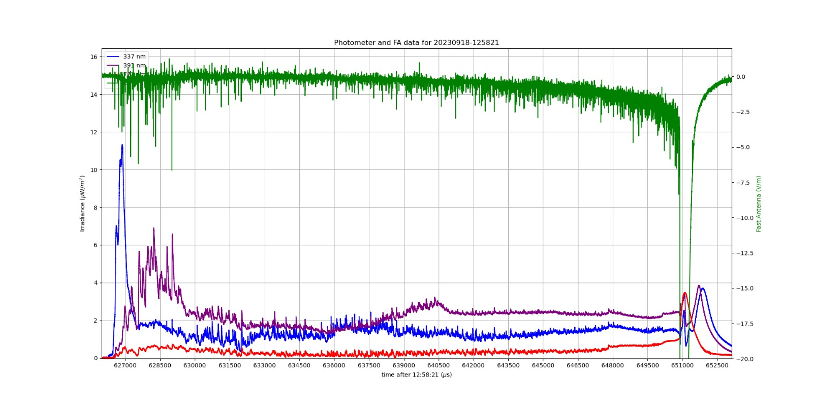
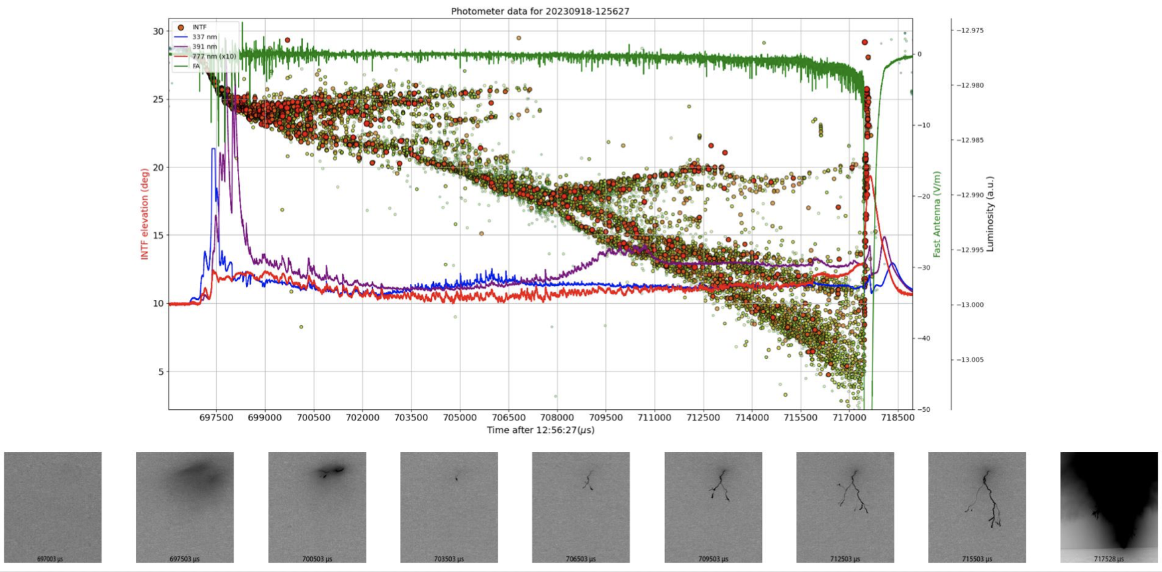
Photometric Array
09/18/2023
6.8 km away
~50 kA

Slide 35
Summary
Cosmic ray detectors are highly important in atmospheric electricity studies
First high-speed video camera of lightning associated with d-TGF.
Intermediate Downward Terrestrial Gamma-ray Flashes as Observed by the Telescope Array Surface Detector
First time-resolved leader spectra associated with d-TGF.
First lightning observations of Photometric Array at the TA detector.

Slide 36
Thank you!

Slide 37
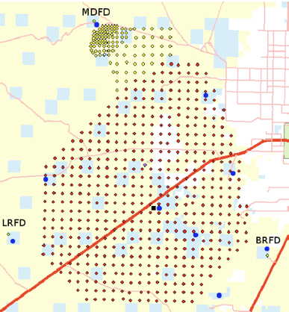
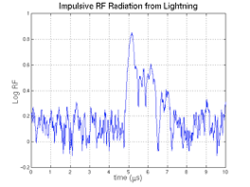
Lightning Mapping Array
9 LMA Stations
60 km in diameter
RF quite locations
> 2015 – data collection. (http://lightning.nmt.edu/talma)
Impulsive radiation converted to source location using time of arrival technique.

Slide 38
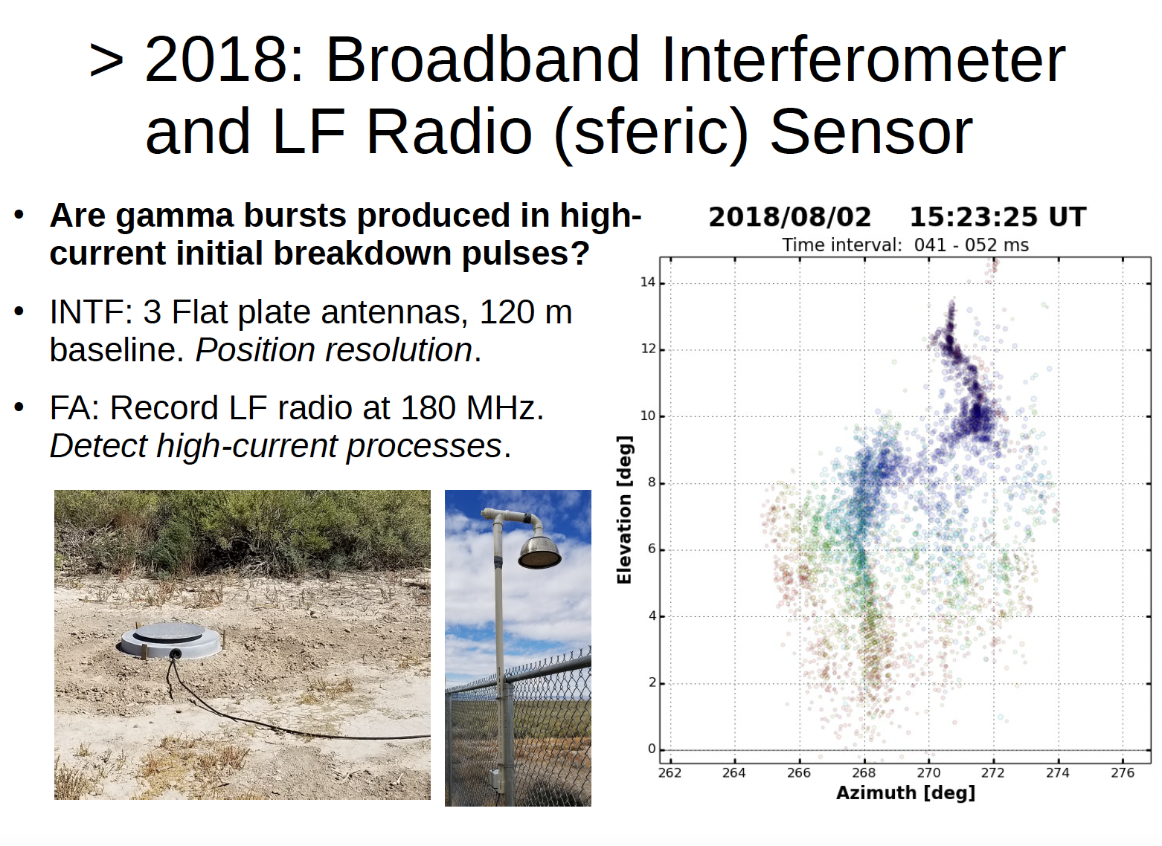

Slide 40
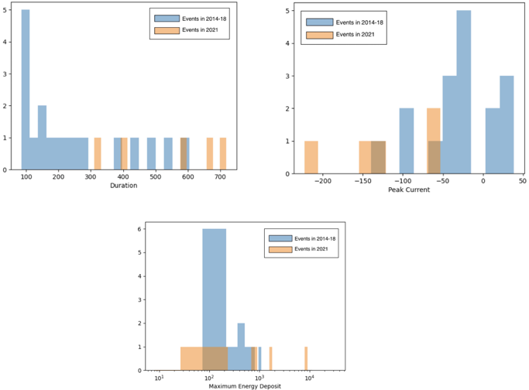
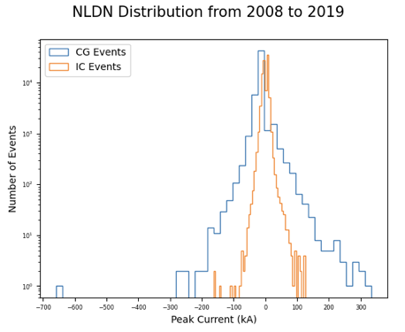
09/11/2021 16:00-18:00 UTC
N. Husseini

Slide 41
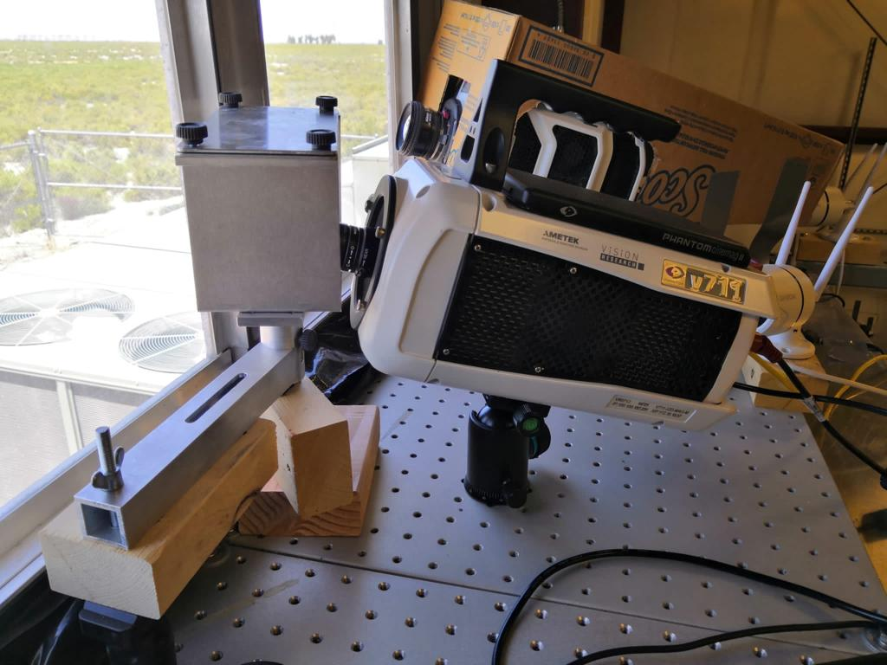
2. Experimental setup
a. The slitless spectrograph
The system includes:
  A high-speed camera
  A collective lens of 14 mm.
  A grism with 600 lines/mm.
  Recording speed 29,990 fps.
a) Spectroscopic system
Time resolution: 33.44 µs, spectral resolution 2.1 nm per pixel

Slide 42
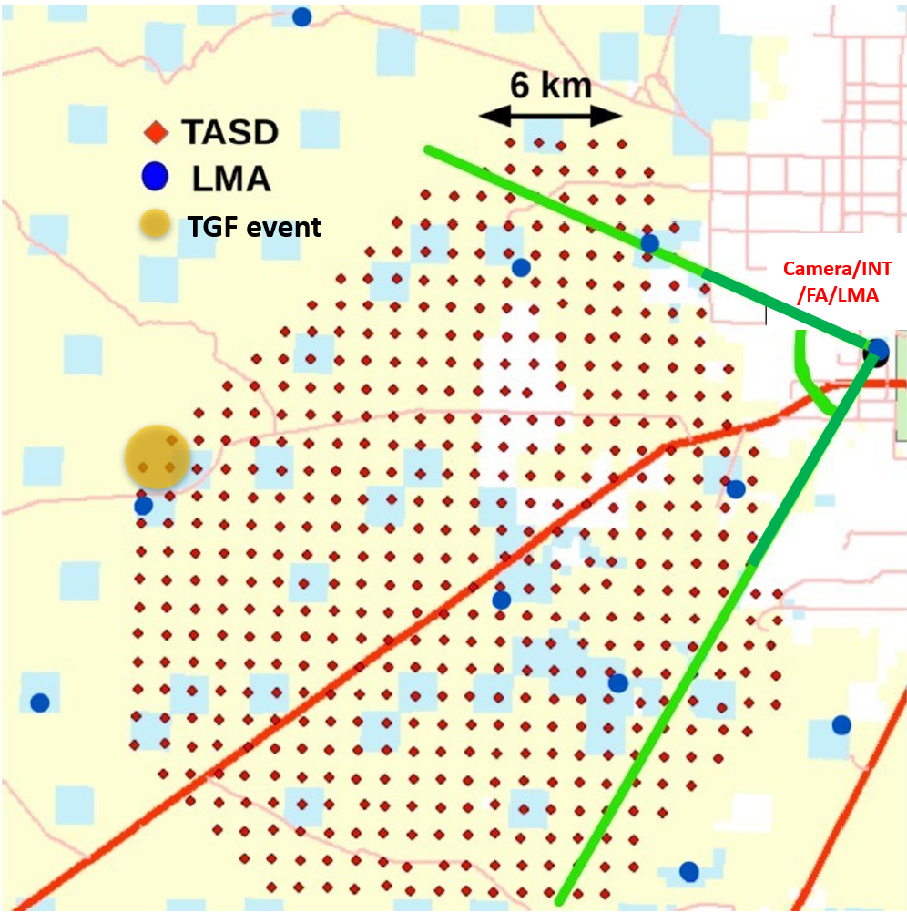
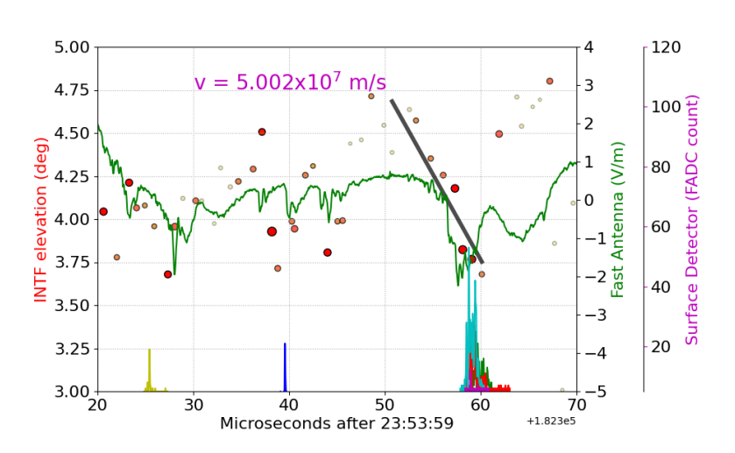
3. TGF Observation
On August 10th, 2022, a burst of TGF was observed by the TASD. The event was 32 km away from the camera.
    NLND data detected a – 18 kA cloud-to-ground return stroke
    The total energy deposit was 153 MeV
Microsecond after 23:53:59.182300

