Slide 1
SHEFALI NEGI INSTITUTE OF PHYSICS OF THE CZECH ACADEMY OF SCIENCES, PRAGUE
AEROSOL MEASUREMENT IN B, V and R FILTER USING WIDEFIELD STELLAR PHOTOMETRY
AtmoHEAD Conference, 15/07/2024

Slide 2
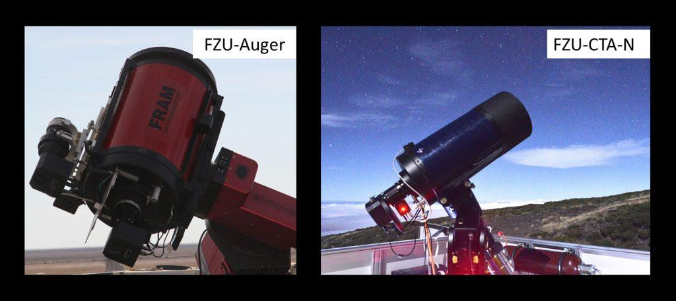
FRAMs (F/Photometric Robotic Atmospheric Monitor)
● Future Cherenkov
Telescope Array(CTAO) site
La Palma (CTAO-n) and
Chile (CTAO-s)

Slide 3
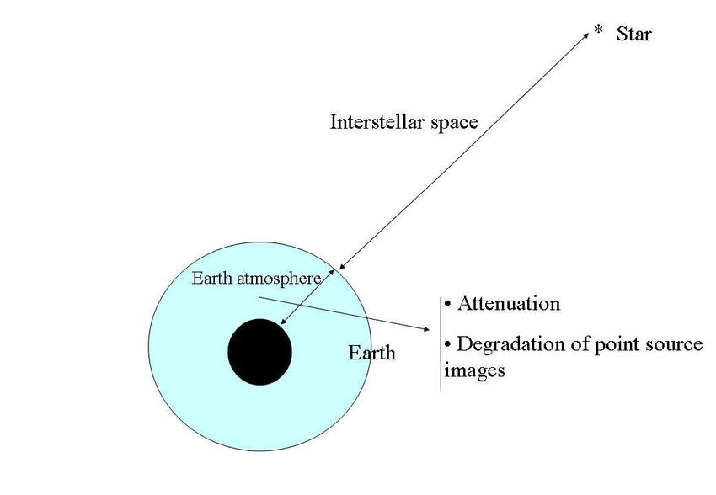
<number>

Slide 4
Rayleigh scattering dominates when particles are smaller than the wavelengths of light
Greater for small wavelengths
<number>

Slide 5
Measured magnitude = modeled magnitude
Model magnitude = catalogue magnitude + extinction model as a function
of airmass
<number>

Slide 7
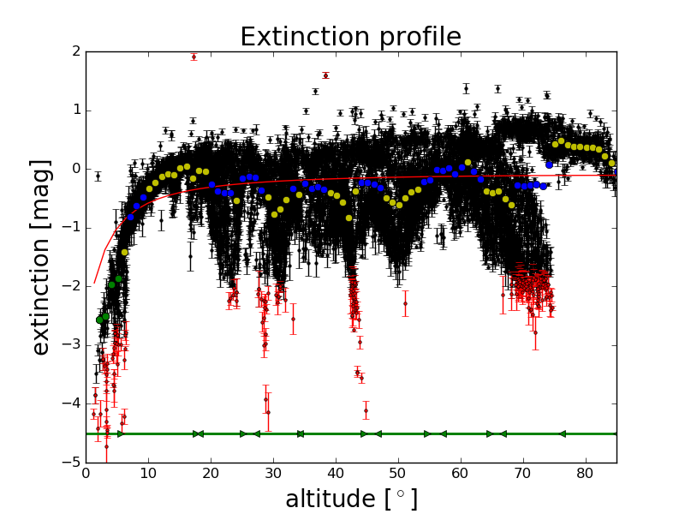

Slide 8
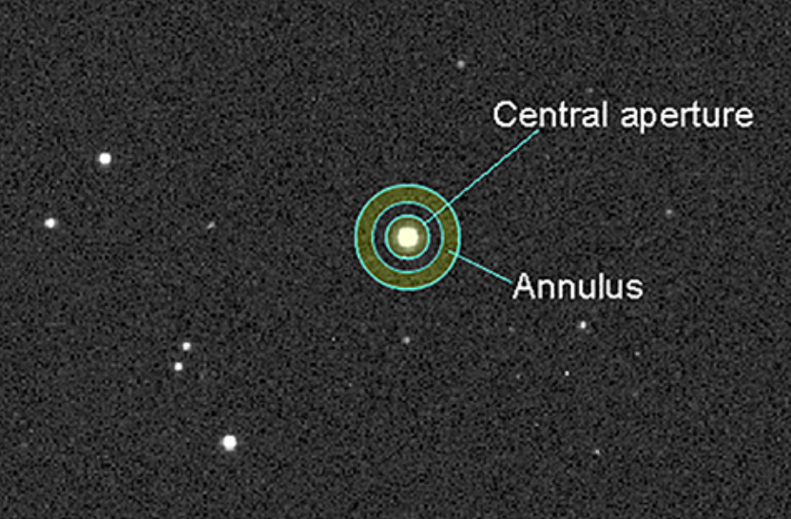

Slide 9
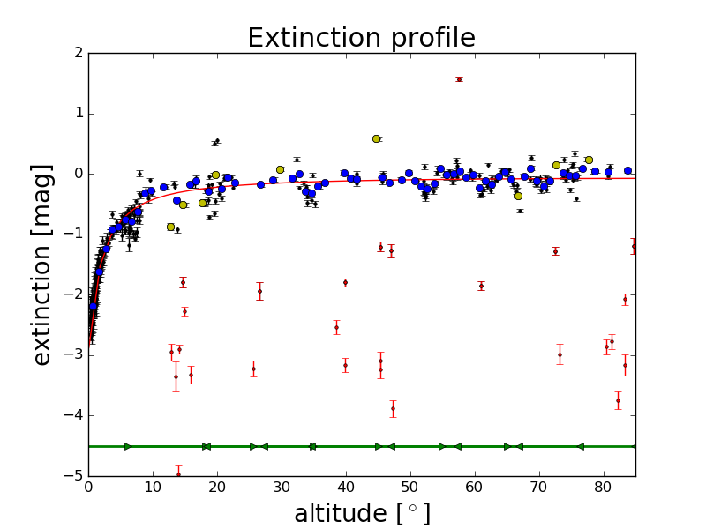
R-filter minimum distance between star: 20 pixels

Slide 10
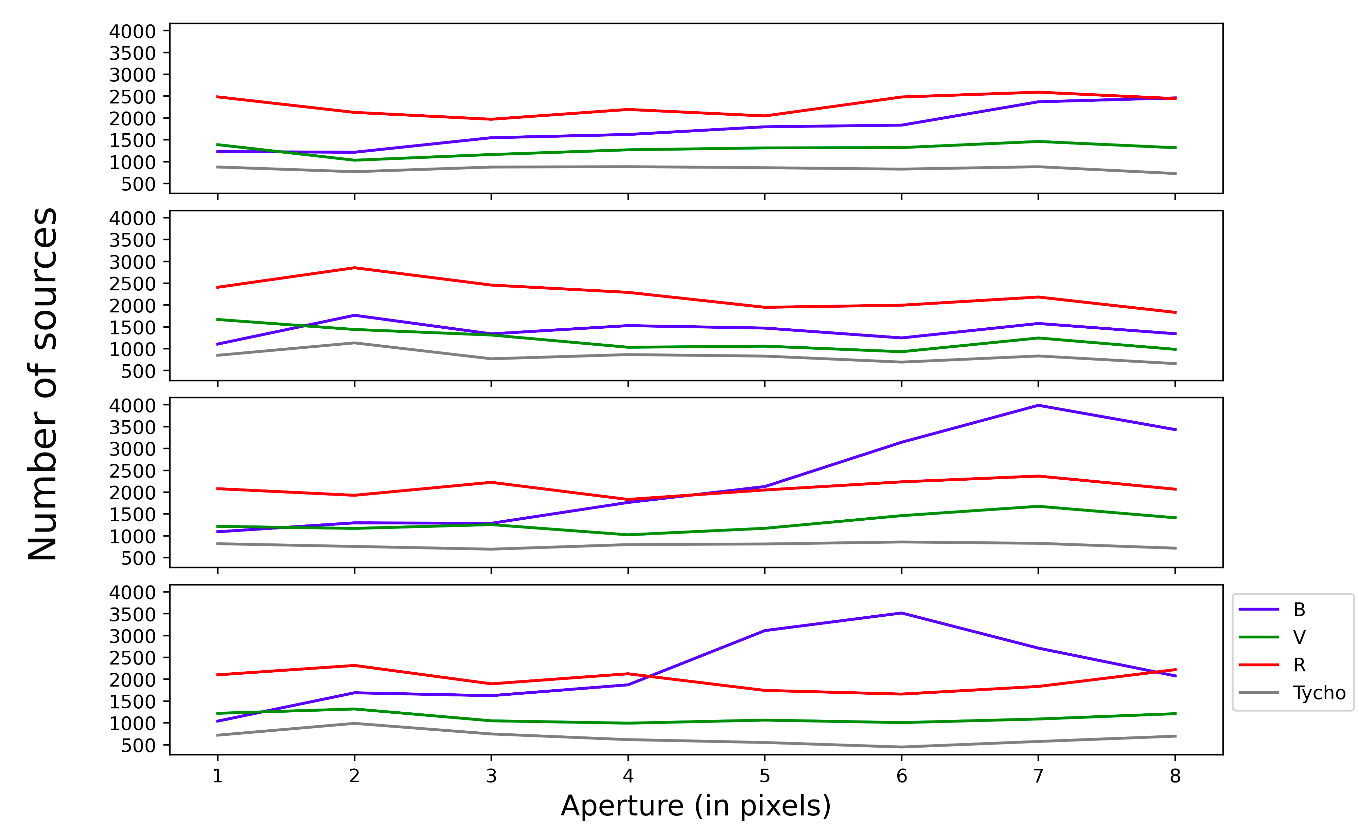

Slide 11
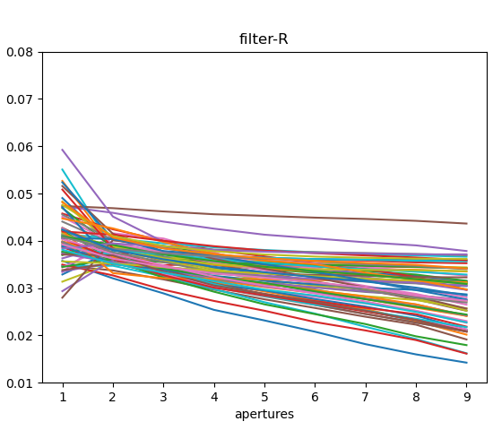
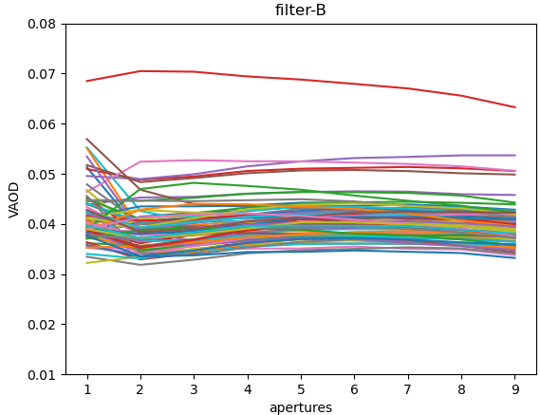
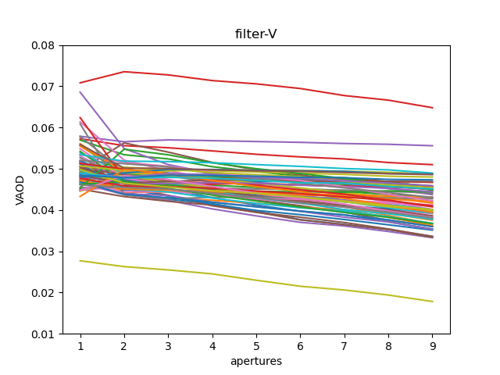
Scattering always decreses with wavelength minimum distance: 10 pixels

Slide 12
Cherenkov Telescope Array at Paranal

Slide 13
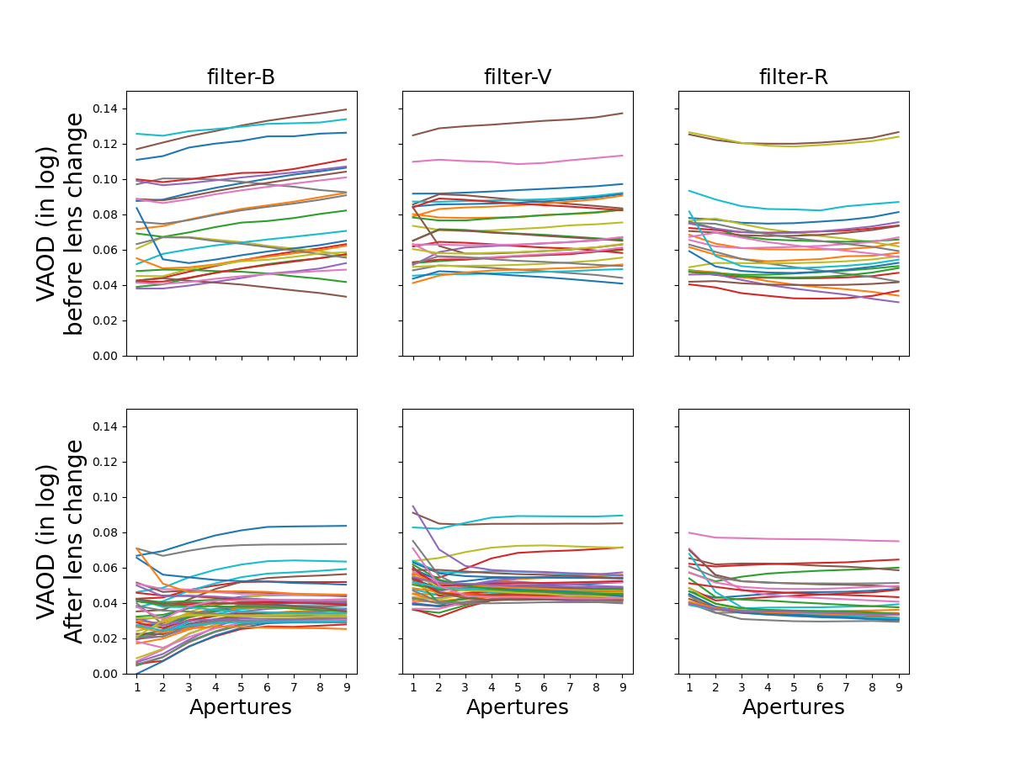
Cherenkov Telescope Array at Paranal

Slide 14
Cherenkov Telescope Array at Paranal

Slide 15
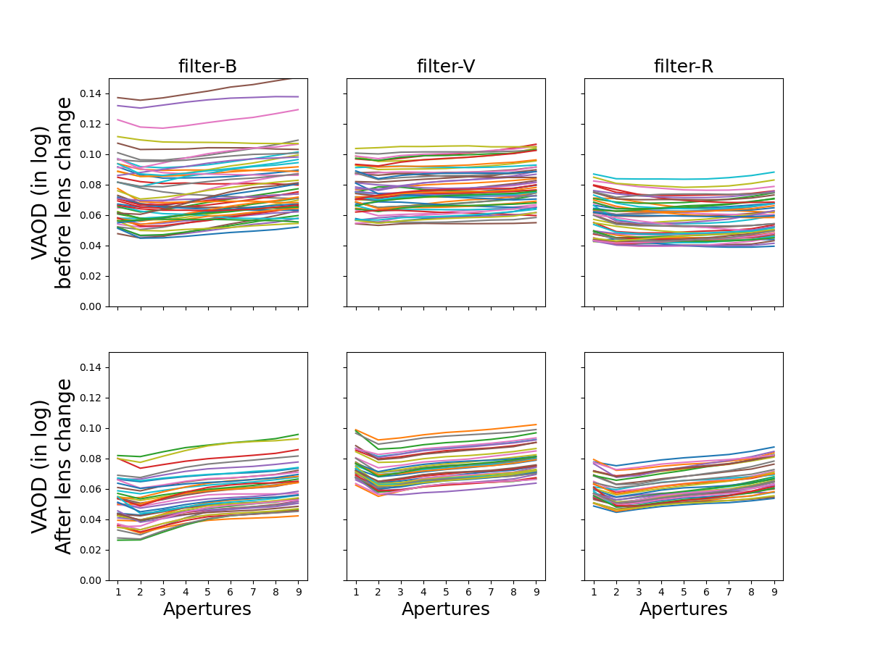
Cherenkov Telescope Array at Chile

Slide 16
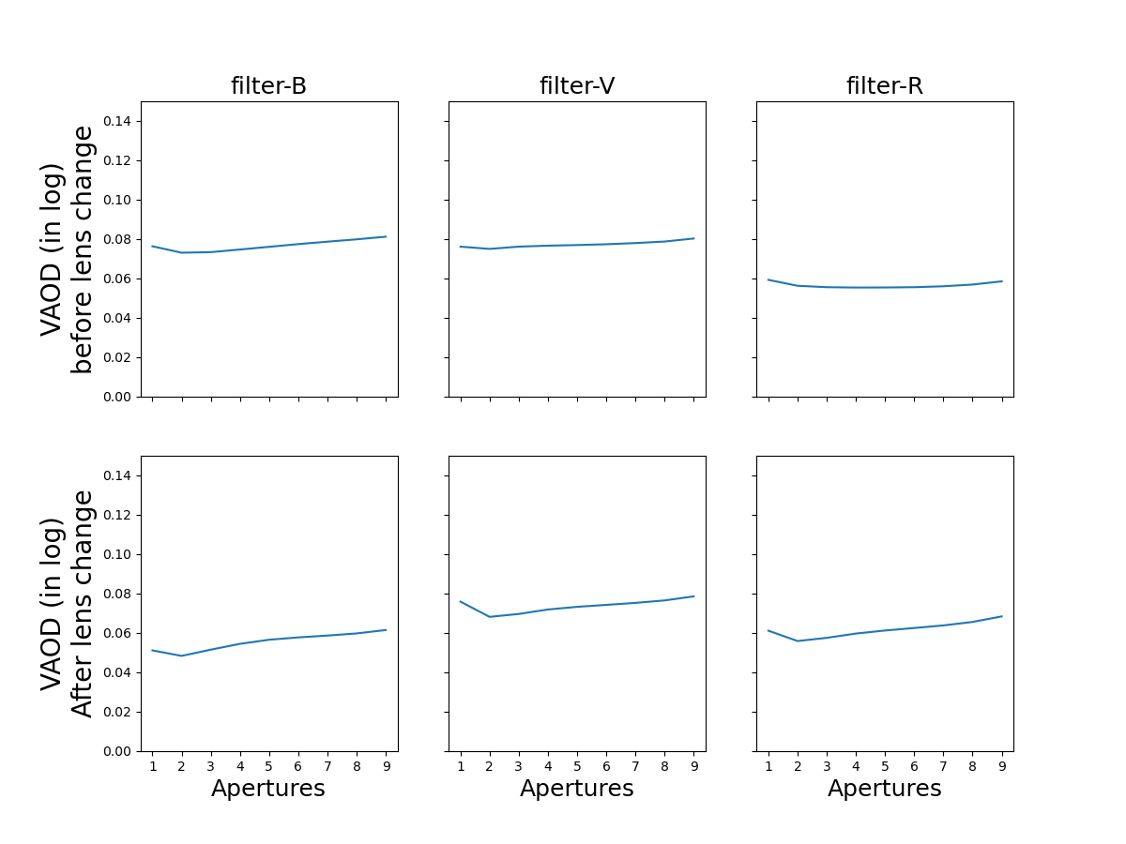

Slide 17
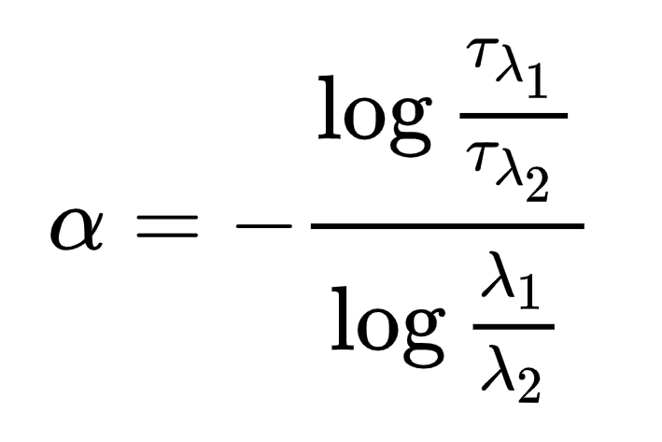
Angstrom exponent
B=440nm
V=540nm
R=620nm
17

Slide 18
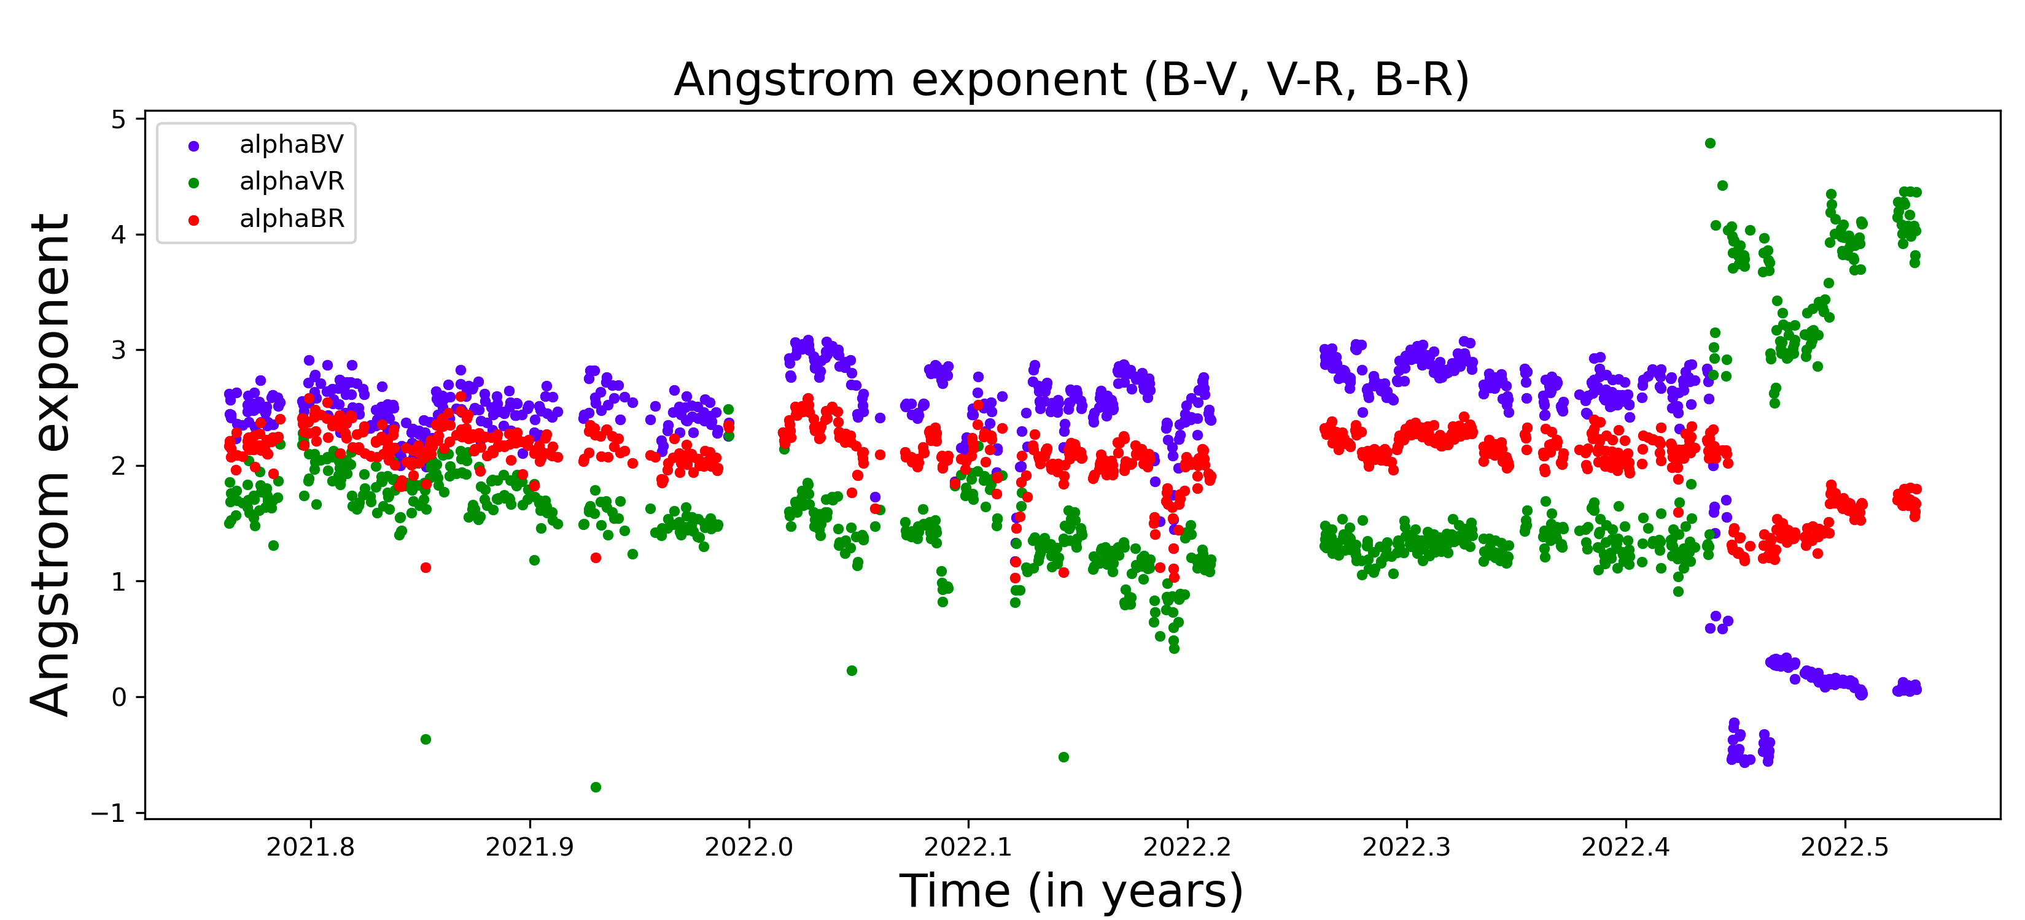
B=440nm
V=540nm
R=620nm
<number>

Slide 19
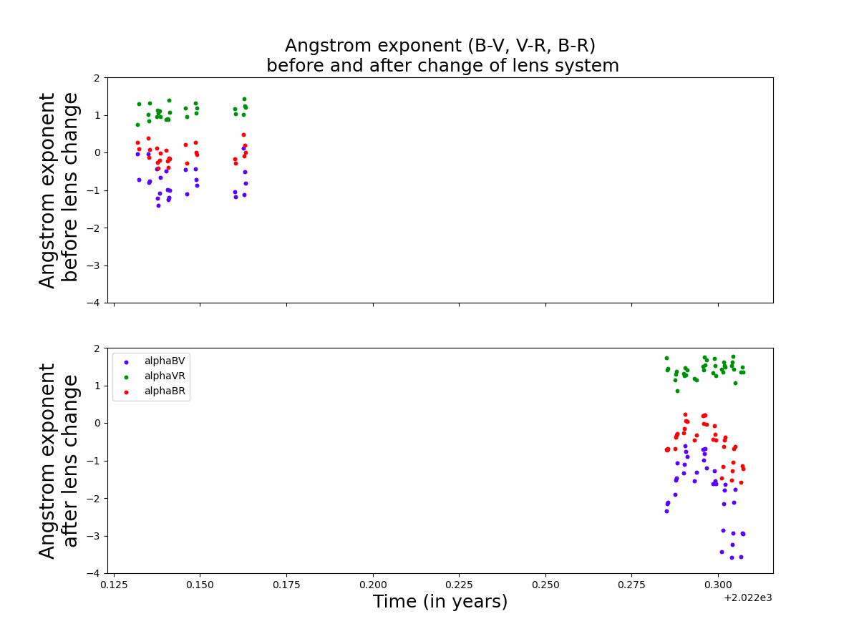
B=440nm
V=540nm
R=620nm
<number>

Slide 20
Conclusion
It is a work in progress!
<number>

Slide 21
Thank You!
<number>

