Slide 1



Two Qubits gate
Qub-IT meeting 29/11/2023
A.S. Piedjou Komnang
D. Labranca
H. Corti
R. Moretti
S. Tocci
L. Banchi

Slide 2
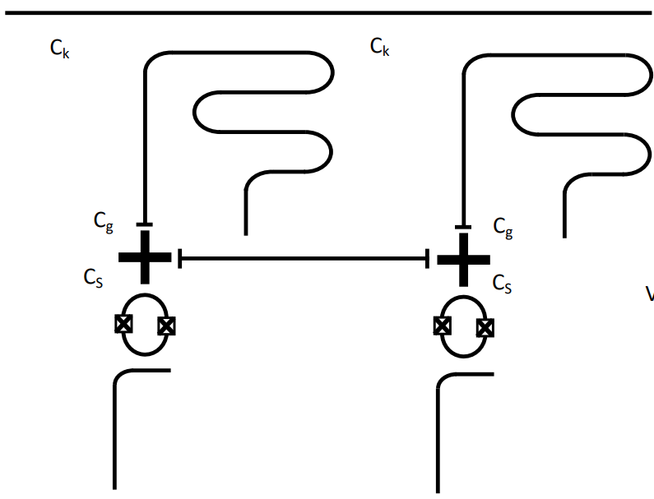
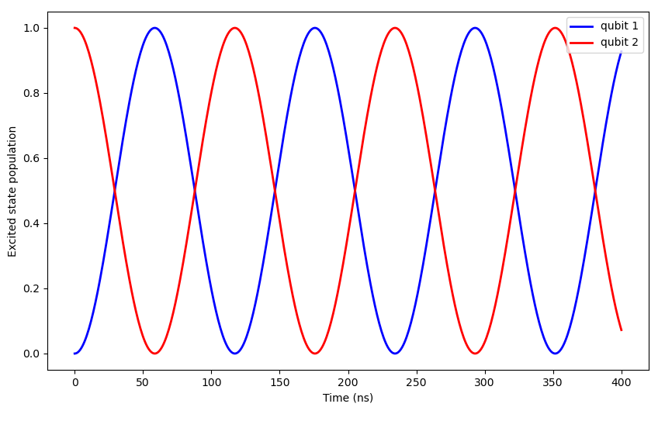

Hamiltonian,
both qubits are strongly detuned from the resonator:

Slide 3
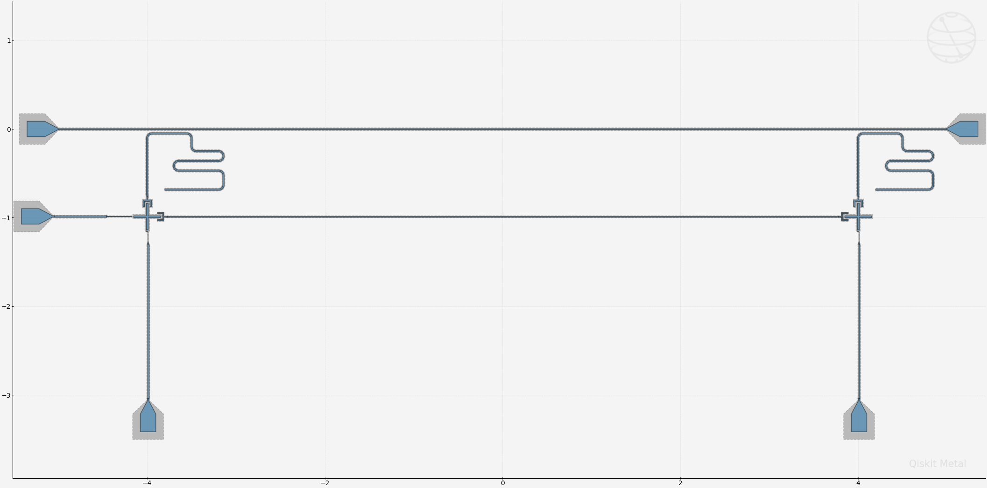
2 Qubits design
Two xmon with readout resonators capacitively connected at the same transmission line
The readout resonators are set to 8 GHz
Frequency of the bus resonator set to 5.5 GHz (half-wave with 7.9mm in length)
Qubits frequencies are fixed
The main qubits parameters are exactly the same

Slide 4
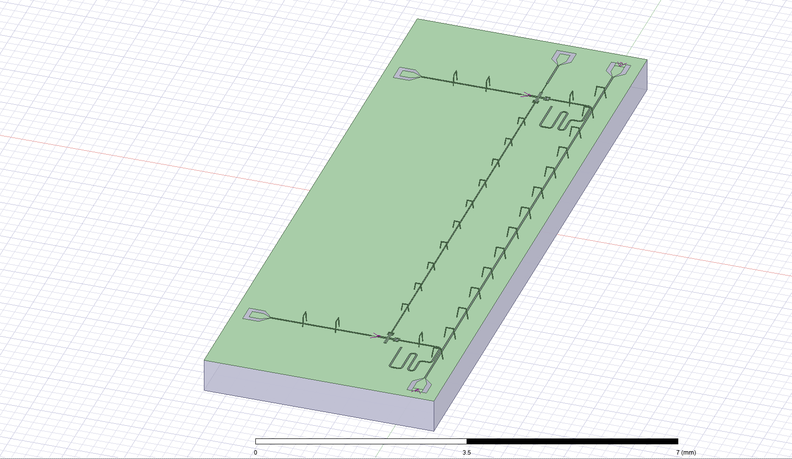
Rendering on Ansys
Q3D capacitance matrix extraction

Slide 5
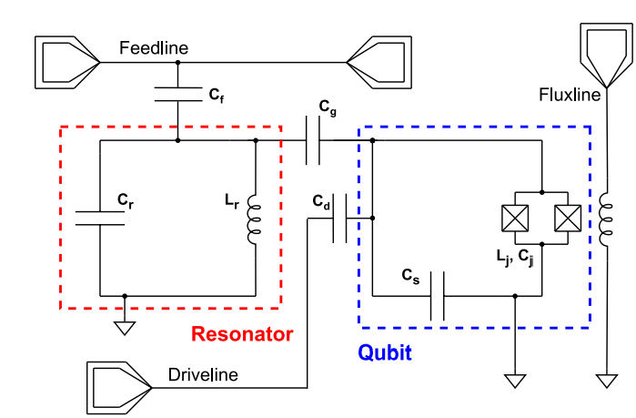
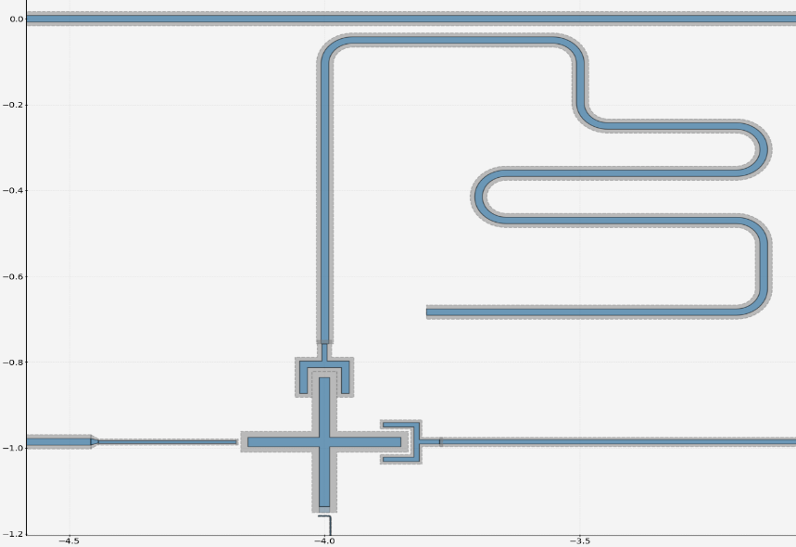
Lumped model: Circuit parameters
From Q3D simulations:
Parameter | Value
L_{J} - Junction inductance | 10 nH
I_{C} - Critical current | 32.911 nA
C_{R} - bus Resonator capacitance | 368.440 fF
Parameter | Value
C_{S} - Qubit shunt | 83.923 fF
C_{c} - Coupling Q-Bus_R | 1.946 fF
C_{g} - Coupling Q-readout | 4.643 fF
Cg
Cc
Cc
Cg
Cr
Lr
expectations
Ej = 16.34 GHz
Ec = 230.84 MHz
Ej/Ec → 70.77 in the transmon regime

Slide 6
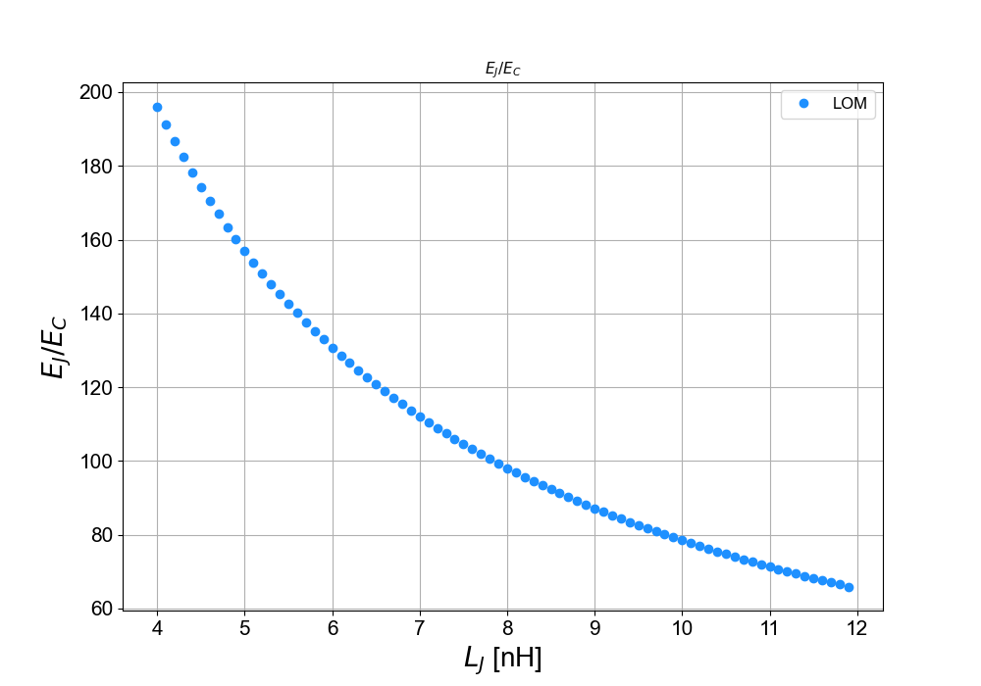
LOM simulation: Ej/Ec
Sweep Lj [4, 12]nH

Slide 7
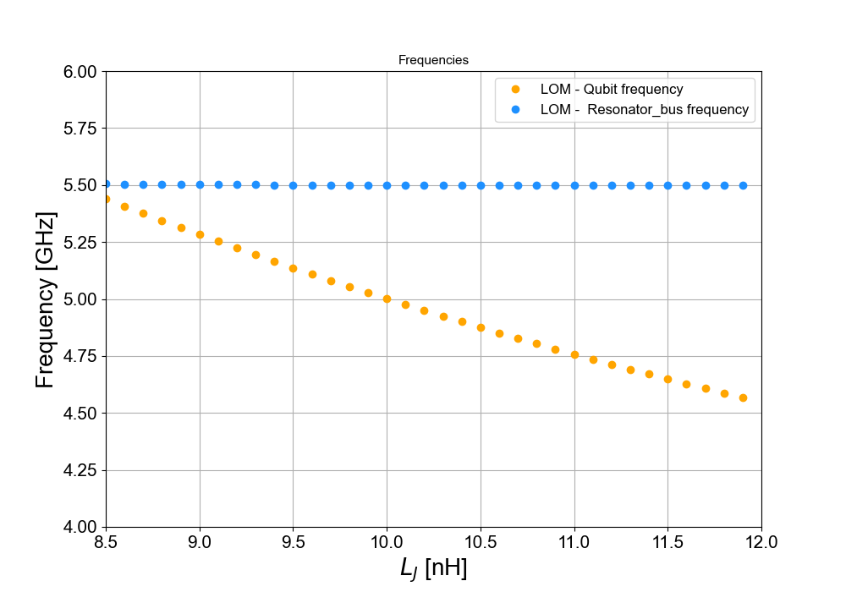
LOM simulation: frequencies of qubit and bus-resonator

Slide 8
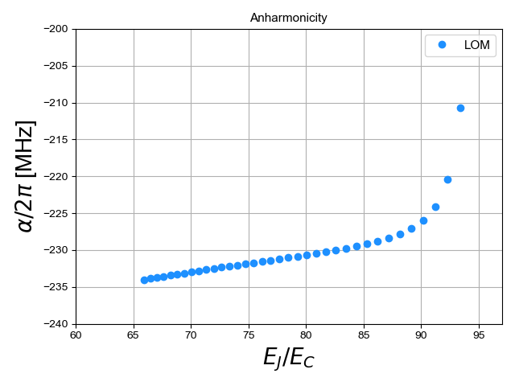
LOM simulation: qubit anharmonicity

Slide 9
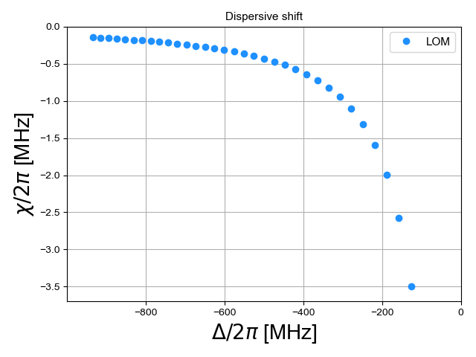
LOM simulation: Dispersive shift

Slide 10
What’s next??
Improve this LOM analysis
EPR analysis ? Analytical calculations?
Tunability ?

