Slide 1

QubIT JOINT MEETING
Aluminum resonant cavities development for 3D transmon application
Speaker:
Giovanni Marconato
Giovanni Marconato

Slide 2

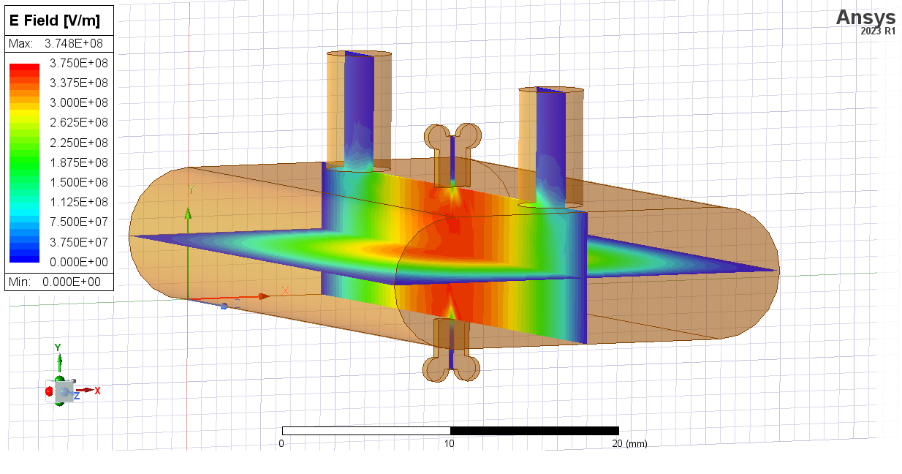
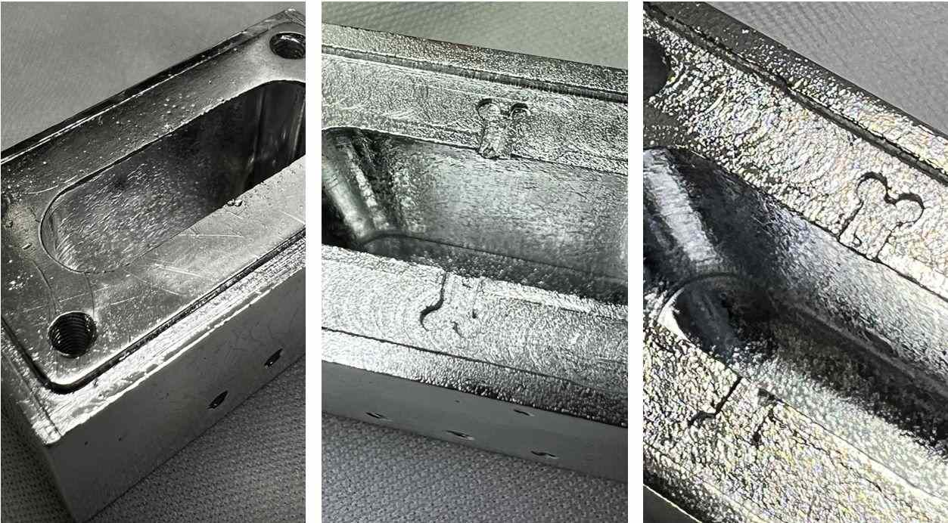

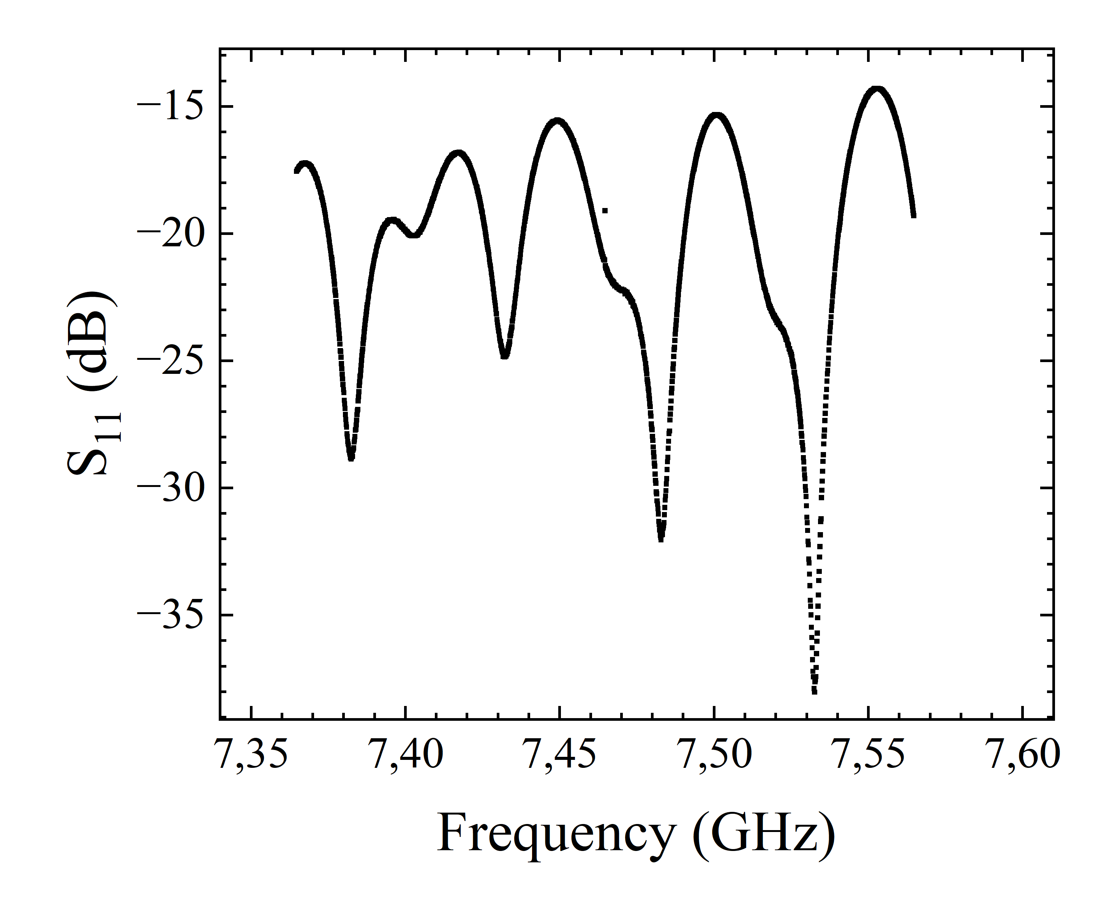
Outline
Introduction
Design of a 7.46 GHz cavity
Fabrication using
pure Al vs Al alloy
Fabrication improvements
Characterization of the Cavity + Qubit

Slide 3

Outline
Introduction
Design of a 7.46 GHz cavity
Fabrication using
pure Al vs Al alloy
Fabrication improvements
Characterization of the Cavity + Qubit

Slide 4
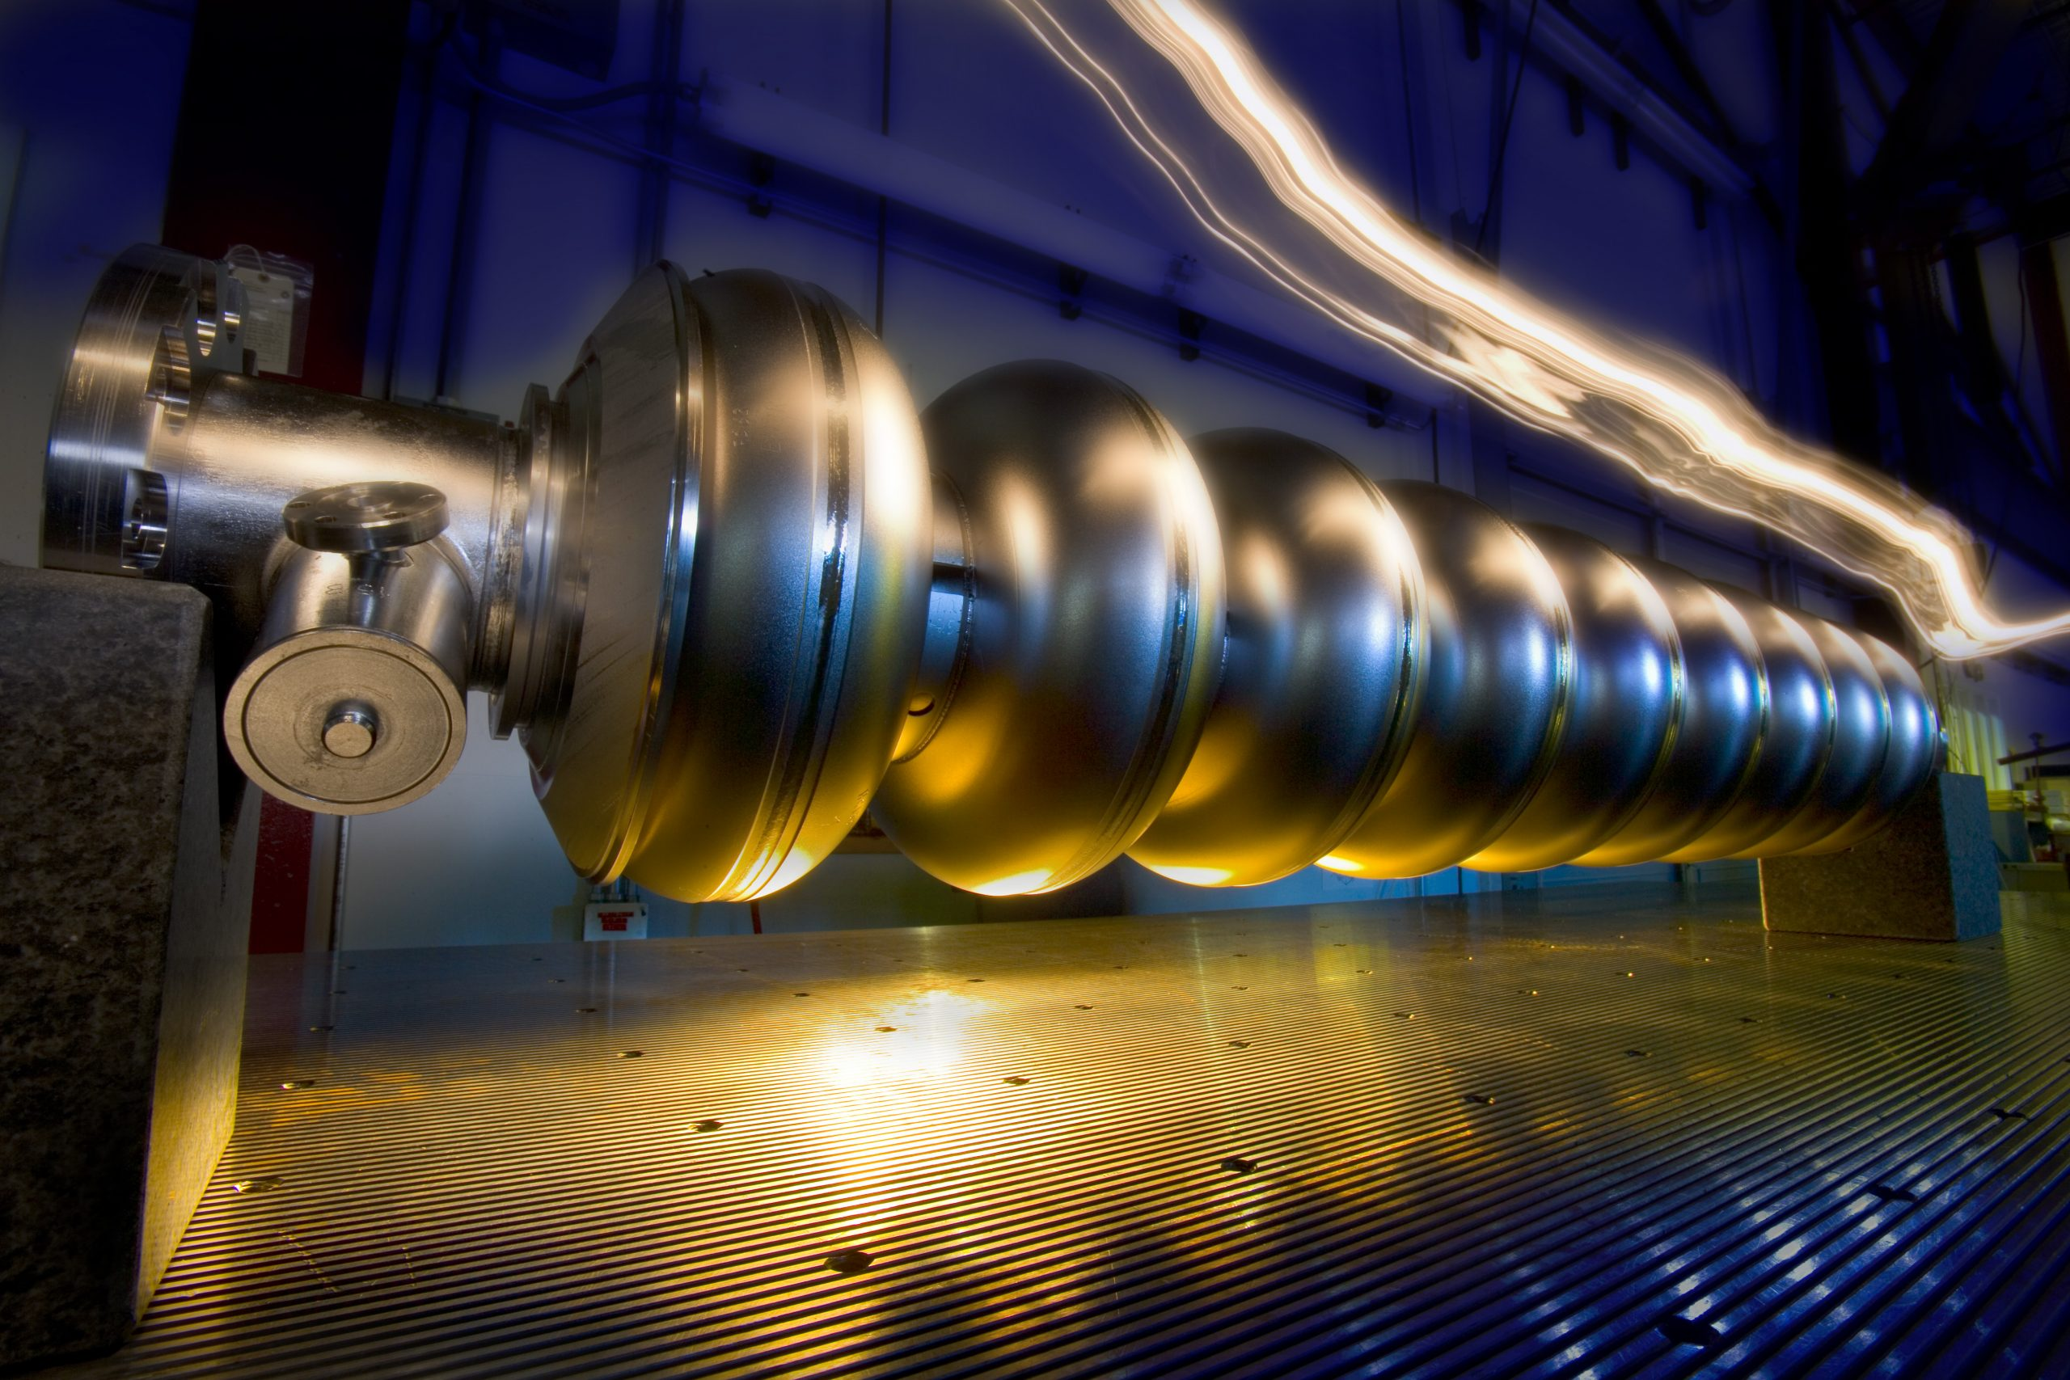
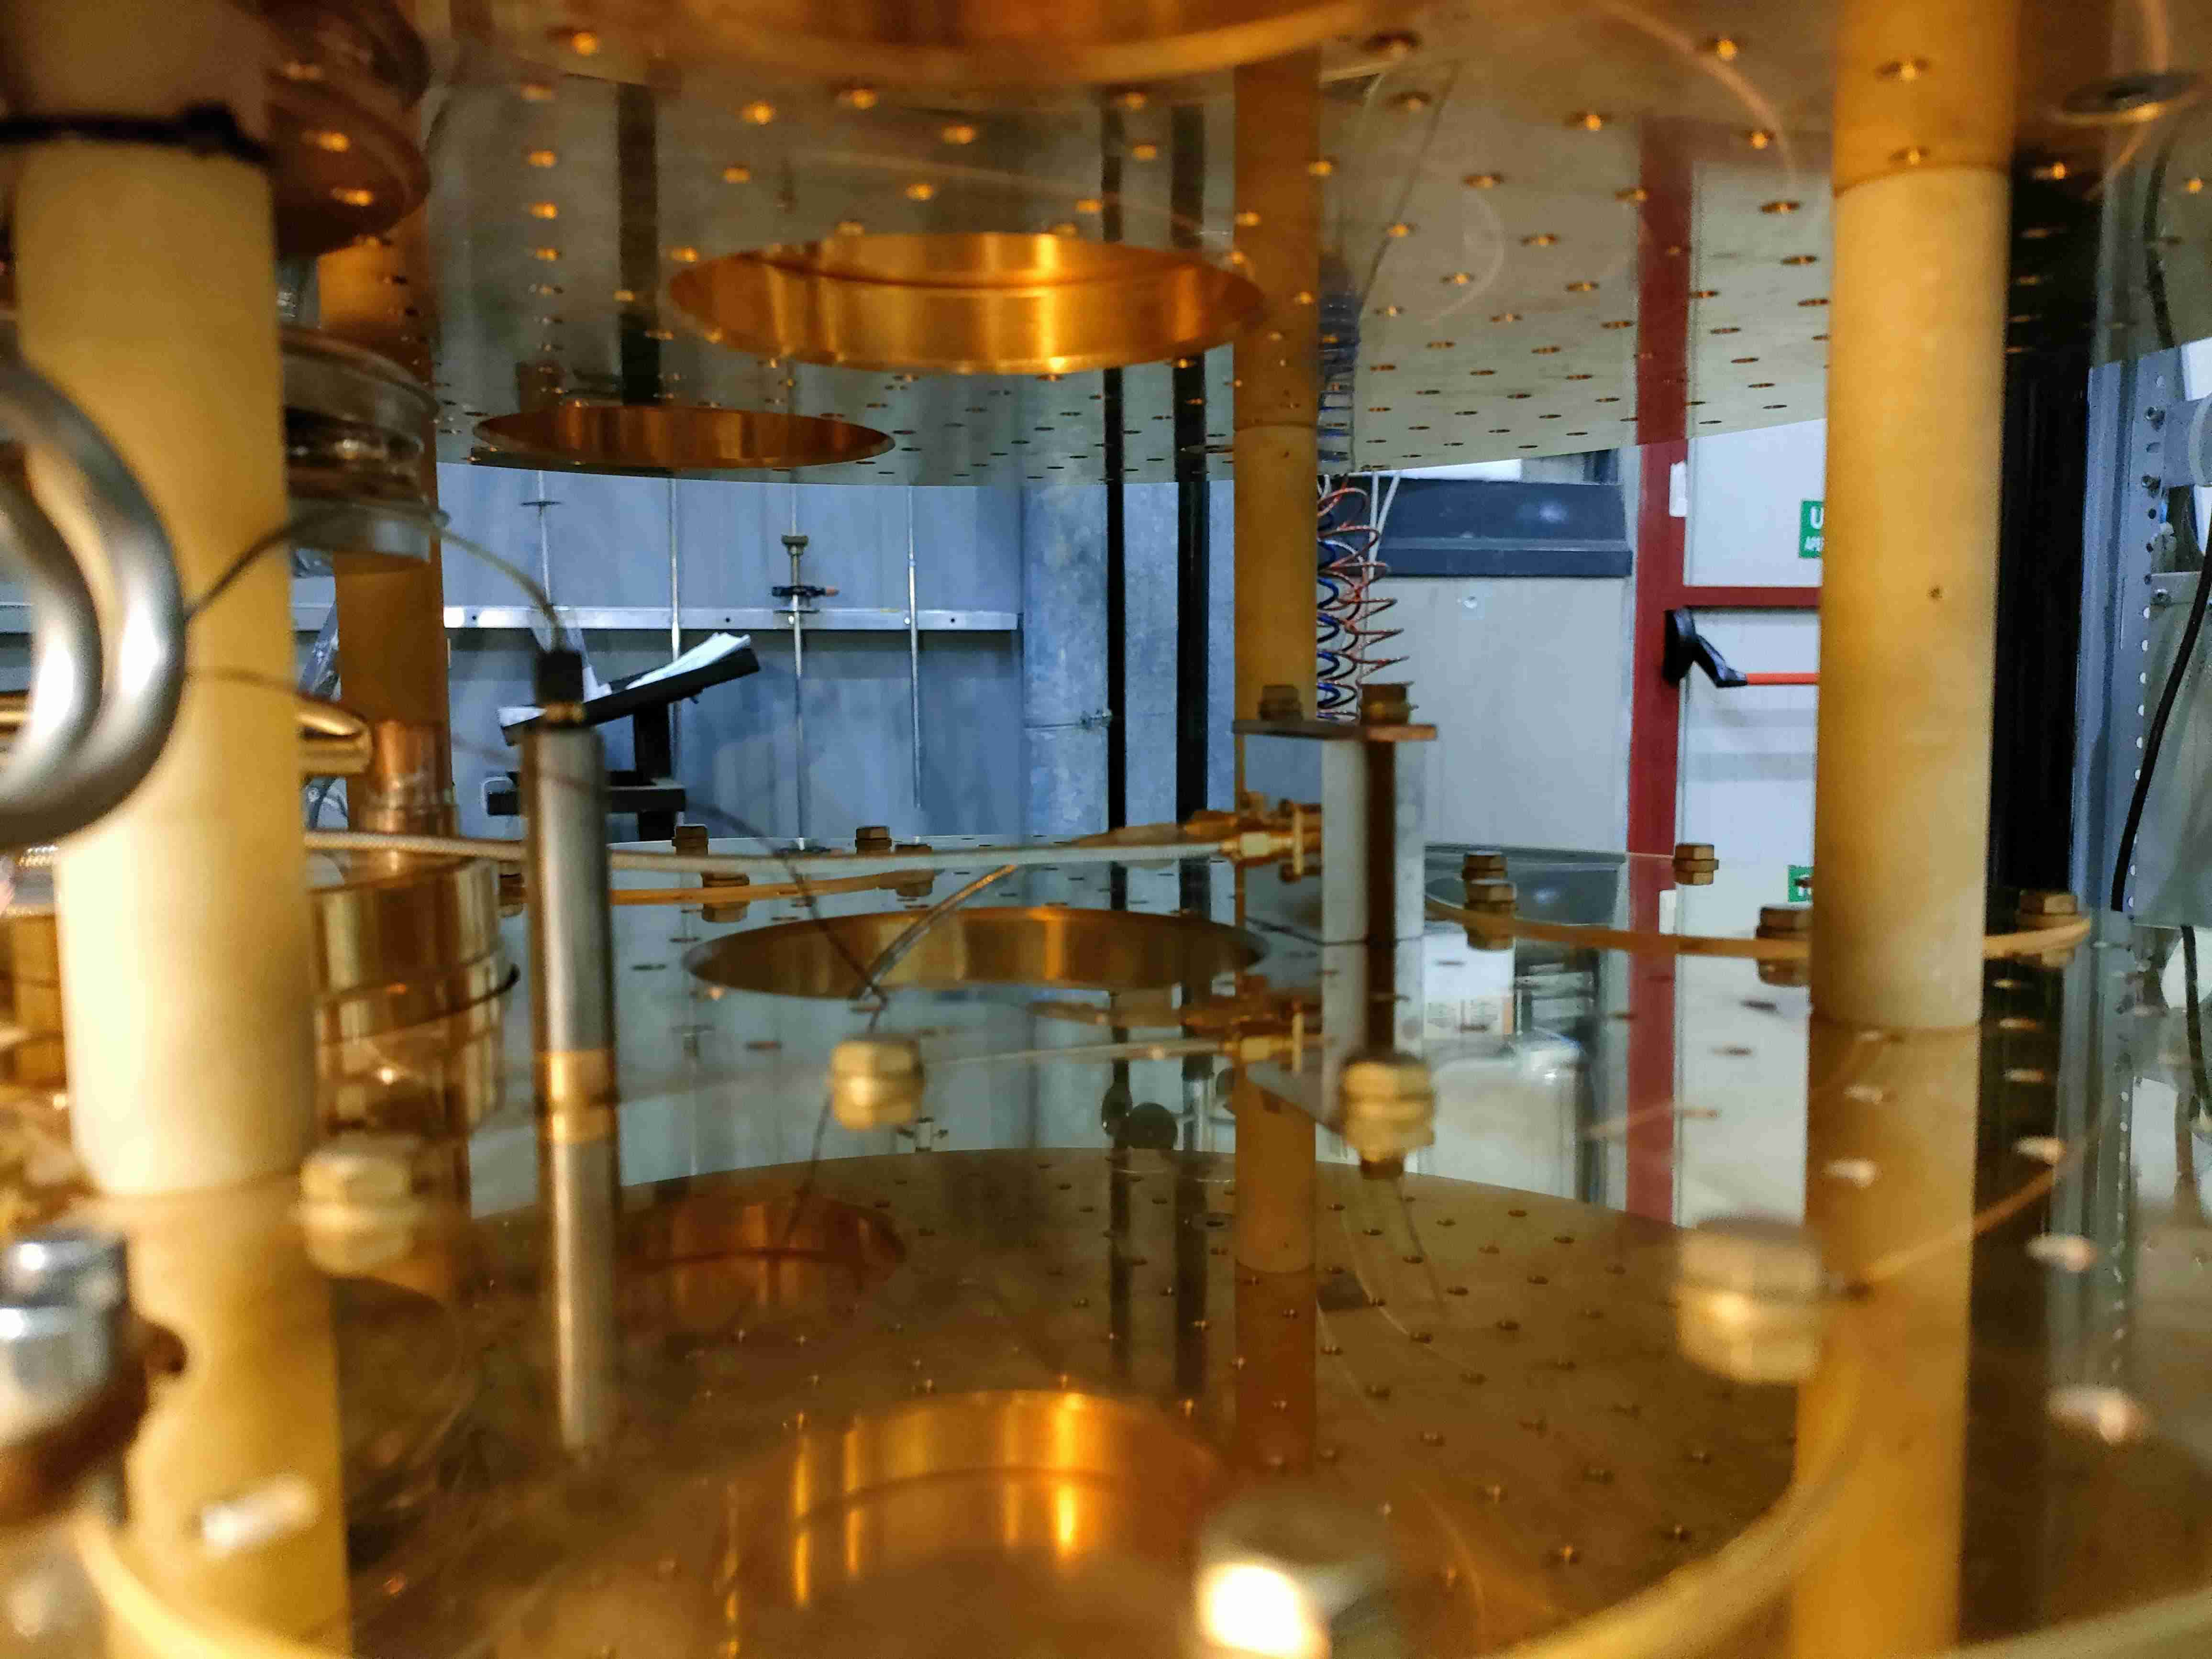
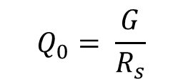
Introduction
Superconducting Resonant Cavities
Important parameters:
Cavity Quality factor (Q₀ )
Accelerating field
2 K or 4.2 K operation temperature
Most common application is particle accelerators
Important parameters:
mK operation regime
Cavity Quality factor (Q₀ )
Quantum computing and sensing
$$Q_{0}= \frac{G}{R_{s}}$$
Depends on shape and frequency
Depends on material/surface treatments
Notes:
Definisci qui il quality factor come larghezza del picco di trasmissione alla risonanza

Slide 5
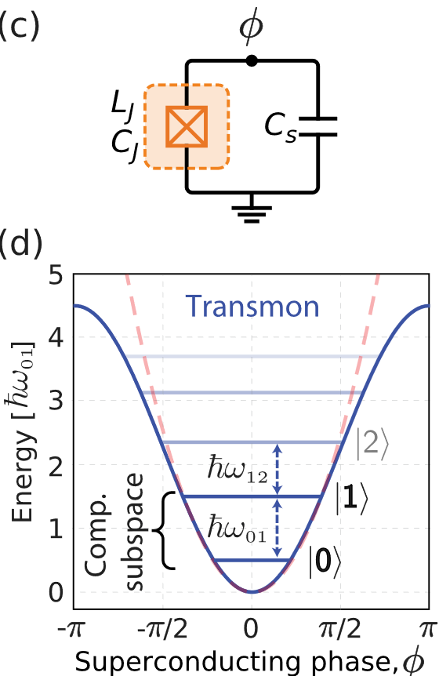
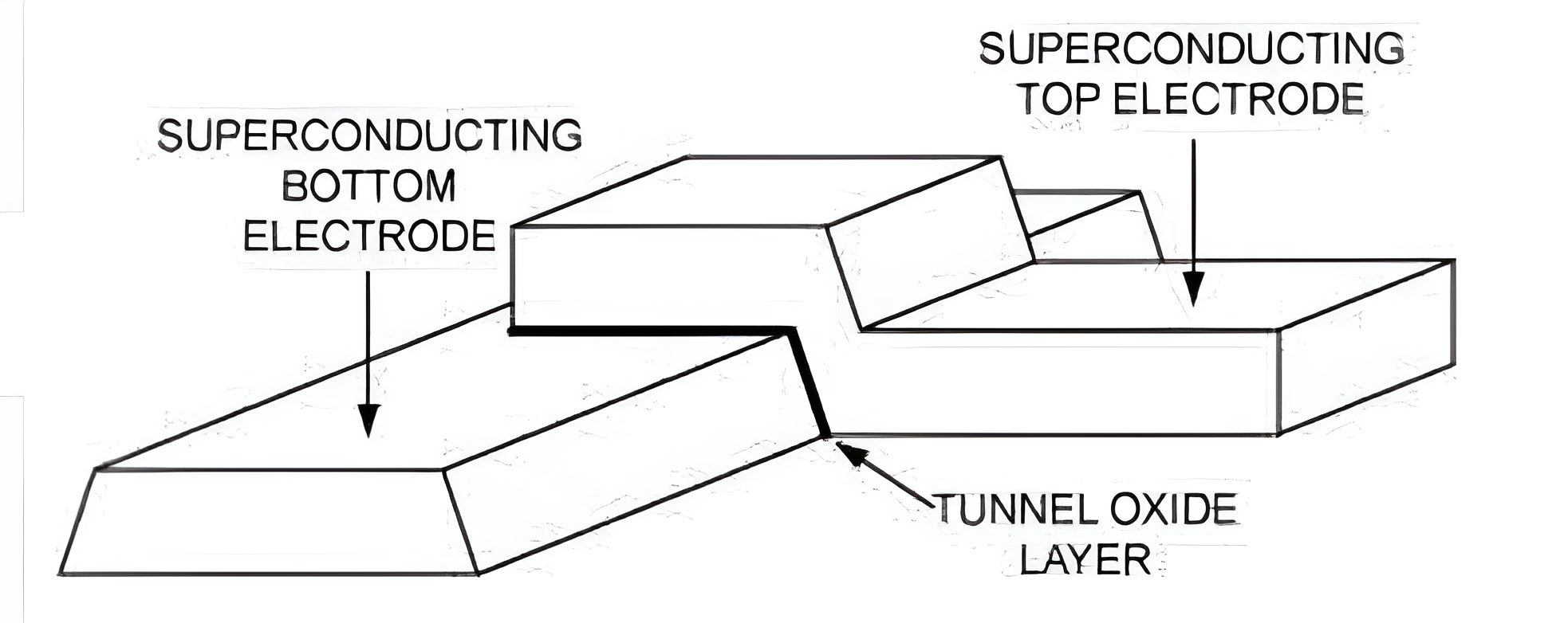
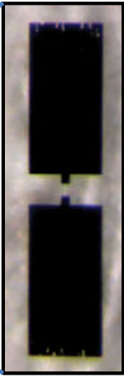
Quantum Computing
Transmon qubit
Josephson junction
Capacitor
Al
P. Krantz, et al., Applied Physics Reviews, vol. 6, fasc. 2, giu. 2019

Slide 6
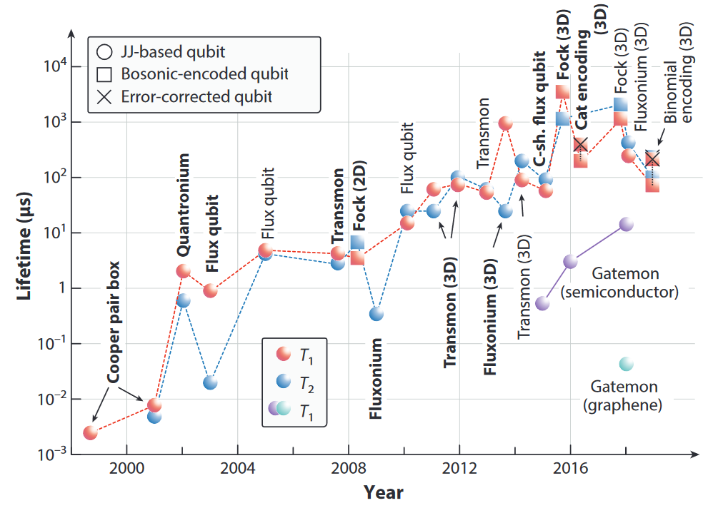
Quantum Computing
Qubit coherence time evolution
M. Kjaergaard et al., Annu. Rev. Condens. Matter Phys., vol. 11, fasc. 1, mar. 2020

Slide 7
Outline
Introduction
Design of a 7.46 GHz cavity
Fabrication using
pure Al vs Al alloy
Fabrication improvements
Characterization of the Cavity + Qubit

Slide 8
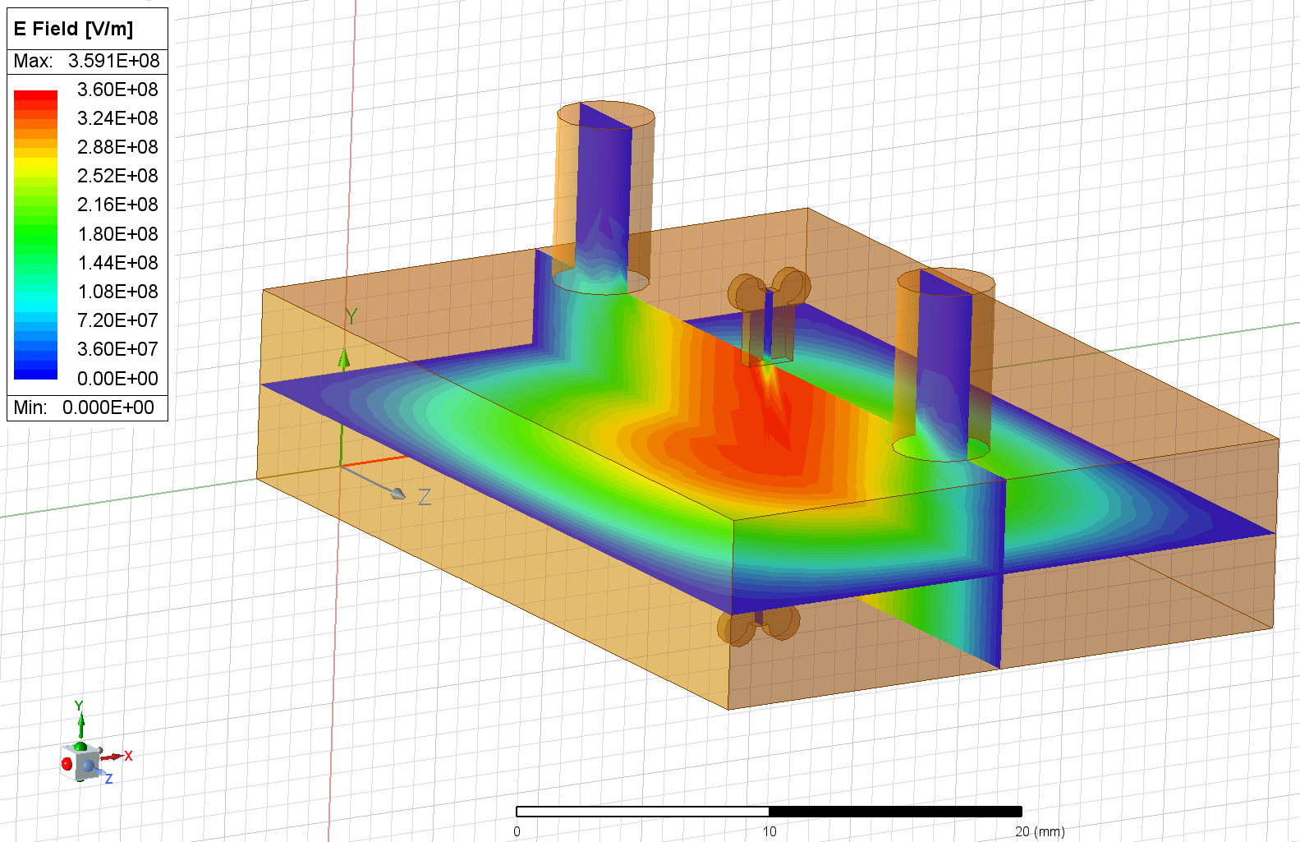
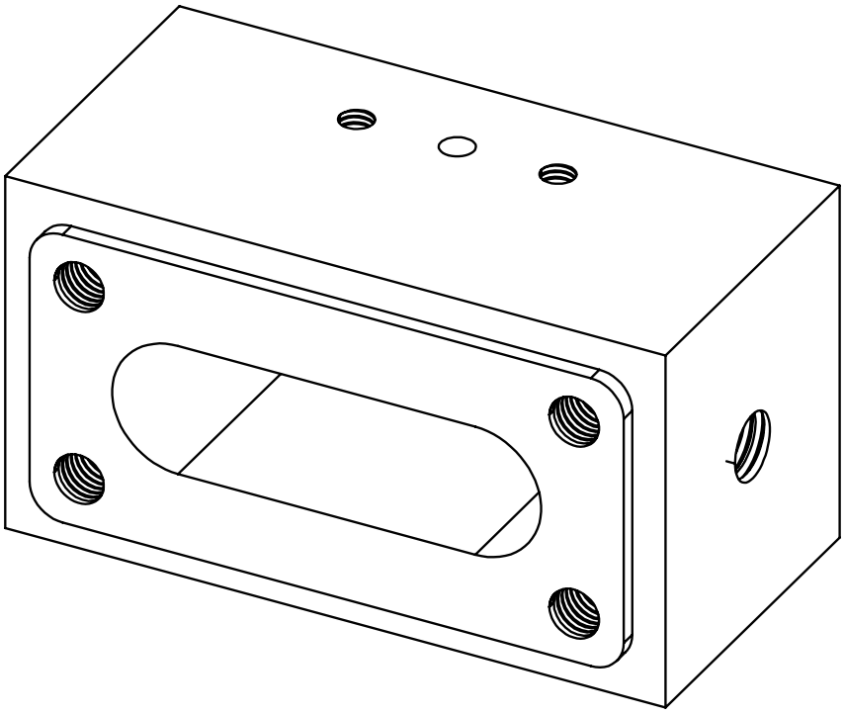
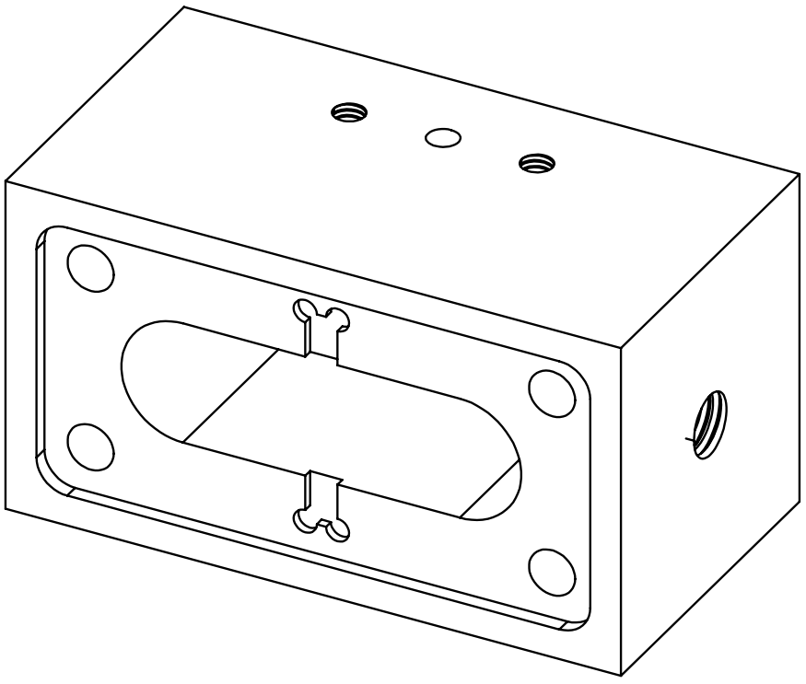
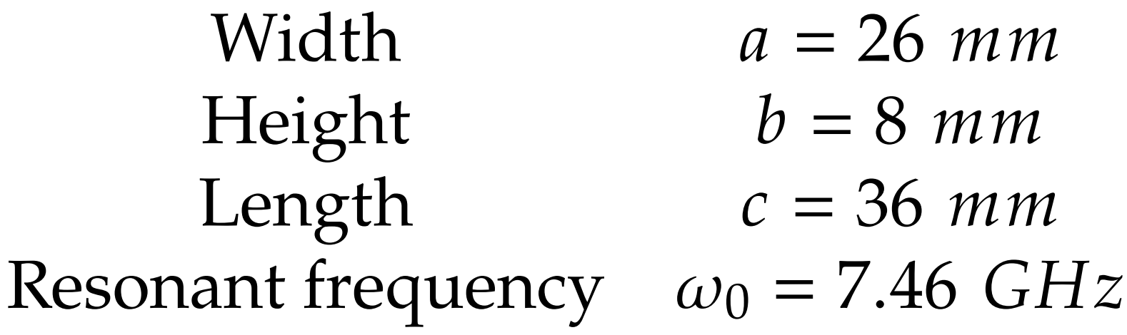
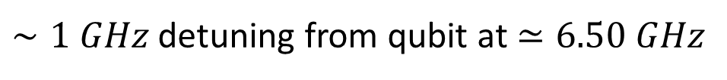
Cavity Design
Shape optimization
Antenna 2
Antenna 1
b
c
a
40 mm
22 mm
$∼1 GHz$ detuning from qubit at $≃6.50 GHz$
20 mm

Slide 9
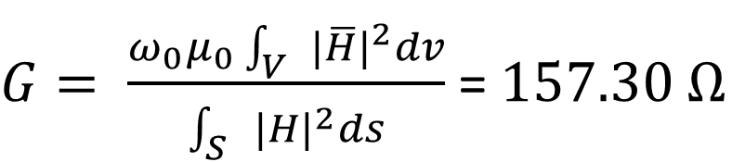

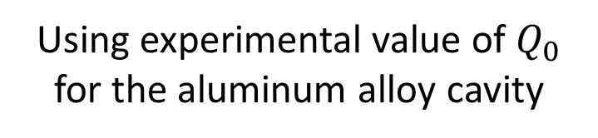
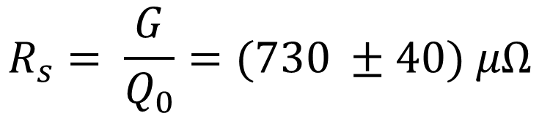
Cavity Design
Surface resistance estimation
$G= \frac{ω_{0}μ_{0}\int_{V}{{|\overline{H}|}^{2}dv}}{\int_{S}{{|H|}^{2}ds}}$ = $157.30 Ω$
Using experimental value of $Q_{0}$ for the aluminum alloy cavity
Only experimentally measurable
$$R_{s}= \frac{G}{Q_{0}}=(730 ±40) μΩ$$
$$R_{s}=R_{BCS}+R_{res}$$

Slide 10
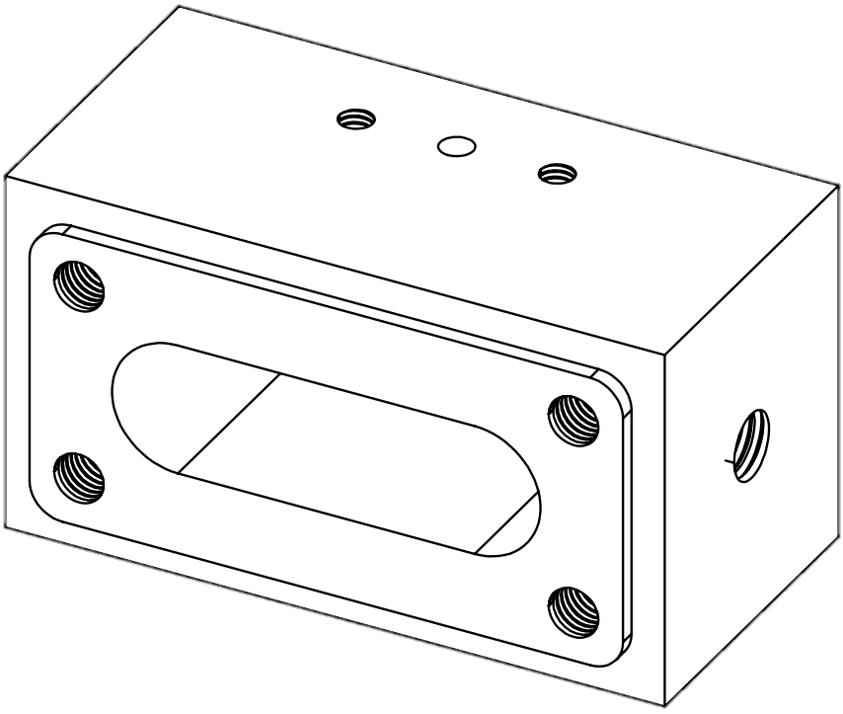
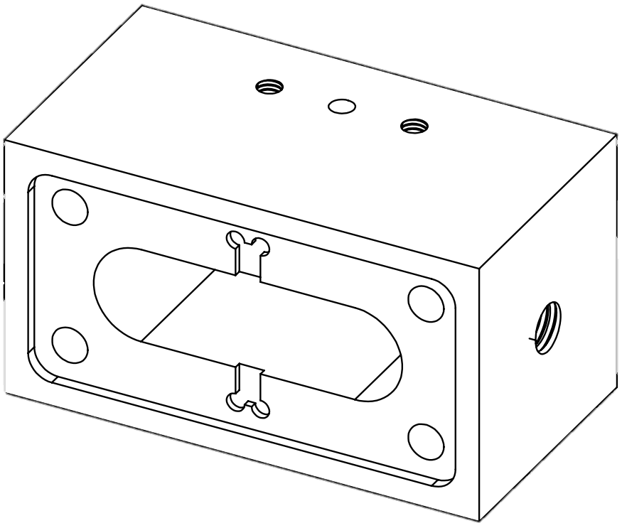
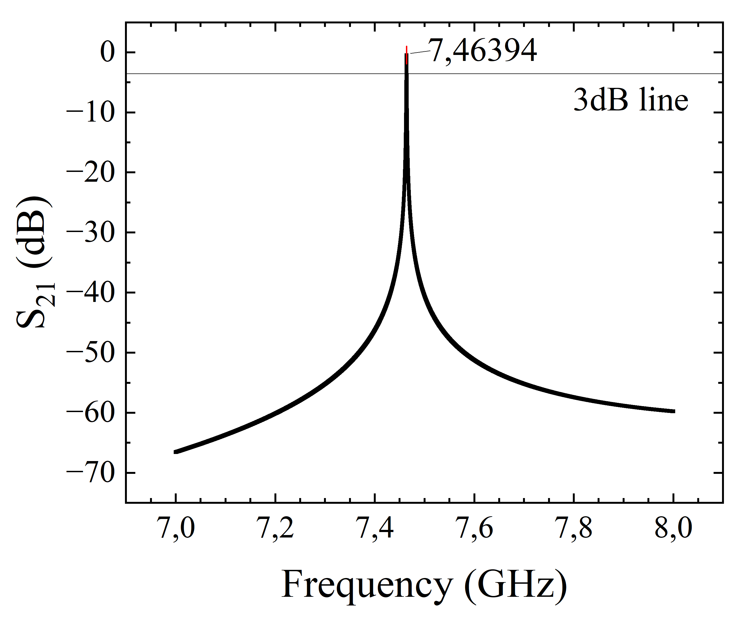
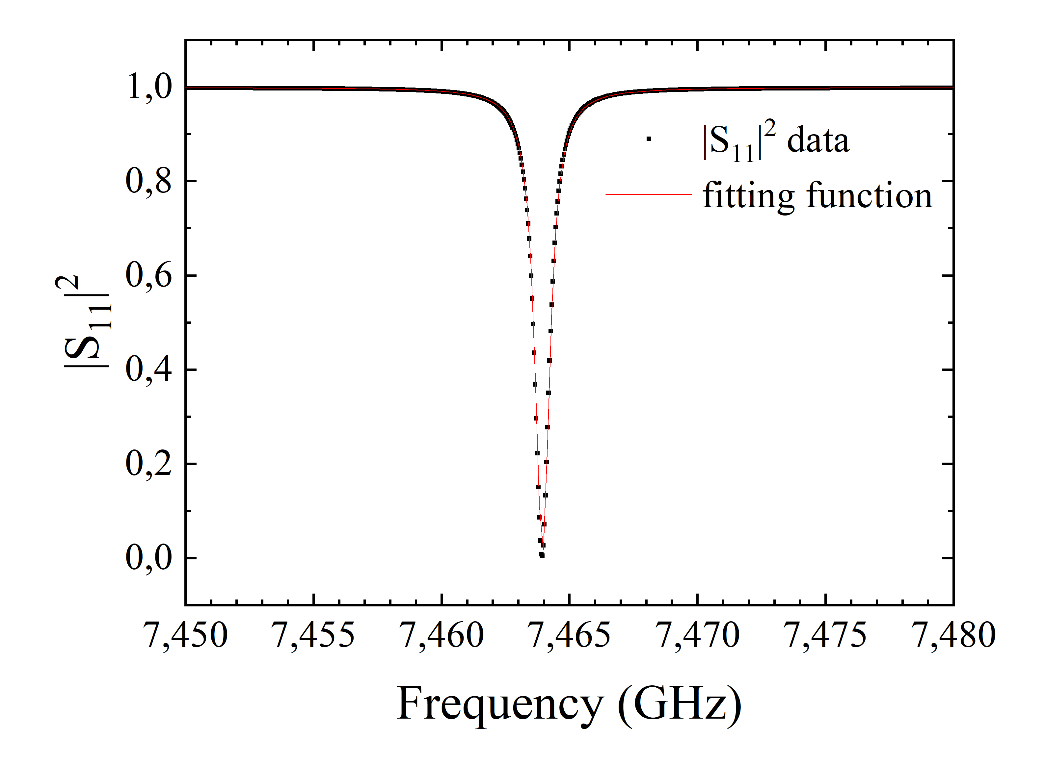
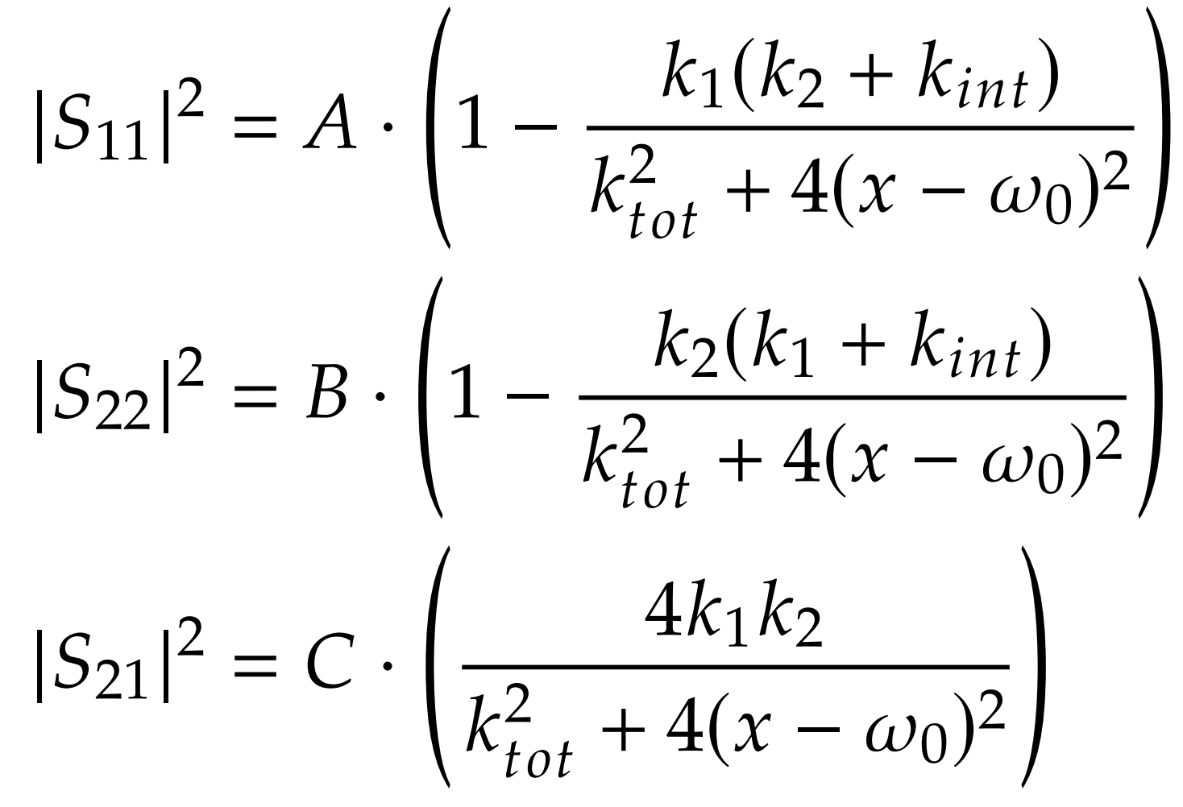
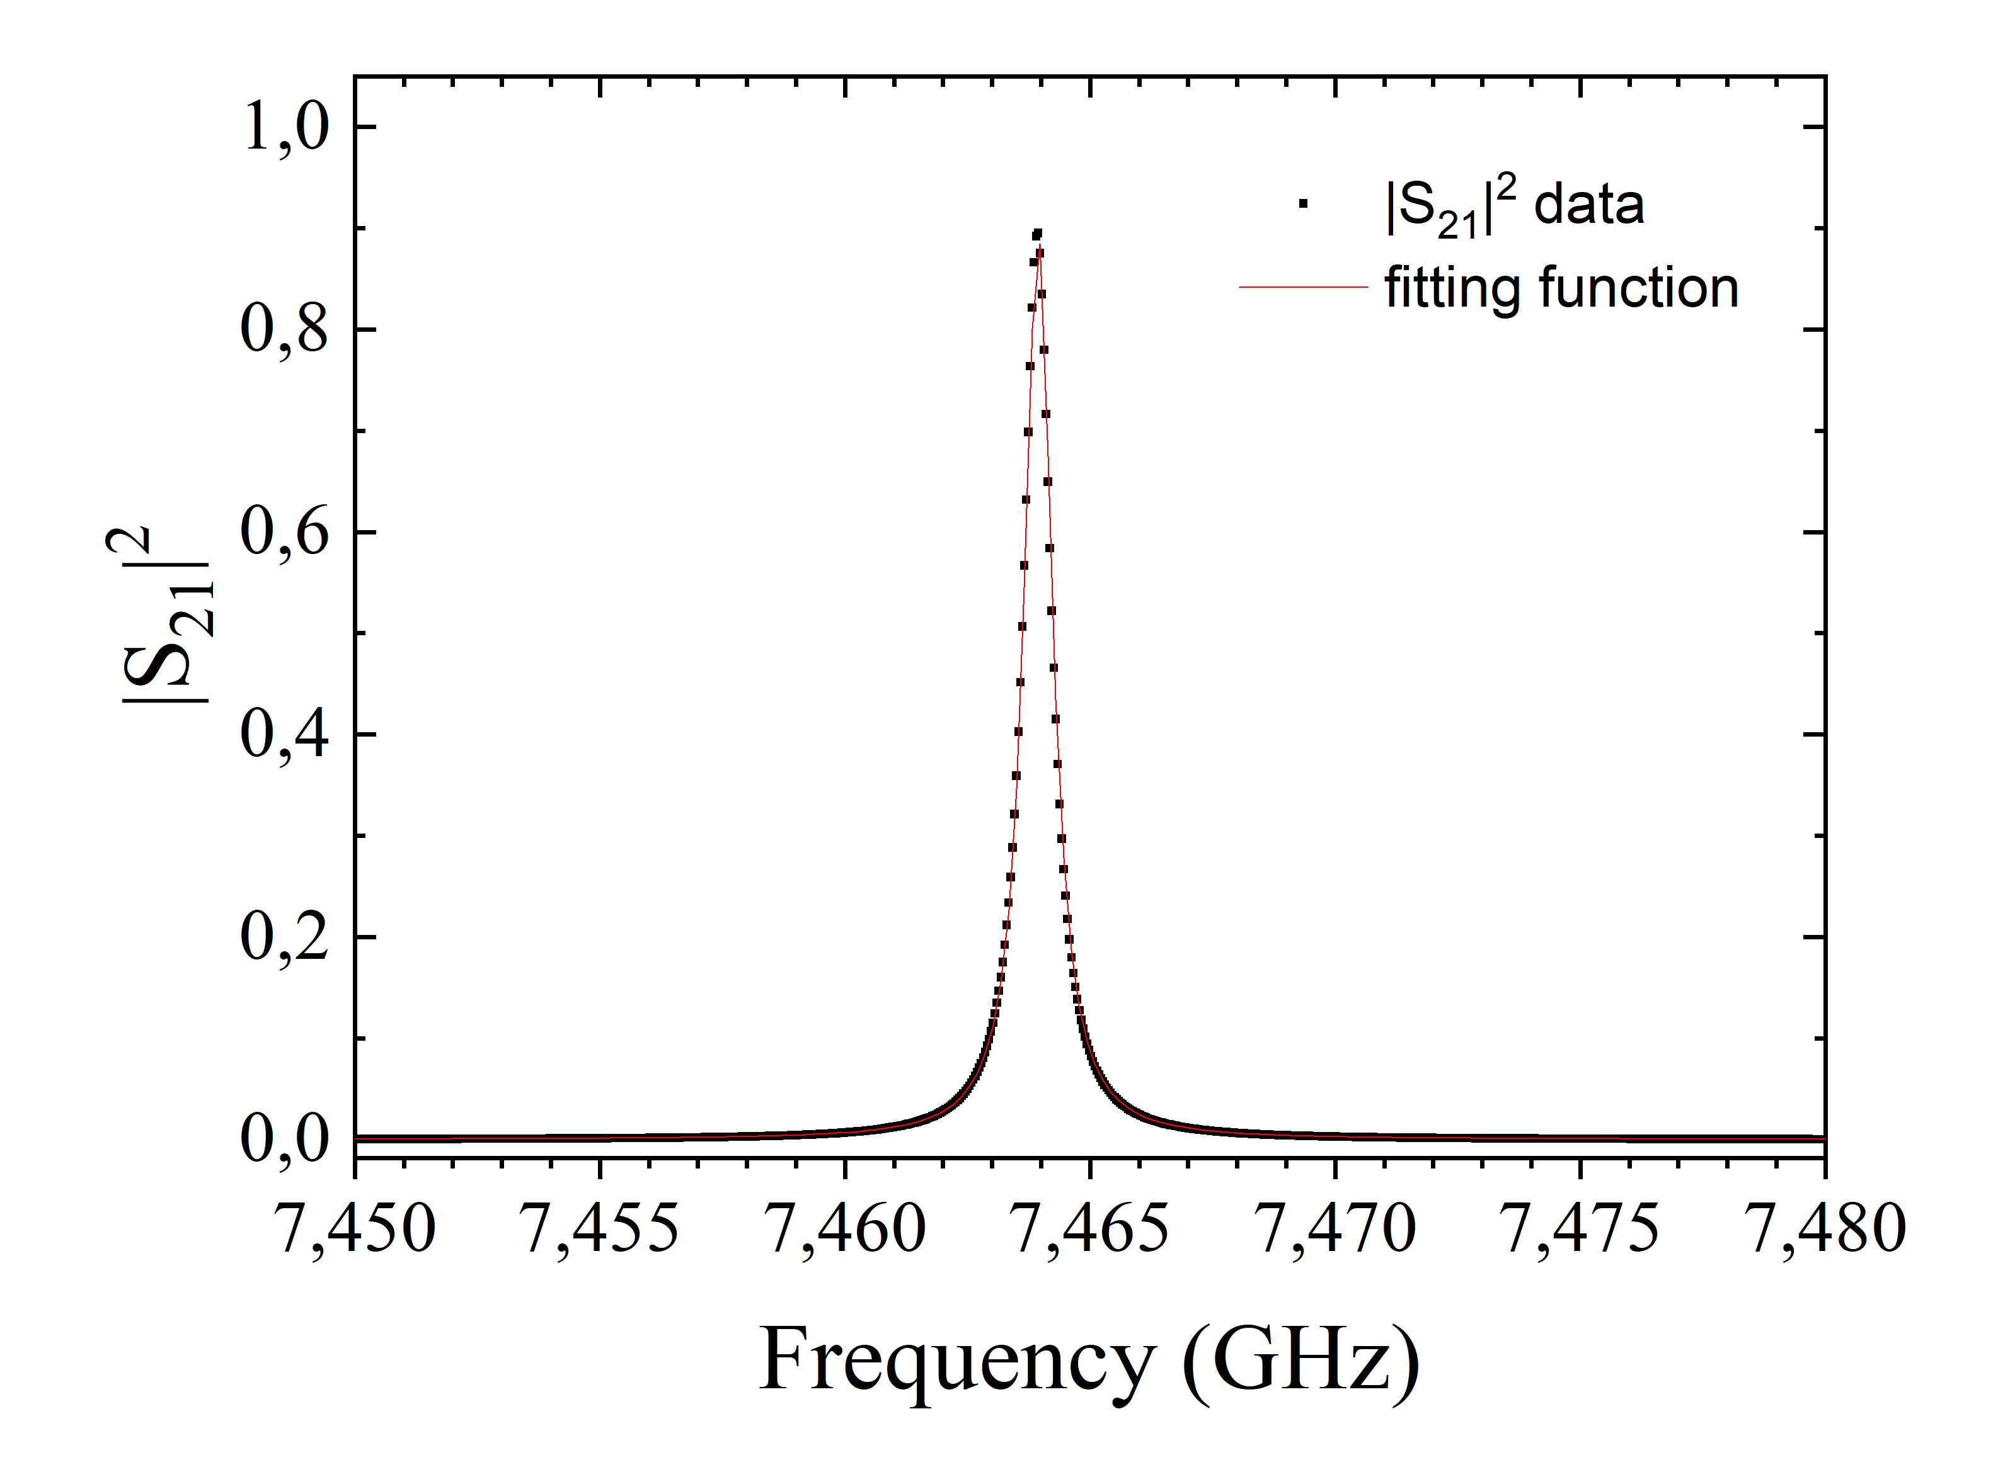
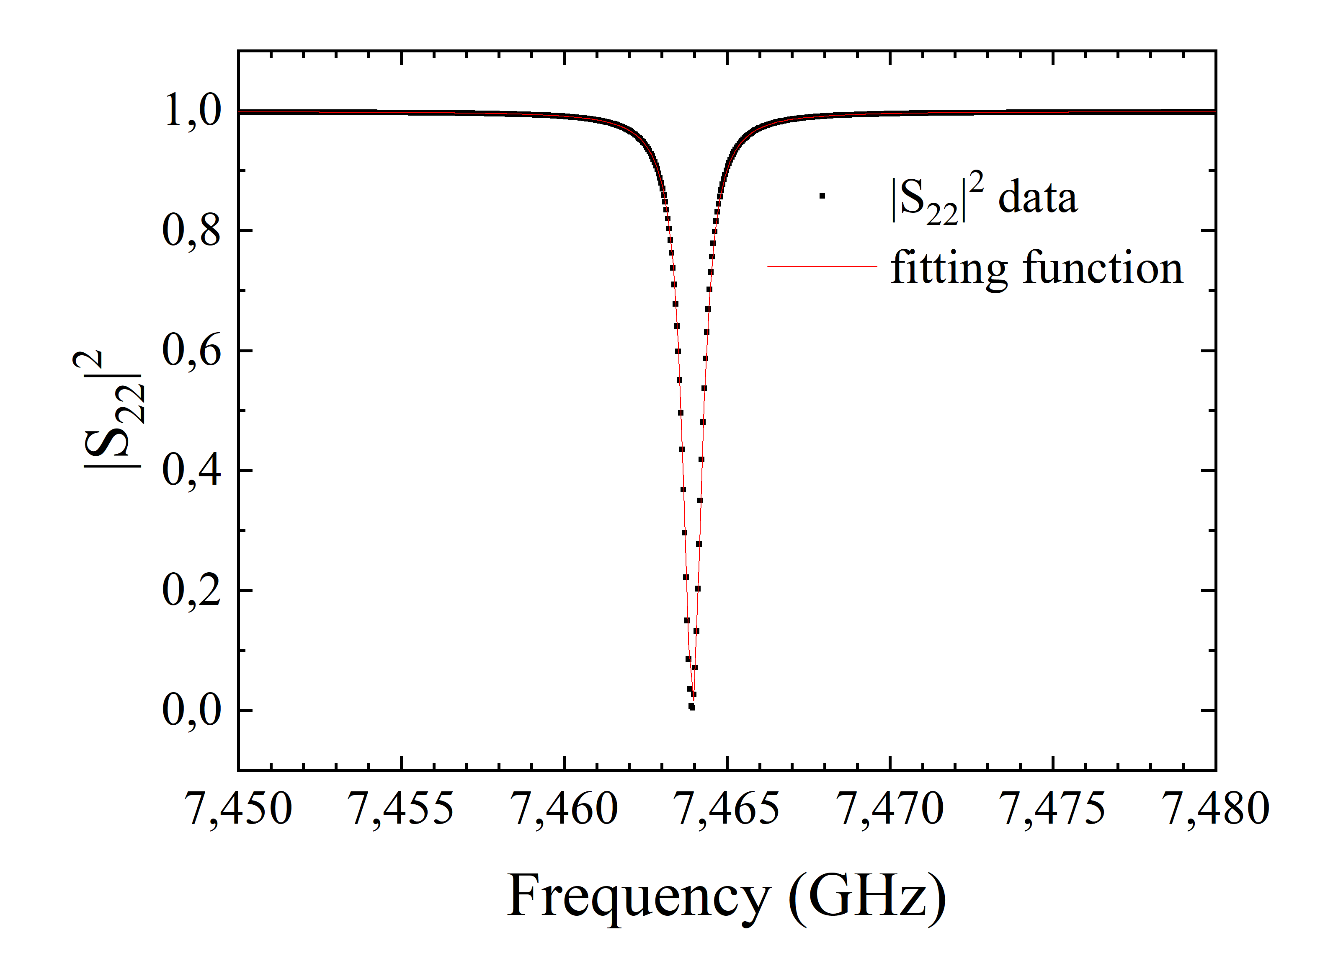
Cavity Simulation
Scattering parameters simulations @7.46 GHz
Transmitted power
Reflected power
Lorentzian fitting function
S₂₁
S₁₁
2
1
2
1
Cavity
Cavity

Slide 11
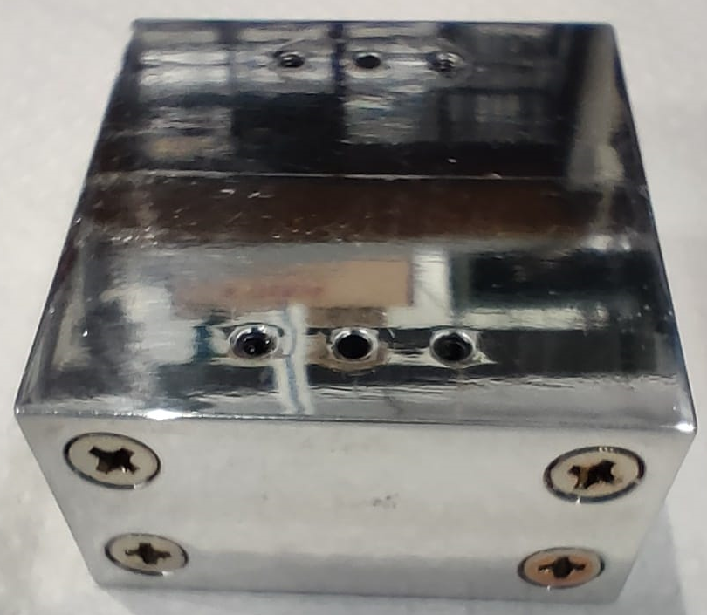
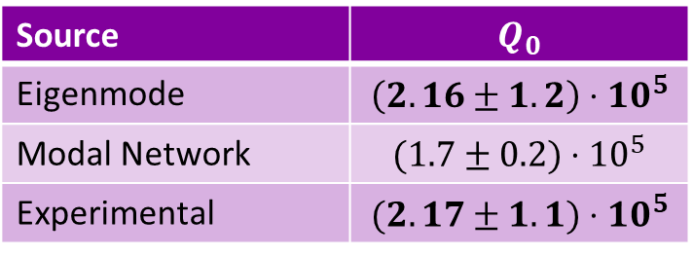
Cavity Simulation
Error most likely due to fit
Source | $$Q_{0}$$
Eigenmode | $$\left(2.16±1.2\right)⋅10^{5}$$
Modal Network | $$(1.7±0.2)⋅{10}^{5}$$
Experimental | $$(2.17±1.1)⋅10^{5}$$
Alloy cavity and qubit
fabricated at TII
(Arab Emirates)
Simulation can reproduce experimental values
Al alloy
Lower bound for next cavity performance
Move to Al 5N (99.999% purity)

Slide 12
Outline
Introduction
Design of a 7.46 GHz cavity
Fabrication using
pure Al vs Al alloy
Fabrication improvements
Characterization of the Cavity + Qubit

Slide 13
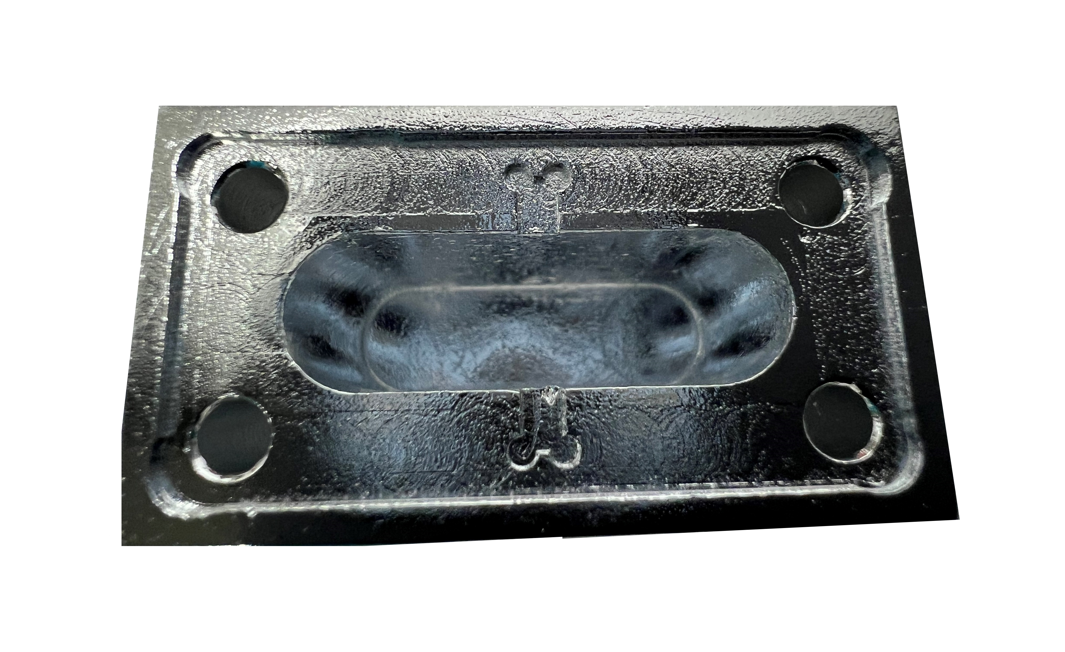
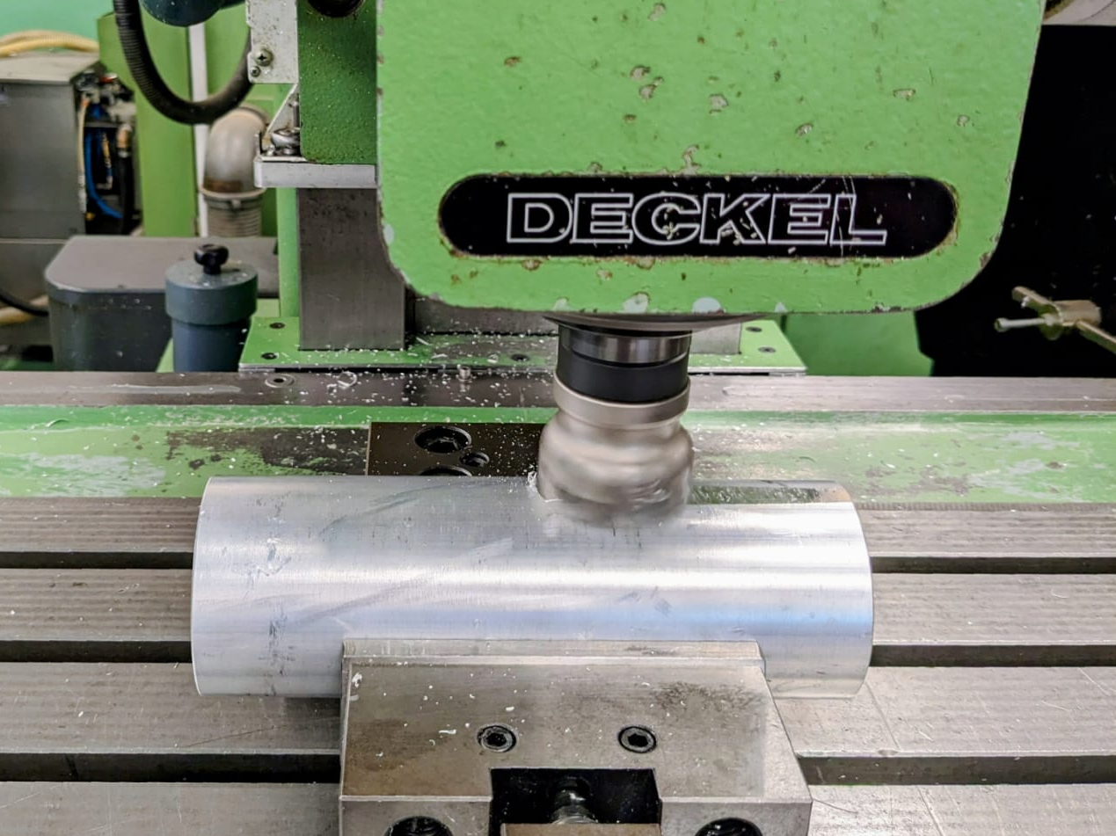
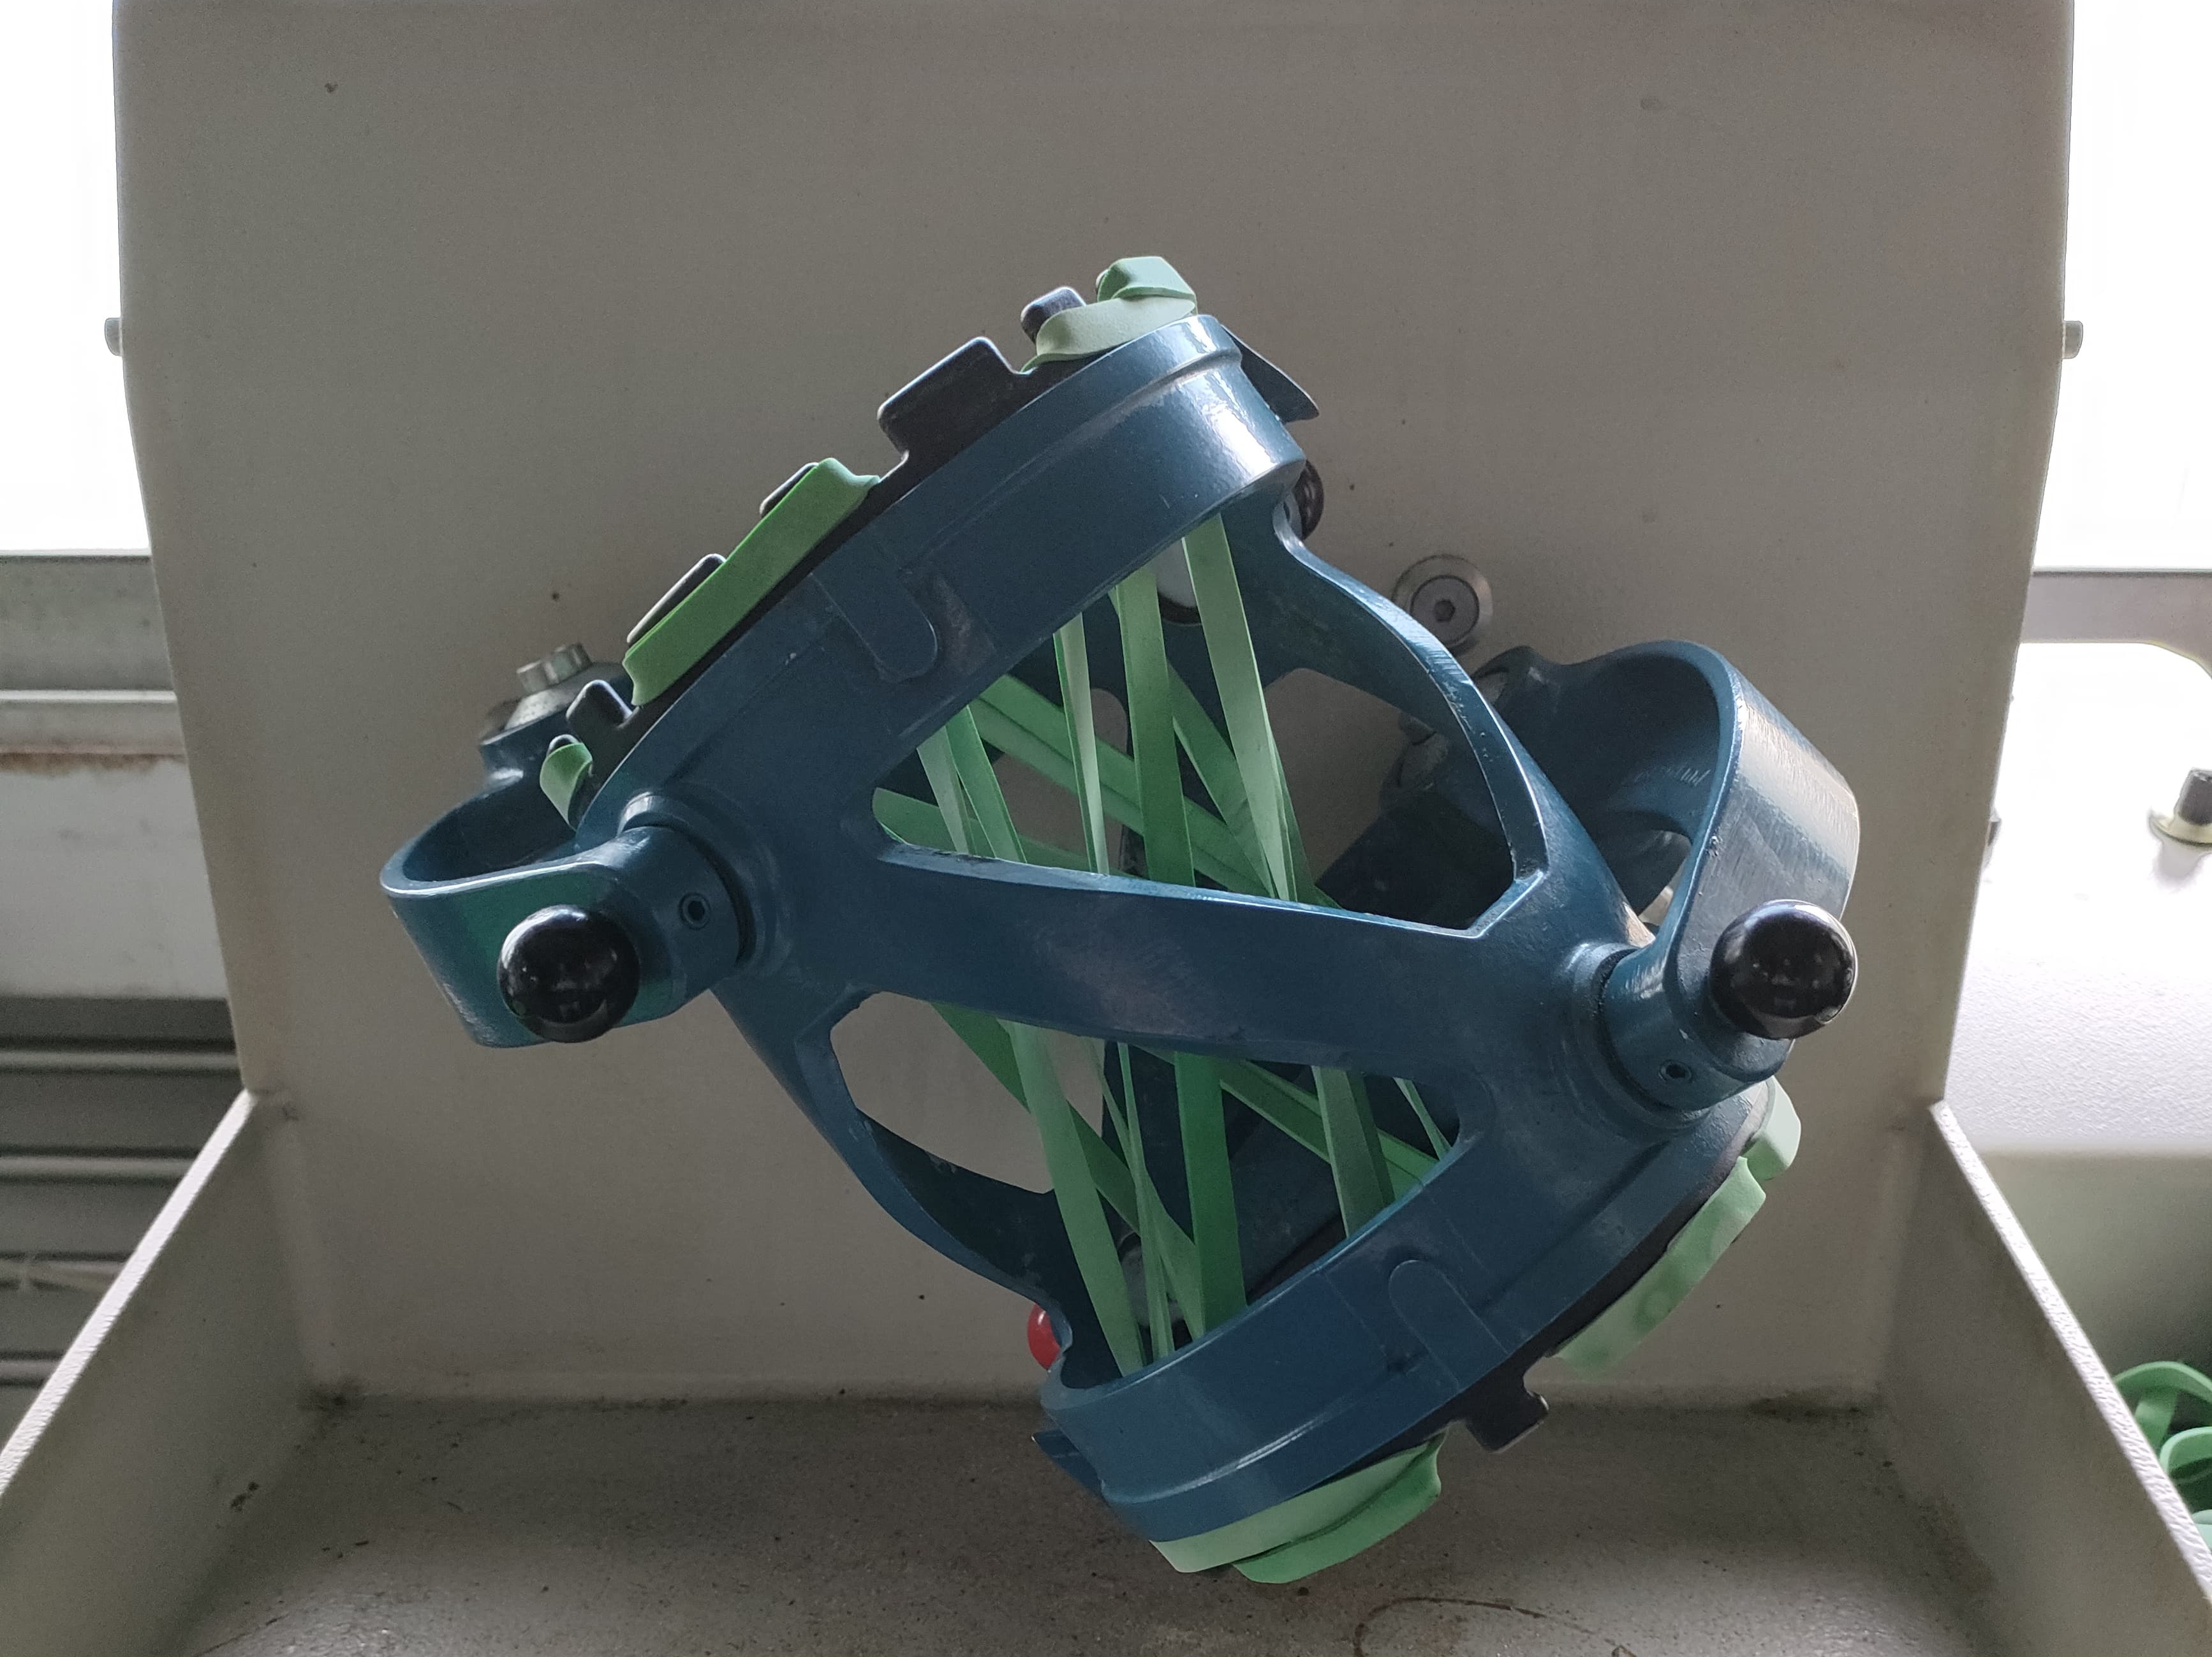
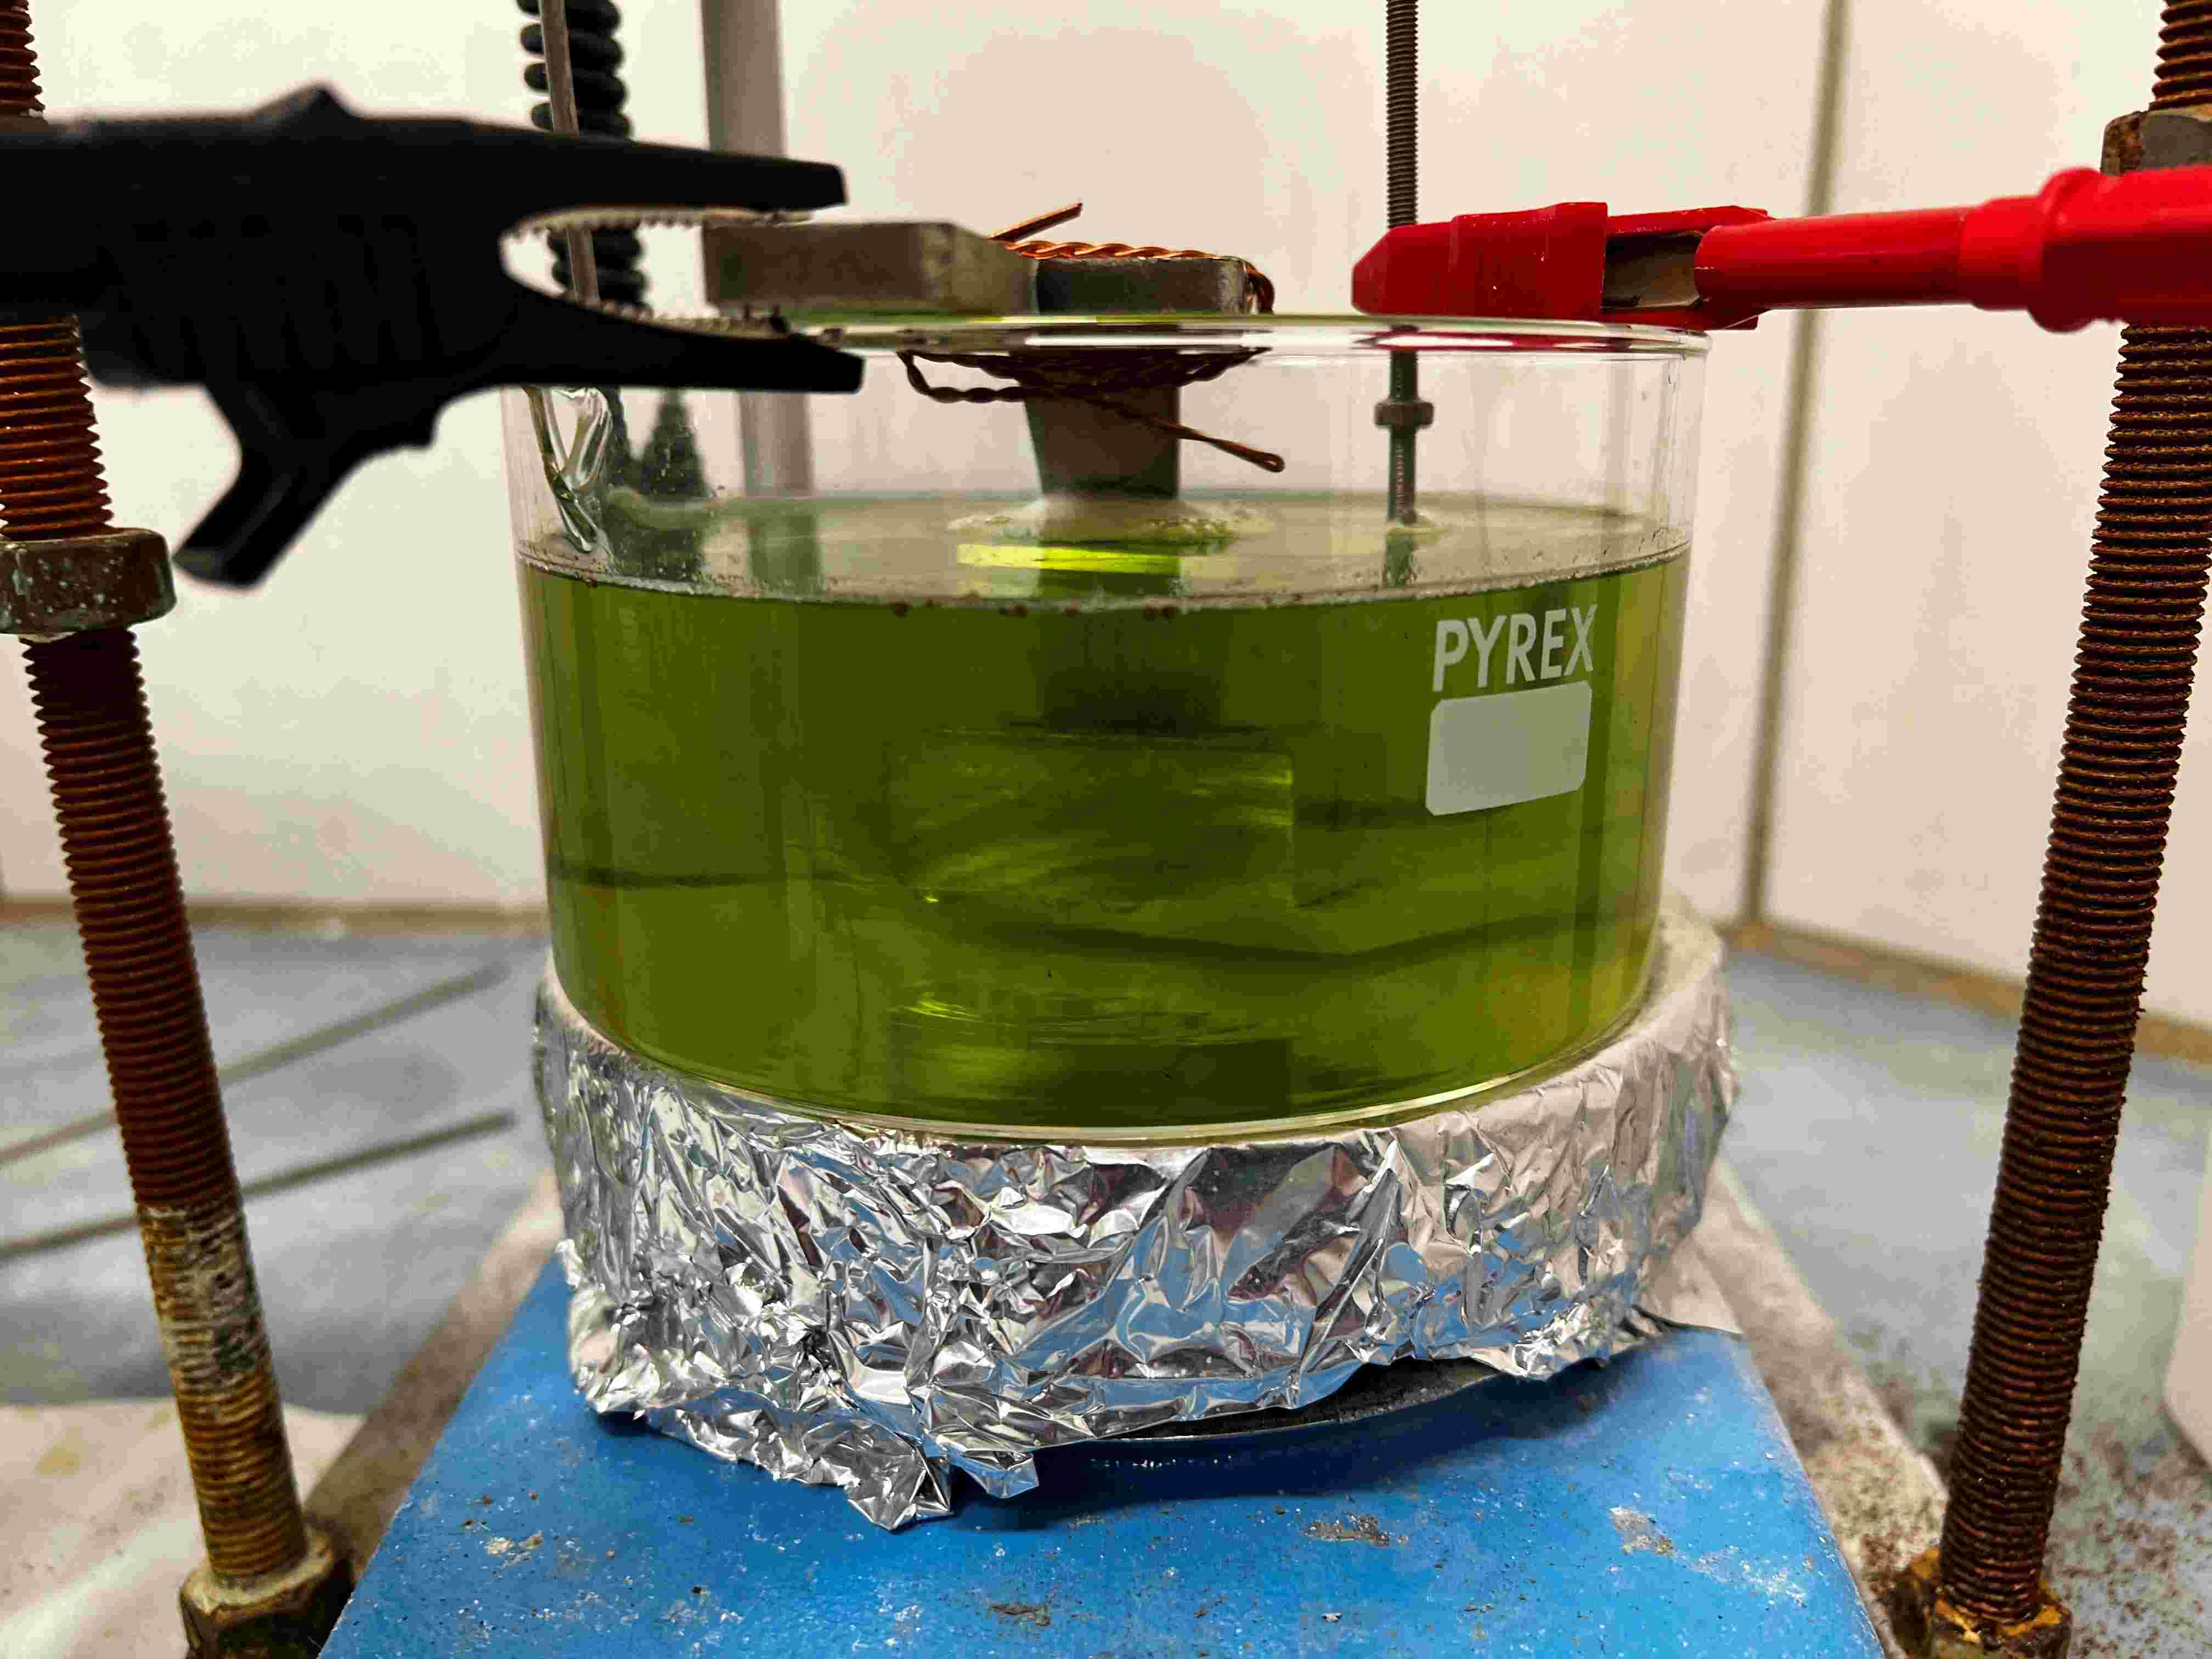
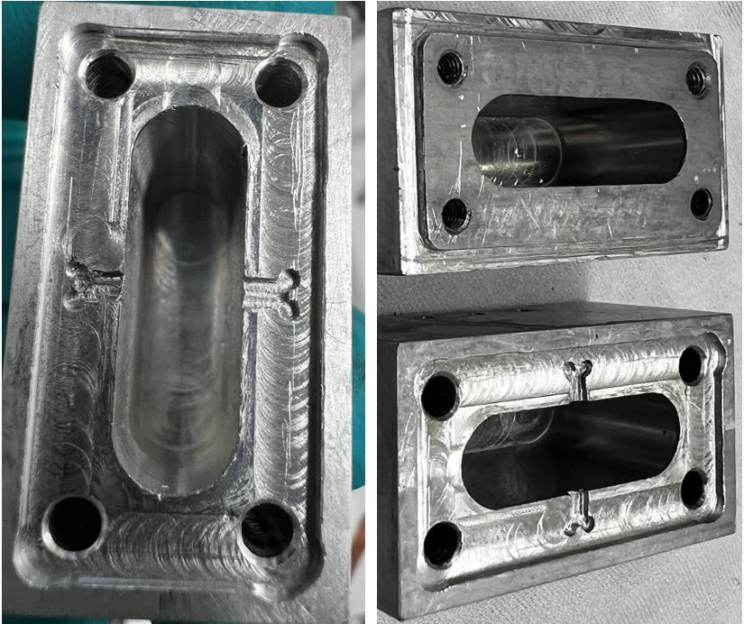
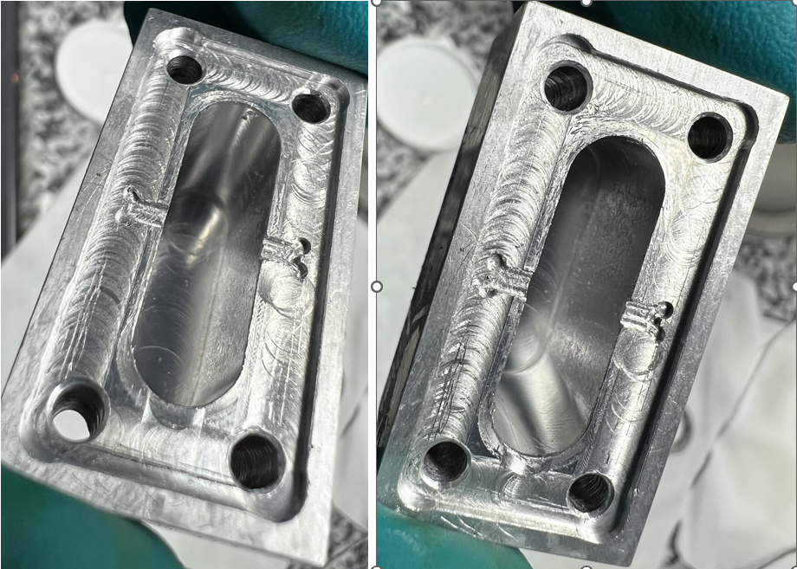
Cavity Fabrication
Qubit chip accommodation
Mechanical
Machining
𝐻₃𝑃𝑂₄ : 𝐵𝑢𝐴𝑐
Tumbling
Electropolishing
Machining defects

Slide 14
Outline
Introduction
Design of a 7.46 GHz cavity
Fabrication using
pure Al vs Al alloy
Fabrication improvements
Characterization of the Cavity + Qubit

Slide 15
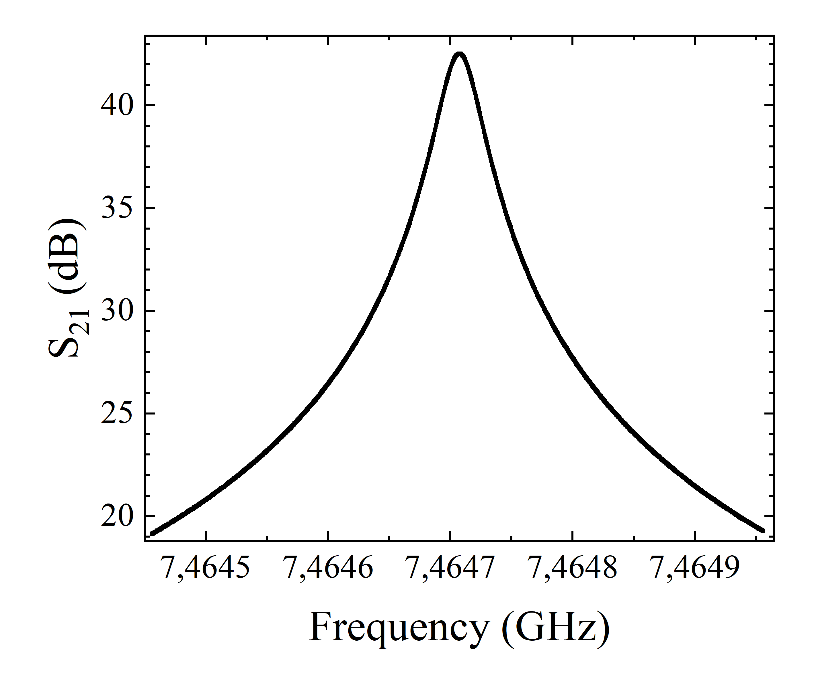
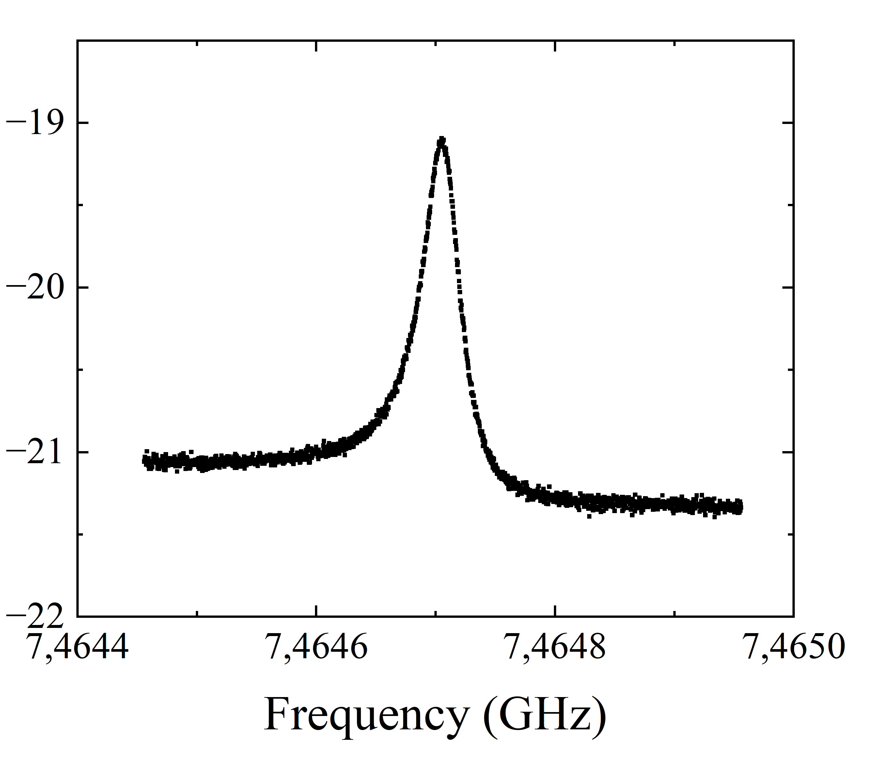
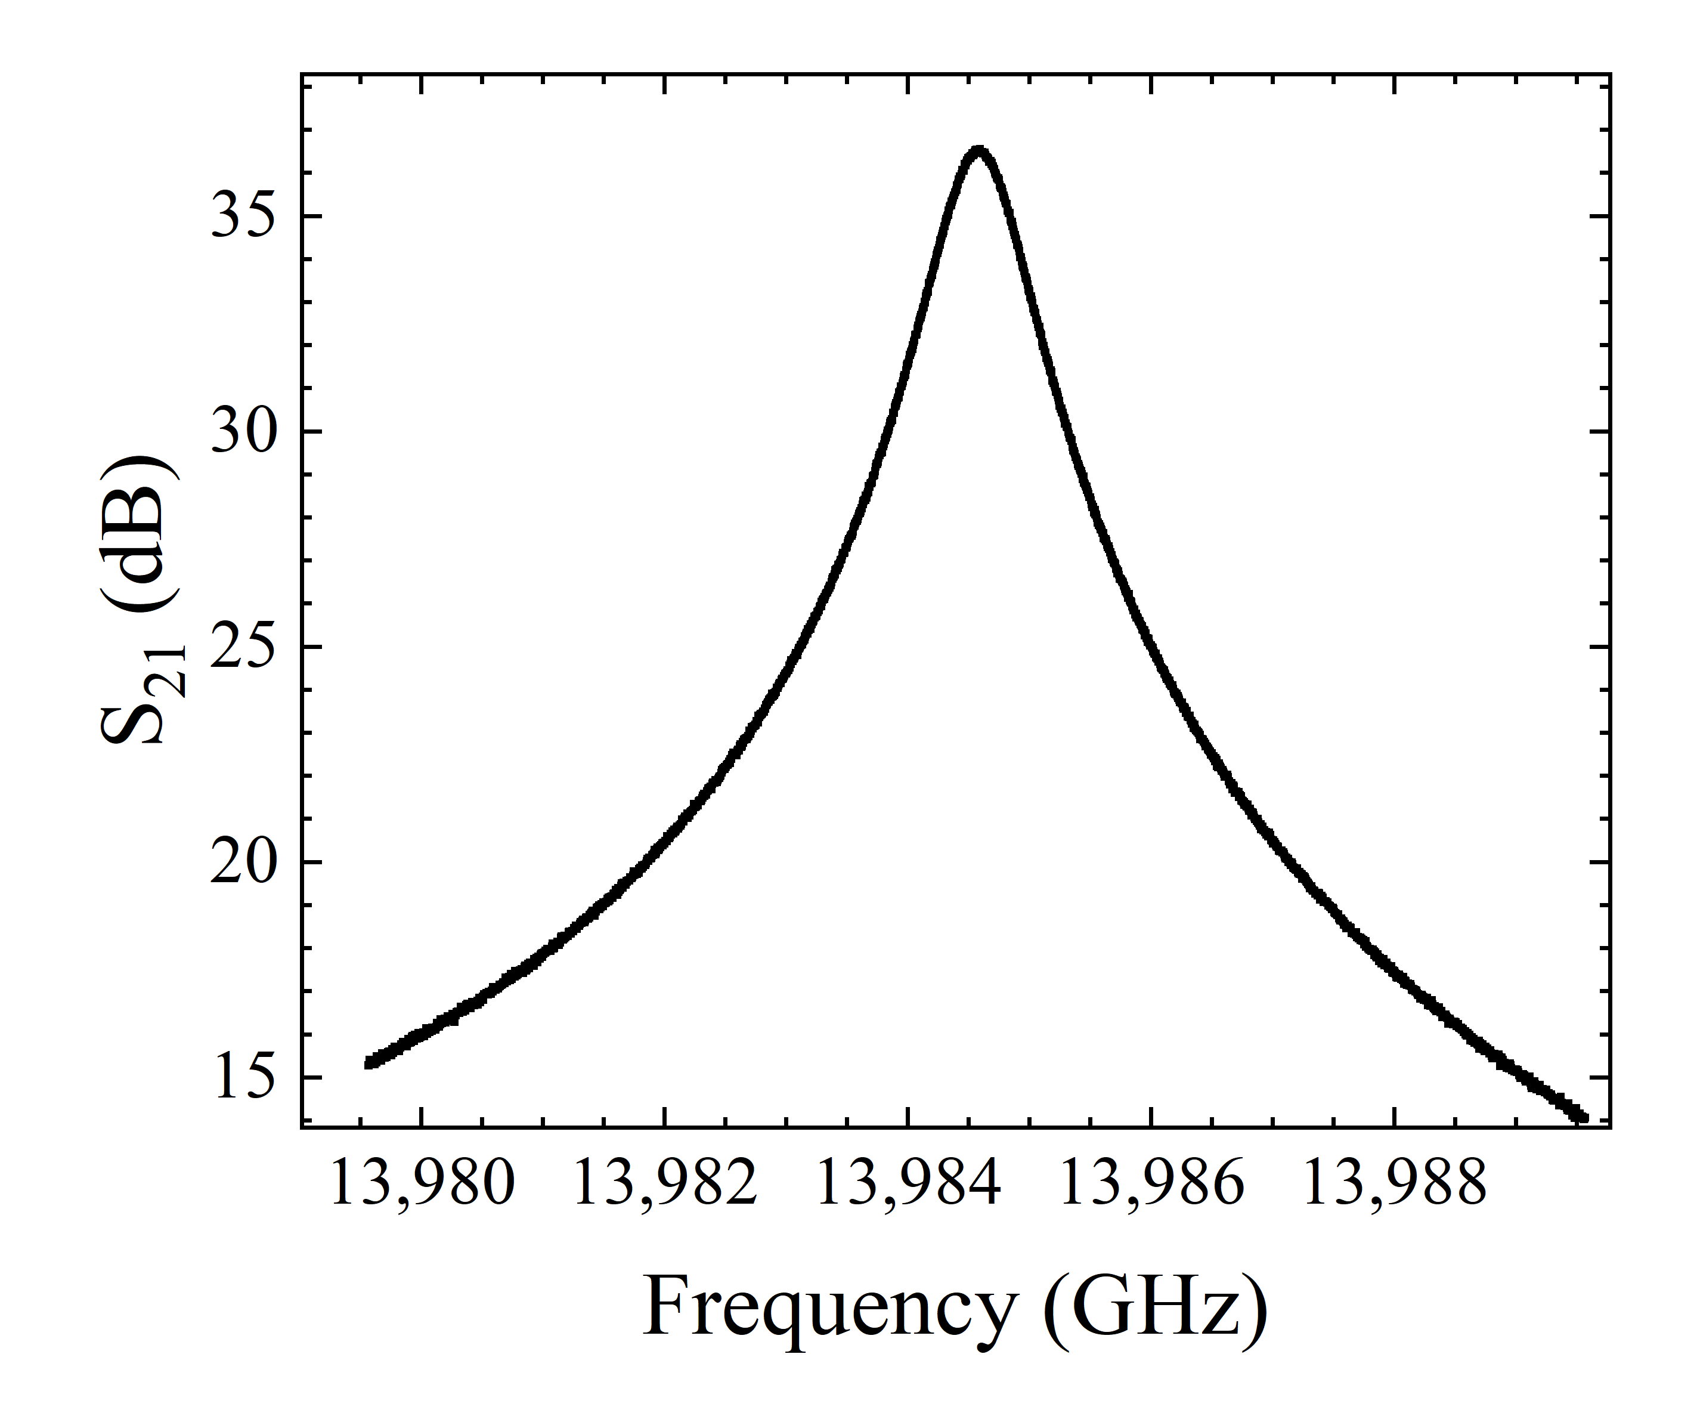
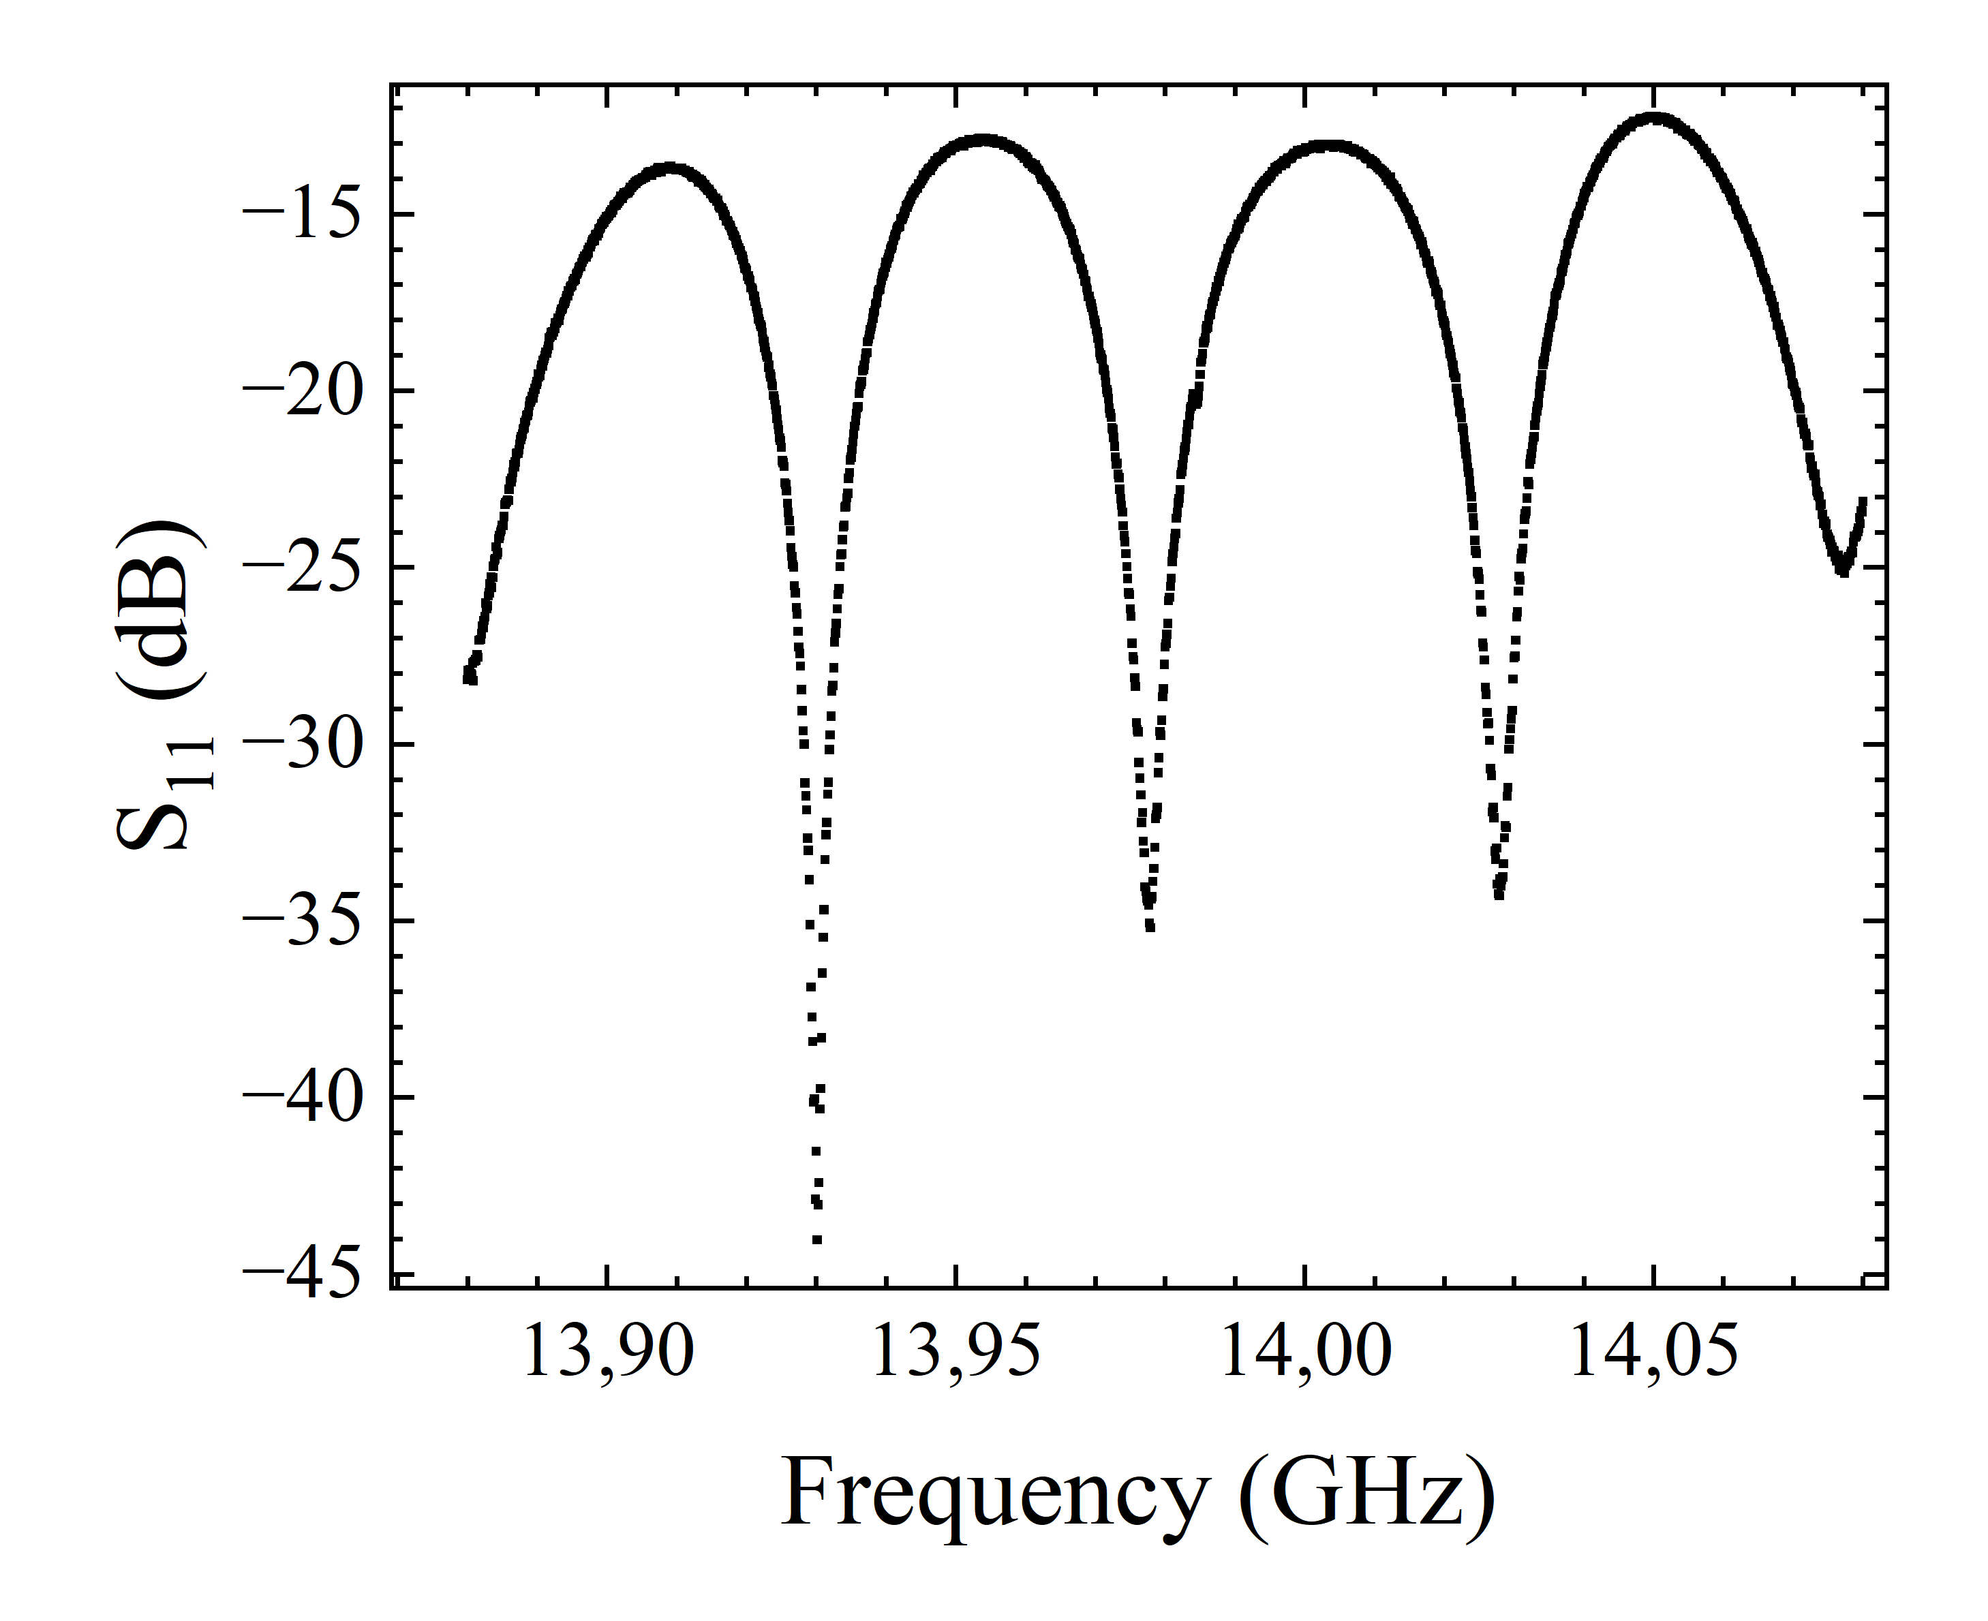
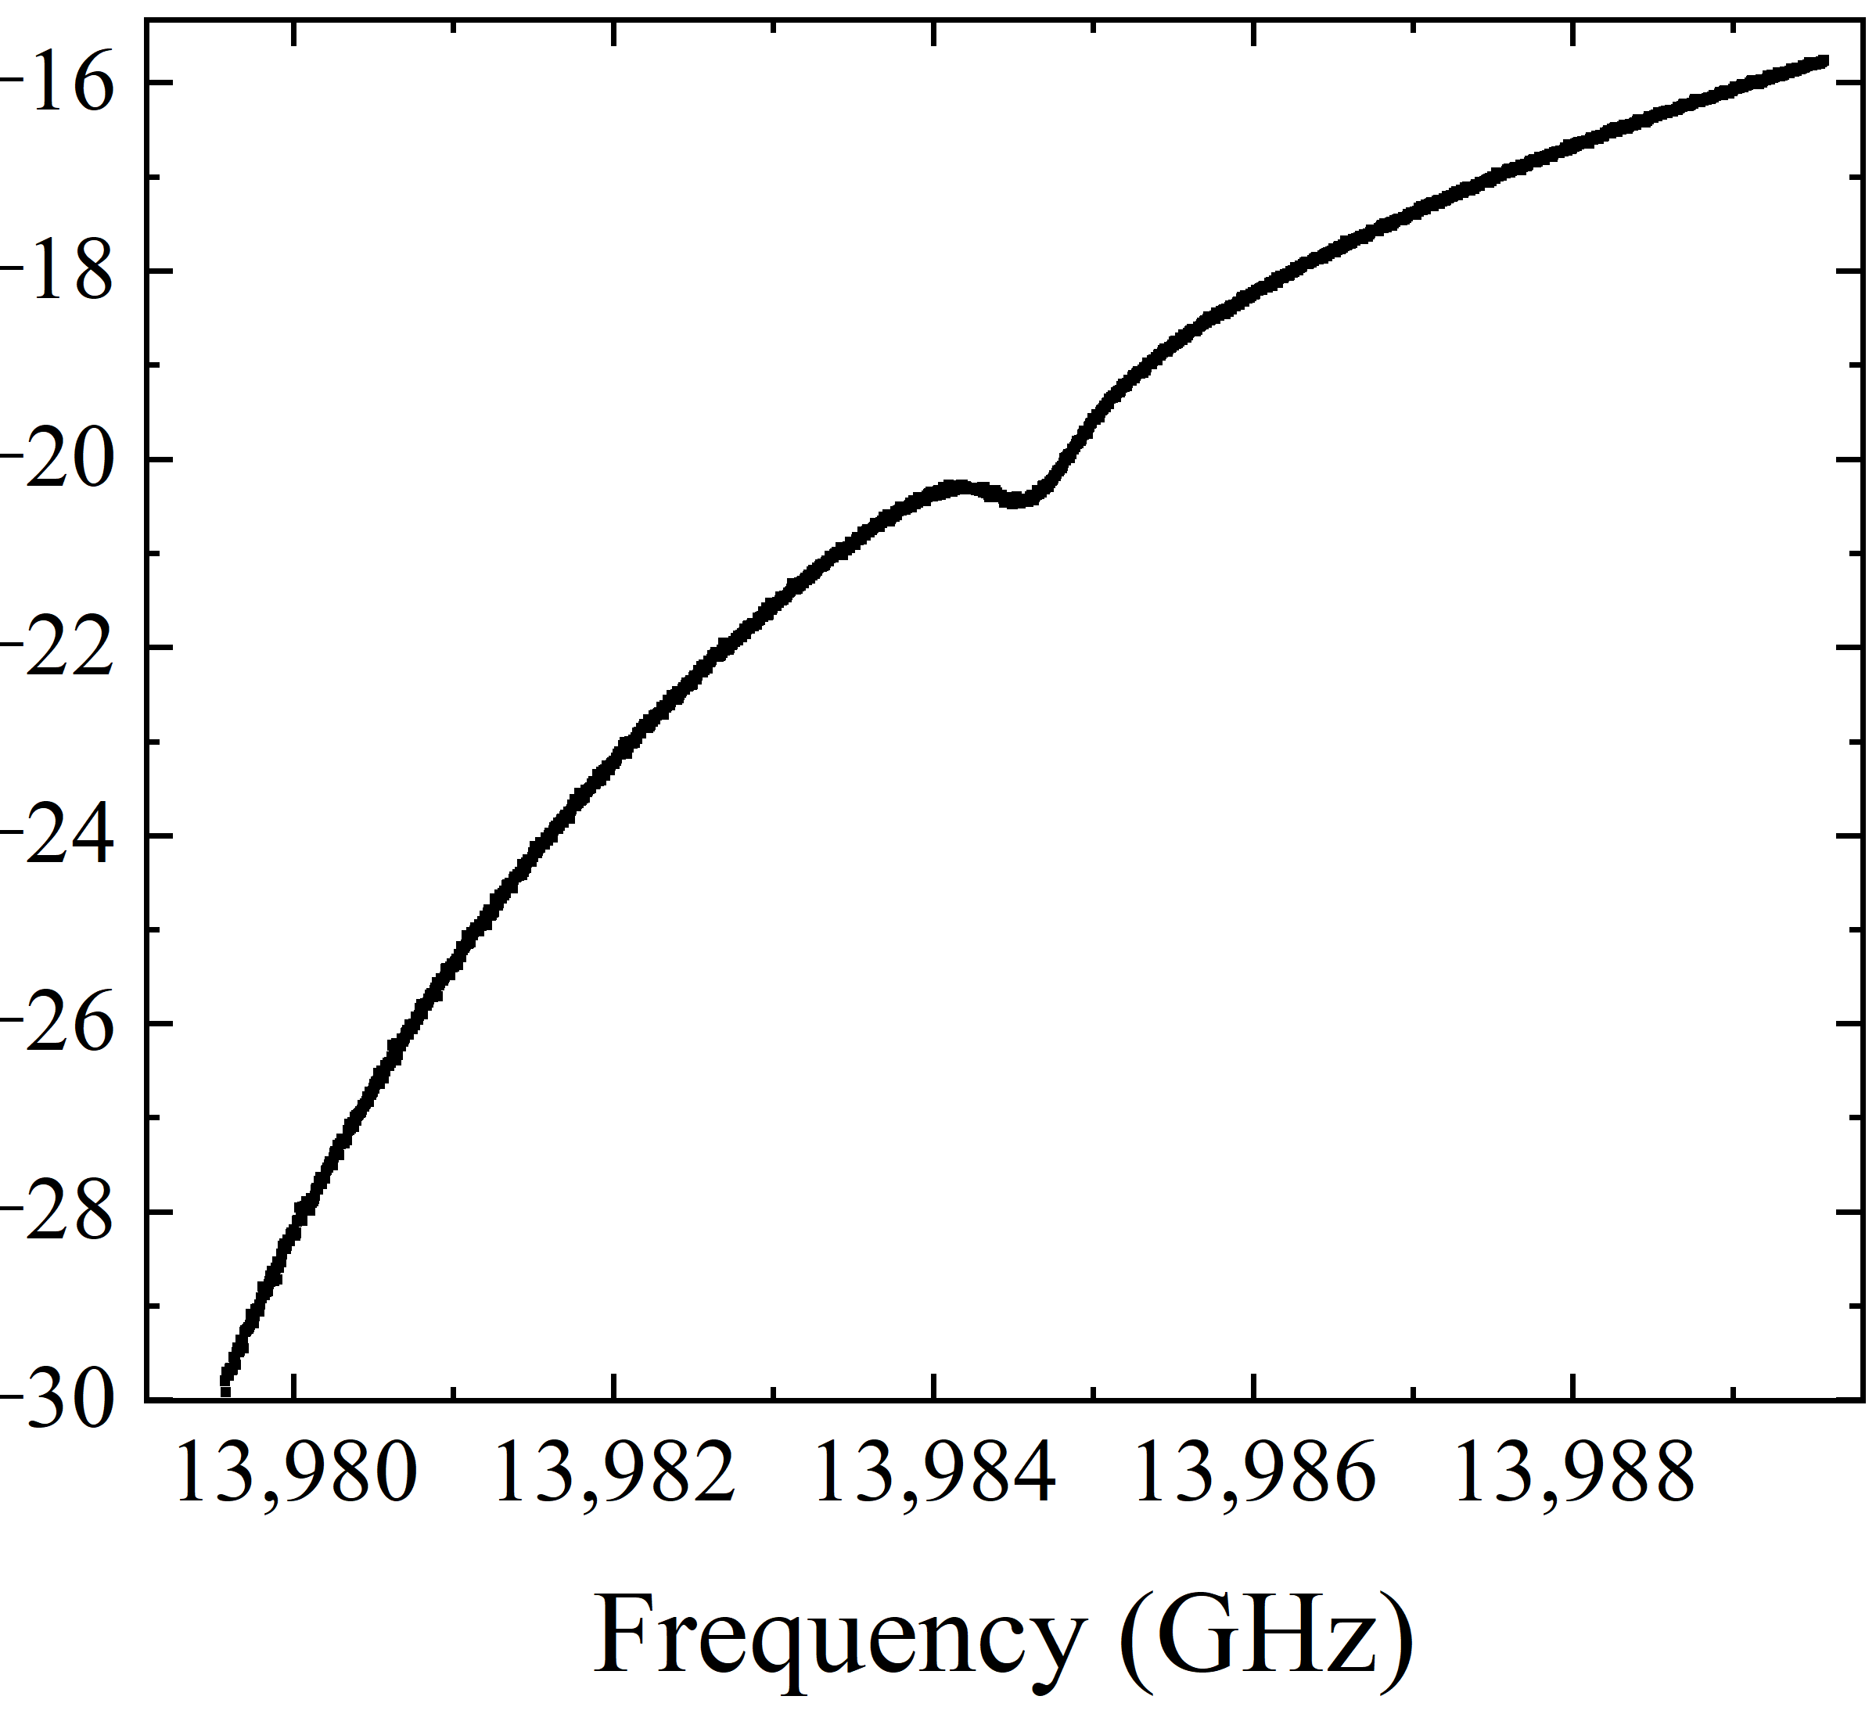


Cavity Characterization
Scattering parameters results
S₂₁
S₁₁
7.46 GHz
2
1
2
1
Cavity
Cavity
All measures at 30 mK
7.46 GHz
$$Q_{L}=\left(2.2±1.0\right)⋅10^{5}$$
Already better
than Al alloy cavity!
13.98 GHz
$$Q_{L}=(1.78±0.9)⋅{10}^{4}$$
13.98 GHz

Slide 16
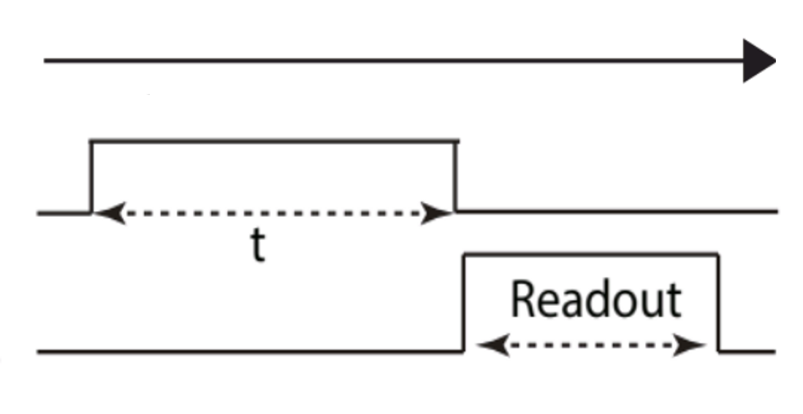
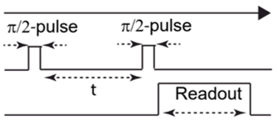
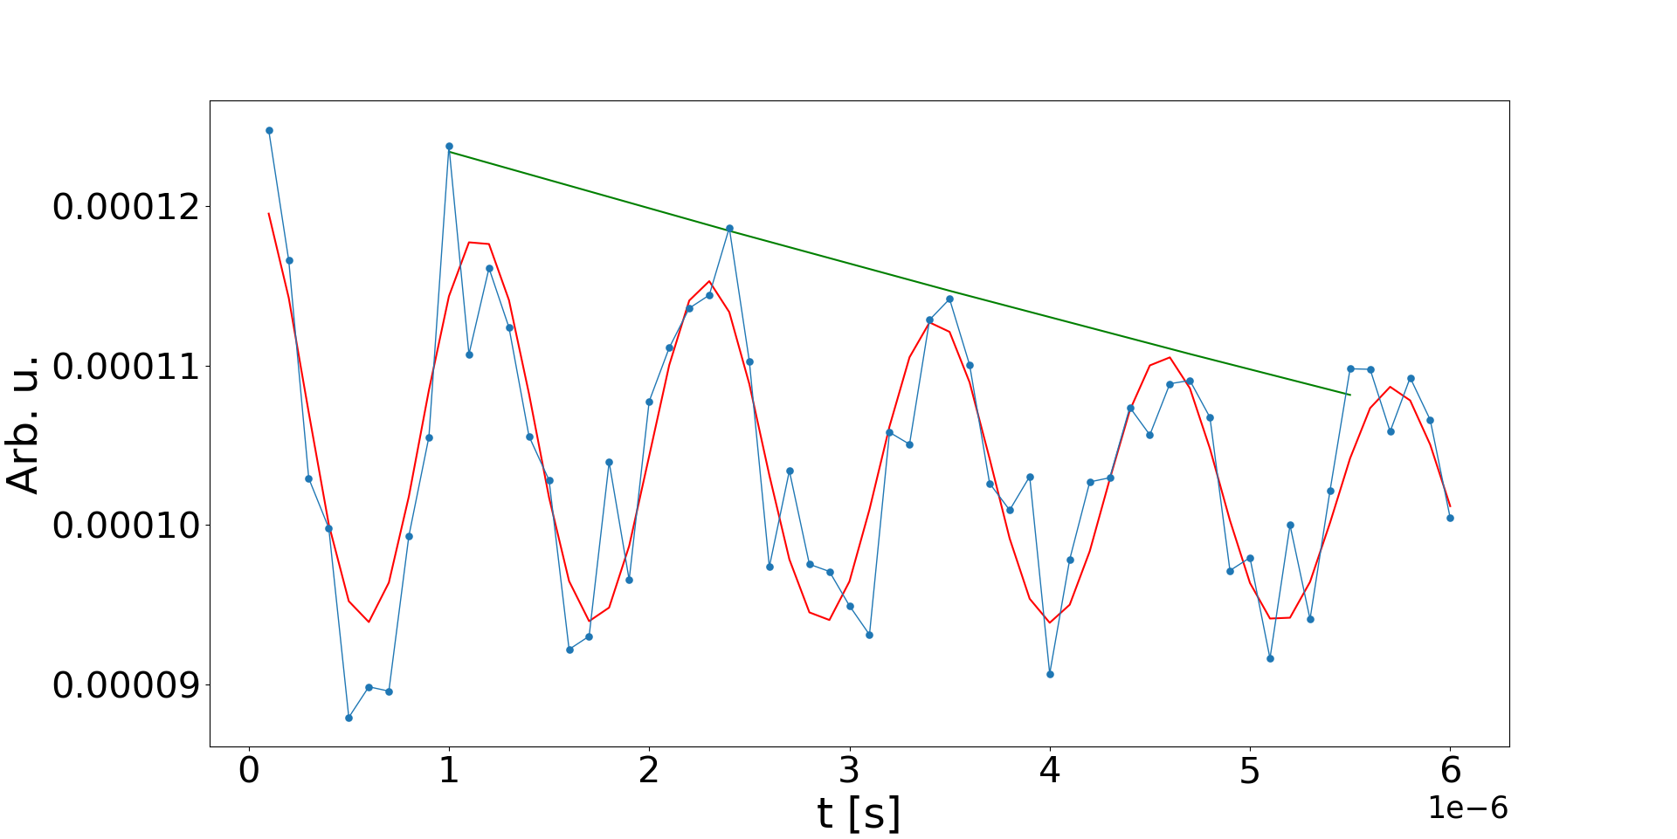
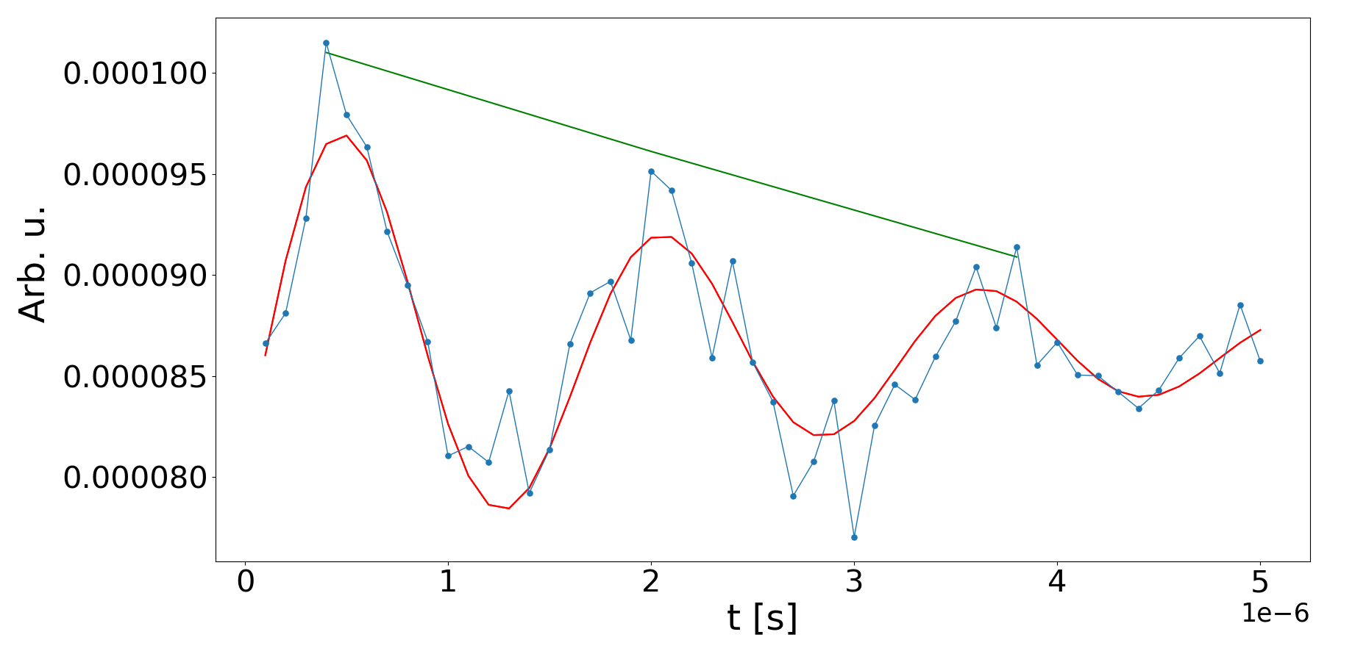
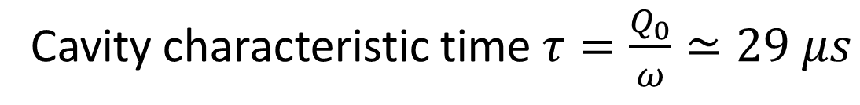


Qubit Characterization
(Al alloy cavity)
Rabi spectroscopy
Ramsey spectroscopy
Pump power -28 dB
Pump detuning 600 kHz
t [μs]
t [μs]
$$T_{1}=\left(6.1±0.3\right)μs$$
$$T_{2}=\left(2.3±0.3\right)μs$$
Cavity characteristic time $τ=\frac{Q_{0}}{ω}≃29 μs$

Slide 17
Qubit Characterization
Cavity
Qubit
M. Kjaergaard et al., Annu. Rev. Condens. Matter Phys., vol. 11, fasc. 1, mar. 2020

Slide 18
Outline
Introduction
Design of a 7.46 GHz cavity
Fabrication using
pure Al vs Al alloy
Fabrication improvements
Characterization of the Cavity + Qubit

Slide 19
Cavity Fabrication
Critical step
Mechanical
Machining
𝐻₃𝑃𝑂₄ : 𝐵𝑢𝐴𝑐
Tumbling
Electropolishing

Slide 20
Cavity Fabrication
Problem is pure aluminum toughness
Try cold machining
Cooling Al in N₂(l)
Mechanical
Machining
Toughness measurements show no improvement

Slide 21
Cavity Fabrication
Problem is pure aluminum hardness
Change machining parameters
Try cold machining
Cooling Al in N₂(l)
Slower process and new tools
Mechanical
Machining
Toughness measurements show no improvement

Slide 22
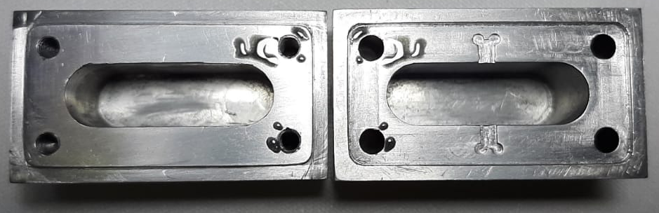
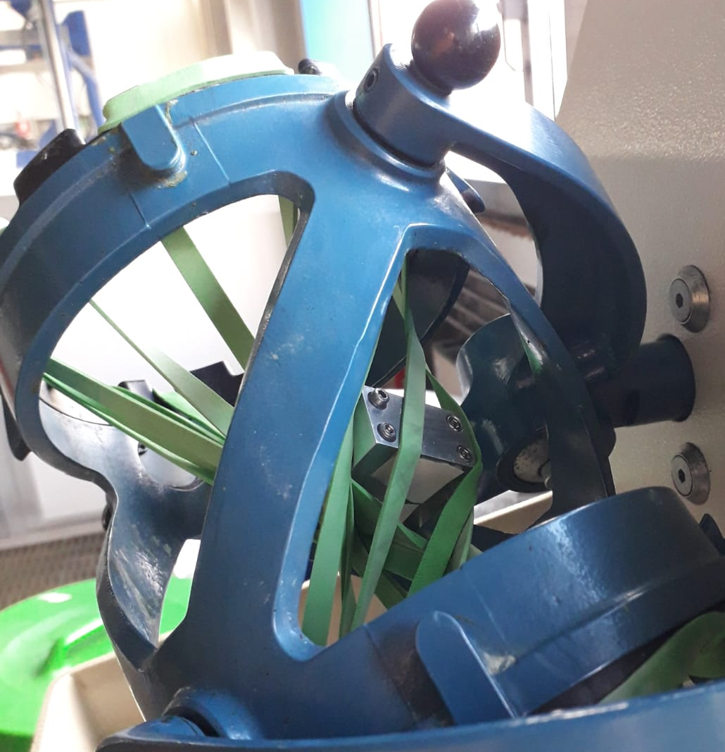
Cavity Fabrication
…
Ongoing in this moment
…
Mechanical
Machining
Tumbling

Slide 23

Cavity Fabrication
Mechanical
Machining
𝐻₃𝑃𝑂₄ : 𝐵𝑢𝐴𝑐
Tumbling
Electropolishing
Evaluating alternatives:
…
Ongoing in this moment
Plasma Electrolytic Polishing
…

Slide 24
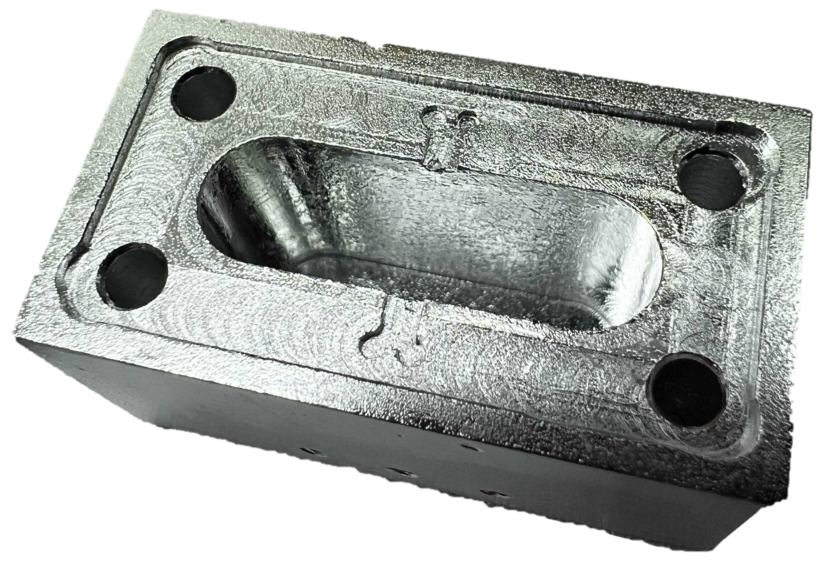
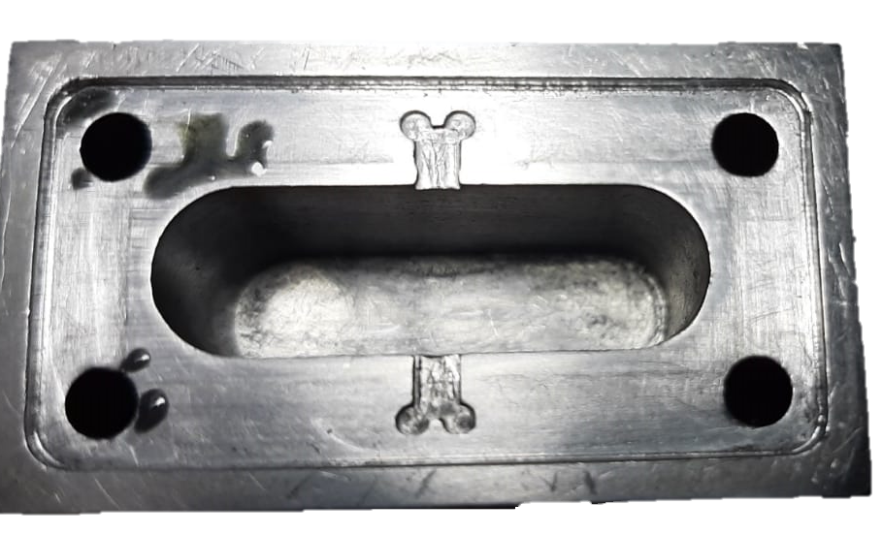
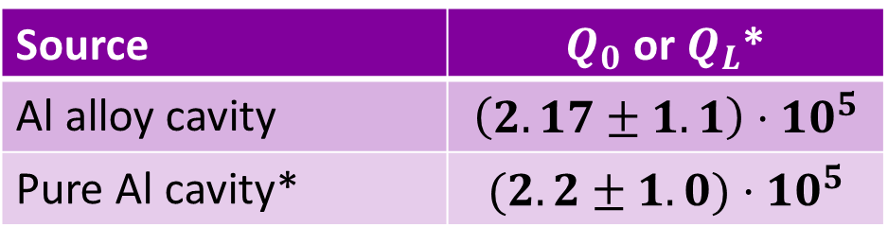
Conclusions
The quality factor of the new Pure Al cavity is higher than the previous Al alloy cavity
Al alloy
Source | $Q_{0}$ or $Q_{L}$*
Al alloy cavity | $$\left(2.17±1.1\right)⋅10^{5}$$
Pure Al cavity* | $$(2.2±1.0)⋅10^{5}$$
The critical step proved to be mechanical machining from the pure Al cylinder
Pure Al #1
Improvements on the machining process are ongoing at LNL
Pure Al #2
The next prototype will be ready shortly

Slide 25
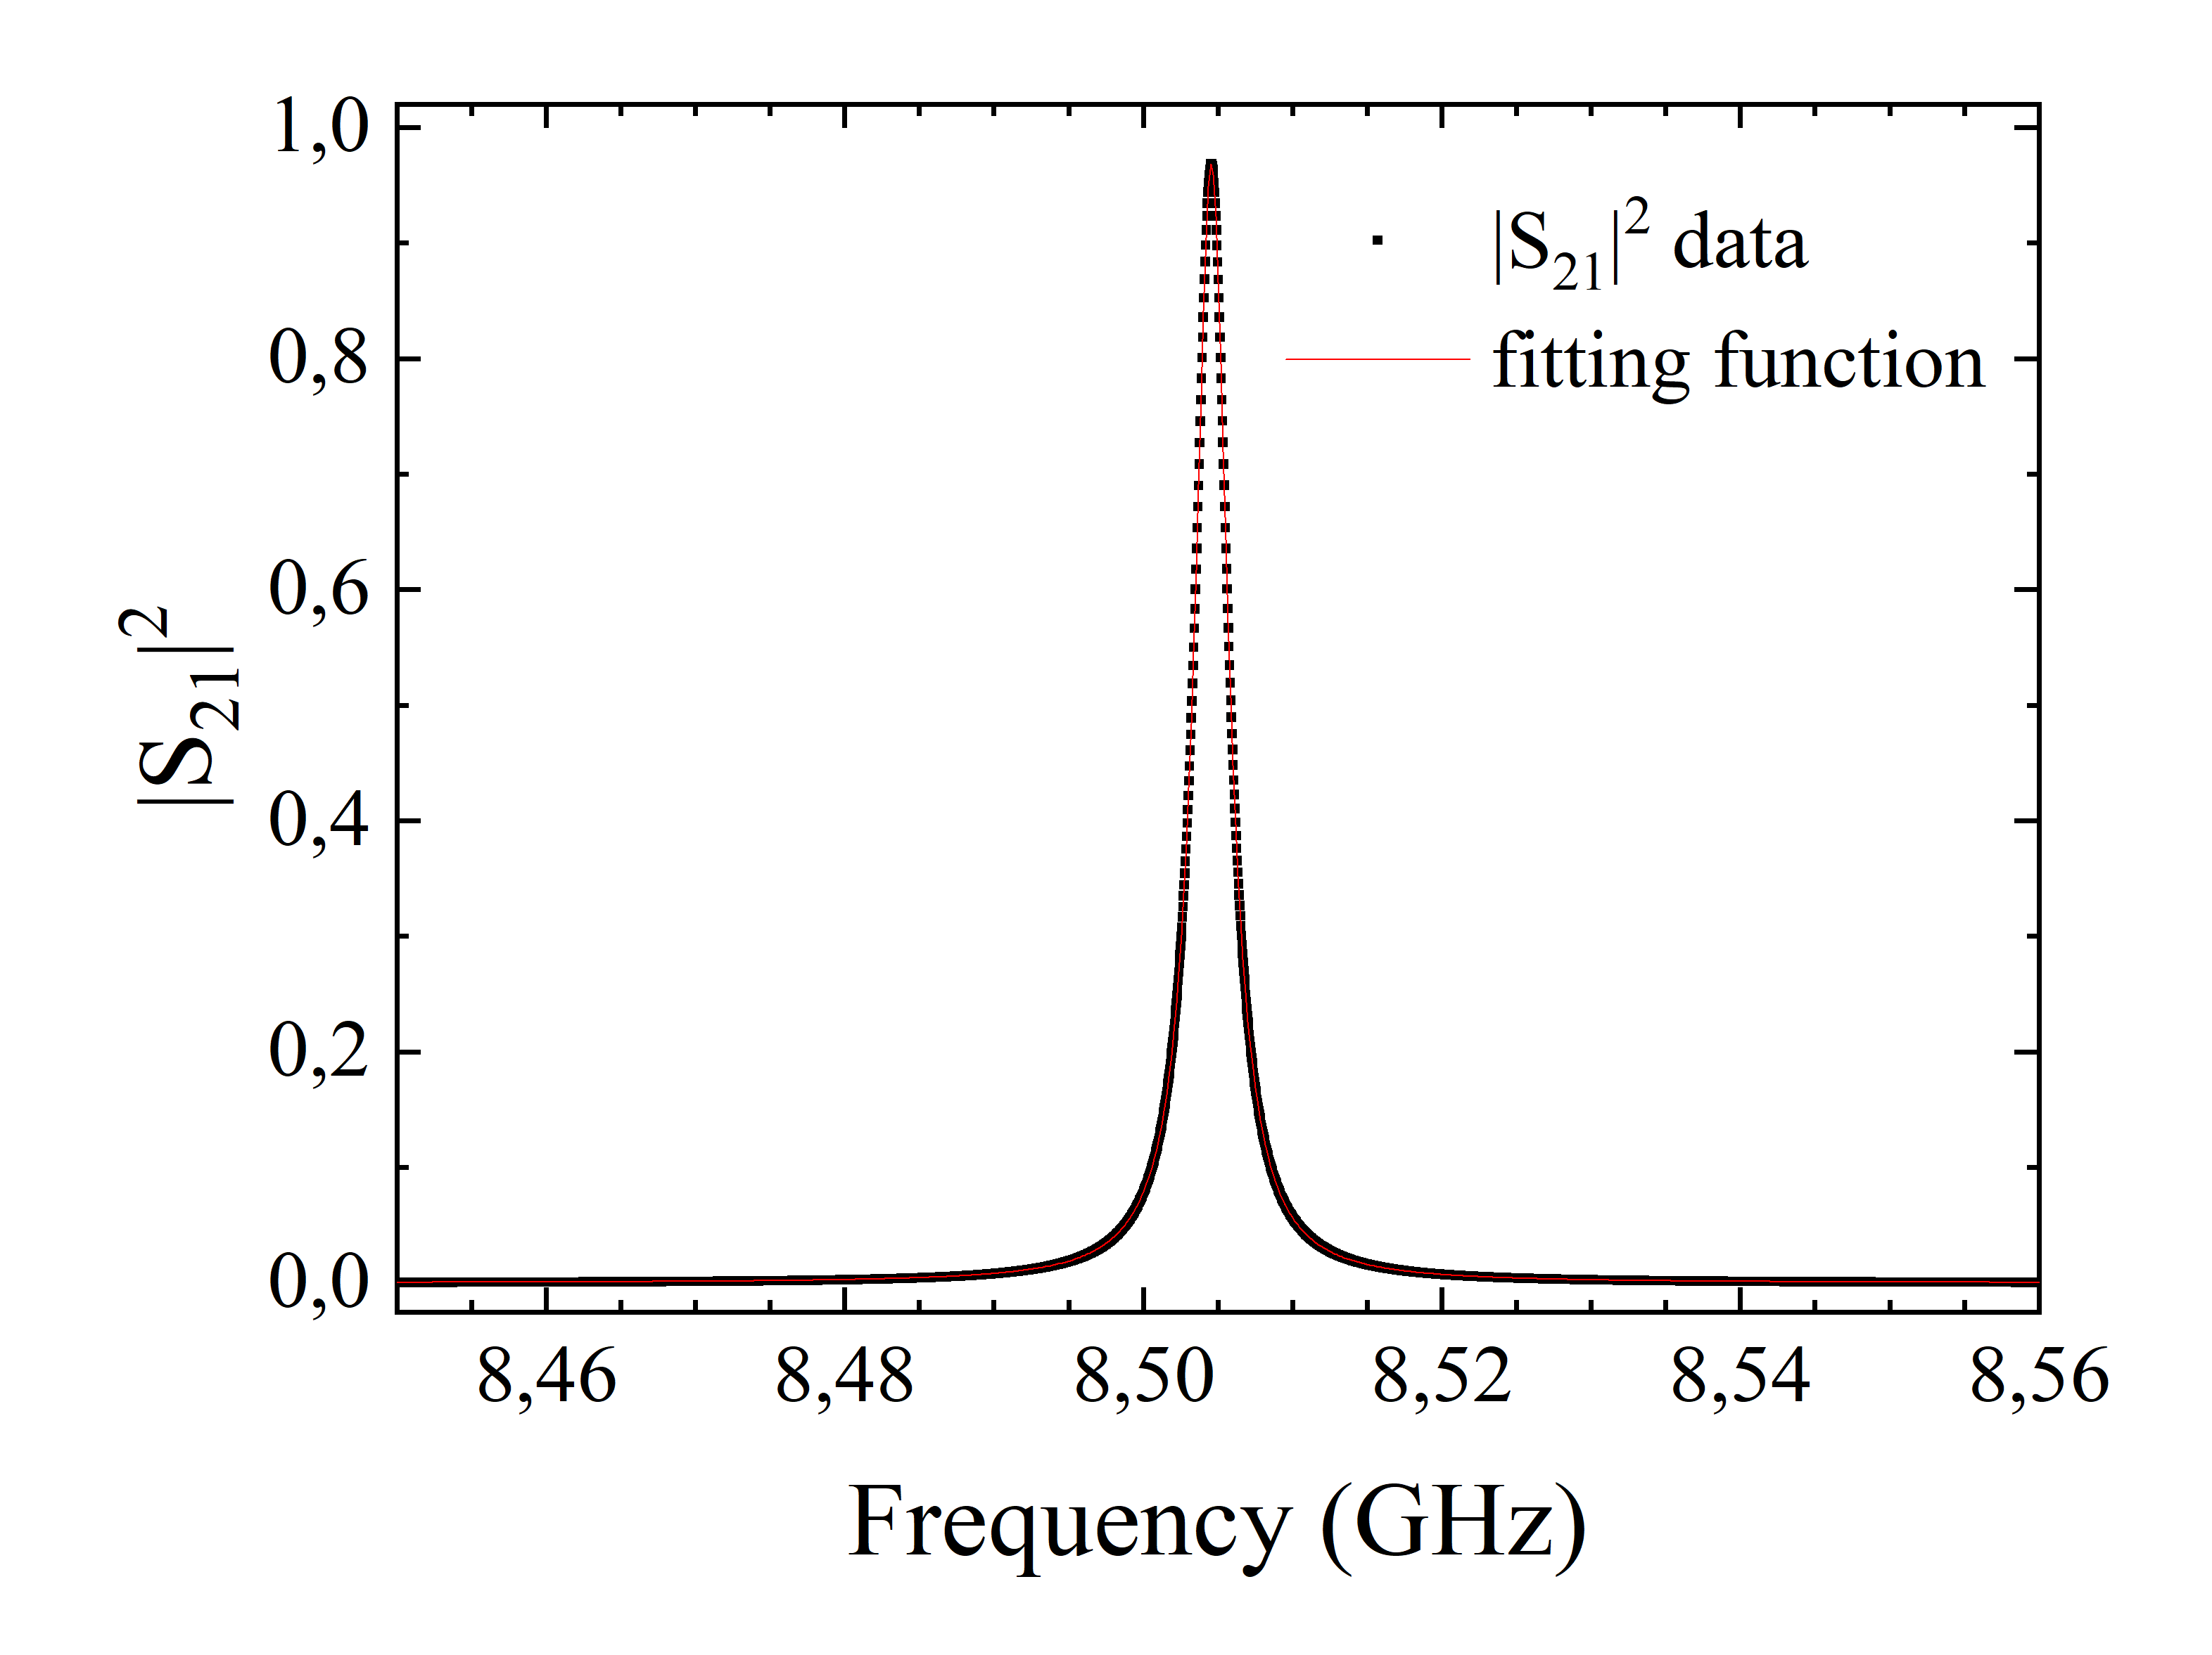
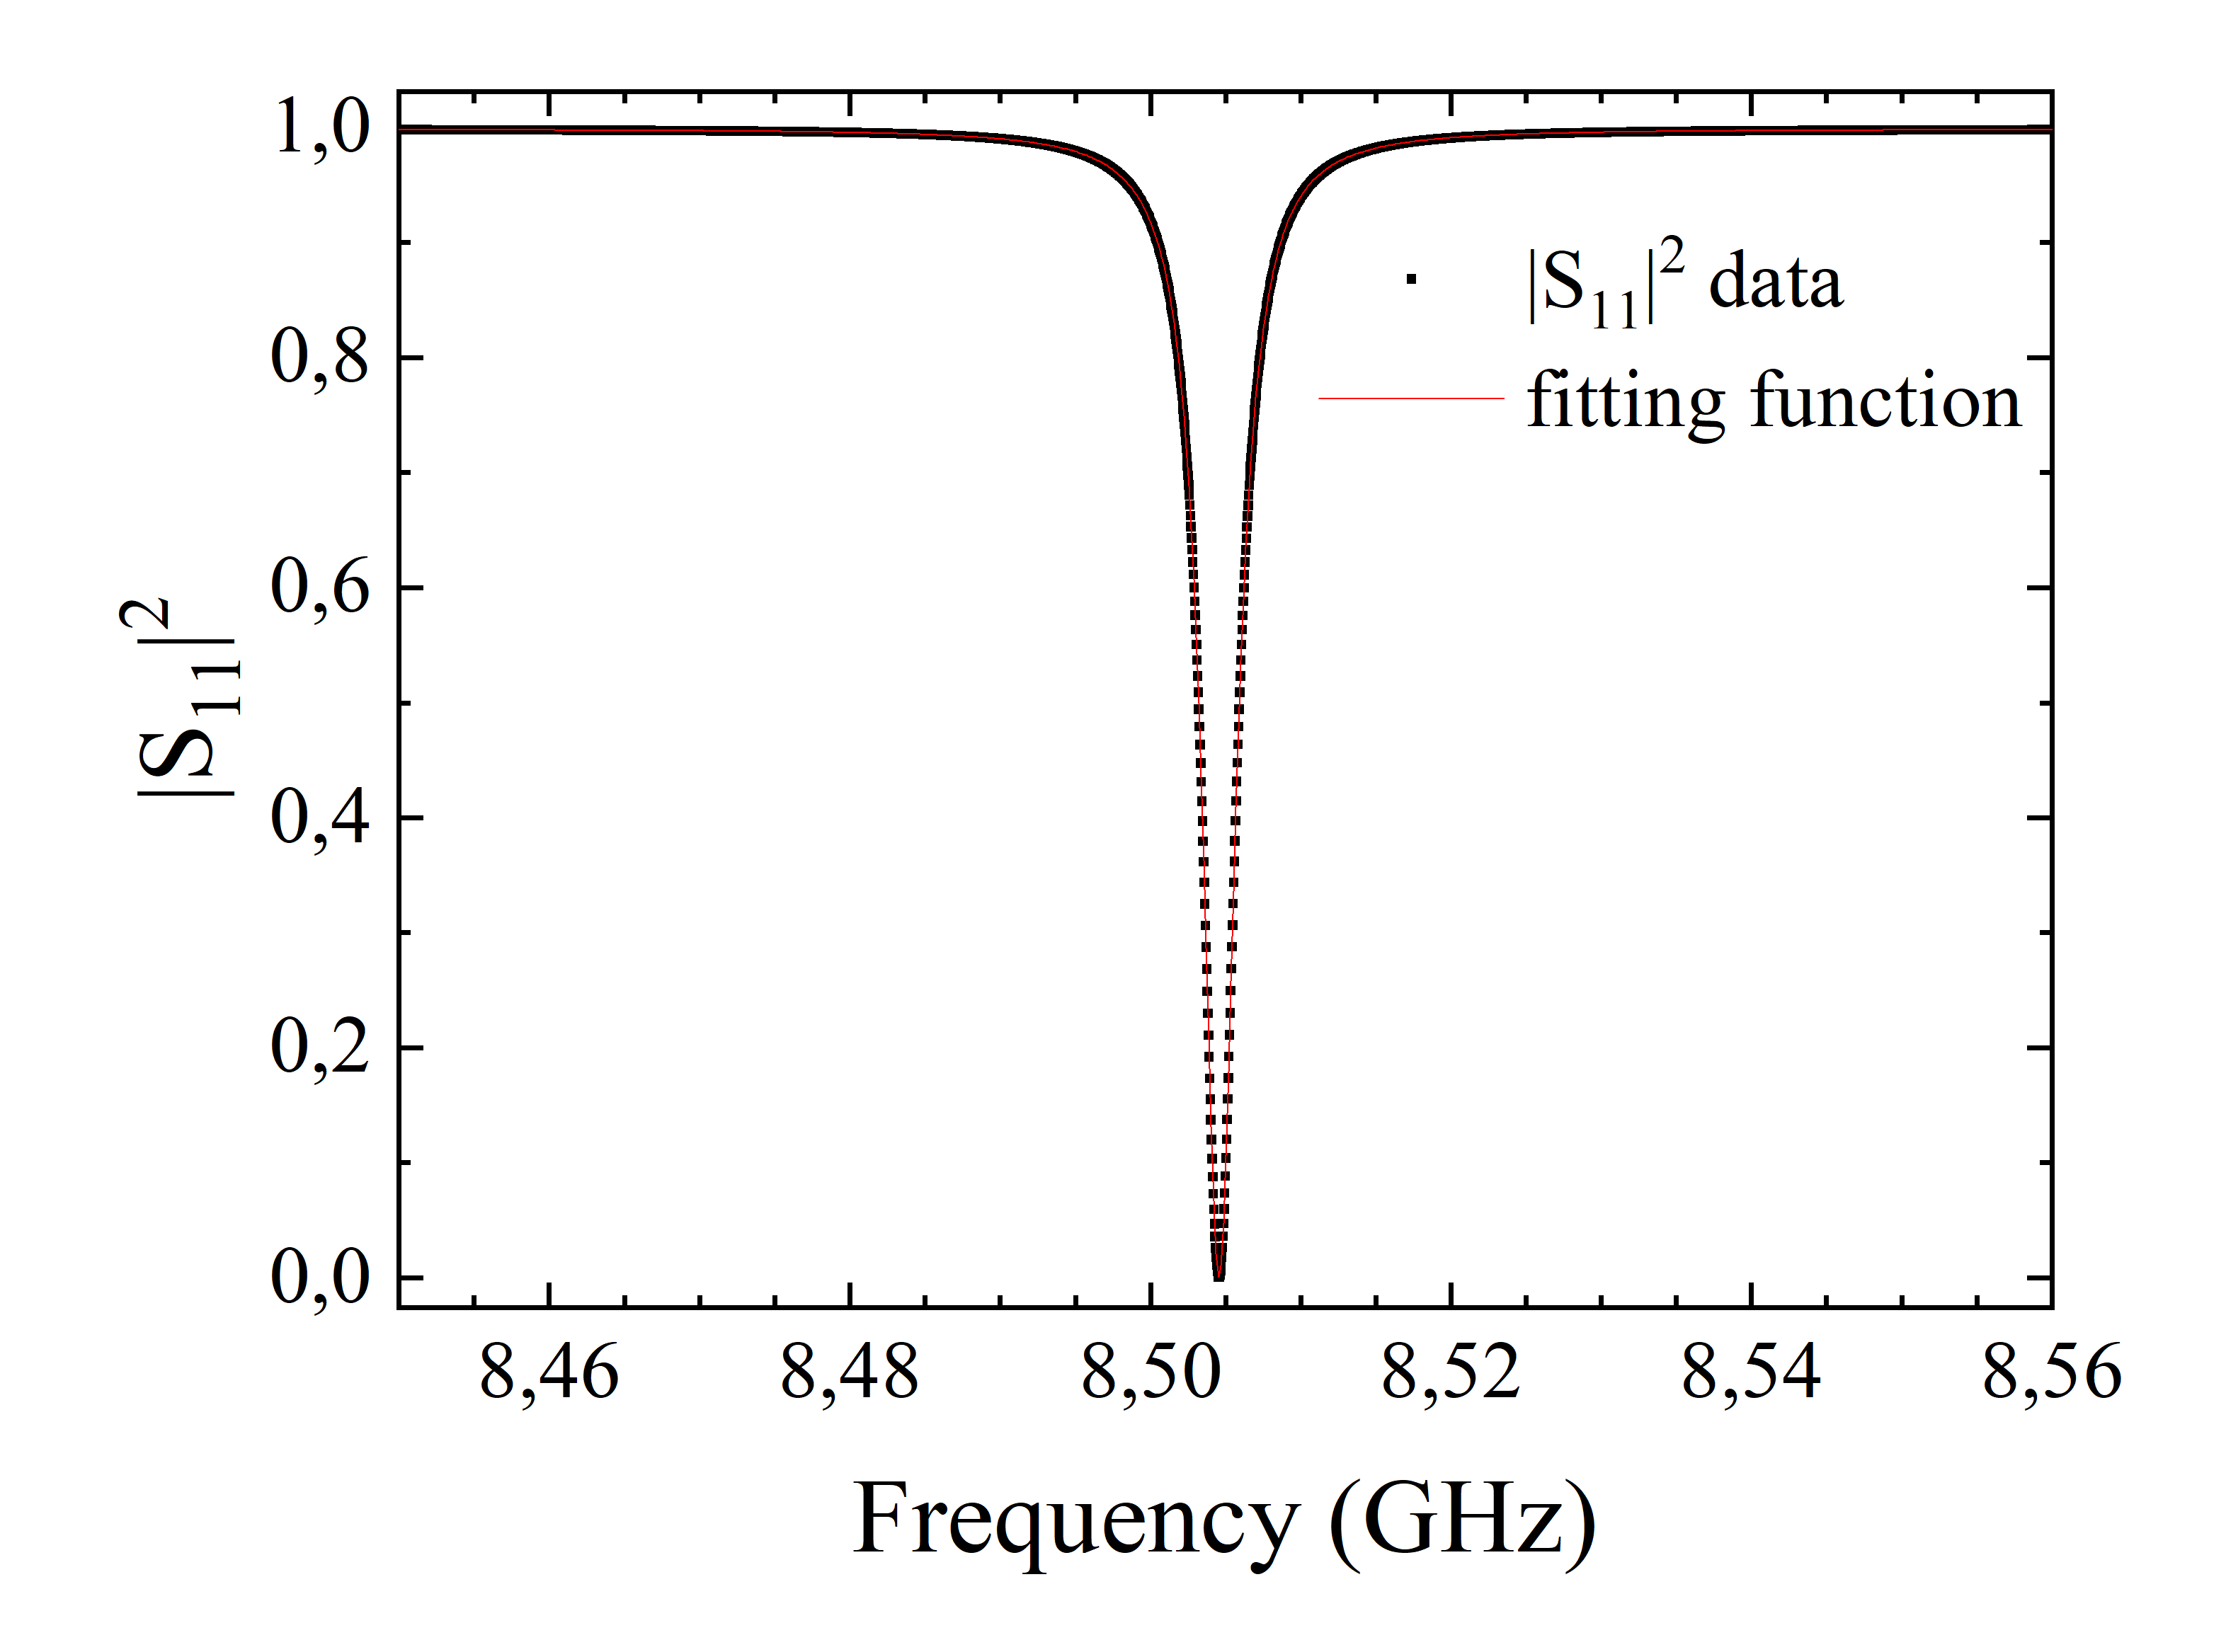




Future Developments
Fabrication and surface treatments improvements on the 7.46 GHz
Scaling to 8.50 GHz for future developments:
Source | $$Q_{0}$$
Eigenmode | $$232000±13000$$
Modal Network | $$230000±20000$$
$$G= 171.76 Ω$$

Slide 26


Backup
Rabi spectroscopy
Ramsey spectroscopy

Slide 27


Backup

