Slide 1
Present and future perspectives for Hadron Physics at LNF's infrastructures
Alessandro Scordo, Laboratori Nazionali di Frascati INFN

Slide 2
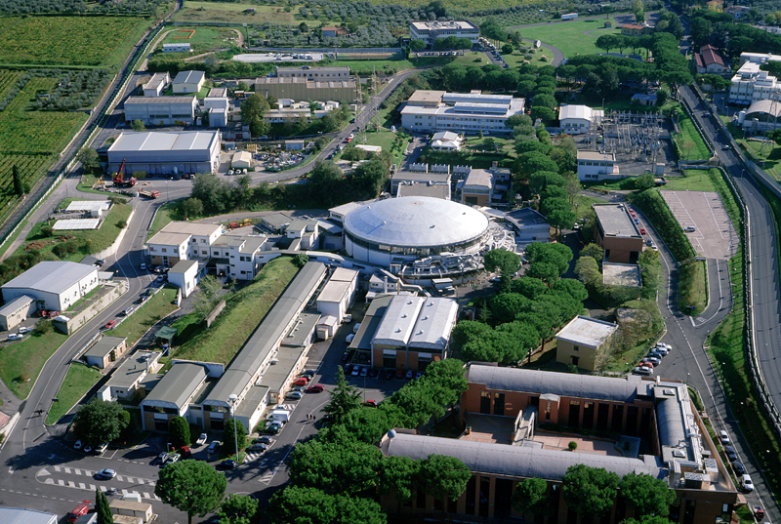
Content
Nuclear Physics @ EuPRAXIA
Kaonic atoms experiments with SIDDHARTA-2 & EXKALIBUR
PADME experiment & Fireball proposal
DAΦNE-Light
BTF
DAΦNE e+e- collider (Φ-factory)
Radiation Detectors characterization laboratories

Slide 3
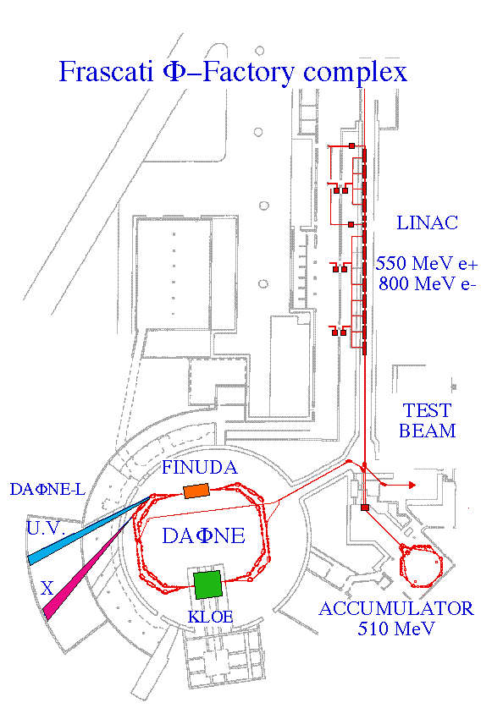
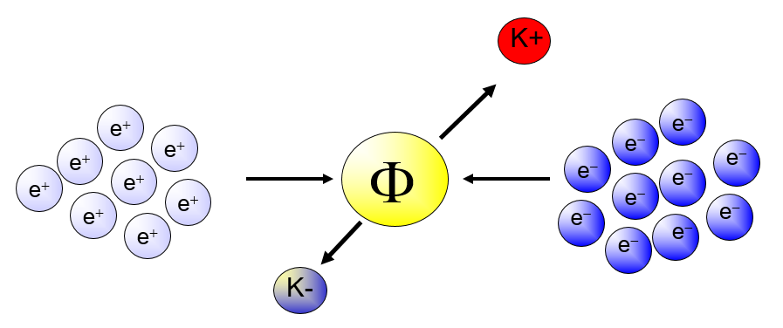
DAΦNE
B.R (φ → K⁺ K⁻ ) = 48,9 %

Slide 4
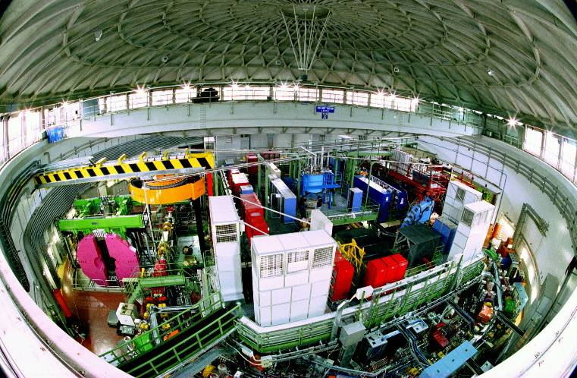
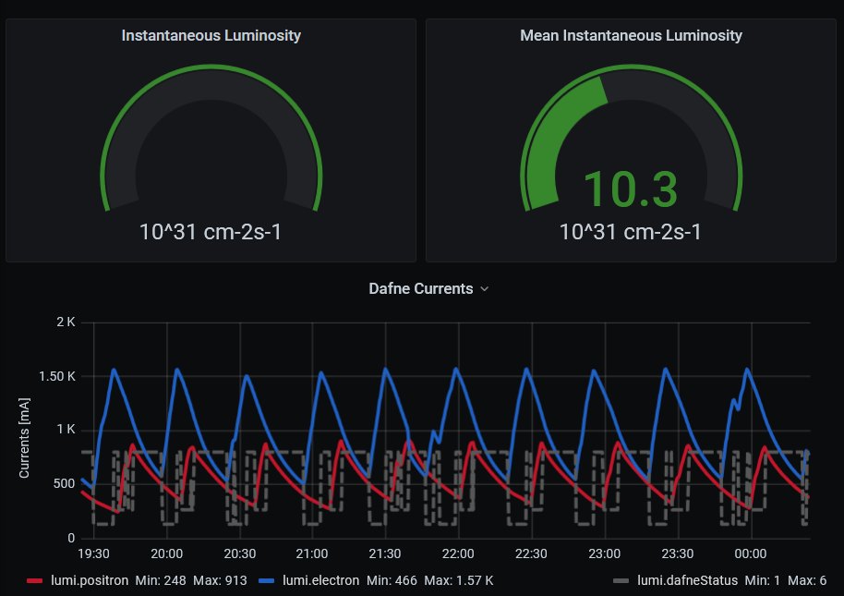
DAΦNE
Φ resonances produced almost at rest decay at 48.9 % in K⁺ K⁻ back to back pairs
P_{K-}(≈ 127 MeV) produced at ~1 kHz
Crab Waist collision scheme
Collision rate (RF) ~ 300 MHz
Injection rate ~ 30 min.
L_{avg} ~ 10³² cm⁻² s⁻¹

Slide 5
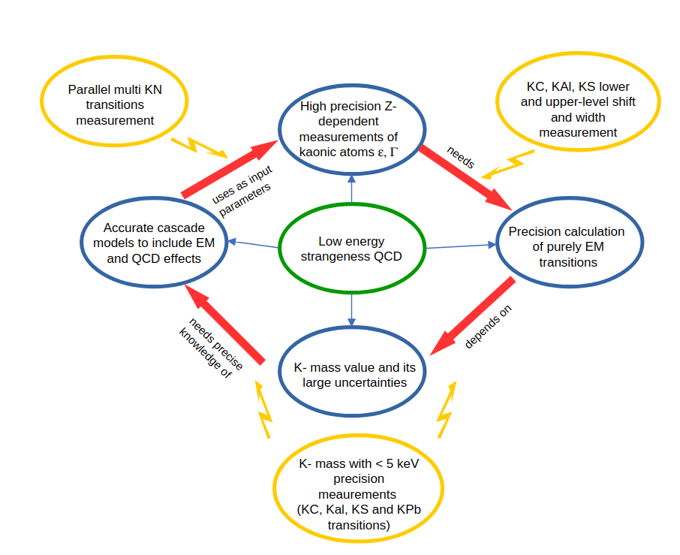
Kaonic atoms experiments @ DAΦNE
Kaonic deuterium and light kaonic atoms in general already discussed by F. Sgaramella on 17/06 morning talk
There is still an impasse in kaonic atoms investigation due to the lack of precise data and on the large errors on the PDG value of the K⁻ mass.
This impasse could be attacked in parallel from several sides thanks to the combined usage of different radiation detectors

Slide 6
Kaonic atoms experiments @ DAΦNE
Crystal spectrometers:
High resolution
Low efficiency
0-20 keV range
Energy
Heavy Kaonic atoms
SDDs
100 eV max resolution
4-40 keV range
High efficiency
300 keV
100 keV
Cd(Zn)Te
20-300 keV range
FWHM / E ∼ %
High efficiency
Room Temperature
Intermediate mass Kaonic atoms
40 keV
Light Kaonic atoms
HPGe
100-1000 keV range
FWHM / E ∼ %
High efficiency
Cooling needed
20 keV
10 eV
100 eV
5 keV
Γ

Slide 7
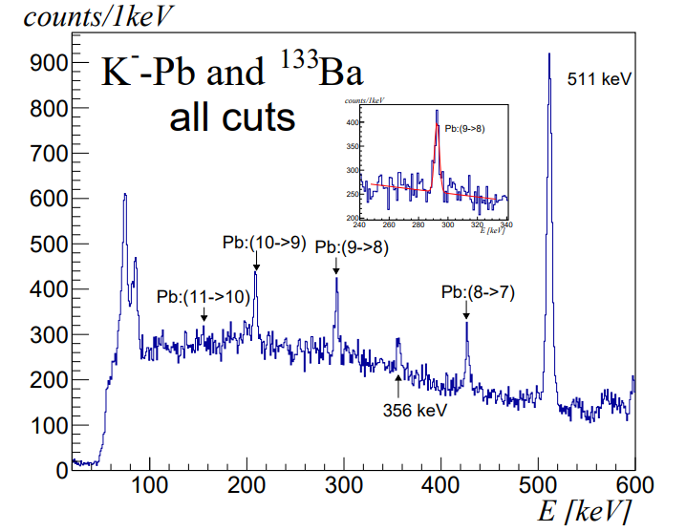
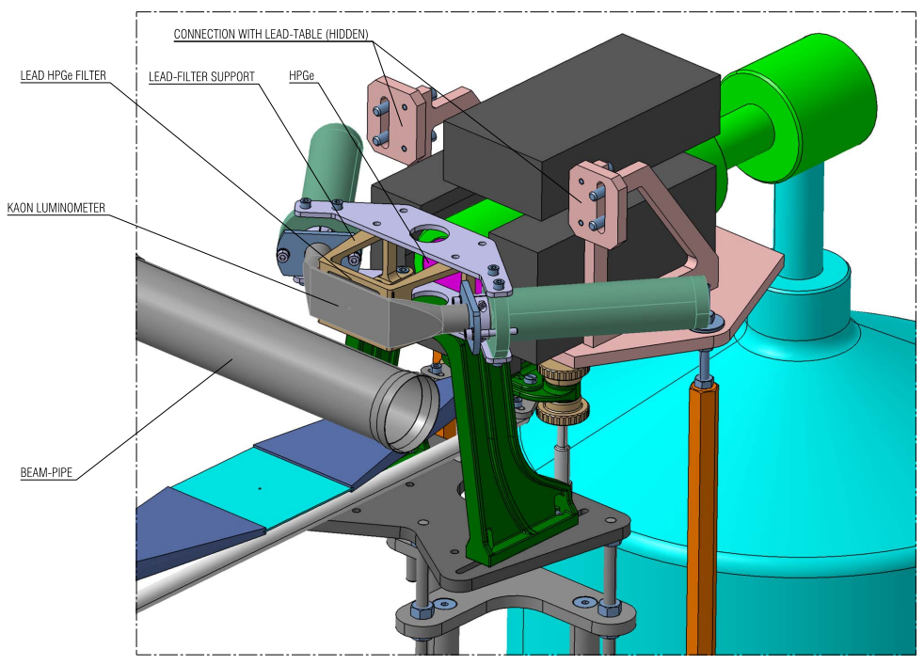
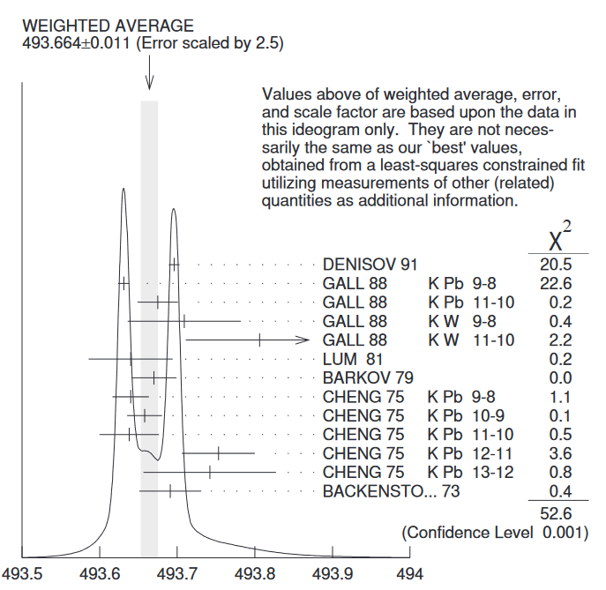
Kaonic atoms experiments @ DAΦNE
Kaon mass precision is still a crucial open issue in strangeness nuclear physics
New test measurement of KPb transitions, including the GALL 88 one
Promising results obtained
Kaon mass puzzle can be addressed with HPGe detectors
Attempt to measure m_{K} with KNe (F. Sgaramella)

Slide 8
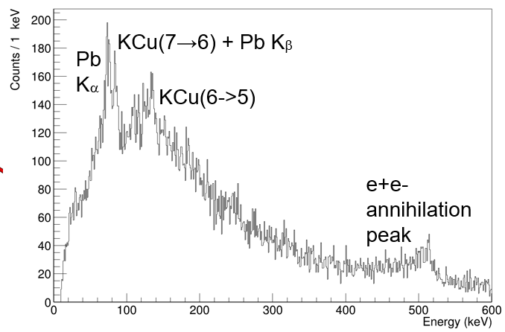
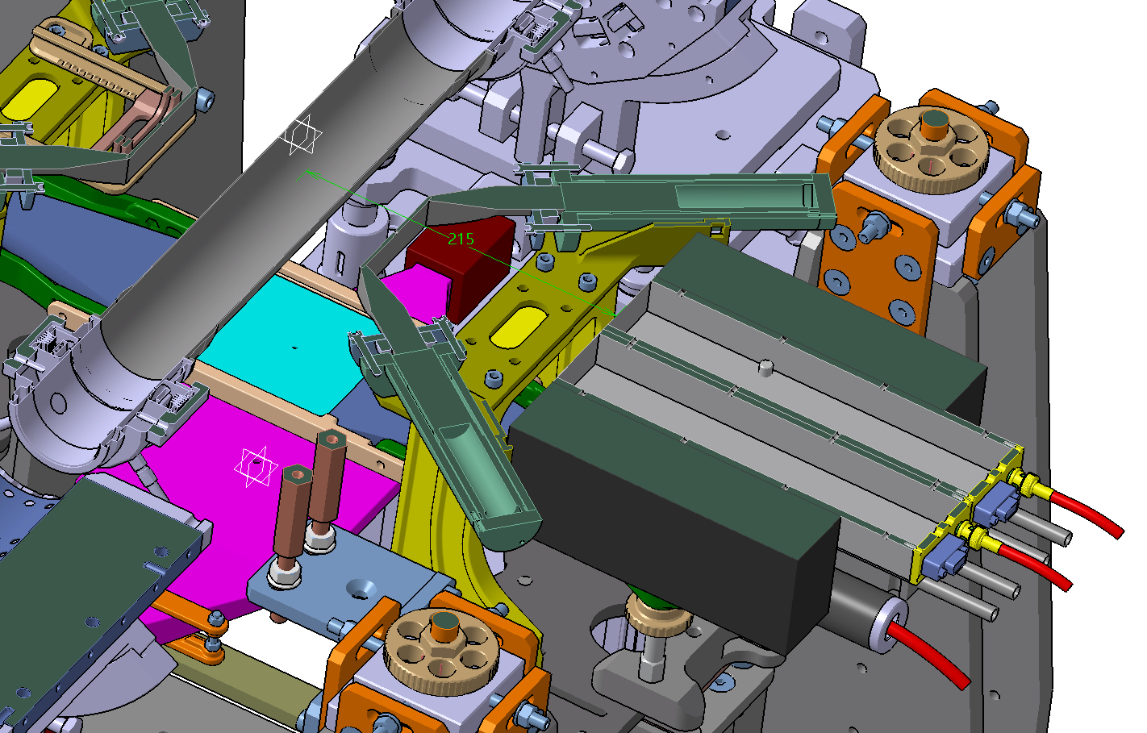
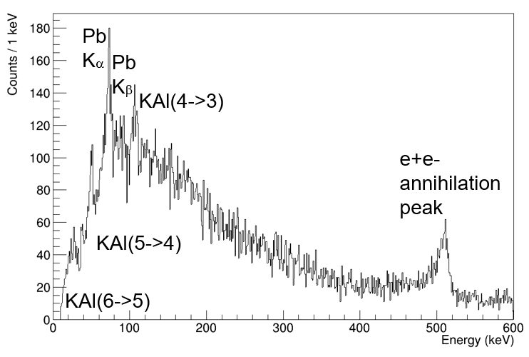
Kaonic atoms experiments @ DAΦNE
Details about CdZnTe detectors
provided by A. Zappettini in his talk on 17/06
~ 60 pb⁻¹ 1 mm Cu
~ 60 pb⁻¹ 2,2 mm Al
First kaonic atoms’ spectra measured with CZT detectors
New perspectives opening

Slide 9
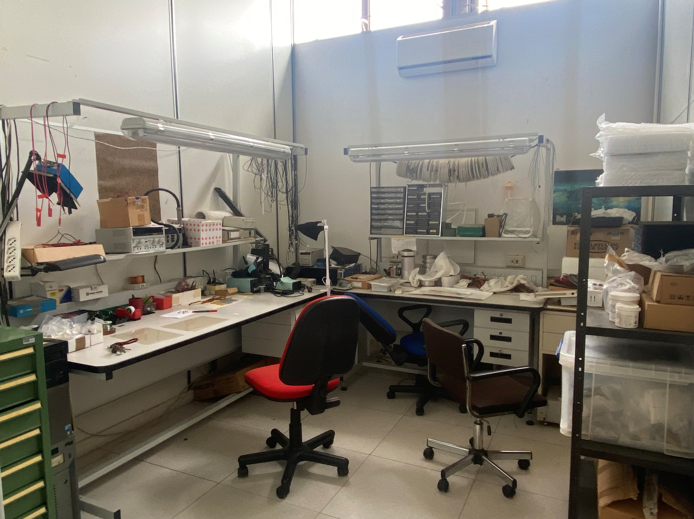
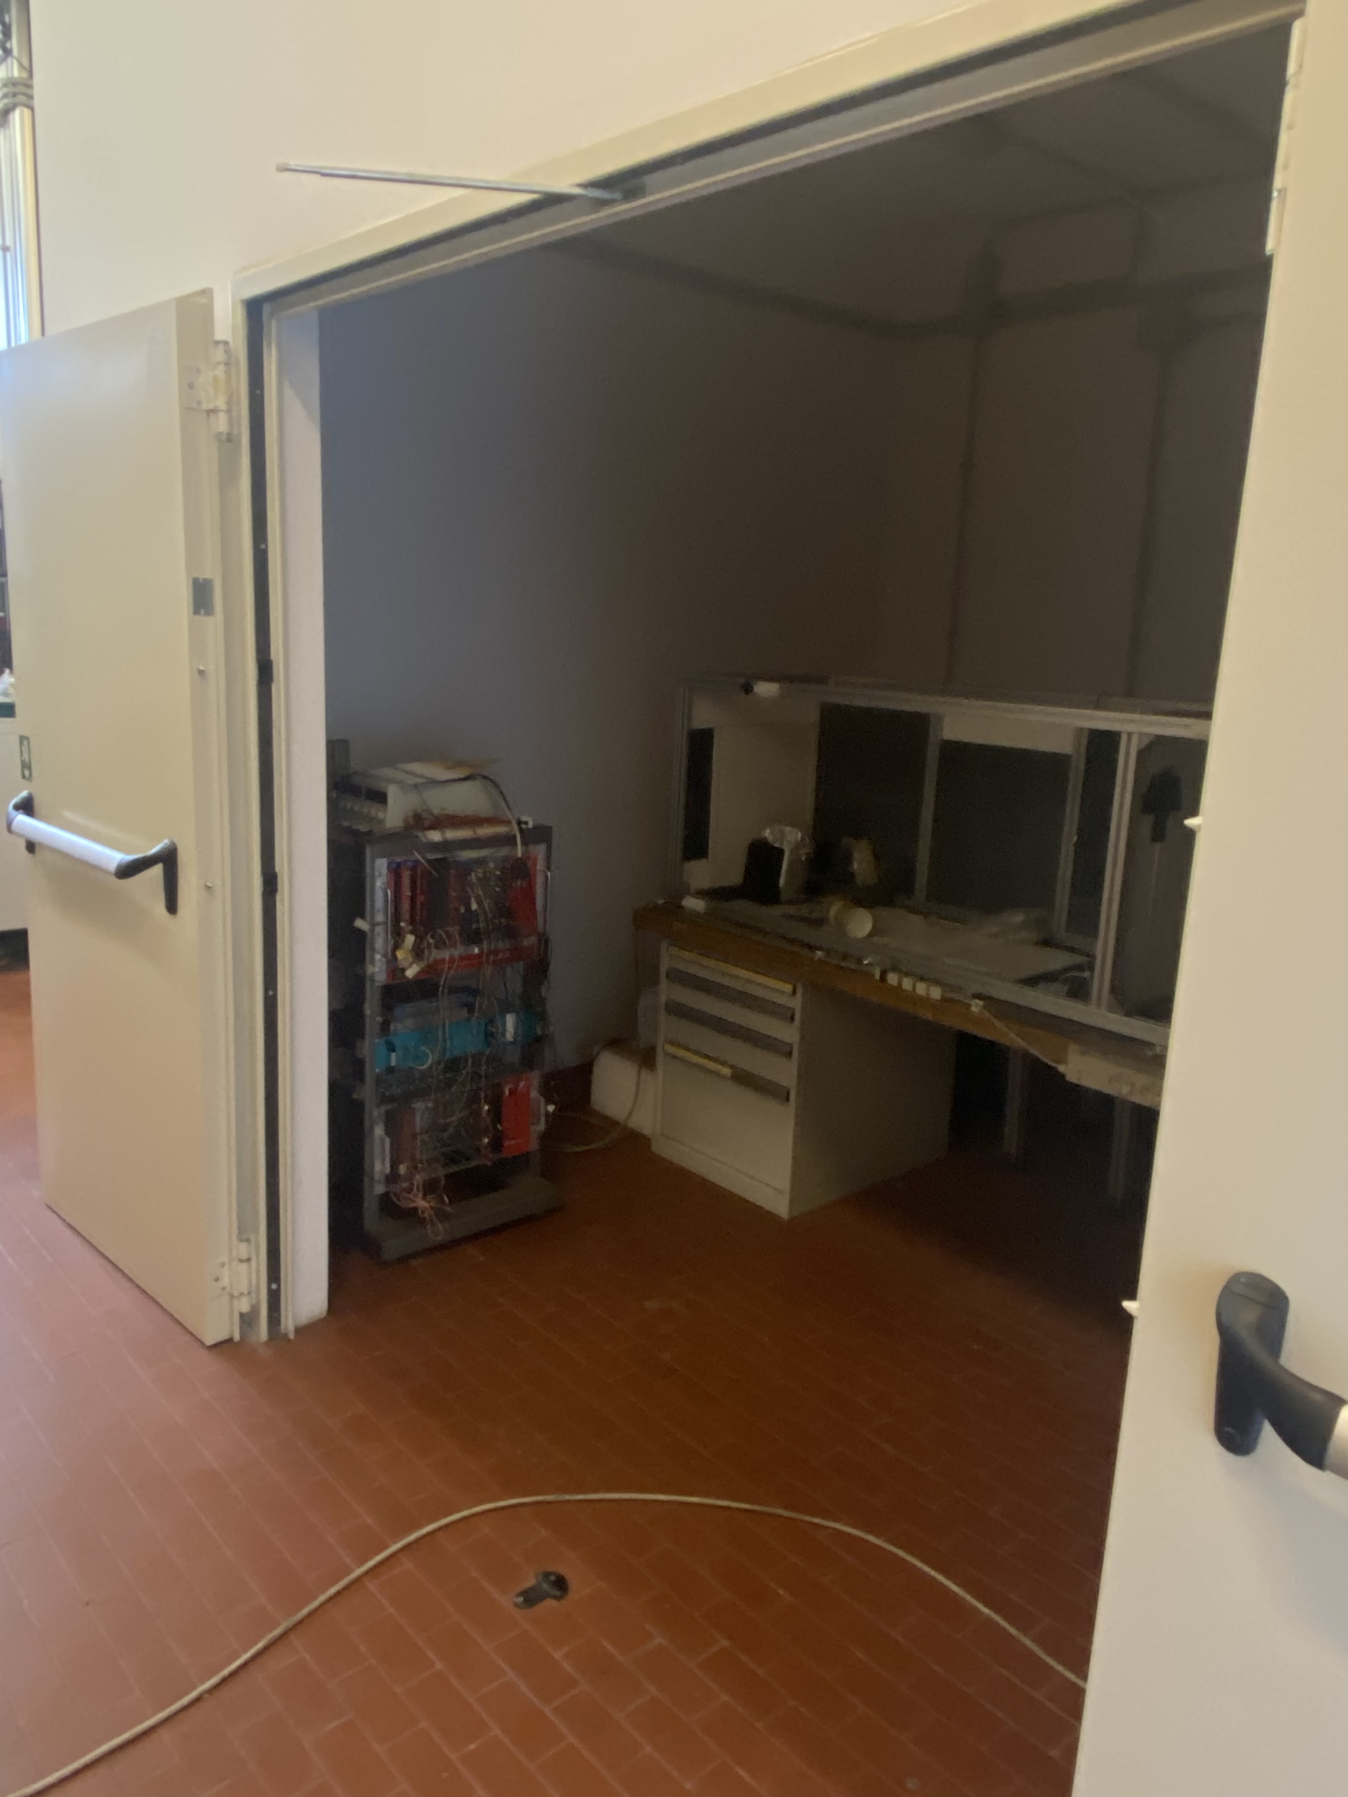
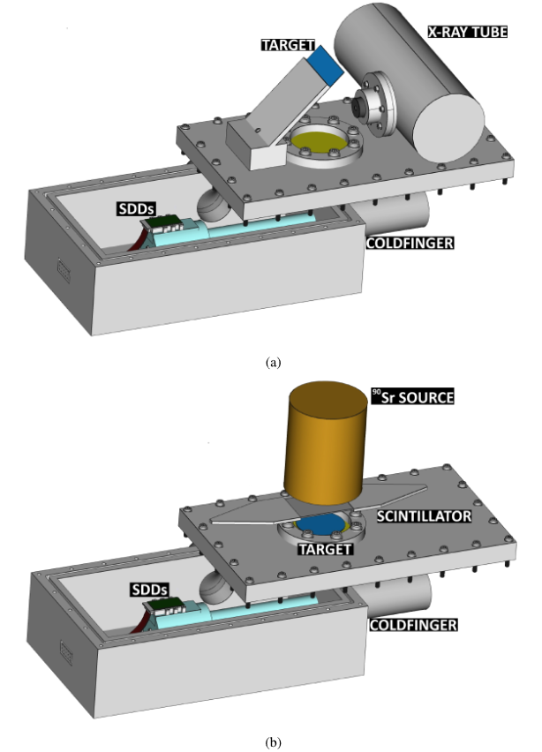
Radiation Detectors Labs
SIDDHARTA Laboratory is equipped for:
Detectors characterization with X-ray tube (2-30 keV)
Detectors characterization with Radioactive sources
Small machinery
Soldering station for electronics implementation

Slide 10
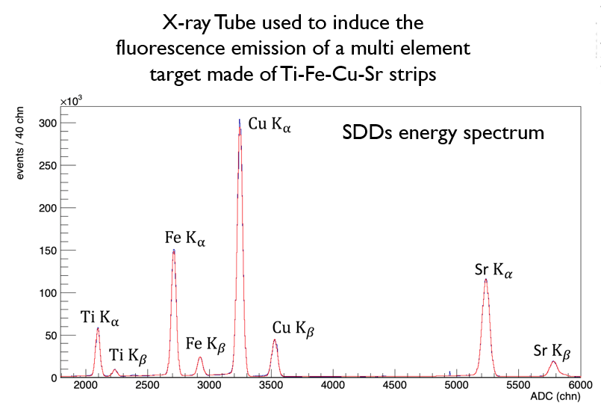
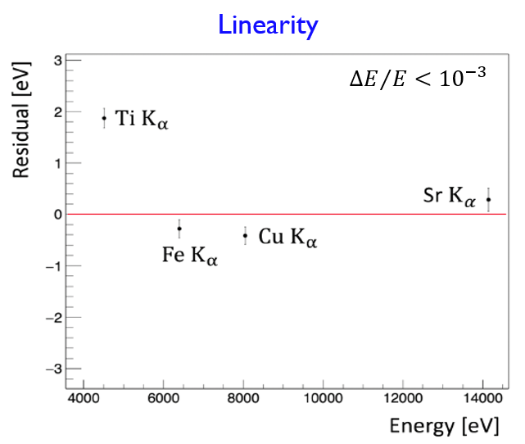
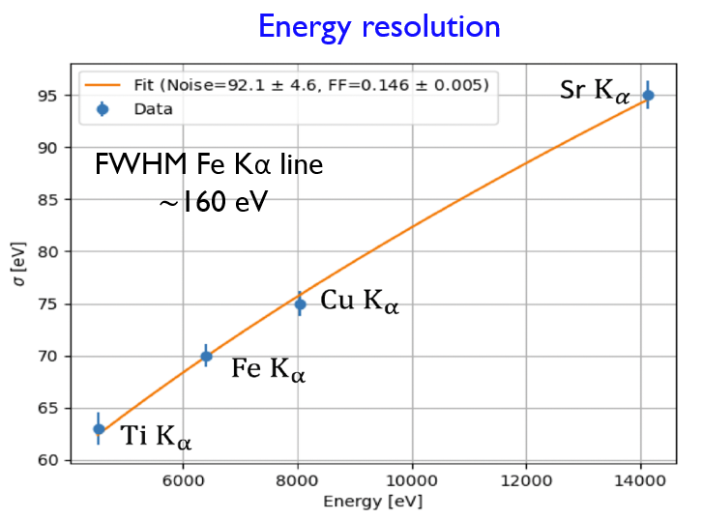
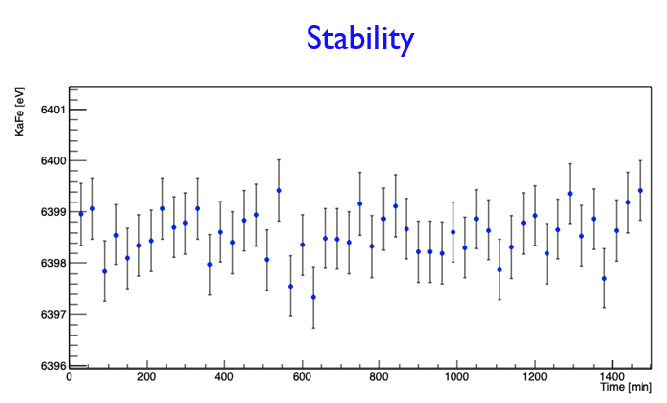
Radiation Detectors Labs
Energy Resolution
Typical characterization preformed in the SIDDHARTA Radiation Detectors’ Lab

Slide 11
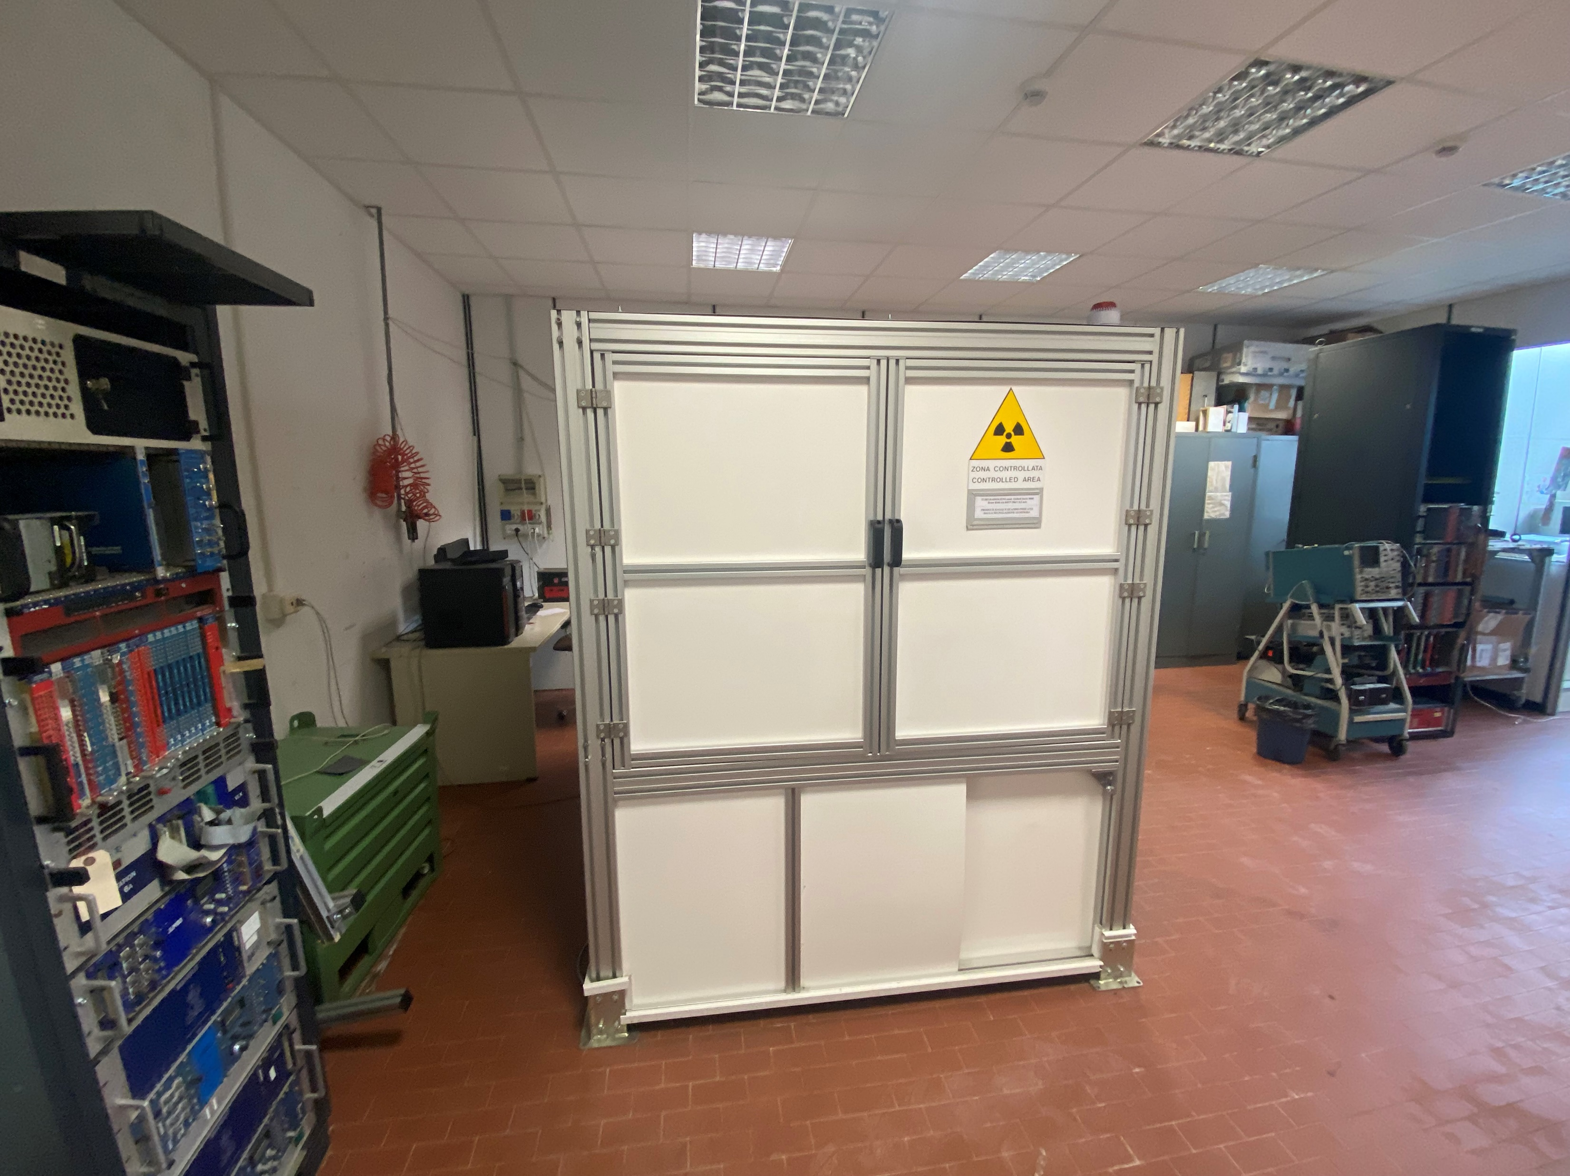
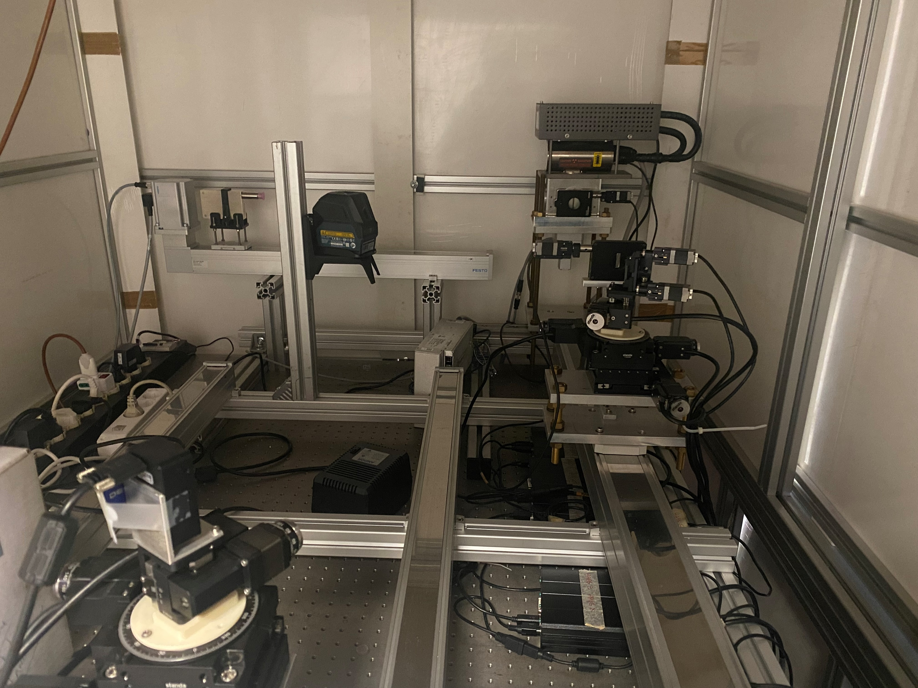
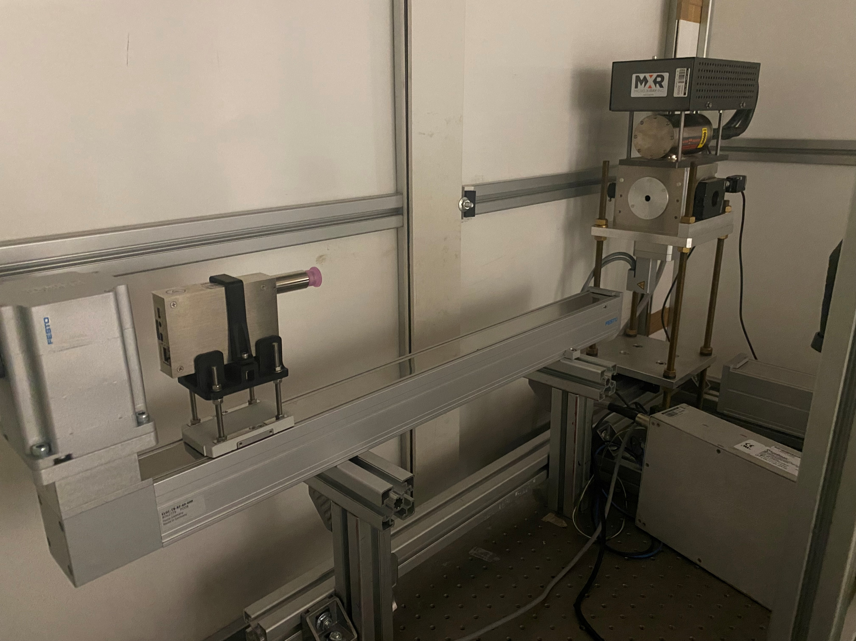
Radiation Detectors Labs
VIP/VOXES Laboratory is equipped with:
High resolution (FWHM ~ 0,1%) Bragg spectroscopy line (4-20 keV) with HAPG mosaic crystals
Large acceptance and efficiency line with a PinDiode detector (2-40 keV)

Slide 12
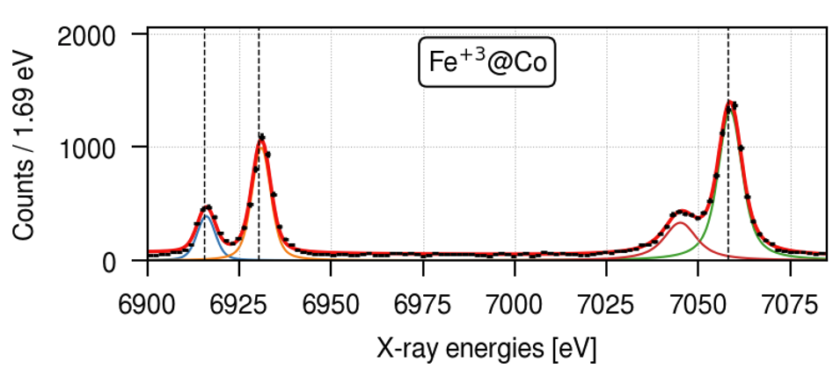
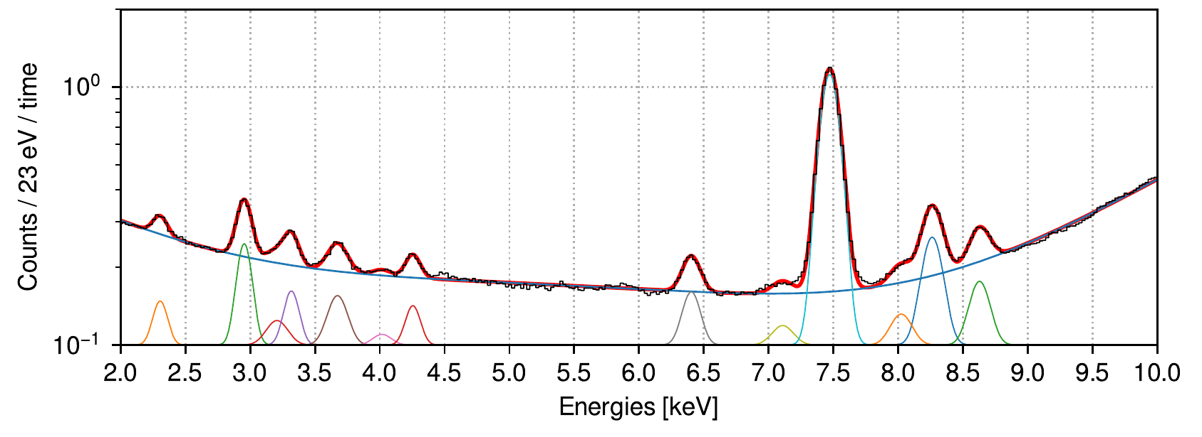
Radiation Detectors Labs
FeKβ_{1,3}
CoKα₁
Fe + Co spectrum obtained with the high resolution Bragg spectrometer line
CoKα₂
FeKβ’
Multi-target spectrum obtained with the high efficiency line

Slide 13
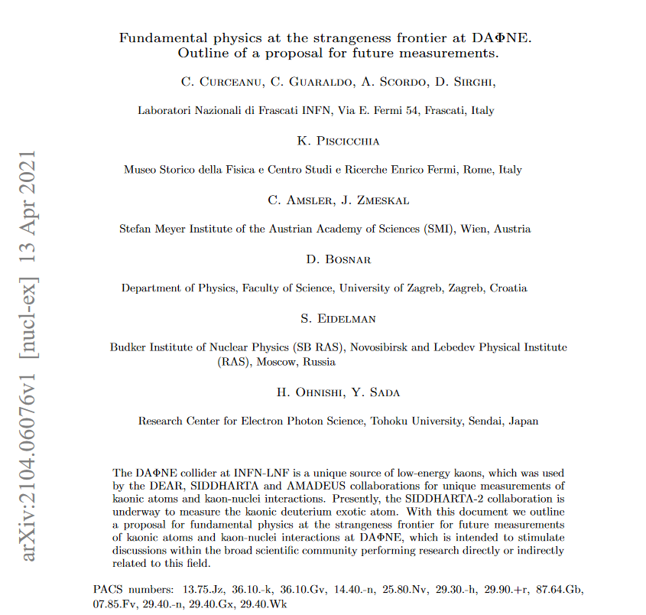
Kaonic atoms’ experiments with EXKALIBUR
Proposal for future extensive kaonic atoms measurements @ DAFNE to be performed exploiting:
450 mm SDD (light KA, up to 15 keV)
1-2 mm SDD (light KA, up to 40 keV)
CdZnTe detectors (Intermediate mass KA)
HPGe detectors (Heavy KA)
Crystal Spectrometer (High-Res light KA)

Slide 14
Kaonic atoms’ experiments with EXKALIBUR
Modular concept for 1-3 years program depending on the availability and conditions of DAΦNE
Strong impacts on several fields
Each module is individually under evaluation by LNF management

Slide 15
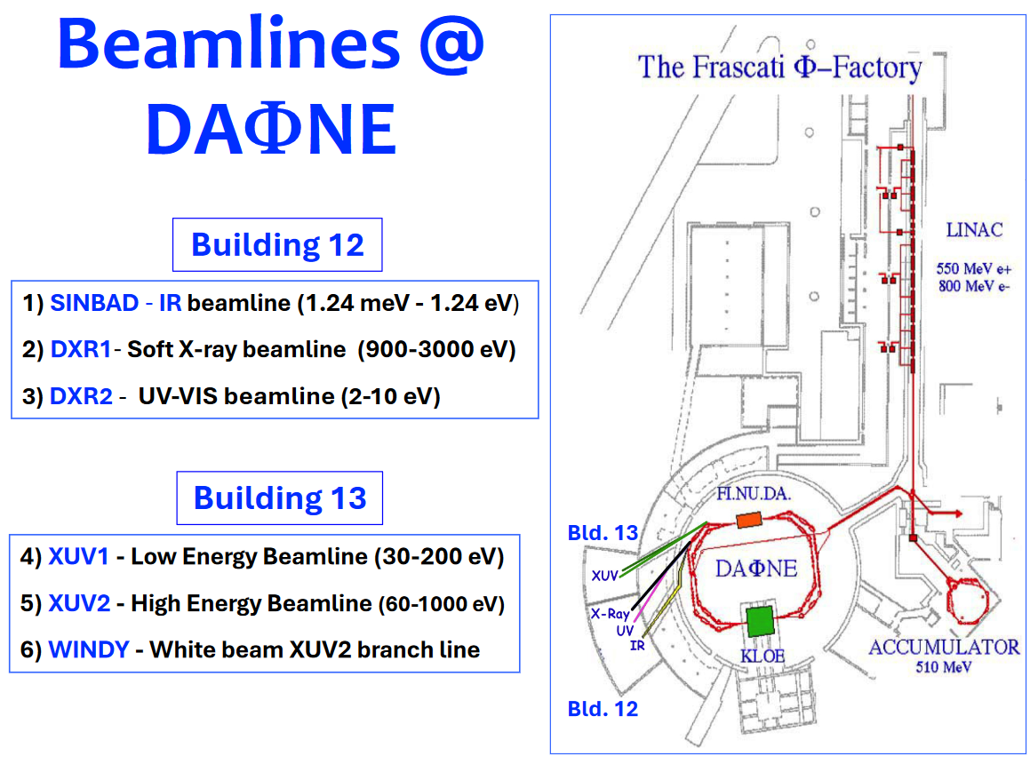
DAΦNE-Light

Slide 16
DAΦNE-Light

Slide 17
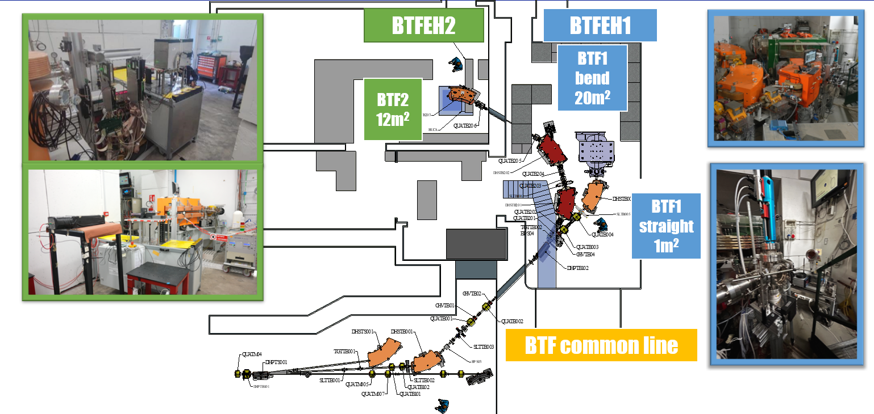
Beam Test Facility
Presently mostly devoted to PADME/X17 runs in 2025
Involved in internal/opportunistic INFN runs
Hall operative from 2022
Currently BTF2 line to external users
Intended for weekly based users
Only secondary beam

Slide 18
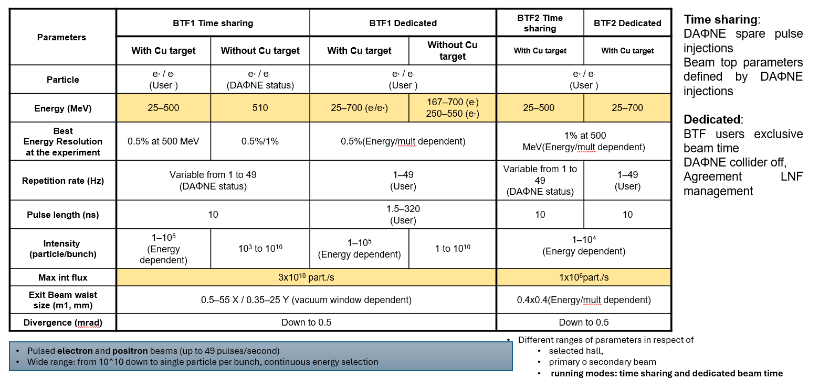
Beam Test Facility
https://btf.lnf.infn.it/schedule-beam-request/
Contact: btf@lists.lnf.infn.it

Slide 19
Beam Test Facility

Slide 20
The PADME experiment

Slide 21
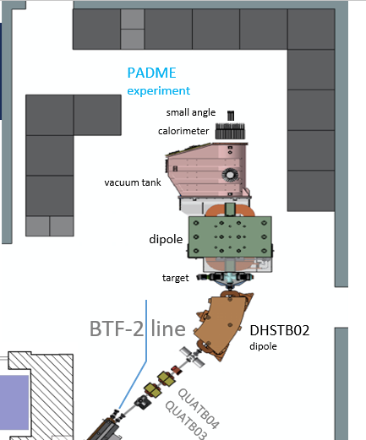
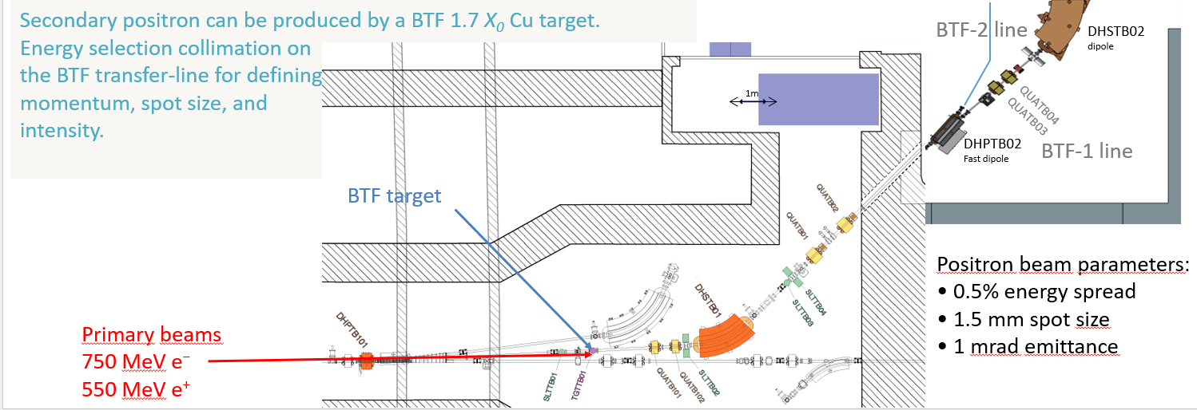
The PADME experiment
Primary electrons come from a gun and are accelerated up to 750 MeV
Primary positrons come from a converter
(2 X₀ W-Re target)
Primary
Installed at the BTFHE1
beam line

Slide 22
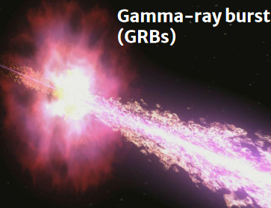
FIREBALL proposal
Recently proposed to the LNF Scientific Committee

Slide 23
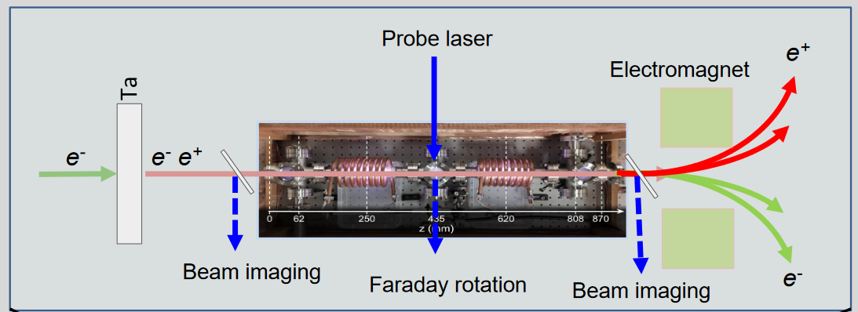
FIREBALL proposal
As the pair beams propagate through the ambient plasma, instabilities develop
High density plasma cell
(pulsed-5 kW RF power supply)
P > 10 mTorr) – n_{e} > 10¹⁴ cm⁻³

Slide 24
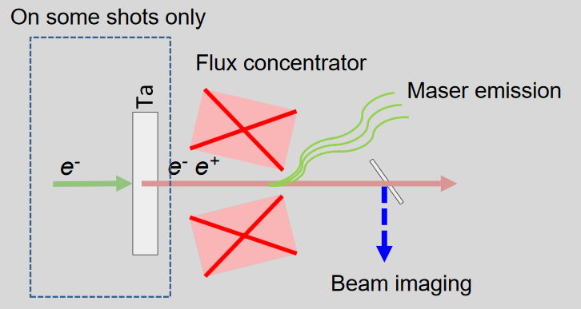
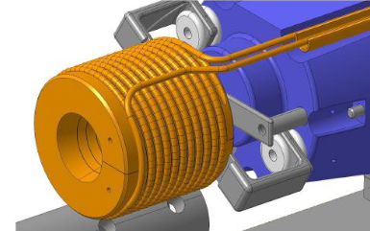
FIREBALL proposal
Expect maser emission concentrated at 0.8 THz (and harmonics), with polarization dependence

Slide 25
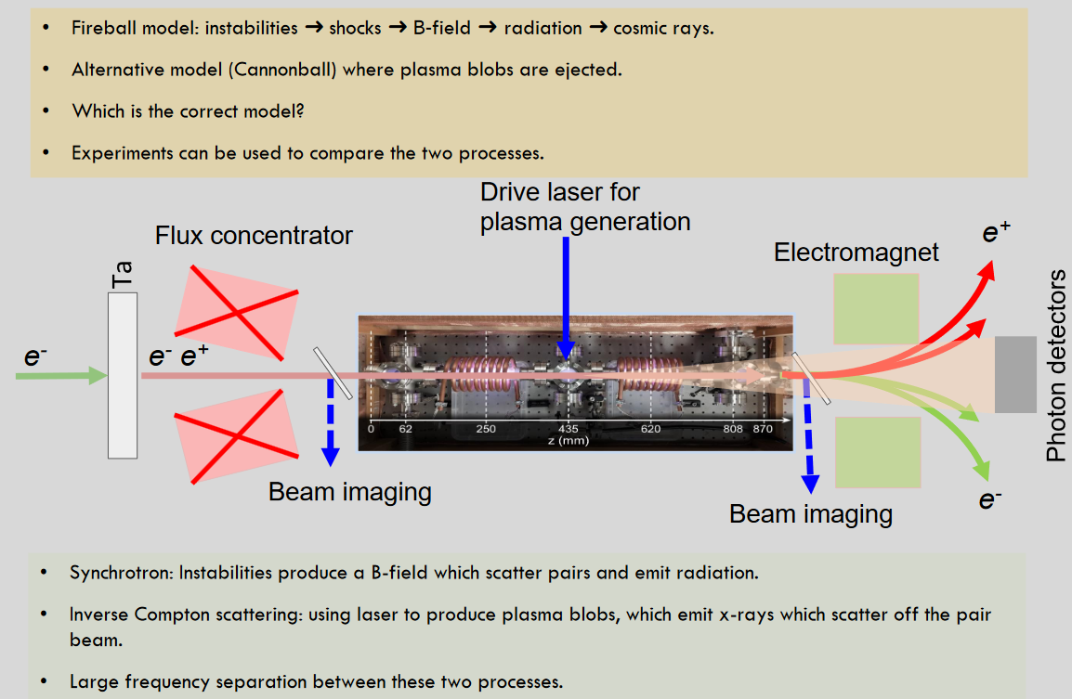
FIREBALL proposal

Slide 26
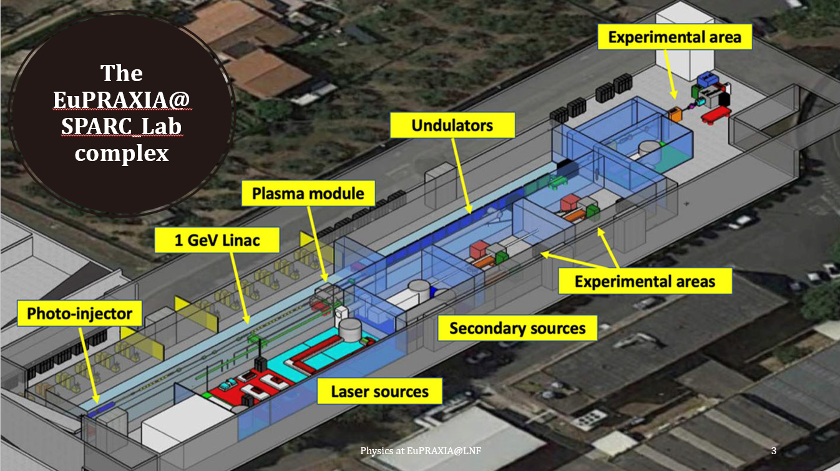
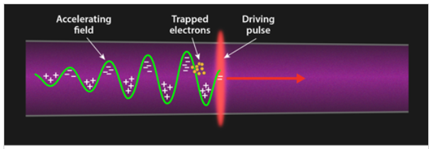
Nuclear Physics with EuPRAXIA
Laser driven WakeField Acceleration (LWFA)
Exploit the PW laser + plasma target to simulate astrophysical conditions for nuclear physics

Slide 27
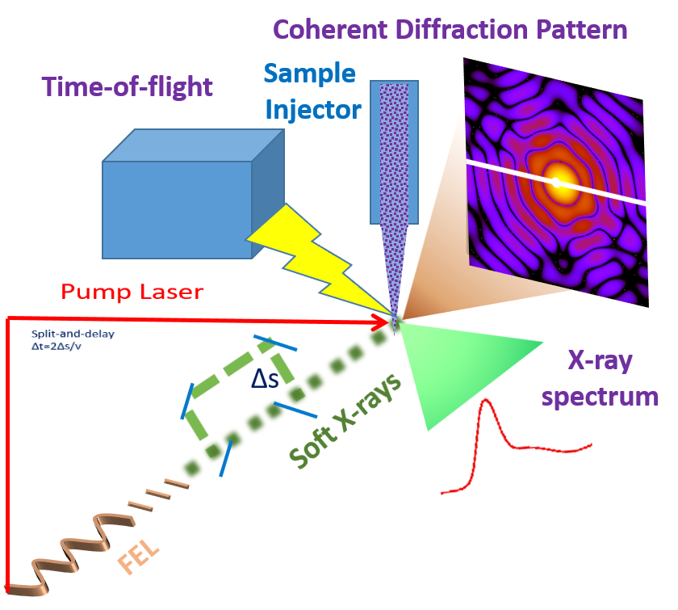
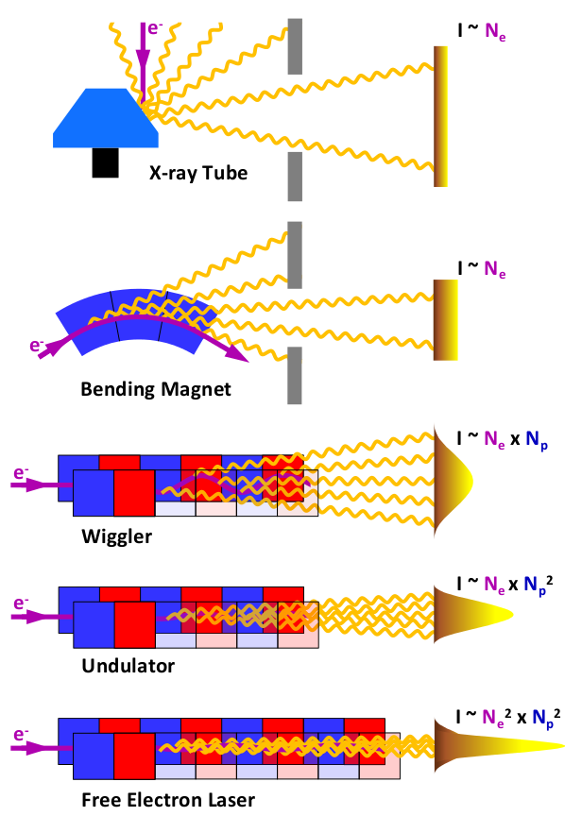
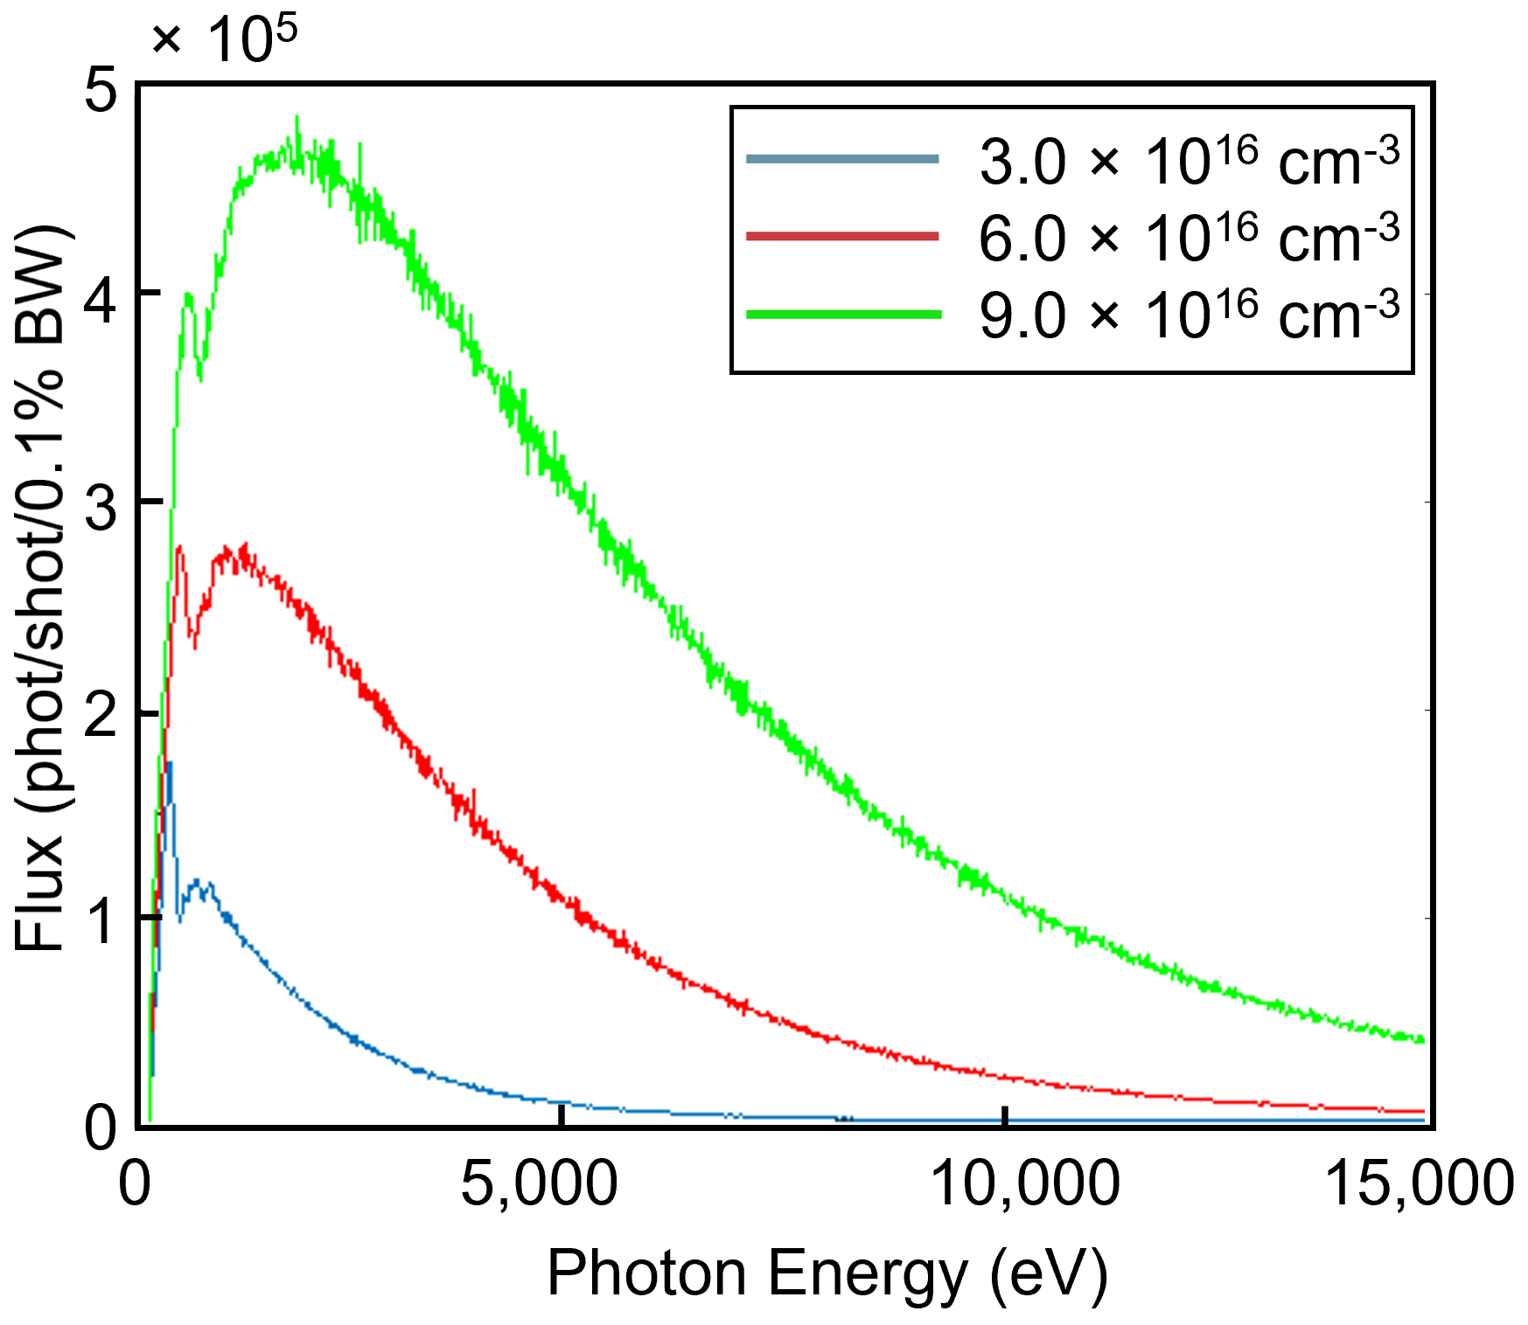
Nuclear Physics with EuPRAXIA
EuPRAXIA is a leading European project aimed at the development of a dedicated, groundbreaking, ultra-compact accelerator research infrastructure based on novel plasma acceleration concepts and laser technology.
LNF will be equipped with a unique combination of:
an X-band RF LINAC generating high-brightness GeV-range electron beams
a 0.5 PW class laser system
the first fifth-generation free electron laser (FEL) source driven by a plasma-based accelerator (EuPRAXIA)
Betatron radiation (EuAPS): Wiggler-like radiation emitted by electrons accelerated in plasma wakefields $→$ it will gives rise to brilliant, ultra-short X-ray pulses
The laser can be used to produce plasma and will allow to perform measurements as
Fusion processes of astrophysical interest in plasma
Nuclear decays in plasma
Coherent Imaging of Biological Samples
Time-Resolved X-ray Absorption Spectroscopy in the Water Window
Time-Resolved Coherent Raman Experiments with X-ray Pulses
Photo-Fragmentation of Molecules
Resonant Inelastic X-ray Scattering
THz/MIR Sources

Slide 28
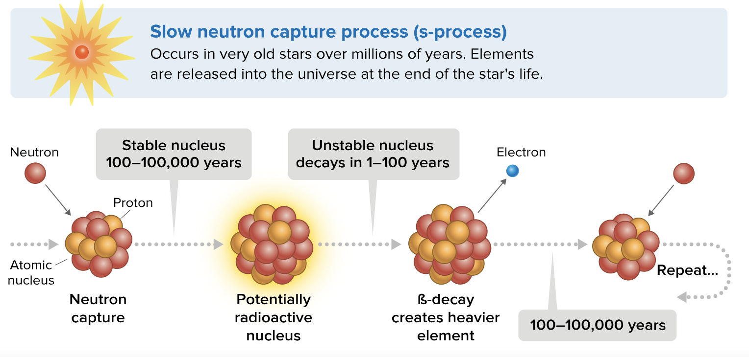
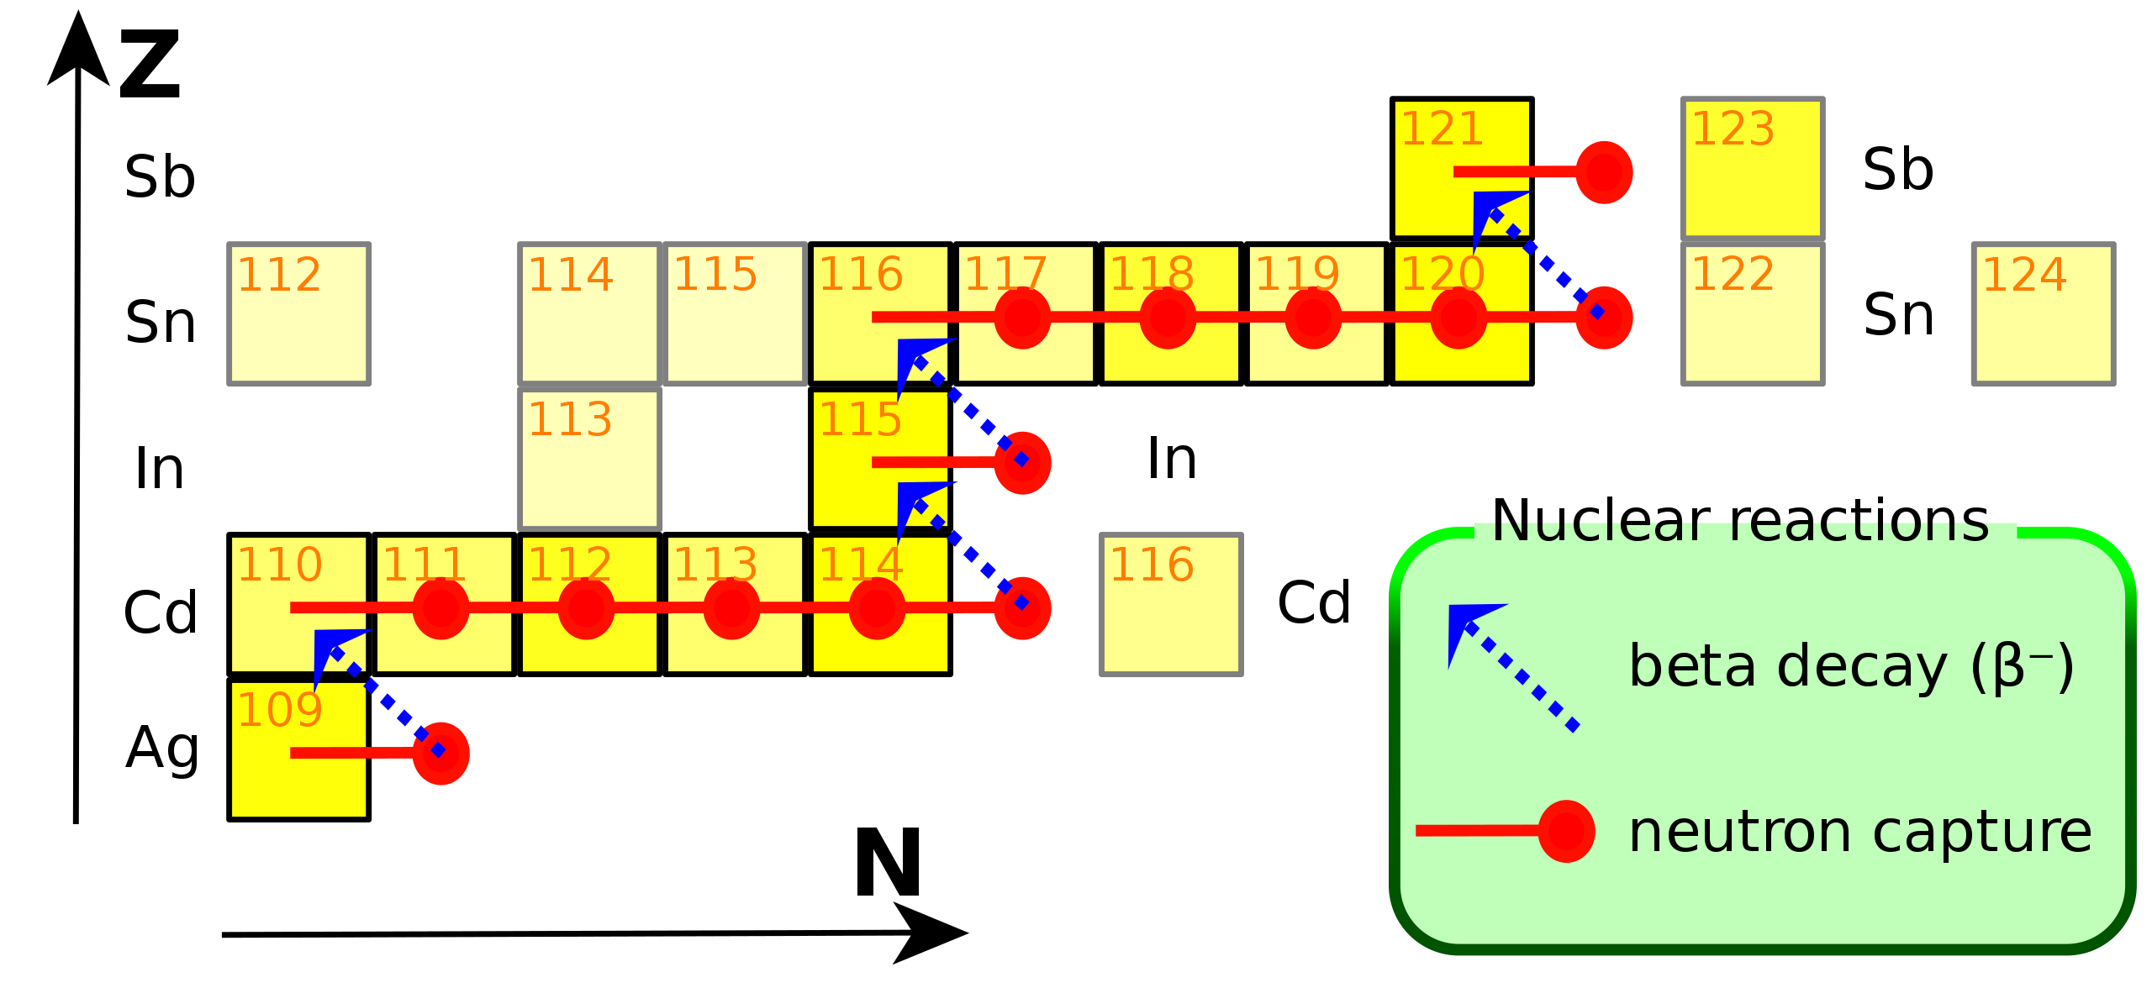
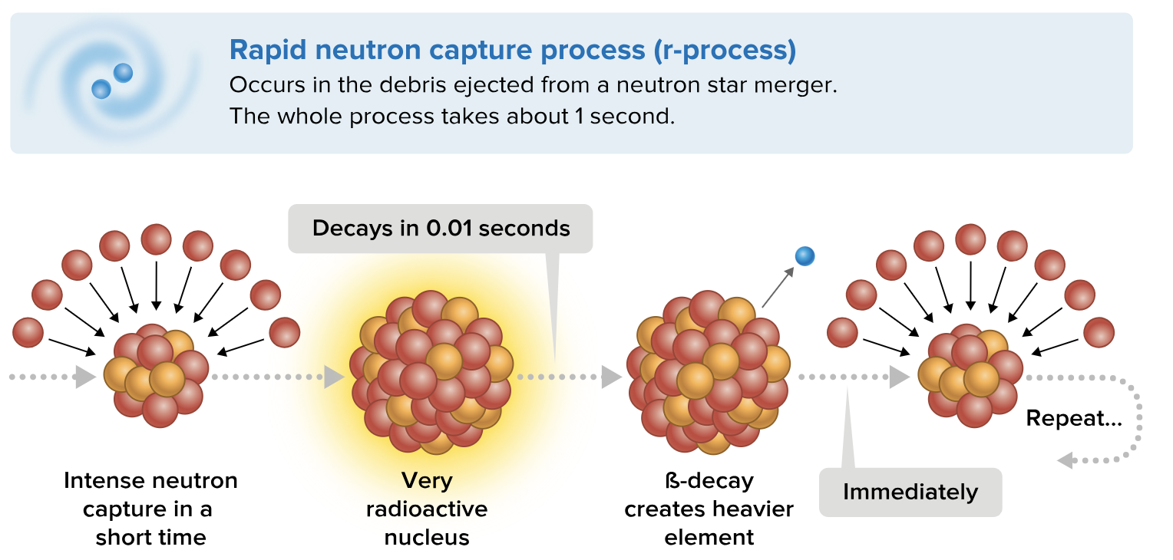
Nuclear Physics with EuPRAXIA
How does the nucleosynthesis chain proceed for elements heavier than Fe?
Crucial role played by the lifetime of
β-decaying elements
Absence of electron screening (full ionization) in stellar environments may change it by several order of magnitudes

Slide 29
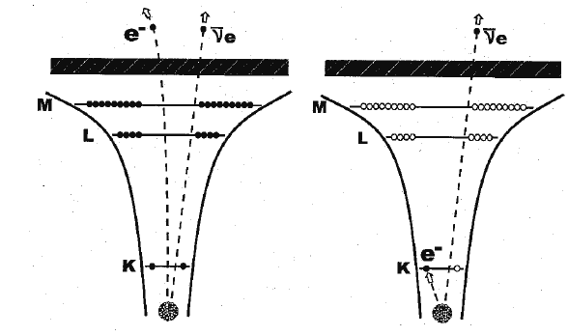
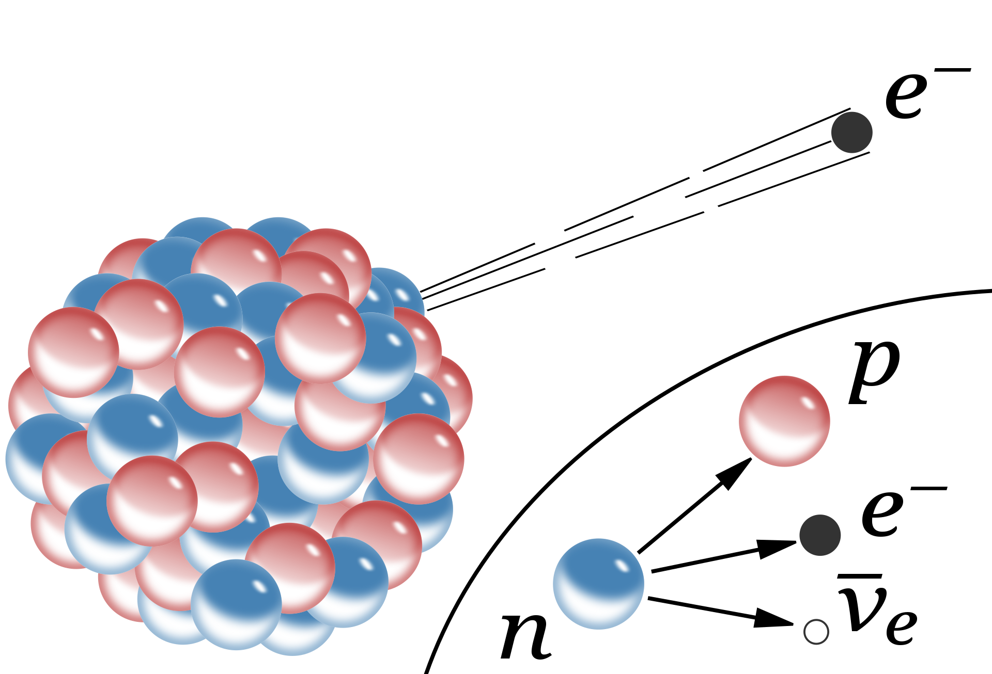
Nuclear Physics with EuPRAXIA
Bound β-decay in plasma
Stellar nucleosynthesis proceeds in a hot and dense environment which affects the degree of ionization of the atoms involved in the stellar nucleosynthesis.
What happens when atoms are highly ionized?
The beta decay in highly ionized atoms shows important variations compared to neutral species
Electron Capture becomes impossible in fully ionized atoms.
Bound state $β$-decay typically marginal can become important.
free β-decay
bound β-decay
Bound-state 𝛽-decay is a nuclear 𝛽- decay process in which an electron is created in a previously unoccupied atomic orbital rather than in the continuum.

Slide 30
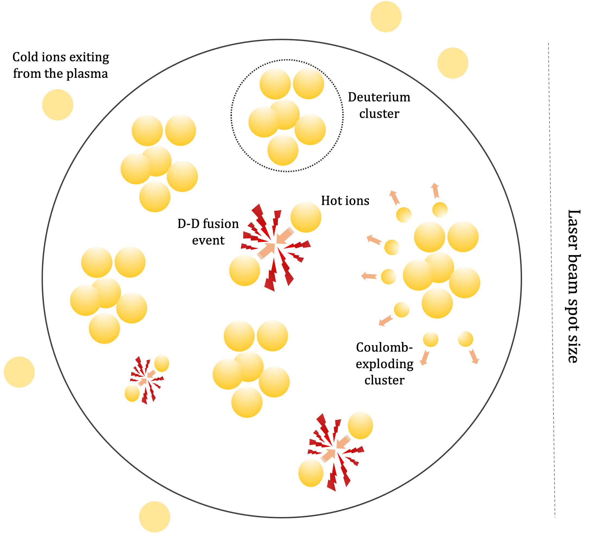
Nuclear Physics with EuPRAXIA
Deuterium fusion in plasma
Plasma conditions form Deuterium clusters
The full ionization condition removes electron screening
Deuterium fusion in plasma may be more energetically favoured than in standard conditions
$d+d →3He$+ n (2.45 MeV)

Slide 31
Conclusions
Top-level and Cutting-Edge technology beamlines
(DAΦNE, DAΦNE-Light, BTF, EuPRAXIA, and others)
Longstanding expertise on kaonic atoms measurements and KN interaction investigations
Fully equipped laboratories for detectors’R&D
Highly qualified services to support experiments with mechanical design and construction, electronics, cryogenic, computing, etc.
Many interesting and fascinating experiments already running and planned for near and far future
LNF has been one of the core laboratories for the Hadron Physics community and will continue to play a key role in its future activities

