Slide 1






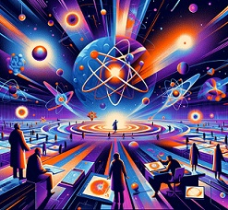
CdZnTe-based radiation detectors, a breakthrough for hadron physics experiments
M. Bettelli¹, D. Calestani¹, A. Scordo², C. Curceanu², A. Buttacavoli³, F. Principato³, L. Abbene³, J. Zmeskal⁴ and A. Zappettini¹
IMEM/CNR, Parma, Italy
Laboratori Nazionali di Frascati, INFN, Frascati, Italy
Department of Physics and Chemistry-E. Segrè, University of Palermo, Italy
Stefan-Meyer-Institut for Subatomic Physik, Wien, Austria

Slide 2
Outline
Motivation
Ongoing activities at DAΦNE Collider
Detection system
The CZT Detectors
Readout electronics
Spectroscopic performances
Measurements at DAΦNE Collider
Potentialities of CZT detectors
Summary

Slide 3
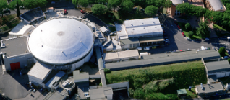
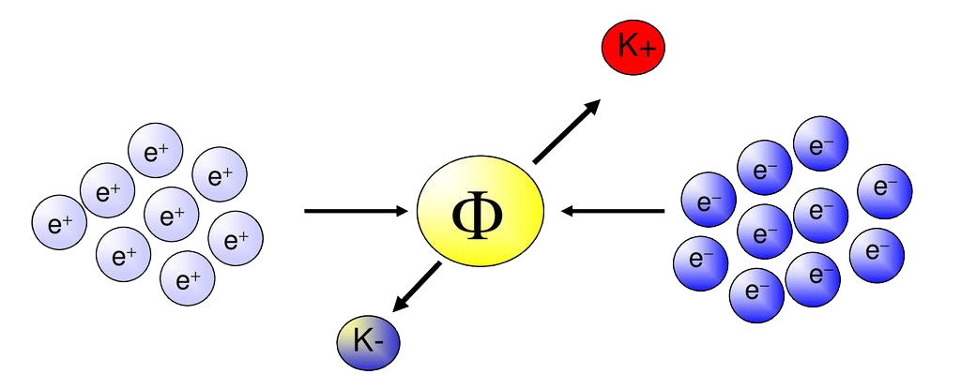
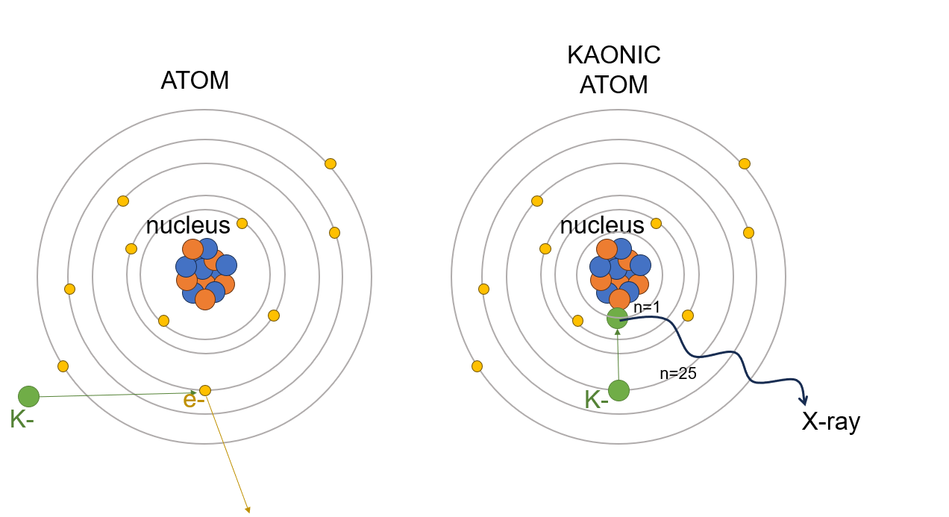
Motivation
AIM: study intermediate kaonic atoms (C, Al and S) through measurements of their hard X-ray emission at DAΦNE collider (Frascati, Italy).
Kaonic atoms are formed when a K−, produced in a back-to-back configuration with a K+ from the Φ decays, is stopped in a selected target through its electromagnetic interaction with the nucleus
Subsequently, the X-rays emitted during the atomic cascade process can be measured by the radiation detector
Measurement of X-rays allow to investigate the strong kaon-nuclei interaction at the low-energy frontier
Presented by
F. Sgaramella
this morning

Slide 4
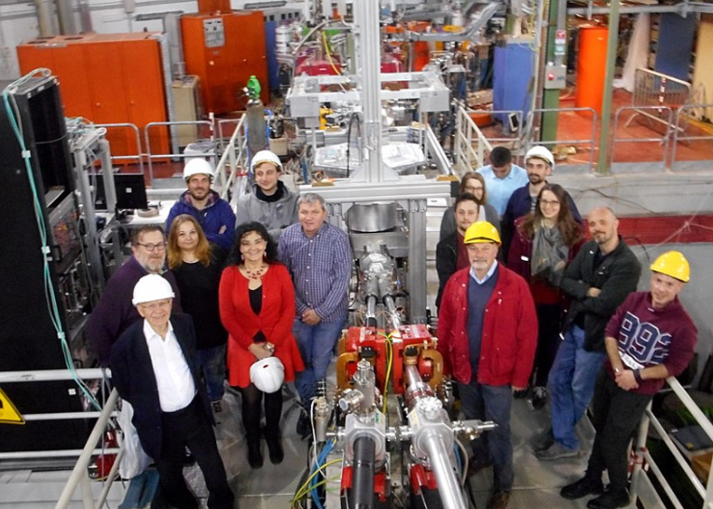
Motivation
Goal:
Development of room temperature spectrometers for hard X-ray spectroscopy (up to 300 keV)
Collaboration between:
LNF, INFN, Frascati, Italy (Italy) (C. Curceanu, A. Scordo)
IMEM-CNR, Parma (Italy) (A. Zappettini, M. Bettelli)
DiFC, University of Palermo (Italy) (L. Abbene, A. Buttacavoli, F. Principato)
SMI, Stefan-Meyer-Institut for Subatomic Physik, Wien, Austria (J. Zmeskal)
Requirements:
Room temperature operation
Energy resolution (FWHM < 3 keV at 120 keV)
Fast time response (< 500 ns )

Slide 5
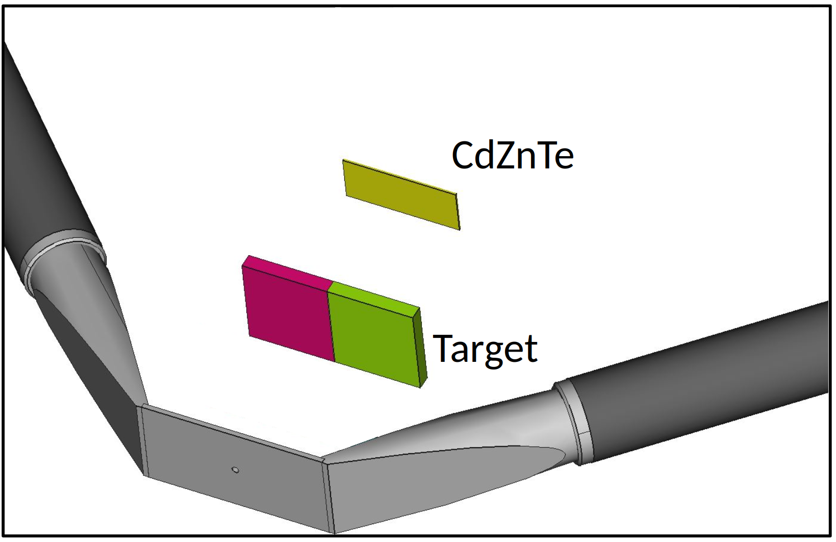
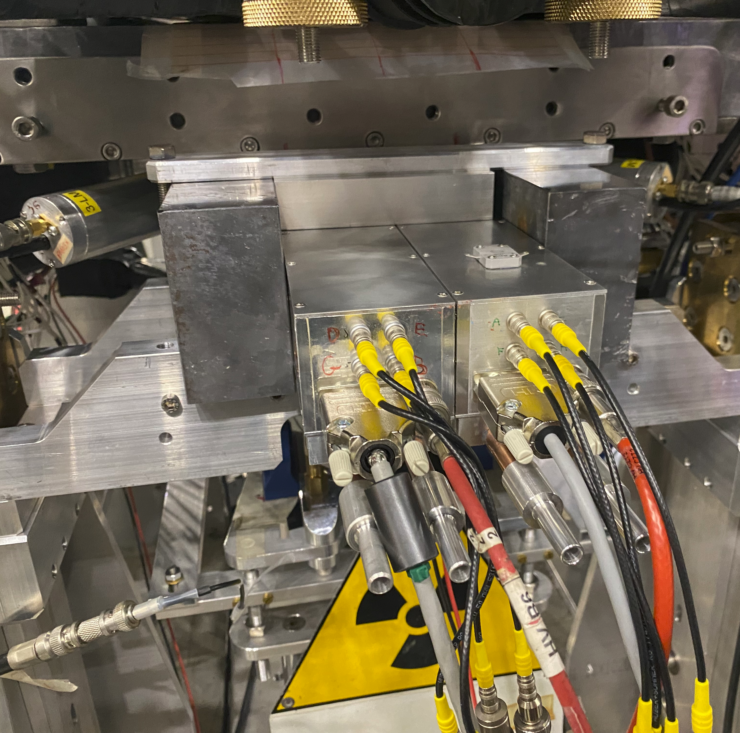
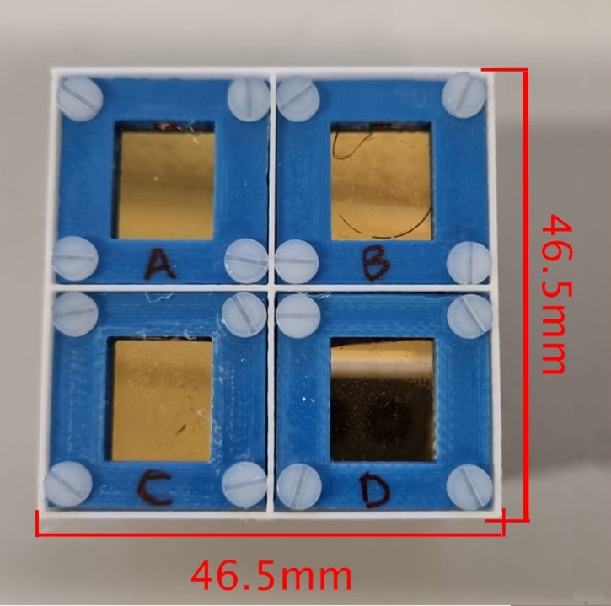
Ongoing activities at DAΦNE Collider
CZT quasi-hemispherical detector array was realized to increase the collecting area (12 cm²)
Al and Cu were placed in front of
the detector as target
Measurements at DAΦNE
from December 2023
Luminometer
Developed
Detection System

Slide 6
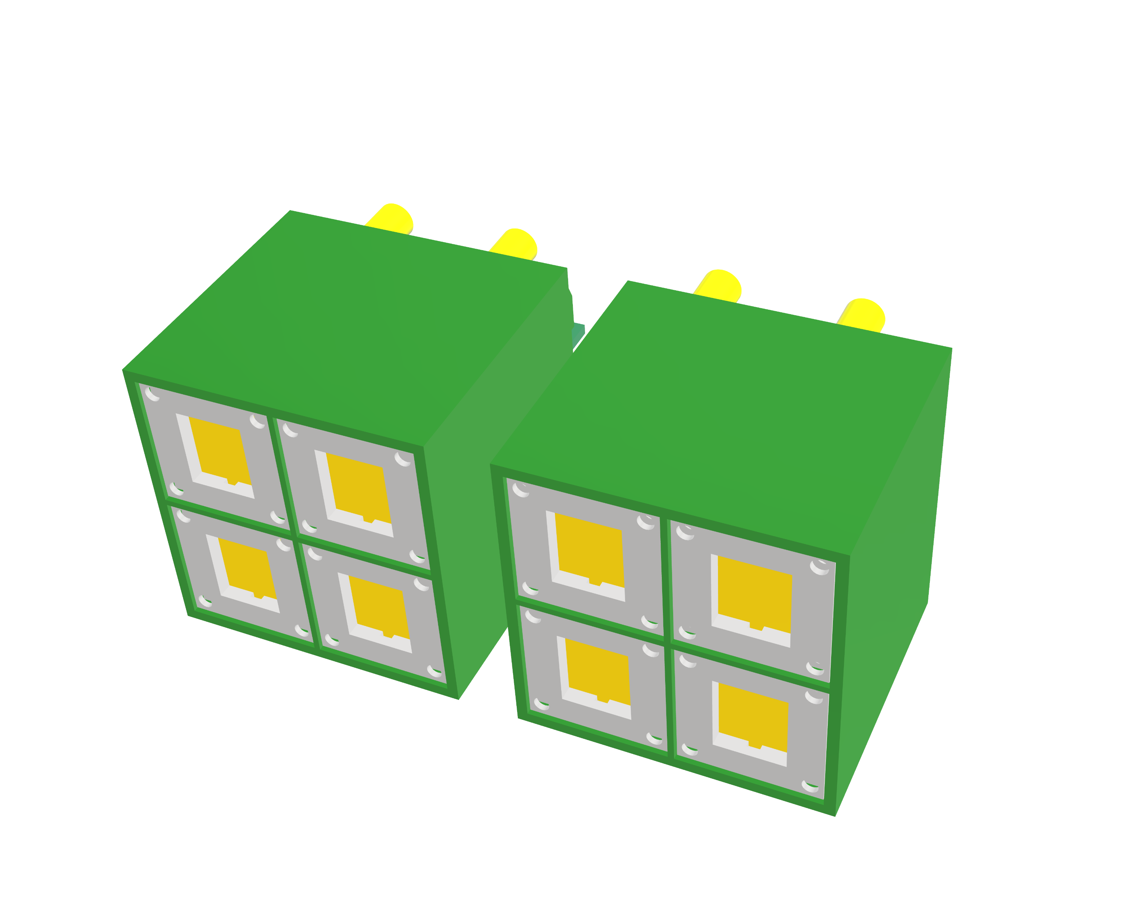
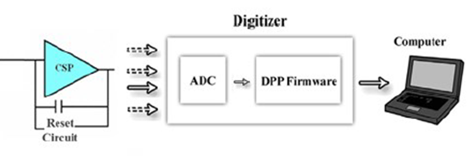
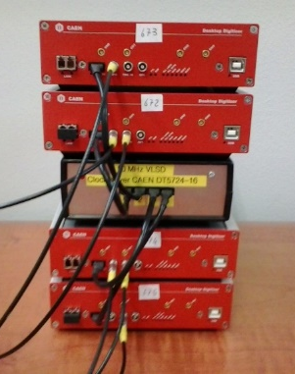
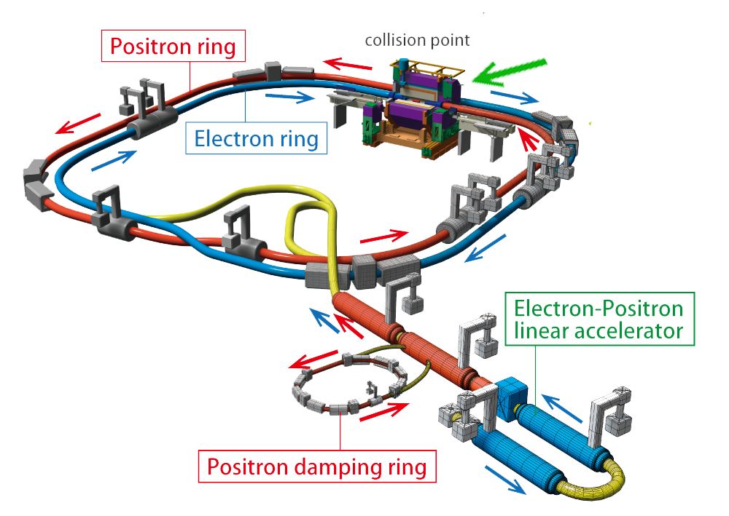
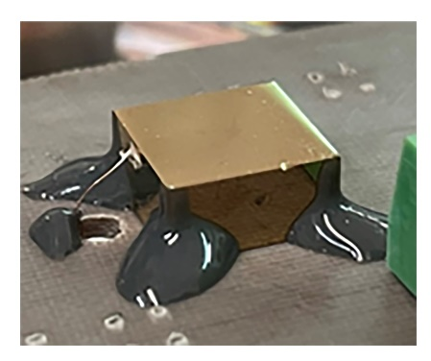
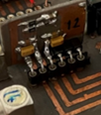
Detection system
8 modules
Φ
Digital Readout Electronics for Pulse Shape and
Height Analysis
(PSHA)
Quasi-Hemispherical CZT Detector
Front-end electronics with
the preamplifier (CSP) stage
Curceanu, C. O., et al. "Kaonic atoms at the DAΦNE collider: A strangeness adventure." Frontiers in Physics 11 (2023)

Slide 7

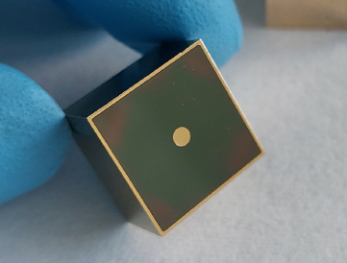
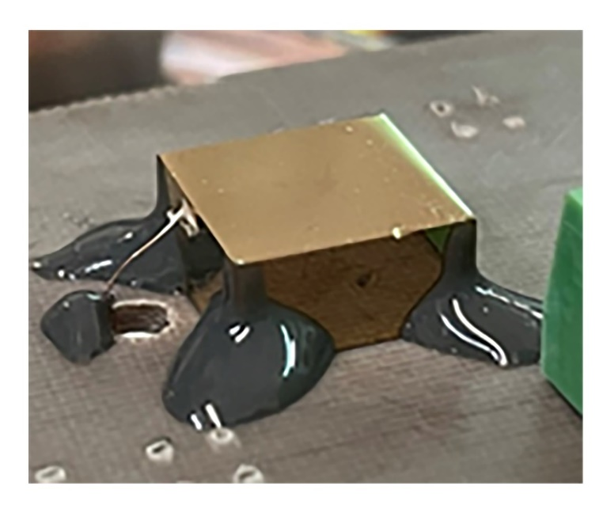
The CZT Detectors
Quasi-Hemispherical Detector (QHD) geometry was chosen
→ Key layout: large area with low number of channels
Two type of detectors:
4x Commercial CZT QHD (15 x 13 x 5 mm³)
4x Customized CZT QHD (10 x 10 x 5 mm³)
Customized CZT QHDs:
Optimized geometry (energy resolution optimized)
Fabricated at IMEM-CNR with the collaboration of due2lab s.r.l.

Slide 8
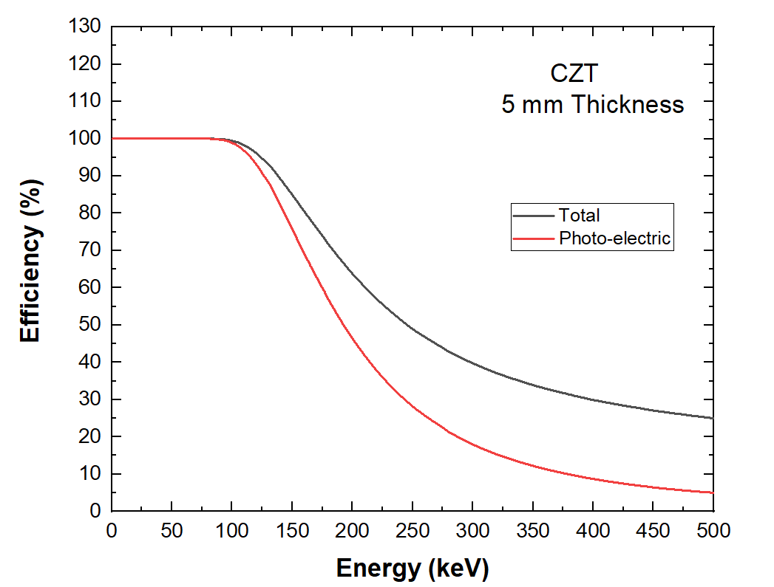
Quasi-Hemispherical CZT Detector
Detector characteristics:
High atomic number of CZT -> Good efficiency 64% at 200 keV

Slide 9
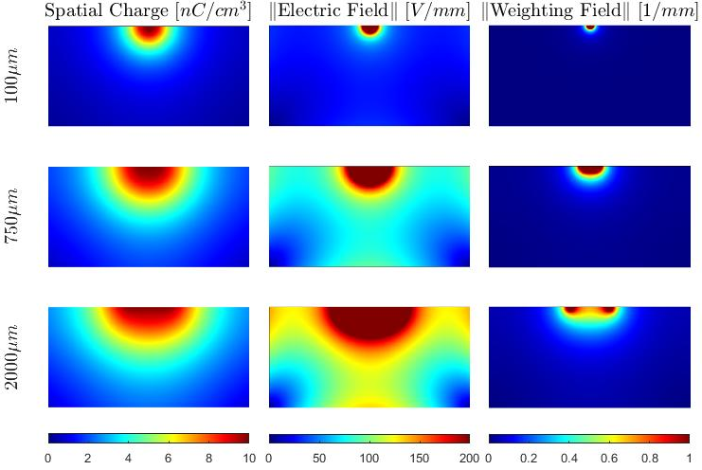
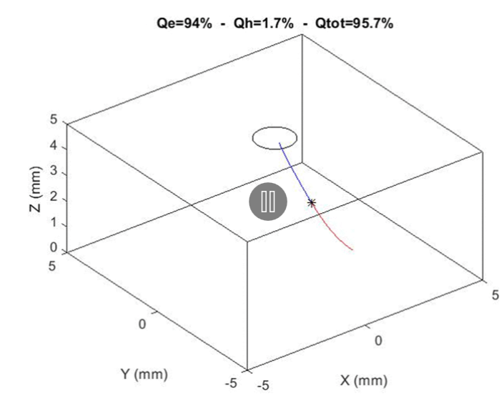
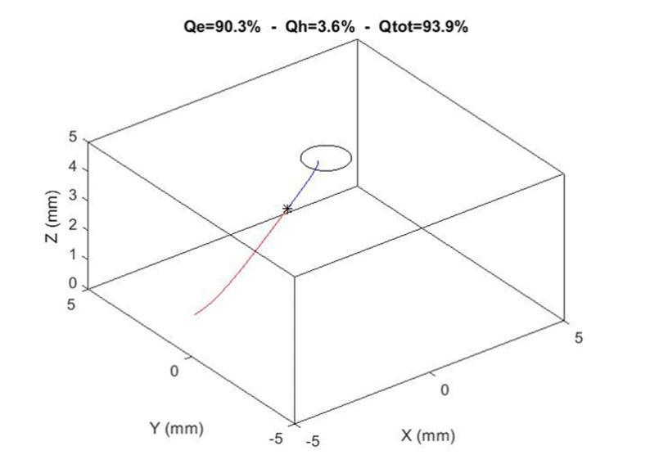
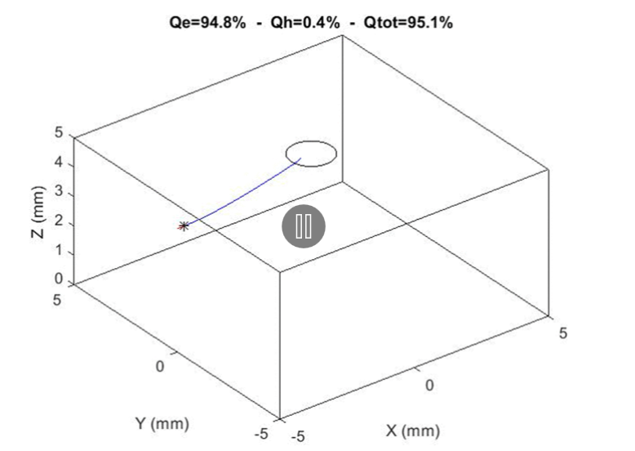
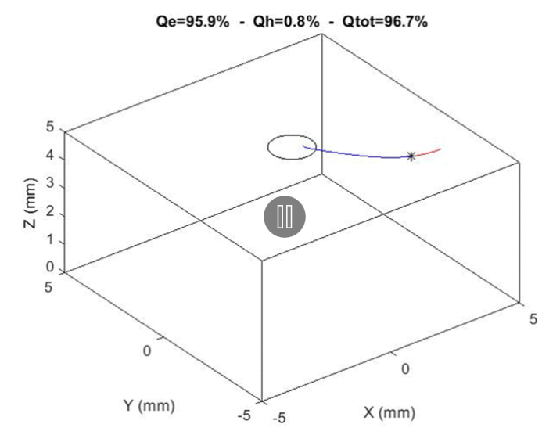
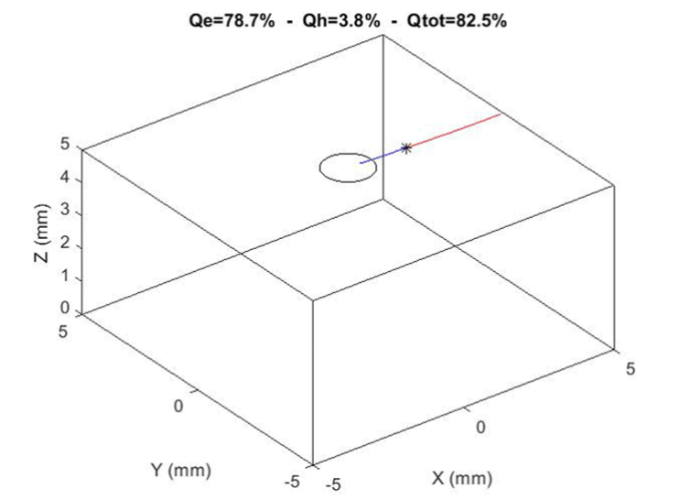
Quasi-Hemispherical CZT Detector
Detector characteristics:
High atomic number of CZT -> Good efficiency 64% at 200 keV
Optimization of pixel dimension with simulations
(only customized QHD)
Vicini, V., et al. "Optimization of quasi-hemispherical CdZnTe detectors by means of first principles simulation." Scientific Reports 13.1 (2023)

Slide 10
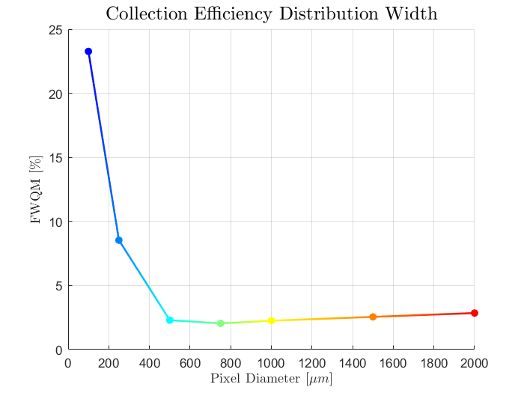
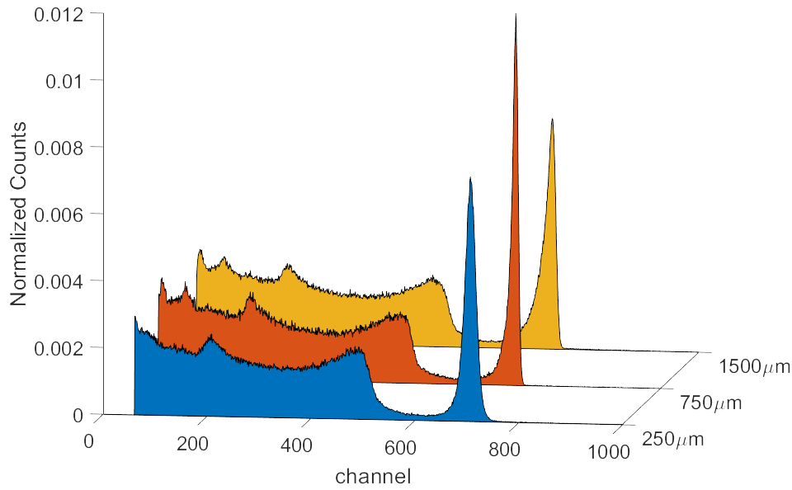
Quasi-Hemispherical CZT Detector
Detector characteristics:
High atomic number of CZT -> Good efficiency 64% at 200 keV
Optimization of pixel dimension with simulations
(only customized QHD)
  Simulations were confirmed by experimental results
  Optimal pixel dimension is 750 µm
Experimental
spectra
Best achieved
energy resolution
Best achieved
energy resolution
Simulation results
Vicini, V., et al. "Optimization of quasi-hemispherical CdZnTe detectors by means of first principles simulation." Scientific Reports 13.1 (2023)

Slide 11
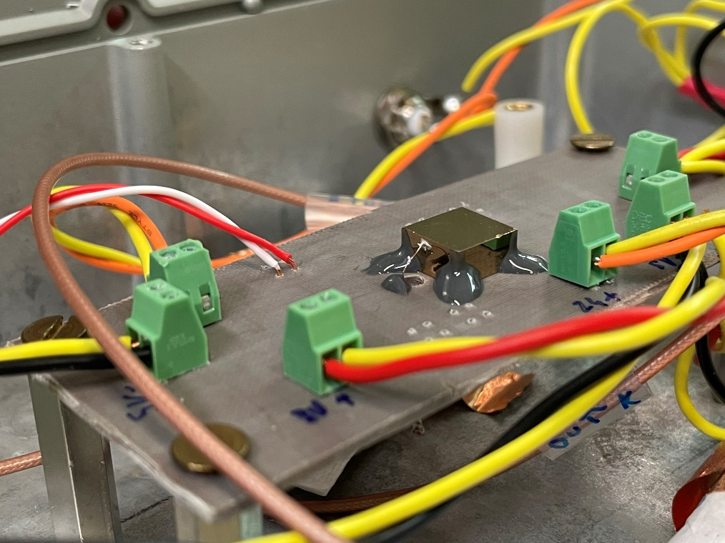
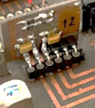

Readout electronics
Front-end:
Charge sensitive preamplifiers (CSP) developed at DiFC (University of Palermo)
Front-end electronics with preamplifier stage
Back-end:
Digital Pulse Processing (DPP) electronics
Custom Firmware based on a DPP strategy developed at DiFC (University of Palermo)
Abbene, L., et al. "Digital fast pulse shape and height analysis on cadmium–zinc–telluride arrays for high-flux energy-resolved X-ray imaging." Journal of Synchrotron Radiation 25.1 (2018)

Slide 12
Spectroscopic Performances
The bias voltage was fine-tuned for the used electronics
High energy resolution and low energy-cut were achieved
PSA of signals allows to further improve the energetic resolution

Slide 13
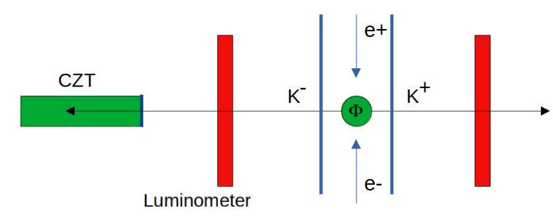

Measurements at DAΦNE Collider
CZT detectors were placed behind one of plastic scintillator (SIDDHARTA-2 luminometer) that are used as trigger
Collision-rate between e- e+ is 340MHz (2.7ns)
Magnets close to the collision region cause a cascade process that generates a particle shower that hits also the detectors -> high background noise
Luminometers are placed back-to-back with respect to the Φ and are used both for:
  Reduce the asynchronous background -> signals that are not synchronous with the collision clock
  Distinguish MIPs (Minimum Ionizing Particles) from Kaons -> Kaons are slow due to their mass, this means that they can be distinguished by analyzing the time-of-flight (between Φ decay and luminometers trigger)
Background
not synchronous
MIPs
synchronous but fast
Kaons
synchronous and slow

Slide 14
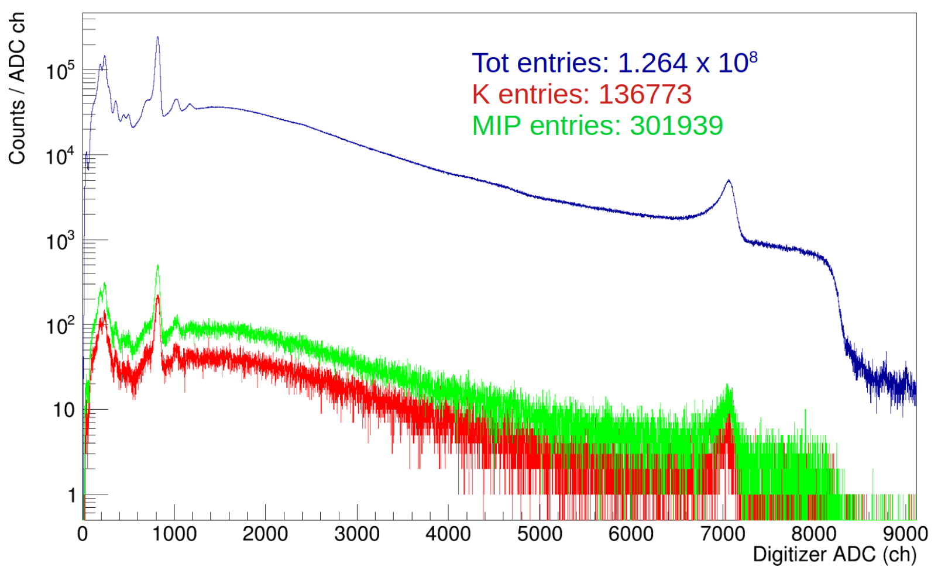
Measurements at DAΦNE Collider
Luminometer and detector signals were analyzed in order to reduce background

Slide 15
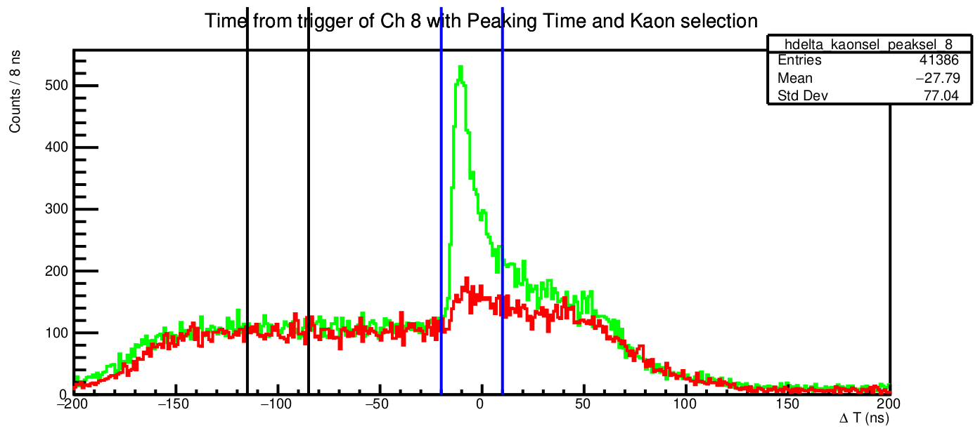
Measurements at DAΦNE Collider
Luminometer and detector signals were analyzed in order to reduce background
Fast time-response of CZT detectors is needed to
minimize the background noise
→ background rejection factor: >2·10⁵

Slide 16
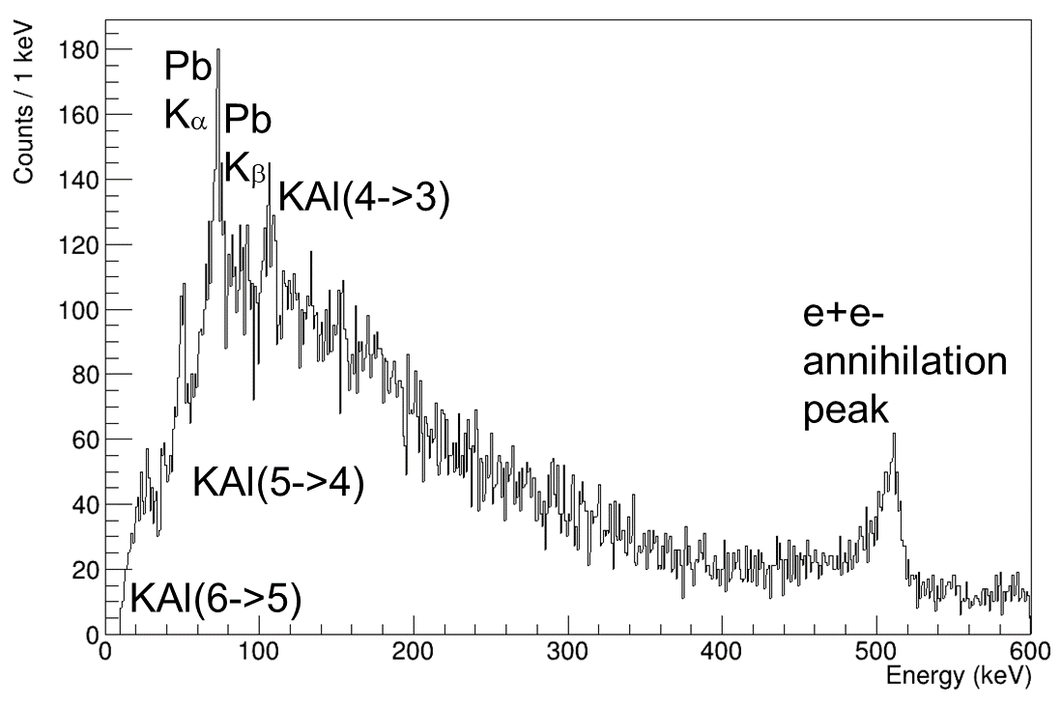
Measurements at DAΦNE Collider
Luminometer and detector signals were analyzed in order to reduce background
Fast time-response of CZT detectors is needed to
minimize the background noise
→ background rejection factor: >2·10⁵
Lines of kaonic Aluminum and Copper are visible
in the respective measured spectra
Aluminum

Slide 17
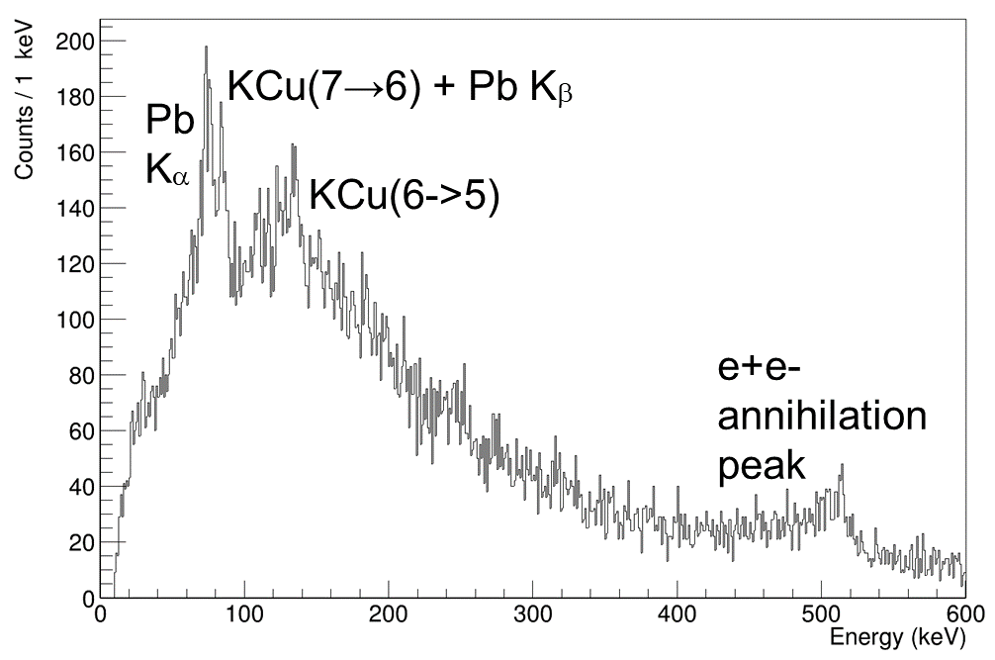
Measurements at DAΦNE Collider
Luminometer and detector signals were analyzed in order to reduce background
Fast time-response of CZT detectors is needed to
minimize the background noise
→ background rejection factor: >2·10⁵
Lines of kaonic Aluminum and Copper are visible
in the respective measured spectra
Copper

Slide 18
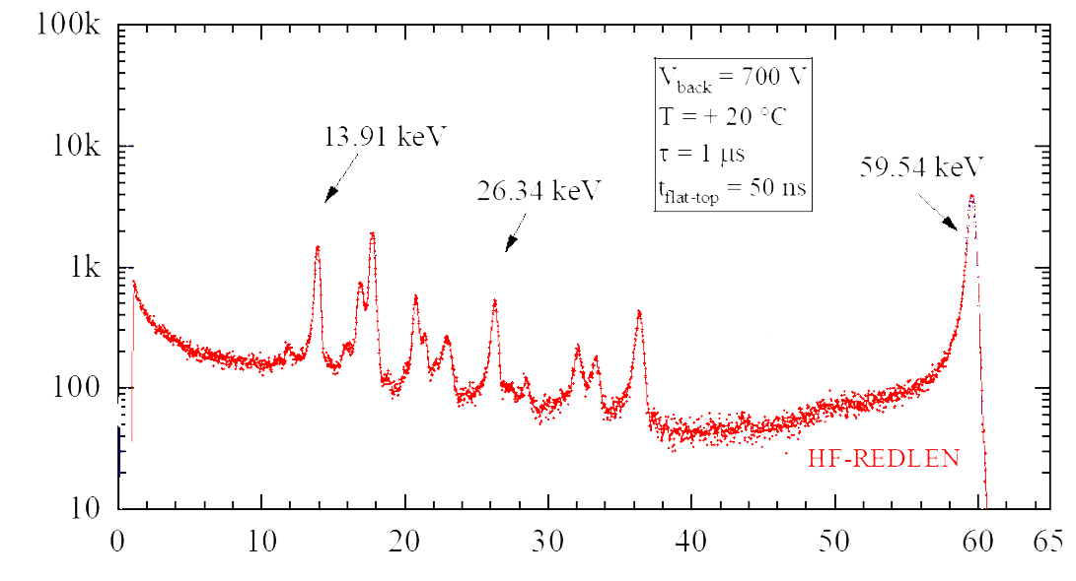
Potentialities of CZT detectors
IMEM CZT detectors were tested with state-of-art front-end electronics (SIRIO ASIC) with following characteristics:
Low ENC (without detector) 3.2 el. r.m.s.
Fast rise-time (without detector): <10 ns
Ultra-high resolution at room temperature (0.6 keV FWHM at 60 keV)
very close to the limit of Fano Noise (0.4 keV at 60 keV)
Mele, F., et al. "SIRIO: A high-speed CMOS charge-sensitive amplifier for high-energy-resolution X-γ ray spectroscopy with semiconductor detectors." IEEE Transactions on Nuclear Science 68.3 (2021)

Slide 19
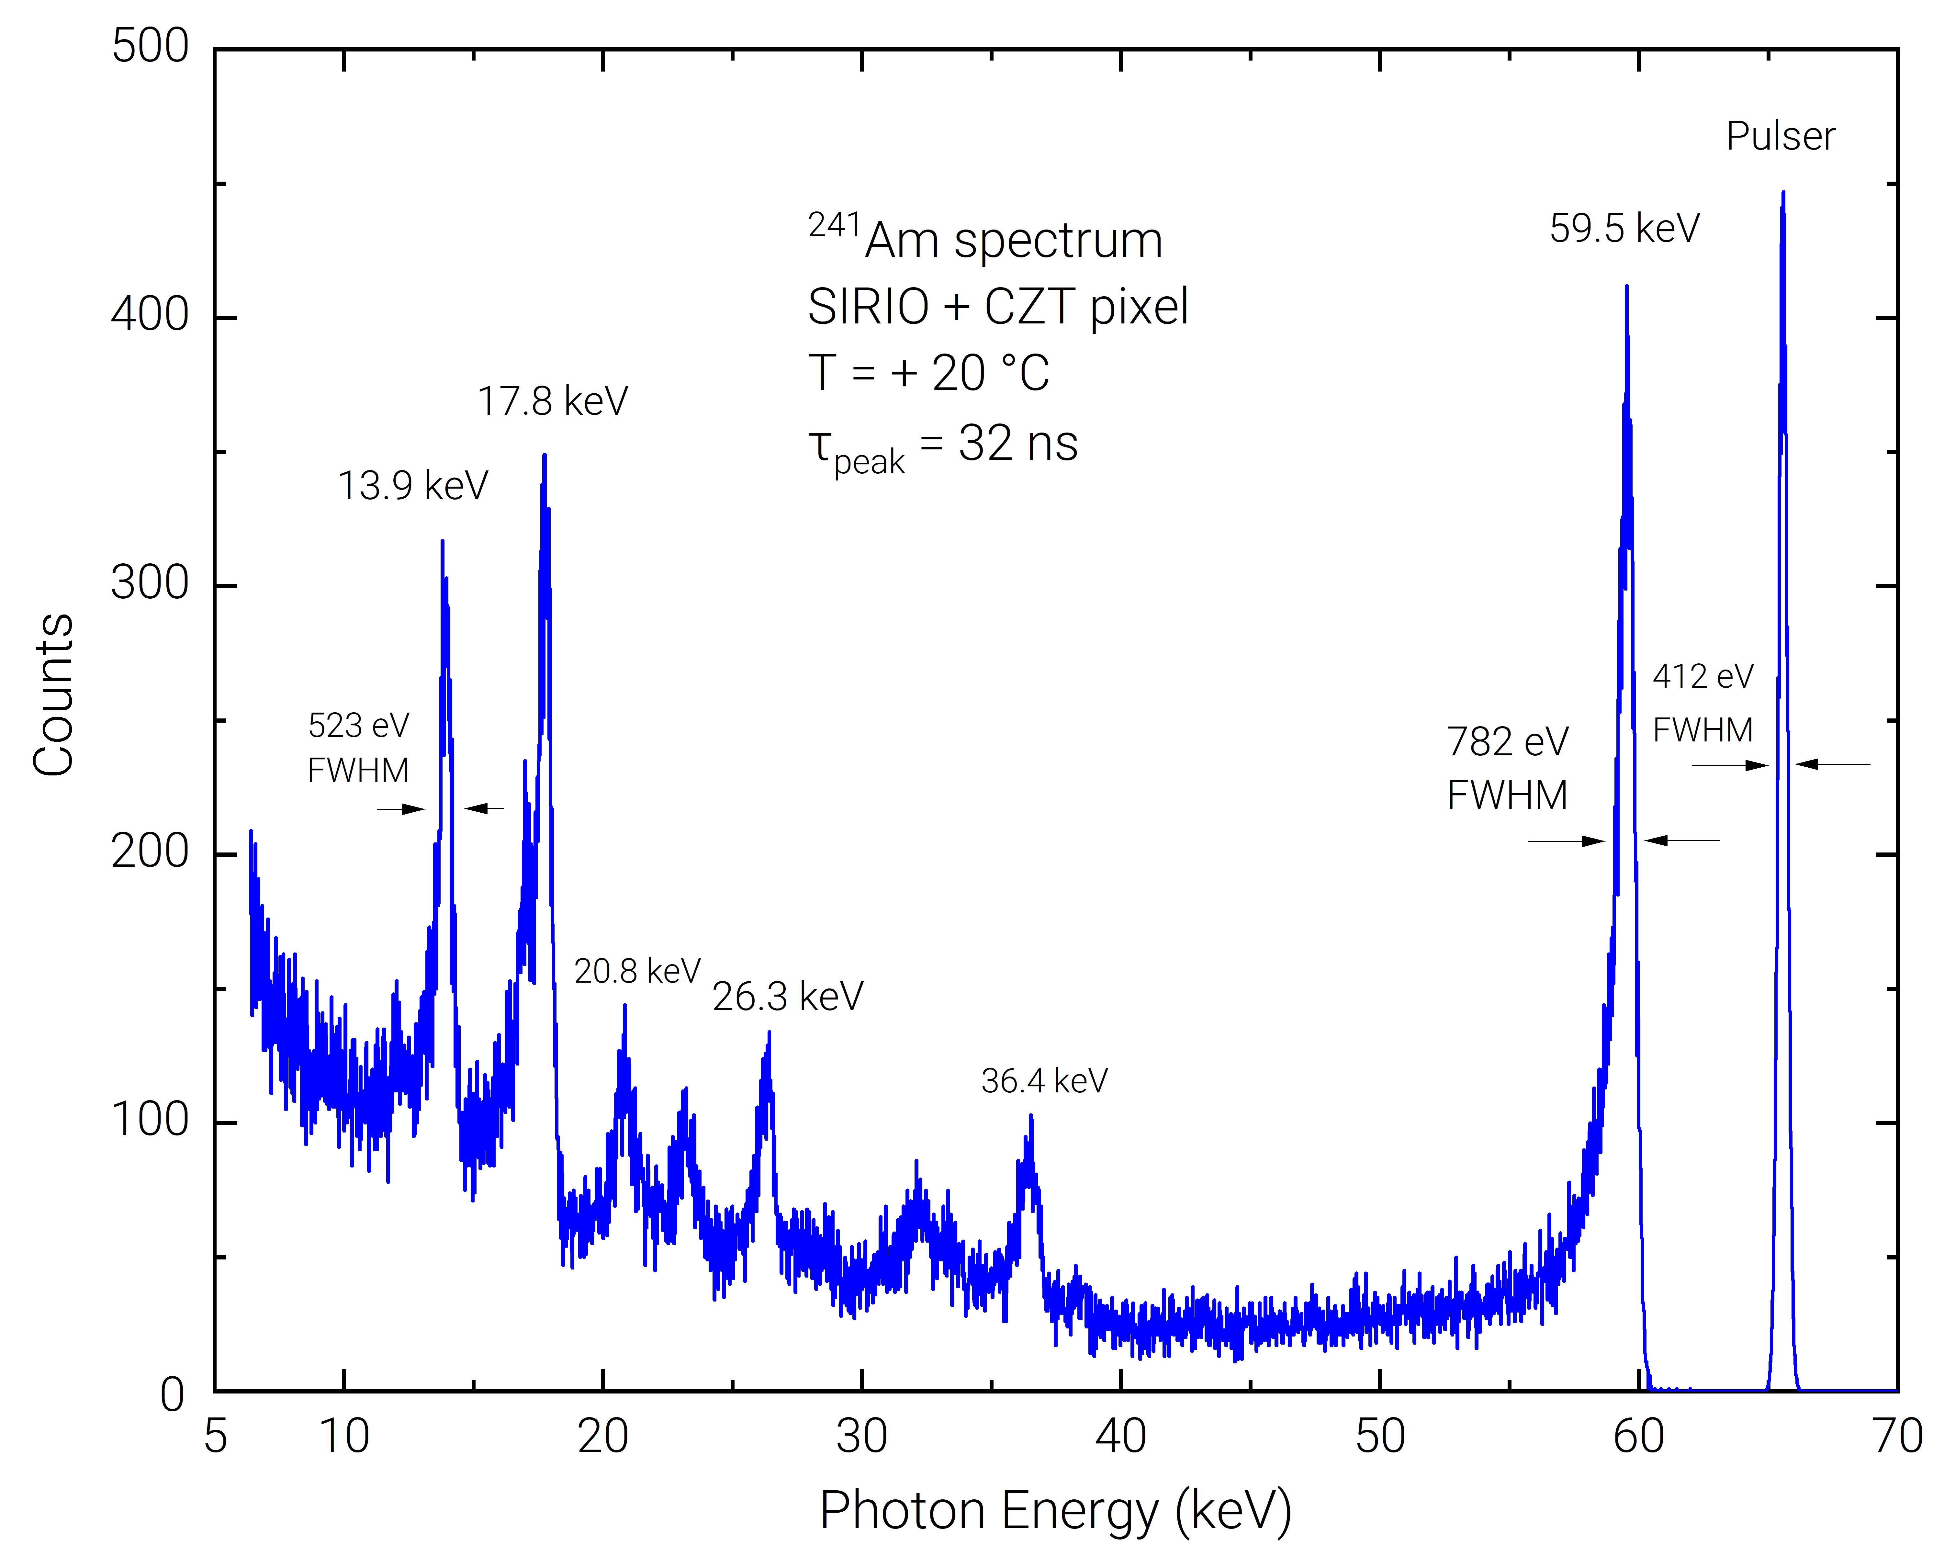
Potentialities of CZT detectors
Same ASIC were tested at low shaping time (32ns) -> extremely high energy resolution considering the rapidity of shaping
Give the possibility to improve further the background reduction without affecting the energy resolution
Mele, F., et al. "Advances in High-Energy-Resolution CdZnTe Linear Array Pixel Detectors with Fast and Low Noise Readout Electronics." Sensors 23.4 (2023)

Slide 20
Summary
CZT quasi-hemispherical detectors with good room temperature performance were successfully installed in DAΦNE collider
Successful first-time preliminary measurement of kaonic atom transitions using CZT detectors was achieved at the DAΦNE collider
The use of state-of-art ASIC technology can further improve the energy resolution and the rapidity of time response

Slide 21
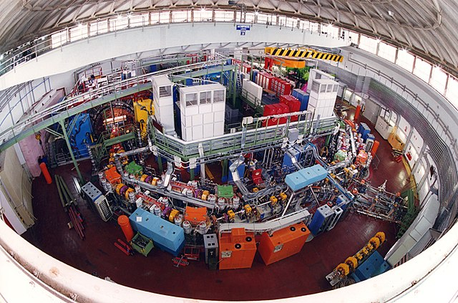
Thanks for listening!
Thanks!
Any questions?
My email:
andrea.zappettini@imem.cnr.it

Slide 23
Digital Pulse Processing
Digital Real-Time Pulse Shaping by using the Single Delay Line (SDL) and Trapezoidal filtering
Outputs:
the arrival time
the pulse height (energy)
the pulse time width and the peaking time (shape)
the acquisition of the CSP waveforms for off-line analysis

Slide 24
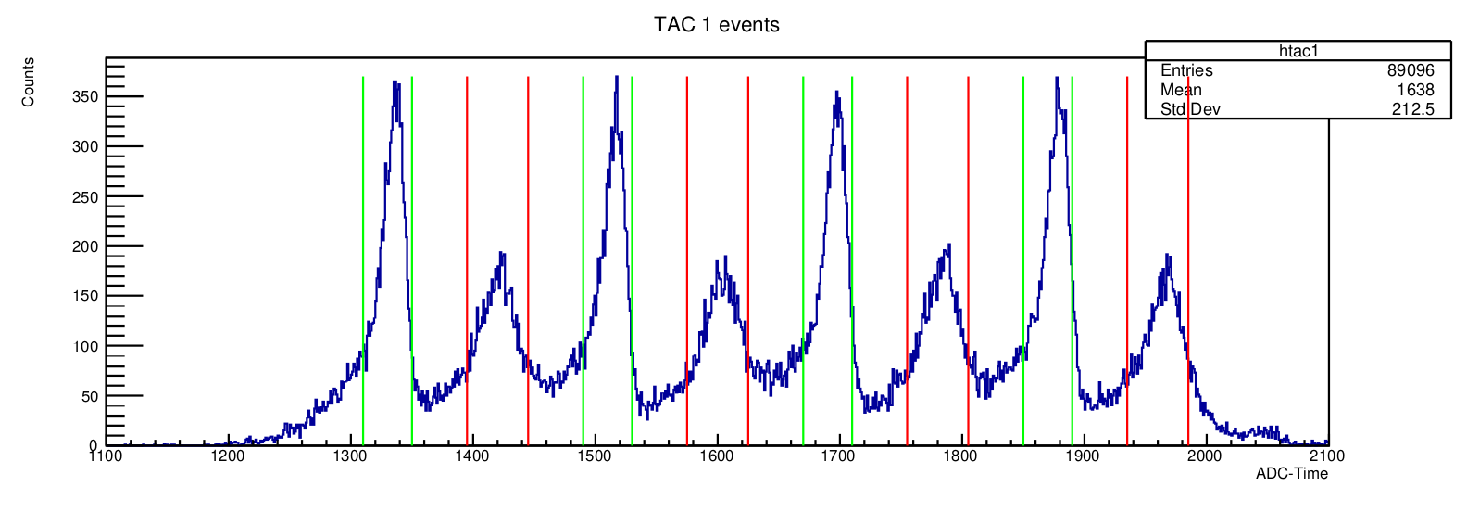
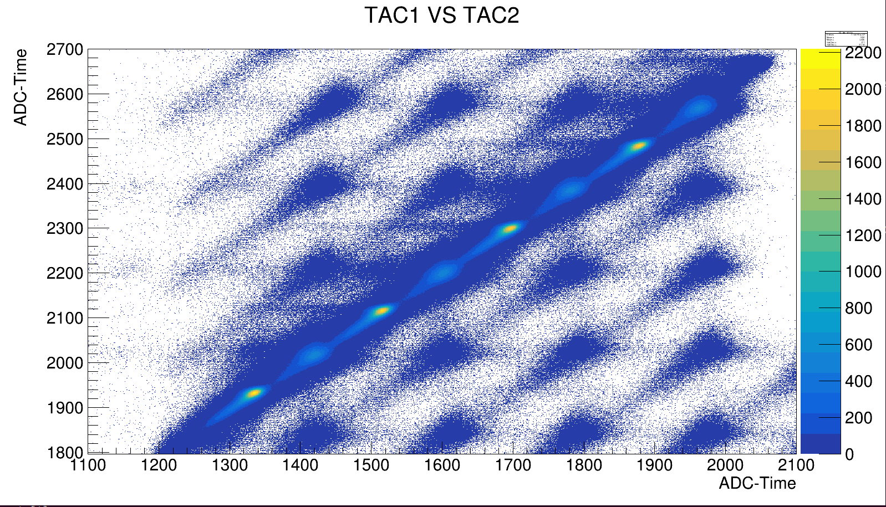
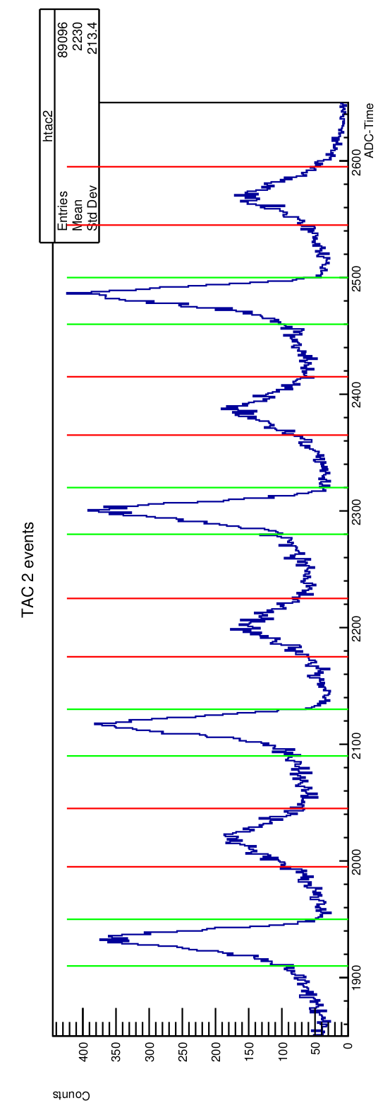
Measurements at DAΦNE Collider
Luminometer and detector signals were analyzed in order to reduce background

Slide 25
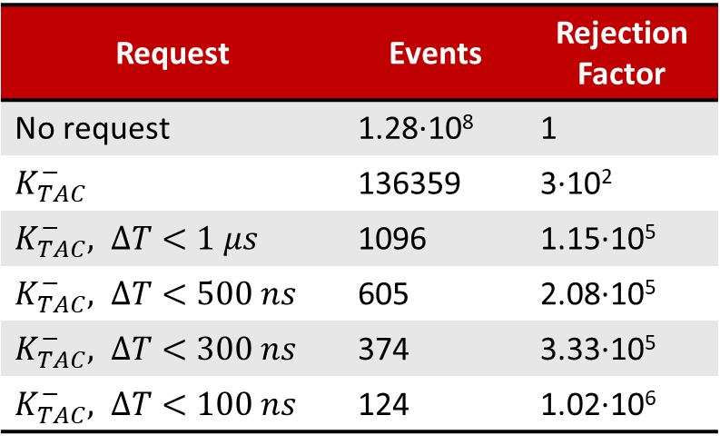
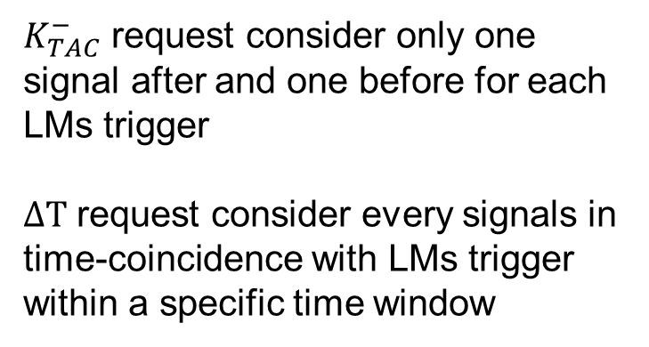
Future Perspective
Request | Events | Rejection Factor
No request | 1.28·10⁸ | 1
$K_{TAC}^{−}$ | 136359 | 3·10²
$K_{TAC}^{−}, ΔT<1 μs$ | 1096 | 1.15·10⁵
$K_{TAC}^{−}, ΔT<500 ns$ | 605 | 2.08·10⁵
$K_{TAC}^{−}, ΔT<300 ns$ | 374 | 3.33·10⁵
$K_{TAC}^{−}, ΔT<100 ns$ | 124 | 1.02·10⁶
Increase the time resolution of event detection in order to tighten the time window and decrease noise
Increase further the collecting area
Use an ultra-low noise readout preamplifier
$K_{TAC}^{−}$ request consider only one signal after and one before for each LMs trigger
$ΔT$ request consider every signals in time-coincidence with LMs trigger within a specific time window

Slide 26
KAONIC
ATOM
ATOM
nucleus
nucleus
n=1
n=25
e-
K-
K-
X-ray

