Slide 1
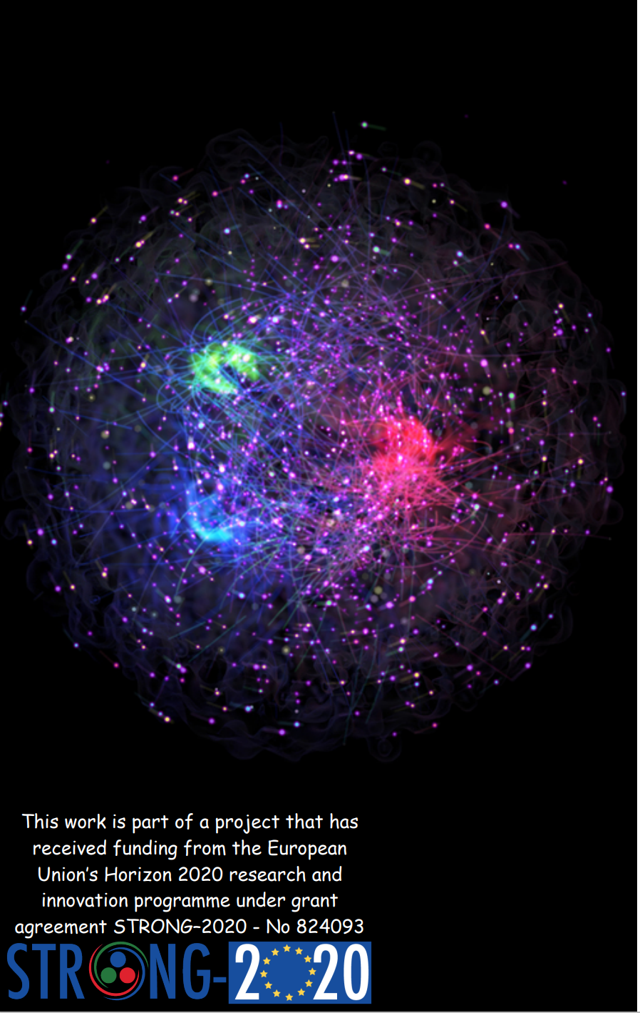

Beam-spin induced polarization of Λ and anti-Λ hyperons in semi-inclusive deep-inelastic scattering
D. Veretennikov
On behalf of the HERMES collaboration

Slide 2
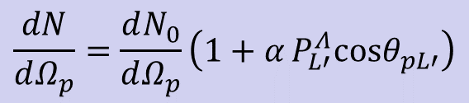

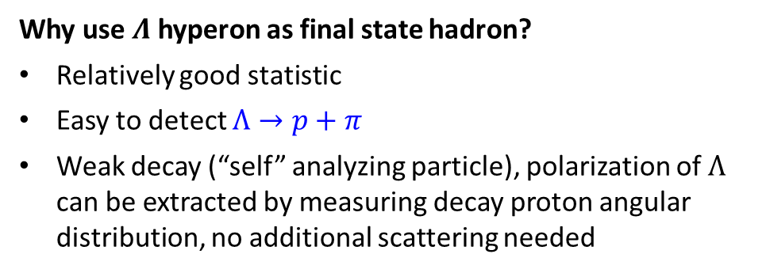
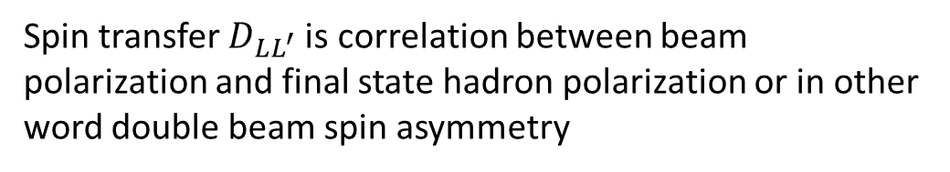
Longitudinal spin transfer D_{LL’} in SiDIS
$$P_{L^{′}}^{Λ}=P_{γ^{∗}}D_{LL^{′}}=P_{b}D(y)D_{LL^{′}}$$
Spin transfer $D_{LL^{′}}$is correlation between beam polarization and final state hadron polarization or in other word double beam spin asymmetry
Why use $Λ$ hyperon as final state hadron?
Relatively good statistic
Easy to detect $Λ→p+π$
Weak decay (“self” analyzing particle), polarization of $Λ$ can be extracted by measuring decay proton angular distribution, no additional scattering needed
$$\frac{dN}{dΩ_{p}}=\frac{dN_{0}}{dΩ_{p}}\left(1+α P_{L′}^{Λ}cosθ_{pL′}\right)$$
Angle between proton momentum and Λ spin in Λ rest frame
Notes:
Spin transfer coefficient from virtual gamma to lambda
struck quark which absorbs the virtual photon acquires the virtual photon polarization . The spin-transfer coefficient dll describes the probability that the polarization is transferred to the Λ hyperon along the secondary quantization axis L’

Slide 3
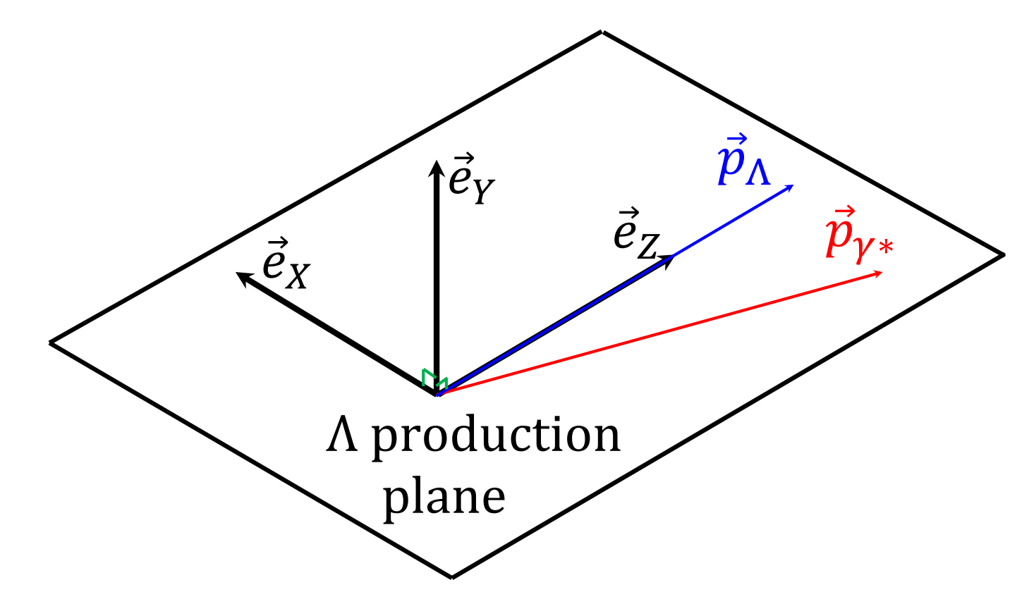
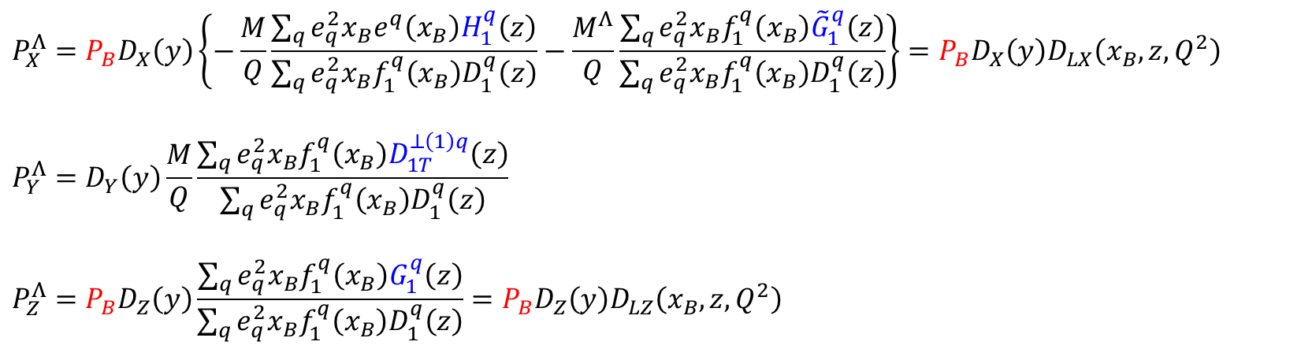
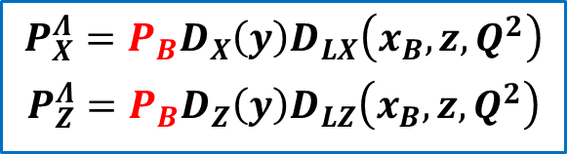
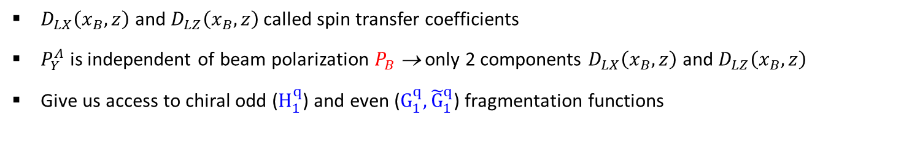
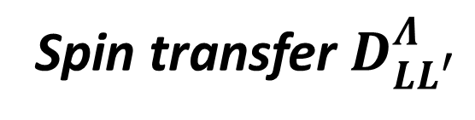
Spin transfer $D_{LL^{′}}^{Λ}$
P.J. Mulders, R.D. Tangerman
Published in: Nucl.Phys.B 461 (1996), 197-237
$$P_{X}^{Λ}=P_{B}D_{X}\left(y\right)\left\{−\frac{M}{Q}\frac{\sum_{q}{e_{q}^{2}x_{B}e^{q}\left(x_{B}\right)H_{1}^{q}\left(z\right)}}{\sum_{q}{e_{q}^{2}x_{B}f_{1}^{q}\left(x_{B}\right)D_{1}^{q}\left(z\right)}}−\frac{M^{Λ}}{Q}\frac{\sum_{q}{e_{q}^{2}x_{B}f_{1}^{q}\left(x_{B}\right){\tilde{G}}_{1}^{q}\left(z\right)}}{\sum_{q}{e_{q}^{2}x_{B}f_{1}^{q}\left(x_{B}\right)D_{1}^{q}\left(z\right)}}\right\}=P_{B}D_{X}\left(y\right)D_{LX}\left(x_{B},z,Q^{2}\right)$$
$$P_{Y}^{Λ}=D_{Y}\left(y\right)\frac{M}{Q}\frac{\sum_{q}{e_{q}^{2}x_{B}f_{1}^{q}\left(x_{B}\right)D_{1T}^{⊥\left(1\right)q}\left(z\right)}}{\sum_{q}{e_{q}^{2}x_{B}f_{1}^{q}\left(x_{B}\right)D_{1}^{q}\left(z\right)}}$$
$$P_{Z}^{Λ}=P_{B}D_{Z}\left(y\right)\frac{\sum_{q}{e_{q}^{2}x_{B}f_{1}^{q}\left(x_{B}\right)G_{1}^{q}\left(z\right)}}{\sum_{q}{e_{q}^{2}x_{B}f_{1}^{q}\left(x_{B}\right)D_{1}^{q}\left(z\right)}}=P_{B}D_{Z}\left(y\right)D_{LZ}\left(x_{B},z,Q^{2}\right)$$
$$P_{X}^{Λ}={P_{B}D}_{X}\left(y\right)D_{LX}\left(x_{B},z,Q^{2}\right)$$
$$P_{Z}^{Λ}={P_{B}D}_{Z}\left(y\right)D_{LZ}\left(x_{B},z,Q^{2}\right)$$
$D_{LX}\left(x_{B},z\right)$ and $D_{LZ}\left(x_{B},z\right)$ called spin transfer coefficients
$P_{Y}^{Λ}$ is independent of beam polarization $P_{B}$ → only 2 components $D_{LX}\left(x_{B},z\right)$ and $D_{LZ}\left(x_{B},z\right)$
Give us access to chiral odd ($H_{1}^{q}$) and even (${G_{1}^{q}, \tilde{G}}_{1}^{q}$) fragmentation functions

Slide 4
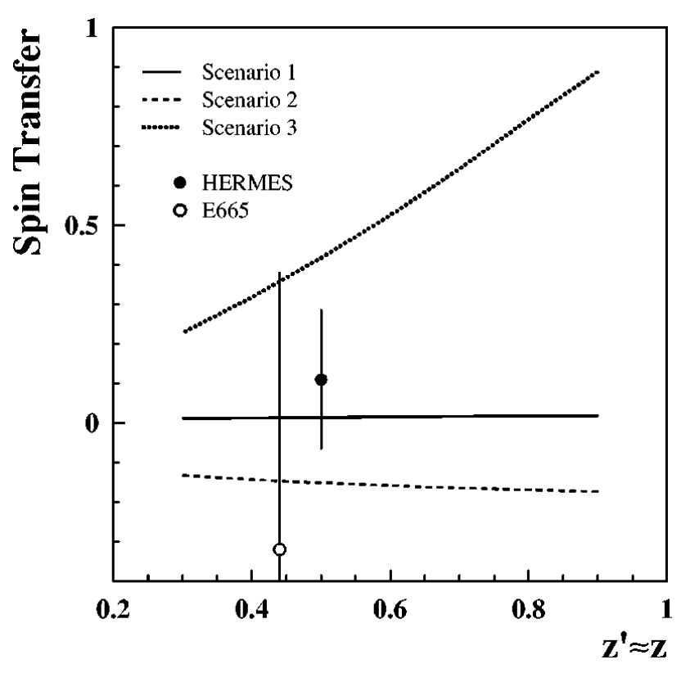
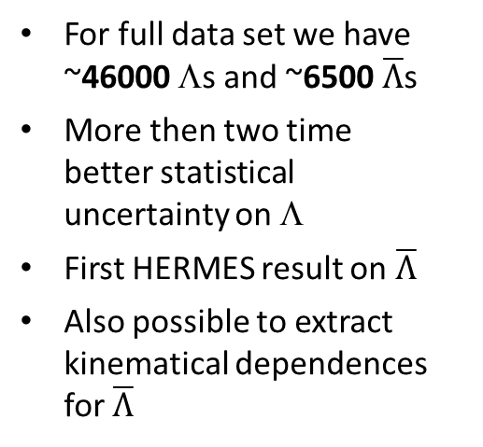
Previous publication
  Phys.Rev. D64 (2001) ~2000 Λs. D_{LL} = 0.11 ± 0.17_{stat} ± 0.03_{syst} (1996-1997 data)
  Phys.Rev. D74 (2006), ~8200 Λs. D_{LL} = 0.11 ± 0.10_{stat} ± 0.03_{syst} (1996-2000 data)
For full data set we have ~46000 Λs and ~6500 $\overline{Λ}$s
More then two time better statistical uncertainty on Λ
First HERMES result on $\overline{Λ}$
Also possible to extract kinematical dependences for $\overline{Λ}$

Slide 5
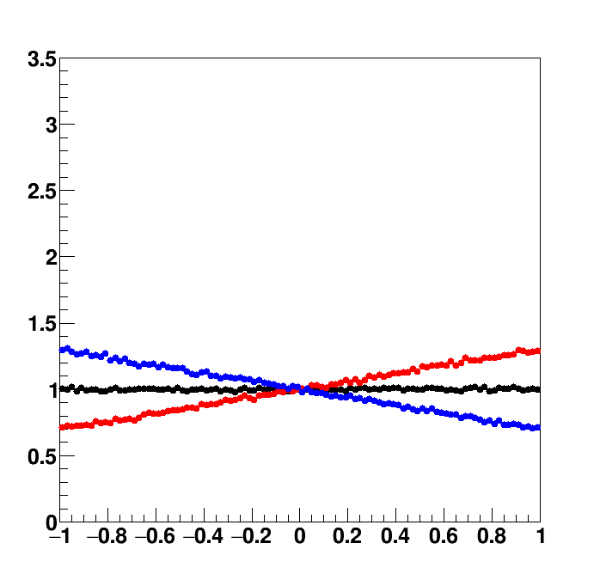
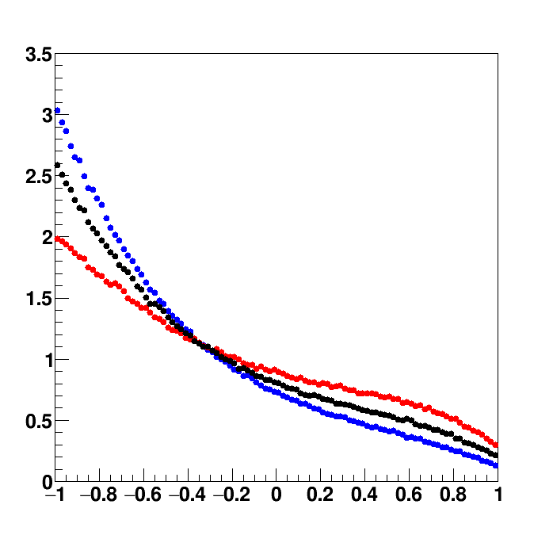
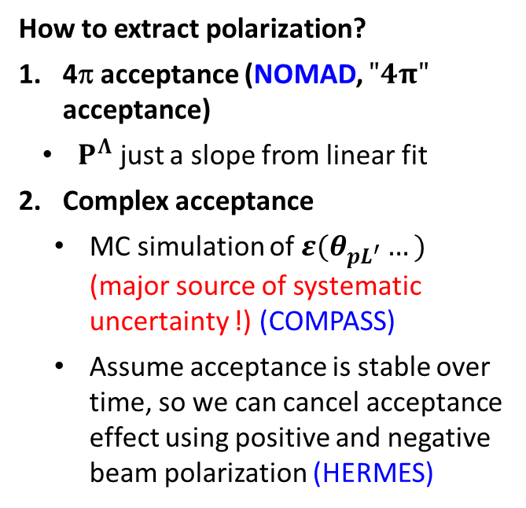
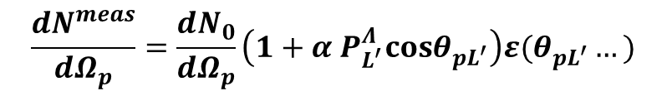

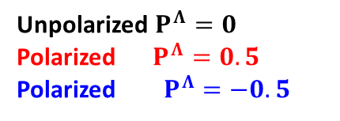
Extraction of $Λ$ polarization
$$\frac{{dN}^{meas}}{dΩ_{p}}=\frac{dN_{0}}{dΩ_{p}}\left(1+α P_{L^{′}}^{Λ}cosθ_{pL^{′}}\right)ε(θ_{pL^{′}}…)$$
Unpolarized $P^{Λ}=0$
Polarized $P^{Λ}=0.5$
Polarized $P^{Λ}=−0.5$
How to extract polarization?
4π acceptance (NOMAD, $"4π"$ acceptance)
  $P^{Λ}$ just a slope from linear fit
Complex acceptance
  MC simulation of $ε(θ_{pL^{′}}…)$ (major source of systematic uncertainty !) (COMPASS)
  Assume acceptance is stable over time, so we can cancel acceptance effect using positive and negative beam polarization (HERMES)
Unknown
4π acceptance
HERMES
acceptance

Slide 6
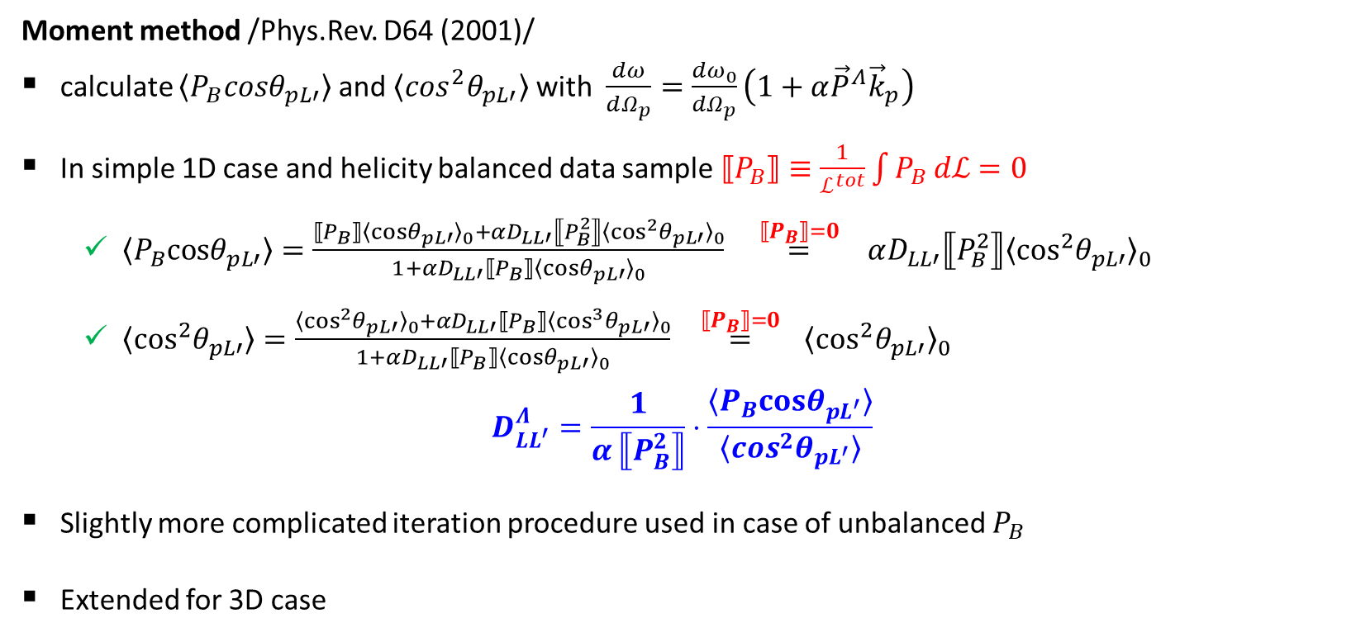
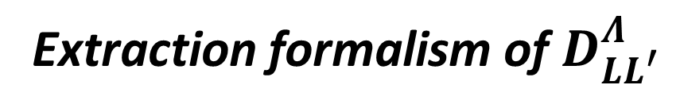
Extraction formalism of $D_{LL^{′}}^{Λ}$
Moment method /Phys.Rev. D64 (2001)/
calculate $〈P_{B}cosθ_{pL′}〉$ and $〈\cos^{2}θ_{pL′}〉$ with $\frac{dω}{dΩ_{p}}=\frac{{dω}_{0}}{dΩ_{p}}\left(1+α{\vec{P}}^{Λ}{\vec{k}}_{p}\right)$
In simple 1D case and helicity balanced data sample $⟦P_{B}⟧≡\frac{1}{ℒ^{tot}}\int{P_{B} dℒ=0}$
  $〈P_{B}cosθ_{pL′}〉=\frac{⟦P_{B}⟧{〈cosθ_{pL′}〉}_{0}+αD_{LL′}⟦P_{B}^{2}⟧{〈\cos^{2}θ_{pL′}〉}_{0}}{1+αD_{LL′}⟦P_{B}⟧{〈cosθ_{pL′}〉}_{0}} \overset{⟦P_{B}⟧=0}{=} αD_{LL′}⟦P_{B}^{2}⟧{〈\cos^{2}θ_{pL′}〉}_{0}$
  $〈\cos^{2}θ_{pL′}〉=\frac{{〈\cos^{2}θ_{pL′}〉}_{0}+αD_{LL′}⟦P_{B}⟧{〈\cos^{3}θ_{pL′}〉}_{0}}{1+αD_{LL′}⟦P_{B}⟧{〈cosθ_{pL′}〉}_{0}} \overset{⟦P_{B}⟧=0}{=} {〈\cos^{2}θ_{pL′}〉}_{0}$
$$D_{LL^{′}}^{Λ}=\frac{1}{α ⟦P_{B}^{2}⟧}⋅\frac{〈P_{B}cosθ_{pL^{′}}〉}{〈\cos^{2}θ_{pL^{′}}〉}$$
Slightly more complicated iteration procedure used in case of unbalanced $P_{B}$
Extended for 3D case
Unpolarized moment (unknown, but its reduced)
No MC simulation of acceptance needed

Slide 7
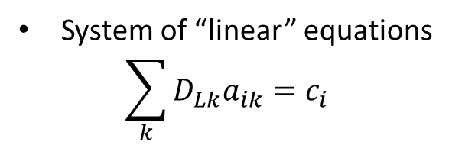
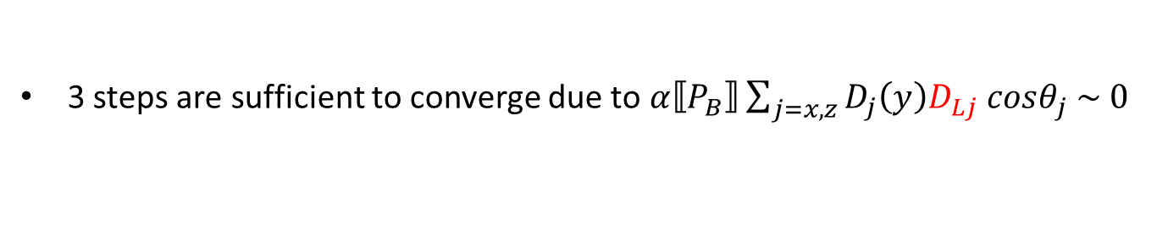
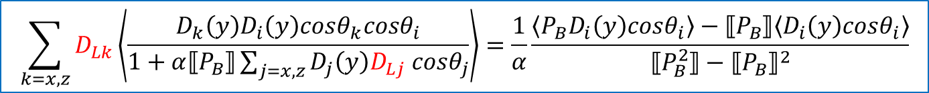
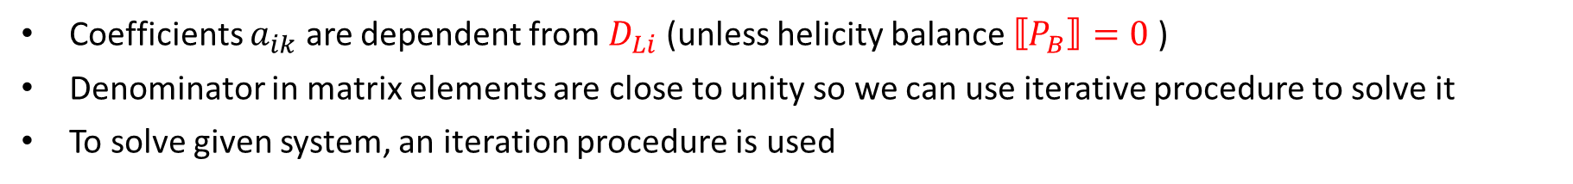
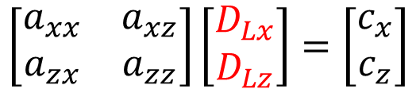
Extraction of spin transfer in 3D and unbalanced case
$$\sum_{k=x,z}{D_{Lk}\left\langle \frac{D_{k}\left(y\right)D_{i}\left(y\right)cosθ_{k}cosθ_{i}}{1+α⟦P_{B}⟧\sum_{j=x,z}{{D_{j}\left(y\right)D}_{Lj} cosθ_{j}}}\right\rangle }=\frac{1}{α}\frac{\left\langle P_{B}D_{i}\left(y\right)cosθ_{i}\right\rangle −⟦P_{B}⟧\left\langle D_{i}\left(y\right)cosθ_{i}\right\rangle }{⟦P_{B}^{2}⟧−{⟦P_{B}⟧}^{2}}$$
System of “linear” equations
$$\sum_{k}{D_{Lk}a_{ik}}{=c}_{i}$$
$$\left[\begin{matrix}a_{xx} & a_{xz} \\ a_{zx} & a_{zz}\end{matrix}\right]\left[\begin{matrix}D_{Lx} \\ D_{Lz}\end{matrix}\right]=\left[\begin{matrix}c_{x} \\ c_{z}\end{matrix}\right]$$
Coefficients $a_{ik}$ are dependent from $D_{Li}$ (unless helicity balance $⟦P_{B}⟧=0$ )
Denominator in matrix elements are close to unity so we can use iterative procedure to solve it
To solve given system, an iteration procedure is used
$${D_{Lk}}^{\left(0\right)}\underset{→}{ \text{calculate} a_{i}^{k} }{a_{i}^{k}}^{\left(0\right)}\underset{→}{ \text{solve} a_{i}^{k}D_{Lk}=c_{i} }{D_{Lk}}^{\left(1\right)}→...$$
3 steps are sufficient to converge due to$α⟦P_{B}⟧\sum_{j=x,z}{{D_{j}\left(y\right)D}_{Lj} cosθ_{j} \sim 0}$

Slide 8
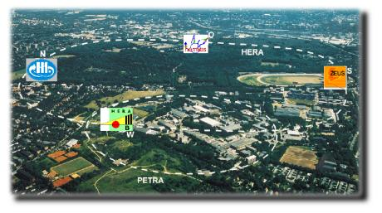
HERMES experiment
Lepton beam “self” transversely polarized up to 60% due to Sokolov-Ternov effect
Spin rotators upstream and downstream of HERMES experiment used to get longitudinally polarize beam
Beam spin flipped every few weeks/months
Located at DESY, Hamburg
27.6 GeV e+/e- beam and 920 GeV proton beam (HERMES used only lepton beam)
Data taking end in 2007

Slide 9
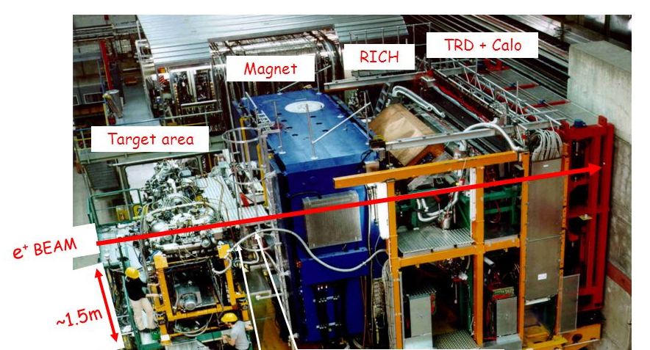
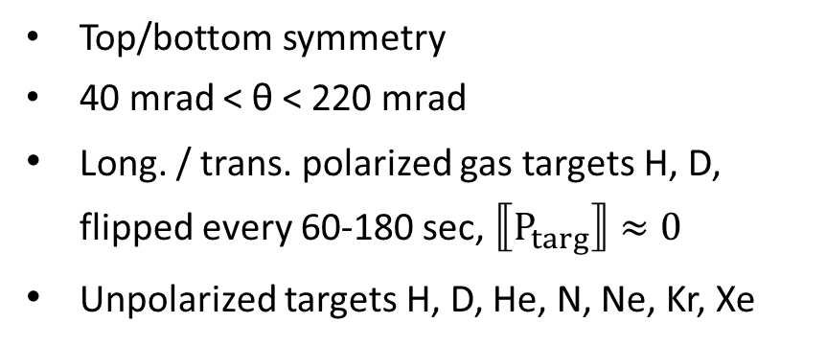
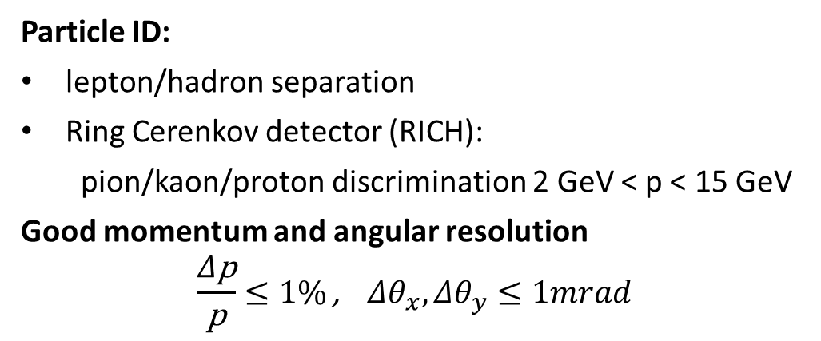
HERMES experiment
Particle ID:
lepton/hadron separation
Ring Cerenkov detector (RICH):
  pion/kaon/proton discrimination 2 GeV < p < 15 GeV
Good momentum and angular resolution
$$\frac{Δ\text{p}}{\text{p}}≤1\% \text{,} Δθ_{x},Δθ_{y}≤1mrad$$
Top/bottom symmetry
40 mrad < θ < 220 mrad
Long. / trans. polarized gas targets H, D, flipped every 60-180 sec, $⟦P_{targ}⟧≈0$
Unpolarized targets H, D, He, N, Ne, Kr, Xe

Slide 10
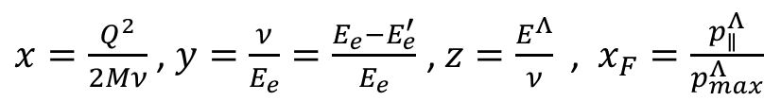
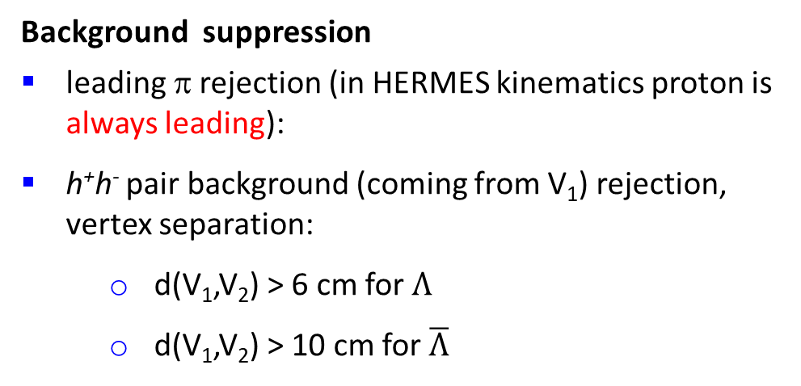
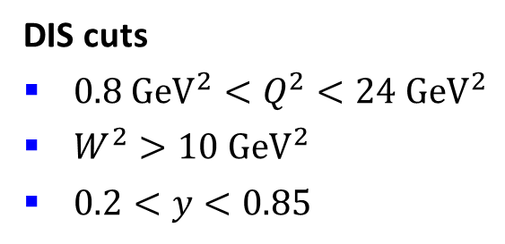
Λ event selection
DIS cuts
${0.8 {GeV}^{2}<Q}^{2}<24 {GeV}^{2}$
$W^{2}>10 {GeV}^{2}$
$0.2<y<0.85$
$x=\frac{Q^{2}}{2Mν}$ , $y=\frac{ν}{E_{e}}=\frac{E_{e}−E_{e}^{′}}{E_{e}}$ , $z=\frac{E^{Λ}}{ν}​​​$ , $x_{F}=\frac{p_{∥}^{Λ}}{p_{max}^{Λ}}$
p
Background suppression
leading π rejection (in HERMES kinematics proton is always leading):
h⁺h⁻ pair background (coming from V₁) rejection, vertex separation:
    d(V₁,V₂) > 6 cm for $Λ$
    d(V₁,V₂) > 10 cm for $\overline{Λ}$
Λ
V
2
π⁻
V
1
e
beam
e’

Slide 11
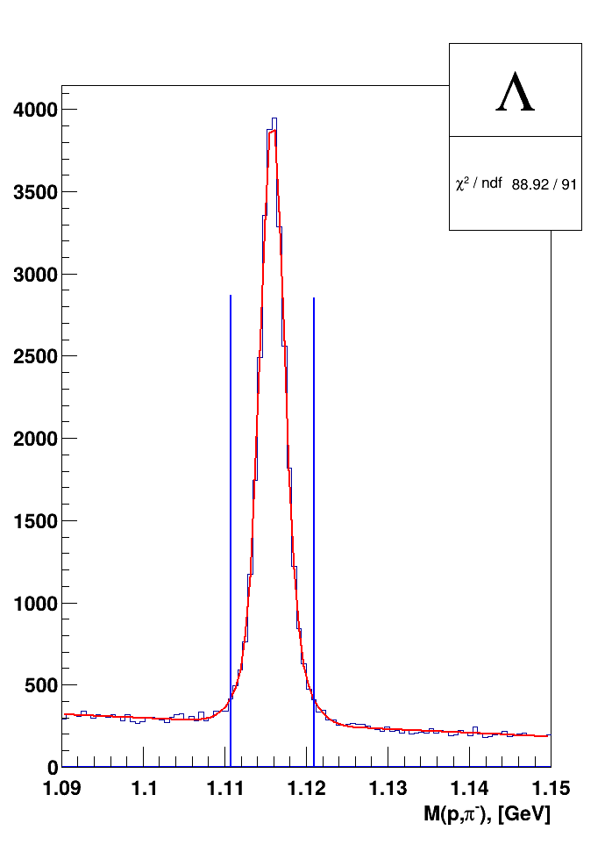
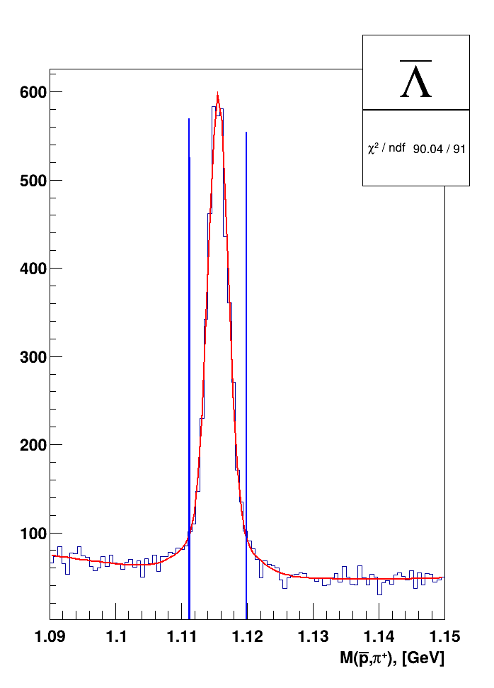
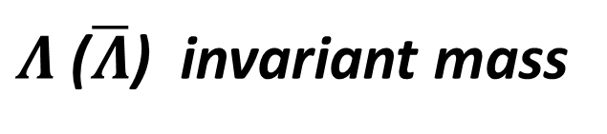
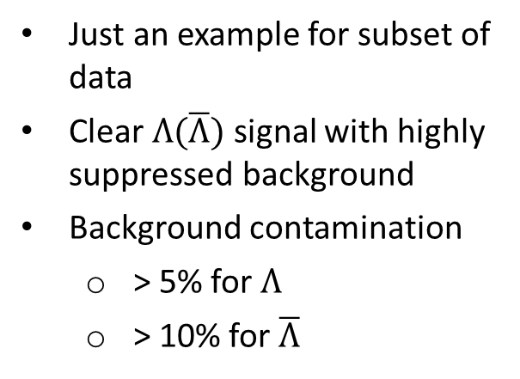
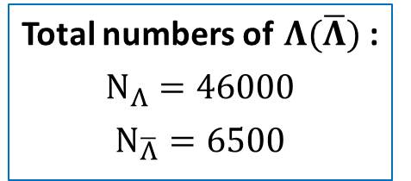
$Λ$ ($\overline{Λ}$) invariant mass
Just an example for subset of data
Clear $Λ(\overline{Λ})$ signal with highly suppressed background
Background contamination
  > 5% for $Λ$
  > 10% for $\overline{Λ}$
Total numbers of $Λ(\overline{Λ})$ :
$$N_{Λ}=46000$$
$$N_{\overline{Λ}}=6500$$

Slide 12
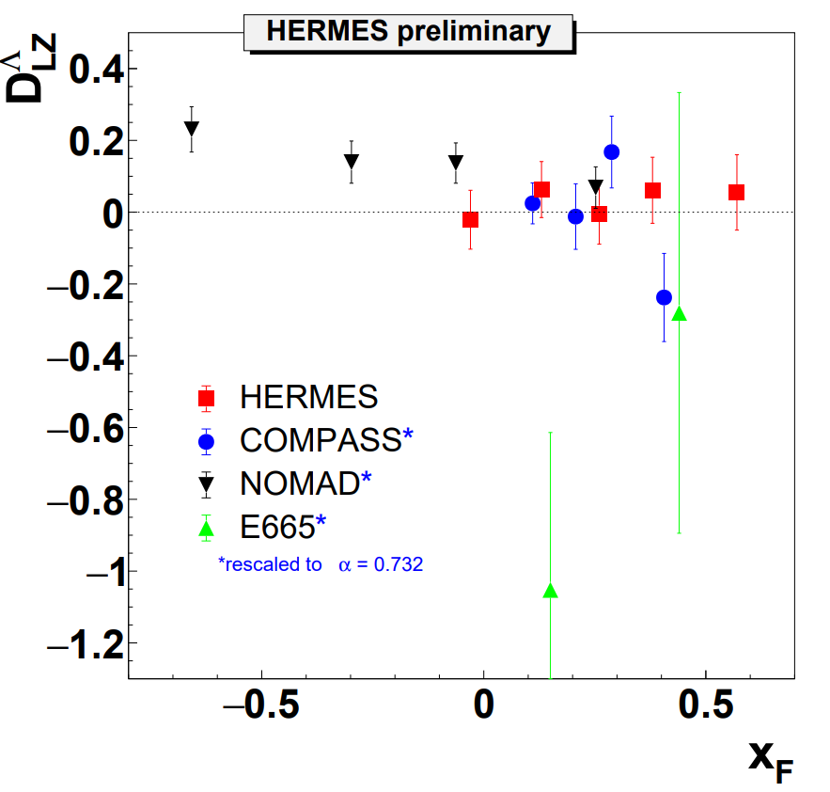
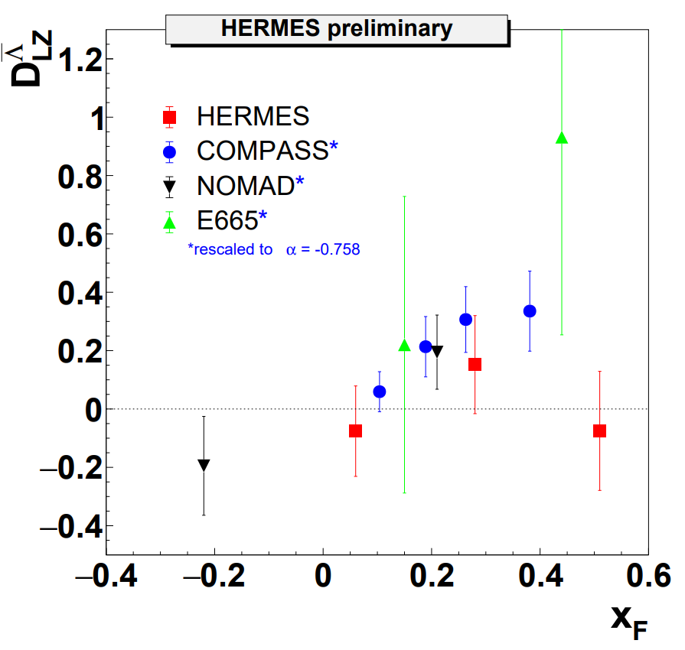
Results
Λ decay constant α has been updated in PDG → use new value and rescale data from other experiment

Slide 13
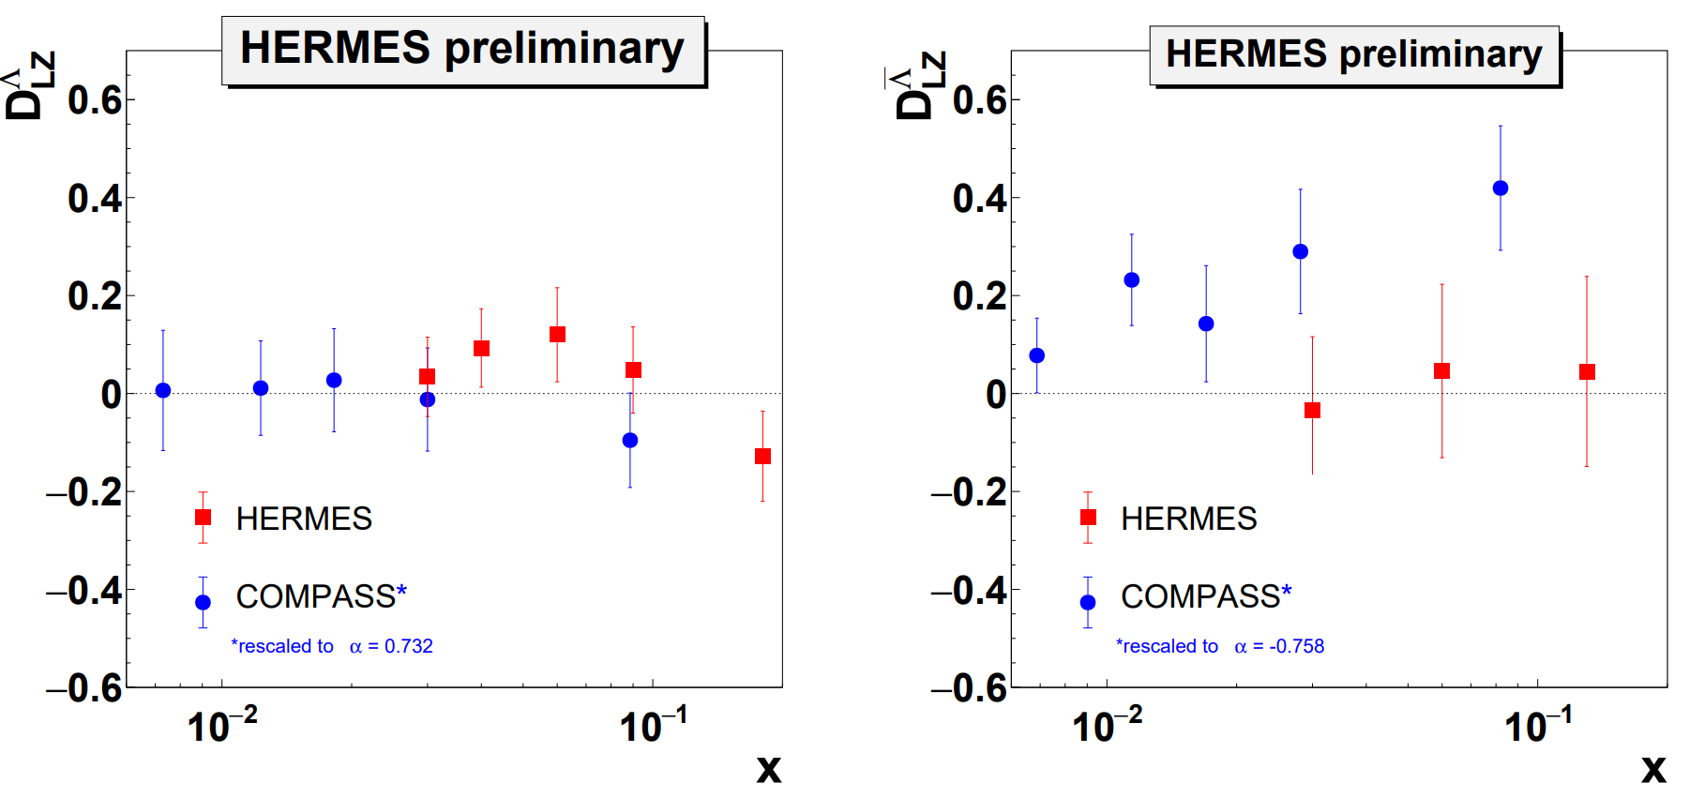
Results

Slide 14
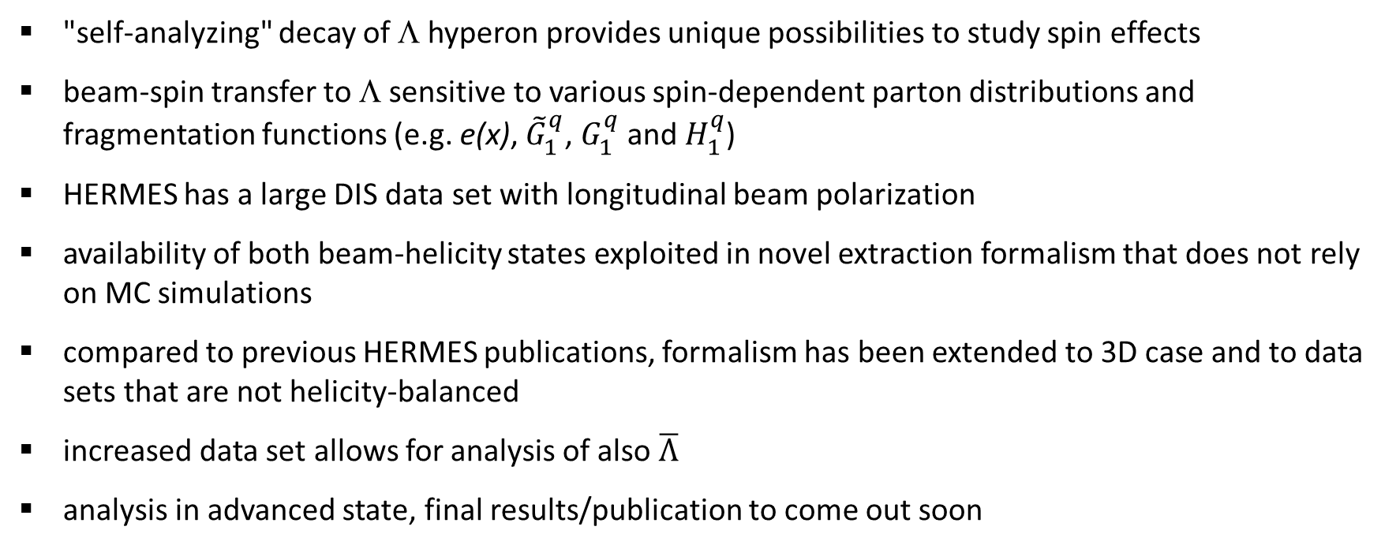
Conclusion
"self-analyzing" decay of Λ hyperon provides unique possibilities to study spin effects
beam-spin transfer to Λ sensitive to various spin-dependent parton distributions and fragmentation functions (e.g. e(x), ${\tilde{G}}_{1}^{q}$, $G_{1}^{q}$ and $H_{1}^{q}$)
HERMES has a large DIS data set with longitudinal beam polarization
availability of both beam-helicity states exploited in novel extraction formalism that does not rely on MC simulations
compared to previous HERMES publications, formalism has been extended to 3D case and to data sets that are not helicity-balanced
increased data set allows for analysis of also $\overline{Λ}$
analysis in advanced state, final results/publication to come out soon

Slide 15
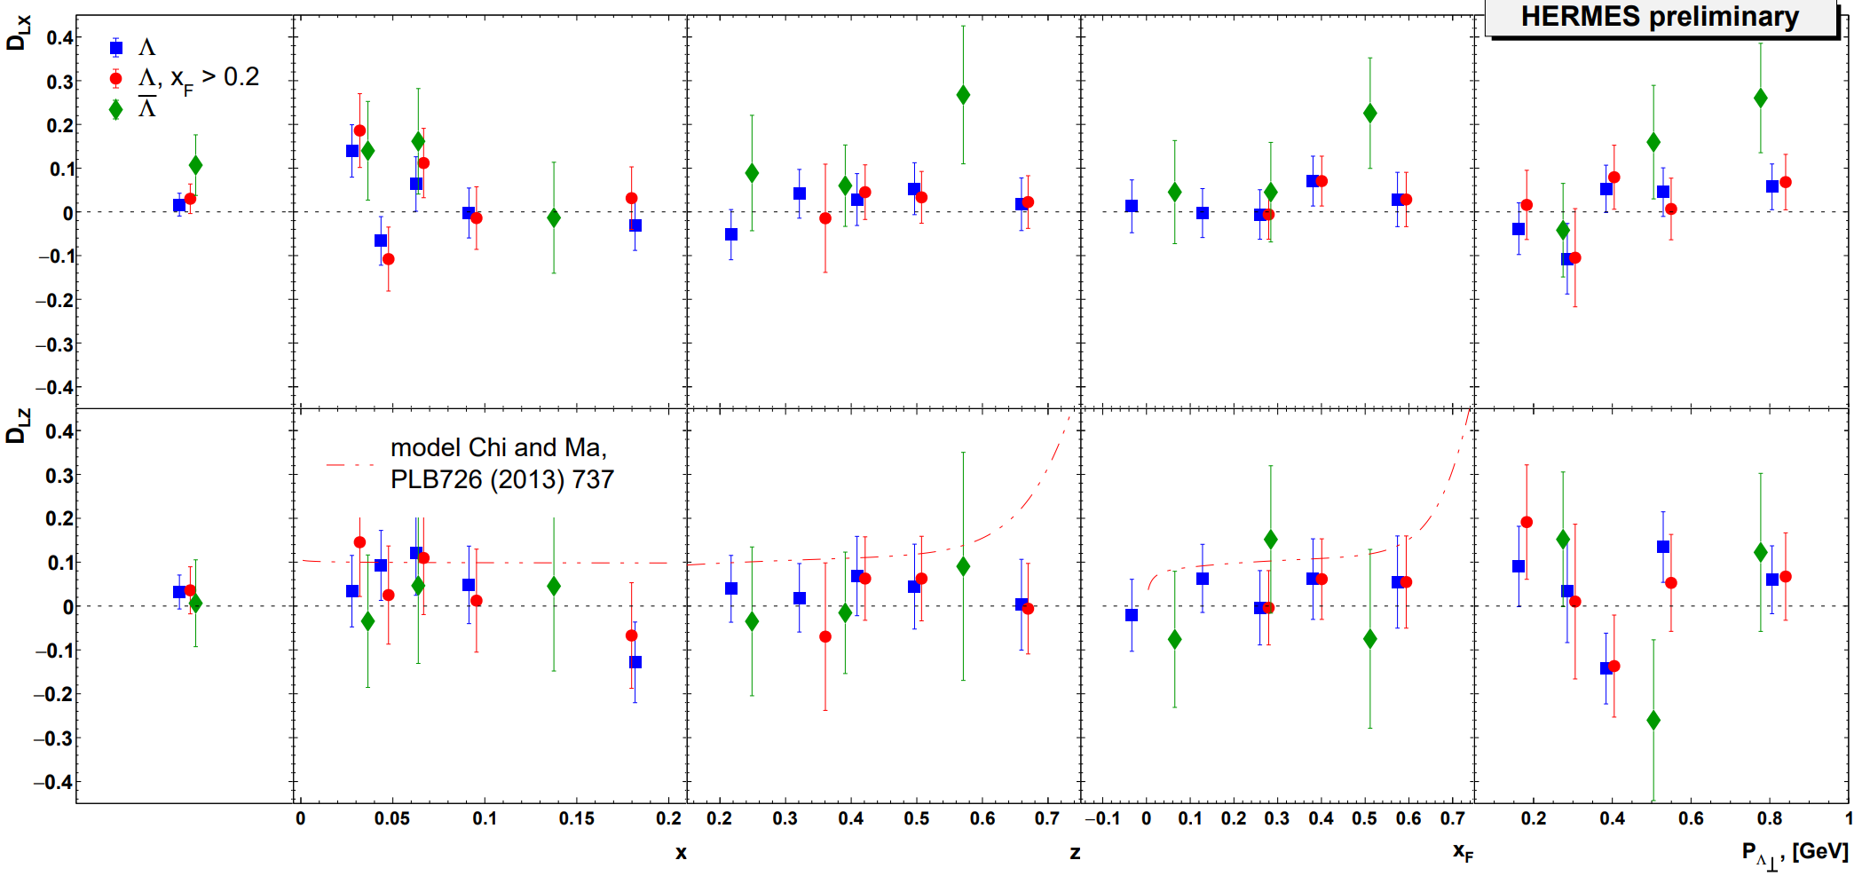
Kinematical dependences
Notes:
Dh q(z) ∼ zqh(z), D- fragmentation func, q –distribution function, Gribov–Lipatov relation

