Slide 1
Optimising Hadrontherapy: challenges and prospects
Treatment planning
- Nuclear fragmentation
Treatment delivery
- Ion gantries, minibeams
Treatment monitoring
- Beam monitoring & Range verification, radioactive beams
New approaches
- Boron Neutron Capture Therapy
- FLASH therapy
Piergiorgio Cerello
INFN, Sezione di Torino, Torino, Italy

Slide 2
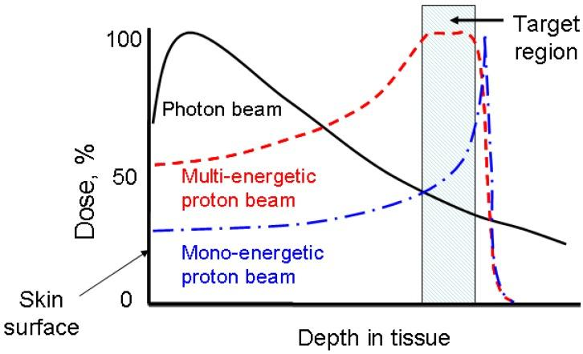
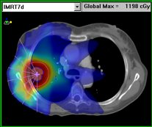
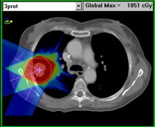
Particle Therapy: the concept
Dose maps
Radiotherapy
Particle therapy
Compared to standard
radiotherapy
reduced toxicity​
lower secondary malignancy risk​
increased tumor local control

Slide 3
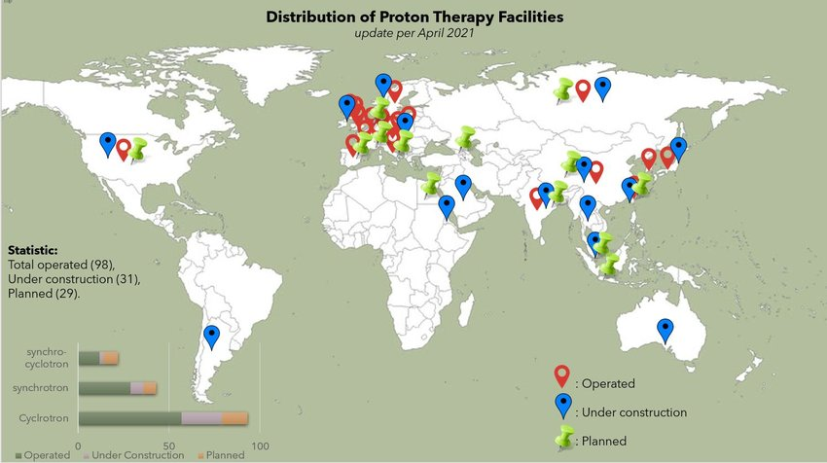
Particle Therapy: Worldwide statistics
Well established
Very effective
At the end of 2023:
Clinical Centres
  ~ 150
Treated Patients:
  ~ 350000 (protons)
  ~ 56000 (carbon)
  ~ 3500 (helium)
https://ptcog.site
Creative commons 3.0

Slide 4
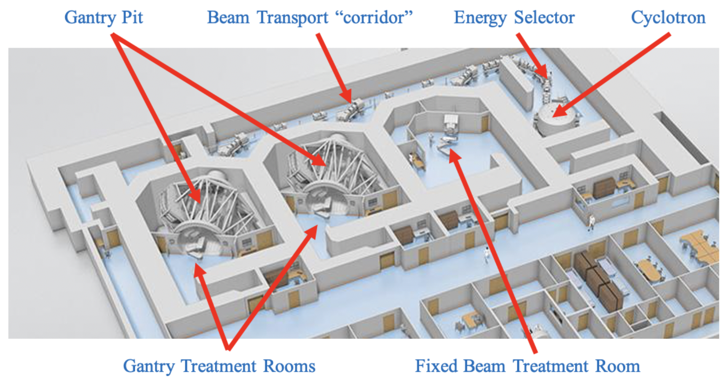
Particle Therapy: the standard
Treatment planning
  Nuclear fragmentation
Treatment delivery
  Ion Gantries
  Minibeams
Treatment monitoring
  Beam monitoring
  Range verification
  Radioactive beams
https://www.oncolink.org/cancer-treatment/radiation/types-of-radiation-therapy/proton-therapy/overviews-of-proton-therapy/proton-therapy-behind-the-scenes

Slide 5
Optimising Hadrontherapy: challenges and prospects
Treatment planning
- Nuclear fragmentation

Slide 6

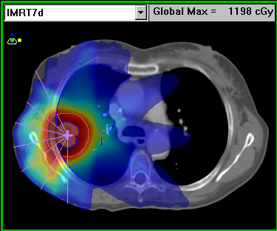

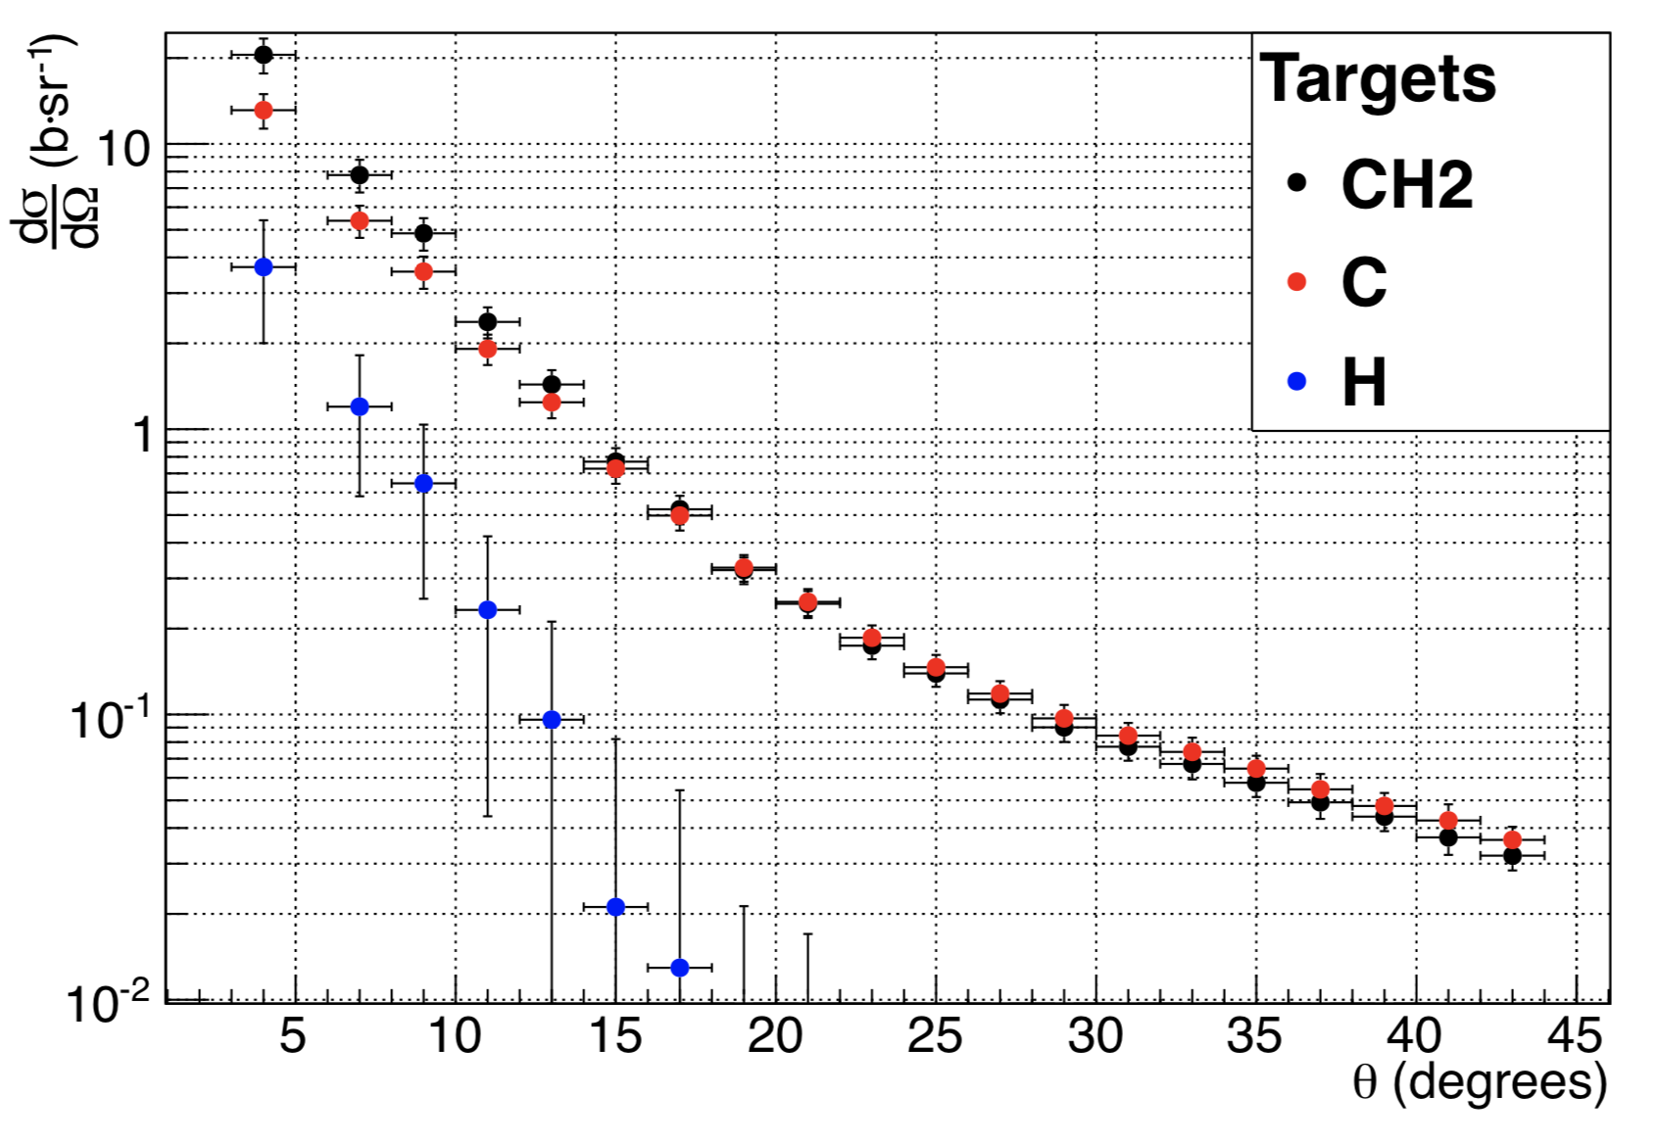
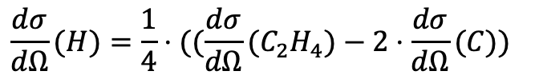
Piergiorgio Cerello
Text
FragmentatiOn Of Target (FOOT)
Particle therapy: E < 500 MeV/u
Inverse kinematics
p
¹²C, ¹⁶O
¹²C
the contribution of tissue fragmentation in the entrance channel was not measured (yet)
$$\frac{dσ}{dΩ}(H)=\frac{1}{4}⋅((\frac{dσ}{dΩ}(C_{2}H_{4})−2⋅\frac{dσ}{dΩ}(C))$$

Slide 7
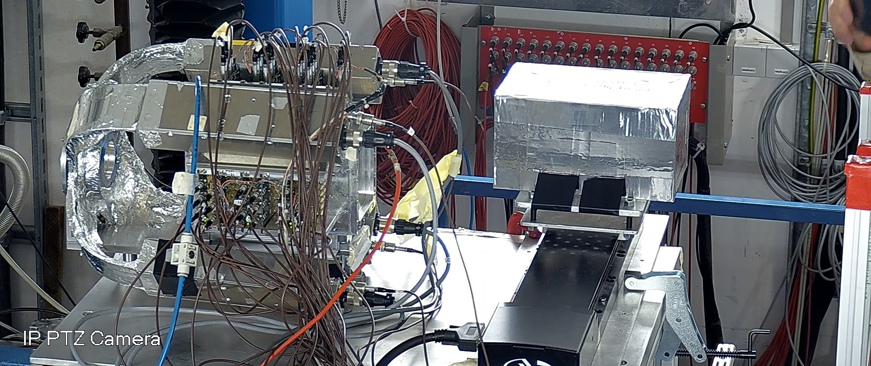
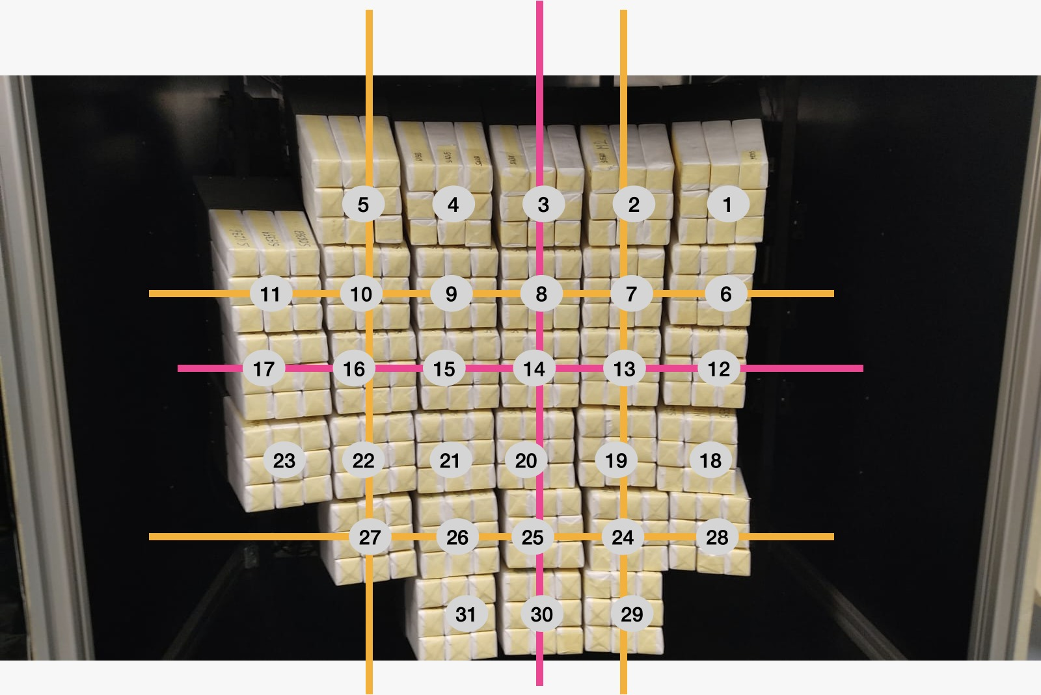
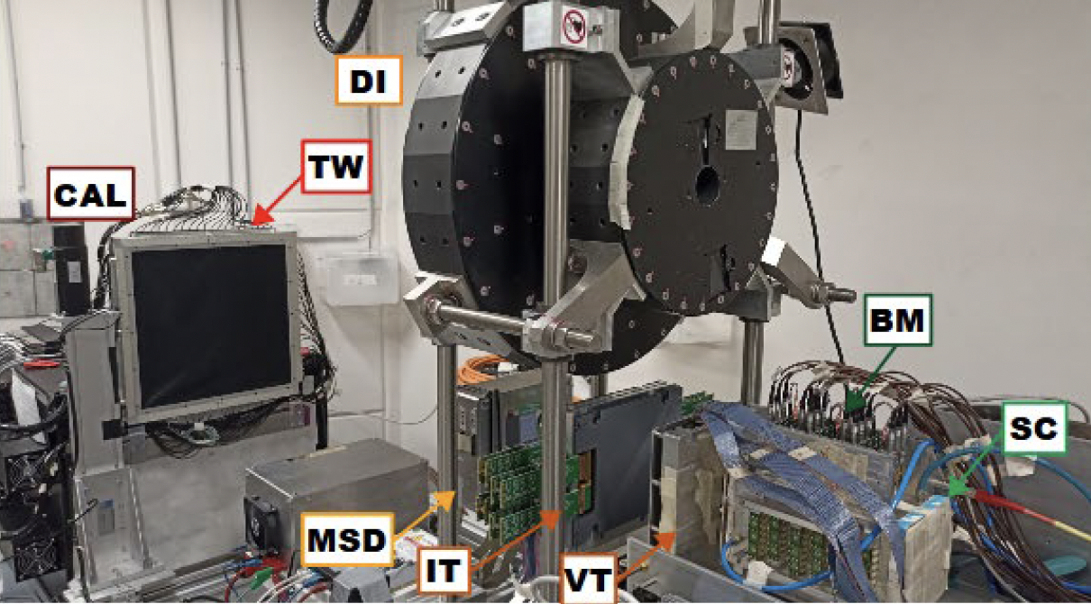
Piergiorgio Cerello
FragmentatiOn Of Target (FOOT)
Emulsion Spectrometer
Electronic Spectrometer
Large acceptance
Low statistics
Forward acceptance (~ 11 degrees)
High statistics
Forthcoming data takings (2025)
¹⁶O beam at GSI
¹²C beam at CNAO

Slide 8
Optimising Hadrontherapy: challenges and prospects
Treatment delivery
- Ion gantries, minibeams

Slide 9
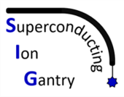
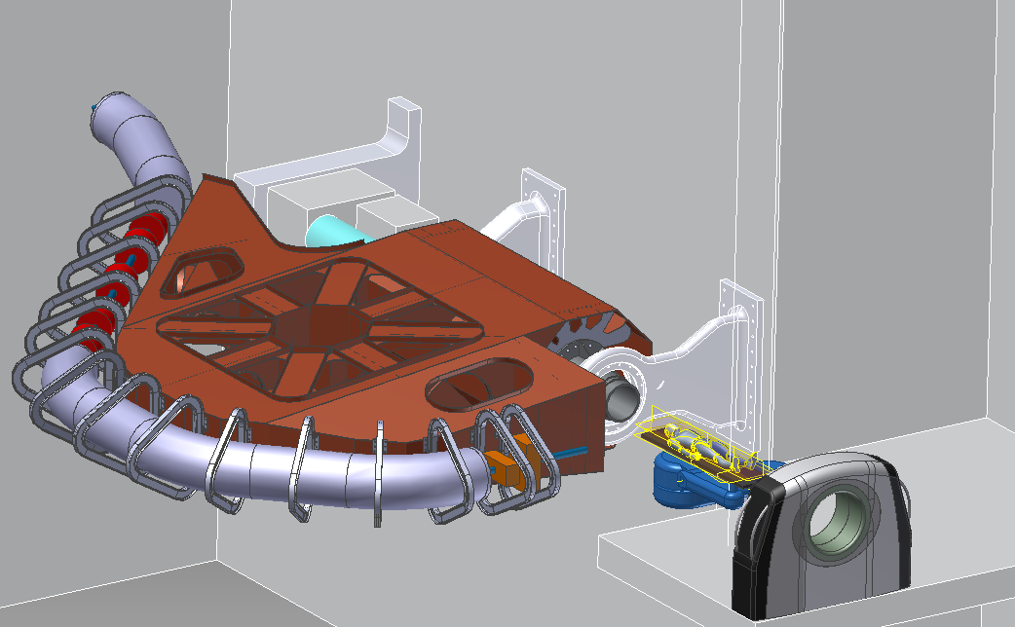
Piergiorgio Cerello
Superconducting Ion Gantry
Study and development of a next generation ion gantry of “only” 50 tons for non-coplanar ion irradiation
Carbon ions up to 430 MeV/u
14 m long, ~50 tons weight
4 T curved superconducting dipoles
Superconducting spool piece quadrupoles
Downstream scanning magnet system
Dose Delivery and Range Verification Systems for adaptive cancer treatments
CERN, CNAO, INFN, MedAustron
Courtesy of Elisa Fiorina, Marco Prioli

Slide 10
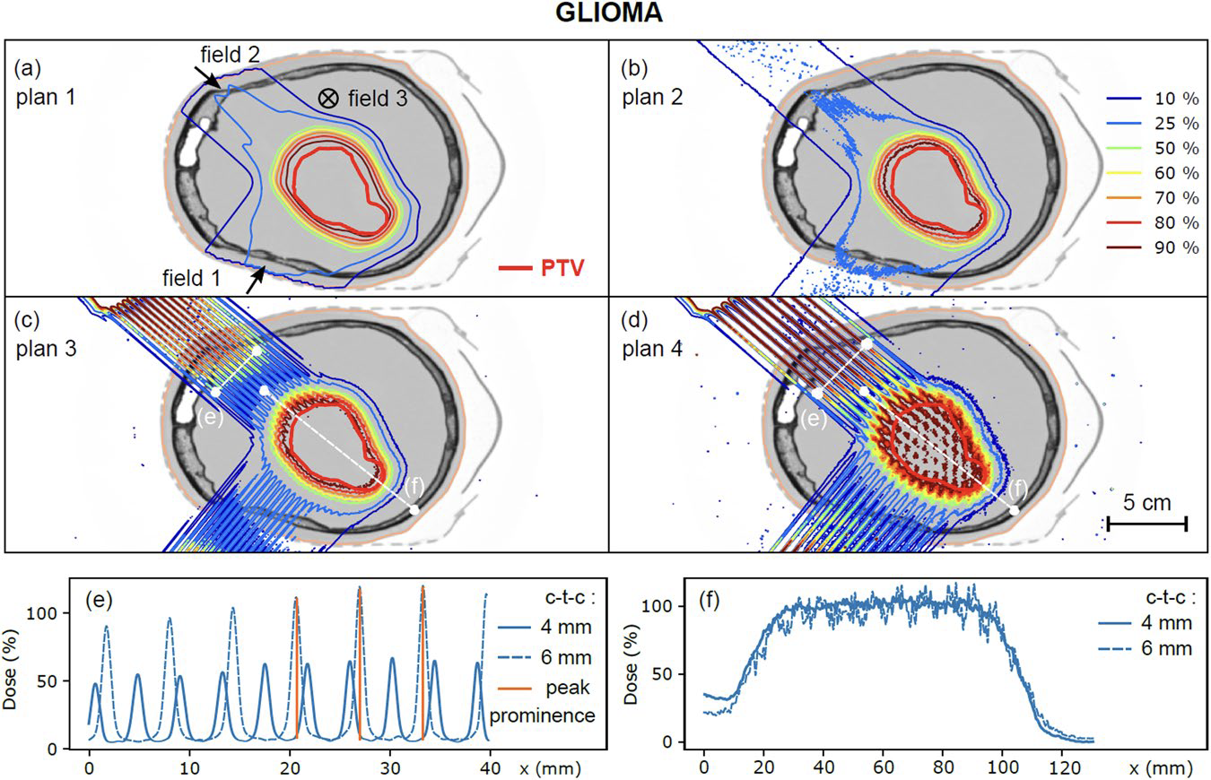
Minibeams
Proton minibeam radiation therapy (pMBRT): a novel dose delivery method based on spatial dose fractionation
Eclipse
MC
Brass collimator provides
beam intensity modulation
with high, thin peaks and
valleys (ctc: centre-to-centre)
4mm ctc
6mm ctc
Dose profile - at 3 cm depth - in the tumour volume
P. Lansonneur et al, Scientific Reports (2020) 10:7025 https://doi.org/10.1038/s41598-020-63975-9

Slide 11
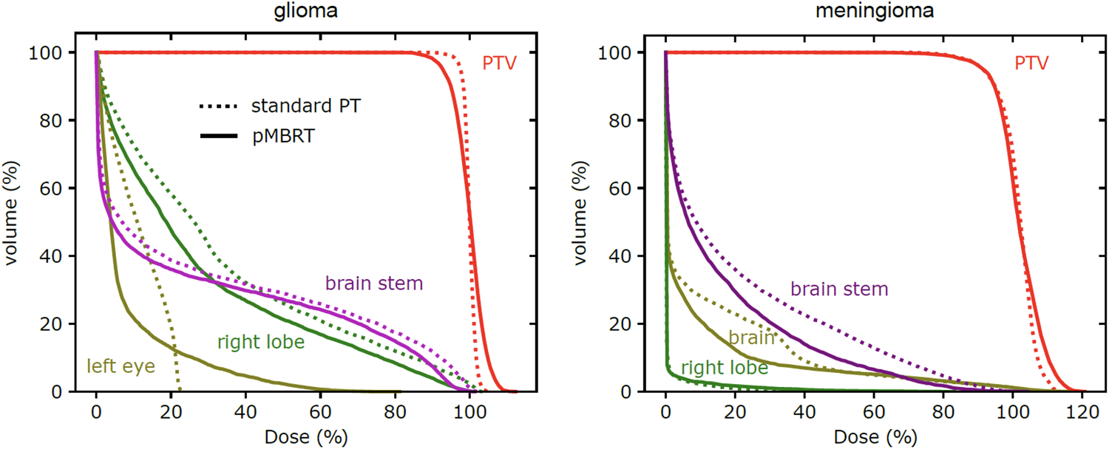
Minibeams
Simulation of Dose comparison for glioma (left) and menigioma (right)
pMBRT provided:
- reduced side effects
- superior tumour control
in high-grade glioma-bearing rats compared to standard irradiation
Next step: clinical studies
P. Lansonneur et al, Scientific Reports (2020) 10:7025 https://doi.org/10.1038/s41598-020-63975-9

Slide 12
Optimising Hadrontherapy: challenges and prospects
Treatment monitoring
- Beam monitoring & Range verification, radioactive beams

Slide 13
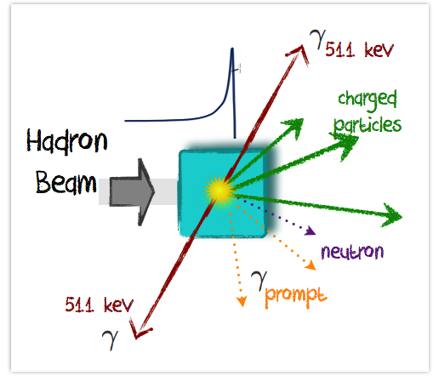
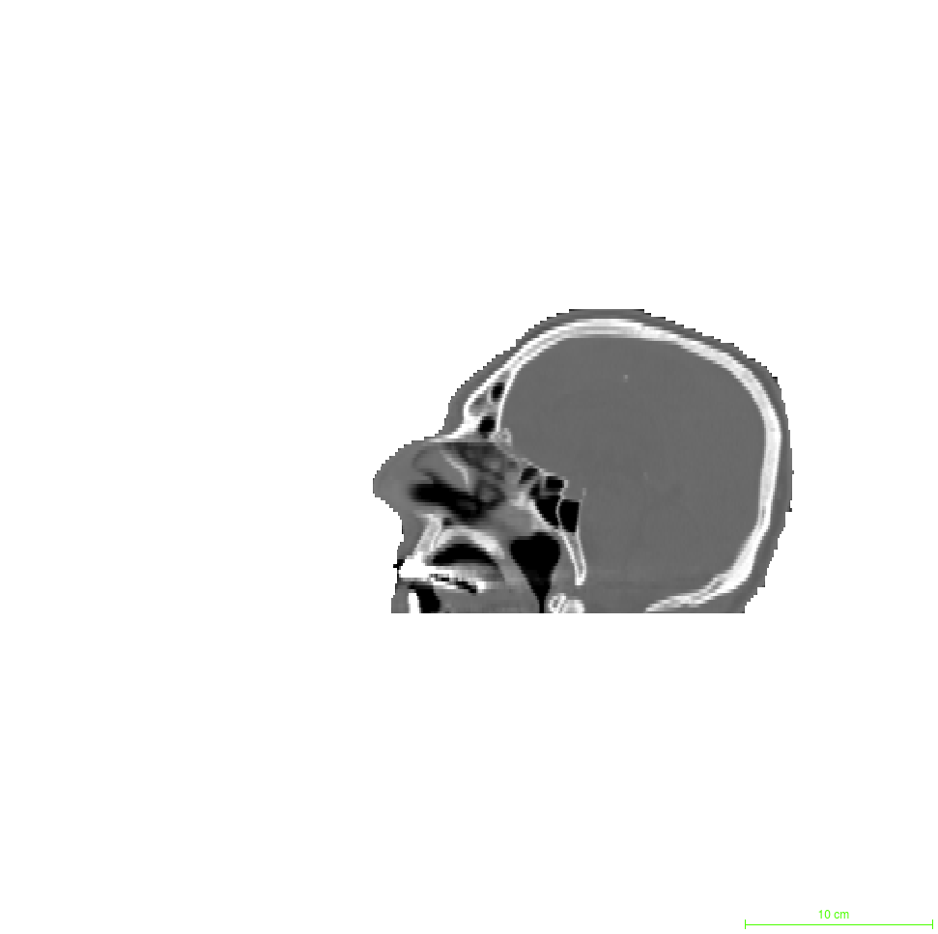
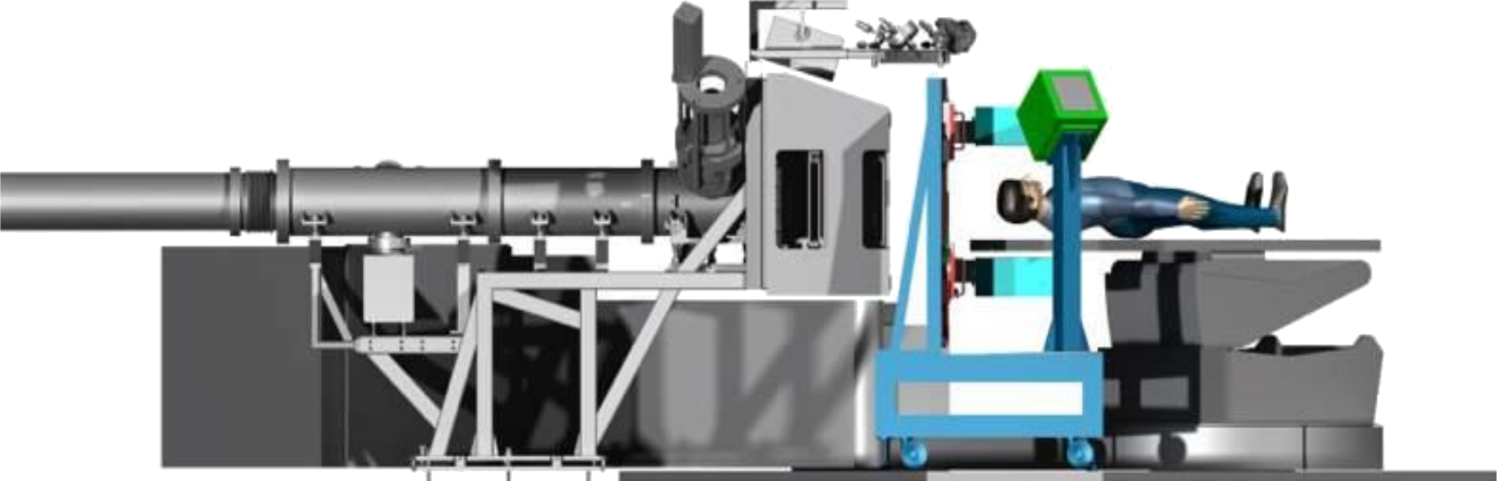
Beam monitoring
Where (x,y) is the beam fired?
What intensity?
Is it compliant with the treatment plan?

Slide 14

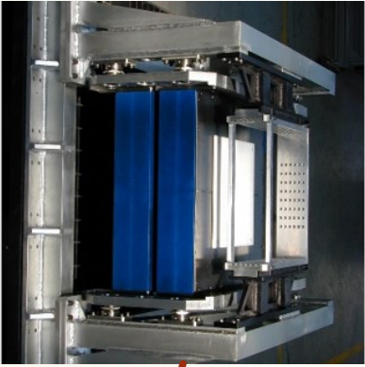
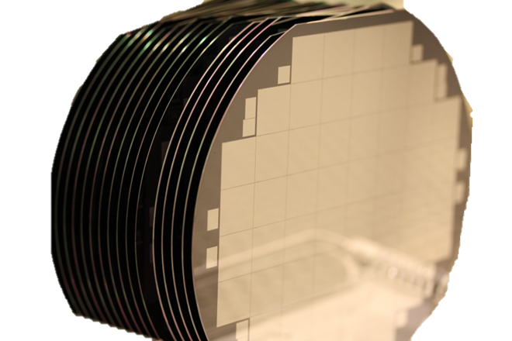
Piergiorgio Cerello
Beam monitoring
IONIZATION CHAMBERS
SOLID STATE DETECTORS
Main issues at
φ = 10¹⁰ p/cm²s
Signal pile-up
→ fast sensors & readout
→ segmentation
Radiation tolerance
→ manufacturing strategies
→ damage compensation
Detector area
→ at least 20x20 cm²
Collection times ~ 100 µs
Sensitivity ~ 10⁴ protons
Time resolution ~ no/poor
~ ns
single protons
< 100 ps
Not suitable for fast scanning modalities and timing applications
proton counting
timing applications
Courtesy of Roberto Sacchi

Slide 15
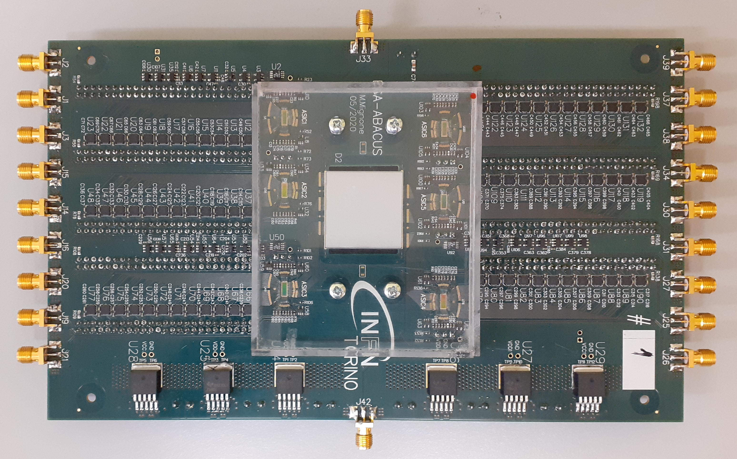
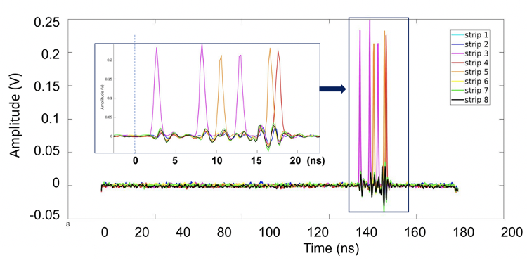
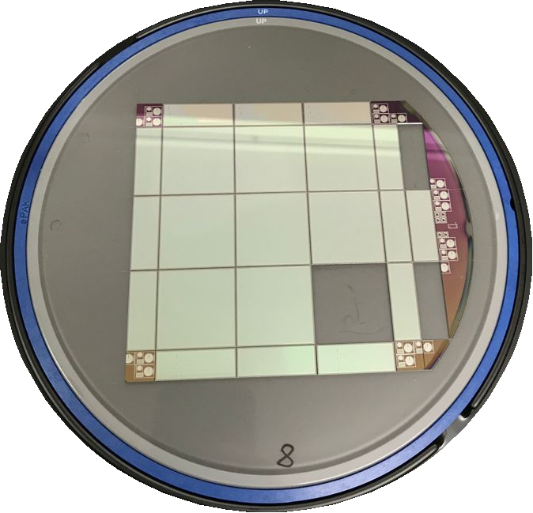
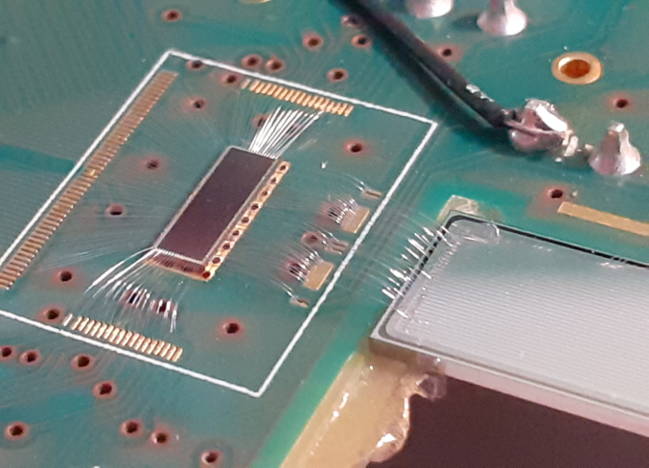

Piergiorgio Cerello
Beam monitoring with LGAD silicon detectors
Single proton identification and timing
2.7×2.7 cm² active area (144 strips)
30 ns
ABACUS ASIC (24 ch)
Carbon ions, 399 MeV/u
Courtesy of Roberto Sacchi

Slide 16
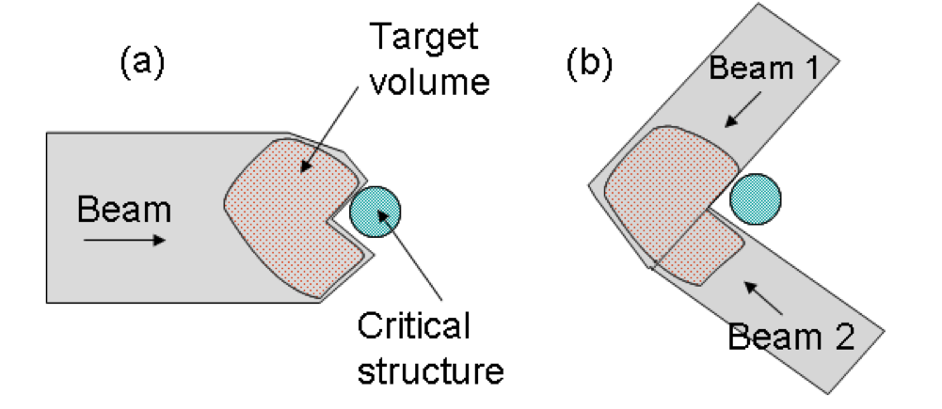
Particle Range Uncertainty
If range well under control,
only
Range uncertainty estimation for robust treatment plans
2.5-3% + 1-3 mm

Slide 17
In vivo range verification
𝛄 511 keV
charged particles
What depth (z) is the beam reaching?
Is it compliant with the treatment plan?
𝛄 511 keV
𝛄 prompt
neutrons

Slide 18
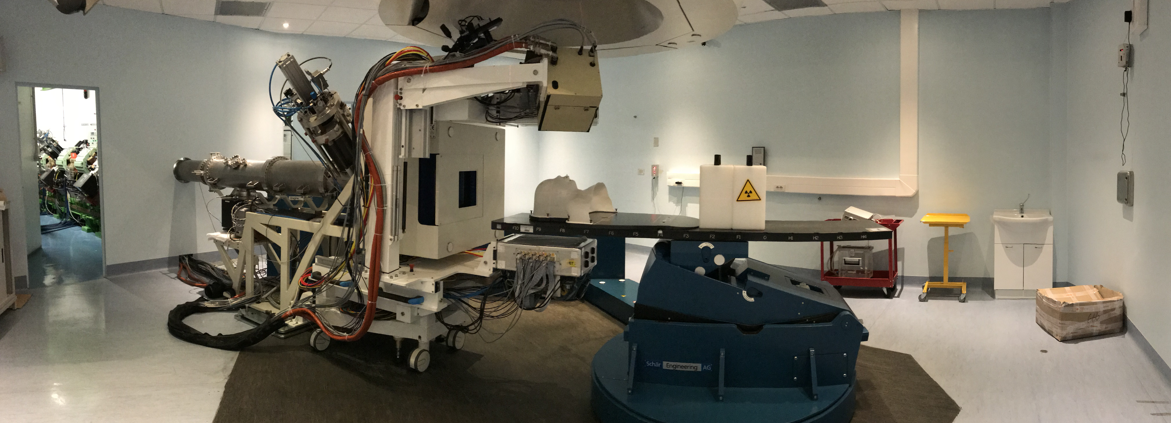







The INSIDE bimodal system
M.G. Bisogni at al, JMI 2017; Ferrero et al., Sci.Rep 2018; Traini et al., Phys. Med., 2017

Slide 19
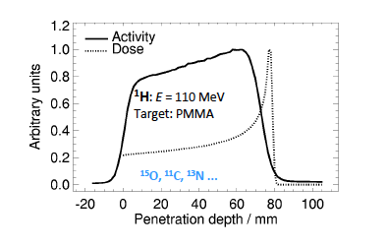
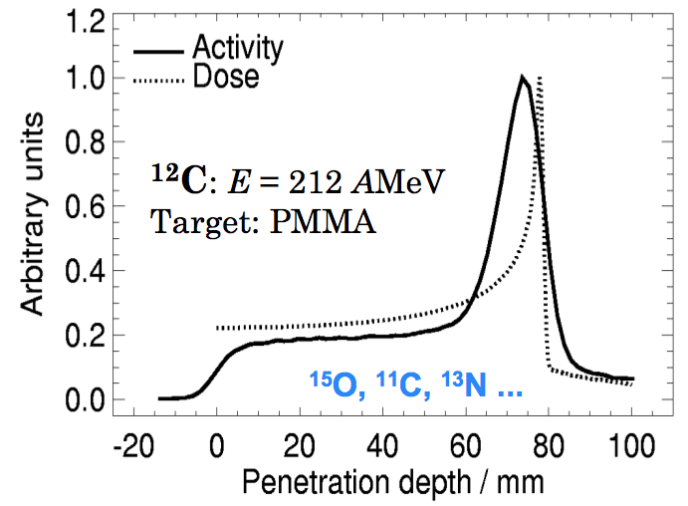
Positron emitters
Protons
Carbon ions
Isotope | T_{1/2}
¹¹C | ~ 20 m
¹⁵O | ~ 2 m
⁸B | 770 ms
¹²N | 0.011 s
⁹C | 126.5 ms
¹³O | 8.58 ms
J Pawelke et al., Proceedings IBIBAM, 26.-29.09.2007, Heidelberg
Activity distribution and Range are correlated
Main contributions from ¹¹C and ¹⁵O
Zhu X, Fakhri GE. Theranostics. 2013;3(10):731-740.

Slide 20
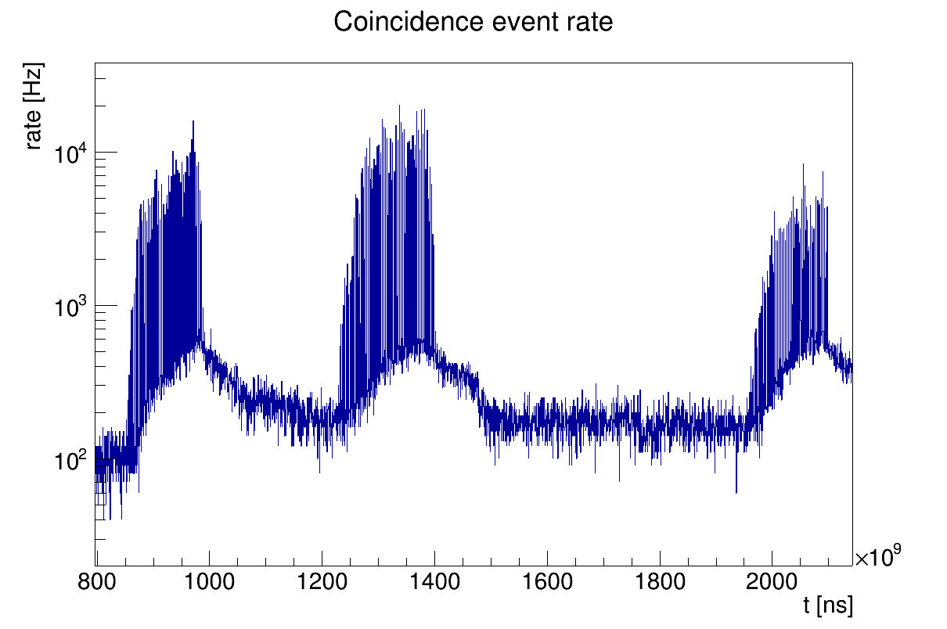

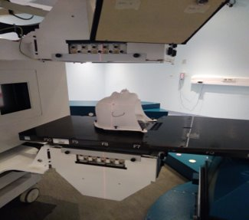
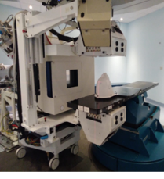
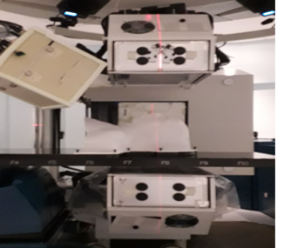
In-beam PET data patterns
Coincidence event rate
In-spill
vs.
Inter-spill
Pz6
Mettere I campi del pz 6
Forse meglio logY?
1st field
270° IEC
2nd field
0° IEC
3rd field
180° IEC

Slide 21
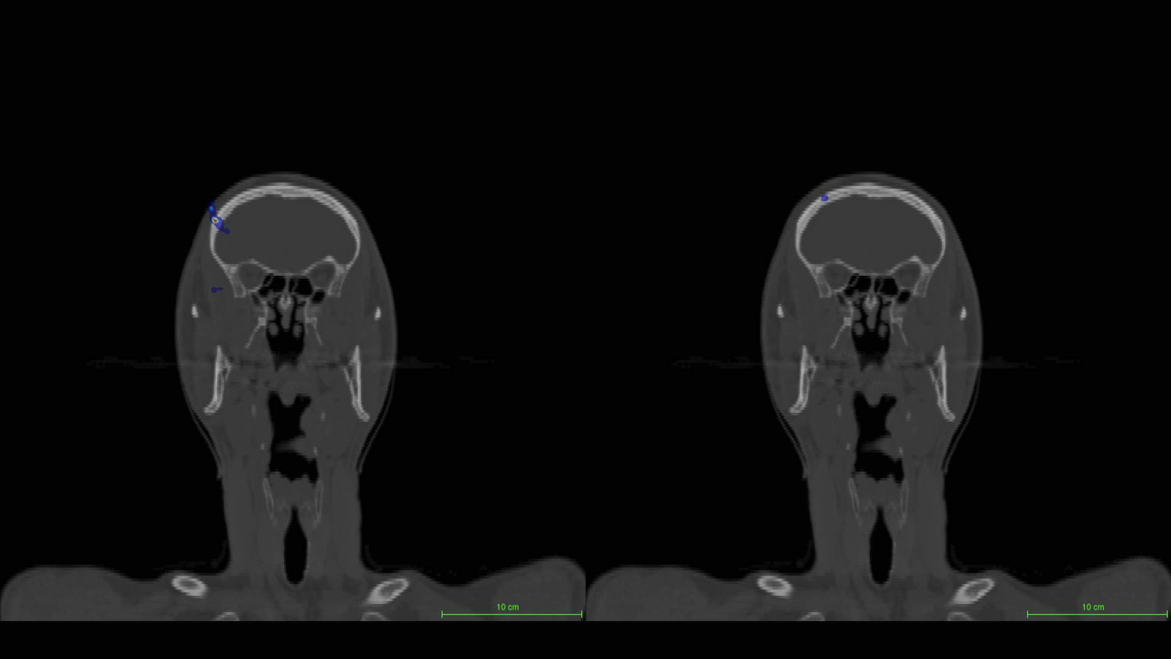
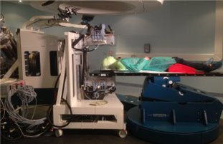
2016: First in-vivo measurement
Ferrero et al., Sci.Rep 2018; Fiorina et al., EJMP, 2018

Slide 22
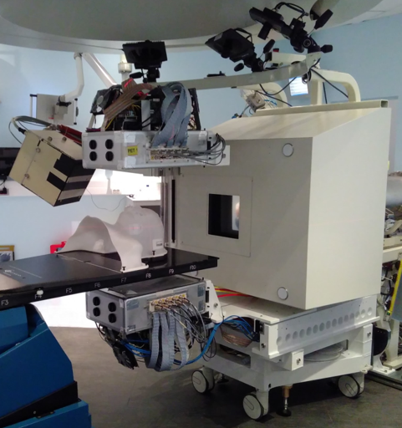
The INSIDE clinical trial
ClinicalTrials.gov NCT03662373
GOALS
Evaluate the INSIDE sensitivity in a clinical environment
Test the INSIDE capability to spot interfractional morphological changes
Phase 1 (2019-2020):
9 proton pts + 10 carbon ion pts
Phase 2 (2024-2025):
10 proton pts + 10 carbon ion pts
5
ACC
4
ACC
3
Meningioma
2
ITAC
5 monitored patients underwent interfractional morphological changes
2 patients needed replanning
1
SCC
chordoma
Chondrosarcoma
MMM
chordoma
Chondrosarcoma
proton patients
carbon ion patients

Slide 23
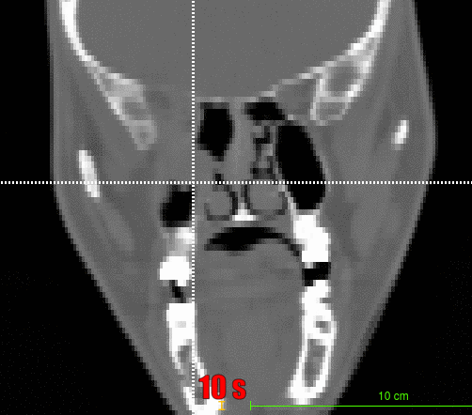
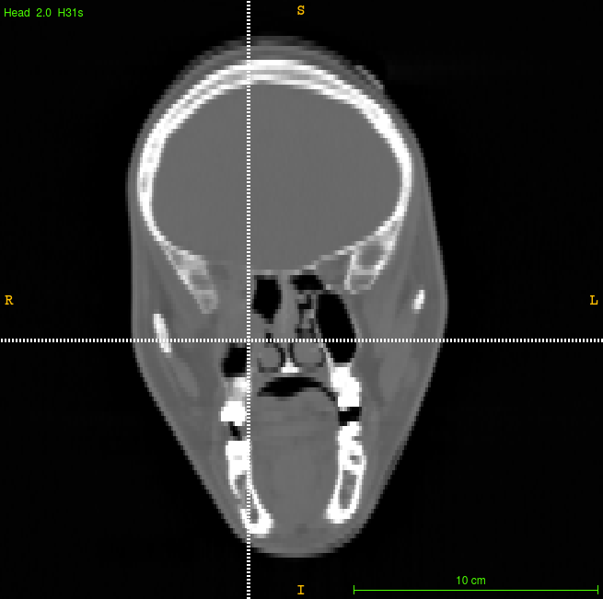
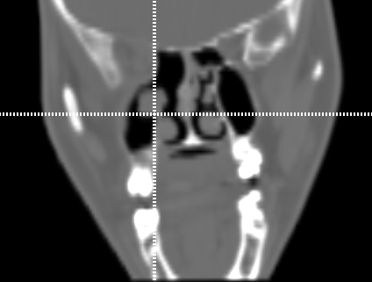
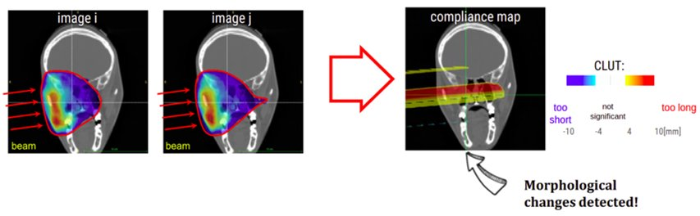
In-beam PET: proton treatments
in-beam PET image - 2 fx
in-beam PET image - 21 fx
Measure the range variation along the beam direction:
- BEV: Beam Eye View method
- Most Likely Shift method
Patient ID: 006P: female, 39y, affected by ACC, IMPT, CTV dose: 70 GyE in 35 fx (2.0 GyE/fx, 5 fx/week), two beams (15° - 175° IEC)
planning CT
control CT - 20 fx
Fiorina et al., Fron. Phys., 2021; Moglioni et al., Front. Onc. 2022

Slide 24
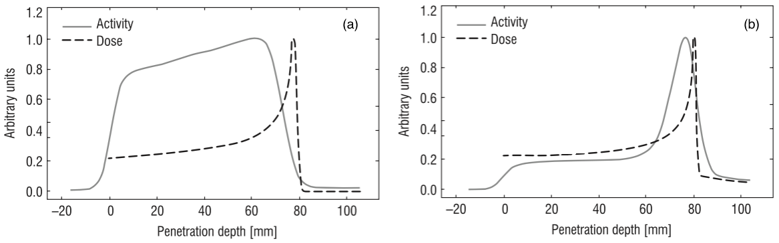
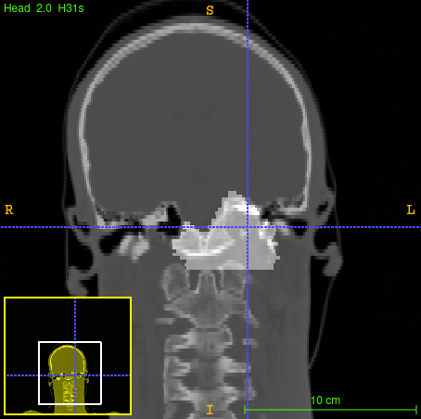
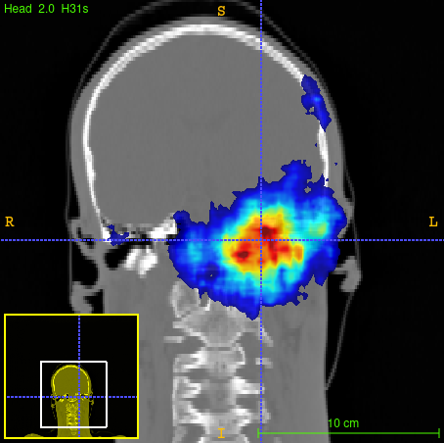
In-beam PET: carbon treatments
~ 1/100 of proton treatments statistics!!!
C, 212 MeV/u
Arbitrary units
CTV
Penetration depth [mm]
Ferrero, Bersani et al., poster IEEE MIC-NSS 2022

Slide 25
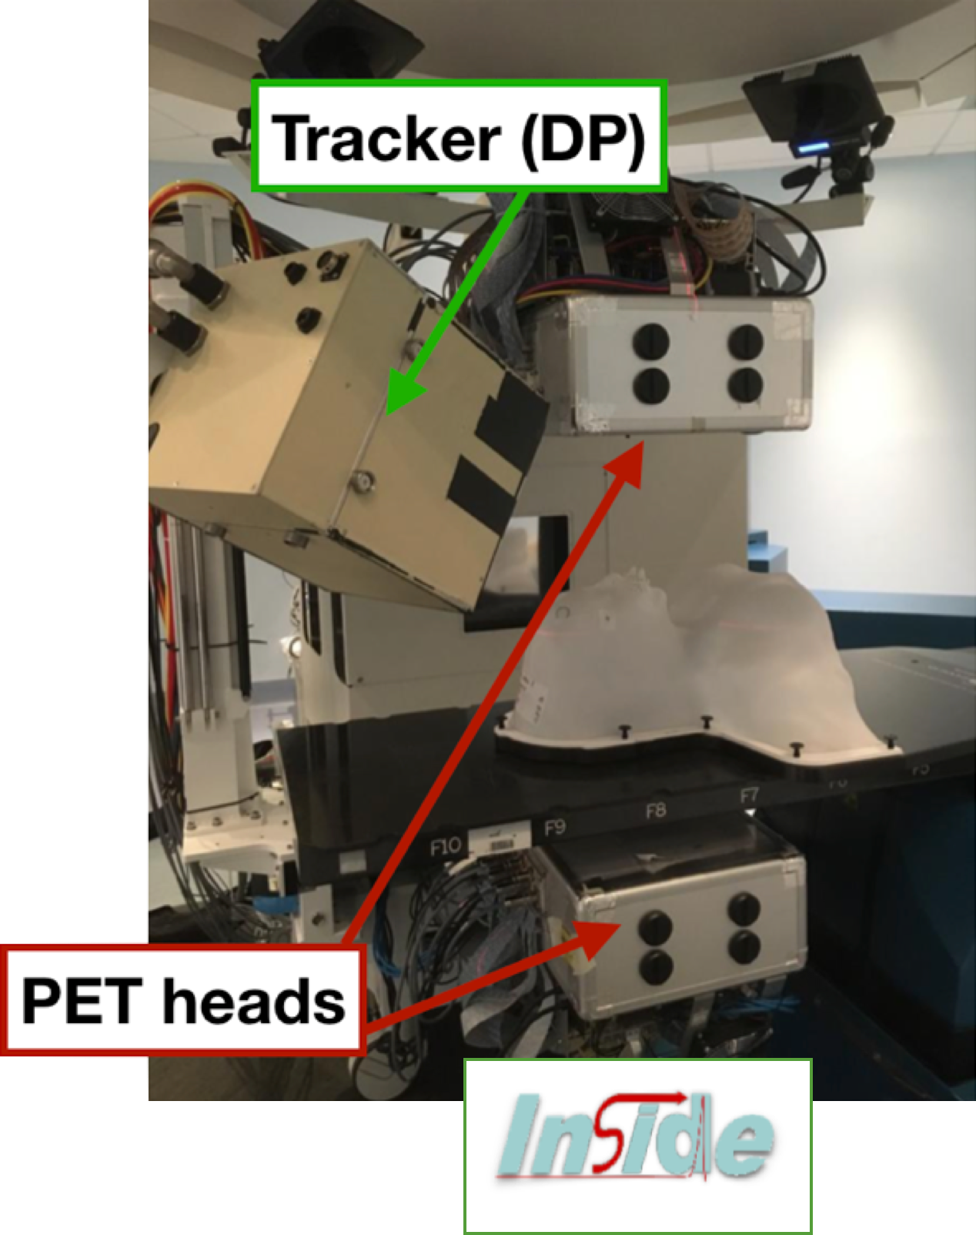
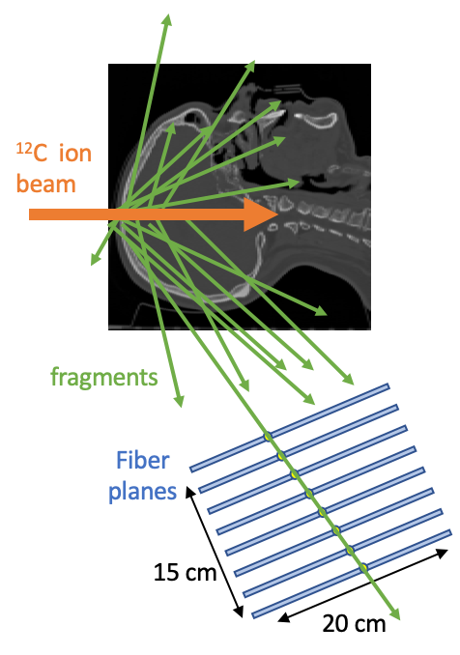
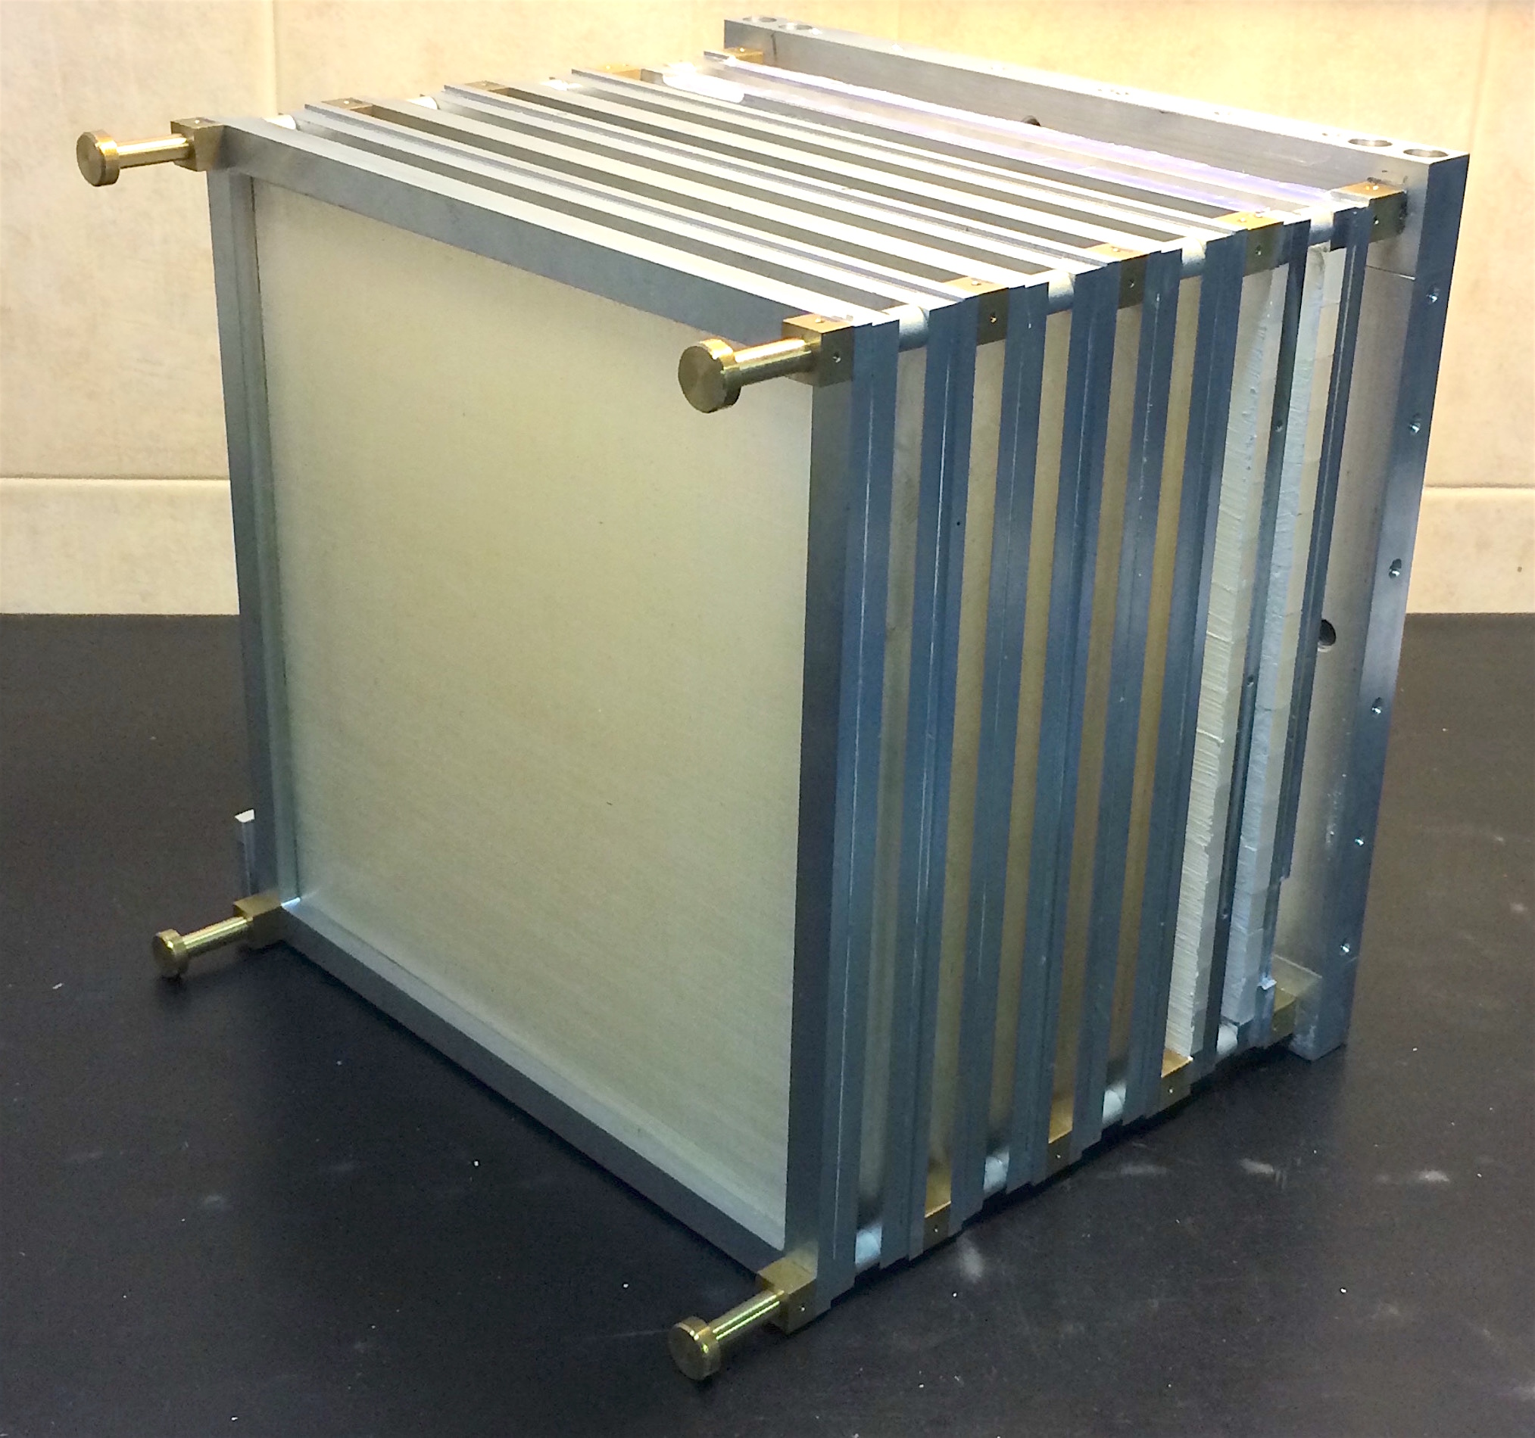
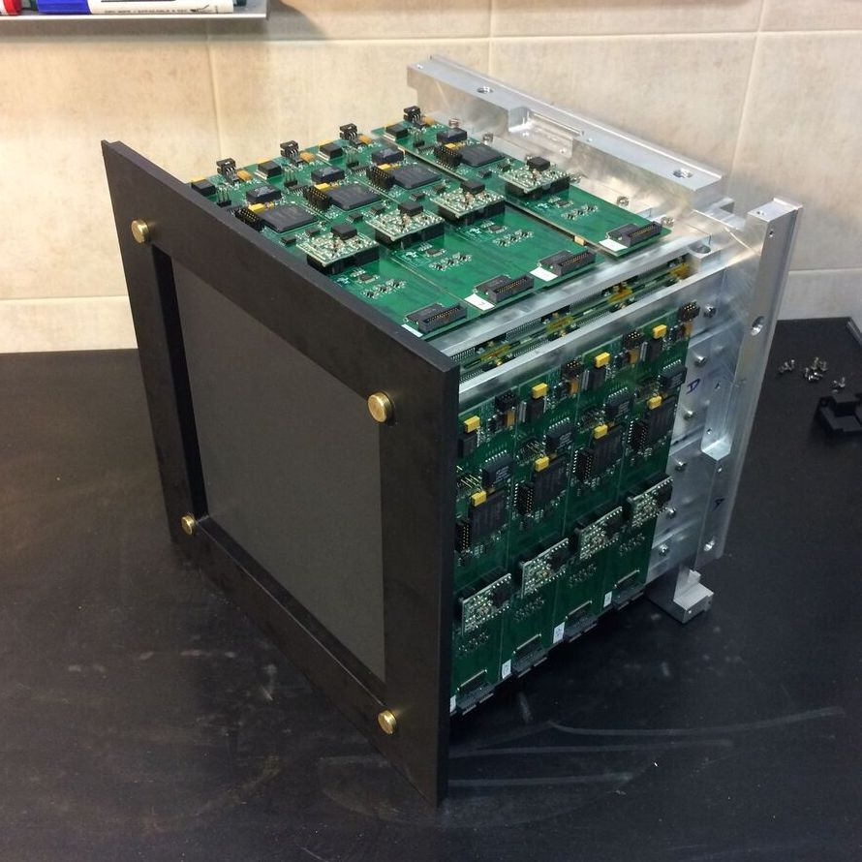
Piergiorgio Cerello
Dose profiler: carbon treatments
Detection of charged secondary fragments emitted @ large angle wrt the beam direction
8 planes composed of 2 orthogonally oriented layers of plastic scintillating fibres
SiPM read-out
Courtesy of Alessio Sarti

Slide 26

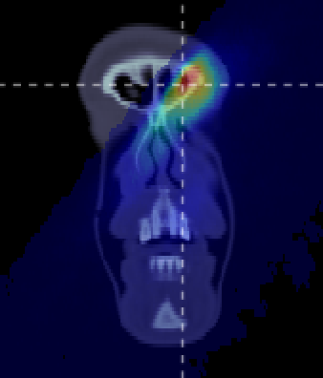
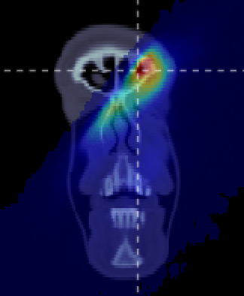


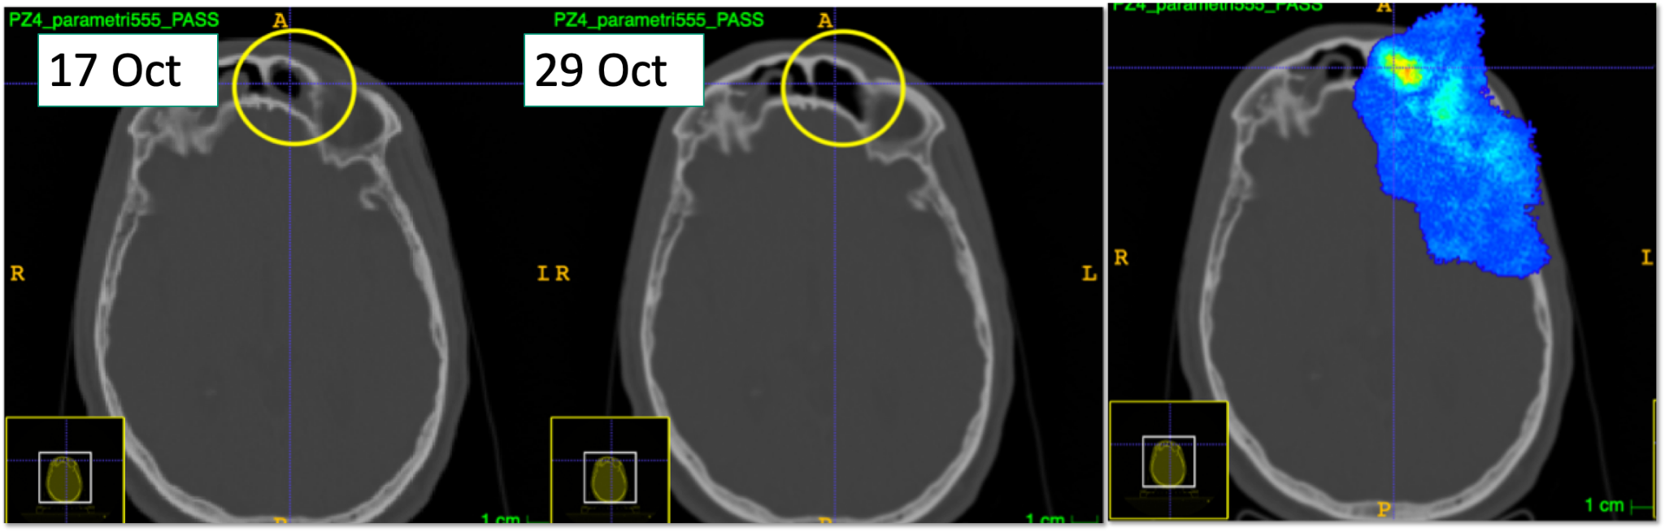
Piergiorgio Cerello
Dose profiler: carbon treatments
3D emission map of fragments collected during the treatment delivery
Gamma test (9mm/10%) has been used for voxel to voxel comparison
beam
gamma map
Courtesy of Alessio Sarti
ClinicalTrials.gov NCT03662373

Slide 27
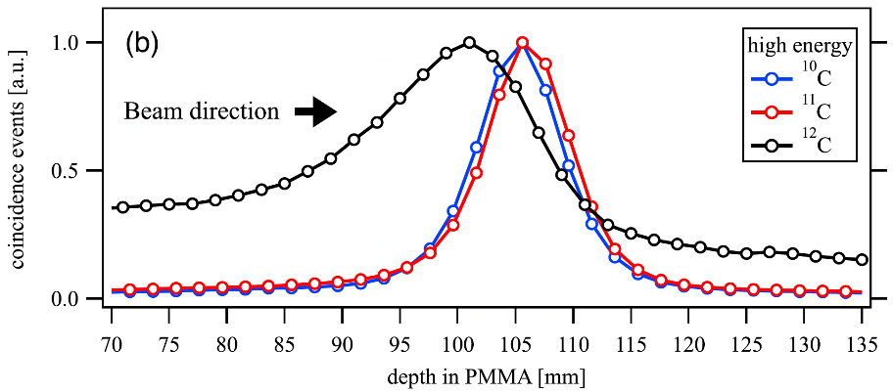





Radioactive ion beams (i.e., ¹¹C)
1/6 of a Siemens Biograph mCT clinical PET scanner with custom-modified detectors.
Two detector panels installed above and below the phantom each at a distance of 30 cm
RIB stops in the PMMA phantom
PET range uncertainty after delivering 1.6 x 10⁷ ions in 4 spills (19.2 s total):
0.04 mm, 0.7mm, and 1.3 mm for ¹⁰C, ¹¹C, and ¹²C
Courtesy of Marco Durante
Kostyleva et al. Phys. Med. Biol. 2022

Slide 28

Prompt photons
Several techniques to detect prompt photons:
Collimated gamma camera
Compton Camera
Prompt Gamma Timing
Magalhaes Martins, P. et al., Sci Rep 10, 7007 (2020)

Slide 29


Prompt Gamma Timing
Beam monitor
TOF = t_stop(𝛾) – t0 (beam particle) = t(beam in air) + t(beam in target) + t(𝛾)
F. Pennazio et al., PMB 67 (2022) 065005, doi: 10.1088/1361-6560/ac5765

Slide 30




Piergiorgio Cerello
Text
Prompt Gamma Timing: Stopping power!
Measurement of the EneRgy Loss for IN-vivo Optimization in particle therapy
Multi-detector approach relying on the SER-PGT reconstruction algorithm
(F. Pennazio et al., Phys Med Biol 2022)
t (ns)
The Bragg curve (in-vivo!!!)
Courtesy of Veronica Ferrero

Slide 31



Piergiorgio Cerello
Prompt Gamma Timing
monitoring of Positron Emitters & Prompt Photons with the same PET detector
First I3PET proton beam test (2021):
primary-secondary radiation coincidences identified!!!
- Trigger on PET detector
- Joint DAQ
I3PET modules
MoVeIT UFSD
beam
5 ns
I3PET module
signal
Secondary radiation
UFSD
signal
Primary beam
Courtesy of Francesco Pennazio

Slide 32




Piergiorgio Cerello
Text
Prompt Gamma Timing
Beam nozzle
Data vs. simulation
UFSD 8 strips
t (ns)
LaBr3 – UFSD time coincidences
Data
with(out) hole
227 MeV p
on PMMA
10⁷ pps
t (ns)
t (ns)
Courtesy of Veronica Ferrero

Slide 33
Optimising Hadrontherapy: challenges and prospects
New approaches
- Boron Neutron Capture Therapy
- FLASH therapy

Slide 34

Boron Neutron Capture Therapy (BNCT)
Piergiorgio Cerello
Text
- neutron flux on ¹⁰B-enriched target tissue
- high LET* secondaries produced in ¹⁰B(n,α)⁷Li
- very short range (μm)
highly effective at cell level
*Linear Energy Transfer
Several facilities built / planned worldwide
Most advanced status:
- clinical trial (Japan)

Slide 35


Piergiorgio Cerello
in vivo BNCT dosimetry by single photon detection
”therapeutic” dose dD(x,y,z) ~ nB10(x,y,z) . Φ(x,y,z)dV ~ dIγ(x,y,z)
accelerator-based neutron source
Photon detectors
Real time measurement of ¹⁰B reaction rate
multiple detectors = multiple projections
BNCT-SPECT or Compton Camera
voxel size < 1 cm³
statistical uncertainty < 10% @478 keV
¹⁰B reaction rate > 10⁶ cm⁻³s ⁻¹
Challenges:
mechanical collimator effective @ 478 keV
intense n+γ background (2.2 MeV γ rays from ¹H captures)
compact and portable system to adapt to patient’s position
Courtesy of Nicoletta Protti

Slide 36







The FLASH effect
FLASH
CONV
Irradiation with ultra-high dose rate
> 40 Gy/s for a total irradiation time < 100 ms
Instantaneous dose rate up to 10⁹ Gy/s
28 Gy 31Gy 34 Gy
(Vozenin et al. 2019, Clin. Canc. Res. )
Decrease of the normal tissue response
Preservation of the tumor responses
(V. Favaudon et al. 2014, Sci. Transl. Med.)
Courtesy of Alessio Sarti

Slide 37

What if FLASH can help on tumours too?
First time it is demonstrated that FLASH can help on hypoxic tumours!
U-87 MG human GBM cells implanted in subcutaneous of female mice
20 Gy single fraction delivered with:
CONV (left)
FLASH (right)
radiation therapy
different oxygenation conditions (physioxia – hypoxia – hyperoxia)
Relative tumour volume
Relative tumour volume
Days after irradiation
Days after irradiation
Oriatron 6e, 6-MeV electron beam linear accelerator (LINAC)
Leavitt RJ et al. Int J Radiat Oncol Biol Phys. 2024 Feb 20:S0360-3016(24)00320-1. doi: 10.1016/j.ijrobp.2024.02.015
Courtesy of Alessio Sarti

Slide 38
What is missing for clinical implementation?
… pretty much “everything” …
Proper explanation of the mechanism and modelling
Tools for the treatment planning
A technology suitable for delivering FLASH treatments meeting the clinical / dose conformity prescriptions for p, 𝛾 & e⁻ machines
A dosimeter/beam monitor technology that can be routinely used in the clinical workflow
Courtesy of Alessio Sarti

Slide 39
Piergiorgio Cerello
Text
Particle Therapy key developments
Beam delivery: ion gantries, minibeams
Beam monitoring: silicon detectors radiation resistance and size
Range Verification: radioactive beams, in-vivo Bragg peak measurement
Target Fragmentation: cross section measurements (p, C beams on C, O, Ca targets)
Boron Neutron Capture Therapy: from clinical trials to clinical implementation
FLASH therapy: «all of it» - but very promising

Slide 40

Piergiorgio Cerello
Unless things are much simpler…
Text
… a sieve to modulate protons,
and a fan to remove neutrons…

Slide 41
Piergiorgio Cerello
Text
Particle Therapy key developments
Beam delivery: ion gantries, minibeams
Beam monitoring: silicon detectors radiation resistance and size
Range Verification: radioactive beams, in-vivo Bragg peak measurement
Target Fragmentation: cross section measurements (p, C beams on C, O, Ca targets)
Boron Neutron Capture Therapy: from clinical trials to clinical implementation
FLASH therapy: «all of it» - but very promising

