Slide 1
SEVEN Sviluppo di detector per risonanza magnetica a 7T
Alessandra Retico
INFN - Sezione di Pisa
Pisa, 14 Giugno 2011

Slide 2
SEVEN Sviluppo di detector multinucleari per risonanza magnetica a 7T Coordinatore: Alessandra Retico (INFN, Pisa) (2011-2012)
A Magnetic Resonance (MR) scanner with ultra high magnetic field strength (7T) available in Pisa (IMAGO7 Foundation).
Radio frequency (RF) detectors (coils) for ultra-high fields and specific applications are neither provided by the scanner manufacturer nor readily available on the market jet.
SEVEN research proposal: design, development and validation of three different models of RF coil prototypes for body extremities of volunteers (wrist, calf, leg).
Final clinical application: Imaging (MRI) and Spectroscopy (MRS) of skeletal muscles to set up a research protocol on inherited neuromuscular disorder.

Slide 3
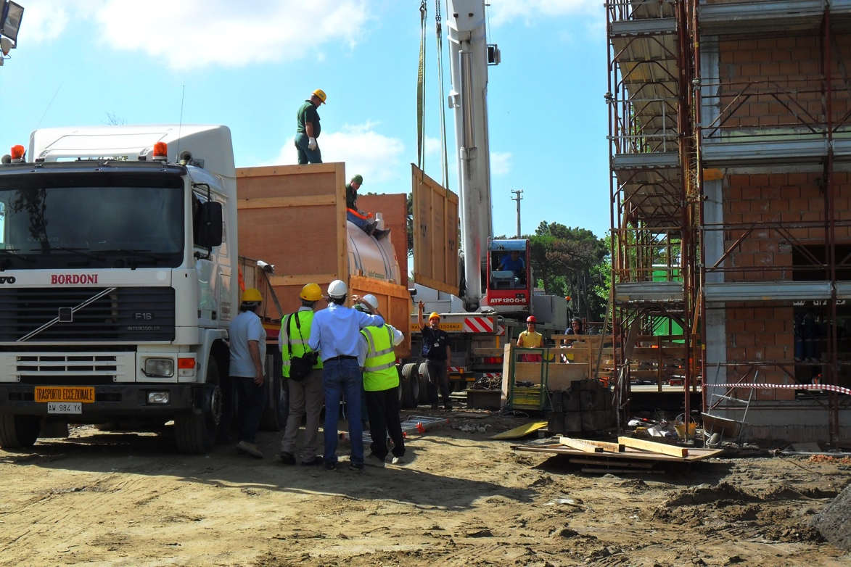
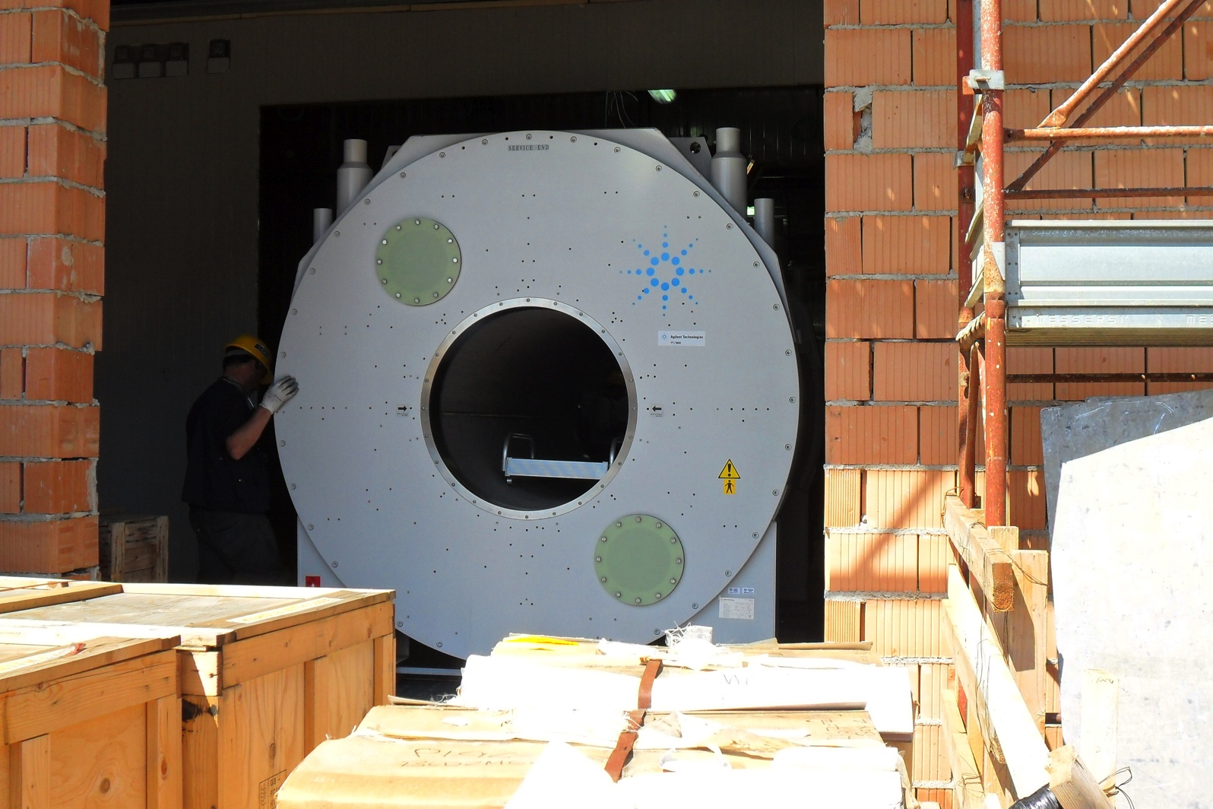
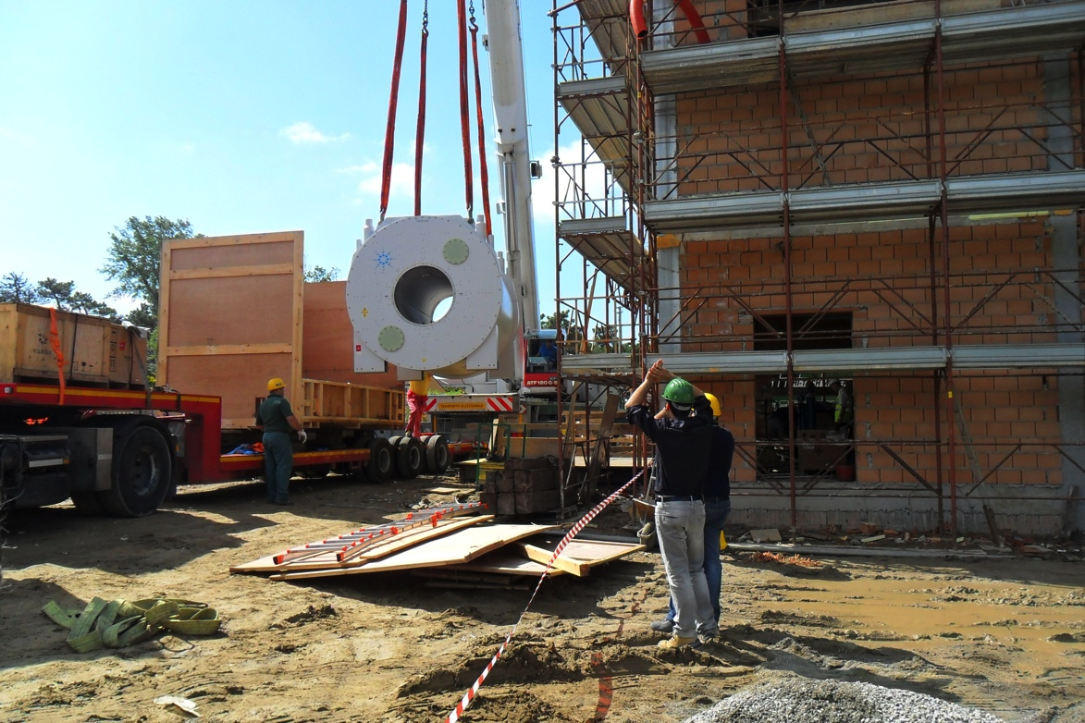
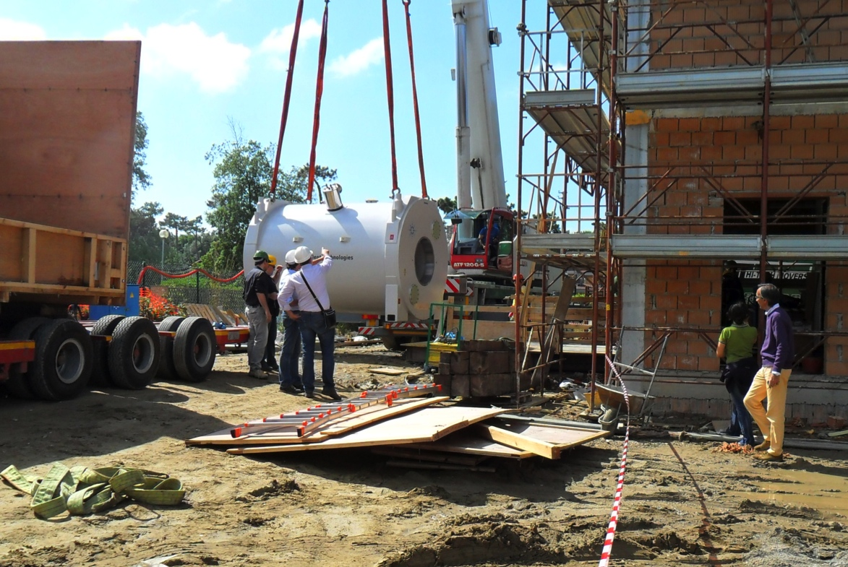
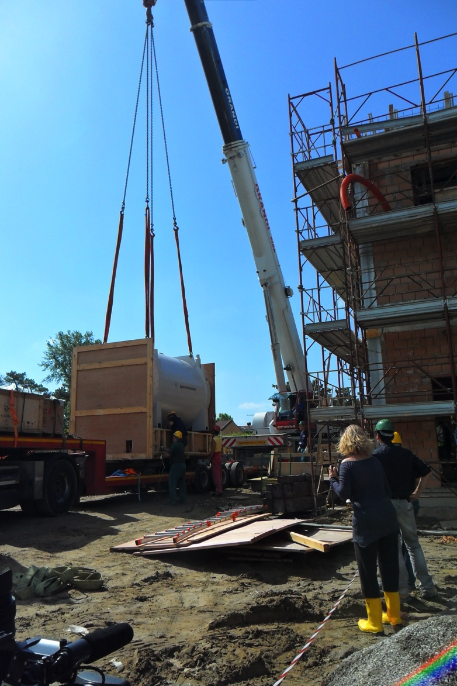
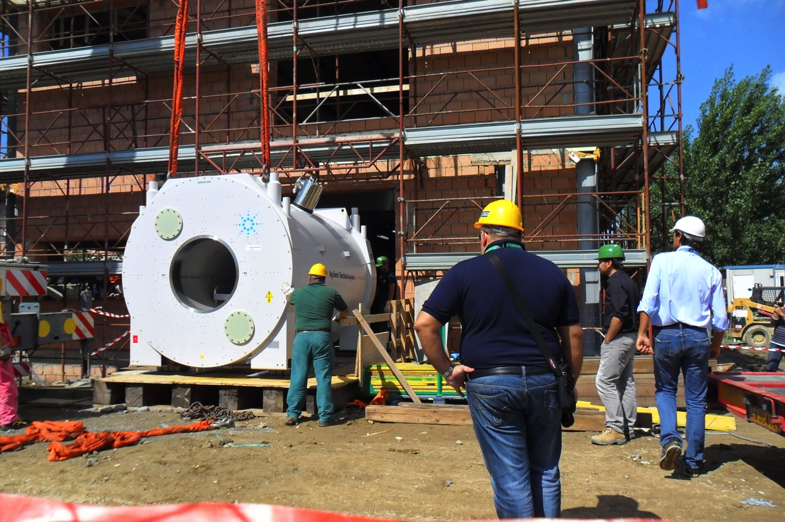
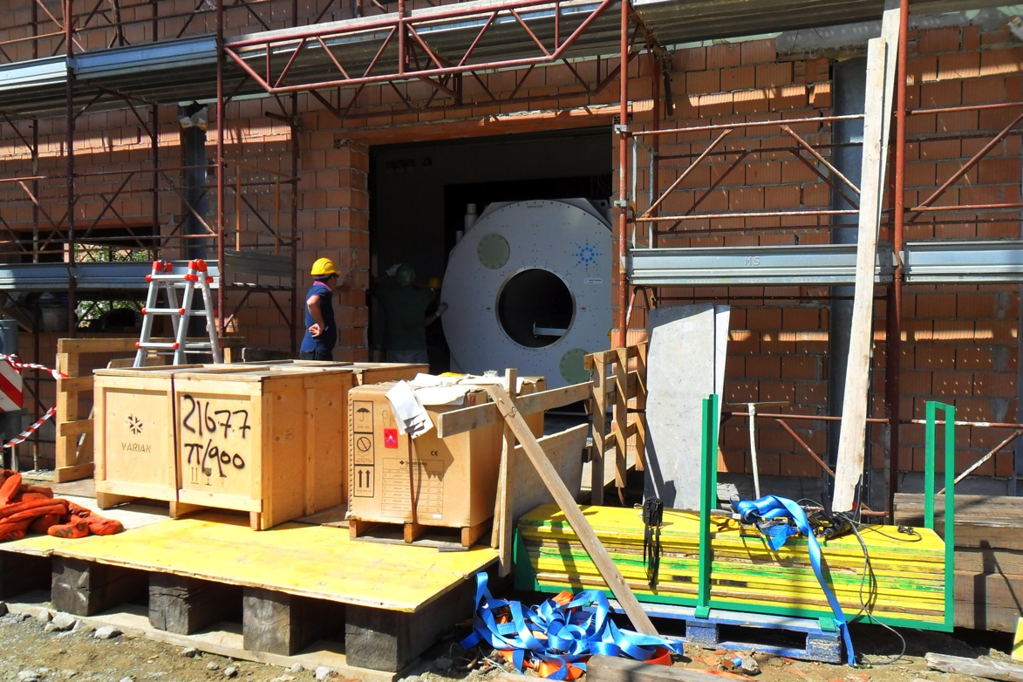
Delivery of the 7T magnet at the Imago7 Foundation – June 9, 2011

Slide 4
Main steps of the project - MILESTONES
Numerical electromagnetic modeling, design, implementation, and 7 T in-magnet testing of the coil prototypes
Design and development of new detectors
Numerical electromagnetic modeling
Design and implementation of suitable phantoms for the in-magnet measurements
4) Implementation and comparison of different B₁ mapping techniques
5) Measurements of B₁ maps and evaluation of SAR maps for each coil prototype
6) Experimental measurements with phantoms and volunteers
7) In vivo MRI and MRS measurements in neuromuscular disorders

Slide 5
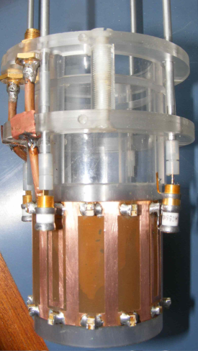
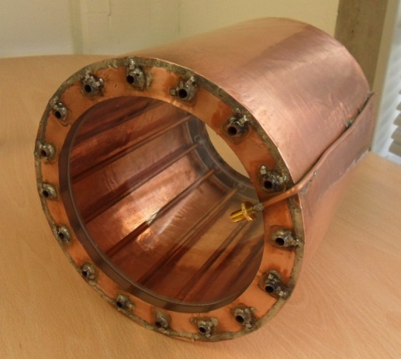
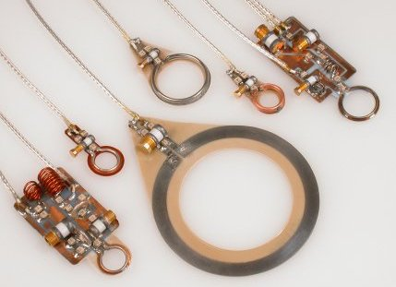
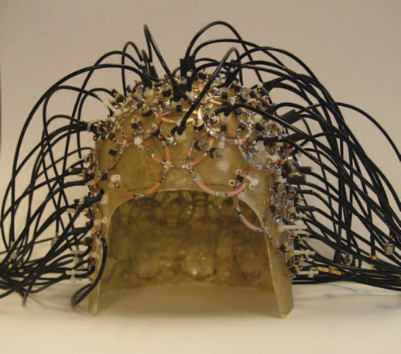
RF coils
Volume Coils ( T only or T/R)
Solenoid
Helmotz pair
Saddle Coil
Birdcage
TEM
Surface Coils (R only or T/R)
Single loop
Quadrature dual loop
Butterfly coil
Phased array
Frequency
Input impedance
Q factor
SNR

Slide 6
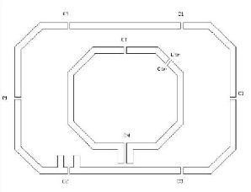
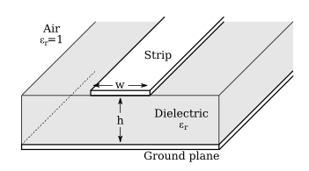
RF coil prototypes
A set of three single-loop surface coils suitable for proton (SL-H) with variable size (diameter in the 3-15 cm range).
A dual-tuned (¹H, ³¹P) surface coil with two concentric rectangular loops (DT-DL) for the detection of proton and phosphorus signals.
A dual-tuned (¹H, ³¹P) RF coil with microstrip technology (DT-microS) for the detection of proton and phosphorus signals.
PI
PI
AQ

Slide 7
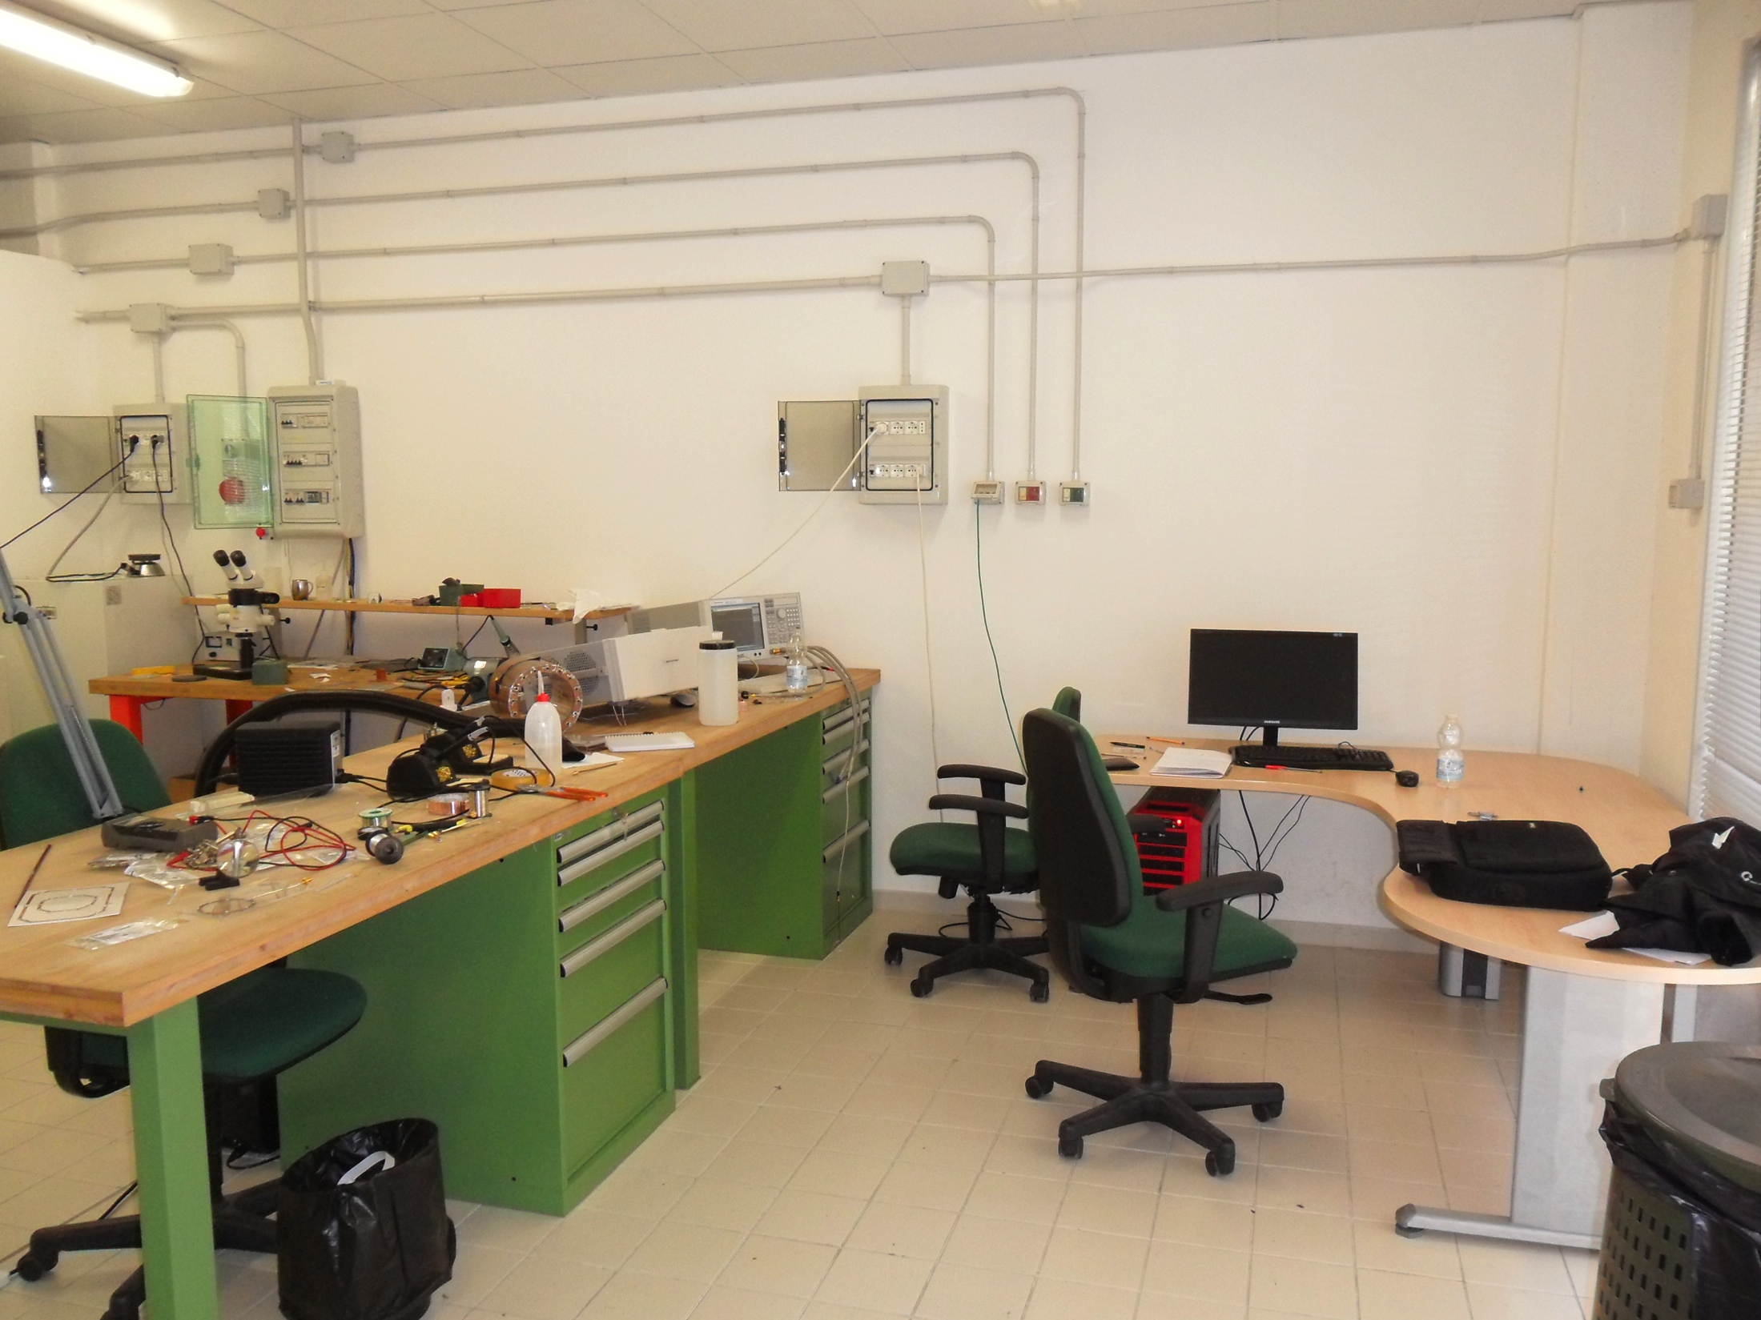
RF LAB

Slide 8
First six months 2011
RF lab activity: coil design and development
Single-loop coils: simulation, prototypes and comparison
the tuning and matching procedures
1.5 T and 7 T examples
Dual-tuned RF coils:
1.5 T and 7 T examples
TEM resonator: simulation, prototypes and comparison
Collaboration with Jim Tropp (GE)

Slide 9
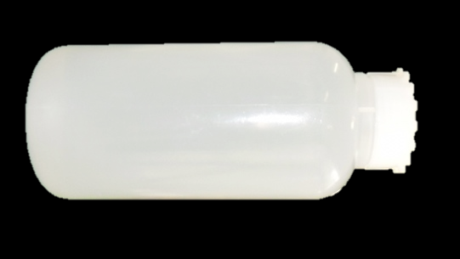
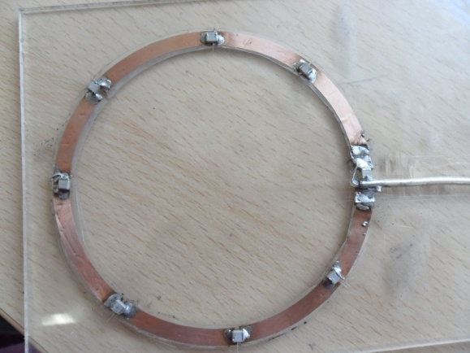
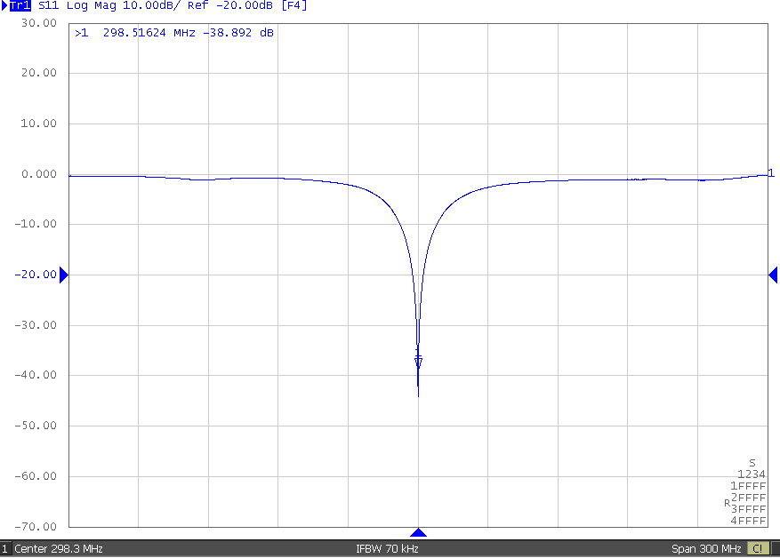
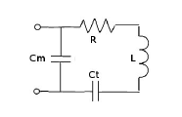
Single loop coil @7 T
A single loop coil with external diameter 8.3 cm has been realized using a copper strip with 4 mm width and 35 micron thickness.
S₁₁ of the matched and tuned single loop (with load):
c_{t} =1.7 pF, c_{m} =8.2 pF
σ=0.69 S/m
ε_{r}=79
Single loop loaded with homogeneous cylindrical phantom

Slide 10
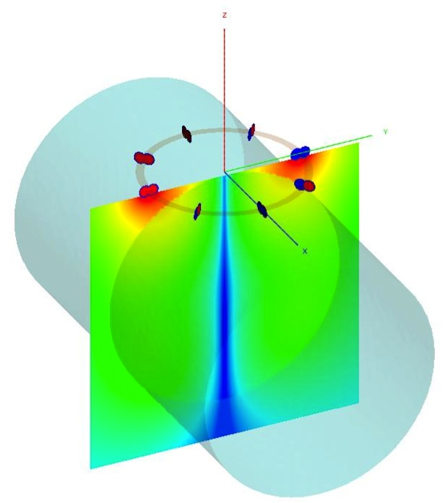
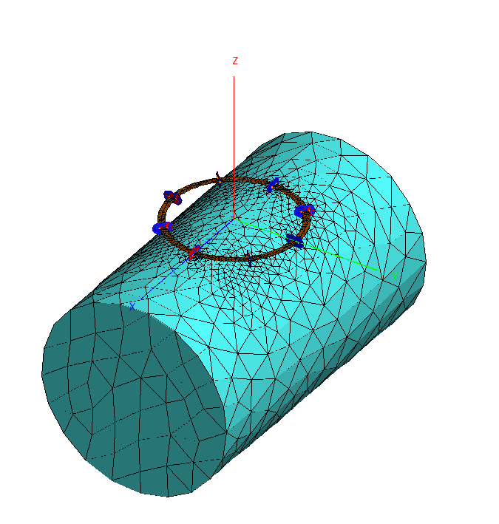
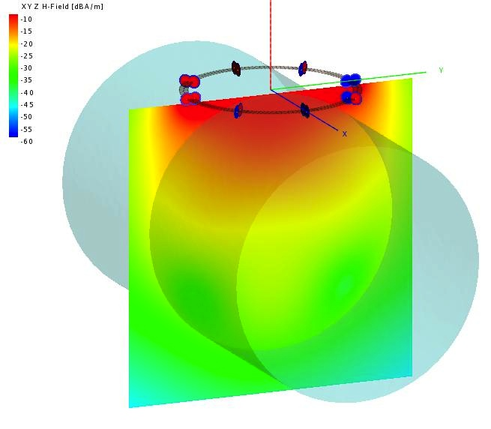
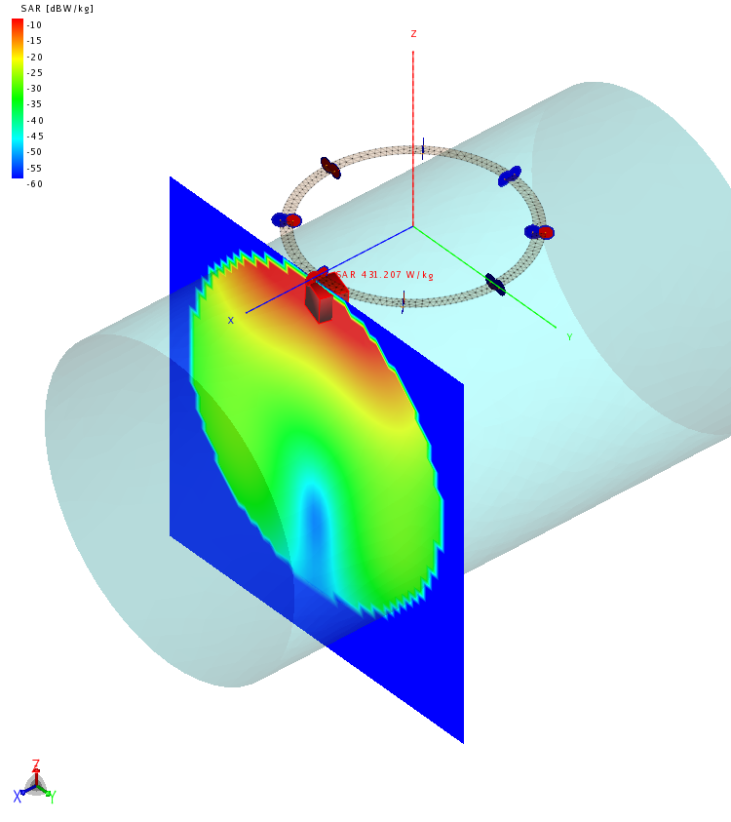
Single loop coil @7 T
Commercial software (FEKO, CST) were used to simulate the coil operating parameters and both magnetic and electric field distributions.
The tuning capacitor c_{t} obtained through conventional workbench procedure is 1.7 pF, while CST and FEKO procedure leads to 1.69 pF and 1.62 pF, respectively (loaded condition).
Magnitude of the normalized electric field and B field distribution, logarithmic scale, in a yz-plane crossing the load.
E
NOTE: Dielectric Resonance!!
NOTE: It can be used for local SAR monitoring!!
B₁
SAR

Slide 11
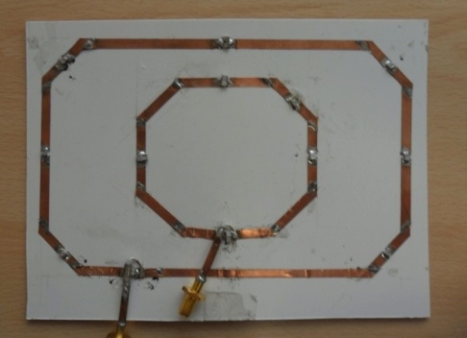
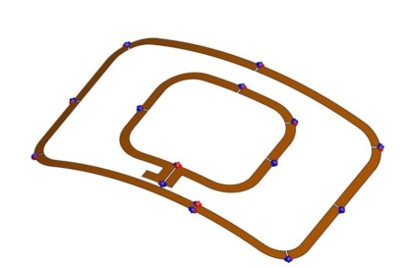
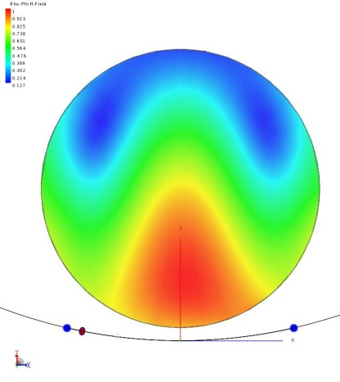
Dual Tuned coil @ 7 T: trap decoupling
First attempt:
same geometry as 1.5 T dual-tuned coil
simulation to evaluate if the design is feasible for 7T
Good agreement between simulation and practical realization
PROBLEMS:
Huge field inhomogeneities due to dielectric resonance
Low sensitivity (due to large dimensions)
In a not uniform sample, i.e. real or more realistic arm/leg phantoms, dielectric resonance is expected to be lower
12x18.5 cm²
B₁

Slide 12
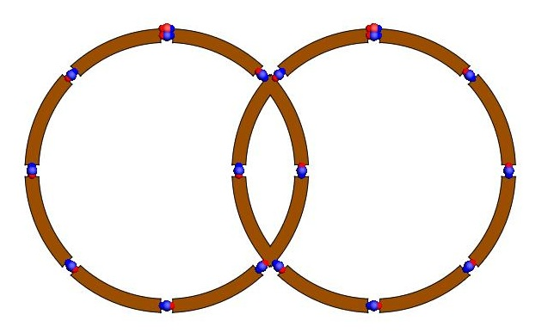
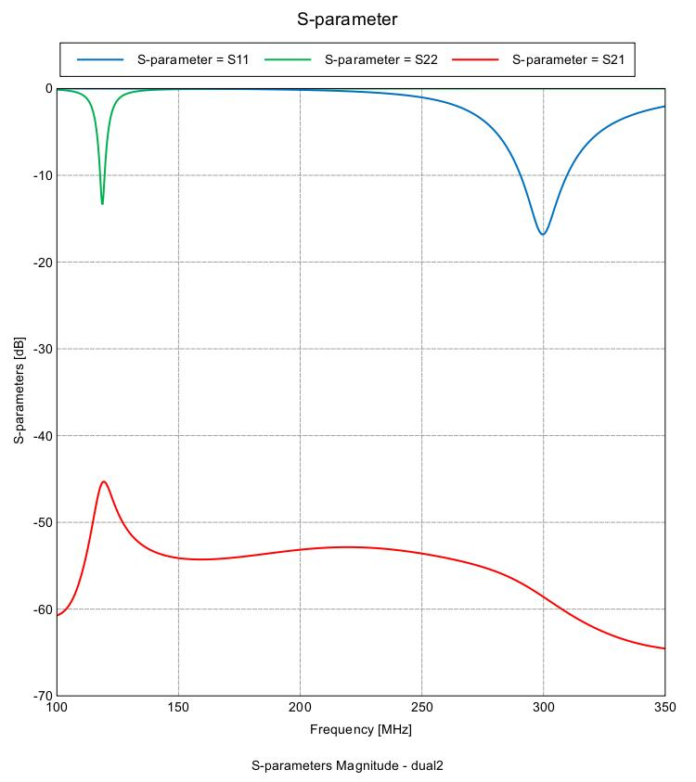
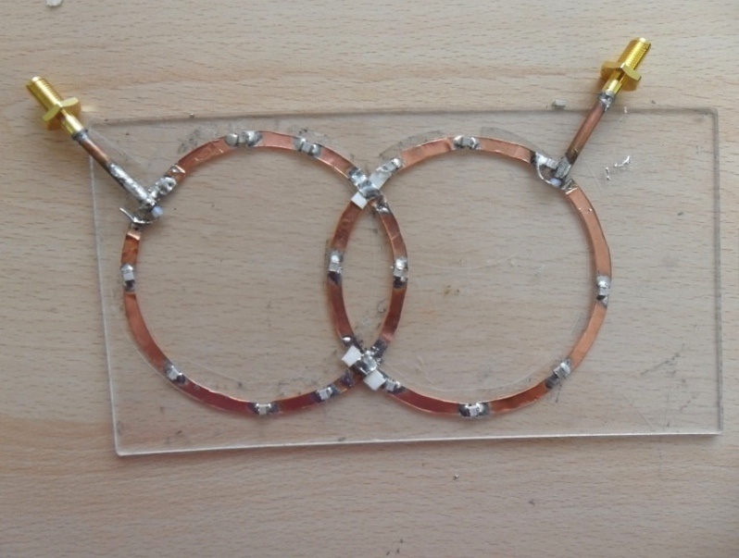
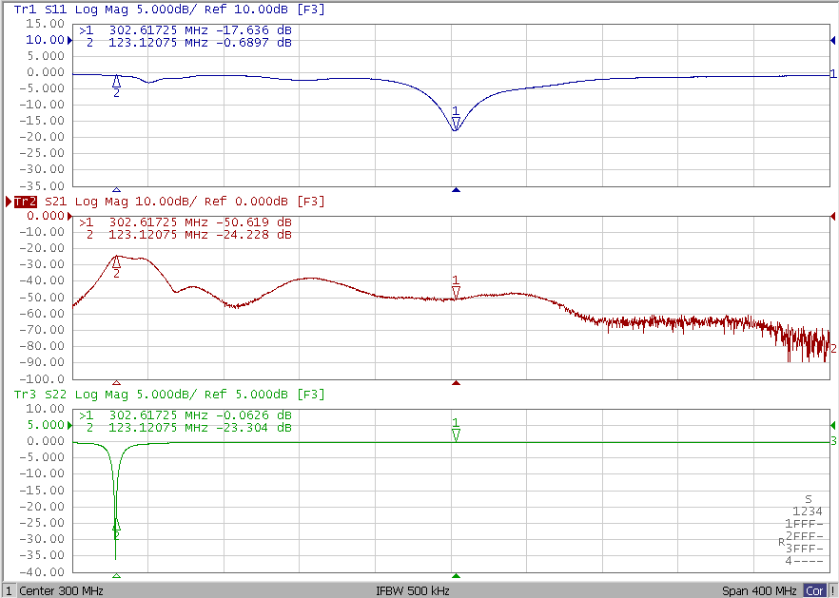
Dual Tuned coil @ 7 T: overlap decoupling
2 loops with partial-overlap decoupling
PROBLEM:
Different FOV between H and P channels
The agreement between simulation and measurement is very good.
The decoupling between the channels is less than -35 dB

Slide 13
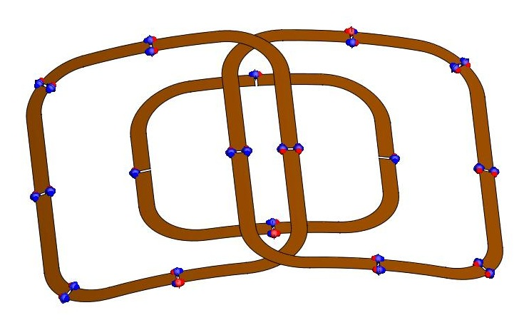
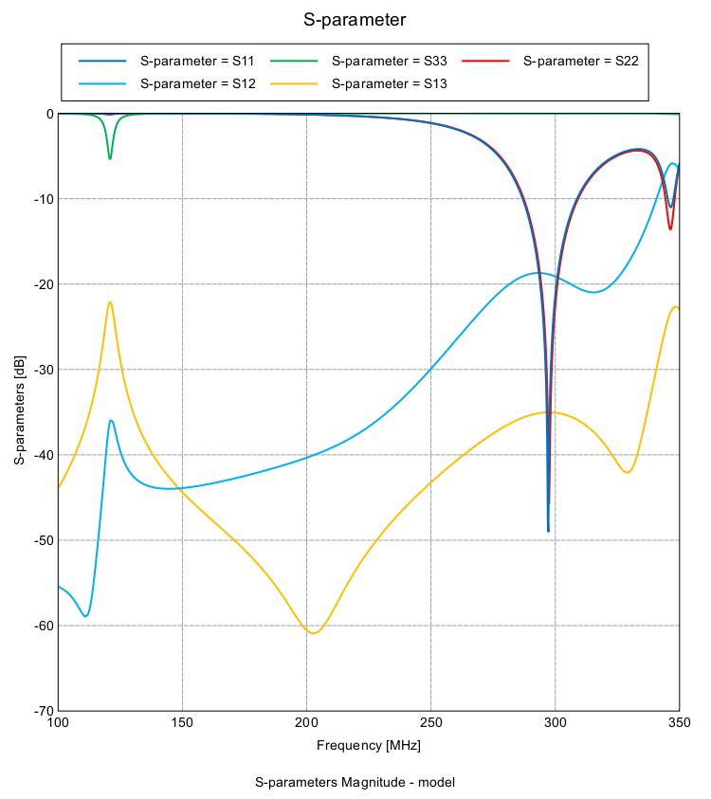
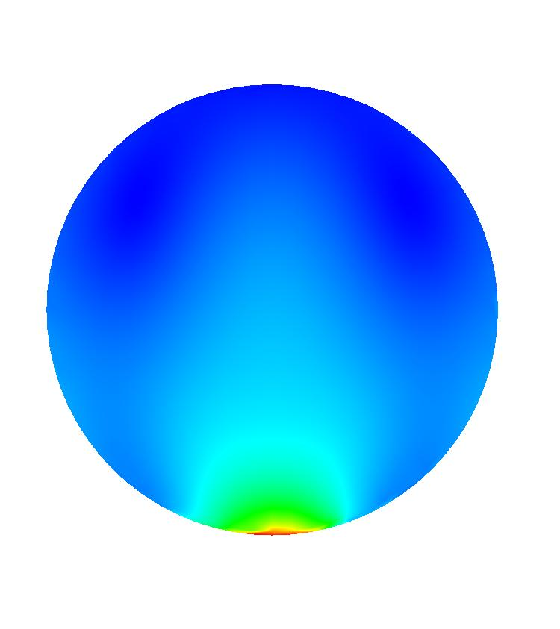
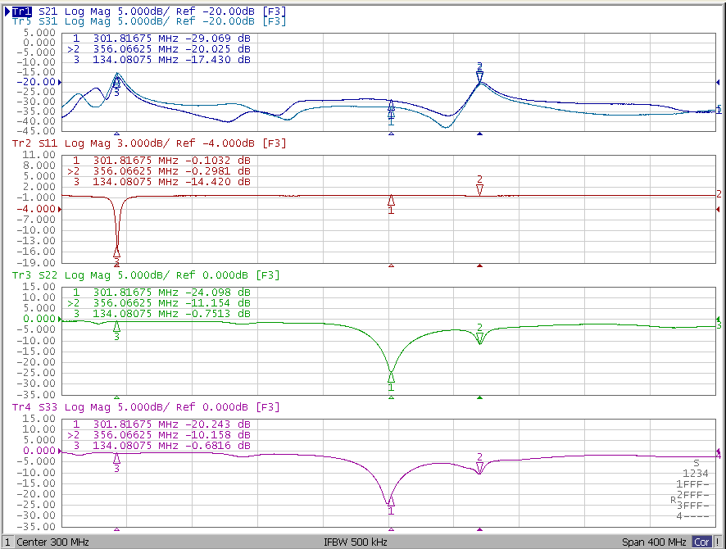
Dual Tuned coil @ 7 T: overlap & trap
We can combine:
Quadrature 1H coil with partial-overlap decoupling
Linear 31P coil with trap circuit decoupling
The agreement between this model and the measurement is very good
Better sensitivity for the proton
Good decoupling between the 3 loops
Less penetration deep
Dielectric resonance
We can use this design only close to the surface.

Slide 14
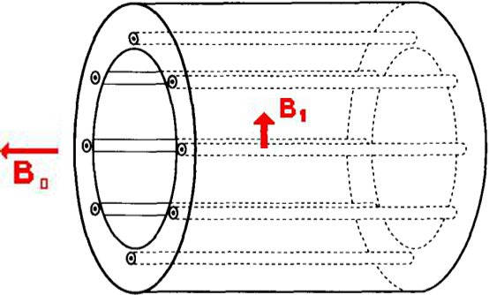
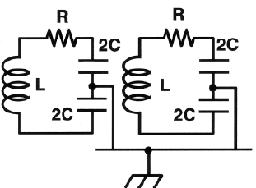
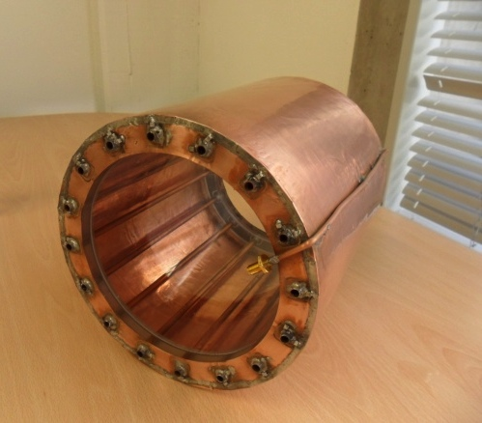
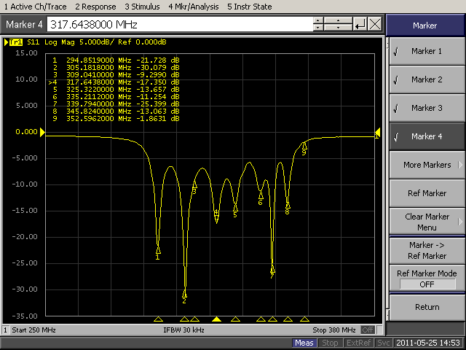
TEM coil @ 7 T
N = 16 legs (length 22.5 cm)
External radius = 10 cm
Bolt circle radius = 8.35 cm
N/2+1 resonant modes appear
Each leg is connected to the external circuit through appropriate capacitors so that the mode N=1 is tuned to the Larmor frequency
LOADED TEM
Mode N=1

Slide 15
 |  | PI | AQ
2011 | 0-6 m | Numerical/analytical modeling of SL-H and DT-DL in the empty condition | Numerical/analytical modeling of DT-microS in the empty condition
 | 7-12 m | Set up of workbench methods for RF coil testing
 |  | Acquisition of basic components for SL-H and DT-DL | Acquisition of basic components for DT-microS
 |  | Development of anatomic and dielectric models of human extremities
 |  | Numerical study of RF distribution of RF coils with tissue models at 7T
 |  | Configuration and building of a phantom
 |  | Study of pulse sequences for estimating SNR, RF homogeneity and SAR at 7T
2012 | 0-6 m | Assembling of SL-H and DT-DL and workbench testing | Assembling of DT-microS and workbench testing
 |  | Design of the optimal matching network for the RF coils
 | 7-12 m | Implementation and test with phantom of sequences for SNR, RF homogeneity and SAR estimate
 |  | Comparison of images and spectra obtained with the RF coil prototypes in vivo
~
~
~

Slide 16
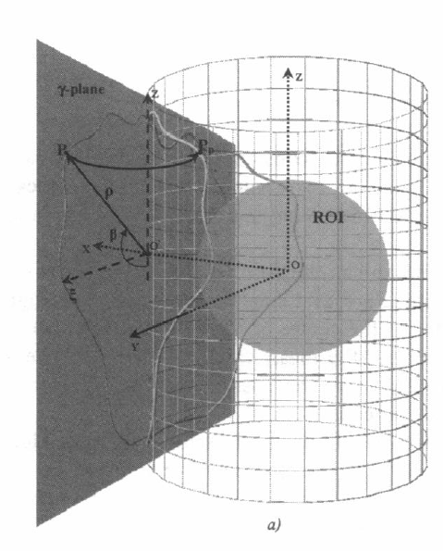
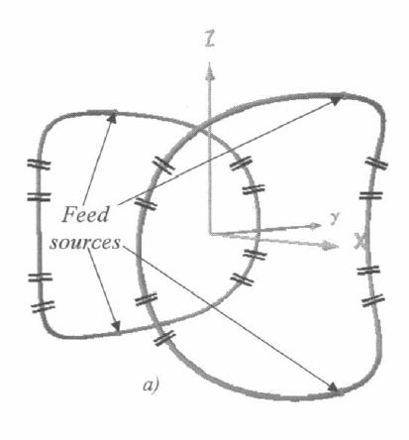
Numerical Methods: why?
Careful selection and design of the RF coil!!
Full-wave simulations for an appropriate investigation of B field (loaded/unloaded) for different modes
Using full-wave simulations SAR analysis can be performed too
Dielectric resonance could be avoided by an appropriate coil design: INVERSE PROBLEM!!
Hybridization CBFM (Characteristic Basis Function Method, Method of Moment based code developed at the Department of Information Eng, Pisa) and Genetic Algorithm!!

Slide 17
SEVEN people (PI)
Sezione di PISA | Qualifica
A. Retico | INFN PI
Stefanini | Fis UniPi
Del Guerra | Fis UniPi
M.E. Fantacci | Ric Fis UniPi
R. Stara | Laureando UniPi
M. Tosetti | Stella Maris
L. Biagi | Stella Maris
G. Manara | Prof Ord Ing UniPi
A. Monorchio | Prof Ass Ing UniPi
N. Fontana | Dottoranda Ing UniPI
NON associabili INFN
G. Tiberi | Ing., IMAGO7
M. Costagli | Ing., IMAGO7
Next visit in Pisa: 14 June – 29 July
Collaborazioni
J. Tropp | General Electrics Senior Scientist, MR Applied Science Laboratory, San Francisco, CA, USA

Slide 18
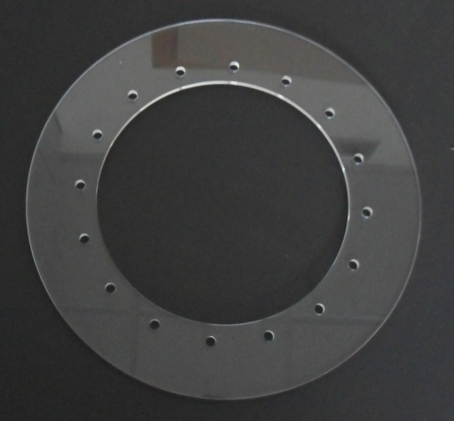
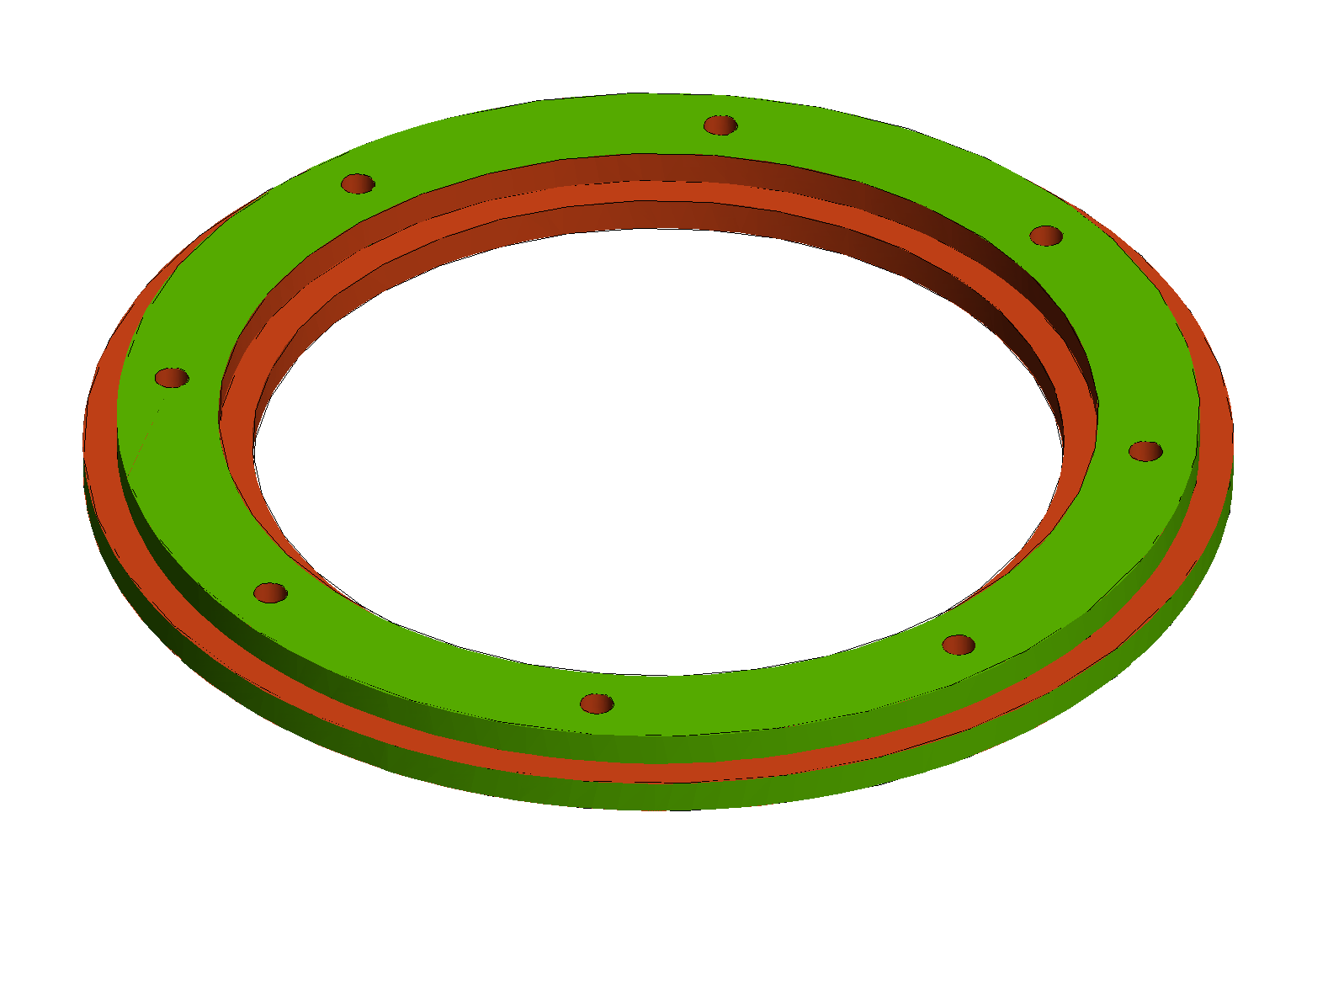
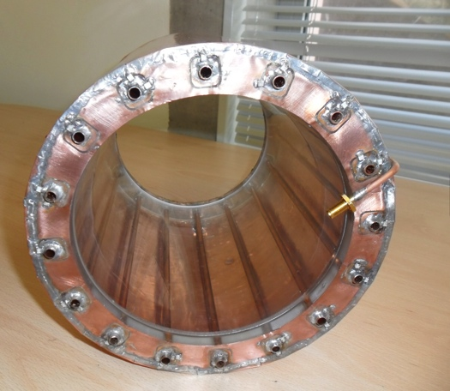
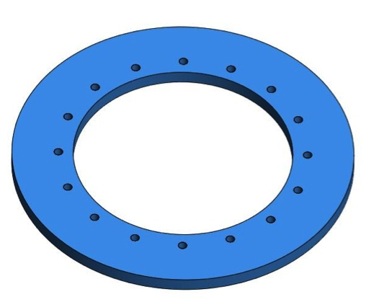
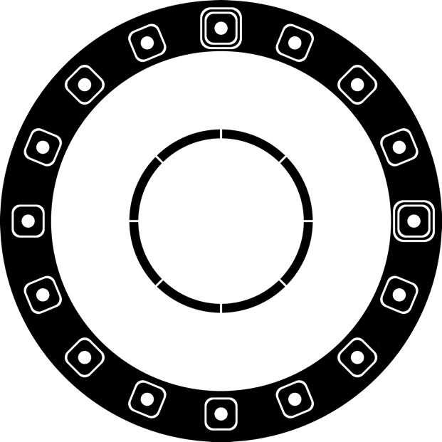
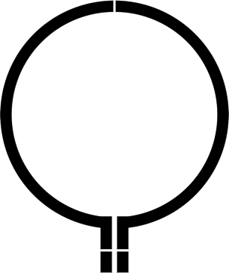
Richieste sui servizi di sezione
Officina meccanica:
supporti meccanici
Servizio di elettronica:
etching
?

