Slide 1


4DMPET
M. G. Bisogni
Preventivi INFN GV 2012
16/06/2011

Slide 2


The INFN DASiPM2 Project
Progetto SiPM
Sviluppo di rivelatori SiPM
INFN-group V - 2005
Progetto DASiPM (Development and Application of SiPM)
INFN-group V - 2006
Produzione e caratterizzazione di SiPM ottimizzati nella regione 400-500 nm
Produzione di matrici di SiPM
Progetto DASiPM2 (Development and Application of SiPM)
INFN-group V - 2007
SiPM Applications:
Medical Imaging: small animal PET demonstrator
Astroparticle: TOF SipM module
High Energy Physics: tracking calorimeter w scintillating fibers
Sezioni di:
Bari, Bologna, Pisa, Perugia,Trento

Slide 3
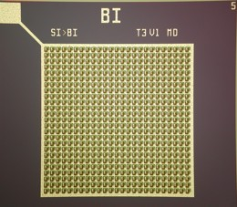
I Silicon PhotoMultipliers
SOLID STATE PHOTODETECTOR➔
SiPM: Multicell Avalanche Photodiode working in limited Geiger mode
n⁺ cathode
+V_{GM}
h
oxide
- 2D array of microcells: structures in a common bulk.
- Vbias > Vbreakdown: high field in multiplication region
- Microcells work in Geiger mode: the signal is independent of the particle energy
- The SiPM output is the sum of the signals produced in all microcells fired.
p high-electric field
multiplication region
e⁻
4 µm
hole
π epilayer
p⁺ substrate
High gain(~ 10⁶)
low bias voltage (~ 50V)
Linear response with the photon flux
  (for Nfot <<Ncell)
PDE
dark noise(2 MHz/mm² @ 1 fotone)

Slide 4
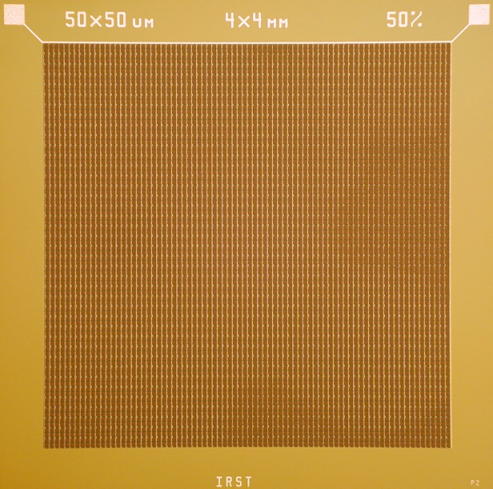
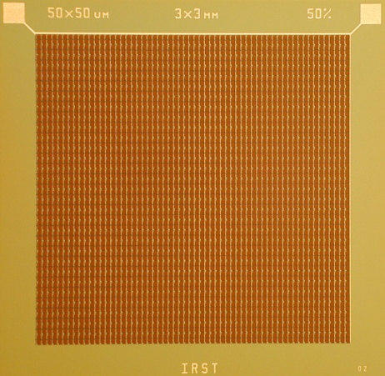
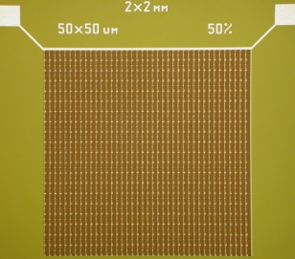
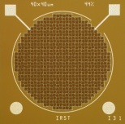
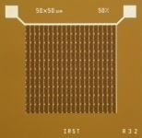
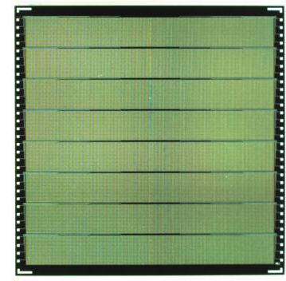
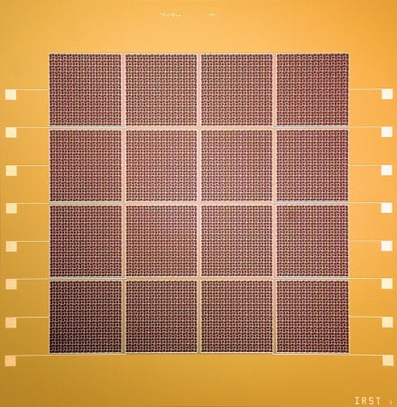
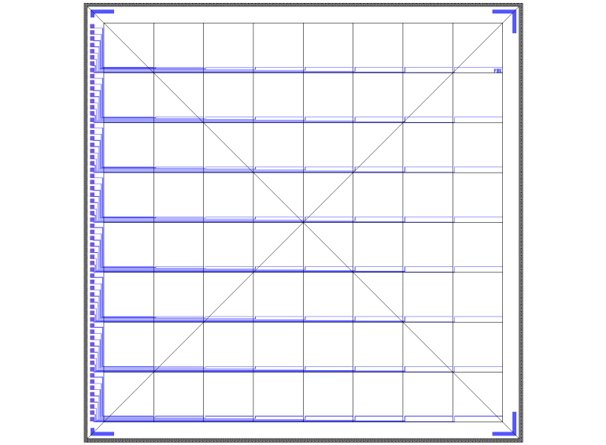
Different geometries
Different geometry,size,microcell size and GF.
40x40μm² => GF 44%
50x50μm² => GF 50%
100x100μm² => GF 76%
circular
1mm φ 1x1mm² 2x2mm² 3x3mm² (3600 cells) 4x4mm² (6400 cells)
1.3cm
Matrices 16 elements (4x4)
4 mm
1.3cm
4 mm

Slide 5
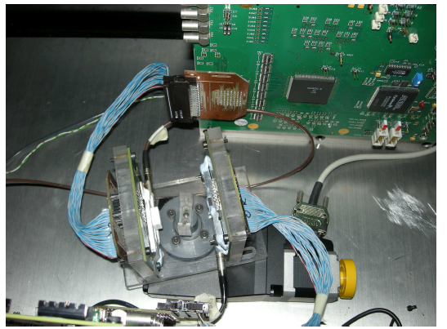
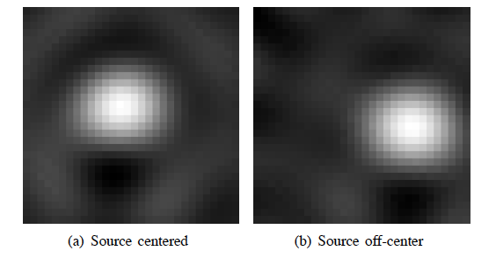
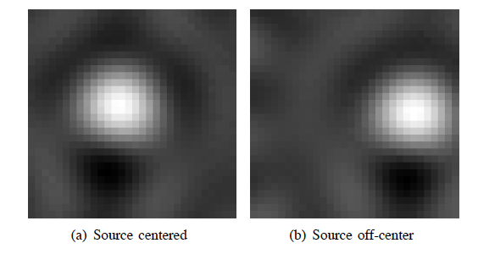
Prime Immagini PET con SiPM DASIPM2
MAROC2 chip
Valencia set-up
G. Llosa et al.
NSS-MIC Conf records 2010
LYSO Crystal array; FBP 6 proiezioni
Pixel size 0.4 mm
LYSO Black slab; FBP 6 proiezioni
Pixel size 0.4 mm

Slide 6
4D-MPET Detector module
Front side
Annihilation
gamma
4.8 cm
4.8 cm
1 cm
Back side
1.2 cm
1.2 cm
Sezioni di:
Bari, Pisa, Perugia,Torino
Notes:
FF-LYNX protocol and interfaces in 4D-MPET
Integrated (i.e.: same protocol and physical links) distribution of trigger (e.g.: coincidence) and controls (e.g.: configuration and monitoring)
Different latency options in frame transmission
Fixed latency for “trigger” data (i.e.: TDC data to coincidence processor)
Unbounded latency for “raw” data (i.e.: ADC data for off-line analysis)
Interfaces to serial links available as IP-cores
Different speed options available (4xF, 8xF, 16xF)
Compatibility with electrical and optical serial links
Availability of FPGA based emulators for functional validation
Innovative approach:
Integrated control and readout systems based on a single flexible protocol
Modular architecture based on fully characterized IP-cores available for ASIC and FPGA developments

Slide 7
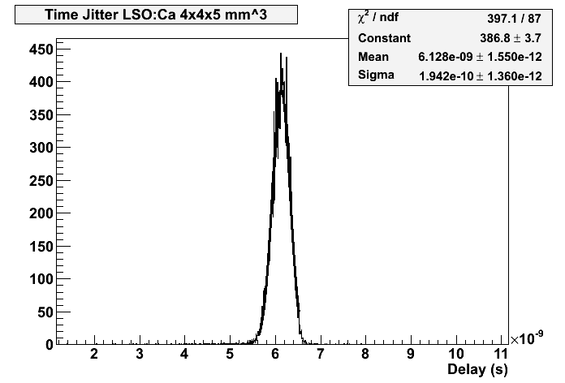
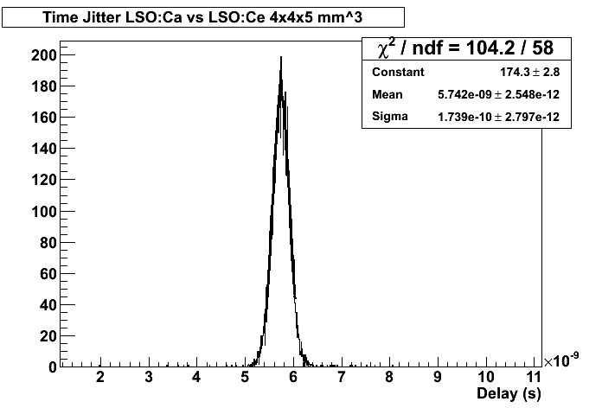
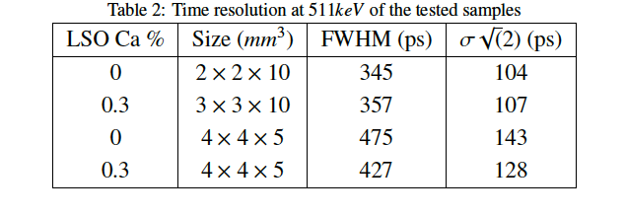
New Crystals

Slide 8
Modular block construction concept
Single scintillating crystal 48 × 48 × 10mm
SiPM readout on both faces, 16 × 16 pixels of size 3 × 3mm
Faces readout identical and independent, with both time and energy measurement for every pixel
Fibre-optics for control and data communication
Magnetic resonance imaging compatibility (no chip packages, no connectors)
Final block design must include direct cooling of ASIC’s for temperature control and stability

Slide 9
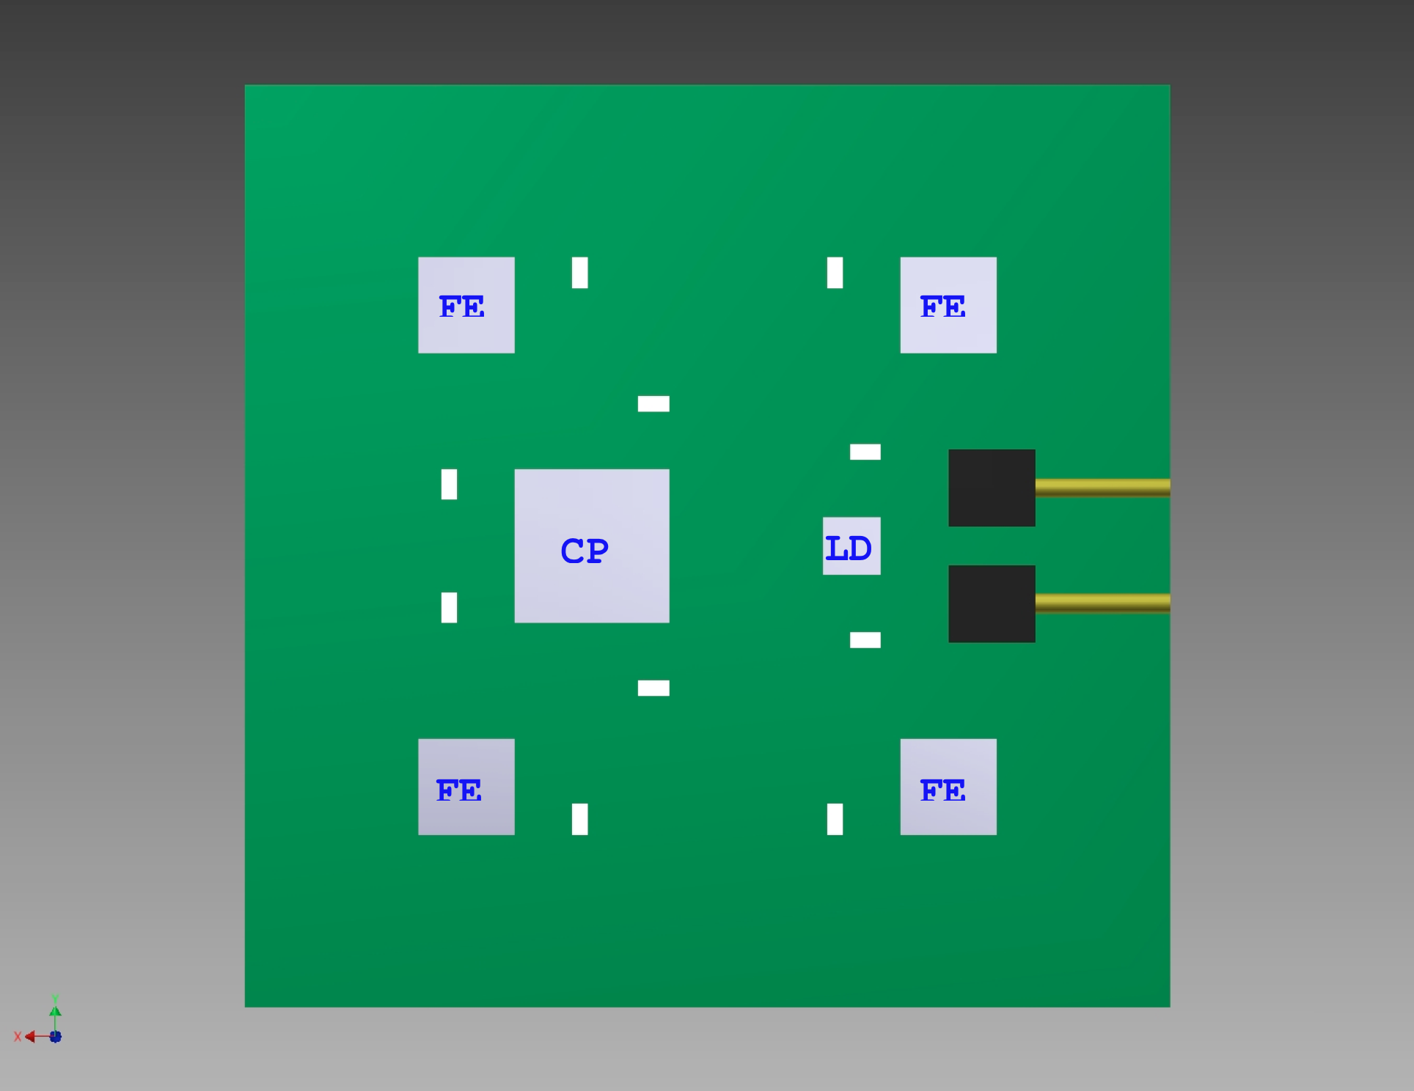
Face readout board concept
Four identical front-end (FE) mixed-mode ASIC’s connected to the SiPM tiles through the readout board. The FE ASIC’s transmit data to a single cluster processor (CP) ASIC for data reduction. The CP ASIC is connected to a laser driver / photodiode receiver / clock reconstruction (LD) ASIC for communication with the external data acquisition system through fibre-optics. All ASIC’s are mounted and wire-bonded without package and then encapsulated after testing for protection and to permit top-side contact cooling. Passive components must be MRI-certified. Board layout, power supply cabling and grounding must take into account the need for magnetic resonance compatibility.

Slide 10
Trigger requirements
The basic premise of the trigger comes from the simulation of the single photon arrival times for the default scintillator choice (LYSO) which has a decay time constant of 40ns.It is not possible to trigger on single photons due to a high background rate of single photo-electron events in SiPM detectors of around 2MHz / mm². This means that at least N photons must be observed within a short time window (order of 10ns) before an event trigger can be generated.
The proposed approach is to have a double-threshold architecture. For every channel the TDC must measure the time when the input signal reaches the threshold for a single photo-electron but that the data will not be passed on, or the ADC triggered, until the input signal reaches a second, higher threshold (for example, three photo-electrons). If the high threshold is not reached within the given time window then the TDC must reset and wait for the next low threshold event.

Slide 11
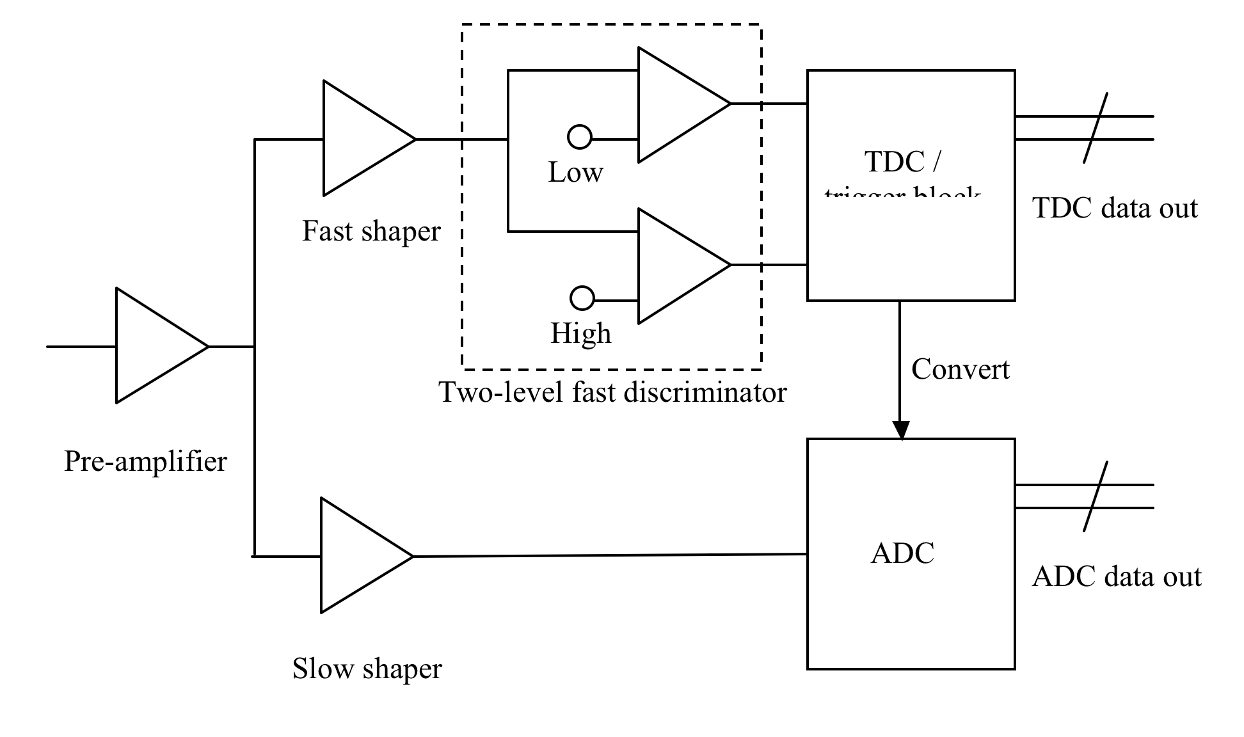
Front-end architecture
The front-end ASIC’s amplify the signals from the SiPM pixels. The ASIC’s are self-triggering, so that when the signals received are found to correspond to a valid event the ASIC proceeds with the conversion of the event and the transmission of the event to the cluster processor.

Slide 12

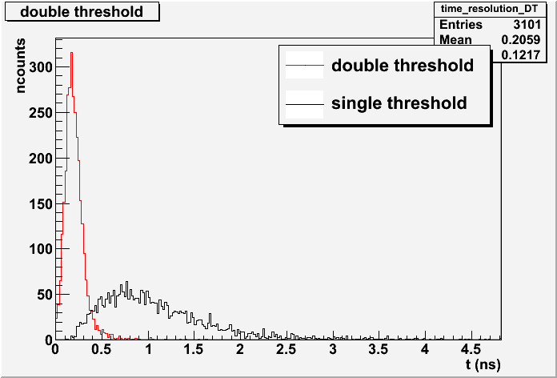
Monte Carlo simulations
The black curve in figure shows the timing distribution for a single face using the double threshold approach, and the red curve shows the timing distribution taking the first pixel time. It is clear that this approach can reach the desired time resolution of 100 ps with the chosen crystal, albeit without any safety margin, and that best performance is achieved when the timing information from both crystal faces is used.
time sigma = 0.122 ns FWHM = 0.16 ns FWTM 0.38 ns

Slide 13
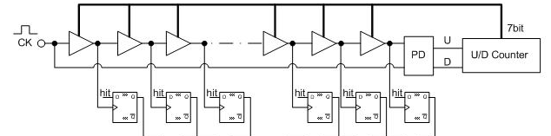
Our TDC topology
A systolic counter might be used together with a DLL:
Counter → Coarse time
All digital DLL → Fine time
  PVT robust
  Low jitter loop behavior
Tecnologia scelta
UMC 130nm tramite EUROPRACTICE
Pros | Cons
High resolution; wide dynamic range. | Semi-custom design required.

Slide 14
Sezioni INFN partecipanti
Pisa (M.G. Bisogni, A. Del Guerra, N. Marino, L. Fanucci, C. Saponara, R. Roncella, F. Baronti, G. Borgese)
  caratterizzazione del modulo
  Elettronica di Read-out
  ASIC TDC alta risoluzione e protocollo di trasmissione FF-LYNX (DIIET)
Bari (F. Corsi, C. Marzocca, G. Matarrese)
  ASIC Front-End
Perugia (G. Ambrosi, C. Santoni)
  Caratterizzazione e test matrici e SiPM singoli
  Integrazione e costruzione del modulo
Torino (C. Peroni, P.G. Cerello, R. Wheadon, F. Pennazio)
  Simulazioni Monte Carlo
  Compatibilita’ magnetica

Slide 15
Workplan
WP1 System Design
  Task 1.1 System requirements (PI)
  Task 1.2 System specifications (ALL)
WP2 FE and TDC chip and DAQ
  Task 2.1 FE (Bari)
    Subtask 2.1.1Test chip
      Test chip design and submission
      Test and debugging
    Subtask 2.1.2 Final version
      Design and submission
      Test
  Task 2.2 TDC (PI-DIIET)
    Subtask 2.2.1 Test chip
      Test chip design and submission
      Test and debugging
    Subtask 2.2.2 Final version
      Design and submission
      Test
  Task 2.3 FF-LYNX IP cores for control and read-out
  Task 2.4 DAQ
    Architecture
    Emulation
    Firmware development
    Test
WP3 Module assembly and testing
  Task 3.1 Scintillator and Photodetector (PE, PI)
    Subtask 3.1.1 Test and selection crystal
    Subtask 3.1.2 Feed-through
  Task 3.2 Module Construction development and test
    Subtask 3.2.1 Mechanics design and production
    Subtask 3.2.1 Module Construction and test
  Task 3.3 Magnetic Compatibility
    Subtask 3.3.1
      simulation
    Subtask 3.3.2
      Components selection and test
    Subtask 3.3.3
      Test module in MRI
WP4 Software (TO)
  Task 4.1 Monte Carlo Simulation for system optimization
  Task 4.2 On line preprocessing algorithms
  Task 4.3 4D hit reconstruction

Slide 16
Persone
Ricercatori |  | %
Bisogni | M.G. | 100
Del Guerra | A. | 40
Marino | N. | 100
Borgese | G. | 100
Camarlinghi | N. | 100
Fanucci | L. | 50
Saponara | S. | 50
Roncella | R. | 50
Baronti | F. | 50
6.4 FTE/ 9 ric
Tesi di Laurea:
G. De Luca
M. Morrocchi
A. Sulaj

Slide 17
Richieste Finanziarie
Richieste 2012
Consumi
Componenti Optoelettronici | 10000
Cristalli | 5000
Submission chip | 30000
Metabolismo | 5000
Inventariabile
Oscilloscopio digitale | 20000
Missioni Interne
Riunione collaborazione | 3000
Missioni Interne
2 Congressi | 4000
totale | 77000

Slide 18
Richieste supporto in sezione
Servizio AT: 1 MU
Servizio Elettronico : progettazione PCB Progettazione Meccanica: disegno supporti 1MU
Officina Meccanica: realizzazione supporti 1 MU

Slide 19
Progetti in corso:
4DMPET 2011-2013(INFN)
ENVISION TOF-PET adroterapia 2010-2013(FP7)
Hadronphysics 3 2011-2014(FP7)
COST PET-MRI2011-2015 (FP7)
Progetti sottomessi:
PRIN2009 2 anni
FIRB2010 PROGRAMMA "FUTURO IN RICERCA” 3 anni

