Slide 1
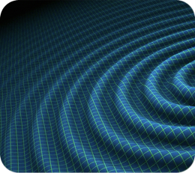
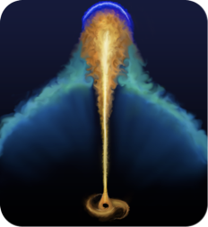
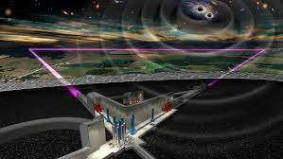
Scuola di Analisi Dati
(onde gravitazionali e astrofisica multimessaggera)

Slide 2
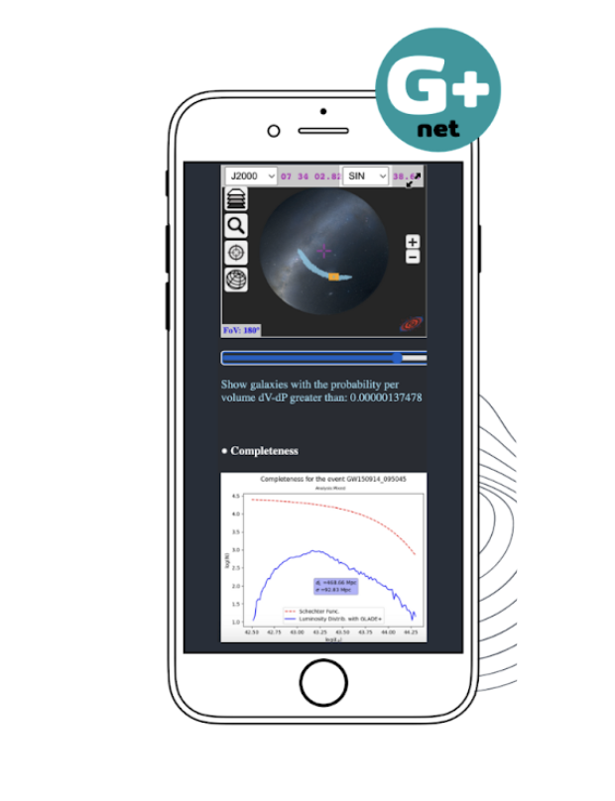
GWFish: Simulation of gravitational-wave detector networks
with Fisher-matrix parameter estimation
Jacopo Tissino e Ulyana Dupletsa
Tools to estimate the capabilities of Einstein Telescope in detecting and estimating the parameters of compact binary sources:
introductory section on how compact binary waveforms are parametrized, analyzed with matched filtering, and the Fisher matrix approach
hands-on session with the software package GWFish will allow attendees to apply these concepts in practice
Virtual Observatory Standards and Tools
Giuseppe Greco
hands-on session on
Virtual Observatory standards in multi-messenger astronomy
GLADEnet web app: credible area of gravitational-wave sky localization using Aladin Desktop and pinpoint galaxies within 90% of the volume
development of a new standard (Space and Time MOC) and its potential applications in the ET era

Slide 3
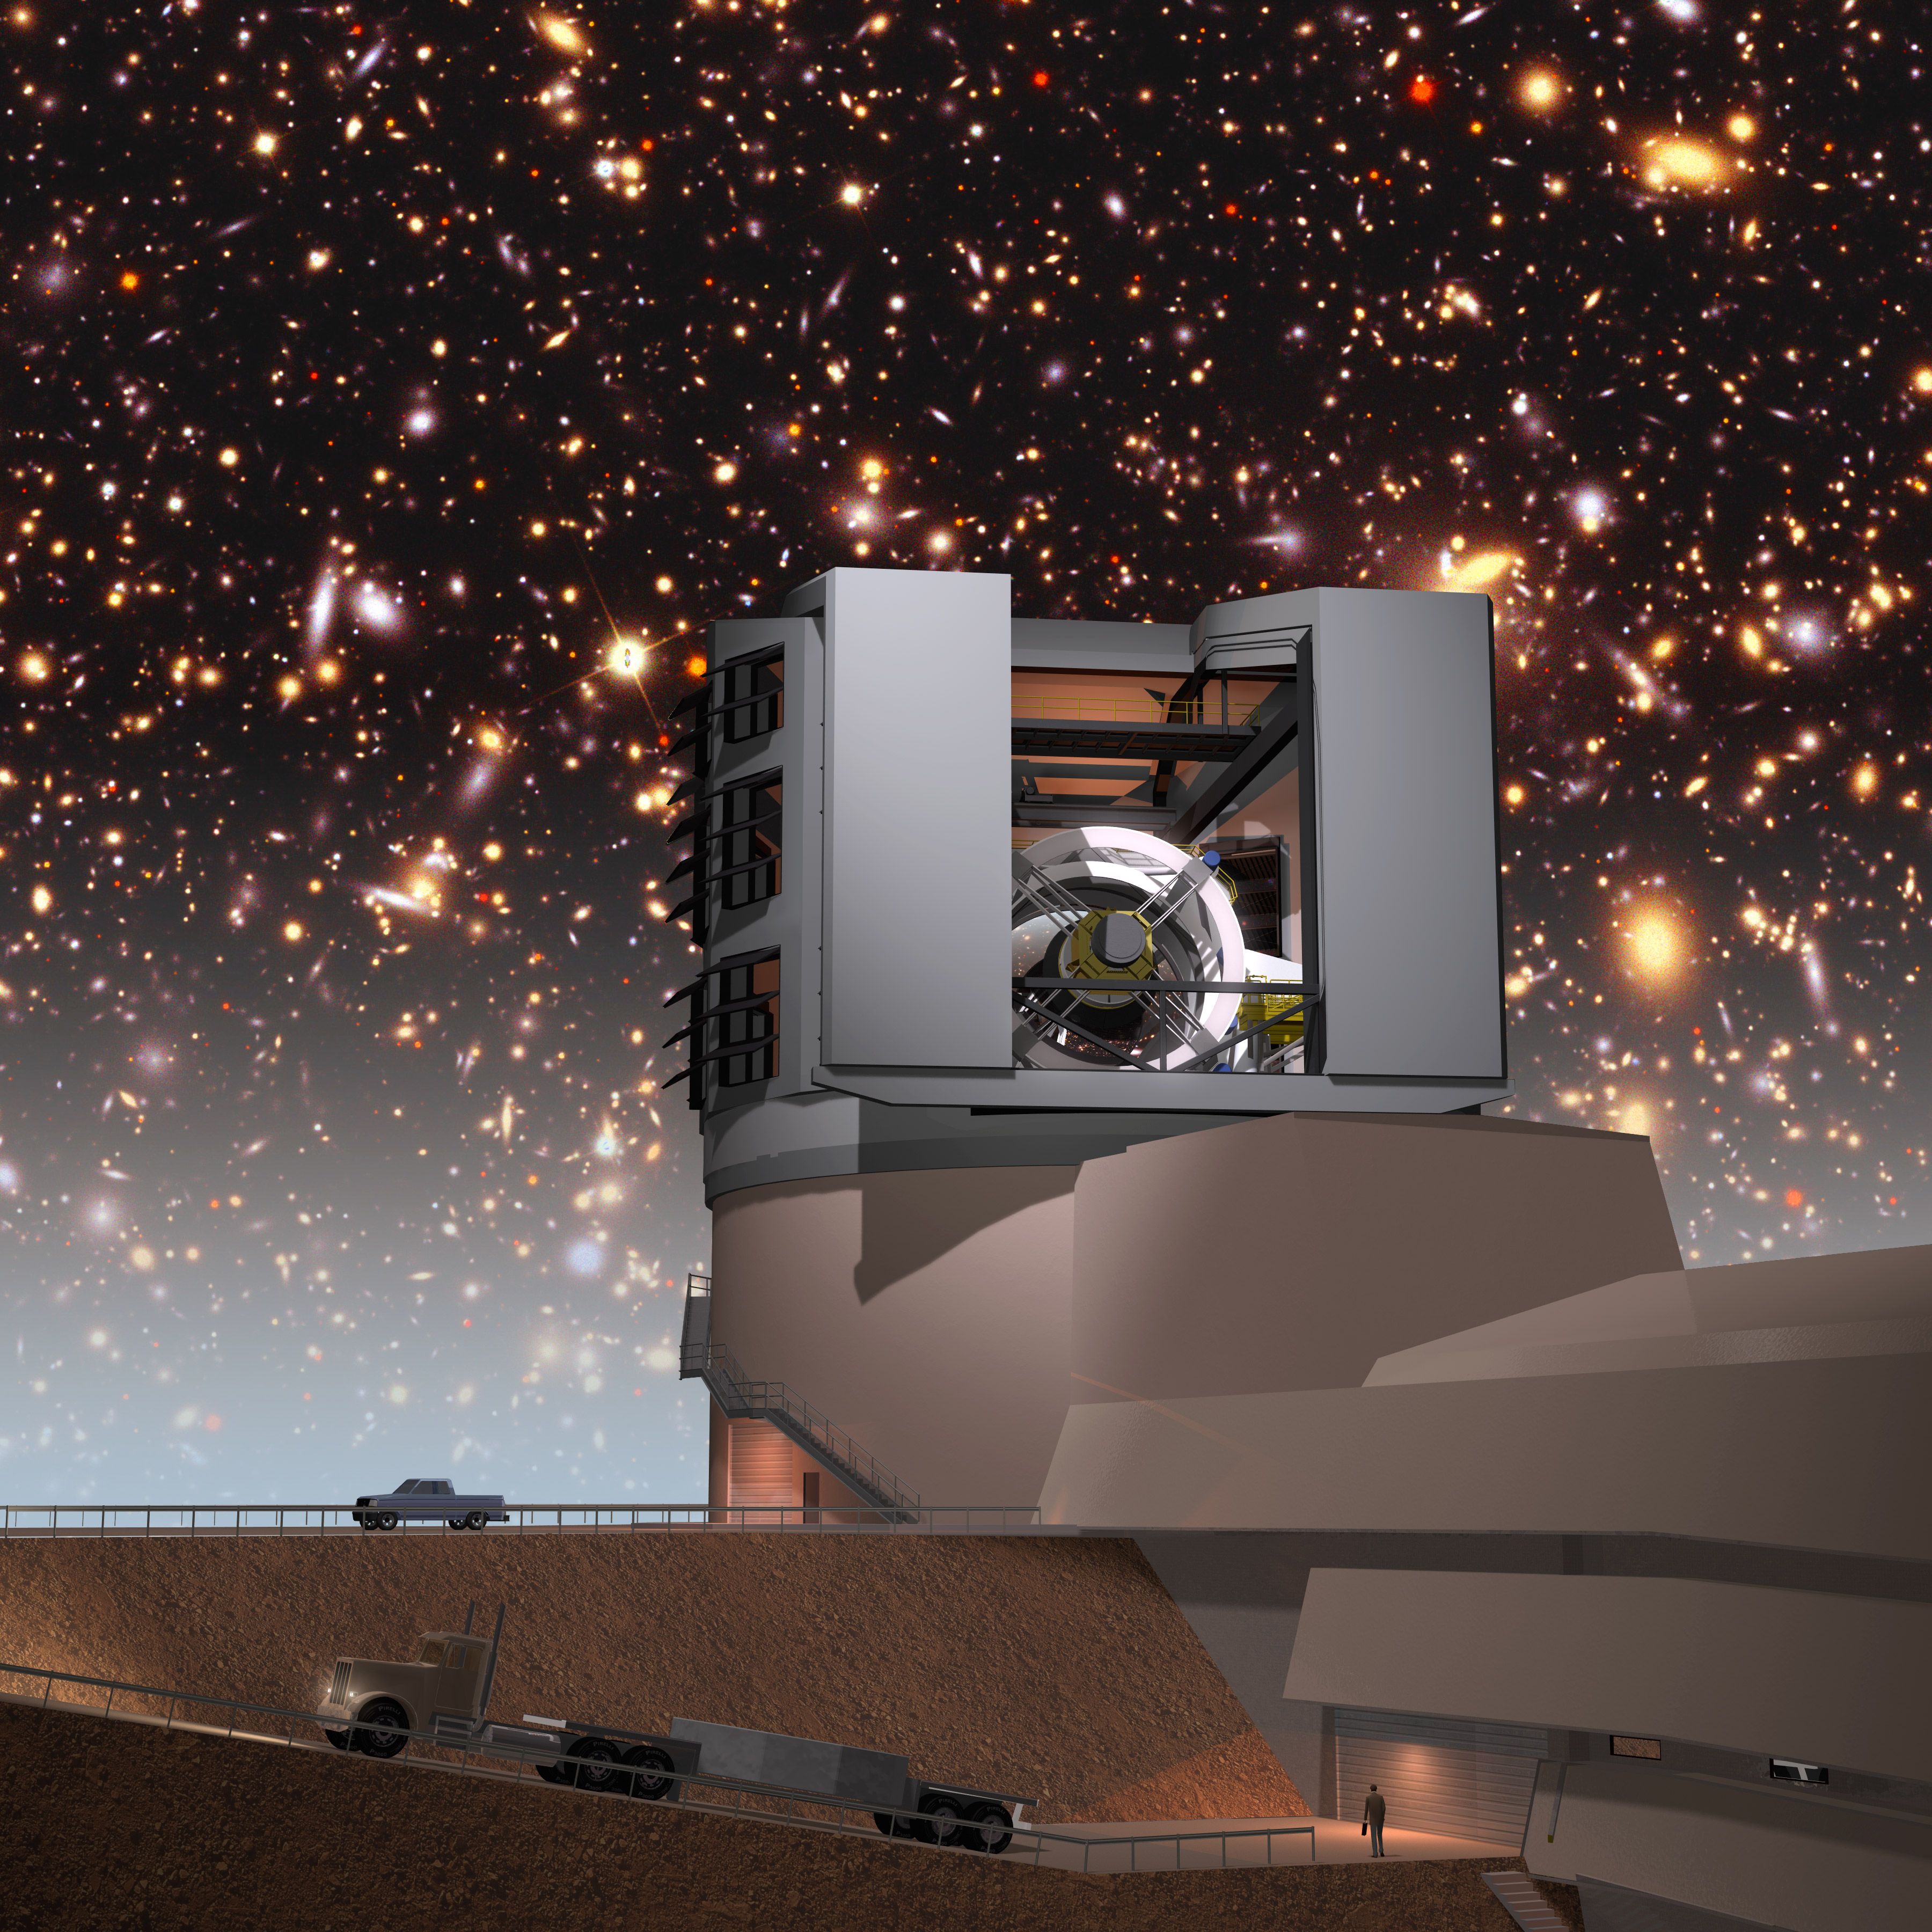
GW follow-up
Fabio Ragosta, Silvia Piranomonte e Andrea Melandri
Hands-on experience on creating and manipulating large data sets for the follow-up of the electromagnetic counterparts of GW sources.
Objectives:
Learn how to build a light curve using Alerts stream.
Learn how classification tools work
ET Introduction Mock Data Challenge (MDC)
Elena Cuoco
MDC hands on:
procedure for accessing the Einstein Telescope MDC
fundamental signal processing techniques applied to noise data
insights into the detection of astrophysical signals.

