Slide 1
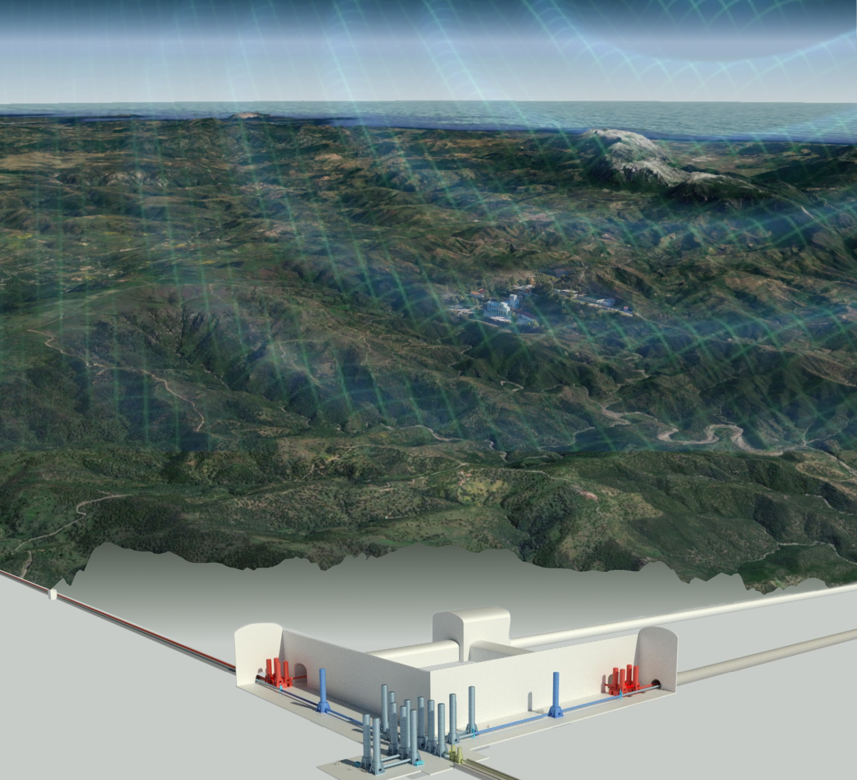
Site Preparation Session Round Table

Slide 2
Two lines of activities
Site Characterization
Infrastructure design

Slide 3
Discussion points
Support to Civil Eng. and feasibility study
identification of local noise sources
mitigation strategy
impact on detector

Slide 4
Discussion points
Next steps
acoustic campaign
wind turbine measurements
urgent: local noise measurements around L verteces (eventually around new triangle verteces )

Slide 5
Discussion points
Lack of manpower
data analysis
measurement campaigns
NN estimation
mitigation strategy

Slide 6
Discussion points: International view
Interaction SPB/Host Teams/ETO
Geometry
Timeline & Roadmap

Slide 7
Discussion points: International view
Host Team
ETO
SPB
ET-C
Interaction SPB/Host Teams/ETO
Currently regular meetings ETO - EMR team
ETO interactions with all host teams should be regular
Interactions should see the participation of SPB that is supposed to take indications from ETO and set standards for host teams studies
ET-C should be involved as well
local administrative, political and economic aspects could have an impact on the ET science case
Coherent detector and physics requirement info to be passed to host teams

Slide 8
Discussion points: International view
Timeline & Roadmap for site candidature:
Sardinia timeline: end of pre-feasibility study by 2025
EMR timeline: ????
Geometry
Sardinia: tender on both geometries, focus on L
EMR: only triangle

Slide 9
Useful links
Wiki page
Mailing list: et-spb@et-gw.eu (subscribe)
Site data Web Services
Einstein Telescope @ Sardinia https://www.einstein-telescope.it/en/home-en/
Einstein Telescope @ EMR https://www.einsteintelescope.nl/en/

