Slide 1





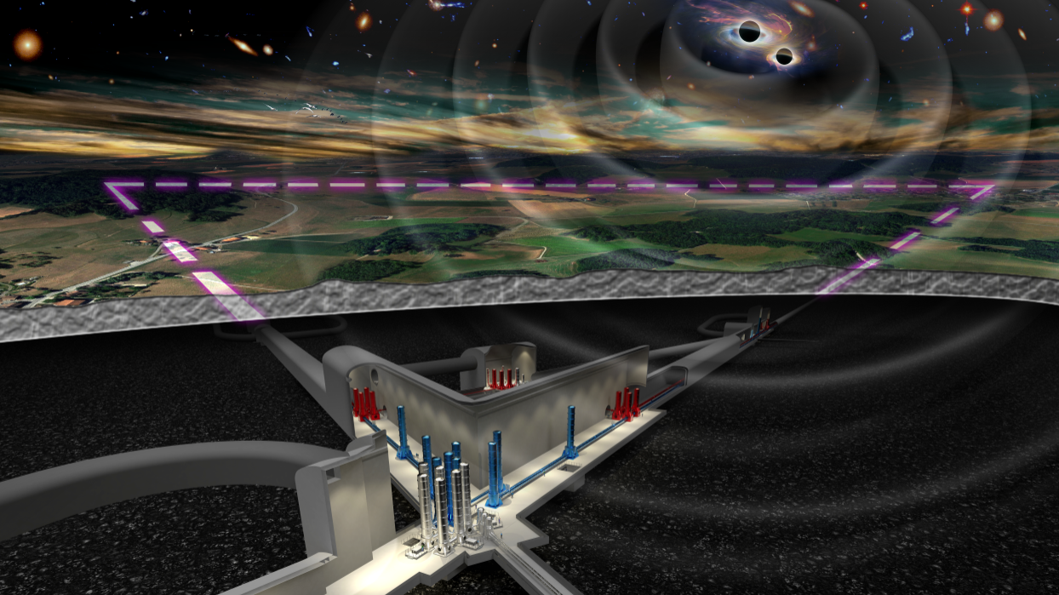
ET Observational Science Board
Marica Branchesi
(Assisi, 23 Febbraio 2024)

Slide 2
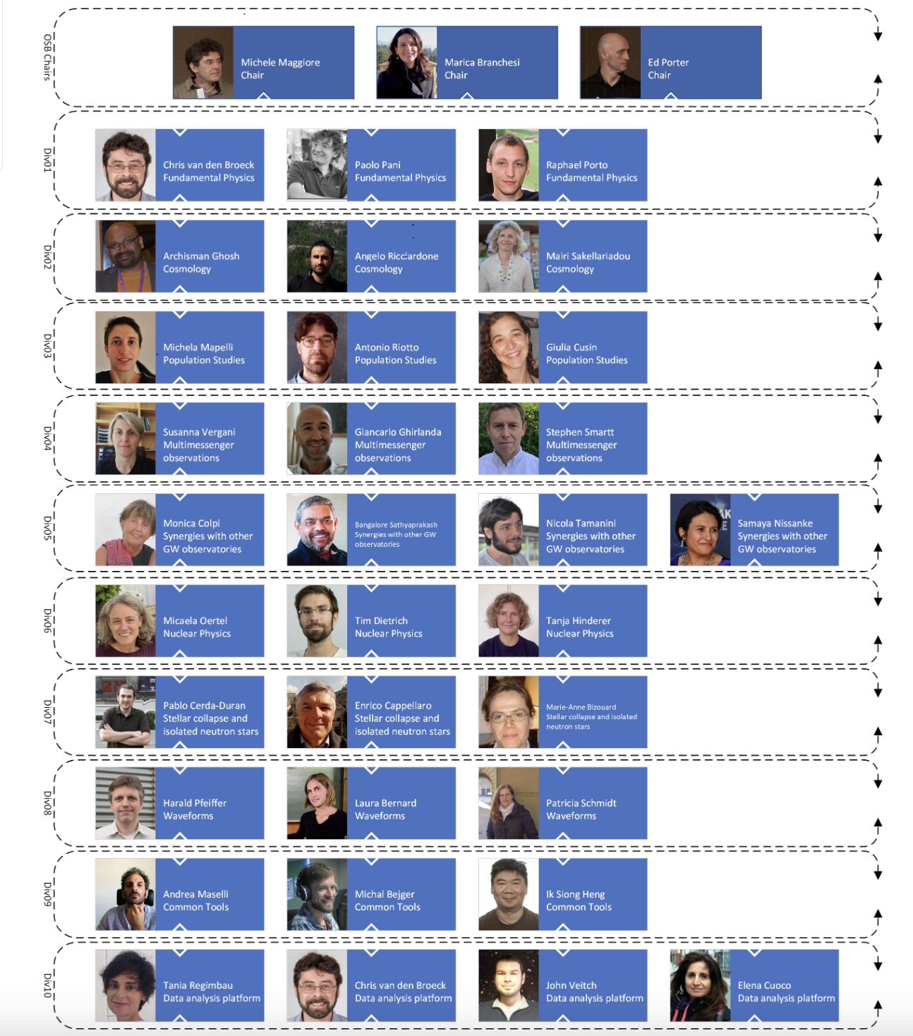
OSB STRUCTURE
OSB chairs
DIV 1:Fundamental Physics
DIV2: Cosmology
DIV3: Population Studies
DIV4: Multimessenger Obs.
DIV5: Synergies with GW
detectors
DIV6:Nuclear Physics
DIV 7: Stellar Collapse
and isolated NS
DIV8: Waveforms
DIV9: Common Tools
DIV10: Data Analysis
Platform

Slide 3
OSB STRUCTURE
OSB chairs
DIV 1:Fundamental Physics
DIV2: Cosmology
DIV3: Population Studies
DIV4: Multimessenger Obs.
DIV5: Synergies with GW
detectors
DIV6:Nuclear Physics
DIV 7: Stellar Collapse
and isolated NS
DIV8: Waveforms
DIV9: Common Tools
DIV10: Data Analysis
Platform

Slide 4
OSB STRUCTURE
OSB chairs
Vacancy
DIV 1:Fundamental Physics
DIV2: Cosmology
DIV3: Population Studies
DIV4: Multimessenger Obs.
Andrew Levan
DIV5: Synergies with GW
detectors
DIV6:Nuclear Physics
DIV 7: Stellar Collapse
and isolated NS
Cristiano Palomba
Marco Limongi
Ik Siong Heng
DIV8: Waveforms
DIV9: Common Tools
DIV10: Data Analysis
Platform
Michele Mancarella
Anuradha Samajdar
Gianluca Guidi

Slide 5
OSB MANDATE
to develop the Einstein Telescope science case, start building the ET scientific community, and bring it to the maturity to exploit the data taken when ET will start operation
From now and next years
Develop the ET science case to help the instrument technical development and implementation;
Write a Blu Book, a living document that summarizes and updates original work related to ET;
Stimulate the interest of scientists involving cosmologists, nuclear physicists, high-energy physicists, astronomers and astrophysicists;
Build the synergy, collaboration and coordination with other gravitational-wave, electromagnetic, neutrino observatories;
Identify the specific data analysis and computing needs for ET and begin the development of data analysis tools and algorithms.
V see CoBA
V under development
V large participation
V under development
V MDC X critical..

Slide 6
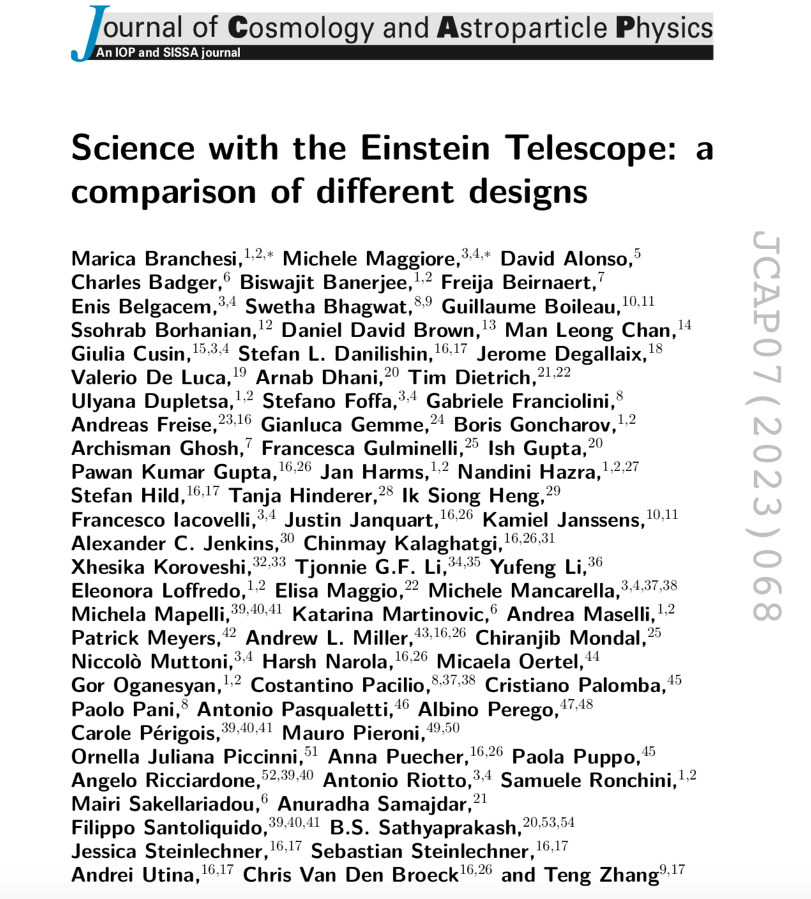
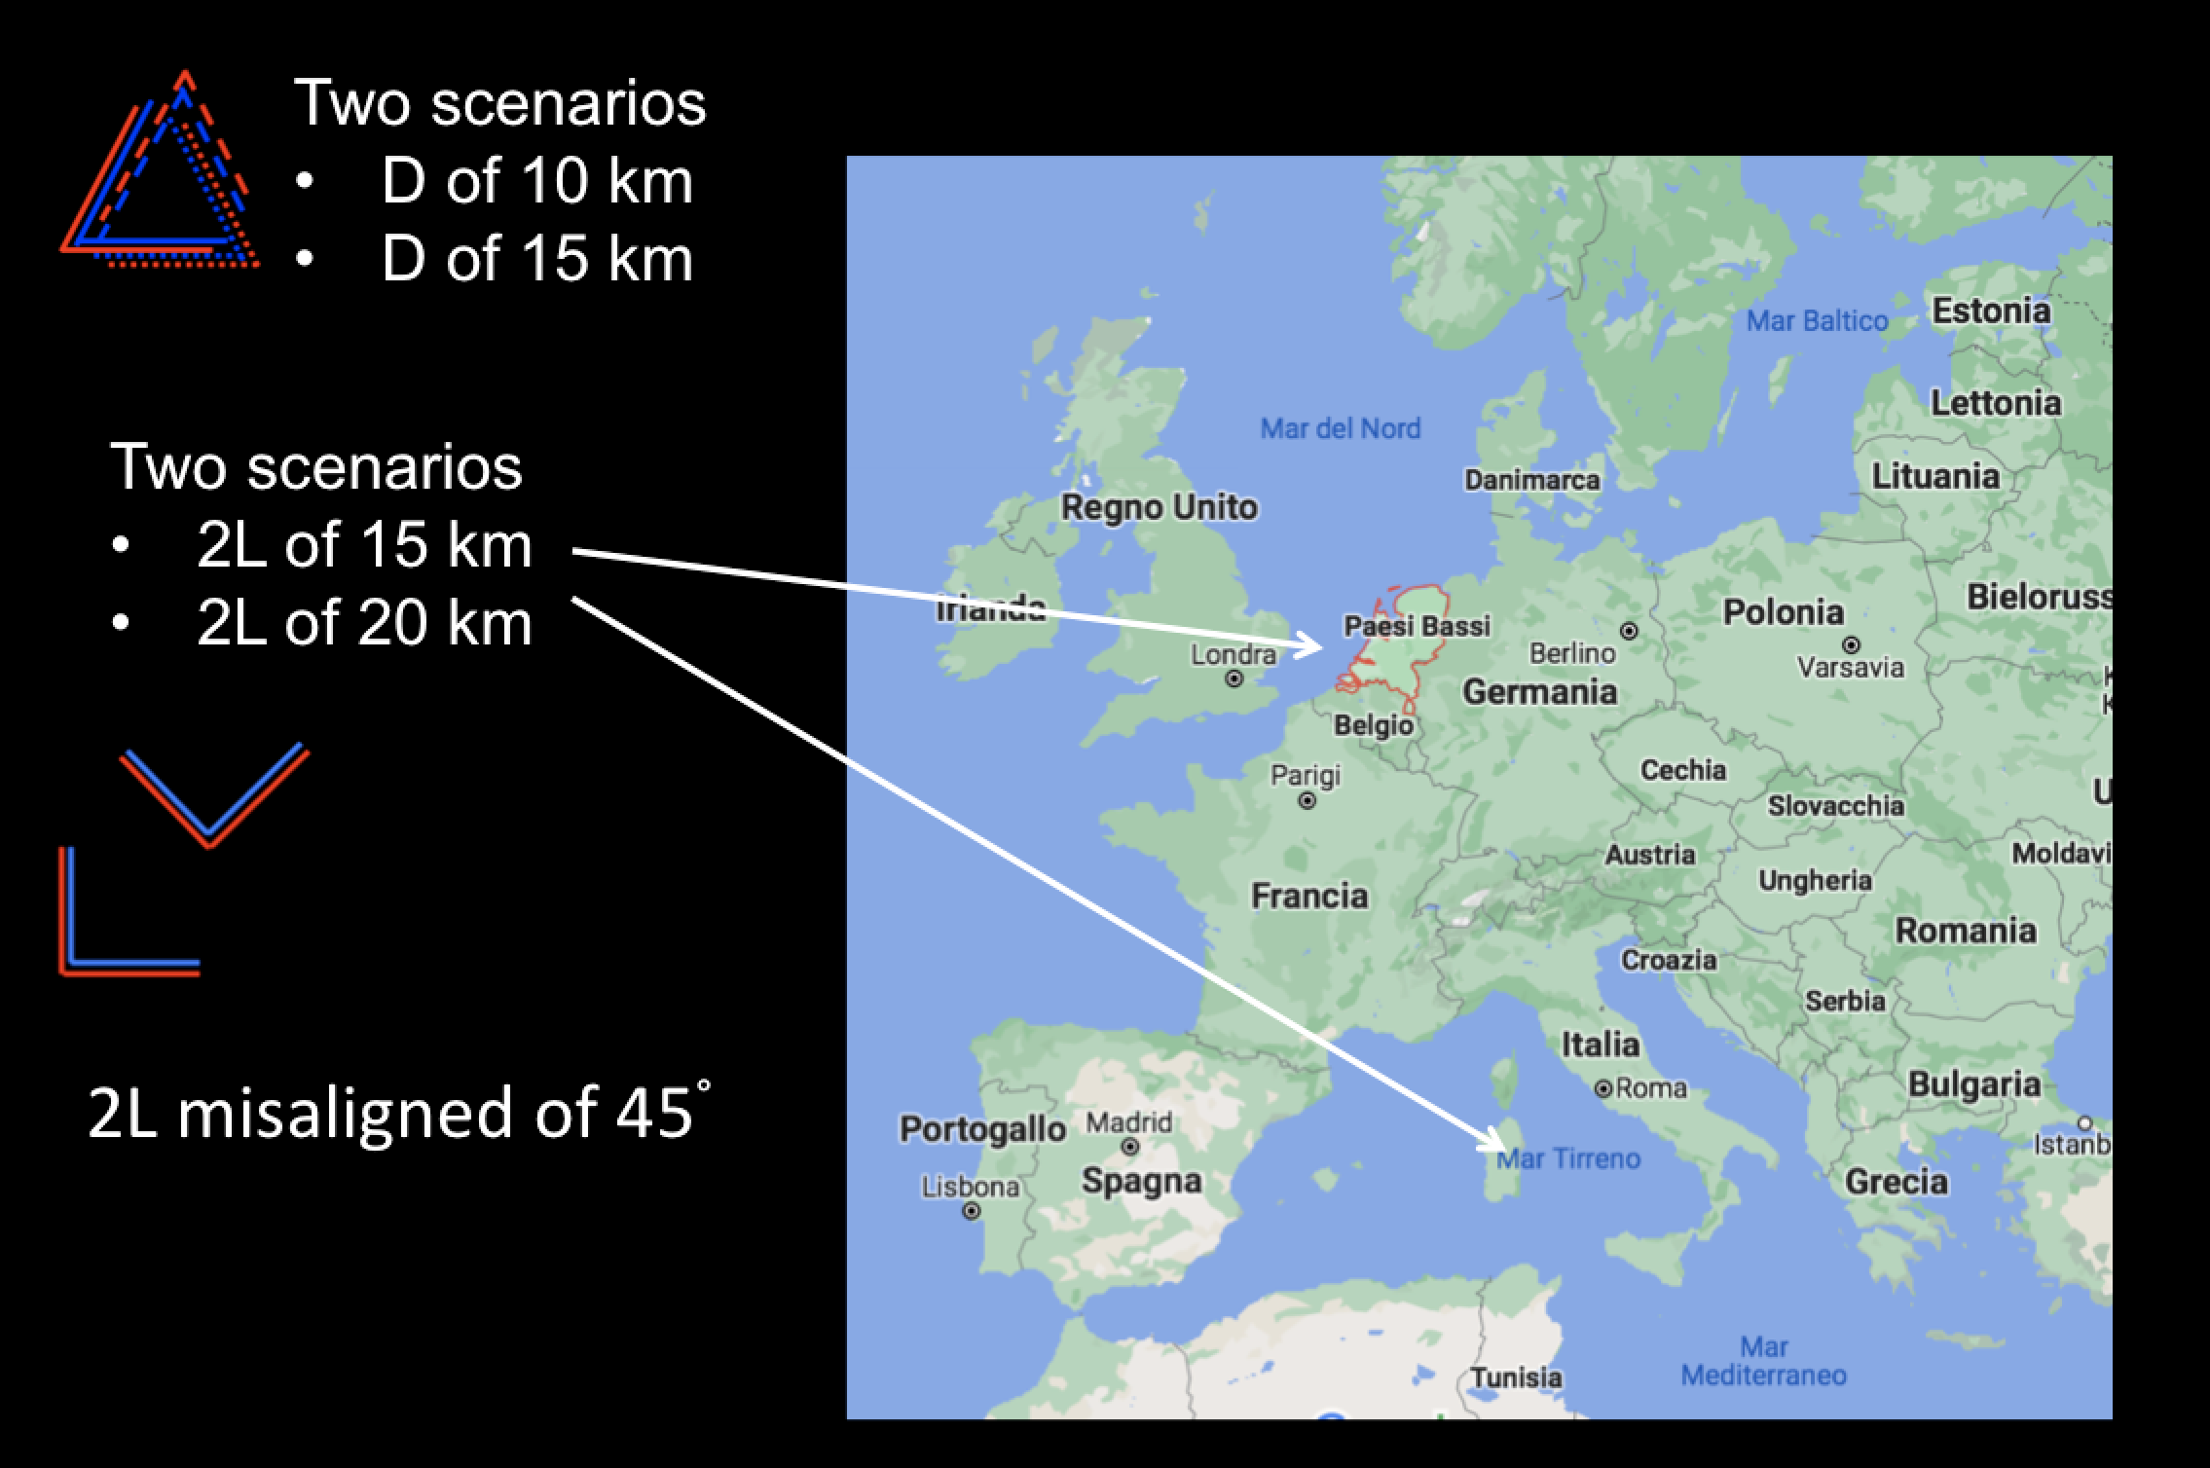
CoBA: science part
First step (lasted several months):
Development and comparison of Fisher codes (DIV9)
GWBENCH (USA-based, CE)
GWFISH (GSSI group)
GWFAST (Geneva Group)
TiDoFM (UK-based)

Slide 7
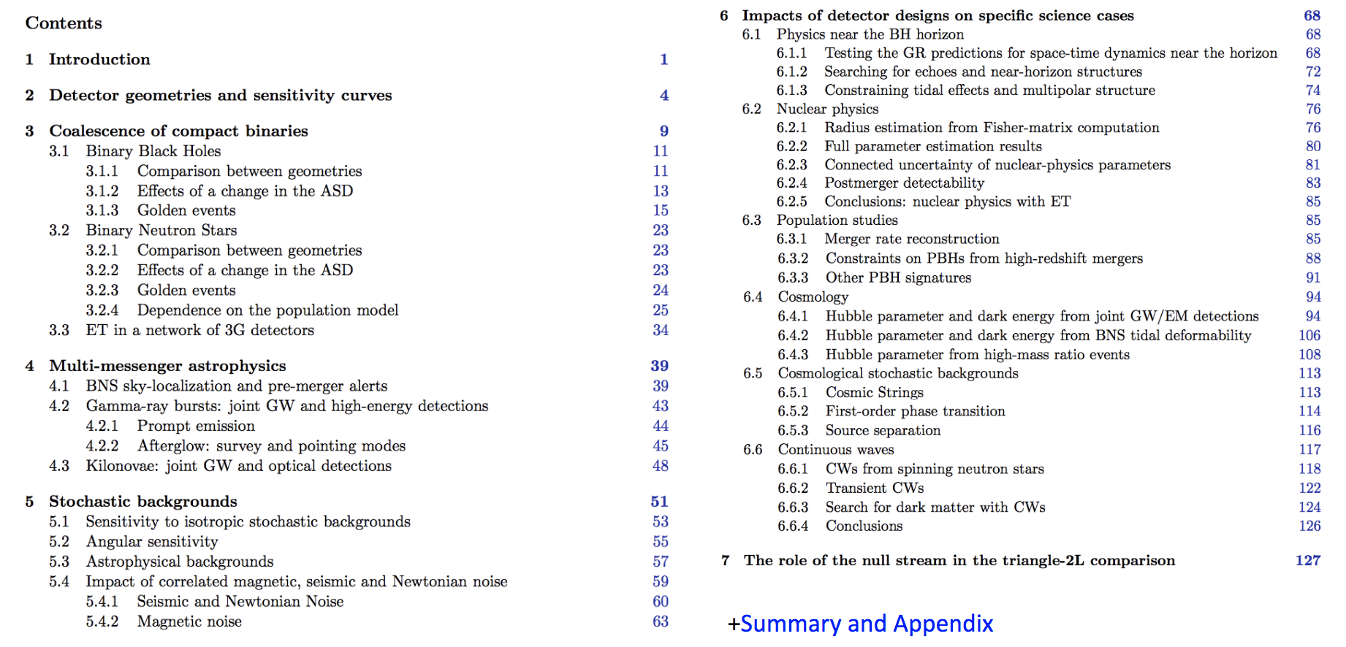
CoBA: science part
New updated Science Paper for ET
Detailed comparison among different configurations and designs through simple metrics and specific science cases

Slide 8
Blue-Book
Goals and Target
will be the reference ET book for the scientific community describing the science
while the CoBA paper goal was a comparison of different ET configurations and designs → common set of modeling and astrophysical assumptions,
the blue book will enlarge the scientific cases and include works from different
groups (published or new) covering several assumptions and models to provide
an global overview of the science
it will be published in a journal
the structure follows the DIV structure
Tanto lavoro on-going in tutte le divisions!
Timeline
first draft (highlighted contents, some texts and plots) for each division for the end of February/early March;
a mature reviewed version for the starting of the summer to be ready to work on the assembly during the summer;
submit to the journal in Autumn
Authorship
Inlcusive, but people who worked!

Slide 9
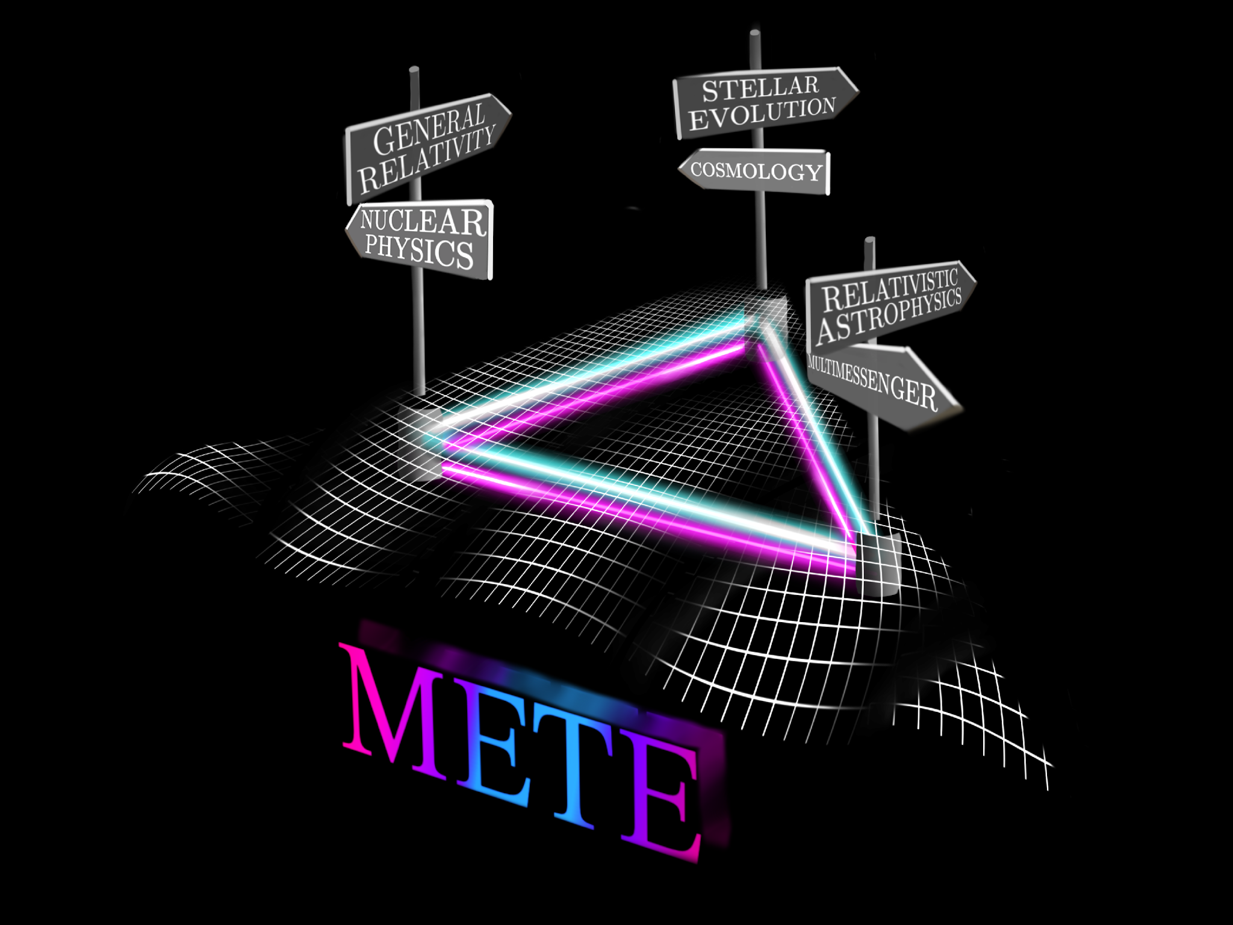


ET capabilities: a few numbers
+ Italian Universities
PRIN 2020 METE 2020KB33TP

Slide 10
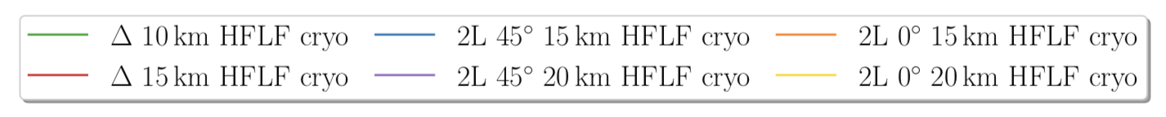
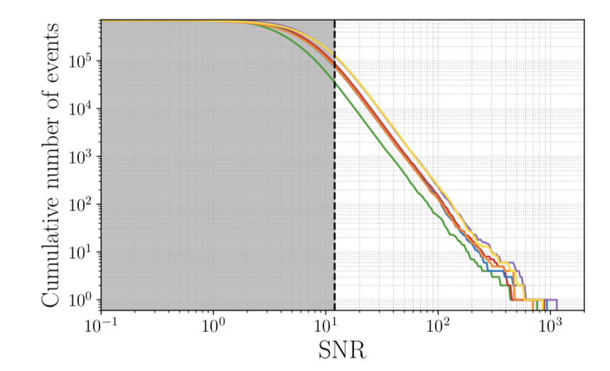
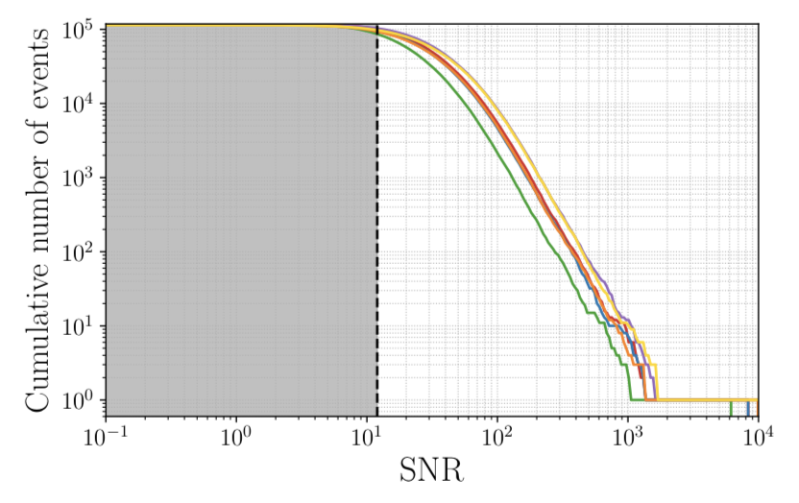
A few ET numbers
BNS
BBH
Branchesi, Maggiore et al. 2023, JCAP
10⁵ BNS alerts per year
10⁵ BBH alerts per year
A few tens of alerts per hour
Overlapping signals

Slide 11
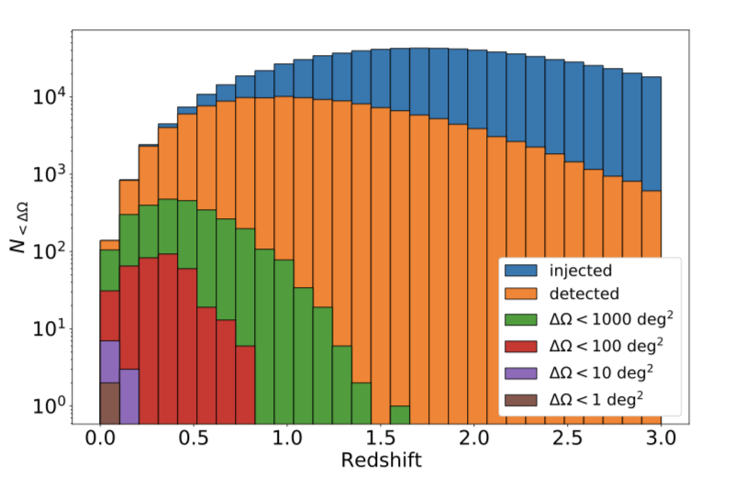
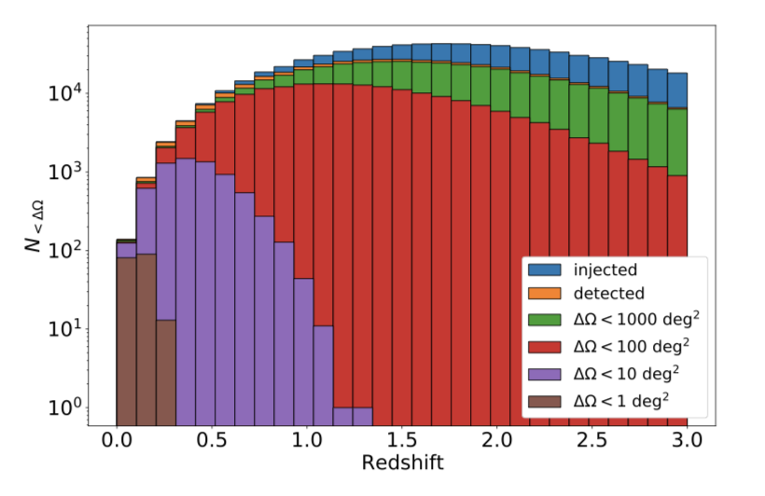
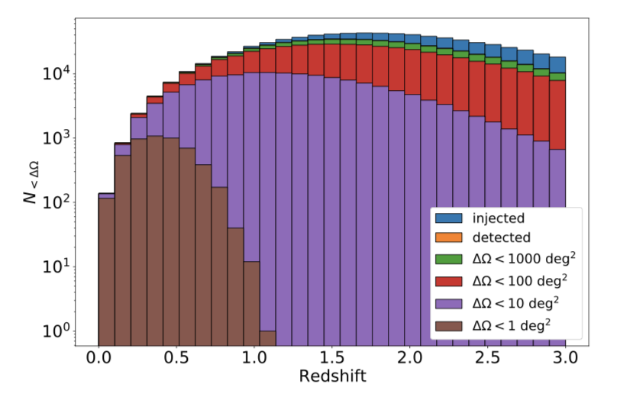
Sky-localization
ET
ET+CE
ET+2CE
ET: O(100) detections per year with sky-localization (90% c.r.) < 100 sq. deg
ET+CE: O(1000) detections per year with sky-localization (90% c.r.) < 10 sq. deg
ET+2CE: O(1000) detections per year with sky-localization (90% c.r.) < 1 sq. deg
Branchesi, Maggiore et al 2023, JCAP
Ronchini et al A&A. 2022

Slide 12
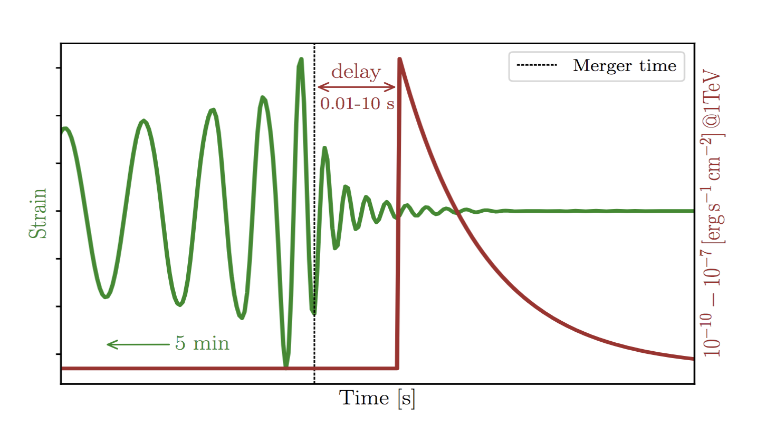
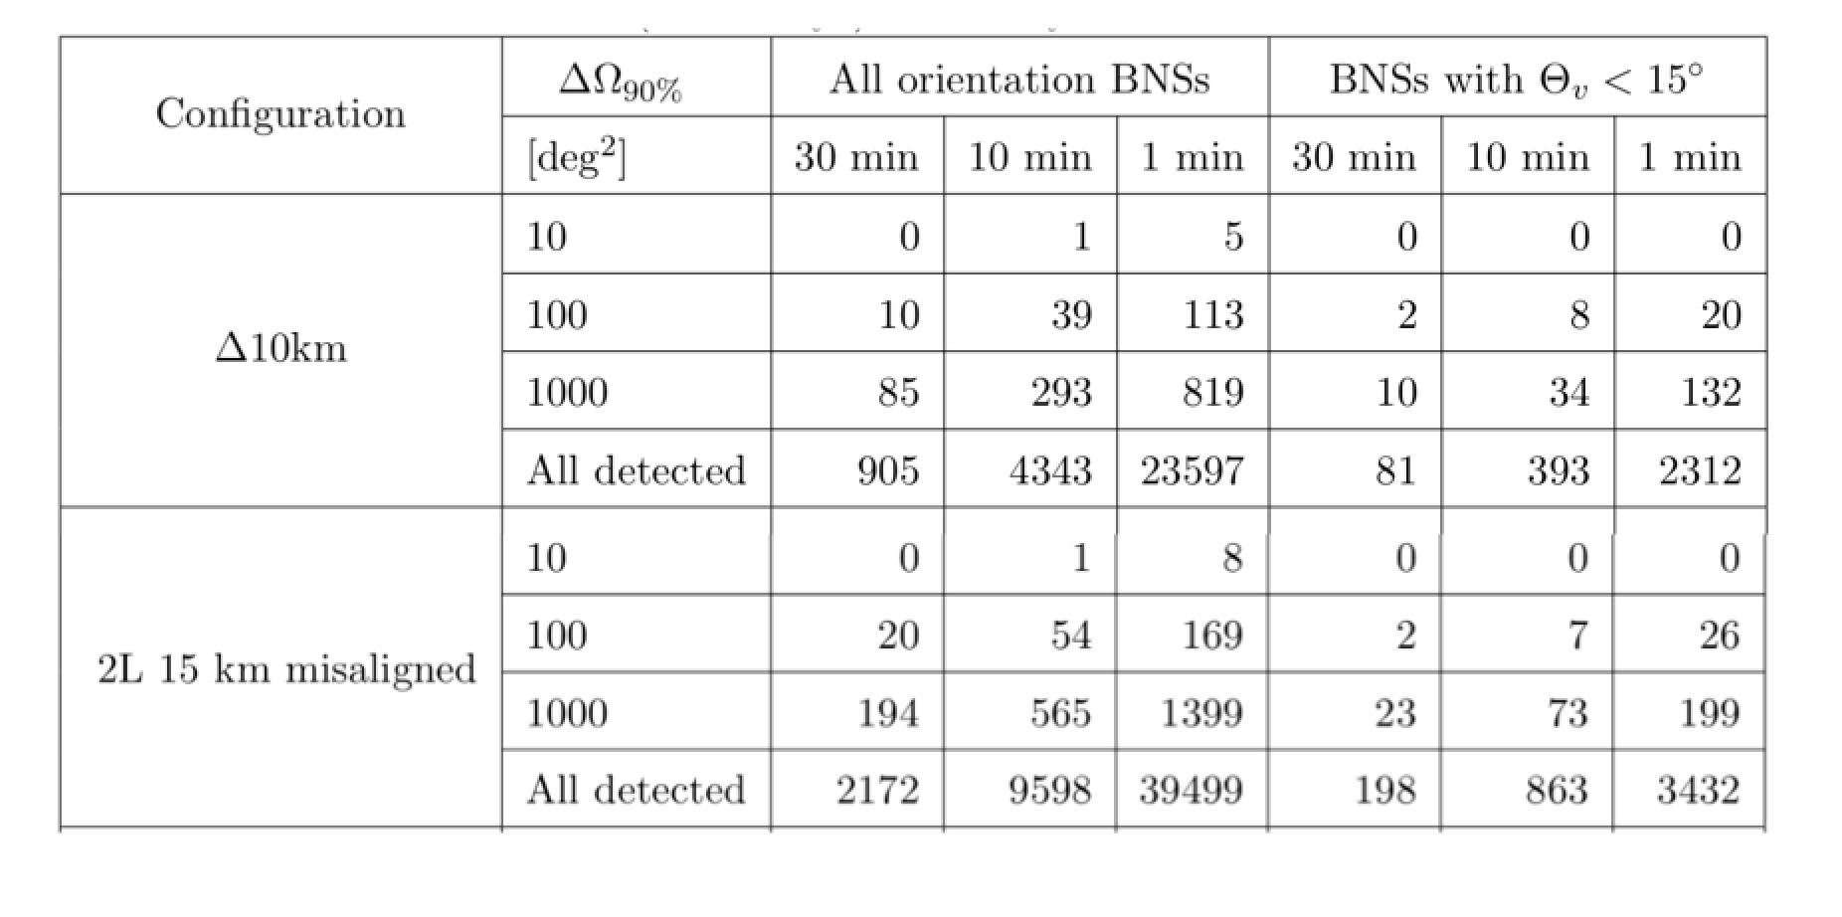
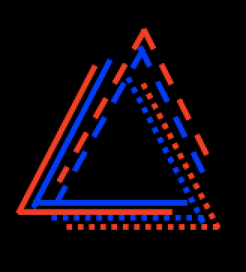
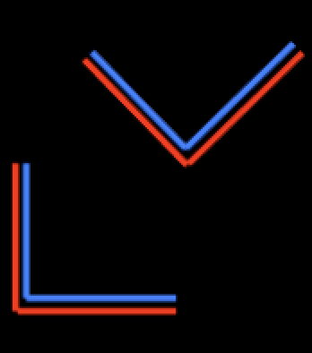
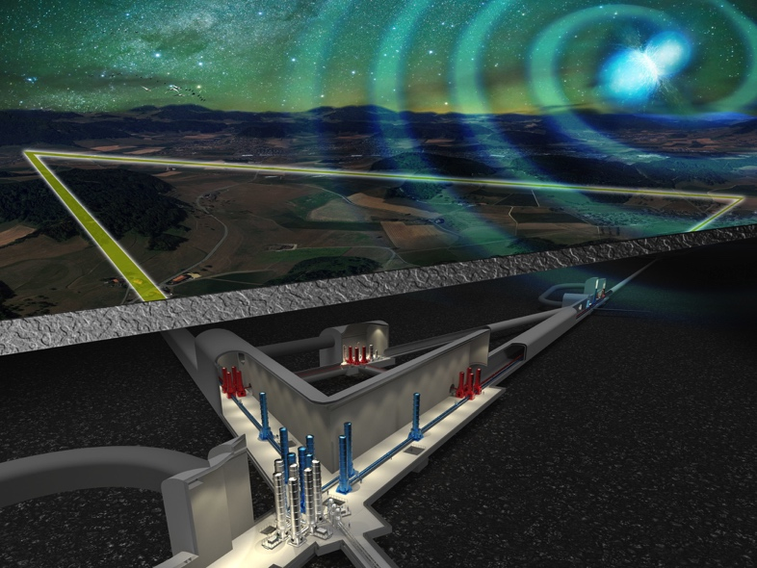
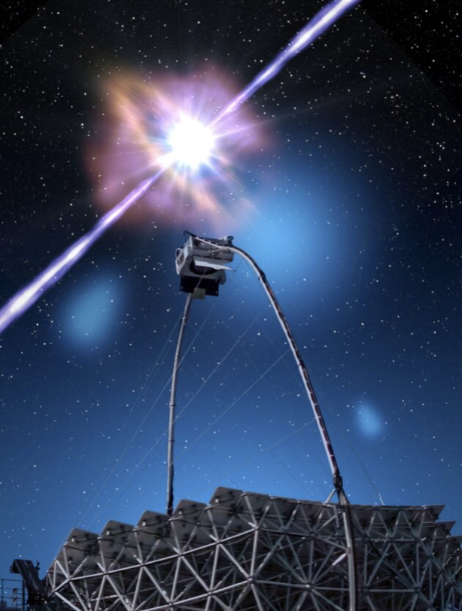

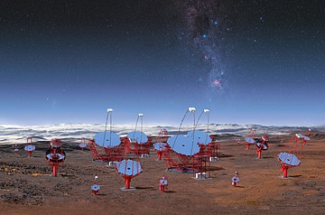
Early warning alerts
ET alone
Branchesi, Maggiore et al. 2023, JCAP
Five minutes before the merger, a factor 10 higher number of well-localizaed events when ET operates in a network of next generation GW detectors
CTA/ET synergies
Banerjee et al. 2023, A&A

Slide 13
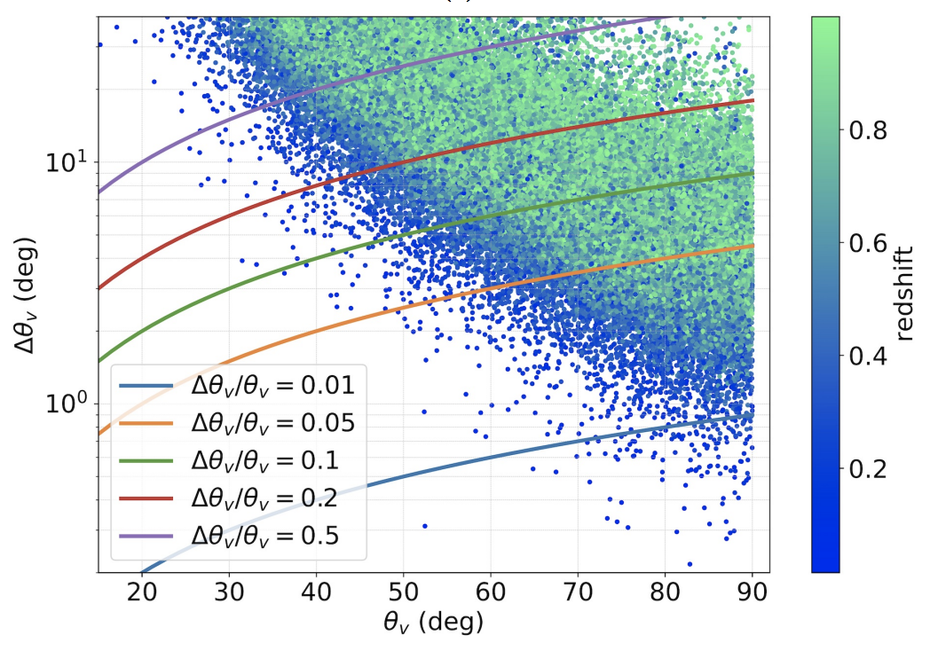
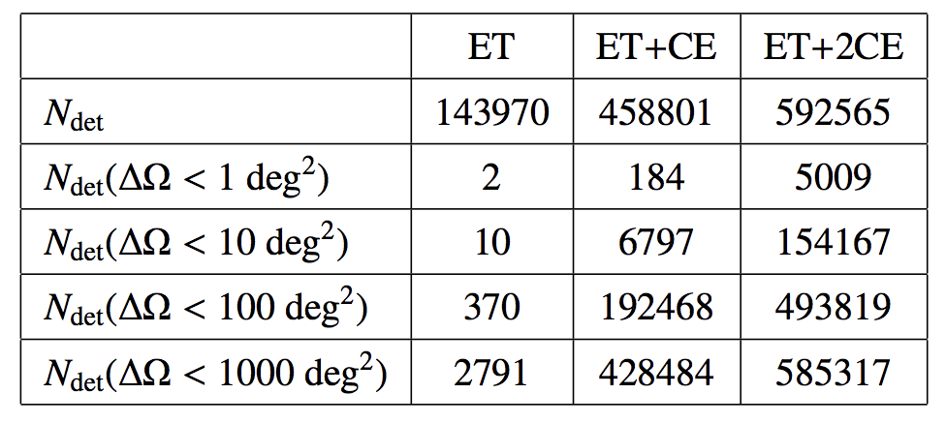
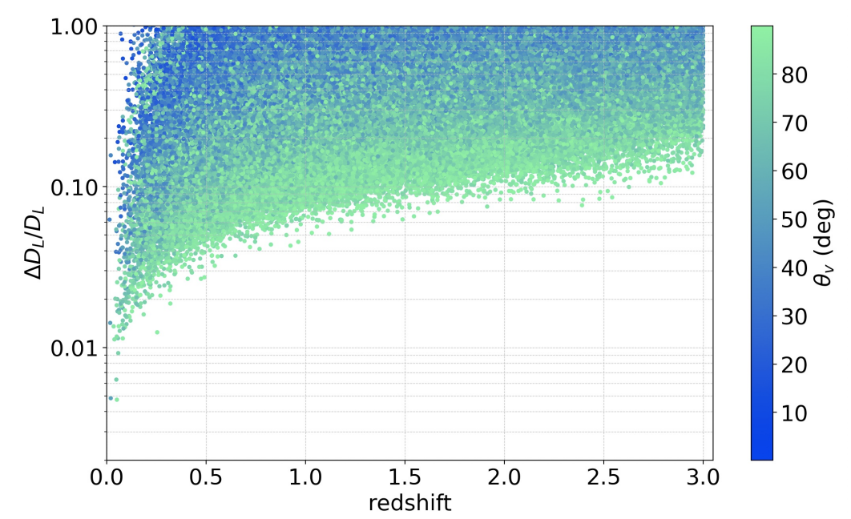
Prioritization of the triggers to be followed
Sky-localization
Viewing angle
Ronchini et al., A&A 2022
Distance
Too large numbers of triggers well localized to be followed-up
Send in low-latency source parameters and continuous updates

Slide 14
Real-time search: overlapping signals, low-frequencies
A few tens of alerts per hour
Pre-merger alerts
Select triggers to be followed
Send in low-latency all source parameters and continuous updates, dyanmical database
GW detectors as external trigger user
What EM oservatories for the search?
What resources to characterize the transients?

Slide 15
Multi-messenger studies
+ Italian Universities
PRIN 2020 METE 2020KB33TP

Slide 16
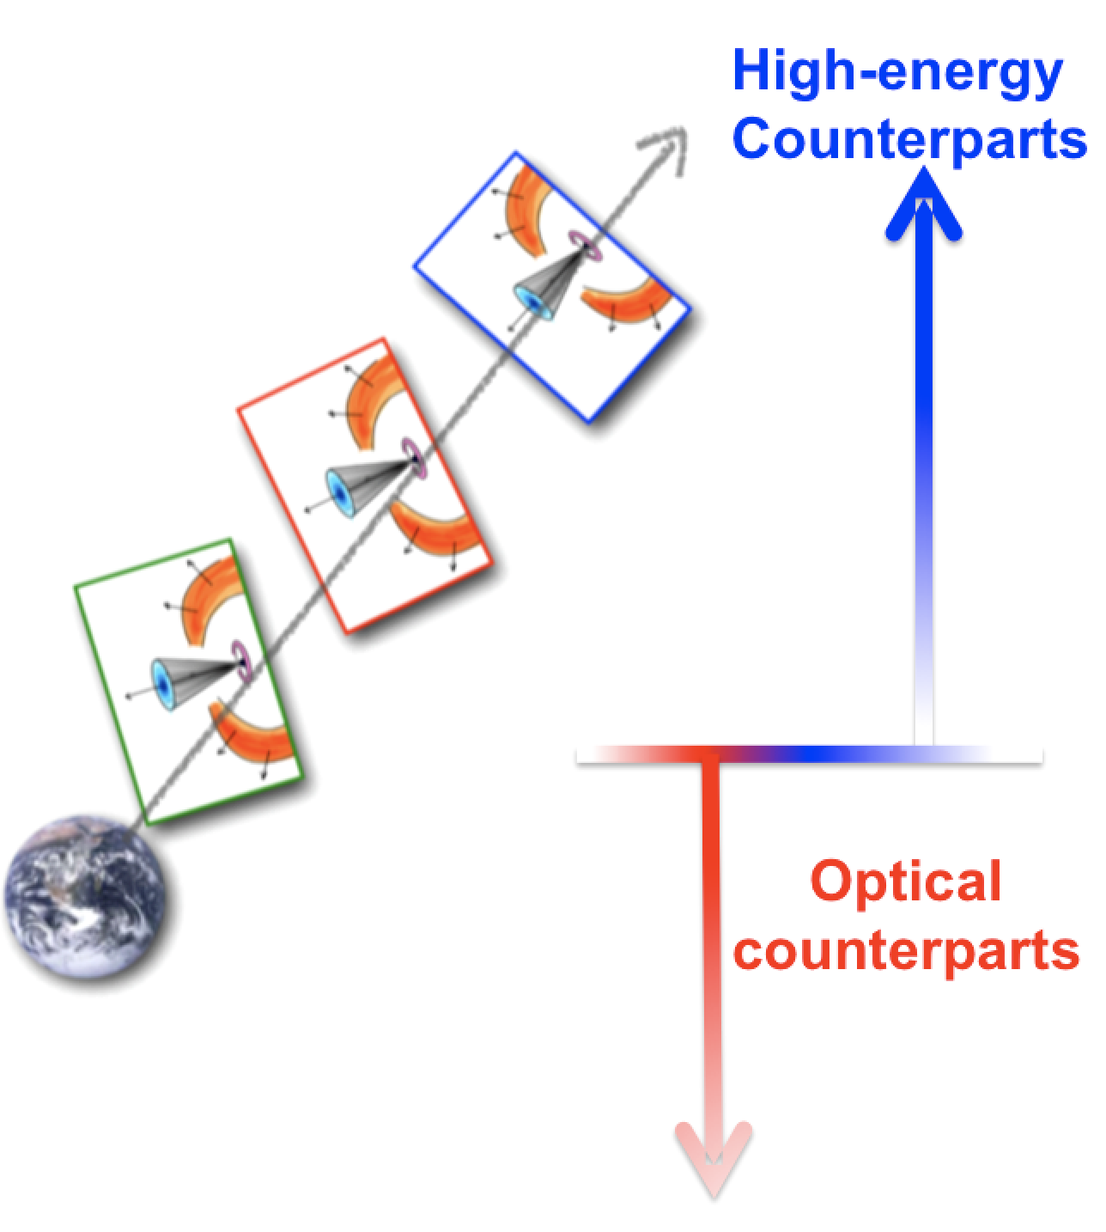
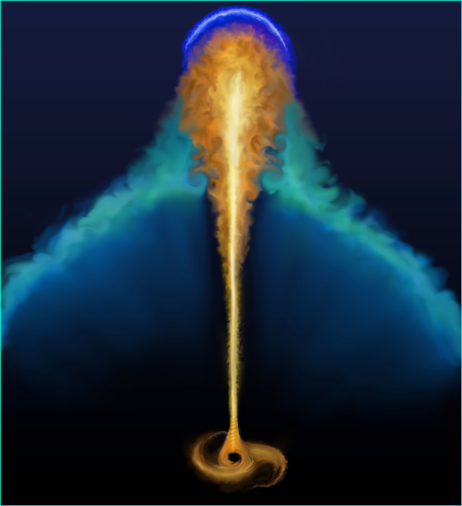
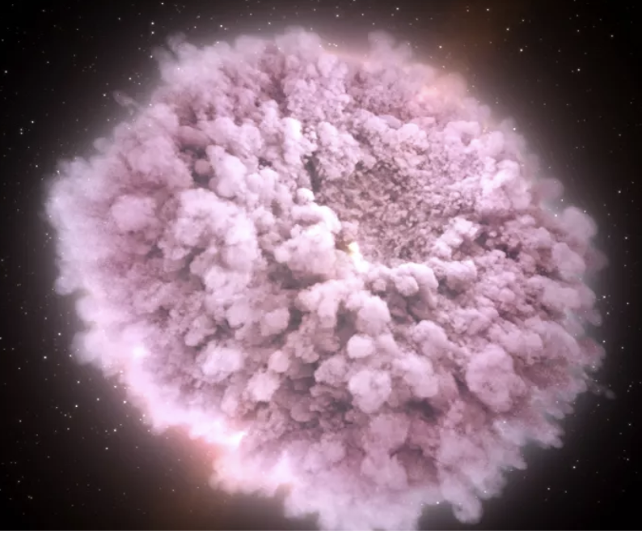
RELATIVISTIC JET PHYSICS,
GRB EMISSION MECHANISMS, COSMOLOGY and MODIFIED GRAVITY
Image Credit: Ronchini
KILONOVA PHYSICS, NUCLEOSYNTHESIS, NUCLEAR PHYISCS and H0 ESTIMATE
Credits: Ghirlanda
Image credit: NASA Goddard Space Flight Center

Slide 17
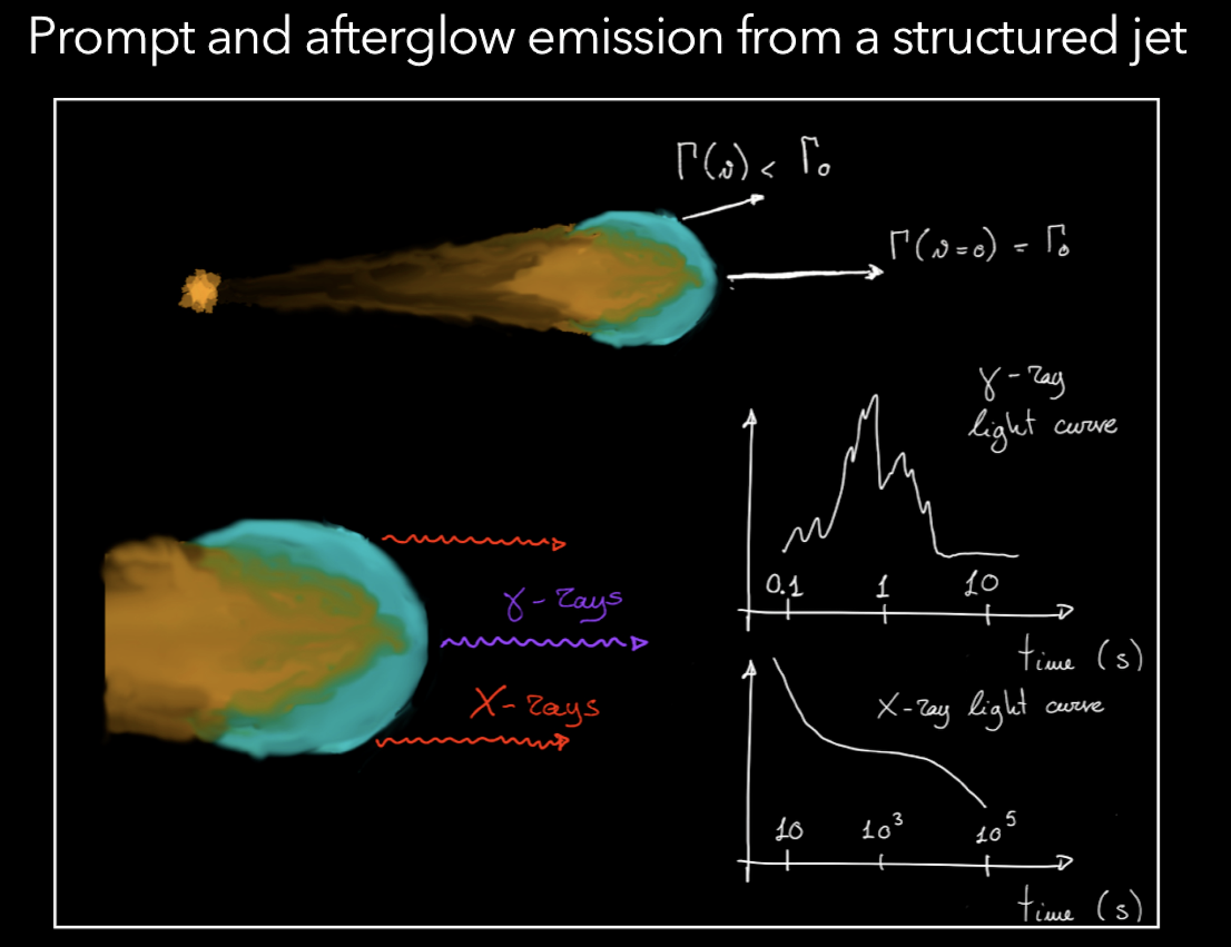
GRB/GW
GRB: gamma/X-ray
RELATIVISTIC JET PHYSICS,
GRB EMISSION MECHANISMS, COSMOLOGY and MODIFIED GRAVITY
Ronchini et al., A&A 2022
Almost all detected short GRB will have a GW counterpart
around 70% ET and 95% ET+CE
Depending on the satellites, we will have tens to hundreds
of detections per year (see HERMES and THESUS!)
Crucial Instruments able to localize at arcmin-arcsec level to drive
multiwavelength and spectroscopic follow-up!

Slide 18
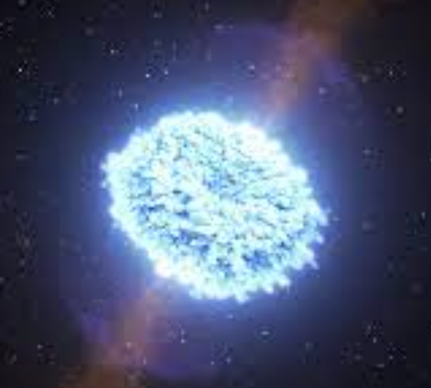
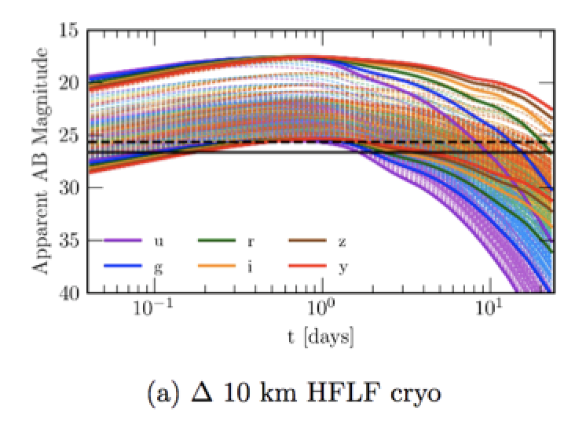
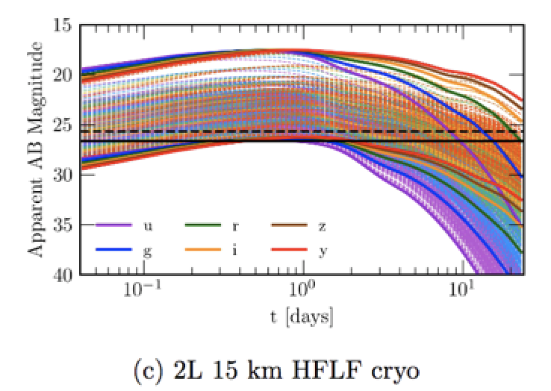

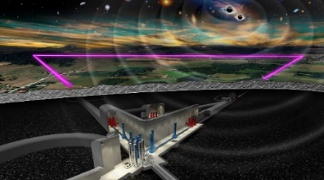
GW/KILONOVA
BNSs detected with a sky-localization < 40 deg²
Branchesi, Maggiore et al. 2023, JCAP
Sevaral tens per year of joint detections of VRO and ET
Several hundreds when ET operates in network of detectors
(also current generation ones)
Loffredo, Hazra, Dupletsa et al. in prep
Bisero et al in prep
Colombo et al. In prep

Slide 19
GW DATA ANALYSIS

Slide 20
Data analisi GW
MDC
V Elena’s talk – DIV 10
Iniziato il primo MDC
Strategico anche a livello internazionale
X critical..
Codice MDC vecchio e non facilmente accessibile
Pipelines di PE non sono pronte
Task Force MDC – codice nuovo?
Roadmap: MDC per training non-esperti e per esperti per identificare i problemi delle pipelines
Lovorare insieme e-infrastructure board
X critical..
Data Analisi per ET
Non possiamo aspettare che venga fatta dentro Virgo
Sviluppare waveforms
Ottimizzare o sviluppare nuove pipelines
Integrare nuove comunità e sperimentare nuovi metodi
Pensare a sinergie in Italia legate anche a LISA
Finanziamenti, software engineering?

Slide 21
Panels to discuss..

