Slide 1
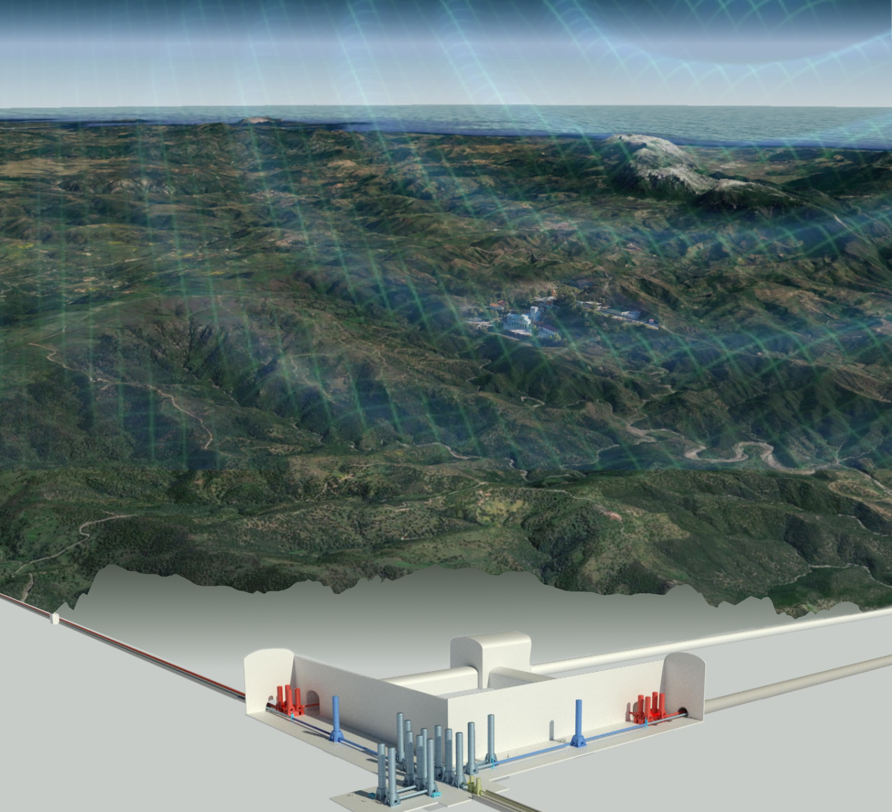
Site Preparation Session Introduction

Slide 2
Two lines of activities
Site Characterization
Infrastructure design

Slide 3
Site Characterization
Verify if the site meets the fundamental requirements
Evaluate the impact of local environmental noises on the detector performances and prepare possible mitigation strategies.
SiteCharacterization coordinated in the framework of the ET Collaboration: Site Preparation Board (SPB).
Strong interaction with the Active Noise Mitigation division in the Instrument Science Board(ISB).
ET Executive Board
Specific Boards
SPB
Site Preparation Board
OSB
Observation Science Board
ISB
Instrument Science Board
EIB
E-Infrastructure Board
WD1 Physical variables and characterization
Fundamental Physics
Suspensions
On-site Infrastructure
Cosmology
WD2 Geology
Optics
Distributed infrastructure
Population Studies
WD3 Bidbooks
Multimessenger Obs.
Interferometer
Software & frameworks
Synergies with GWDs
WD4 Cost timing and risk assessment
Nuclear Physics
Vacuum and Cryogenics
WD5 Legal and site preservation
Transient GW Sources
Active Noise Mitigation
Waveforms
WD6 Socio-Economic and environmental impact
Scientific potentials …
Civil Infrastructures
Data Analysis Platform

Slide 4
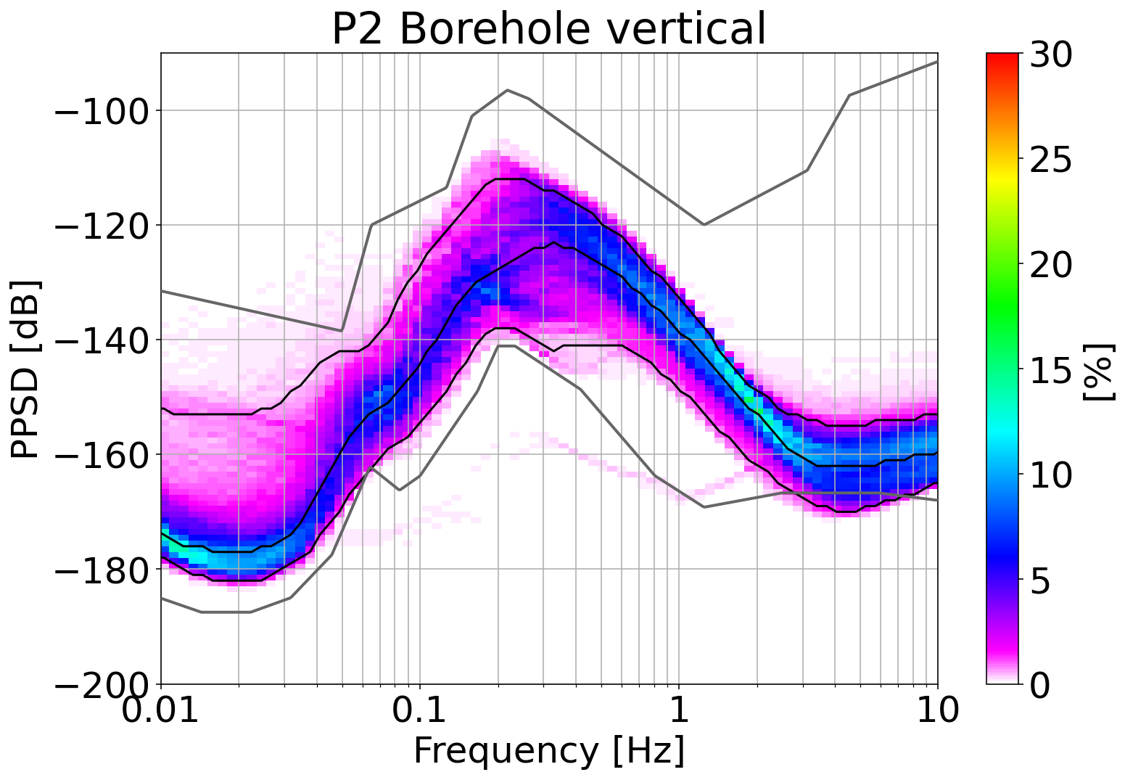
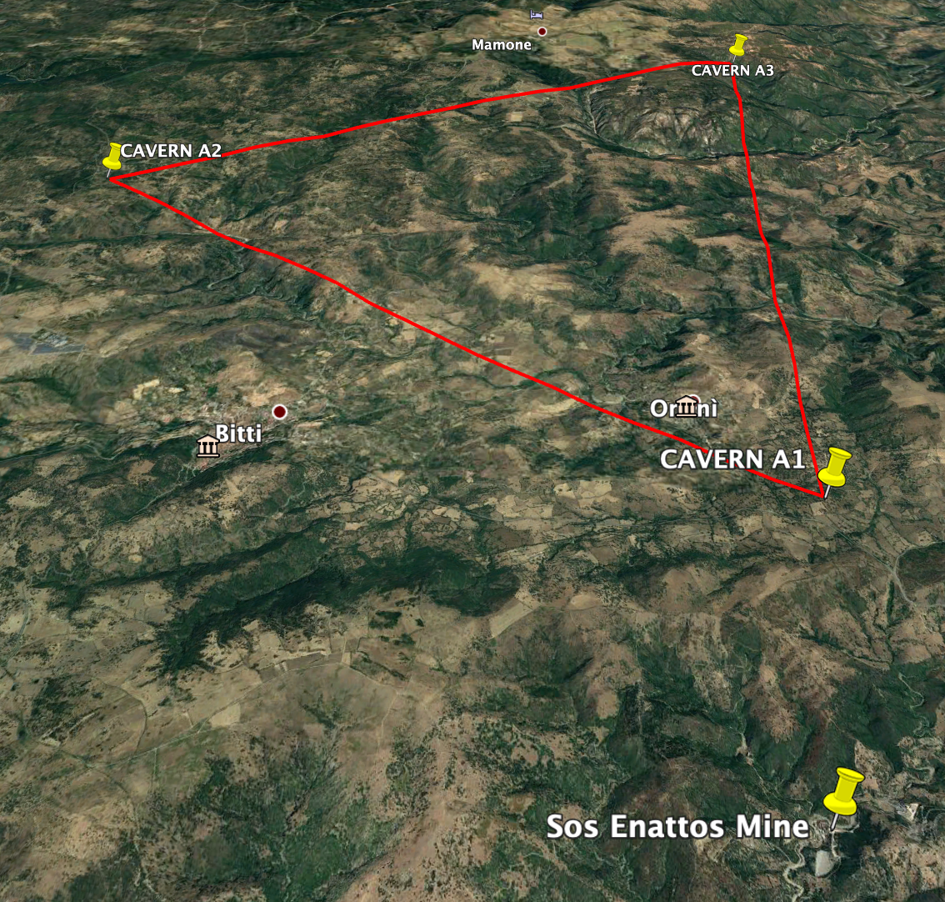
Monitoring del sito
P2 (-264m) : 2021/10/01– 2021/03/20
Characterization of the Bitti and Onanì corners:
Surface and underground seismic and environmental measurements
Vedi talk L. Naticchioni, Giunchi, Olivieri.
SarGrav surface lab
SOE0 (surface)
SOE1, SOE2, SOE3
(-84m, -111m, -160m)
SarGrav surface lab
SOE0 (surface)
SOE1, SOE2, SOE3
(-84m, -111m, -160m)
integrated into the INGV seismometer network
http://cnt.rm.ingv.it/en/instruments/station/SENA
4 broadband seismometers, 3 short-period seismometers, 2 magnetometers, 1 microphone+microbarometer and 1 tiltmeter distributed over underground and surface stations
Credits to L. Naticchioni

Slide 5
Contributions
From the Characterization team (people from INFN, INGV and several universitie):
Status of the ET Sites Data repository (A. Fiori)
Status of Site Characterization Measurements of Sos Enattos area (L. Naticchioni)
Active and passive seismic measurements at the Sardinia ET vertices (C. Giunchi)
Local noise sources (M. Olivieri)

Slide 6
Useful links
Wiki page
Mailing list: et-spb@et-gw.eu (subscribe)
Site data Web Services
Einstein Telescope @ Sardinia https://www.einstein-telescope.it/en/home-en/
Einstein Telescope @ EMR https://www.einsteintelescope.nl/en/

