Slide 1
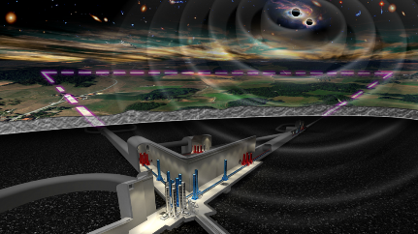
ETIC - GEMINI
The first underground facility for the development of vibration control
http://www.einstein-telescope.it

Slide 2
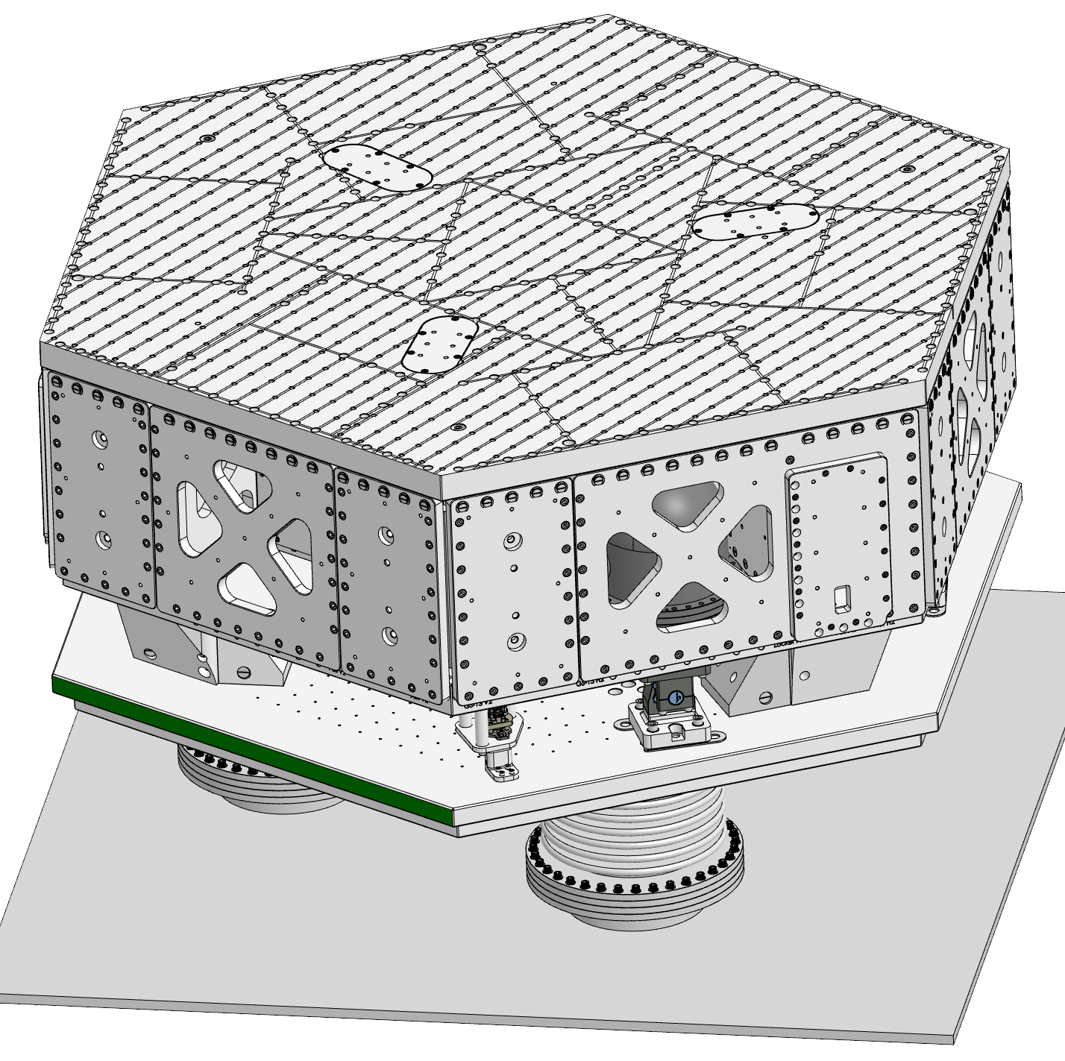
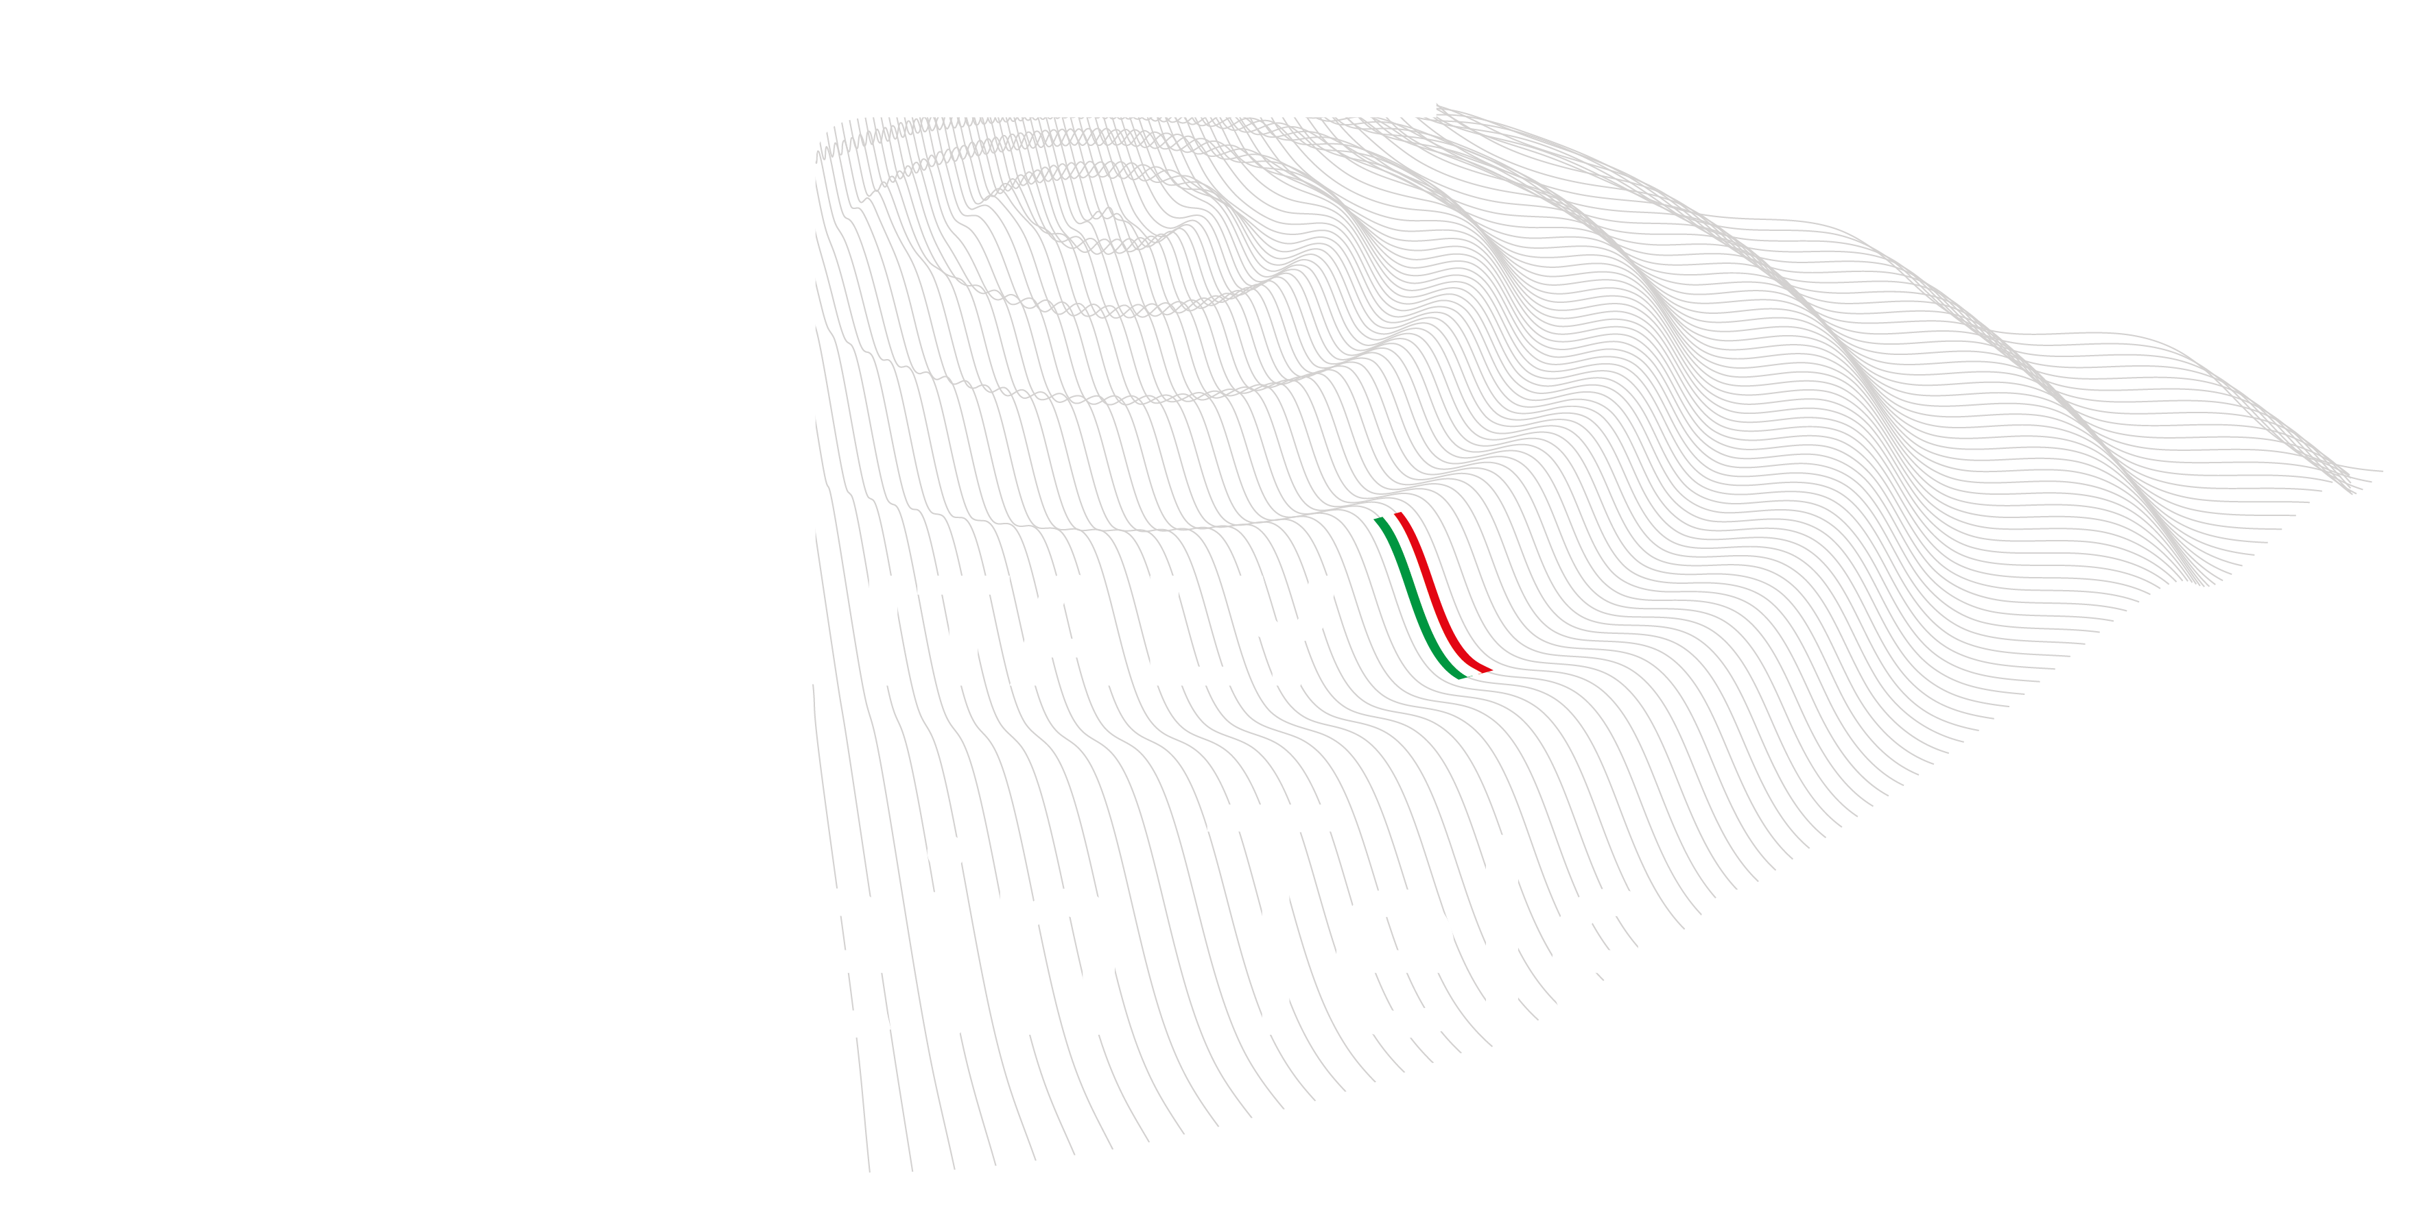
Team
Gran Sasso Science Institute
Jan Harms, Ilaria Caravella
INFN – LNGS
Carlo Bucci, Daniele Cortis, Nicola D’Ambrosio, Massimiliano De Deo, Marco D’Incecco, Alessandro Lalli, Donato Orlandi, Stefano Pirro
External collaborators
Jeff Kissel (LIGO Hanford), Brian Lantz (Stanford), Rich Mittleman (MIT), Conor Mow-Lowry (VU Amsterdam), Marco Ricci (La Sapienza), Jamie Rollins (Caltech), Jim Warner (LIGO Hanford)
Einstein Telescope Infrastructure Consortium (ETIC - IR0000004)
PNRR MISSIONE 4, COMPONENTE 2, INVESTIMENTO 3.1

Slide 3
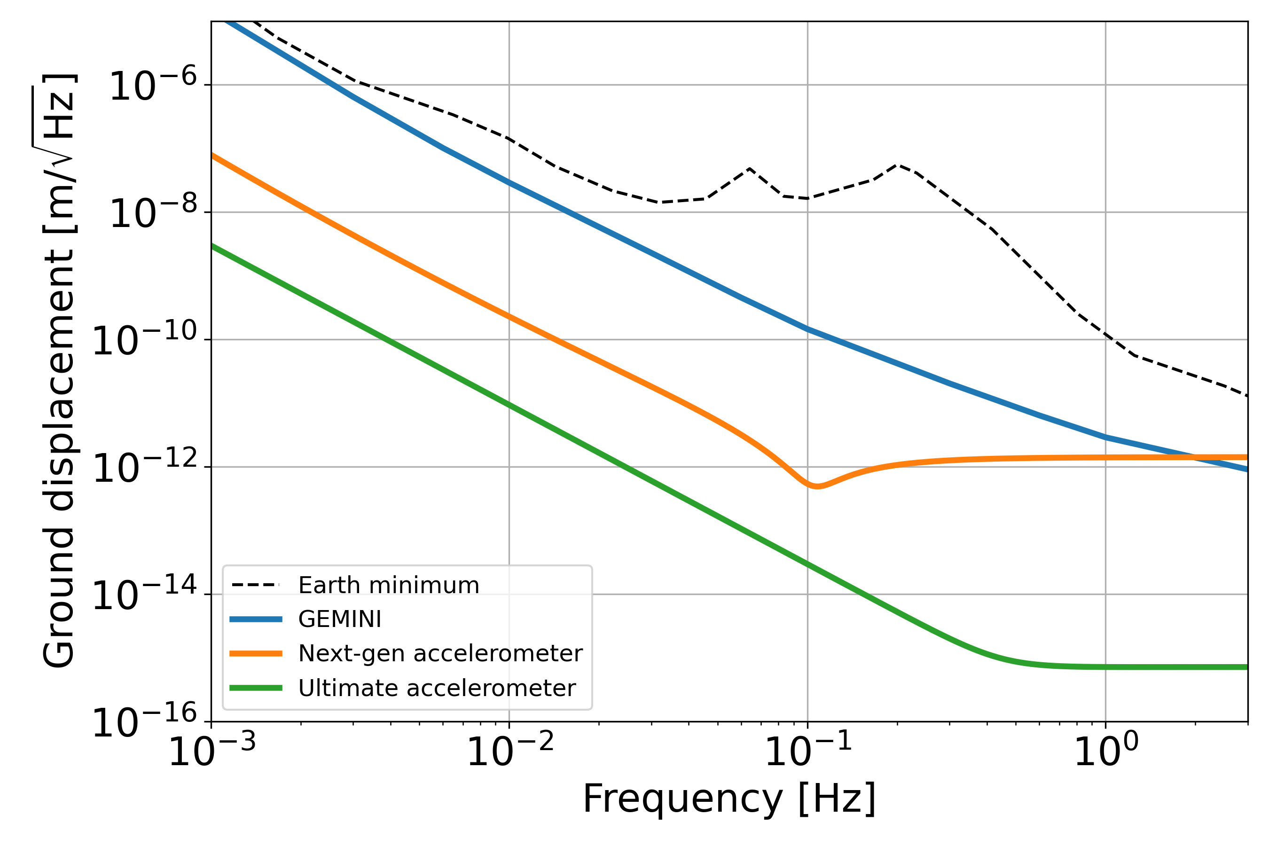
Target
Create the lowest-vibration platforms on Earth between 0.1Hz and 1Hz
Develop vibration control / active seismic isolation in an underground environment: local as well as inter-platform
Characterization of environmental noise in an underground research facility
Test high-performance inertial sensors on the platform at cryogenic temperatures
Einstein Telescope Infrastructure Consortium (ETIC - IR0000004)
PNRR MISSIONE 4, COMPONENTE 2, INVESTIMENTO 3.1

Slide 4
Stato delle attività
Platform mechanical design was produced by LNGS engineers as adaptation of the LIGO HAM-ISI
Alca Technology was selected for the vacuum system
Galli & Morelli was selected for the mechanical platforms excluding the spring blades
The 6 T360 GSN Vault seismometers from Nanometrics are expected to be delivered in the next few months
Ongoing activities
Preparing the tender for the real-time and data-acquisition system
Preparing the tender for the spring-blade test stand
Design of thermal link for the cold box, and of the T360 vacuum pods
4
Einstein Telescope Infrastructure Consortium (ETIC - IR0000004)
PNRR MISSIONE 4, COMPONENTE 2, INVESTIMENTO 3.1

Slide 5
Finanziamenti sinergici
250k€ from PNRR Vitality – Advanced Space Technologies and Research Alliance (ASTRA)
Cryocooler, thermal link, cold box, vacuum pods, DAQ/control system
Application for other funding submitted and to be submitted in the next weeks.
5
Einstein Telescope Infrastructure Consortium (ETIC - IR0000004)
PNRR MISSIONE 4, COMPONENTE 2, INVESTIMENTO 3.1

Slide 6
Necessità Future
Funding for equipment:
Actuators and position sensors
Laser-interferometric readout of inter-platform motion
Array of infrasound microphones
6
Einstein Telescope Infrastructure Consortium (ETIC - IR0000004)
PNRR MISSIONE 4, COMPONENTE 2, INVESTIMENTO 3.1

Slide 7
Ruolo in ET
Development of an active seismic isolation system to help with the control of auxiliary degrees of freedom and to reduce stray-light noise
GEMINI is a contribution to the ISB ANM WP on inter-platform motion and WP environmental sensing
R&D at GEMINI will be useful for ISB SUS (active isolation), ISB IFO (controls optimization), and ANM (LF controls noise)
GEMINI might be the only large scale underground seismic-isolation facility in the world in the next 10 years
The environmental monitoring system of GEMINI will provide important insight into noise produced by ventilation, pumps, etc
7
Einstein Telescope Infrastructure Consortium (ETIC - IR0000004)
PNRR MISSIONE 4, COMPONENTE 2, INVESTIMENTO 3.1

