Slide 1

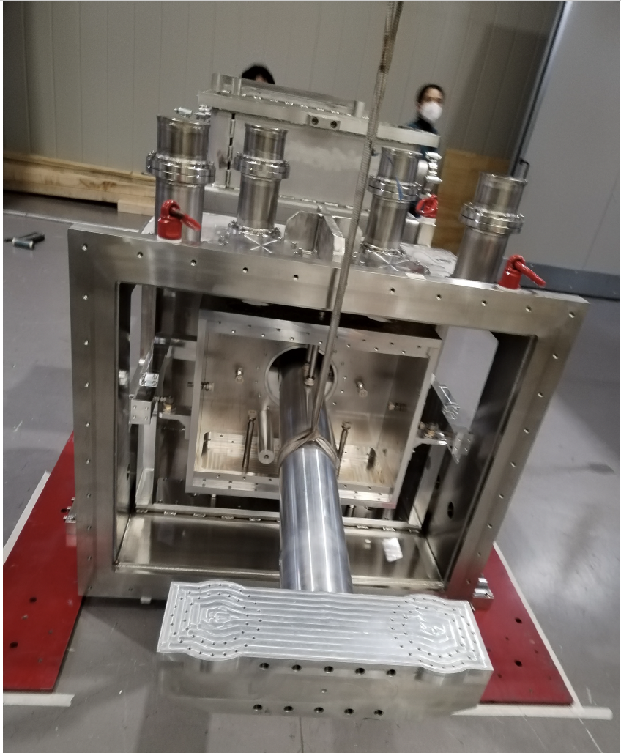
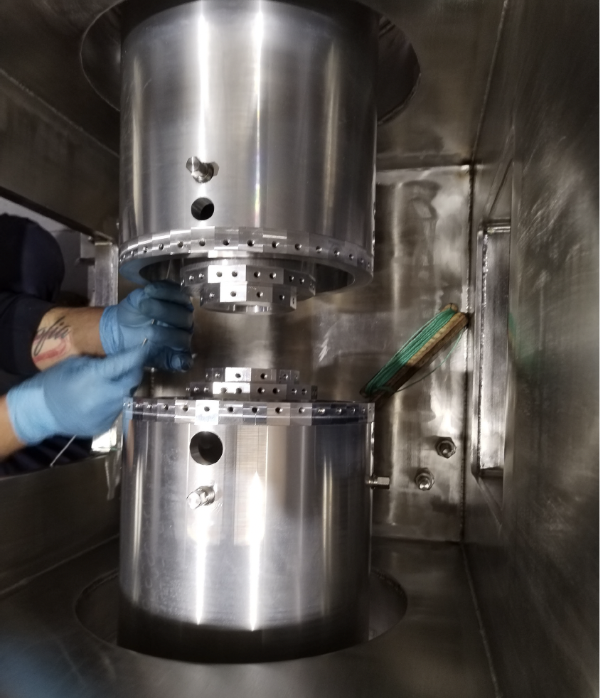
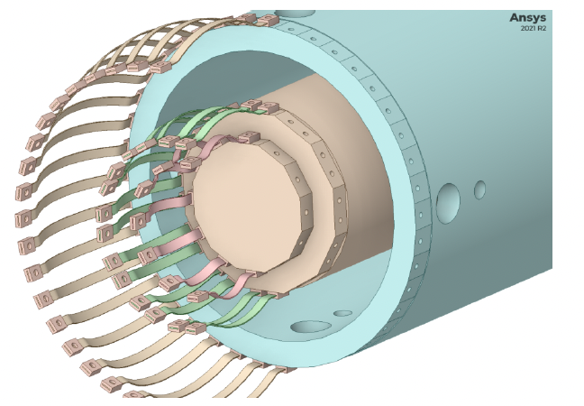
ARC-ETCRYO
INFN Sezione di Roma
Sapienza Univ- Dip di Fisica
E. Majorana
on behalf of the ETIC group
at INFN and Dep of Physics
21 febbraio 2023
Missione 4 • Istruzione e Ricerca

Slide 2
ARC-CRYOET infrastructure purpose
What do we want to study here ?
Viable Cryogenic payload solutions for ET
Cooling large mass payloads through solid conduction
What is not included in the apparatus we are developing ?
Seismic Isolation. Due and crucial for actual ET design, modelling of payloads takes it into account. However, the mechanical and thermal performance of the suspensions embedded in the payload system, are not affected by Seismic Isolation system presence.
➔ Preserving the seismic isolation provided at the level of payload suspension point is the main constraint in cryogenic suspension system design.
Y
seismic suspension
cryogenics
Test mass payload
0.6 T
20 K
Missione 4 • Istruzione e Ricerca
Missione 4 • Istruzione e Ricerca

Slide 3
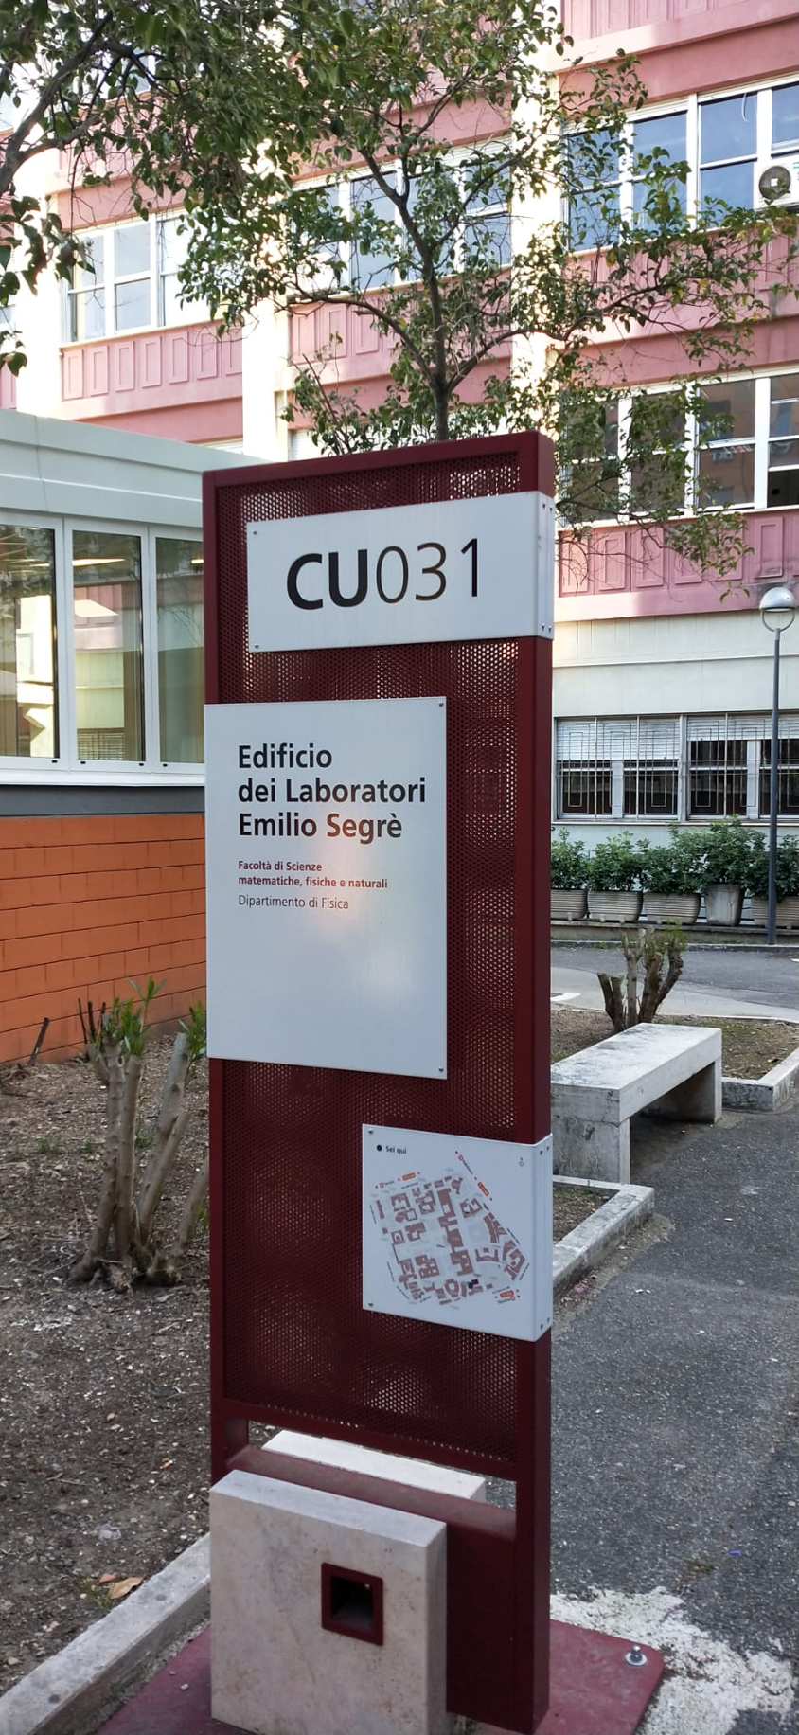
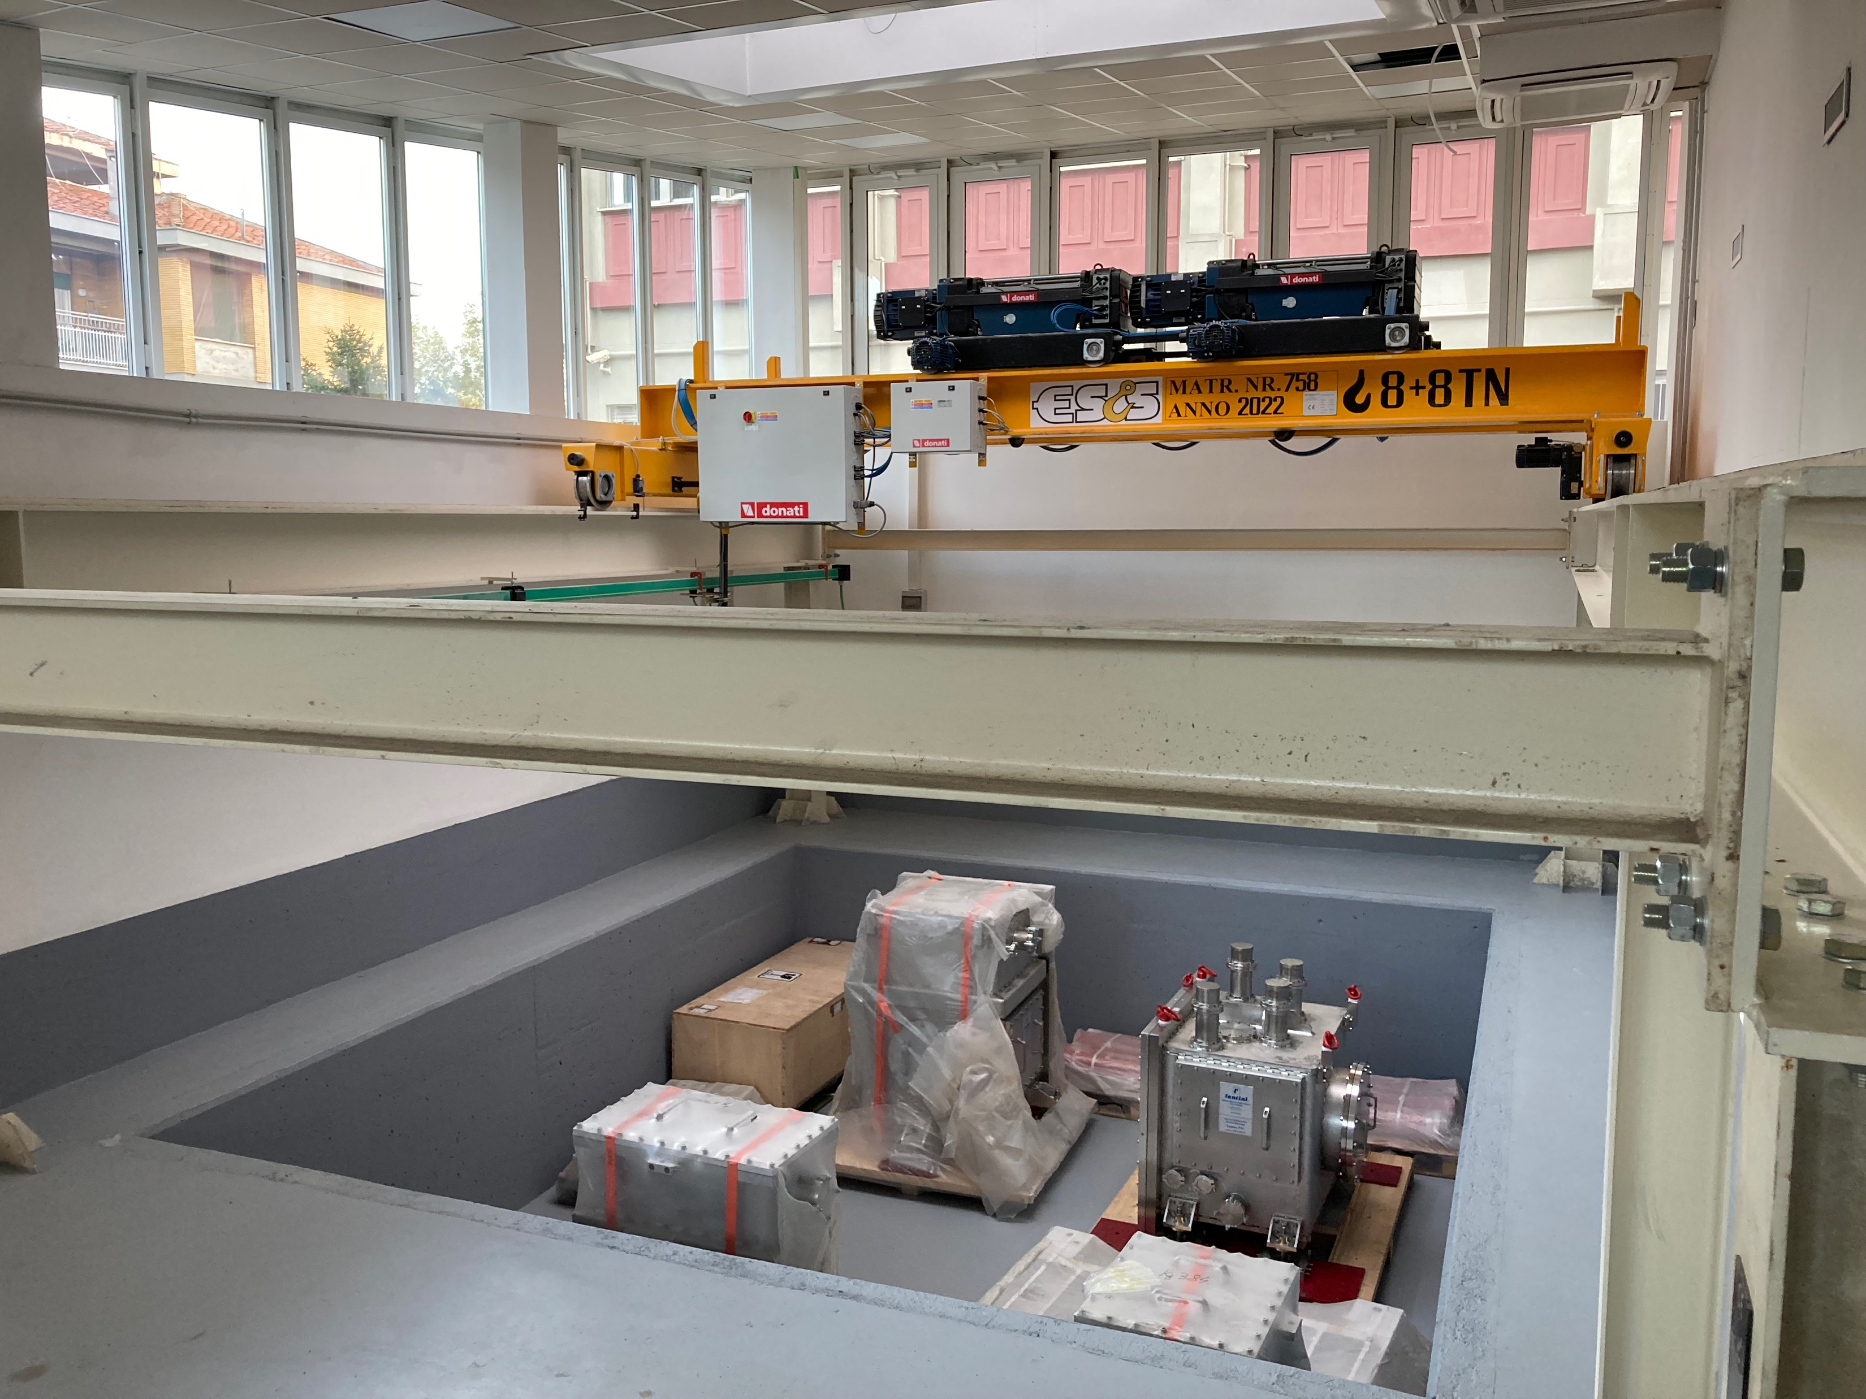
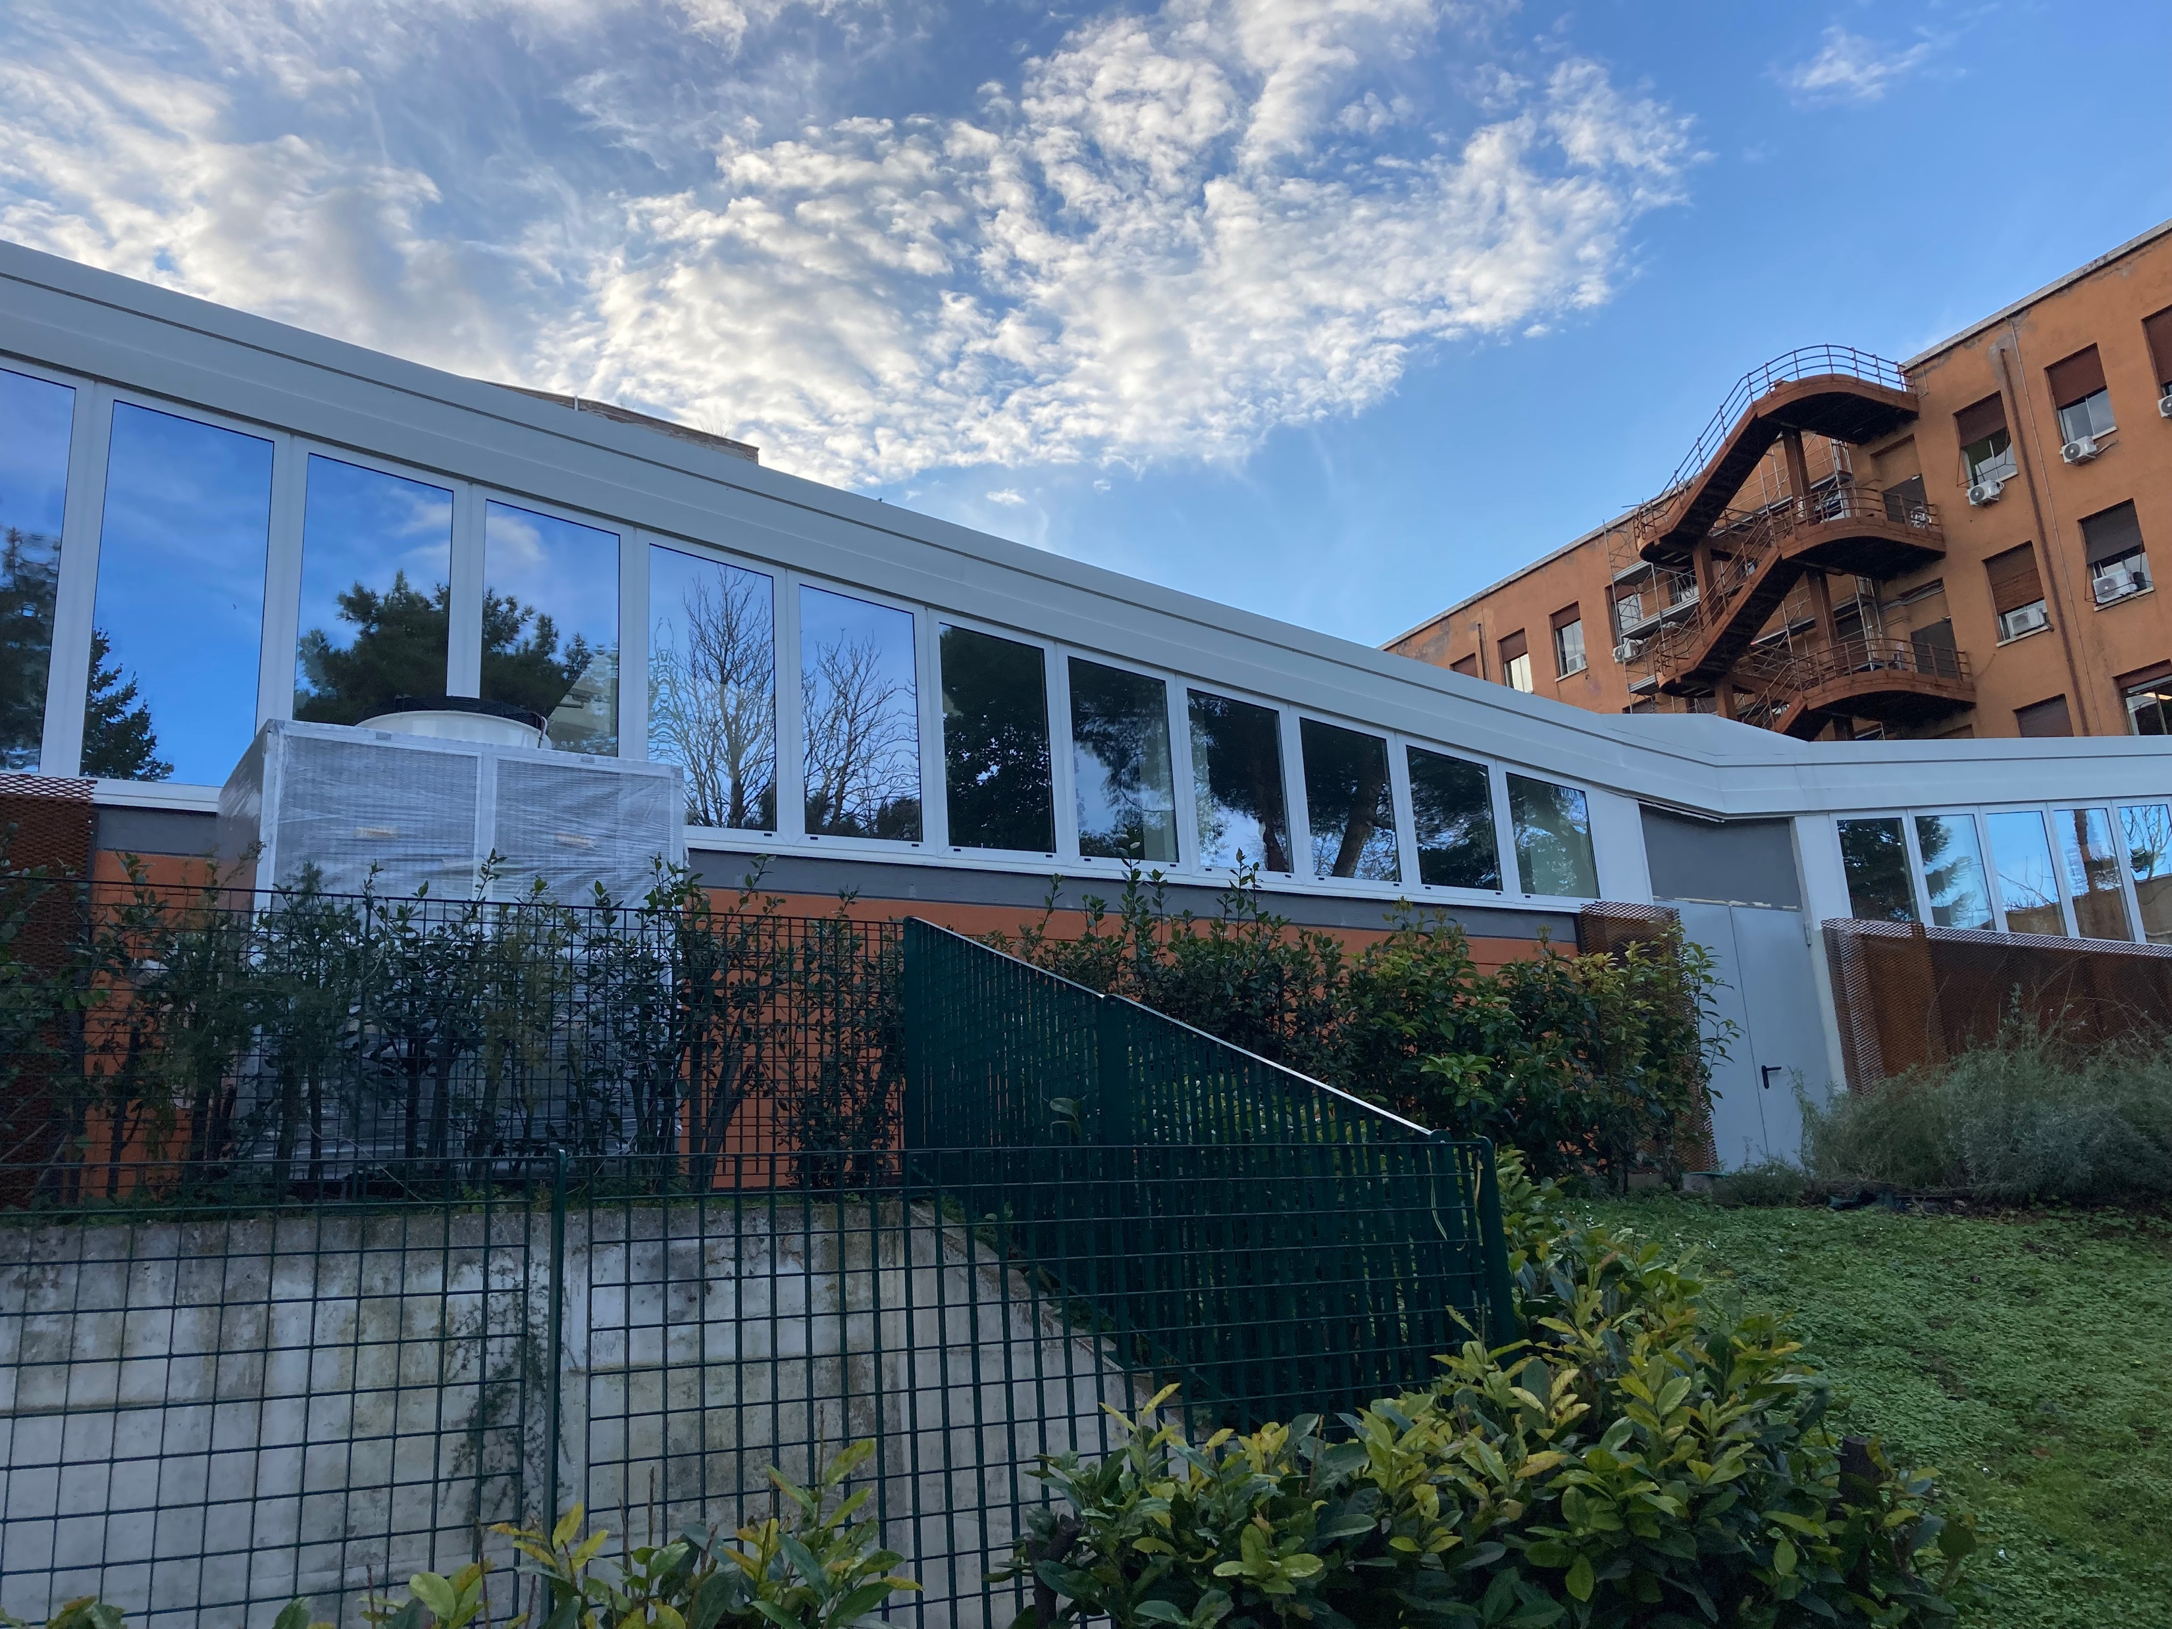
The place
The laboratory is growing up
Several infrastructure apparatuses must be modified or installed, the main are:
- Suitable electric cabin (order ~OK)
- Custom clean booth apparatus to protect the cryostat once installed (design ~OK)
- Crane height adjustment (order ~ OK)
Missione 4 • Istruzione e Ricerca

Slide 4
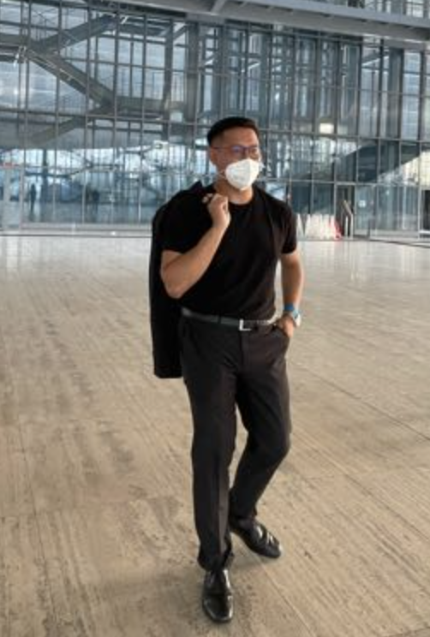

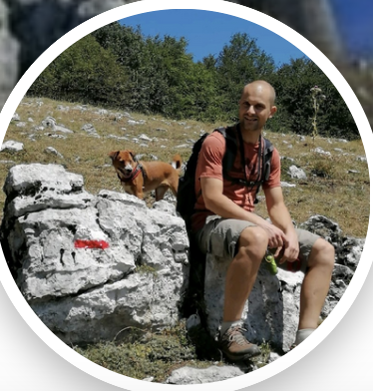
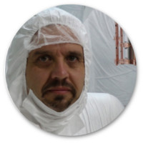
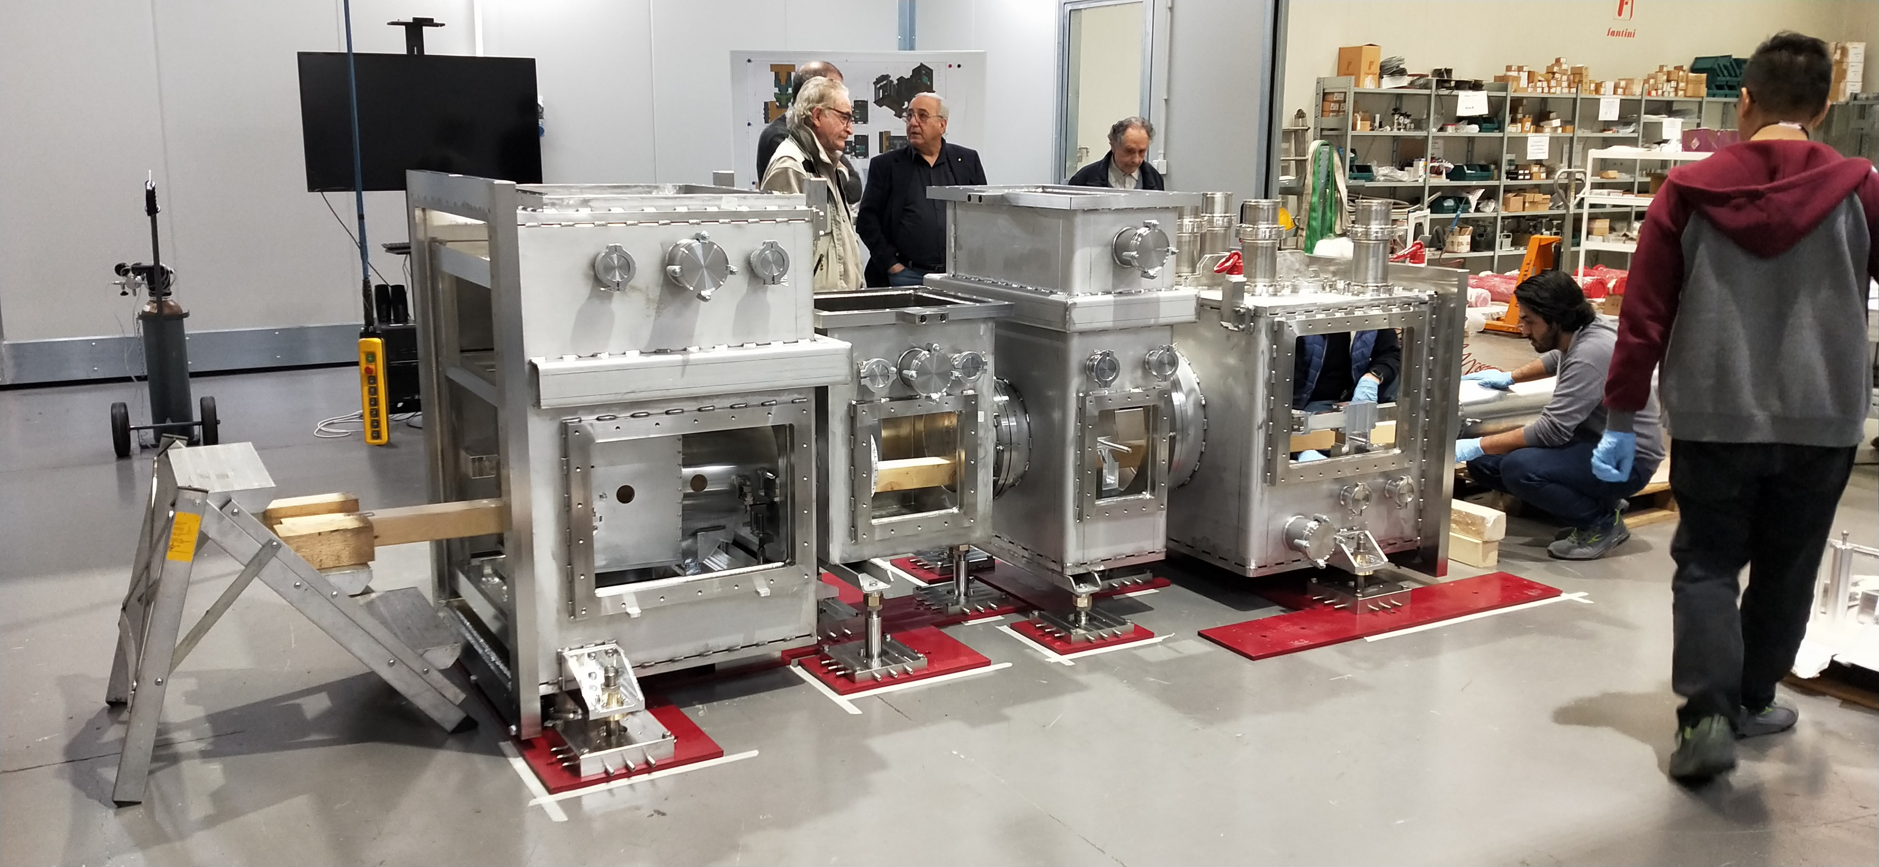

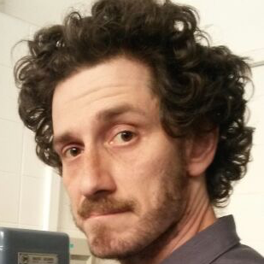
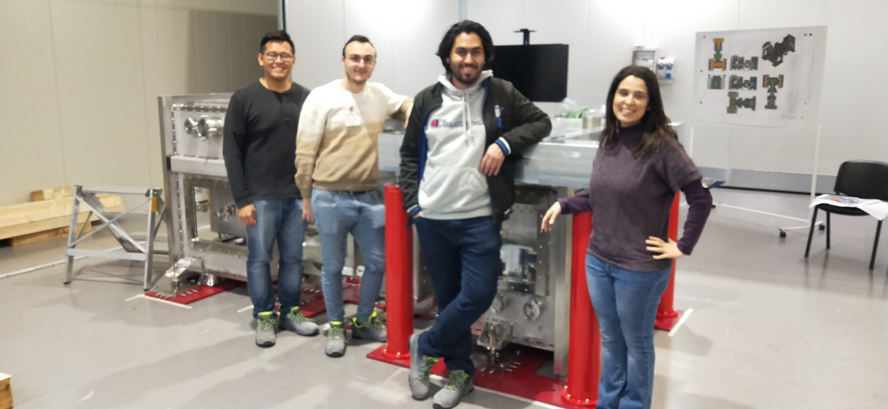
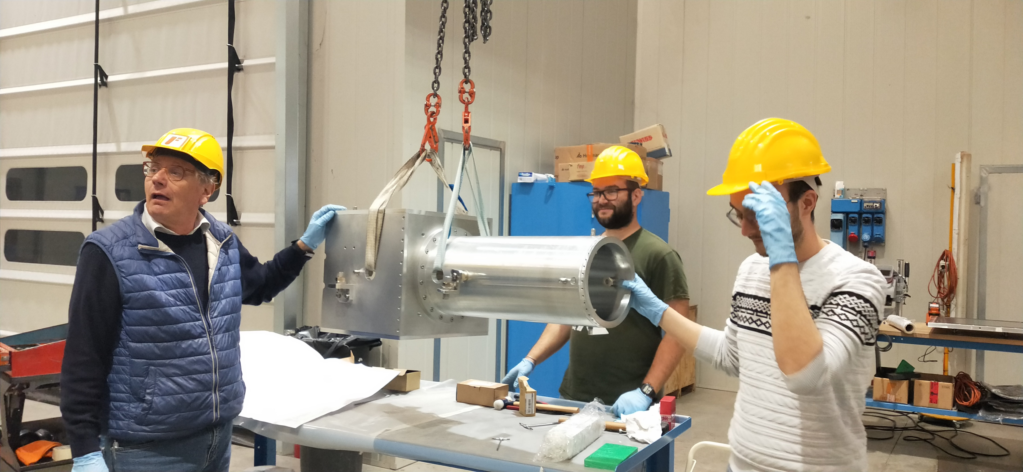
ETIC group @ARC
humans
F. Hoang
V. Martella, soon
E. Benedetti
(26/giugno)
L. Naticchioni
Marco Orsini
(1/agosto)
(1/agosto)
P. Puppo
S. Pirro
(1/6 signed!)
E. Majorana
M. Ricci
A. Rezaei (on leave..)
A. Cruciani
P. Rapagnani
F. Ricci! (ext. coll.)
D. Pasciuto
V. Mangano
ET Scienza e Tecnologia in Italia - Assisi 20/02/2024
Missione 4 • Istruzione e Ricerca

Slide 5
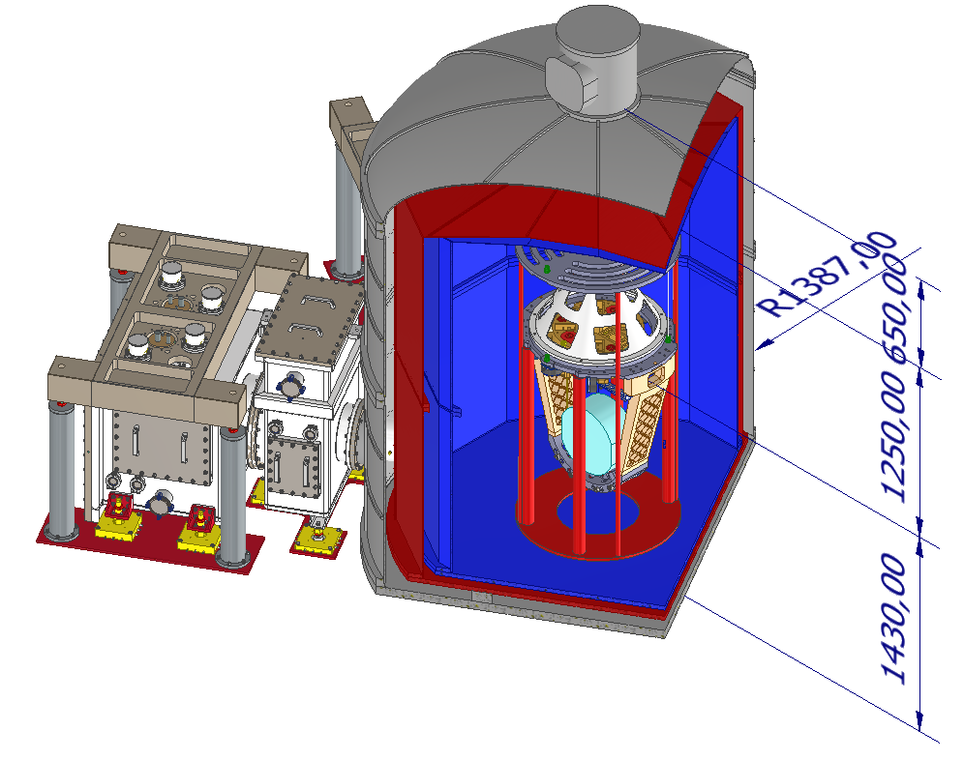
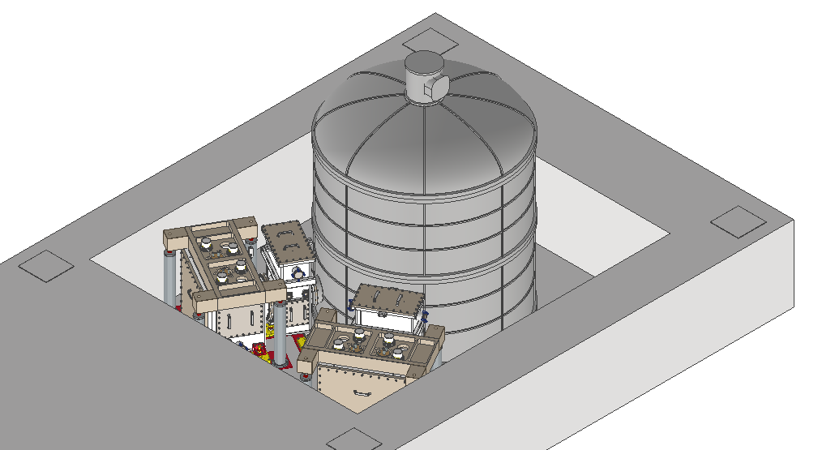
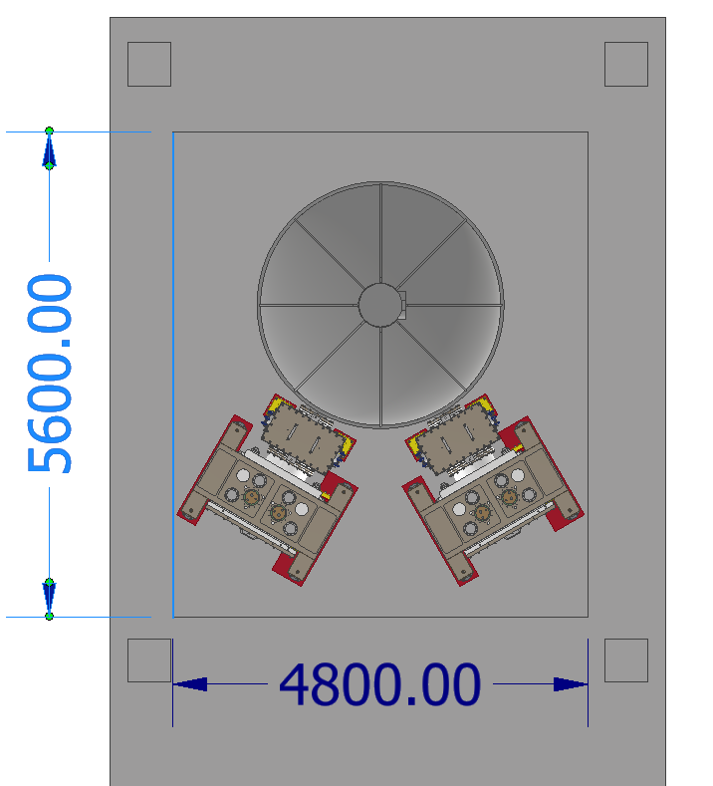
Cryostat design tuning phase
The cryostat is positioned in a 5.6x4.8 m hole, along with the two refrigeration lines. Design will be finalized by the company.
Vacuum Chamber:
External vacuum vessel, Steel AISI 304, thickness 8mm + supporting beams. Outer diameter: 2774 mm.
Outer Thermal Shield (OTS):
Aluminum Al6063, @ 60÷80 K.
Inner Thermal Shield (ITS):
Aluminum Al6063 or Al1080, @ 8÷10 K.
Top Technical Chamber (TTC):
to raise and lock in place Payload through suspension wire
These three structures are divided in two parts + dome, allowing partial disassembly and to work inside the cryostat.
OTS and ITS are 12-side polygonal shaped, allowing
Implementation of RML (rigid multi – layer) insulation.
Missione 4 • Istruzione e Ricerca

Slide 6
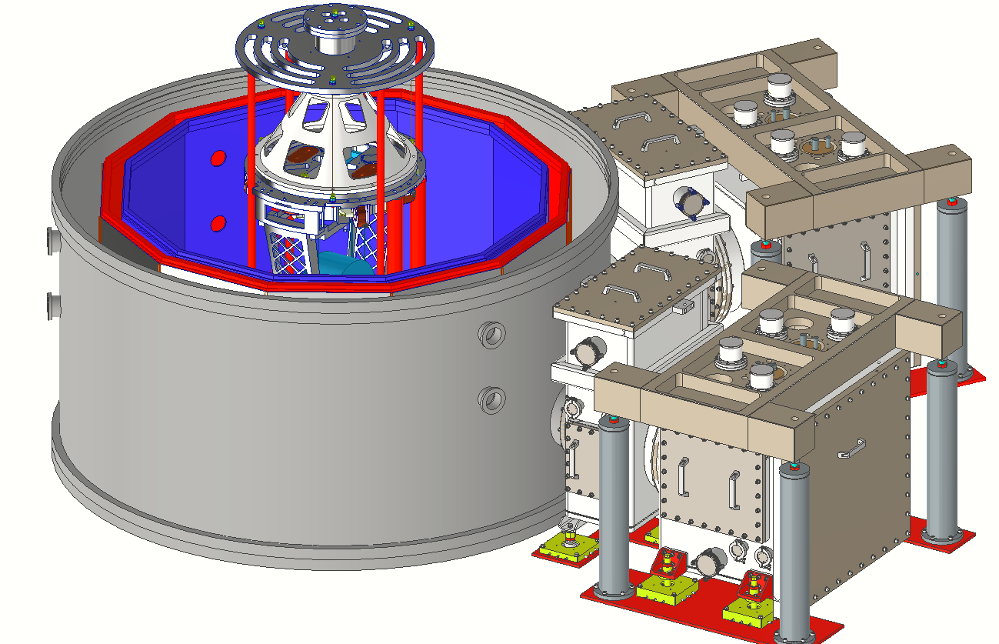
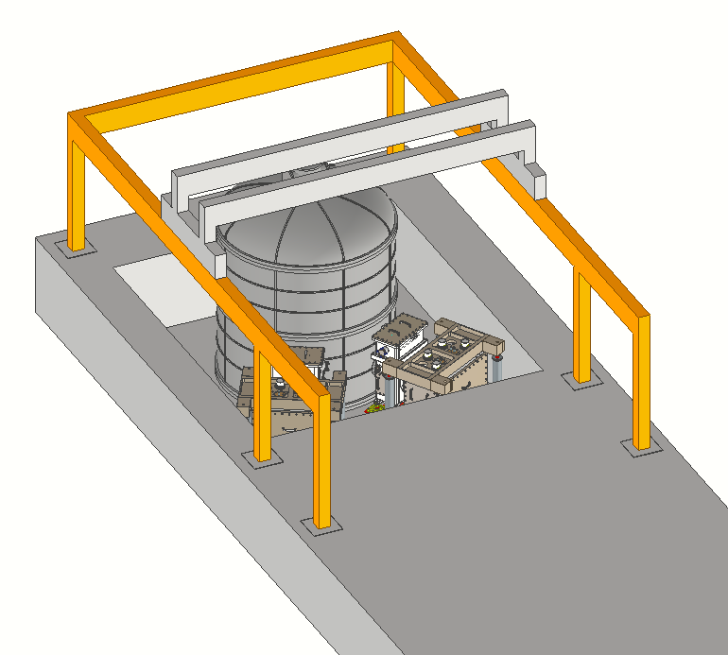
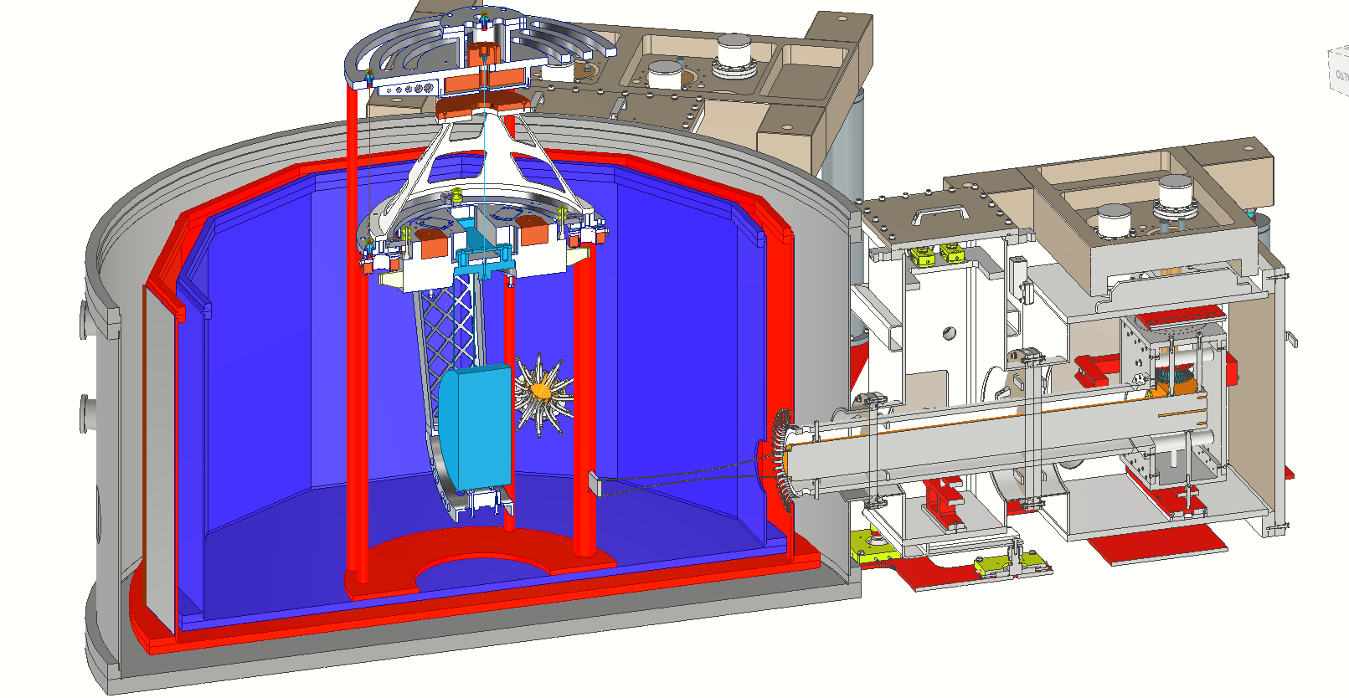
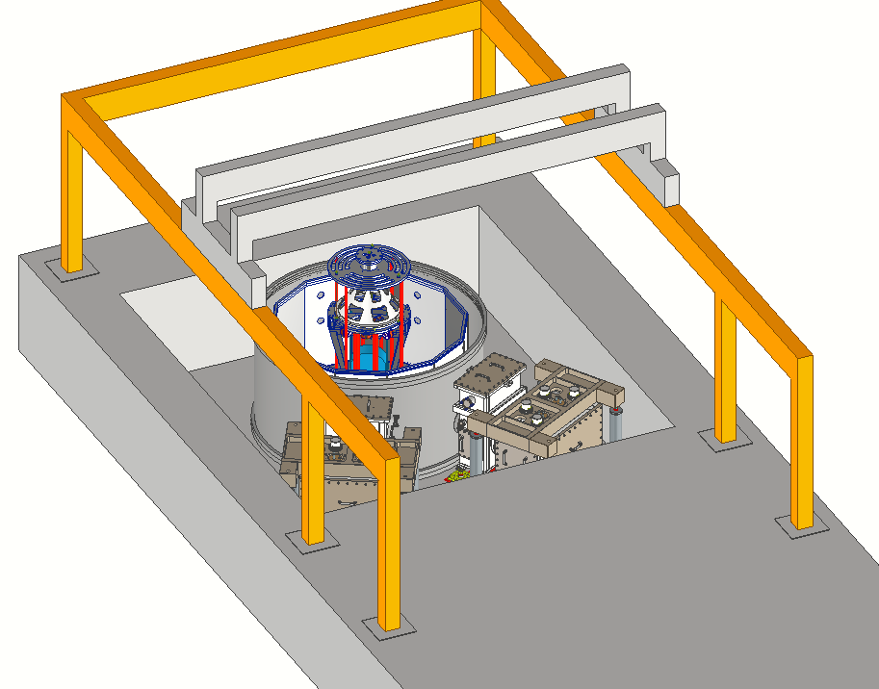
operational configuration
maintenance and installation
70 cm of man-workspace
Missione 4 • Istruzione e Ricerca

Slide 7
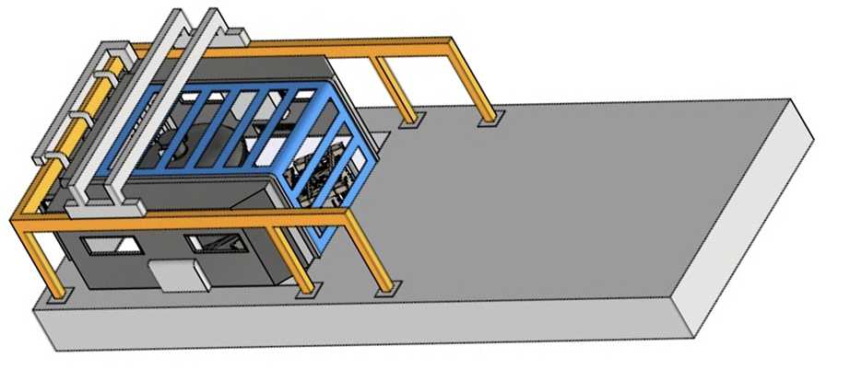
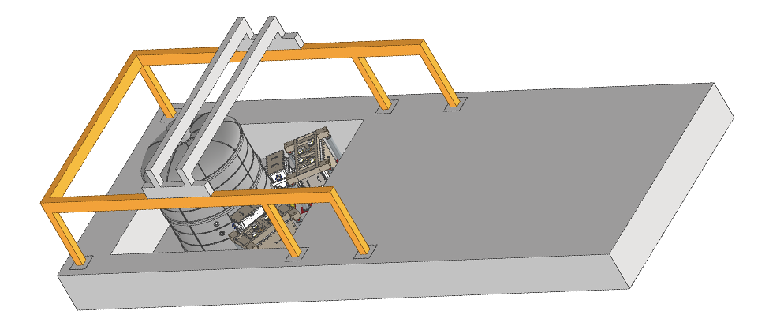
Clean boot, needed !
Minimal measure to preserve clean environment during 6-12 month-long assembling phases, controlled contamination of air particles and dust with high efficiency filters (HEPA). ISO 6 ‘AT REST’ and ISO 7 ‘IN OPERATION’
Due to severe clearance constraints (the whole lab is 100 m²) we need:
A retractile/flexible mechanism compatible with the crane. It requires custom and very careful design for our purposes.
* Probably we are finally close to the feasibility green light
ET Scienza e Tecnologia in Italia - Assisi 20/02/2024
Missione 4 • Istruzione e Ricerca

Slide 8
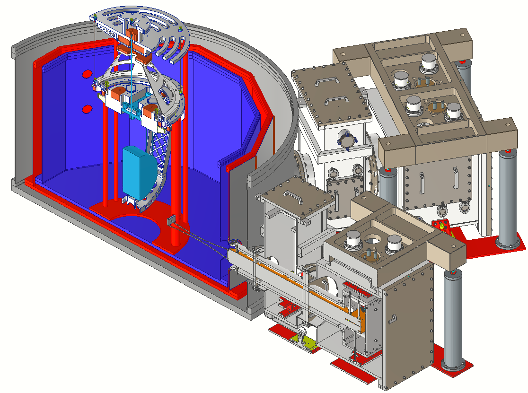
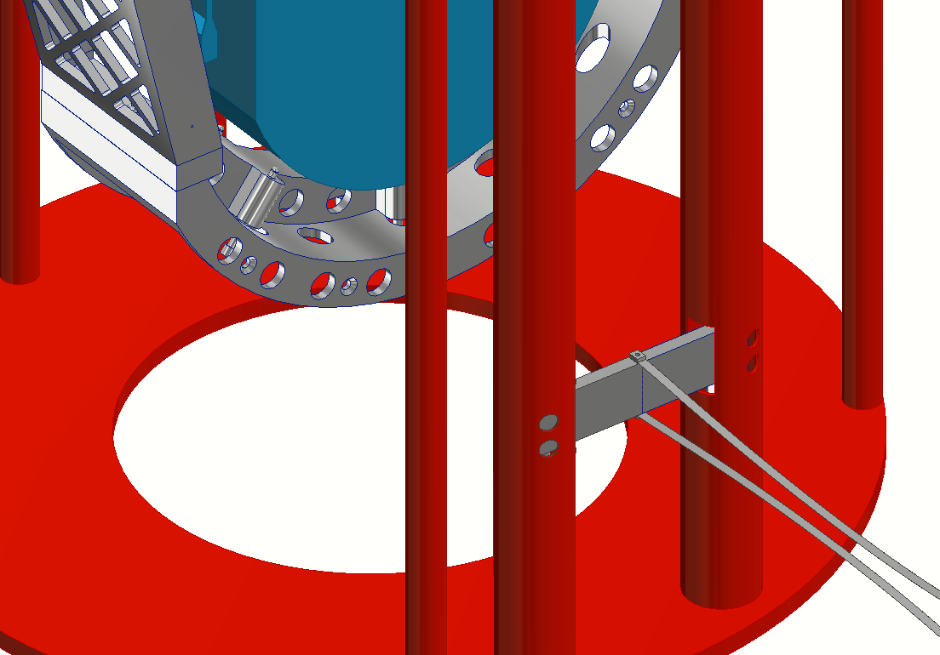
To cool-down the payload, ~36 soft heat links (each composed by ~49 0.1 mm Al6N)will connect two cooling bars, hosted inside the assembly frame, to the cage to the cold finger delivering the cooling power through the assembling frame and insulated from it.
This structure is composed by two bars (30 mm diameter) and a plate of 15 mm thickness.
The payload is seated on the structure shafts and pulled upwards using a metal wire (and detached from the structure) to speed up the ITS cooling at first
Once cold and suspended, the dynamics and the dissipation of the system will be studied
Cryostat core section
ET Scienza e Tecnologia in Italia - Assisi 20/02/2024
Missione 4 • Istruzione e Ricerca

Slide 9
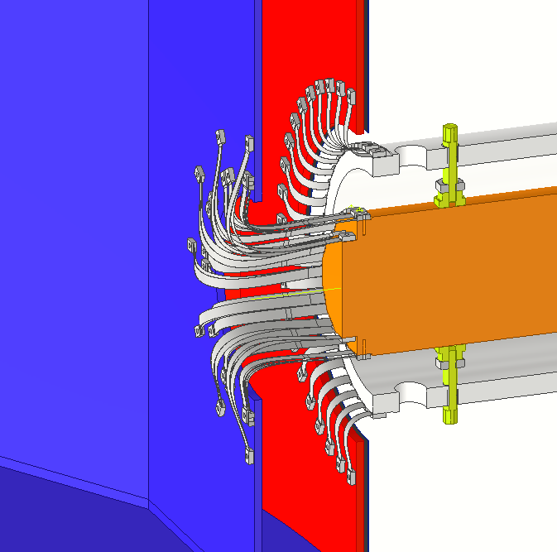
Soft links along cooling duct
40 Copper heat links thermalize the OTS
36 Al6N heat links thermalise the ITS
ET Scienza e Tecnologia in Italia - Assisi 20/02/2024
Missione 4 • Istruzione e Ricerca

Slide 10
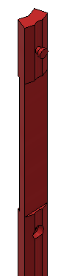

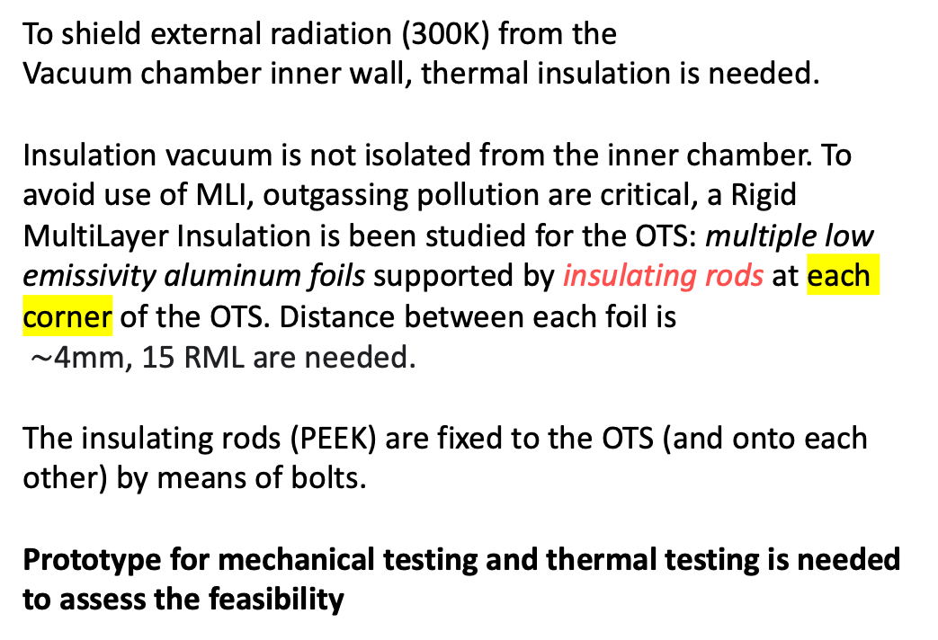
12 mm
RML – Rigid Multi Layer
Pulling Pin
OTS
ITS
To shield external radiation (300K) from the
Vacuum chamber inner wall, thermal insulation is needed.
Insulation vacuum is not isolated from the inner chamber. To avoid use of MLI, outgassing pollution are critical, a Rigid MultiLayer Insulation is been studied for the OTS: multiple low emissivity aluminum foils supported by insulating rods at each corner of the OTS. Distance between each foil is
$∼$4mm, 15 RML are needed.
The insulating rods (PEEK) are fixed to the OTS (and onto each other) by means of bolts.
Prototype for mechanical testing and thermal testing is needed to assess the feasibility
ET Scienza e Tecnologia in Italia - Assisi 20/02/2024
Missione 4 • Istruzione e Ricerca

Slide 11
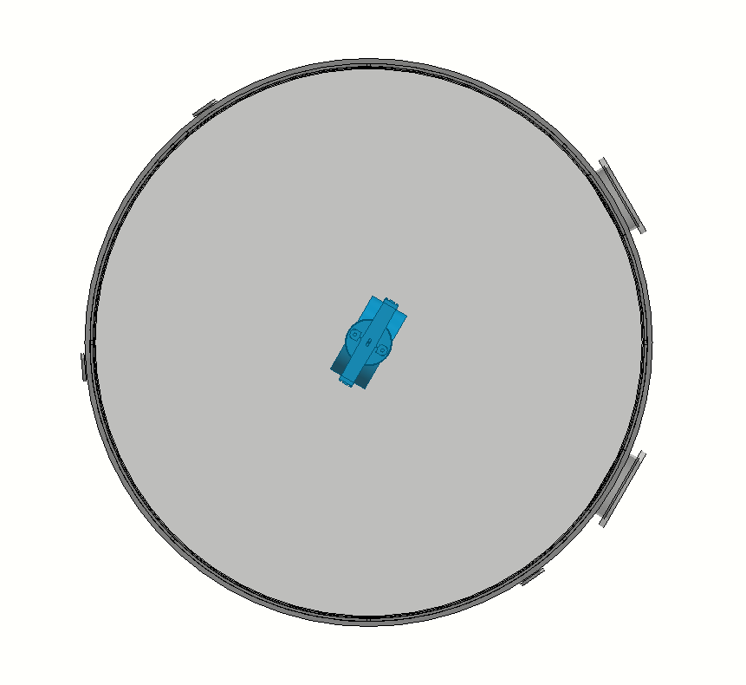
OpLev readout for payload mechanical transfer function measurements
Optical windows are designed with respect with the overall position of the payload in the cryostat. They are strongly determined by the arrangement feasibility in the within the available room.
Two sets of optical windows are needed: one for the marionette, one for the mirror.
ET Scienza e Tecnologia in Italia - Assisi 20/02/2024
Missione 4 • Istruzione e Ricerca

Slide 12
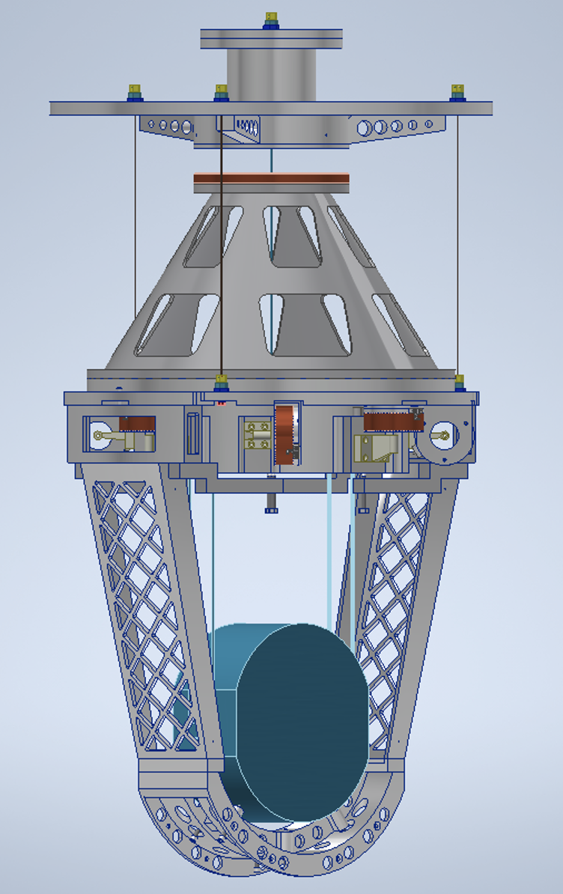
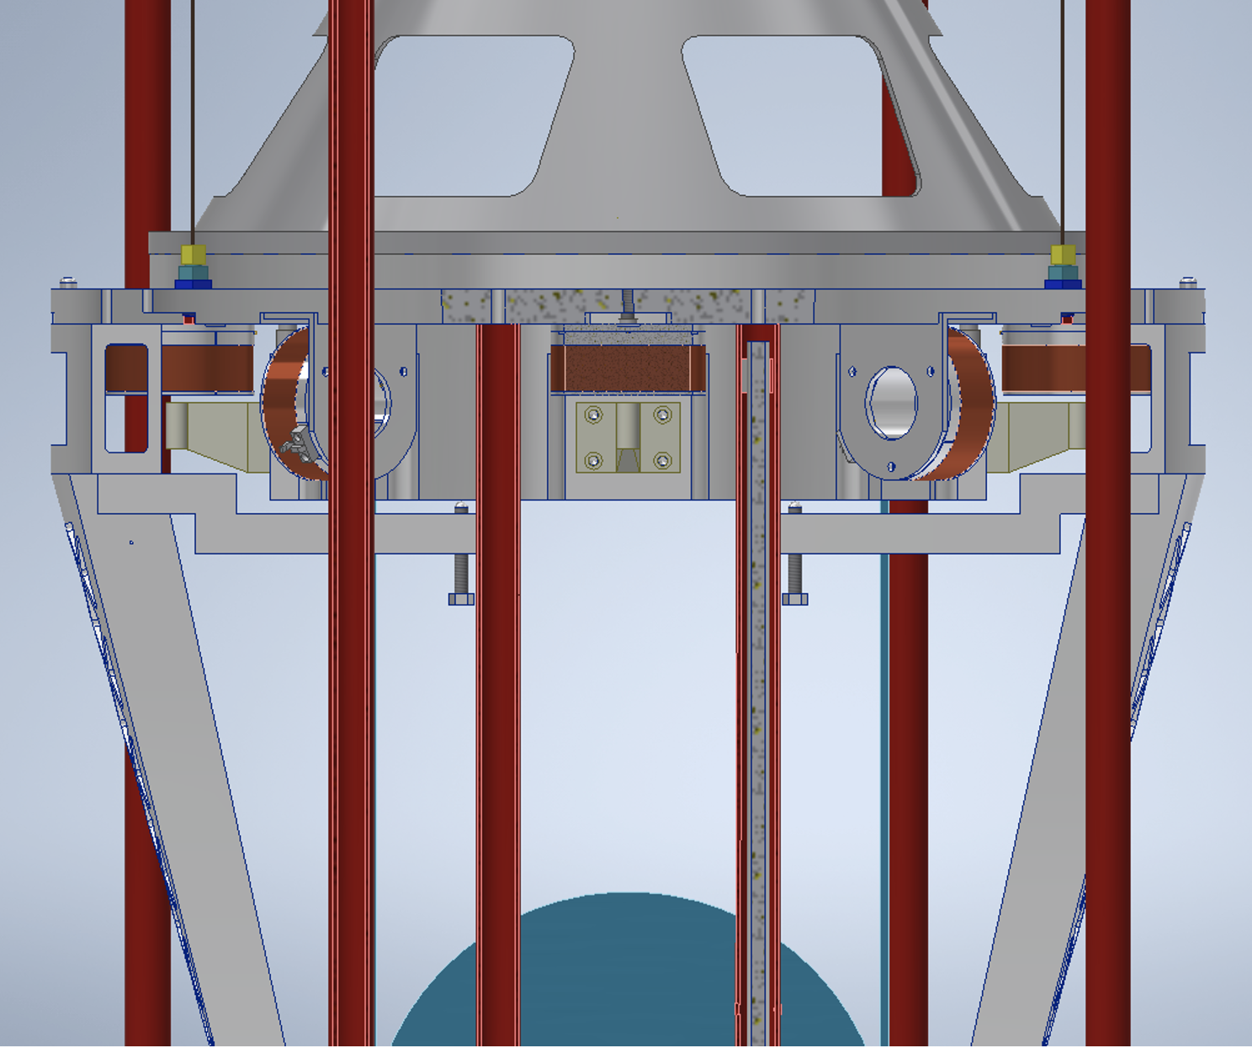
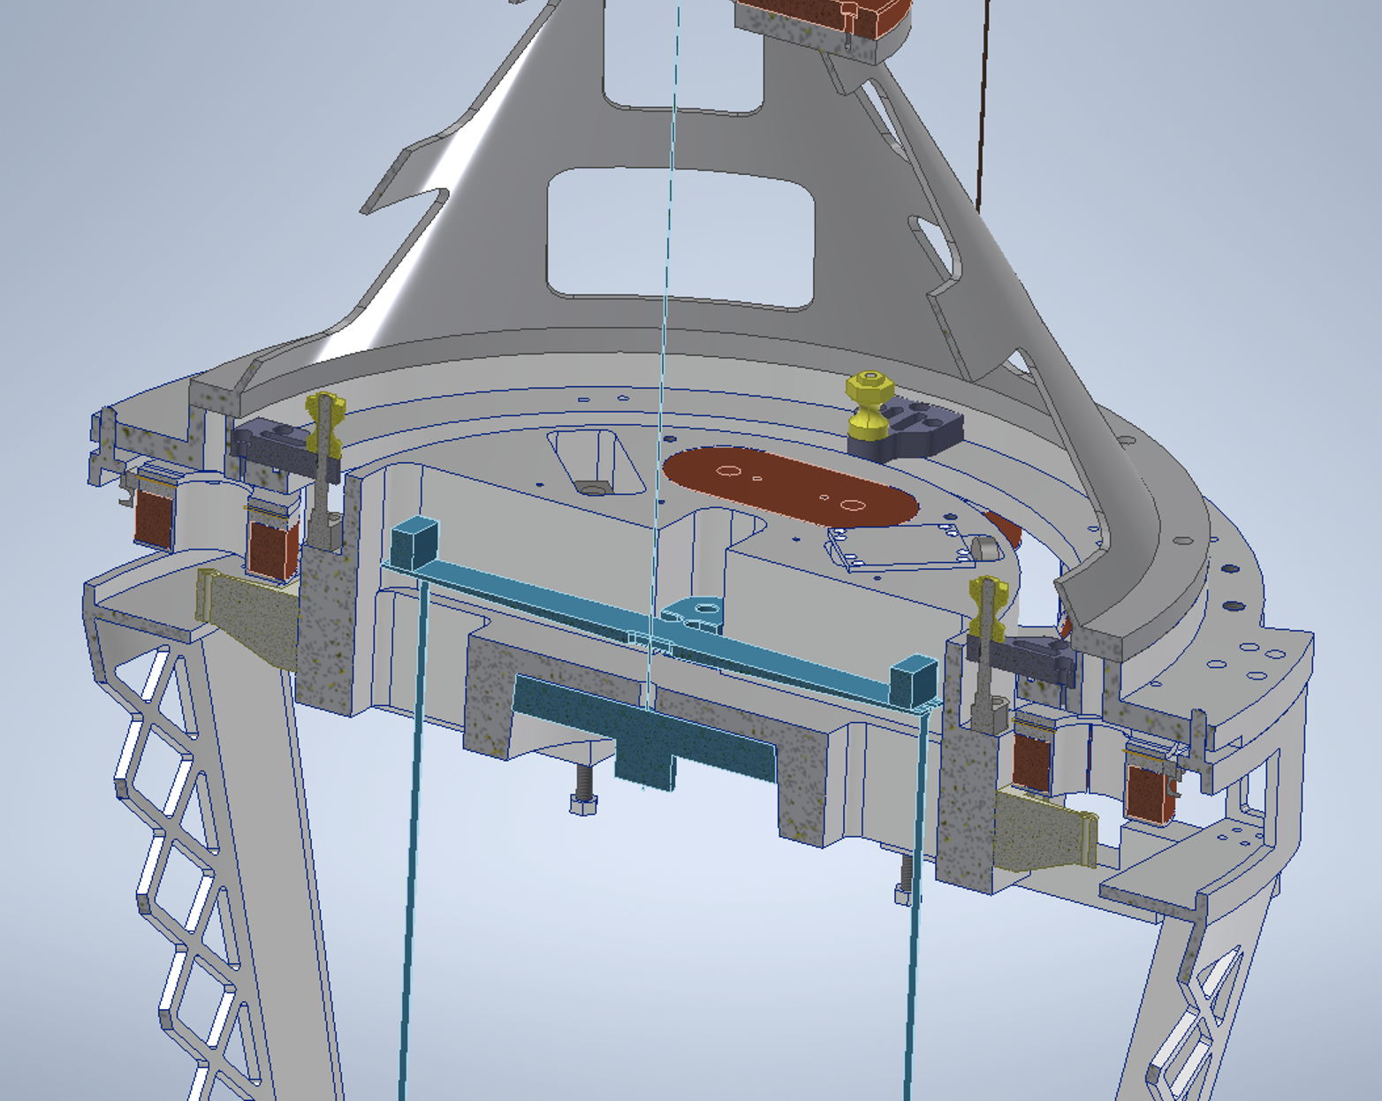
Cryogenic Payload prototype, under development (commitment by firm started)
Height: 1900 mm
Payload max diam: 1000 mm
Mass : 490 kg
  Marionette: 120kg
  Actuation cage: 134kg
  Mirror (dummy)+ Al₂O₃ suspension parts: 132kg
  Platform: 104 kg
1900 mm
Pure Al core into the assembly structure (concept)
Al₂O₃, high Tconductivity, high quality factor, high strength
ET Scienza e Tecnologia in Italia - Assisi 20/02/2024
Missione 4 • Istruzione e Ricerca

Slide 13
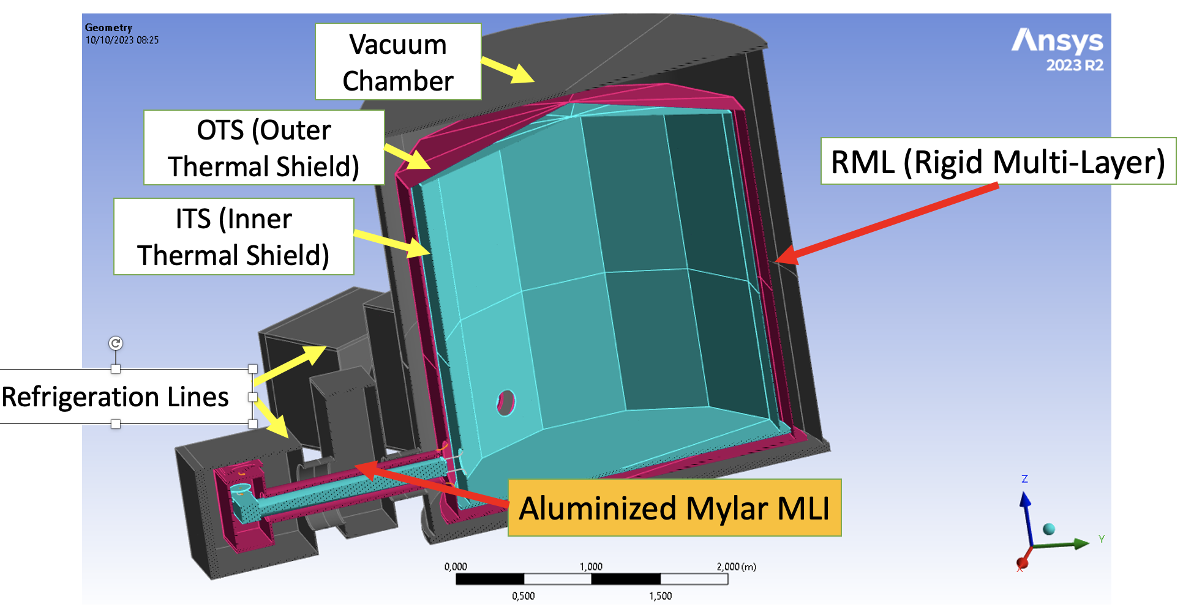
Transient thermal simulations
ET Scienza e Tecnologia in Italia - Assisi 20/02/2024
Missione 4 • Istruzione e Ricerca

Slide 14
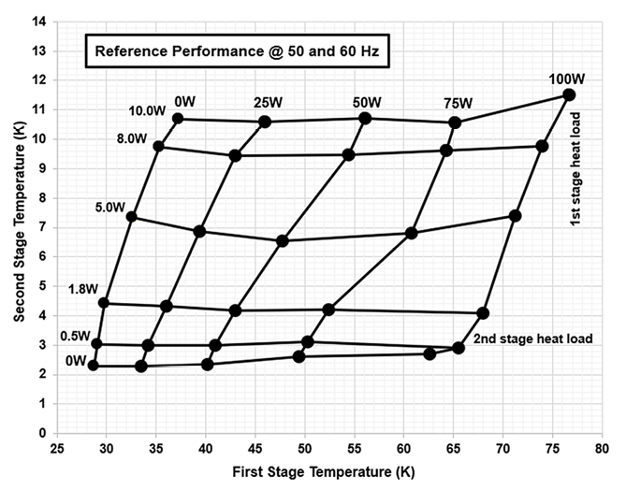

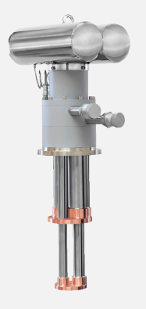

Refrigeration Lines
Refrigeration lines
2 X
+ 2 X PT425
ET Scienza e Tecnologia in Italia - Assisi 20/02/2024
Missione 4 • Istruzione e Ricerca

Slide 15
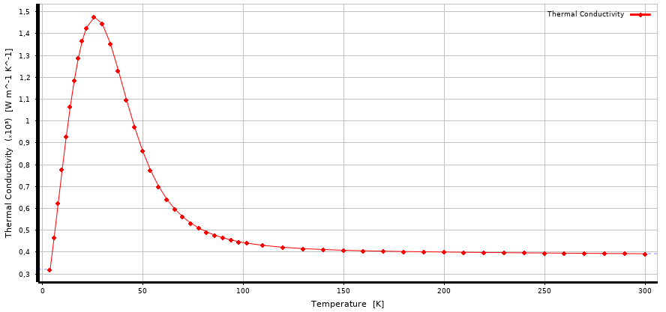
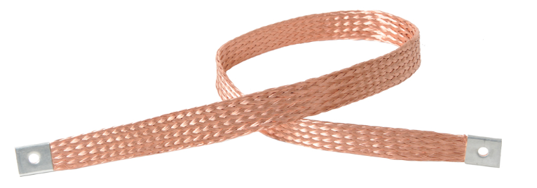

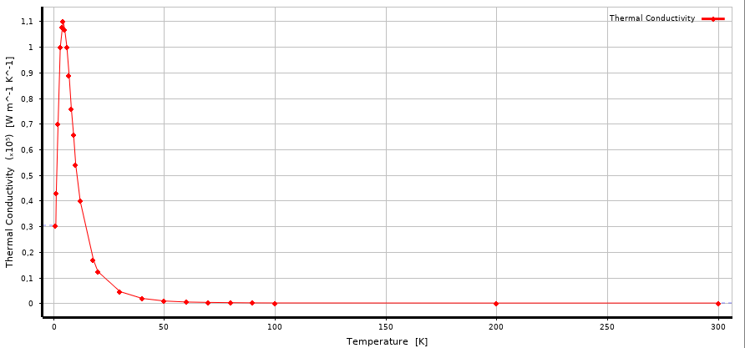
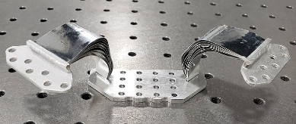



Target Temperature
Design
Thermal Conductivity
Thermal connections PURE MATERIALS !
Cu OFHC
1 stage
$∼$ 60 – 80K
2 stage
$∼$ 4 – 10K
Al 6N Sup
ET Scienza e Tecnologia in Italia - Assisi 20/02/2024
Missione 4 • Istruzione e Ricerca

Slide 16
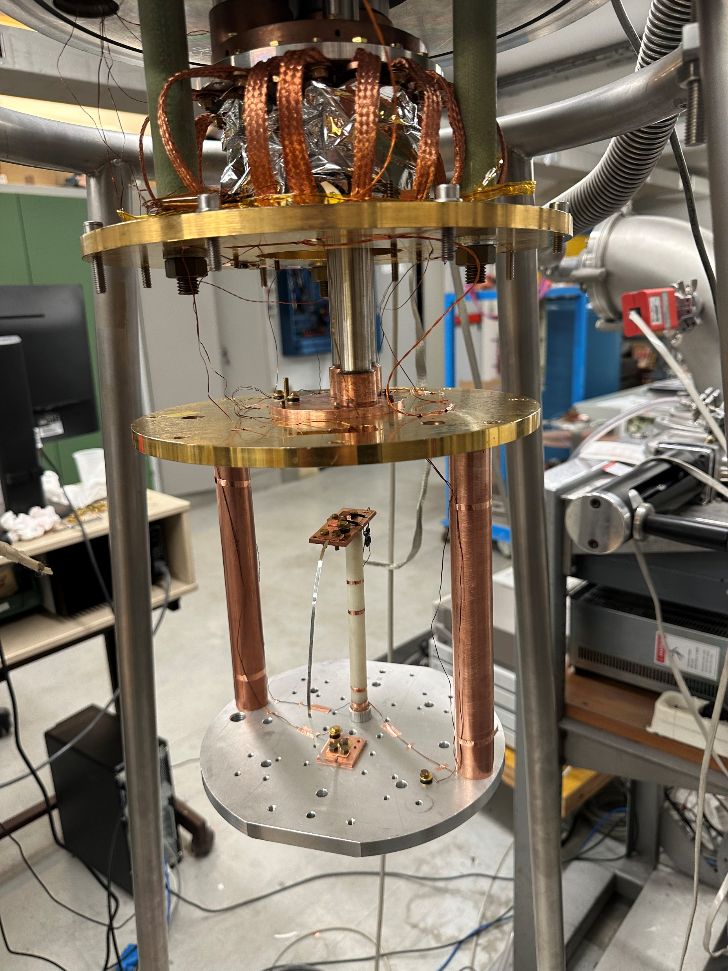
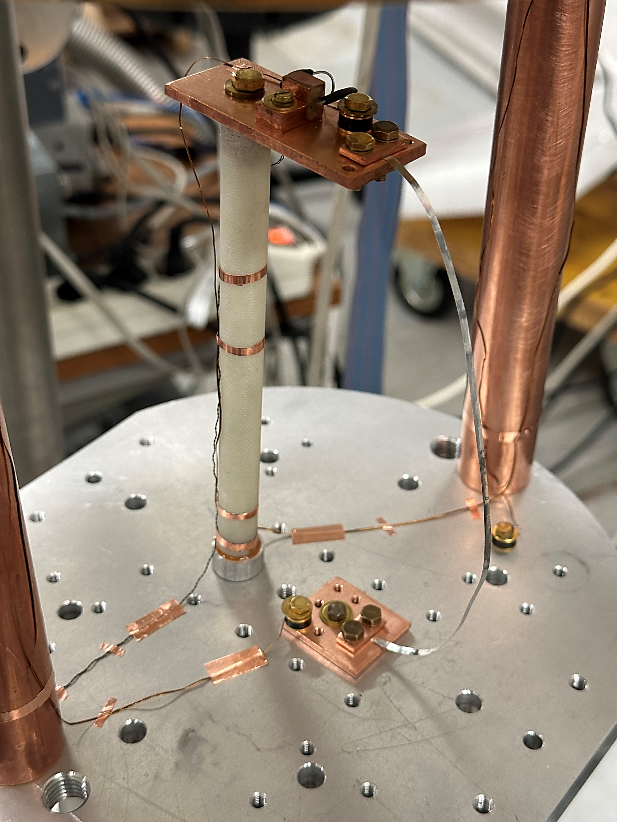
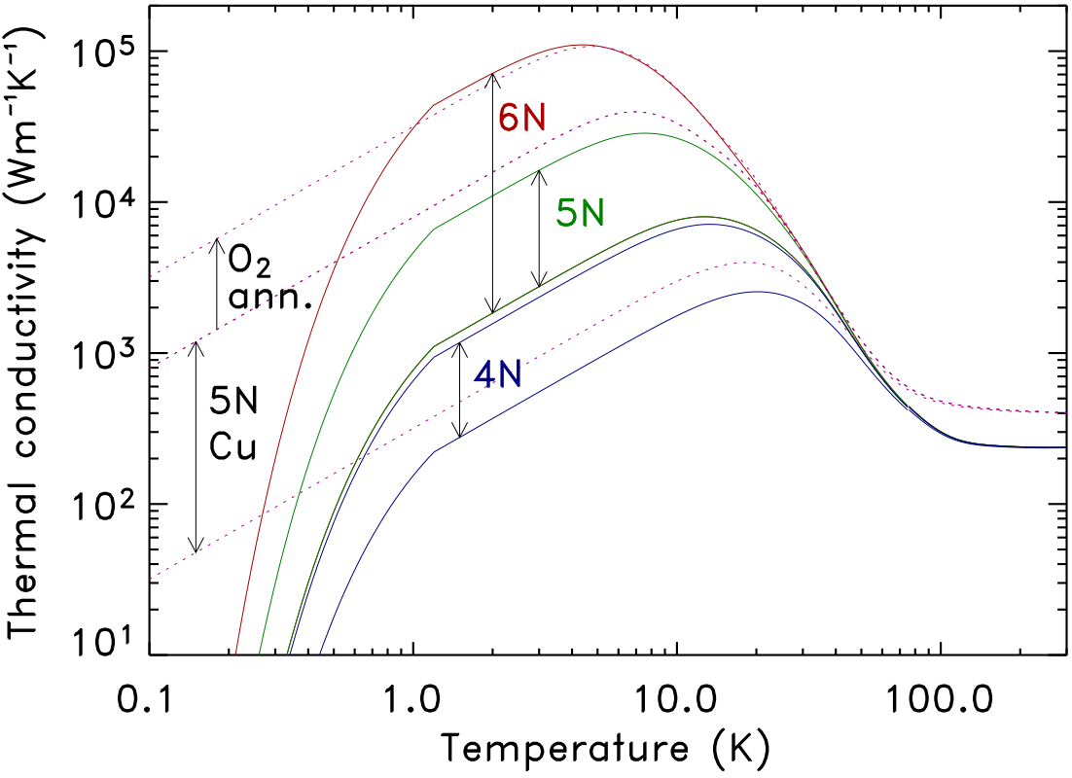
Thermal conductivity assumptions
Transient Thermal Simulation
Al 6N curve
Experimental checks are fundamental
ET Scienza e Tecnologia in Italia - Assisi 20/02/2024
Missione 4 • Istruzione e Ricerca

Slide 17
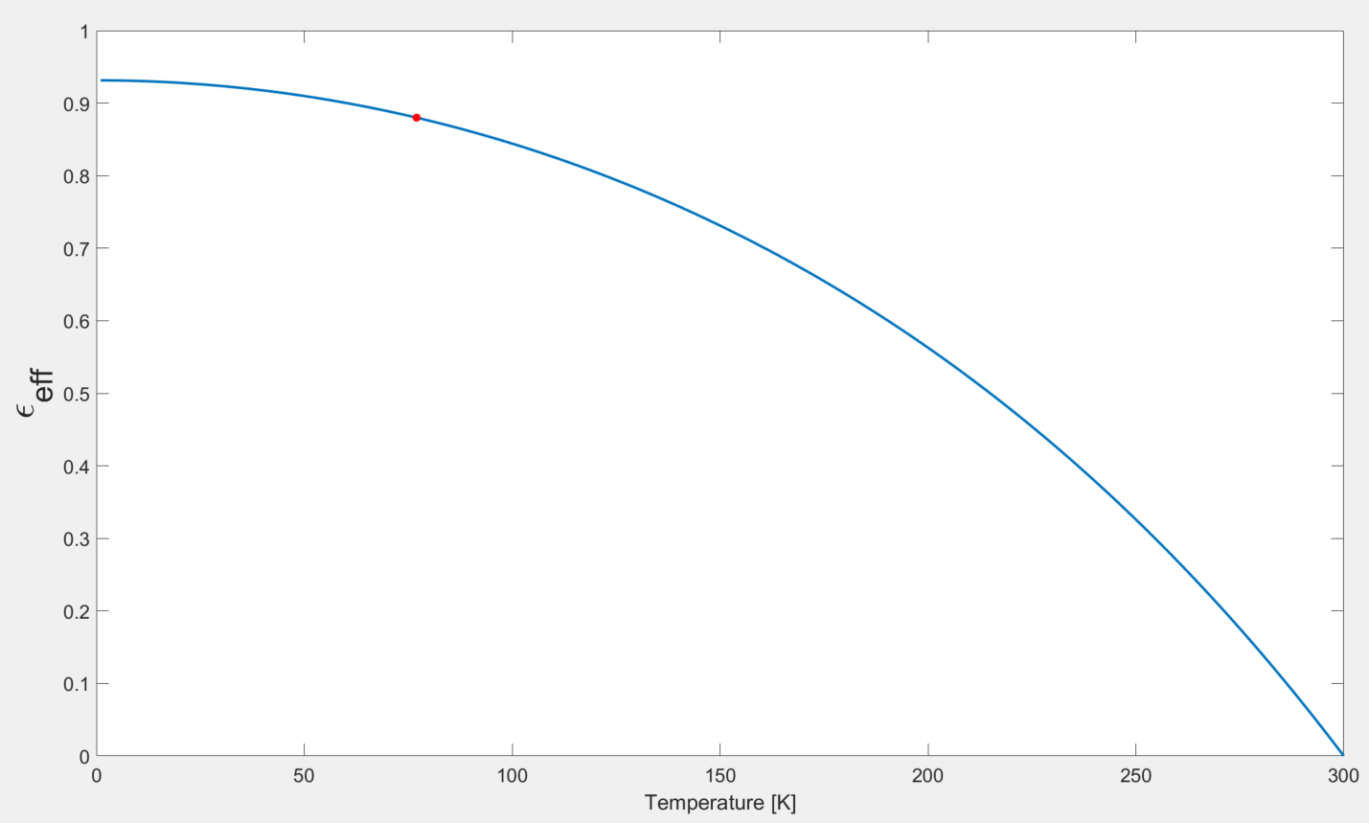
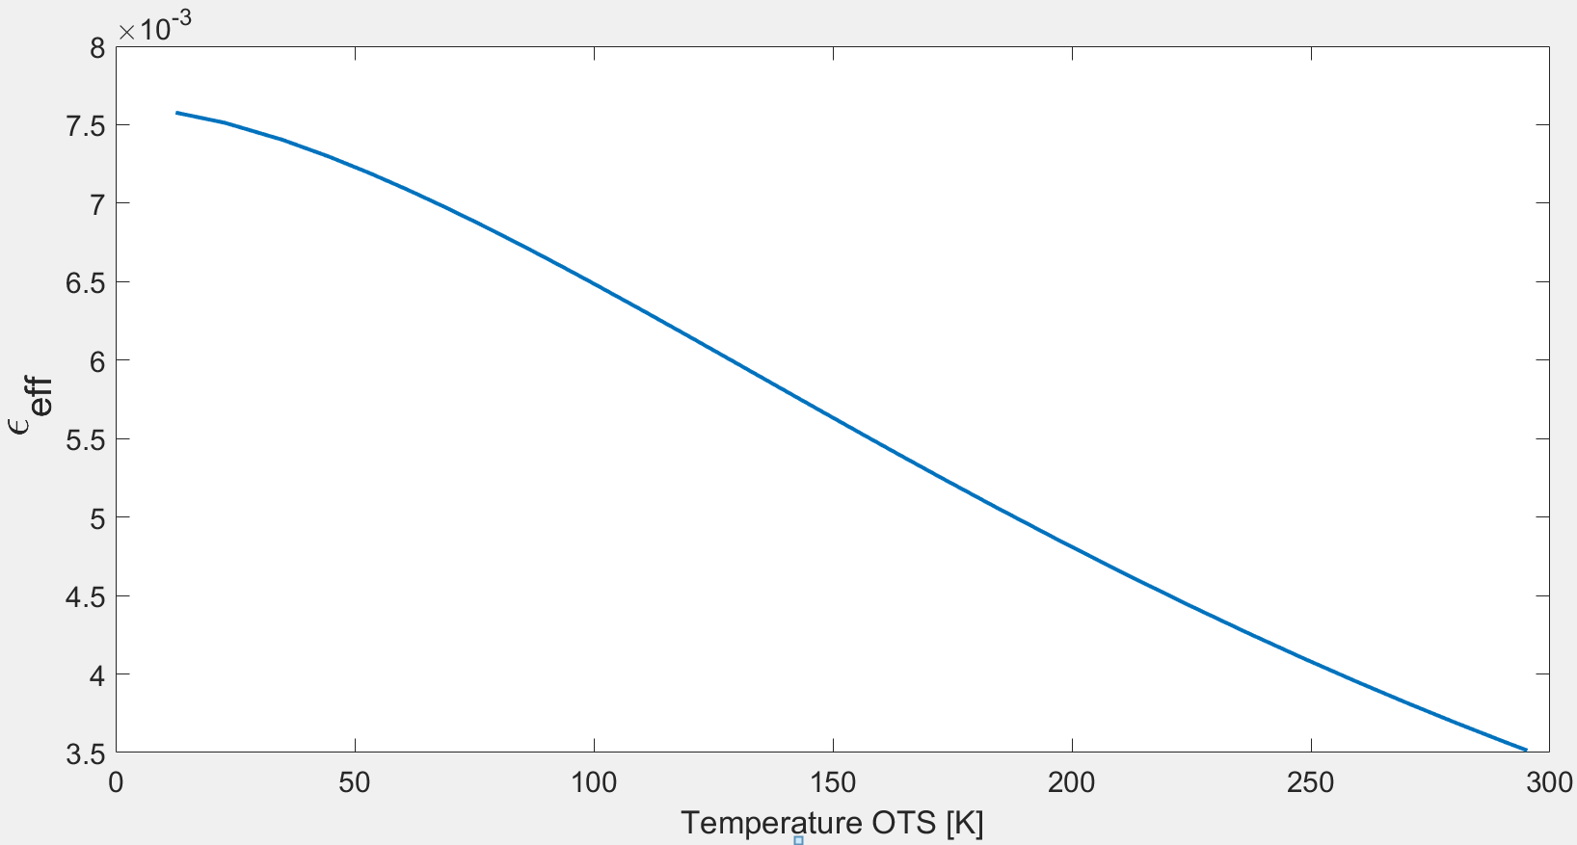
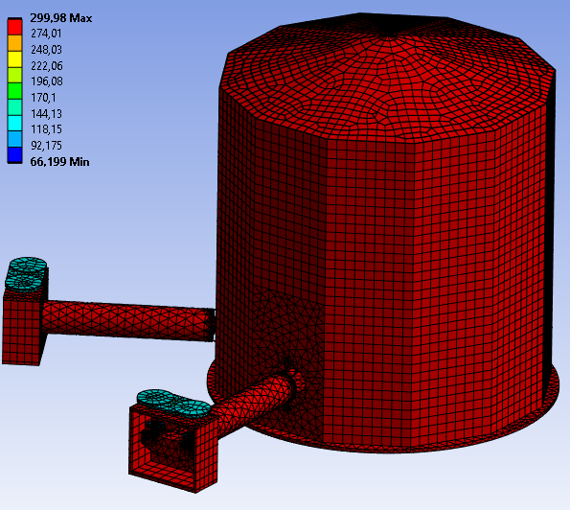


Aluminized Mylar MLI
Transient Thermal Simulation
$${\text{ε} }_{EFF}$$
Refrigeration Lines
RML (Rigid Multi-Layer)
$${\text{ε} }_{EFF}$$
Simulation Ongoing!
ET Scienza e Tecnologia in Italia - Assisi 20/02/2024
Missione 4 • Istruzione e Ricerca

Slide 18
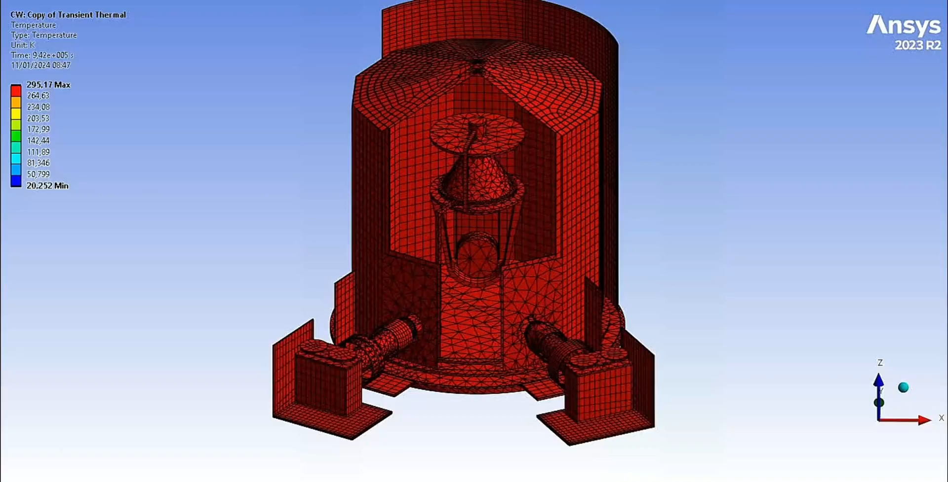
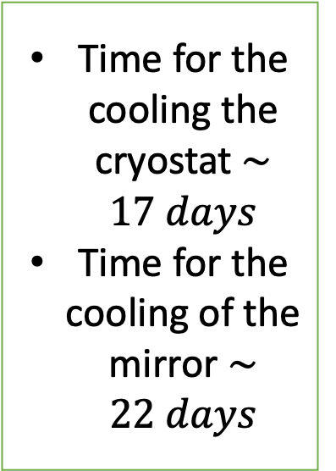
A concept modelling with massive cold finger contacted to the payload
Time for the cooling the cryostat $∼17 days$
Time for the cooling of the mirror $∼22 days$
ET Scienza e Tecnologia in Italia - Assisi 20/02/2024
Missione 4 • Istruzione e Ricerca

Slide 19
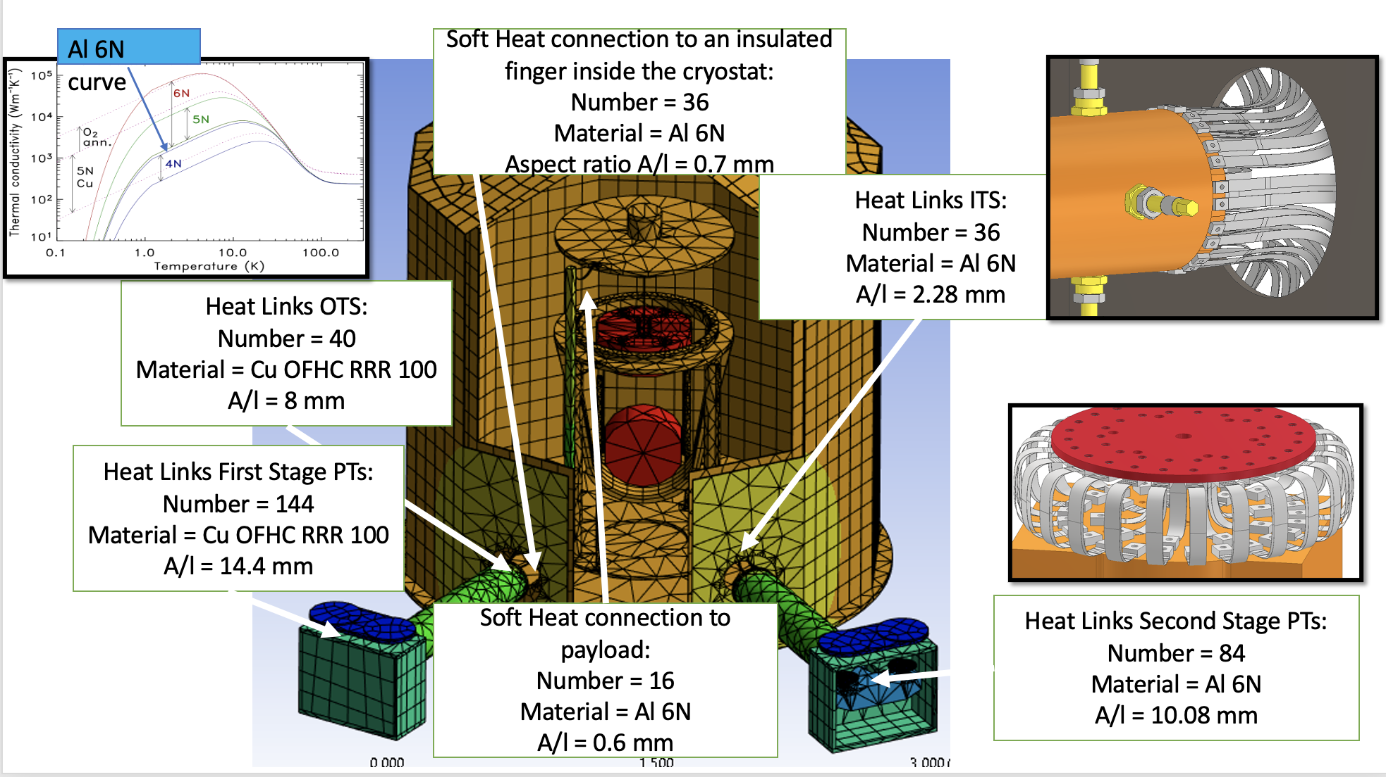
concept modelling with soft links
ET Scienza e Tecnologia in Italia - Assisi 20/02/2024
Missione 4 • Istruzione e Ricerca

Slide 20
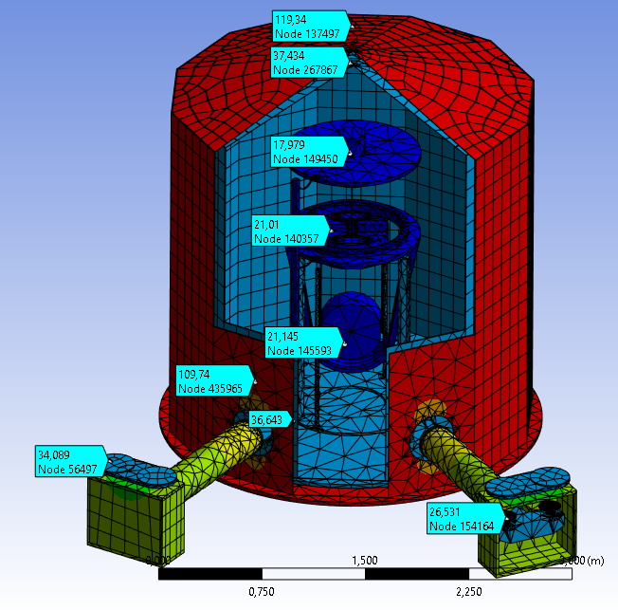
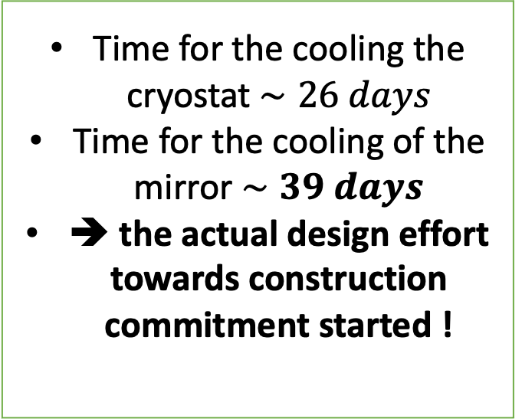
Time for the cooling the cryostat $∼26 days$
Time for the cooling of the mirror $∼39 days$
➔ the actual design effort towards construction commitment started !
ET Scienza e Tecnologia in Italia - Assisi 20/02/2024
Missione 4 • Istruzione e Ricerca

Slide 21
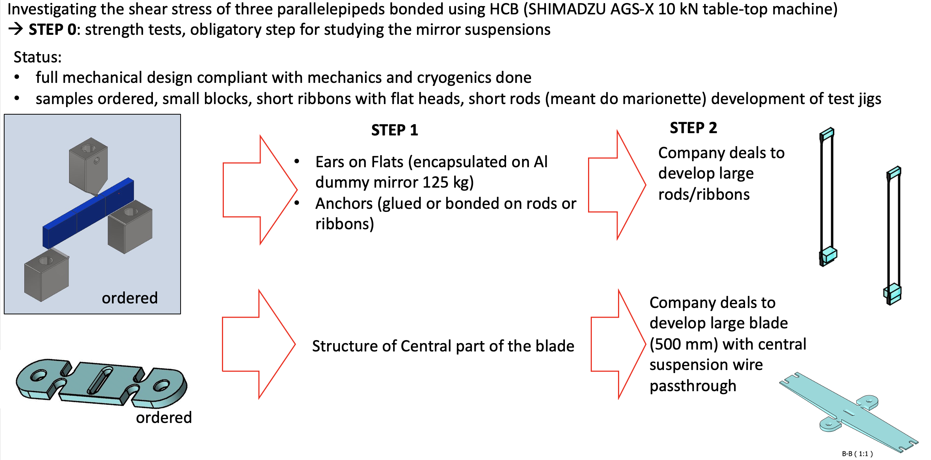
A glance on Al2O3, we miss it in Italy
We plan a further consistent investment on Sapphire parts for the payload
ET Scienza e Tecnologia in Italia - Assisi 20/02/2024
Missione 4 • Istruzione e Ricerca

Slide 22
conclusions
Main orders issued
Residual investment aimed to complete the lab infrastructures. Urgent in order to use the lab
Residual investment on Sapphire. Urgent, due to development and production schedule
ET Scienza e Tecnologia in Italia - Assisi 20/02/2024
Missione 4 • Istruzione e Ricerca

