Slide 1

Efficient I/O
Vincenzo Vagnoni
(INFN Bologna)

Slide 2
Outline
Introduction
  What is I/O and overview of I/O models
Storage devices
  Overview of common use technologies
Page caching
  Brief explanation and practical demonstration of how it works
I/O monitoring
  Discussion on common tools useful to understand I/O of your applications
  Practical demonstration
Advanced I/O API
  Scatter/Gather, Memory mapping, Asynchronous I/O
  Practical demonstration

Slide 3
Disclaimer
This lecture is far from being a complete overview of all aspects of I/O
  There is a world behind it
  I can just touch what are in my opinion some topical points (and not all of them), focusing on file I/O
In particular I will not be covering networking technologies and techniques
  This is yet another world and would need at least a lecture on its own
  By the way many concepts and even API functions are in common with file I/O
    Will only make one example to show this

Slide 4
Introduction

Slide 5
First of all let’s state the obvious
(and less obvious)
The obvious statement: computation “inside” computers is useful
only if some results are communicated “outside”
Less obvious (but still obvious): communication (I/O) must be as fast
as the computation is, otherwise an I/O bottleneck arises
Two extreme cases:
  CPU bound problems
    The amount of data needed in input and produced in output is negligible → total
    time is dominated by computation (e.g. HEP MC simulations)
  I/O bound problems
    The data processing is trivial and involve a limited number of cycles → total time is
    dominated by I/O (e.g. some light algorithms of HEP analysis jobs)
Many real use cases live in some point between the two
Rule of thumb: when you run a data processing job of any kind, and
the CPU load of the job is not approaching 100%, it means that very
likely there is an I/O bottleneck in your application
  Corollary: if the CPU load is <<100% then you are wasting a lot of
  precious CPU cycles, and you need to improve the efficiency of your I/O

Slide 6
I/O abstraction and semantics
The Operating System virtualizes a wide range of
devices into a few simple abstractions, as
  Storage (including hard drives, tape drives, etc.)
  Networking (including 1-10 GE, etc.)
OS provides consistent calls to access the abstractions
  Otherwise, programming would too hard and unsafe
There are various approaches for I/O processing
  I/O buffering: buffered or unbuffered
    i.e. file system access is usually buffered in kernel space via the page cache, and there can be even another buffering layers in the user space to limit user to kernel context switches
  I/O model: blocking or non-blocking, synchronous or asynchronous
    Simple minded blocking I/O is mostly used in common applications

Slide 7
Buffered I/O
if the buffers on the hardware device are small, blocking I/O calls can become inefficient
  e.g. frontend memory of a hard disk is usually very small
buffered I/O allows the kernel to make a copy of the data and so adjust to different device speeds
  with a buffered write(), bytes are written into a memory buffer and the process can continue quite soon
  e.g. in Linux, all writes onto common filesystems go straight to the memory cache, and the data are flushed to disk asynchronously by the kernel
    by the way, certain applications which implement their own memory caching (e.g. complex DB engines) can by-pass the OS cashing
    open() semantics allow to do that via the O_DIRECT open flag
buffered I/O is useful in case of burst writes, but almost useless when writes are sustained for long times
for buffered reads(), the buffer cache can result useful to implement “read-ahead” mechanisms, as well as to reduce the number of physical accesses to the device in cases where the required file page is already in the cache

Slide 8
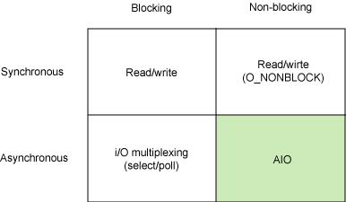
Various I/O models
Schematically, we can identify two orthogonal dimensions
  synchronous and asynchronous
  blocking and non-blocking
Each of these I/O models
has usage patterns that are
advantageous for
particular applications
Understanding which to
use is matter of experience in evaluating pros and cons for the specific problem to be solved
  The design should take into account the trade off between performance gain and increased complexity and readability of the code

Slide 9
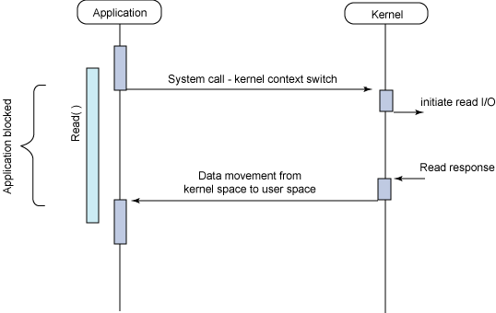
Synchronous blocking I/O
Simplest approach, and most commonly used
  application performs a system call and blocks until I/O operation is completed (either successfully or not)
In this state the application does not load the CPU and simply awaits the response
  From a computational point of view this is a dead time → depending on the application it can be large or even negligible
Let’s make the example of
a read call
  read system call is invoked
  and context switches to the
  kernel
  read is then initiated
  when finished, kernel
  moves the data to the user
  space and context is returned
  to the application

Slide 10
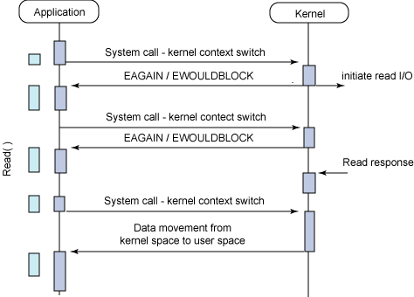
Synchronous non-blocking I/O
Kind of a variant of synchronous blocking I/O
In this approach, instead of completing an I/O immediately, a read may return an error code as the command could not be immediately satisfied
  The application can decide to do something else instead of waiting for I/O and retry later
By the way, the application
can make several calls to
await completion
  can be inefficient since
  increases the number of
  context switches between
  kernel and user spaces
  latency in the I/O because
  the application cannot know
  when data is ready

Slide 11
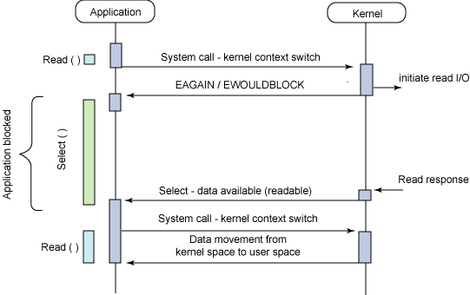
Asynchronous blocking I/O
In this approach the I/O is initiated as non-blocking but the notification is received in a blocking fashion by means of the select() system call
  The select() system call is able to determine if a given file descriptor is ready for I/O
What is the convenience with respect to the simpler
and well established synchronous I/O then?
  the select() call is thought to notify
  not only the activity on one
  file descriptor, but a list of them
  as soon as one or more of the
  many file descriptors in the
  list passed to the select() call
  is ready to be read, the call
  unblocks and the application
  can issue the read call, retrieve
  and process the data

Slide 12
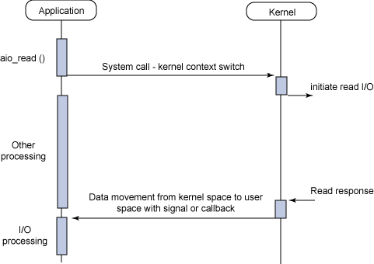
Asynchronous non-blocking I/O (AIO)
With this approach, on which we will focus later, data processing and I/O are fully overlapped
  In our usual read example, the read() call returns immediately
  the application can perform computation while the actual read is executed in background by the kernel
So far nothing new, but the
novelty is that when the read
response arrives, a signal or a
thread-based callback is
generated to complete the I/O
  the application has not to loose
  time in checking if I/O is ready,
  since it is the kernel itself taking
  care of telling the application
  the CPU can process data whose
  I/O has already completed and at
  the same time new I/Os can be initiated

Slide 13
Summary of I/O models
Blocking models imply that the application blocks when the I/O starts
  Hence I/O and processing cannot be executed at the same time
The synchronous non-blocking model allows to overlap I/O and processing
  But the application must repeatedly check the status of the I/O
Asynchronous non-blocking I/O (a.k.a. AIO) permits full overlap of processing and I/O, by means of asynchronous notifications of I/O completions via signals or callbacks
  the select() function (used in what we called asynchronous blocking I/O) provides a similar functionality but it still blocks
  However, it blocks on notifications instead of the I/O call and can manage multiple file descriptors at the same time

Slide 14
Storage devices

Slide 15
Device Types
Three main device types
Character devices
    Basically serial lines
Block devices
    Mass-storage (e.g. disks, etc.)
    Commands include read, write, seek
    The device as a large array of blocks
      User can read/write only in fixed-size blocks
    Unlike other devices, block devices support random access
Network devices
    Network interfaces (e.g., network interface card)
    Like block-based I/O devices, but each write call either sends the entire block (packet), up to some maximum fixed size, or none
    On the receiver, the read call returns all the bytes in the block, or none

Slide 16
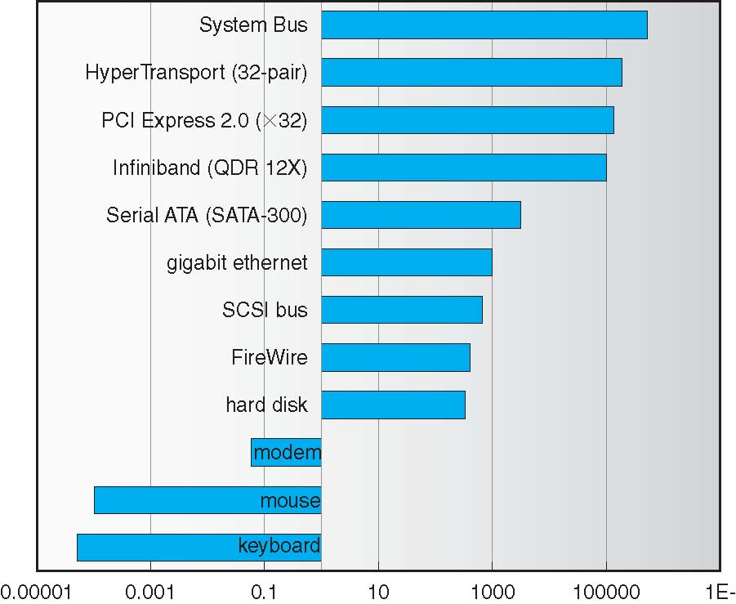
Transfer Rates
Mbit/sec
Various data transfer technologies nowadays available span many orders of magnitudes in transfer rate

Slide 17
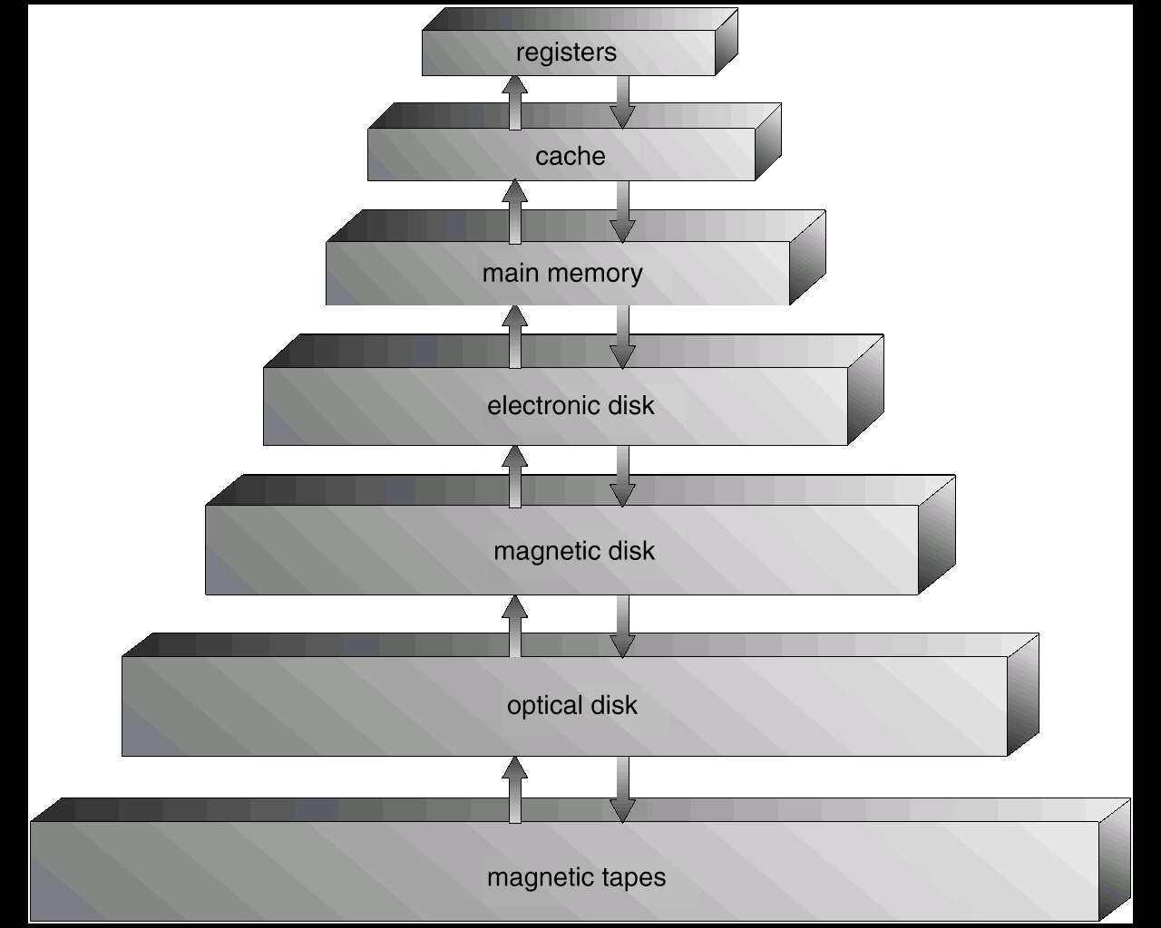
Storage device hierarchy
Main memory is much more expensive than disk storage
The cheapest tape drives and the cheapest disk drives have had about the same storage capacity over the years
Tape storage gives a cost savings only when the number of cartridges is considerably larger than the number of drives

Slide 18
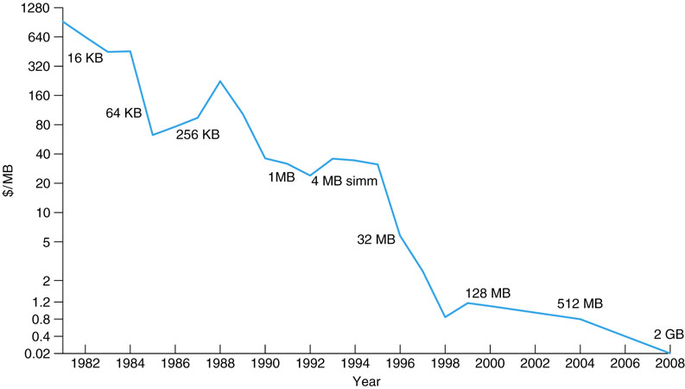

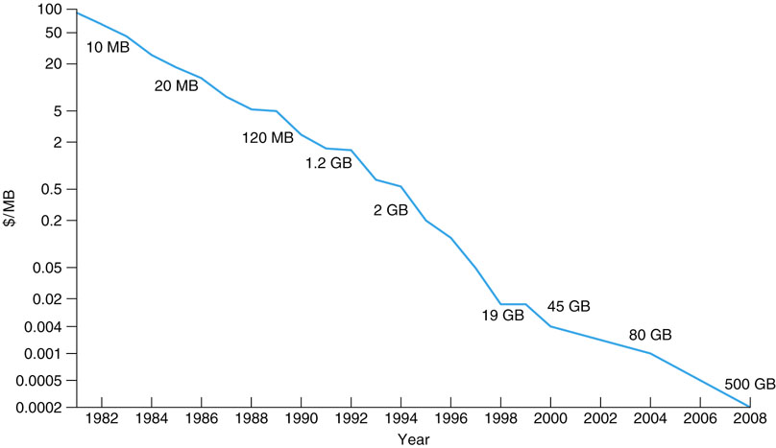
Cost of memory and disks (up to 2008)
This was in the 80’s… amazing!
DRAM cost
US Dollars per MB
Disk cost
US Dollars per MB
Unitary costs span 5-6 orders of magnitude in 25 years!
Still disk space costs a factor 100 less than memory space

Slide 19
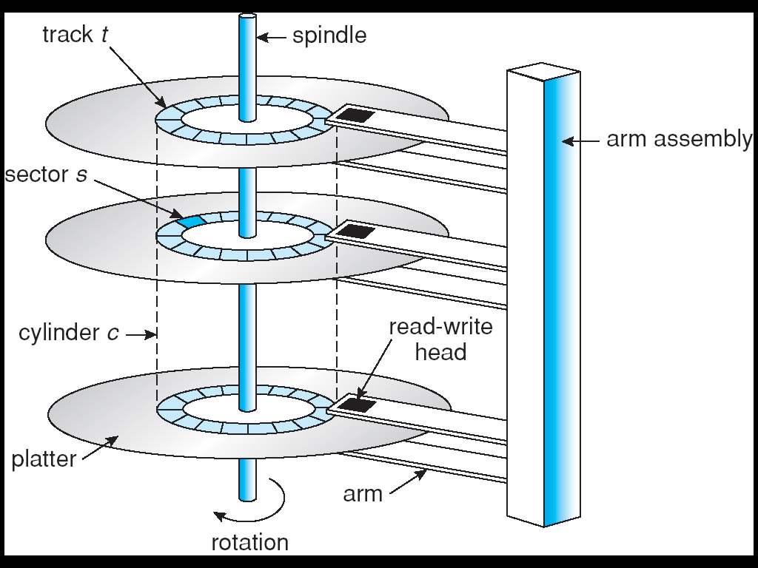
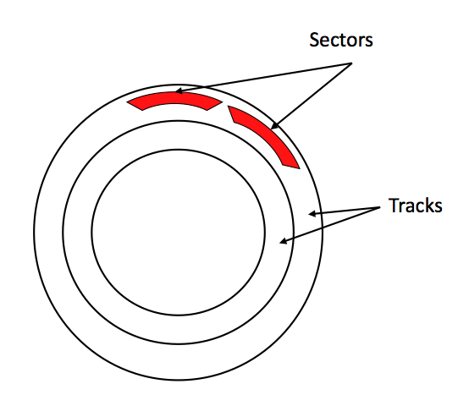
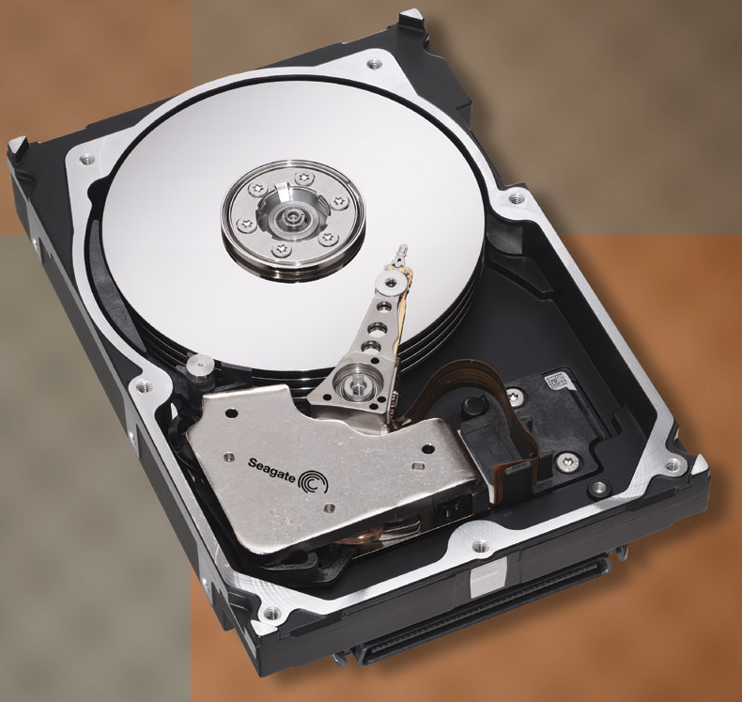
Moving-head Disk Mechanism
Seek time: time to move the disk head to
the desired track
Rotational delay: time to reach desired
sector once head is over the desired track
Transfer rate: rate data read from/written
to disk

Slide 20
Mechanical movements are slow
Seagate Barracuda 180
-t
0
1
2
3
4
5
6
7
8
9
10
11
12
cwt
Seek time 7.4ms
Rot Delay 4.17ms
x
Reading 64KB requires on average about 12 ms
  channel wait time + seek time + rotational delay largely dominate
Actual data transfer (x) occupies disk ~2% of the total time
Ones needs to read almost 2 MB to achieve 50% channel
utilization!
The faster Cheetah drive accomplishes this 50% faster (~6 ms),
but channel utilization drops to less than 1% requiring a read of
3 MB for 50% channel utilization

Slide 21
Redundant Array of Inexpensive Disks (RAID)
In large or even moderate storage systems, individual disks are not usually addressed, but rather multiple disks are used in cooperation
In a RAID configuration, a set of physical disk drives are viewed
by the OS as a single logical unit, as a kind of “super drive”
made by the aggregation of many drives which are accessed
in parallel
  this lead to an increase of the total space available in a single logical device as well as to improved performance
Redundant disk capacity is used to compensate for the increase in the probability of failure due to the presence of multiple drives
  The probability that at least one disk in the RAID set fails during the lifetime of the array increases roughly linearly with the number of drives
  Without redundancy, an array of many disks would be unusable as the risk of loosing data for a single drive failure would be too high

Slide 22
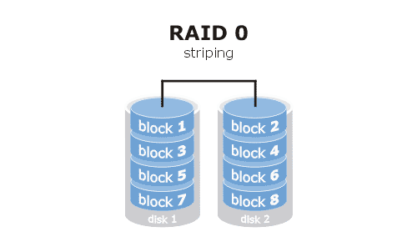
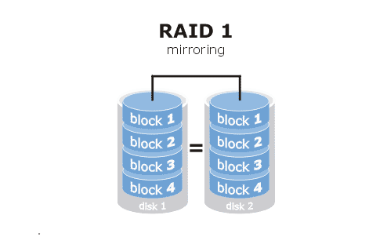
Simplest configuration without redundancy
Data blocks are striped across the available disks
Total storage space across all disks is divided into strips which are mapped round-robin to consecutive disks
Ideally can be made with an arbitrary number of disks
RAID configuration with highest performance but lowest data protection
Simplest configuration with redundancy, achieved by duplicating all the data
Every disk has a mirror disk that stores exactly the same data
A read can be serviced by either of the two disks which contains the requested data
Write request must be done on both disks but can be done in parallel
Recovery in case of single disk failure is simple but the cost is high (x2)

Slide 23
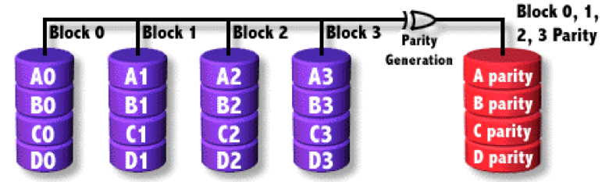
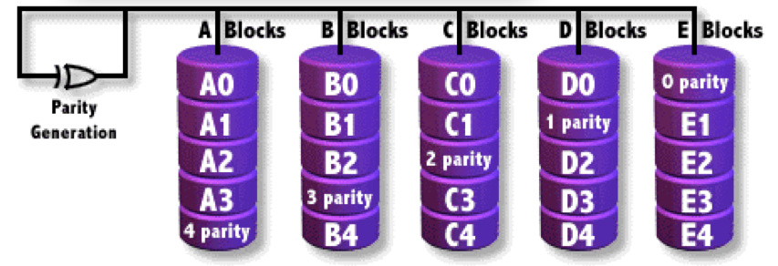
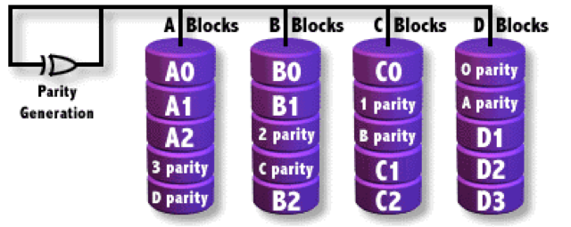
RAID 4 RAID 5
Uses block-level striping with dedicated parity disk
Requires minimum of 3 drives to be implemented
Can survive the loss of one disk, the broken disk can be substituted and rebuild using the information of the remaining disks
For certain write workloads, parity disk can become a bottleneck
Total space available is given by the total number of disks minus one
Very similar to RAID 4, but parity is distributed across all disks with a predefined fixed pattern, overcoming the single parity disk bottleneck
Also RAID 5 can survive the loss of one disk, which can be rebuilt using the information of the other disks
Total space available is given by the total number of disks minus one
Very popular configuration
RAID 6
As the size of disks increases, the time needed to rebuild a disk in case of a failure increases as well
During this time, a failure of a second disk would disrupt a RAID 5 array
For this reason RAID 6, similar to RAID 5 but with double distributed parity, has become increasingly popular during the last few years

Slide 24
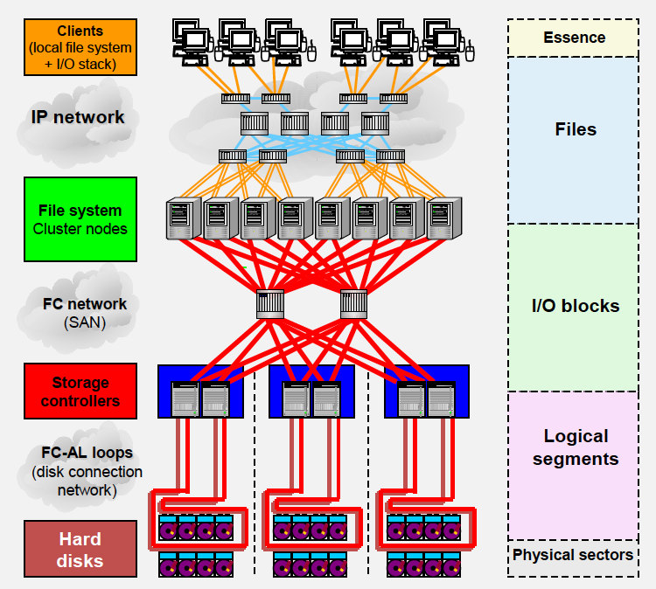
How a large high performance storage system looks like in today’s real life
Lots of variables influencing the overall I/O performance
Client hardware
Operating System
Application parameters
Transport protocol parameters
Server hardware
Operating System
File System settings
Transport protocol parameters
Network topology and technology
Network latency
Network protocol parameters
Controller configuration
RAID settings
LUN settings
Number of disks
Disk size
Disk cache
But don’t worry: these will never be under your direct control
You have just to hope that your sys admins made it right ☺

Slide 25
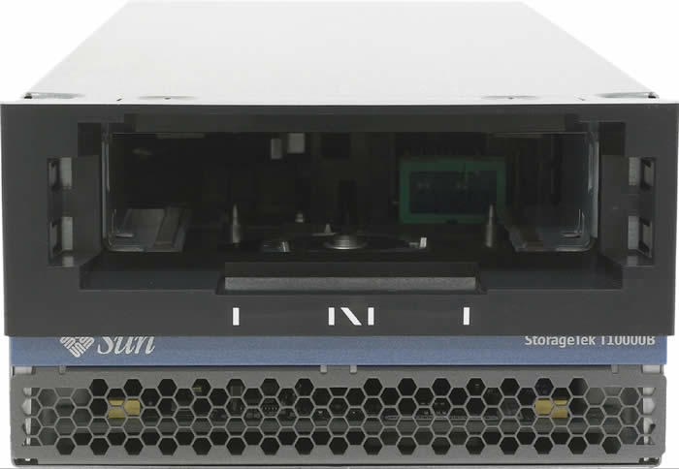
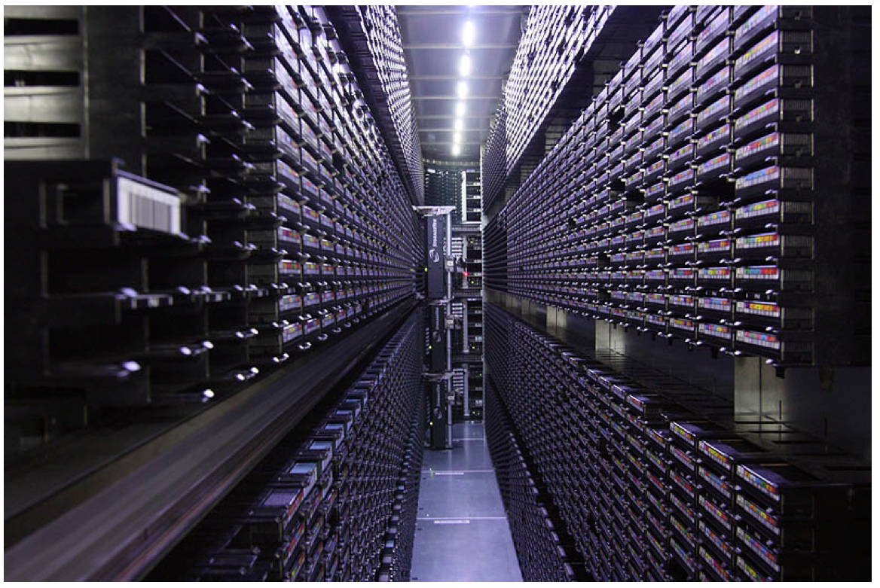
Magnetic tape drives
Relatively permanent and holds large quantities of data, but access time is slow
  “random” access 1000 times slower than disk
Mainly used for backup or long term custodial,
but also storage of infrequently used data
Modern cartridges in the 1-5 TB size range
Tape drives are “append-only” devices
Once data under head, transfer
rates comparable to disk
In data centres tape drives are hosted in large libraries with mechanical arms which pick up tapes and moves them to drives
  A modern large library can have tens of tape drives and tens of PetaBytes available nearline

Slide 26
Network File System (NFS)
Disk access from remote nodes via network generally based on TCP/IP over Ethernet
NFS is a client/server application developed by Sun Microsystems, very common in Unix/Linux environments
It lets a user view, store and update files on a remote computer as though the files were on the user's local machine.
The basic function of the NFS server is to allow its file systems to be accessed by any computer on an IP network
NFS clients access the server files by mounting the servers exported file systems
/storage/software bertinoro-server-1:/home/software
bertinoro-student-xx
bertinoro-server-1

Slide 27
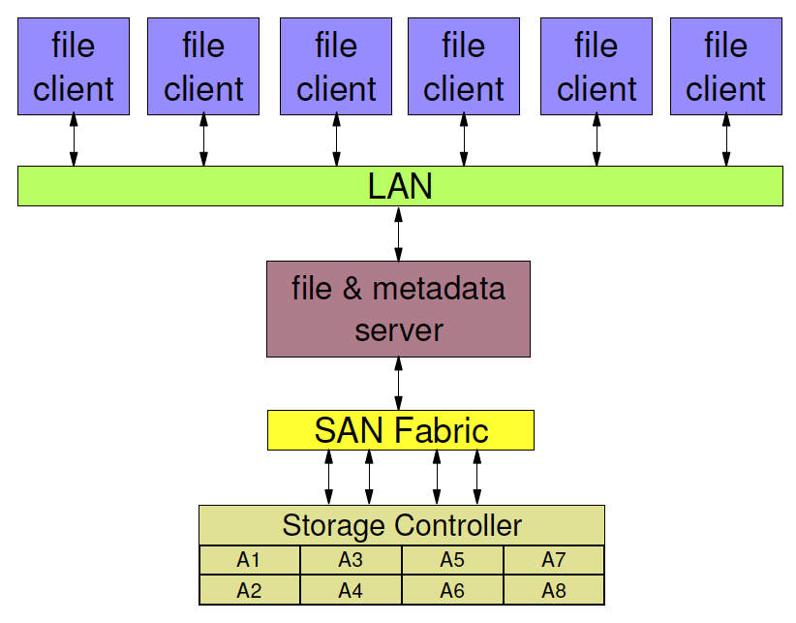
Limitations of NFS
Traditional NFS configurations limited by "single server” bottleneck
  a single NFS file server manages both user data and metadata operations
  this limits performance scaling and presents a single point of failure
  if NFS server goes down all the processing nodes have to wait until the server comes back into life.
When the number of
computing nodes exceeds
the performance capacity
of the NFS server, the
file system becomes slow
and at some point even unusable
Could add more memory, processing
power and network interfaces at the
NFS server, but you will soon run out
of CPU, memory and PCI slots, no way
NFS server
Not necessarily a SAN, can be a common attached storage
Cannot be used for large data stores

Slide 28
Solution: parallel filesystems
Instead of having one server exporting a file via one single NFS server, you may have N servers exporting portions of a file to tasks running on multiple processing nodes over the network
  The aggregate bandwidth exceeds that of a single machine exporting the same file to all processing nodes
This works much the same way as RAID 0 – file data is striped across all I/O nodes
    this is how e.g. GPFS (IBM) and Lustre (Oracle) work
  A simpler variant of this model consists in storing the files in their entirety on the various disk-servers in a balanced way, i.e. without striping individual files
    this is how Castor, dCache, xrootd, and DPM work
Disk-server 1
Client 1
Disk-server 2
Client 2
Network
Disk-server N
Client M
Metadata server(s)

Slide 29
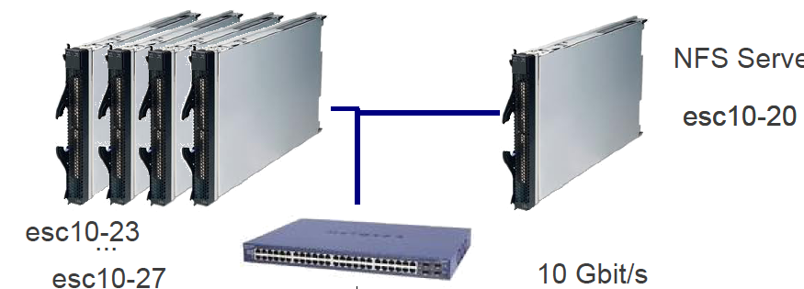
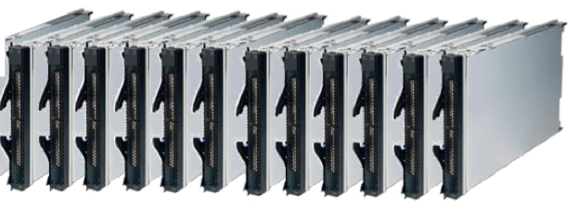
Infrastructure at this school
4 GPFS servers
(4 disks in total: 8 TB)
1 NFS server
(1 disk only: 2 TB)
Maximum theor. bandwidth
Write: ~200 MB/s
Read: ~400 MB/s
Write throughput is smaller
since files are replicated twice
on the servers (sort of RAID 1 across different servers on the network)
Maximum theor.
bandwidth
Write: ~100 MB/s
Read: ~100 MB/s
1 GE switch
Bertinoro-student-01…12

Slide 30
Page caching

Slide 31
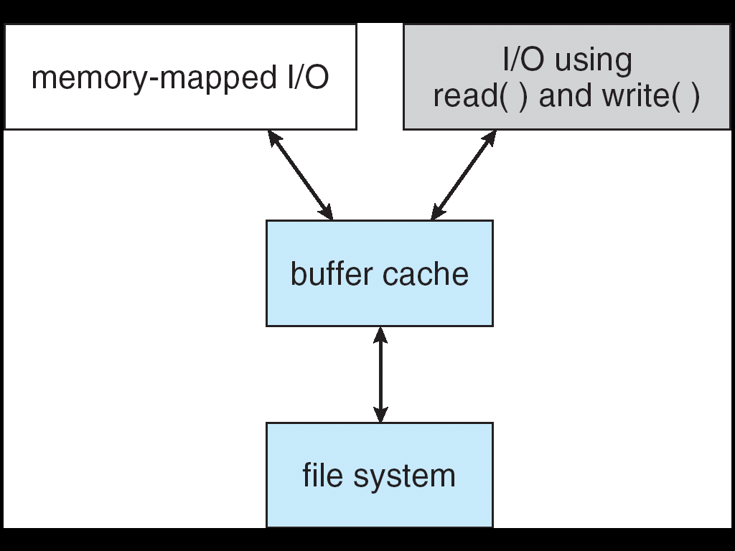
Linux page cache
The page cache is a collection of memory pages that normally belong to files
Every I/O operation on filesystems, either using memory mapped I/O or simple read()/write() calls, proceeds via the cache

Slide 32
Memory pages
The Linux kernel breaks disk I/O into pages
  the default page size on most Linux systems is 4 KB
  the kernel reads and writes disk blocks in and out of memory in 4 KB page sizes
  you can check the page size of your system by e.g. using the time command in verbose mode and searching for the page size:
# /usr/bin/time -v date 2>&1 | grep “Page size”
Page size (bytes): 4096
When an application tries to access a file, the kernel checks if the requested page is cached, and if not it issues a page fault which triggers real I/O from disk
The pages are kept in memory as long as is possible for performance reasons and after a certain amount of time may take up the majority of the available memory

Slide 33
Lifetime of memory pages
At some point the free memory gets short and the kernel needs to "free" the pages which have not been accessed recently
When one sees a low amount of free memory but a large amount of cached memory, this simply means that the system is making good use of its caches
This is an output taken from the /proc/meminfo where most of the memory is used by the page cache
# cat /proc/meminfo
MemTotal: 2075672 kB
MemFree: 52528 kB
Cached: 1766844 kB
...
The system here has a total of 2 GB of RAM available on it, with only 52 MB of free RAM and 1.7 GB of pages in the cache
The page cache can be entirely emptied by issuing with root privileges the following command
# echo 3 > /proc/sys/vm/drop_caches

Slide 34
Types of memory pages
Read Pages
  These are read-only pages read from disk and include static files, binaries, and libraries that do not change
Dirty Pages
  These are pages of data that have been modified while in memory and must be synced to disk at some point by the pdflush kernel daemon
    Of course they cannot be removed from memory until the changes are on disk
  Applications themselves may choose to write dirty pages to disk immediately on request using the fsync() or sync() system calls
Anonymous Pages
  These are pages of data that belong to a process, but do not have any file or backing store associated with them, hence they cannot be synchronized back to disk
  In the event of a memory shortage, the kswapd kernel process writes these to the swap device as temporary storage until more RAM is free ("swapped" pages).

Slide 35
How to remove the pages of a file from the cache
int fd;
fd = open(argv[1], O_RDONLY);
if (fd < 0) {
perror("open");
return 1;
}
// flushes all data buffers of the file to disk
if (fdatasync(fd)<0) {
perror("fdatasync");
return 1;
}
// tell the kernel that we do not need this file using posix_fadvise()
// the kernel will immediately remove the associated pages from the cache
if (posix_fadvise(fd, 0,0,POSIX_FADV_DONTNEED) < 0){
perror("posix_fadvice");
return 1;
}
if(close(fd)<0) {
perror(”close");
return 1;
}

Slide 36
Sequential and random access
Sequential access is the easiest to handle for filesystem and disk
  Large disk devices are inherently sequential
  Kernel can read ahead into the page cache
However, your application is not running alone on a node
  application interleaving produces quasi-random I/O
Each sequential request should be large enough for optimal performance
  1-4 MB per request usually OK
Random I/O is a performance killer for mechanical disks
  cycle length is important for exploiting the page cache efficiently
Read Offset
0
4096
8192
12288
16384
20480
24567
2048
Cycle Length
of 7 pages
> cache size
of 6 pages
Read Offset:
2048
0
4096
8192
12288
16384
20480
24567
Page
Page
Page
Page
Page
Page
Page containing offset 0 replaced
Reading offset 2048 requires re-read!
NB: extreme example, real life caches are much larger than this

Slide 37
Practical demonstration #1
In your home directory you can find a directory io_exercise
# cd ~/io_exercise/demo1
Open with your favorite editor the file README.txt and follow the instructions therein

Slide 38
I/O monitoring tools

Slide 39
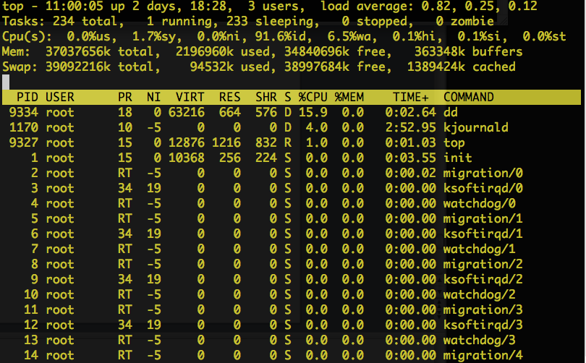
I/O monitoring tools: top ☺
A tool for very first screening is the old uncle top
# dd if=/dev/zero of=test.1.dat bs=64k count=163840 oflag=sync
This dd command writes a zero’ed file of 10 GB, automatically sync’ing to disk (to avoid caching effects)
top shows that the CPU load of the dd process is <<100% (15.9% in this snapshot) → the disk subsystem is saturating, i.e. there is an I/O bottleneck
It is also apparent that the fraction of I/O wait is not negligible (6.5%)
Already from such a first screening you can understand what is going on

Slide 40
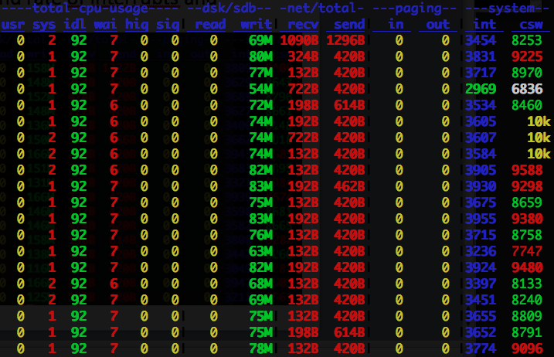
I/O monitoring tools: dstat
dstat is a widely used utility, similar to vmstat but more complete and versatile
It allows to monitor the time evolution of the disk and network I/O with given time granularity
  It also dumps other useful information, such as CPU cycles spent in user, system, wait, hard and soft IRQ’s, and rate of interrupts and context switches
This snapshot is taken during the same dd comand of the previous slide (each row is 1s stat)
Note that the machine has 12 cores, hence 7% of global I/O wait time means almost 100% of one core!

Slide 41
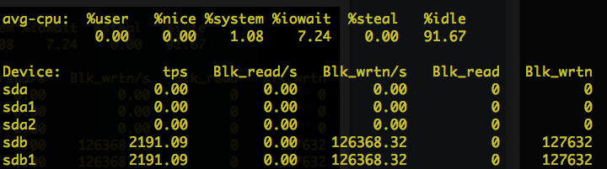
I/O monitoring tools: iostat
iostat gives the possibility to disentangle traffic of the various disks
It is useful e.g. on systems with more than one disk attached
  on large systems with with storage area networks there might be hundreds of disks accessible by a single node
Again, the snapshot is taken during the same dd command of the previous slides
In this example the I/O is expressed in terms of blocks written per second (a block is defined as 512 bytes)
The I/O writes are being issued on device /dev/sdb, in particular on partition sdb1

Slide 42
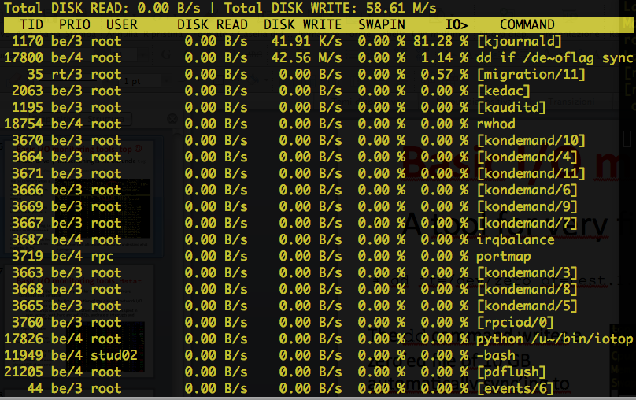
I/O monitoring tools: iotop
Tools like dstat and iostat are able to monitor machine wide disk I/O performance
  You cannot distinguish which process is actually loading your machine
In certain situations, it is very useful to have single process I/O monitoring granularity
  e.g. the machine where your processes run are not of your exclusive use, hence there might be
  other processes which
  complicate the
  understanding of what
  your processes are doing
iotop provides various
disk I/O information on a
process-by-process basis
Snapshot is taken during our usual dd command

Slide 43
A simple (but powerful) profiler: strace
strace is a powerful utility that can be used to profile any application
  it is able to trace every single system call of a process
  In this example it is used to profile the time spent by each type of system call
  You can also attach
  to an already running process, and detach by hitting CTRL-C
  A similar tracer, ltrace, can be used for library calls instead of system calls
# strace -c dd if=/dev/zero of=test.1.dat bs=64k count=163840 oflag=sync
% time seconds usecs/call calls errors syscall
------ ----------- ----------- --------- --------- ----------------
99.80 4.635656 130 35594 write
0.19 0.009053 0 35598 read
0.00 0.000013 1 14 mmap
0.00 0.000000 0 7 open
0.00 0.000000 0 7 close
0.00 0.000000 0 5 fstat
0.00 0.000000 0 1 lseek
0.00 0.000000 0 7 mprotect
0.00 0.000000 0 1 munmap
0.00 0.000000 0 3 brk
0.00 0.000000 0 6 rt_sigaction
0.00 0.000000 0 1 rt_sigprocmask
0.00 0.000000 0 1 1 access
0.00 0.000000 0 1 execve
0.00 0.000000 0 1 getrlimit
0.00 0.000000 0 1 arch_prctl
0.00 0.000000 0 1 futex
0.00 0.000000 0 1 set_tid_address
0.00 0.000000 0 1 clock_gettime
0.00 0.000000 0 1 set_robust_list
------ ----------- ----------- --------- --------- ----------------
100.00 4.644722 71252 1 total

Slide 44
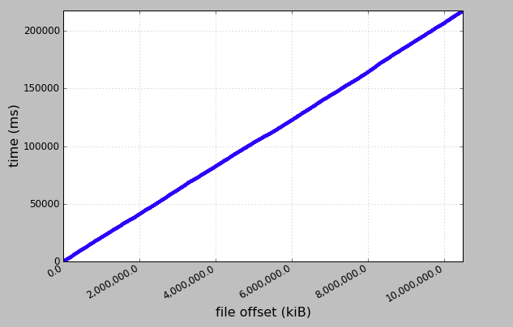
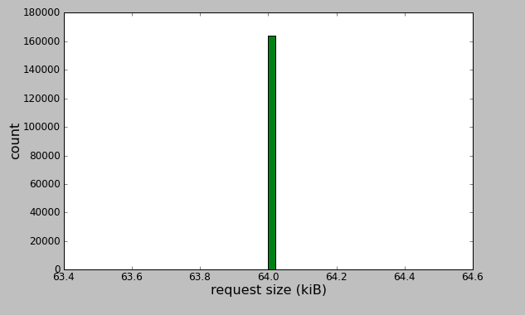
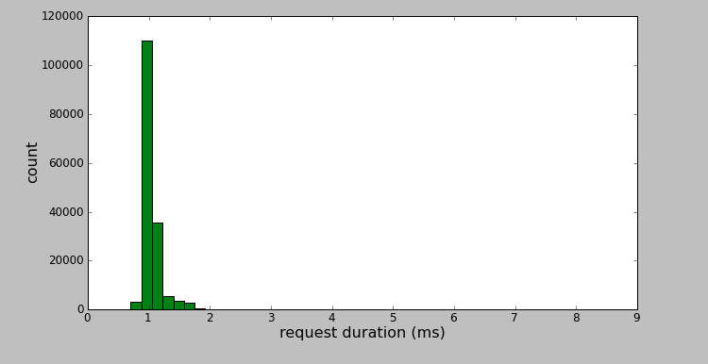
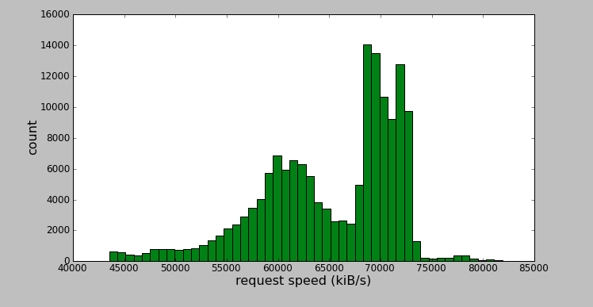
ioprofiler: a graphical tool on top of strace
ioprofiler is a simple graphical tool that takes as input the strace dump of I/O system calls and it is able to represent graphically some useful quantities
# strace -q -a1 -s0 -f -tttT –o strace.out –e trace=file,desc,process,socket \
dd if=/dev/zero of=test.1.dat bs=64k count=163840 oflag=sync
# ioprofiler.py
time vs offset
request size
Purely sequential!
request duration
request speed

Slide 45
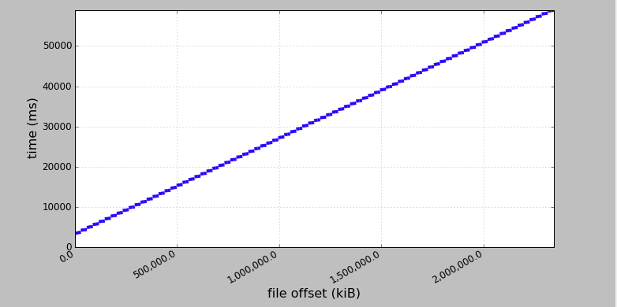
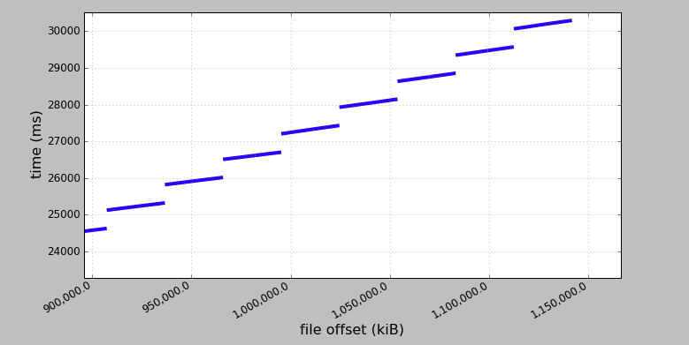
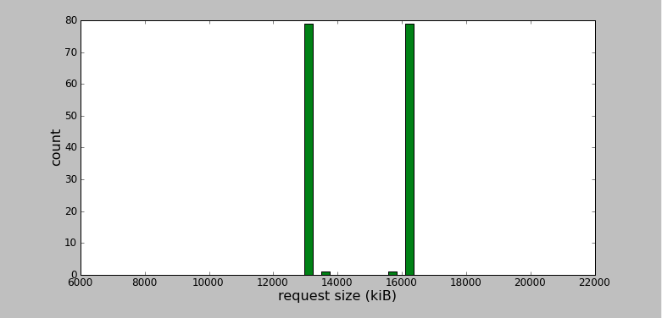
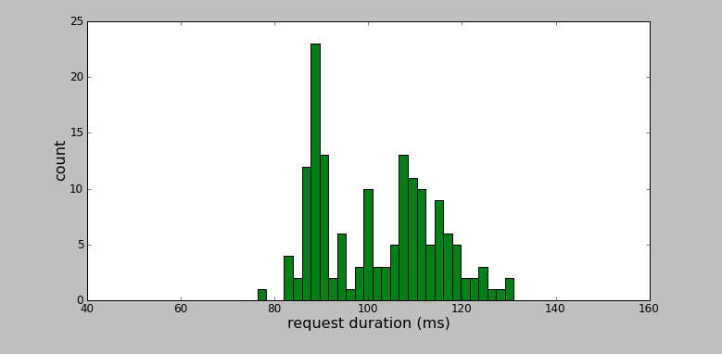
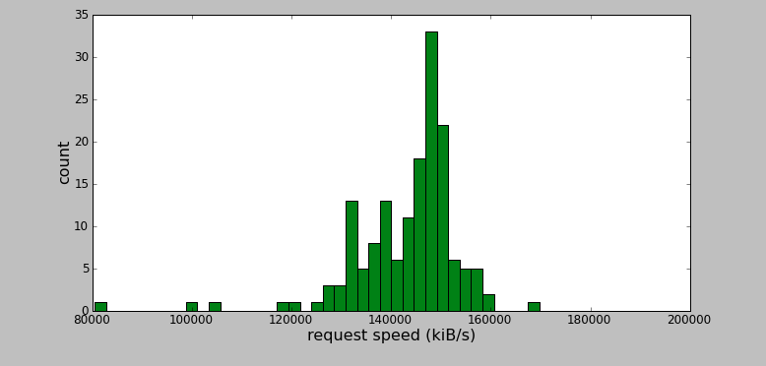
A slightly different pattern
Obtained using a simple ROOT benchmarking macro reading a TTree from the local disk
# strace -q -a1 -s0 -f -tttT –o strace.out –e trace=file,desc,process,socket \
root -l BenchTree.C
# ioprofiler.py
time vs offset
time vs offset
(magnified)
…but if you zoom it some details start to be visible!
Still looks perfectly linear…
request size
request duration
request speed

Slide 46
Practical demonstration #2
# cd ~/io_exercise/demo2
Have a look into README.txt

Slide 47
Advanced I/O API

Slide 48
Basic I/O API
We assume that you are already familiar with basic I/O calls such as
  open(), close(), read(), write()
Maybe you are less familiar with
  lseek()
    used to move the offset of a given file descriptor, in order to access any arbitrary point within the file
      e.g. used in random access patterns
  pread()
    like a read(), but allows to specify the offset as an argument
      atomic lseek+read(), useful in multi-threaded programs which access the same file simultaneously from many threads
  pwrite()
    analogue to pread(), but for writing
In the following, we will focus on more advanced I/O techniques, specifically
  Scatter/Gather I/O, Memory mapped I/O, Asynchronous I/O

Slide 49
The basic I/O API calls are simple, but not always things are as simple as they seem
In this extreme example we read 1 byte every 8192 bytes from the local disk
It looks like the OS should read from disk only 131072 bytes out of 1073741824 bytes, but indeed the OS retrieve from disk half of the file
Even if we try to read 1 byte at a time, the OS reads 4096 bytes as a minimum block size
This block size is not universal, but depends on the filesystem in use
To achieve optimal I/O performance you also need to know how the underlying backend (either local or network filesystem) works in conjunction with your workload
int fd = open(”1GBfile.dat", O_RDONLY);
if (fd < 0) {
perror("open");
return 1;
}
struct stat st;
if (fstat(fd, &st)) {
perror("fstat");
return 1;
}
long long offset = 0;
long long filesize = st.st_size;
printf("File length: %lld\n", filesize);
char buf[1];
while (offset < filesize) {
int n = pread(fd, buf, 1, offset);
if (n <= 0) {
perror("pread");
return 1;
}
offset += 8192;
}

Slide 50
Scatter/gather I/O
Scatter/gather I/O (a.k.a. vectored I/O) is a method of input and output where a single system call can read/write to a vector of buffers from a single data stream in place of a single buffer
  the standard read and write system calls provide instead linear I/O
Scatter/gather I/O provides several advantages over linear I/O methods
  first of all if your data is naturally segmented, vectored I/O allows for intuitive and immediate manipulation
  a single vectored I/O operation can replace multiple linear I/O operations, drastically reducing the rate of kernel context switches
In addition to the reduction in the number of system calls, a vectored I/O is internally instrumented at the kernel level with a series of optimizations which improve performance and would be impossible to be implemented in user land
  you may e.g. think that a process could concatenate the disjoint vectors into a single buffer before writing or decompose the returned buffer into multiple vectors after reading
  this is a user-space implementation of S/G I/O, but for several reasons it would be not as efficient as what the kernel can do by itself

Slide 51
readv() and writev()
The readv() and writev() functions behave exactly the same as read() and write() except that multiple buffers are involved
// writev() writes at most count segments from the iov array
// into the file descriptor fd
ssize_t readv (int fd, const struct iovec *iov, int count);
// readv() does the same but for reading
ssize_t writev (int fd, const struct iovec *iov, int count);
Each iovec structure describes an independent disjoint buffer, which is called a segment
struct iovec {
void *iov_base; // pointer to start of buffer
size_t iov_len; // size of buffer in bytes
};

Slide 52
writev() example
struct iovec iov[3];
ssize_t nr;
int fd, i;
char *buf[] = { “This is the third edition of the INFN ESC11 school. The goal of the ”,
“school is to increase the awareness of the new generations of ”,
“scientists that will face future challenges in scientific computing.” };
fd = open (”esc11.txt", O_WRONLY | O_CREAT, 0666);
if (fd == -1) {
perror ("open");
return 1;
}
// prepare the 3 iovec structures...
for (i = 0; i < 3; i++) {
iov[i].iov_base = buf[i];
iov[i].iov_len = strlen (buf[i]);
}
// ...and with a single call, write them out!
nr = writev (fd, iov, 3);
if (nr == -1) {
perror ("writev");
return 1;
}
printf ("wrote %d bytes\n", nr);
if (close (fd)) {
perror ("close");
return 1;
}

Slide 53
Poor man’s implementation of writev()
ssize_t ret=0;
int i;
for (i = 0; i < count; i++) {
ssize_t nr;
nr = write (fd, iov[i].iov_base, io[i].iov_len); if (nr == -1) { ret = -1; break; } ret += nr;
}
return ret;
Logically equivalent implementation by using linear I/O, but by far less efficient
Even more, Linux kernel internally implements all I/O as vectored, and linear I/O is treated as a limit case ov vectored I/O with only one segment

Slide 54
readv() example
char buf_1[69], buf_2[63], buf_3[69];
struct iovec iov[3];
ssize_t nr;
int fd, i;
fd = open (”esc11.txt", O_RDONLY);
if (fd == -1) {
perror ("open");
return 1;
}
// prepare the iovec structures
iov[0].iov_base = buf_1; iov[0].iov_len = sizeof(buf_1)-1;
iov[1].iov_base = buf_2; iov[1].iov_len = sizeof(buf_2)-1;
iov[2].iov_base = buf_3; iov[2].iov_len = sizeof(buf_3)-1;
// read into the structures with a single call
nr = readv (fd, iov, 3);
if (nr == -1) {
perror ("readv");
return 1;
}
for (i = 0; i < 3; i++) printf ("%d: %s", i, (char *) iov[i].iov_base);
if (close (fd)) {
perror ("close”);
return 1;
}
Reads back the file written before

Slide 55
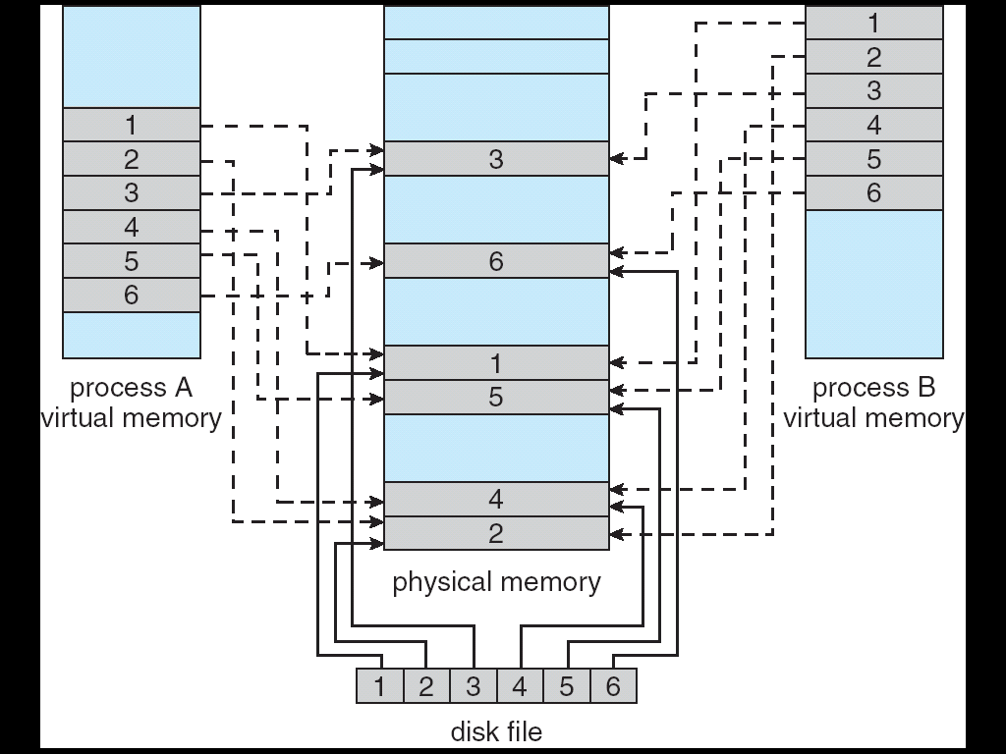
Memory mapped I/O
Memory-mapped file I/O allows file I/O to be treated as routine memory access by mapping a disk block to a page in memory
A file is initially read using demand paging
A page-sized portion of the file is read from the file system into a physical page
Subsequent reads/writes to/from the file are treated as ordinary memory accesses

Slide 56
Advantages of memory mapped I/O
Manipulating files via mmap() has a handful of advantages over the standard read() and write() system calls
  reading from and writing to a memory-mapped file avoids the data movement from kernel space to user space, and viceversa, that occurs when using the read() or write() system calls (see next slide)
  reading from and writing to a memory-mapped file does not incur any system call or context switch overhead
    data access is as simple as accessing memory, no need of calls like lseek()
  when multiple processes map the same object into memory, the data can be shared amongst all the processes

Slide 57
Memory mapping avoids data copy
Without mmap
With mmap
Request
read()
Complete
Disk I/O
Disk I/O
Copy
Memory Mapping
Application Process
User Space
Application Process
User Space
Kernel
Kernel
By mapping the physical memory to the virtual memory living in user space avoids the copy. Physical I/O is transparently triggered by page faults, i.e. when pages not yet in memory are accessed
With usual read() a copy of the data from the kernel space to the user space is required

Slide 58
Memory mapping interface
mmap()
  establishes a memory mapping
munmap()
  unmaps an established memory mapping
msync()
  forces modified pages to be written to disk. Depending on the flags passed can be blocking or unblocking
mlock() and munlock()
  locks and unlocks pages in memory. If locked, the pages cannot be swapped out by the kernel when the machine runs out of free memory
madvise()
  tell kernel how memory mapped pages should be handled, e.g. if you plan to access the memory page-by-page in a sequential or random order

Slide 59
Memory mapped I/O example
struct stat sb; off_t len; char *p; int fd;
fd = open (“myfile.dat”, O_RDONLY); if (fd == -1) { perror ("open"); return 1; }
if (fstat (fd, &sb) == -1) { perror ("fstat"); return 1; }
// map the file and attach to the pointer p
// PROT_READ: the map is read only. MAP_SHARE: the map can be shared with other processes
p = mmap (0, sb.st_size, PROT_READ, MAP_SHARED, fd, 0); if (p == MAP_FAILED) { perror ("mmap"); return 1; }
if (close (fd) == -1) { perror ("close"); return 1; }
// dump the file to stdout byte by byte
for (len = 0; len < sb.st_size; len++) putchar(p[len]);
// unmap the file
if (munmap (p, sb.st_size) == -1) { perror ("munmap"); return 1; }

Slide 60
Memory mapped I/O example with two files
int fd1, fd2;
char *buff1, *buff2;
struct stat stat;
// Input file is read-only. The mapping will be private
// open() flags and memory mapping must be coherent
if ((fd1 = open( "file1", O_RDONLY )) < 0) { perror(“open”); return 1; }
if ((fstat(fd1, &stat)) { perror(“fstat”); return 1; }
// map the input file. The file cannot be written and the mapping is not shared
buff1 = (char *)mmap(0, stat.st_size, PROT_READ, MAP_PRIVATE, fd1, 0);
if (buff1 == MAP_FAILED) { perror(“mmap”); return 1; }
// Open the output file
if ((fd2 = open( "file2", O_RDWR )) < 0) { perror(“open”); return 1; }
if ((fstat(fd2, &stat)) { perror(“fstat”); return 1; }
// map the output file
buff2 = (char *)mmap(0,stat.st_size,PROT_READ|PROT_WRITE,MAP_SHARED, fd2,0);
if (buff2 == MAP_FAILED) { perror(“mmap”); return 1; }
// now copy 1024 bytes from input file to output file. It is a simple memory copy
memcpy(buff2, buff1, 1024);
// call msync() to start sync to disk immediately
// specify in this example that this has to be non-blocking. For blocking call use MS_SYNC
if (msync (buff2, stat.st_size, MS_ASYNC) == -1) { perror ("msync"); return 1; }

Slide 61
AIO in linux
The introduction of AIO support into the linux kernel is relatively recent
As we have already said, the basic idea behind AIO is to allow a process to initiate a number of I/O operations without having to block or wait for any to complete
At some later time or upon a notification from the kernel that the I/O has been completed, the application can retrieve the results of the I/O
In the meantime, waiting for I/O, the application can actively perform computation

Slide 62
The AIO Interface
The AIO interface API is quite simple, but it provides all the necessary functions to transfer data with two different notification models
  aio_read()
    Request an asynchronous read operation
  aio_write()
    Request an asynchronous write operation
  aio_cancel()
    Cancel an asynchronous I/O request, i.e. a previous read or write
  aio_error()
    Check the status of an asynchronous request
  aio_return()
    Get final status of completed request
  aio_suspend()
    Suspend the calling process until one or more asynchronous requests have completed (or failed)
  lio_listio()
    Initiate list of I/O operation

Slide 63
aiocb structure
Each API function uses the aiocb structure for initiating or checking the status of an I/O request
  This structure has many elements, here we only show those that one needs to use
The sigevent structure tells AIO what to do when the
I/O completes
  We will see how it works in the AIO demonstration later
struct aiocb {
int aio_fildes; // File descriptor
int aio_lio_opcode; // valid for lio_listio operation
volatile void *aio_buf; // Data buffer
size_t aio_nbytes; // Length of buffer in bytes
struct sigevent aio_sigevent; // Structure used for notification
off_t aio_offset; // Offset of the first byte to read
// Other fields
...
};

Slide 64
AIO read example
#include <aio.h>
int fd, rc, ret;
struct aiocb my_aiocb;
fd = open( "my_file", O_RDONLY ); // Open the file as usual
if (fd < 0) perror(“open”);
memset((char *)&my_aiocb, 0, sizeof(my_aiocb)); // Initialize to zero: recommended
// Allocate a data buffer for the aiocb request
my_aiocb.aio_buf = malloc(BUFSIZE);
if(!my_aiocb.aio_buf) perror(“malloc”);
// Initialize aiocb structure
my_aiocb.aio_fildes = fd;
my_aiocb.aio_nbytes = BUFSIZE;
my_aiocb.aio_nbytes = 0; // set the offset to the first byte of the file
// this is pleonastic here, but in any call you must specify
// the correct offset for every call
// submit the read
rc = aio_read( &my_aiocb );
if(rc < 0) perror(“aio_read”);
while( aio_error( &my_aiocb ) == EINPROGRESS ); // Loop checking if I/O is over
if ((ret = aio_return( &my_aiocb )) >= 0) { // data is ready, call aio_return and get it
// got ret bytes from the read, can consume what is in the buffer
} else {
perror(“aio_return”);
}
Nota Bene: this example is for illustrative purposes only, it does not really make sense as it is implementing a blocking behaviour!

Slide 65
Other common AIO functions
aio_write() is used to submit a write, in an analogue way to aio_read()
aio_suspend() can be used to block the calling process until an asynchronous I/O request has completed, a signal is raised, or a timeout occurs
  A list of aiocb references is provided: if any of them complete, the call returns
aio_cancel() is used to cancel one or all requests previously submitted to a given file descriptor
struct aiocb *my_list[MAX_LIST];
memset( (char *)my_list, 0, sizeof(mylist) ); // Clear the list
// Load one or more references into the list
my_list[0] = &my_aiocb_0;
my_list[1] = &my_aiocb_1;
...
ret = aio_read( &my_aiocb_0 );
ret = aio_read( &my_aiocb_1 );
// block with aio_suspend, NULL elements in my_list are ignored
ret = aio_suspend( my_list, MAX_LIST, NULL );

Slide 66
lio_listio()
AIO provides a way to initiate multiple transfers at the same time
  lio_listio() is useful because it allows you to start lots of I/Os within one single kernel context switch
The read operation is noted in the aio_lio_opcode field with LIO_READ (LIO_WRITE for a write operation)
The LIO_WAIT means the call will block
  Better way to use it is with LIO_NOWAIT, i.e. non-blocking exploiting asynchronous notification, as we will see in a while
struct aiocb aiocb1, aiocb2;
struct aiocb *list[MAX_LIST];
...
// Prepare the first aiocb
aiocb1.aio_fildes = fd;
aiocb1.aio_buf = malloc(BUFSIZE);
aiocb1.aio_nbytes = BUFSIZE;
aiocb1.aio_offset = next_offset;
aiocb1.aio_lio_opcode = LIO_READ; // the operation must be indicated in the aiocb
...
memset( (char *)list, 0, sizeof(list) );
list[0] = &aiocb1;
list[1] = &aiocb2;
// issue the lio_listio with LIO_WAIT (means blocking)
ret = lio_listio( LIO_WAIT, list, MAX_LIST, NULL ); // ignores NULL elements

Slide 67
AIO notification
The AIO notification relies on two different techniques
  signal and callback notifications
The use of signals is a common mechanism in unix systems and is also supported by AIO
  The application can define a special function (a so-called signal handler) that is invoked when a specified signal occurs
  We can configure AIO via the aiocb structure such that an asynchronous request will raise a signal when the I/O request has completed
Using callbacks, instead of raising a signal for notification, AIO calls a function in user-space upon I/O completion
  In this case sigevent structure into the aiocb is used specify the pointer to the function to be called back

Slide 68
Signal-based AIO notification example
int fd;
struct sigaction sig_act;
struct aiocb my_aiocb;
...
// Set up the signal handler
sigemptyset(&sig_act.sa_mask);
sig_act.sa_flags = SA_SIGINFO;
sig_act.sa_sigaction = aio_completion_handler; // function to call when signal fires
// Set up the aio request
memset( (char *)&my_aiocb, 0, sizeof(struct aiocb) );
my_aiocb.aio_fildes = fd;
my_aiocb.aio_buf = malloc(BUFSIZE);
my_aiocb.aio_nbytes = BUFSIZE;
my_aiocb.aio_offset = next_offset;
// Link the aio request to the signal
my_aiocb.aio_sigevent.sigev_notify = SIGEV_SIGNAL;
my_aiocb.aio_sigevent.sigev_signo = SIGIO; // in this example use SIGIO signal
my_aiocb.aio_sigevent.sigev_value.sival_ptr = &my_aiocb;
// Map the signal to the signal handler
ret = sigaction( SIGIO, &sig_act, NULL );
...
ret = aio_read( &my_aiocb ); // submit the read request and return immediately
... // perform some computation while I/O is being carried out
void aio_completion_handler( int signo, siginfo_t *info, void *context ) {
struct aiocb *req;
req = (struct aiocb *) info->si_value.sival_ptr;
if (aio_error( req ) == 0) { // Did the request complete succesfully?
// Request completed successfully, get the return status
ret = aio_return( req );
}
return;
}
Not done in this example, but to increase performance the handler could continue the I/O by requesting the next asynchronous transfer. In this way,
when one transfer has completed, the next is immediately started.

Slide 69
Callback-based AIO notification example
int fd;
struct aiocb my_aiocb;
...
// Set up the aio request
memset( (char *)&my_aiocb, 0, sizeof(struct aiocb) );
my_aiocb.aio_fildes = fd;
my_aiocb.aio_buf = malloc(BUFSIZE);
my_aiocb.aio_nbytes = BUFSIZE;
my_aiocb.aio_offset = next_offset;
// Link the aio request with a thread callback
my_aiocb.aio_sigevent.sigev_notify = SIGEV_THREAD;
my_aiocb.aio_sigevent.notify_function = aio_completion_handler;
my_aiocb.aio_sigevent.notify_attributes = NULL;
my_aiocb.aio_sigevent.sigev_value.sival_ptr = &my_aiocb;
...
ret = aio_read( &my_aiocb );
void aio_completion_handler( sigval_t sigval ) {
struct aiocb *req;
req = (struct aiocb *)sigval.sival_ptr; // cast from sigval to get the aiocb pointer
// Check if the request completed successfully
if (aio_error( req ) == 0) {
// Request completed successfully, get the return status
ret = aio_return( req );
}
return;
}

Slide 70
AIO kernel tuning and conclusions
The proc file system contains two virtual files that can be tuned for asynchronous I/O performance
  /proc/sys/fs/aio-nr provides the current number of system-wide asynchronous I/O requests
  /proc/sys/fs/aio-max-nr is the maximum number of allowable concurrent requests
    This value is commonly 65535 which is adequate for most applications
Asynchronous I/O is a tool which allows to design efficient I/O applications
  This is of interest when the application I/O and data processing can be overlapped and executed in parallel
  This I/O model differs from the traditional simple minded blocking patterns, by the asynchronous notification model is conceptually simple, although technically more advanced

Slide 71
Practical demonstration #3
# cd ~/io_exercise/demo3
Have a look into README.txt

Slide 72
Practical demonstration #4
# cd ~/io_exercise/demo4
Have a look into README.txt

Slide 73
Free demonstration
If in the past days you have run some realistic job which reads files in input or writes files to output, and you remember how to rerun it, try to launch, monitor and profile the application by your own

Slide 74
Fin
Good luck guys!

