Slide 1

High throughput DAQ systems
Niko Neufeld, CERN/PH

Slide 2
Outline
History & traditional DAQ
Buses
LEP / Tevatron
LHC DAQ
Introduction
Network based DAQ
Ethernet
Scaling Challenges
Switches
Nodes
Challenges (buffer occupancy) Packet-sizes
Push & Pull
Real LHC DAQ architectures (bandwidth vs complexity)
Eventfilterfarms
“Ultimate” DAQ
Trigger-free / Sampling, ILC, Clic
Almost there: CMB
Longterm: LHC upgrade
Ethernet (again)? / InfiniBand

Slide 3
Disclaimer
I have been working in this field since 11 years and admit readily to a biased view
I have selected DAQ systems mostly to illustrate throughput / performance → not mentioned does not mean that it is not an interesting system
“High throughput” brings a focus on large experiments: the greatest heroism in DAQ is found in small experiments, where the DAQ is done by one or two people part-time and in test-beams. I pay my respects to them!

Slide 4
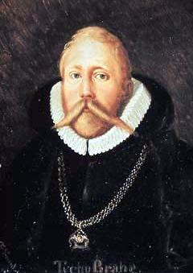
Tycho Brahe and the Orbit of Mars
I've studied all available charts of the planets and stars and none of them match the others. There are just as many measurements and methods as there are astronomers and all of them disagree. What's needed is a long term project with the aim of mapping the heavens conducted from a single location over a period of several years. Tycho Brahe, 1563 (age 17).
First measurement campaign
Systematic data acquisition
Controlled conditions (same location, same day and month)
Careful observation of boundary conditions (weather, light conditions etc…) - important for data quality / systematic uncertainties

Slide 5
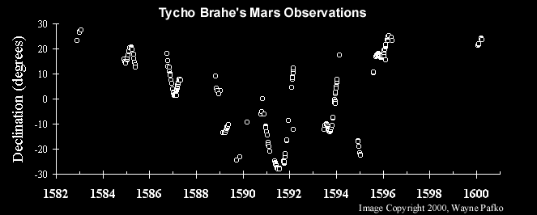
The First Systematic Data Acquisition
Data acquired over 18 years, normally e every month
Each measurement lasted at least 1 hr with the naked eye
Red line (only in the animated version) shows comparison with modern theory

Slide 6
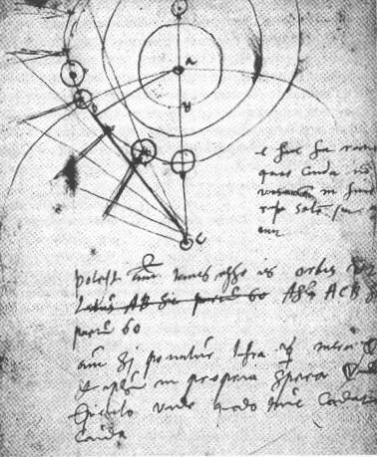
Tycho’s DAQ in today’s Terminology
Trigger = in general something which tells you when is the “right” moment to take your data
In Tycho’s case the position of the sun, respectively the moon was the trigger
the trigger rate ~ 3.85 x 10⁻⁶ Hz (one measurement / month) compare with LHCb 1.0 x 10⁶ Hz
Event-data (“event”) = the summary of all sensor data, which are recorded from an individual physical event
In Tycho’s case the entry in his logbook (about 100 characters / entry)
In a modern detector the time a particle passed through a specific piece of the detector and the signal (charge, light) it left there
Band-width (bw) (“throughput”) = Amount of data transferred / per unit of time
“Transferred” = written to his logbook
“unit of time” = duration of measurement
bw_{Tycho} = ~ 100 Bytes / h = 0.0003 kB/s bw_{LHCb} = 55.000 Bytes / us = 55000000 kB/s

Slide 7
Lessons from Tycho
Tycho did not do the correct analysis (he believed that the earth was at the center of the solar system) of the Mars data. This was done by Johannes Kepler (1571-1630), eventually paving the way for Newton’s laws → good data will always be useful, even if you yourself don’t understand them!
The size & speed of a DAQ system are not correlated with the importance of the discovery!

Slide 8
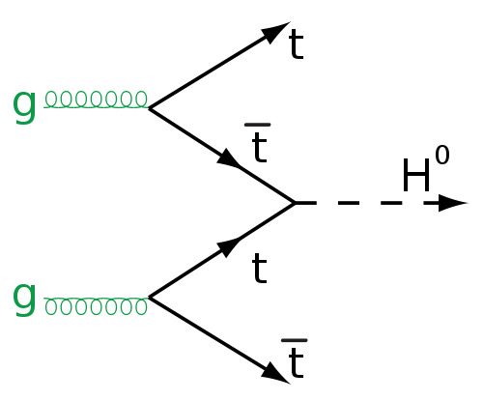
Physics, Detectors, Trigger & DAQ
High rate collider
Fast electronics
signals
decisions
data
Trigger
Data acquisition
rare, need many collisions
decisions
data
Event Filter
Mass
Storage

Slide 9
Before the DAQ - a detector channel
Detector / Sensor
Amplifier
Filter
Shaper
Range compression
clock (TTC)
Sampling
Digital filter
Zero suppression
Buffer
Feature extraction
Buffer
Format & Readout
to Data Acquisition System

Slide 10
Crate-based DAQ
19”
Many detector channels are read-out on a dedicated PCB (“board”)
Many of these boards are put in a common chassis or crate
These boards need
Mechanical support
Power
A standardized way to access their data (our measurement values)
All this (and more ☺) is provided by standards for (readout) electronics such as VME (IEEE 1014), Fastbus, Camac , ATCA, uTCA
6/9U VME Crate
(a.k.a. “Subrack”)
9U
Backplane Connectors
(for power and data)
VME Board
Plugs into Backplane

Slide 11
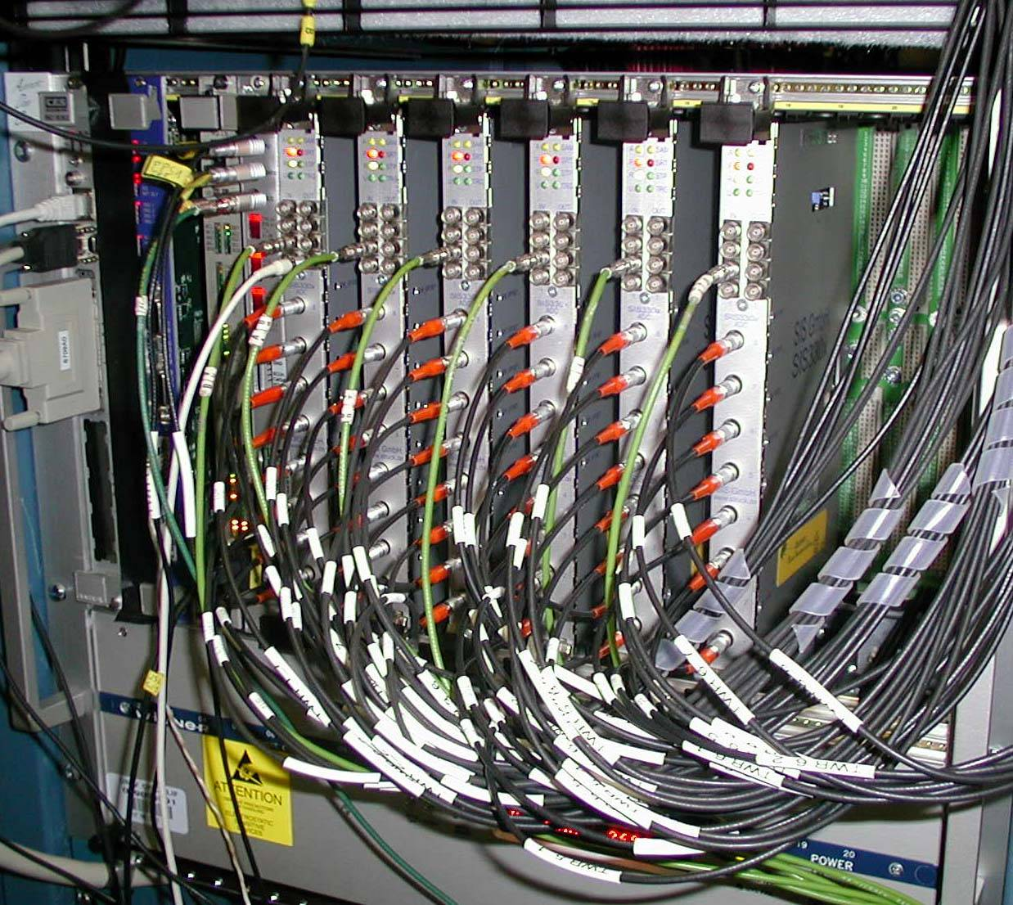
Example: VME
Readout boards in a VME-crate
mechanical standard for
electrical standard for power on the backplane
signal and protocol standard for communication on a bus
Notes:
modules (6U x 200 mm, 9U x 400 mm)
Crates 19’’ wide

Slide 12
Communication in a Crate: Buses
A bus connects two or more devices and allows the to communicate
The bus is shared between all devices on the bus → arbitration is required
Devices can be masters or slaves and can be uniquely identified ("addressed") on the bus
Number of devices and physical bus-length is limited (scalability!)
For synchronous high-speed buses, physical length is correlated with the number of devices (e.g. PCI)
Typical buses have a lot of control, data and address lines
Buses are typically useful for systems << 1 GB/s
Master
Slave
Slave
Master
Device 1
Device 2
Device 3
Device 4
Device 1
Device 2
Device 3
Device 4
Data Lines
Data Lines
Select Line
Select Line
Notes:
Address and data signals can be on separate electrical lines or share the same lines (multiplexed)

Slide 13
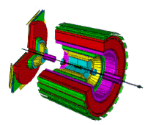
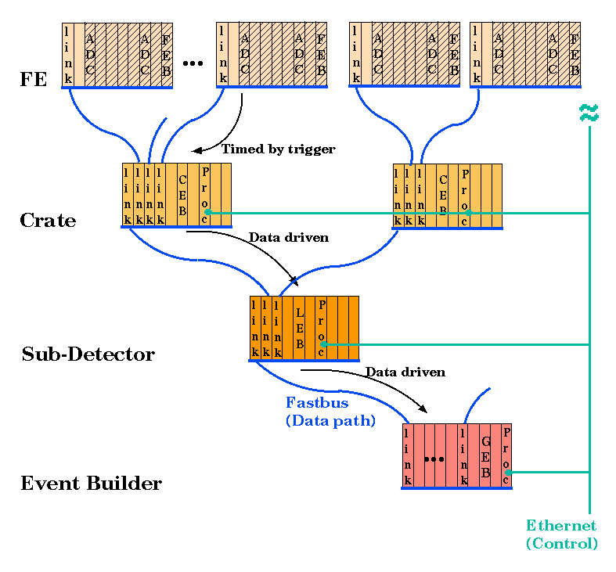
Crate-based DAQ at LEP (DELPHI)
200 Fastbus crates, 75 processors
total event-size ~ 100 kB
rate of accepted events O(10 Hz)
FE data
Full Event
adapted from C. Gaspar (CERN)

Slide 14
Combining crates and LANs: the D0 DAQ (L3)
Read Out Crates are VME crates that receive data from the detector. Event-size 300 kB, at ~ 1 kHz
ROC
Most data is digitized on the detector and sent to the Movable Counting House
Detector specific cards in the ROC
DAQ HW reads out the cards and makes the data format uniform
Farm Node
ROC
Farm Node
ROC
Farm Nodes are located about 20 m away (electrically isolated)
Event is built in the Farm Node
There is no dedicated event builder
Level 3 Trigger Decision is rendered in the node in software
Farm Node
ROC
ROC
Between the two is a very large CISCO switch… (2002)

Slide 15
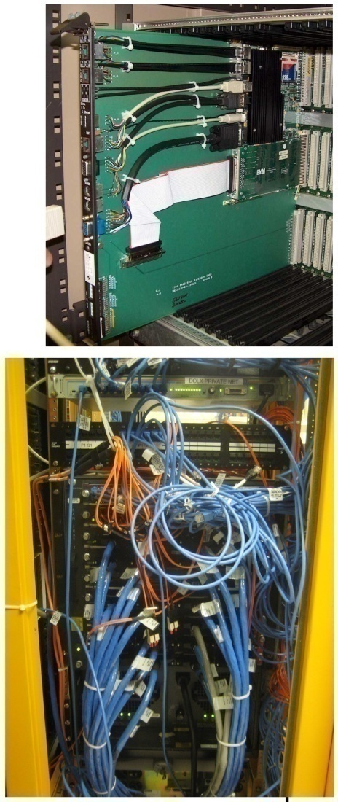
The DO DAQ in 2002 - 2011
ROC’s contain a Single Board Computer to control the readout.
VMIC 7750’s, PIII, 933 MHz
128 MB RAM
VME via a PCI Universe II chip
Dual 100 Mb ethernet
4 have been upgraded to Gb ethernet due to increased data size
Farm Nodes: 288 total, 2 and 4 cores per pizza box
AMD and Xeon’s of differing classes and speeds
Single 100 Mb Ethernet
Less than last CHEP!
CISCO 6590 switch
16 Gb/s backplane
9 module slots, all full
8 port GB
112 MB shared output buffer per 48 ports

Slide 16
LHC DAQ
DAQ for multi-Gigabyte/s experiments

Slide 17
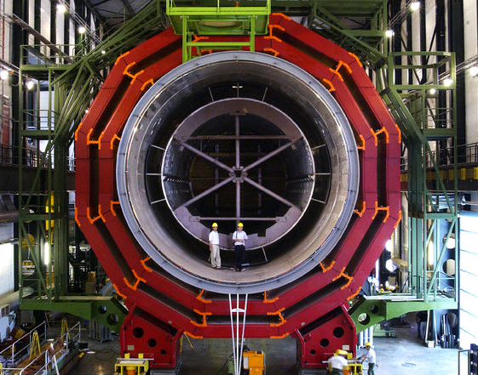
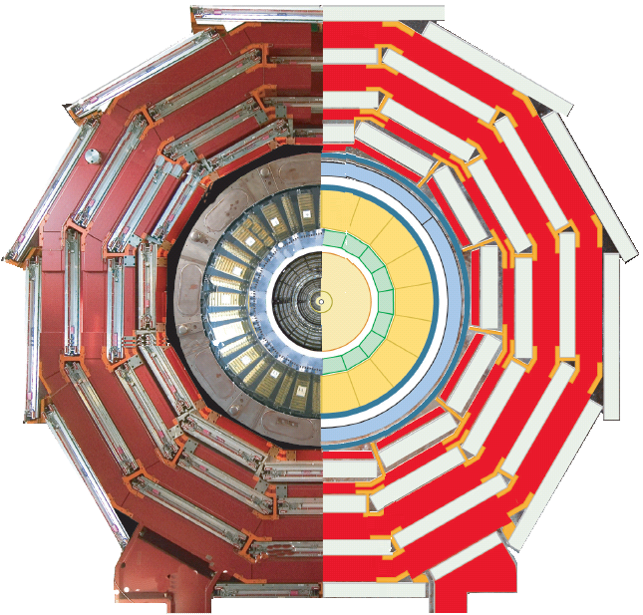
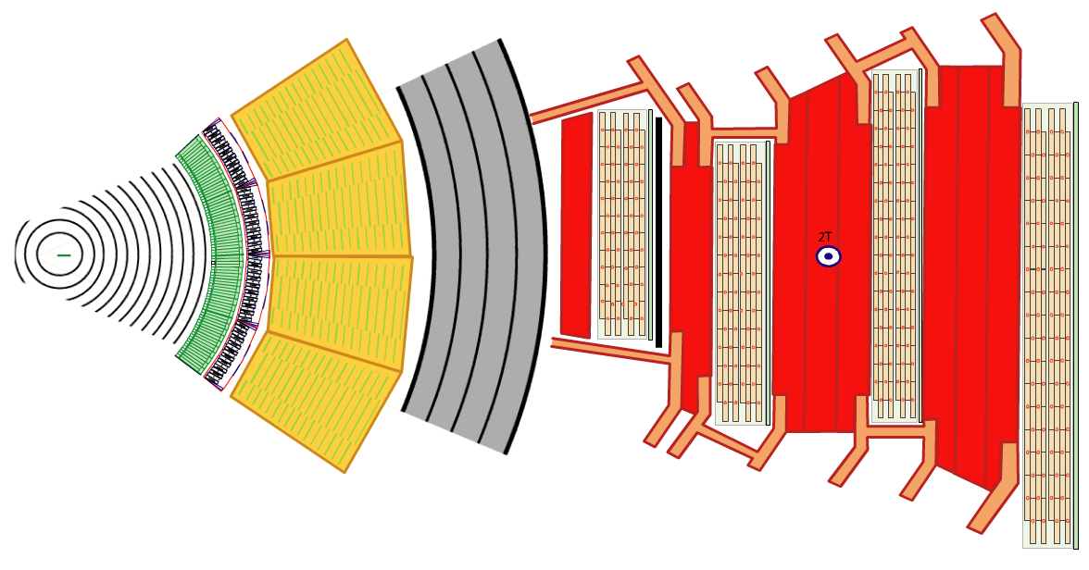
Moving on to Bigger Things…
The CMS Detector

Slide 18
Moving on to Bigger Things…
15 million detector channels
@ 40 MHz
= ~15 * 1,000,000 * 40 * 1,000,000 bytes
= ~ 600 TB/sec
?

Slide 19
Know Your Enemy: pp Collisions at 14 TeV at 10³⁴ cm⁻²s⁻¹
σ(pp) = 70 mb --> >7 x 10⁸ /s (!)
In ATLAS and CMS* 20 min bias events will overlap
H→ZZ
Z →μμ
H→ 4 muons:
the cleanest
(“golden”)
signature
And this
(not the H though…)
repeats every 25 ns…
^{*)}LHCb @2x10³³ cm⁻²-1 isn’t much nicer and in Alice (PbPb) it will be even worse

Slide 20
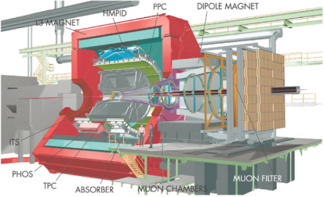
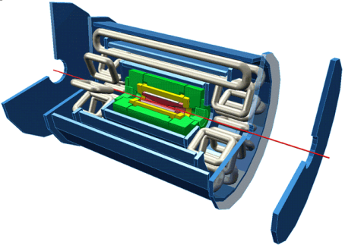
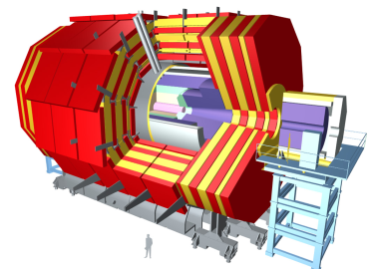
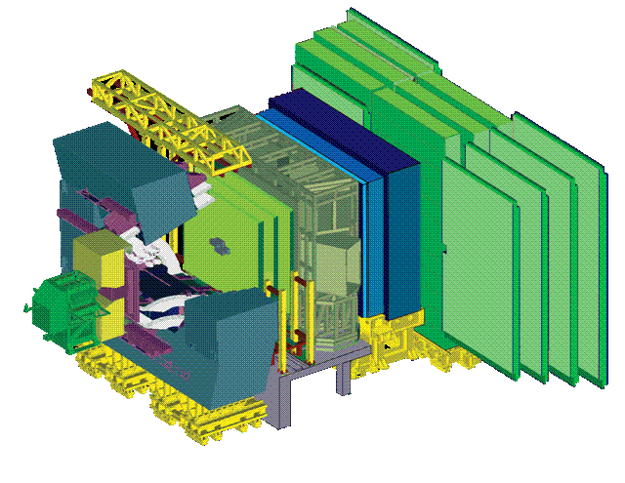
LHC Trigger/DAQ parameters
# Level-0,1,2 Event Network Storage
Trigger Rate (Hz) Size (Byte) Bandw.(GB/s) MB/s (Event/s)
4 Pb-Pb 500 5x10⁷ 25 1250 (10²)
p-p 10³ 2x10⁶ 200 (10²)
3 LV-1 10⁵ 1.5x10⁶ 4.5 300 (2x10²)
LV-2 3x10³
2 LV-1 10⁵ 10⁶ 100 ~1000 (10²)
2 LV-0 10⁶ 5.5x10⁴ 55 150 (2x10³)
ALICE
ATLAS
CMS
LHCb
Notes:
Trigger levels include HLT which is operating on entire events

Slide 21
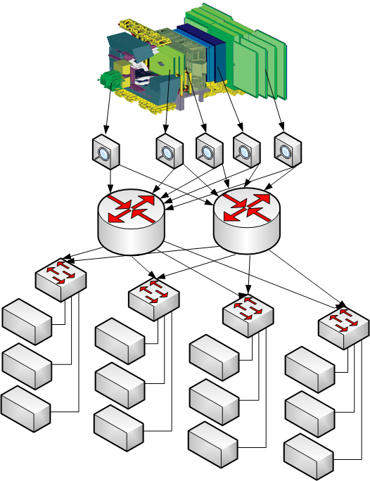
DAQ implemented on a LAN
Typical number of pieces
Detector
1
Custom links from the
detector
1000
“Readout Units”
for protocol adaptation
100 to 1000
Powerful Core routers
2 to 8
Edge switches
50 to 100
Servers for event
filtering
> 1000

Slide 22




Event Building over a LAN
To Trigger
Algorithms
Event Builder 1
Event Builder 2
Data Acquisition
Switch
Event Builder 3
1
2
3
4
Event fragments are received from detector front-end
Event fragments are read out over a network to an event builder
Event builder assembles fragments into a complete event
Complete events are processed by trigger algorithms

Slide 23
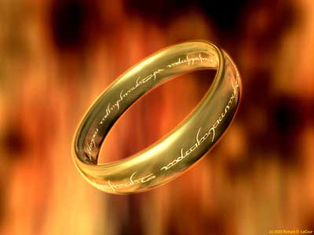
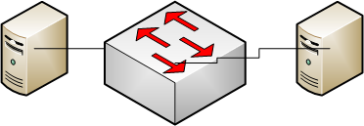
One network to rule the all
Ethernet, IEEE 802.3xx, has almost become synonymous with Local Area Networking
Ethernet has many nice features: cheap, simple, cheap, etc…
Ethernet does not:
guarantee delivery of messages
allow multiple network paths
provide quality of service or bandwidth assignment (albeit to a varying degree this is provided by many switches)
Because of this raw Ethernet is rarely used, usually it serves as a transport medium for IP, UDP, TCP etc…
Ethernet
Flow-control in standard Ethernet is only defined between immediate neighbors
Sending station is free to throw away x-offed frames (and often does ☹)
Xoff
data

Slide 24
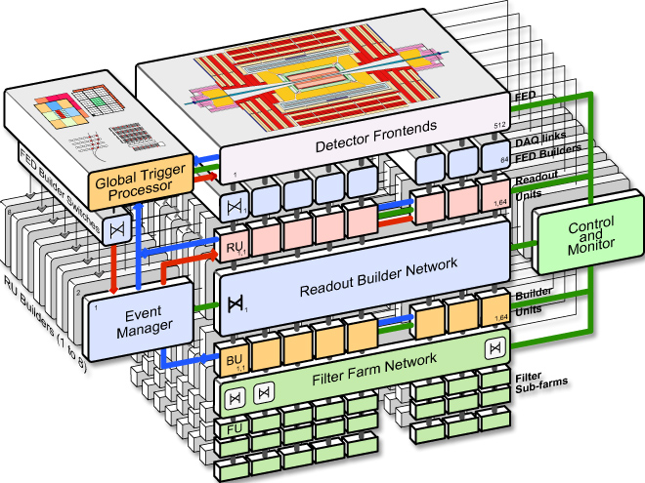
CMS Data Acquisition

Slide 25
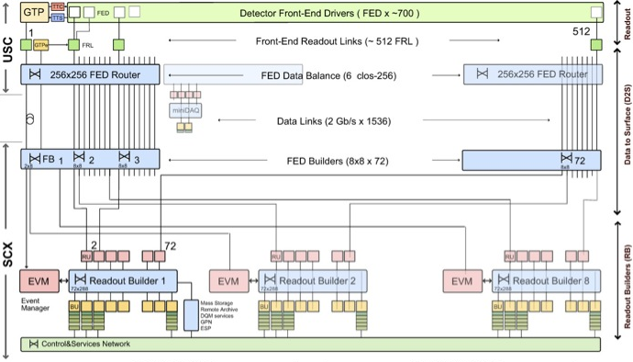
2-Stage Event Builder
1st stage “FED-builder”
Assemble data from 8 front-ends into
one super-fragment at 100 kHz
100 kHz
8 independent “DAQ slices”
Assemble super-fragments into full events
12.5 kHz
12.5 kHz
…
12.5 kHz

Slide 26
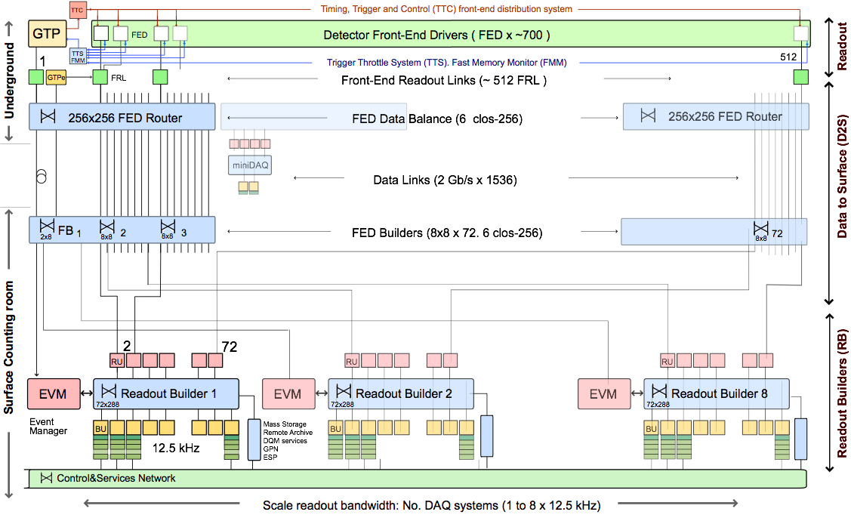
Super-Fragment Builder (1st stage)
based on Myrinet technology (NICs and wormhole routed crossbar switches)
NIC hosted by FRL module at sources
NIC hosted by PC (“RU”) at destination
~1500 Myrinet fibre pairs (2.5 Gbps signal rate) from underground to surface
Typically 64 times 8x8 EVB configuration
Packets routed through independent switches (conceptually 64)
Working point ~2 kB fragments at 100 kHz
Destination assignment: round-robin
loss-less and backpressure when congested

Slide 27
Scaling in LAN based DAQ

Slide 28
Congestion
2
"Bang" translates into random, uncontrolled packet-loss
In Ethernet this is perfectly valid behavior and implemented by many low-latency devices
Higher Level protocols are supposed to handle the packet loss due to lack of buffering
This problem comes from synchronized sources sending to the same destination at the same time
2
Bang
2

Slide 29
Push-Based Event Building
Switch Buffer
Event Builder 1
Event Builder 2
Data Acquisition
Switch
“Send next event to EB1”
Event
Manager
“Send next event to EB2”
1
2
3
Event Manager tells readout boards where events must be sent (round-robin)
Readout boards do not buffer, so switch must
No feedback from Event Builders to Readout system

Slide 30
Cut-through switching Head of Line Blocking
1
3
The reason for this is the First in First Out (FIFO) structure of the input buffer
Queuing theory tells us* that for random traffic (and infinitely many switch ports) the throughput of the switch will go down to 58.6% → that means on 100 MBit/s network the nodes will "see" effectively only ~ 58 MBit/s
2
2
4
Packet to node 4 must wait
even though port to node 4 is free
2
4
*) "Input Versus Output Queueing on a Space-Division Packet Switch"; Karol, M. et al. ; IEEE Trans. Comm., 35/12

Slide 31
Using more of that bandwidth
Cut-through switching is excellent for low-latency (no buffering) and reduces cost (no buffer memories), but “wastes” bandwidth
It’s like building more roads than required just so that everybody can go whenever they want immediately
For optimal usage of installed bandwidth there are in general two strategies:
Use store-and-forward switching (next slide)
Use traffic-shaping / traffic-control
Different protocols (“pull-based event-building”), multi-level readout
end-to-end flow control
virtual circuits (with credit-scheme) (InfiniBand)
Barrel-shifter

Slide 32
Output Queuing
In practice virtual output queueing is used: at each input there is a queue → for n ports O(n²) queues must be managed
Assuming the buffers are large enough(!) such a switch will sustain random traffic at 100% nominal link load
1
3
2
2
4
Packet to node 2 waits at output to
port 2. Way to node 4 is free
4
2

Slide 33
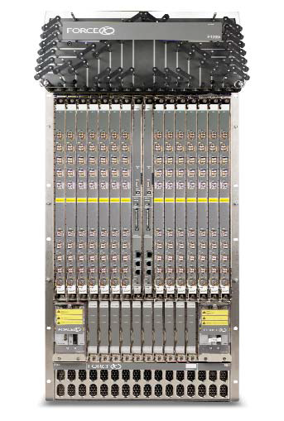
Store-and-Forward in the LHC DAQs
256 MB shared memory / 48 ports
Up to 1260 ports (1000 BaseT)
Price / port ~ 500 - 1000 USD
Used by all LHC experiments
6 kW power, 21 U high
Loads of features (most of them unused ☺ in the experiments)

Slide 34
Buffer Usage in F10 E1200i
Buffer usage in core-router with a test using 270 sources @ 350 kHz event-rate
256 MB shared between 48 ports
17 ports used as “output”
This measurement for small LHCb events (50 kB) at 1/3 of nominal capacity

Slide 35
Push-Based Event Building with store& forward switching and load-balancing
“Send me
an event!”
“Send me
an event!”
Event Builder 1
Event Builder 1
“Send me
an event!”
Event Builder 2
Data Acquisition
Switch
“Send me
an event!”
Event Builder 3
EB1:
EB2:
EB3:
0
0
0
1
1
1
0
1
1
0
0
1
1
0
1
“Send next event to EB1”
“Send next event to EB2”
“Send next event to EB3”
Event Manager
1
2
3
Event Builders notify Event Manager available capacity
Event Manager
ensures that data are sent only to nodes with available capacity
Readout system relies on feedback from Event Builders

Slide 36
DAQ networks beyond push and store & forward
Reducing network load
Pull-based event-building
Advanced flow-control

Slide 37

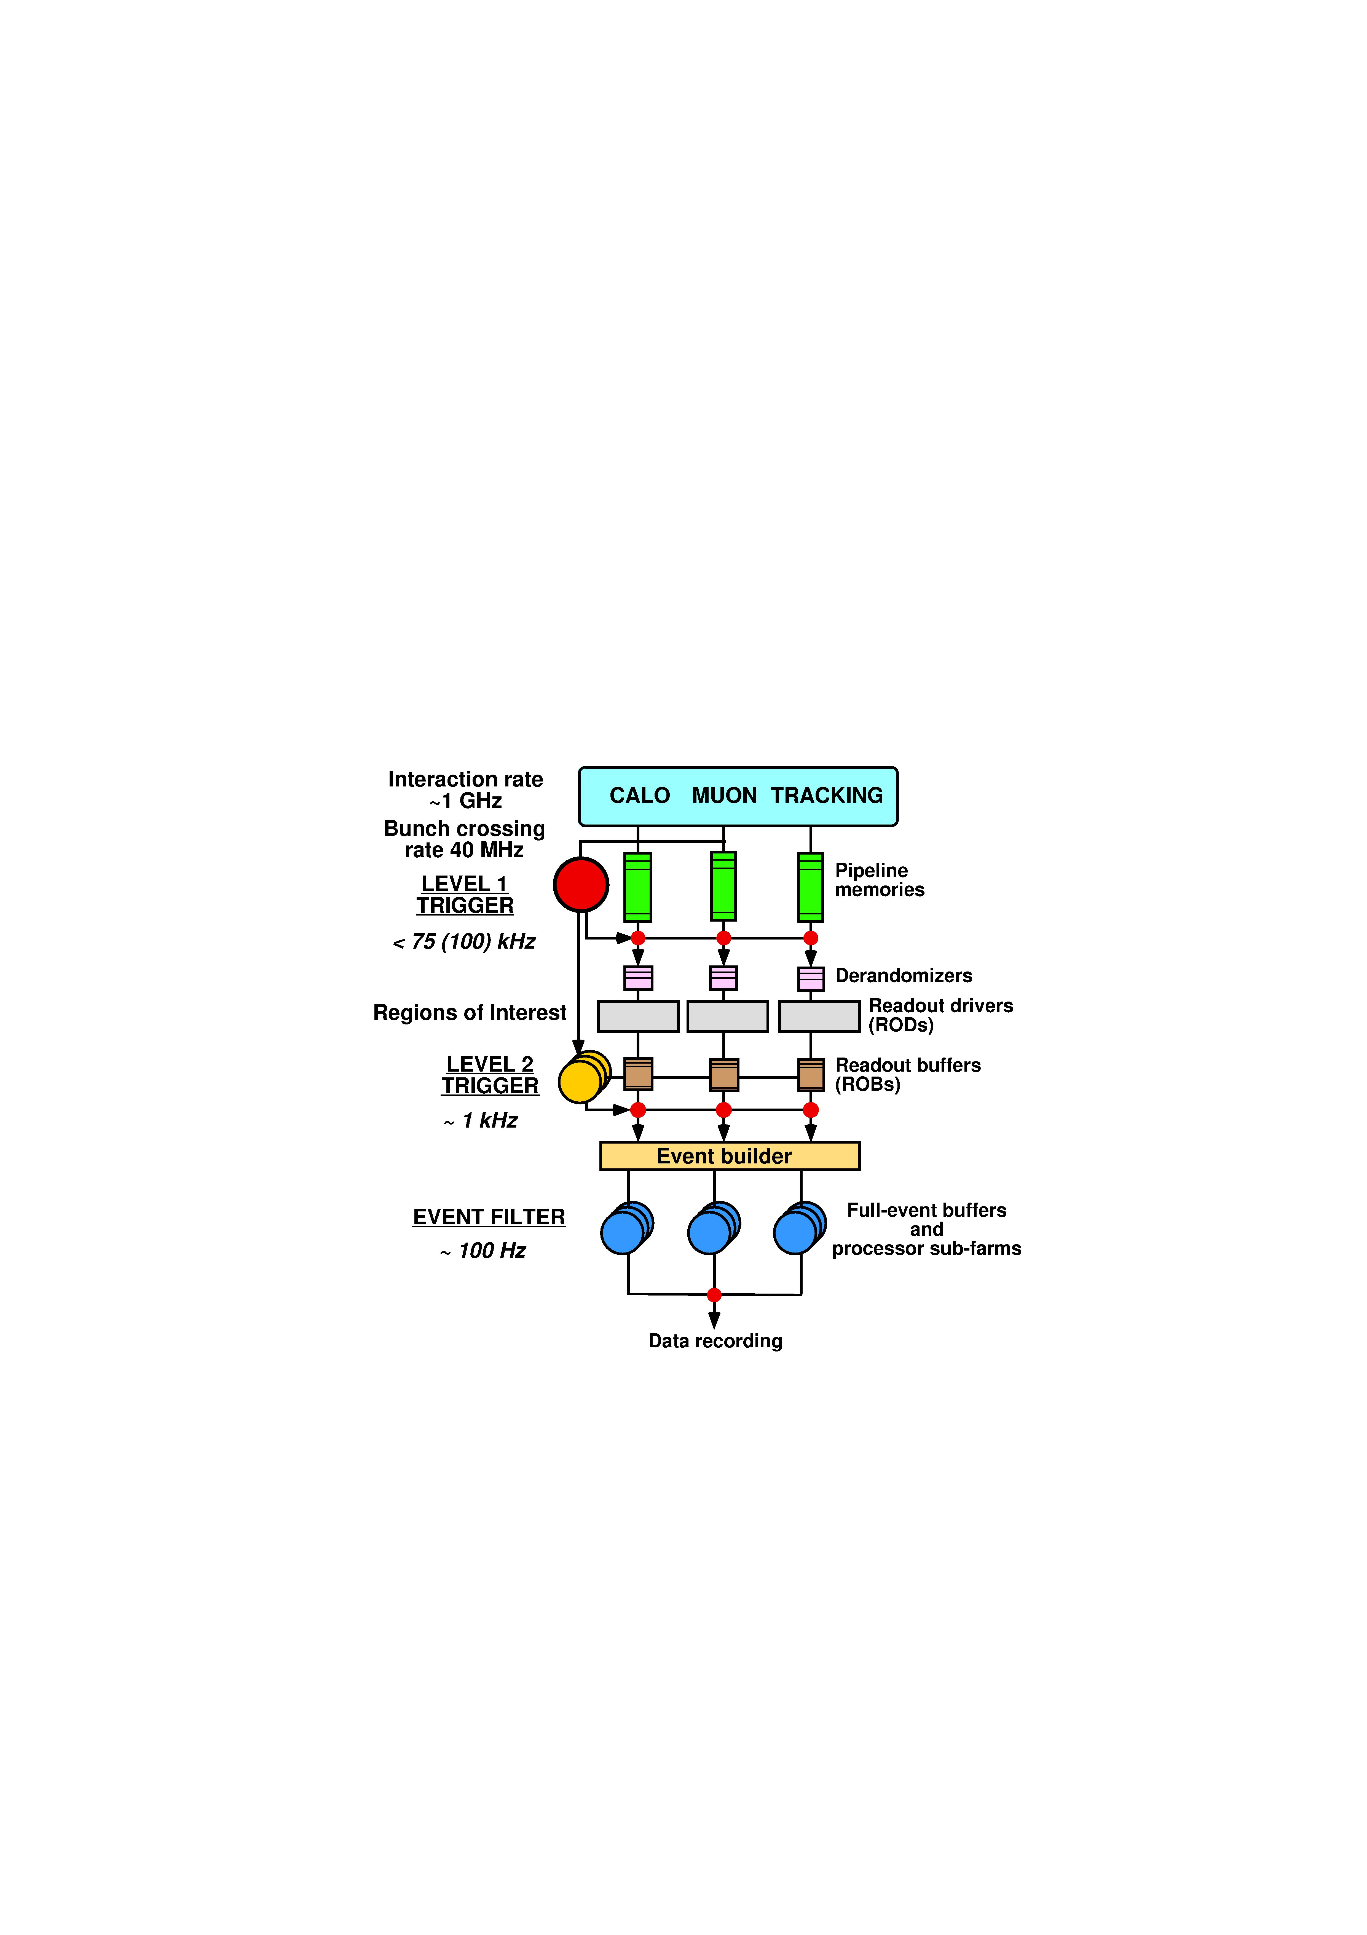
Progressive refinement: ATLAS
3-level trigger
Partial read-out (possible because of the nature of ATLAS physics) at high rate
Full read-out at relatively low rate
→ smaller network

Slide 38
ATLAS DAQ (network view)
Optional connection to use Level 2 farms for Level 3 use
Farm interface processors
collect full data of accepted events from buffers and distribute them though backend core chassis to third level trigger processor farms
over a TCP routed network
Collect accepted events and transfer them over 10G fiber to storage and Grid
2 * 1G trunks

Slide 39
Pull-Based Event Building
“Send event to EB 1!”
“Send me
an event!”
“Send event to EB 1!”
“Send me
an event!”
“Send event to EB 1!”
Event Builder 1
“Send event to EB 1!”
Event Builder 1
“Send me
an event!”
Event Builder 2
Data Acquisition
Switch
“Send me
an event!”
Event Builder 3
EB1:
EB2:
EB3:
0
0
0
1
1
1
0
1
1
0
0
1
1
0
1
“EB1, get next event”
“EB2, get next event”
1
2
3
Event Builders notify Event Manager of available capacity
Event Manager elects event-builder node
Readout traffic is driven by Event Builders

Slide 40
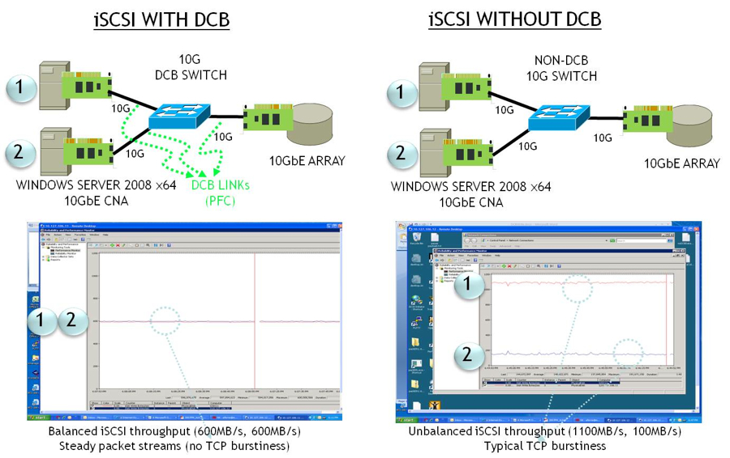
Advanced Flow-control DCB, QCN

Slide 41
Why is DCB interesting?
Data Center Bridging tries to brings together the advantages of Fibrechannel, Ethernet and InfiniBand on a single medium
It has been triggered by the storage community (the people selling Fibrechannel over Ethernet and iSCSI)
It achieves low latency and reliable transport at constant throughput through flow-control and buffering in the sources
802.1Qau, 802.1Qbb, 802.3bd could allow us to go away from store&forward in DAQ LANs (→ extensive R&D required)

Slide 42
Moving the data in and through a PC

Slide 43
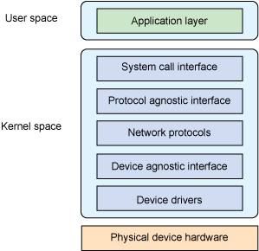
Sending and receiving data
Multiple network protocols result in multiple software layers
Data moving can be expensive
Passing data through the layers sometimes cannot be done without copying
Header information needs to be stripped off → splicing, alignment etc…
In Ethernet receiving is quite a bit more expensive than sending
Holy grail is zero-copy event-building (difficult with classical Ethernet, easier with InfiniBand)

Slide 44
The cost of event-building in the server
% CPU of one Intel 5420 core (a 4 core processor running at 2.5 GHz
MEM is resident memory (i.e. pages locked in RAM)
Precision of measurements is about 10% for CPU and 1% for RAM

Slide 45
Frame-size / payload & frame-rate Or: why don’t they increase the MTU?
Overheads calculated only for
Ethernet: 38 bytes / frame
IP adds another 20
TCP another 20(!)
Gigabit Ethernet = 10⁹ bit/s
1500 bytes leads to good link-usage
Network guys are happy
But frame-rate could still be lowered

Slide 46
Tuning for bursty traffic
In general provide for lots of buffers in the kernel, big socket buffers for the application and tune the IRQ moderation
Examples here are for Linux, 2.6.18 kernel, Intel 82554 NICs (typical tuning in the LHCb DAQ cluster)
/sbin/ethtool -G eth1 rx 1020 # set number of RX descriptors in NIC to max
# the following are set with sysctl -w
net.core.netdev_max_backlog = 4000
net.core.rmem_max = 67108864
# the application is tuned with setsockopt()

Slide 47
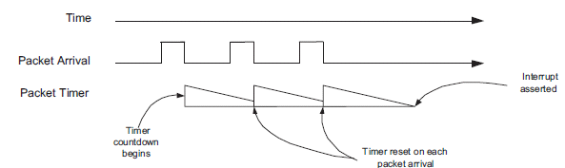
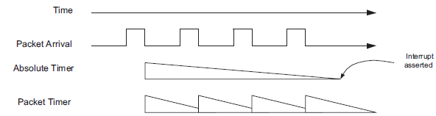
Interrupt Moderation
Careful tuning necessary – multi-core machines can take more IRQs (but: spin-locking…)
Can afford to ignore at 1 Gbit/s but will need to come back to this for 10 Gbit/s and 40 Gbit/s

Slide 48
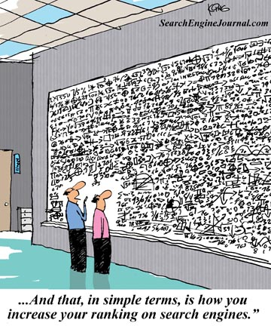
High Level Trigger Farms
And that, in simple terms, is what we do in the High Level Trigger

Slide 49
Event-filtering
Enormous amount of CPU power needed to filter events
Alternative is not to filter and store everything (ALICE)
Operating System: Linux SLC5 32-bit and 64-bits: standard kernels, no (hard) real-time
Hardware:
PC-server (Intel and AMD): rack-mount and blades
All CPU-power local: no grid, no clouds (yet?)

Slide 50
Online Trigger Farms 2011
 | ALICE | ATLAS | CMS | LHCb
# cores | 2700 | 17000 | 10000 | 15500
total available power (kW) |  | ~ 2000⁽¹⁾ | ~ 1000 | 550
currently used power (kW) |  | ~ 250 | 450⁽²⁾ | ~ 145
total available cooling power | ~ 500 | ~ 820 | 800 (currently) | 525
total available rack-space (Us) | ~ 2000 | 2400 | ~ 3600 | 2200
CPU type(s) | AMD Opteron, Intel 54xx, Intel 56xx | Intel 54xx, Intel 56xx | Intel 54xx, Intel 56xx | Intel 54xx, Intel 56xx
(1) Available from transformer (2) PSU rating

Slide 51

Faster, Larger – the future A bit of marketing for upcomig DAQ systems

Slide 52
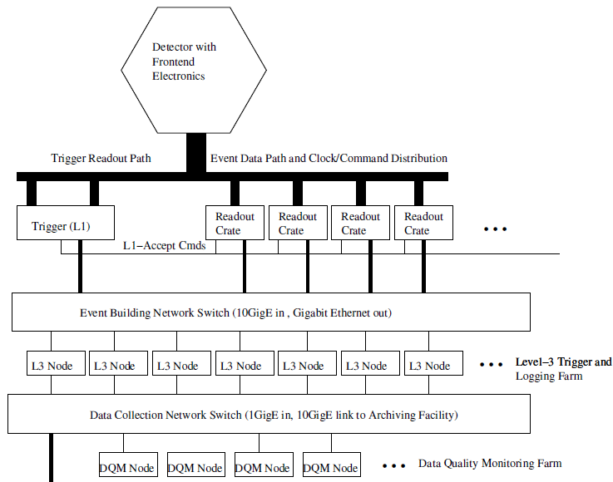
SuperB DAQ
Collection in Readout-Crates
Ethernet read-out
60 Gbit/s
→ if you look for a challenge in DAQ, you must join LHCb ☺ - or work on the SLHC

Slide 53
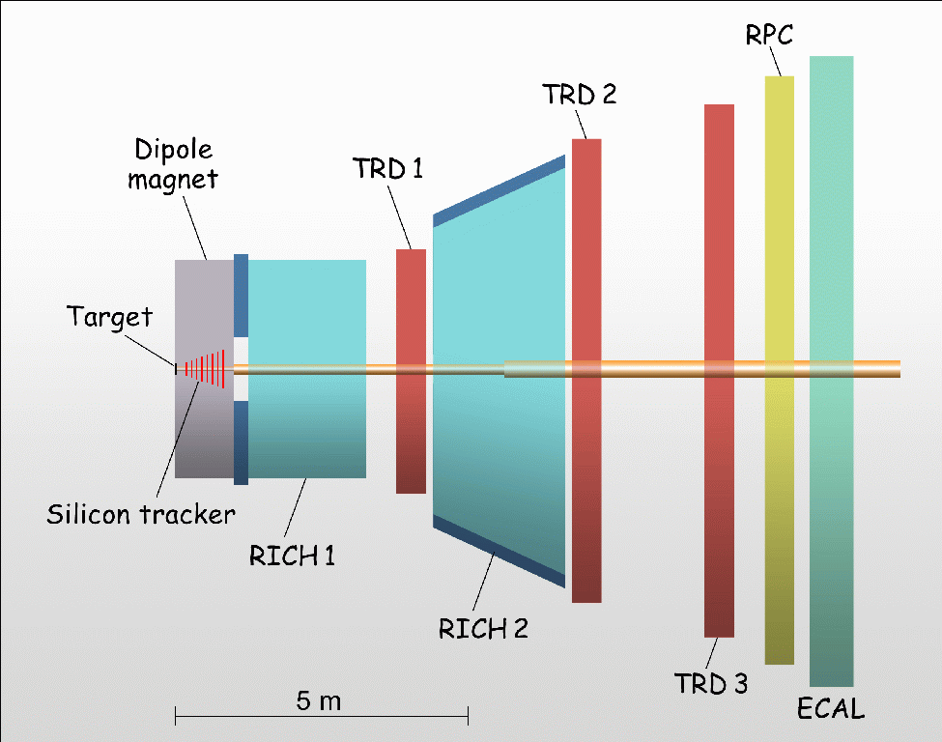
Compressed Baryonic Matter (CBM)
Heavy Ion experiment planned at future FAIR facility at GSI (Darmstadt)
Timescale: ~2014
Detector Elements
Si for Tracking
RICH and TRDs for Particle identification
RPCs for ToF measurement
ECal for Electromagnetic Calorimetry
AverageMultiplicities:
160 p
400 π⁻
400 π⁺
44 K⁺
13 K
800 γ
1817 total at 10 MHz

Slide 54
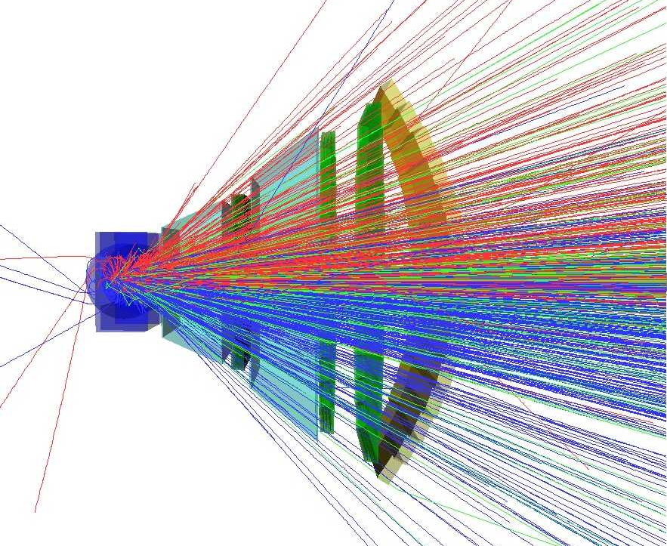
High Multiplicities
Quite Messy Events… (cf. Alice)
Hardware triggering problematic
Complex Reconstruction
‘Continuous’ beam
Trigger-Free Readout
‘Continuous’ beam
Self-Triggered channels with precise time-stamps
Correlation and association later in CPU farm

Slide 55
CBM DAQ Architecture

Slide 56
CBM Characteristics/Challenges
Very much network based → 5 different networks
Very low-jitter (10 ps) timing distribution network
Data collection network to link detector elements with front-end electronics (link speed O(GB/s))
High-performance (~O(TB/s)) event building switching network connecting O(1000) Data Collectors to O(100) Subfarms
Processing network within a subfarm interconnecting O(100) processing elements for triggering/data compression
Output Network for collecting data ready for archiving after selection.

Slide 57
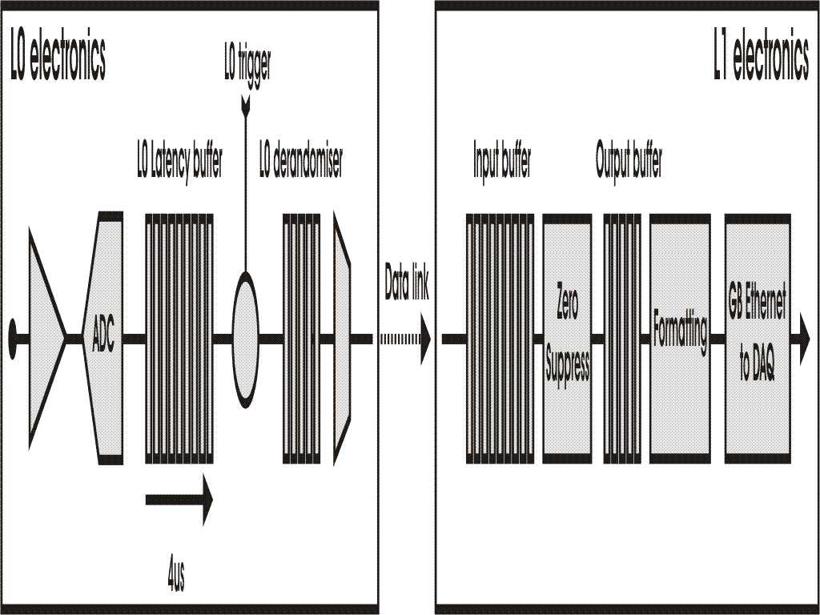

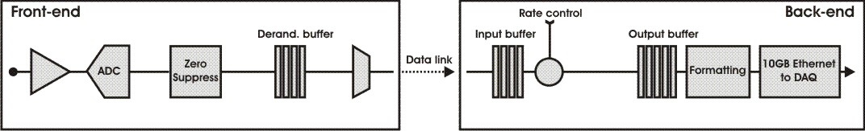
LHCb DAQ Architecture from 2018
Readout
Supervisor
L0 Hardware
Trigger
Current
HLT
1 Gb
Ethernet
1 MHZ
Tell1
Readout
Supervisor
Interaction
Trigger
40 MHZ
10 Gb
Ethernet
HLT++
Upgrade
1…40 MHZ
Tell40
GBT (4.8Gb/s)
data rate 3.2 Gb/s
- All data will be readout @ collision rate 40 MHz by all frontend electronics (FEE) → a trigger-free read-out!
- Zero-suppression will be done in FEEs to reduce the number of the GigaBit Transceiver (GBT) links

Slide 58
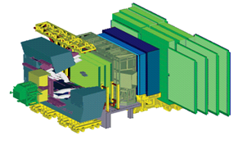
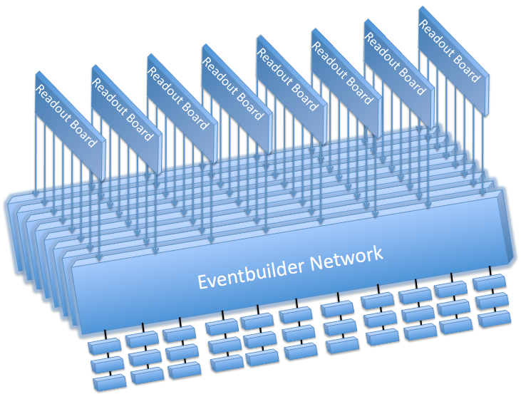
Requirements on LHCb DAQ Network
Design:
100 kB@30 MHz (10 MHz out of 40 MHz are empty) ➔ 24 Tbit/s network required
Keep average link-load at 80% of wire-speed
~5000 Servers needed to filter the data (depends on Moore’s Law)
We need:
(input) Ports for Readout boards (ROB) from the detector: 3500x10 Gb/s
(output) Ports for Event Filter Farm (EFF): 5000x10 Gb/s
Bandwidth: 34 Tb/s (unidirectional, including load-factor)
Scaling: build several (8) sub-networks or slices. Each Readout Board is connect to each slice.

Slide 59
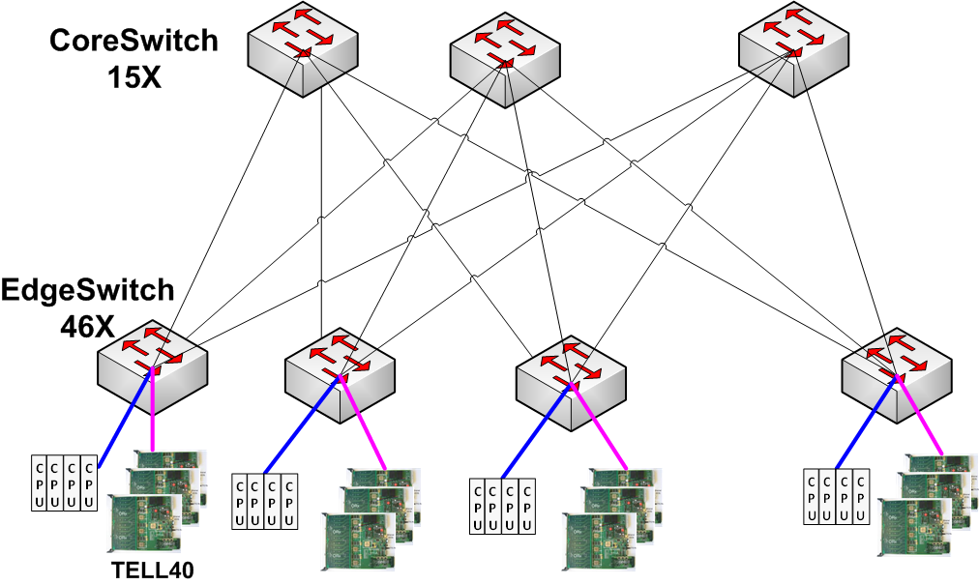
Fat-Tree Topology for One Slice
48-port 10 GbE switches
Mix readout-boards (ROB) and filter-farm-servers in one switch
15 x readout-boards
18 x servers
15 x uplinks
Non-block switching
use 65% of installed bandwidth
(classical DAQ only 50%)
Each slice accomodates
690 x inputs (ROBS)
828 x outputs servers
Ratio (server/ROB) is adjustable
Notes:
Take advantage of unidirection

Slide 60
InfiniBand
 | SDR | DDR | QDR | FDR | EDR | HDR | NDR
1X | 2 Gbit/s | 4 Gbit/s | 8 Gbit/s | 14 Gbit/s | 25 Gbit/s | 125 Gbit/s | 750 Gbit/s
4X | 8 Gbit/s | 16 Gbit/s | 32 Gbit/s | 56 Gbit/s | 100 Gbit/s | 500 Gbit/s | 3000 Gbit/s
12X | 24 Gbit/s | 48 Gbit/s | 96 Gbit/s | 168 Gbit/s | 300 Gbit/s | 1500 Gbit/s | 9000 Gbit/s
High bandwidth (32 Gbit/s, 56 Gbit/s …) – always a step ahead of Ethernet ☺
Low price / switch-port
Very low latency

Slide 61

InfiniBand: the good, the bad and the ugly
Cheap, but higher-speed grades will require optics
Powerful flow-control / traffic management
Native support for RDMA (low CPU overhead)
Cabling made for clusters (short distances)
Very small vendor base
Complex software stack
Some of the advanced possibilities (RDMA, advanced flow-control) become available on “converged” NICs (e.g. Mellanox, Chelsio)

Slide 62
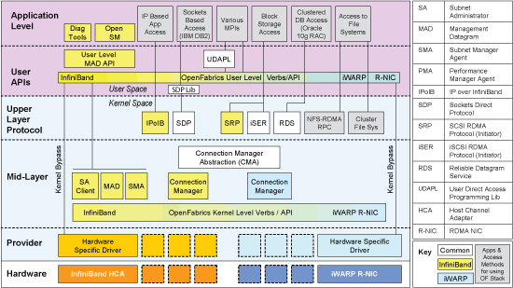
Is the future of DAQ in the OFED?

Slide 63
Future DAQ systems (choices)
Certainly LAN based
InfiniBand deserves a serious evaluation for high-bandwidth (> 100 GB/s)
In Ethernet if DCB works, might be able to build networks from smaller units, otherwise we will stay with large store&forward boxes
Trend to “trigger-free” → do everything in software → bigger DAQ will continue
Physics data-handling in commodity CPUs
Will there be a place for multi-core / coprocessor cards (Intel MIC / CUDA)?
IMHO this will depend on if we can establish a development framework which allows for longterm maintenance of the software by non-”geek” users, much more than on the actual technology

Slide 64
Summary and Future
Large modern DAQ systems are based entirely on Ethernet and big PC-server farms
Bursty, uni-directional traffic is a challenge in the network and the receivers, and requires substantial buffering in the switches
The future:
It seems that buffering in switches is being reduced (latency vs. buffering)
Advanced flow-control is coming, but it will need to be tested if it is sufficient for DAQ
Ethernet is still strongest, but InfiniBand looks like a very interesting alternative
Integrated protocols (RDMA) can offload servers, but will be more complex

Slide 65
Publicita / Publicité / Commercial

Slide 66


Slide 67
Thanks
I acknowledge gratefully the help of many colleagues who provided both material and suggestions: Guoming Liu, Beat Jost, David Francis, Frans Meijers, Gordon Watts, Clara Gaspar

Slide 68
Appendix

Slide 69
Managing Online farms
How to manage the software: Quattor (CMS & LHCb) RPMs + scripts (ALICE & ATLAS)
We all *love* IPMI. In particular if it comes with console redirection!
How to monitor the fabric: Lemon, FMC/PVSS, Nagios, …
Run them disk-less (ATLAS, LHCb) or with local OS installation (ALICE, CMS)
How to use them during shutdowns: Online use only (ALICE, ATLAS, CMS), use as a “Tier2” (LHCb)

Slide 70
LEP & LHC in Numbers

Slide 71
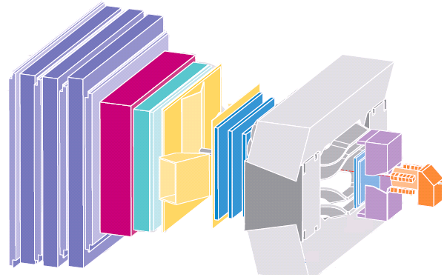
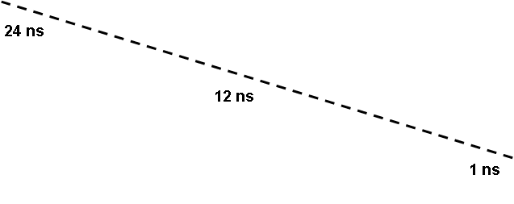
Challenges for the L1 at LHC
N (channels) ~ O(10⁷); ≈20 interactions every 25 ns
need huge number of connections
Need to synchronize detector elements to (better than) 25 ns
In some cases: detector signal/time of flight > 25 ns
integrate more than one bunch crossing's worth of information
need to identify bunch crossing...
It's On-Line (cannot go back and recover events)
need to monitor selection - need very good control over all conditions

Slide 72
Constantly sampled
Needed for high rate experiments with signal pileup
Shapers and not switched integrators
Allows digital signal processing in its traditional form (constantly sampled data stream)
Output rate may be far to high for what following DAQ system can handle
With local zero-suppression this may be an option for future high rate experiments (SLHC, CLIC)
Sampling clock
Shaping
ADC
DSP
(zero-sup.)
DAQ

Slide 73
Improving dead-time with buffers
Sensor
Trigger
Discriminator
Delay
Start
Busy Logic
ADC
and
Full
FIFO
DataReady
Proces-
sing
storage
Buffers are introduced to de-randomize data,
to decouple the data production from the data
consumption. Better performance.

Slide 74
Trigger in 6 slides

Slide 75
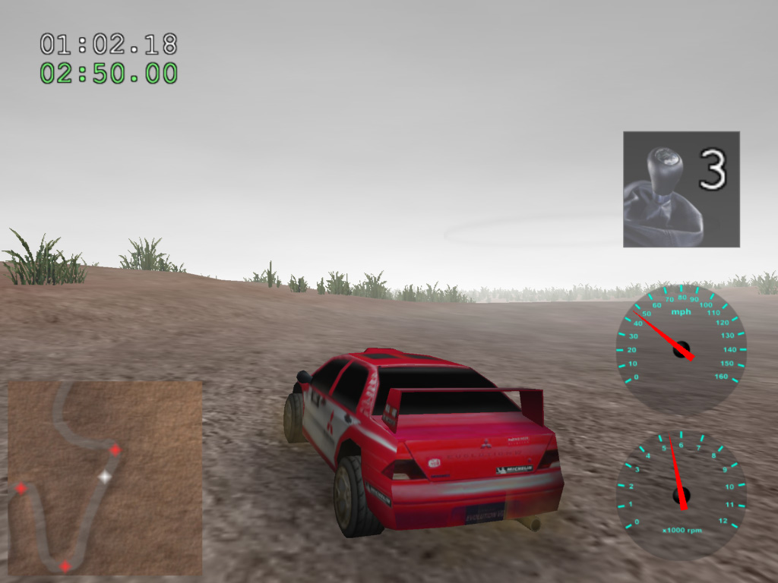
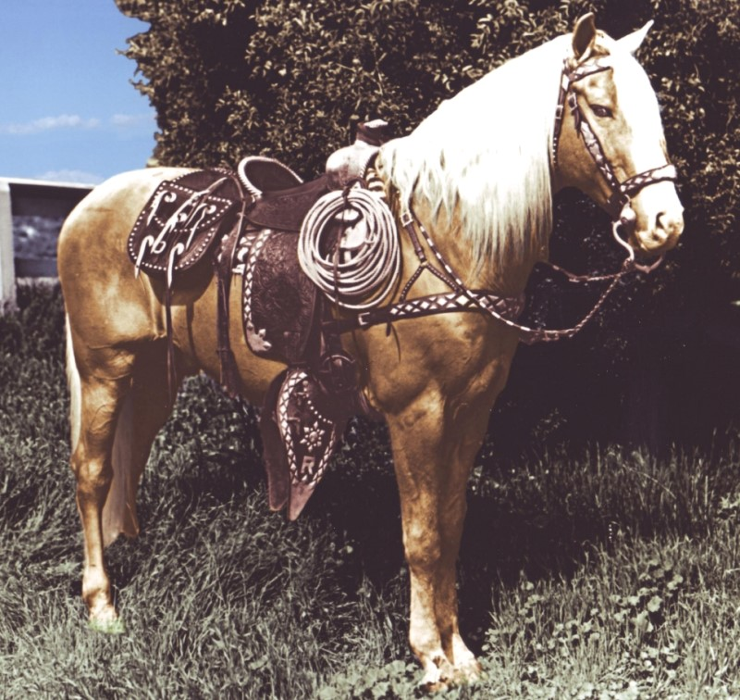
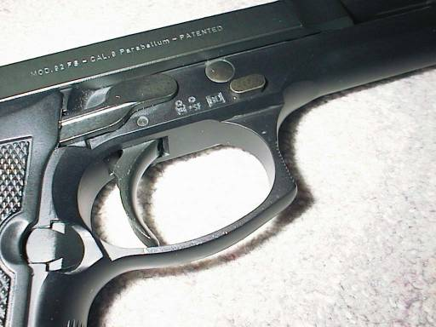
What is a trigger?
An open-source 3D rally game?
An important part of a Beretta
The most famous horse in movie history?

Slide 76
What is a trigger?
Wikipedia: “A trigger is a system that uses simple criteria to rapidly decide which events in a particle detector to keep when only a small fraction of the total can be recorded. “
Simple
Rapid
Selective
When only a small fraction can be recorded

Slide 77
Trivial DAQ
External View
sensor
Physical View
sensor
CPU
ADC Card
disk
Logical View
Proces-
sing
ADC
storage

Slide 78
Trivial DAQ with a real trigger
Sensor
Trigger
Delay
Discriminator
ADC
Start
Proces-
sing
Interrupt
storage
What if a trigger is produced when the ADC or
processing is busy?

Slide 79
Trivial DAQ with a real trigger 2
Sensor
Trigger
Delay
Discriminator
Start
Busy Logic
ADC
and
not
Proces-
sing
Interrupt
Set
Clear
Q
Ready
storage
Deadtime (%) is the ratio between the time the DAQ
is busy and the total time.

Slide 80
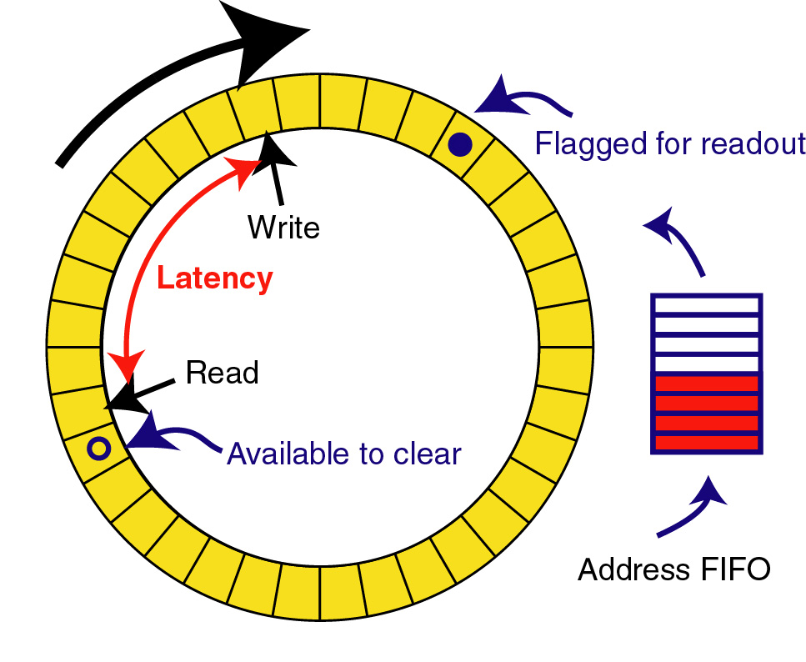
Triggered read-out
Trigger processing requires some data transmission and processing time to make decision so front-ends must buffer data during this time. This is called the trigger latency
For constant high rate experiments a “pipeline” buffer is needed in all front-end detector channels: (analog or digital)
Real clocked pipeline (high power, large area, bad for analog)
Circular buffer
Time tagged (zero suppressed latency buffer based on time information)
Shaping
Constant writing
Channel mux.
ADC
DAQ
Trigger

