Slide 1
SCD IT Data Format for Test Beam 2023
Jiang Yaozu

Slide 2
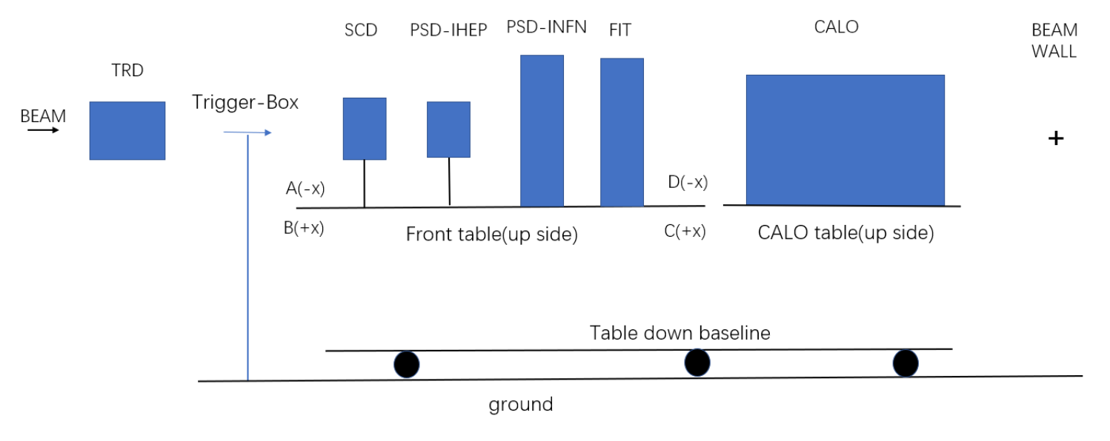
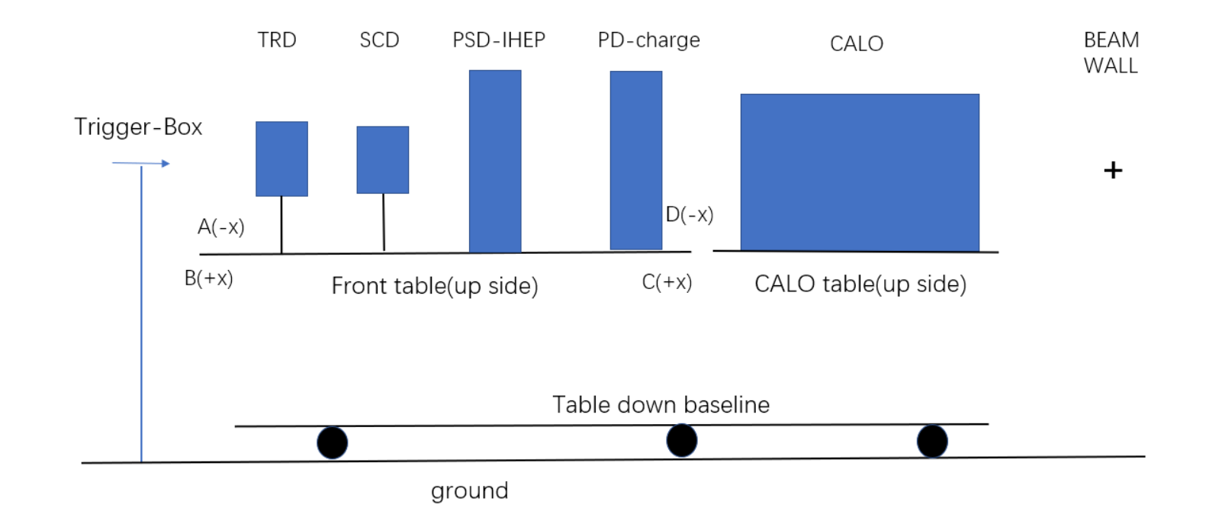
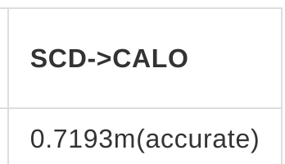
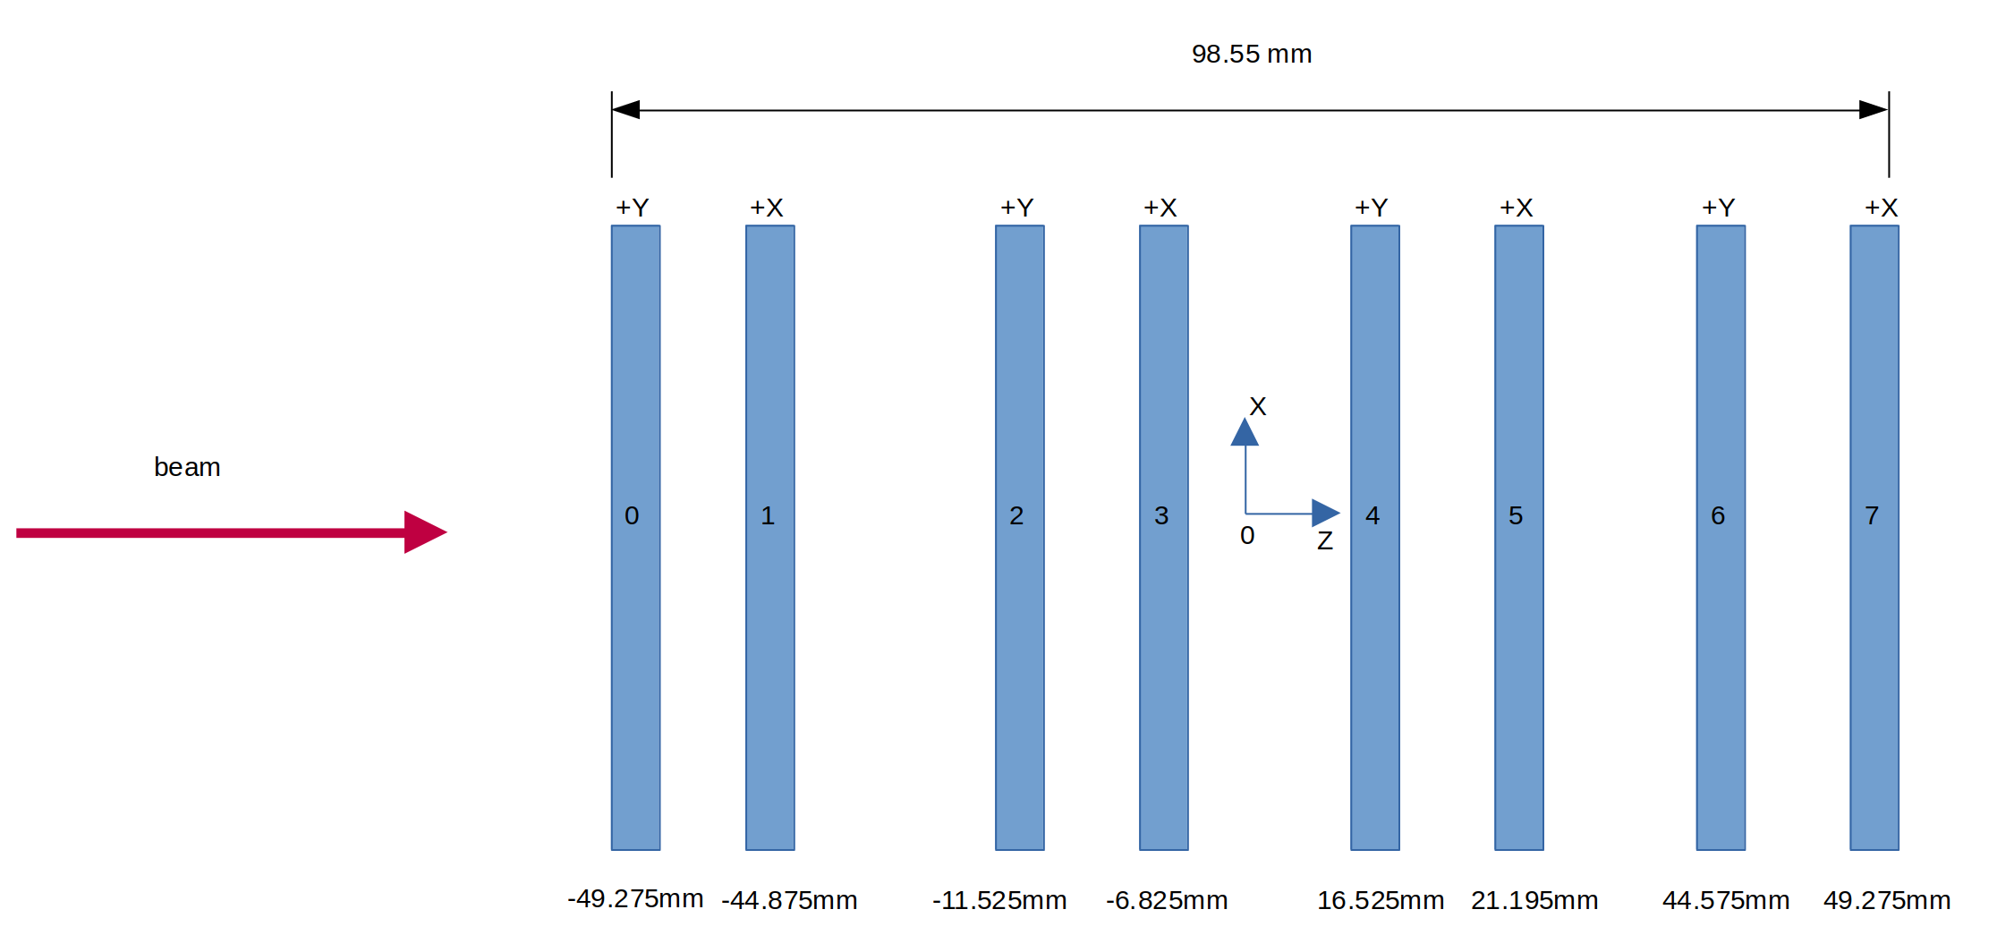
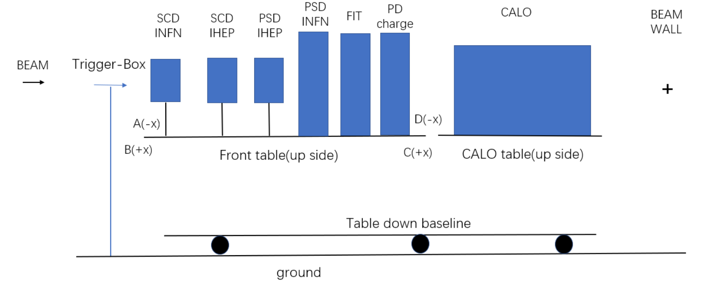
PS 06/09/2023
SPS 14/09/2023
(2)
(1)
SPS 09/10/2023
SCD
(3)

Slide 3
PS 06/09/2023
SPS 14/09/2023
SPS 09/10/2023
Runs worked/Total runs: 118/131
Runs unworked:
68,88,92,95,119,121,124,128,134,140,143,150,151,159,160,165,180,185,218,219,220,221,222
Runs worked/Total runs: 76/149
Runs unworked:
173-300
Runs worked/Total runs: 96/130
Runs unworked:
479,490,494,495,501,502,507,509,510,541,542,543,549,561,562,566,567,568,578,584,585,592,593,597,617

Slide 4
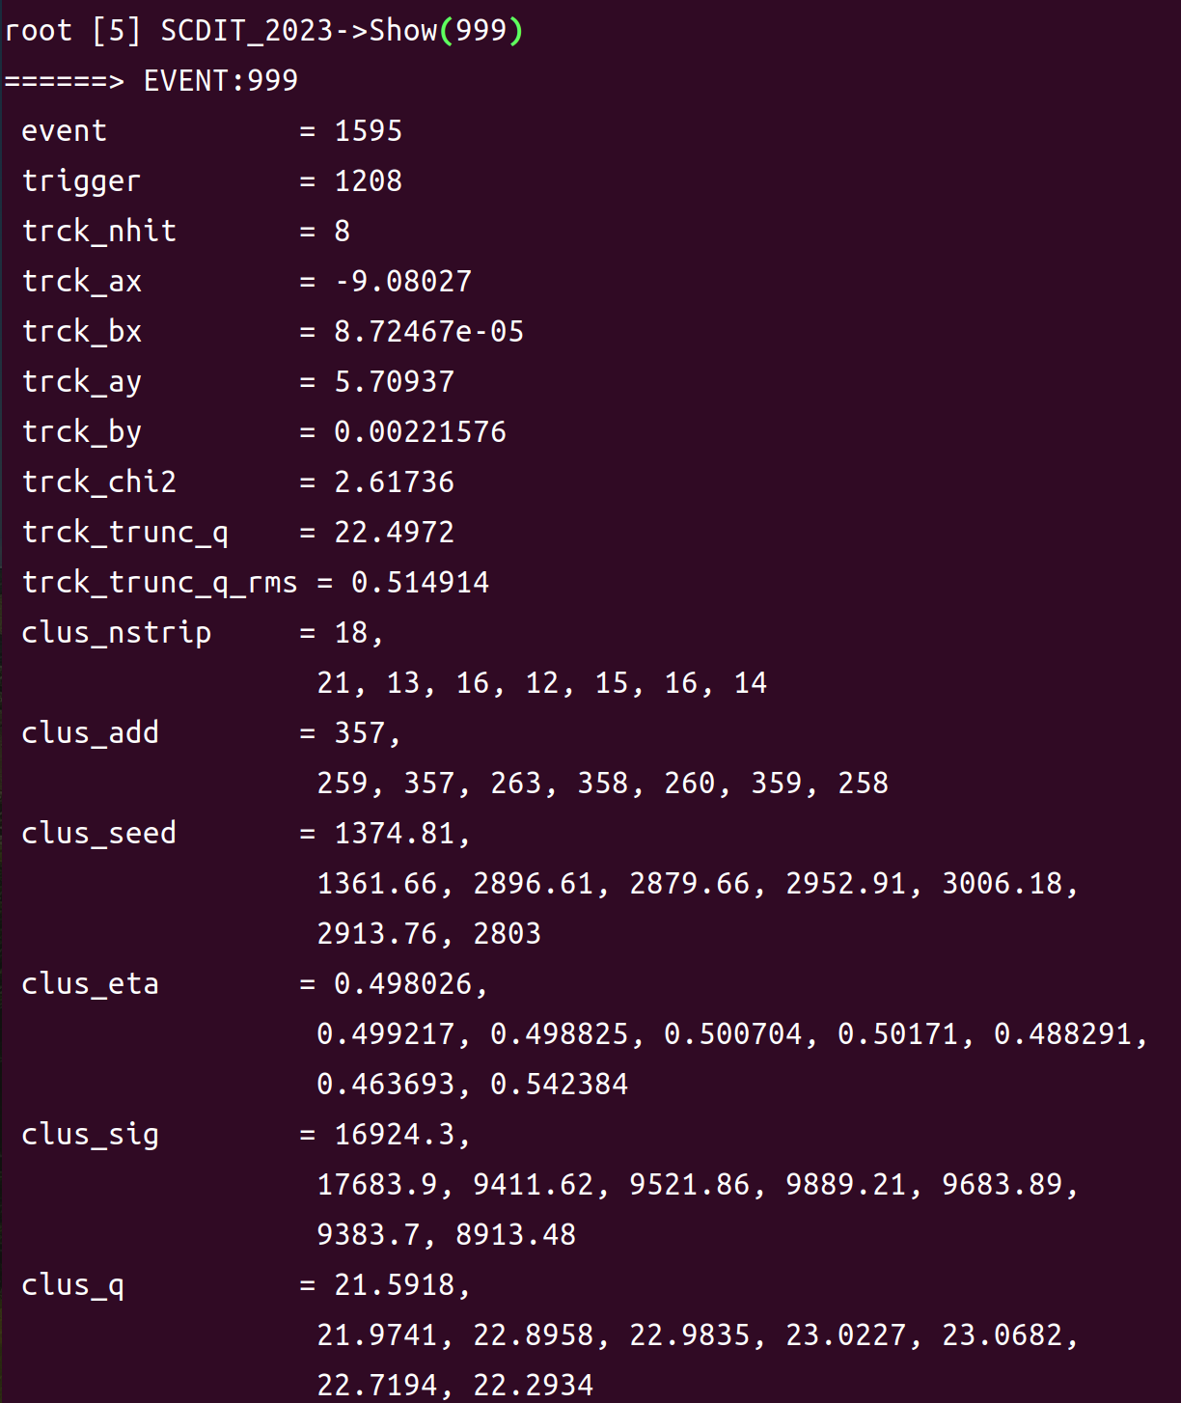
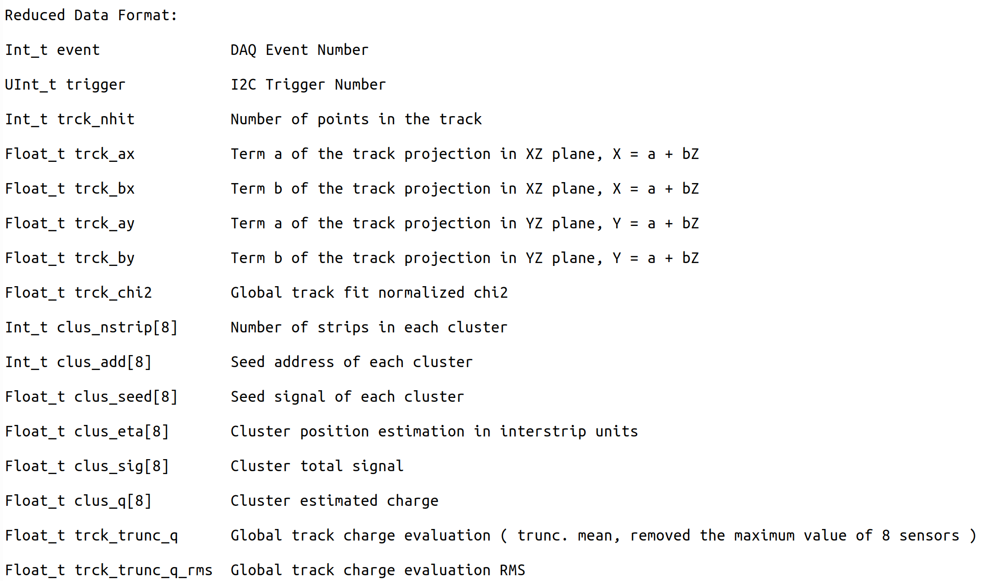
Data Format

Slide 5
Data Format

Slide 6
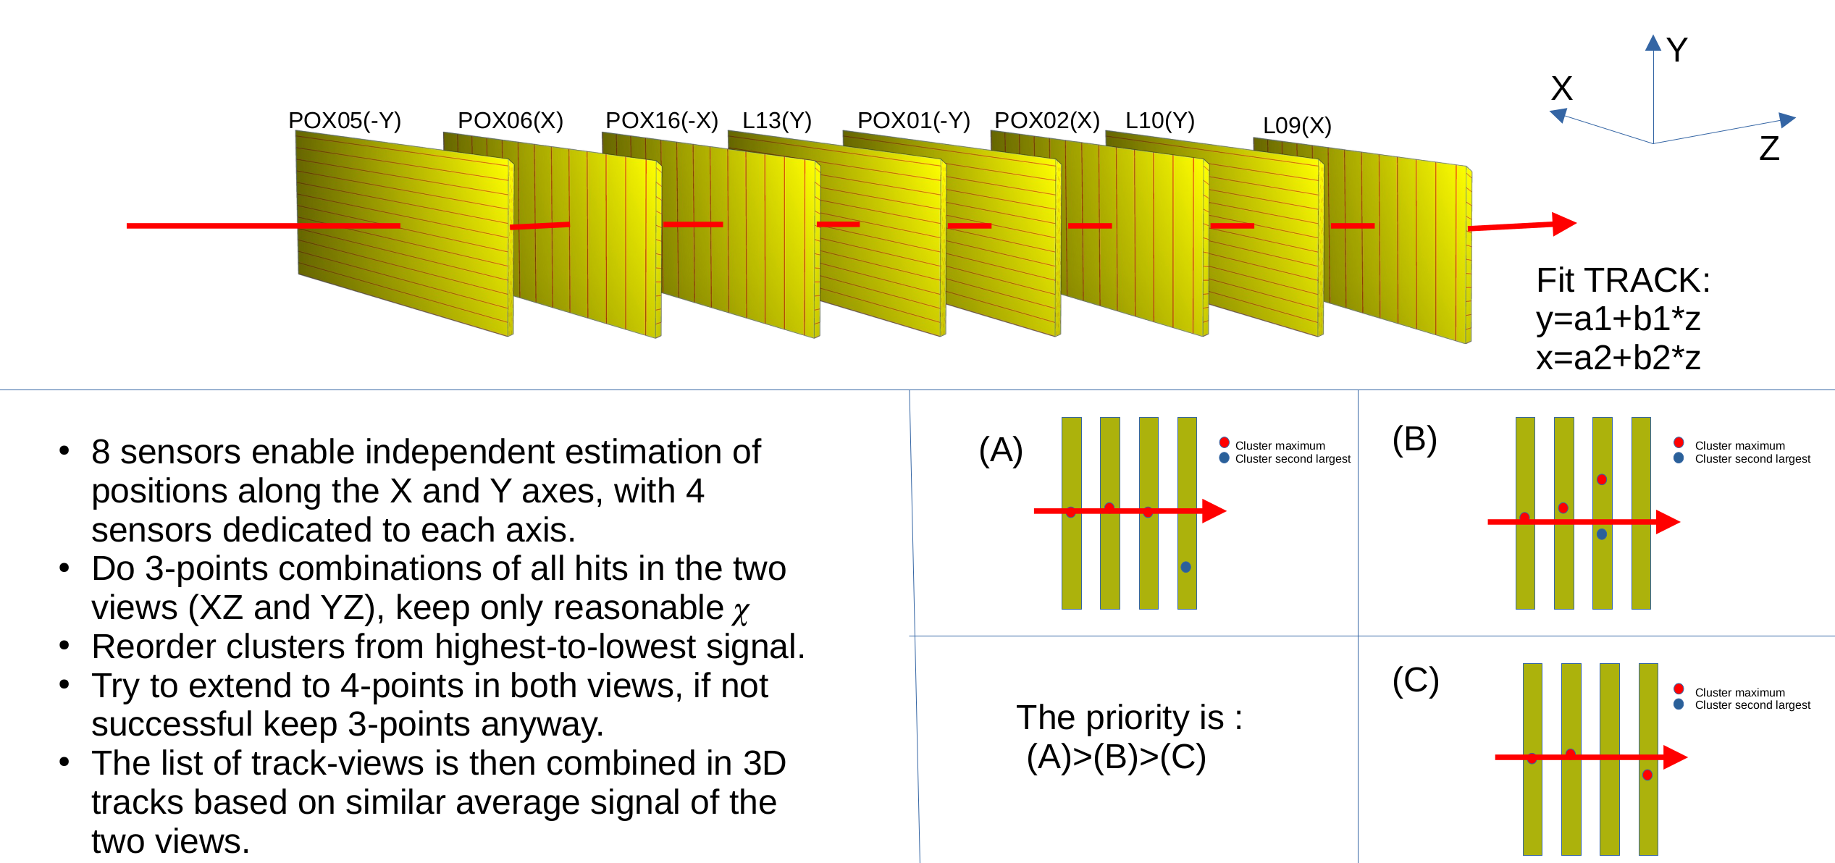
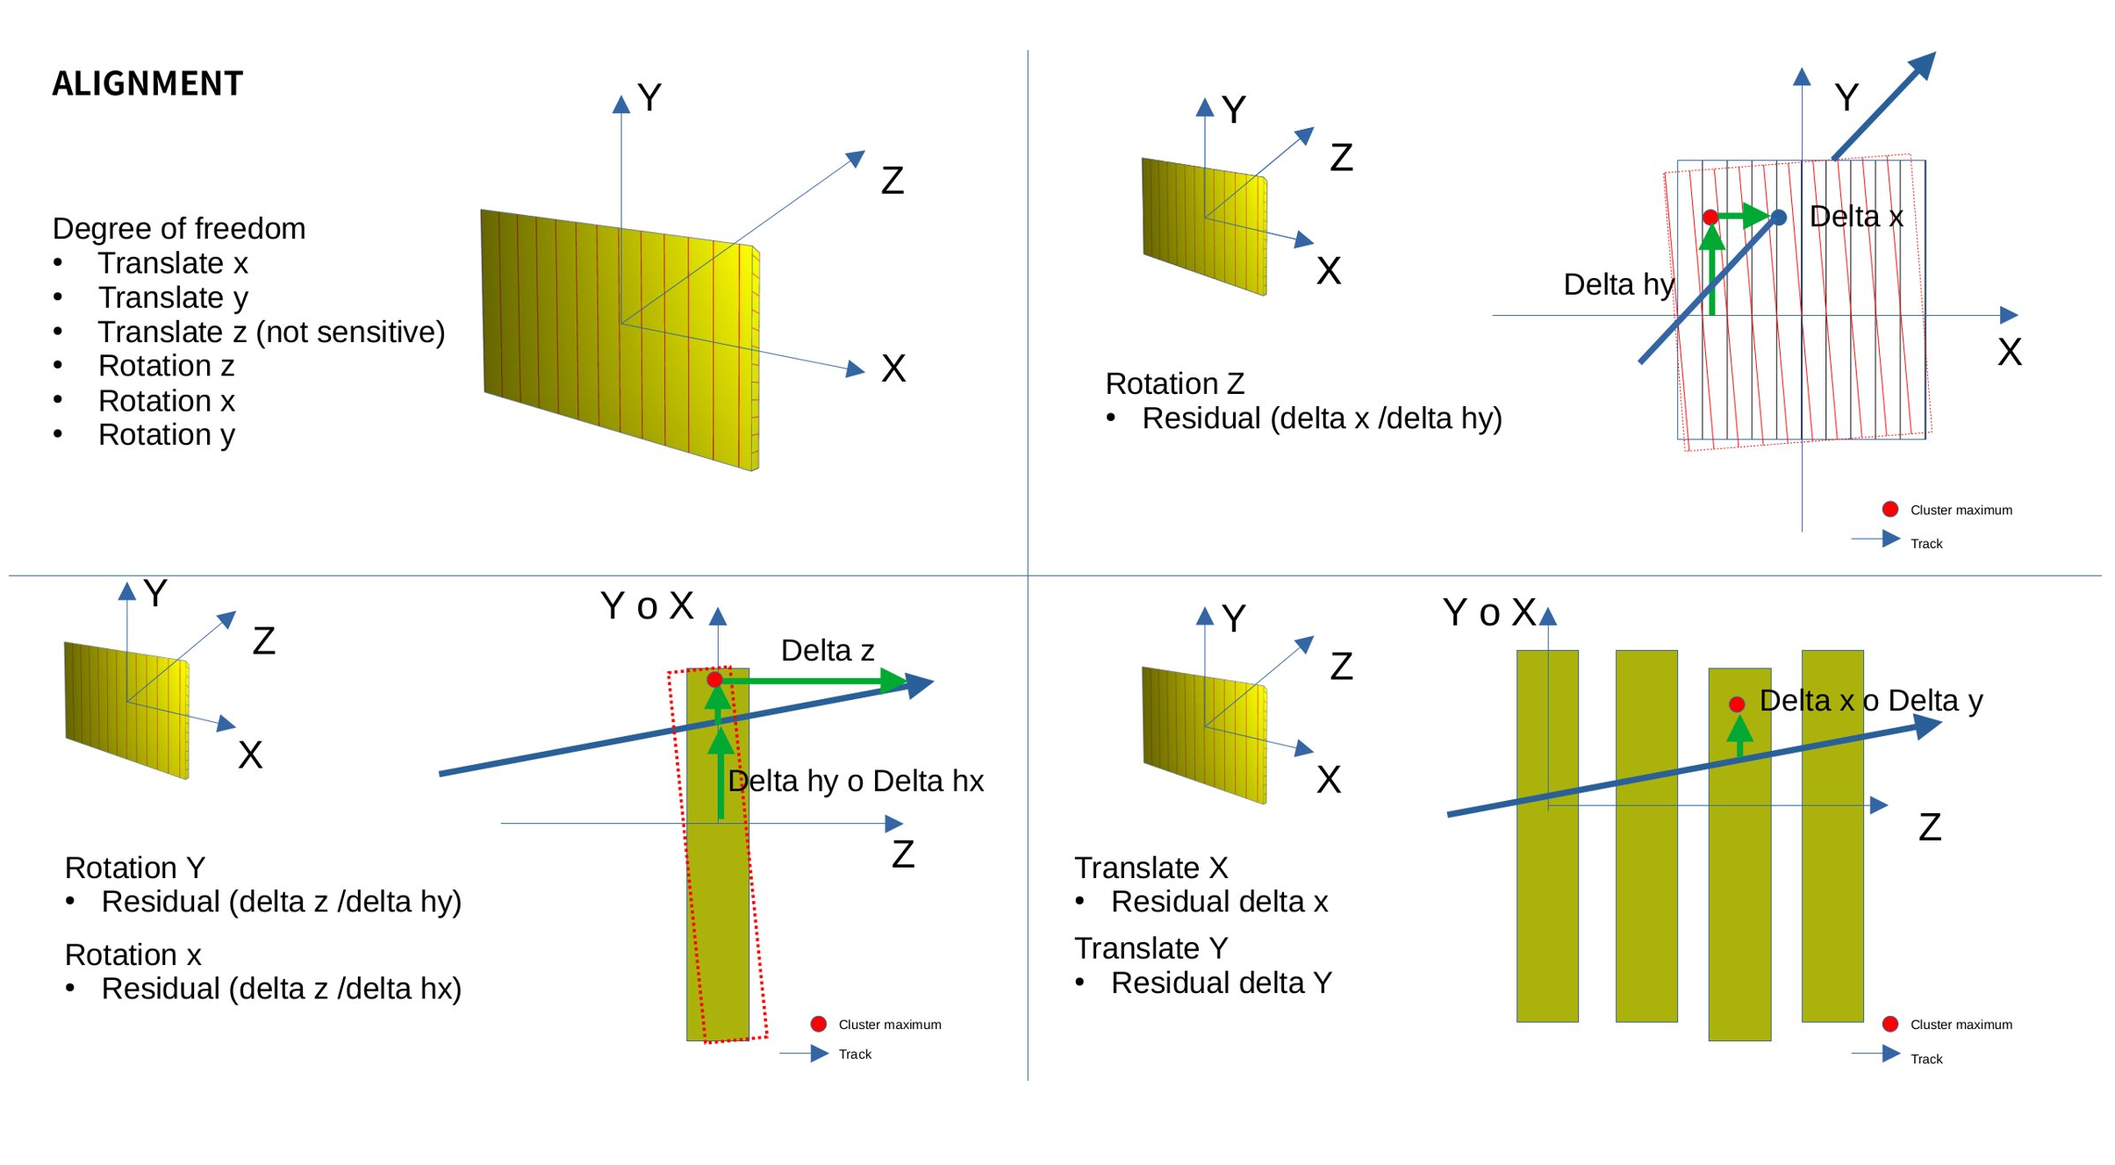
Track
8 sensors enable independent estimation of positions along the X and Y axes, with 4 sensors dedicated to each axis.
Reorder clusers from highest-to-lowest signal, and do all-points combinations of all hits in the two views (X-Z and Y-Z), keep only tracks with reasonable chi-square
The list of track-views is then combined in 3D tracks based on similar average signal on the two views

Slide 7
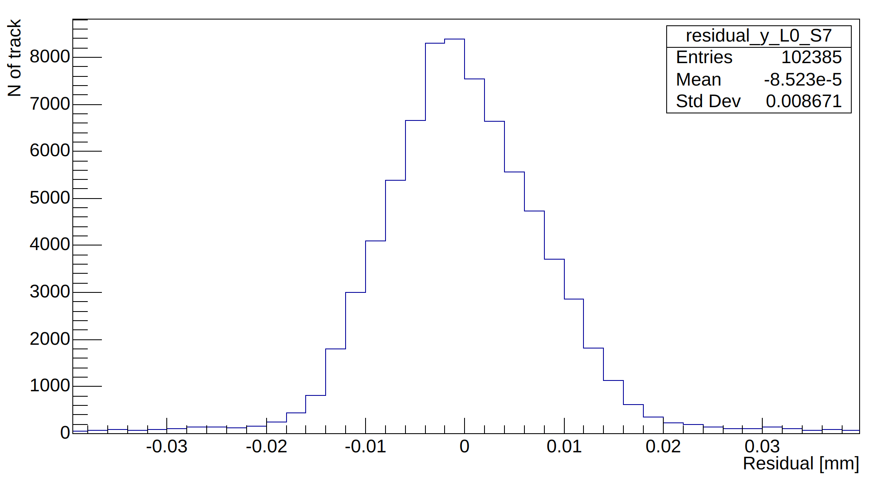
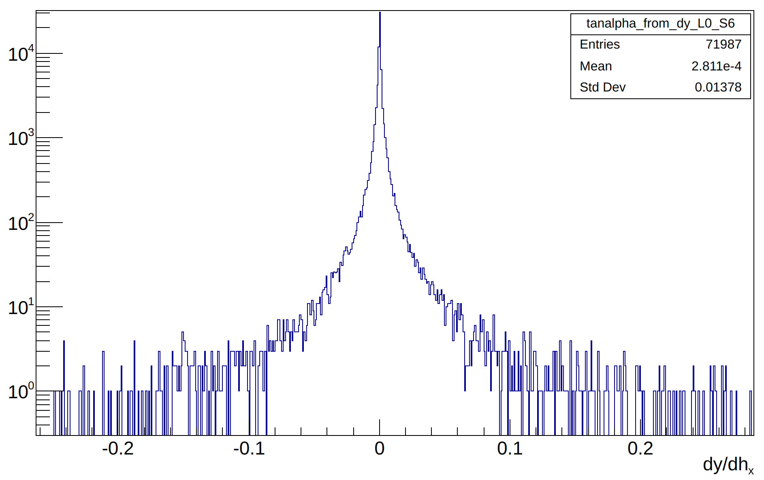
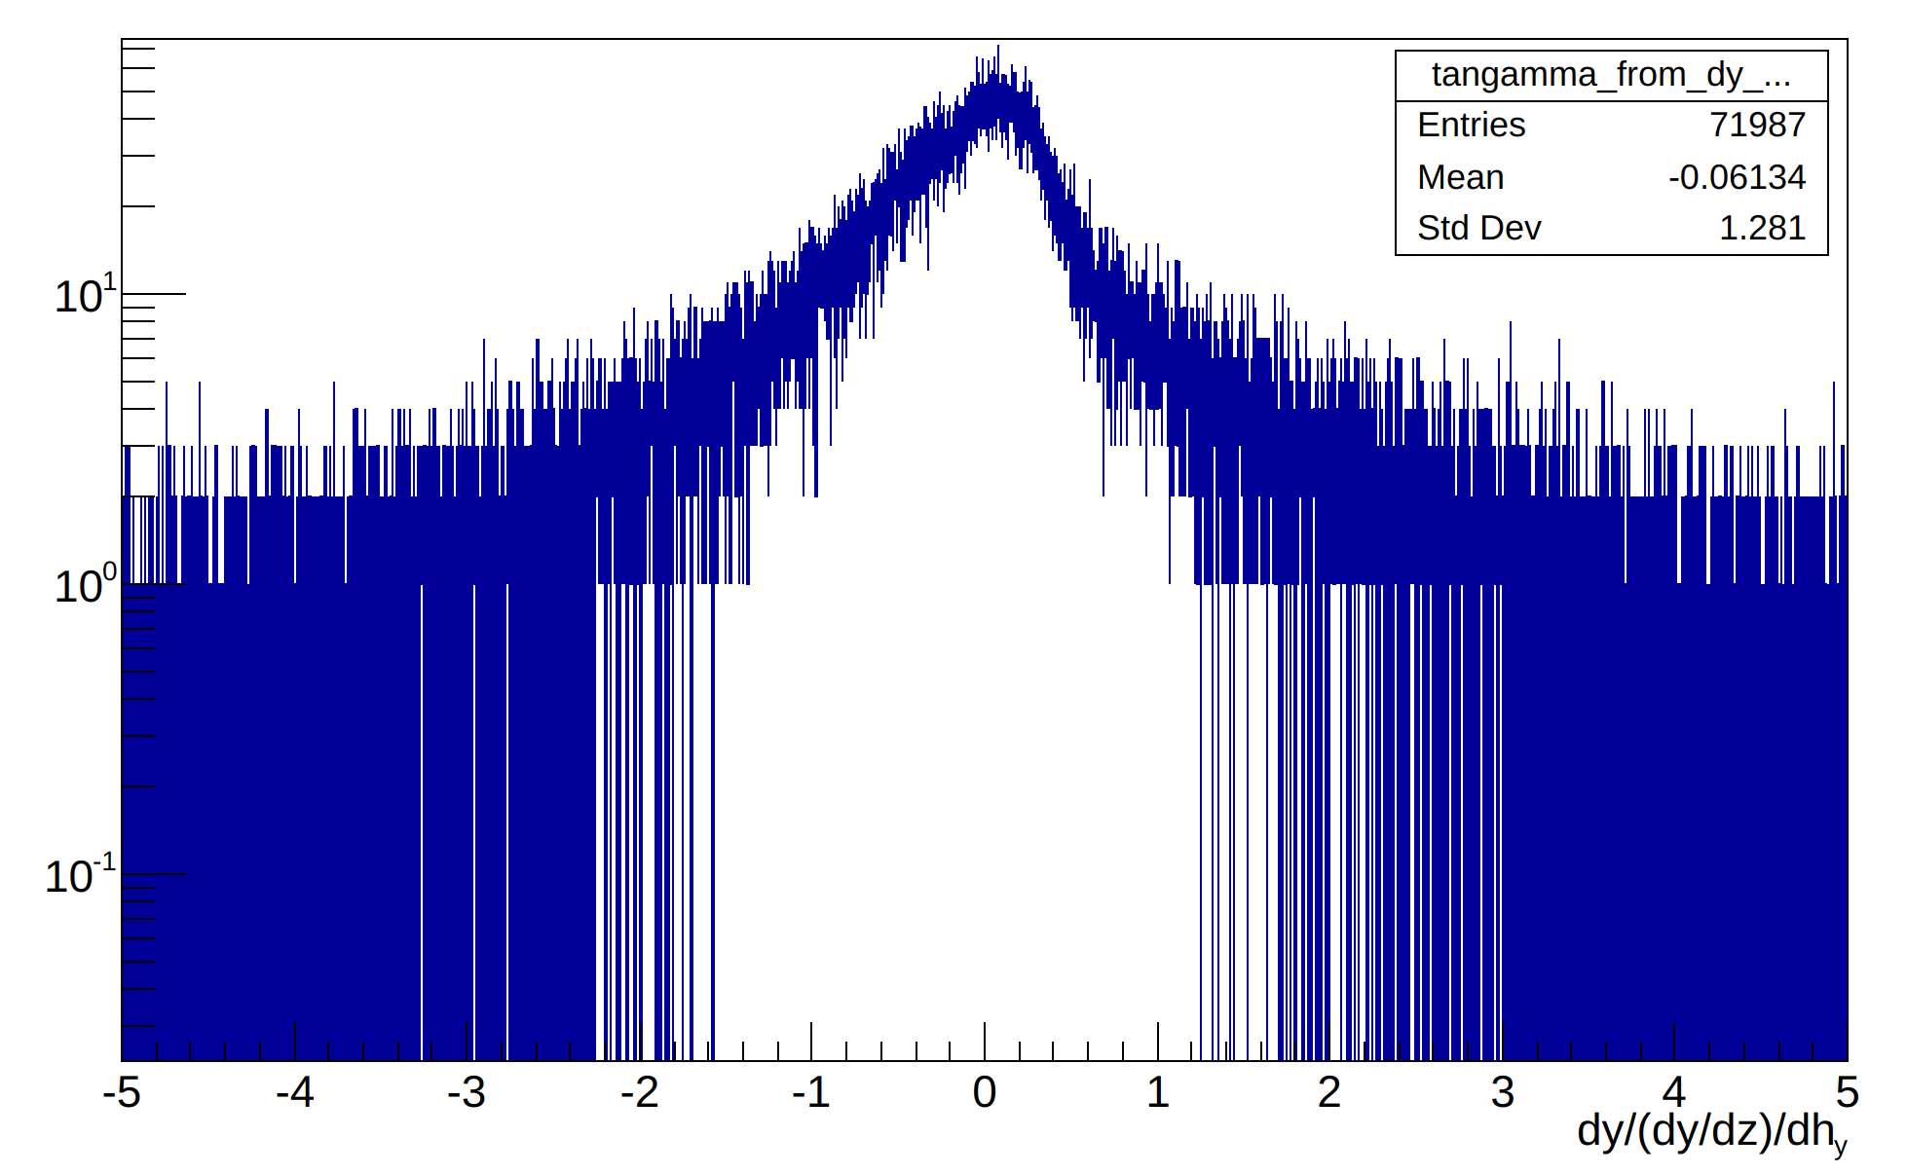
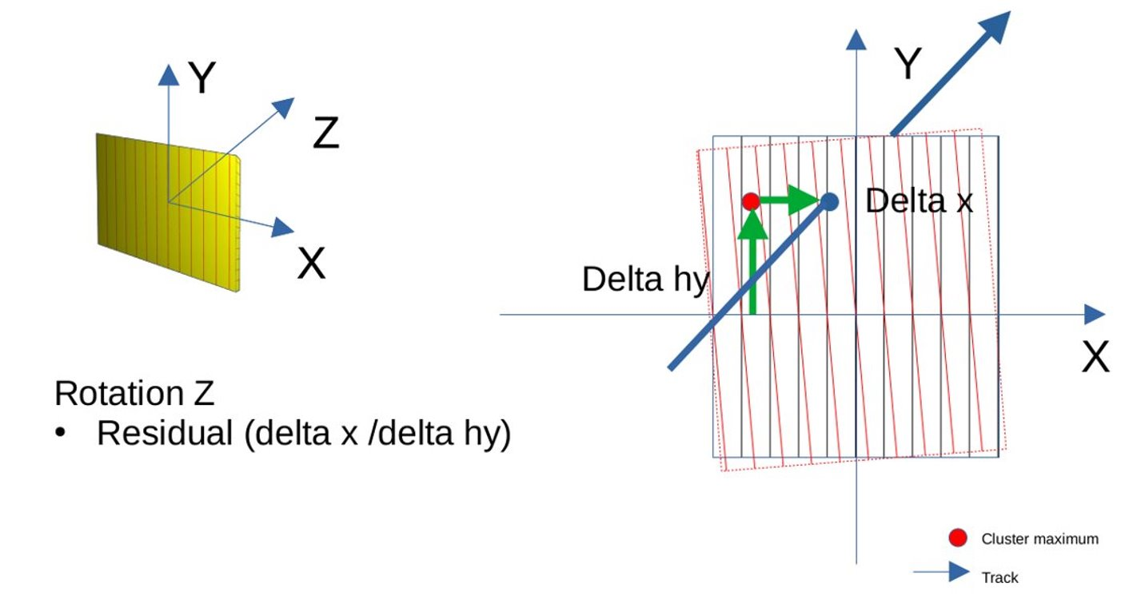
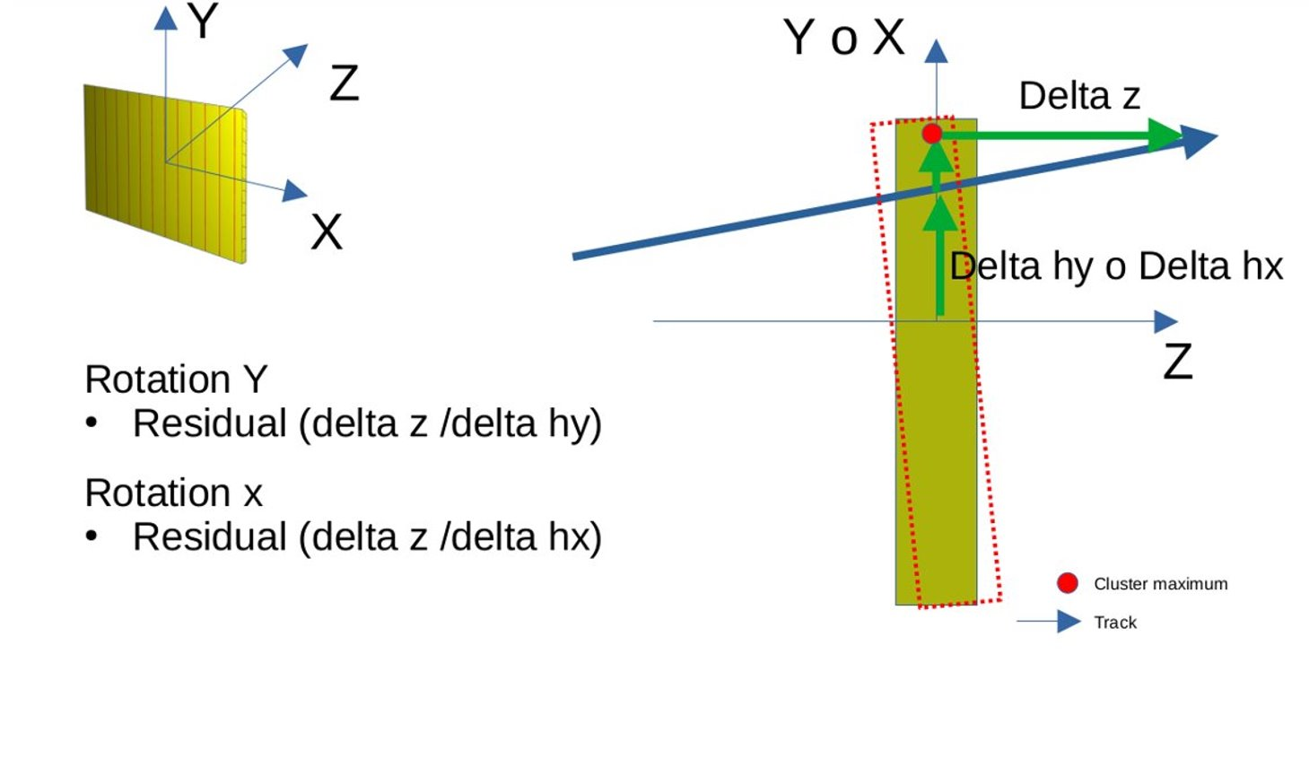
Alignment
Note: Beam Test 2023 HERD, run448, sensor 0

Slide 8
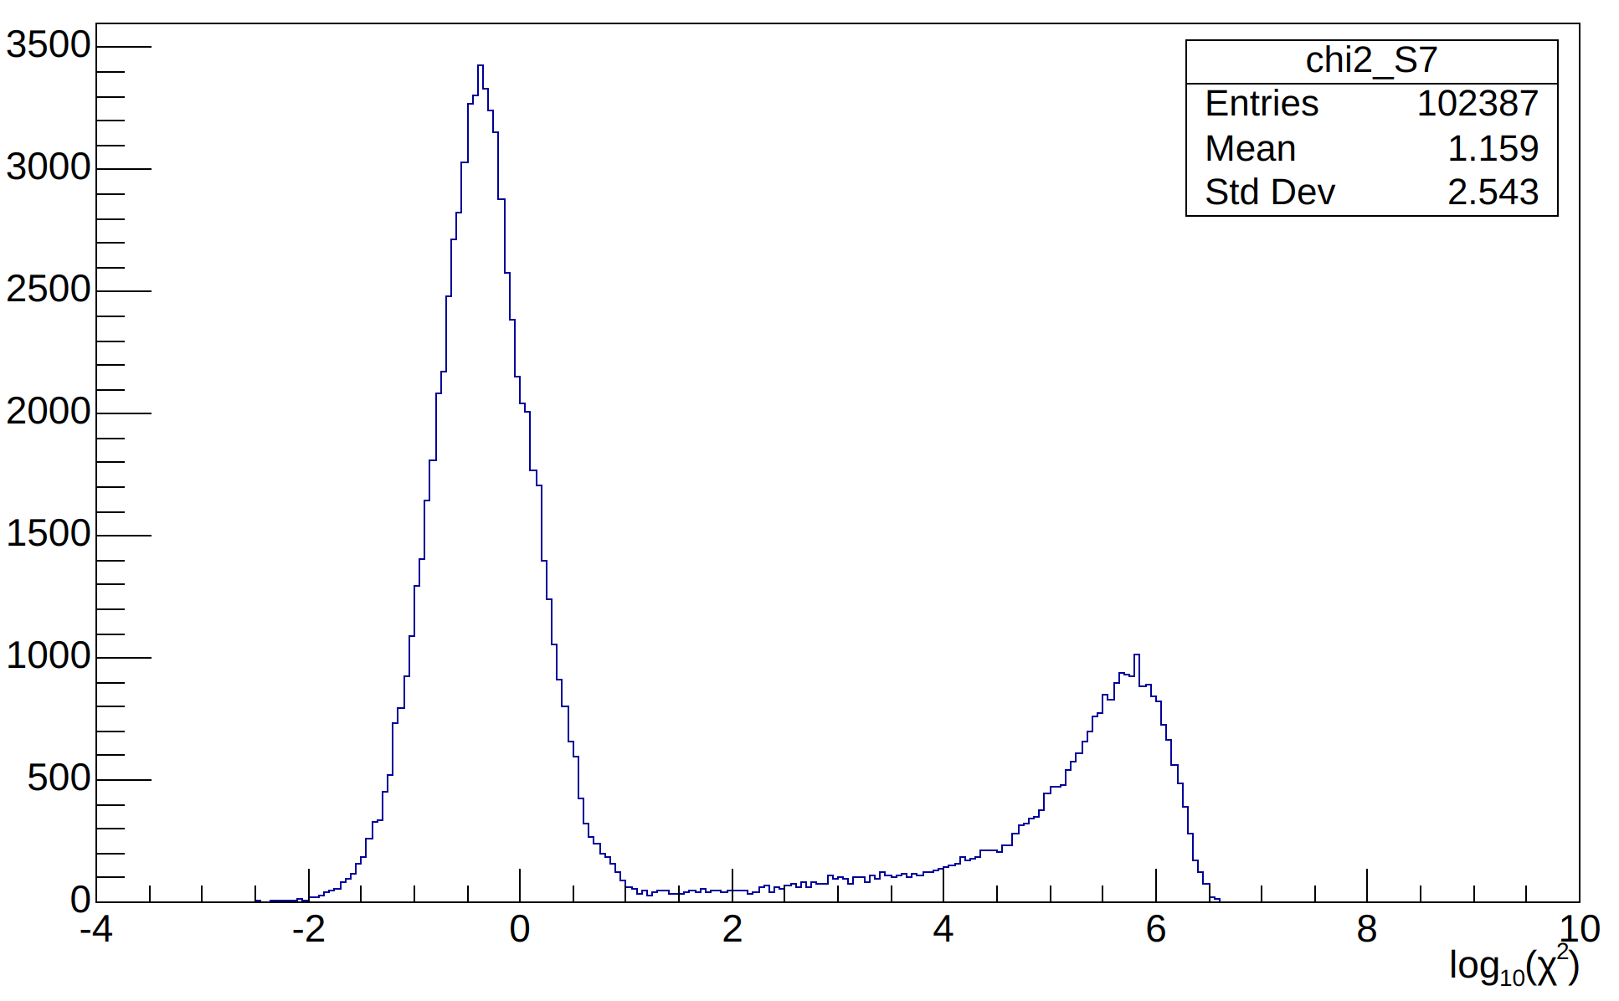
Global track fit normalized chi^2

Slide 9
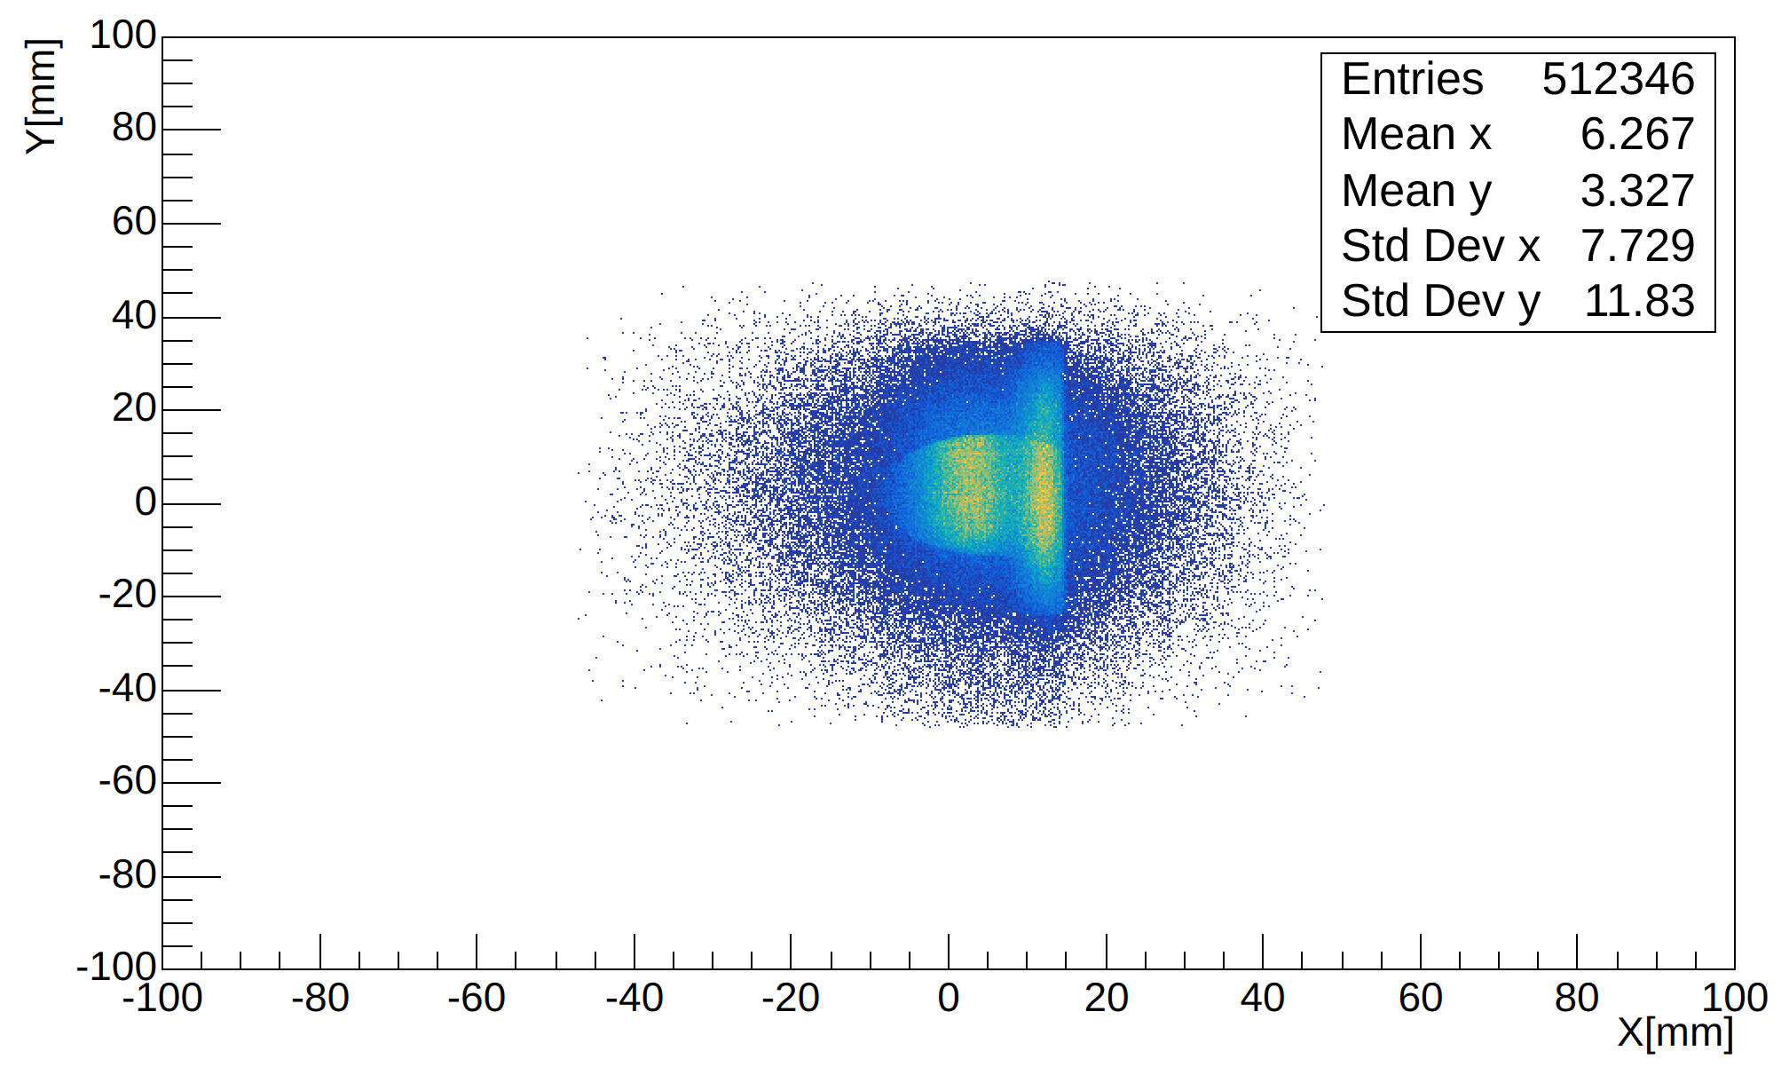
Tracks projected to the Z position of SCD
Note: Beam Test 2023 OCT HERD run_448

Slide 10
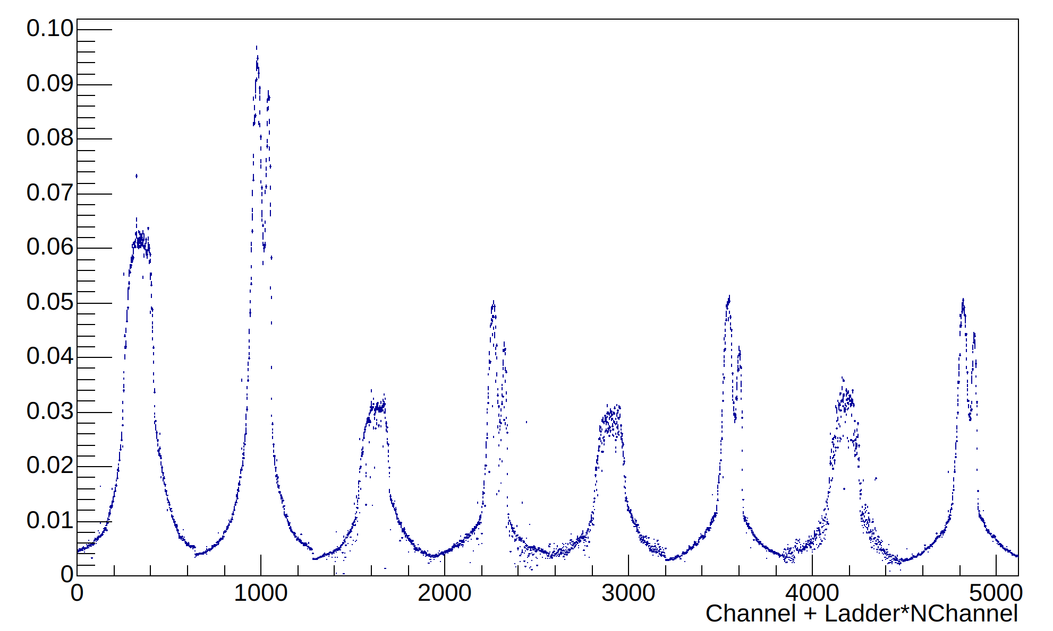
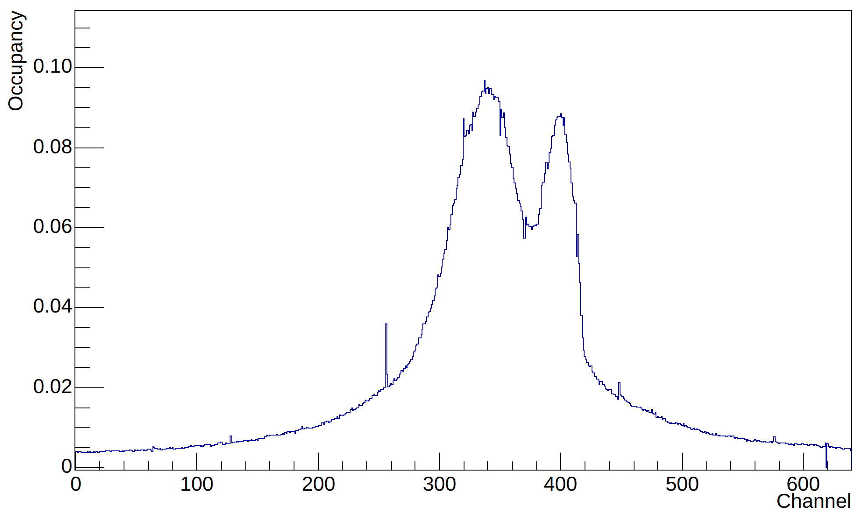
Occupancy
+Y +X +Y +X +Y +X +Y +X

Slide 11
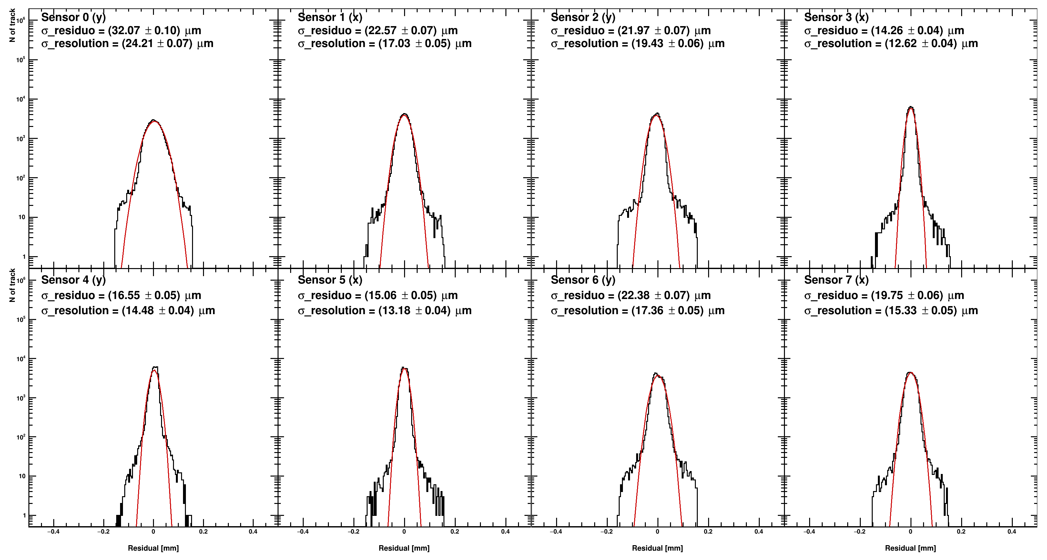
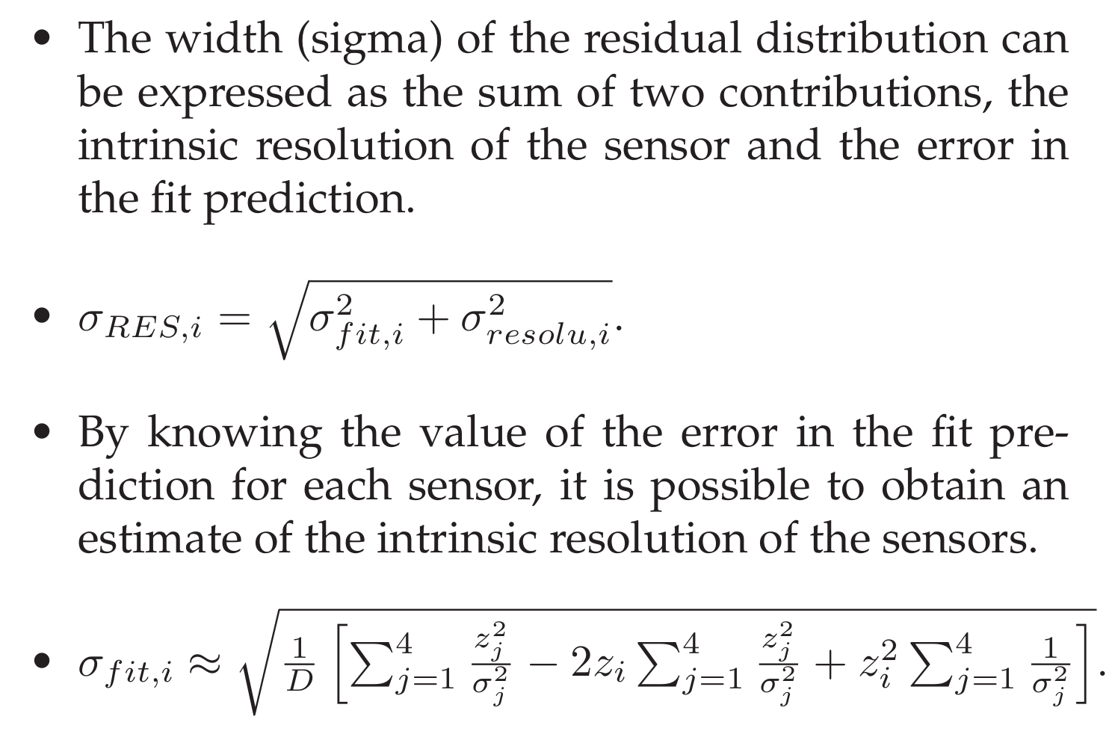
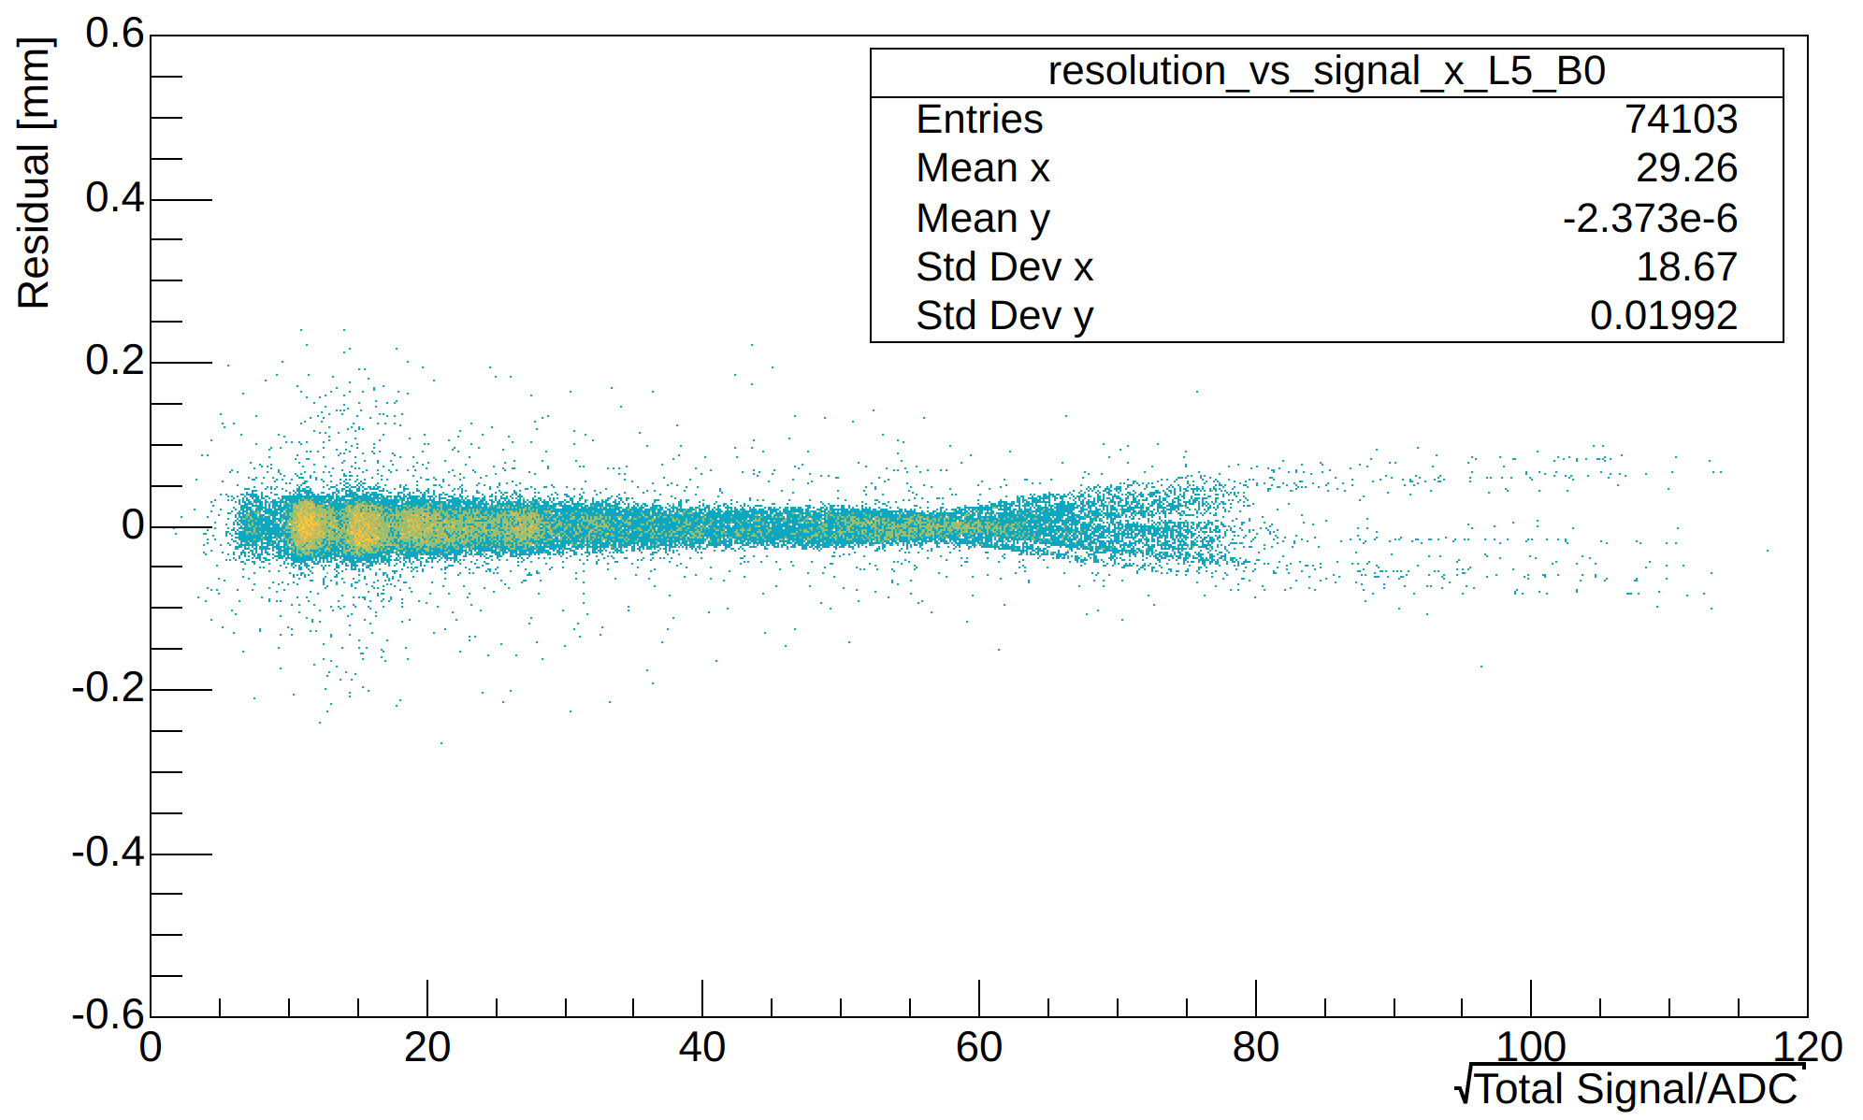
THE SPATIAL RESOLUTION
Note: Beam Test 2023 OCT HERD run_448

Slide 12
Data Format

Slide 13
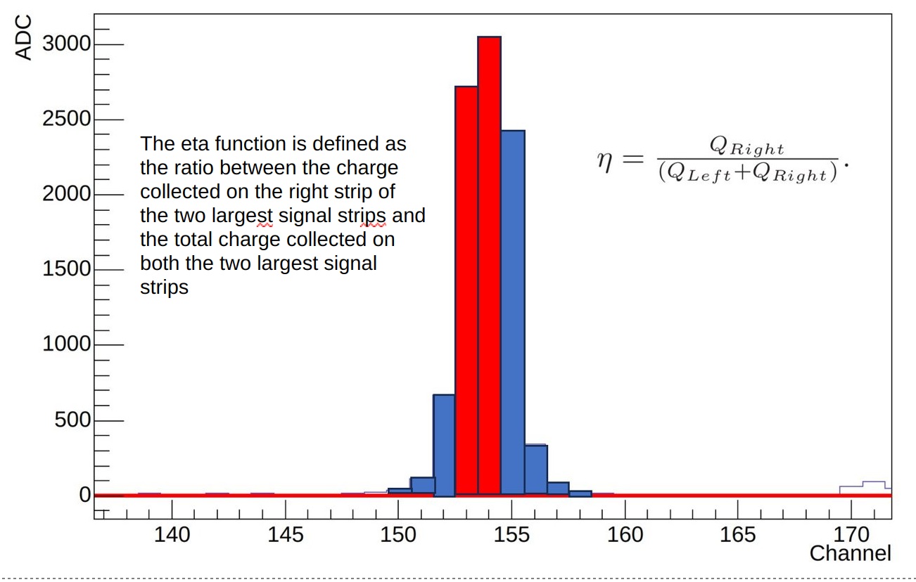
Eta

Slide 14
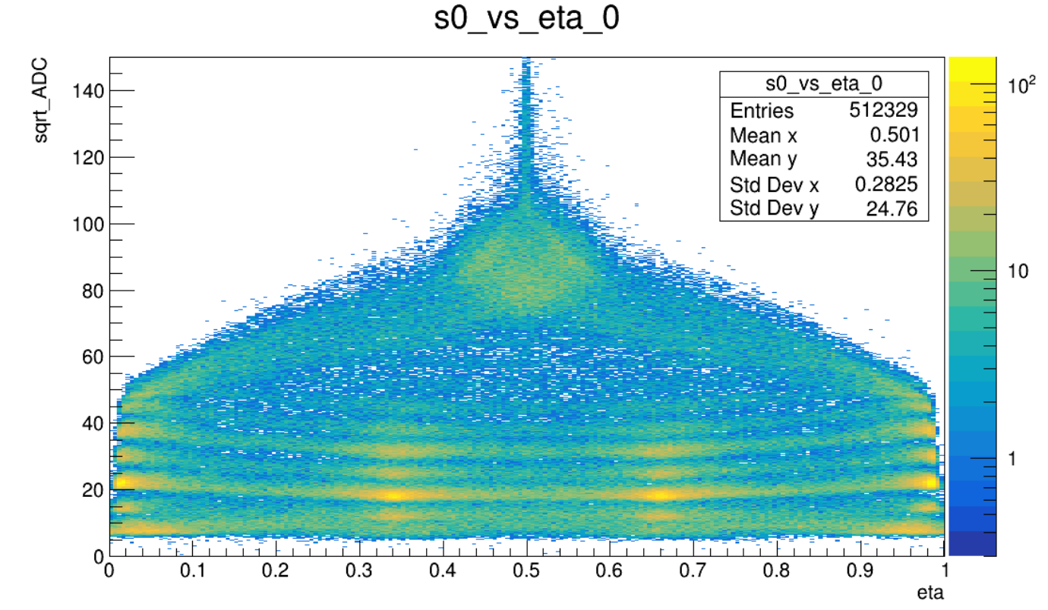
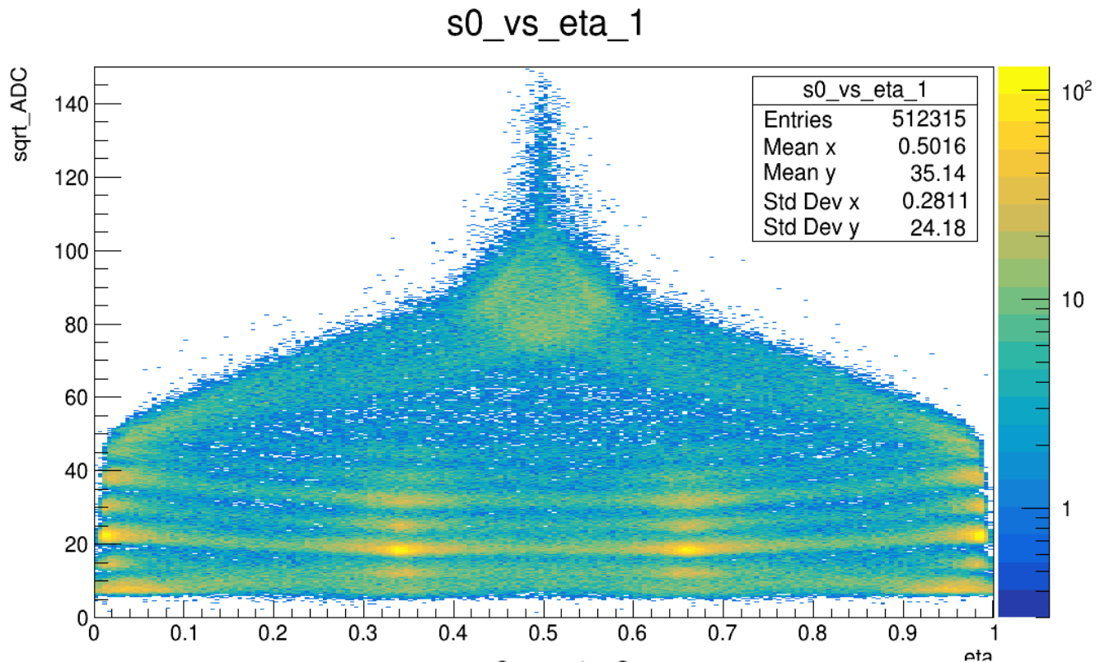
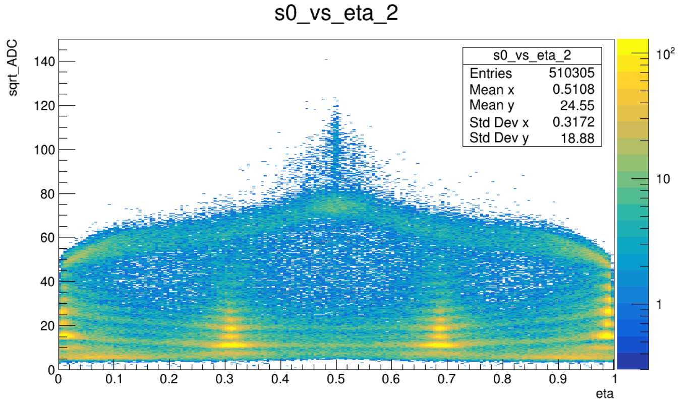
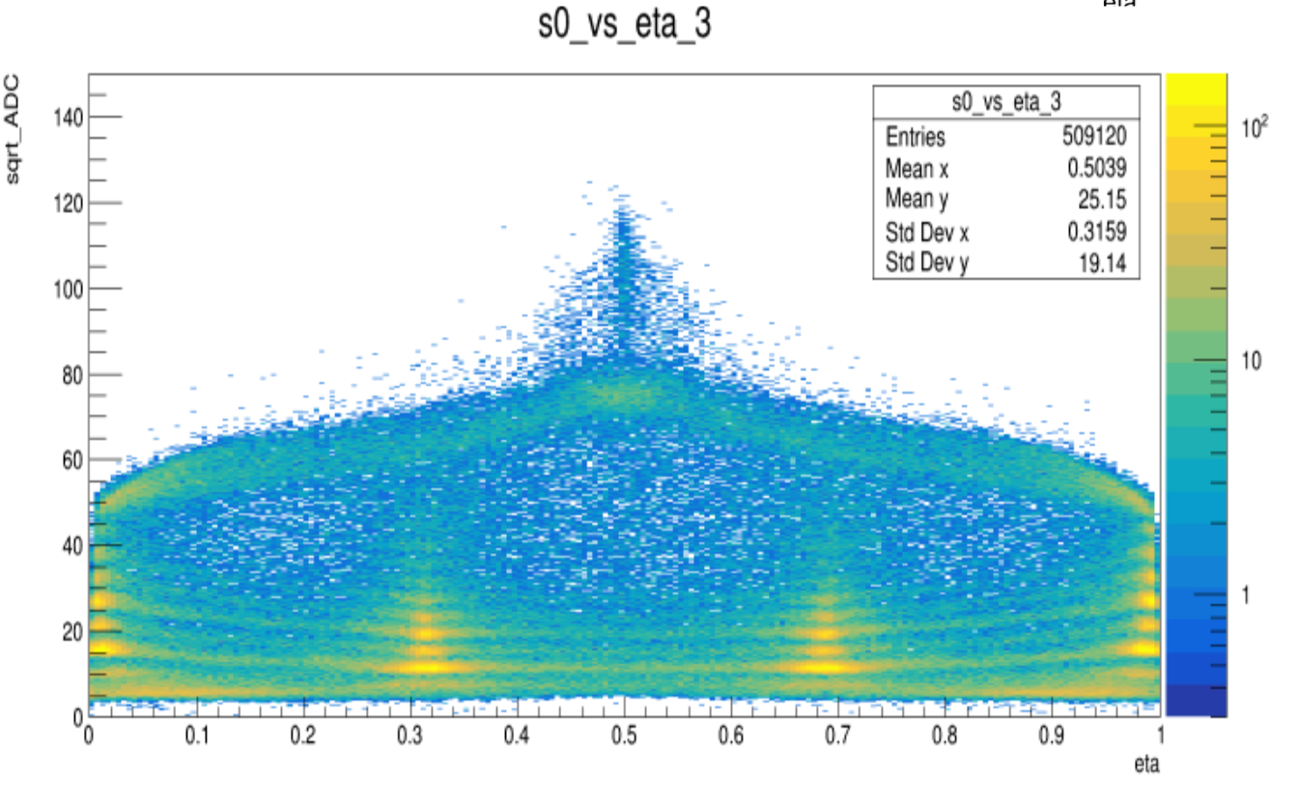
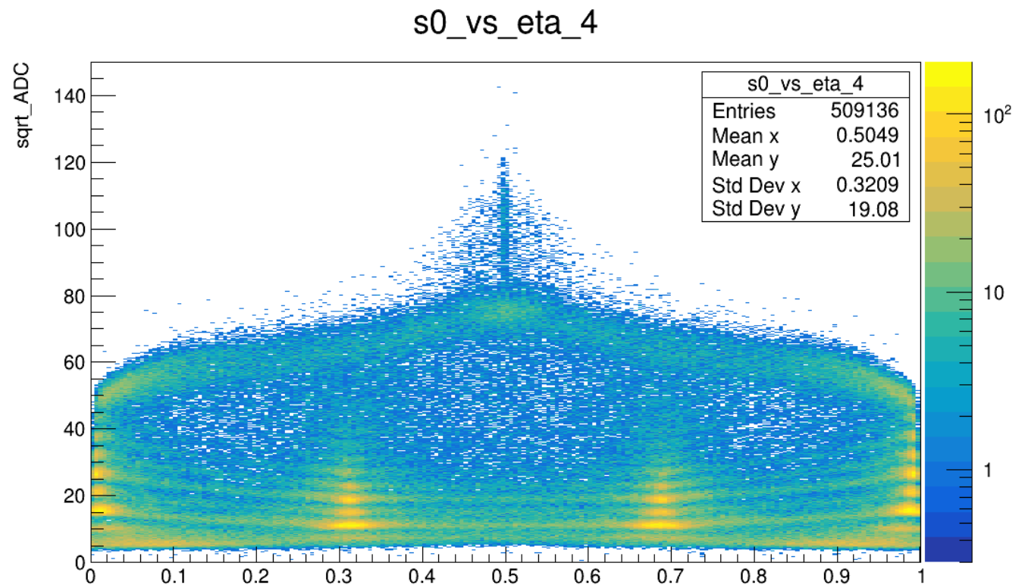
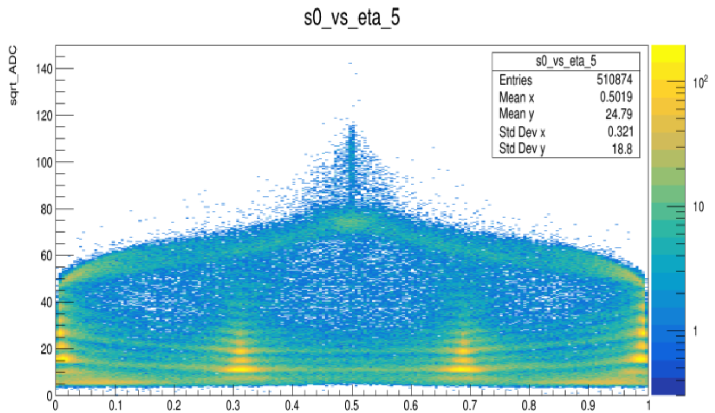
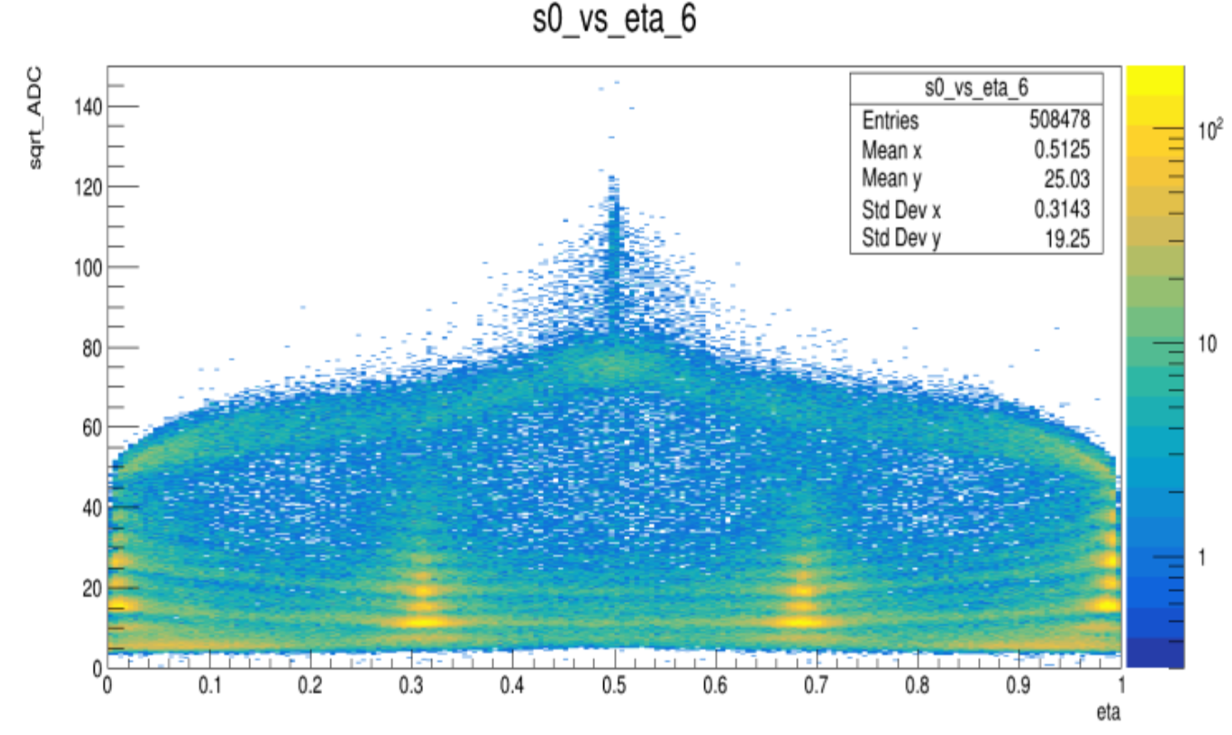
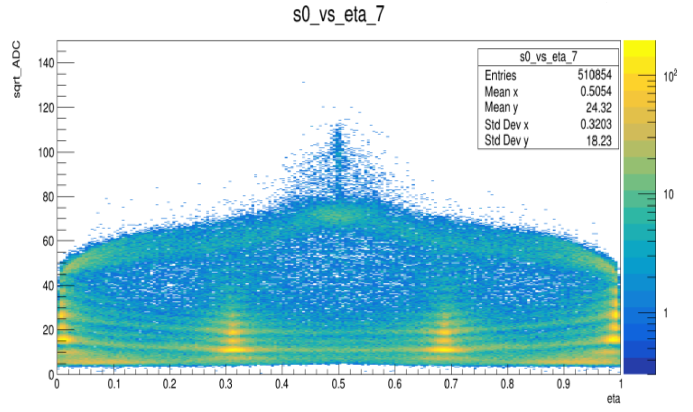
readout
floating
floating
readout
Note: Beam Test 2023 OCT HERD run_448

Slide 15
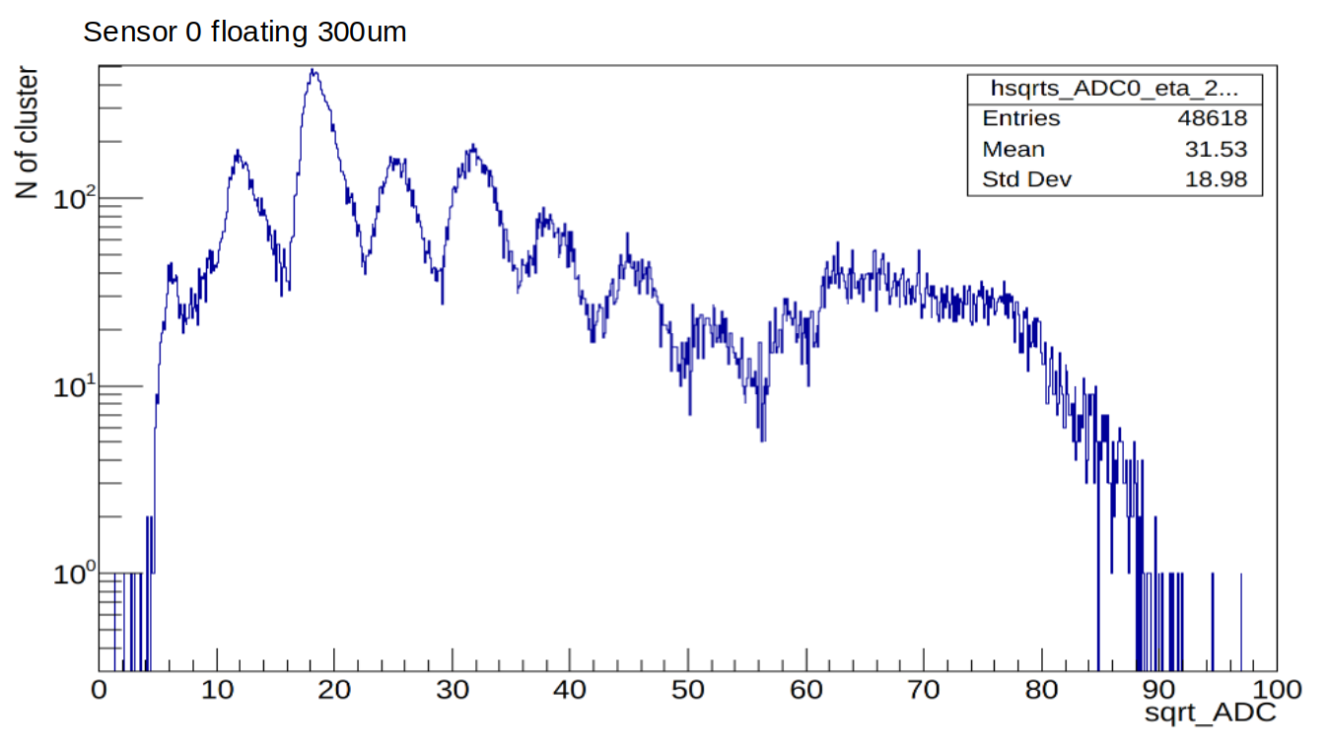
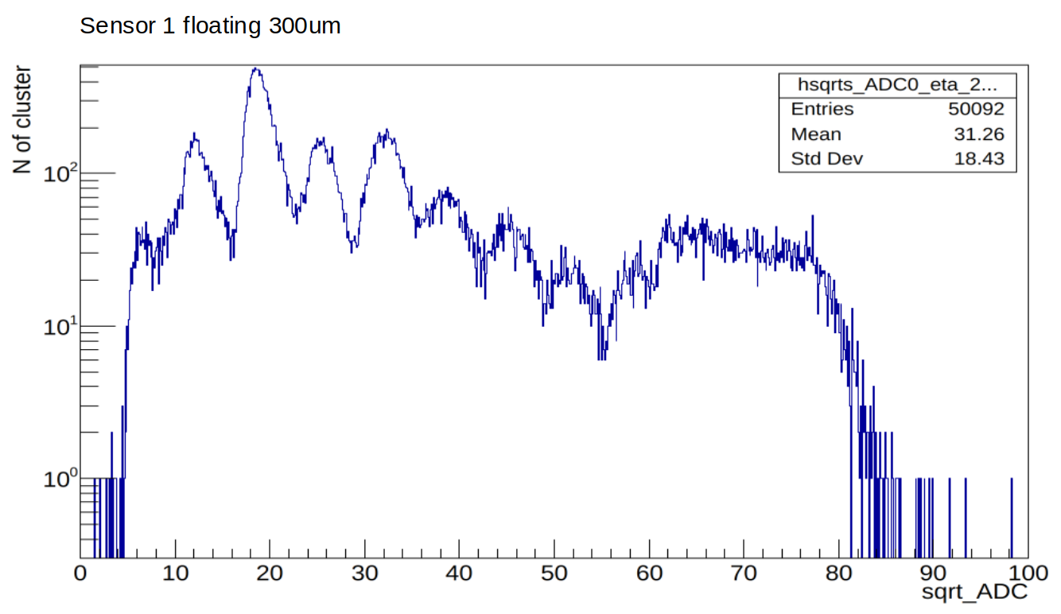
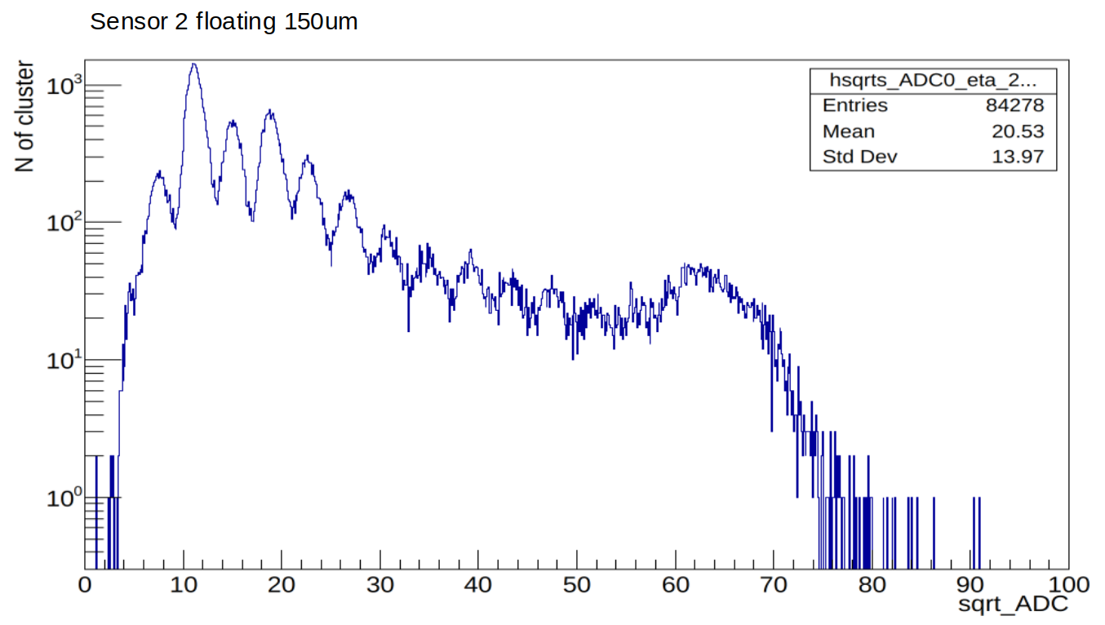
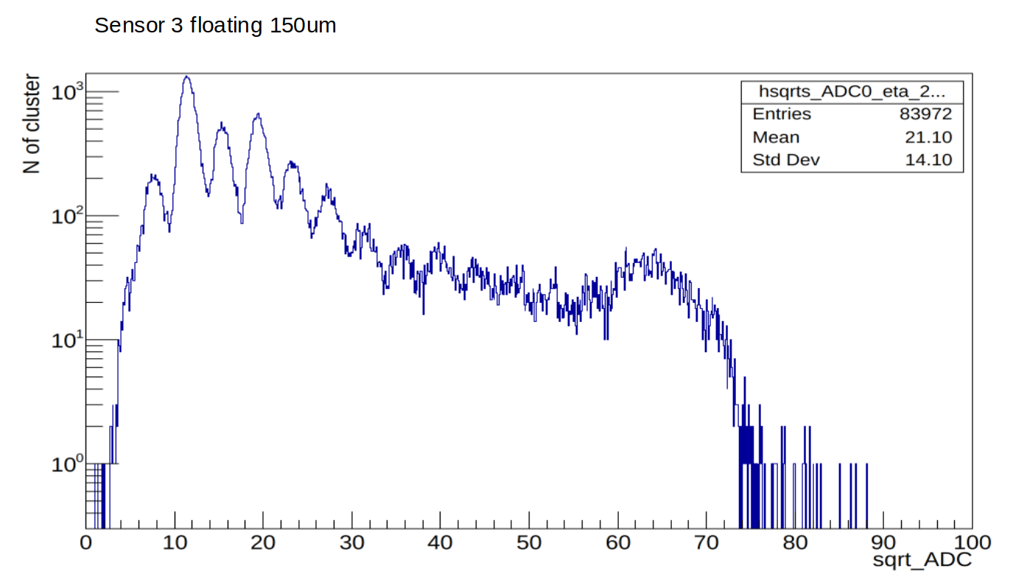
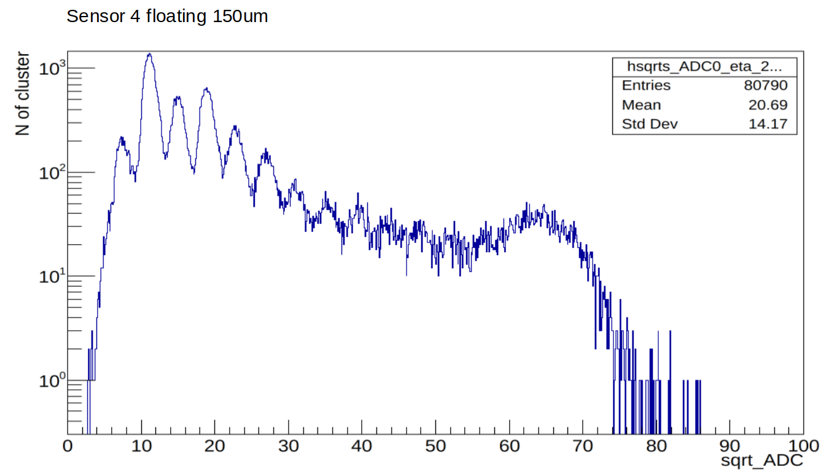
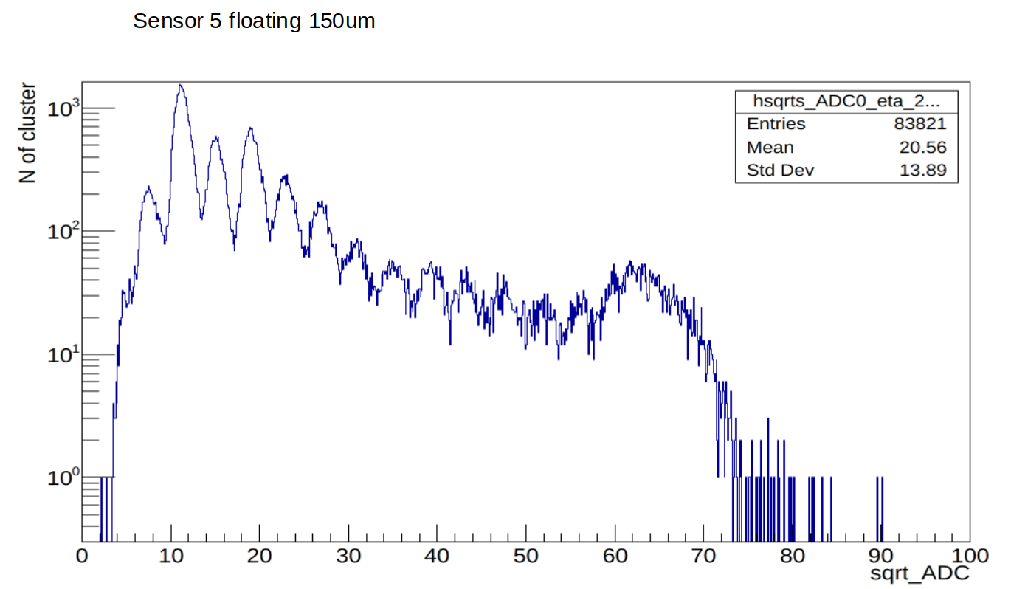
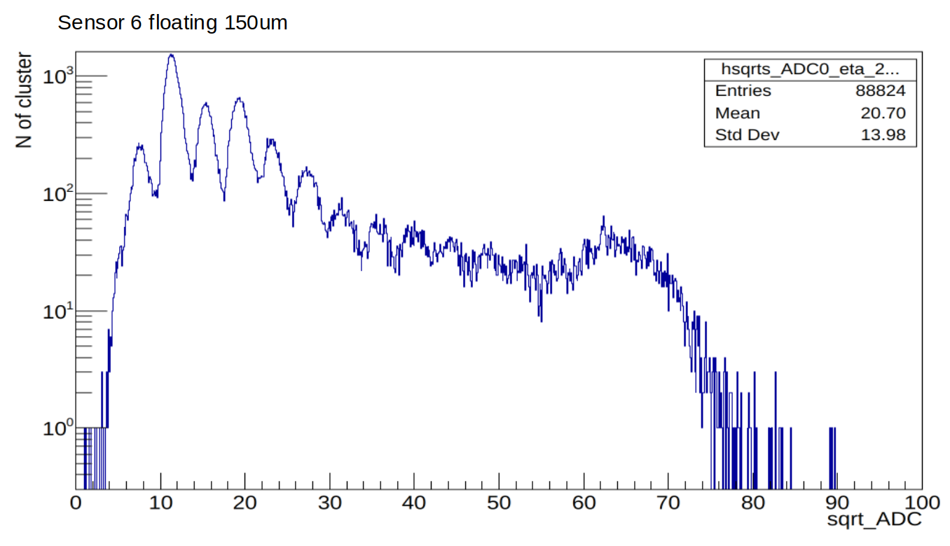
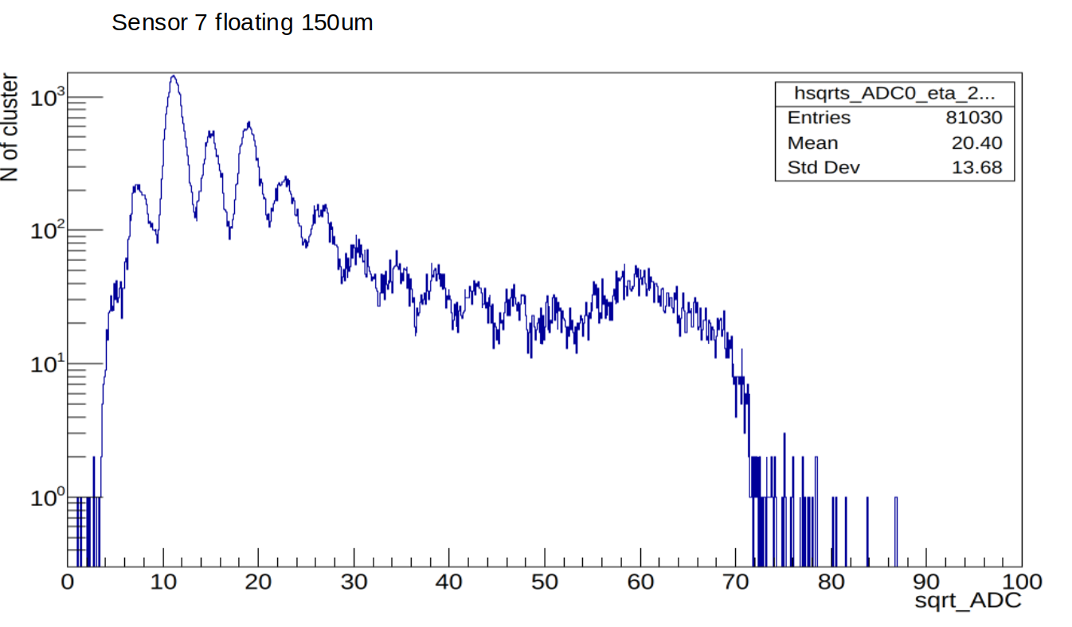
Note: Beam Test 2023 OCT HERD run_448

Slide 16
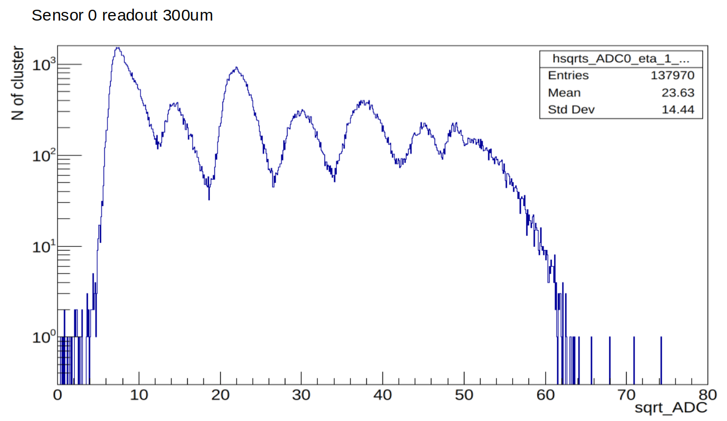
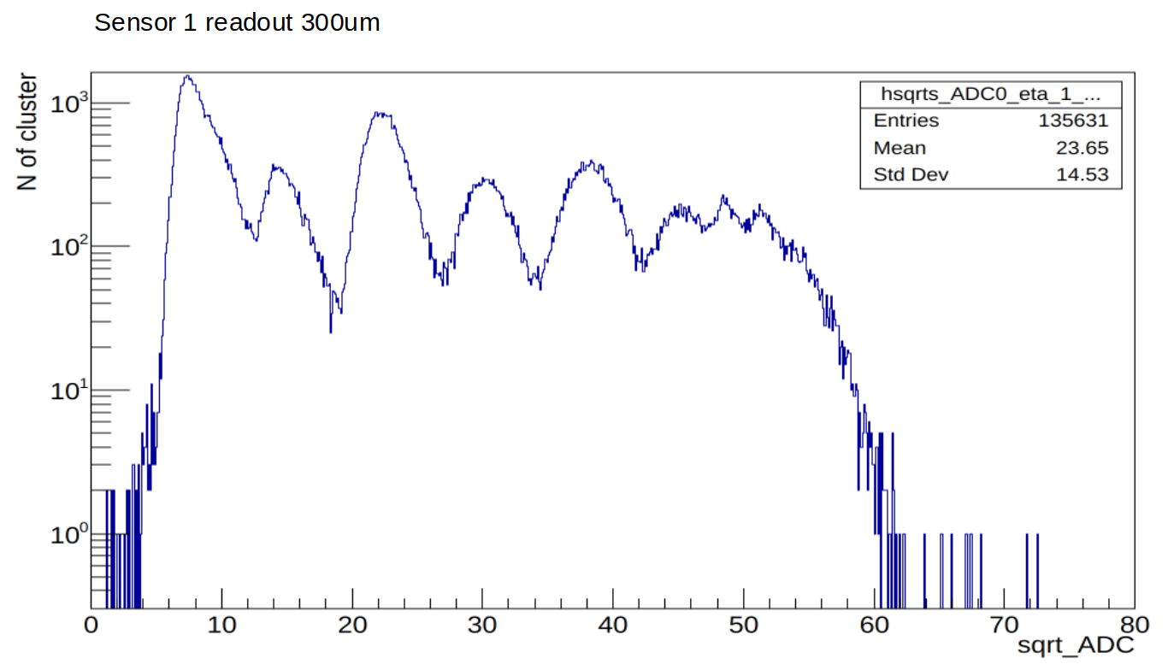
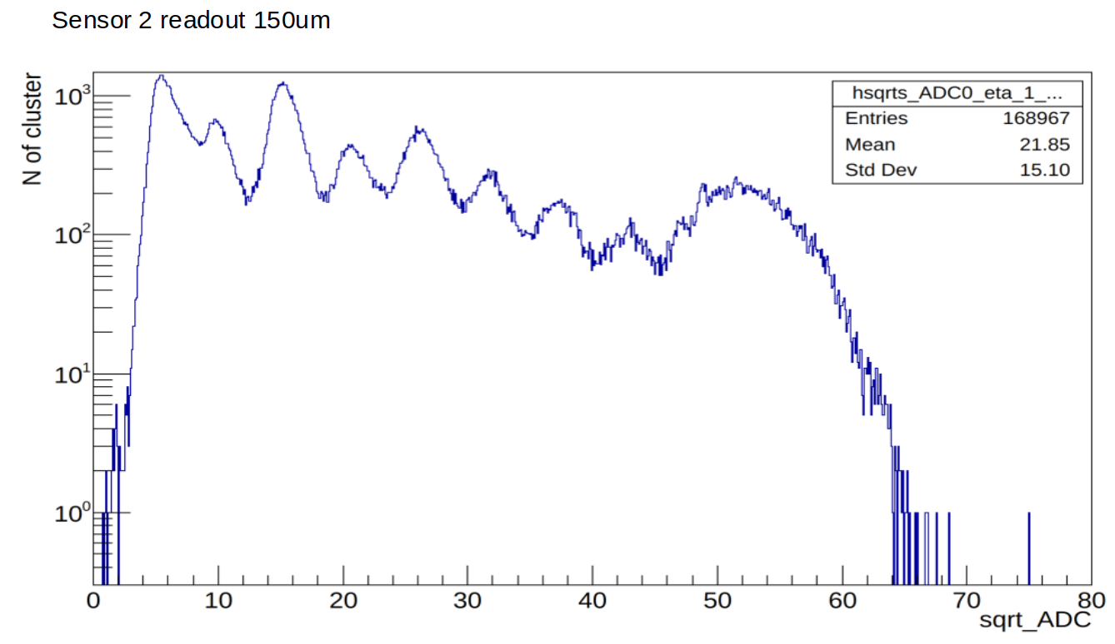
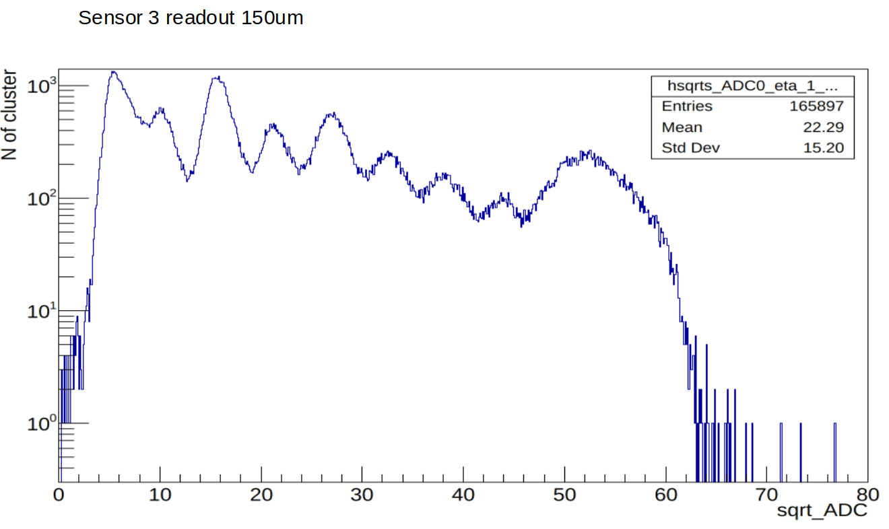
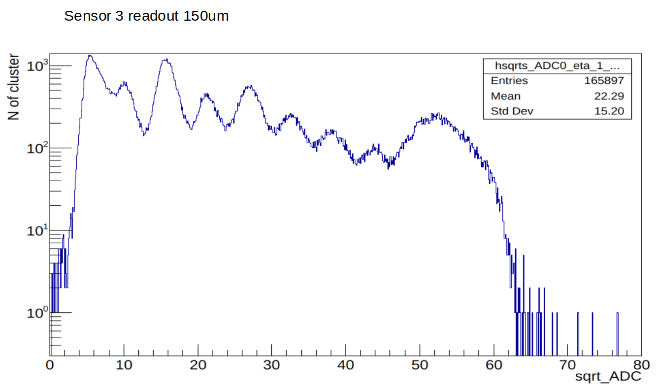
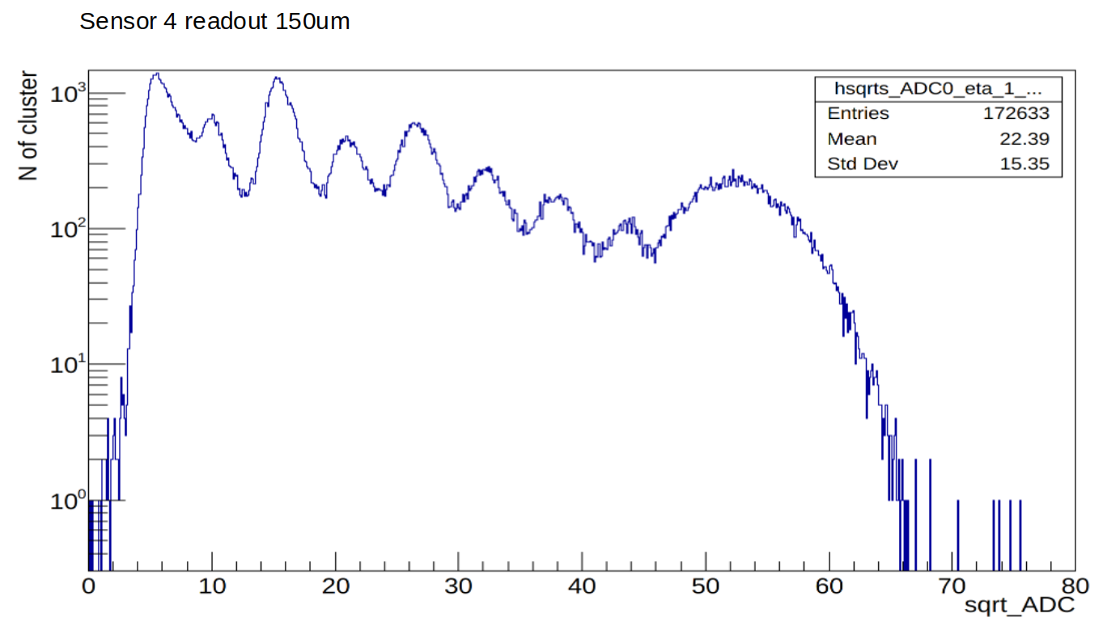
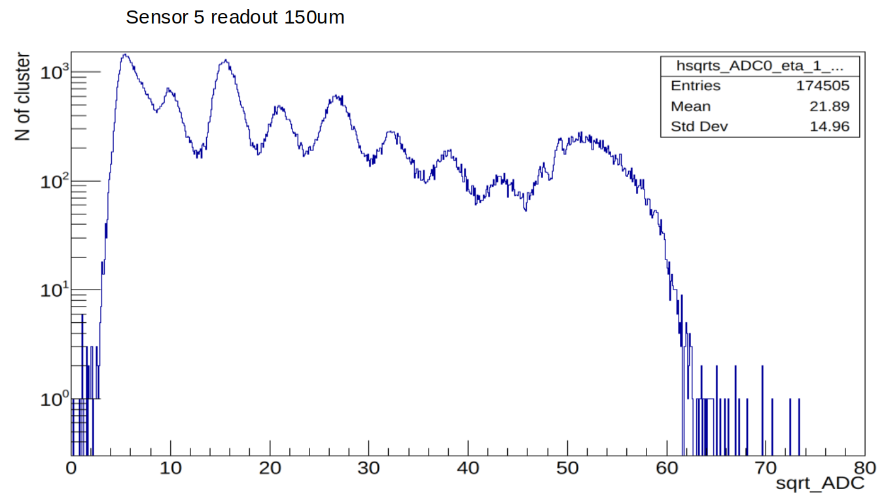
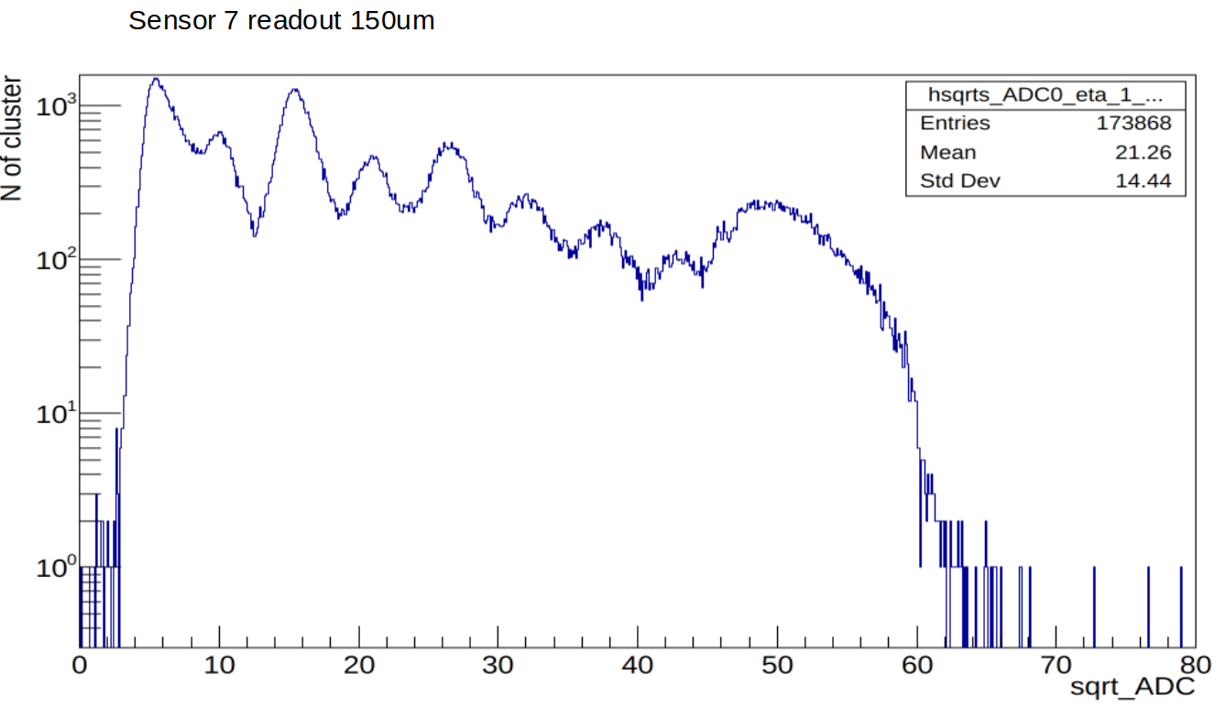

Slide 17
Data Format

Slide 18
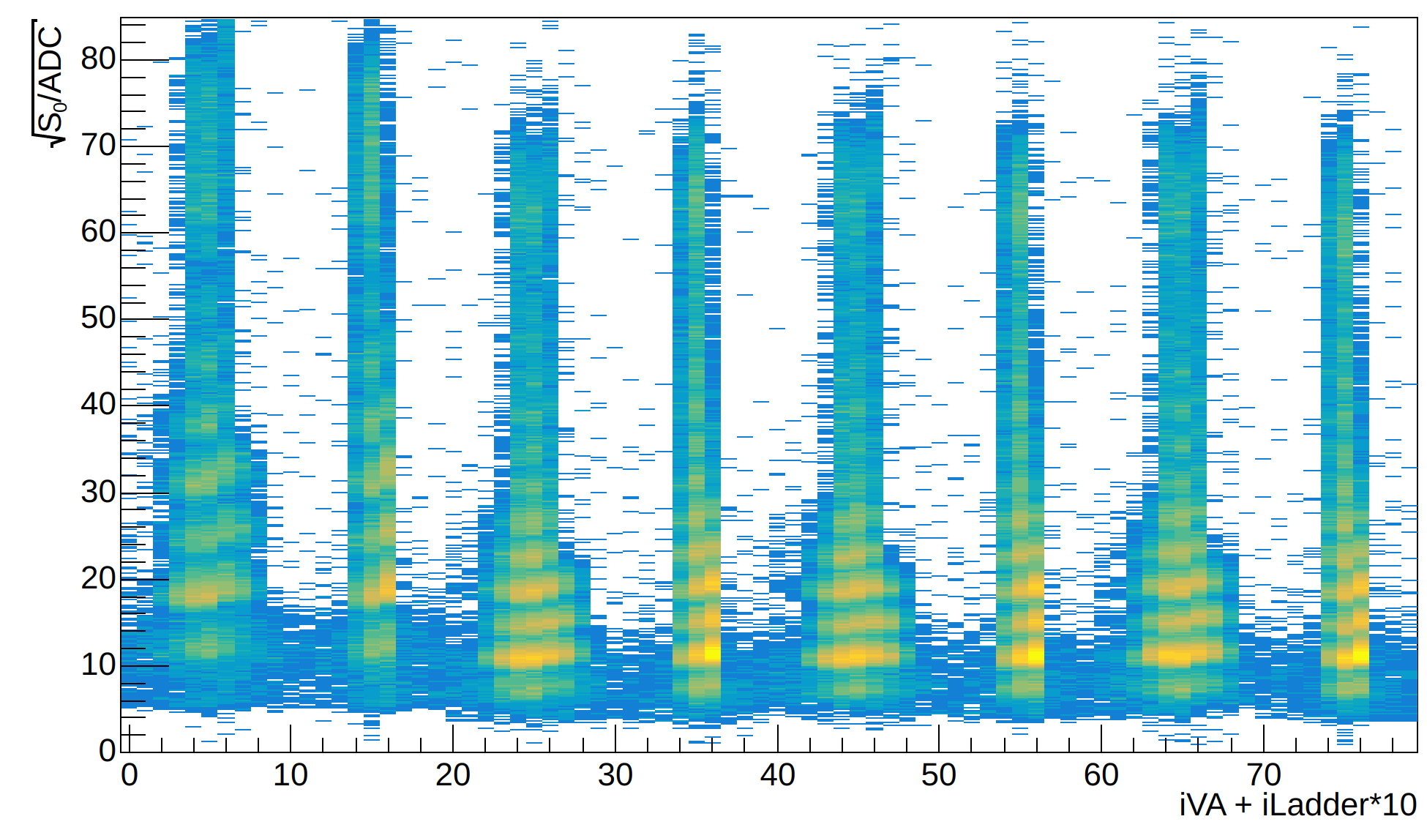
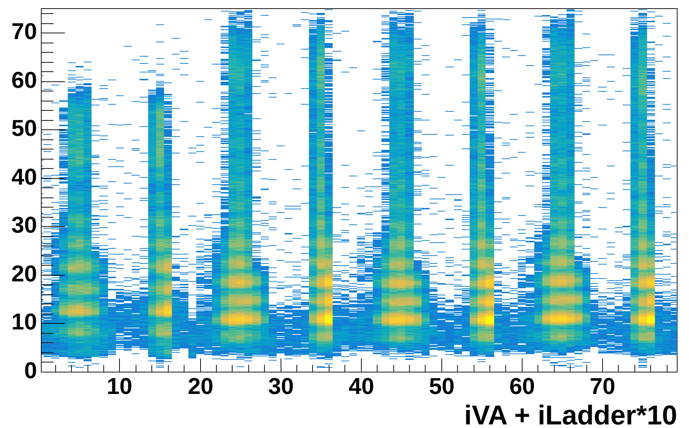
Gain correction
Before Gain correction
After Gain correction
Note: Beam Test 2023 HERD, run448

Slide 19
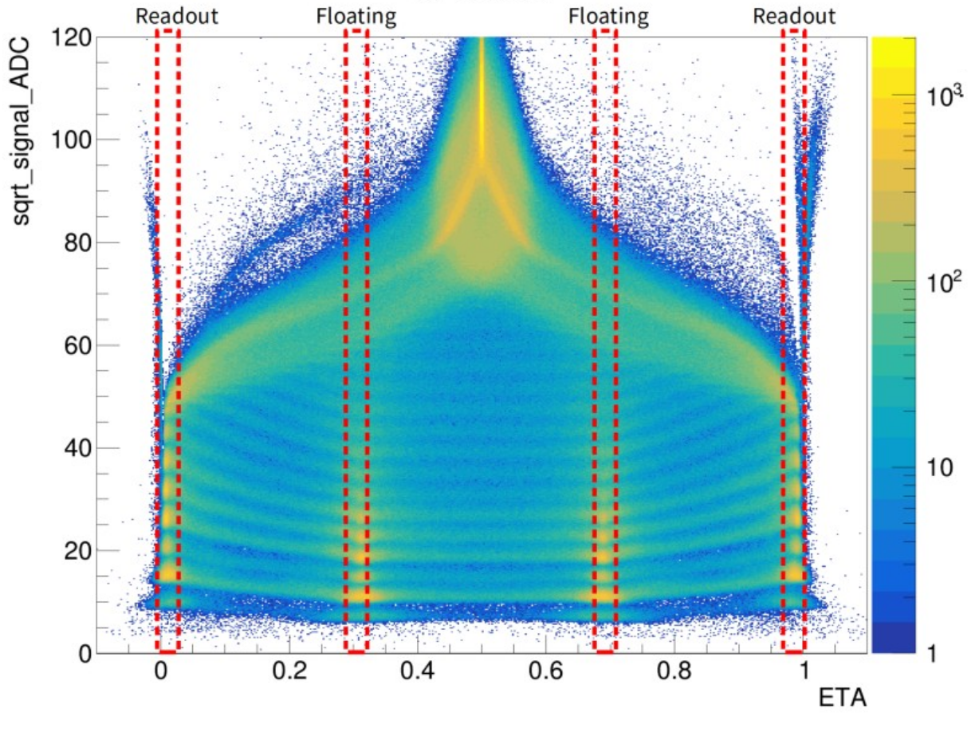
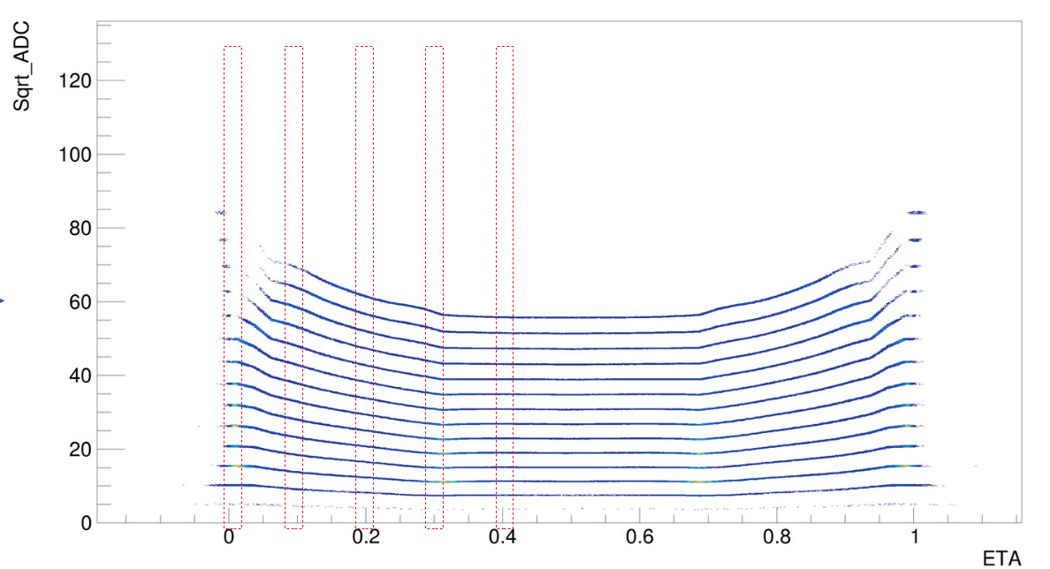
Process of Eta correction
Find the charge line
Calculate the ratio Z/√ADC for each bin each Z (e.g. I did only 4 bins)
Calculate the ratio for all bins , we can get the conversion function (the z-axis represents the ratio Z/ √ADC)
(1)
(2)
(3)
The eta function is defined as the ratio between the charge collected on the right strip of the two largest signal strips and the total charge collected on both the two largest signal strips
z

Slide 20
Note: Beam Test 2023 HERD, run448

Slide 21
Cluster estimated charge
Sensor 0
Sensor 1
Sensor 2
Sensor 3
Sensor 4
Sensor 5
Sensor 6
Sensor 7
Note: Beam Test 2023 HERD, run448

Slide 22
Data Format

Slide 23
Global track charge evaluation ( trunc. mean)
Note: Beam Test 2023 HERD, run448

Slide 24
fine

