Slide 1
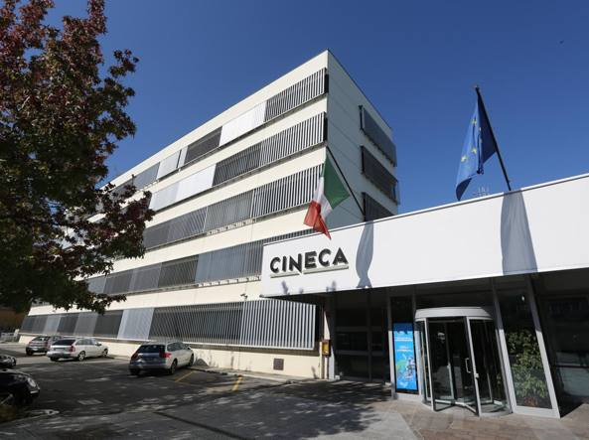
A little logistics first of all…
Agenda here
4 coffee breaks + 1 lunch
We organize off-program a dinner tomorrow evening – please update / write us NOW if you changed your mind wrt the registration!
Thanks for being here! It is not a trivial effort in this part of the year
We decided to dedicate this meeting to:
Reports from the Hub and its boards
Reports from the Spoke Leaders
Report from activities (WPs and IGs)
… and a very important part: let’s get to know the new members of ICSC!
Many thanks to CINECA for hosting us!

Slide 2
ICSC_progetto_comunicazione**
Spoke 2 - FUNDAMENTAL RESEARCH & SPACE ECONOMY
Sandra Malvezzi (INFN – MIB)
Antonio Stamerra (INAF – OAR)
Tommaso Boccali (INFN – PI)
Meeting di fine 2023 / Fine attivita primo anno

Slide 3
Cose che mancano
Come e’ andata con referees
Bando Open Calls
Per la tavola rotonda
Personale assunto: nomi e associazione tasks
Stato pubblicazioni e conferenze
Github: fare fork sincronizzati

Slide 4
The Spoke 2 of ICSC in one slide
1
2
ISTRUZIONE E FORMAZIONE, IMPRENDITORIALITÀ,
TRASFERIMENTO DI CONOSCENZE, POLICY, OUTREACH
FUNDAMENTAL RESEARCH
& SPACE ECONOMY
FUTURE HPC
& BIG DATA
Spoke Leader Institution: INFN
Co-Leader Institution: INAF
Academic Affiliates: 13 Universities+ 2 Public Research Institutions
Private Affiliates (via Innovation Grants): 6 Large Enterprises + 1 Small Enterprise
Being formalized in these very days
3
4
ASTROPHYSICS & COSMOS OBSERVATIONS
EARTH
& CLIMATE
5
6
ENVIRONMENT
& NATURAL DISASTERS
MULTISCALE MODELING
& ENGINEERING APPLICATIONS
7
8
IN-SILICO MEDICINE
& OMICS DATA
MATERIALS &
MOLECULAR SCIENCES
9
10
DIGITAL SOCIETY
& SMART CITIES
QUANTUM COMPUTING

Slide 5
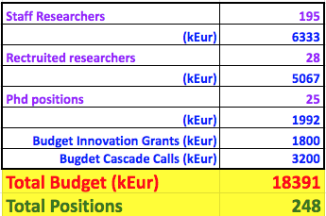

Slide 6
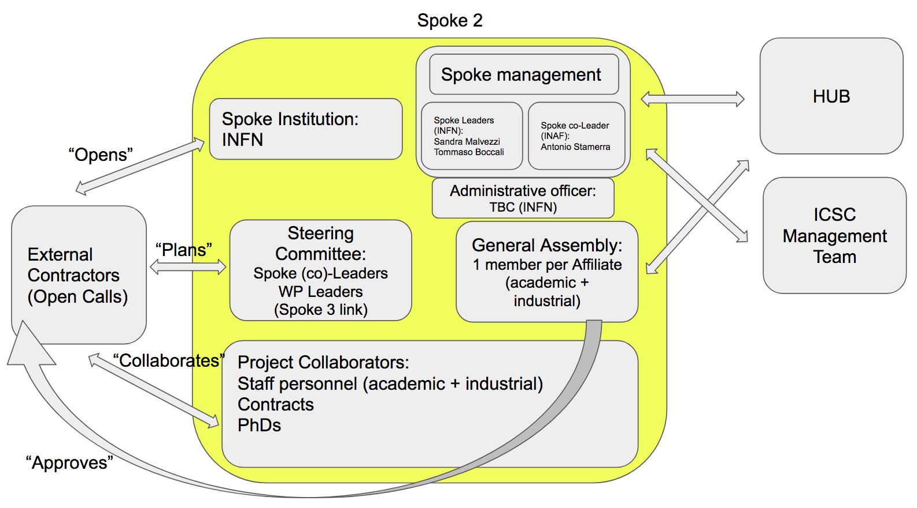
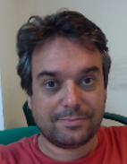
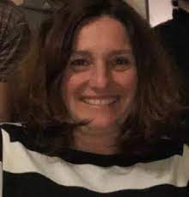
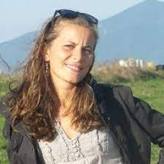
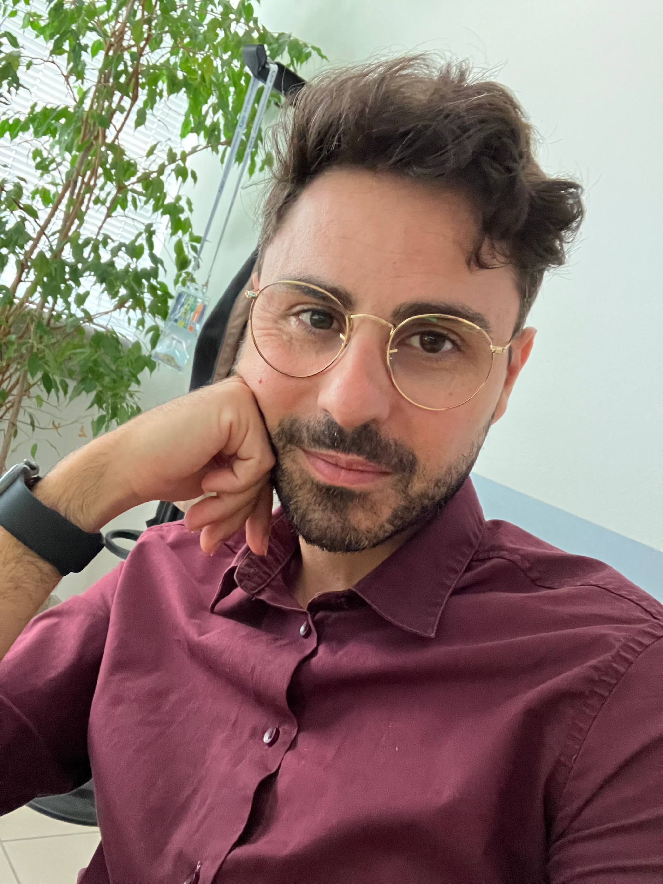
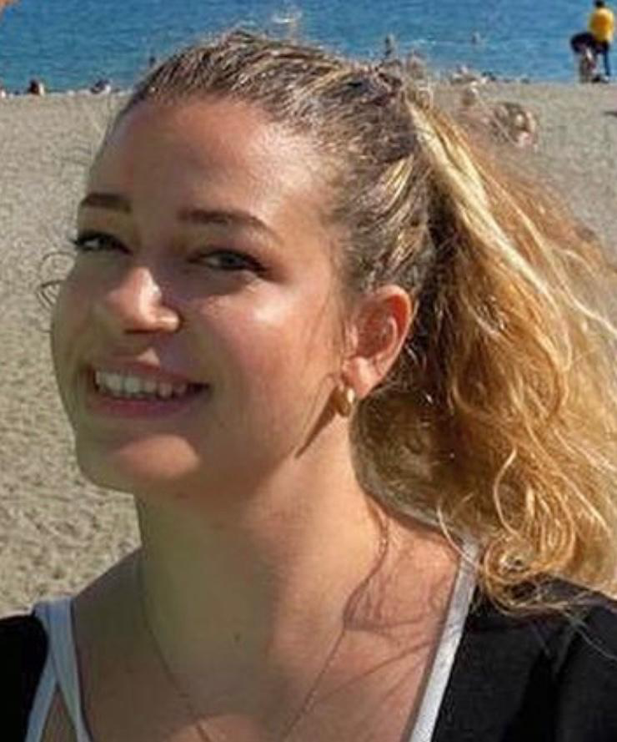
Spoke Organization
Spoke Leaders (INFN):
Sandra Malvezzi (MIB)
Tommaso Boccali (PI)
Spoke Co-Leader (INAF):
Antonio Stamerra (OAR)
Financial Officer (INFN):
Simona Petronici (PI)
+ team
Boards:
Steering Committee: SLs, WPLs, WP3 link
General Assembly: Affiliates

Slide 7
Budget!
No details here, just the grand summary

Slide 8
Budget 🡪→ → Simona dopo in dettaglio
195 names at the moment of submission
6.33 MEur for staff personnel («massa critica»)
5.07 MEur for RTD/TD
1.99 MEur for PhD
1.8 MEur «Innovation Grants»
3.2 MEur for «Open calls»
Indication of the budget one can account on LT contracts; this and the previous category can be «complemented»
PhD budget usable for other types of contracts (for example, BT)
Reserved for activities with the Industries within the ICSC
For «outside ICSC» collaborations

Slide 9
Other constraints (either external or self-imposed)
Overall: 40+% spent in southern regions
Only INFN, INAF, Innovation Grants and Open Calls can
Innovation Grants: at least 51% to Industrial partners
40% women ….
In practice we already surrendered, since we in many cases the applicants were already too imbalanced

Slide 10
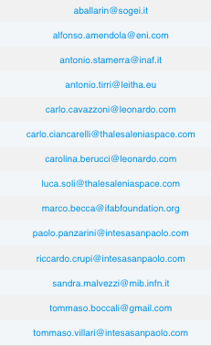
Affiliates / Assembly
cn1-spoke2-industrie@lists.infn.it
Ente | Nome | Mail
INFN | Sandra Malvezzi, Tommaso Boccali | sandra.malvezzi@mib.infn.it, tommaso.boccali@pi.infn.it
INAF | Antonio Stamerra | antonio.stamerra@inaf.it
UNIBA | Antonio Marrone | antonio.marrone@uniba.it
POLIBA | Nicola Giglietto | nicola.giglietto@ba.infn.it
UNIMIB | Leonardo Giusti | leonardo.giusti@unimib.it
UNINA | Guido Russo | guido.russo@unina.it
ROMA1 | Shahram Rahatlou | guido.russo@unina.it
UNITS | Edoardo Milotti | milotti@units.it
UNIBO | Daniele Bonacorsi | daniele.bonacorsi@unibo.it
UNIFI | Vitaliano Ciulli | vitaliano.ciulli@unifi.it
UNICT | Alessia Tricomi | alessia.tricomi@dfa.unict.it
UNIPD | Marzo Zanetti | marco.zanetti@unipd.it
UniCal | Enrico Tassi | enrico.tassi@unical.it
SALENTO | Daniele Martello | daniele.martello@le.infn.it
UNIFE | Eleonora Luppi | eleonora.luppi@unife.it
We had many meetings with academic affiliates(“General Assembly”), we will soon include Industrial affiliates (when the “accordi” are signed)

Slide 11
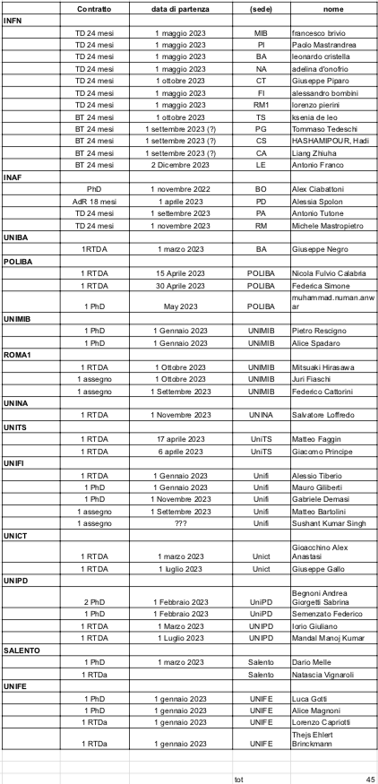
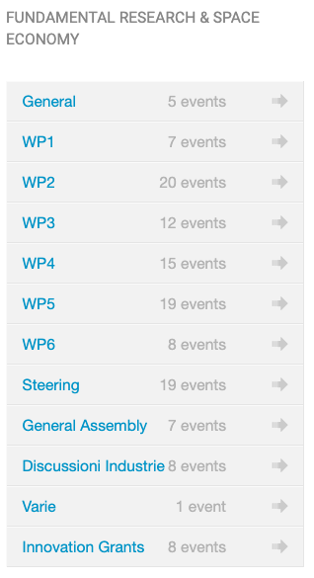
Organization in Numbers
Using INFN Agenda for meeting, and INFN SYMPA for mailing lists
https://agenda.infn.it/category/1774/, https://lists.infn.it/sympa
To-date: 21 mailing lists, 129 meetings in agenda
Recruitment:
More positions than anticipated (co-funding, synergies) – 45 at mid-October
Please keep it up-to-date

Slide 12
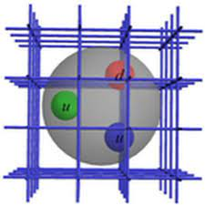
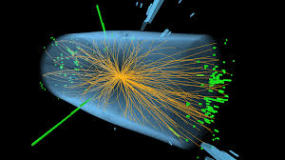
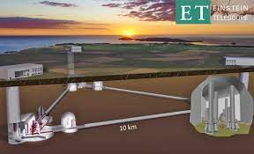
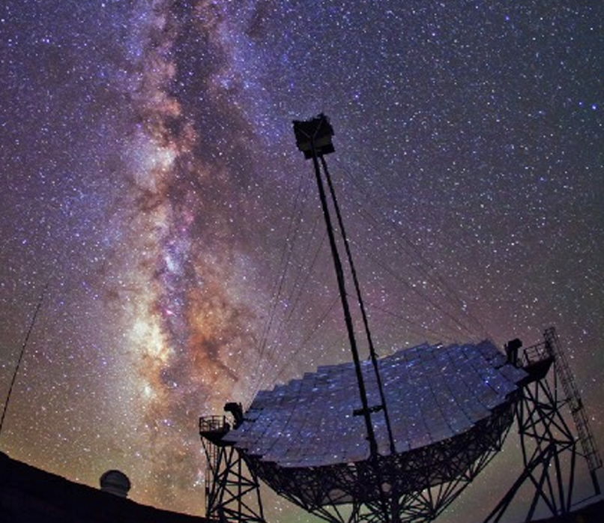
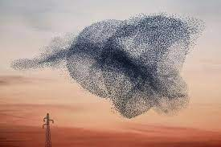
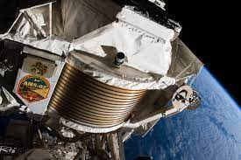
Who are “we?
‹#›

Slide 13
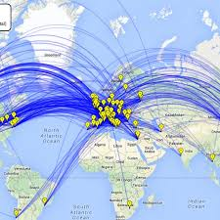
Why our communities need an ICSC
The Worldwide LHC Computing GRID
Since at least 2 decades, research at the fundamental frontier is heavily “computing bound”
Latest (and next) generation experiments collect data at the Exabyte and beyond
Simulation efforts in theoretical and experimental physics are at the Exascale
We have been forced to develop in-house solutions when nothing was available, with a good success. But it is now due time to evolve to a shared infrastructure model
The Web, the GRID, …
Examples:
LHC has has already surpassed the global scale of several Exabytes of Data, and more than 1 Million CPU cores
Lattice QCD simulations are, with Meteo, the main driver and benchmark for HPC systems
Lattice QCD on HPC

Slide 14
Overall Spoke 2 goals
“no basic science, but computing FOR basic science”
“share solutions between partners”
“use the CN infrastructure as enabling technology”
‹#›

Slide 15
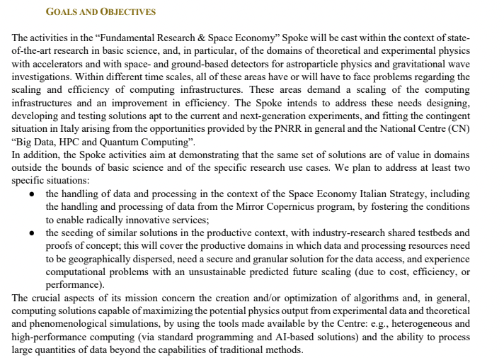
“design and test novel computing oriented solutions”
“go outside the academic environment; not to teach, but to share experience in both directions”
Some high level ideas / keywords
‹#›

Slide 16
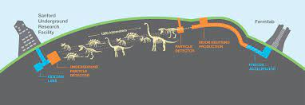
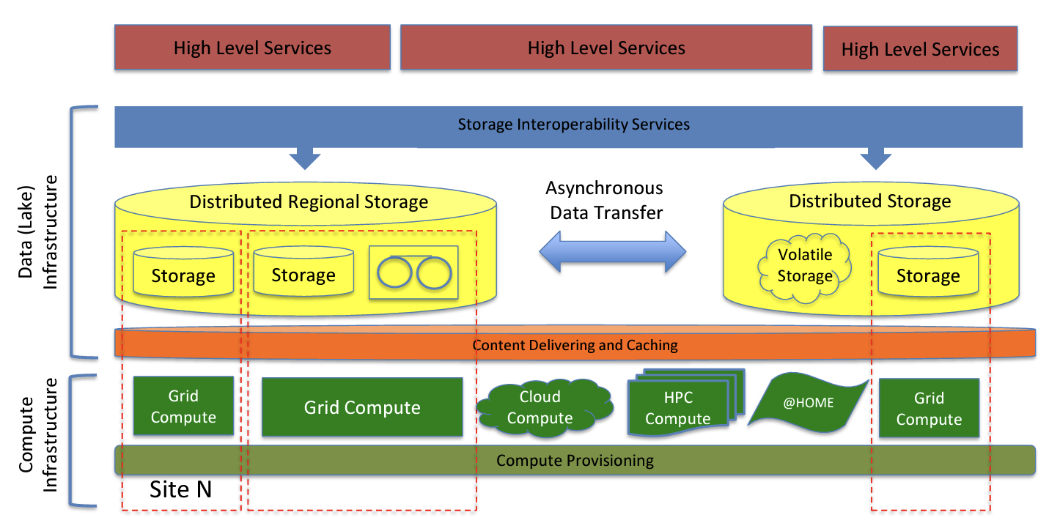
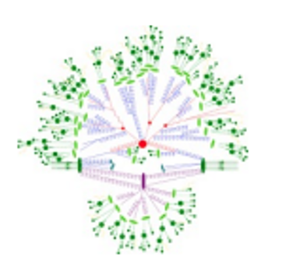
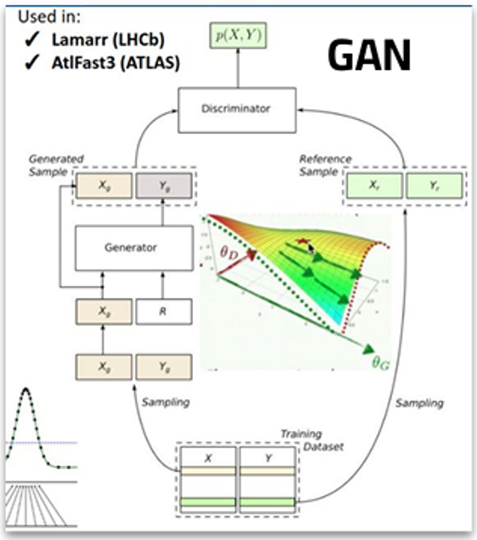
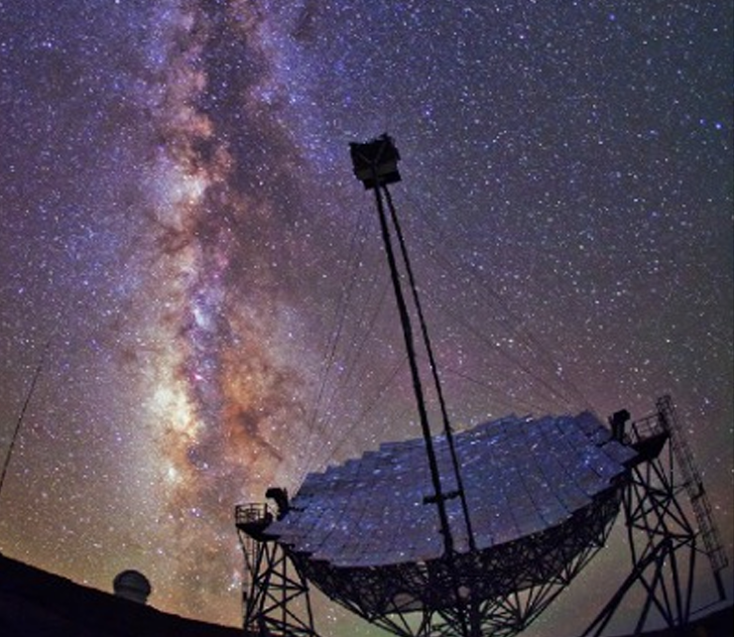
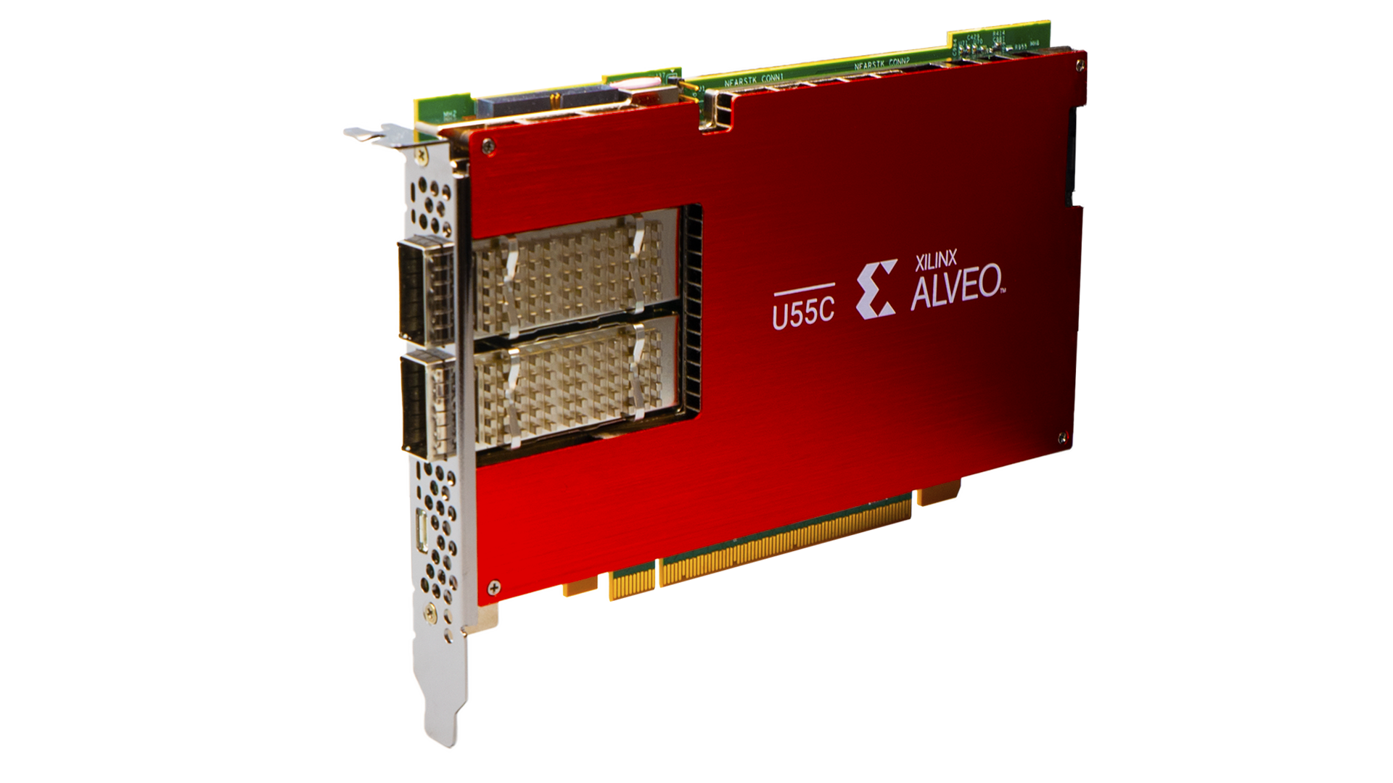
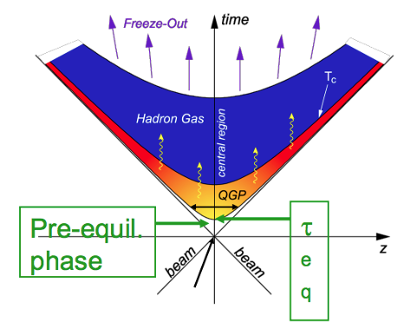
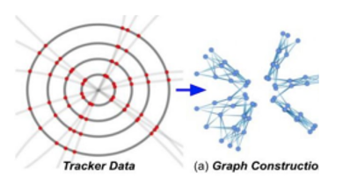
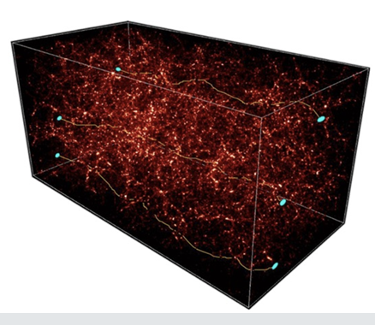
Work Package Structure
WP1: tools and algorithms for Theoretical Physics
WP2: tools and algorithms for Experimental Collider Physics
WP3: tools and algorithms for Experimental Astroparticle Physics and Gravitational waves
WP4: tools for porting / optimization on new architectures (low power, GPU, FPGA, …)
WP5: data management on the distributed CN infrastructure
WP6: cross domain initiatives, + space economy

Slide 17
Work Packages – the structure
“technological” WPs: they harvest / investigate technical solutions in computing, on the infrastructure of the ICSC and beyond, and provide support / training for these; at the same time propose these to a larger audience, including industries
We defined 2 types of Work Packages:
“scientific” WPs: they analyze the needs of the (sub-)domain, and pose open problems for which advanced computing solutions are needed
Has a need; searches for a solution
WP1/2/3
WP4/5/6
Has a technology; searches for a test use case

Slide 18
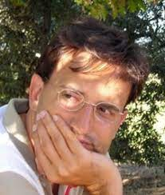
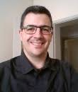
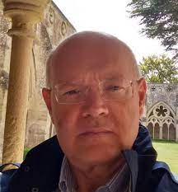
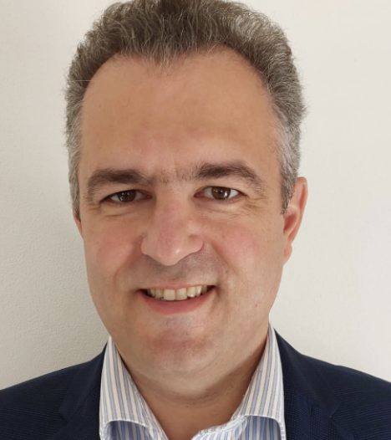
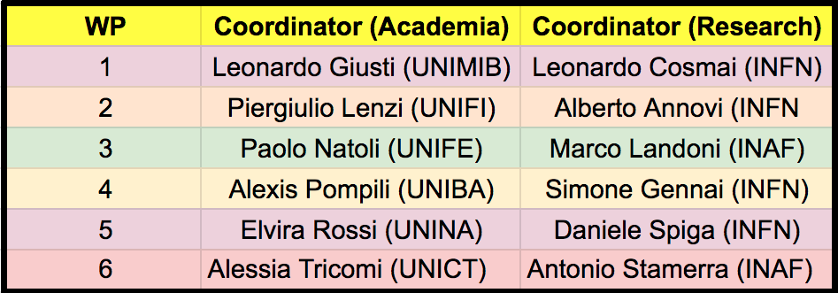
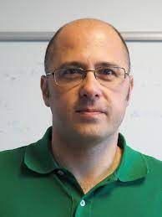
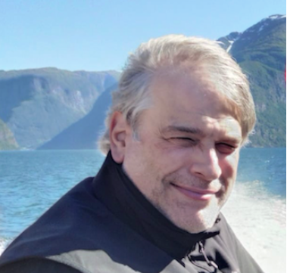
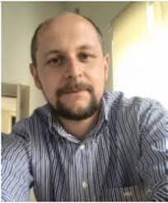
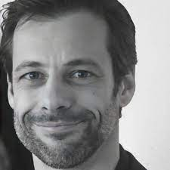
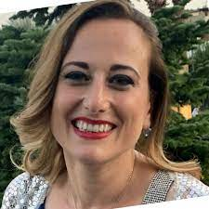
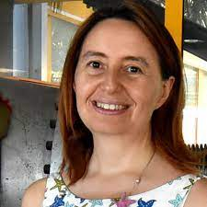
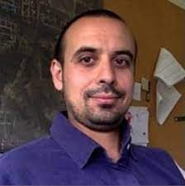
WP leaders
Strategy: in each WP, appoint one coordinator from Academia and one from Research Institutions

Slide 19
Plan of Work
planning and identification: the first year of the project is dedicated to a landscape recognition for interesting state-of-the-art use case; its outcome is a work plan identifying the activities on which the core part of the project will be focusing - in particular, algorithms and services to be accomplished;
a realization phase, in which the actual development is performed via the staff/ hired personnel; the outcome is usable algorithms / services, documented (alpha/beta level) and ready to be tested on a larger scale;
a validation phase, in which the outcomes of the realization phase are verified in testbeds and proofs of concept, and benchmarked in order to assess their adherence to the specifications;
4. a wrap-up phase, in which results are analysed and consolidated in reports and white papers to be used as guidelines for similar use cases.
All the activities designed in the submitted project with a standard 4-phase plan over the three years
We are now in the crucial year: the realization phase
MS4,5
Y1
MS6
MS7
Y2
MS8
MS9
Y3
MS10

Slide 20
Milestone table
We need to use the ones defined by the ICSC, which are closed in time at the start (since in this way … money flows in a more efficient way):
MS1-MS2-MS3 are basically descoped (they were attached to PhD recruitment)
MS4 | MS5 | MS6 | MS7 | MS8 | MS9 | MS10
09/22-04/23 | 11/22-04/23 | 05/23-09/23 | 10/23-02/24 | 01/24-07/24 | 07/24-11/24 | 10/24-08/25
We are here

Slide 21
Plan of work
The first year was dedicated to team-building and to the identification “bottom-up” of relevant computing-bound scientific use cases (WP1-2-3) and realization solutions (WP4-5-6)
”Our” definition of Flagship projects is:
We define a category of projects, in the same subdomain (a.g. algorithms for Gravitational Waves detection)
In each category, we select a Flagshig project which is the driver, and on which we base milestones and KPIs
In the initial definition of the project, we had put “at least one flagship per WP”; we later (MS4) revised it to “at least 2 flagships per WP, possibly shared between scientific and technical WPs”

Slide 22
MS4 used as a checkpoint for MS6; MS6 🡪
6 Landscape reports produced to assess the needs from fundamental research, and the technology drivers available with the ICSC and beyond
19 Flagship projects defined and fully defined (Milestones, KPIs, resource request to the ICSC, …)
Not going for any detailed explanation here, just flashing titles and scopes

Slide 23
Landscape Documents

Slide 24
Flagships – 19 in total
WP1 (4): «Multilevel Hybrid Monte Carlo for lattice QCD», «QCD under extreme conditions», «Advanced Calculus for Precision Physics (ACPP)», «Large Scale Simulations of Complex Systems»
WP3 (7): «Frequency Hough (FH) Transform analysis on GW continuous sources», «Efficient use of machine learning and GPUs in cosmological data analysis: from theory to likelihood to statistical inference», «Inference of cosmological and astrophysical population properties from GW observations with and without electromagnetic counterparts», «Development of innovative analysis techniques using realistic simulations of the upgraded Auger Observatory within the context of a machine learning environment», «Detection and classification of SSO in Euclid Simulated data», «Pipeline optimization for space and ground based experiments (PSGE)», «Hydrodynamical simulations to test the nature of dark matter»
WP2 (5): «Advanced Machine Learning - Flash Simulation and bleeding edge applications», «Porting Algorithms on GPU», «Ultra-fast algorithms running on FPGA», «Validation of HEP reconstruction code on ARM», «Quasi interactive analysis of big data with high throughput»

Slide 25
WP4 and WP5 do not have specific Flagship, but participate to most of the other flagships, with themes like
GPU / FPGA utilization
Low power computing with ARM
High rate analysis solutions on the Data Lake
Machine learning at large scale
Fast simulations via generative networks,
…
WP6 (3): «Enhancing Geant4 Monte Carlo Simulations through Machine Learning Integration», «Fast Extended Computer Vision», «AI algorithms for (satellite) imaging reconstruction»

Slide 26
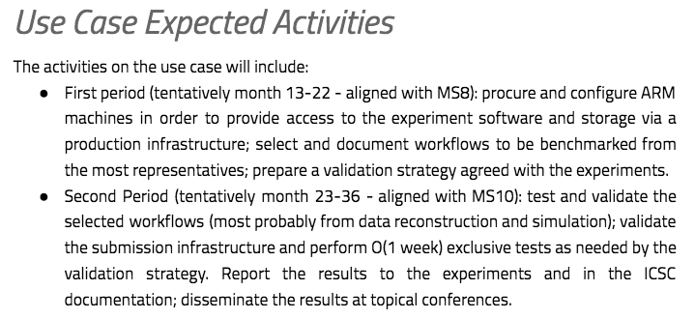
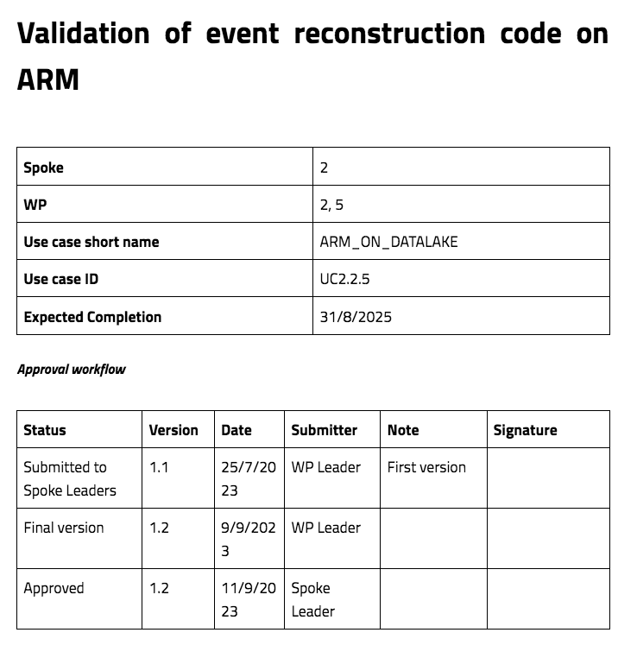
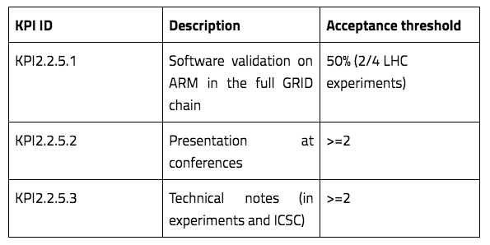
An example of a Flagship

Slide 27
M4C2: “Dalla ricerca all’impresa”
Major focus of ICSC is to include theproductive system as a first citizen in the project, via two mechanisms
“Innovation Grants”: 1.8 MEur budget in Spoke 2 for projects shared with partner industries
First tranche by MS6, a second tranche later
“Cascade Calls”: 3.2 MEur budget in Spoke 2 for projects in part destined to external industrial partners
In the project initially in MS4, centrally delayed

Slide 28
Innovation Grants
Drivers:
Find commonalities between needs in research and industry, and test industrial use cases with similar technologies as in the flagship use cases
Give access to ICSC infrastructures to PoCs from the industrial system
Money allocation:
The company uses / acquires internal manpower and/or equipment
The company asks academia to hire additional positions for a shared use case on (for example) industrial data
Technology points of contact:
Machine Learning use cases (streams, images, …)
High rate data analysis on distributed data
Data Management solutions for Big and Distributed data
…
From LHC reconstruction techniques to industrial use cases: GANs, PIML, DL
From distributed analysis on multisource physics data to … any data
From the Exabyte-level data management of LHC to the management of any data

Slide 29
7 innovation grants activated (Sept 2023 – Aug 2025)
Eni:
(with Spoke 0): enable the Eni Green Data Center in Ferrera Erbognone for Spoke2/WP1 use cases
Predictive maintenance on ENI’s industrial plants
Physics Inspired ML per l’utilizzo di risorse naturali
Leonardo + TASI:
(with Spoke 3) Interoperable Datalake: Data management + Block Chain pilot for Space Economy data
UnipolSAI + SOGEI + IFAB:
(with Spokes 0, 1, 3, 4, 5): monitoring urban areas’ danger and vulnerability situations for prevention and assurance evaluation
Intesa Sanpaolo:
(with Spoke 5 and TASI): finding correlations between satellite images and financial situation of agricultural enterprises
(with Spokes 3 and 10): Fraud detection on streams of financial data

Slide 30
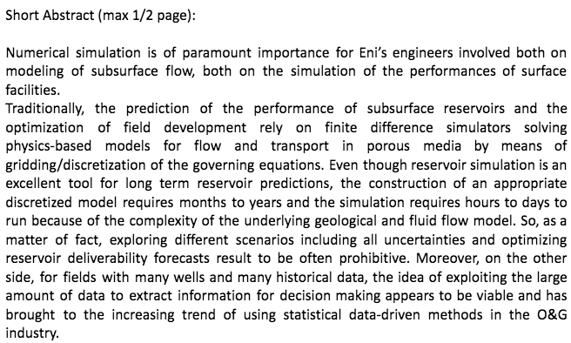
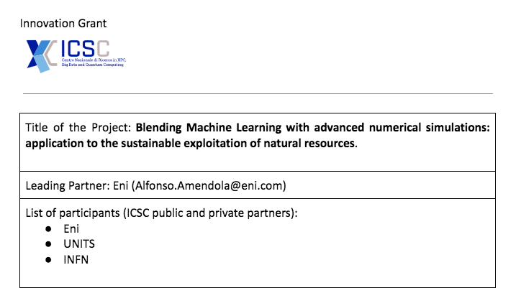
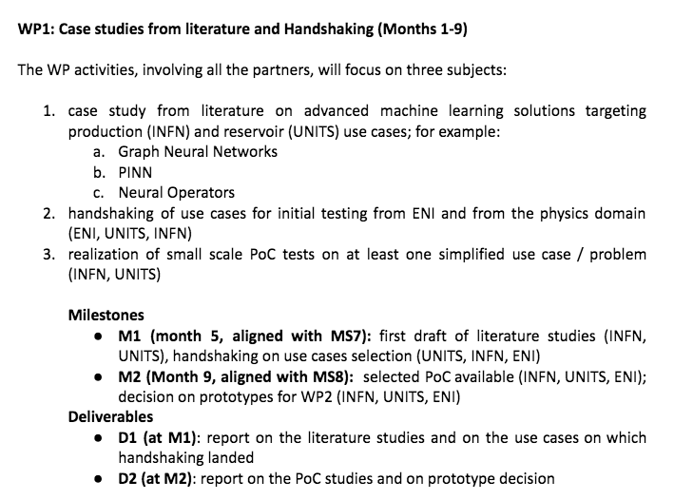
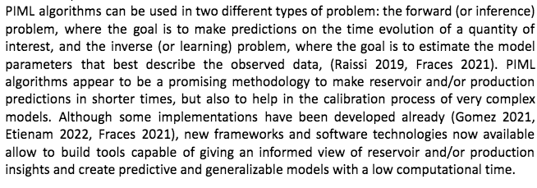
The IG projects
They are designed as full projects, with milestones, KPIs, deliverables

Slide 31
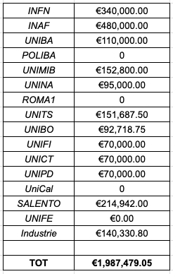
Innovation Grants
All the budget (and then some) allocated by MS6, with 43% in southern regions
Companies have decided in most cases to fund the academia
Not always easy for them to get accounted for by the PNRR
A major goal is to attract talents and they are more easily found via the academia

Slide 32
Second round of Innovation Grants
Even if we already «spent our share of budget» (and some more), there are still the ~8 MEur left in the HUB
An added project from the first round: Intesa Sanpaolo / Spoke 1: Federated Learning Finance
Spoke 2 contributed to 3 additional Innovation Grants:
IFAB: SAFE (Secure anomaly detection edge AI system For critical Environments)
Bonfiglioli S.p.A.
Tampieri S.p.A.
SECO S.p.A.
Università di Bologna S.p.A.
IFAB: SowStain (Digital Twins for Precision Agriculture) – Spokes 2,4,5,9
Unical
SECO
Coldiretti
…
Intesa: Differential privacy
UniPD
Intesa
Quota SUD not relevant: these are accounted to the HUB

Slide 33
What is an affiliate expected to do (adm level)?
If the grant has as a part of “Massa Critica”
Either increase the PM of staff already in Massa Critica
Or add collaborators: needs to be communicated to the Hub, needs to start filing Timesheets
If the grant has a part of “New Hires”
Do it! We already received official info from the Hub
The sooner the better!
IGs formally started on Sept 1st 2023
IGs for academic affiliates are just “additional budget”: the same rules apply!
IGs for industrial friends are a new thing… but in general the budget is low so “somehow we will make it”

Slide 34
Cascade Calls (i.e. funding for external partners)
The Cascade Calls were designed in the initial project as a means to extend the ICSC actions beyond the limited number of partners
Extending to:
Academia: involve some of the Universities / Research Institutions not selected for ICSC, allowing them to propose use cases to enrich the Spoke 2 scientific program
Private Companies: request services and actions (top down) and asking for industrial use cases (bottom up)
Remember: the external private partners will not be reimbursed at 100%, so even the services should be interesting to them. It is not a procurement!
ICSC centrally requests them to be at least 51% towards the productive system (in addition to 50% in Southern regions)
Current status 🡪

Slide 35
Current best assumption
We received a template tender notice, which we are trying to push asap
If all goes well, we could aim to 18 months projects + 6 months of extension if the ICSC can account up to Feb 26, 2026 (sort of expected)
We (the ICSC) are very late … and honestly, we (me) fear a low participation
Limited reimbursement rate for the private
Too much bureaucracy for the academic
Discussion at the end of today!

Slide 36
Objectives - academic
Development of data acquisition and trigger strategies in the context high background, rare event experiment, using acceleration on hybrid CPU/FPGA architectures, in the context of the activities of the Spoke2 in ICSC
Development of a multipurpose/multi experiment high level cloud infrastructure for small/medium astroparticle experiments, on the infrastructure of ICSC and for the benefit of Spoke 2 use cases
Development of a GPU library for massively parallelized simulations of QCD and QCD+QED on the lattice in the context of the activities of the Spoke2 in ICSC
Development and performance optimization of typical simulation code in HEP and Astro, for the use cases of Spoke 2
Advanced algorithms for GW experiments (Virgo and ET) in the context of the activities of the Spoke2 in ICSC
Solving the quantum Boltzmann equation following neutrino flavour conversion in a dense environment in the context of the activities of the Spoke2 in ICSC
Development of algorithms for boosted topologies at LHC/FCC, in the context of the activities of the Spoke2 in ICSC
Accelerated analysis of Astrophysical data in the Photon Counting Big Data era, in the context of the activities of the Spoke2 in ICSC

Slide 37
Objectives - private
Data Management tests using Spoke 2 solutions in industrial environments
Support for R&D activities on the ARM architecture (support + access to remote resources not available in the CN/Spoke0 + help in the sw porting)
Porting and optimization (on GPU, on FPGA, on CPU) of algorithms of interest of AstroParticle experiments
Realization of tools and pilots for the Space Economy domain, using the infrastructure of the ICSC
Realization of a PoC market exchange for Space Economy, on the infrastructure of the ICSC
Heterogeneous industrial use cases on the Spoke 2 platforms (GPU + FPGA + ARM)
Support for profiling, code engineering and code quality on Spoke 2 code repositories
Support of Spoke 2 tools and solutions towards industrial cascade call recipients

Slide 38
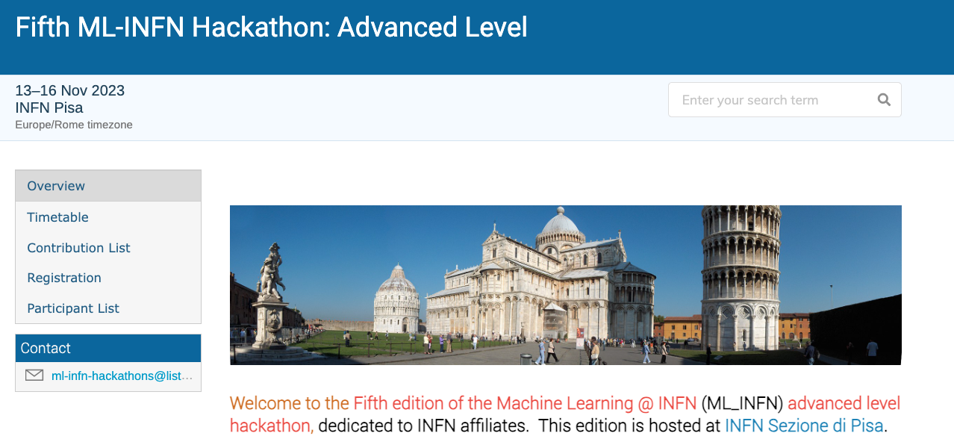
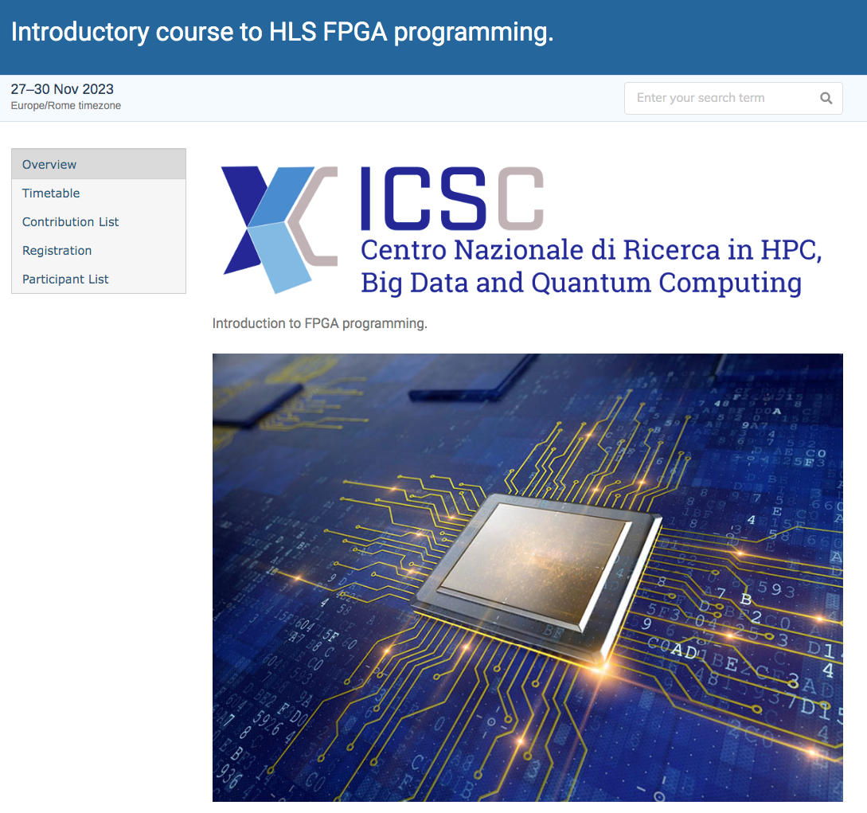
Organization of events
Especially regarding the technical part, it is important to organize training / education opportunities
As of now, we have (co-)organized
A school on GPU programming
A Space Economy Workshop
A school on Distributed Computing and Cloud
A school on FPGA Programming
A school on Machine Learning

Slide 39
Needs for the utilization of ICSC Infrastructure resources
Activities Spoke2 need to access to the ICSC infrastructure
HPC core Hours, Cloud VMs, storage, access to FPGA systems, …
(otherwise they would have been executed before / elsewhere …)
When compiling the Flagship and the IG proposals, the proponents were asked to specify the computing needs to be forwarded to ICSC’S RAC
Leonardo Giusti (UNIMIB) member of RAC designated by Spoke2/3

Slide 40
To-date (Friday 15th)
5 IG RAC requests inserted (Agri@Intesa missing)
6 requests from WP1 (Flagship and not)
3 from WP2 (they do NOT include ARM and FPGA … we go a different road)
Waiting for O(10) WP3 requests
Workflow:
PIs of initiatives (IGs, Flagship, other inititives) proposes them to the WP leaders
Approval of WP Leaders
Uploading to the portal
(when asked) SP Leaders will prioritize
(as of last week, Spoke2 had submitted > 80% of the total requests ?!?!??!?)

Slide 41
Papers, Conferences, Tools…
Help us keep a list of relevant papers / contribution to conferences
We are admittedly, a bit late, with O(20) conferences + O(10) papers
But …
The major Experiments at LHC have evaluated the ICSC as a sizeable source of support and solutions. We have negotiated putting ICSC as an acknowledgements in all papers which used the technologies we are proposing
Pubblicazioni, Conferenze
We will move now to the same request to smaller experiments
Tools:
We created a Spoke-wide GitHub repository to allow for a coherent view of the codes
We have a GDrive area for the Boards / the WPs

Slide 42
The reports up to now
As per the initial project, the activities were organized on an annual basis as per the idea explained before
In this view, at MS6 (Aug 2023) we have concluded the scouting / technology tracking / use case definition phase
At MS4, control point for the activities
In the following: a fast recap of the MS4 and MS6 KPIs

Slide 43
MS4

Slide 44
MS4

Slide 45
MS4

Slide 46
MS6

Slide 47
MS6

Slide 48
Now we are in M7 since more than 3 months
All but one the kickoff meetings for the Innovation Grants have happened. “Light” program of work for M7 is expected
know each other
Collect specific use cases and datasets on which to operate
Test solutions on synthetic data
(hire personnel)
For the Flagship projects, some projects have explicit M7 goals (producing the synthetic data needed afterwards, start optimization of codes, choice of actual technology, literature studies, …)
We think all the activities are currently not suffering important delays, but any hiccup would create some (no allocation of resources, problems in hiring procedures, …)

Slide 49
Critical aspects
From the meeting with referees …
Timing is strict for Innovation Grants: they started on Sept 1°, but legal agreements with industrial parties take time; on top of that, new academic hires will also take time and after the start of PNRR it is difficult to find people (even more in southern regions, which are even more under pressure)
Timing is even more strict for Cascade Calls. We (all the spokes) have plans but making them a tender will take a lot of time. There is the risk that the projects will be only slighly longer than 1 year (which is very short, even more for the academic targets which will need to hire etc …)
The computing requests to the ICSC’s RAC are large and challenging, not clear yet which fraction will be possible to accomodate
A very good fraction of the hiring has been successful; still we feel we have emptied the candidate lists. The next hirings (Innovation Grants, inevitable churn of personnel finding other opportunities, we will have problems, especially in the Southern Regions
Communications with industries not always easy. Now that we are getting into a more technical ground, things are improving

Slide 50
What is going “better than expected”
From the meeting with referees …
A few initiatives were designed and launched mostly for ”technological interest”, but seem to have acquired much more critical mass than expected
FPGA programming, Low-power ARM, blockchains for data certification, …
In general, the “atmosphere”
There is no tension Research-Institutes vs Academia
The atmosphere is very positive if not straight pleasant
We NEVER needed to use a voting procedure; all the decisions taken by very wide / unanimous consensus
Communications lines work well (Spoke to WPs, WPs to affiliates, …)
The quality of the hires is very good, with a lot of enthusiasm sensed

Slide 51
Referee report …
Not yet exisiting as far as I know
In general:
Very good feeling at the Spoke2 referee meeting, they seemed really satisfied
It has been «orally communicated» that the report will be «largely positive»
They were also very impressed by the Tecnopolo infrastructure

Slide 52
Some help needed from ALL of you! (most already specified)
Easy ones:
Take care of updating personnel: here
Take care of updating conference talks: here
Take care of updating papers: here
More complex:
Take care of providing “rough” activities per person: here
In case we are asked …
Open calls: help in formulating the objectives (later today)
…

Slide 53
Conclusions
We are already in the “Phase-2” of ICSC: the realization phase
A big project with many partners and actors, and many formal steps to be fulfilled
Not everything as smooth as hoped
Still:
We have formed a tightly-connected team
The new hires are competent and enthusiastic
The scientific initiatives in which we move have recognized the importance of ICSC
The scientific potential of what we do is HUGE … let’s get it realized!

