Slide 1

IG Interoperable Data Lake (IDL)
Meeting di Fine Anno Spoke 2 _ 18-20 Dicembre 2023
ICSC Italian Research Center on High-Performance Computing, Big Data and Quantum Computing
Missione 4 • Istruzione e Ricerca
Notes:
Cover

Slide 2





Summary
Data Space & High-Level Technical Concepts
Interoperable Data Lake - General Objectives
Activities & Work Packages structures of the project
        INFN - DataLake
      INAF - Data Models and metadata definition
      INFN - BlockChain system
      Leonardo - Database technology
      Thales Alenia Space - Architecture and Algorithms for SSA Processing
Project management structure
Targets and milestones
Centro Nazionale di Ricerca in High-Performance Computing, Big Data and Quantum Computing
Missione 4 • Istruzione e Ricerca

Slide 3
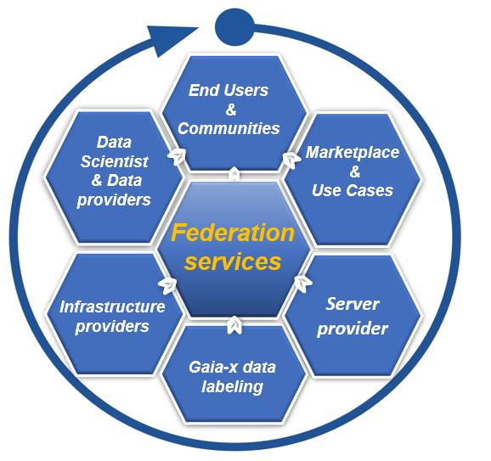
Space Data Space
Our objective is to facilitates access to space data, to foster innovation and to help attract new potential partnership
The Space industry is characterized by the sharing economy, there is a more open, wider market participant outreach that includes academic, commercial and governmental players.
Our solution is a data exchange platform, builds on existing infrastructures (CN HPC), where data acquirers and data providers meet to source, distribute, exchange data securely, in compliance with Gaia-x regulations
The initiative combines platforms and different ecosystems that all follow a common set of rules and policies and deploy a common marketplace to enable a Federated Data Ecosystem
Centro Nazionale di Ricerca in High-Performance Computing, Big Data and Quantum Computing
Missione 4 • Istruzione e Ricerca

Slide 4


Embedding space ecosystem into data value chain
Data sources
Standardized data
Optimized data
Sharing models
Data use
Input sensor and data layer
Aggregation and normalization of data within local, interoperable repositories
Sharing prerequisites through harmonized access management
Depending on the legal basis and use case
Data, insights, software and algorithms as a service
Space satellite sensor
Providers and
Metadata
Security & access management
National Hubs
research institutions
Observatory
Use case
FAIR data
Findability Accessibility
Interoperability Reusability
Data catalogue
Insights
Data
Data Space
data repository
user communities
Harmonized Privacy management
ESA - DIAS
ASI - SSDC
Marketplace
PAAS
SAAS
Centro Nazionale di Ricerca in High-Performance Computing, Big Data and Quantum Computing
Missione 4 • Istruzione e Ricerca

Slide 5
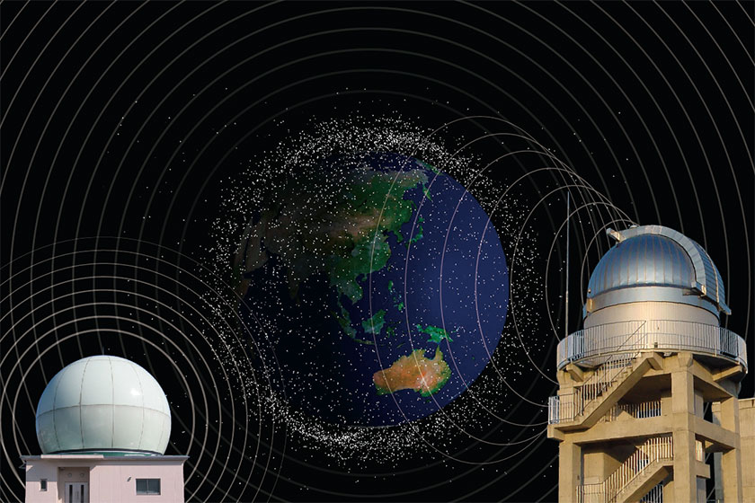
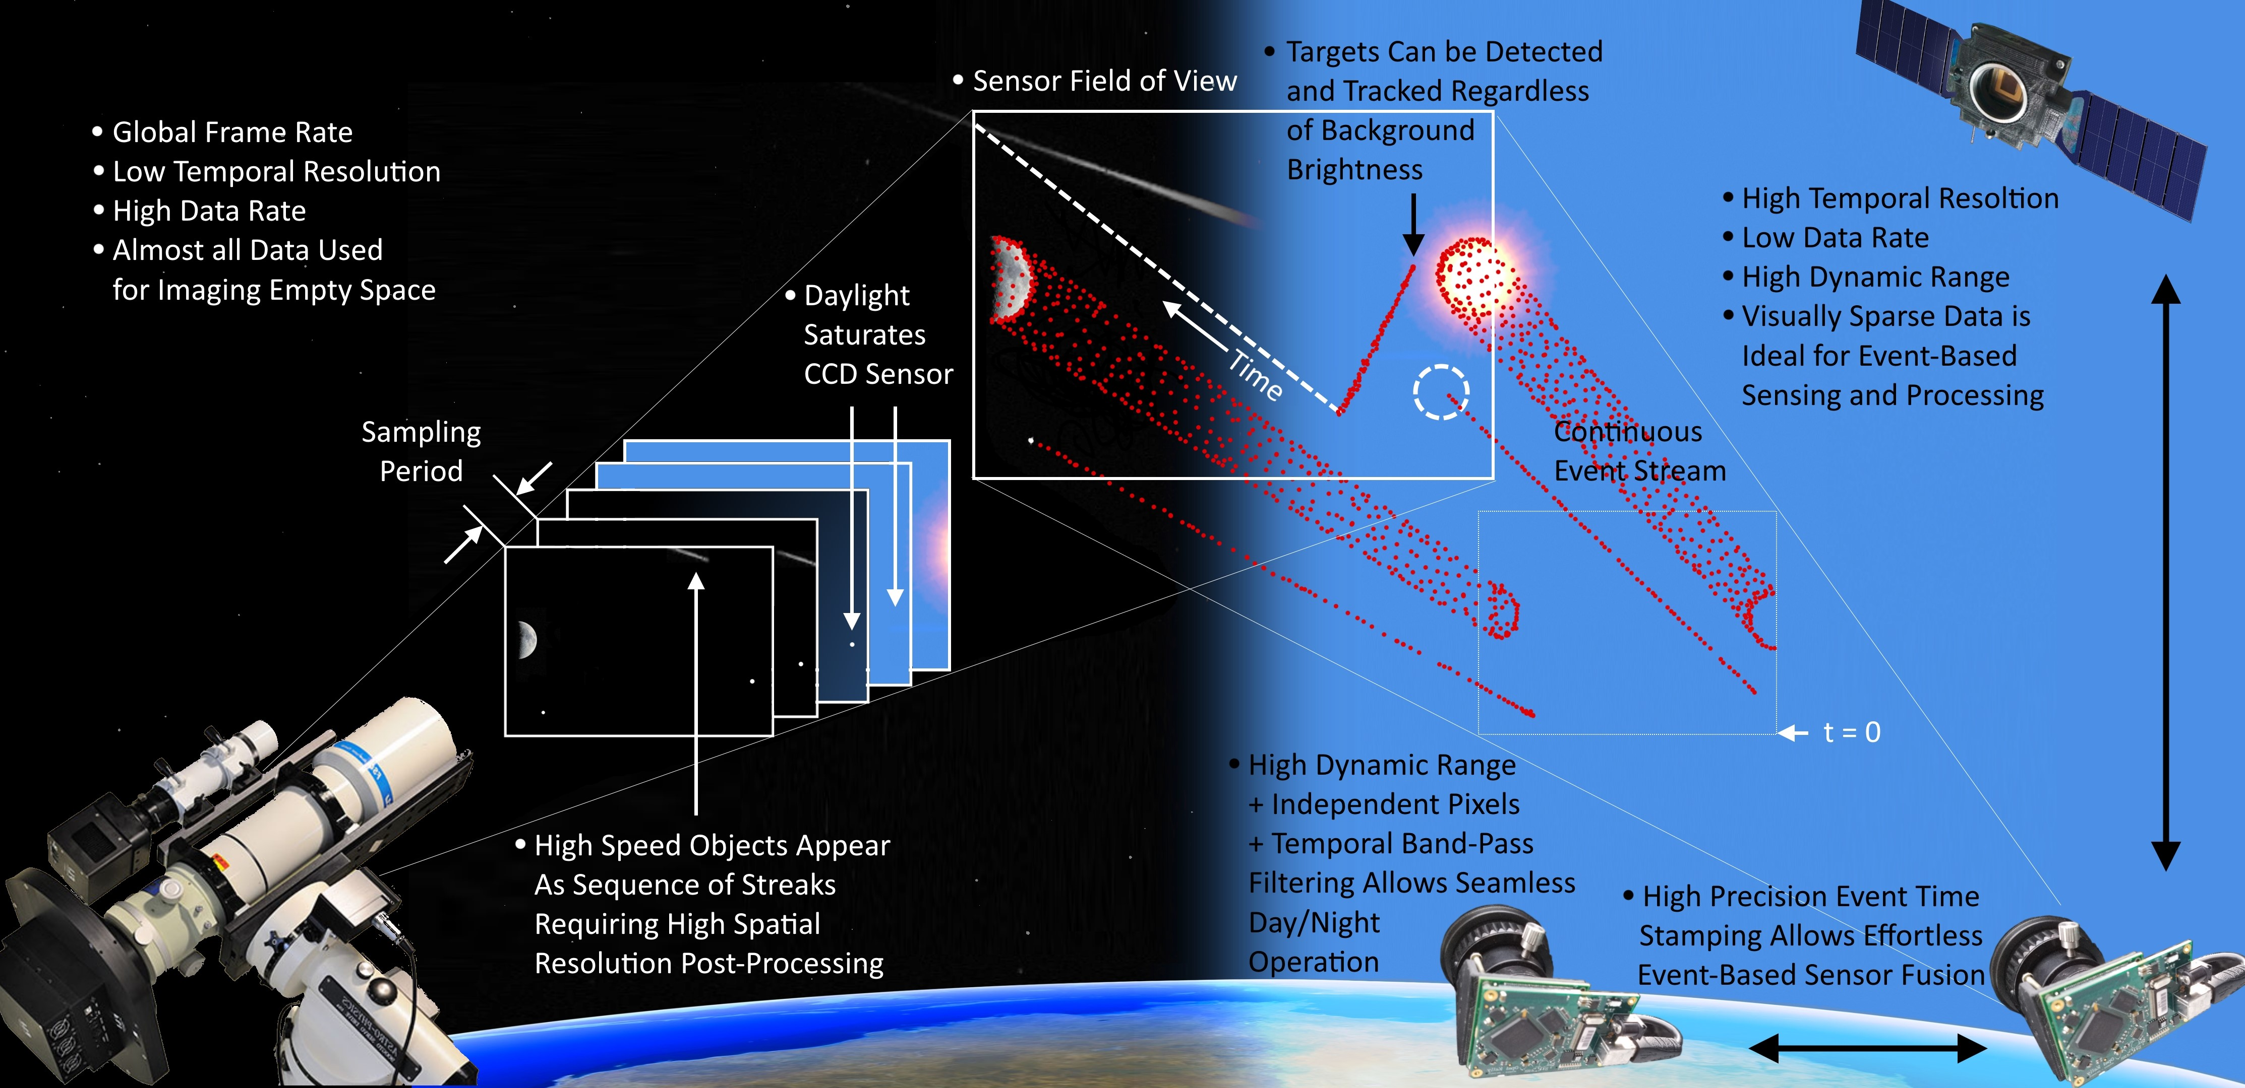
Space Situational Awareness (SSA)
SSA refers to the knowledge of the space environment, including location and function of space objects and space weather phenomena. SSA is generally understood as covering three main areas:
- Space Surveillance and Tracking (SST) of man-made objects
- Space WEather (SWE) monitoring and forecast
- Near-Earth Objects (NEO) monitoring (only natural space objects)
Space sensors in both in Low Earth Orbit (LEO), Medium Earth Orbit (MEO) and Geostationary Earth Orbit (GEO) are suitable to provide:
  operation and continuity: space-based surveillance and tracking are not impacted by atmospheric and weather conditions and by day and night cycles
  Accuracy: space-based measurements are not affected by the impairments of the atmosphere
  Global coverage: space sensors are designed and deployed to complement and augment the coverage of ground-based assets, whose installation/operation is precluded in remote and oceanic areas
  Responsiveness: space sensors can improve the revisit of the space volume(s) requiring “constant” monitoring; further, space-based data relay (i.e. inter-satellite links) can provide real time tasking and fast telemetry transmission of/by space sensors.
Centro Nazionale di Ricerca in High-Performance Computing, Big Data and Quantum Computing
Missione 4 • Istruzione e Ricerca

Slide 6
General Objectives
The Project aims at creating a Data Lake service, supporting a seamless access to space and ground-based observations and simulated data. The project addresses the design and commissioning of an interoperable, distributed data archive, relying on state-of-the-art open technologies, supporting both science and industry.
The service will specifically address the challenges related to the big data scenario, in terms of both data management, storage, access, identification and of access to computing resources necessary to process the data.
Test solutions for managing data in a geographically distributed environment by building end-to-end prototype and testbeds to demonstrate - to optimize big data storage and efficiency of data retrieval, exploiting state-of-the-art cloud-based technologies
Definition of a data model to describe and access the data will be designed according to FAIR, IVOA and GAIA-X standards.
New techniques of block-chain and web-based stacks like Object Storage, will be used, tuned and linked together
Updating existing debris databases with new space–based observations and observations from space;
Simulation of state of art algorithms for processing of space-based sensors data for SSA and evaluation of the computational load
Centro Nazionale di Ricerca in High-Performance Computing, Big Data and Quantum Computing
Missione 4 • Istruzione e Ricerca

Slide 7
Activities & Work Packages structures of the project
Centro Nazionale di Ricerca in High-Performance Computing, Big Data and Quantum Computing
Missione 4 • Istruzione e Ricerca

Slide 8



INFN – WP1: Data lake
INFN proposes to test solutions for managing data in a geographically distributed environment to exploit the Data lake. All the services will be deployed in the form of containers managed via container orchestrators. Test solutions for managing data by building end-to-end prototype and testbeds to demonstrate the data management capability and the data and compute integration for an effective processing and analysis
Objective 1:
Definition and PoC of the deployment model of the Data Management system.
Workplan (high level) and Objectives
Deploy the Data Management system, storage backends and basic compute services, perform functional tests and document the overall implementation
Open the Data Lake to the real tests. Astrophysical observations and simulations are used for the system evaluation
Objective 2:
Evaluation and benchmarking the Data Management system with domain specific data.
The proposed architecture will be developed integrating the INFN-Cloud portfolio of services.
Containers (i.e. Docker)
Container orchestration
PaaS Solutions
The adopted technologies enable a Lego-like approach: services can be composed and modules reused to create the desired infrastructure.
Centro Nazionale di Ricerca in High-Performance Computing, Big Data and Quantum Computing
Missione 4 • Istruzione e Ricerca

Slide 9

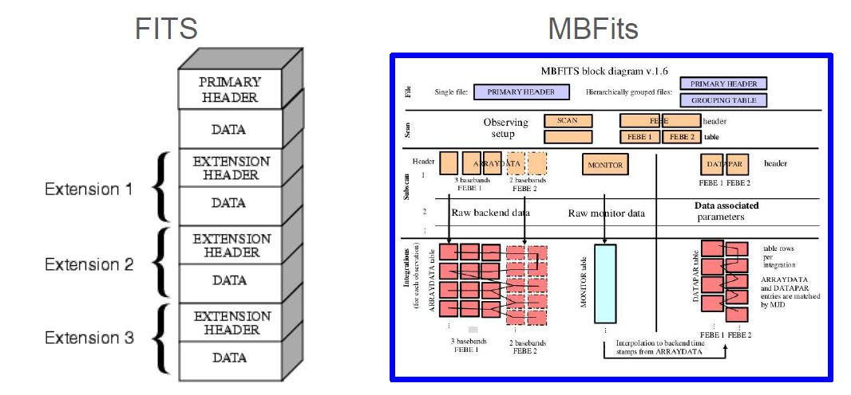
INAF & LDO – WP2: Data Models and metadata definition
A key activity to obtain this objective is the definition and use of a metadata layer and standard, to be developed in close collaboration with data provider communities.
Astrophysics data formats
The data model will include all relevant information about data, software for data reduction, analysis, data policy, and all the information for data filtering for retrieval.
Datasets identification: selection of data coming from radioastronomy, space debris observations & numerical simulations;
Data Models and metadata definition: Identification of a suitable data model and metadata definition, Implementation of an ingestion software;
Requirement analysis (for DB): choice, implementation, testing and verification of the database technology to be integrated on top of the data-lake.
Database deployment in ICSC infrastructure: deployment of the ingestion software and the chosen DB into the ICSC infrastructure
Validation and testing: performance test of the processing pipelines on a hybrid HPC/cloud
Centro Nazionale di Ricerca in High-Performance Computing, Big Data and Quantum Computing
Missione 4 • Istruzione e Ricerca

Slide 10

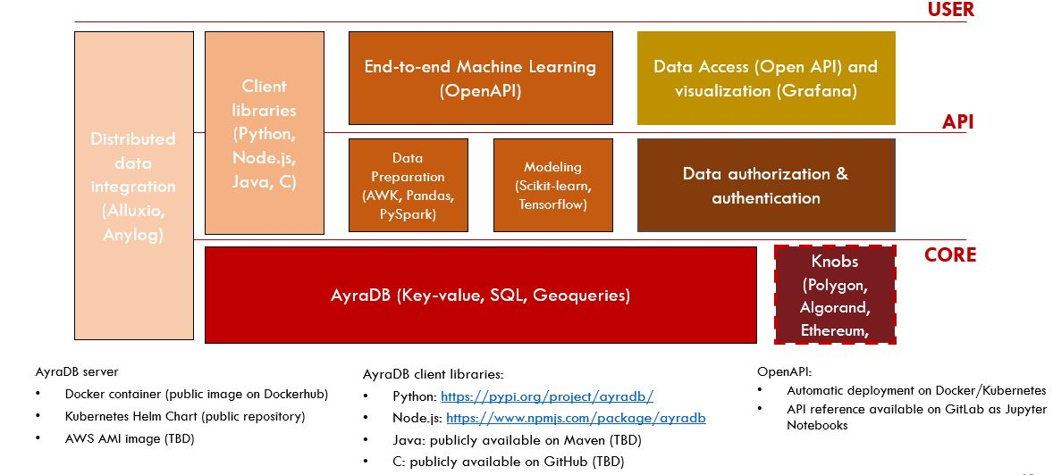
LDO & Cherrydata - Cloud-native distributed database
WP2: Data Models and metadata definition, data archiving
Objective. Support the integration and query of data coming from different sources, complemented with simulated data, with a performance that enables novel application with real-time requirements in SSA use case, to achieve maximum effectiveness and efficiency in data provisioning and exploitation
Requirement analysis:
  Gather information necessary for the definition, implementation, testing and verification of the database technology to be integrated on top of the data-lake.
  Analysis and definition of the required data processing activities: preprocess, cleaning, normalize, rescale data, with a focus on data models and metadata definition.
Database deployment in ICSC infrastructure, validation and testing
Implementation of the data ingestion service, to collect data efficiently from the instrument/sensor network.
Integrate the components of the prototype system with their applications and data platform and deploy them on the Consortium infrastructure.
Technology Stack
Centro Nazionale di Ricerca in High-Performance Computing, Big Data and Quantum Computing
Missione 4 • Istruzione e Ricerca

Slide 11
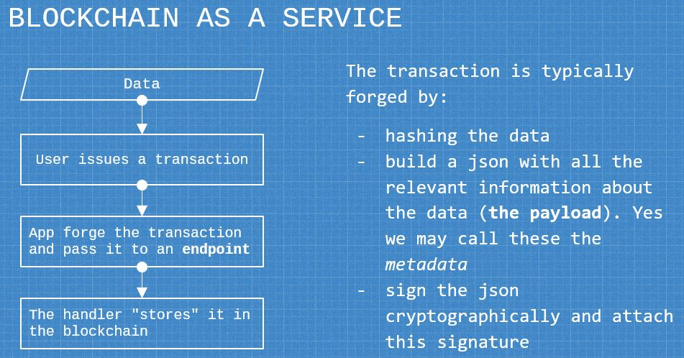
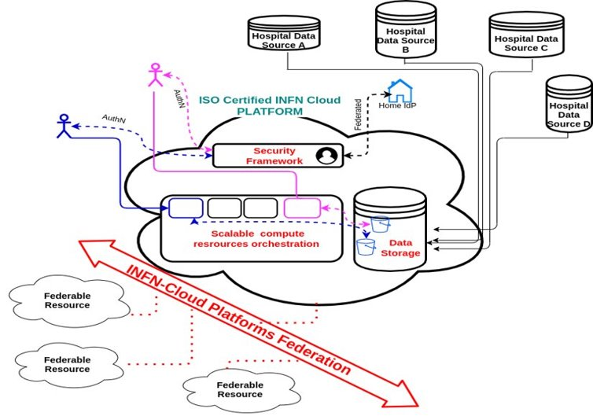
INFN – WP3, 4: BlockChain
WP4: Blockchain deployment on the ICSC Data lake
Wp3: Blockchain system for the data lake
Objectives
Definition and PoC of the deployment strategies on the Data lake
Report on the BC technology tracking and comparison of solutions
Activities
Scouting and tech tracking of open-source BC technologies
To be deployed on Cloud (ICSC federated resources)
  As a managed infrastructure service
  On-demand
Deployment of a blockchain network to execute fundamental CRUD (Create, Read, Update, Delete) operations, catering to the requirements of the project.
This blockchain network will be accessible through a REST API with an HTTPS backend, facilitating seamless communication between the blockchain and databases.
INFN Cloud technologies are already the basis for several research projects at national and European level:
Several national projects funded under the EU Recovery and Resilience Plan
Harmony Alliance
Health Big Data
Centro Nazionale di Ricerca in High-Performance Computing, Big Data and Quantum Computing
Missione 4 • Istruzione e Ricerca

Slide 12
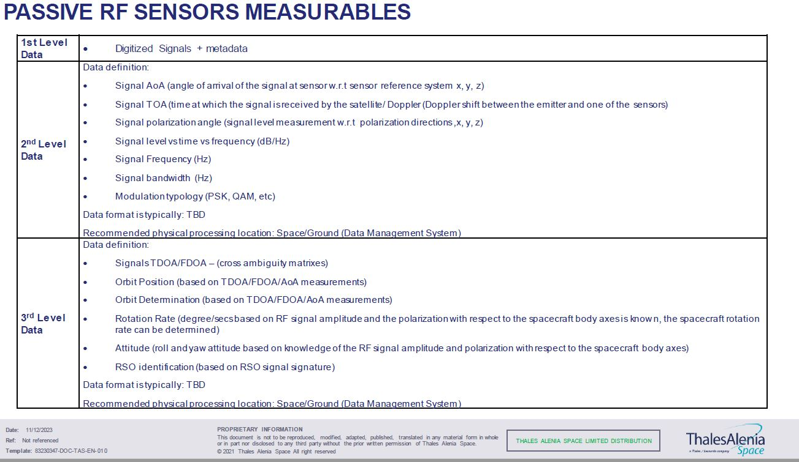
Thales Alenia Space
WP5: Architecture and Algorithms for SSA Processing
Simulation of state of art algorithms for processing of space-based sensors data for SSA and evaluation of the computational load. The simulator will provide:
Information to support architectural trade-offs in terms of optimal split between on board and on ground processing
A reference to evaluate complex scenarios with multiple sensors processing
Topics
Investigate existing and upcoming sensors typologies and technologies for space based ssa applications, identify measurable space objects characteristics they can detect and the data typologies they generate
Selection of a representative subset of sensors and identification of the state of art algorithms for data processing
Design and implementation of a mock up (simulator) which is capable to generate a synthetic data set for the selected sensors, implement the algorithms of the processing chain and evaluate the computational load
Centro Nazionale di Ricerca in High-Performance Computing, Big Data and Quantum Computing
Missione 4 • Istruzione e Ricerca

Slide 13
WP1: DataLake
Leader: Daniele Spiga (INFN)
Project management structure
WP2: Data Models and metadata definition
Leader: Cristina Knapic (INAF)
GDL1
Project PI
PI: Carolina Berucci (Leonardo) Co-PI: Cristina Knapic (INAF) Technical Manager: Daniele Spiga (INFN)
WP3: BlockChain system for the data lake
Leader: Francesco Visconti (INAF)
Management Board
Composed by one representative for each industrial partner, one representative for each Spoke the Technical Manager and the WP Leaders. Coordination, verification and planning of the project activities. Fixed meetings: every month.
WP4: Blockchain deployment on the ICSC Datalake
Leader: Alessandro Costantini (INFN)
GDL2
WP5: Architecture and algorithms for data processing
Leader: Gaetano Pastore (TASI)
ICSC Italian Research Center on High-Performance Computing, Big Data and Quantum Computing
Missione 4 • Istruzione e Ricerca
Notes:
Template e guide lines

Slide 14
Targets and milestones
WP | Del. code | Definition | Del. date
1 | TN1 | Report the deployment solution used to implement the Data Managementnd results of the functional tests | M12
1 | TN2 | Report the deployment solution used to implement the Data Management and results of the functional tests | M24
2 | TN1 | Dataset identified and data model vs1 | M12
2 | TN2 | Technical report of the database | M18
2 | TN3 | Final report on database and data model vs1.1 | M24
2 | TN1 | Functional, Analysis, document | M6
2 | TN2 | Workflow definitions for data object tracking, and implementation in the licensed software | M18
3 | TN1 | Functional, Analysis, document | M6
3 | TN2 | Workflow definitions for data object tracking, and implementation in the licensed software | M18
4 | TN1 | Report the deployment solutions on the Datalake, with initial evaluation of results | M12
4 | TN2 | Technology tracking report on the blockchain solutions maturity | M24
5 | TN1 | sensors technologies and data typologies report | M8
5 | TN2.1 | Algorithms and simulator design and verification report | M18
5 | TN2.2 | Update - Algorithms and simulator design and verification report v.2 | M24
Centro Nazionale di Ricerca in High-Performance Computing, Big Data and Quantum Computing
Missione 4 • Istruzione e Ricerca

Slide 15
Thank you for your attention!
Centro Nazionale di Ricerca in High-Performance Computing, Big Data and Quantum Computing
Missione 4 • Istruzione e Ricerca

