Slide 1


Exploring new Technologies for Muon Collider topic 1: SC Magnets for the collider ring topic 2: SC Magnets foe the Cooling Cell
Thesis supervisor : Prof. Lucio Rossi (lucio.rossi@unimi.it)
Professor of Accelerator Physics at University of Milano
Topic1 co-supervisor: Dr. Samuele Mariotto (Unimi and INFN)
Topic2 supervisor: Dr. Marco Statera (INFN)
Place of thesis work: Milano at the LASA Laboratory of University and INFN

Slide 2

The Muon Collider is the raising hope for a energy-frontier collider: it can deliver both high energy and high precision
It si fully driven by muon lifetime: 2.2 μs at rest!!! And by the necessity to cool it quickly and efficienty!
Short intense proton bunches produce muons that
are captured
6D - Ionisation cooling of muon in matter
Acceleration to collision energy
Collision
Fast and efficient cooling of the Muons is necessary in order to pass from a “cloud of particles” to a cold beam. The cooling Cell is maybe the most critical element of the accelerator: no cooling, no muons to collide…
The coling is obtained by absorbing energy in all direction and giving back energy inone direction:
Efficient eabsorber; large acceptance RF Cavity; Strong, very large acceptance Supercond. Magnets for focusing
2

Slide 3
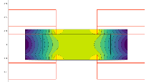
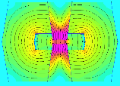
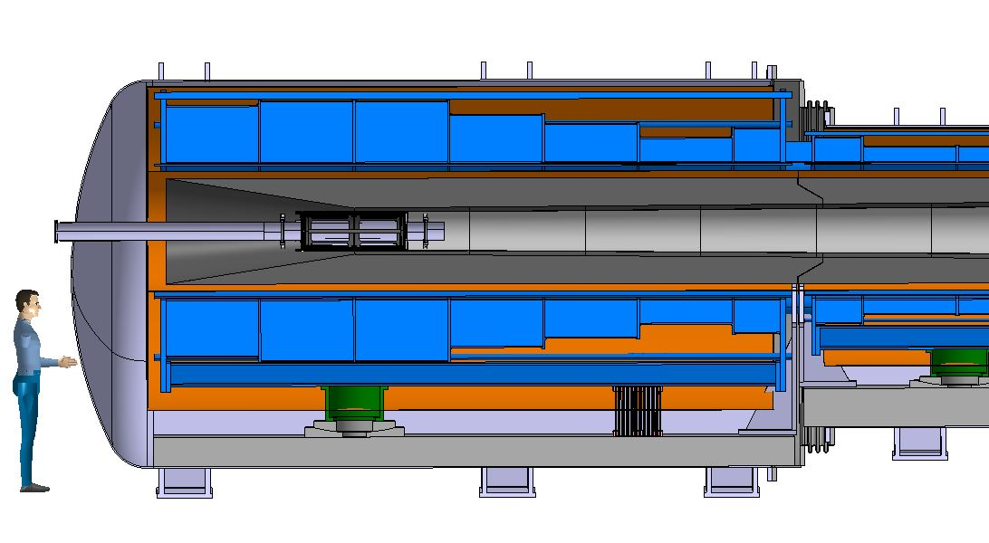
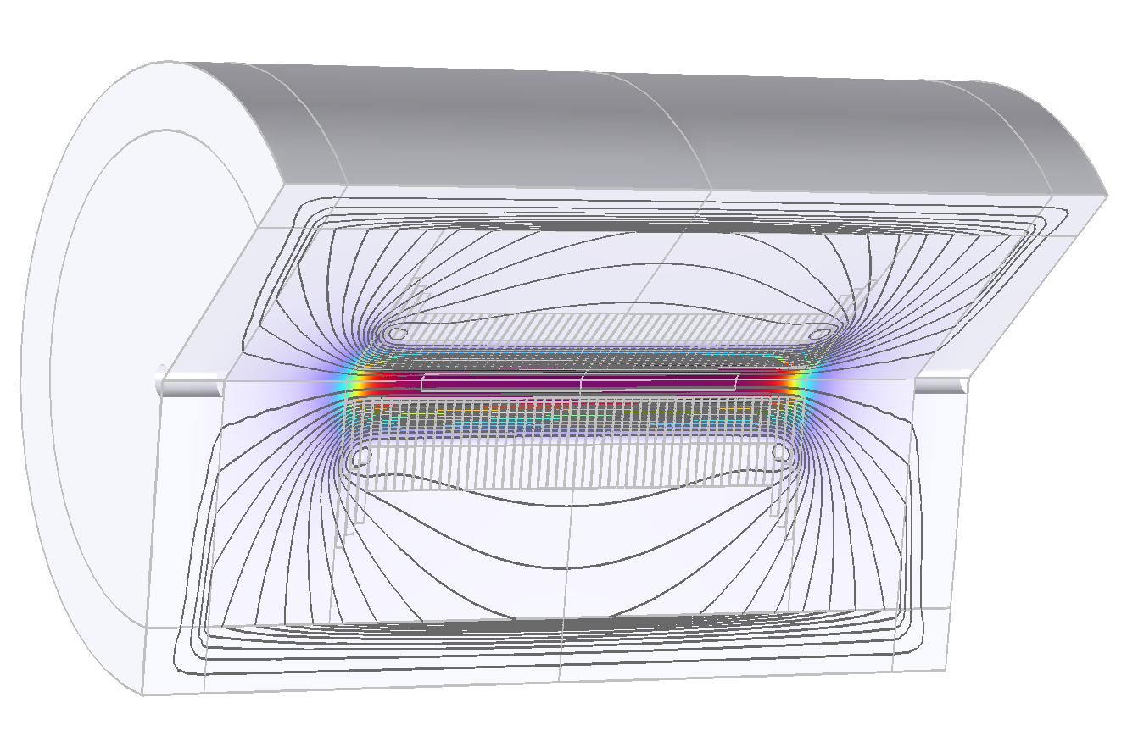
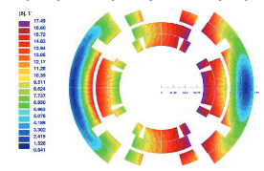
Muon Collider magnets
20 T, 200 mm
Radiation heat load ≈ 5…10 kW
Radiation dose: 80 MGy
NC ±1.8 T, 400 Hz 100 mm x 30 mm
SC < 10T
100 mm x 30 mm
SC dipole
NC dipole
NC dipole
SC dipole
RCS
> 40 T, 60 mm
16 T peak, 160 mm
Radiation heat load ≈ 5 W/m
Radiation dose ≈ 20…40 MGy

Slide 4
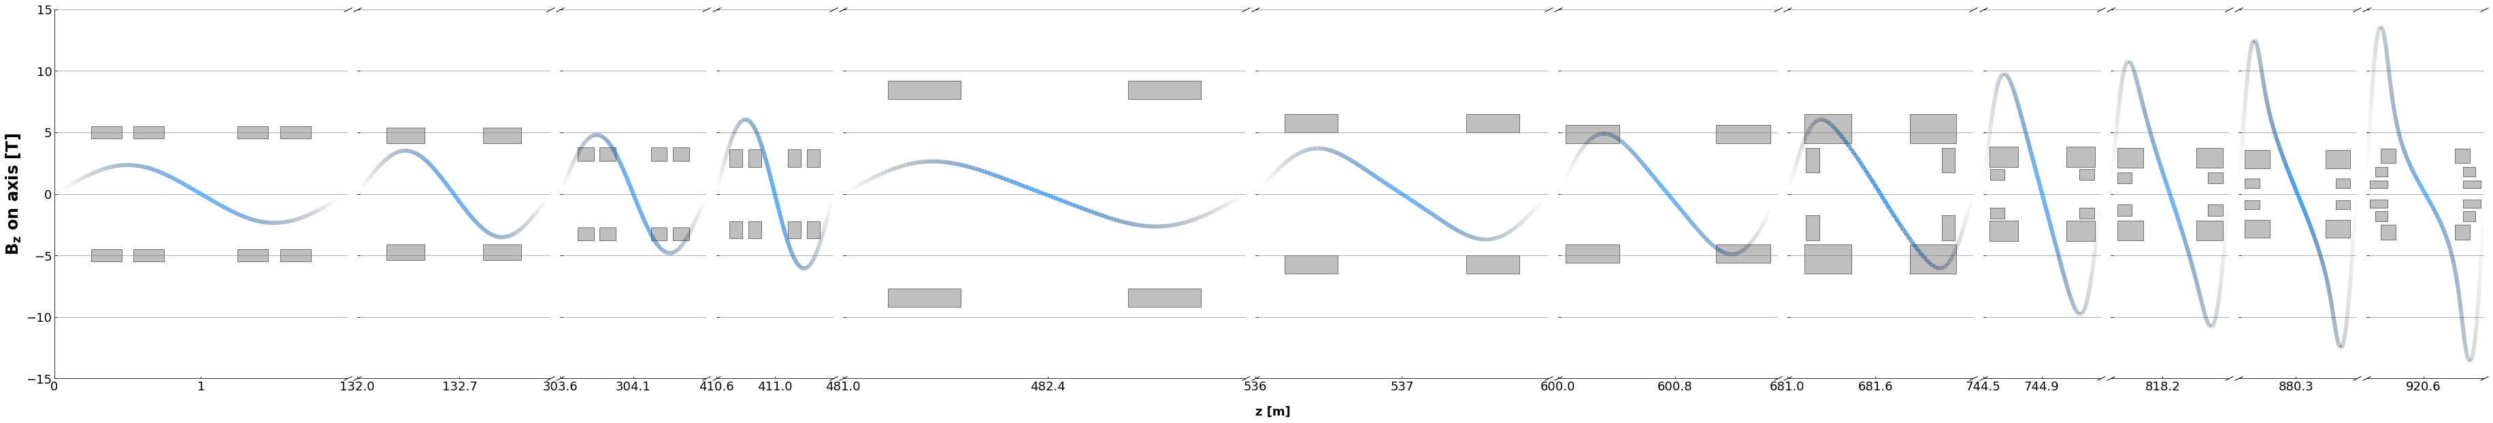
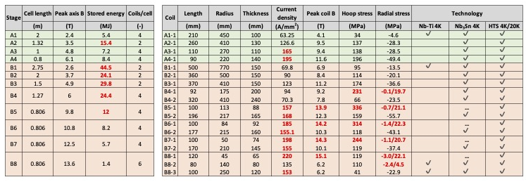
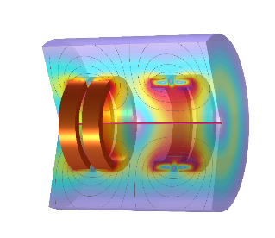
6D Cooling Cells
15
10
A1
A2
A3
A4
B1
B2
B3
B4
B5
B6
B7
B8
5
B(T)
0
-5
-10
-15
Coil size
Quench protection
Margin
Mechanics
Courtesy of J. Pavan, UMIL, and S. Fabbri, CERN

Slide 5
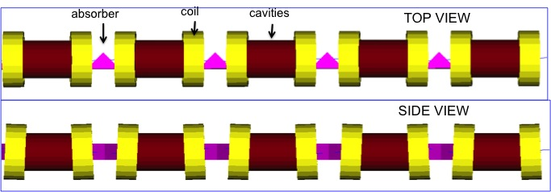
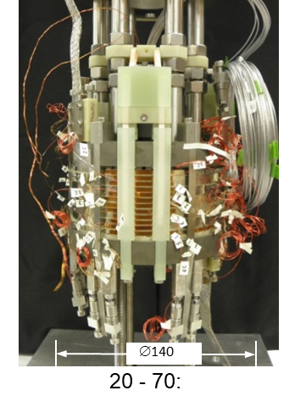
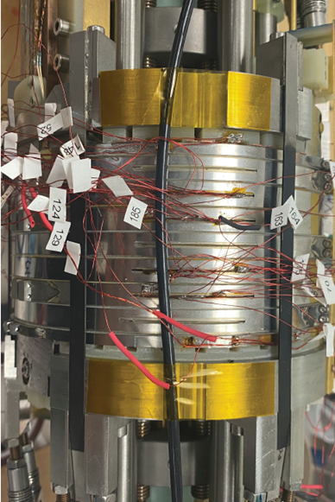
Magnet zoo for the Cooling cell …
Unique challenge: Magnets and RF cavity must overlap (very unusual)
PhD Thesis work:
Design of very high fields (3- 30 tesla!!) Solenoids
Exploring brand new technologies: Non-Insulated coil with HTS (high temperature superconductor)
Construction of a prototype for 3-5 T an then design of a proto of 20+ T
Experimental test of a solenoid (3-5 T) couple with 650 or 1300 MHz Cavity.
Study of the best optical configuration for maximum performance.
Design of prototype Full Cell, solving integration issues , for the CCC (CERN Cooling Cell) demonstrator
Proto of small high field SC solenoid in HTS (USA)
Exploring non-insulated technology has never bene done on such scale.
Possibility to learn on subscale coils, development of multiphysics modelling: Electromagnetic, thermo-mechanical, optical and integration

Slide 6
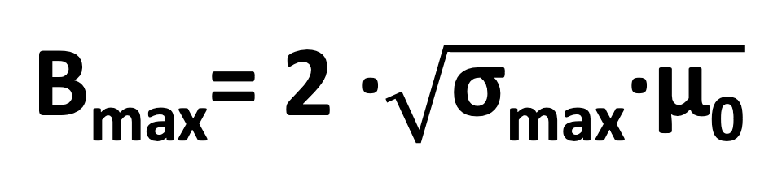

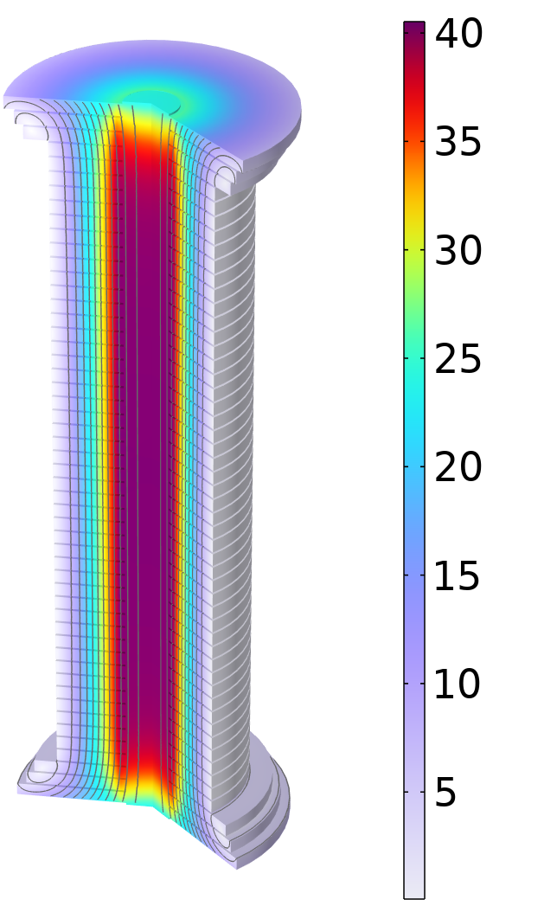
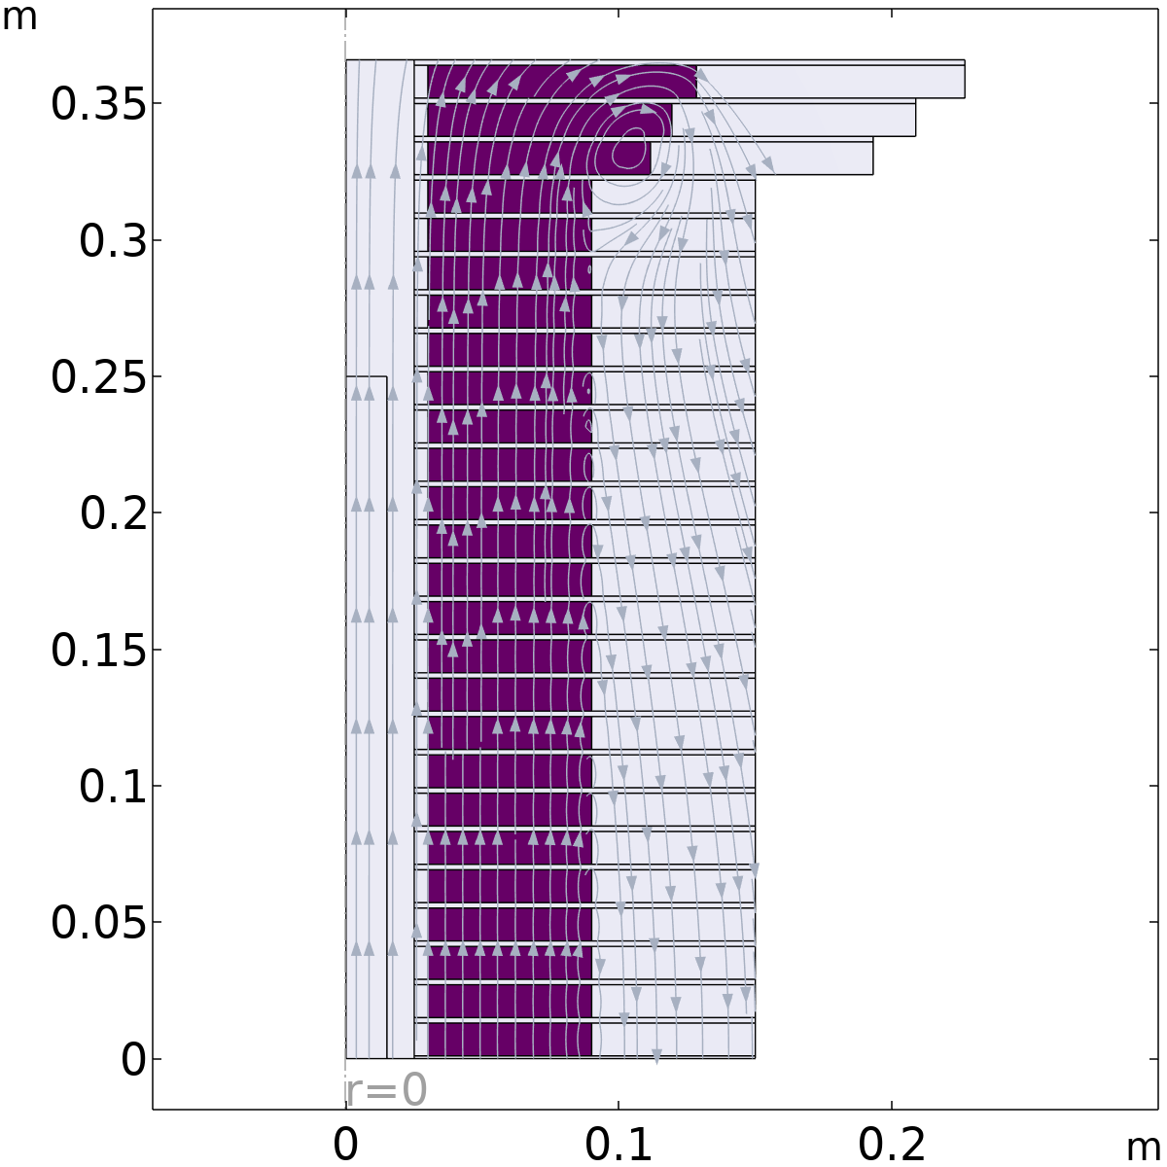
Final cooling (40 T) magnetics
σ_{max} = 600 MPa
  Modular pancake design with supporting ring and plates to manage hoop, radial and vertical stresses
  Free bore 50 mm
  Inner ring thickness 5 mm
  Coil winding thickness 60 mm
    J_{e} = 632 A mm⁻² → 40 T
  Outer ring thickness 60 mm
    Outer radius 150 mm
  Horizontal plate thickness 2 mm
Cross Section of ¼ Solenoid
Inner Ring
‘Correction’ Coil
Outer Ring
Bore
lines represent the field direction
Magnetic Field Modulus, T
‘Modular’ Coil
1 % Field Homogeneity
Support Plate
  46 identical ‘modular’ pancakes and 6 ‘correction’ pancakes are used to straighten the field lines at the solenoid ends
Courtesy of B. Bordini and A. Dudarev, CERN

Slide 7
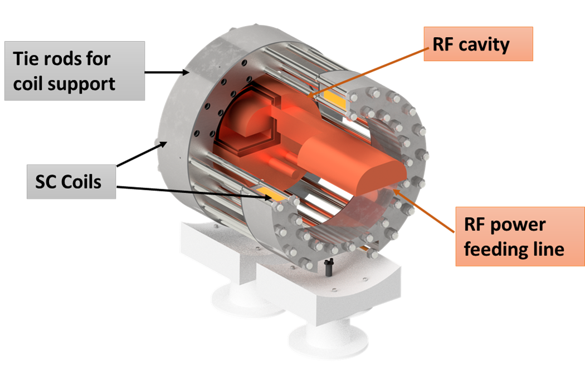
Facility under design at LASA lab
7 T splice coil in HTS, cryogen-free, for RF cavity test

Slide 8
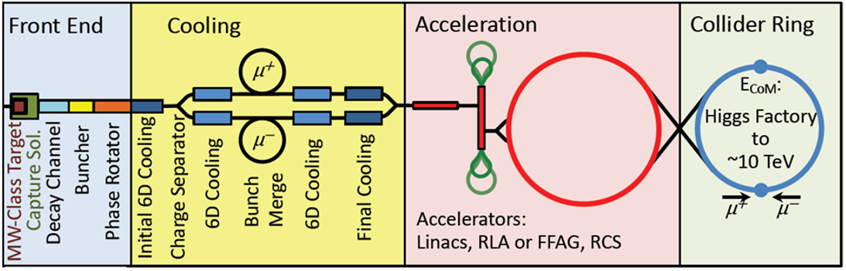
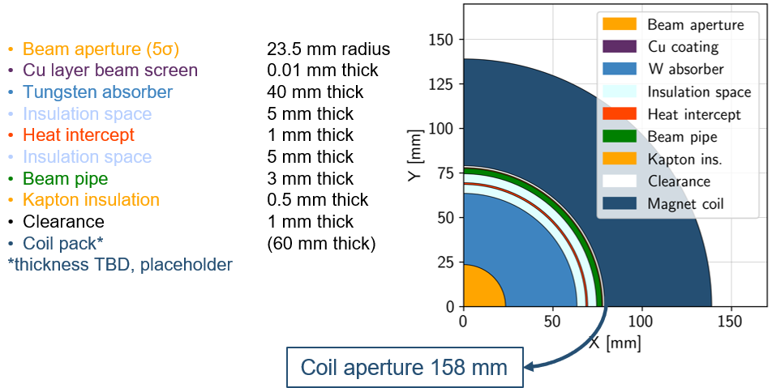
Collider Magnets Requirements
B. Caiffi e S. Mariotto
Field: 16 T peak (IR 20 T)
Length: 10…15 m (x 700)
Space between magnets: 300 mm
Radiation heat load: 5 W/m
Cumulative dose: 20…40 MGy
Aperture
Inserire testo
Courtesy of Patricia Borges de Sousa
https://indico.cern.ch/event/1250075/contributions/5357594/
Assuming 10 TeV machine and coil at 4.5 K
! Need for large fields in large apertures $→$ discussion on parameter limits

Slide 9
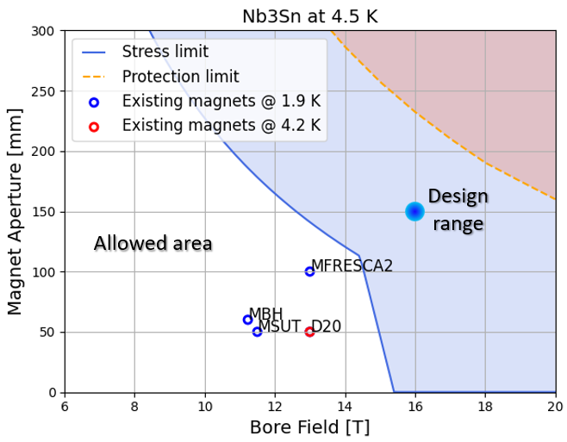
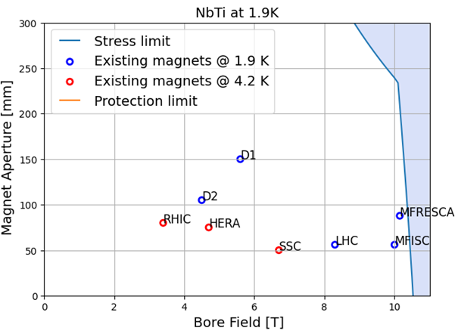
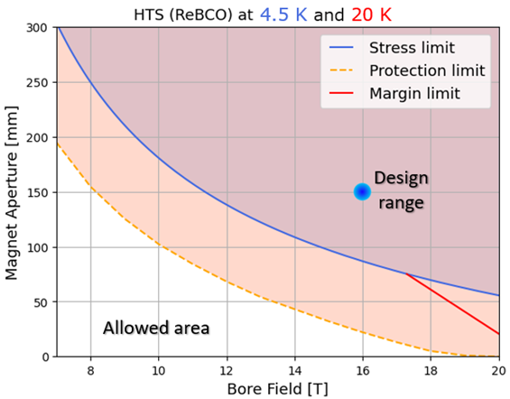
A-B plots Nb₃Sn
B. Caiffi e S. Mariotto
Allowed area
T_{op} = 1.9 K
We are using the aspirational value for the SC cost (700 EUR/kg).
Nb₃Sn falls short of required performance because of operating margin and peak stress.
Reducing the operating temperature at 1.9 K, the change in the slope occur at higher field.

Slide 10
A-B plots HTS
B. Caiffi e S. Mariotto
4.5 K
20 K
We are using the aspirational value for the SC cost (2500 EUR/kg).
HTS falls short of required performance because of peak stress and protection.
Need to devise alternative protection schemes.
Up to 17 T working with a cold mass operating temperature of 20 K.

Slide 11
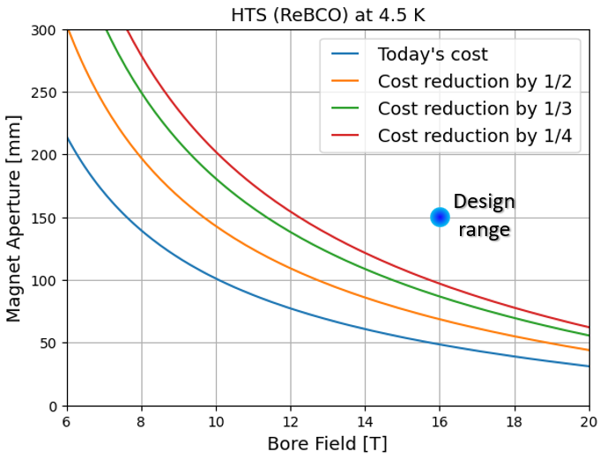
A-B plots
B. Caiffi e S. Mariotto
Reducing the cost of HTS will result in a bigger allowed area.
  Reducing the unit cost by a factor 1/4 doubles the maximum magnet aperture at 16 T.
The reduction in the cost of the HTS is obviously does not depend on us.
  Is it possible to spend more on the collider?
  (It is not 100 km long like the FCC).
Operation in the range of temperature 10 K…20 K (above liquid helium) will reduce magnet aperture requirements.
  Acceptable heat loads is increased by a factor 2…4, thus reducing the need for shielding.
Cost Reduction
Typical A-B range can be (12 T, 160 mm) to (16 T, 100 mm) for the SC dipoles, using the HTS at a cost reduction of 1/4.

Slide 12
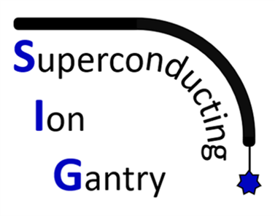
Superconducting Gantry Magnets for improving ion beam therapy
Thesis Tutor : Prof. Lucio Rossi (lucio.rossi@unimi.it)
Professor of Accelerator Physics at University of Milano
Thesis Supervisor: Dr. Marco Prioli with Dr. Ernesto De Matteis
INFN-Sezione di Milano - LASA laboratory
Place of thesis work: Milano at the LASA Laboratory of University and INFN

Slide 13
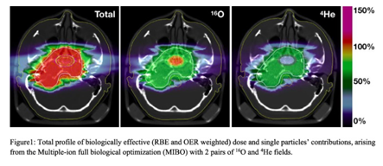
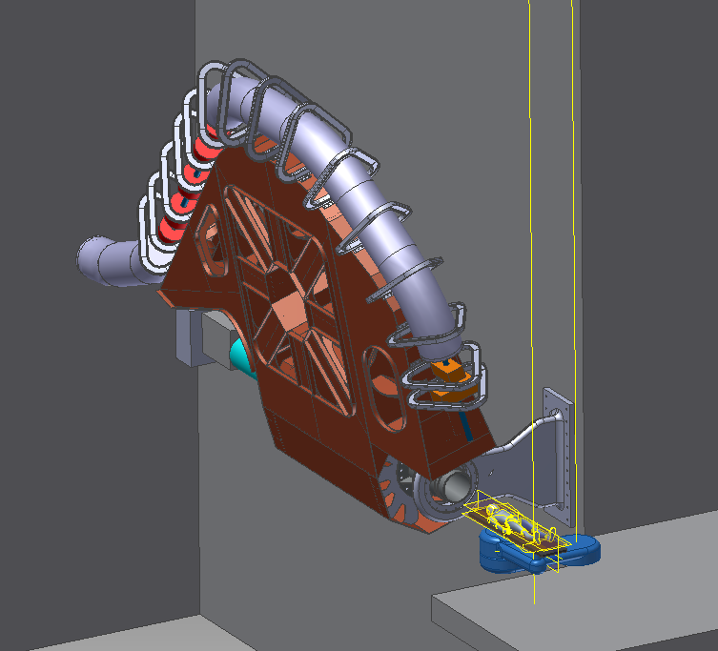
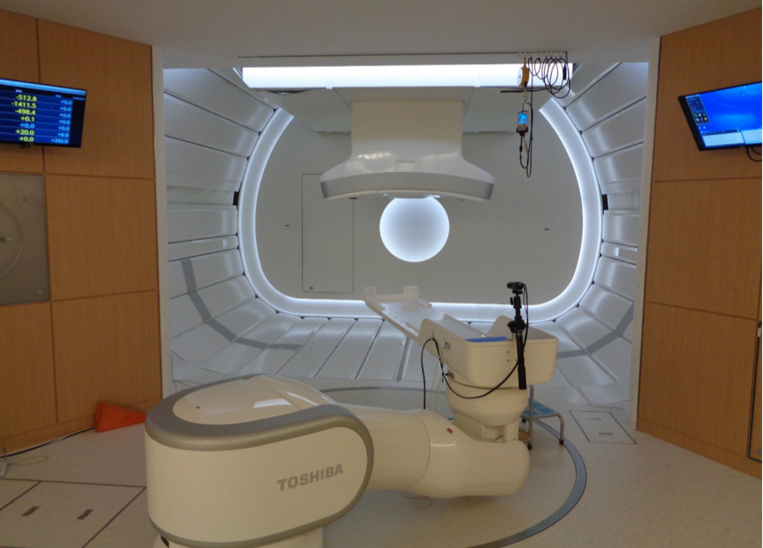
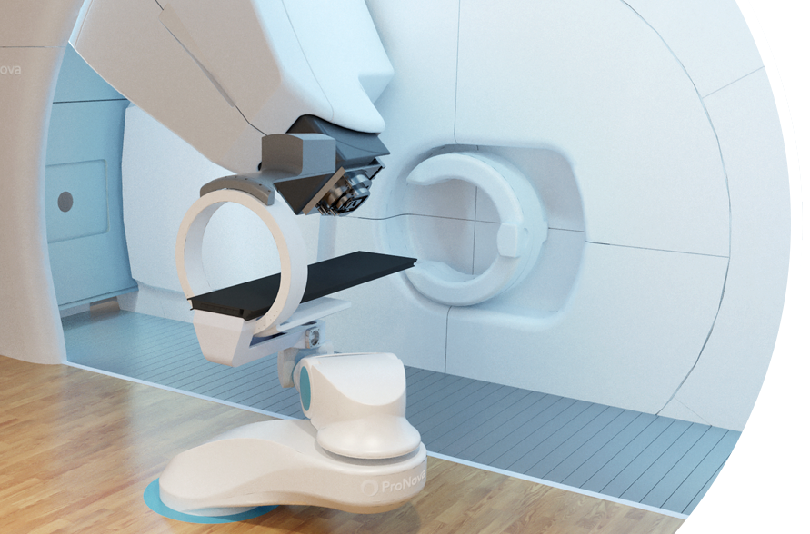
What’s next for particle therapy?
Multiple ions delivered with light-weighted Gantry
Rotatable gantry allows non-coplanar irradiation, enhancing effectiveness
Treatment rooms equipped with patient imaging
Dose Delivery and Range Verification Systems able to adapt online the dose delivered
Ion gantry @ Himac (Jp)
Gantry and imaging system of a proton therapy center
Sketch of the ion gantry in the treatment room
Notes:
come sarà l’adroterapia tra 10-15 anni? userà

Slide 14





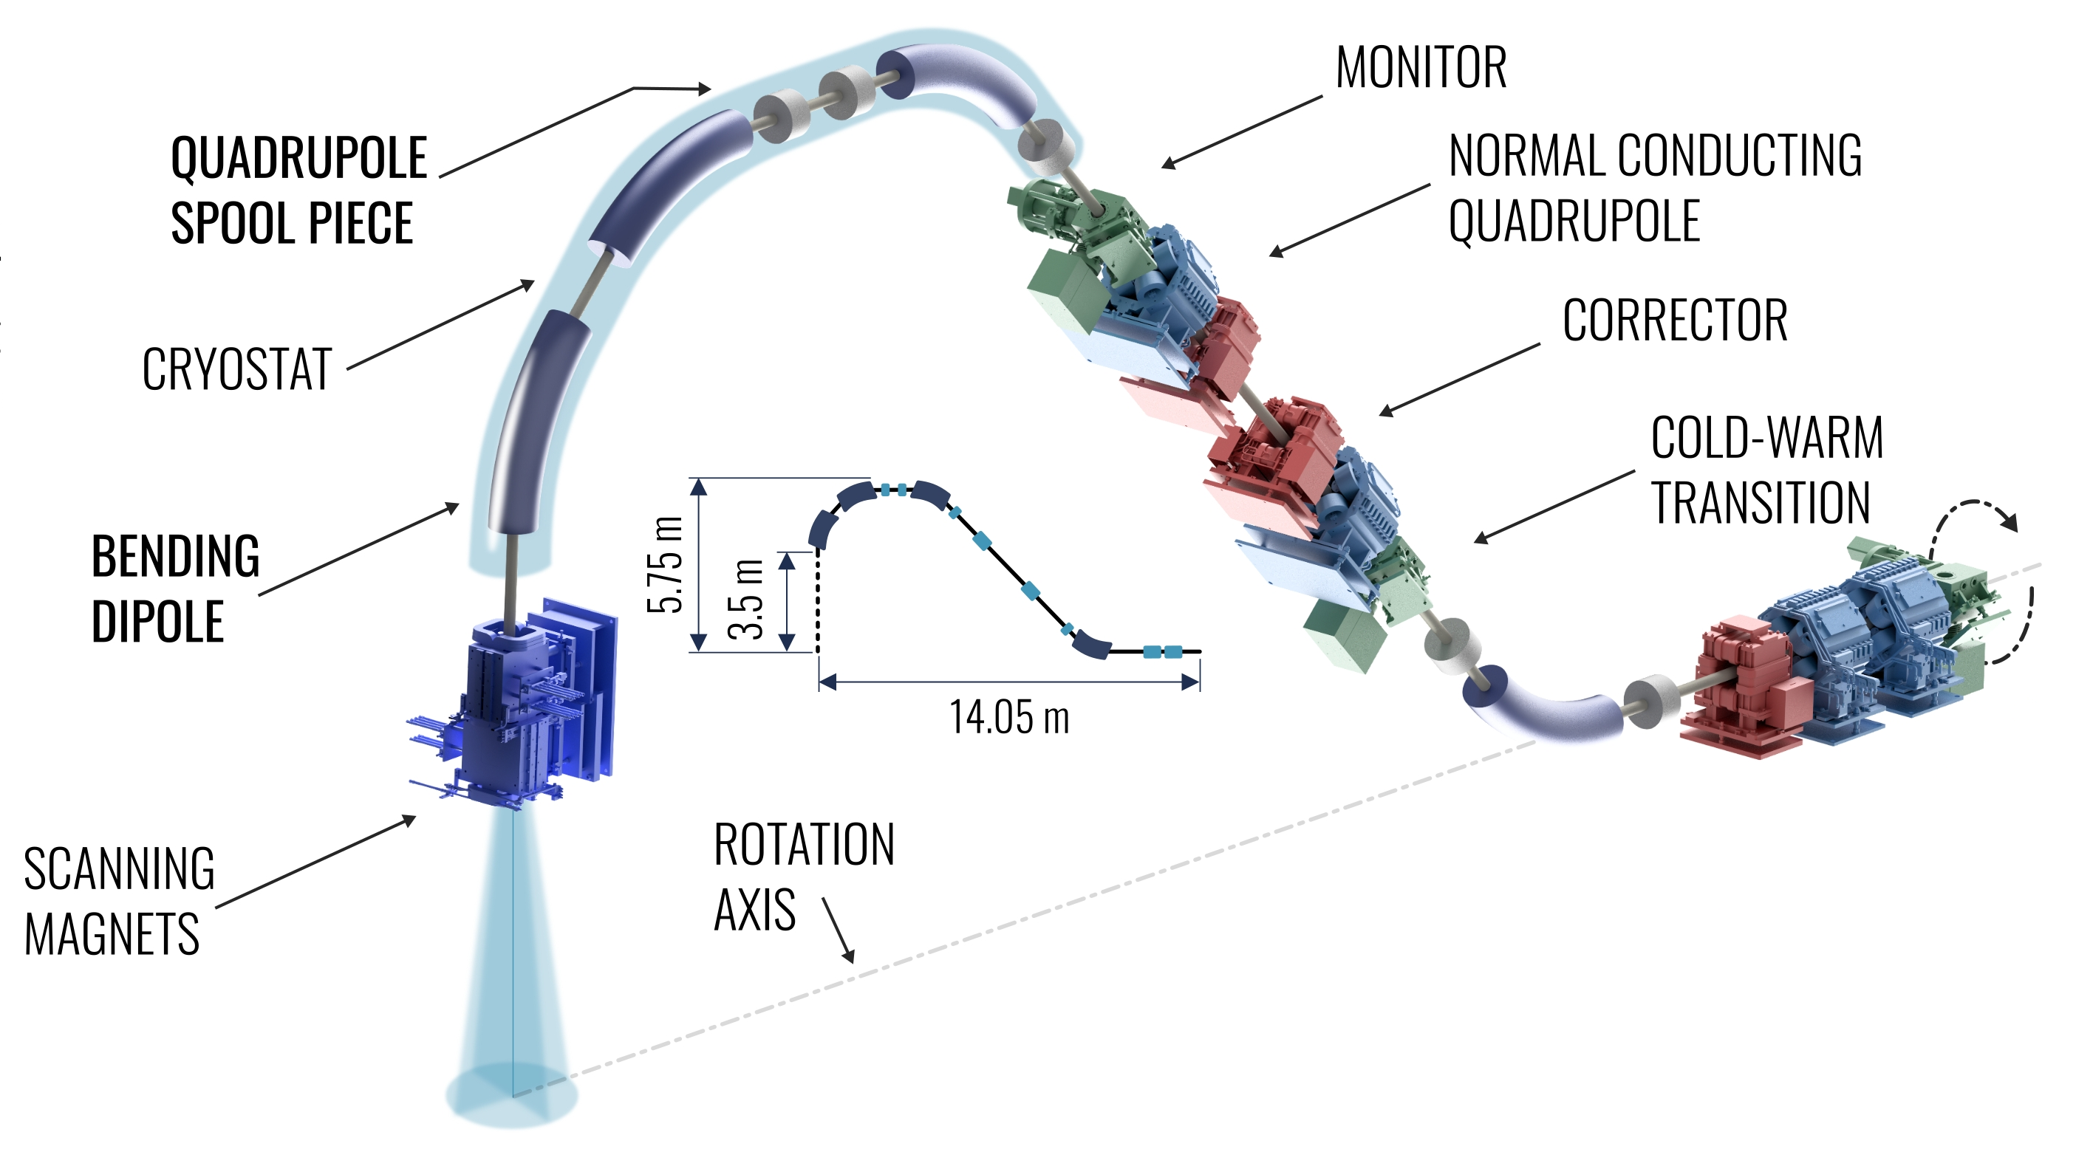
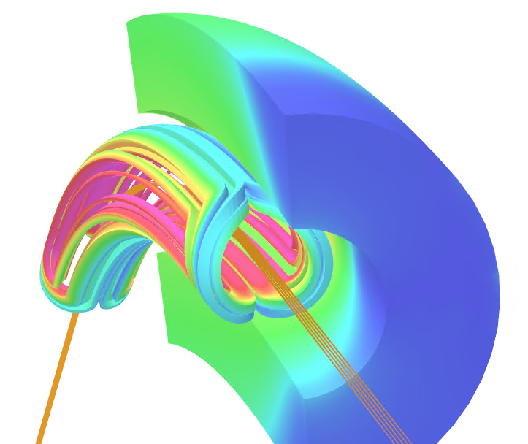
SIG WP2 scope
EuroSIG
Design, construction and test of a curved superconducting demonstrator magnet (SDM-c) for ion gantries
Main demo. magnet params
  NbTi superconducting Rutherford cable
  Cos-θ coils
  Pure dipolar field: 4 T
  Bore diameter: 80 mm
  Small curvature radius: 1.65 m (Challenge #1)
  Angular sector: 30°
  High field ramp-rate: 0.15 T/s - 0.4 T/s (Challenge #2)
  Compatible with conduction cooling (no LHe)
  but no optimization (Challenge #3)
A parallel program at CERN is devoted to the construction of a straight thermal demonstrator SDM-s

Slide 15
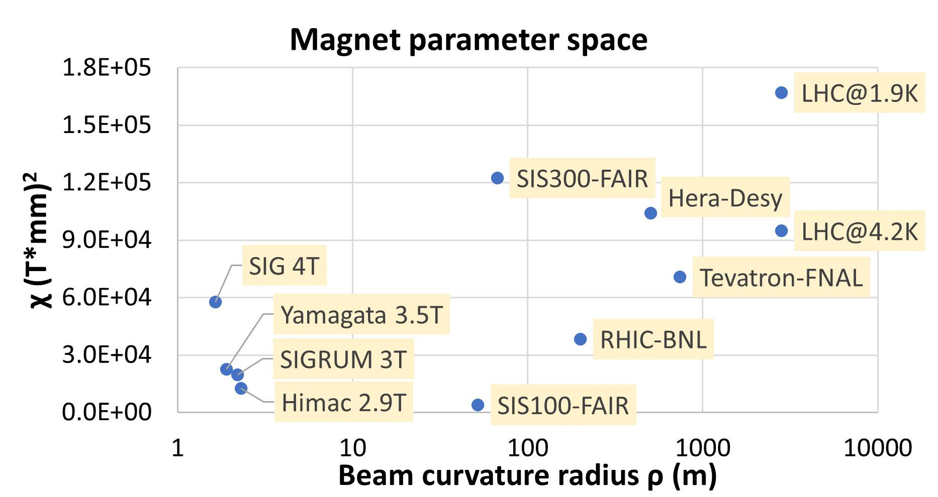
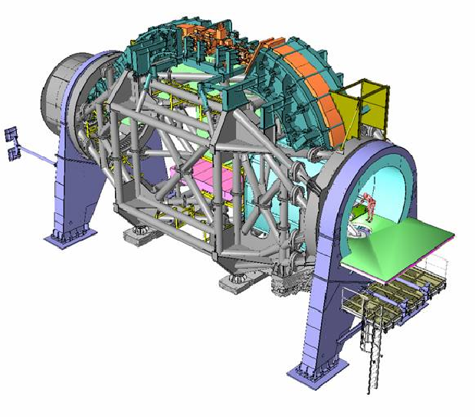
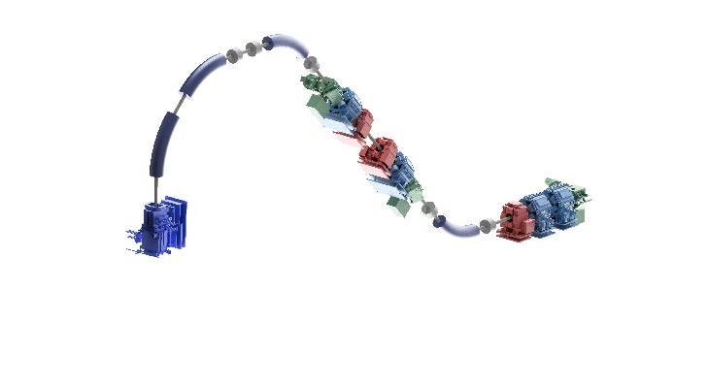
Heidelberg Gantry ~600 tons
SIG is very ambitious!!!
THESIS work:
MultiPhysics design
Construction of prototype
Test & Qualification of a new CURVED SUPERCOND. DIPOLE magnet as demonstrator for next generation gantry.
Project already financed by INFN-CNAO-CERN.
Technologies to be explored both with simulation (FE) and with experimental work
Compact SIG Gantry ~50-80 tons easy-to rotate and accessible.
Candidate Profile: Applied Physicists or Engineer.

Slide 16
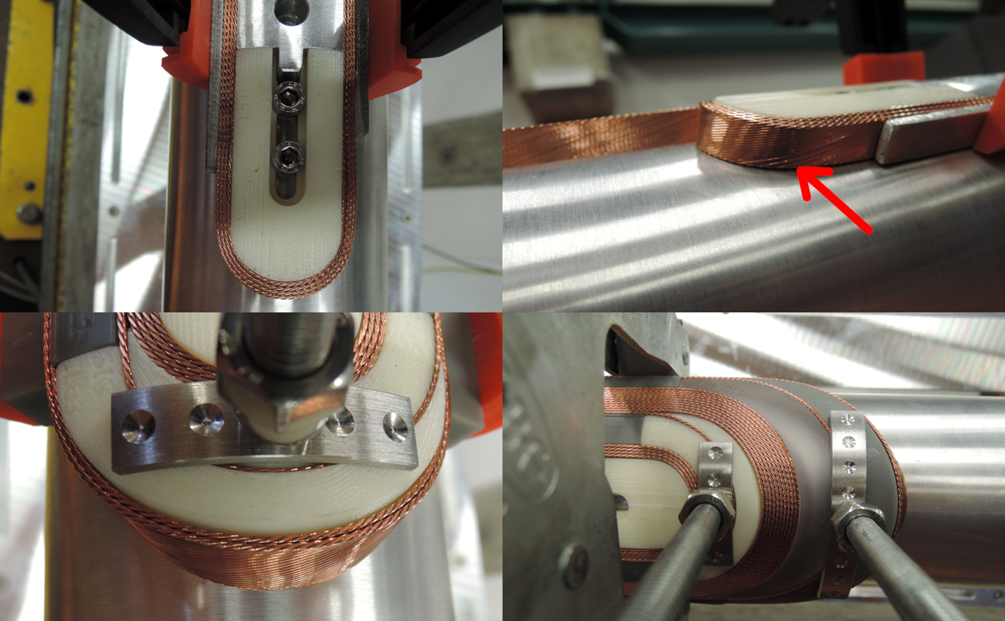
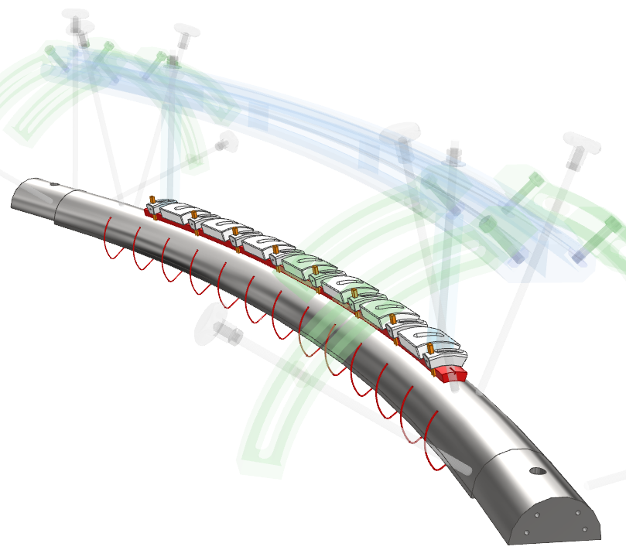
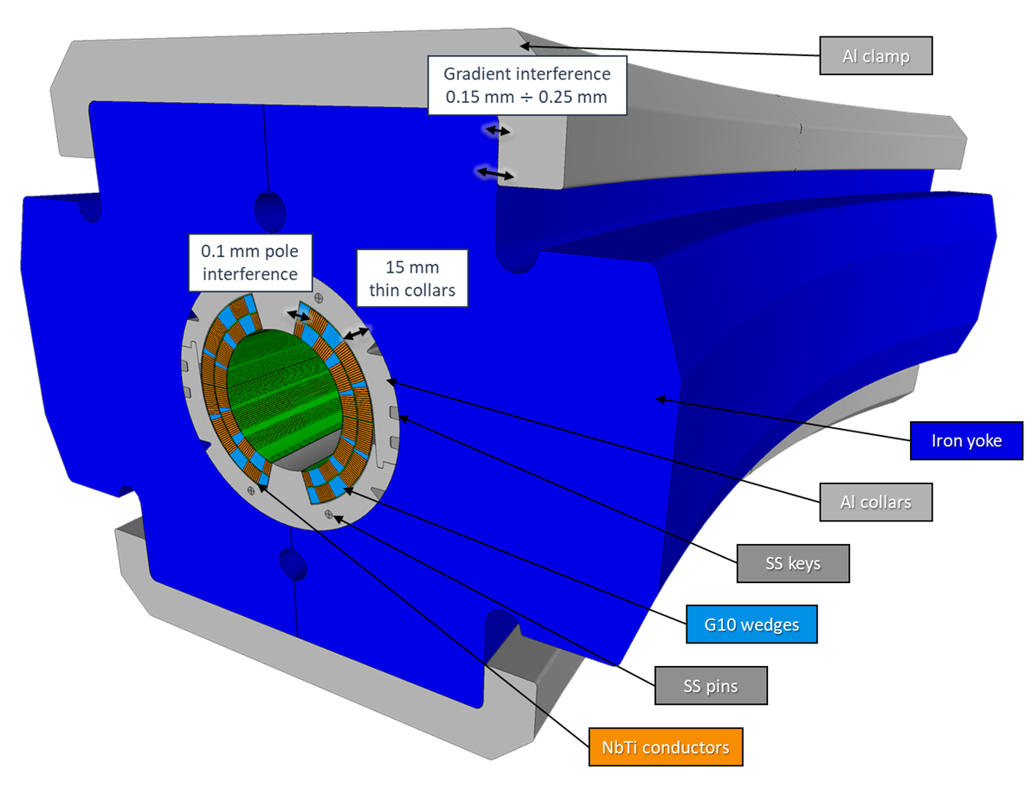
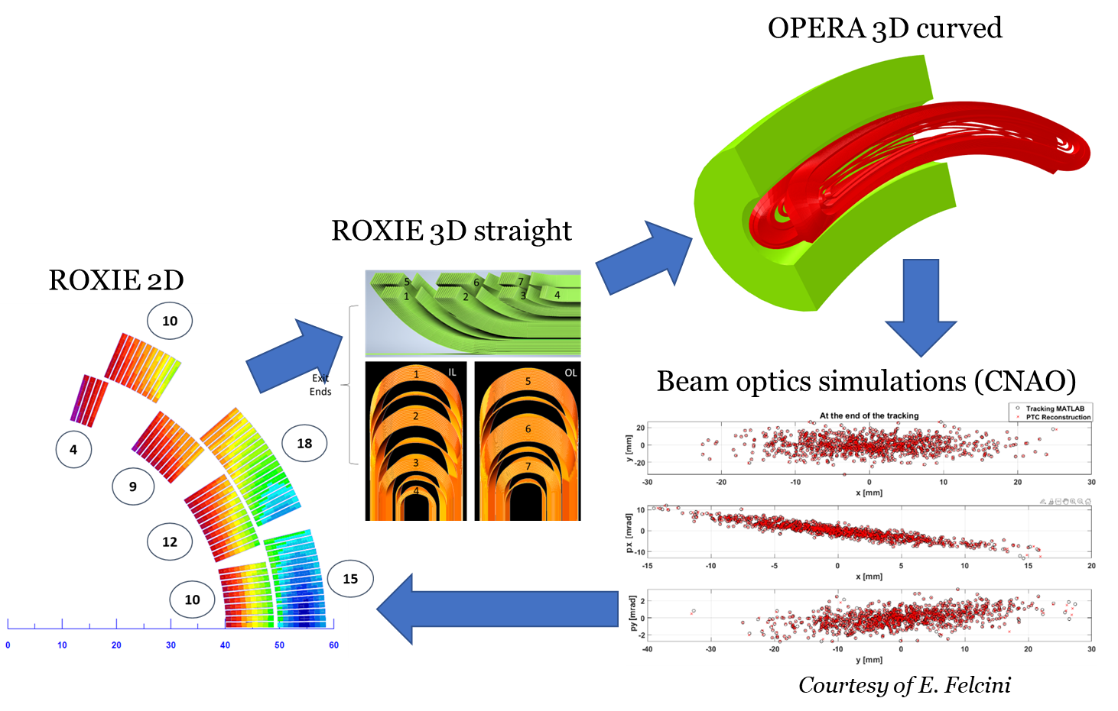
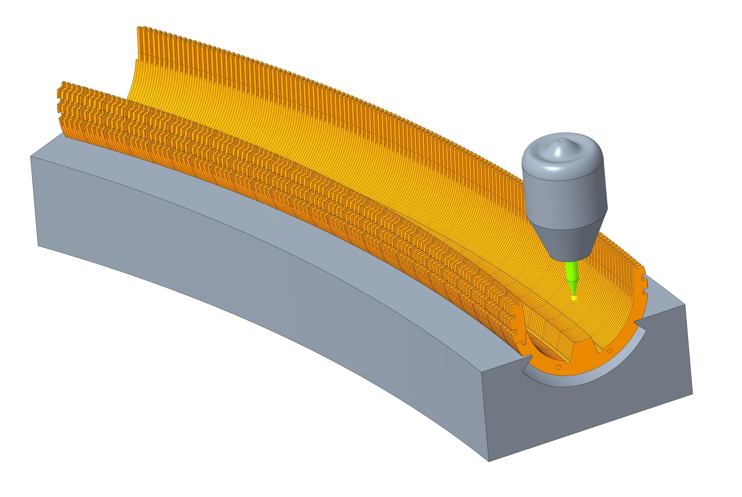
SIG WP2 status
First winding trial of a straight coil performed at LASA →
The present focus is on the curvature, demanding for the:
  Electromagnetic design & modelling
  Winding tooling and procedure
  Mechanical design and manufacturing techniques
Courtesy of F. Levi
Electromagnetic design loop
Winding tooling
Structural concept
Curved collar assembly

Slide 17










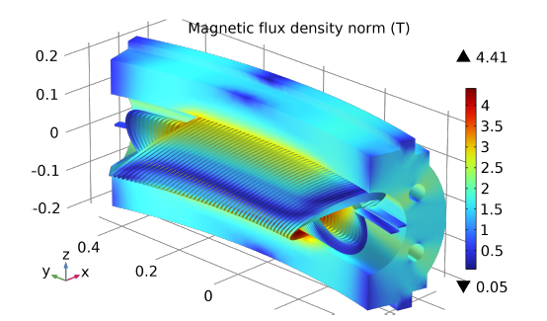

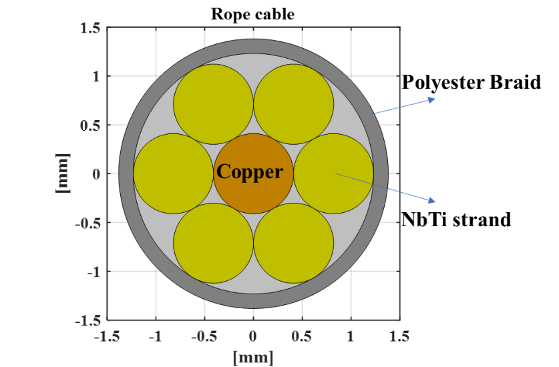
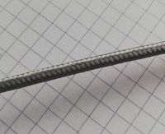
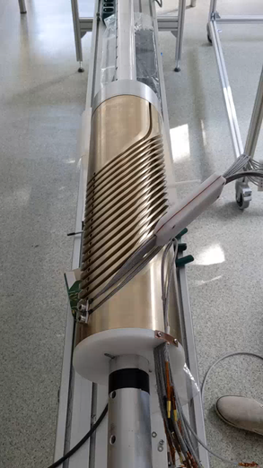
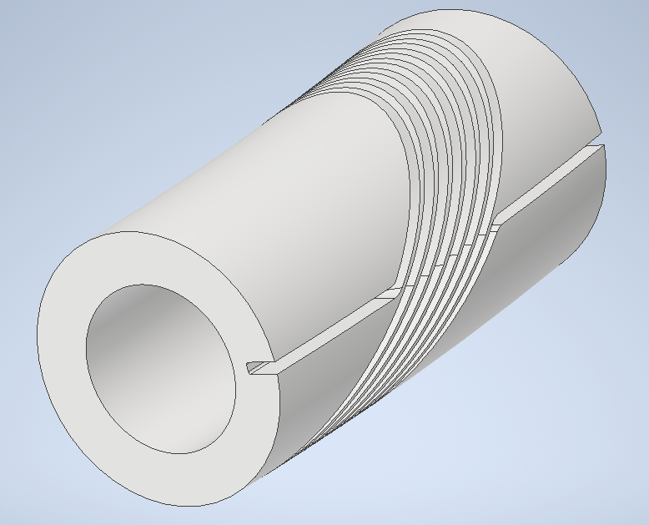
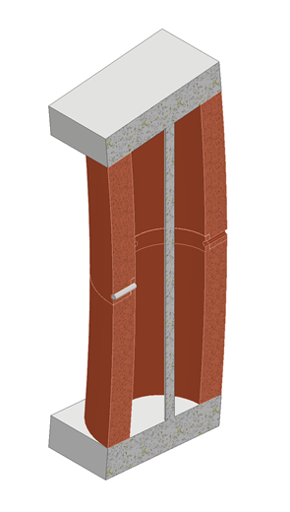
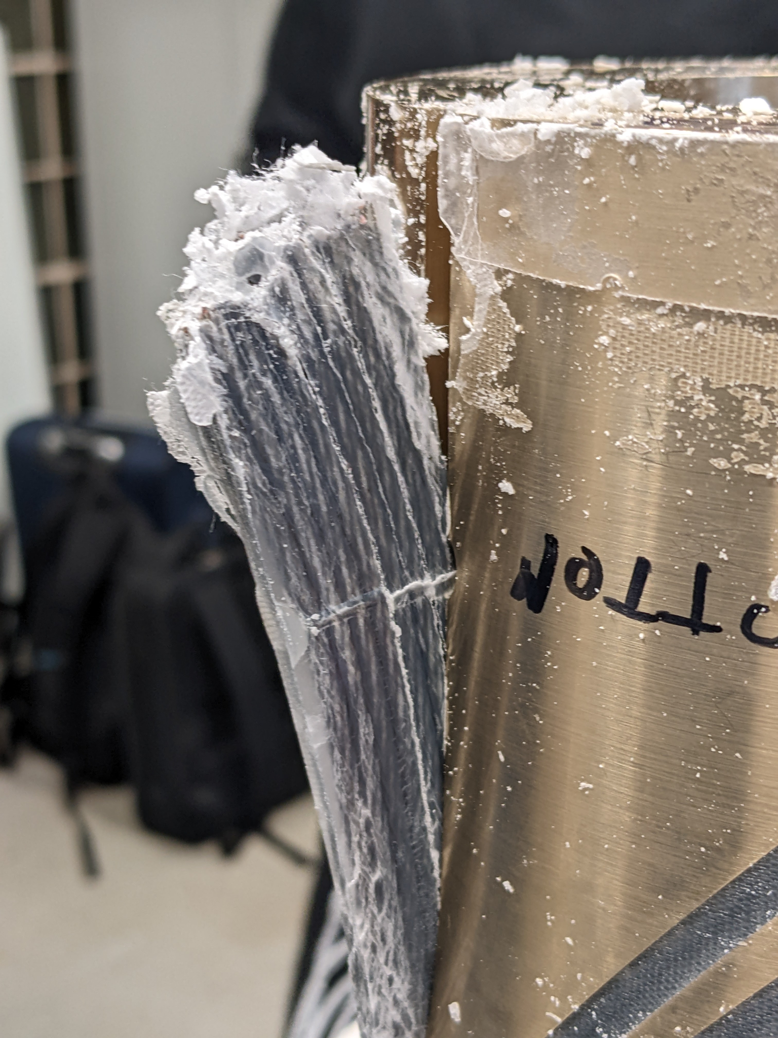
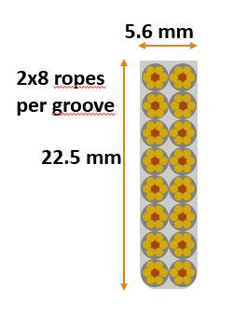
HITRIplus WP8 – Superconducting magnet design
Construction and test of a small demonstrator for feedback useful for accelerator as well as gantry final magnet design.
The decision to explore a curved CCT layout magnet based on NbTi (Low losses strand) and conductor (rope 6+1 strands);
Main Parameters of demonstrator:
4 T pure dipole, Top of 4.7 K;
Bore diameter: 80 mm;
Curvature radius: 1.65 m;
Angular sector: 30°;
High field ramp-rate: 0.4 T/s;
Compatible with conduction cooling;
Wax impregnation test;
Priority is to construct the curved former (AlBr);
Short test former
The challenge is the heat extraction generated by superconductor and former (AC losses) without LHe cooling

Slide 18

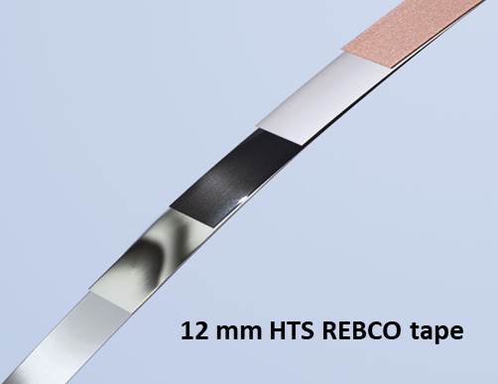




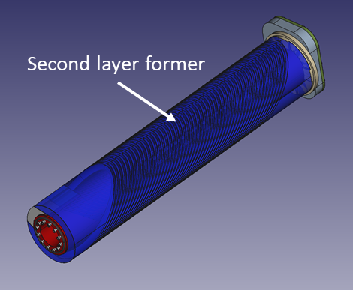
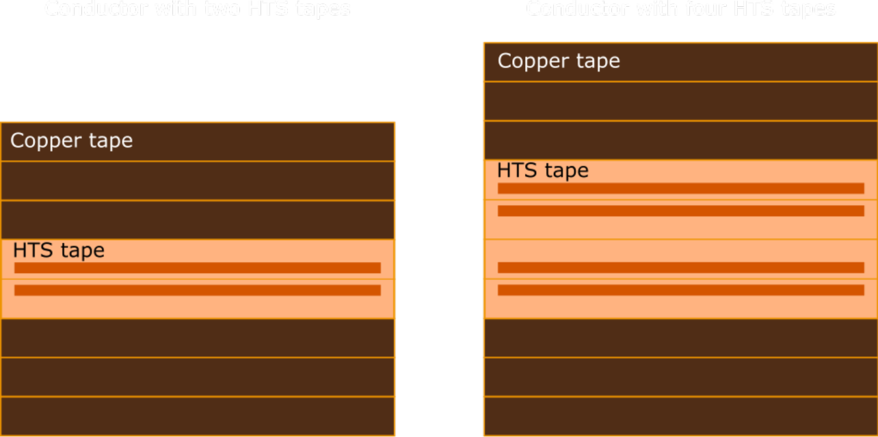
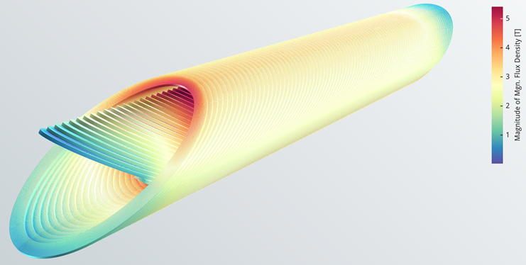
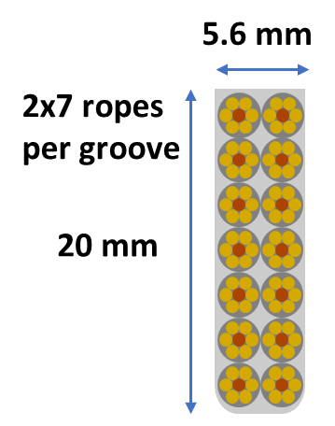
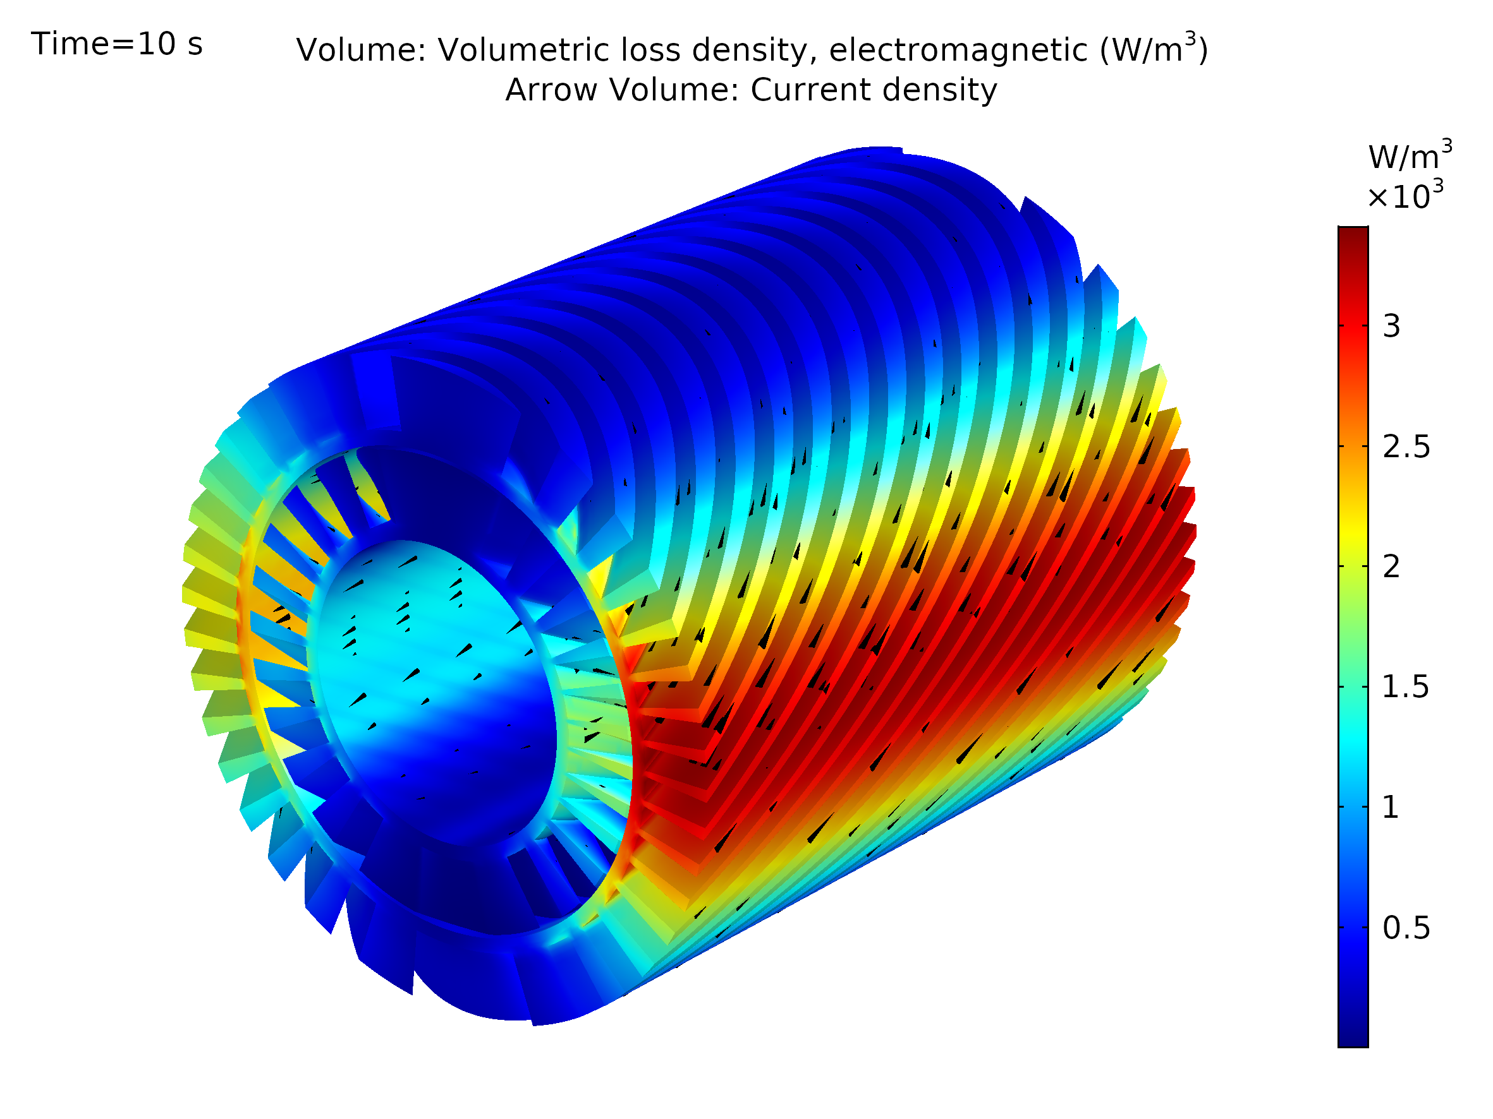


I.FAST WP8 – Innovative superconducting magnets
Exploring Canted Cosine Theta with HTS superconductor (main goal), preceded by a combined function CCT based on LTS
Construction of the two demonstrators: winding and magnet assembly, magnet test and validation:
Combined CCT based on LTS (rope 6 NbTi + 1 copper strand as HITRIplus):
4 T dipole + 5 T/m quadrupole (important feature to test it for CCT);
Demonstrator for testing the combined feature of CCT and thermal study of AC losses (0.4 T/s);
CCT based on HTS (REBCO tape 4 mm wide):
4 T dipole with a new Top of 20 K (> 10 K of margin);
Frenet-Serret frame used for the conductor (avoid hard way bending);
Straight geometry just to start the study (HTS is already difficult enough);
Two design options: 2-tapes (980 A) and 4-tapes cable (1990 A);
Quench protection is demanded (Cu stabilizer added for this);
Short test former

Slide 19
HTS Energy saving magnets for particle accelerators, beam lines and experimental detectors
Thesis Tutor : Prof. Lucio Rossi (lucio.rossi@unimi.it)
Professor of Accelerator Physics at University of Milano
Thesis co-Supervisor: Dr. Samuele Mariotto (Unimi and INFN)
INFN-Sezione di Milano - LASA laboratory
Place of thesis work: Milano at the LASA Laboratory of University and INFN

Slide 20



Problem: Large Energy Consumption
Energy consumption of particle accelerator facilities is expected to increase in the future:
Upwards electricity price trend is foreseen
Courtesy D. Tommasini, CERN
Need for «Improvement of energy efficiency»
European Strategy for Particle Physics 2020
«Cryogen-free superconducting magnets instead of common resistive magnet for heavy particles beam lines»
Objectives:
Use of MgB₂ or HTS conductors
Energy consumption 5-20 lower
Work @ T=8-20 K with solid conduction cooling to reduce cryogenic power consumption
MNP33-Dipole
NA62-CERN
7560 MWh
SM2-Dipole
Compass-CERN
6953 MWh

Slide 21




Energy Saving Magnets - ESABLIM
Need for «Improvement of energy efficiency»
European Strategy for Particle Physics 2020
Revamp of common resistive magnets for heavy particles beam lines with Cryogen-free superconducting magnets.
Use of MgB₂ or HTS conductors reusing iron yoke;
Obtain energy consumption 5-20 time reduction;
Work @ T=8-20 K with solid conduction cooling to reduce cryogenic power consumption;
Two case studies: research and medical applications
3.2 m
 | PSI (Steady State) | CNAO (Ramped)
Magnetic Field | 1.45 T | 1.74 T
Weight | 50 tons | 75 tons
Air Gap | 100 mm | 200 mm
Max. Current | 1 kA | 2.28 kA
Max. Power | 95 kW | 700 kW
Cond. Dimensions | 18.5 x 18.5 mm² | 39.8 x 14.3 mm²
Energy Consumption | 715 MWh/year | 262 MWh/year
Copper Coils
6.5 m
Iron Yoke
3.3 m
Courtesy of S. Mariotto (Dep. of Physics, Univ. of Milan)
samuele.mariotto@unimi.it

Slide 22




Field Quality
No available requirements on the field quality:
TARGET:
NC design reconstructed FQ
Quality evaluated on the whole length of the magnet on the middle plane
Comparison between different simulation configurations:
  Baseline
  Superconducting Design
  Sup. Des. with mechanical deformations
Y
X
Z
s

Slide 23



Thermal Design
Cryo B (60 K shield)
Aluminum thermal shield (6 mm thickness)
working @ 60 K covered with 30 MLI layers (minimzation of radiation load).
Cryo A
(20 K coils)
Coil modelled as orthotropic material Cu (22%), MgB₂ (29%), epoxy resin (49%)
Cryocoolers installed on both side of the magnet
TS (3.4 kW) 2 AL230
Coils (8.4 kW only for 1/10 of the year) 2 AL60
20 K
MAGNET | Coils @ 20 K |  | Shield @ 60 K
Q support | 1.1 [W] |  | 35 [W]
Q CL | 0.2 [W] |  | 24 [W]
Q radiation | 0.38 [W] |  | 19.52 [W]
LOSSES | Hyst | ISCC |  | IFCC
 | 34.2 [W] | .1.55 [W] |  | 0.17 [W]
Total magnet energy consumption: 4.3 kW (vs 30 kW DC resistive).
21.7 K
$≈$7 times lower
AL230 Cryomech and AL60 Cryomech

Slide 24




Energy Saving Magnets - ESABLIM
CRYOSTAT
Superconducting Design
COIL
New designs with MgB₂ (ASG, Genova) rope conductors instead of copper coils optimized to produce same field working at T=20 K.
Mechanical Electromagnetic Forces managed using
SS tie-rods (PSI) or G10 Cylindrical Supports (CNAO)
Use of an aluminum thermal shield (6 mm thickness)
working @ 60/70 K and covered with 30 MLI layers (minimization of radiation load).
Cryo B (70 K shield)
THERMAL SHIELD
Cryo A
(20 K coils)
PSI Option:
Cryocoolers installed on one side of the magnet
Magnet energy consumption 5 kW (vs 190 kW resistive).
Cryo B (60 K shield)
$≈$40 times lower
CNAO Option:
4 different Cryocoolers installed on both sides of the magnet (2 for the coils/2 for thermal sh.)
Magnet energy consumption 4.3 kW (vs 30 kW DC resistive).
COILS
THERMAL SHIELD
BAR
$≈$7 times lower
Cryo A
(20 K coils)
CRYOSTAT
CYLINDRICAL SUPPORTS

Slide 25



The FCC integrated program
inspired by successful LEP – LHC programs at CERN
complementary physics, common civil engineering and technical infrastructures, building on and reusing CERN’s existing infrastructure, FCC integrated project allows seamless continuation of HEP after HL-LHC
Phase 1 : FCC-ee
collisioneur electron - positon
usine à Higgs, Z, W, ttbar
Phase 2 : FCC-hh
collisioneur proton - proton
frontière des hautes énergies
FCC-hh
FCC-ee
Energy saving magnets to replace energy intensive resistive magnets of the lattice (Sextupoles)
2020 - 2040
2040 - 2055
2060 - 2090

Slide 26


The LASA in the Nord-Est corner of Milano
Laboratorio Acceleratori & Superconduttività Applica co-managed by University of Milan and INFN-Milan
Hub of IRIS - largest PNRR accelerator project (MI-GE-LNF-NA-SA)

