Slide 1
Setup and preliminary results on CsI for the SuperB trigger
P. Branchini (INFN Roma 3)
Involved Group:
INFN-Roma1 V. Bocci,
INFN-Roma3
INFN-Na

Slide 2
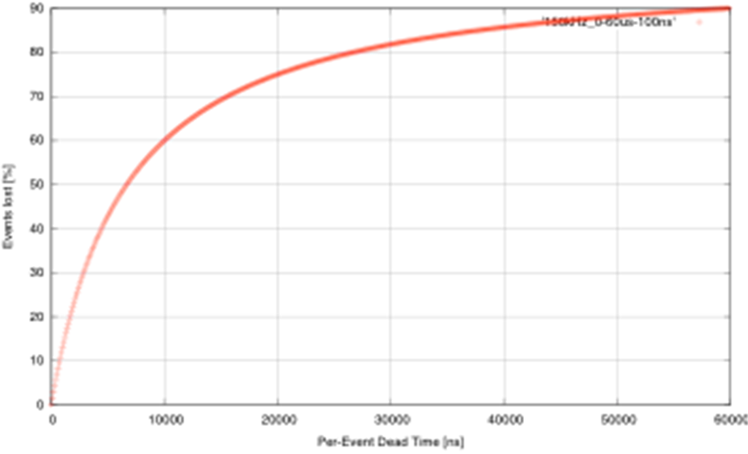
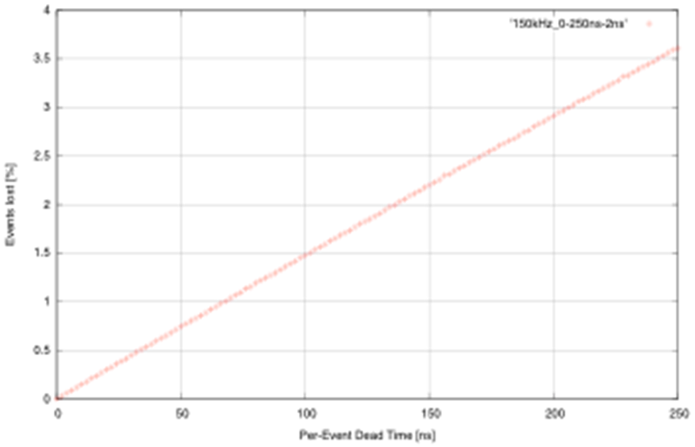
Let’s remember the specs in SuperB
Baseline:
re-implement BaBar L1 trigger with some improvements
  Shorter latency (~6us instead of 12us)
  Higher sampling frequencies (DCH and EMC)
  2-d map for calorimeter
Possible additions
SVT trigger
What about the TOF ? (in DELPHI we used it in the trigger)
Bhabha Veto
Do we need an absolute time stamp at the trigger level?
Challenge
To keep the event loss due to dead time below 1% => a maximum of ~70ns “per-event dead time” is allowed in trigger and FCTS
Other considerations
What goes in L1, what in L3, what’s the optimum?
150kHz
Exponential Inter-arrival time pdf.
Luitz 2010

Slide 3
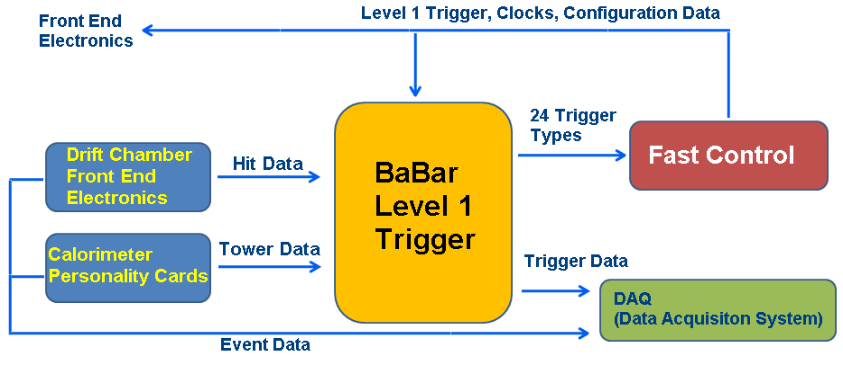
BaBar: Trigger Layout
J. C. Andress et Al., “BaBar Calorimeter Level 1 Trigger Design” , BaBar Note (1998)

Slide 4
Latency in the EMC Barrel
ADC conversion time.
Depends on
Shaping, can
it be changed?
J. C. Andress et Al., “Babar Calorimeter Level 1 Trigger Design” , BaBar Note (1998)
Can we improve latency here?

Slide 5
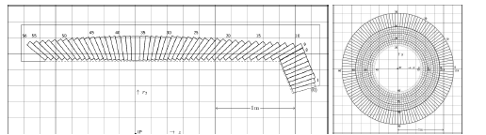
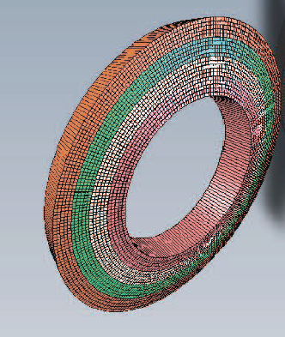
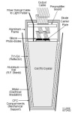
SuperB EMC
  EMC Barrel :
  5760 CsI(Tl) Crystals
EMC Forward =
4400 Lyso Crystals
(176 modules)

Slide 6
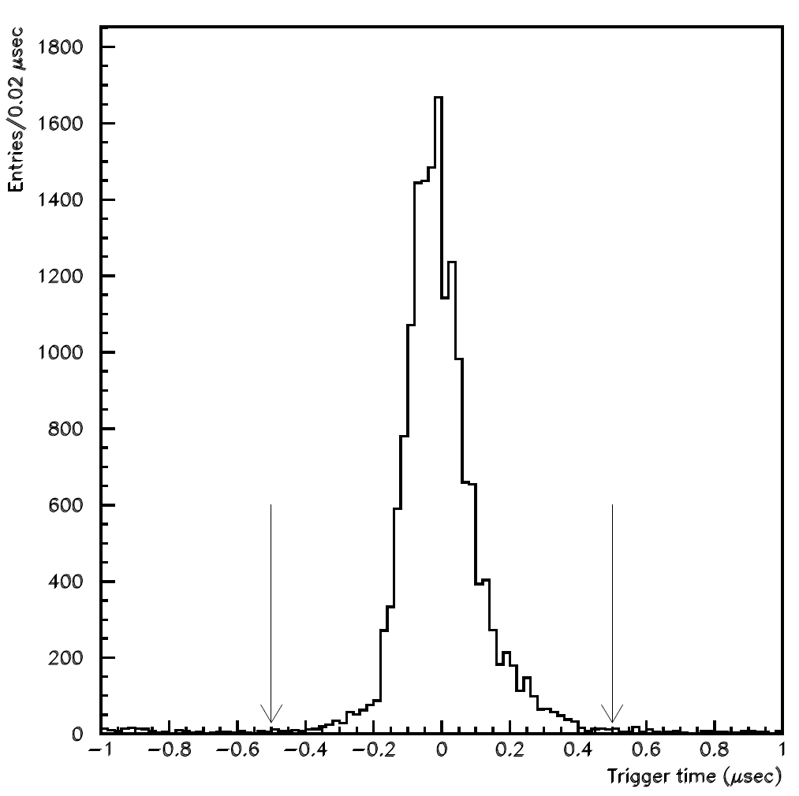
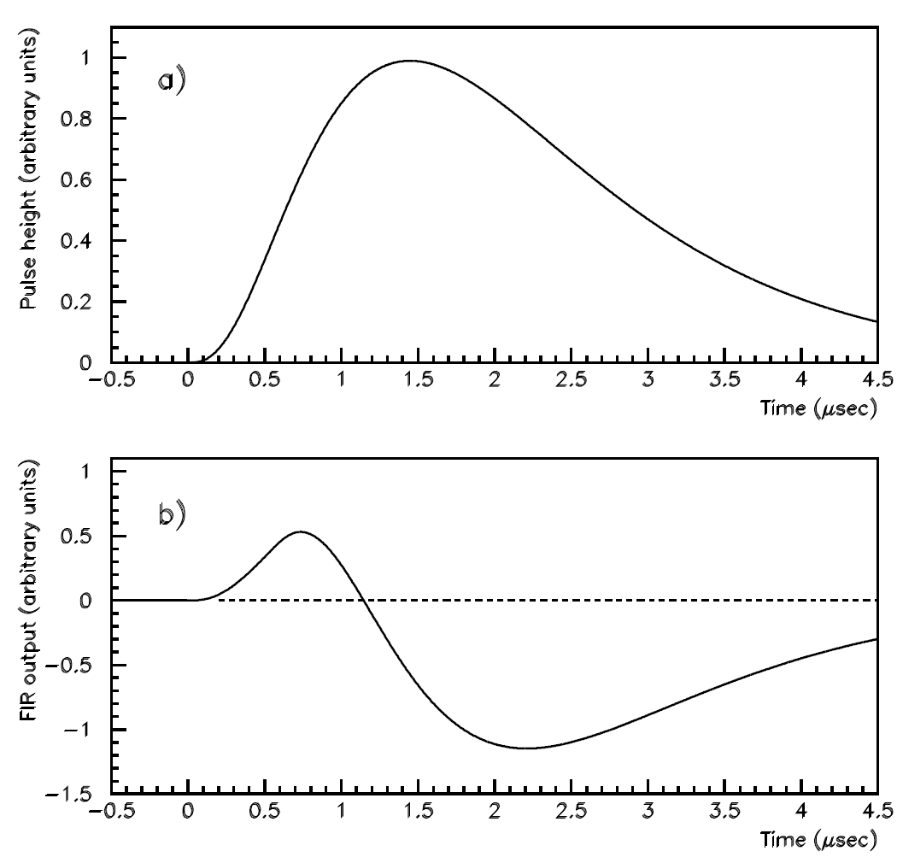
Barrel CsI (Tl doped) original BaBar
P. D. Dauncey et Al., “Design and performance of the level 1 calorimeter trigger for the BABAR detector” (2001)
3 thresholds applied to the signal of the tower.
The plot shows the difference between the EMC trigger time and the DC trigger time.
μ+μ- events used to select good resolution in DC.
A FIR Filter with 8 parameters was applied to the signal. Its zero crossing occurred
at roughly a fixed time distance from the start of the signal, it was used to gate
the threshold information. Due to this mechanism the time resolution was about 100 ns.

Slide 7
CsI crystals
We received 2 crystals from Bill in july.
They have been delivered with their standard electronics.
We have equipped them with out read out chain as well to understand how to
improve trigger performance.

Slide 8
Brief description (of what we have got)
1 CsI (in Rome3) the other is in Roma1
1 APD glued on the opposite side of the crystal with respect to PIN diodes.
We have built a TI amplifier.
We have built a receiver to read differential signals from PIN diode standard electronics

Slide 9
Roma3 setup

Slide 10
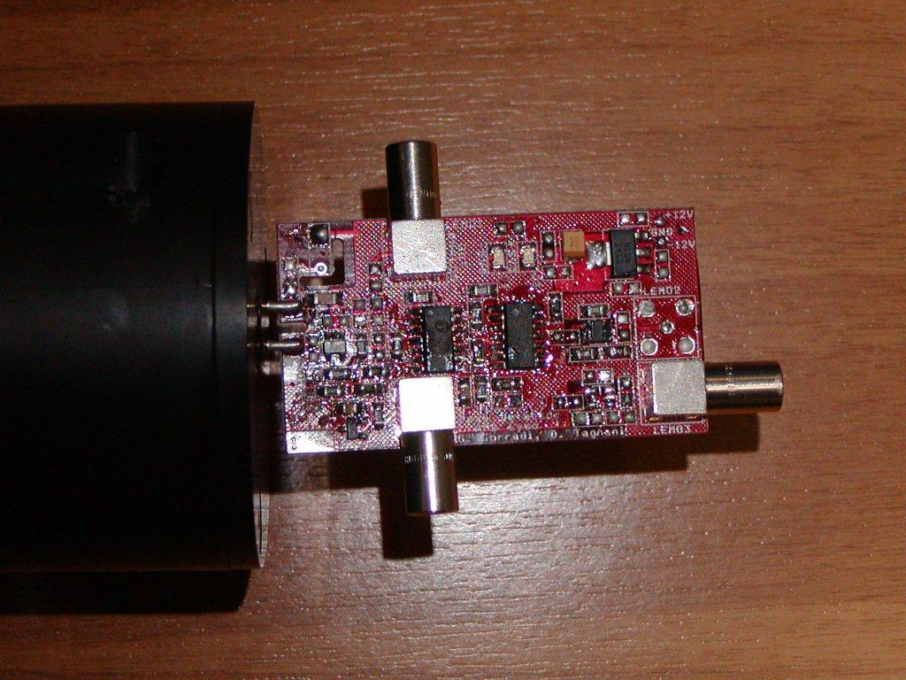
APD read-out electronics
3 outputs from the TI in order to be able to measure time and charge and
assert a trigger if necessary.

Slide 11
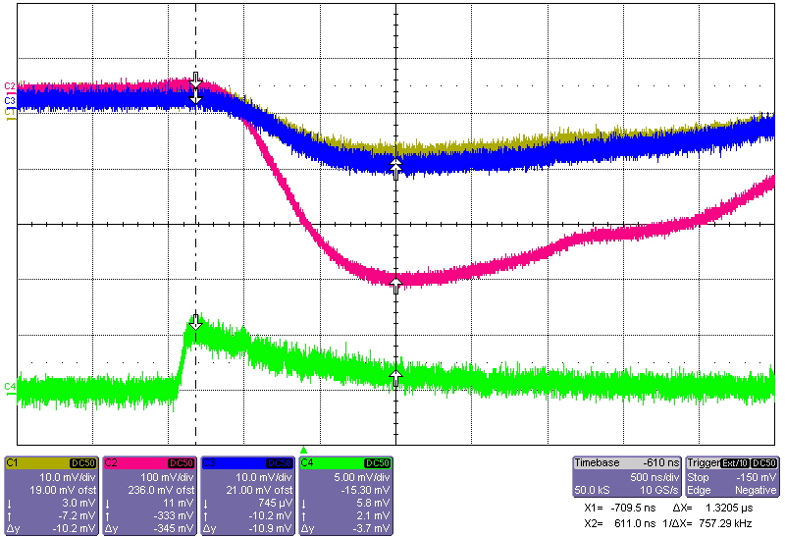
Waveforms
PIN diode low gain
High gain
APD signal
Most waveforms are like this

Slide 12
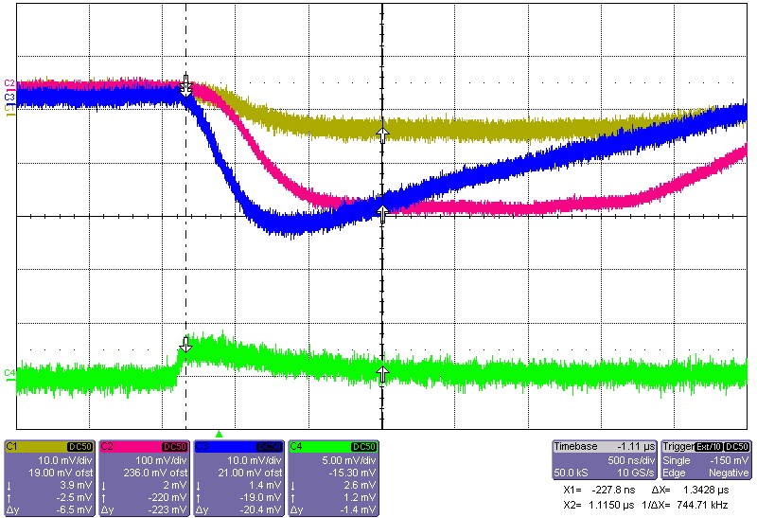
But sometimes
Signal is only
on 1 pin diode and
high gain chain
saturates.
This could be explained
by Roma1 (V. Bocci) see
Later on.

Slide 13
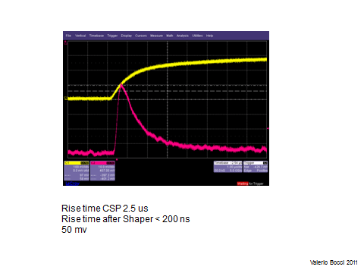
CsI read-out by Lyso CSP electronic chain (Roma1)

Slide 14
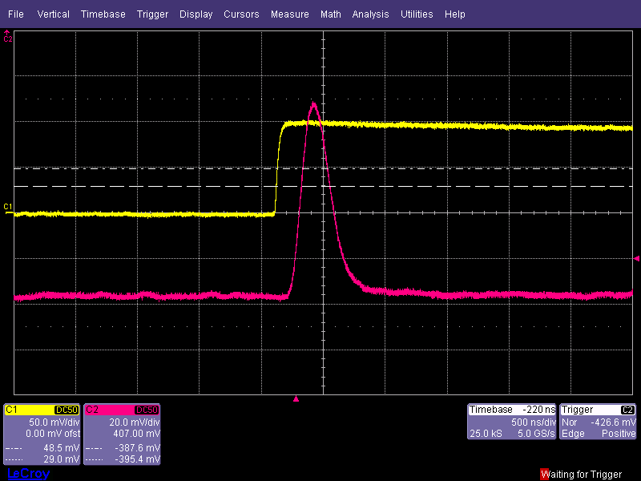
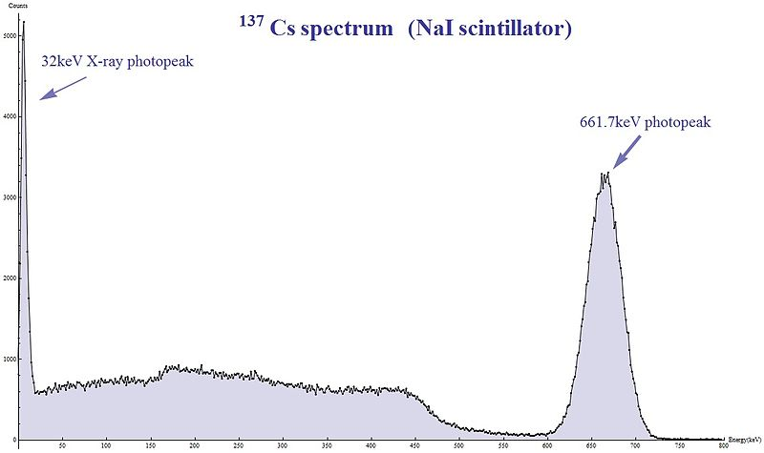
Nuclear counting effect
Fast signal coming from APD (Cs137 decay ) no light from scintillator
The same signal coming out when we put a Cs137 source near the APD
This effect is
Llklely to fire only 1
Pin diode.
Rise time < 100 ns
Shaping time 100 ns
Peak 90 mv
nuclear counter effect caused by minimum ionizing
charged particles in APDs
Valerio Bocci 2011

Slide 15
Time measurements
We have triggered on APD and measured:
1) Time distance in between low gain PIN Diode chains. (hint on time resolution)
2) Time distance in between APD’s peak
high (low) gain chain peak. (latency)

Slide 16
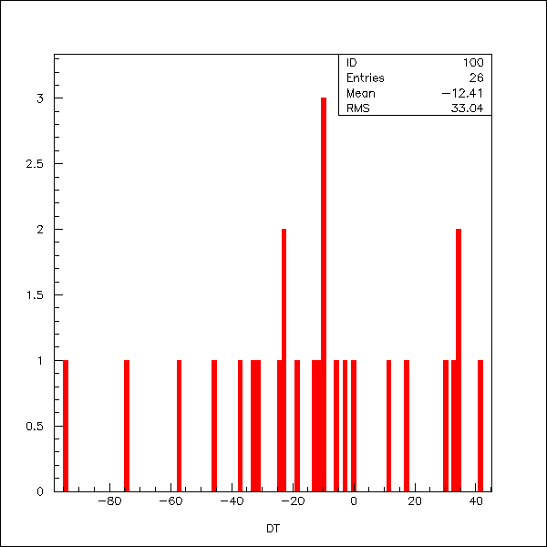
Time resolution
RMS is 34 nsec
We can expect a time
resolution of 34/sqrt(2)=24 nsec
With pin diode and standard
electronic chain.

Slide 17
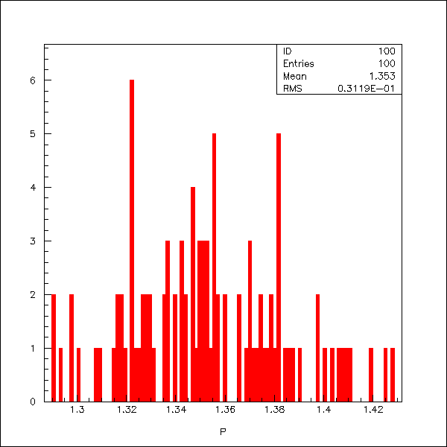
Latency
We can gain about 1.36 μs using
an APD and its TI read-out.
1.36 μs

Slide 18
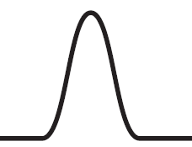
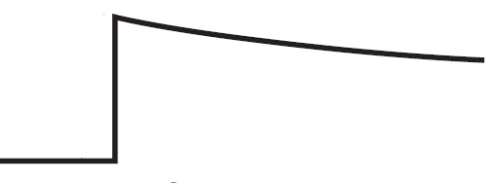
From Crystals to trigger formation: EMC fast trigger and energy paths
Energy accurate measurement path
Double
Range
shaper
Range (0,1)
CSP
X N_{cryst}
Trigger Fast Path
Analog
Σ
n
Pulse
Encoder
LVDS

Slide 19
EMC forward tentative implementation
Double
Range
shaper
X5
Range
CSP
X5
X5
5
input
Σ
VME Range
Shaper
VFE
New Circuit Analog Sum
over 5 input.
Analog
Σ
Pulse
Encoder
5
input
LVDS
Trigger Tower module

Slide 20
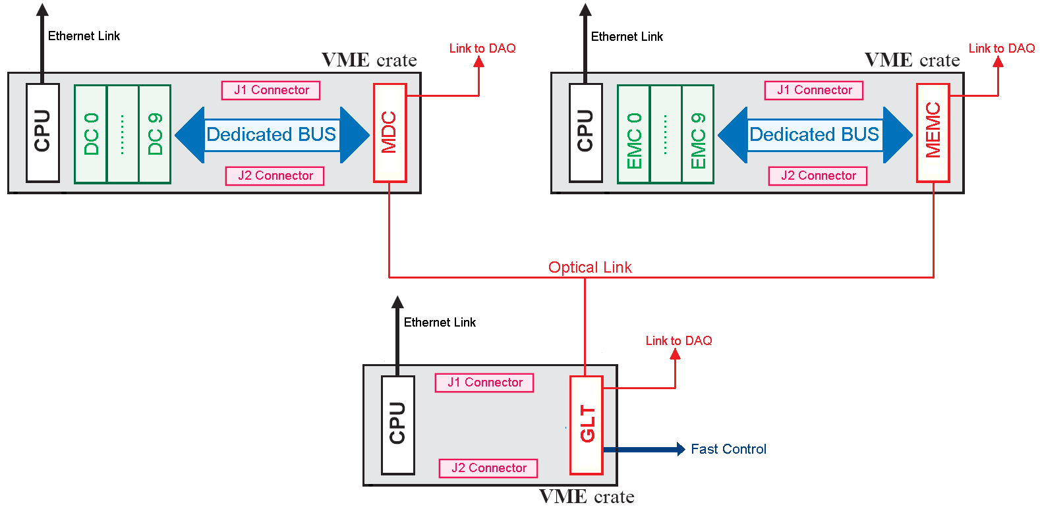
A possible sketch of trigger system in SuperB
DC and EMC trigger crates have a common inteface (LVDS or optical) with pertaining
sub-detectors. EMC(i) and DC(i) boards share a common hw platform and
only differ in firmware.

Slide 21
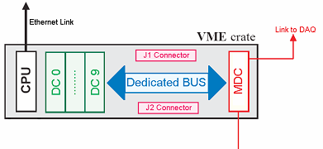
ETD/trigger:Connectivity
VME64x based + TriggerBus (custom)
Connectivity point-2-point on the backplane between receivers and hubs via high-speed serial links (>=2Gb/s )
Scalable architecture, we could accomodate up to 2 hubs.
CPU
Rec
Rec
HUB
Rec
Rec
Up to 8 receivers
Up to 8 receivers
Rec
Rec
HUB
HUB
HUB
Rec
CPU
Rec
Up to 8 receivers
Up to 8 receivers

Slide 22
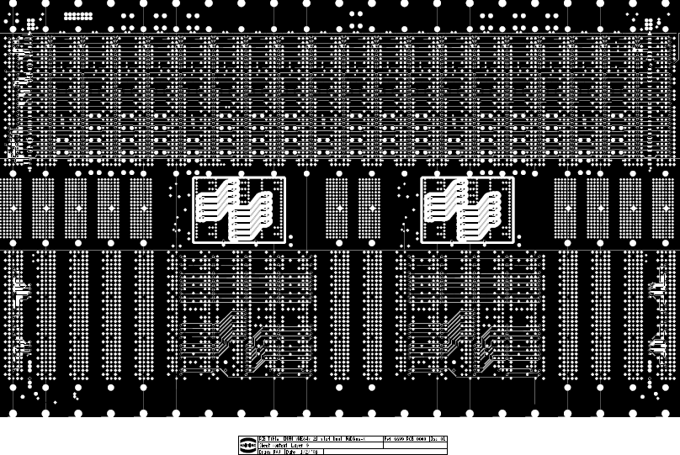
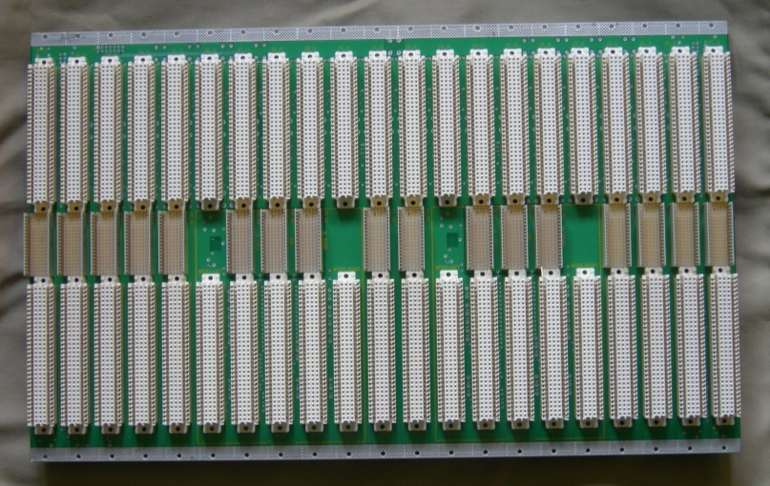
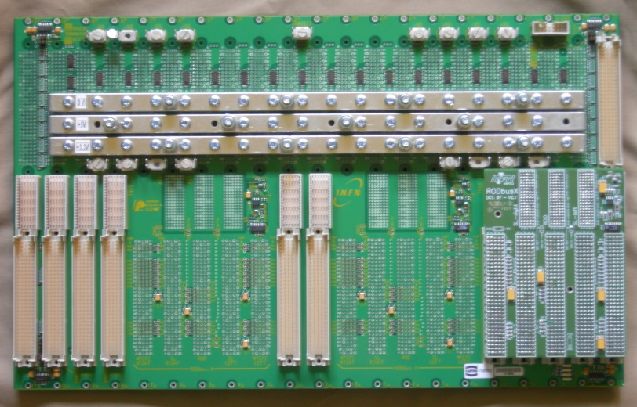
VME64x + triggerbus in ATLAS
Custom VME64x backplane has been adopted in ATLAS
Developped with HARTING
Point to point speed up to 3 Gb/s
Front view
Rear view
Embedded RODbus
Piggy-back RODbus

Slide 23
Next steps
Perform the same measurements with beam (a few hours@BTF would be fine)
Use the same setup with a SiPm.

Slide 24
Thank you for your kind attention !

Slide 25
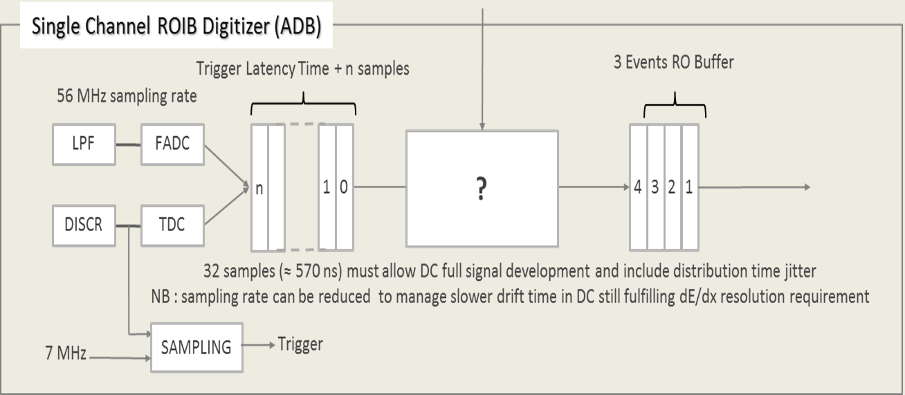
DC Dual path

Slide 26
Throughput of the DC System
7104 wires
3.7 MHz sampling frequency
1 bit (over threshold yes/no)
Total 3.2 Gbytes/s
1 Gb link profile → 30 to 40 links.

Slide 27
Throughput of the EMC System
6580 EMC barrel channel
4440 Forward EMC number of channels
3.7 MHz sampling frequency
16 bit Energy deposit
Total 82 Gbytes/s
Trigger gets sum in tower made of 24 crystal throughput 3.5 Gbytes/s
1 Gb link profile → 30 to 40 links.

Slide 28
Considerations on links
From NA Group experiments : only 1 Gbit/s has been proven to be radiation hard.
So if we really need a radiation hard link and we increase sampling frequency by a factor say 4, then we’ll correspondingly increase the number of links from about 40 to 160 per detector.
If we could house the radiation sensitive hardware in a shielded zone we could profit of faster links and reduce number of links thus simplifying the problem. Does such a place exist?

Slide 29
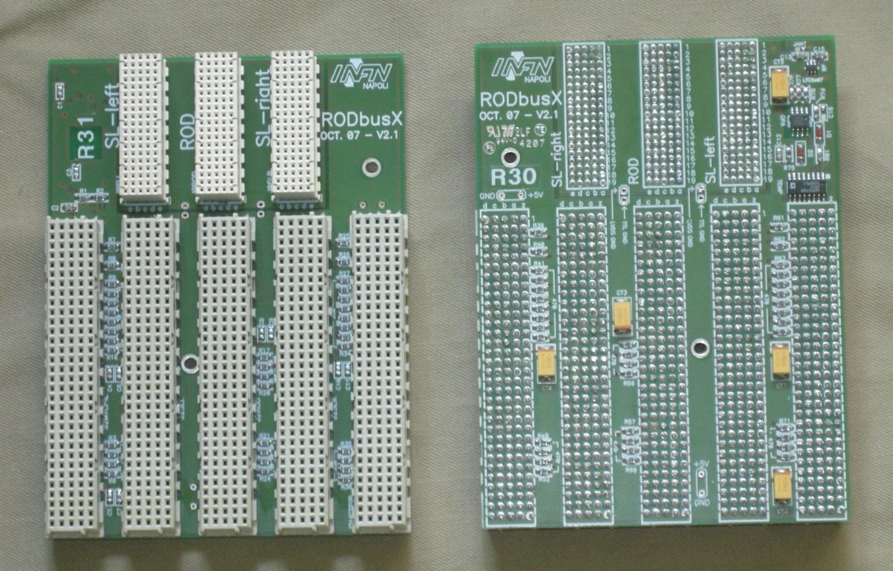
RODbus: Physical Layer
5-slot backplane, piggy-back module to the VME64x rear side
LVDS busses on J0
TTL busses on J2, terminated as VME
temperature, power supply, ripple monitors (via I2C bus)

