Slide 1
SuperB Integration
SuperB Experimental hall.
Related topics of Slac D&D activities.

Slide 2
SuperB Experimental hall
General considerations on the Babar experimental area
Preliminary space requirements hall proposal.
A floor plan.
Specification step plan.
Conclusions

Slide 3
General considerations on the Babar experimental area
Babar Floor plan is about 38mX22m
The actual space in the interaction area does not allow an easy access to the detector for maintenances.
The doors can not clear complete the central part of the detector (IFR).
The new inner tracker + machine interface will require maybe more longitudinal space for extraction.
The position of the beam axis respected to the floor should be increase at least of .5m + the increase of the steel size. The previous beam height from the floor was 3.5m
The overhead crane hook high was 34.10’ ( 10.39meter). It was not comfortable for assembly the detector. We need to increase at least .5 meter or more.

Slide 4
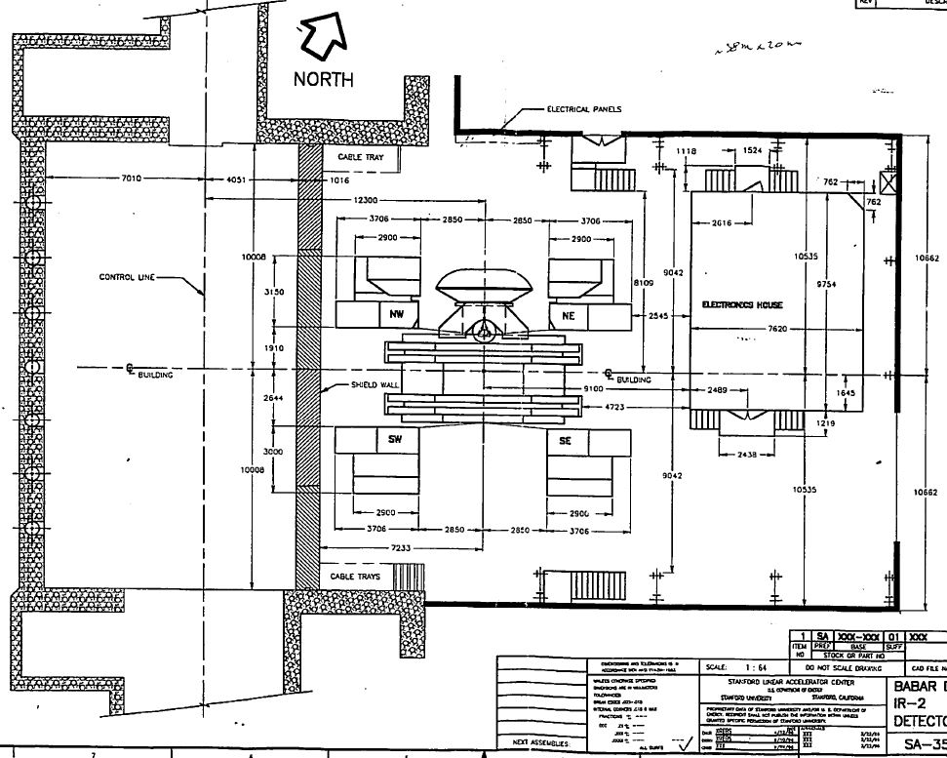
General considerations
Assembly configuration
38m
21.324m
Architecture of the Babar experimental area

Slide 5
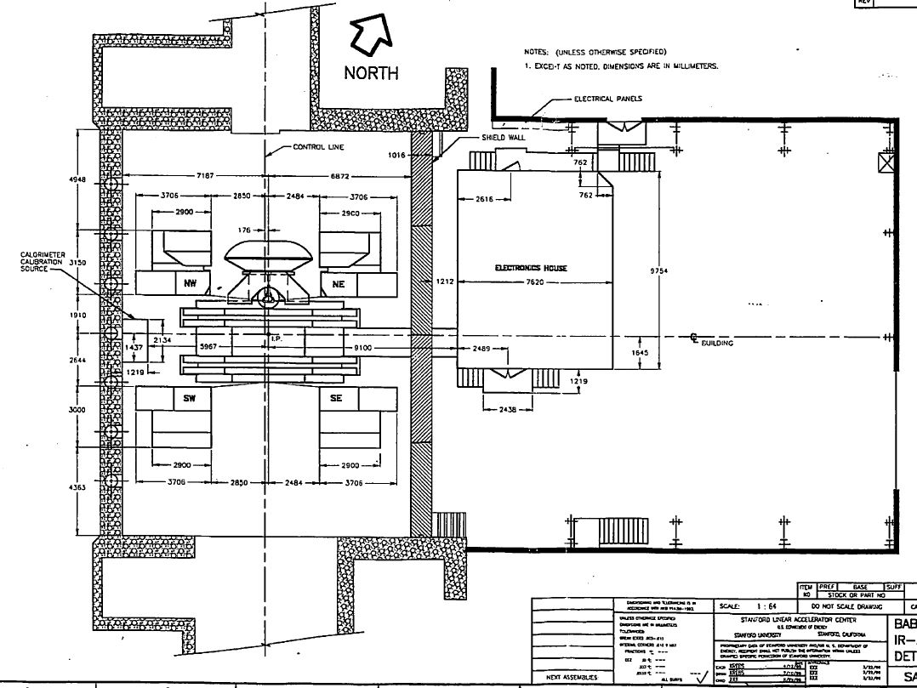
General considerations
Running configuration
38m
21.324m
Architecture of the Babar experimental area

Slide 6
Preliminary space requirements hall proposal.
Assuming to adopt the Babar architecture is necessary for the independence of accelerator and detector activities.
Other advantages: a) Only a big crane can handle all the heavy parts b)the tooling for preparation and adjusting are present in only one place; c) Commissioning of the subsector using the final services.
1)We need a large collision area for an easy maintenance.
2)A temporary storage and preparation area for mounting parts.
3) Enough space for the required service.
4) Space for mounting the detector.
5) We need to decided if it necessary to have an area for the service accessible during all phases, assembly commissioning and running.

Slide 7
A floor plan proposals.
Super B detector assembled, commissioned at proper beam axis distance, minimizing the travel to his final position.
It is important to define the beam axis position respect to the ground level. Depending of what we could have: a) a pit with a crane on surface level; b) a dedicate access ramp.
The two configurations have an impact of the way of organizing the handling and commissioning of the sub detector and safety issues.
The accelerator tunnel will be enlarged in the interaction area to locate the machine apparatus . This must be integrate in the design of the experimental hall.

Slide 8
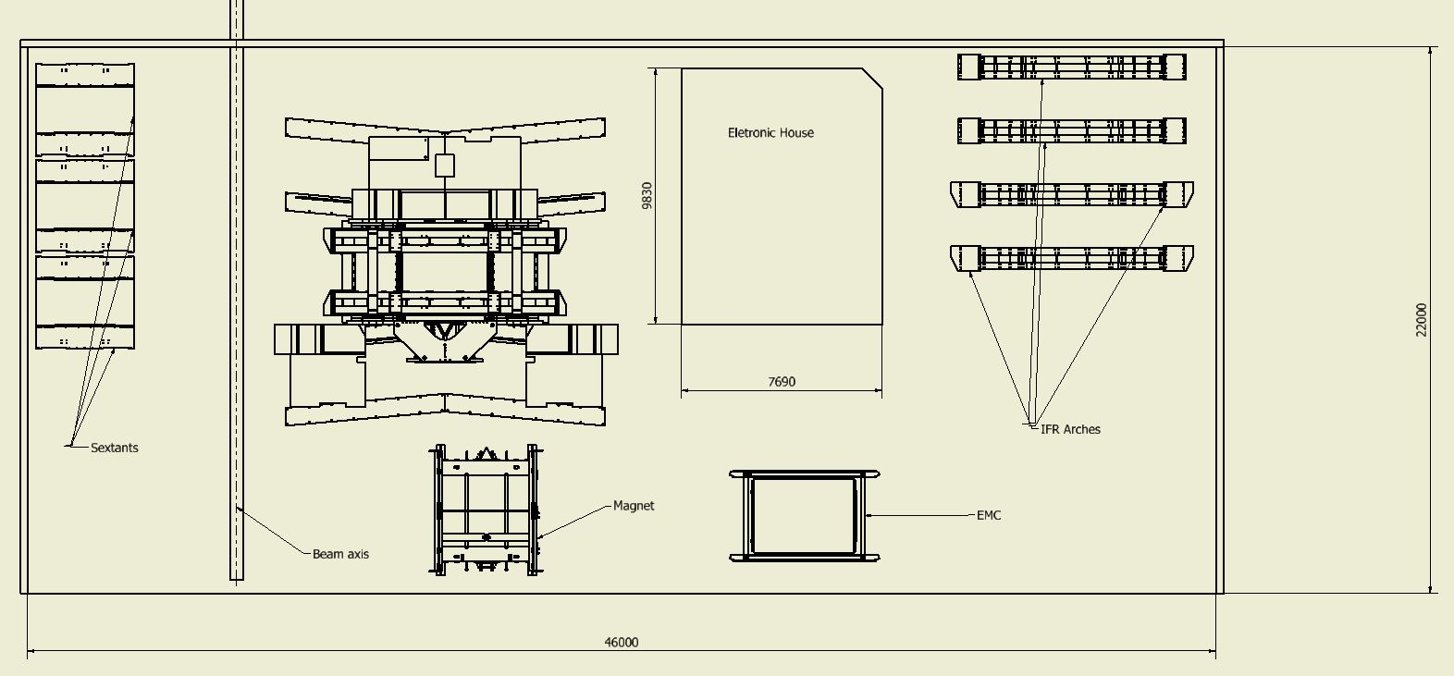
A floor plan proposals.
Radiation shielding
Assembly stage

Slide 9
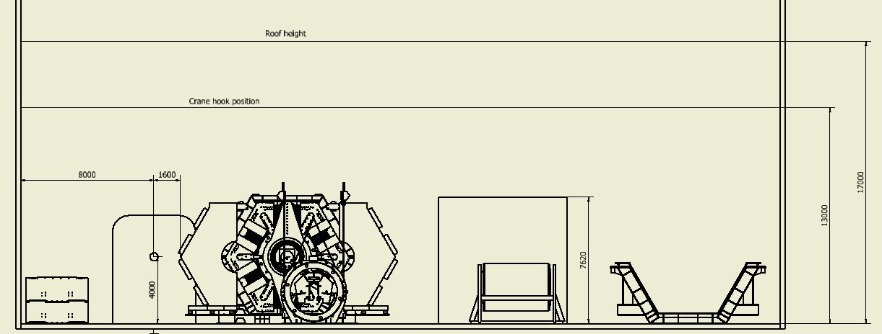
A floor plan proposals.
Assembly stage

Slide 10
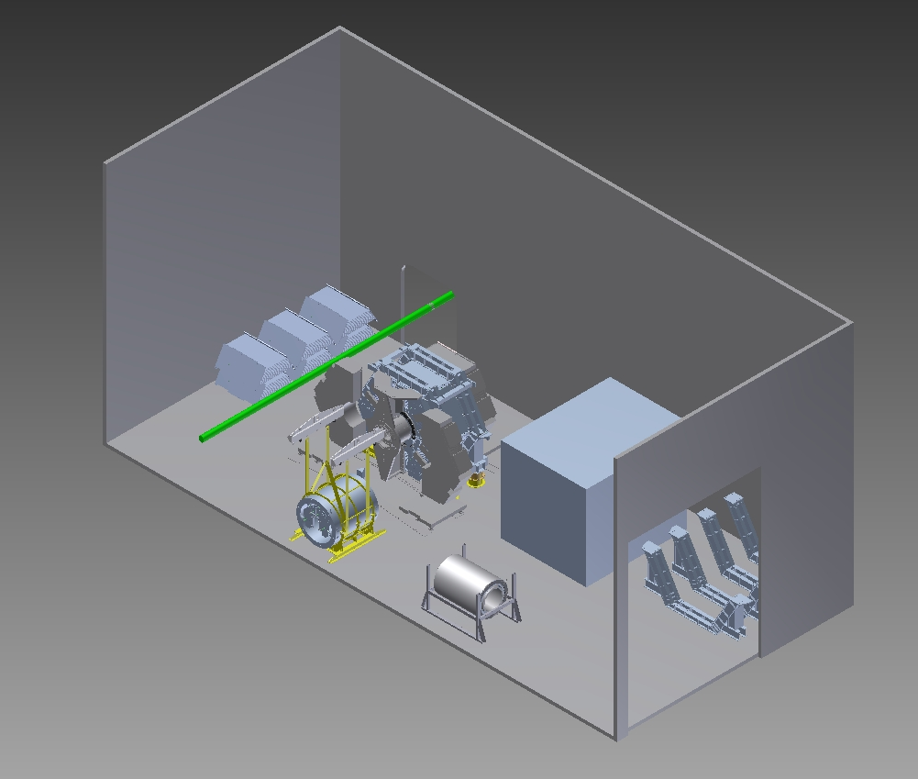
A floor plan proposals.
Assembly stage

Slide 11
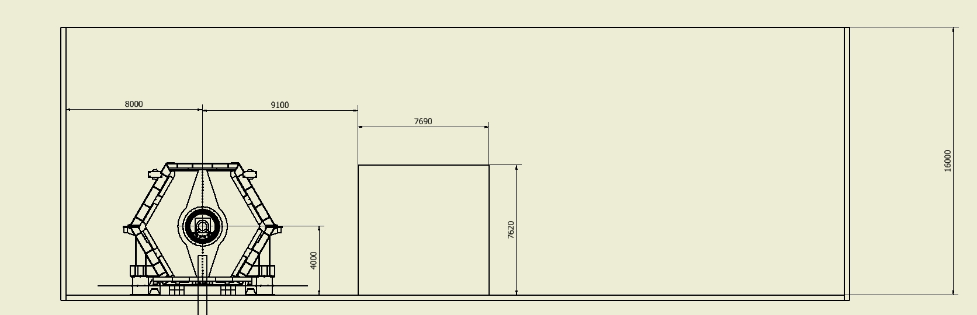
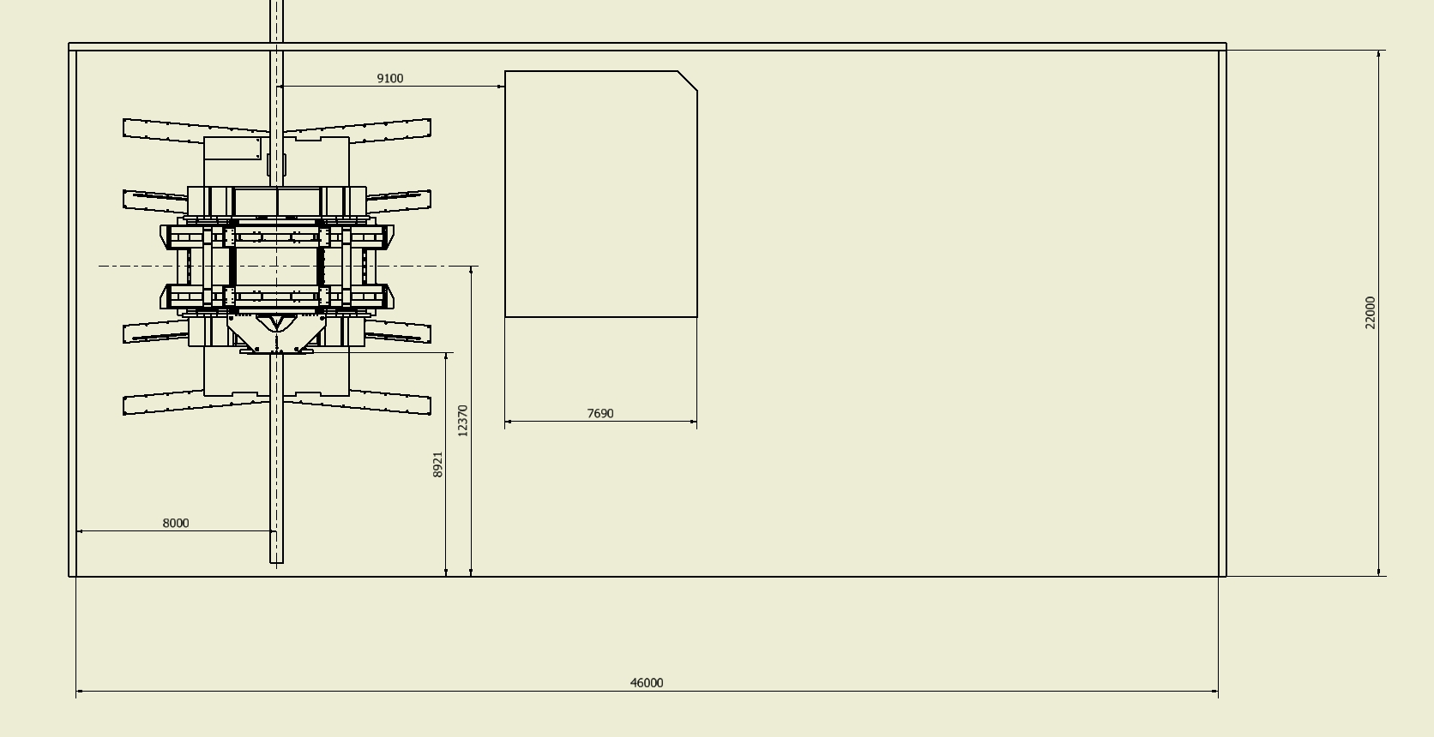
A floor plan proposals.

Slide 12
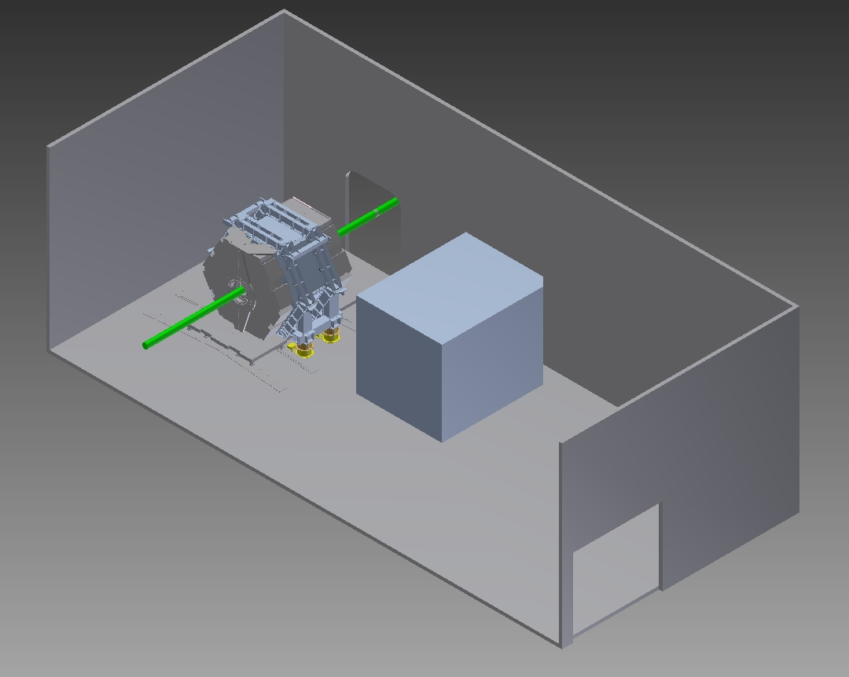
A floor plan proposals.
Beam pipe location

Slide 13
Specifications Step Plan. (SSP)
Define the architecture of the experimental area such that makes the works of the detector and accelerator people easy and economical. This work needs to be made involving the machine people that are the interface with the experimental area. I believe that the solution with an access ramp in which everything is at the same level is the more economical and efficient.
We need to get all the information from the sub component and detector in term of needs of service (size, position respect to detector, energy dissipated and cooling required, etc). In the region of the interaction we need to establish a direct line with the machine people.
Furthermore to understand better of the requirements of detectors in term of accuracy, environmental control services, this will add many specification to the experimental area.
3)Iteration while the design of the experiment will be in progress will make changes on the specification document.

Slide 14
Conclusions
At this stage of the project is premature to go in deep in precise study when it is not clear for instance location space available for access, constrain on environmental impact ,etc.
We need to have an interaction with the machine people to understand: the machine equipment near to the detector; the position of the tunnel; the constrain of the experimental building.
A better understanding of the requirements of detectors services, this will add many specification to the experimental area.
To gathering all the information we need to start circulating some questionnaire to all people involved of detector.

Slide 15
Questionnaire.
SuperB integration questionnaire
Data: xx\xx\xx
Sub detector name:
Author:
Electronics:
Number of electronic channesl:
Power dissipated per channels:
Volume occupied by the electronics:
Max tolerable distance between the detectors to the electronic module:
Requirement of cooling system:
Frequency access on the external electronic services per year:
Frequency access on the detector per year:
Cooling:
Requirement of cooling system:
Power, flow and temperature type of fluid:
Allowed temperature variation:
Size of the chiller:
Cables:
Power cable number:
Power cable sizes:
Number of Read-out cables:
Size of the read-out cables:
Number of slow control cables:
Size of the slow control cables:
Information on the cable distribution around the detector geometry
Space for storage in the experimental hall and in fracture required.
Describe other requirements that have an impact of the space available like space for access etc.

Slide 16
Related topics of Slac D&D activities
Dismount Status
Following:
Disposal space at SLAC
Transportation issues

Slide 17
Status at SLAC
Bill Wisniewski
Notes:
17

Slide 18
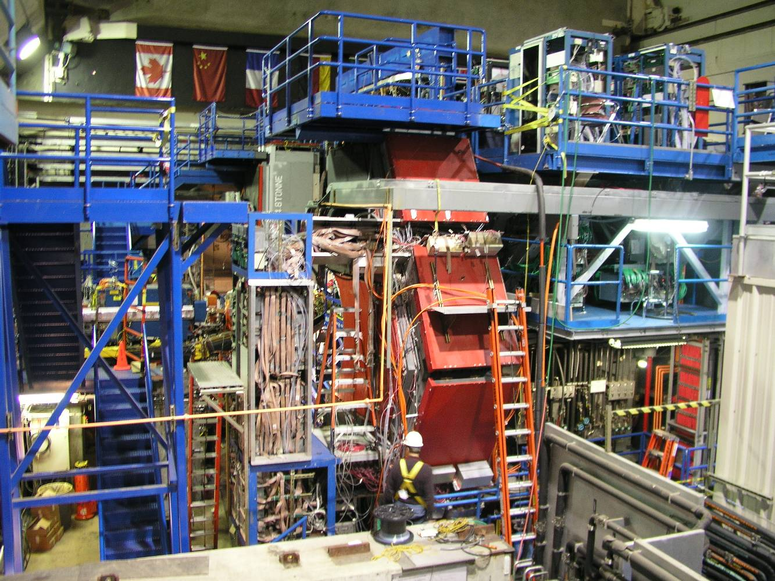
March 2009
Status at SLAC – QMUL 18

Slide 19
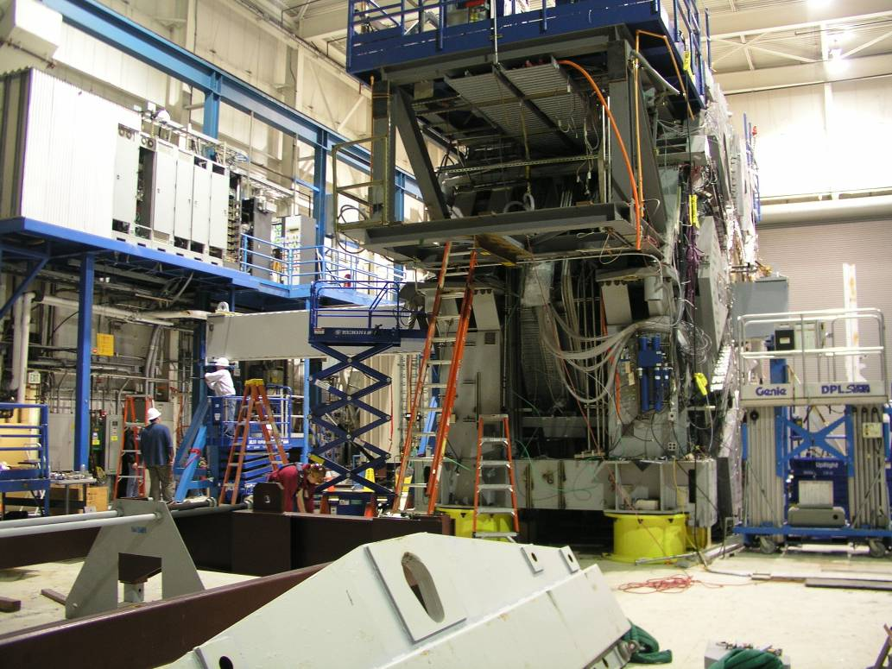
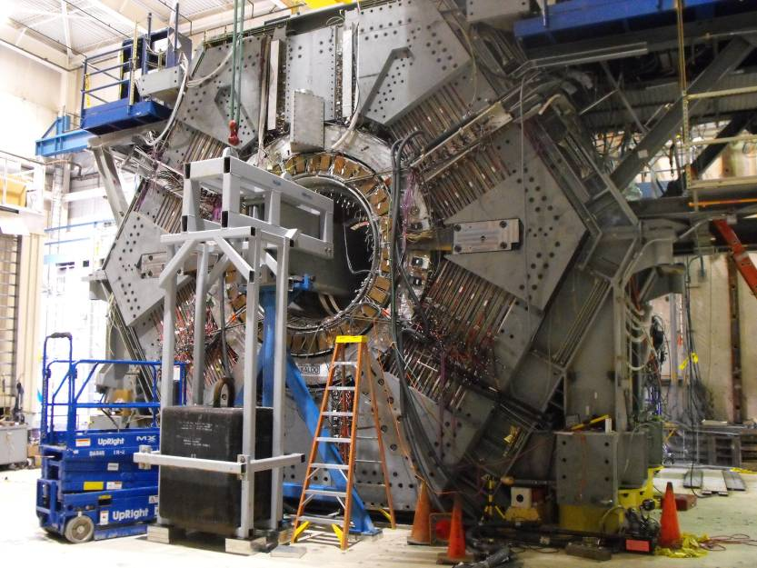
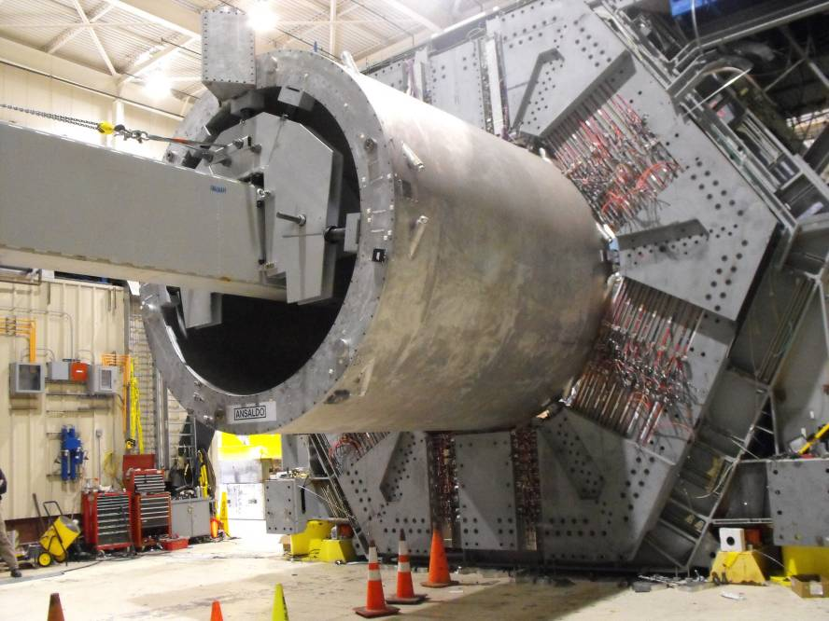
Installation of Solenoid Removal Tooling

Slide 20
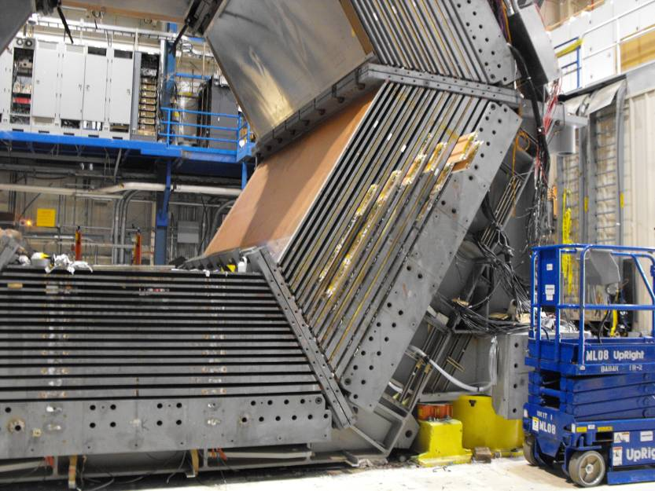
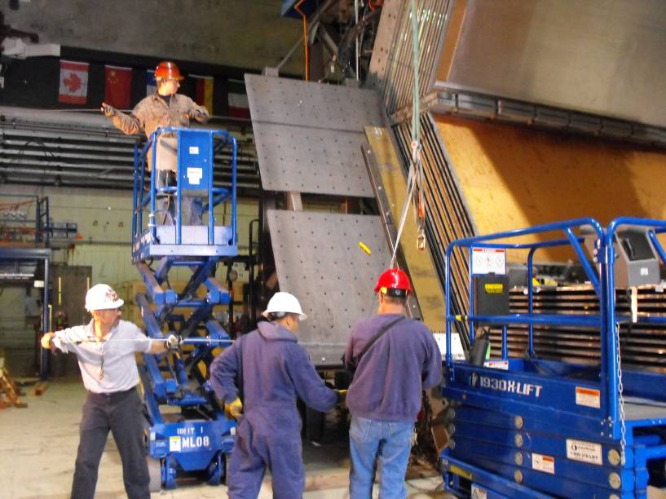
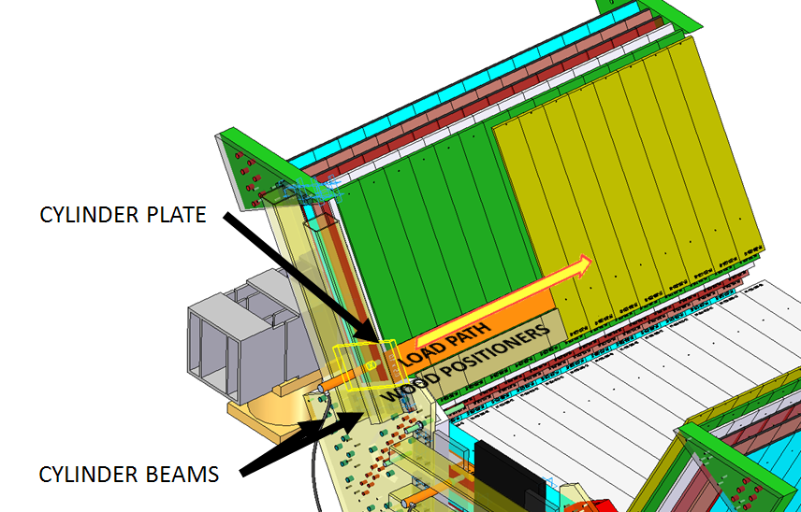
LST and Brass Removal
Status at SLAC – QMUL 20

Slide 21
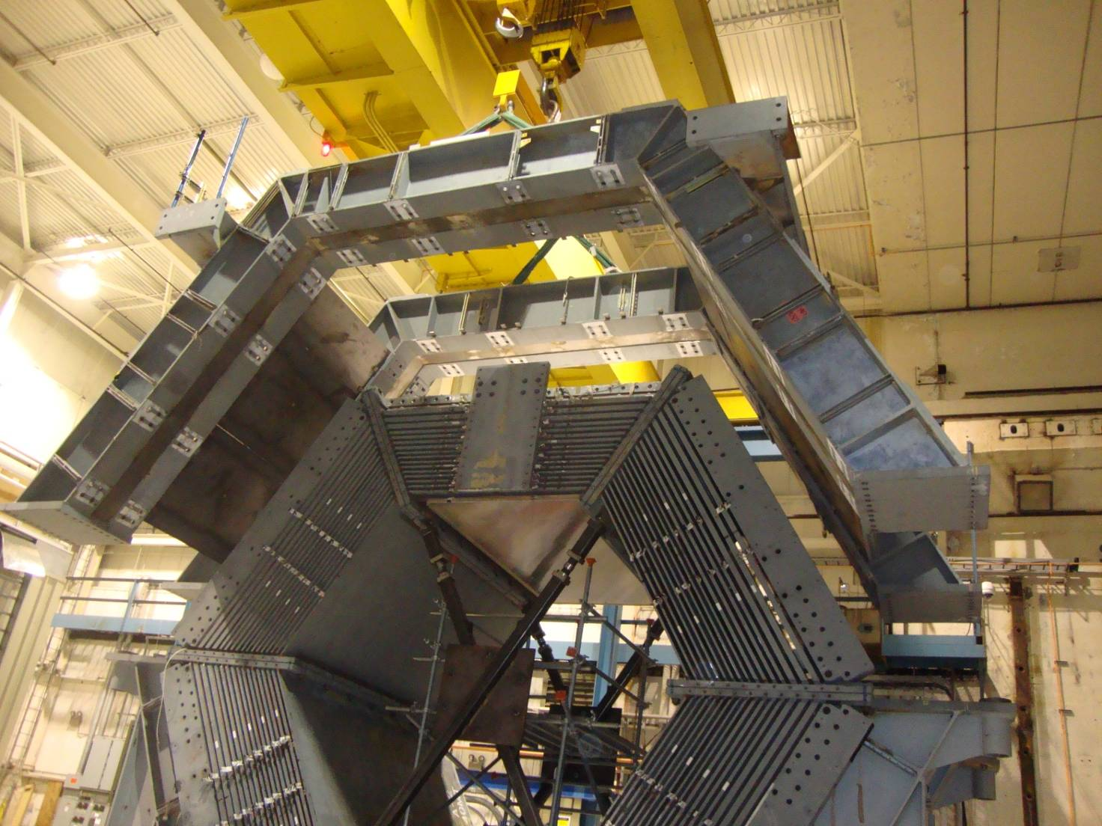
Removal of Upper Arch Assembly

Slide 22
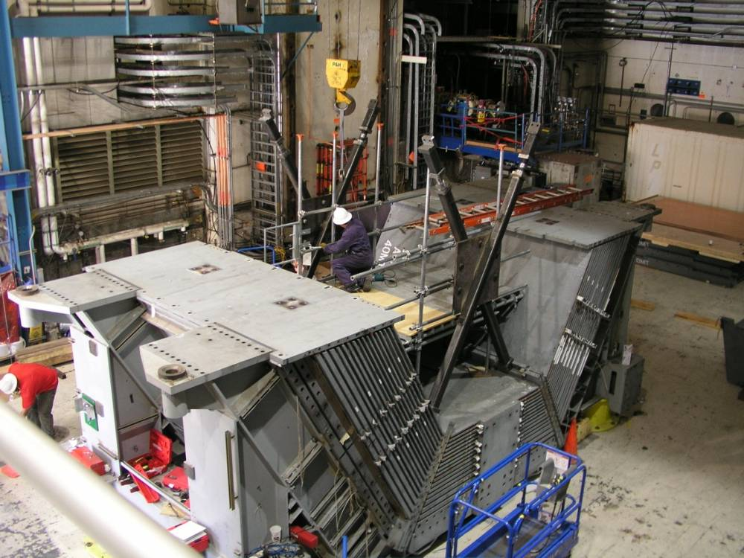
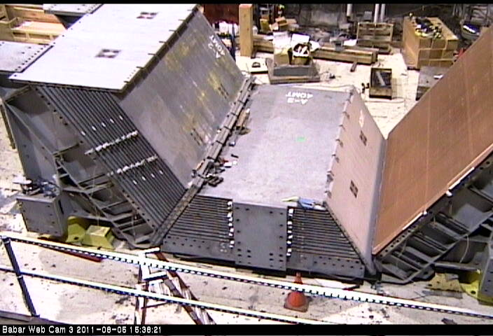
Top Sextants & Bottom Inner West Block Removed

Slide 23
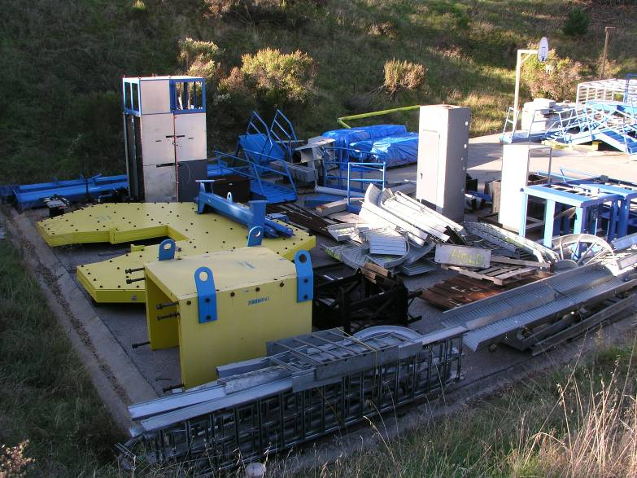
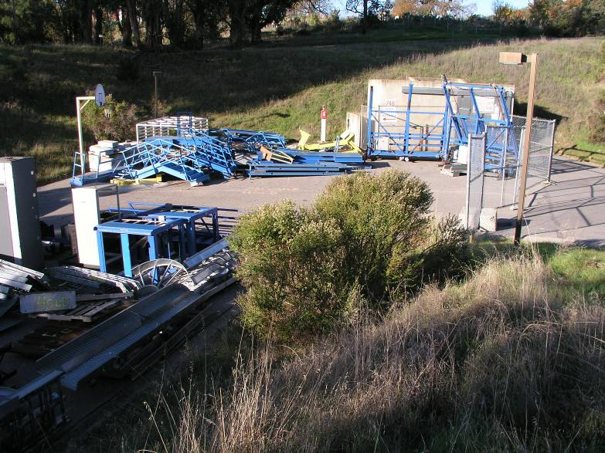
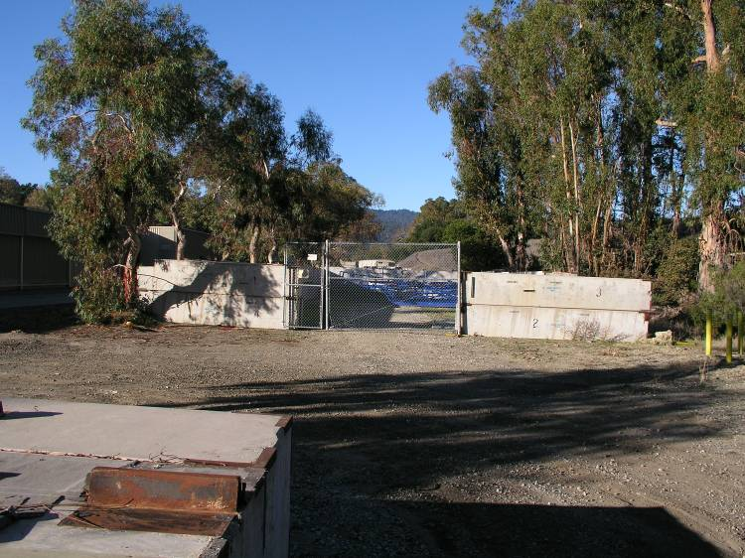
Deconstructed Onion Storage – Outdoors
Now all full
Status at SLAC – QMUL 23

Slide 24
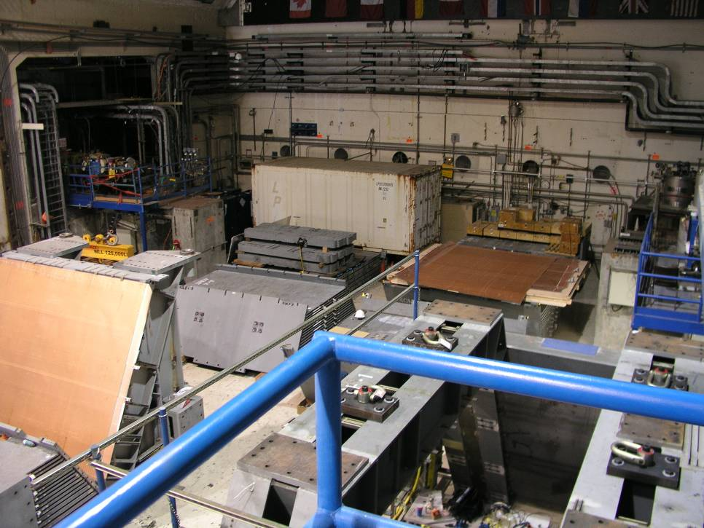
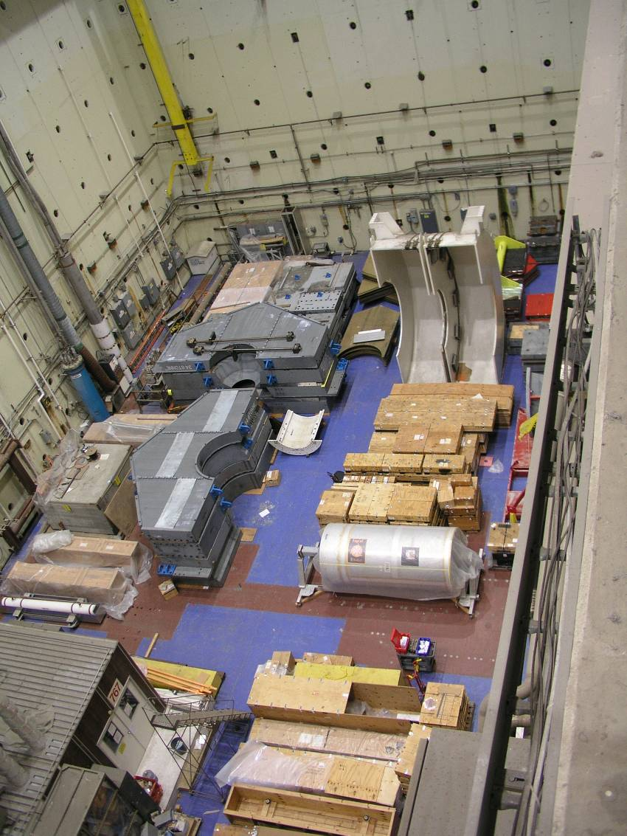
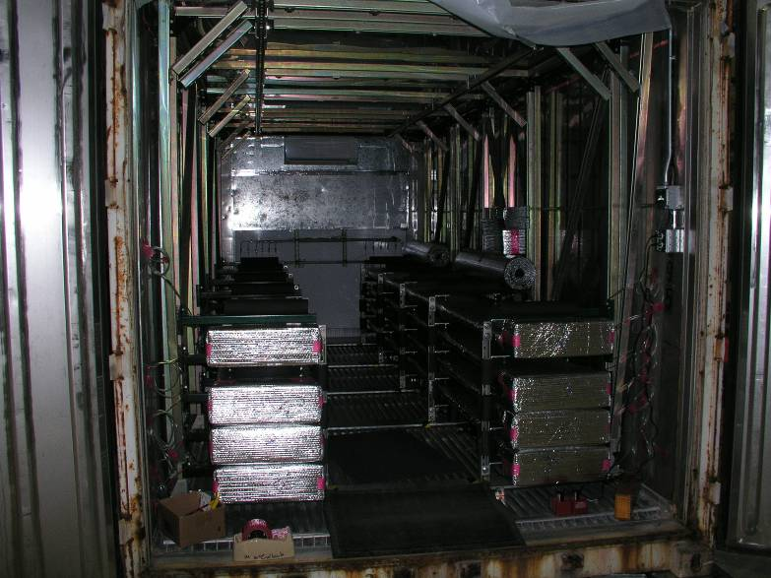
Deconstructed Onion Storage_ CEH, IR2
Status at SLAC – QMUL 24

Slide 25
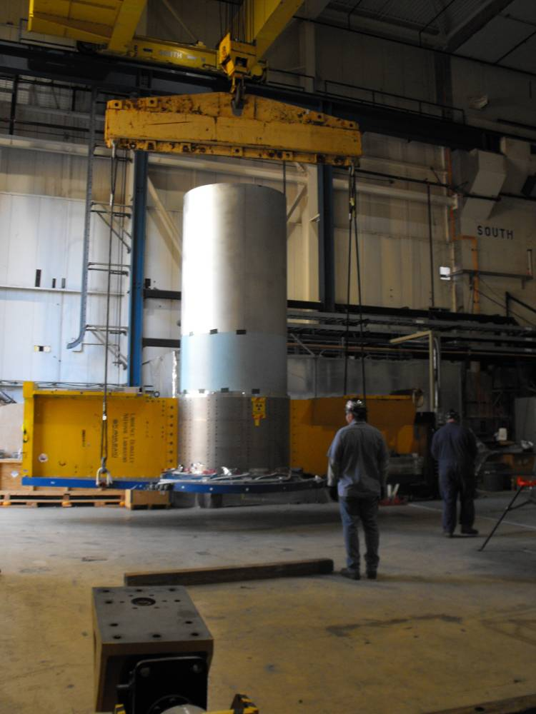
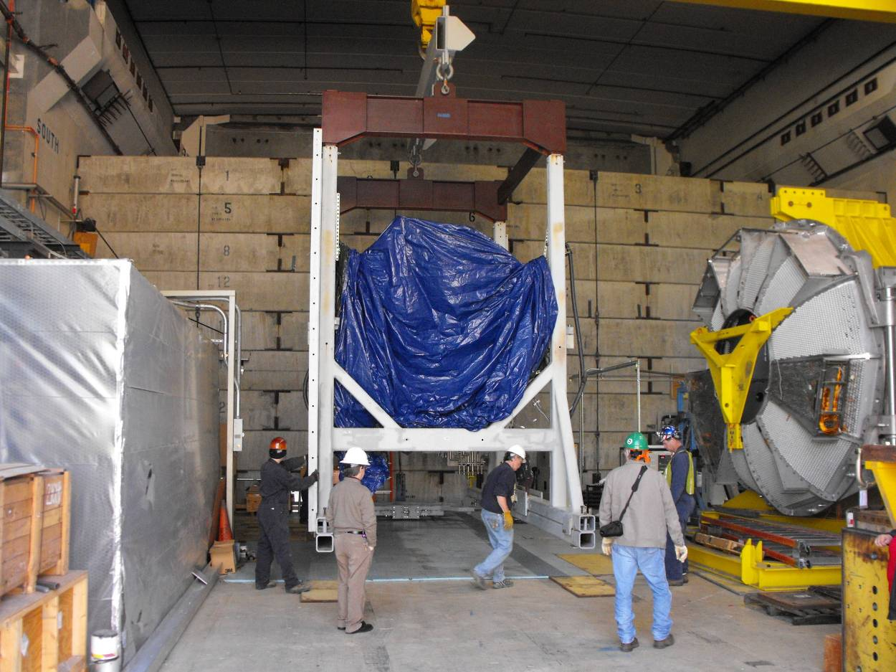
Deconstructed Onion Storage _ IR12
Status at SLAC – QMUL 25

Slide 26
Transportation issues
All Babar components has been dismount and disposed in the SLAC area.
We need to decided what we want to get and make a list of the components with their physical data.
We need to make a transportation planning that takes in account all aspects.
Most of components can be shipped without making special packaging or studies, but still we need to find storage space.
The electromagnetic calorimeter and bar box need engineering studies and the design of a transportation tooling.
Status at SLAC – QMUL 26

