Slide 1
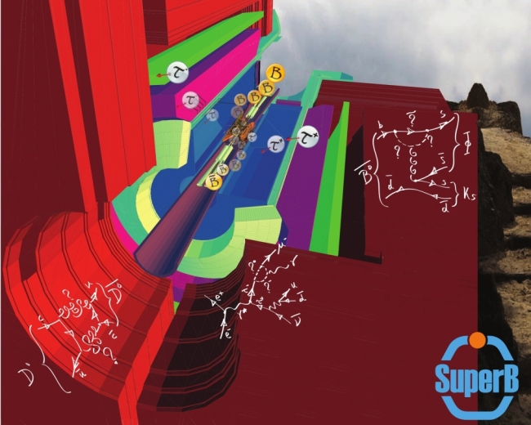

SuperB Physics
Adrian Bevan
1st SuperB Collaboration Meeting, London 13-16th Sept. 2011
email: a.j.bevan@qmul.ac.uk

Slide 2
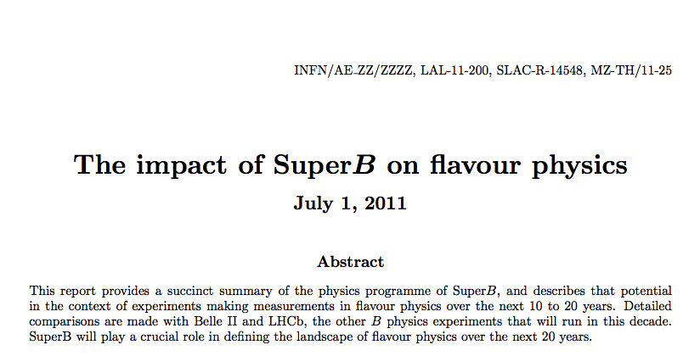
Comparison Document
Need to update charm numbers for LHCb, otherwise finished.

Slide 3
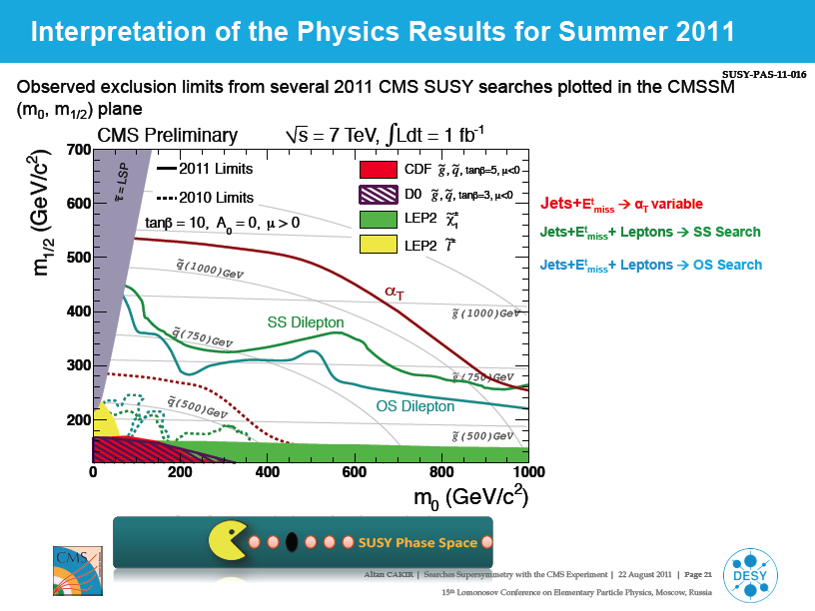
LHC Results on SUSY (slide from A. Cakir, Lomonosov XV)
So far no evidence for SUSY.
The SUSY mass scale is now looking likely to be above 1TeV.
This has interesting implications for some of our measurements.
We need to make sure our benchmark processes and assumed scales are still valid.
Hone our case for indirect constraints.
Trivial SUSY doesn't exist.

Slide 4
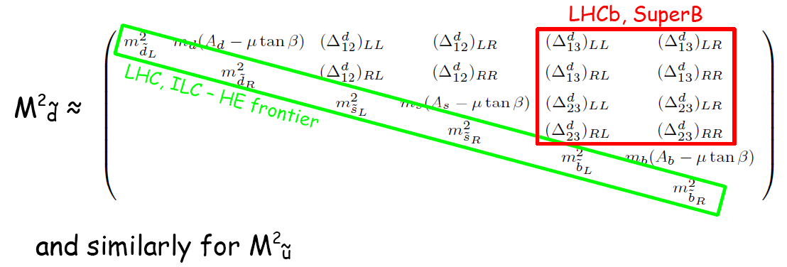
SUSY
Example: Consider MSSM as an illustration of SUSY
  Simple, and being constrained by the LHC but general enough to illustrate the issue:
  In many NP scenarios the energy frontier experiments will probe the diagonal elements of mixing matrices.
  Flavour experiments are required to probe off-diagonal ones.
e.g. MSSM: 124 (160 with ν_{R}) couplings, most are flavour related.
Δ's are related to NP mass scale.

Slide 5
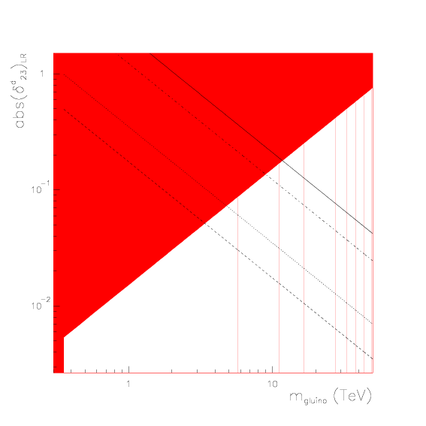


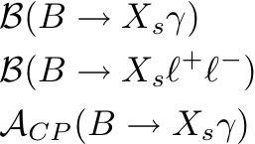

SUSY
e.g. MSSM with generic squark mass matrices.
Use Mass insertion approximation with to constrain couplings:
Can constrain the δ^{d}_{ij}'s using
LHC constraints on the gluino mass, mean couplings are non-zero, and SuperB can provide an upper bound on Λ_{NP}.
1
10⁻¹
10⁻²
δ measured with greater than 3σ significance
1 10 0
e.g. see Hall et al., Nucl. Phys. B 267 415-432 (1986)
Ciuchini et al., hep-ph/0212397

Slide 6
SUSY
e.g. MSSM with generic squark mass matrices.
Use Mass insertion approximation with to constrain couplings:
Can constrain the δ^{d}_{ij}'s using
LHC constraints on the gluino mass, mean couplings are non-zero, and SuperB can provide an upper bound on Λ_{NP}.
1
10⁻¹
10⁻²
δ measured with greater than 3σ significance
e.g. LHC excludes 1 TeV gluinos, and SuperB measures (δ^{d}₂₃)_{LR}~0.05 would imply Λ_{NP} < 3.5 TeV.
1 10 0
e.g. see Hall et al., Nucl. Phys. B 267 415-432 (1986)
Ciuchini et al., hep-ph/0212397

Slide 7
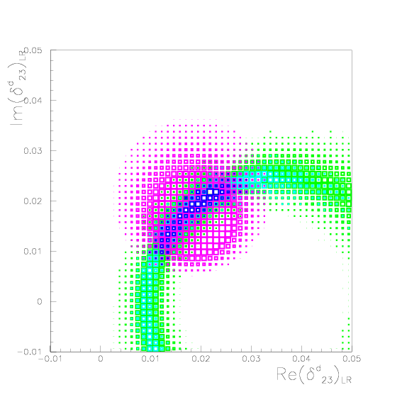


SUSY
e.g. MSSM with generic squark mass matrices.
Use Mass insertion approximation with to constrain couplings:
Can constrain the δ^{d}_{ij}'s using
0.05
0.04
0.03
0.02
0.01
0.0
−0.01
−0.01 0 0.01 0.02 0.03 0.04 0.05
e.g. see Hall et al., Nucl. Phys. B 267 415-432 (1986)
Ciuchini et al., hep-ph/0212397

Slide 8
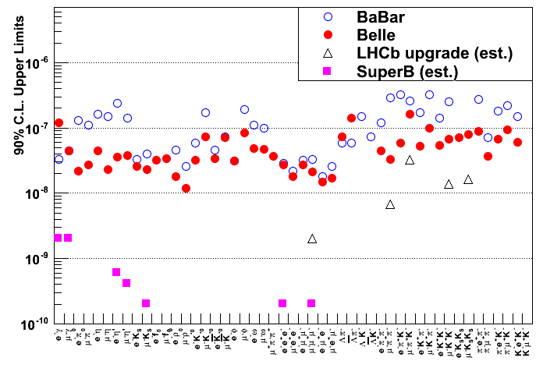
Charged Lepton Flavour Violation (LFV)
ν mixing leads to a low level of charged LFV (B~10⁻⁵⁴).
  Enhancements to observable levels are possible with new physics scenarios.
  Searching for transitions from 3rd generation to 2nd and 1st, i.e.
  and
N.B. e⁻ beam polarisation
helps suppress background.
Two orders of magnitude improvement at SuperB over current limits.
Hadron machines are not competitive with e⁺e⁻ machines for this.

Slide 9
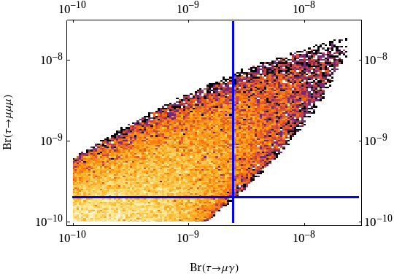

The golden LFV modes: hb
Symmetry breaking scale assumed: 500GeV.
NP scale assumed: 500GeV.
Current experimental limits are at the edges of the model parameter space
SuperB will be able to significantly constrain these models, and either find both channels, or constrain a large part of parameter space.
c/o M. Blanke
M. Blanke et al. arXiv:0906.5454

Slide 10
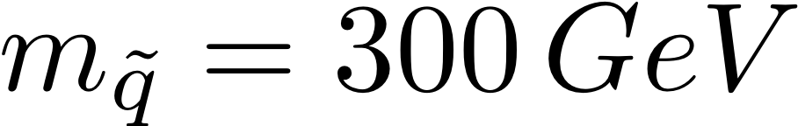
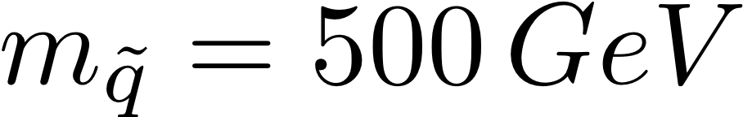
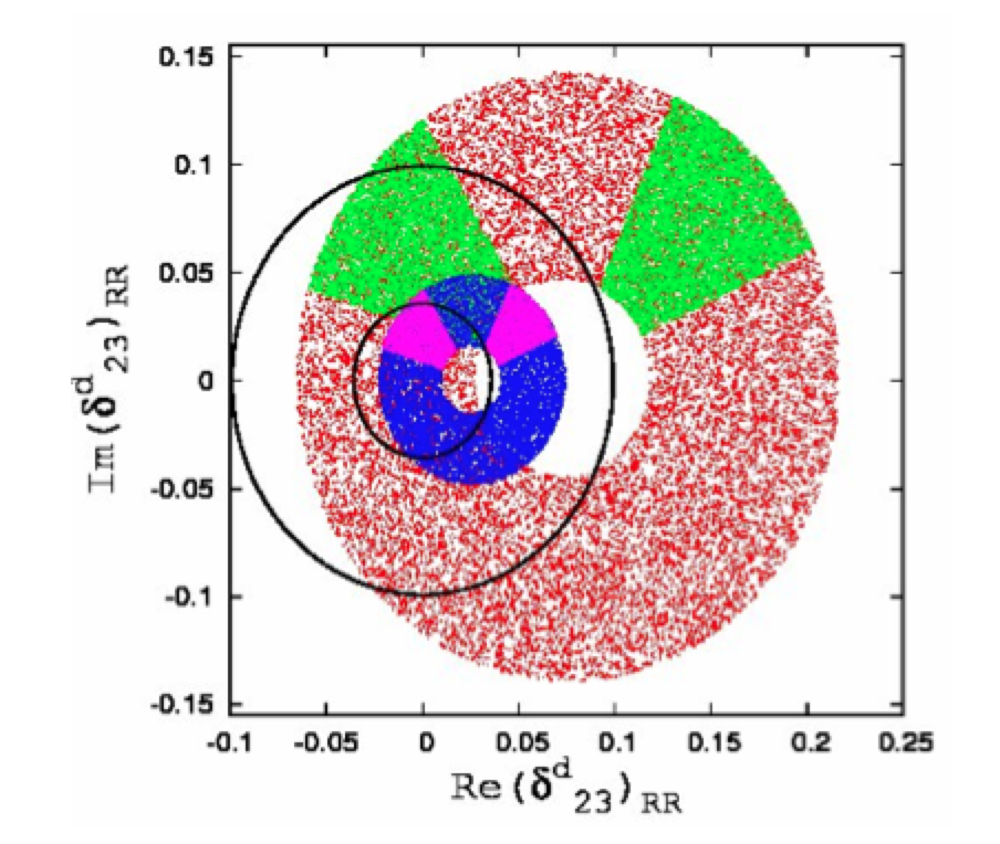
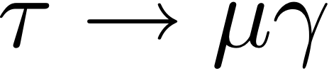
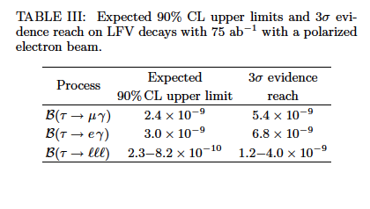
Specific example: k
Only accessible in e⁺e⁻ (golden modes: μγ, 3 lepton)
Model dependent NP constraint.
Correlated with other flavour observables: MEG, LHCb etc.
BLUE
RED
Not updated to latest results from LHCb
Φ_{s} + Δm_{s}
Δm_{s}
Parry and Zhang Nucl.Phys.B802:63-76,2008

Slide 11
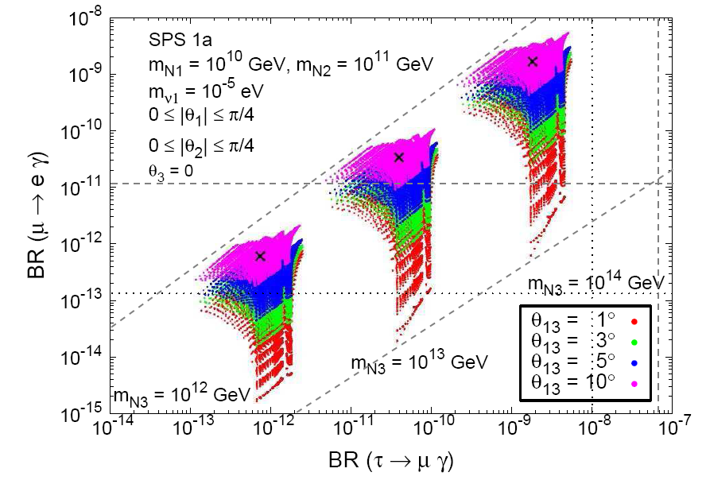
Another model...
τ→μγ upper limit can be correlated to θ₁₃ (neutrino mixing/CPV, T2K etc.) and also to μ→eγ.
SUSY seasaw = CMSSM + 3ν_{R} + ν
Combine information from:
2nd →1st generation transitions
3rd → 1st generation transitions
Neutrino mixing: θ₁₃.
Correlated results from T2K,
MEG and SuperB
Arganda et al., JHEP, 06:079, 2008.

Slide 12
Another model...
τ→μγ upper limit can be correlated to θ₁₃ (neutrino mixing/CPV, T2K etc.) and also to μ→eγ.
SUSY seasaw = CMSSM + 3ν_{R} + ν
Combine information from:
2nd →1st generation transitions
3rd → 1st generation transitions
Neutrino mixing: θ₁₃.
SuperB
MEG (now)
MEG (design)
This model will be ruled out if we find μγ
Correlated results from T2K,
MEG and SuperB
Arganda et al., JHEP, 06:079, 2008.

Slide 13
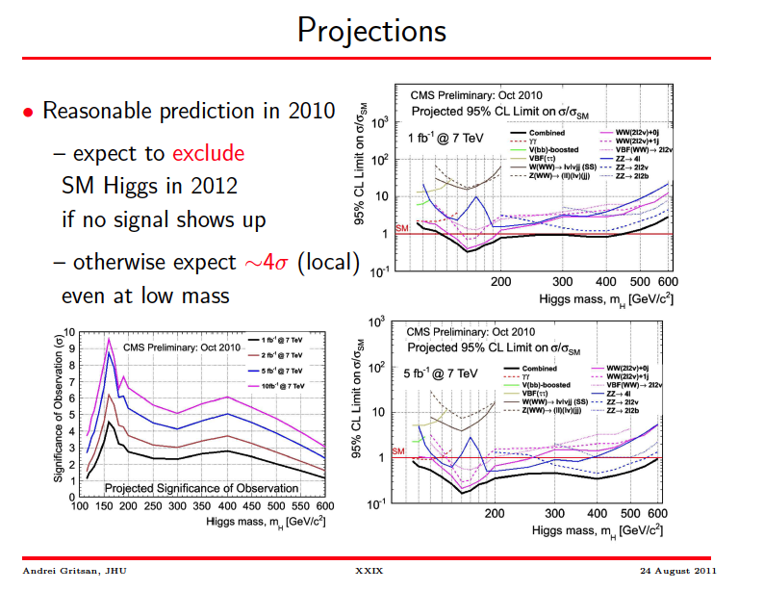
Higgs searches from the LHC
(slide from A. Gritsan, Lomonosov XV)
EW data point to a light Higgs (~115 GeV). Nothing found so far.
Searches for a SM Higgs could yield a stable point to guide non-SM Higgs searches.
Non-SM searches are of relevance for many of our rare decays.
No SM Higgs would take the field back to the drawing board, and in this case FCNC's will have an inevitable role in understanding nature.

Slide 14
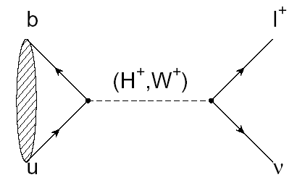

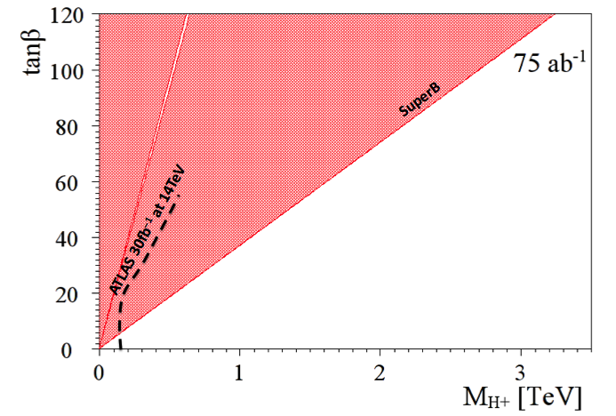
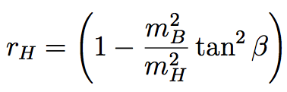
B_{u,d} physics: Rare Decays
Example:
  Rate modified by presence of H⁺
Currently the inclusive b to sγ channel excludes m_{H+} < 295 GeV/c².
The current combined limit places a stronger constraint than direct searches from the LHC for the next few years.

Slide 15

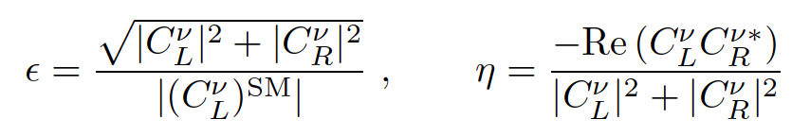
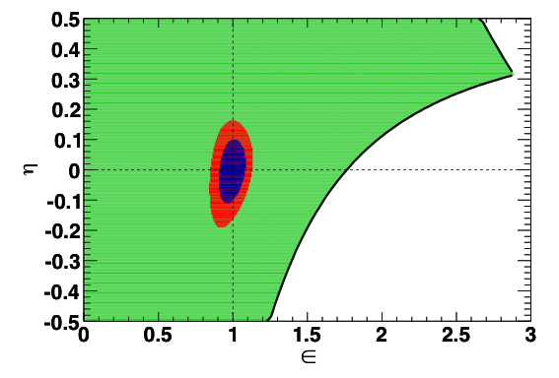

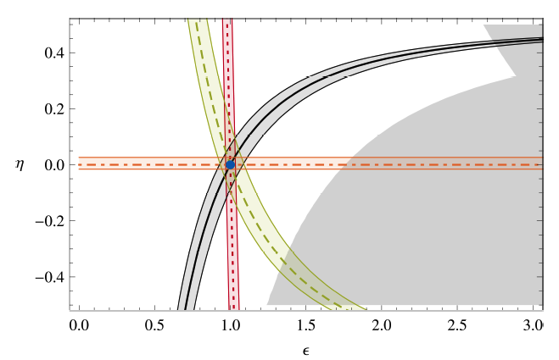
B_{u,d} physics: Rare Decays
Example:
  Need 75ab⁻¹ to observe pseudoscalar and vector modes.
  With more than 75ab⁻¹ we could measure polarisation.
Sensitive to models with
Z', RH currents and light scalar particles.
e.g. see Altmannshofer, Buras, & Straub
Constraint on (ε, η) now
with 75ab⁻¹
(Theoretical uncertainties)
(Experimental uncertainties)

Slide 16
b→ sl⁺l⁻
SuperB can measure inclusive and exclusive modes.
  Crosscheck results to understand source of NP.
  Important as theory uncertainties differ.
  Expect: 10-15,000 K*μμ and 10-15,000 K*ee events
SuperB can study all lepton flavours
  Equal amounts of μ and e final states can be measured.
    Need both of these to measure all NP sensitive observables.
    LHCb will accumulate slight more events in the μμ mode.
    Expect superior statistics wrt LHCb for ee mode.
    S/B~ 0.3, c.f. S/B~1.0 for LHCb.
  Can also search for K^{(*)}τ⁺τ⁻ decay.
  ... and constrain Majorana ν's using like sign final states.
    Also of interest for D_{s} decays to K^{(*)}ll final states near charm threshold.

Slide 17

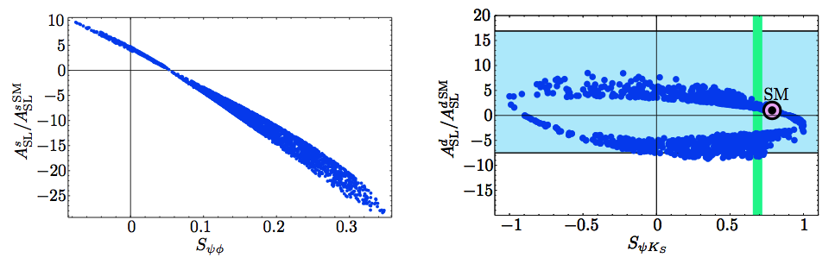
B_{s} physics
Can cleanly measure A^{s}_{SL} using 5S data
SuperB can also study rare decays with many neutral particles, such as , which can be enhanced by SUSY.
Little Higgs (LTH) scenario

Slide 18
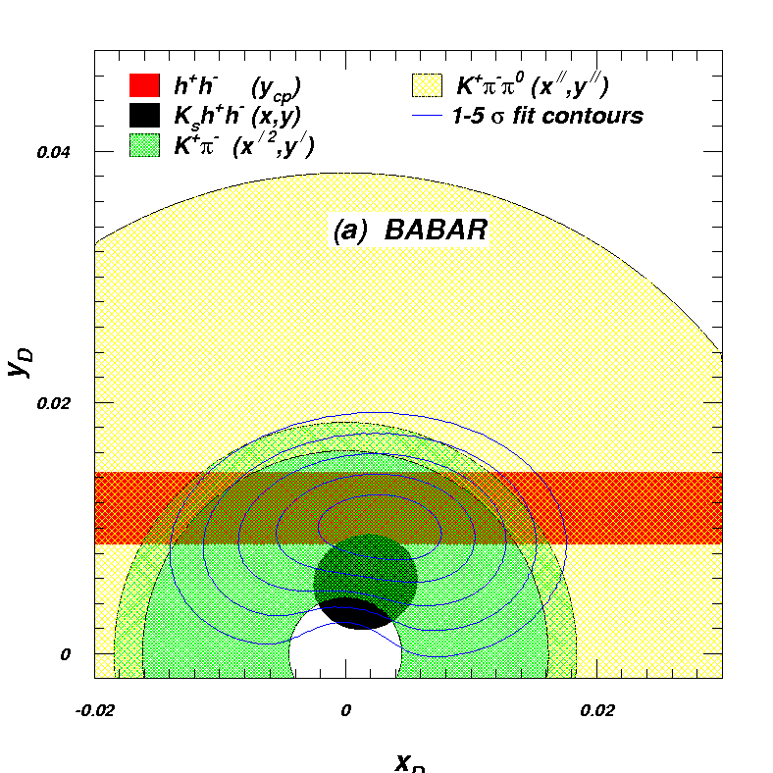
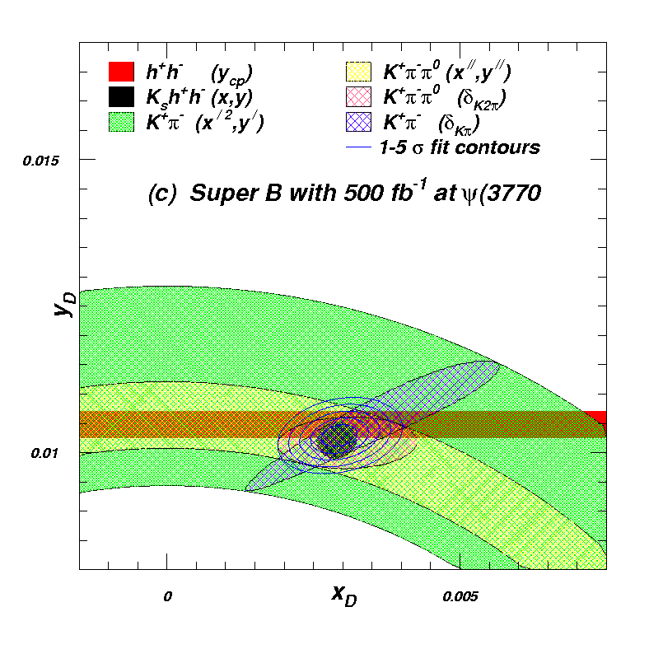
Charm Mixing
Collect data at threshold and at the 4S.
  Benefit charm mixing and CPV measurements.
  Also useful for measuring the Unitarity triangle angle γ (strong phase in D→Kππ Dalitz plot).

Slide 19
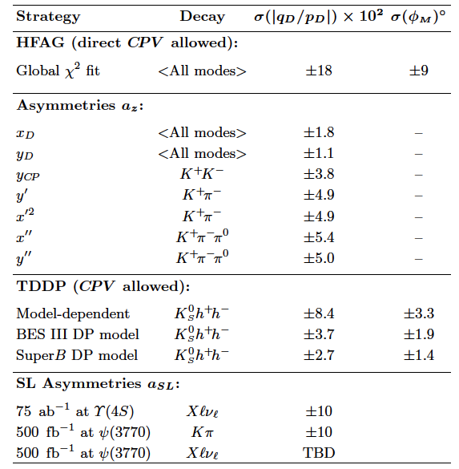
Charm Mixing: Summary
Can perform a precision measurement of charm mixing.
Need to evaluate the potential of TDCPV to measure charm mixing: a number of modes can each provide a sub 2° measurement.

Slide 20
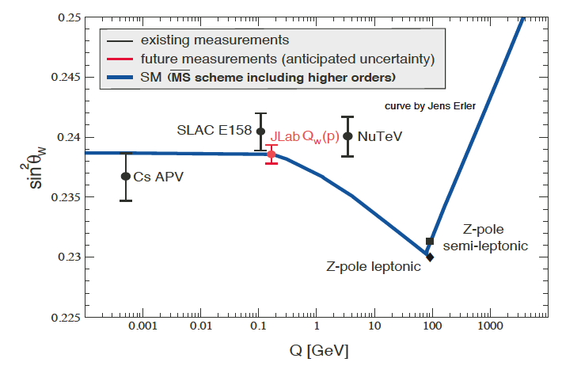
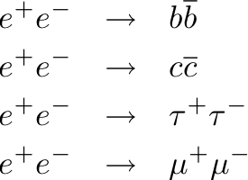
Precision Electroweak
sin²θ_{W} can be measured with polarised e⁻ beam
  √s=ϒ(4S) is theoretically clean, c.f. b-fragmentation at Z pole
Measure LR asymmetry in
at the ϒ(4S) to same precision as LEP/SLC at the Z-pole.
Complements measurements planned/underway at lower energies (QWeak/MESA).
SuperB
Plot adapted from QWeak proposal (JLAB E02-020)

Slide 21
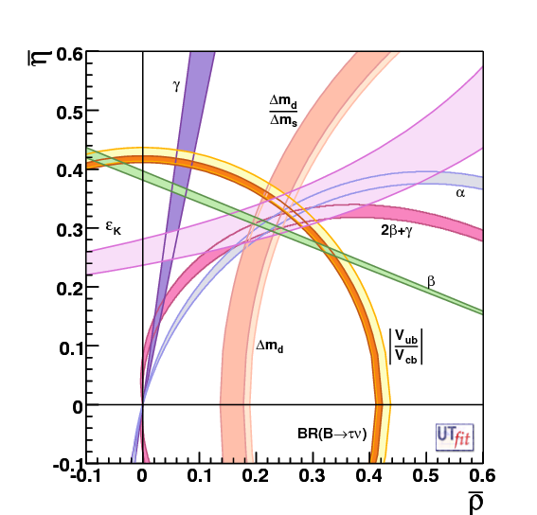
Precision CKM constraints
The "dream" scenario with 75ab⁻¹
Unitarity Triangle Angles
  σ(α) = 1−2°
  σ(β) = 0.1°
  σ(γ) = 1−2°
CKM Matrix Elements
  |V_{ub}|
    Inclusive σ = 2%
    Exclusive σ = 3%
  |V_{cb}|
    Inclusive σ = 1%
    Exclusive σ = 1%
  |V_{us}|
    Can be measured precisely using τ decays
  |V_{cd}| and |V_{cs}|
    can be measured at/near charm threshold.
SuperB Measures the sides and angles of the Unitarity Triangle

Slide 22
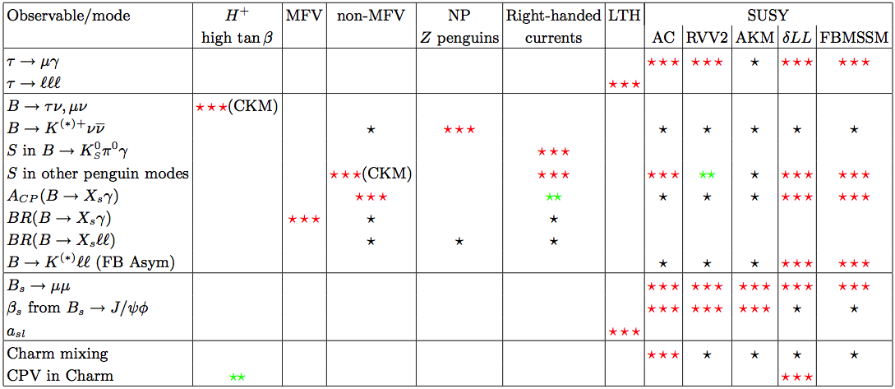
Interplay
Combine measurements to elucidate structure of new physics.
✓
✓
✓
✓
✓
✓
✓
✓
✓
✓
✓
✓
✓
✓= SuperB can measure this
More information on the golden matrix can be found in arXiv:1008.1541, arXiv:0909.1333, and arXiv:0810.1312.

Slide 23
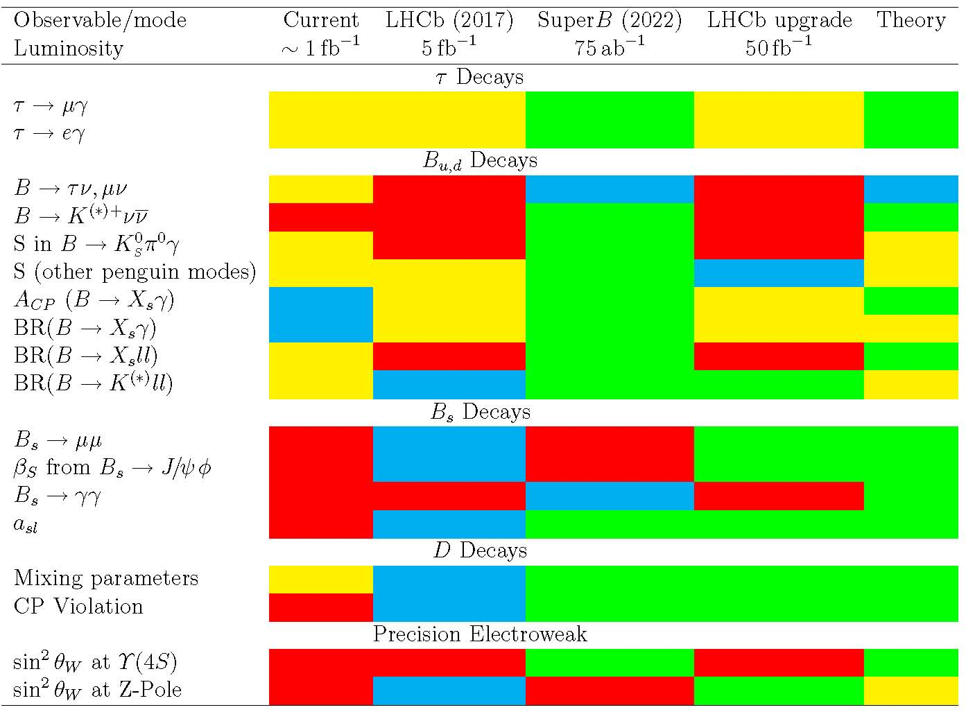
Golden Measurements: General
Benefit from polarised e⁻ beam
very precise with improved detector
Statistically limited: Angular analysis with >75ab⁻¹
Right handed currents
SuperB measures many more modes
systematic error is main challenge
control systematic error with data
SuperB measures e mode well, LHCb does μ
Clean NP search
Theoretically clean
b fragmentation limits interpretation

Slide 24
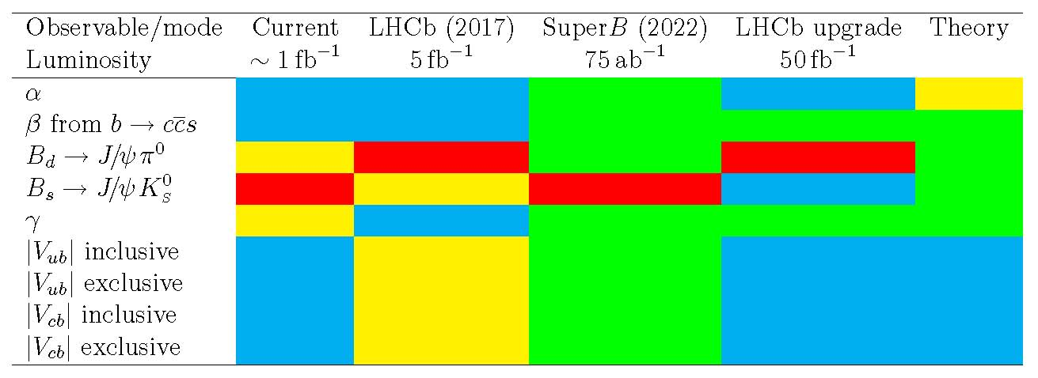
Golden Measurements: CKM
Comparison of relative benefits of SuperB (75ab⁻¹) vs. existing measurements and LHCb (5fb⁻¹) and the LHCb upgrade (50fb⁻¹).
LHCb can only use ρπ
βtheory error B_{d}
βtheory error B_{s}
Need an e⁺e⁻ environment to do a precision measurement using semi-leptonic B decays.

Slide 25
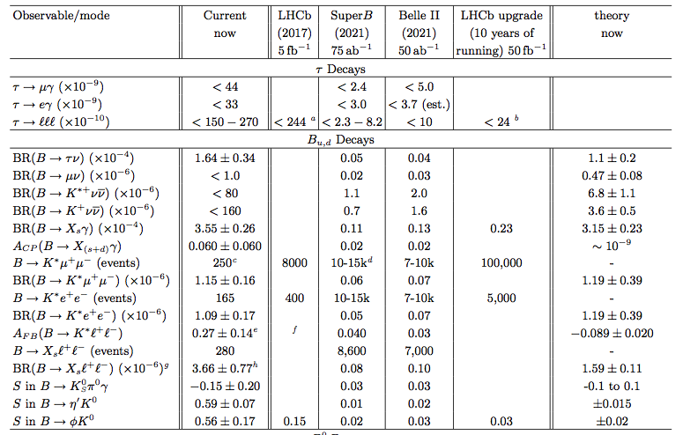
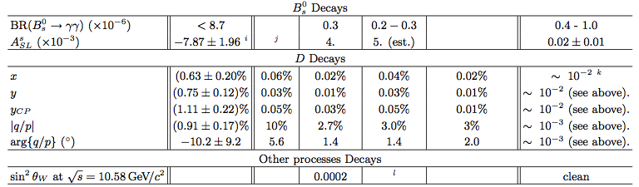

Slide 26
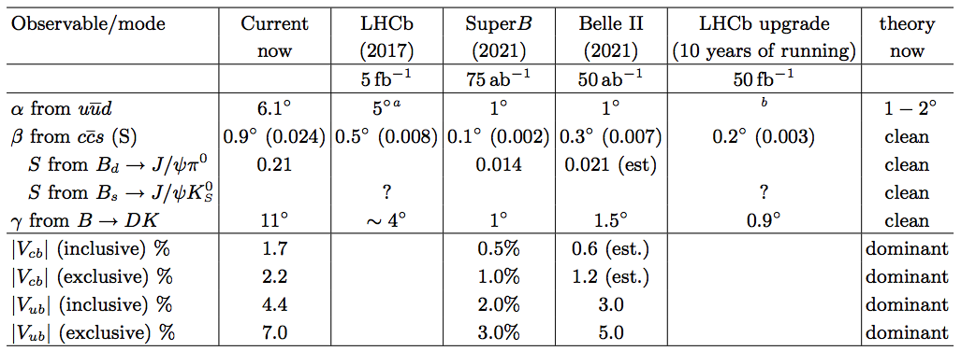
With the exceptions of y_{CP} and K*μμ, there are no planned or existing experiments that will surpass SuperB precision in these modes for at least the next two decades.
The best place to measure the other 33 golden modes is SuperB!

Slide 27
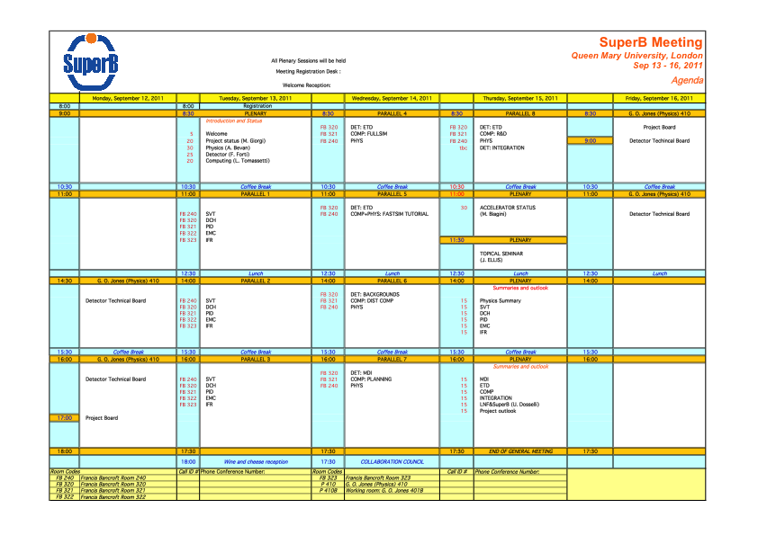
This week:
Charm
Charm
4 general parallel sessions covering D, B and Precision EW physics & discussion
Planning
B / EW
+ Convenor meeting at 13:00 on Wednesday in here (FB 240)

Slide 28
This week:
FastSim Tutorial:
Learn how to start doing physics studies.

Slide 29
This week:
Topical Seminar: John Ellis on SUSY

Slide 30
Physics tools
Many opportunities to contribute:
detector response simulation in FastSim (SVT, DCH, DIRC, EMC, IFR)
PID selectors
simulation of background
physics analysis tools (tagging, vertexing, …)
development of ‘skims’ for physics studies
documentation
for more information contact Matteo Rama

Slide 31
Charm Threshold Generation
CLEO-c have given us their code and DEC files for charm threshold simulation.
  Follows from a request made by Brian for access to these.
  This generous donation of technology will give the SuperB physics effort a head start for threshold running studies.
DECAY.DEC for generating *uncorrelated* D0D0bar MC
Source code for QCMCReweightProc, a filtering processor that discards events from the uncorrelated MC to make it look more like correlated MC. By no means is this meant to be a complete simulation of all strong phases in all modes; we were mainly concerned with the particular modes in our analysis (CP eigenstates, semileptonic, and two-body Kpi).
Documentation (K0SPi+Pi- and K0LPi+Pi-, using the CLEO Dalitz model is not documented in this).
There is also a known bug: the spins of resonances in the final state were ignored in determining the strong phase to be assigned to the decay mode. So, PP, VP, and VV modes with the same flavor content are all given the same phase. For example, K-pi+, K*-pi+, and K*-rho+ all have a phase of zero, whereas K*-pi+ should have a phase of pi (because L=1), and the phase of K*-rho+ depends in principle on the helicity amplitudes.

Slide 32
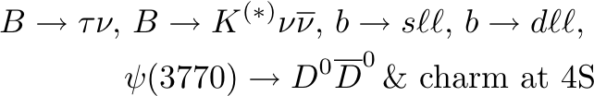

Monte Carlo resource request
Estimate for Monte Carlo simulation: 134×10⁹ events
  Requests broken down into:
    Recoil (SL and Had tags) + Charm:
    Generic backgrounds dominate sample requests, but we will also need large samples of signals generated.
    Calorimeter: calibration mode
  Expect that requests may come for 5S once we have integrated appropriate generators.

Slide 33
TDR / December Workshop
TDR: Need to prepare
  A section for the detector TDR.
  A section for the accelerator TDR.
Planning for the December workshop:
What have we learned from the summer conference results?
Are there any channels that are no longer interesting to focus on?
Are there any channels that are more important now, than before?
What changes are there to the interplay problem in terms of elucidating new physics?
What are the highest priority areas to get analysts working on?
What computing resources are required to perform such an analysis?
What tools are require to perform such an analysis (are they available)?

Slide 34
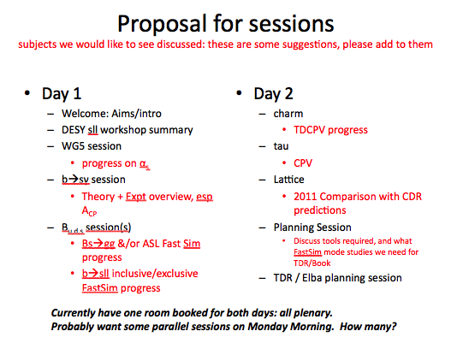
December Physics Workshop
Dates: 11th-12th December (just before next CM)
Location: LNF
Organisation will be discussed in one of the parallel sessions this week.
Please give your input for the agenda.

