Slide 1
B Field Magnitude at Y(4S) and Charm Threshold
Daniel O’Hanlon
Analysis:
D⁰ -> π ⁺ π –
Simulation:
Y(4S): 1.0 – 1.5T
CT: 1.0 – 1.5T
βγ = 0.237
Require that m_{D}0 be within ± 0.14 PDG value
FastSim V0.2.7, Kosta’s PacMC_CT
Figures of merit:
RMS of m_{D}0 , m_{ES} , ΔE
Reconstruction efficiency
m_{D}0 , m_{ES} , ΔE fitted with two Gaussians (common mean), polynomial background
Similar analysis of detector configurations at 4S done by Rolf Andreassen last year
for D⁰ -> K_{s}π ⁺ π –

Slide 2
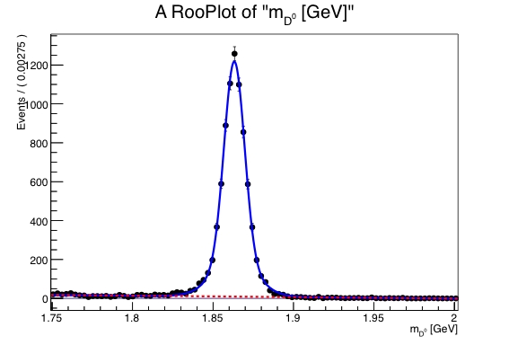
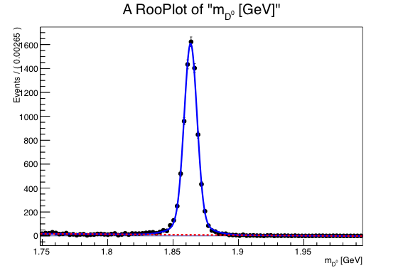
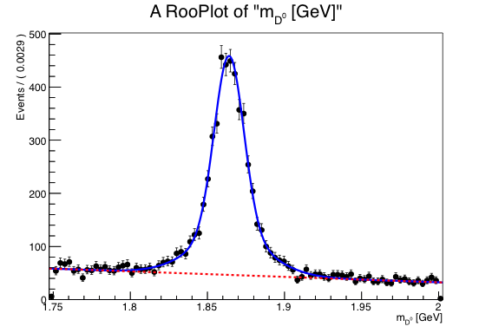
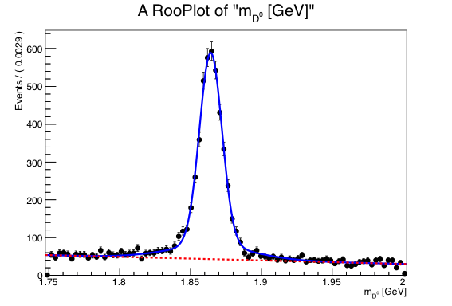
Fits to m_{D}0
B Field Magnitude at Y(4S) and Charm Threshold
Daniel O’Hanlon
1.0 T
1.5 T
Y(4S)
CT

Slide 3
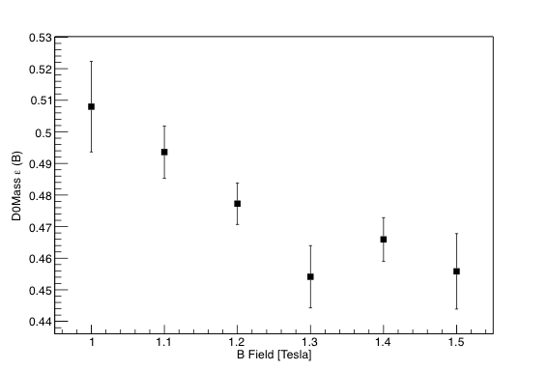
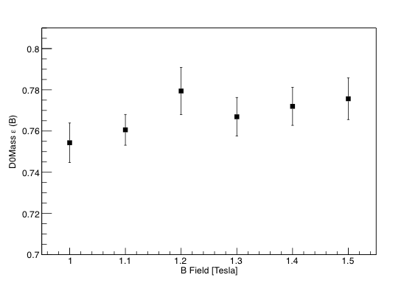
m_{D}0 reconstruction efficiency
B Field Magnitude at Y(4S) and Charm Threshold
Daniel O’Hanlon
Y(4S)
CT

Slide 4
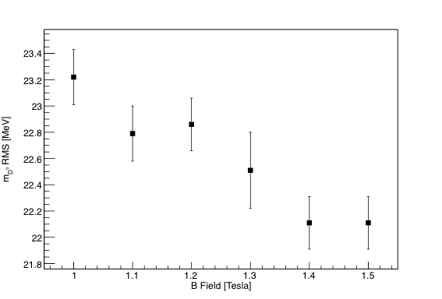
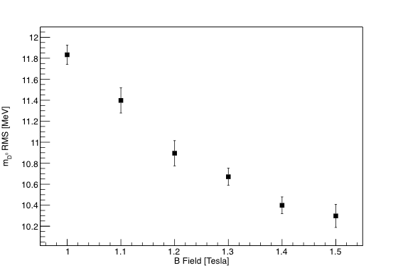
m_{D}0 RMS
B Field Magnitude at Y(4S) and Charm Threshold
Daniel O’Hanlon
Y(4S)
CT
~5% decrease in RMS
~15% decrease
in RMS
B-Field [T] | m_{D}0 RMS Y(4S) [MeV] | m_{D}0 RMS CT [MeV]
1.0 | 23.22 ± 0.21 | 11.833 ± 0.091
1.1 | 22.79 ± 0.21 | 11.398 ± 0.12
1.2 | 22.86 ± 0.20 | 10.895 ± 0.12
1.3 | 22.51 ± 0.29 | 10.671 ± 0.082
1.4 | 22.11 ± 0.20 | 10.399 ± 0.08
1.5 | 22.11 ± 0.20 | 10.399 ± 0.11

Slide 5
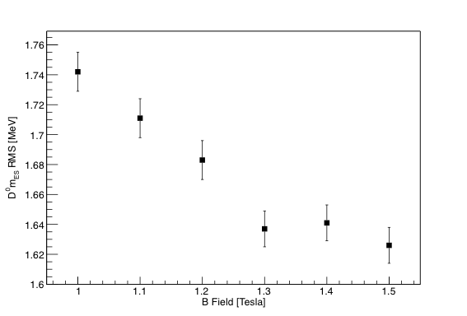
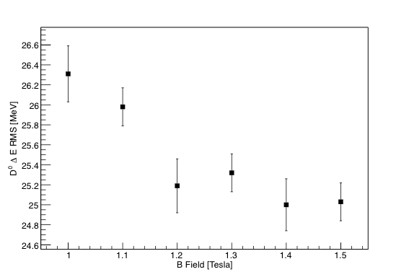
RMS (at Charm Threshold)
B Field Magnitude at Y(4S) and Charm Threshold
Daniel O’Hanlon
m_{ES}
ΔE
~7% decrease in RMS
~ 5% decrease in RMS
~7% decrease in RMS
B-Field [T] | m_{ES} RMS CT [MeV] | ΔE RMS CT [MeV]
1.0 | 1.742 ± 0.013 | 26.31 ± 0.28
1.1 | 1.711 ± 0.013 | 25.98 ± 0.19
1.2 | 1.683 ± 0.012 | 25.19 ± 0.27
1.3 | 1.637 ± 0.012 | 25.32 ± 0.19
1.4 | 1.641 ± 0.012 | 25.00 ± 0.26
1.5 | 1.626 ± 0.012 | 25.03 ± 0.19

Slide 6
Conclusion
B Field Magnitude at Y(4S) and Charm Threshold
Daniel O’Hanlon
At Y(4S): Increasing B-field from 1.0 T to 1.5 T results in ~5% improvement in m_{D}0 resolution,
but ~10% decrease in reconstruction efficiency
At charm threshold: Increasing B-field from 1.0 T to 1.5 T results in ~15% improvement
in m_{D}0 resolution (with 5% and 7% improvement in ΔE and m_{ES} resolution respectively)
and with little (2%) change in reconstruction efficiency at βγ = 0.237
A full analysis would take into account centre of mass boost, βγ
Acknowledgements
Thanks to Adrian Bevan and everyone else at Queen Mary

Slide 7
Backup Slides

Slide 8
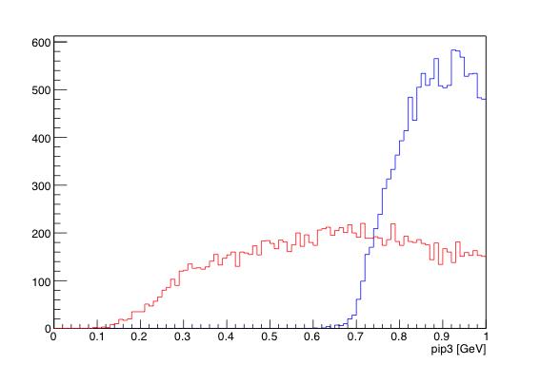
B Field Magnitude at Y(4S) and Charm Threshold
Daniel O’Hanlon
Pion Momenta
1.5 T
βγ = 0.237
Charm Threshold
Y(4S)

Slide 9
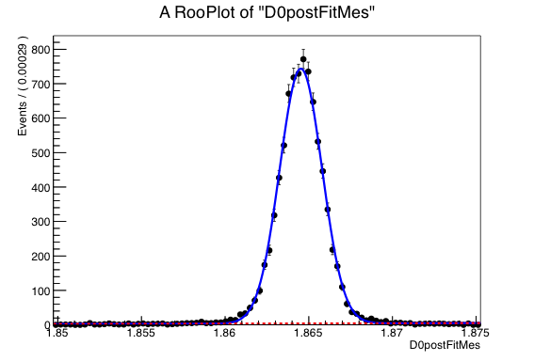
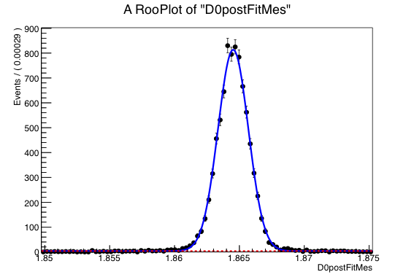
Fits to m_{ES}
B Field Magnitude at Y(4S) and Charm Threshold
Daniel O’Hanlon
1.0 T
1.5 T
CT

Slide 10
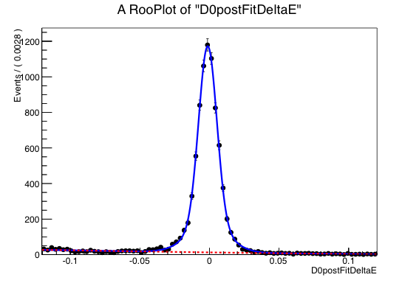
Fits to ΔE
B Field Magnitude at Y(4S) and Charm Threshold
Daniel O’Hanlon
1.0 T
1.5 T
CT

